Slide 1
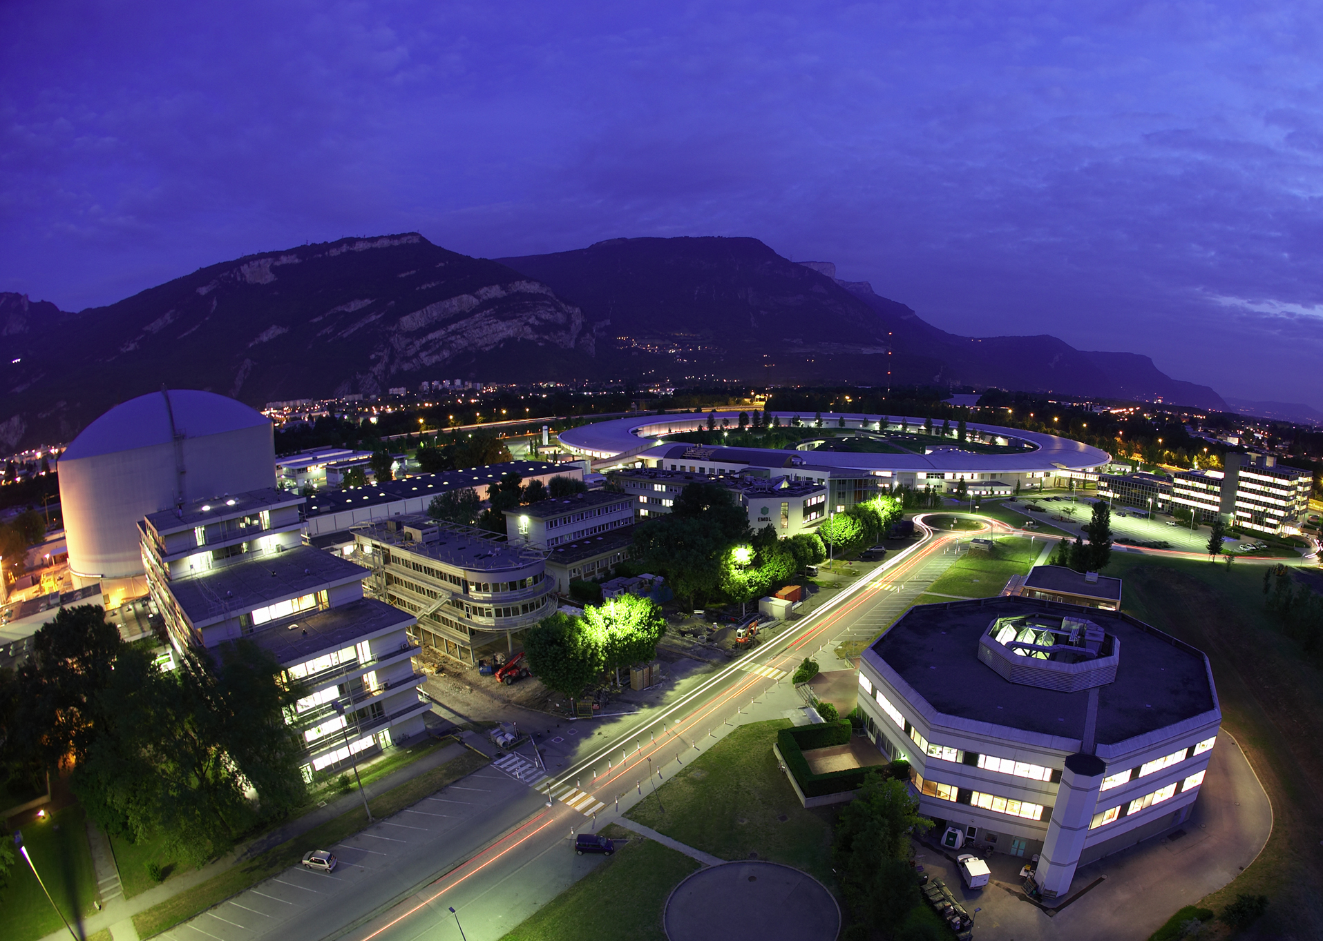

Addressing cosmological questions with neutron experiments
Guillaume Pignol
LAL seminar, Orsay, 3 March 2015

Slide 2

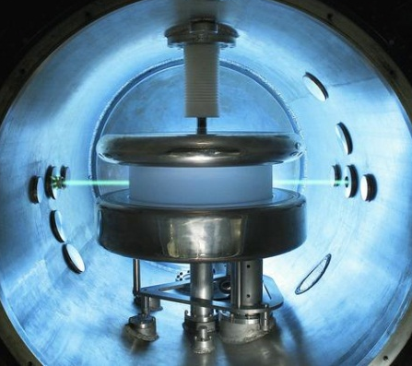
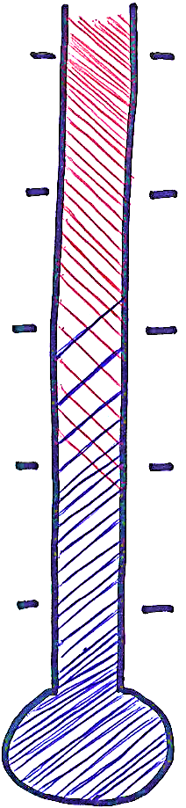
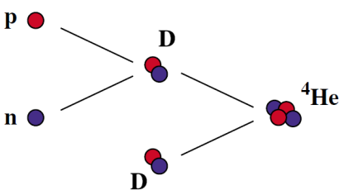
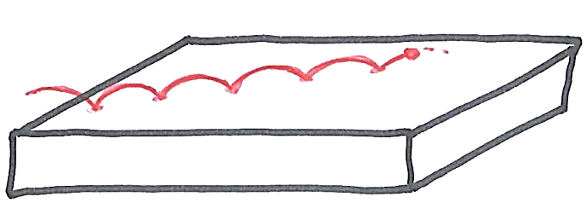
neutrons and the Universe
10¹⁵ GeV
Inflation ends?
Search for the neutron electric dipole moment to explain the matter-antimatter asymmetry
Baryogenesis
?
100 GeV
Electroweak
transition
1 MeV
Nucleosynthesis
Measuring the neutron lifetime to predict the primordial production of light elements
1 eV
Decoupling of CMB
Dark energy
Bouncing neutrons could probe
Dark Energy models
1 meV
Today

Slide 3
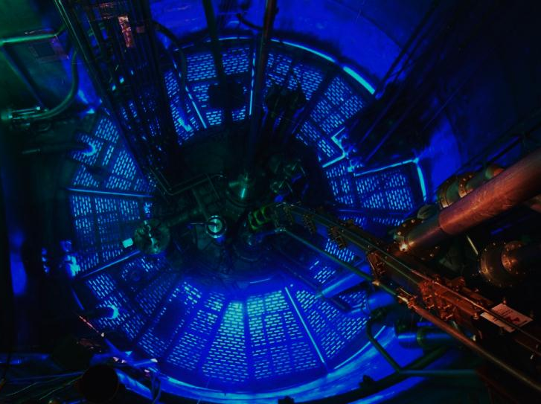
Outline
1 Ultracold neutrons, neutron lifetime and Big Bang nucleosynthesis
2 The neutron Electric Dipole Moment and baryogenesis
3 Bouncing neutrons, GRANIT
and Dark Energy

Slide 4
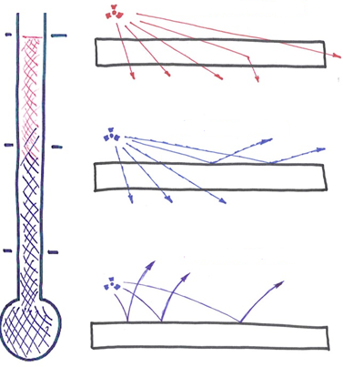

Ultracold neutrons (UCN)
Thermal neutrons
UCNs can be stored in bottles for very long times (1000 s)
Measurement of the neutron lifetime
precision measurement of the neutron electric dipole moment (nEDM)
Cold neutrons
Ultracold neutrons
UCNs feel gravity
GRANIT to measure the bouncing quantum states
Neutrons with energy < 100 neV, or velocity < 5 m/s
are reflected by material walls

Slide 5
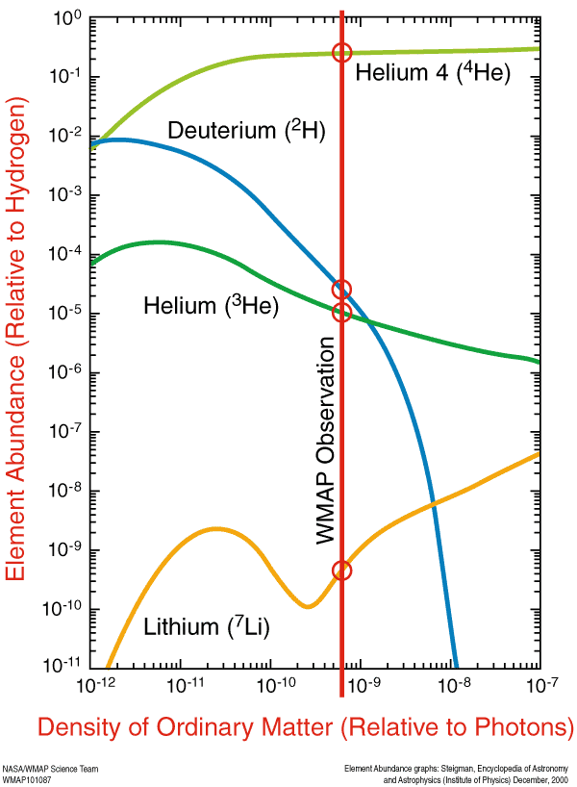
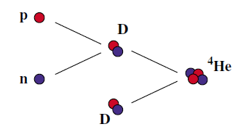
Big Bang nucleosynthesis
[Planck (2014)]
[Deuterium abundance from Lyα, Cooke et al (2014)]
BBN calculations need to know the neutron lifetime:

Slide 6


Two complementary experimental methods
Counting the dead neutrons: BEAM METHOD
A detector records the decay products in a well defined part of a neutron beam. A neutron beam is indeed radioactive due to beta decay.
Counting the surviving neutrons: BOTTLE METHOD
UCNs are stored in a bottle, the number of neutrons remaining in the bottle after a certain storage time t is measured.
$$−\frac{dN}{dt}= \frac{N}{τ_{n}}$$
$$N(t)=N\left(0\right)e^{−t/τ_{n}}$$

Slide 7
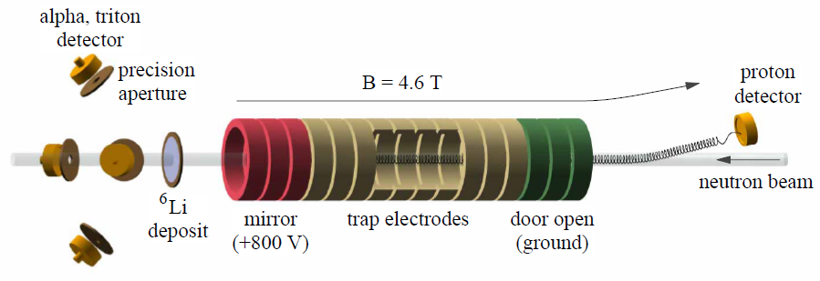
Beam method: counting the protons
Nico et al (2005)
Protons produced almost at rest
(endpoint energy = 800 eV)
are accumulated in a Penning trap.

Slide 8
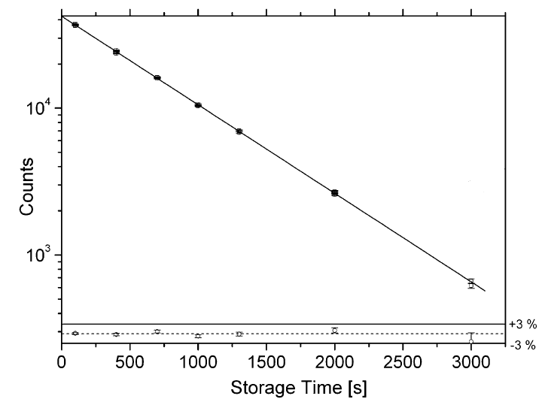
Principle of a bottle UCN measurement
Switch moved to FILL position, Valve OPEN for 20 s
Close Valve,
  Switch moved to EMPTY position
Wait period t
OPEN Valve, count neutrons
Repeat the sequence with different t
STORAGE VOLUME
VALVE
UCN
SWITCH
DETECTOR
MAMBO II @ ILL

Slide 9
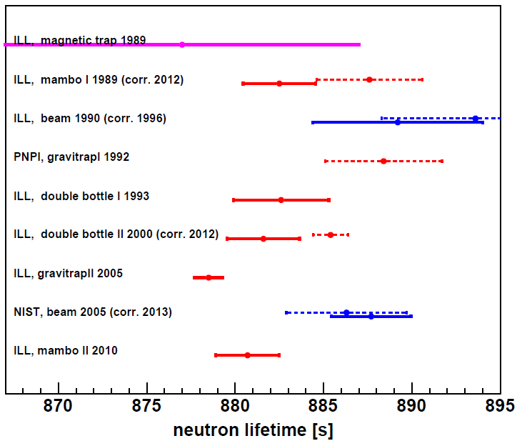
Current status on the neutron lifetime
The 2015 situation
There is a 3.8 σ discrepancy
between the bottle method combination and the beam method combination.
To be continued…

Slide 10
Outline
1 Ultracold neutrons, neutron lifetime and Big Bang nucleosynthesis
2 The neutron Electric Dipole Moment and baryogenesis
3 Bouncing neutrons, GRANIT
and Dark Energy

Slide 11
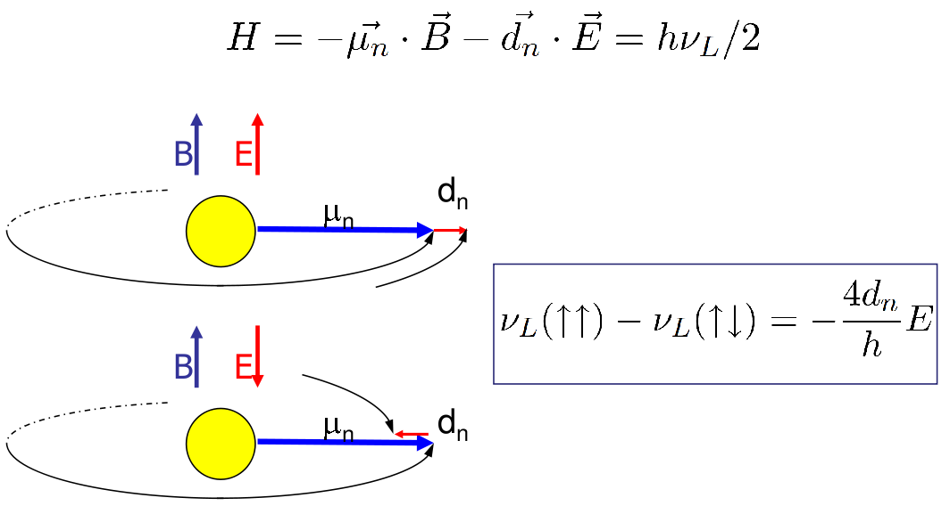
Principle of the nEDM measurement
A non-zero EDM violates T reversal
(thus violates CP symmetry)

Slide 12
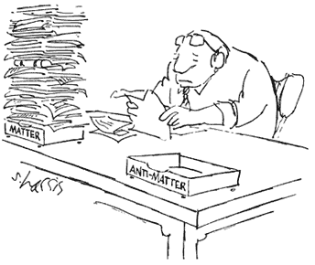
Electroweak baryogenesis
Sakharov conditions
at electroweak phase transition
1 Departure from thermal equilibrium
requires BSM scalar sector
to get a strong first order transition.
May or may not be accessible at the LHC
2 CP violation
requires BSM physics,
accessible by the next generation of EDM experiments
3 Violation of B conservation
SM sphaleron transitions in the symmetric phase

Slide 13

The electroweak phase transition (EWPT)
Standard Model:
Non-standard scalar sector, e.g.
$$V_{BSM}=V_{SM}+\frac{1}{8Λ} φ^{6}$$
The phase transition is second order:
no baryogenesis at EWPT
EWPT could be first order to make baryogenesis viable

Slide 14
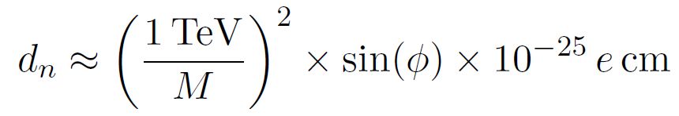
New CP violation at the TeV scale
Present limit (RAL-Sussex-ILL, 2006)
nEDM is sensitive to BSM CP violation
at the multi TeV scale

Slide 15
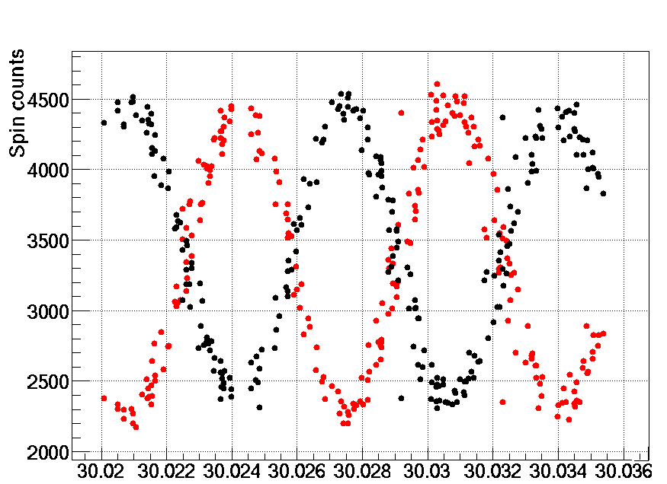
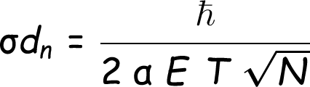


The Ramsey method
“Spin up” neutron...
Apply π/2 spin-flip pulse...
Applied pulse frequency [Hz]
Free precession...
T ~ 200 s
Second π/2 spin-flip pulse
polarization
electric field
counts
precession time

Slide 16
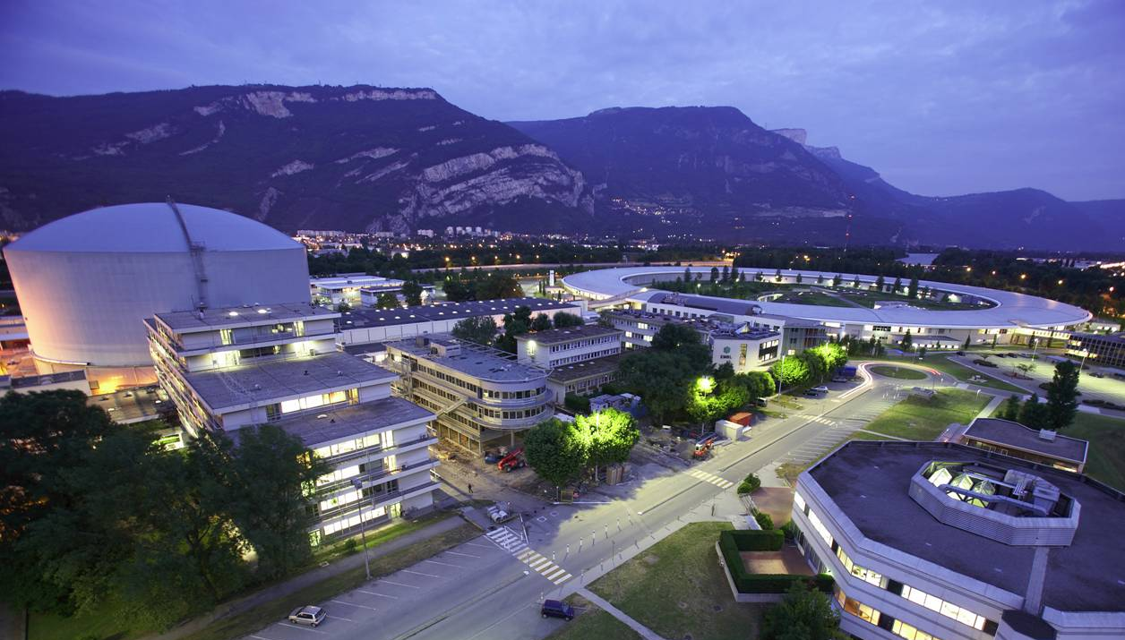
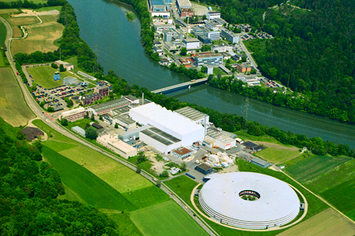
RAL-Sussex apparatus, moved from ILL to PSI
Institut Laue Langevin, Grenoble
ILL 58 MW high flux reactor
PF2 instrument, since 1985
UCNs extracted from 20K moderator 2 UCN/cm³ in EDM experiment
Paul Scherrer Institute, Zurich
PSI 600 MeV, 2.5 mA proton beam
lead spallation target
solid deuterium UCN convertor started in 2011

Slide 17
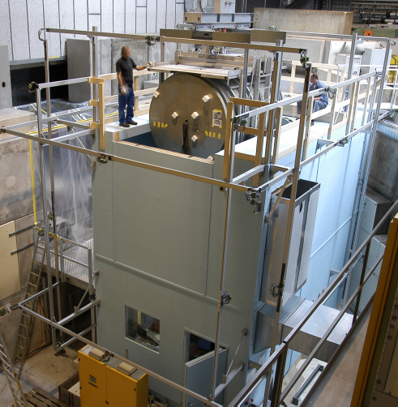
Current nEDM apparatus at PSI
Shielded magnetic environment
Homogeneity < 10⁻³
Time stability < 10⁻⁶
B₀ = 1 µT
Electric field 150 kV / 12 cm
Installation in the wooden house
With B-field compensation

Slide 18
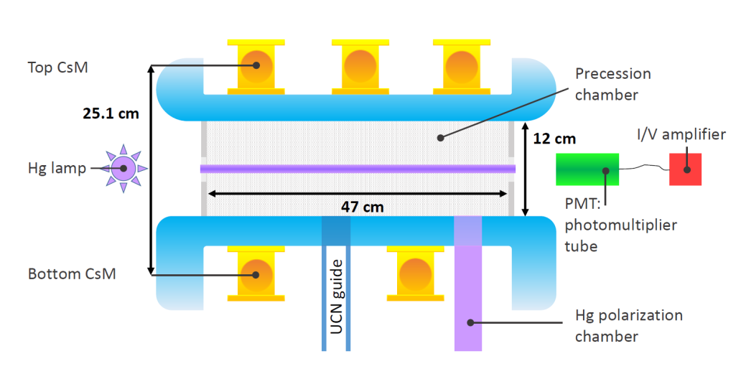
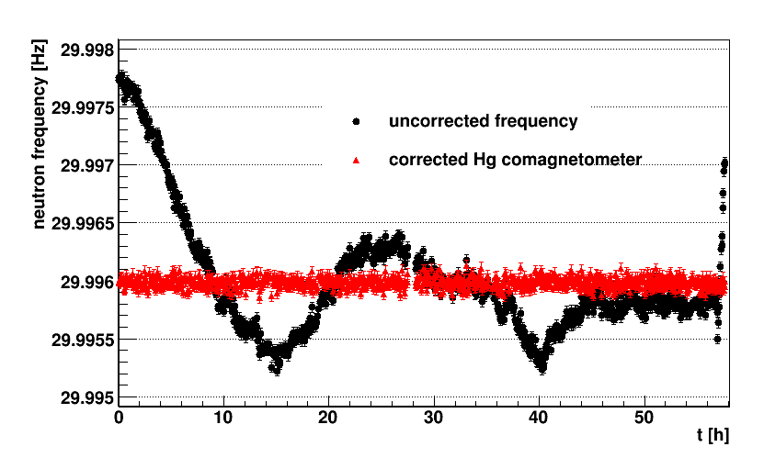
The mercury co-magnetometer
Mercury spins (polarized with optical pumping) precess, measuring the B-field
Same time average
Same volume average
As UCNs
The Hg comagnetometer compensates for the fluctuations of the B-field.
» Fluctuations limited by UCN counting statistics

Slide 19
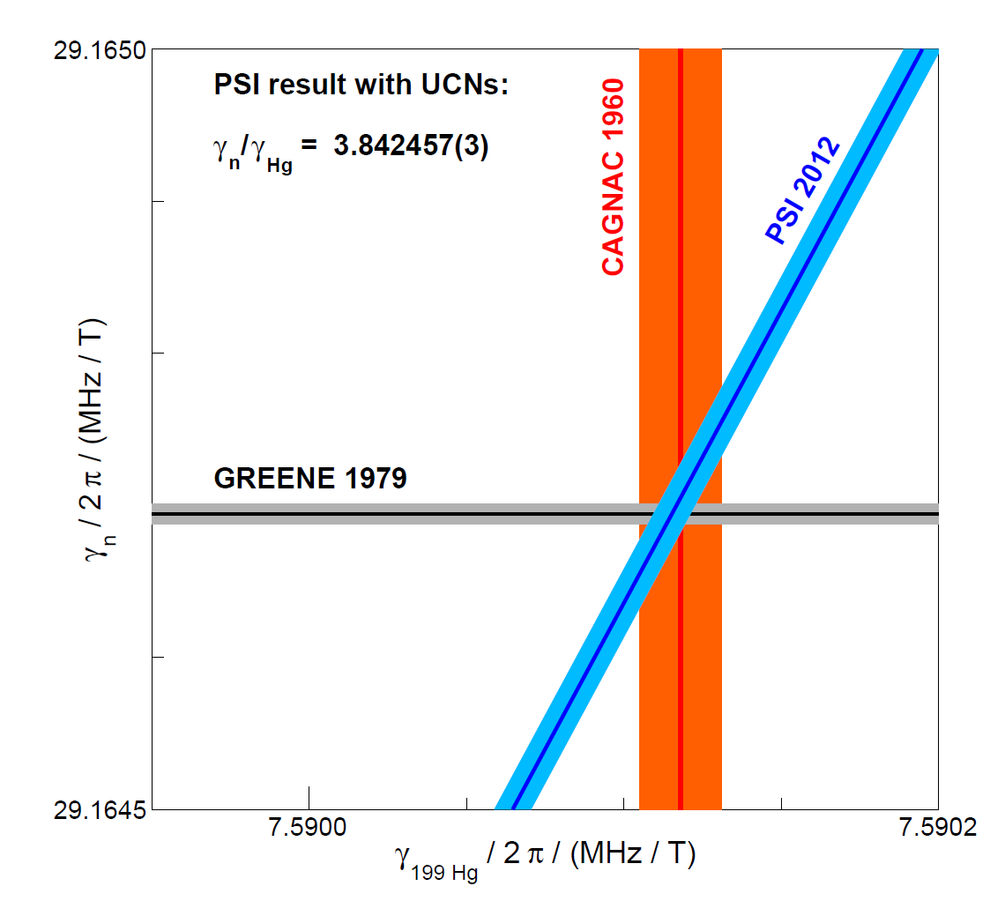
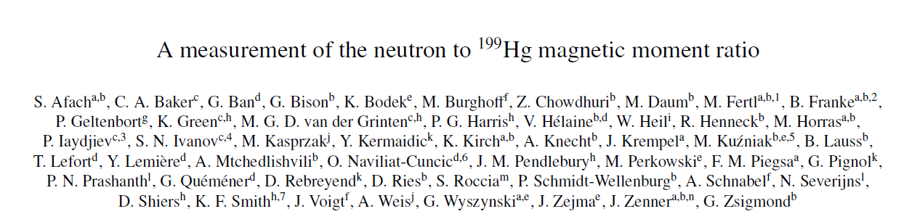
New measurement of the neutron magnetic moment
S. Afach et al., PLB 739, 128 (2014)

Slide 20
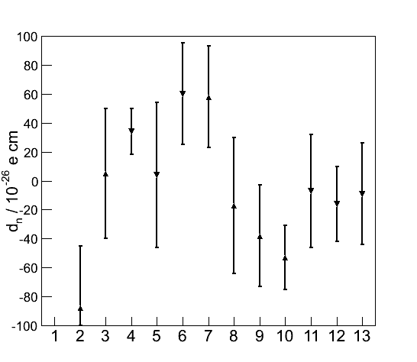
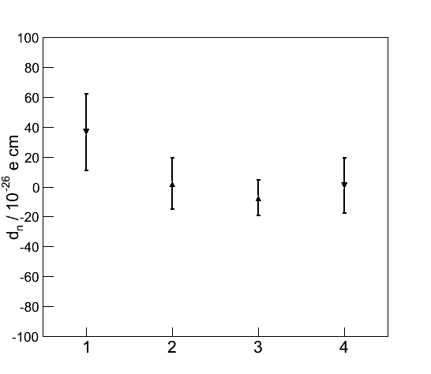
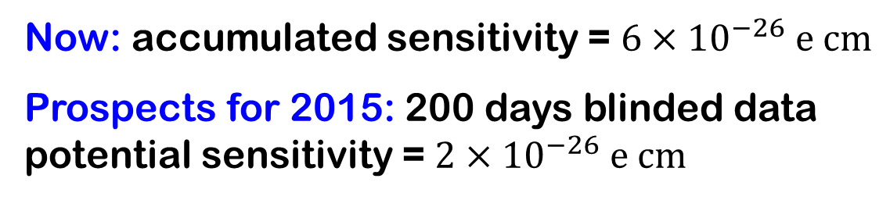
nEDM data taking
2013 data (13 runs, 30 days)
2014 data (4 datasets, 30 days)
Now: accumulated sensitivity = $6×{10}^{−26} e cm$
Prospects for 2015: 200 days blinded data potential sensitivity = $2×{10}^{−26} e cm$

Slide 21
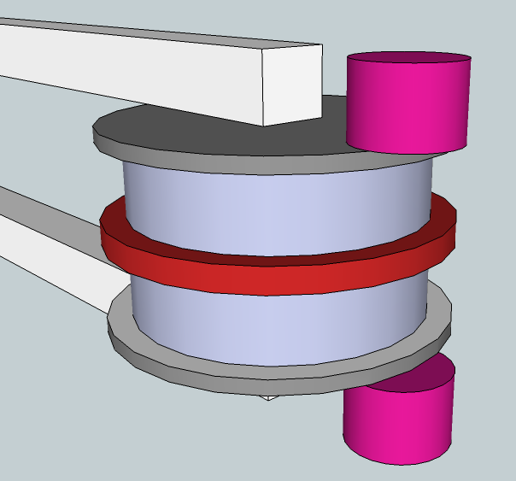
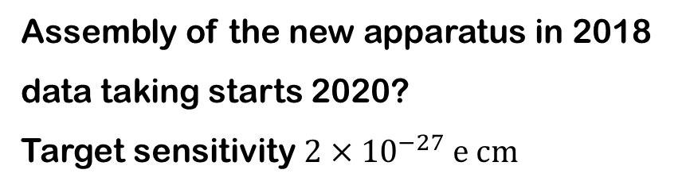
Next, n2EDM
Two large chambers with opposite E-field
Hg comagnetometry + external magnetometers (Cs + 3He)
Bigger and better mumetal magnetic shield
Assembly of the new apparatus in 2018
data taking starts 2020?
Target sensitivity $2×{10}^{−27} e cm$

Slide 22
Outline
1 Ultracold neutrons, neutron lifetime and Big Bang nucleosynthesis
2 The neutron Electric Dipole Moment and baryogenesis
3 Bouncing neutrons, GRANIT
and Dark Energy

Slide 23
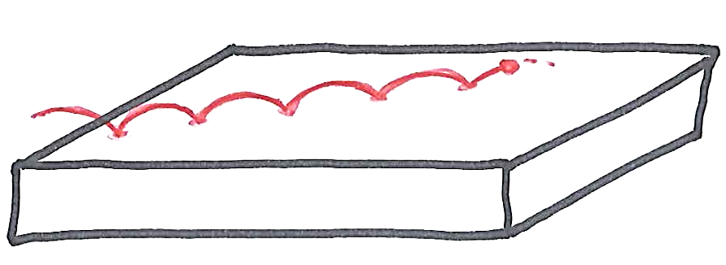
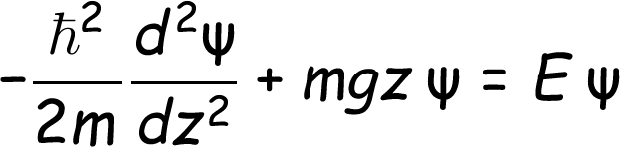
Bouncing neutrons: quantum states
Neutrons with energy < 100 neV
can bounce above a glass mirror.
m g z
Vertical energy (peV)
The vertical motion is a simple quantum well problem
Height (µm)

Slide 24
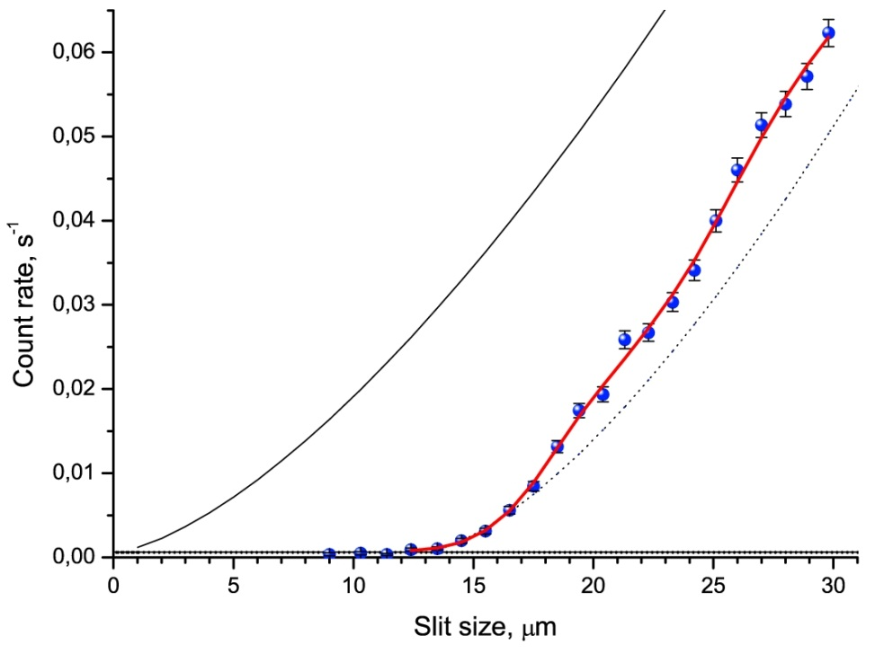

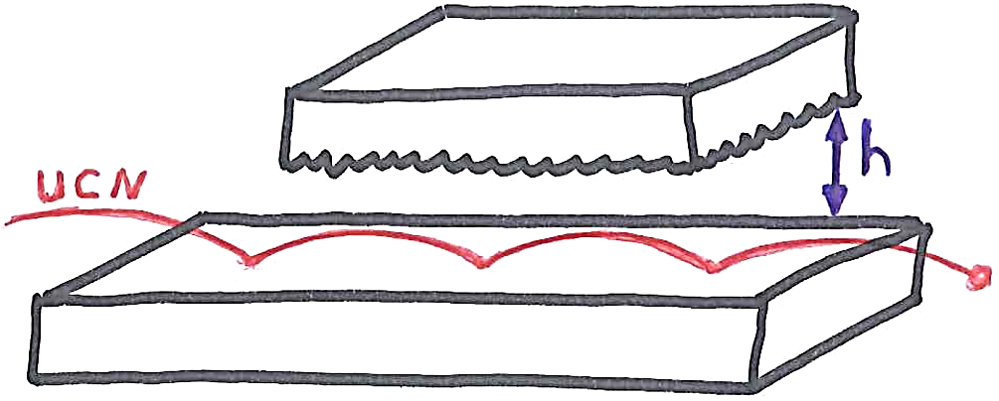
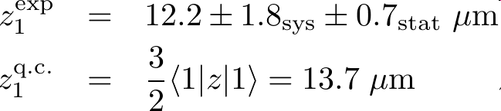
Discovery of the quantum levels for the neutron bouncer
[Nesvizhevsky et al Nature 415 (2002)]
[Nesvizhevsky et al EPJC 40 (2005)]
Neutron absorber
CLASSICAL
QUANTUM
Mirror (glass),
Length 10 cm

Slide 25





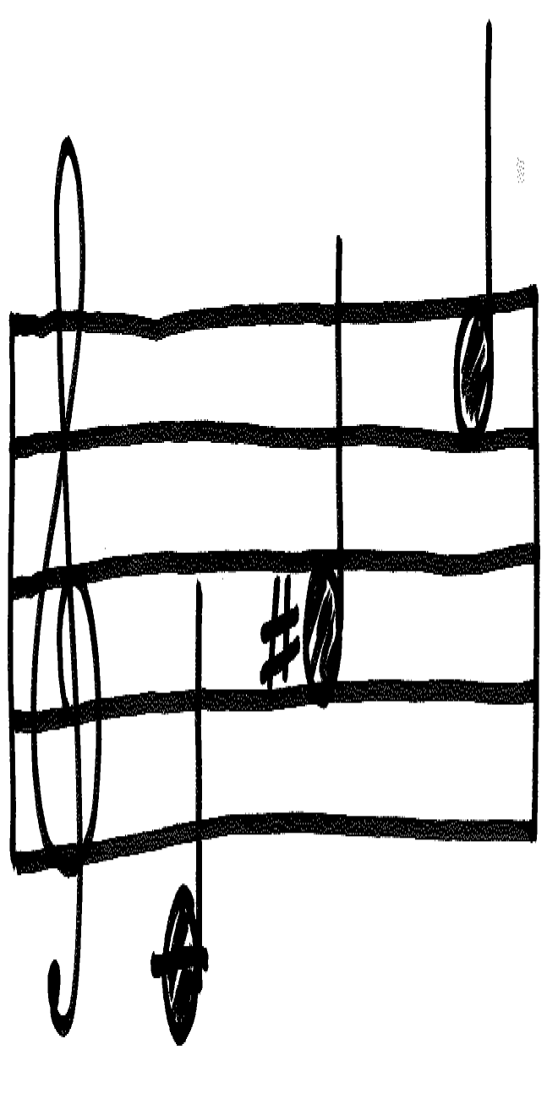
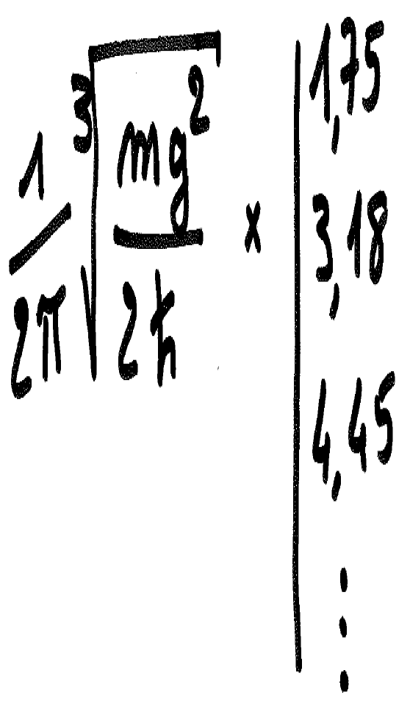
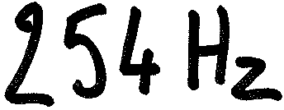
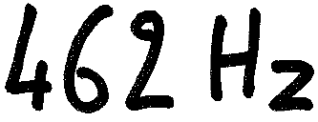
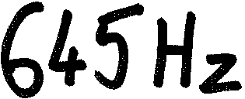
Musique quantique d’un neutron bondissant

Slide 26
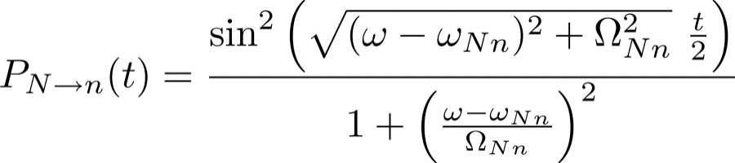
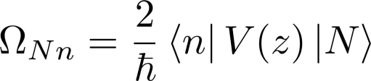
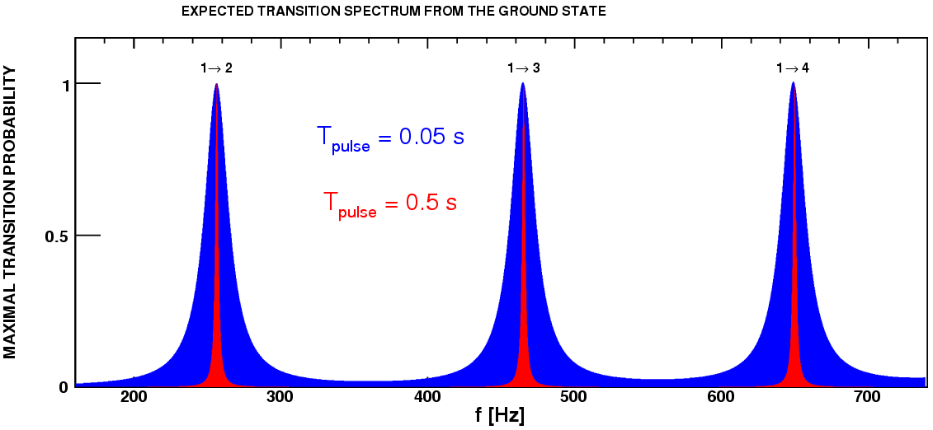


Excitation of resonant transitions
One applies an harmonic excitation V(t)
Of frequency ω/2π and duration t
Excitation frequency [Hz]
Rabi resonances
One measures energy differences

Slide 27

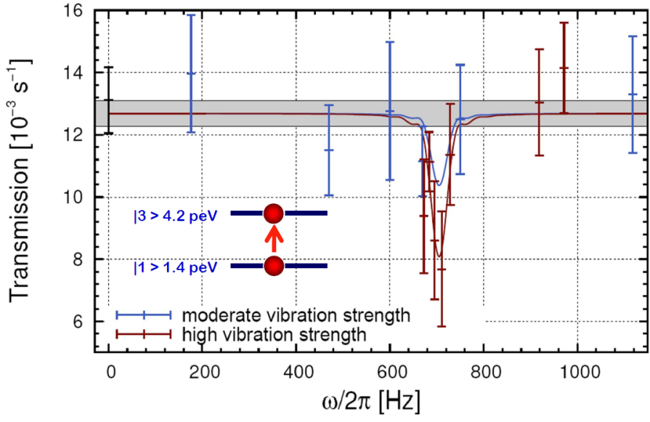

How to excite resonant transitions?
1) Mirror vibrations
[Jenke et al Nature physics 7 (2011)]
2) Magnetic excitation
V = ± µ B

Slide 28

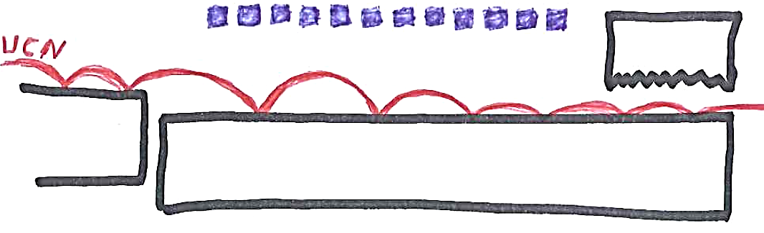
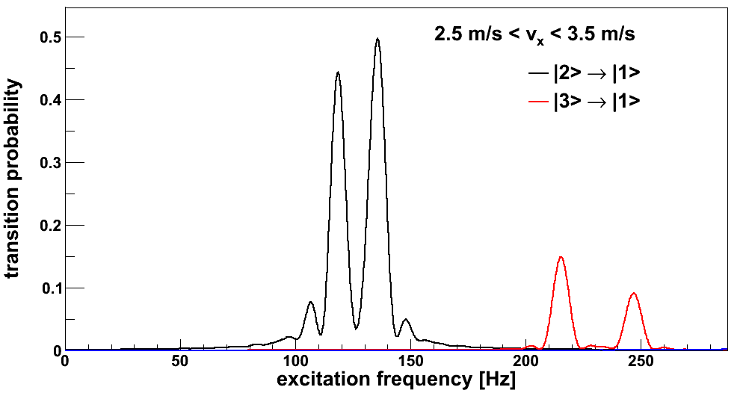
Resonant transitions in GRANIT
step
Magnetic excitation
FILTER
Detector
Mirror 25 cm x 30 cm
simulation

Slide 29
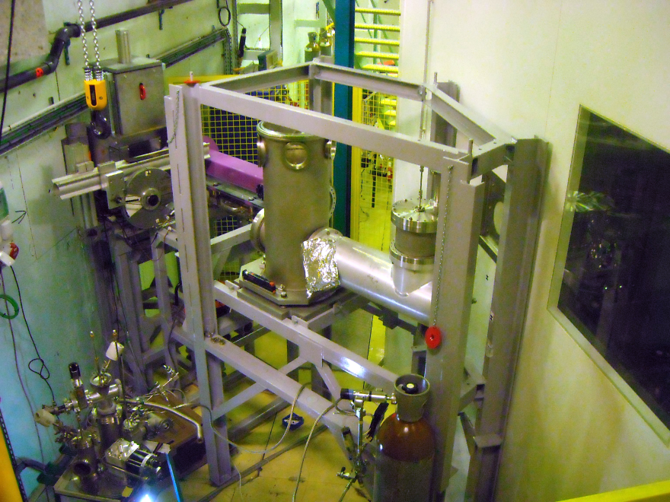
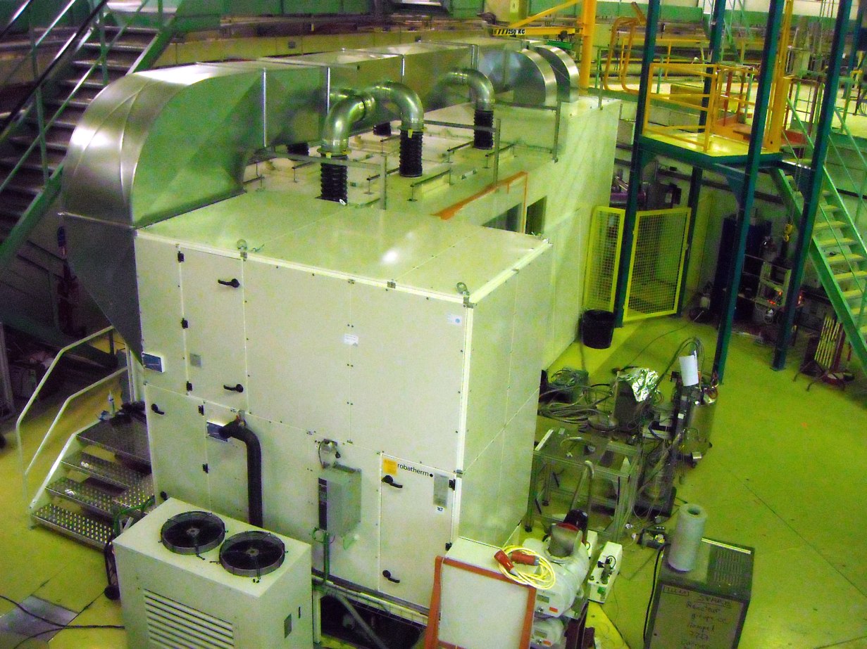
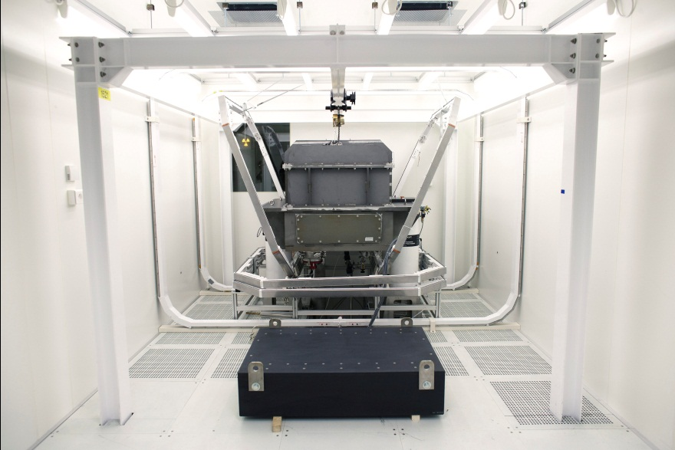
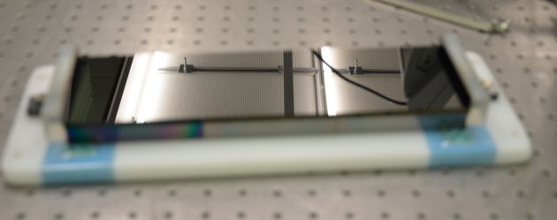
The GRANIT instrument at ILL level C
UCN source
Clean room
Vacuum chamber
Mirrors

Slide 30

Searching for a fifth force
m g z + ?
Consequences for
the quantum states
Squeezing of the wave functions
Dilatation of the energy spectrum
Vertical energy
Heigth
There is a new force if there is a new field….

Slide 31



Quintessence as Dark Energy
Ratra-Peebles potential
Dark Energy is (maybe) due to a cosmological scalar field φ

Slide 32



The chameleon scalar field: quintessence coupled with matter
Field equations (nonlinear):
Term responsible for the cosmic acceleration, with
Possible coupling with matter. Chameleon effect
µm

Slide 33





The chameleon mechanism
A way to reconcile
gravity tests and cosmology
Standard massive Klein-Gordon field,
Mediating a force with finite range
[Khoury & Weltman PRD 69 (2004)]
High density environment,
high effective mass
Quintessence field coupled with matter:
Low density environment,
low effective mass

Slide 34



Probing the chameleon in the lab
Above the mirror
[Brax Pignol Roulier PRD 88 (2013)]
µm
Consequences for the bouncing neutron
Squeezing of the wave functions
Dilatation of the energy spectrum

Slide 35
The end
10¹⁵ GeV
GUT epoch
?
100 GeV
Electroweak
transition
1 MeV
nucleosythesis
1 eV
?
1 meV
Today

Slide 36
gravitational effect
Same precession chamber
UCN gaz
Mercury gaz
g
Center of gravity height difference is
R = fn / fHg depends on vertical gradients

Slide 37
Magnetic moment

Slide 38


Superthermal source of UCNs
UCN Source
UCN production in superfluid Helium
[Zimmer et al PRL 107 (2011)]

Slide 39




Superthermal source of UCNs
December 7 2012
July 2012
March 2013

Slide 40
UCN output
With MEASURED properties of the Be UCN production volume + measured 9 A cold neutron flux
STARucn
Simulation
2.5 Hz
GRANIT 2014
130 mHz
@1.3 K
PF2 (2000)
GRANIT 2013
10 mHz
@1.4 K

Slide 41



The expansion of the Universe
Hubble law:
velocity = H₀ x distance
E. Hubble 1929
More accurate value

Slide 42


Accelerated expansion of the universe
Dark Energy?
Cosmological constant?

Slide 43


Field profile above an infinite mirror
In the strong coupling regime
[Brax & Pignol PRL 107 (2011)]
Independent of the
mirror’s density, independent of β !
Distance scale:
µm

Slide 44



Understanding the chameleon mechanism
Poisson equation for the electric potential
Plate with charge density ρ
φ
ρ small
ρ large
Electric field dφ/dx proportional to ρ

Slide 45



Understanding the chameleon mechanism
Nonlinear equation for the chameleon field
φ
Plate with mass density ρ
ρ = 0
Large ρ
Saturation effect and screening mechanism.
For large β the force between macroscopic bodies is independent of β

Slide 46


Searching for a fifth force
Modification of the Newton’s law?

Slide 47
The quintessence hypothesis
Dark Energy is due to a cosmological scalar field φ
Field equations (nonlinear):
Term responsible for the cosmic acceleration, with
Possible coupling with matter. Chameleon effect
µm

Slide 48





Ultracold neutrons (UCN)
UCN =
Total reflexion at any angle
We can store UCNs in material bottles
Storage time limited by neutron beta decay
Gravity is important for UCNs

Slide 49






Cooling down neutrons
10 MeV
Fission neutrons
Ballistic moderation
25 meV
Thermal neutrons
Mean Fermi potential
100 neV
Ultracold neutrons
Optical
behaviour

