Slide 1


Observation of Pentaquark Candidates at LHCb
Liming Zhang, Tsinghua University
1 Dec., 2015

Slide 2
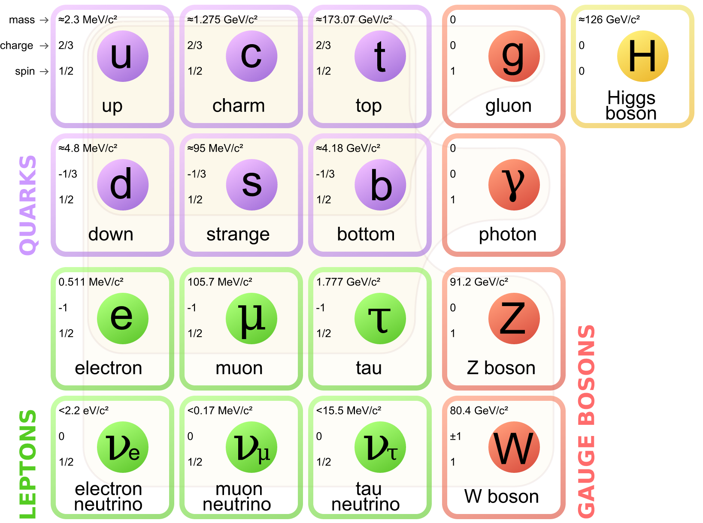
What are particles made of?
Fundamental particles
  Leptons
  Quarks
  Gauge bosons
Composite particles
called hadrons, made of spin=1/2 quarks
  Baryons normally are composed of 3 quarks. Quarks come in 3 colors, for baryons one of each as r+b+y=white (colorless)
  Mesons normally are composed of a quark + antiquark, e.g, rr or bb or yy

Slide 3
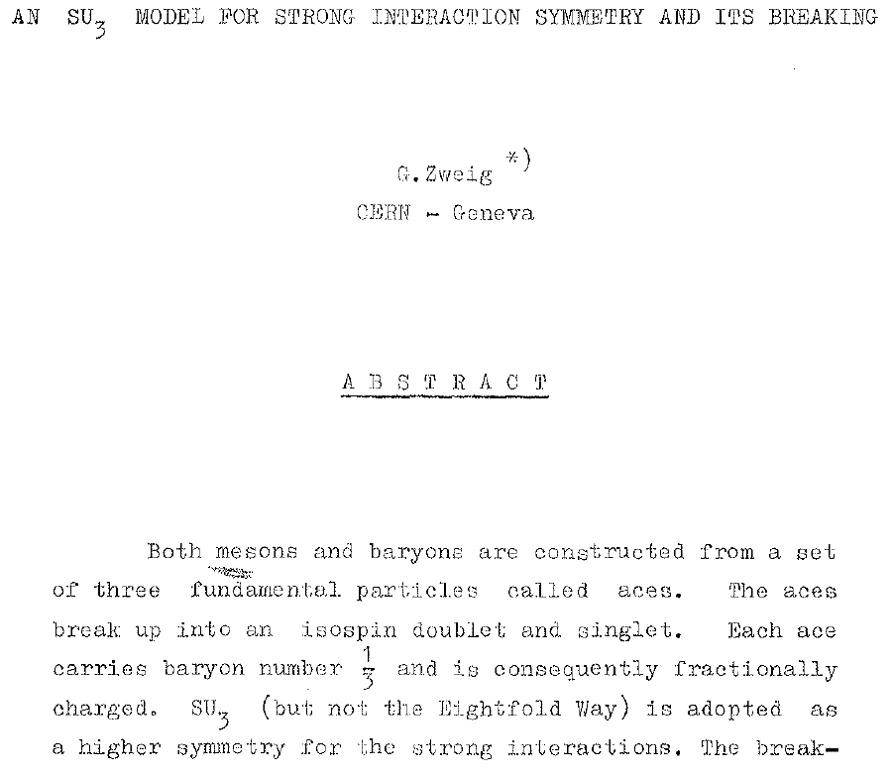


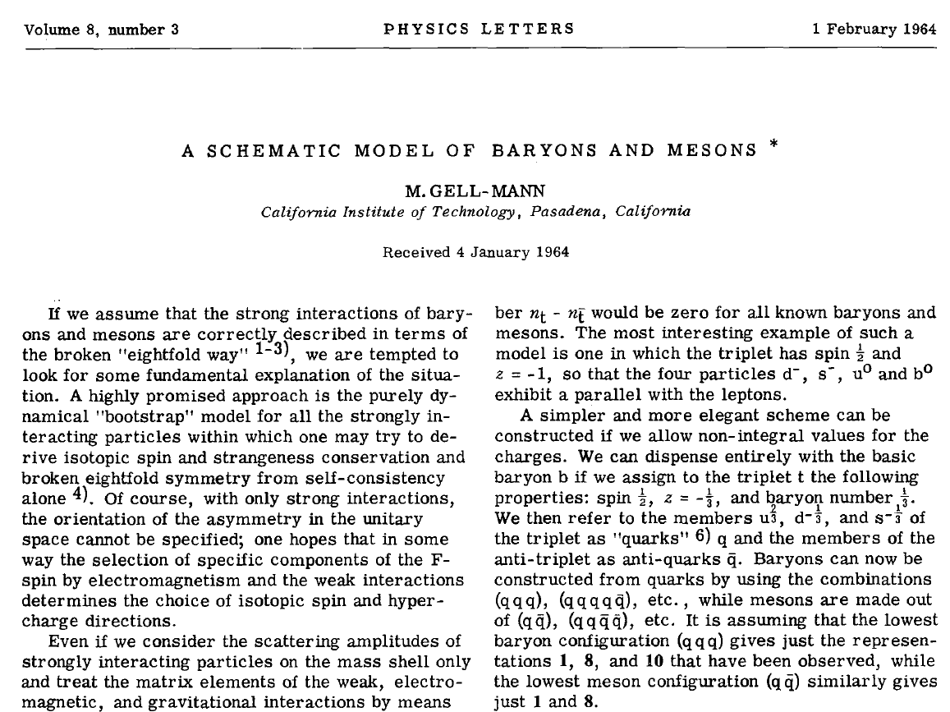
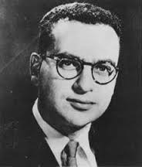
Quark model
In the beginning multiquark objects
were predicted- now called exotic
_
qqqqq baryons later
called “pentaquarks”;
qqqq meson called
“tetraquarks”
_ _

Slide 4
Why pentaquarks?
Interest in pentaquarks arises from the fact that they would be new states of matter beyond the simple quark-model picture. Could teach us a lot about QCD.
There is no reason they should not exist
  Predicted by Gell-Mann (64), Zweig (64), others later in context of specific QCD models: Jaffe (76), Högaasen & Sorba (78), Strottman (79)
These would be short-lived ~10⁻²³ s “resonances” whose presence is detected by mass peaks & angular distributions showing the presence of unique J^{P} quantum numbers

Slide 5
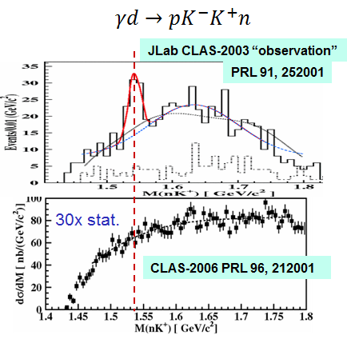
Past claimed pentaquark
No convincing states 50 years after Gell-mann paper proposing qqqqq states
Prediction: Θ⁺ (uudds) could
exist with m ≈1530 MeV
In 2003,10 experiments
reported evidences of
narrow peaks of 𝐾⁰𝑝 or
𝐾⁺𝑛, all >4 σ
High statistics repeats from
JLab showed the original
claims were fluctuation
It was merely a case of “bump hunting”
_
See summary by [K. H. Hicks, Eur. Phys. J. H37 (2012) 1]

Slide 6

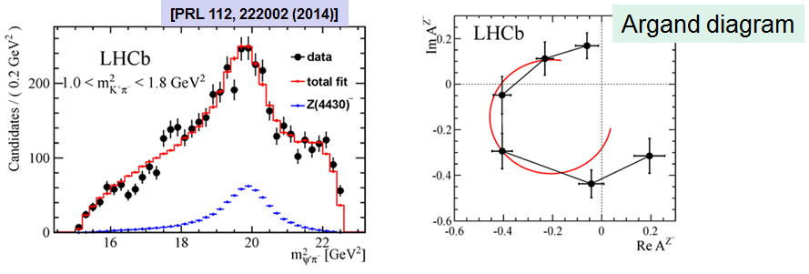
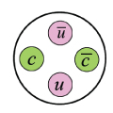
Tetraquark
Experimental evidence started to appear only recently
𝑍(4430)⁺→ψ’ π⁺ (Belle, LHCb) from B⁰ →ψ’ K⁻ π⁺
Both analyses performed full amplitude fits
𝑍_{𝑐}(3900)⁺ and its families (BESIII)
𝑍_{𝑏}(10610)⁺ and 𝑍_{𝑏}(10650)⁺ (Belle)
These give support to the possibility of pentaquark states

Slide 7
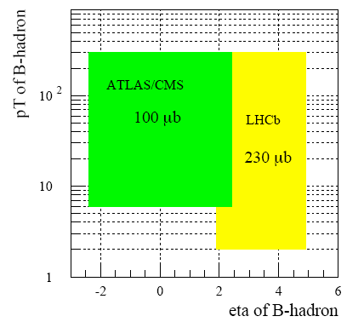
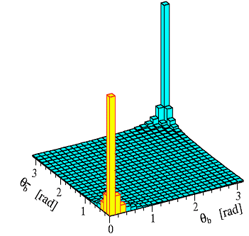
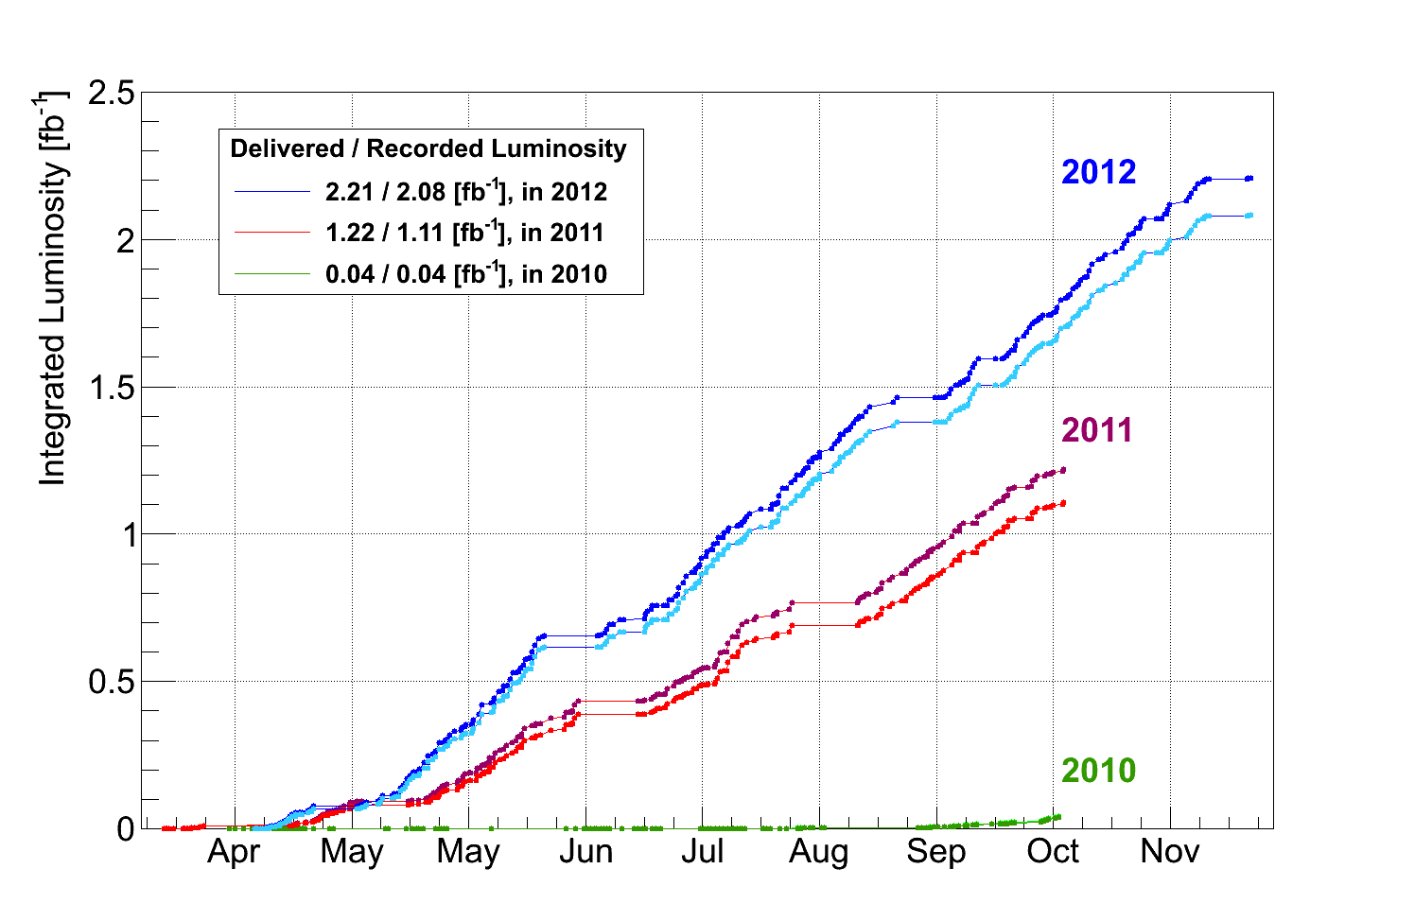
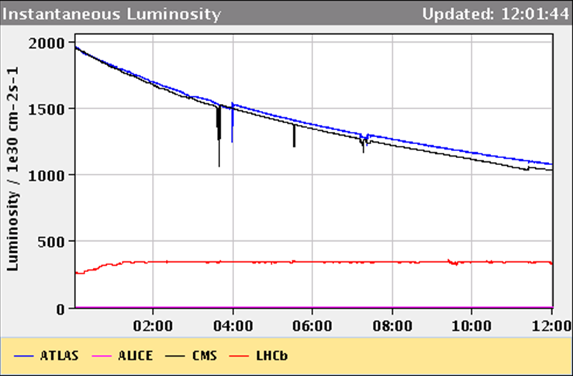
The LHCb Experiment
LHCb is a dedicated B physics experiment at LHC
  ~1000 × large b production rate than B factory @ Υ(4S)
  Access to all b-hadrons: B⁺, B⁰, B_{s}, B_{c}, b-baryons
Production ∠ of B vs B
LHCb acceptance optimised for forward bb production: forward single arm spectrometer 1.9<η<4.9
Luminosity is at ~4×10³² cm⁻²s⁻¹ to limit multiple interactions per bunch crossing
often
θ B (rad)
θ B (rad)
RUN I: 3fb⁻¹
Lumi. of LHCb “leveled”

Slide 8
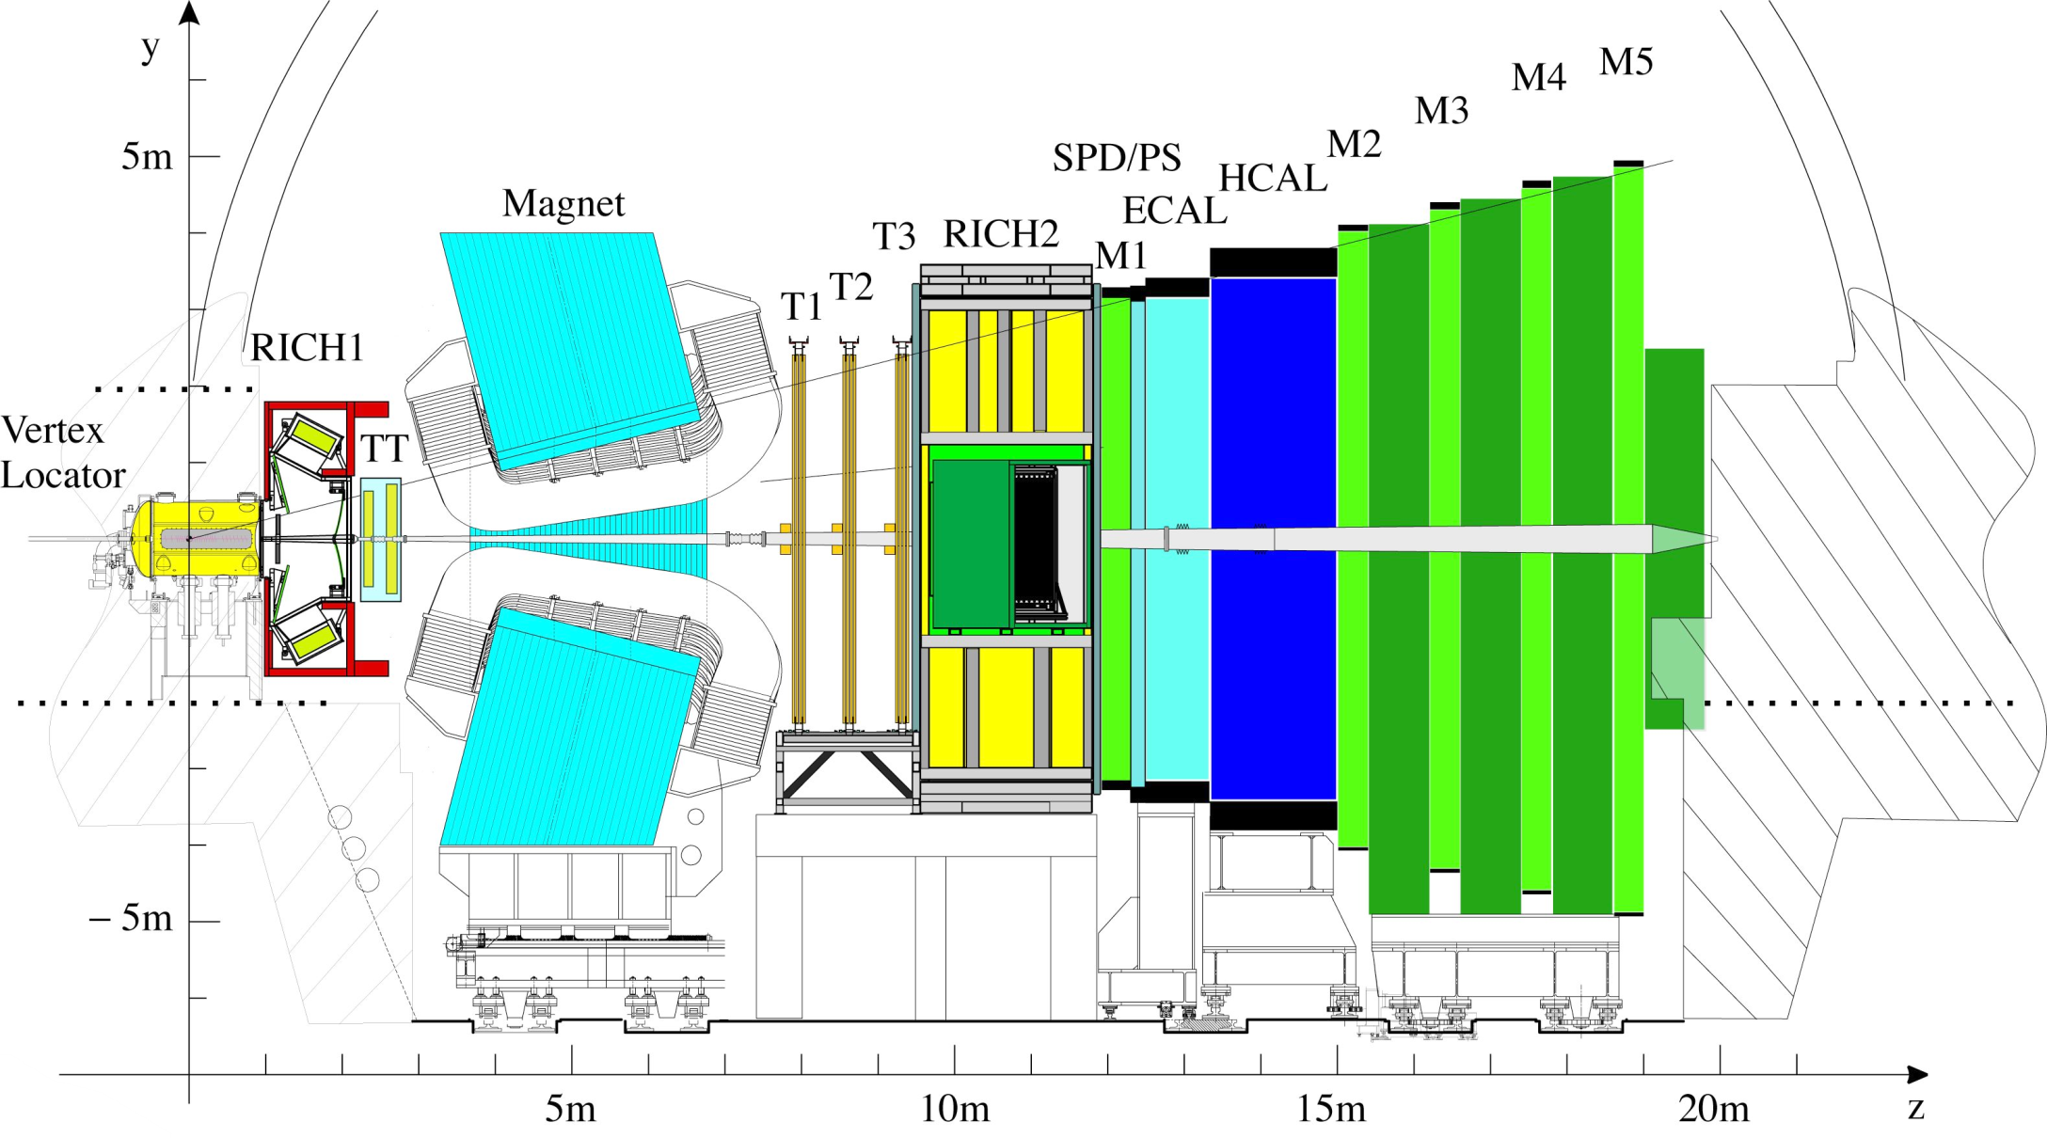
LHCb Detector
p
p

Slide 9
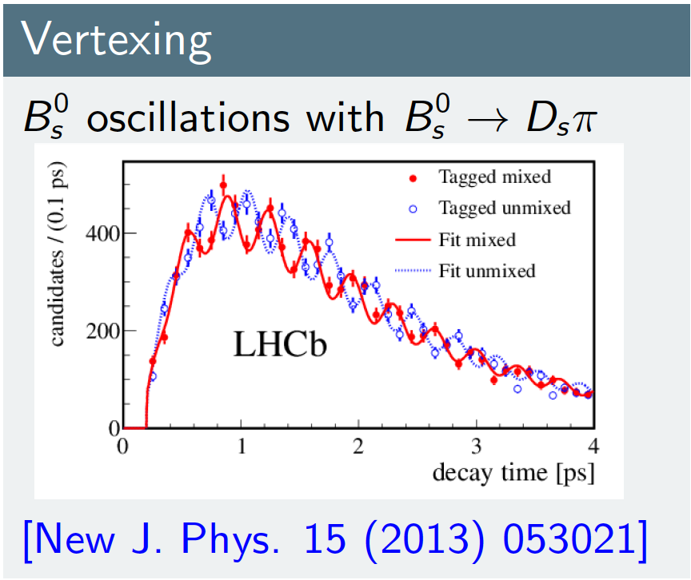
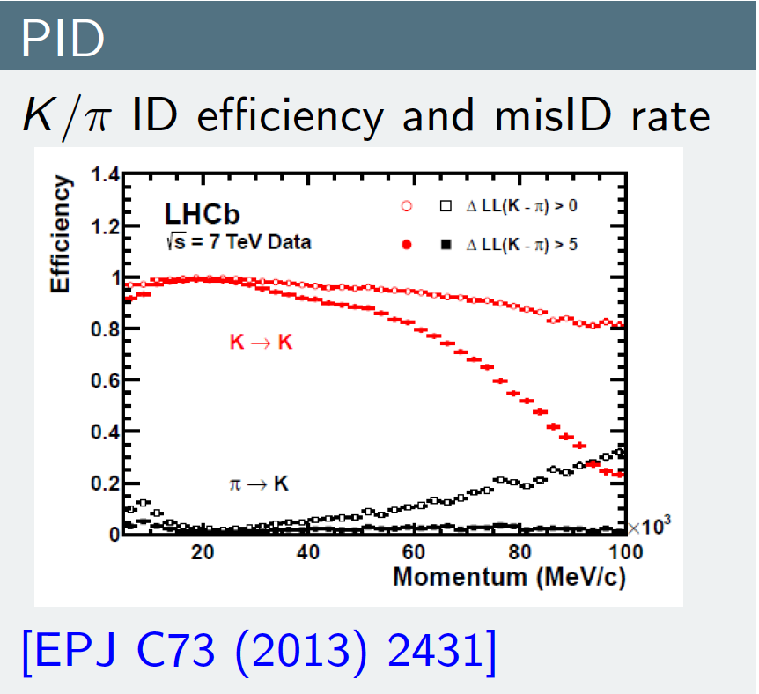
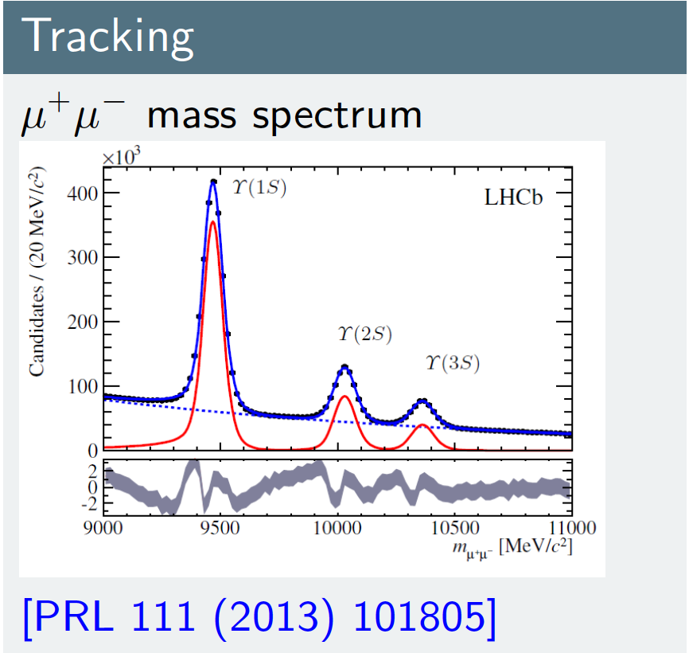
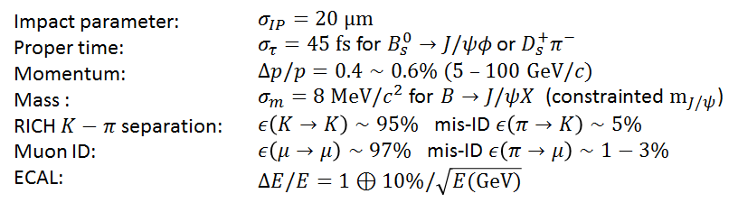
Detector performance

Slide 10
LHCb goals
Find or establish limits on physics beyond the standard model using CP violating & rare beauty & charm decays
Rare: B_{(s)}→μ⁺μ⁻, B⁰→K*μ⁺μ⁻, B⁻→Ke⁺e⁻/Kμ⁺μ⁻
CP violation: determine ∠’s: γ, β, φ_{s}
  γ measured with B⁻→D⁰ K⁻ decays
  φ_{s} measured with B_{s}→J/ψφ & J/ψπ⁺π⁻ decays
  All B→J/ψ π⁺π⁻ & J/ψK⁺K⁻ studied
  In study of B⁰→J/ψK⁺K⁻ [arXiv:1308.5916], Λ_{b}→J/ψK⁻p was suggested as a potential background

Slide 11
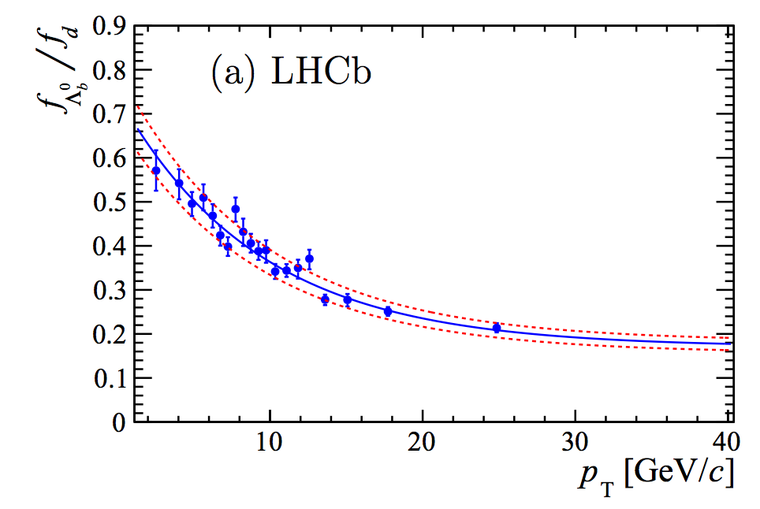
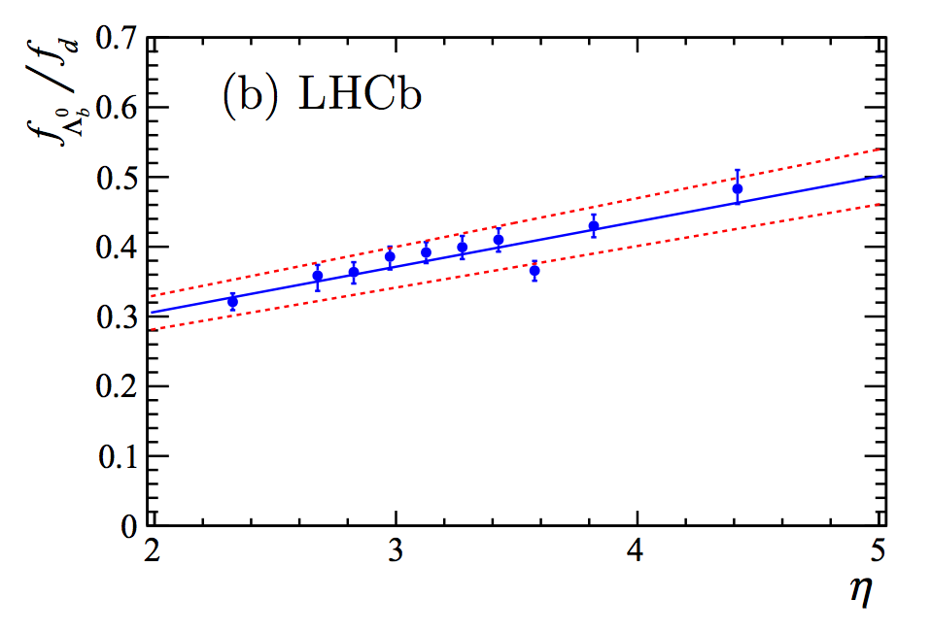
fΛ_{b}/f_{d}
Determine the p_{T} and η dependence of fΛ_{b}/f_{d}
Clear increase of Λ_{b} at low p_{T} and large η
  Many more Λ_{b} in LHCb than central detectors
The LHC is a Λ_{b} factory: 4:2:1 B⁰:Λ_{b}:B_{s} in LHCb acceptance
[LHCb, JHEP 08(2014) 143, arXiv:1405.6842]

Slide 12
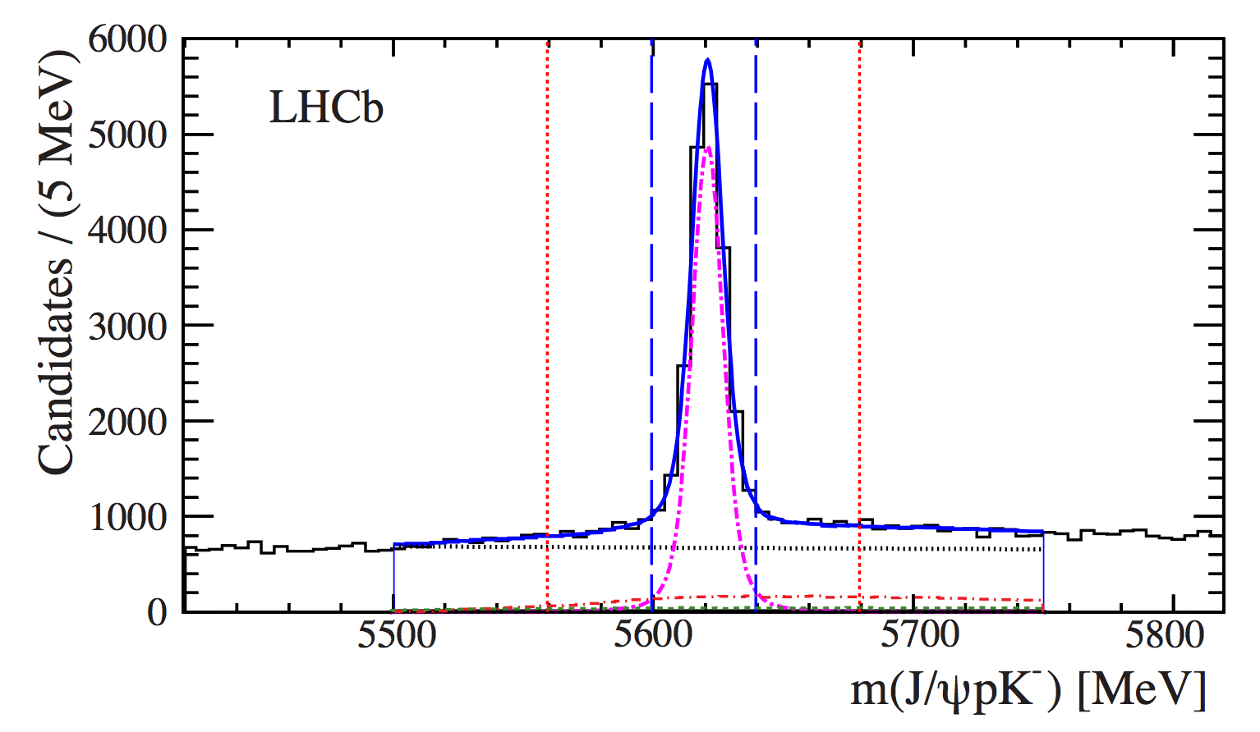
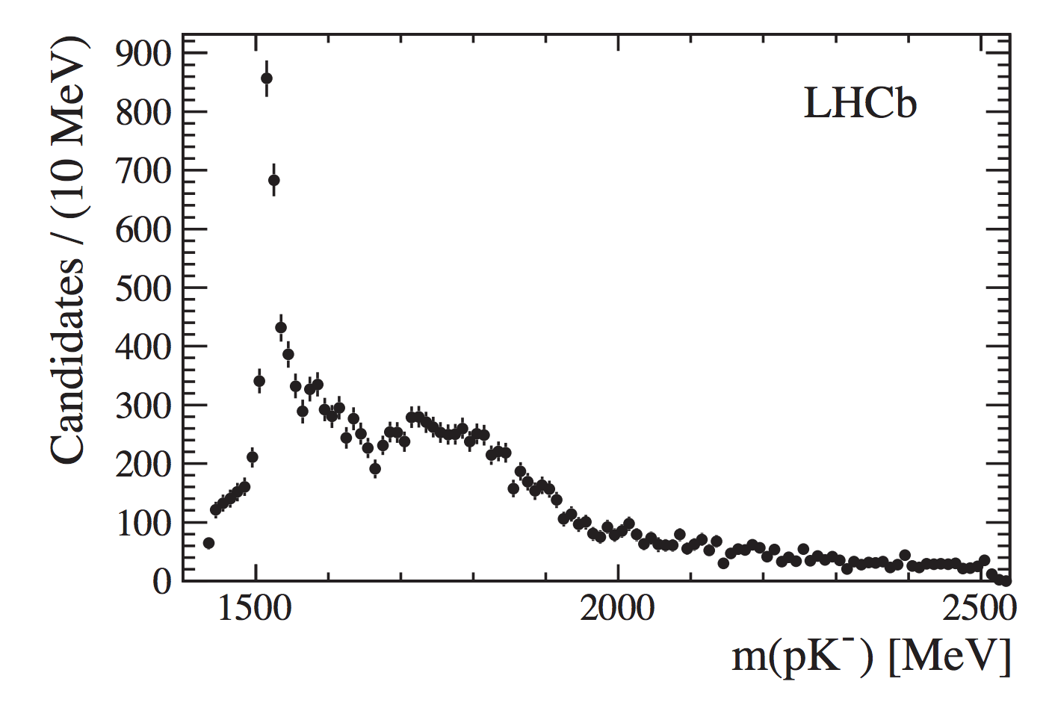
Λ_{b}→J/ψK⁻p
First observation of the decay with 2011 data
Unexpected large yield, interesting structure in pK mass
Used to measure Λ_{b} lifetime
[LHCb, PRL 111 (2013) 102003, arXiv:1307.2476]
Update with 2011+2012 data
[LHCb, PLB 734 (2014) 122, arXiv:1402.6242]

Slide 13
Measurement of Λ_{b}/B⁰ lifetime
Long history of a puzzling discrepancy between Λ_{b} and B lifetime
Heavy Quark Expansion (HQE) predicts similar lifetime
With our precision measurements, this story now ends

Slide 14
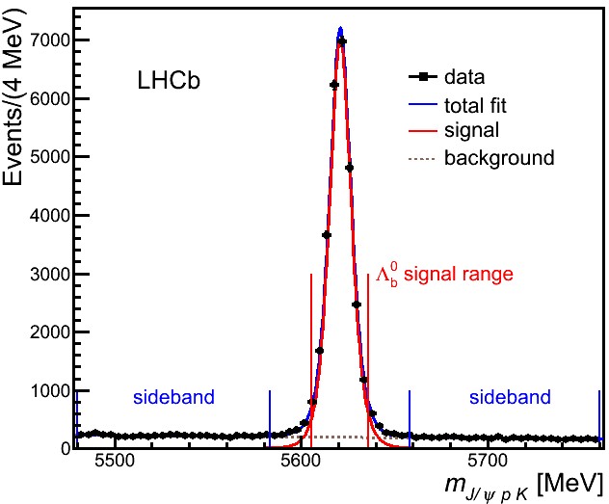
Data and selection
p
2011+2012 3fb⁻¹
Reoptimized selection
for this study
  B_{s}→J/ψK⁻K⁺
  & B⁰→J/ψK⁻π⁺ misID
  backgrounds are
  vetoed
Large and clean
Λ_{b} signals
K⁻
μ⁻
0
b
Λ
μ⁺
Primary vertex
Run I
3 fb⁻¹
26,007±166
Λ_{b} signals
94.6% purity
[PRL 115, 072001 (2015)]
m(J/ψK⁻p) [MeV]

Slide 15
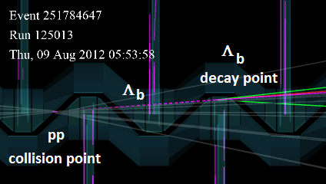
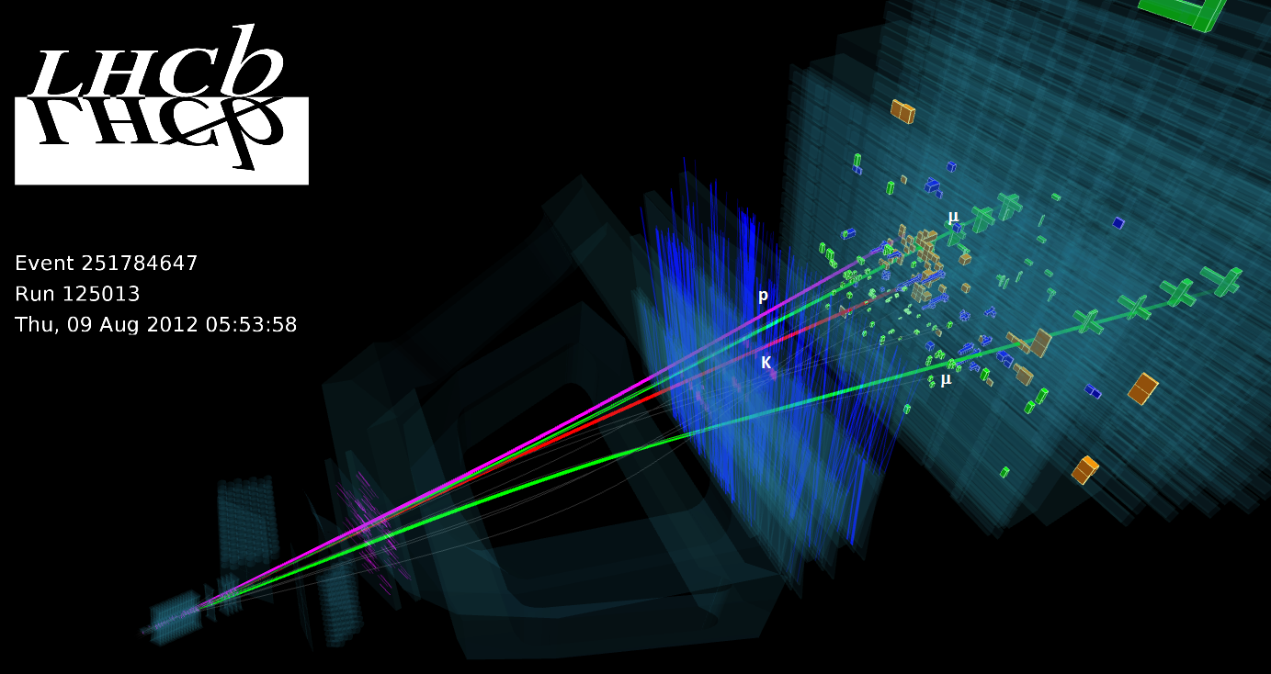
A Λ_{b}→J/ψK⁻p candidate
VELO
μ
p
K
μ

Slide 16
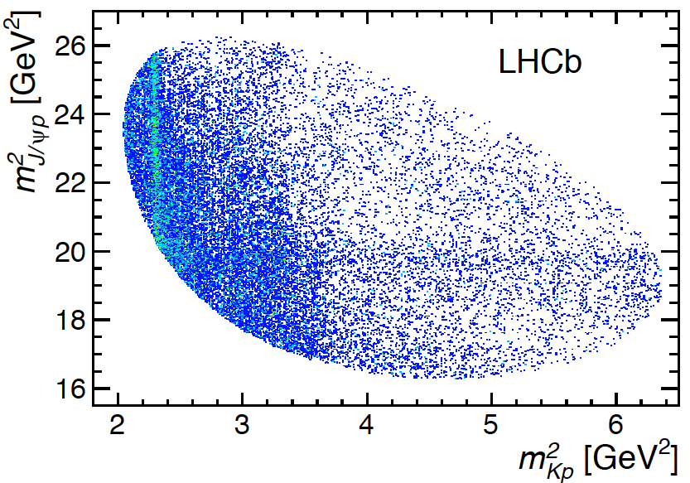
“Dalitz-plot” distribution
Dalitz-plot generally used for studying
3-body decays
3-body decays are often dominated by resonance processes, can be viewed by the distribution
Make a Dalitz plot.
Showed an
unusual feature
…Λ*’s
m²(J/ψ p)
[PRL 115, 072001 (2015)]
m²(K⁻p)
16

Slide 17
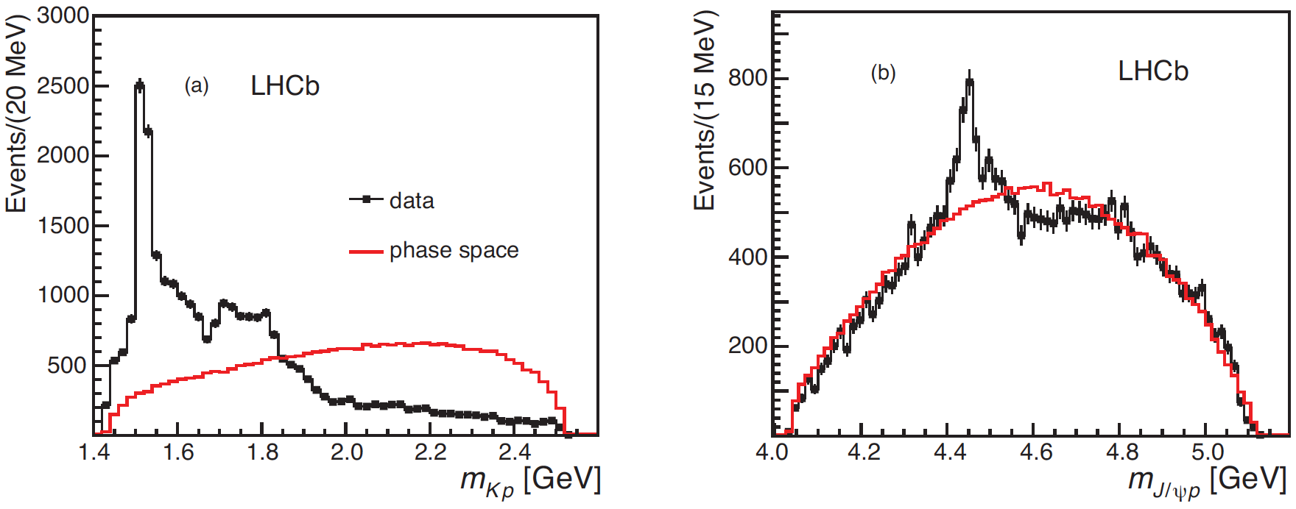
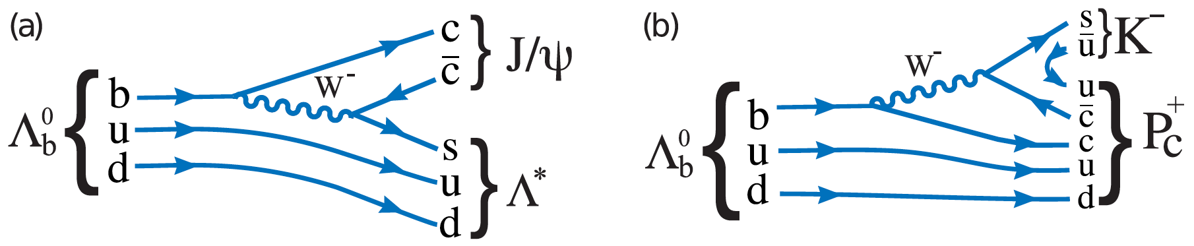
Projections
[PRL 115, 072001 (2015)]
Does a 4 quark +q state exist?

Slide 18
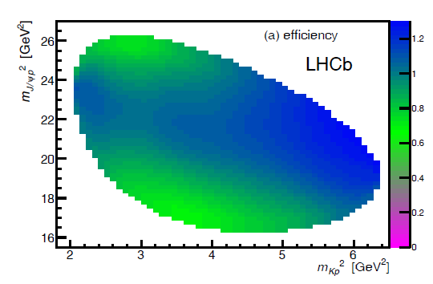
Is the peak “an artifact”?
Many checks done: this is not be the case:
  MisID background of B⁰
  and B_{s} are vetoed
  Ξ_{b} decays checked
  Efficiency doesn’t make
  narrow peak
  No peaking sideband bkg
  Clones & ghost tracks eliminated
Can interference between Λ* resonances generate a peak in the J/ψp mass spectrum?
  A full amplitude analysis is performed using all known Λ* resonances
Total Efficiency

Slide 19
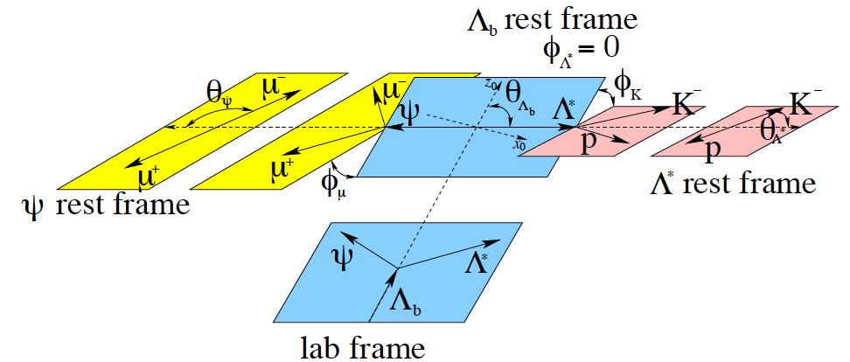
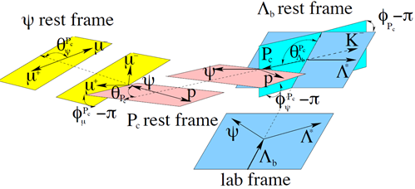
Amplitude analysis
Two interfering channels:
Λ_{b}→J/ψΛ∗, Λ∗→K⁻p
&
Λ_{b}→P_{c}⁺K⁻, P_{c}⁺→J/ψ p
Use m(K⁻p) & 5 decay ∠’s as fit parameters

Slide 20
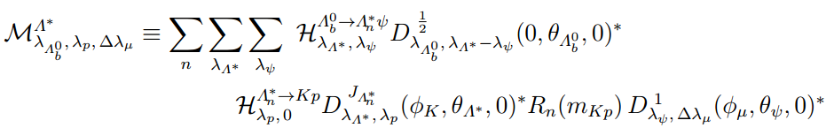
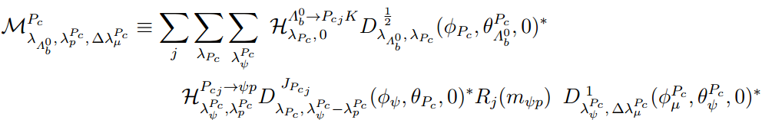

Amplitude Analysis
The matrix element for the Λ* decay is:
And for the P_{c}:
$ℋ$ are complex helicity couplings determined from the fit

Slide 21
Amplitude Analysis
The matrix element for the Λ* decay is:
And for the P_{c}:
R(m) are resonance parametrizations, generally are described by Breit-Wigner, Flatte´ amplitude

Slide 22
Amplitude Analysis
The matrix element for the Λ* decay is:
And for the P_{c}:
Wigner D-matrix arguments are Euler angles corresponding to the fitted angles.

Slide 23
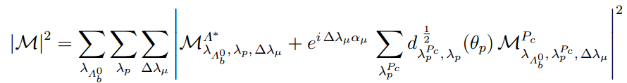
Amplitude Analysis
The matrix element for the Λ* decay is:
And for the P_{c}:
Add together coherently to allow them interfering

Slide 24
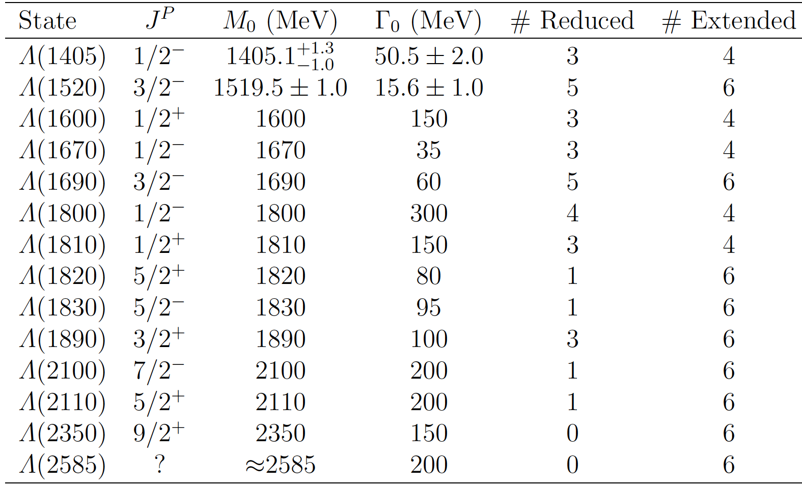
Models: extended & reduced
Consider all Λ* states & all allowed L values
Flatte´
BW
↓
# parameters 64 146

Slide 25
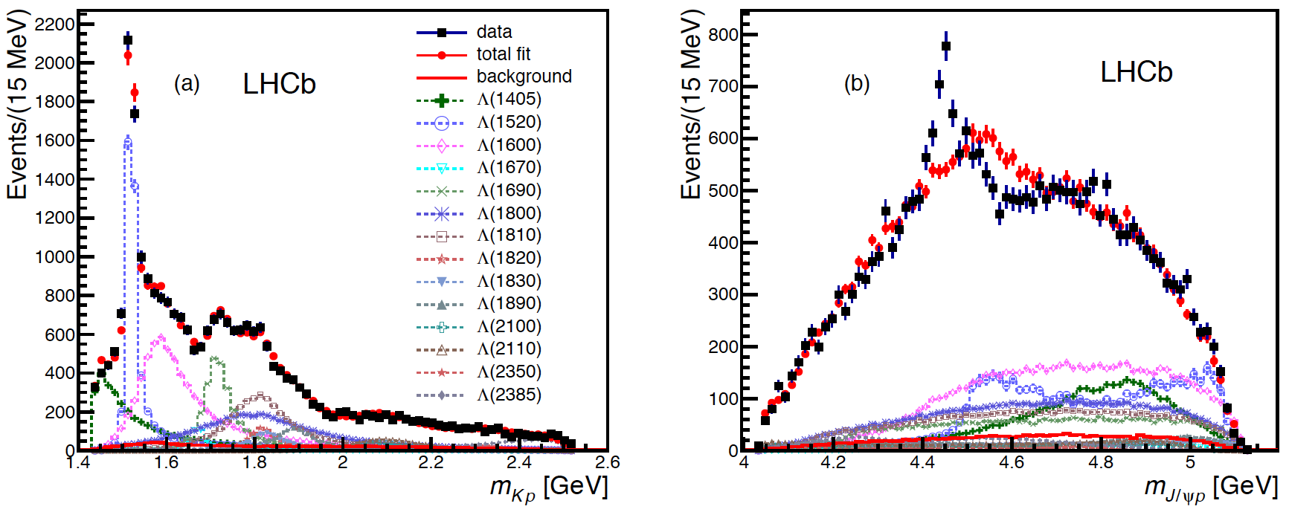
Results without P_{c} states
Use extended model, so all possible known Λ* amplitudes. m_{Kp} looks fine, but not m_{J/ψp}
Additions of non-resonant, extra Λ*, all Σ* (isospin violating process) doesn’t help

Slide 26
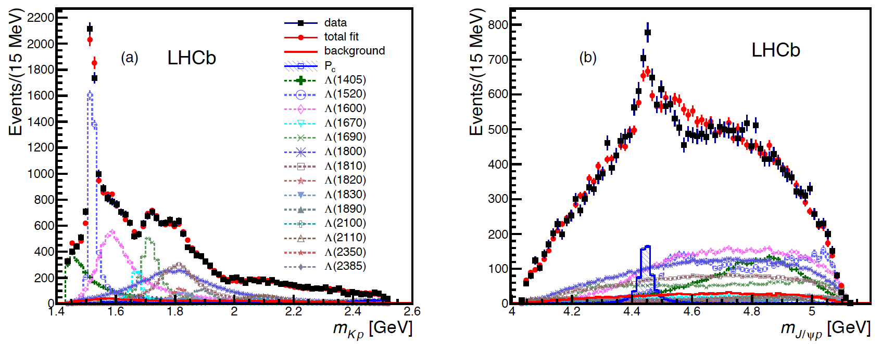
Extended model with 1 P_{c}
Try all J^{P} up to 7/2±
Best fit has J^{P} =5/2±. Still not a good fit

Slide 27
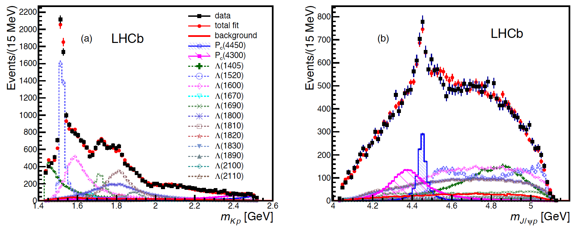
Reduced model with 2 P_{c}’s
Best fit has J^{P}=(3/2⁻, 5/2⁺), also (3/2⁺, 5/2⁻) & (5/2⁺, 3/2⁻) are preferred

Slide 28
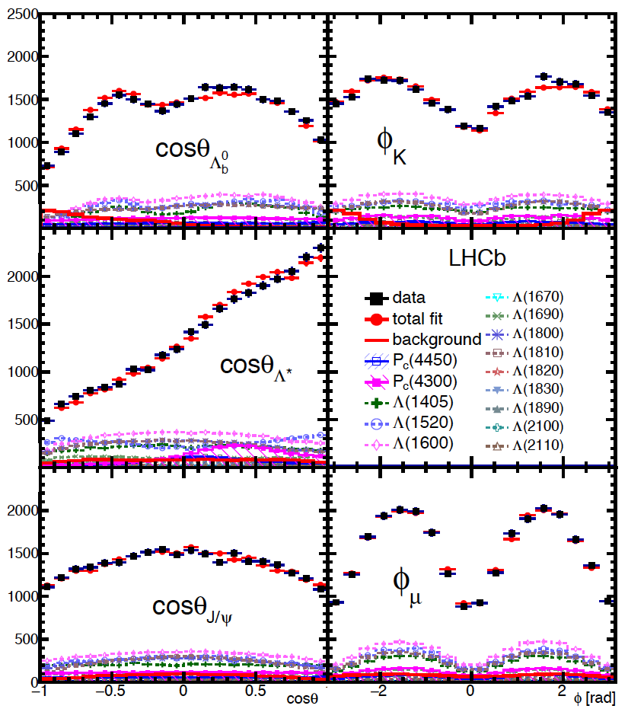
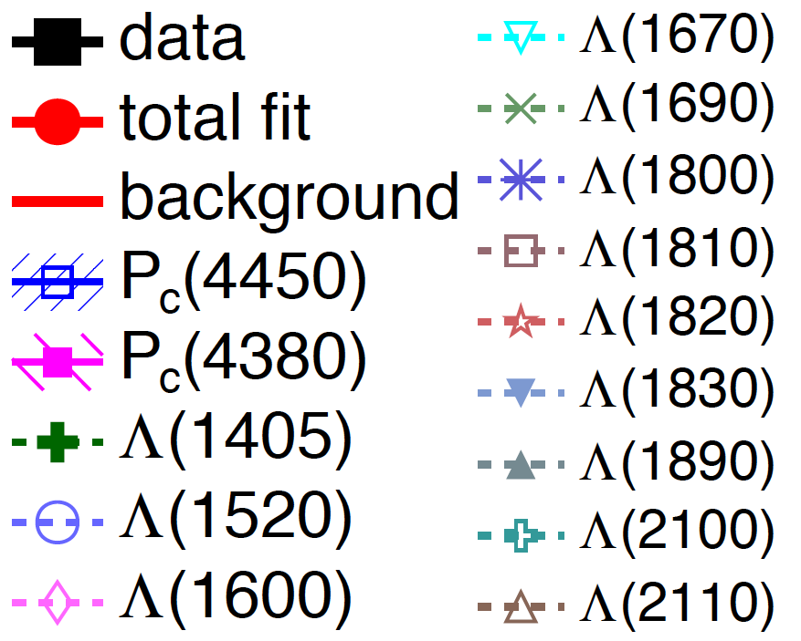
Angular distributions
Good fits in the angular variables
8

Slide 29
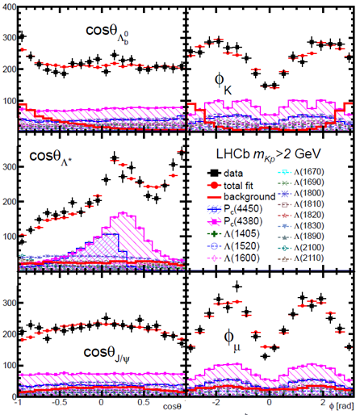
Better View
Cut m_{Kp}>2GeV to enhance P_{c}⁺ fraction
Should be visible by other LHC experiments

Slide 30
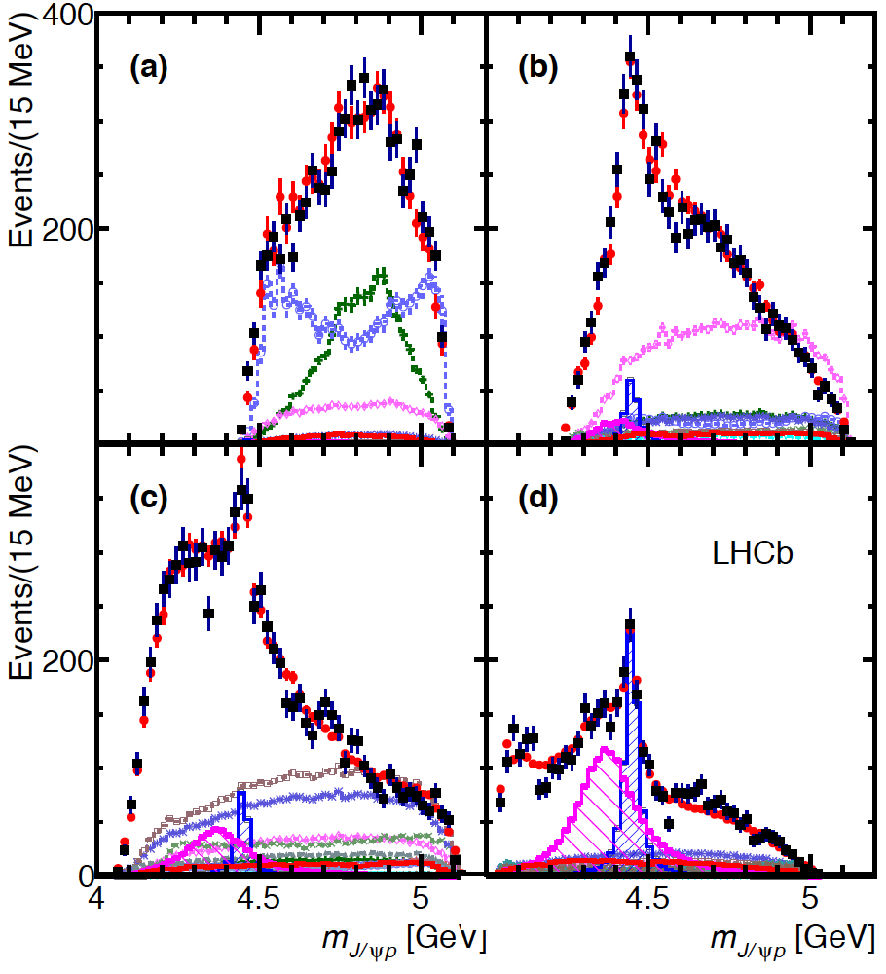
In m(K⁻p) slices
P_{c}’s cannot appear in first interval as they would be outside of the Dalitz plot boundary
M(Kp)<1.55 GeV
1.55<M(Kp)
<1.70 GeV
Events/(20 MeV)
1.70<M(Kp)
<2.00 GeV
2.00 GeV<M(Kp)
Events/(20 MeV)

Slide 31
Data demands 2 states
Interference between opposite parity states needed to explain P_{c} decay angle distribution
Fit projections
Small m(Kp) region
positive interference
Large m(Kp) region
negative interference

Slide 32
m(J/ψ K⁻)
Our fit explains m(J/ψ K⁻)
1.55<M(Kp)
<1.70 GeV
M(Kp)<1.55 GeV
2.00 GeV<M(Kp)
P_{c}
1.70<M(Kp)
<2.00 GeV
All M(Kp)

Slide 33
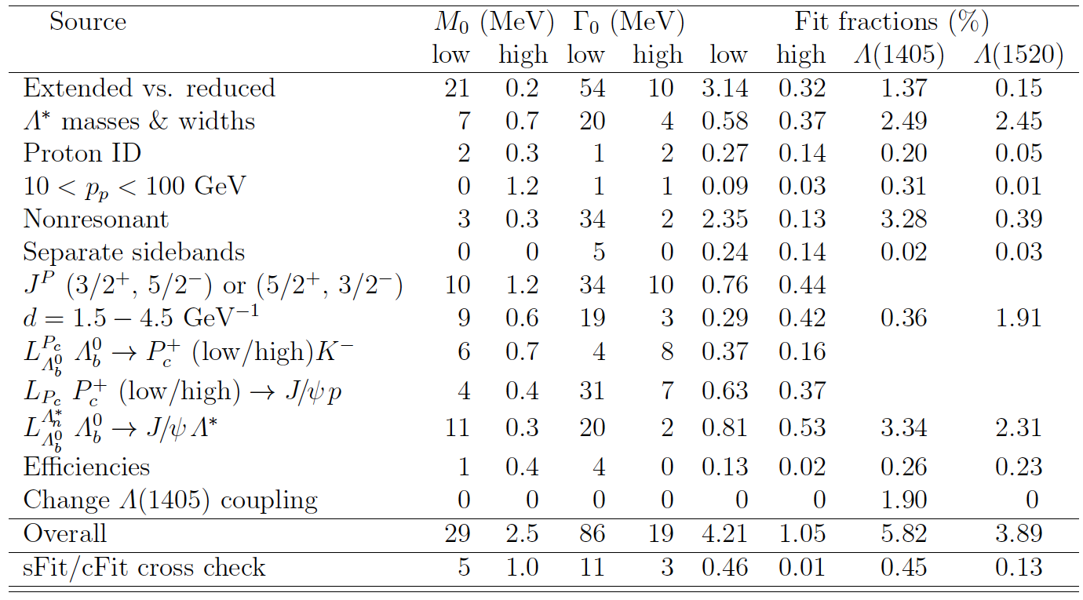
Systematic uncertainties

Slide 34
Significances
To include systematic uncertainty, the extended model fits are used
Fit improves greatly, for 1 P_{c} Δ(-2lnL)=14.7², adding the 2nd P_{c} improves by 11.6², for adding both together Δ(-2lnL)=18.7²
Toy MCs are used to obtain significances based on Δ(-2lnL)
Significances:
  1st P_{c} (4450)⁺ : 12𝜎
  2st P_{c} (4380)⁺ : 9 𝜎
  Total : 15𝜎

Slide 35
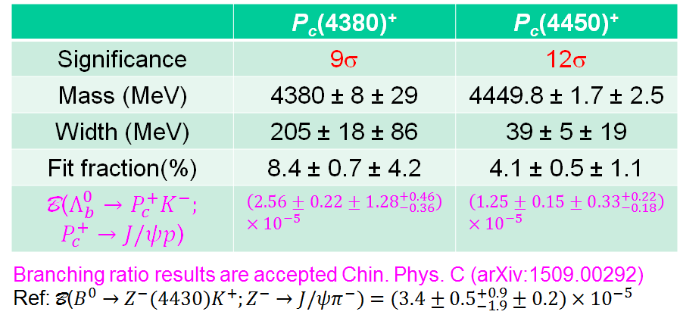
Fit results

Slide 36
Cross-checks
Many done, some listed here:
Signal found using different selections by others
Two independently coded fitters using different background subtractions (sFit & cFit)
Split data shows consistency: 2011/2012, magnet up/down, Λ_{b}/Λ_{b}, Λ_{b}(p_{T} low)/Λ_{b}(p_{T} high)
Selection varied
  BDTG>0.5 instead of 0.9 (default)
  B⁰ and B_{s} misID background modeled in the fit instead of veto

Slide 37
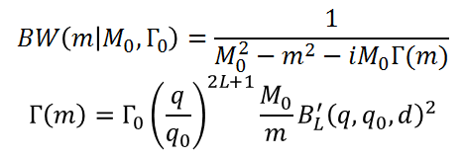
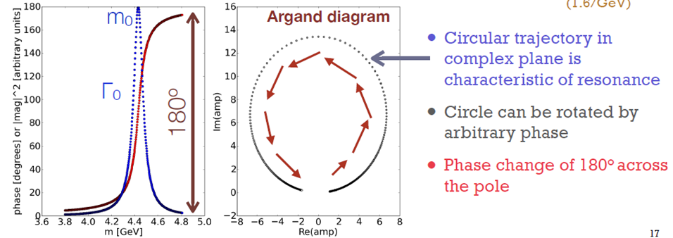
Breit-Wigner amplitude
Often a relativistic Breit-Wigner amplitude is used to model resonance
Function has Re
& Im parts

Slide 38
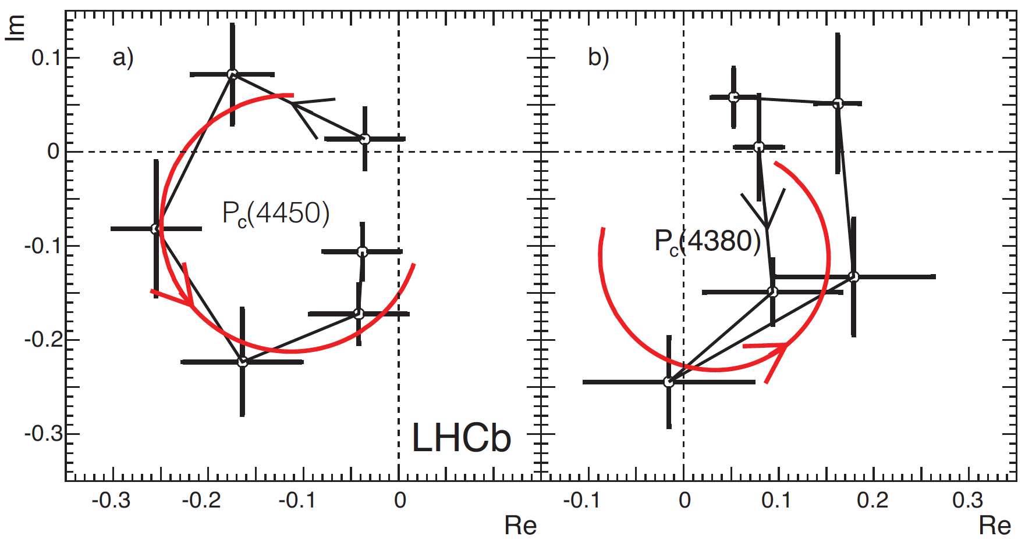
Argand diagrams
Breit-
Wigner
Breit-
Wigner
Amplitudes for 6 bins between +Γ & -Γ
Left: too good, Right: one point 2σ away from expectation

Slide 39
What’s a pentaquark

Slide 40
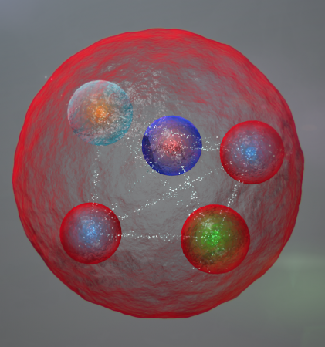
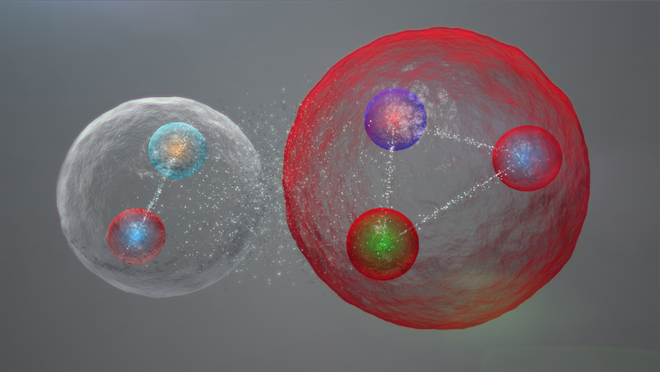
Popular explanations
tightly bonded quarks
Weakly bound “molecules”
of baryon-meson
Already >80 papers citing our result, with many possible interpretations

Slide 41
Pentaquark models
All models must explain J^{P} of two states
not just one. They also should predict
properties of other states: masses,
widths, J^{P}.
Many models: Lets start
with tightly bound quarks ala′ Jaffe
  Two colored diquarks plus the anti-quark, L.Maiani, et. al, [arXiv:1507.04980]
  Colored diquark + colored triquark, R. Lebed [arXiv:1507.05867]

Slide 42
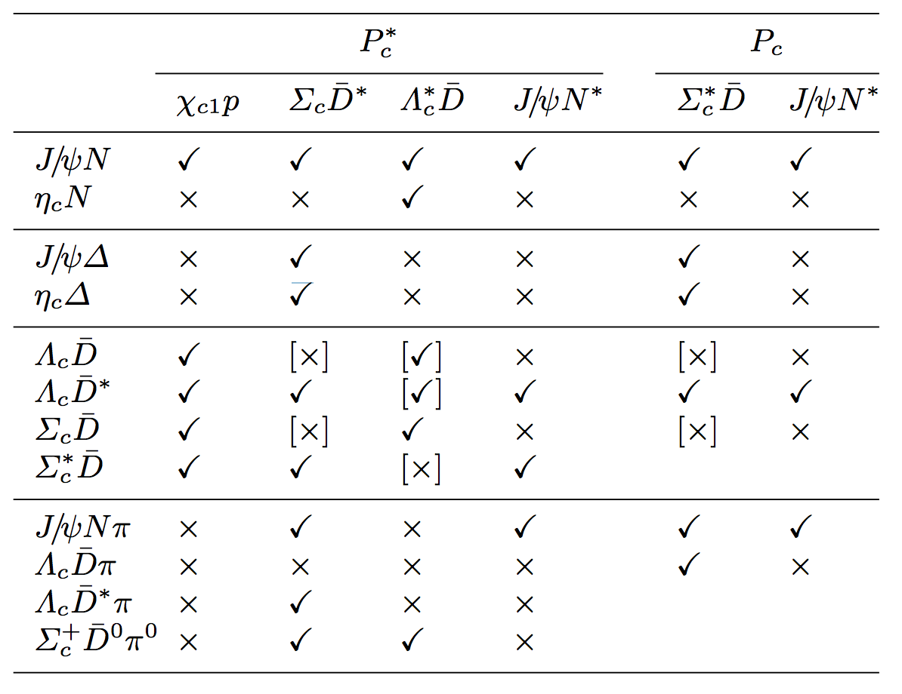
Molecular models
  Molecular models, generally with meson exchange for binding
  Inspired by proximity of baryon-meson
  mass sums to
  P_{c} masses
P_{c}(4450)
P_{c}(4380)
composition
Possible decay modes
[Burns arXiv:1509.02460]

Slide 43
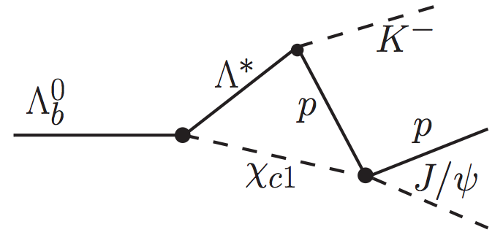
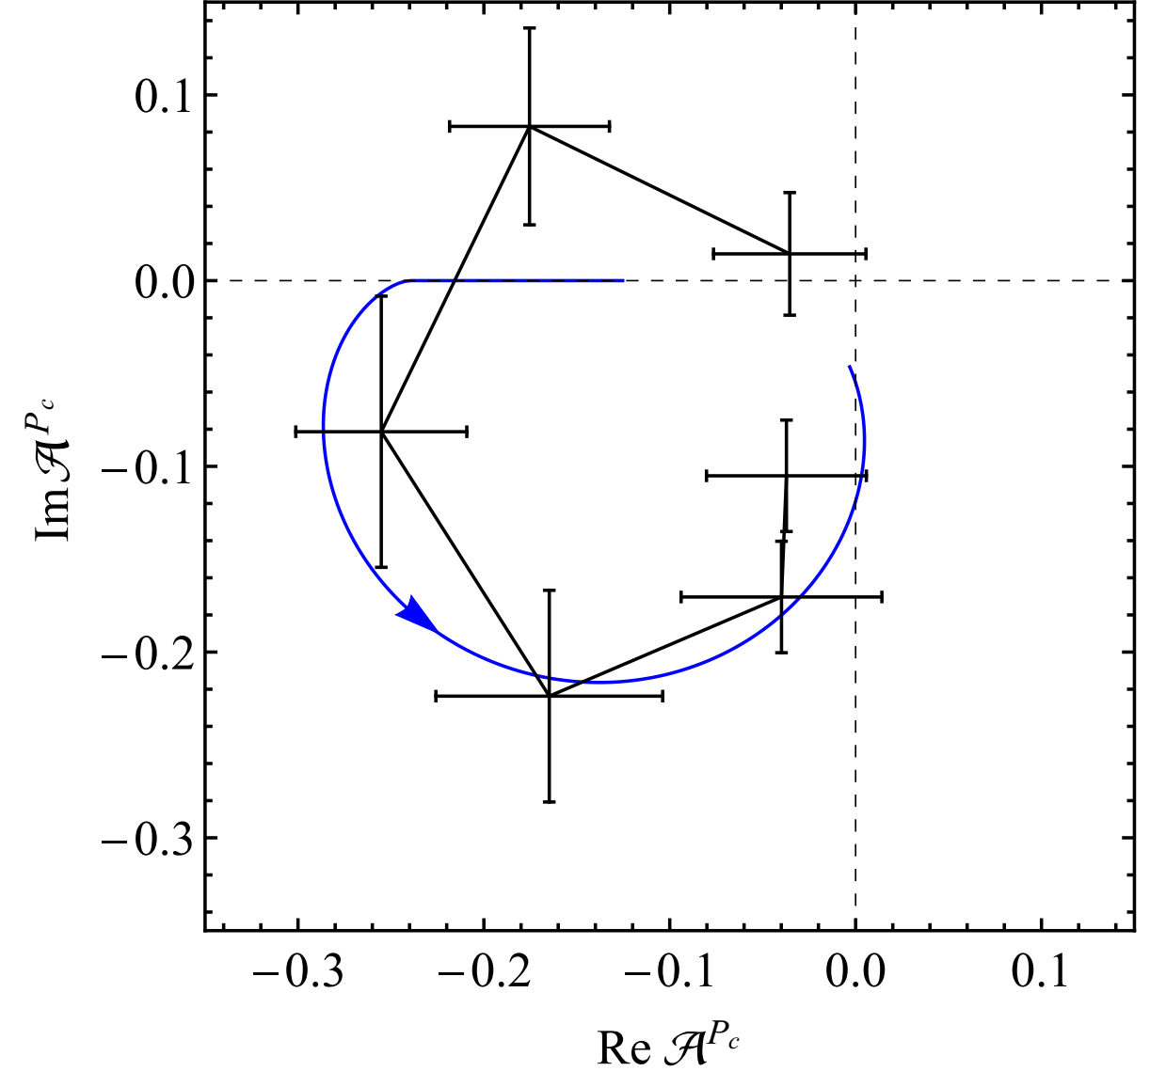
Rescattering
As m(χ_{c1}p)=m(P_{c}(4450)),
P_{c}(4450) is explained
as χ_{c1}p→J/ψp
Can explain phase motion
No predict the size of the
rescattering amplitude
Also difficult to predict
two states…
Experimental test: Could be killed if seeing P_{c}(4450) → χ_{c1}p from Λ_{b}→χ_{c1}pΚ⁻
[Guo et. al. arXiv:1507.04950]

Slide 44
Other P_{c} channels
Yields: at least 1/10 smaller than ideal mode J/ψp
B-Baryon decays:
  Λ_{b}→J/ψpπ⁻: Cabibbo-suppressed
  Hadronic: Λ_{b}→Λ_{c}D⁰K⁻
  Other charmonium: ηp, χ_{c1}p from Λ_{b} decays
Direct production: background is high in low p_{T}, other LHC experiment can do it in high p_{T}?
From non-hadron collider experiment:
  Photon production: γp→J/ψp could be done at Jlab
  e⁺e⁻→J/ψpp
Generic pentaquarks: [budud] and [busud]
+

Slide 45
Conclusions
LHCb has found two resonances decaying into J/ψp with pentaquark content of uudcc.
They have spin 3/2 & 5/2 & opposite Parity
Determination of their internal binding, the “color chemistry” will require more study.
Other exotic states have appeared containing cc (or bb) quarks: the Z⁺(4430)→ψ´π⁺ appears to be a tetraquark with J^{P}=1⁺. Is binding stronger for c & b?
We look forward to further searches for exotics
We encourage our LHC colleagues to testify our results
[PRL 115, 072001 (2015)]

Slide 46
The End

Slide 47

Z(4430)⁺ tetraquark
B⁰→ψ´π⁻K⁺, peak in m(ψ´π⁻), charged charmonium state must be exotic, not qq
  First observed by Belle M=4433±5 MeV, Γ=45 MeV
  Challenged by BaBar: explanation in terms of K*’s
  Belle reanalysis using full amplitude fit: M= MeV, Γ=200 MeV, 1⁺ preferred but 0⁻ & 1⁻ not excluded [arXiv:1306.4894]
LHCb analysis also uses
full amplitude fit
  M= MeV
  Γ=172 MeV [arXiv:1404.1903]
see also , LHCb-PAPER-2015-038 in preparation

Slide 48




LHCb Amplitude analysis
Full 4D fit to both K*→K⁻π⁺ & Z→ψ′π⁻ states
J^{P}=1⁺
Unambiguously

Slide 49

Is it a resonance?
LHCb produced an Argand plot that shows a clear & large phase change
There are also attempts at rescattering explanations
data
Low
Z mass
Breit-Wigner
prediction
High
Z mass

Slide 50



Other Explanations
Molecule:
L. Ma et.al, [arXiv:1404.3450]
T. Barnes et.al, [arXiv:1409.6651
Same scattering phase
as Breit-Wigner
Rescattering:
P. Pakhov & T. Uglov
[arXiv:1408:5295]
Opposite phase
Ruled out by LHCb
Argand diagram

Slide 51


Extended model with 2 P_{c}’s

Slide 52

Amplitude formalism
◼︎The amplitude for the Λ* decay sequence is given by
The matrix element for the $Λ^{∗}$ decay is:
◼For the P_{c}:

Slide 53
Amplitude formalism II
◼︎The amplitude for the Λ* decay sequence is given by
◼For the P_{c}:
R(m) are resonance parametrizations, generally are described by Breit-Wigner amplitude

Slide 54
Amplitude formalism III
◼︎The amplitude for the Λ* decay sequence is given by
◼For the P_{c}
$ℋ$ are complex helicity couplings determined from the fit

Slide 55
Amplitude formalism IV
◼︎Λ* decay sequence is given by
◼For the P_{c}
Wigner D-matrix arguments are Euler angles corresponding to the fitted angles.

Slide 56


Amplitude formalism V
They are summed as:
◼α_{μ} & θ_{p} are rotation angles needed to align the final
state helicity axes of the μ & p, as the initial helicity
frames are different for the two decay chains
Helicity couplings $ℋ$ ⇒ LS amplitudes B via:
  ◼ Convenient way to enforce parity conservation in the strong decays via: P_{A}

Slide 57








Other tetraquark candidates
Thus far, no
amplitude
analyses for
these states
Belle
Y(3940)
BaBar
Y(4260)
B→K ωJ/ψ
Belle
BaBar
Y(4008)?
M(ωJ/ψ)
Z(4430)
M(ωJ/ψ)
M(π⁺π^{-J/}ψ)
M(π⁺π^{-J/}ψ)
Y(4350) & Y(4660)
Y(4140)?
CDF
Belle
Z₁(4050), Z₂(4250)
B→K π⁺χ_{c1}
BaBar
Belle
B→K φJ/ψ
M(φJ/ψ)−M(J/ψ)
M(π⁺π⁻ψ’)
M(π⁺π⁻ψ’)
M(π±χ_{c1} )
All current candidates
contain a cc or bb
BES
e⁺e-→Y(4260)→π⁺Z_{c}(4020)⁻→π⁻h_{c}
M(π±h_{c})

Slide 58


Detector Workings
LHCb detector ~ fully installed and commissioned → walk through the detector using the example of a B_{s}→D_{s}K decay

Slide 59
Masses
12 orders of magnitude differences not explained; t quark as heavy as Tungsten

Slide 60



Some History: The a₁
Is it possible for other processes to mimic resonant effects?
Example: The Deck effect, a lesson in confusion: π⁺p→π⁺ρ⁰p, ρ⁰→π⁺π⁻, using a 3.65 GeV π⁺ beam, G. Goldhaber et. al, PRL 12, 336 (1964)
a₂
a₁
Note BeV≡GeV

Slide 61


“Kinematical” effect
Clear enhancement near threshold. Is it a new resonance as suggested in original paper?
Theorists, first Deck, suggest that the threshold enhancement can be due to off shell πp scattering R.T. Deck, PRL 13, 169 (1964)
Deck
effect
Deck’s fit to
data can
provide
adequate
explanation
30
20
10
M²(π⁺ρ⁰) (GeV²)

Slide 62

τ⁻→(πππ)⁻ν
Controversy continued until observation of a₁ in τ−→π⁺π⁻π⁻ν decays, ~1977
Surmises: a full amplitude analysis may have proved the resonant nature of the a₁ earlier. Important to see resonant states in several ways. There never was an unambiguous demonstration of the “Deck” effect.
π⁻π⁻π⁺
π⁻π⁰π⁰
MAC (PEP) data 1987

Slide 63
Fit results
Mass (MeV) | Width (MeV) | Fit fraction (%)
4380±8±29 | 205±18±86 | 8.4±0.7±4.2
4449.8±1.7±2.5 | 39±5±19 | 4.1±0.5±1.1
Λ(1405) |  | 15±1±6
Λ(1520) |  | 19±1±4

