Slide 1
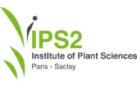
Automation for Chemical Analysis Techniques
Management of Data for the Analysis of Lipids, Metabolites and Isotopes: 'MoDALMI'
Developer: Diem BUI THI (UFR Pharmacie)
Investigator: Sana TFAILI (UFR Pharmacie)
Collaborators: Karima RAFES (INRIA), Valérie CANTONY (IPS2)
CDS Project Sponsor: Balázs KEGL (LAL)
‹#›

Slide 2
PROJECT ‘S GOAL
APPROACH
CREATE OPEN DATABASE PLATFORM
CENTRALIZE DATA
PROMOTE THE COLLABORATION IN CHEMICAL RESEARCH COMMUNITY
INDICATE SCIENTIFIC WORKFLOW
DESCRIBE KNOWLEDGE BASE
EXPLOIT DATA FORMAT
COMPUTERIZE THE WORKFLOW
AUTOMATE THE SYSTEM
AGENDA
SCENARIO
CONVERSION
PRE-TREATMENT
PROCESSING METADATA
CONCLUSION
FUTURE WORK
Notes:
The project aims to create an open database platform for achieving, structuring, sharing, integrating the considerable amount of generated data in analytical chemistry.
First approaches are to make clear and specify the scientific workflows, accompany with scientists to describe their base knowledge of chemistry on Wikipedia and exploit the various format data.
Then, demonstrate the implementation of possible solutions how to computerize and automate the current workflows
to simplify and reduce the complexity of using the system.
---- the left column
From this, I… (right column)
In the agenda, I’m going to talk the overview of the system through the first point to the last point.
First, I’ll indicate the actual context in the laboratory.
Then, I’ll talk about development steps of automatic toolkit during three next points.
After that, I point out a further collaborations inside and outside.
Finally, I’ll summarize what I’ve done and what I should do.

Slide 3
Scenario
DIVERSE FORMAT
DISORGANISED
LOCAL STORAGE
MANUAL MANAGEMENT
INSTRUMENT:INCREASE
TECHNIQUE: VARIETIES
CONVERSION
PRE-TREATMENT
TREATMENT
ANALYSIS
CURRENT SCIENTIFIC WORKFLOW
BIG QUESTION
How a user without IT knowledge can select reliable tools or master computing language to treat huge dataset?
MANUAL
DUPLICATION
VARIOUS DATA PROCESSING METHOD
REQUIRE COMPUTING KNOWLEDGE
DEPENDS ON ACQUISITION SOFTWARE
SOLUTION
COMPUTERIZE THE WORKFLOW
AUTOMATE THE SYSTEM
Notes:
Because of practical needs, the improvement of instruments and the varieties of analytical techniques produce the high volume of chemical data.
The capacity of output data is locally archived and individually managed and not well organized.
Plus, It’s formed with the varieties of format such as raw, spc, jdx, d, wiff and so on …
All data is manually proceeded with conversion, pretreatment, treatment before the analysis. This chain requires tools and a certain knowledge of programming languages.
The big question is how a user without IT knowledge can select reliable tools or master programming language for data treatment to work with the huge experimental dataset? You can see a duplication in searching, installation and even problems related to system configuration.
With the view of engineers, the difficulties in information system look like the exciting challenges but they are nightmares for scientists.
They need a better designed system that can shoulder and automate the hard parts of their scientific workflow, provides them a qualified result plus performance and user oriented system.
We propose a solution which can technologize the scientific workflow. Finally, The system enables to automate workflows with less efforts and without having manually initiate the complex configuration.

Slide 4
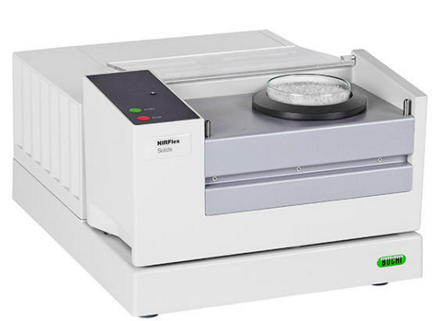
Automatic Conversion
MsConverter
Raman Microspectrometer
Wiff2MzData
Mass Spectrometer
Analyst
NIRFlex N-500
FORMAT: DIVERSE
STORAGE: DISTRIBUTED + LOCAL
CONVERTER: VARIOUS
Notes:
Raw data generated by experimental instruments is in a proprietary format and depend on the acquisition software of the manufacturer of the instrument and need to be converted into formats compatible with the file processing software.
The conversion is done by the different converters and requires the different setting parameters. We can see the problem of individual conversion duplication, the potential risk of selecting a good tool.
The repetition is being replaced by an tool which is customized to work with different file extensions. It is activated nightly by a job scheduler. The input and output are located in fileserver. It allows multi-users to access the same dataset and to see the relevance between the raw and converted files.
This work urgently requires to be optimized and more productive by automating the conversion process.
Automatic conversion is specially customized to work with different proprietary format. This tool permits scientists independent to the sophistication of conversions tool on the market.
The input and output are centralized on fileserver where allows user to access online.
It is fully simple to allow users flexibly to schedule or re-schedule the running system.
Data generated most of instruments in the laboratory is formed under different formats. As usual, the conversion is done before other steps in the scientific workflow.
after doing an experiment, instruments produces proprietary files which are only treated by acquisition softwares of instrument vendors. To indepent with acquisition software, many of them convert raw data to open data format by their own tool and keep converted file on their computers.
They could not find a good mean to share their result with others.
We can see the problem of duplication of converting dataset, the potential risk of selecting a good tool and the repetition of work costs the time and the effort.
This work urgently requires to be optimized and more productive by automating the conversion process.
Automatic conversion is specially customized to work with different proprietary format. This tool permits scientists independent to the sophistication of conversions tool on the market.
The input and output are centralized on fileserver where allows user to access online.
It is fully simple to allow users flexibly to schedule or re-schedule the running system.
Many people work on the same dataset to produce the same expected result with the different tools. We can see the problem of duplication of converting dataset, the potential risk of selecting a good tool and the repetition of work costs the time and the effort.
This work urgently requires to be optimized and more productive by automating the conversion process.
Automatic conversion is specially customized to work with different proprietary format. This tool permits scientists independent to the sophistication of conversions tool on the market. It is fully simple to allow users flexibly to schedule or re-schedule the running system.
(It can guarantee for the security and correctness of normalized data through testing)

Slide 5
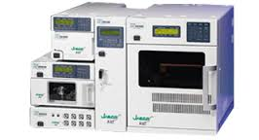
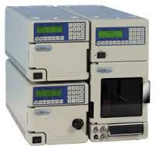
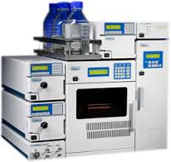
BEFORE
AFTER
CONVERTER: UNIFIED
ACTIVATION: AUTOMATIC
STORAGE: CENTRALIZED
Pharmacy’s Scientist
Pharmacy’s Scientist
FileServer@ParisSud
Pharmacy’s Scientist
.CDF
USB
CONVERTER
.SPC
Pharmacy’s Scientist
USB
CONVERTER
.RAW
JobScheduler
.WIFF
AUTOMATE CONVERSION FROM WIFF TO MZDATA
Pharmacy’s Scientist
ConvertWiff2MzData
Notes:
this idea of automation is applied for the second feature of the toolbox
Reorganize the slide:
Left side: the old situation: usb, various converters, distributed file extensions
Right side: solution
Before talking about the solution: I will give you an example of one of techniques to demonstrate the solution.
Let’s have a look an example of data conversion
If someone in the laboratory has a demand to convert wiff files to mzData. First, they will open a request and then put their files to the centralized fileserver.
A script corresponding to the request is added to toolkit. It is triggered nightly by a scheduler service in the system.
The design is projected and applied for the other types of file in the laboratory.
First, someone put the raw data on the shared file server. They open a request, for example, help to convert their wiff files to mzData.
I’ll build a script to convert raw files to their wanted results. Meanwhile, a night job is scheduled to detect and do the conversion if there some new files arriving.
This work is duplicated and customized for the other data formats like .d, .raw,
Then, converted files are the input of extraction that I’ll talk in couples of next slide.

Slide 6
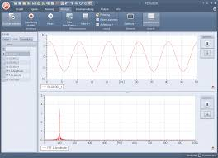
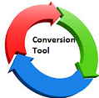
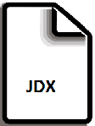
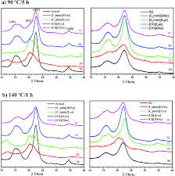
Automatic Pre-processing
DATA: LOCAL
TOOL: VARIOUS
PROCEDURE: MANUAL
2D ARTIFACTS
Notes:
According to their habits, some scientists ...
The second feature in the automation tool is automatic pretreatment.
For example, if someone produces a qualified script, we can reuse and apply for the others in use.
Pretreatment of raw data is a frequent activity of user after doing experimental acquisitions.
Because of their convenience, Someone use matlab, someone use R, someone use excel + their own model formulation.
The manual pretreatment procedure work on the same dataset and produce the similar result.
There is no way to gather data and share the preprocessing techniques and the accurate result among people.
In the other hand, people tend to try out different parameters and combinations.
The purpose of pretreatment is to neutralize people from depending the acquisition software. It helps to obtain the accurate result without solid programming languages.
It eliminates the human variation in the manual procedure. It provides a superior and consistent performance.
Like conversion step, people pretreat the same dataset and acquired the same purpose with different approaches.
Their approaches are different. Someone use Matlab or R to visualize the data. The others utilizes Excel plus a their own formulation to visualize the graphic graphs.
In the other hand, When analyzing spectral data, people tend to try out different parameters and combinations. Also, some commercial acquisition soft-wares limit the number of installation.
The automation of pretreatment neutralizes with the tool and enables experimentalists obtain the result without solid knowledge of programming languages.
It eliminates human variation in the procedure. It provides a superior and consistent performance than manual.
This tool is verified and optimized with functional tests and complexity reduction. It is one of ways to reuse and share the knowledge among people.
(Additionally, the configuration for running system is flexible and simple.)

Slide 7
Automatic Pre-processing
Pharmacy’s Scientist
DATA: CENTRALIZED
METHOD: UNIQUE
PROCEDURE:AUTOMATIC
Pharmacy’s Scientist
2D ARTIFACT
Pharmacy’s Scientist
RamanPretreatment
FileServer@ParisSud
JobScheduler
AUTOMATE THE PRE-TREATMENT FOR RAMAN SPECTROMETRY TECHNIQUE
Notes:
Here, the target of my work is to automate the working procedure, to unify the processing method and to centralize the data.
The raw data and artefacts where they are accessible to all users.
I’ll show you how to automate the pretreatment for Raman spectra
First, users push their raman files to filer server. A pretreatment script for Raman is added to automation tool and it will be activated by a job scheduler.
The artifacts produced by raw files are placed on file server. User can find the relevance between raw files and 2D artifaces via the file name.
Users can flexibly change the execution time if they want.
Similar to the design for conversion tool, users place their data on file server and open a pretreatment request.
Then, automation toolkit produces 2D graphical plots from raw files. This executed script is nightly scheduled.
Users can re-schedule the execution time if they want.
This work is also applied for the rest of file extensions.

Slide 8
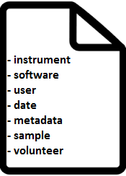
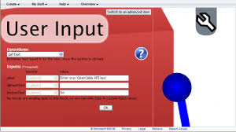
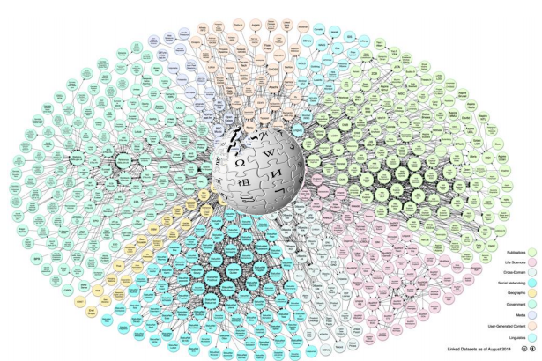
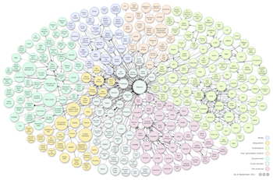
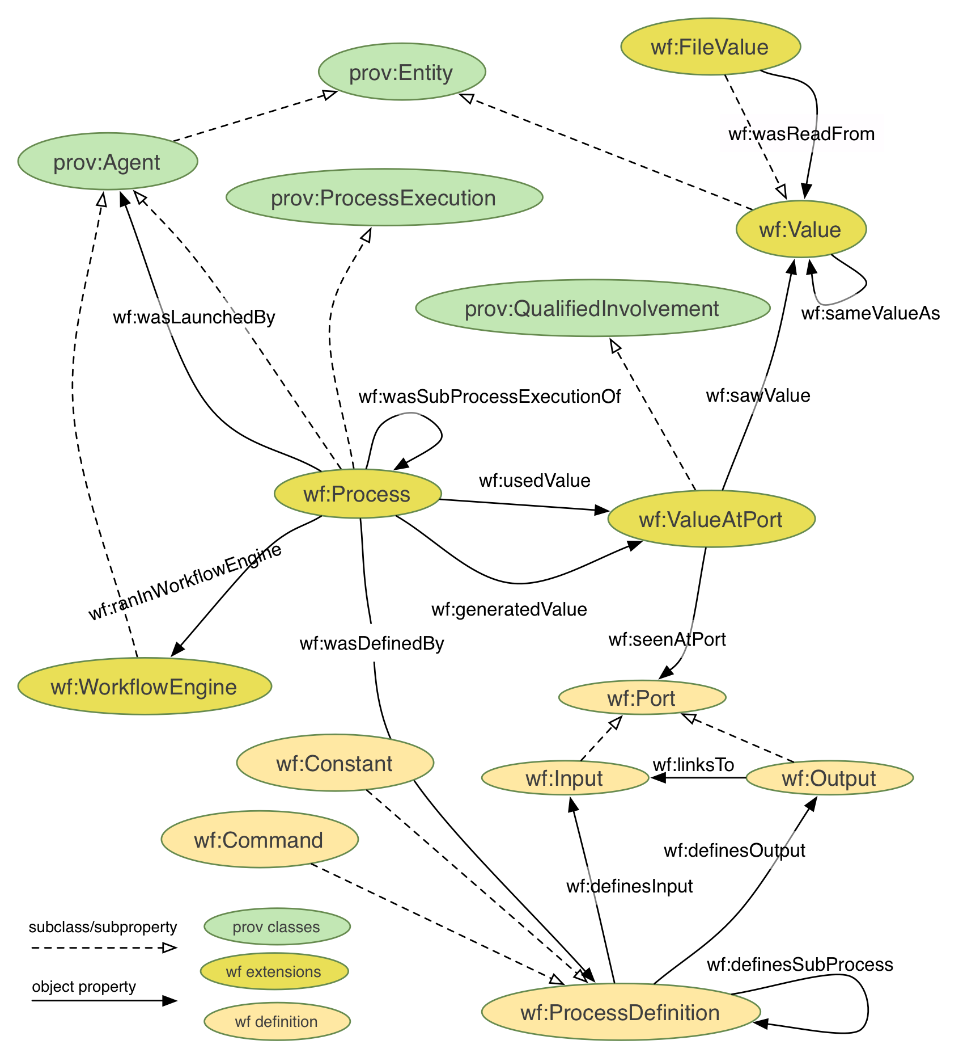
Processing Metadata
TRADITIONAL APPROACH
MORE EFFORT
EASY FAULT
LOST DATA
SPARQL
MODERN APPROACH
AUTO EXTRACTION
MORE PERFORMANCE
FAULT TOLERANCE
Integration
SPARQL
Pluggable Parser
Ontology
Private Linked Database
Notes:
Increase the size for text (file image, save image, parser image)
Processing metadata = Extraction + Integration
We have a demand is to collect and store the metadata of acquisitions.
However, an acquisition relates to many information: information of volunteer, instruments, data acquisition, metadata generated by the instrument.
If I went with the traditional approach by adding the input data by hand, it would take more effort and less accurate.
Fortunately, I realize that all the complex data is structured in output file. It is better to implement a parser corresponding to one file type. The system extracts properties and their values in files with known format and add the data to linked database.
This can lead to build a platform for data mining and conducting the new research.
It is helpful for scientists to interpret the analytical result if they want to repeat the experiments with different parameters, combinations or samples.
Scientists can obtain a better understanding on the knowledge and refining scientific workflows.

Slide 9
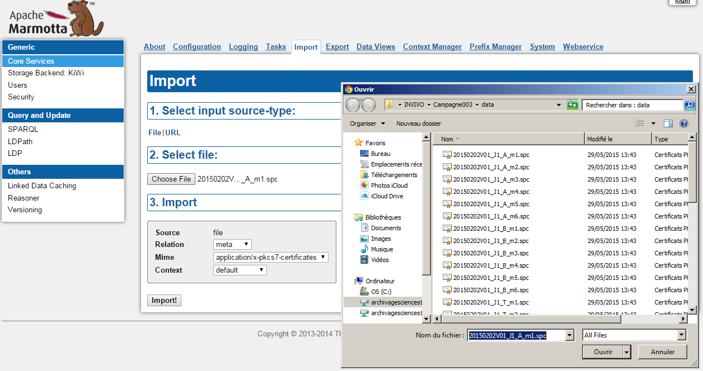
Processing file by file
Notes:
Now the data is available in the db, users can benefit to query and import. For example…
Users can import file by file via user interface.
The server permit remotely access with an account registered before.
Otherwise, if they put all files on FileServer, system can timely check the new arriving files and automatically import to system.

Slide 10
Automatic Processing
Metadata under RDF Format
Linked Database
Copy files to Server
FileServer@ParisSud
File Detection
JobScheduler
Processing a dataset
Notes:
Now the data is available in the db, users can benefit to query and import. For example…
Users can import file by file via user interface.
The server permit remotely access with an account registered before.
Otherwise, if they put all files on FileServer, system can timely check the new arriving files and automatically import to system.

Slide 11
ACHIEVED WORK: Pluggable Metadata Parsers
RamanParser
MzDataParser
MzXMLParser
MzDataReader
MzXmlReader
Notes:
currently?, …. Im going to work for chromatography
Make the text bigger
Bold the effort of making the decision to develop the first parser…
Point out the perspective for next parsers…
The important thing in this feature is pluggable parsers (currently, Parser for Raman, LC-MS) integrated with Apache Marmotta (Open Platform for Linked Data) to retrieve the metadata in different files that are the output of Raman spectrometry instrument and presenting the metadata as ontology graphs under RDF format.
These graphs are inserted to Linked Data Platform (LDP) of Apache Marmotta server as nodes.
The end users can remotely query metadata by performing SPARQL queries. Users distantly access Marmotta to query the metadata which is imported manually or automatically.
Two pictures below illustrate the metadata in Raman spectra file (.spc) imported to Apache Marmotta.
The metadata is extracted and presented under OWL by SPC parser plugin.
The following SELECT query selects file URI, file name and volunteer identification.

Slide 12
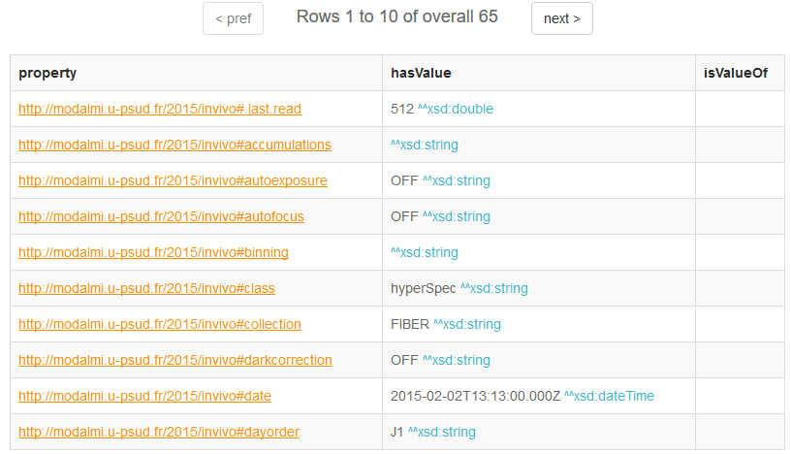
RamanParser for parsing Raman files (.spc)
into RDF format
Notes:
Add a paraph to say about the benefit of using the user interface to view data instantly.
After that, users can perform comprehensive SPARQL to retrieve back metadata when they want.
Especially, Apache Marmotta provides one export feature which can export the current data in the database and integrate with another LDP system. This also is helpful for sharing and integration of metadata.
We try to provide a tight association between base knowledge of chemistry, raw data and the processing data.
We defined an analytical techniques map. This result is an agreement between IBP and UFR.
For example, show the picture

Slide 13
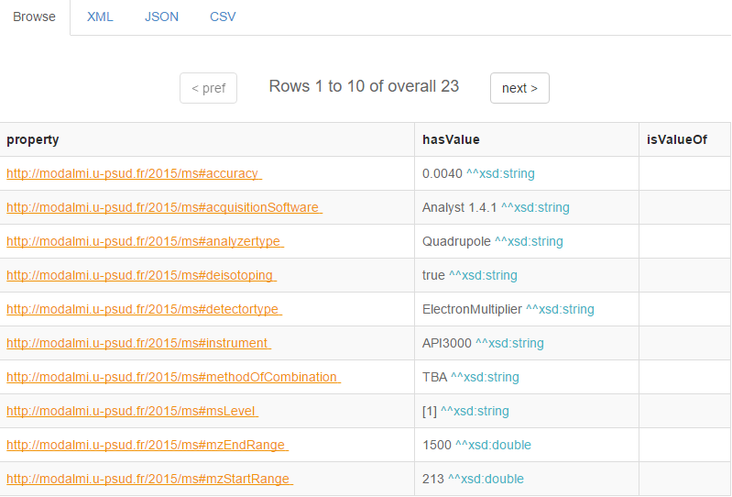
MzDataParser for parsing MzData files (.mzData)
into RDF format
Notes:
Add a paraph to say about the benefit of using the user interface to view data instantly.
After that, users can perform comprehensive SPARQL to retrieve back metadata when they want.
Especially, Apache Marmotta provides one export feature which can export the current data in the database and integrate with another LDP system. This also is helpful for sharing and integration of metadata.
We try to provide a tight association between base knowledge of chemistry, raw data and the processing data.
We defined an analytical techniques map. This result is an agreement between IBP and UFR.
For example, show the picture

Slide 14
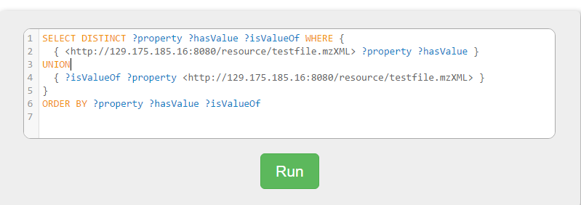
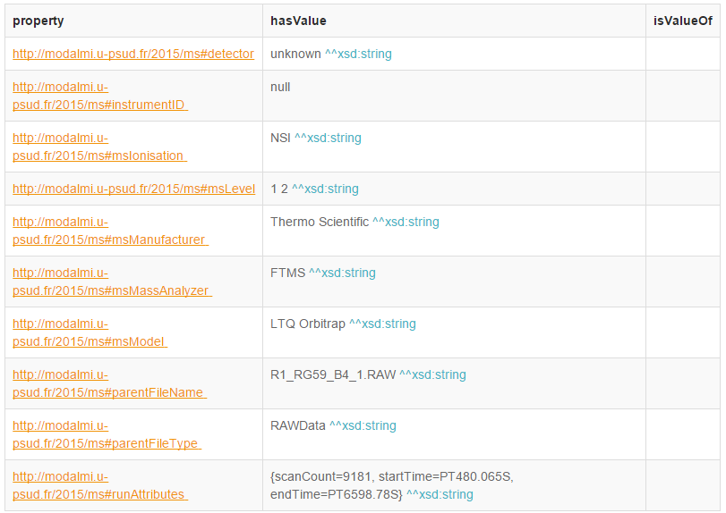
MzXMLParser for parsing MzXML files (.mzXML)
into RDF format
Notes:
Add a paraph to say about the benefit of using the user interface to view data instantly.
After that, users can perform comprehensive SPARQL to retrieve back metadata when they want.
Especially, Apache Marmotta provides one export feature which can export the current data in the database and integrate with another LDP system. This also is helpful for sharing and integration of metadata.
We try to provide a tight association between base knowledge of chemistry, raw data and the processing data.
We defined an analytical techniques map. This result is an agreement between IBP and UFR.
For example, show the picture

Slide 15
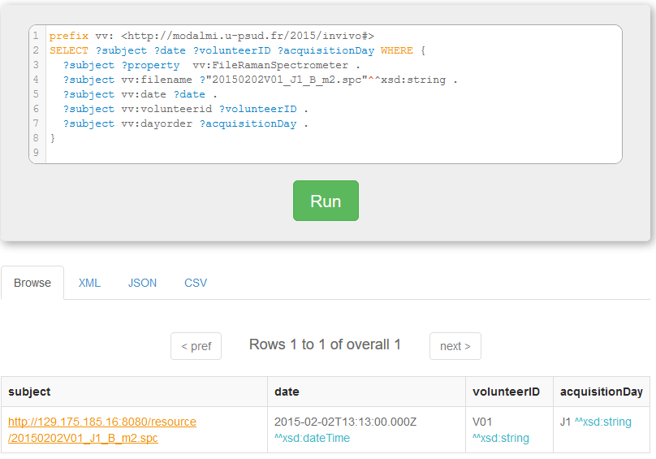
FileName is the correlation of results from the first step to the last step in workflow
PRETREATMENT
ARTIFACTS
Raman Microspectrometer
20150202V01_J1_A_m1.spc
METADATA
PROCESSING
20150202V01_J1_A_m1.jpg
Notes:
Box the filename of three images
Increase the siwe of sparql texts
Even, user can find the correlation among raw data, 2D visualization and Ontology data by filename.
Example. A raman file named 20150202V01_J1_A_m1.spc. After pretreatement, it produces an 2D image named 20150202V01_J1_A_m1.spc.jpg. Then, metadata of this file is extracted and integrated to LDP database and filename is one of property. So, if users know the file name, they can find the data inside the file.

Slide 16
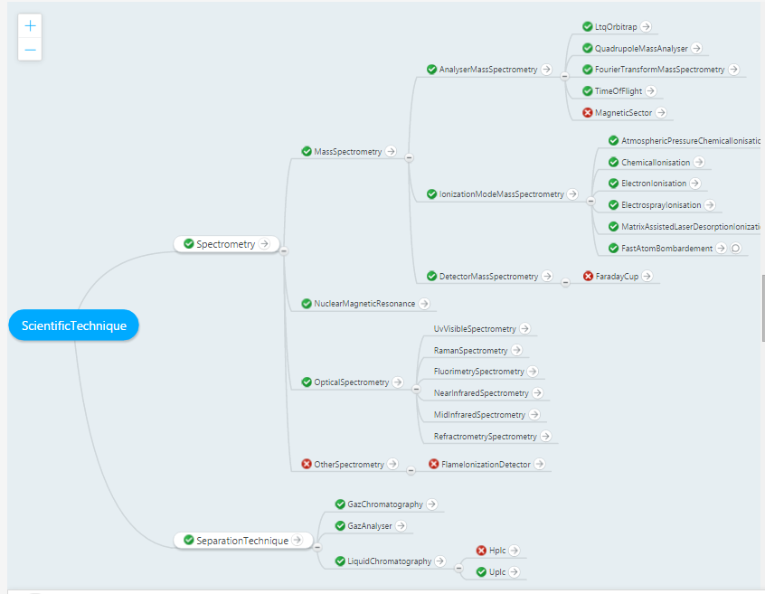
Map of scientific techniques is available on the main page of http://daap.eu/
Notes:
Add a text: techniques map being available on the main page of wiki
Each item navigates to a specific page on wikipedia where describes the technique in detail.

Slide 17
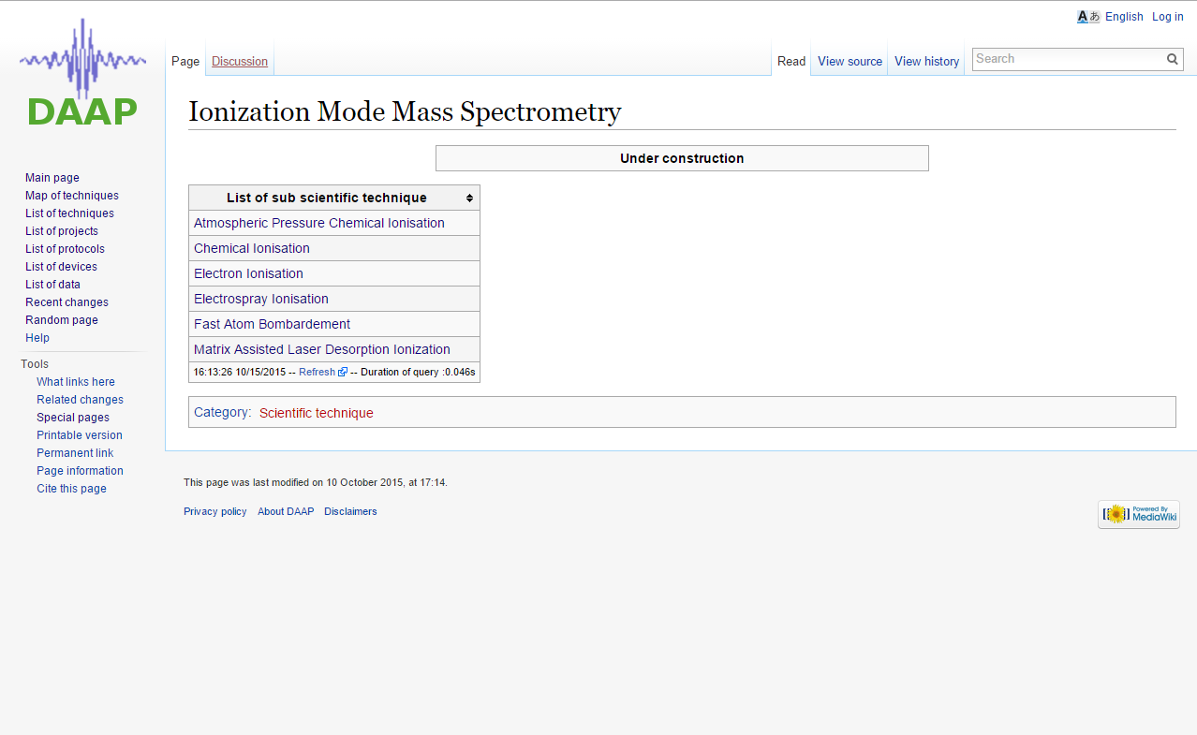
One of pages on public wikipedia to describe Ionization technique.
Notes:
In the future, Wikipedia can be visible on dataset of paris saclay.
Add some key workds on the slide

Slide 18
CONCLUSION
FUTURE WORK
Database is available for querying the metadata
Work done for Raman Spectroscopy and Mass Spectrometry
Users integrating the system
Open training sessions
Improve the system more robust
Develop GUI for automation toolbox
Work with chromatography
Continue training sessions
Notes:
continue training:
Bold the results.
Champ + papers + meeting for ontology + more scientists aware
+ training to make p.P adapt to this working method and use it fluently and secure method
+ CDS benefits from the chemical metadata
Perpective:
Continue this work, apply this design for chromatography to enrich database
Continue training session
Looking a funding to continue the proj because …
We proposed a system of automation for data conversion, pre-treatment and processing metadata from proprietary and open data formats. The initial version is applied for Raman spectrometry and Mass Spectrometry and the result demonstrates the model can widely be applied for other instruments.
In the future, we plan to develop the system more robust and even mechanize for configuration.
Last but not least, we work more closely with scientists and users to get their participation on using the system and collaborate with them to completely fulfill the scientific workflows.

Slide 19
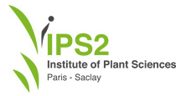
THANK YOU
Produce data for enriching the LDP
Create a common Ontology model
Contribute to the growth of DAAP
Organize ontology training
Provide Wikipedia
Sponsor the Project
Engage the collaboration between Data scientists and Data providers
Offer 1 terabyte for Centralized Data Storage
Notes:
Thank to
IBP
LipSys
→ ontology, DAAP, Data producer
BorderClound: make the ontology training + provide wikipedia
CDS: funding acknowledge + data producer
Paris sud DI: offer 1TG + Cécile, Julien + Denis

Slide 20
Notes:
Last but not least, I will give you a general picture about the goal of the project and the current results as well as some perspectives.

