Slide 1

ToWARDS & Beyond DREAMS
A review of recent ELECTRONICS developments FOR GAZEOUS DETECTORS at IRFU
E. Delagnes
CEA/DSM/IRFU/SEDI
Slides are from Denis Calvet, I. Mandjavidze, P. Baron ….
Saclay, 20 Novembre 2015

Slide 2
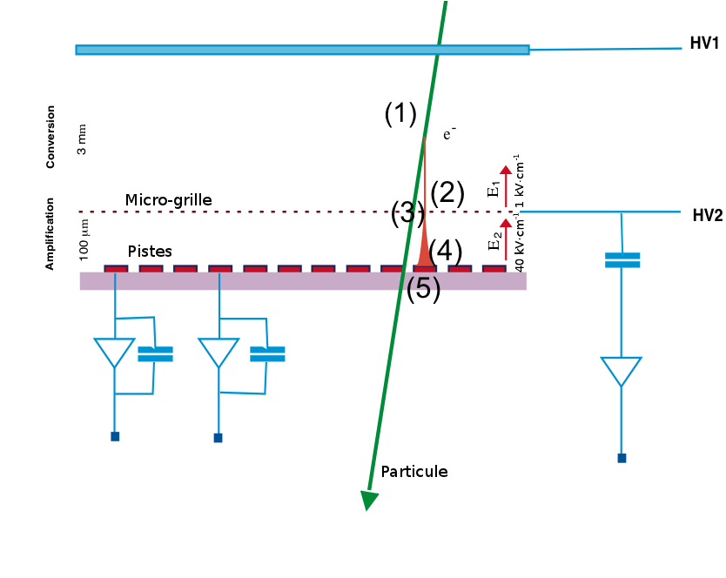
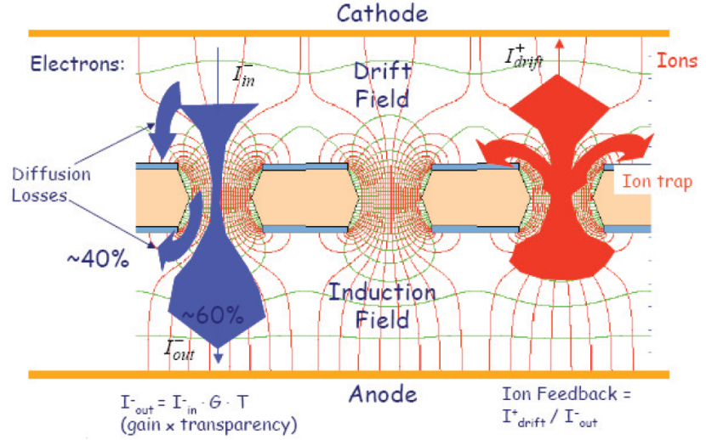
gaseous detectors
  Gaseous detector usually allows to cover large volume/surface for moderate cost:
    10-100 cheapers than silicon,
    Low material budjet (low X0, low mass)
    Can act as a target.
  Rising interest driven by the developments of Micro Pattern Gaseous Detectors (:GEM, Micromégas,, LEM …) invented in 1990’s
    Provides Charge amplification by 10 – 1E5
    High rate capabilities
    No ion tail
    Based on PCB techniques
    Easier’ to manufacture than wire-based detectors
    High Versatility for readout electrods( strips/ pads, pseudo X, multiplexing …)
-
+

Slide 3
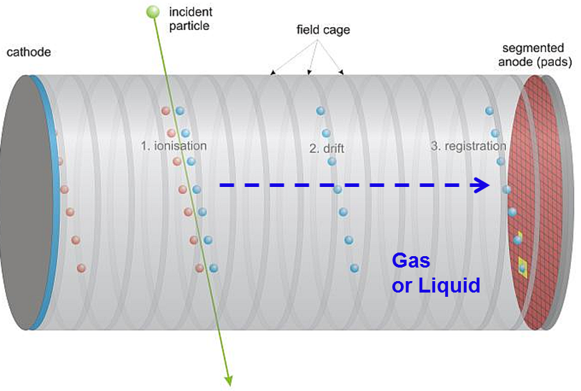
gaseous detectors
TPC
Interceptive Trackers
-
  2 main « families » :
Signal Shape : information on track
Z is given by the time of arrival of drifted e-
dE/dx = collected charge
Signal Shape : information on track
10-12 bit dynamic range
Moderate speed
XY are given by the pad/strip
Deposit charge => interpolation
6-10 bit dynamic range
« fast electonics »

Slide 4
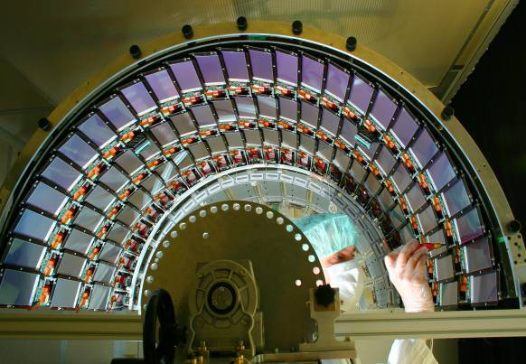
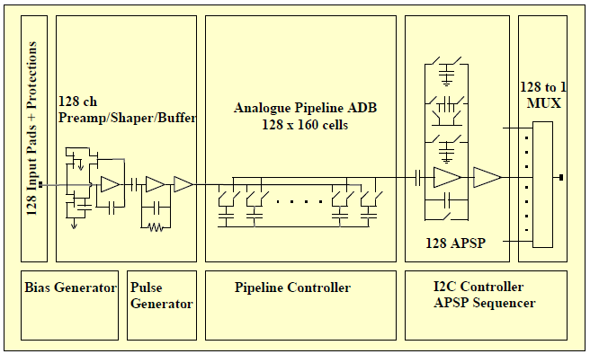
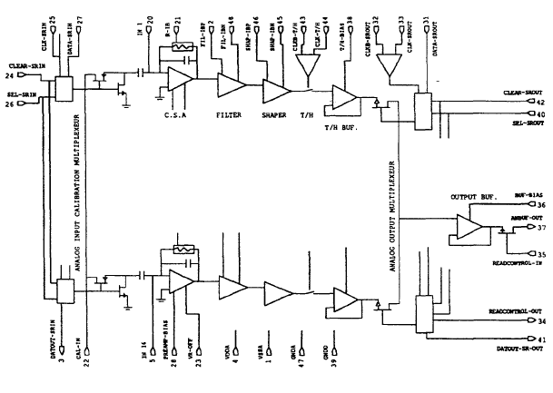
Specific ? Electronics for MGPD
  Electronics designed for Si could work in many case.:
    Sucessful use of the APV chip (Si CMS-> GEM COMPASS)
  But there are main difference in many case:
    Higher charge collected (gain)
    Larger dynamic range (Multiplication process + TPC)
    Slower signal ( if we want to measure the ion signal)
    Larger capacitance (large detectors)
    Ion tail (wire chambers)
    Need for the signal shape (TPC)
    Si Silicon are more & more binary => Gas det often requires analog information
    Sparks !
  Susccesful design of mixed-use chips:
  Santiard/Jarron’s Gassiplex
  The key word is Versatility & Re-use

Slide 5
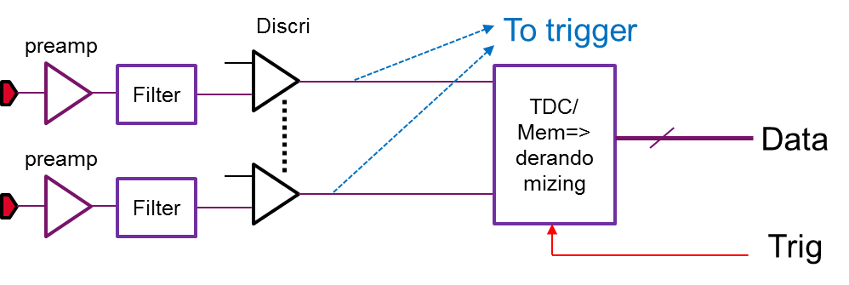
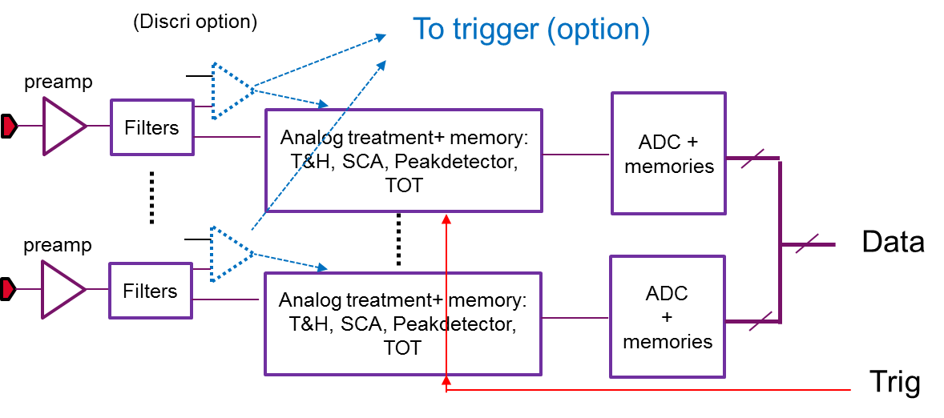
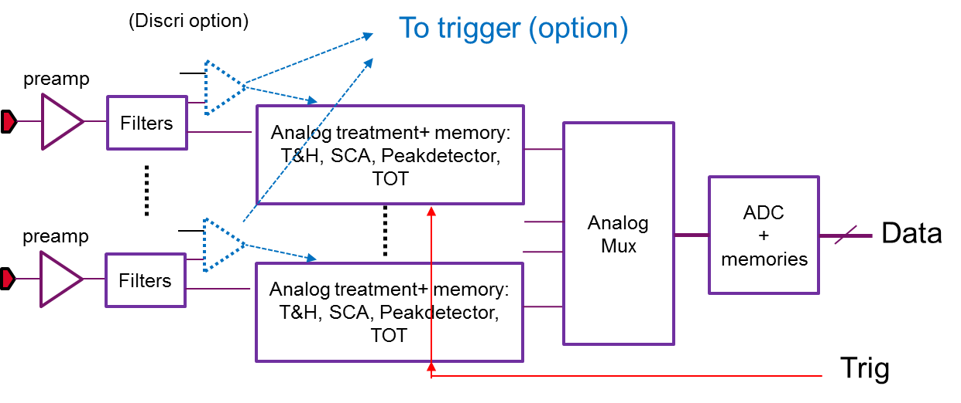
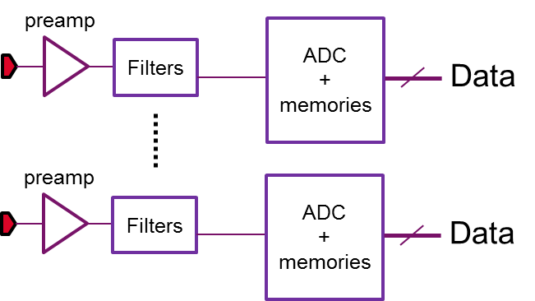
Some Front-end electronics architectureS
Pure Binary:
Low power, compact, low cost
No need for a trigegr
Sensitive to common noise
Analog
Can integrate a triggering channel:
  For self triggering
  To generate a trigger
  If no, need for an external trig
If self triggering:
If sampling, common noise rejection is possible
Muxed Analog :
Same, than Analog, but less power, less connexions with the external world
Direct Digitization:
Exteneded Self triggering capabilities
VersatilityPower of the digital treatment/filtering
Huge power consumption/ Data flow

Slide 6
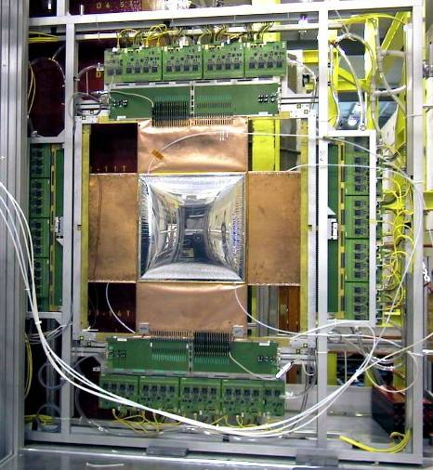
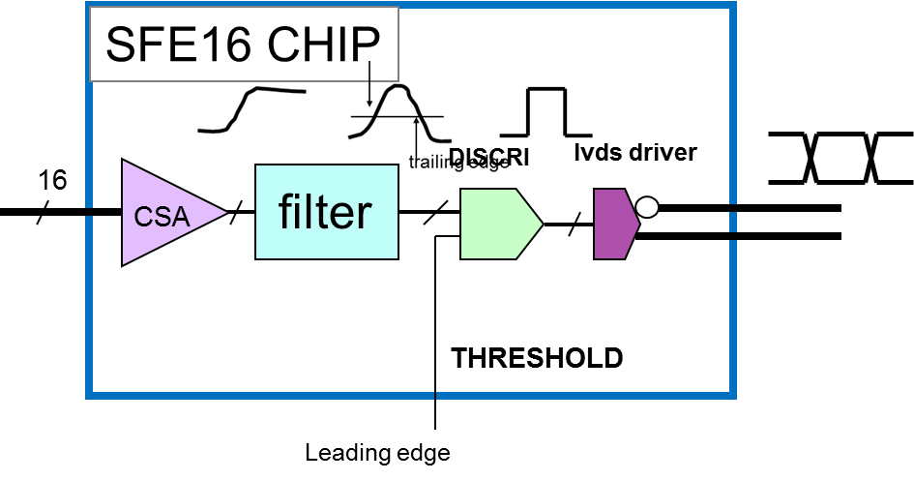
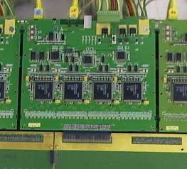
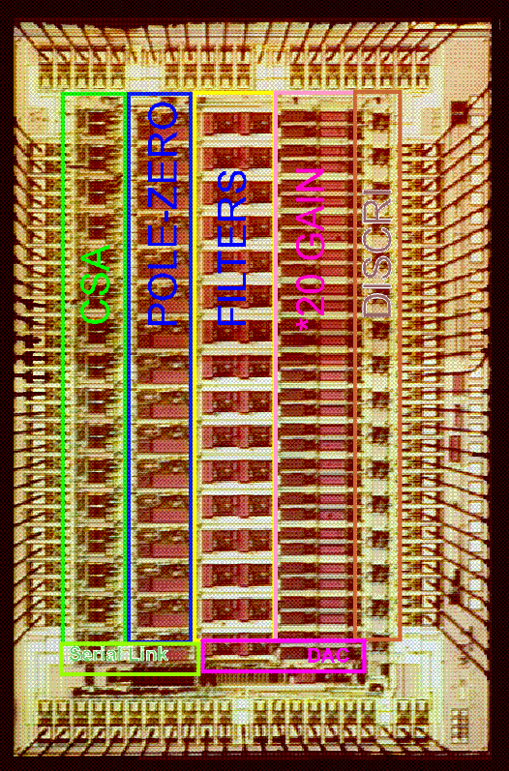
The SFE16 ASD – based electronics
XY doublet equipped with its electronics
40x40cm2 Micromegas
#2048 channels
  First large detectors 12000 equiped with MPGD
  First chip designed for Micromégas
  Binary architecture.
  Time digitization by TDC
  Charge gieven by Time over Threshold (First)
  One of the first versatile chip (Slow control)
  Large detector => Large capacitance
    => But Limited detector gain
    => S/N challenge: 4 sigma threshold, low noise
  Threshold system = very sensitive to noise/grounding
    => Real issue
  Replaced after 15 years of operation:
SFE16 Asic
#16 channels
0.8µm biCmos
Noise 1000e rms
TDC board

Slide 7
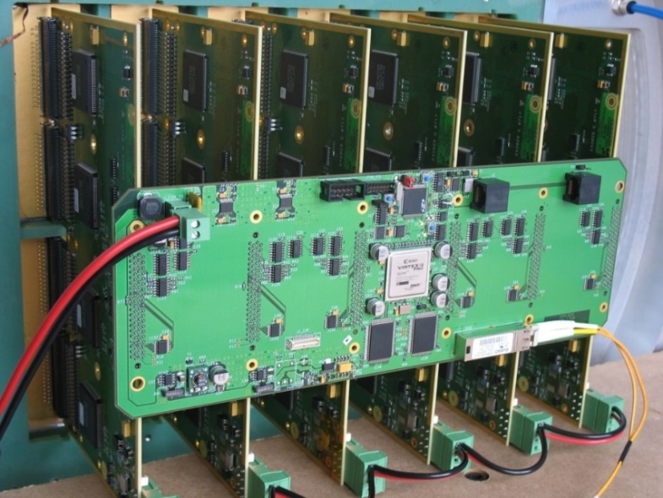
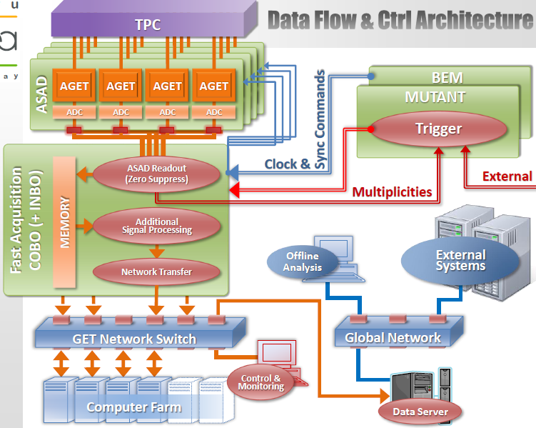











Electronics for gaseous detectors (and other types of detectors)
ASIC generation
AFTER
Asic For Tpc
Electronic Readout
AGET
Asic for General Electronics
for Tpc
DREAM
Dead timeless REadout
Asic for Micromegas
2006
2009
2012
  Over 150.000 channels in operation (80% in T2K neutrino experiment)
  20 applications in physics
  Optimized for trackers
  Target experiments: Clas12, Asacusa, Gbar, WatTo, etc.
  Optimized for active target TPC’s
  Over 22 deployments underway
  SEDI has years of experience in the design of ASICs for TPCs as well as the electronics, the software and all the other components of a complete data acquisition chain

Slide 8
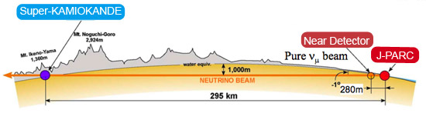
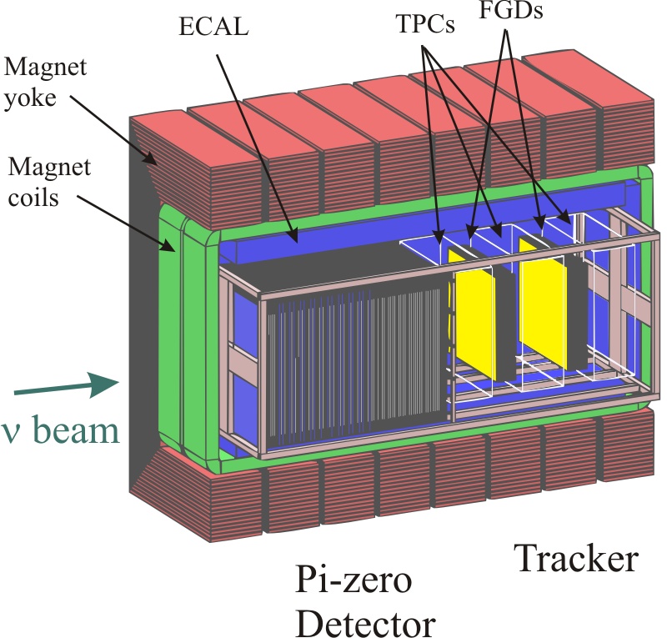
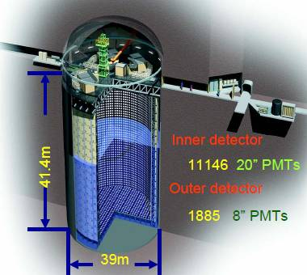










THE T2K Neutrino Oscillation Experiment aND THE Deployment of ITS TPC’s
50 kT water
target
Micromegas readout selected for the TPCs of the near detector :Need for 12000 electronics channels
  Main physics goals
  ν_{μ} disappearance for improved accuracy on θ23
  ν_{e} appearance to improve sensitivity to θ13

Slide 9
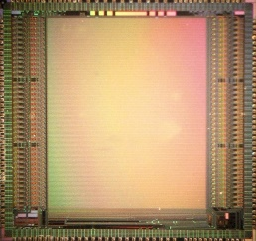
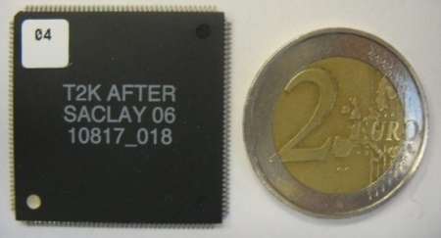
the AFTER chip
  Functional diagram
  Principle of operation
  Star TPC electronics principle, with far higher level of integration
  Input signals sampled in circular analog memory buffers (Switched Capacitor Array – SCA)
  SCA frozen by a global external trigger signal
  Digitization of SCA matrix by an off-chip ADC
  Specifications
Parameter | Value
Acceptable signals | Negative or Positive – selectable by external resistors
Number of channels | 72
Charge measurement
Input dynamic range | 120 fC, 240 fC, 360 fC, 600 fC
Output dynamic range | 2V p-p (differential) : 12bits
I.N.L | < 2%
Resolution | < 850 e- (Gain: 120fC; Peaking Time: 200ns; Cinput < 30pF)
Sampling
Peaking time | 100 ns to 2 µs (16 values)
SCA depth | 511 time buckets
Sampling Frequency | 1 MHz to 50 MHz
Readout
Hardware | Requires external 12-bit ADC clocked at 20-25 MHz
Readout mode | All channels, Number of time buckets read out programmable from 1 up to 511
Minimum dead-time | Fixed: 79 * 40 ns * Number_Of_Time_Buckets
Test
calibration | 1 channel among 72; 1 external test capacitor
test | 1 channel among 72; internal test capacitor (1 among 4)
functional | 1 to 72(76) channels; 1 internal test capacitor per channel
Counting rate | < 0.3 Hz/channel
Power consumption | < 10 mW / channel @ 3.3V
  AFTER chip design facts
  Technology: AMS CMOS 0,35 µm
  Highly Configurable
  Die area: 7,8 x 7,4 mm²
  500,000 transistors
  Package: LQFP 160 (28 x 28 x 1,4 mm)
  Production volume: 5300 chips
  Low cost: 5E channel for the whole electronics

Slide 10

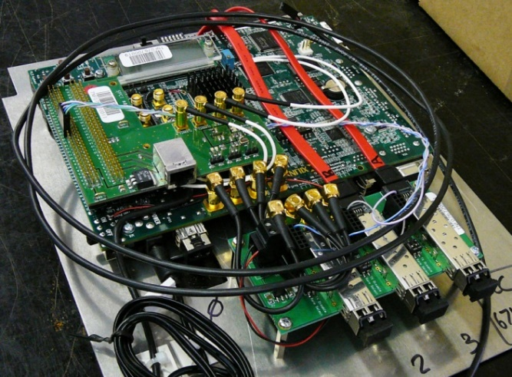
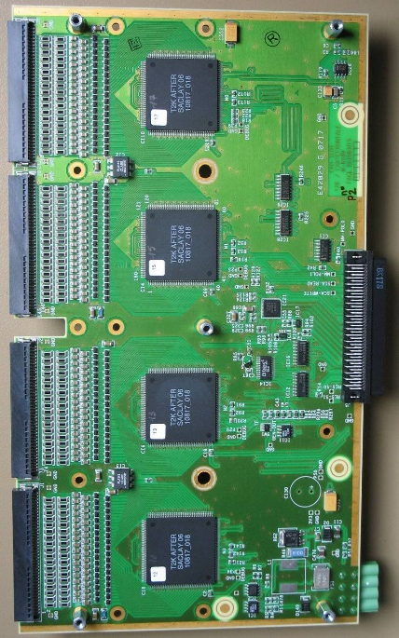
the T2K Electronics
On-detector
Off-detector
  Front End Card - FEC
  4 AFTER chips
  288 channels
  5 W consumption
  Designed at Irfu
  Front End Mezzanine Card - FEM
  Controls 6 FECs, i.e. 1728 channels
  Interface to back-end electronics via 2 Gbps optical link
  Specific board designed at Irfu
  Data Concentrator Card - DCC
  Controls 4 FEMs,6912 channels
  Interfaces to DAQ PC via Gigabit
  Ethernet
  Customization of commercial Xilinx ML405 evaluation kit
  System optimized for low event rate of up to 20 Hz, low channel occupancy
  High level of channel multiplexing for low cost and system scalability to over 100,000 channels

Slide 11
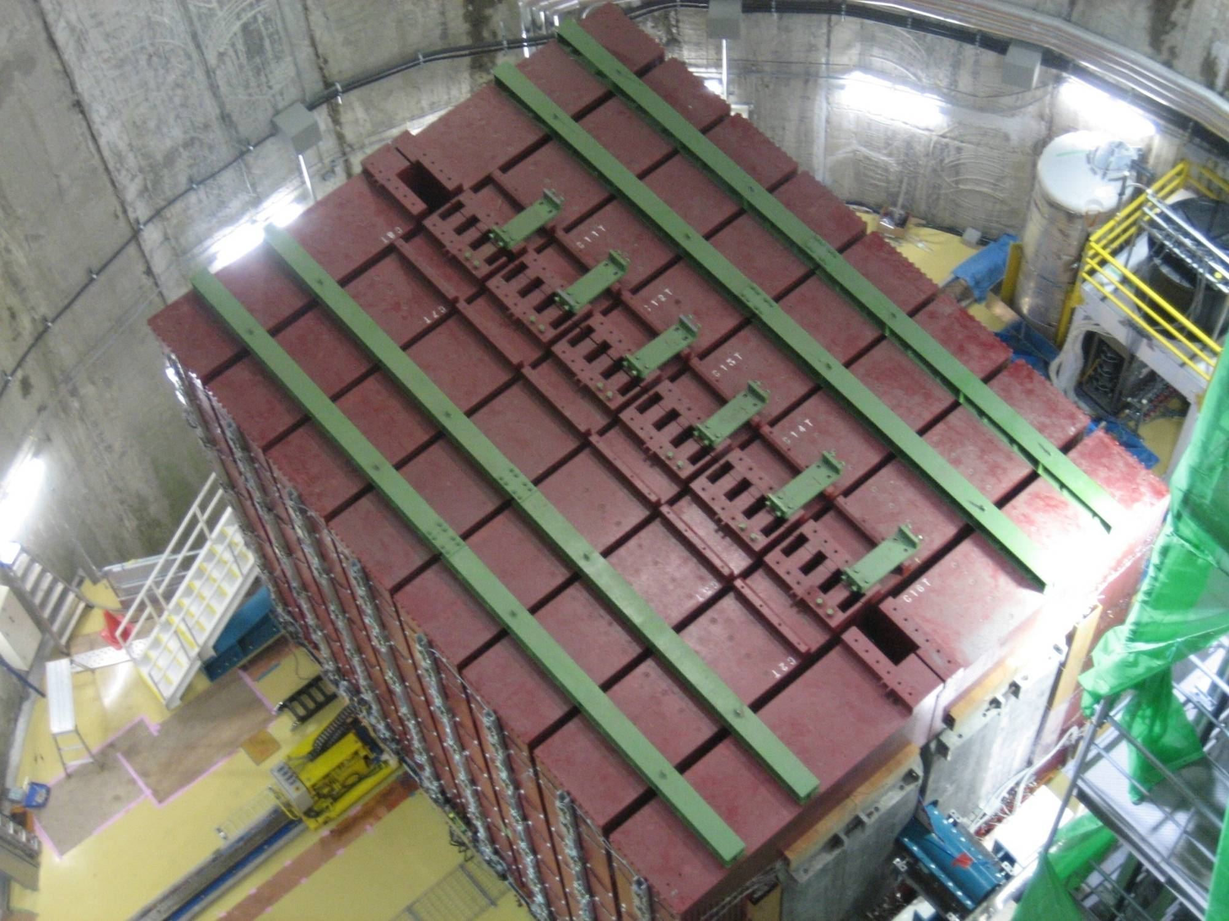
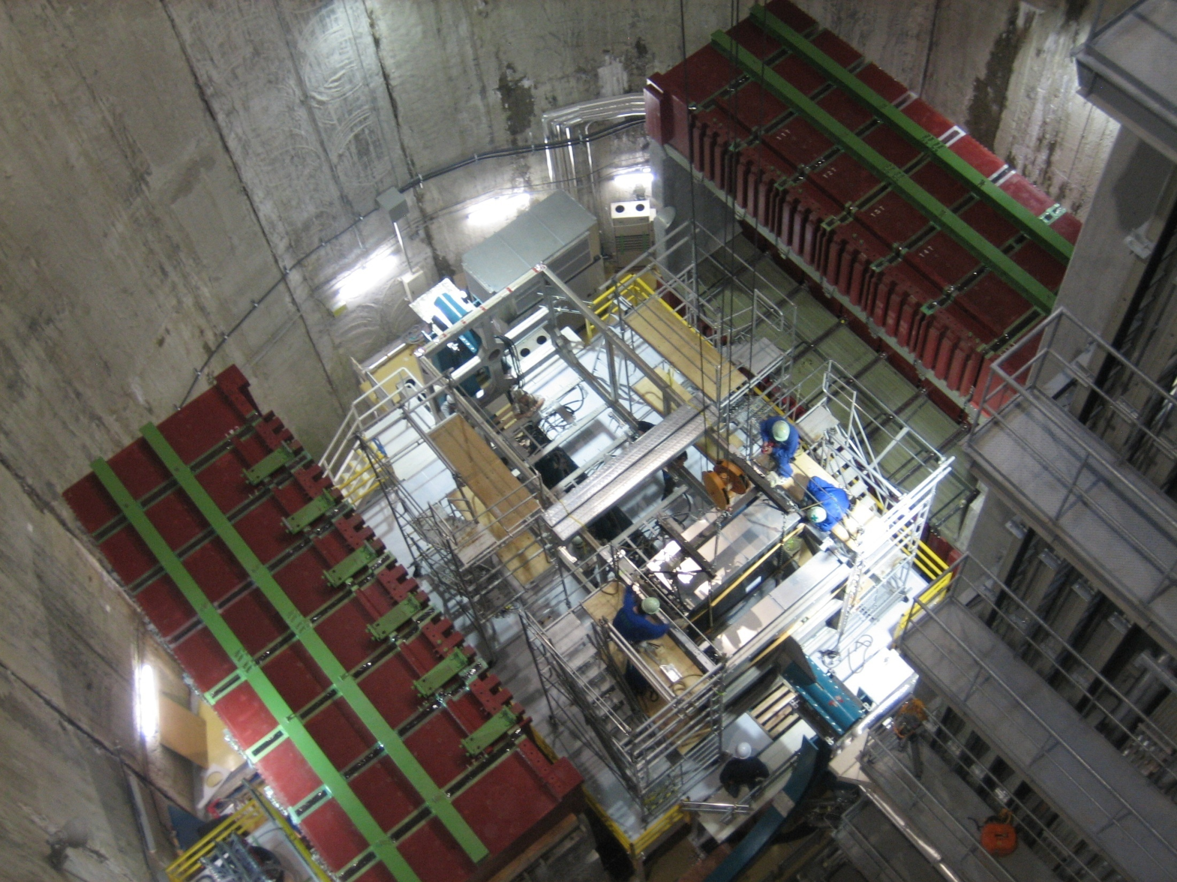
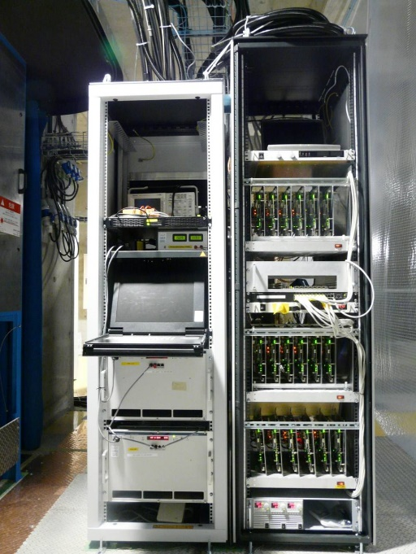
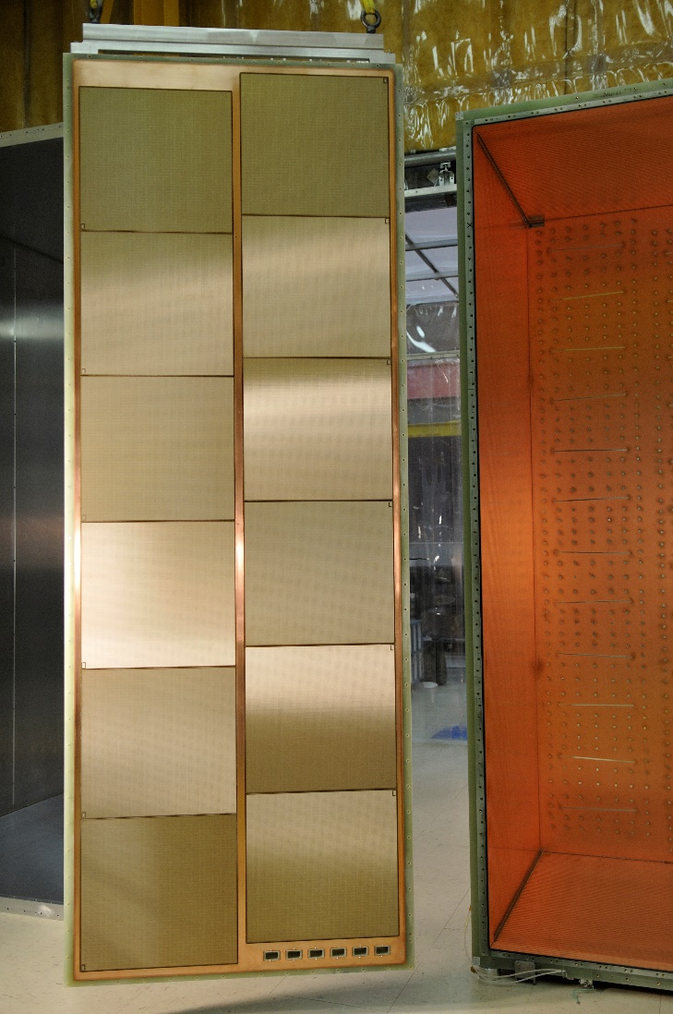
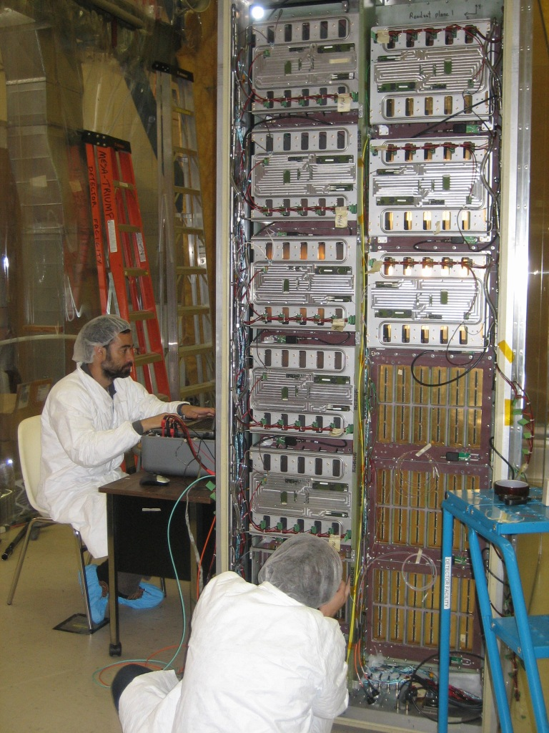
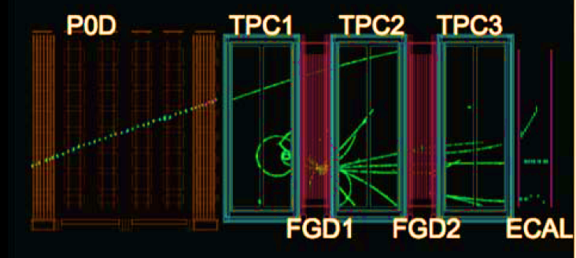
T2K aND THE Deployment of ITS TPC’s
  Outlook on T2K
  Experiment running since 2009. Numerous scientific publications. Listed in the 100 top stories of 2013 in all sciences by Discover Magazine
  Largest deployment of Micro Pattern Gaseous Detectors at this time
  Very sucessfull deployment of Micromegas detectors, ASICs, readout electronics, firmware, software and system integration made at Irfu
  AFTER chips also used in T2K for the two “Fine Grain Detectors – FGD” read out by Silicon Photomultipliers
  Over 20 users of T2K or AFTER-based electronics for detector R&D, small experiments, test benches, etc.
  Used to read the HARPO –TPC prototype
  Back-end electronics
  18 DCC’s
  (124,416 channels)
  2.5 kW power supplies for front-end electronics
  Slow control PC
  Trigger interface, etc.
  Detector plane and TPC cage
  12 Micromegas detector modules with 1726 channels each
  6 end-plates in total, i.e.
  ~9 m² of sensitive area
  Integration of front end electronics

Slide 12
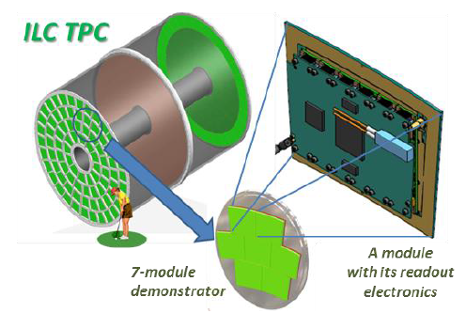
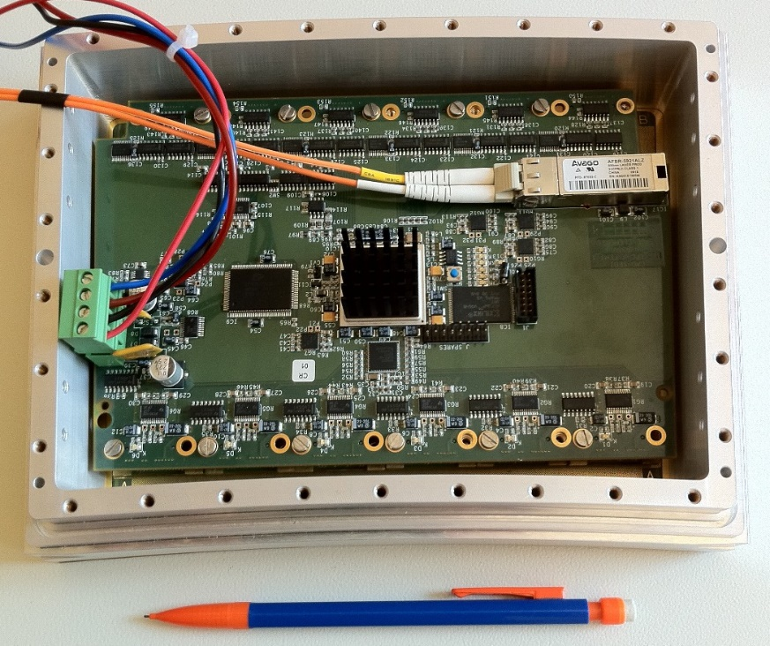
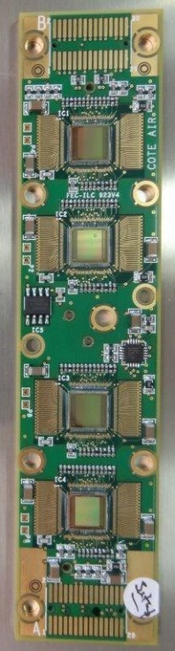

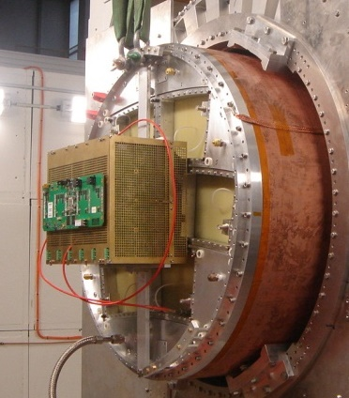
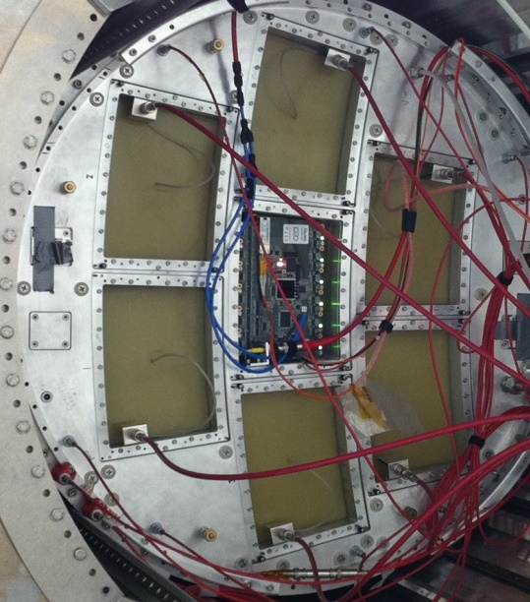
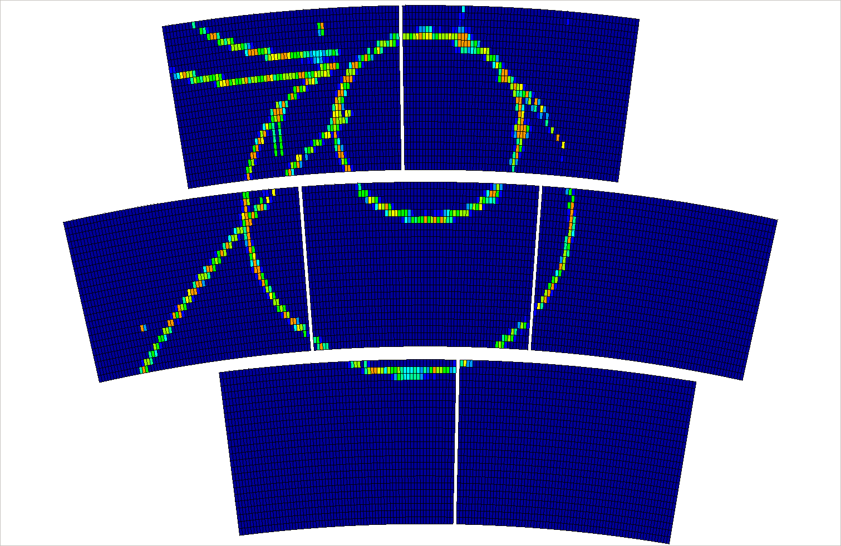
Ultra compact Electronics based on AFTER for The large TPC prototype of ILC
Test-beam setup at DESY…
…based-on T2K
electronics
…based-on FEMi/FECi
electronics
  Front end Electronics – FEMi and FECi
  Extremely compact design for FECi using chip bounding for the 4 AFTER chips
  Readout of 1728 channels in a module of 200 cm² area x 3 cm thickness
  19 W power consumption (11 mW/channel)
  System optimized for channel density and low volume

Slide 13
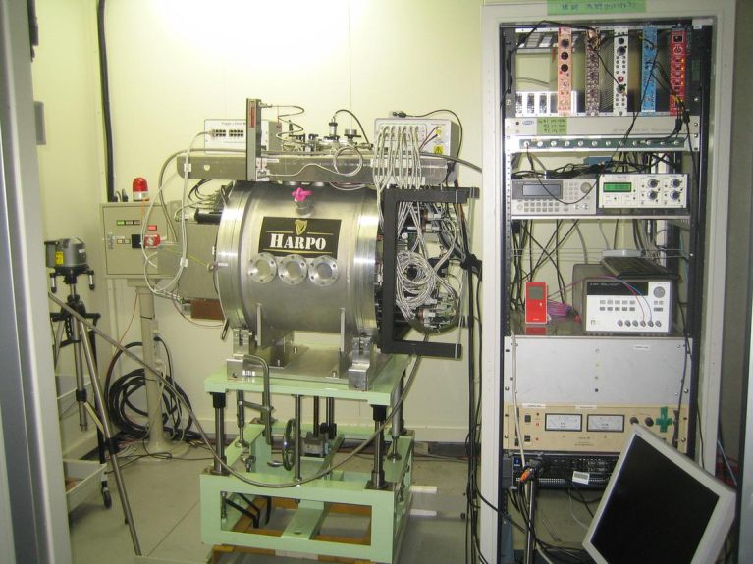
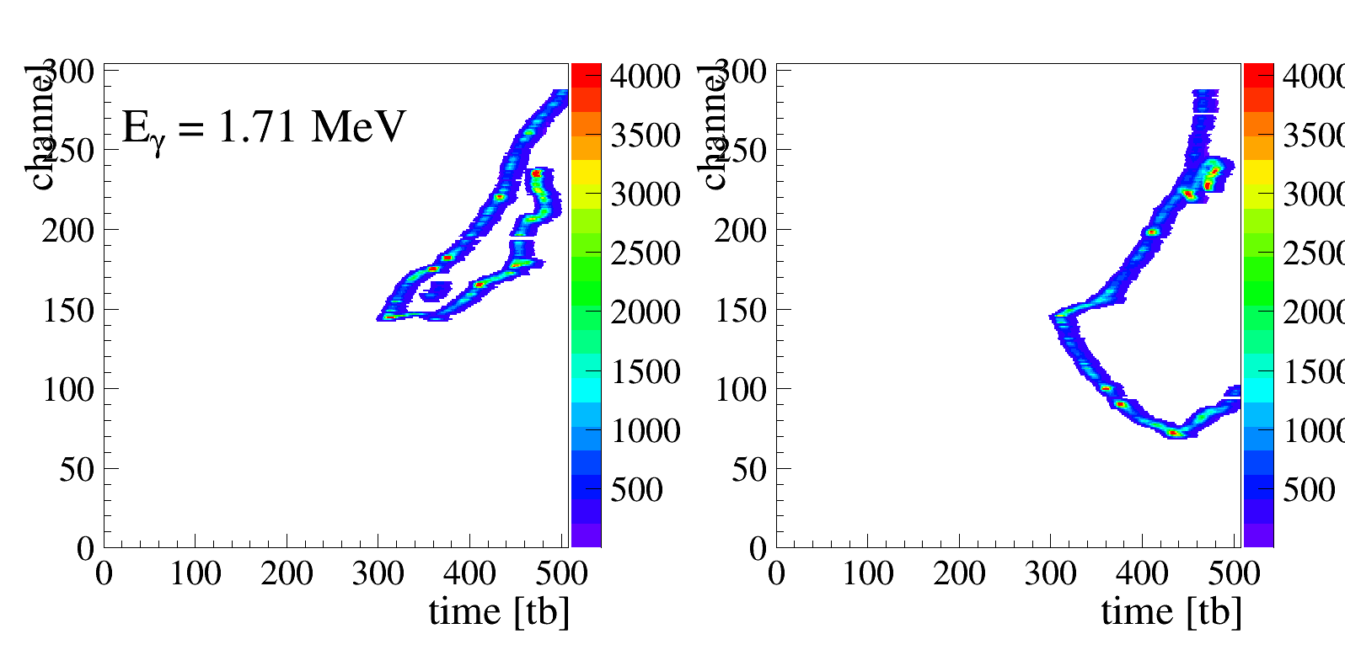
HARPO (LLR) for gamma detecTion
Micromegas + GEM TPC
Strip readout

Slide 14

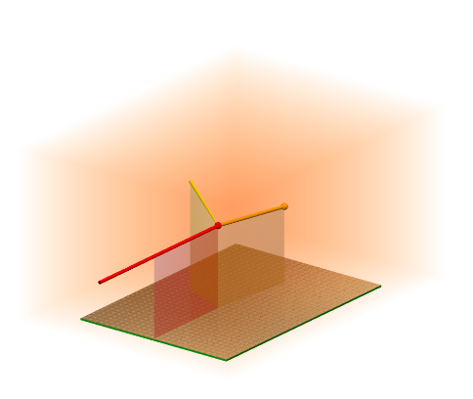
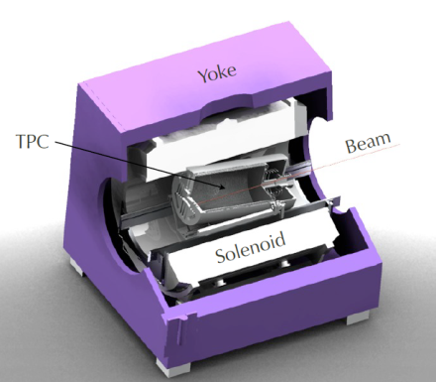
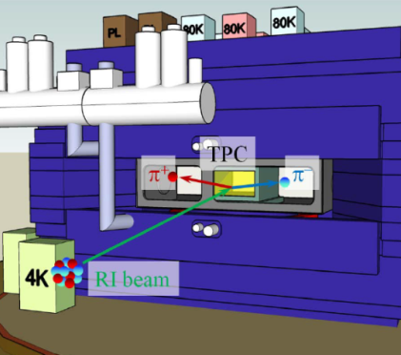




The GET project: General Electronics for TPC’s
  Background
  Following T2K developments, several laboratories involved in nuclear physics, CENBG (Bordeaux), IRFU (Saclay), GANIL (Caen) in France, MSU (United States) and later RIKEN (Japan) decided to join their efforts in the GET project to develop a new and generic readout system for TPC’s and active target TPC’s
  Funding received from the French National Research Agency (ANR) in France and NSF in USA
  Project started in 2010 and successfully completed in 2014
  Initial applications
ACTAR
  ACTAR TPC
  Micromegas or GEM
  ~16,000 channels
  CENBG TPC
  GEM ampli.
  ~16,000 channels
  AT TPC
  Micromegas ampli.
  ~10,000 channels
  SPIRIT TPC
  Wire amplification
  ~12,000 channels

Slide 15
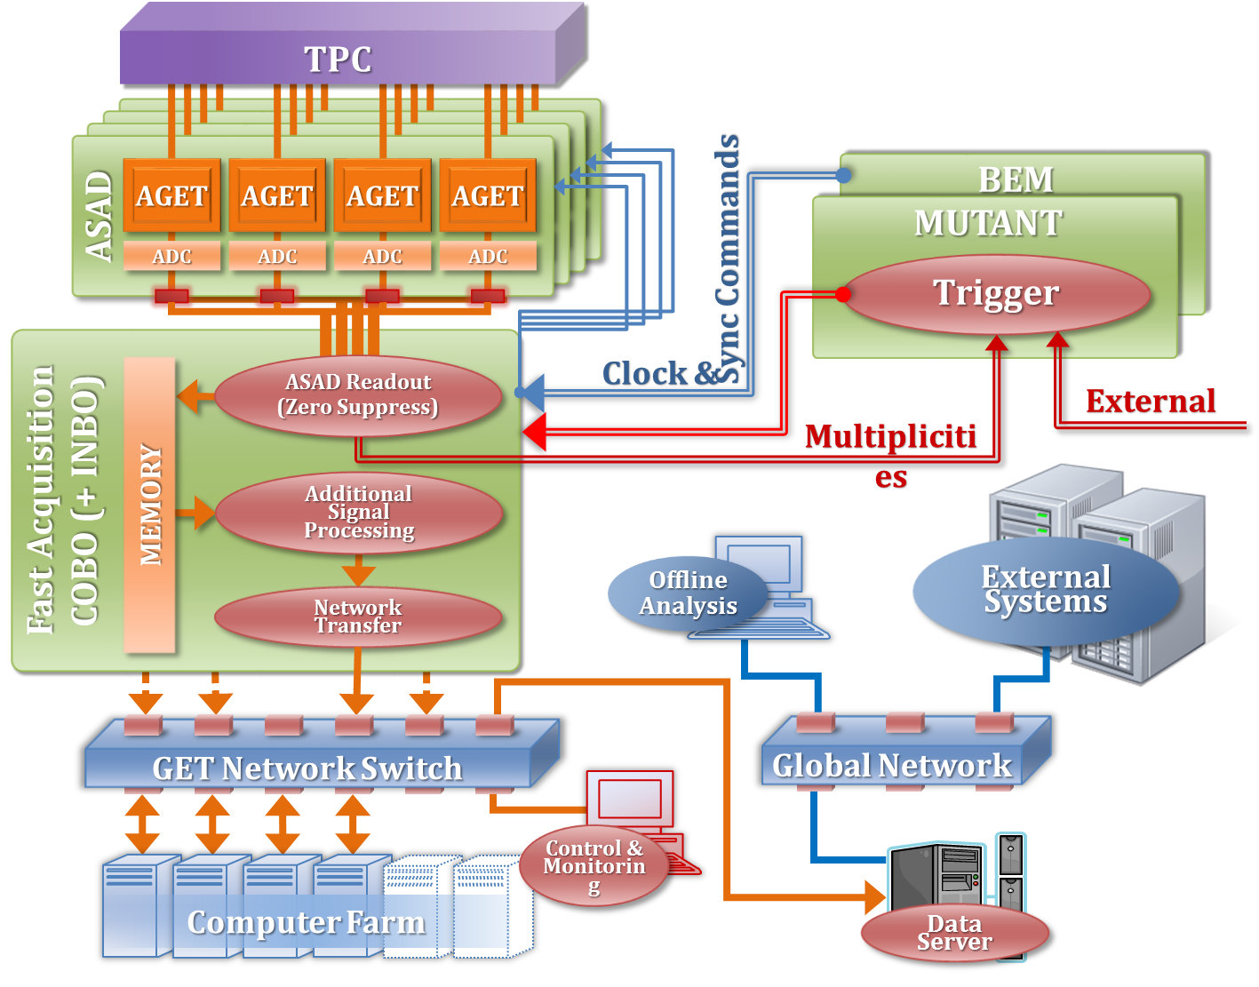
ARCHITECTURE of The GET System
Intelligent Trigger
(GANIL)
ASIC « AGET »
(IRFU)
Front-end
electronics
(CENBG)
Back-end
electronics
(HW: MSU
SW: IRFU)
Configuration,
Monitoring,
Run control
DAQ software
(IRFU,GANIL)

Slide 16
the AGET chip: versatility and genericity
64 channels
AGET
1 channel
Σ 64 discri.
DAC
Discri
Trigger pulse
Charge range
inhibit
Hit register
SCAwrite
FILTER
SCA
CSA
x68
ADC
512 cells
tpeak
12-bit ADC
BUFFER
TEST
SLOW CONTROL
Power on
Reset
SCA MANAGER
Readout
Mode
Asic “Spy” Mode
W / R
CK
In Test
Serial Interface
Mode
CK
CSA;CR;SCAin;DISCRIin(N°1)
  64 analog channels : CSA, Filter, SCA (512 cells), Discriminator
  Auto triggering : per channel discriminator + threshold (DAC)
  Multiplicity signal : analog OR of 64 discriminators
  Hit Channel register. Accessible in R/W
  SCA readout mode: all, hit or specific channels (gives lower dead-time)
  4 charge ranges/channel: 120 fC; 240 fC; 1 pC;10 pC (e.g. for Silicon detectors)
  Input current polarity positive or negative, selectable by software programming
  Possibility to bypass the CSA: enter directly into the RC2 filter or SCA inputs
*in red: difference with AFTER, new in AGET

Slide 17
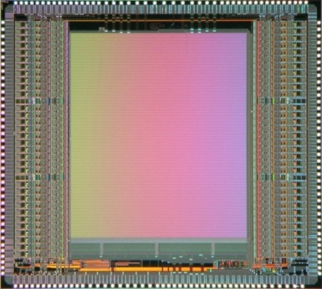
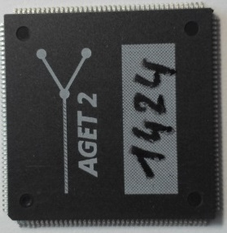
The AGET CHIP – Feature summary
  Specifications
  Design Facts
  Technology: AMS CMOS 0,35 µm
  Surface: 8,5 x 7,6 mm²
  700,000 transistors
  Package: LQFP 160 (28 x 28 x 1,4 mm)
  Production volume (up to 2014): 3200 chips
Parameter | Value
Polarity of detector signal | Negative or Positive – Selectable by register programming
Channels number | 64
External Preamplifier | Yes; access to the filter or SCA input (external CSA)
Charge measurement
Input dynamic range | 120 fC, 240 fC, 1 pC, 10 pC
Gain | Adjustable per channel
Output dynamic range | 2V p-p (differential)
I.N.L | < 2%
Resolution | < 850 e- (Gain: 120fC; Peaking Time: 200ns; Cinput < 30pF)
Sampling
Peaking time | 50 ns to 1 µs (16 values)
SCA time bin number | 512 or 2 x 256 cells
Sampling Frequency | 1 MHz to 100 MHz
Multiplicity
Multiplicity signal | Analog “OR” of 64 discriminator outputs
Input dynamic range | 5% or 17.5% of input channel input charge range
I.N.L | < 5%
Threshold value | 7-bit DAC [(3-bit + polarity bit) common DAC + 4-bit DAC/channel]
Readout
Readout frequency | 25 MHz
Channel Readout mode | Hit, selected or all
SCA Readout mode | 1 to 512 cells
Test
calibration | 1 channel among 64; 1 external test capacitor
test | 1 channel among 64; internal test capacitor (1 among 4)
functional | 1 to 64(68) channels; 1 internal test capacitor per channel
Counting rate | < 1 kHz
Power consumption | < 10 mW / channel @ 3.3V

Slide 18
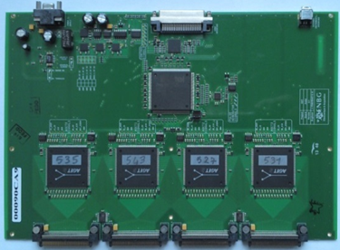
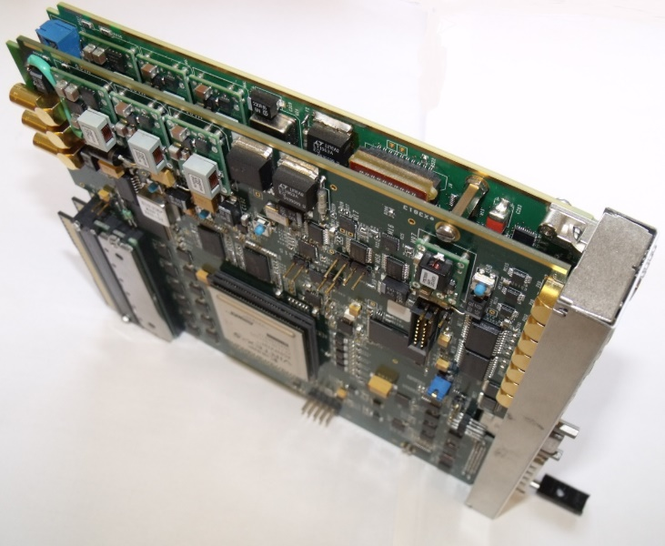
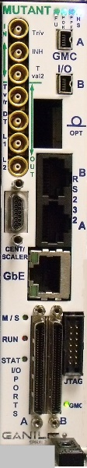
GET System BUILDING BLOCKs
  ASAD (CENBG)
  256 channel front-end boards
  4 AGET chips
  Optional spark protection board
  Commercially available from
  FED company (FRANCE)
  AGET (IRFU)
  Mutant (GANIL)
  Trigger and Multiplicity processing
  Controls up to 10 CoBos in a µTCA shelf (i.e. 10240 channels). Scales up to 3 µTCA shelves (i.e. 30 K channels)
  MicroTCA board
  Commercially available soon
  CoBo (MSU)
  Controls 4 ASAD (i.e. 1024 channels)
  MicroTCA board
  Virtex 5 FPGA with PowerPC
  Commercially available from
  Vadatech company (USA)
  Software (GANIL - IRFU)
  Configuration / Run Control / Monitoring / DAQ / GUI
  “Narval” framework based option
  “Mordicus” framework based option

Slide 19
Example of advanced TRIGGER Generation using GET
  Basic One Level Self Trigger
  AGET chips send their multiplicity signal to CoBo’s
  CoBo’s transfer multiplicity data to Mutant
  Mutant processes multiplicity data to build a trigger signal sent to CoBo’s and all AGETs
  Data from hit channels are digitized and send to CoBo’s for processing and transfer to DAQ
  Two Level Self Trigger
  AGET chips send their multiplicity signal to CoBo’s
  CoBo’s transfer multiplicity data to Mutant
  Mutant processes multiplicity data to build a L1 trigger signal sent to CoBo’s and all AGETs
  The Hit Channel Register of AGET chips is read out and sent to CoBo’s then Mutant
  The global channel hit pattern is analyzed by Mutant to elaborate a L2 trigger signal sent back to AGET chips via CoBo’s
  Data from hit channels are digitized
  → Large flexibility of schemes and algorithms for trigger generation

Slide 20
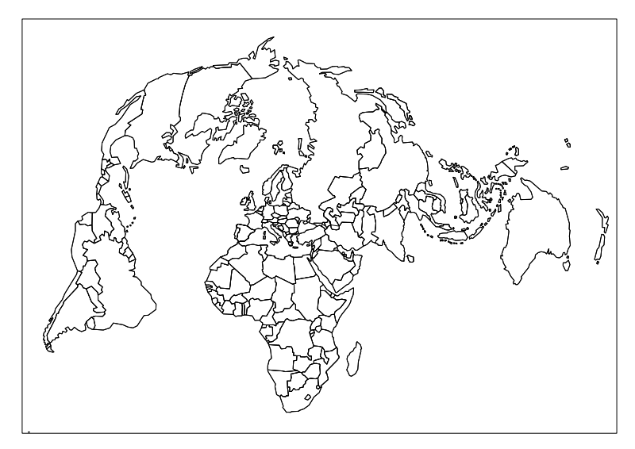
GET: A worlwide success (Juin 2015)
  Also used for:
  Si cetectors fo Nuclear physics
  SiPM

Slide 21
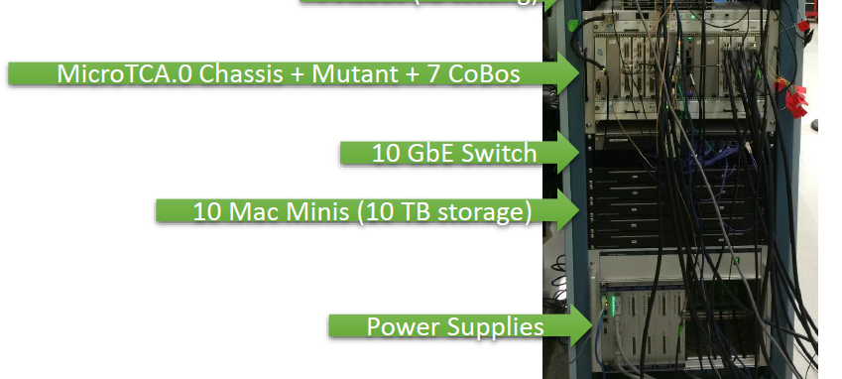
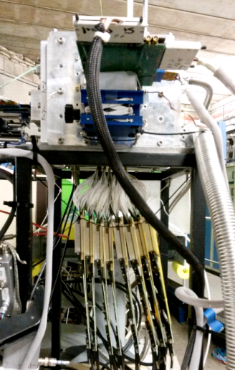
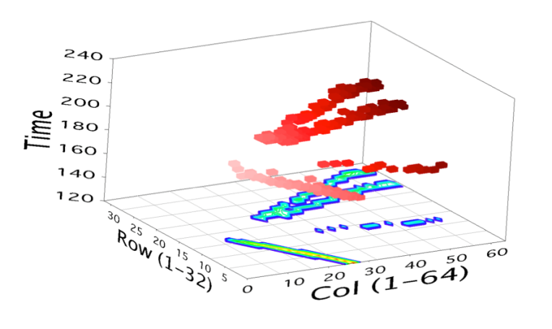


Deployment of the GET SYSTEM
  ACTAR Demonstrator
  8 AsAd v2.1 cards + 2 CoBo boards
  µTCA crate with 10 GbE MCH
  PC & switch with 10 GbE connexion
  AT TPC Setup
4-particle event
(@Bacchus IPNO)
ATTPC (MSU)

Slide 22

Deployment of the GET SYSTEM

Slide 23





Minos – A new instrument for in-beam spectroscopy of exotic nuclei
TPC End-Plate & field cage element. Internal R= 4cm
  Project proposed by A. Obertelli and financed by ERC grant 2011-2015
  4K channel TPC with Micromegas amplification + optional DSSSDs and Micromegas curved tracker
  Does not require sophisticated self trigger capability. Needed a development cycle shorter than GET
  → This motivated the development of the FEMINOS system, an evolution of T2K electronics that can use the AGET chip in an infrastructure lighter than that of GET but with less functionality

Slide 24





The Feminos: AN Evolutive system compatible with after and aget
T2K FEC: 4 AFTER chips
FEMINOS Board
OR
×24 max. i.e.
6K channels
  Main features
    For small to medium scale systems 6K channels
    Close to the lowest possible dead-time of AFTER and AGET to reach high event rate
    External trigger or basic self trigger on multiplicity
    Low cost system in a light infrastructure
MINOS FEC: 4 AGET chips
(pin-compatible with AFTER)
  Consider building an improved version (e.g. more scalability) and could become a commercial product

Slide 25





Dead time reduction using R/W capability of AGET HIT Channel Register
Long tail on ASIC with the largest number of channel hit in the event is seen. Leads to increased dead-time.
Busiest chip occupancy from dec. 2014 physics data taking at RIKEN where this dead time reduction feature was used
Events with large number of hit channels are either caused by noise that illuminate 1 chip or 1 board, or busy events that have no value for physics.
  Erase abnormally busy channels prior to SCA digitization
  Upon trigger read Hit Channel Register of each AGET and count number of hit channels
  For all AGET that have channel hit count above a programmable threshold, clear the Hit Channel Register
  Digitize the SCA matrices of the AGET chips for the remaining hit channels

Slide 26



Commissioning: partial in 2015, full in 2016
Clas12 Micromegas Vertex Tracker
5T Solenoid
CND &
Central
detector
MVT &
Beam pipe
MVT
Forward detector
A fixed target experiment to study nuclei structure (CEBAF, JLAB)
Barrel MVT: 6 cylindrical layers
  Coverage: 145°-35°, 2.7 m2
  Precision: O(100µ)
  ~18 000 Z & C strips
Forward MVT: 6 disks
  Coverage 35°-5°, 1.3 m2
  Precision: ~100µ
  ~6 000 X & Y strips
Resistive Micromegas
1.5m
2m

Slide 27




64-channel Dream ASIC
Dead-timeless Read-out Electronics ASIC for Micromegas
Characteristics
  4 gain ranges: 60 fC, 120 fC, 240 fC, 600 fC
  16 programmable peaking times: from 50 ns à 1 µs
  Sampling rate: 1- 50 MHz
  512-cell deep analog memory per channel
    Trigger pipeline + de-randomization buffer
  Readout rate: 20 (40) MHz
  Discriminator per channel for trigger building
  128-pin small footprint package
  Optimized for large detector capacitance
New
DREAM 1
A versatile chip adapted for different detector types with dead-time free operation

Slide 28








Challenging requirements => choice of an off-detector FE electronics
Off-detector frontend electronics
~1.5-2m
Synchronous
optical links
Concentrator electronics
~10-20m
Trigger interface
optical fiber
← clock/ trigger
↔ fast control
FrontEnd Unit (FEU)
Back-End Unit (BEU)
FEU
FEU
FEU
FEU
FEU
FEU
FEU
CPU
SD
SSP
SSP
SSP
TI
Micro-coaxial
assemblies
FEU
FEU
FEU
FEU
FEU
FEU
FEU
DAQ interface
Ethernet
→ data
↔ slow control
VXS / VME64
Adaptation of JLab developments
Development based on a new ASIC Dream
(Dead-timeless Readout Electronics ASIC for Micromegas)
Dream
FEU
SSP
01000011 - C
01101100 – l
01100001 - a
01110011 - s
00110001 - 1
00110010 - 2
01001001 - I
01100100 – d
01101111 - o
Number of channels: ~24 000
  Barrel: 18 curved tiles: ~18 000
  Forward 6 disk: ~6 000
Physics background: 20 MHz
  Up to 60 kHz hit rate
Trigger rate: 20 kHz
  Pipeline: 16 µs
Timing resolution: ~10 ns
  Charge measurements: 10-bit
Detector capacitances: 100-200 pF
  Required Signal / Noise ~ 40
Hostile off-detector area
  Limited space
  1 T residual magnetic field

Slide 29






64-channel Micro-coaxial Signal Cables
0.2600 mm
Shield
Extremely compact micro-coaxial cable assemblies
Signal
conductor
R&D cables from 50 cm to 2 m
  Compared with Flex cables
1.5m
2m
50cm
1m
40cm
Flex
80cm
Production cables from Hitachi: 1, 1.5 and 2m
  Capacitance 43 pf/m; Weight 40 g/m; Size 18 mm x 1.5 mm
  Terminated by 70-pin Mec8 edge connector from Samtec
  560 cables produced
Lightweight compact shielded cables with low linear capacitance

Slide 30



Readout electronics for CLAS12 Micromegas Vertex Tracker
Front-End Unit – FEU
      512 channels; 8 DREAMs, 4 on each side
      Xilinx Virtex-6 FPGA
      2 SFP transceivers (Small Form-Factor Pluggable)
      2,5 Gbit/s optical link with backend
      GE link for test bench or standalone acquisitions
      On-line pedestal equalization, common mode noise subtraction
Front-end crate
      Mechanics based on 6U VME
      8 FEUs / crate => 4096 channels / crate
      4,3V or 5V; 20 W
      Tolerant to at least 1.5 T field
Optical & GB Ethernet
Heated air extraction
JTAG slow ctrl
Aux. clock / trigger
Back-end Electronics
      JLab design (VXS board)
Power
Air cooling inlets

Slide 31




Dream: A few plots
Largest MM of CLAS12 + 1.5m cable under test
Before subtraction
After subtraction

Slide 32

Thought and Real
Long way from CAD design in 2011 till …
1.5m
2m
… setup for partial integration in 2015
  6 barrel and 3 Forward detectors
  9000 electronics channels
  Tested with cosmic rays
Today all in boxes traveling to US
Exited time ahead!

Slide 33





Re-use of the DREAM-ELECTRONICS
  DREAM electronics is very attractive:
    Optimized for high capacitance :
    => cables
    => multiplexed & very large detectors
    Low noise/ Common noise suppression
    Highrate/ deadtime free architecture
    Low power (can operat on batery/solar panel )
  Already succesfully reused in :
    CLAS12 forward tagger (Micromégas)
    Muon tomography programs:
    ASACUSA Micromégas tracker(anti-matter @ CERN/AD)
2XY layer of MM. ~8cm radius
AMT is inside the Magnet
nuage d’antiproton reconstruit

Slide 34













Gaseous detector projects: building blocks reuse strategy
GET ANR, ACTAR
(valorization of AGET chips)
CLAS12
Hadronic Phyisics
T2K TPCs
AGET ASICS
ASACUSA (valo anti-matter)
AFTER Design
AFTER Design
Resistive MM
Bulk MM
AFTER ASICS, FEM
Curved MM, resistive MM cables, DREAM, FEU
Curved MM, resistive MM cables, DREAM, FEU, TCM
Small R cylindrical ,
XY anode
AFTER,AGET
Bulk
FEM
Detectors
Software
+ Analysis
Bulk, Electronics, resistive MM
Small radius TPC
FEMINOS,
TCM board
FE & back-end electronics
Minos (Nuclear Structure)
ASICs
Multiplexing
Pixels, MM + Gem
Industry
Muon tomography programs
Homeland security + earth sciences, archeology
GBAR Micromegas Tracker (anti-matter)
Compass
(Hadronic Physics)

Slide 35
PerspeCtive
  Rad-Hard and improved version of AGET
  Test/use of DREAM:
    Directly soldered/bonded on detector
  Re-design of FEMINOS system (obsolescence)
  SCA-based chips are old-fashion, but VERY EFFICIENT.
  But SCA : haev limitations:
    * Limited memory depth
    * Not suited to advanced microecltronics
    * Requires a lot of expertise
  Our next generation of chips will probably integrate:
  * on-chip digitization
  * continuous on-chip digitization (without SCA) (PANDA- X project ?)

Slide 36
Summary
  Portfolio of ASICs for TPCs and gaseous trackers
      (AFTER), AGET and DREAM, multi-channel devices based on replication of a low noise charge sensitive amplifier, filter and switched capacitor array analog memory
      Chips also suited to read out other types of detectors, e.g. Silicon PM, DSSSDs,…
      Several hundred thousand channels installed and over fifty applications running or being prepared
  Portfolio of hardware based on these ASICs and associated data acquisition software
      Designed internally (e.g. Feminos and FEU)
      Made by collaborators and commercially available (e.g. GET system)
  Keep evolving
      R&D driven by the needs of one or several physics application(s)
      Provide generic solutions for common needs and a specifically optimized system if some particular application needs it
  Multi-domain panel of competences at IRFU
      On-site expertise in physics, detectors, electronics, mechanics, computing, etc.
      Develop partial or complete solutions for detection and data acquisition in physics
      Electronics development are seen as re-usable parts of a toolbox

Slide 37
BAckup

Slide 38


Few words about the noise:
Expressed as Equivalent Nose Charge => input refered noise.Several sources, adding quadratically,can be categorized
  Parallel noise: current noise at chip input. Scales as t_{p}^{1/2}
  Serie noise: voltage noise at chip input. Scales as Cdet and tp^{-1/2}
  1/f noise: 1/f noise of preamp: Scales as Cdet. Constant with tp.
  2nd stage noise : constant.
Analytical model takes into acount these noise sources.
Parameters come from:
  Measurements on AFTER
  Simulation
  Theory

Slide 39
ENC Model
In red: Chip Parameters: (extracted from measurements)
In blue: detector parameters (calculated from theory)
Tp: « free parameter »

Slide 40



ALTRO for the ALICE TPC [BOE03] [MUS 03]: early digitization
Philosophy: In (large) detectors, the signals are perturbated by common mode noise, fix pattern parasitics…that makes their discrimination difficult (or zero supress).
Instead of removing them in the analogue world (grounding…), let us filter them digitally…
PASA (AMS 0.35):
  16 CH CSA+ SHAPER
  AMS 0.35 µm
ALTRO (ST 0.25) 64mm²
  16 ADC 10-bit 20MHz
  Digital filtering
  Memories & RO
TOTAL POWER =40 mW/ch
© L. Musa

Slide 41






SALTRO chip [ASP 03]
© M. De Gaspari
ALTRO in a single chip
  Demonstrator for ILC
  16 channels
  CSA+ SHAPER
  40 MHz 10 bit pipeline ADC (1.5bit stages)
  Digital filters
  Readout (40b //bus)
  47 mW, 4.4 mm²/ch
34mW/ch @40MHz
9bit ENOB
~700e- + 15e-/pF @120ns
IBM 0.13: 5730µm x 8560µm
1.5nF/ch bypass capacitors
Use of BFMOAT for A/D separation

Slide 42



DSP in SALTRO16
© M. De Gaspari

Slide 43




DSP in SALTRO
Programmable coeff
Zero supress

Slide 44


Future of SALTRO-like architecture
Still too big for high density detectors,
Too large Power consumption => ADC,
Large improvements during the last few years (SAR),
Gain by a factor of 10 seems possible,
But Power consumption for references or digital corrections are often forgoten in papers,
2 chips currently under design:
  GDSP (CMS Muon + ILC)
    IBM 0.13, 128 ch
  SAMPA (ALiCE TPC + DIMuon)
    TSMC01.3, 32 ch
FOM ~ P / (2ENOB. 2BW)
SALTRO ADC
Target
Source : B. Murmann, Stanford, USA

Slide 45

VMM chips for ATLAS muon chambers
© G. De Geronimo
New electronics for HL-LHC Muon chambers (>1000 m²)
ITGC and resistive Micromegas
Now same detectors for the trigger and and the tracking.
  25ns Real time position of the hits:
  Fast shaping required
  Fine measurements :
      Timing used for track angle measurement (mini TPC mode).
      « risetime measurement »
      High dynamic range (gas)
      Good resolution required => centroïd for position.
Totally Asynchronous architecture:
  Discri + Peak detectors
Treatment on hit channels + neighbours
On chip digitization.
Ultra versatile: 10pF-200pF, 25ns-200ns, all polarities
64 channels; IBM 0.13
4mW/Ch
VMM1 tested succesfully, VMM2 is comming soon
Expected size =9x9 mm

Slide 46
VMM2 (VMM1 in yellow) architecture [DE GER 13]
© G. De Geronimo
neighbor
trigger
TGC out (ToT, TtP, PtT, 6bADC) x 64
TGC clock (160 MHz)
logic
or
ART (flag, serial address)
6b ADC
ART clock (160 MHz)
CSA
shaper
peak
spr
1-bit
10b ADC
thr
1-bit
time
10b ADC
addr
6-bit
FIFO
DATA 48-bit
2-bit
ampl
10-bit
12b BC
time
10-bit
addr.
8b L1A
BC
12-bit
channel (64x)
L1A
8-bit
DATA clock (80 MHz)
Gray code cter
DATA sync
logic
BC clock (40 MHz)
L1A trigger
TGC: 64 outputs, PtT, 6-bit ADC 25ns serial with dedicated clock
ART: flag and address serialized with dedicated clock
10-bit ADCs 200ns for amplitude and timing, digital memories
Gray-code counters for BC-ID (12-bit) and L1A-ID (8-bit)
2-bit DATA output with dedicated sync and 80 MHz clock

Slide 47


VMM timing
Timing achieved by:
  peak detection together with amplitude
  enabled by discri
  ramp TAC
Less sensitive to common mode noise an time walk
Pulse risetime used as delay, allowing measurement of neighbors under threshold
Sub ns timing resolution

Slide 48




VMM chips
Real Time Address of first event transmission
(160 MHz clock)
Gain independant of Cd on a
very large range
Neighbour channel processing:First event detected by channel Xing Enables peak detectors of the channel +
Neighbours + readout
Extremely good ENC (for low and high values of C_{D})

