Slide 1
SwissFEL Injector Test Facility (SITF)
Project mission, commissioning experience and experimental results
Marco Pedrozzi :: Paul Scherrer Institut :: in behalf of the SITF crew
LAL- April 29, 2016

Slide 2
Outline presentation
Introduction to the SITF project and goals
Machine layout and expected performances
Overview of machine evolution and experiments
Overview of some accelerator components and their evolution
Beam developments and machine performances
Lessons learned and conclusions
A selection between the many different activities and developments…

Slide 3
Introduction: SwissFEL is the final goal
1st Construction phase
2013-2016
2nd construction phase
2018-2020
ATHOS 0.7-7nm
user
stations
BC1
BC2
2.6-3.4 GeV
Injector
Linac 1
Linac 2
Linac 3
0.35 GeV
2.0 GeV
3.0 GeV
2.1-5.8 GeV
ARAMIS 0.1-0.7 nm
ARAMIS
  Hard X-ray FEL, λ=0.1-0.7 nm
  Linear polarization, variable gap, in-vacuum undulators
  First users end 2017
  Operation modes: SASE & self seeded
ATHOS
  Soft X-ray FEL, λ=0.7-7.0 nm
  Variable polarization, Apple II undulators
  First users 2020
  Operation modes: SASE & self seeded
  Main parameters
  Wavelength from 0.1nm–7nm
  Photon energy 0.2-12 keV
  Pulse duration 1 fs - 20 fs
  e⁻ Energy (0.1 nm) 5.8 GeV
  e⁻ Bunch charge 10-200 pC
  Repetition rate 100 Hz

Slide 4
Introduction: Why do we needed a test facility?
Explore the generation of high brightness beam according to the SwissFEL requirements ⇒ demonstration of feasibility
SwissFEL Electron beam parameters @ the undulator line | Baseline requirements SwissFEL DCR
 | Long pulse | Short pulse
Charge per bunch (pC) | 200 | 10
Core slice emittance – normalized (mm.mrad) | 0.43 | 0.15
Projected emittance - normalized (mm.mrad) | 0.65 | 0.25
Slice energy spread (keV, rms) | 350 | 350
Peak current (kA) | 2.7 | 1.5
Bunch length (fs, rms) | 25 | 2.1
Bunch compression factor (two stages) | 125 | 170
Performance at 5.8 GeV and 1 Å wavelength
Saturation pulse energy (µJ) | 150 | 10
Photon pulse length (fs, rms) | 21 | 1.8
Bandwidth, rms (%) | 0.05 | 0.07
# of photons per pulse (x 10⁹) | 73 | 5
R. Ganter et al, Swiss FEL DCR, PSI Report No. 10-04, 2012 => https://www.psi.ch/swissfel/swissfel

Slide 5
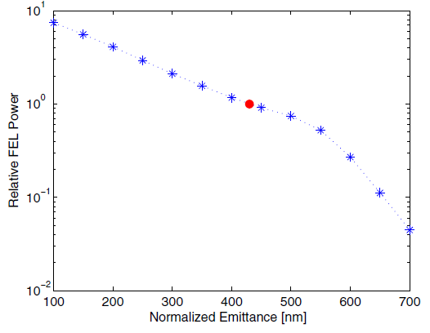
Introduction: SwissFEL SASE performances versus emittance
SASE nominal case – Genesis computations
200 pC charge – 5.8 GeV
12 undulator modules – period 15 mm
1 Å photon wavelength (12.4 keV)
Between the few FEL of this class:
the lowest beam energy
the shortest undulator period
The hardest emittance requirements
Saturation not reached
Design parameters
Courtesy E. Prat
Relative radiated power: reference the power at the design emittance of 0.43 mm.mrad

Slide 6
Introduction: mission of SITF
The SwissFEL Injector Test Facility was operated at the Paul Scherrer Institute between March 2010 and October 2014 serving as a pilot plant and testbed for the development and realization of SwissFEL
The facility provides the necessary background to analyze the generation and propagation of high brightness beams compatible with the specification of the SwissFEL. The diagnostic system is designed for a careful comparison with the Beam Dynamic Simulations.
During the injector commissioning and optimization the operator crew will elaborate, optimize and automatize the commissioning and operation procedures later transferable to SwissFEL.
The short and bright beam bunches delivered by the injector are used to support the components development: the key hardware components are developed and tested in order to reach the required functionality for the SwissFEL.
Establish the commissioning/operation crew and consolidate the know how for the SwissFEL commissioning and operation.
M. Pedrozzi et al, CDR accelerator test facility for SwissFEL, PSI Report No. 10-05, 2010 => https://www.psi.ch/swissfel/swissfel

Slide 7
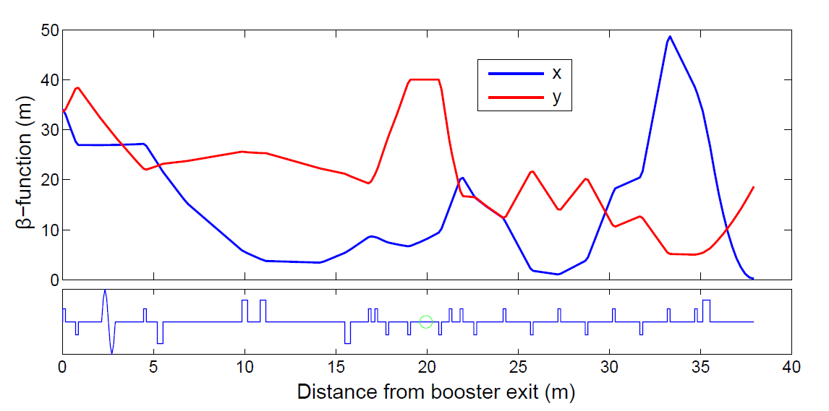

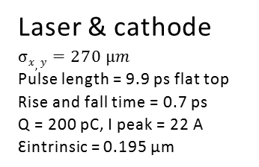
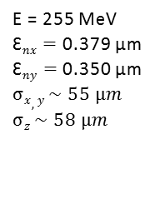
Layout and design parameters
Large for optimal resolution
Large for optimal streaking
RF-Gun
100 MV/m peak
37.89 degree from zero crossing
Typical lattice optimization
solenoid
dipole
quadrupole
BPM+screen
screen
S-Band linac
13.59 &18.86 MV/m 17.5 MV/m
0 degree -34.2 degree
X-Band
21.2 MV/m
-180 degree
ΔE = -20 MeV
BC1
E = 255 MeV
$σδ=$ 1.674%
R56 = 46.8 mm
θ = 4.1 deg
RF deflector
slice measurements
HR screen
Quad scan emmittance measurement
BPM tests
0 m 2.95 m 12.95 m 28.14 m 38.64 m 42.47 m 57.5 m
Laser & cathode
$$σx,y=270 µm$$
Pulse length = 9.9 ps flat top
Rise and fall time = 0.7 ps
Q = 200 pC, I peak = 22 A
Ԑintrinsic = 0.195 µm
SR monitor
E = 255 MeV
Ԑ$nx=$ 0.379 µm
Ԑ$ny=$ 0.350 µm
$$σx,y \sim 55 µm$$
$$σz \sim 58 µm$$
Off crest for compression
BAM 1
Coherent diffraction radiation
EO sampling
CSR (THz)
Test non destructive longitudinal monitors
3.5 cell FODO
55° phase advance / cell
Test emittance measurements
Later Quad. powered independently
M. Pedrozzi, Proceedings of FEL2009, Liverpool, UK, pg. 321 - Y. Kim et al, Proceedings of EPAC08, Genoa, Italy, pg. 100

Slide 8
Layout and building
Dedicated building delivered in June 2009 (March 2010 first tests with beam)
Technical extension
Electronic lab
Laser lab
Air conditioning
GUN
S-Band 2998 MHz
Max 35 MW – 4.5 µs
Klystron TH2100
LINAC - S-Band 2998 MHz
Mode 1: 45 MW – 4.5 µs
Mode 2: 60 MW – 1.2 µs
Klystron TH2100
LINEARIZATION
X-Band 11992 MHz
Max 50 MW – 1.5 µs
Klystron: XL5 - SLAC
DEFLECTOR
S-Band 2998 MHz
Max 7.5 MW – 4.5 µs
Klystron: TH2157
-10 m
0 m
10 m
20 m
30 m
40 m
50 m
60 m

Slide 9
SITF summary of simulated performances
Parameter | Values simulated for SITF
Charge (pC) | 10 | 200
Laser diameter on cathode (μm) | 400 | 1080
Laser pulse length FWHM – uniform distribution (ps) | 3.7 | 9.9
Peak current on cathode (A) | 3 | 22
Thermal emittance (mm.mrad) | 0.072 | 0.195
Core nor. slice emittance before/after BC (mm.mrad) | 0.078/0.078 | 0.32/0.33
Normalized projected emittance before BC (mm.mrad) | 0.095 | 0.35
Normalized X/Y projected emittance after BC (mm.mrad) | 0.104/0.096 | 0.379/0.35
RMS Bunch length before BC (ps) | 1.05 | 2.8
RMS Bunch length after BC (fs) | 33.2 | 193.3
Peak current after BC (A) | 104 | 352
RMS beam size on OTR in 3rd FODO cell (mm) | 14 | 55
Y. Kim et al, Proceedings of EPAC08, Genoa, Italy, pg. 100

Slide 10
Introduction: some key technical aspects to be investigated I
Stability and reliability of RF power plants
  Jitter RF phase and amplitude generates fluctuation of the peak current at the second compression stage (cumulative effect of wake field along the C-Band Linac) ⇒ Fluctuation of beam energy (i.e. FEL spectrum)and X-rays arrival time
  Power source reliability: Klystron modulator technology, arc behavior klystron and cavities, klystron life-time
  Reliability and resolution of LLRF measurements
Stability and reliability of the photo-emission => laser & cathode
  Cathode preparation, aging – evolution of quantum efficiency (QE)
  Laser + QE: transverse homogeneity has a large contribution to the beam emittance.
  Laser: longitudinal shaping ⇒ best compromise for optimal compression
  Laser : arrival time jitter with respect to RF phase typically < 40 fs
  Minimize dark current and his transport to reduce radiation losses and protect the undulators

Slide 11
Introduction: some key technical aspects to be investigated II
Compression
  Linearization + define a robust setting procedure compressor
  Identify and minimize the process responsible for the emittance growth (micro-bunching instabilities – amplification of longitudinal charge charge modulations, spurious dispersion, chromatic effects,…)
Diagnostics (large dynamic range 200 to 10 pC – possibly down to 1 pC)
  Orbit control within 1 µm along the undulator (development cavity BPM)
  Monitoring beam arrival time with <10 fs resolution (dev. optical BAM)
  Compression monitors
  Transverse screen monitors and coherent optical transition (COTR) effects
  Synchronization
  Distribution of absolute reference with <10 fs shot to shot jitter and drift
    Synch. Photo-cathode Laser + laser arrival time measurement
    Synch. RF
    Measurement beam arrival time
    FEL experiments, measurement arrival time pump lasers & arrival time X-rays
  Mechanical stability of support systems – vibrations aspects

Slide 12
Assembly and commissioning phases
Phase 1: Electron gun and diagnostics
March 2010 - May 2010
Characterization of the RF-gun (CTF3 gun #5)
Installation of the machine behind a shielding wall
Phase 2: Two S-Band-Structure, without bunch-compressor
Official inauguration 24. August 2010
Setting up procedures for machine optic and emittance measurement (Oct. 2010 – June 2011)
Phase 3: From 4 S-band operational to full Machine
August 2011: Installation of bunch compressor
End of May 2013: X-Band cavity in operation for beam developments
Phase 4: Implementation PSI-RF gun & Test Undulator-Prototype with beam
Integration undulator-prototype (December 2013)
Undulator removed & integration PSI RF-gun (May 2014)
dipole
quadrupole
BPM+screen
screen

Slide 13
Photo cathode Laser Systems I
[2]
[1]
Parameter | Unit | Req. SwissFEL | Ti:sapphire [2] | Nd:YLF [1]
Pulse duration | ps | 3-10 | 3-10 | 8
Pulse rise time | ps | <0.7 | 0.5-1 | 5
Temporal shape |  | Flat-top | Flat-top stacked | Gaussian
Energy at cathode | µJ | Min. 30 | <40 | <20
Central wavelength | nm | ~260 | 257-280 | 262
UV energy stability at cathode | % (rms) | <0.5 | 1-2 | 09-1.2
Transverse profile |  | Uniform | Truncated Gaussian | Truncated Gaussian
Laser-to-rf jitter | Fs | <100 | <30 @ oscillator 160 at cathode | <40 @ oscillator 130 @ cathode
Beam pointing stability (rel. to laser size) | % (peak 2 peak) | <1 | 0.15 | 0.15
Nd:YLF Neodymium-doped yttrium lithium fluoride (Time-Bandwidth: Jaguar)
  Simple and robust but very limited flexibility
  Single stage regenerative amplifier + two stages BBO second harmonic crystals
  Gaussian longitudinal shape (transform limited)
  In SITF we tested the two bunch mode producing two pulse replica with this system
Ti: sapphire (Amplitude Technologies: Pulsar)
  Very flexible system but more complicated to handle and high operational costs
  Requires 16 pump laser in the last amplification stage (Centurion, Quantel ) for 0.4% energy stability
  Broad band chirped pulse amplification. Advanced pulse shaping allows broad band (100 nm) or narrow band within 770-830 nm (used to test intrinsic emittance versus laser wavelength)
[1] M. C. Divall, et al, Methods Phys. Res., Sect. A 735, 471 (2014) - [2] A. Trisorio, et al, Opt. Express 19, 20128 (2011).

Slide 14
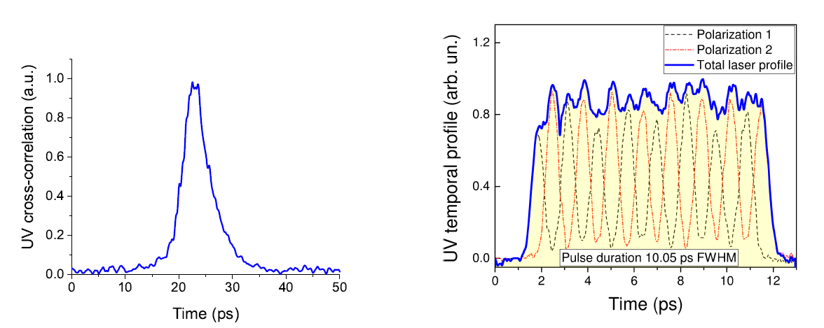
Photo cathode Laser Systems II
Longitudinal laser shape measured with cross-correlation in the UV
Nd:YLF
Ti:Saph. Pulse shaping stacking 16 replica
We will come back to the modulations later!

Slide 15
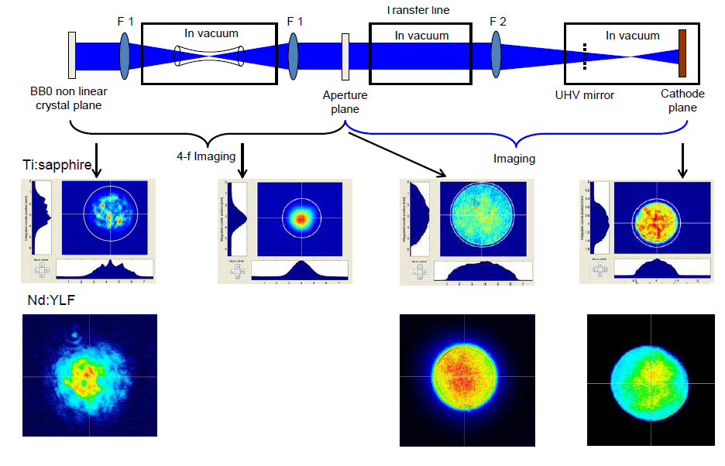
Photo cathode Laser Systems III
The homogeneity of the final transverse shape is very sensitive to the drifts of the transfer line, in particular the filtering in the capillary for the TI:sapphire

Slide 16
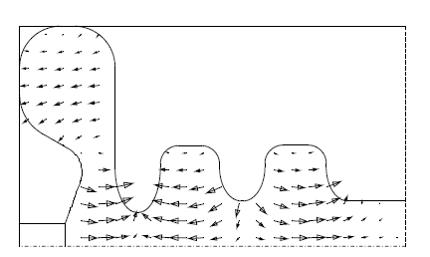
Source: CTF RF-gun a starting point
CTF gun #5 on loan from CERN. Operational until May 2014. Meanwhile PSI designed and manufactured a new gun best suited for FEL applications (see next slides)
Main constraints CTF gun
  10 Hz operation max (mainly thermal load on pickup)
  Dark current in nC range (up to 7 nC when focusing on the Faraday Cup, 1.5 nC with 1.5µs RF pulse)
  No racetrack geometry of input coupler for quadrupole compensation
  21 MW for 100 MV/m (relatively high RF power)
  But nevertheless providing remarkable low emittances in SITF
M. Bossard et al, CLIC note 297 and PS/RF note 95-25, 1995 - M. Bossard et al, Design of a RF gun for heavy beam loading, Proc. EPAC96

Slide 17

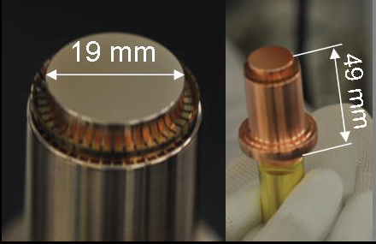
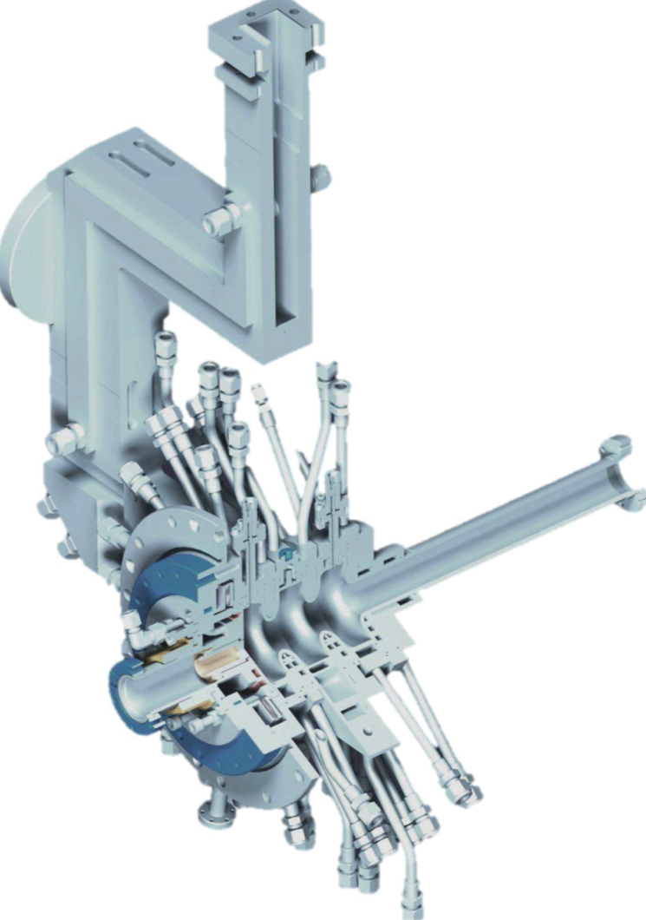
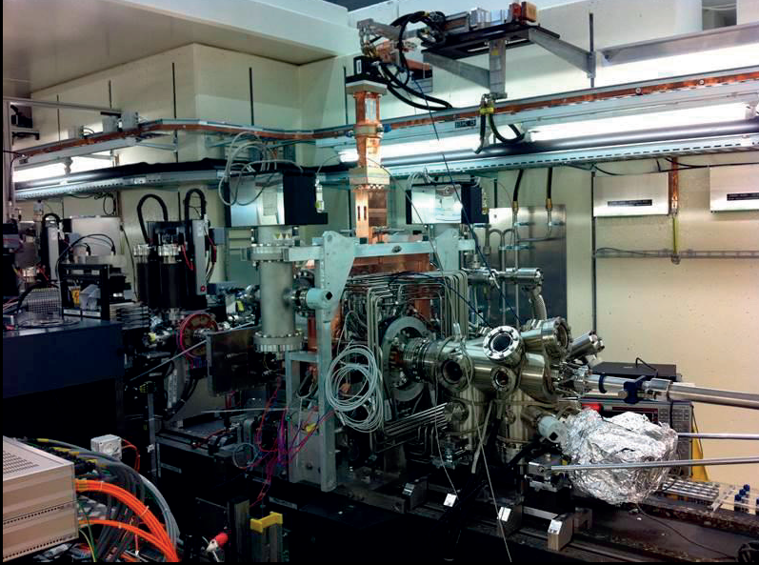
Final source: PSI RF-gun (⇒ Phin Slac Inside)
Machined “on tune” according to HFSS
No tuning plungers
No tuning step during machining
Best design features from SLAC and PHIN/CTF
2.5 cells
Racetrack cell with symmetric z-coupling for dipole and quadrupole compensation
Removable backplane but, load lock for in vacuum cathode replacement
Cathode plug for fast replacement
⇒ CTF design
SITF 15.07.2014
In operation at SITF from May until October 2014
SwissFEL today
Load lock
RF and mechanical design: PSI
Fine machining cavities : VDL
Pre-machining & Brazing: PSI workshop
Cathode plug
U. Ellenberger, et al., The SwissFEL RF Gun: manufacturing and (…), Proc. of FEL2014, Basel, Switzerland

Slide 18
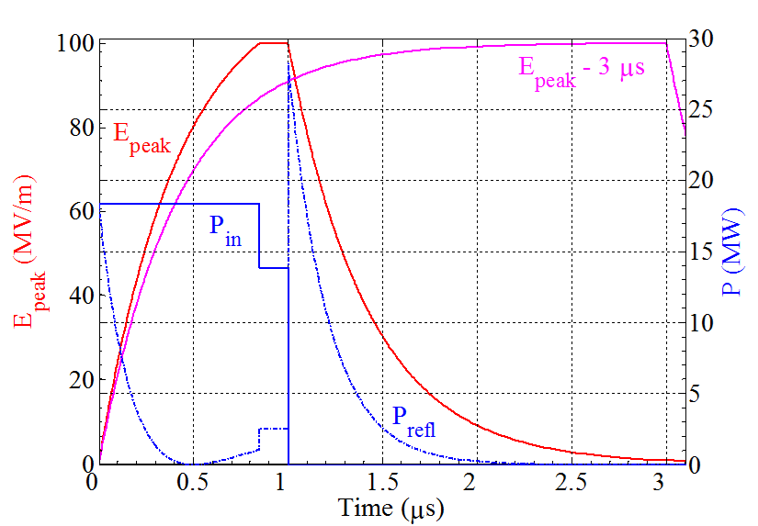
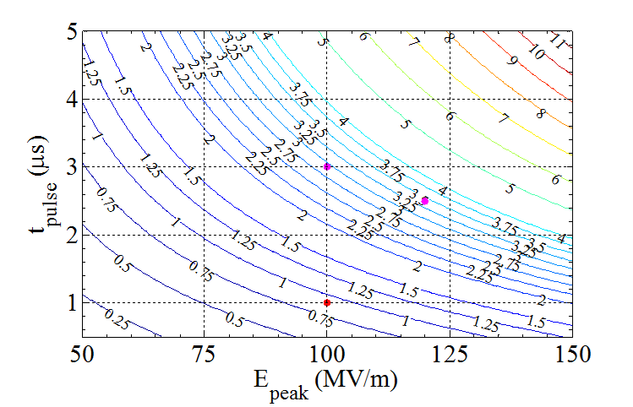
PSI RF-gun: filling scheme and thermal losses
Amplitude modulation scheme
Fast filling
150 ns flattop for two bunch operation.
Shorter RF pulses
Thermal load reduction from 3 to 0.9 KW
Dark current reduction (~50 pc @ 100 MV/m)
Reduction of RF breakdowns (6 Months operation ~arc free)
J.-Y. Raguin, et al., The SwissFEL RF Gun: RF design and thermal analysis, Proceedings of LINAC2012, Tel-Aviv, Israel

Slide 19
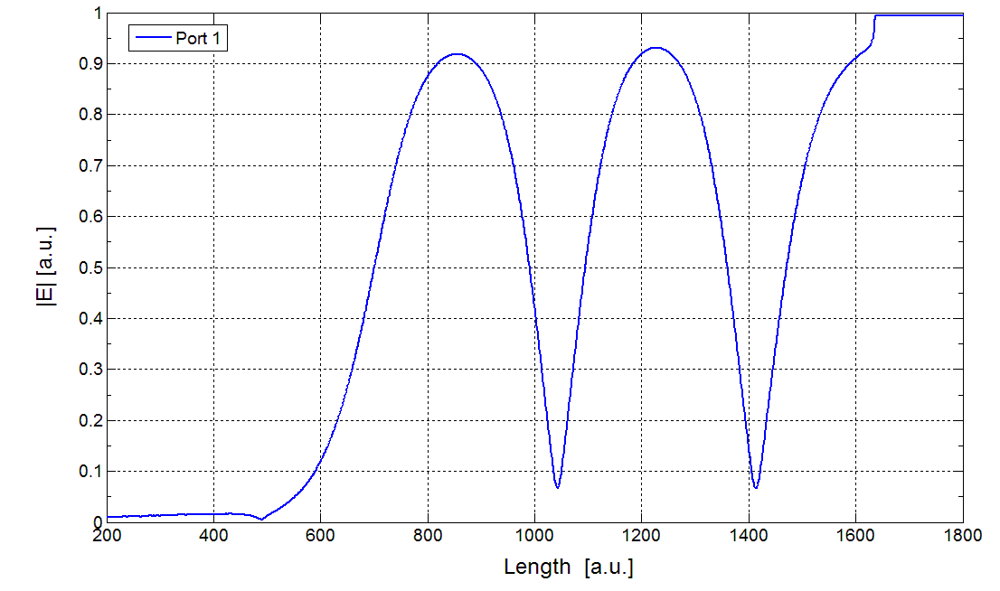
PSI RF gun: cold test results
Field balance at resonance (bead pool)
PI mode | Design | Measured
Freq. @ 40 °C | 2998.8 MHz | 2998.55 MHz ±35 kHz
β | 1.98 | 2.02 in reflection 1.99 in transmission
Q₀ | 13631 | 13691 in reflection 13320 in transmission
PI – PI/2 mode | 16.36 MHz | 16.196 MHz
No mechanical tuning of the cavity after brazing
Operation at 35 °C to compensate the 250 kHz frequency error
(one contribution ⇒ error radius first half cell during UP machining)
Cell 2/Cathode
100% ± 1%
Cell 1/Cathode
101% ± 1%
Pickup calibration: half cell = -64.5 dB
Cell 1 = -66.7 dB
Cell2 = -55.9 dB
P. Craievich et al, High power test and analysis of dark current in the SwissFEL-Gun, Proc. of FEL2014, Basel, Switzerland

Slide 20
Photo emission process and intrinsic emittance
β is the local field enhancement factor, E_{c}(ϕ) the applied field at the cathode
hν
Metal
Vacuum
Semiconductor
Vacuum
Energy
Energy
φ_{Schottky}
φ_{Schottky}
φ_{ea}
φ_{w}
φ_{w}
φ_{eff}
Conduction band
Potential barrier
Without and with external E field
Fermi Energy
φ_{eff}
Fermi Energy
φ_{gap}
Valence band
Direction normal to surface
Direction normal to surface

Slide 21
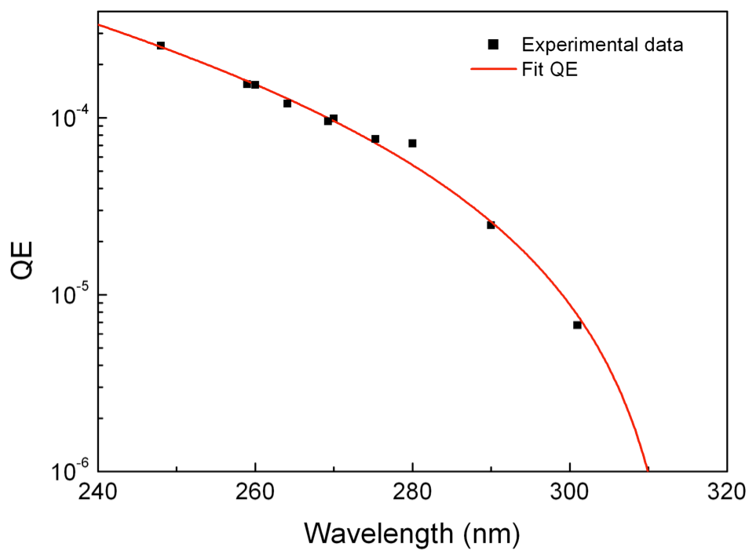
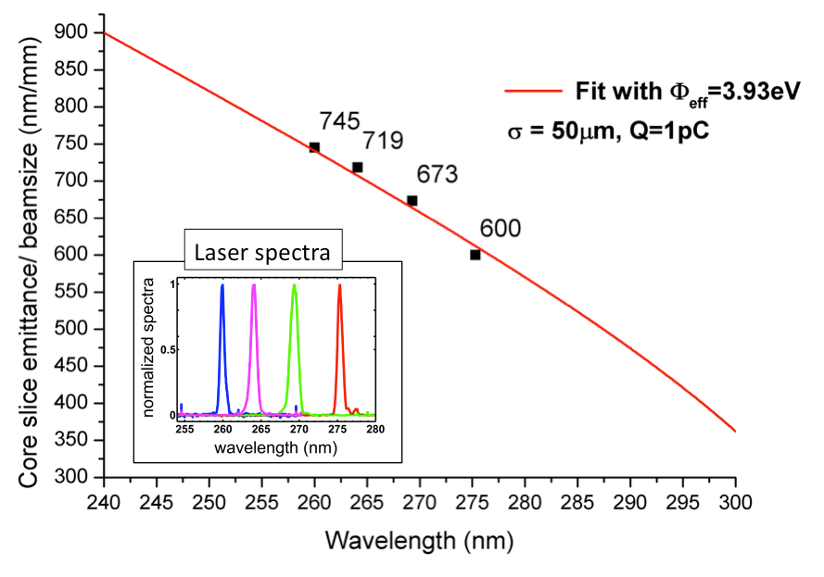
Measurement intrinsic emittance
Two methods for measuring the intrinsic emittance:
Shottky scan ⇒ E_{c}(ϕ)
Photon energy scan ⇒ hν
QE=Quantum Efficiency
SITF Tunable hν 5-4.12 eV
Example Cu cathode characterized with photon energy scan.
This cathode wasn’t particularly good ⇒ Note φ_{eff} is affected by contaminants!
C. Vicario et al, Photocathode laser wavelength tuning for thermal emittance and QE studies, Proc. of FEL2013, NY, USA

Slide 22
PSI RF-Gun: Which cathode for SwissFEL?
Quantum Efficiency (QE) @ SITF
Normalized intrinsic emittance @ SITF
QE of Cs₂Te is orders of magnitude higher than for Cu (acceptable QE for Cs₂Te after 60 days of 10 Hz operation)
The difference in emittance is insignificant
The excess laser energy for Cs₂Te can be used to improve the beam emittance by optimizing the laser shaping. Alternatively, a less powerful (cheaper) laser can be used - < 1µJ UV at cathode
longer time response of Cs₂Te helps to have smoother longitudinal profile of the e-bunch with pulse stacking
Cs₂Te is at this stage the technology selected for SwissFEL (+less stress on UV optical components)
E. Prat et al, Thermal emittance measurements at the SwissFEL Injector Test facility, Proc. of FEL2014, Basel, Switzerland

Slide 23
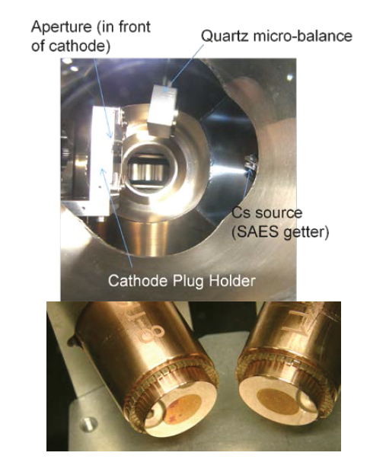
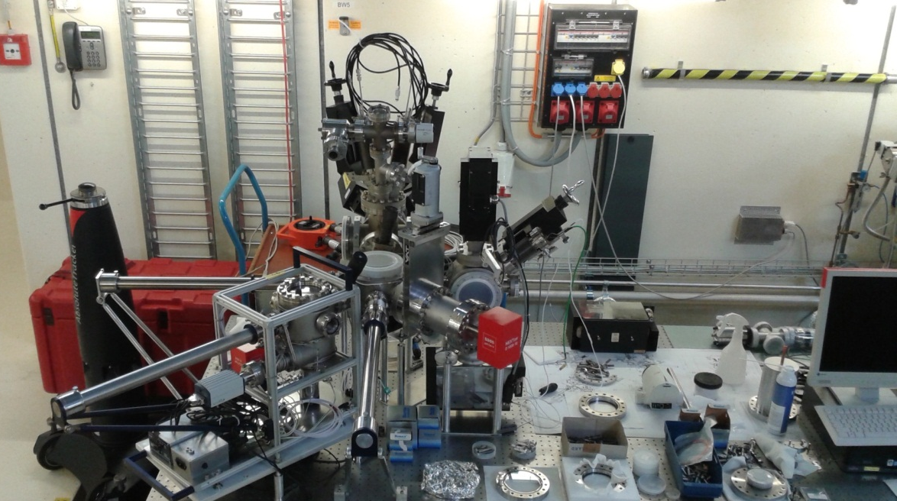
Cs₂Te cathode preparation & load lock system courtesy Romain Ganter
Diamond turning hydrostatic pressed copper (extern company)
Transport in N2 atmosphere
3 steps ultrasound baths
  Degrease (“soap”)
  Acetone
  Alcohol
Annealing 10 hours at 250°C
Cs2Te deposition
Storage
In vacuum
J. Bossert et al, Cu and Cs2Te Cathode preparation and QE history at the SwissFEL Injector test Facility, Proc. of FEL2014, Basel, Switzerland

Slide 24
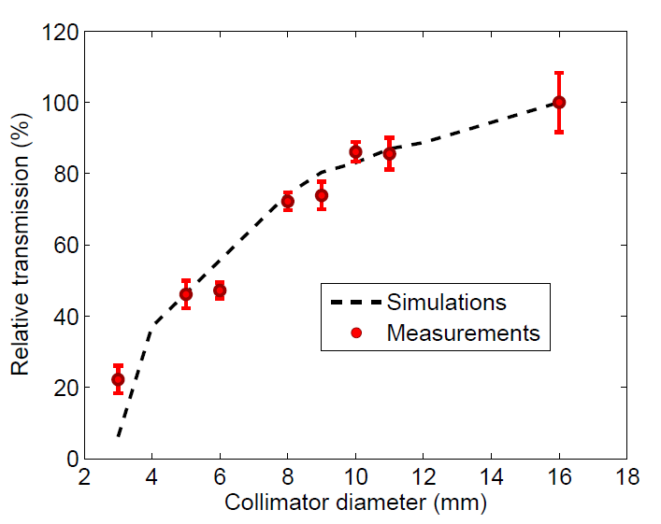
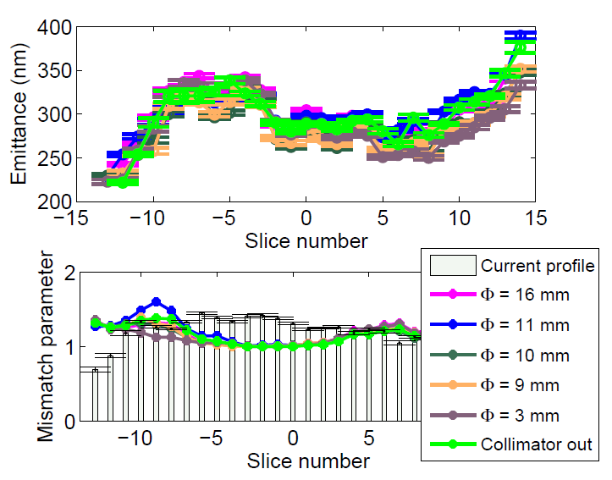
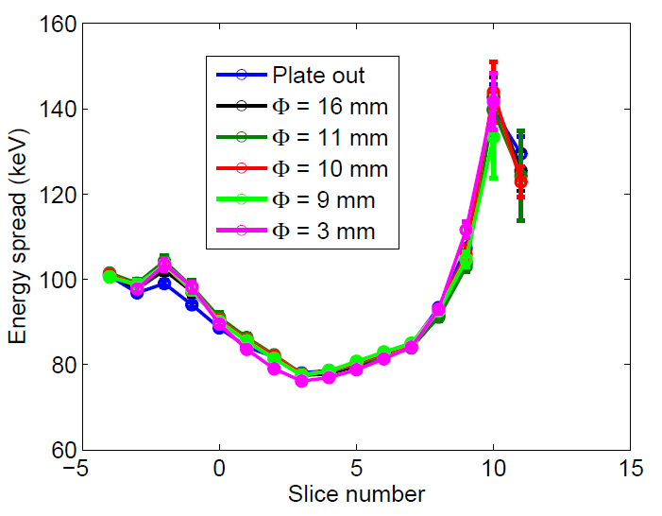
Dark current PSI RF-gun & low energy collimation
Strong reduction of Dc with respect to the CTF gun:
50 pC (1 µs) toward 1 nC (1.5 µs)
As measured collimating the Dc in the Faraday-Cup at the gun exit
Dc transport model benchmarked in SITF with collimator iris at low energy (in front of acc. Cavity 1)
SITF shows no appreciable effect of collimator iris on beam quality
24
S. Bettoni et al, Dark Current Transport and Collimation studies for SwissFEL, Proceedings of FEL2013, New York, NY, USA

Slide 25
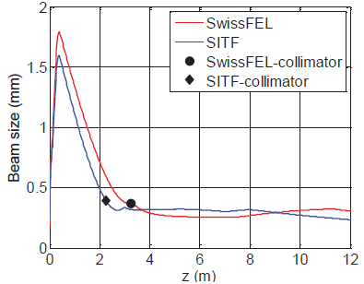
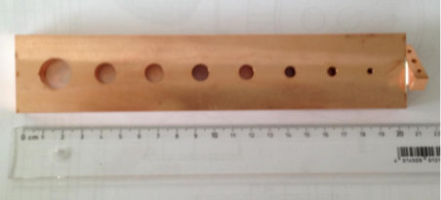
RF-gun: dark current transmission in SwissFEL
Collimation sled in SITF
FC
Collimator
RF structure 1
RF structure 2
Expected 0.13 % transmission with Ø 5 mm
PSI RF-Gun ~50 pC ⇒ 65 fC
CTF RF-Gun ~5 nC ⇒ 6.5 pC
RF Structure 1
Turbo ICT
25

Slide 26
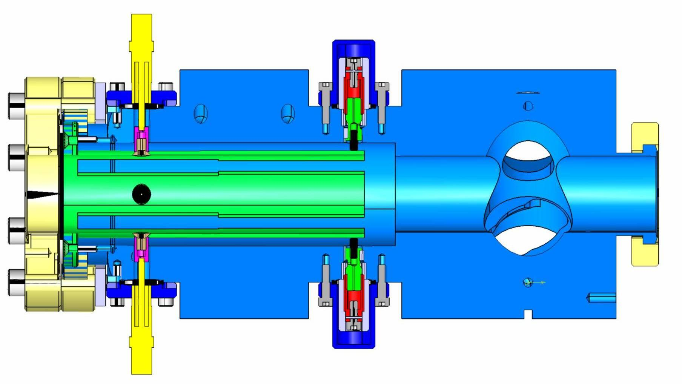
BPM system SITF we needed a fast development and procurement
Solution selected for SITF: a re-optimization of SLS resonant strip line BPM
Monoblock BPM + screen monitor
Resonant frequency 500 MHz
Single bunch performances
position resolution
    7µm (@ 5 - 1000 pC: ADC dominated)
    35µm (@ 1 pC: thermal noise RF front end)
Charge resolution
    0.2 % @ 5 – 1000 pC bunch
    3-4 fC rms @ 1 pC bunch
    OK for SITF but not enough for SwissFEL
Keil et al., Proceedings of FEL2010 Malmö, Sweden, pg. 429

Slide 27
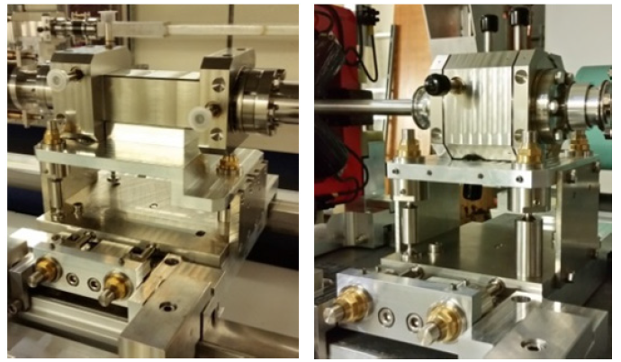
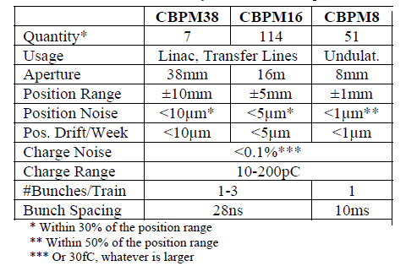
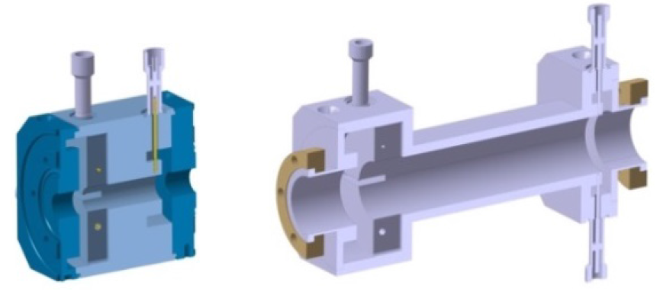
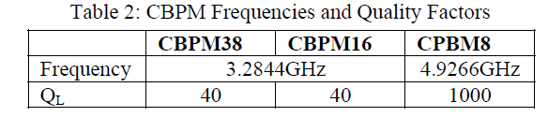
BPM system SwissFEL: collaboration PSI-DESY
SwissFEL requirements
Ø 38
Ø 16
Exp. resolution Ø16 mm in SITF test beamline
  <0.8 µm noise with 0.35 mm beam offset &136 pC
  < 0.07% Charge resolution (<8 fC absolute)
  <1 % absolute accuracy with cross calibration
Low Q, Stainless steel
Two bunches 27 ns
High Q, Copper
Single bunch
Keil, et al., Proceedings of IBIC2013, Oxford, UK, pg. 427 -- Keil et al, Proceedings of IBIC2015, melbourne, Australia, pg. 497

Slide 28
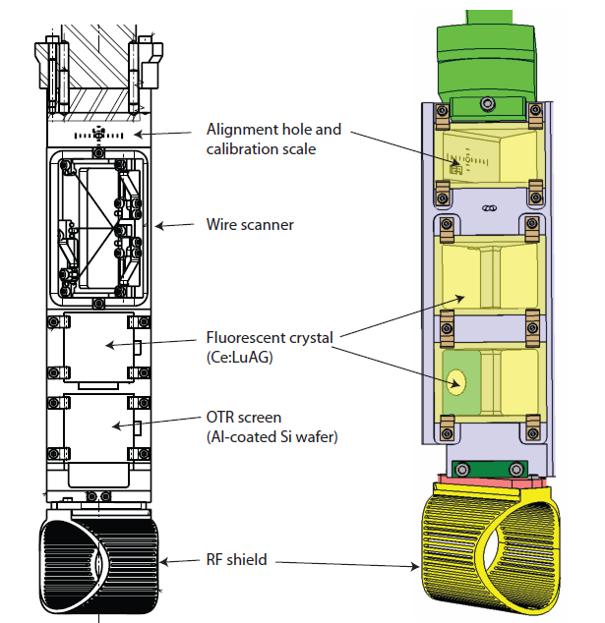
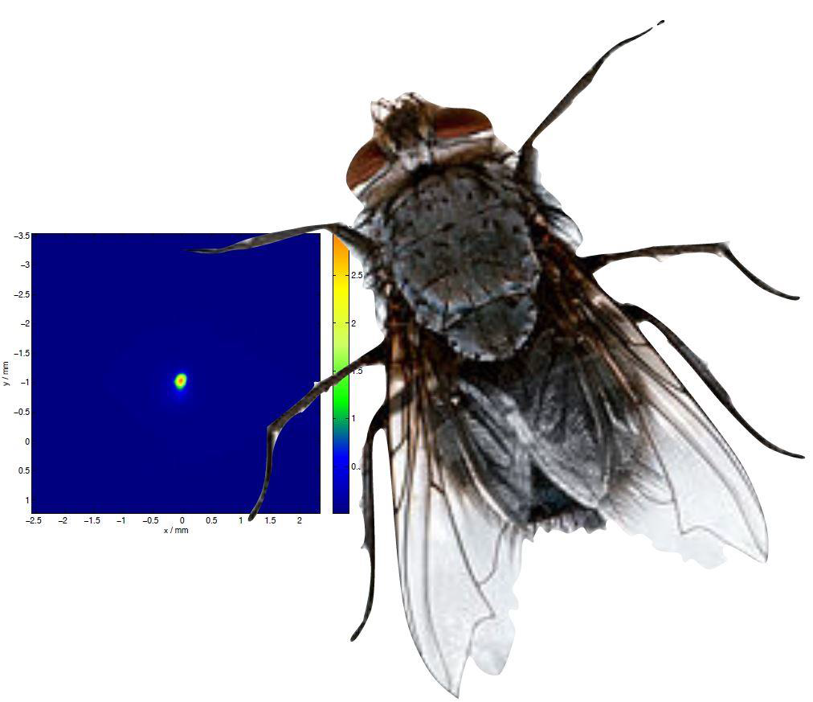
Standard screens in SITF (27 stations)
High energy version
orientation screens 45 °
Scintillator screens
resolution limited by crystal thickness to about 200 m
OTR
Low signal to noise at low charge
Sensitive to COTR with compressed bunches
Low energy version (7 MeV)
Only fluorescent screen
orientation screens 90°
45 ° mirror behind the screen
Necessary to develop a new transverse profile imager:
High sensitivity for low charge ⇒ scintillator
<10 µm spatial resolution
COTR insensitive
R. Ischebeck et al, Profile monitors for SITF, Proceedings of Linear Accelerator Conference LINAC2010, Tsukuba, Japan
R. Ischebeck et al, Instrumentation activities at SITF, Proceedings of IBIC2013, Oxford, UK

Slide 29
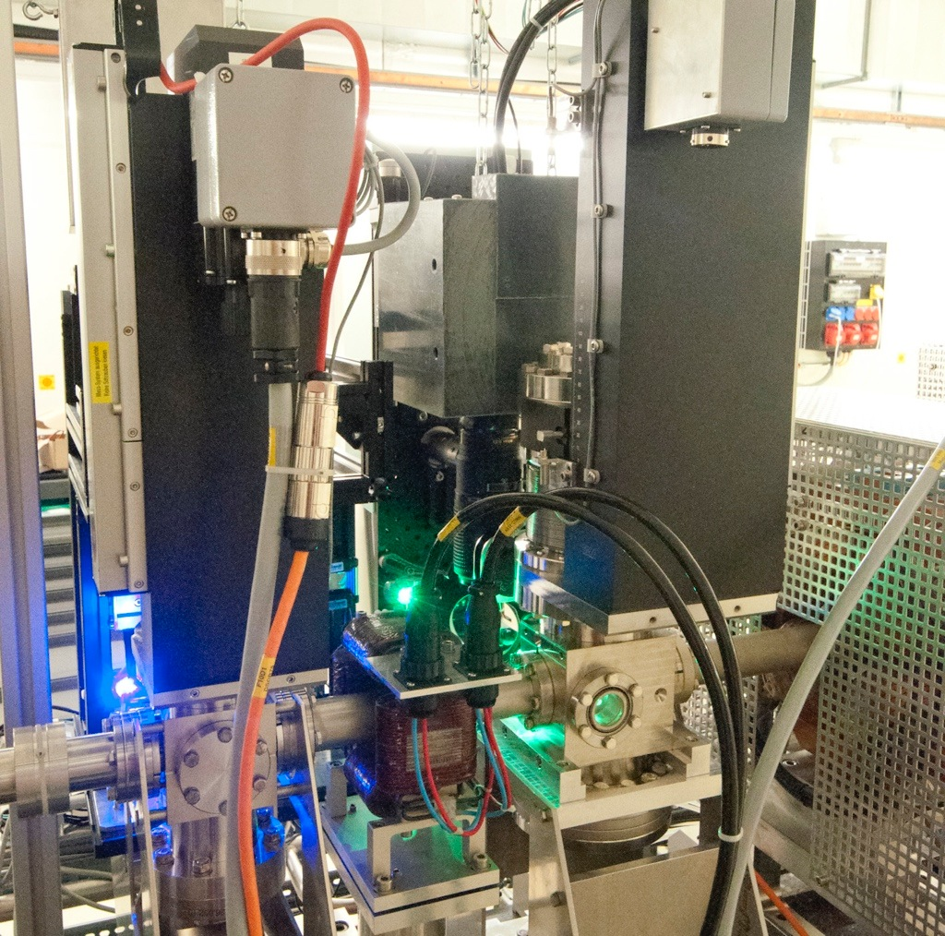
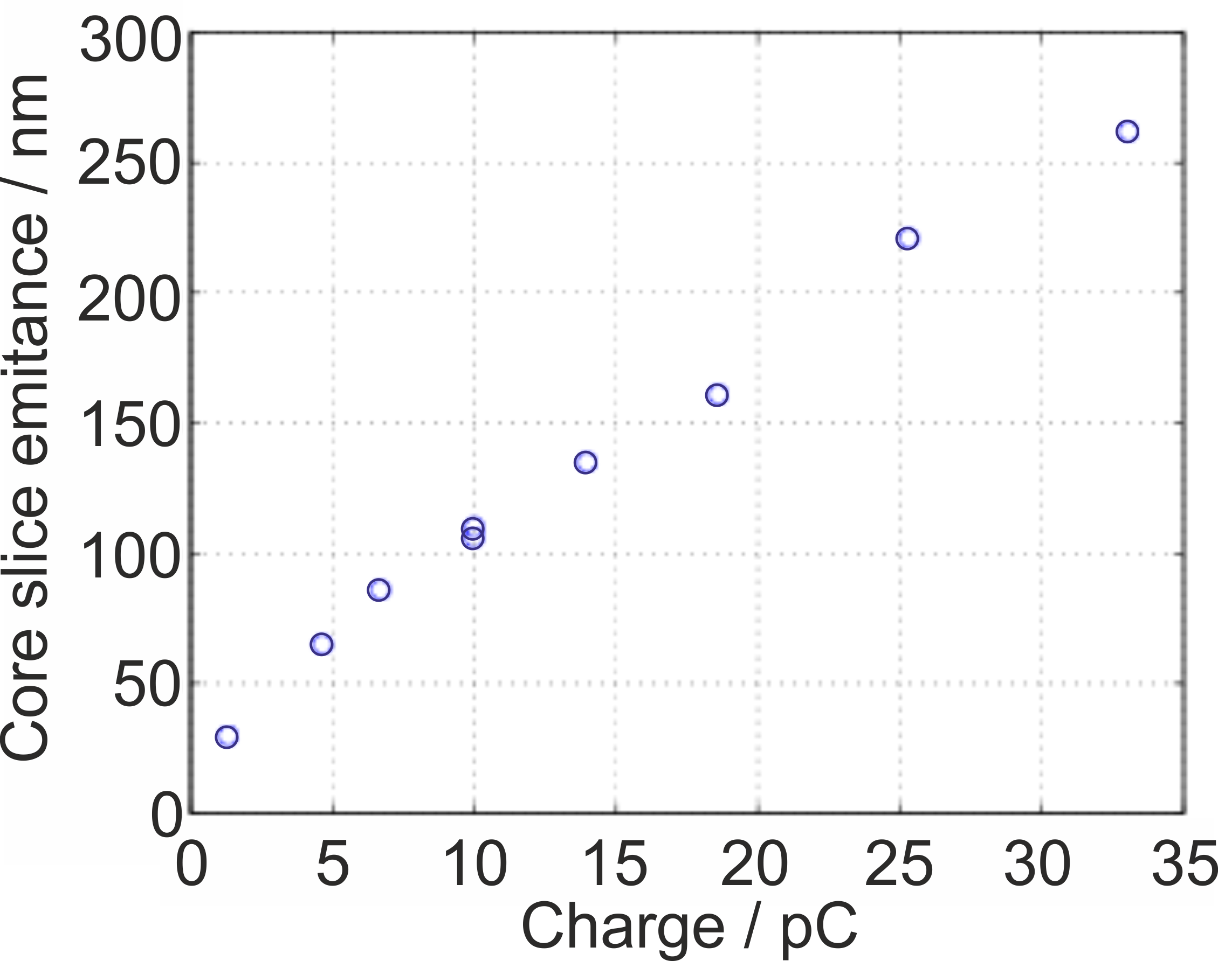
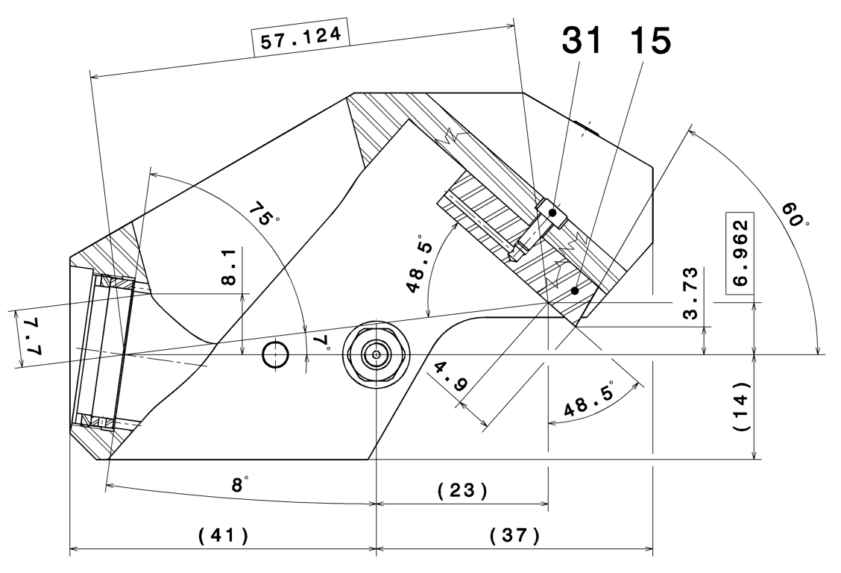
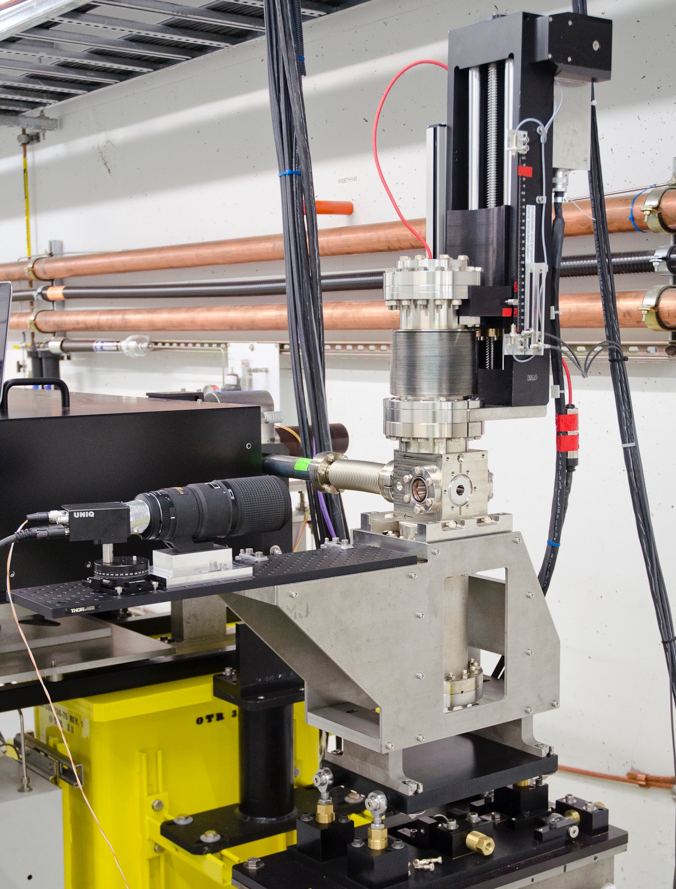
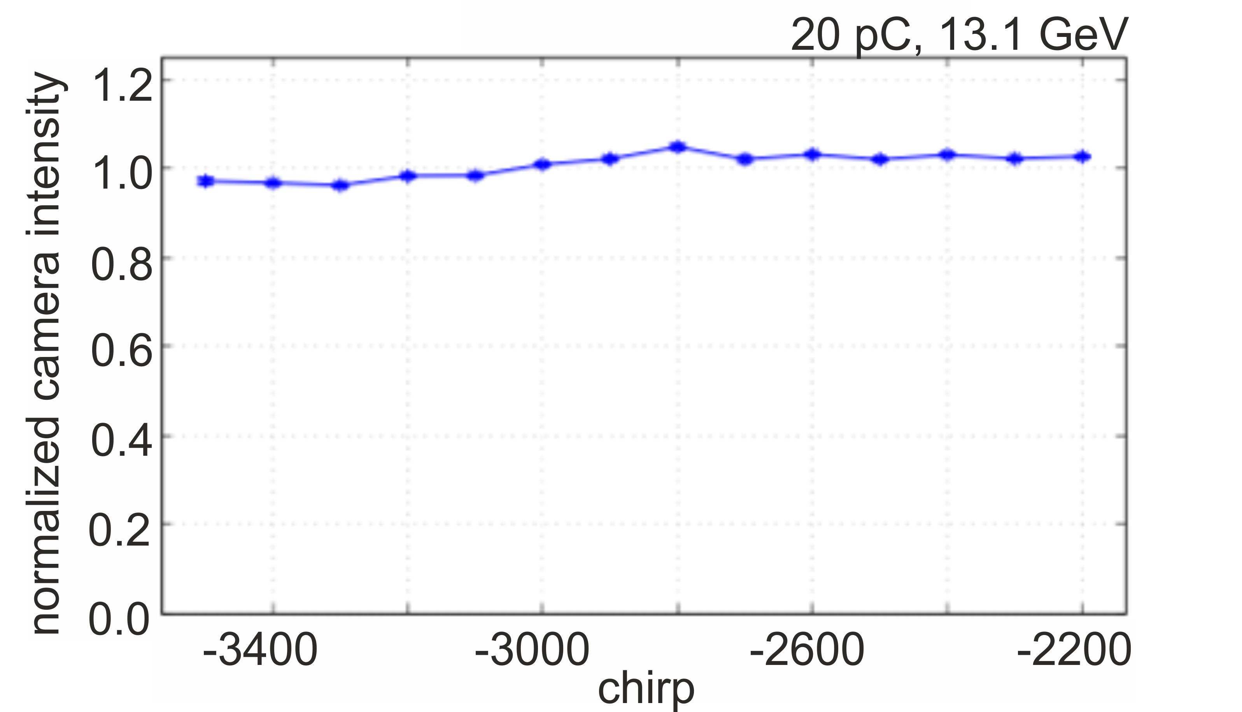
Screen developments
Design Goals: > Avoid coherent optical transition radiation (COTR) – spatial resolution of 8 µm
> Resolution to measure sub-micrometer normalized emittance
> Measurements at the SwissFEL Injector Test Facility
Core slice emittance as a function of charge
(coherent)
OTR
> Measurements at the LCLS linac-to-undulator line
to camera
Intensity as a function of compression
(not affected by COTR or saturation!)
European Patent EP 2 700 979 A1
Intensively used at SITF for the emittance measurements
R. Ischebeck et al, Transverse profile monitors for SwissFEL, Proceedings of IBIC2014, Monterey, CA, USA

Slide 30
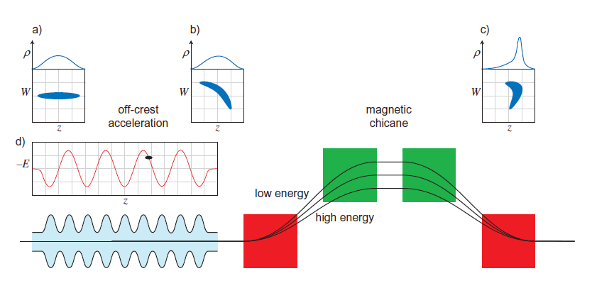
Magnetic compression chicane: remind of concept
Picture: PhD Thesis R. Ischebeck, Univ. Hamburg 2003
Possible complications:
Coherent Synchrotron Radiation inducing a dilution of the emittance – to be minimized with careful design
(Longitudinal and transverse kick → the electron is not anymore on the correct orbit → the dispersion is not closed)
RF non linearity inducing a head and tail strong current spikes (increasing CSR) – requires a linearization of the longitudinal phase space → 4th harmonic cavity – X-Band (12 GHz) for a S-Band injector
Amplification of longitudinal charge modulations (space charge effect) ⇒ laser shaping

Slide 31
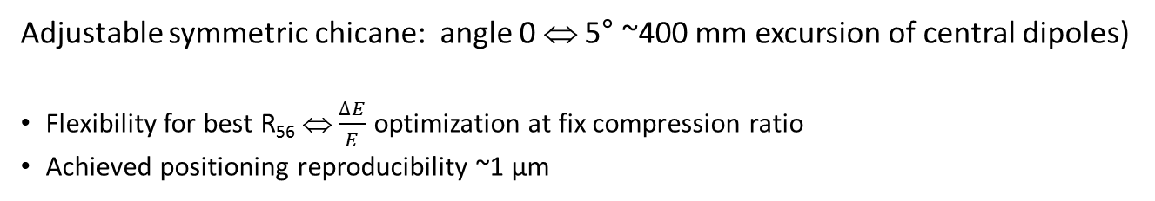


SITF Bunch compressor
Adjustable symmetric chicane: angle 0 ⇔ 5° ~400 mm excursion of central dipoles)
Flexibility for best R₅₆ ⇔ $\frac{∆E}{E}$ optimization at fix compression ratio
Achieved positioning reproducibility ~1 µm
$∆S=R_{56}\frac{∆E}{E}$ +$T_{566 }{\left(\frac{∆E}{E}\right)}^{2}$
$$R_{56}=2θ^{2}{\left(L+\frac{2}{3}L_{dip}\right)}^{2}$$
L
L_{dip}

Slide 32
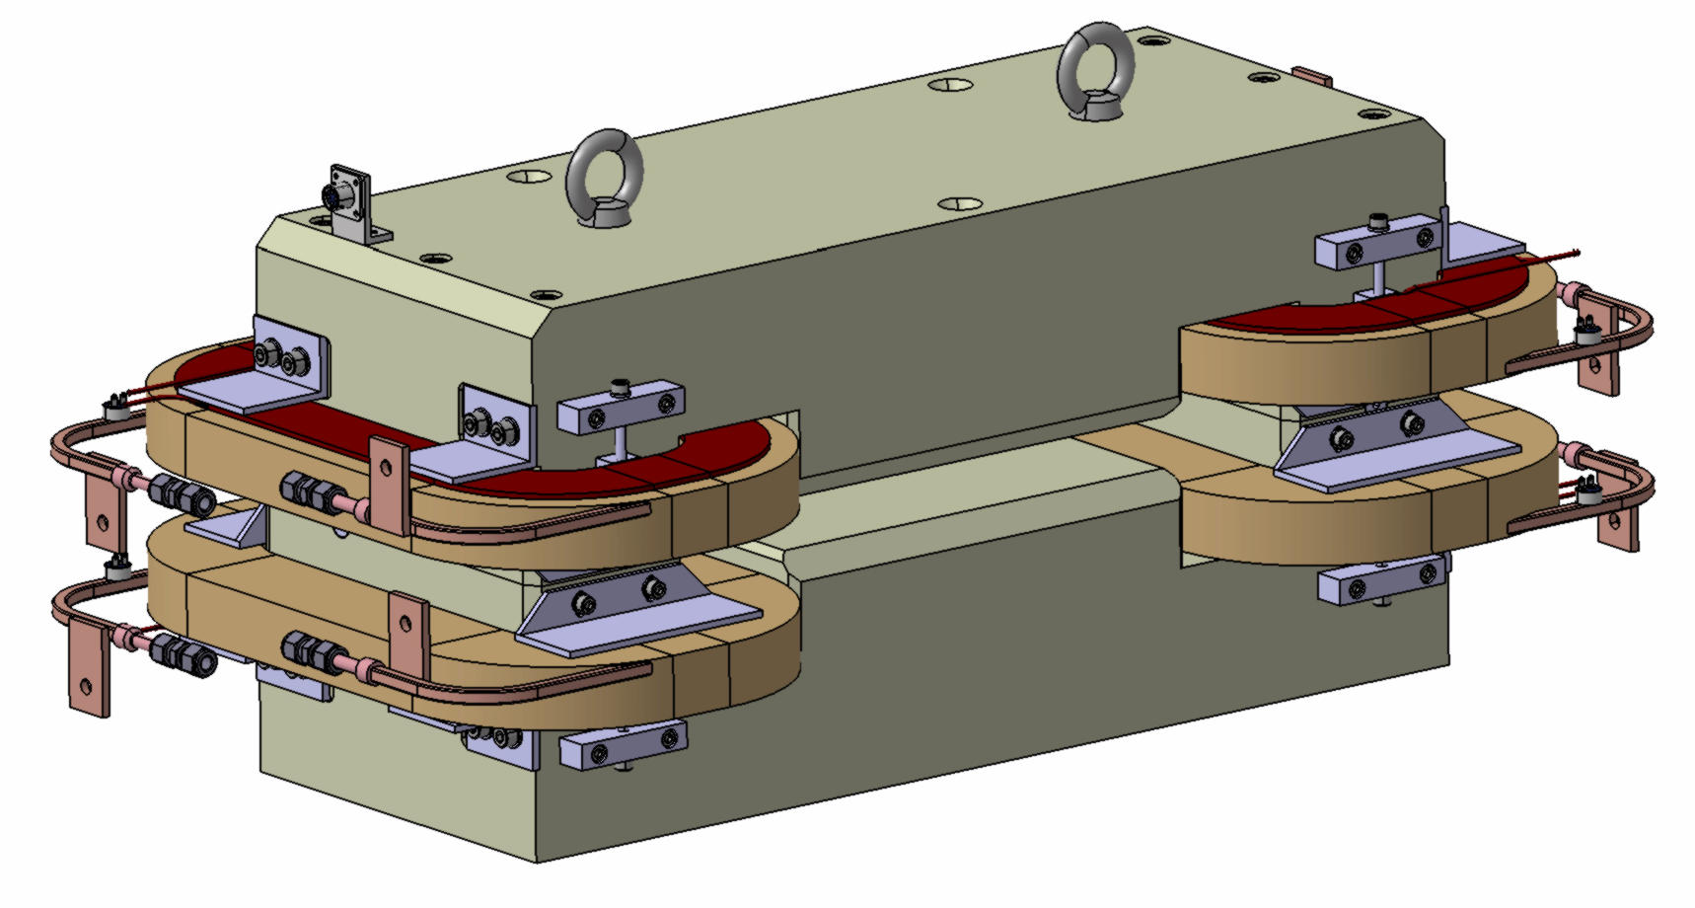
Bunch compressor: dipoles filed quality
Good field region versus stray field. The stray field of AFBC2 was perturbing the orbit already few meters in front of the chicane.
AFBC2 (SITF) – first installed
Optimized for large good field region
Max. 0.138 T/m
L_{dip} = 0.25 m
AFBC1 - Installed in May 2014
Best compromise
Max 0.124 T/m
Ldip = 0.25 m
Good field region (required <10⁻⁴ over ±27 mm)
Motivation of change: long stray field of AFBC2

Slide 33
Bunch compressors: from SITF to SwissFEL
 | SITF BC1 | SwissFEL BC1 | SwissFEL BC2
Dipole separation L (m) | 4.375 | 6.0 | 7.0
Typical angle (deg) | 4.48 | 3.85 | 2.15
Typical R56 (mm) | 55.7 | 55.7 | 20.69
Min – max angle (deg) | 0 – 5 | 0 - 4.5 | 0 - 3.7
Transverse range (mm) | 0 - 405 | 0 - 490 | 0 - 485
dipole
Cavity BPM-C38
Corr. quadrupole
Profile monitor
Corr. Skew quadrupole
Horizontal scrapers
BC1. corr. sextupole
Slotted foils
SRM Sync. Rad. port
CSR Coherent Sync. Rad. port
BPM-Strip line
QFB-skew
BPM-C38
QFB-skew
AFBC2
QFB
SR monitor
QFB
Longer chicanes to reduce the CSR kick
Profile monitor
Horiz scraper
SITF BC1 (10.5 m)
L
CSR monitor
Back to AFBC1 dipole
(tested at SITF)
AFBC1
QFB-skew
Beam direction
QFA-skew
QFB
BPM-C38
QFB
SwissFEL BC1 (13.75 m)
HFA
HFA
AFBC3
QFB-skew
QFD-skew
QFB
BPM-C16
QFB
Radiation shielding
SwissFEL BC2 (16.95 m)
HFB
HFB

Slide 34
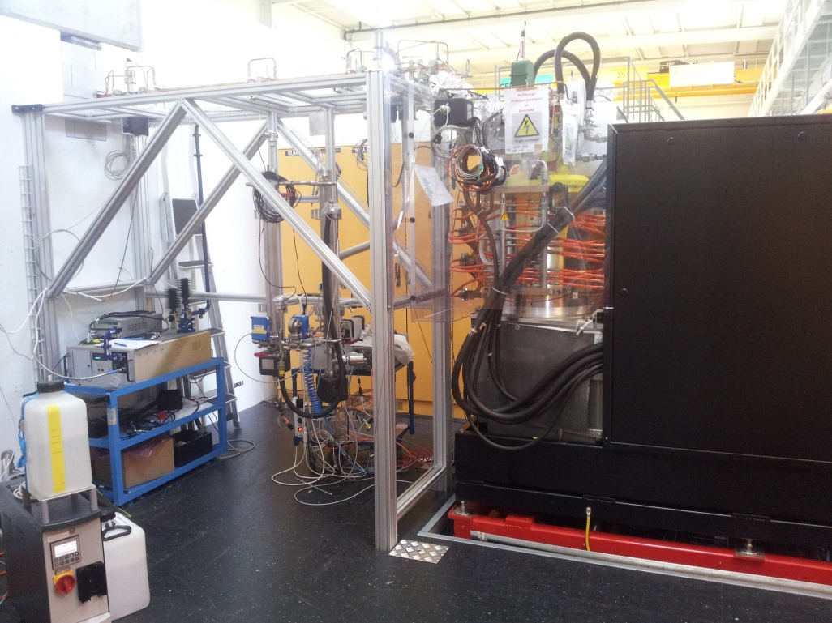
X-band: SITF (SwissFEL) RF power plant
XL5 SLAC klystron
XL5 klystron (collab. PSI-FERMI-CERN-SLAC)
Two tubes were manufactured for PSI
KLY#2 Operation in SITF (typically running up to 20 MW)
KLY#1 developed vacuum fluctuation at the gun during the commissioning. Requires repairs (gun replacement).
For SwissFEL one tube + one spare is the absolute minimum to guarantee the user operation!
Compatible industrial version available by CPI. SAT first tube ordered by CERN was mid January 2014 (OK but we still need more op. experience). PSI must order one!
SN klystron modulator
Operating frequency | 11995.2 | MHz
RF peak power | 50 | MW
RF average power | 5 | kW
Klystron voltage range | 410 | kV
Klystron current range | 262 | A
Pulse length (top) | 1 | μs
Max pulse length (at 76%) | 3.4 | μs
Repetition rate | 10-100 | Hz

Slide 35
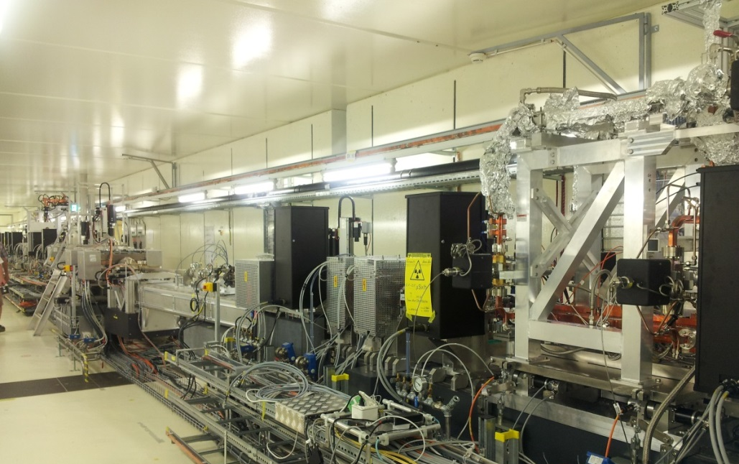
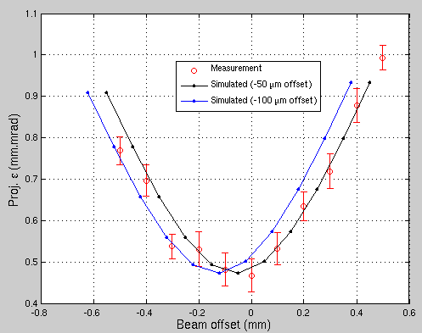
X-band: SITF (SwissFEL) RF cavity
X-band cavity on movable support
Coollaboration PSI-FERMI-CERN
Operating frequency | 11995.2 MHz
Phase advance | 5π/6
Operating temperature | 31 C ± 0.1 C
Flange-to-flange total length | 965 mm
Number of cells (incl. matching cells) | 72
Iris radius at 20 C | 4.991 to 4.106 mm
Input / Output coupler type | Mode launcher
Shunt impedance per unit length | 60.2 MΩ/m
Peak power for 20 MV/m | 7 MW
Filling time | 105 ns
Maximum pulse repetition rate | 100 Hz
Bunch Compression Chicane
Two cavities available at PSI
One cavity was in operation at SITF
Two cavities installed SwissFEL
Proj. emittance dilution versus vert. offset of the cavity
Measurements & simulations assuming an initial offset respectively of -50 and -100 μm
M. Dehler et al, A multipurpose X band accelerating structure, Proceedings of IPAC2012, New Orleans, Louisiana, USA

Slide 36
Linearization and X-Band system
RF phase stability dominate the compression stability: required <0.07 ° shot to shot jitter @ cavity. This include the pre-amplification chain jitter, the power station jitters (required klystron modulator voltage < 3 ppm) and the measurement precision (LLRF)
In general X-band are still non standard components and one feces some difficulties for the procurement. The situation ameliorates progressively but the technology remains expensive and fragile.
Two cavities in SwissFEL allow for lower klystron power requirements or higher harmonic voltage.
Highest impedance along the accelerator ⇒ transverse wake kicks can influence the emittance (alignment issue) ⇒ in SITF and SwissFEL the cavities are mounted on a motorized support

Slide 37
Emittance measurements: techniques
Betatronic transfer matrices R^{i}
Reference point
screen
Define a set of optics ⇒ measure σ_{i} ⇒ determines beam moments solving the syst. of equations
Projected emittance: symmetric single quadrupole scan with optics chosen to achieve minimum beam size in both plane at zero quadrupole gradient (covering ~0 to 180° phase advance µ_{x,y}). Advantage: one scan for both plans.
Slice emittance: more constraints
    Horizontal plane covering 0-180° phase advance as far as possible
    Vertical (streak) direction const. phase advance fulfilling sin(µ_{y})=1 for optimum resolution
    Large β_{y} at the deflector for efficient streaking
    Large β_{x} at the screen for optimum resolution
    Trick : keep beam size at screen ̴constant
Deflector
HR Meas. Screen
Multiple quadrupole scan +
E. Prat et al, Phys. Rev Special Topics – Accelerators and beams 17, 104401 (2014)

Slide 38
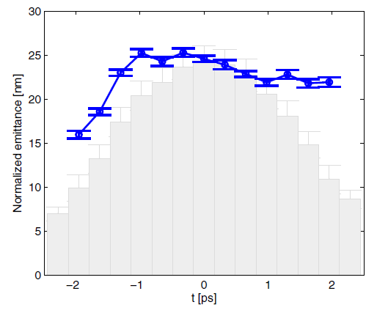
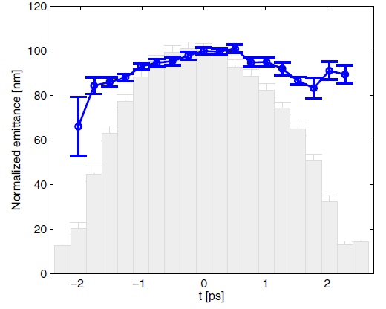
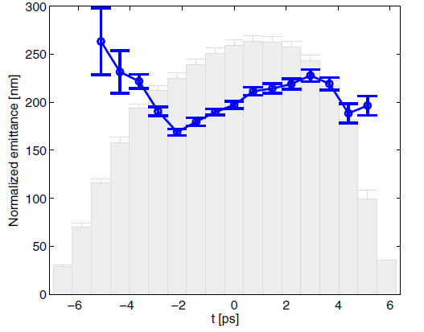
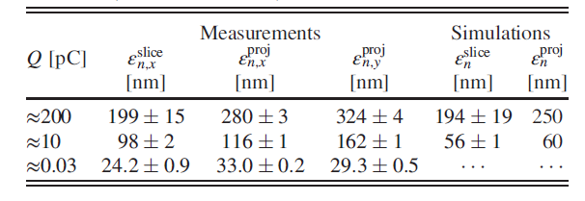
Emittance measurements uncompressed
30 fC
10 pC
Results for CTF RF gun with copper cathode
200 pC
± Represents statistical fluctuations for few measurements
E. Prat et al, Phys. Rev Special Topics – Accelerators and beams 17, 104401 (2014)

Slide 39
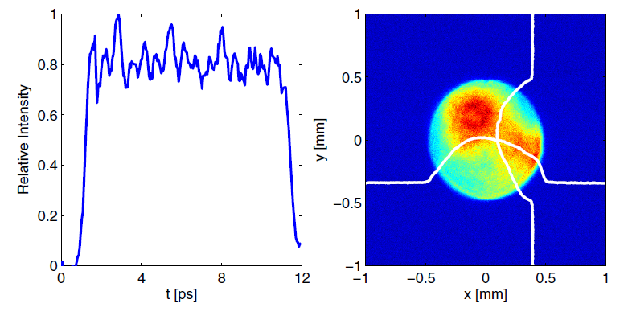
Emittance measurements: possible complications
Spurious dispersion
Evolves during the scan increasing the beam size
Keep the orbit with orbit feedback (Ok but best orbit is optic dependent)
Run bumps at the measurement screen minimizing ε measurement (compensation of average dispersion effect)
Laser shape
Longitudinal modulations can show up at compression diluting the emittance and energy spread (Space charge & CSR effects, microbunching) ⇒ see next slide
Transverse inhomogeneity can to some extents be compensated with a touchy optimization of the optics and skew quads. But the machine behaves very sensitive
Typical longitudinal laser shape with pulse stacking and sub-optimal transverse shape (200 pC). Allowed nevertheless good uncompressed emittance performances as in previous slide

Slide 40
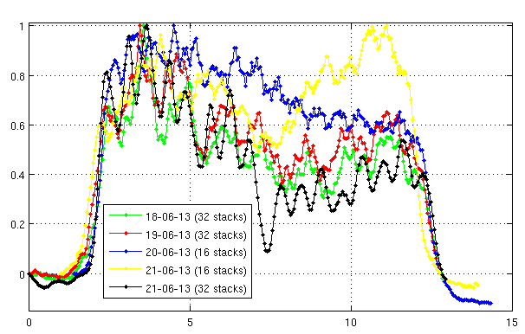
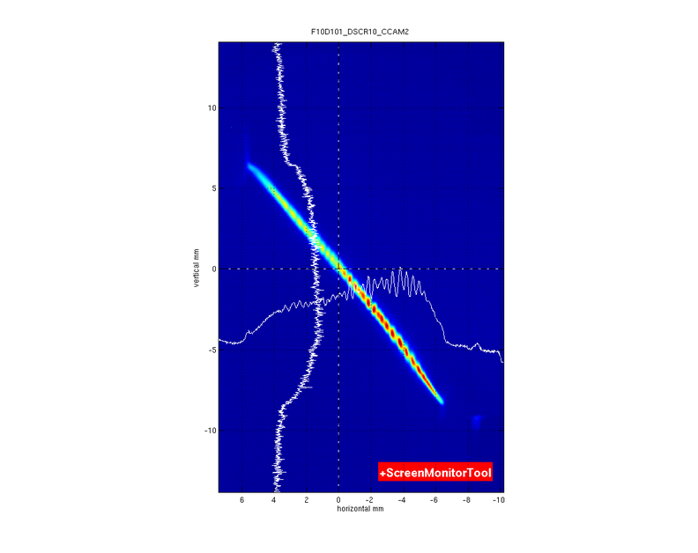
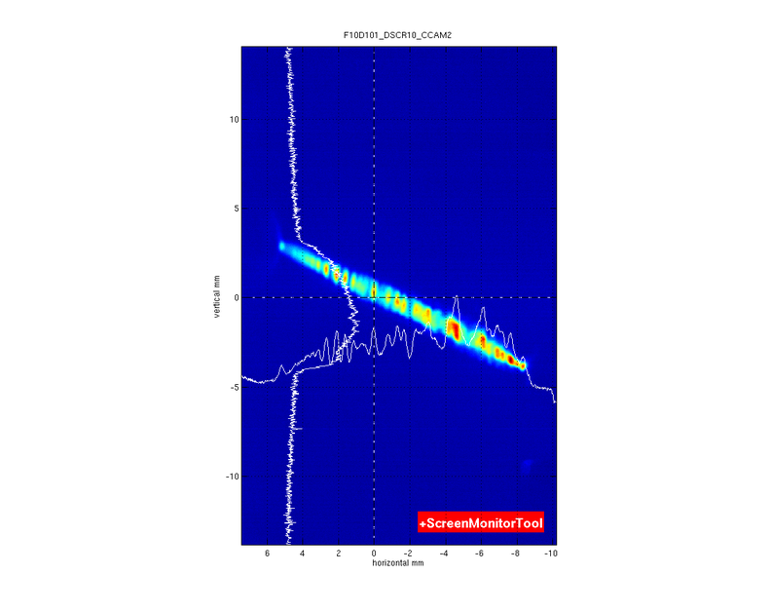
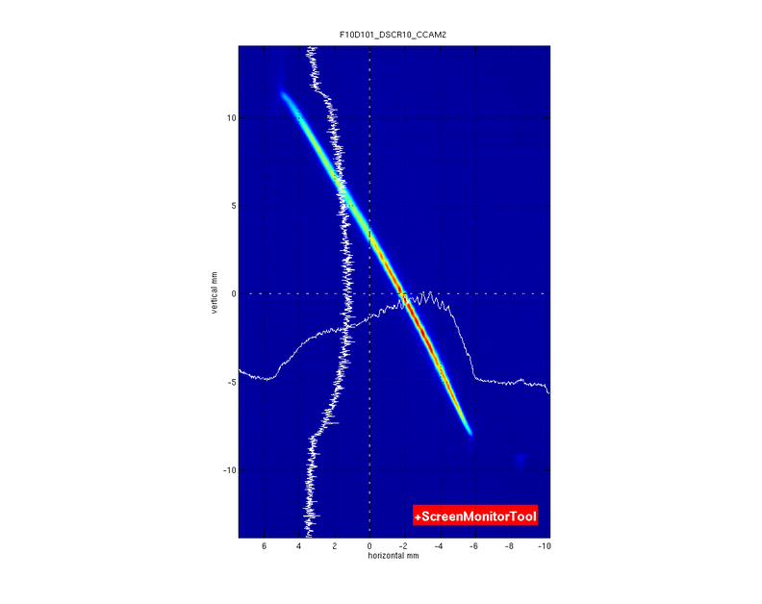



Compression and emittance preservation I
Longitudinal laser profile with pulse stacking ⇒ Ti-Saphire laser
First observation at SITF with copper cathodes and longitudinal laser shaping via pulse stacking
An energy band structure appears for compressed beams (similar to spike break up observed for nonlinear compression).
Structures on the longitudinal beam profile are converted into energy modulations via long. space charge interactions after compression.
Large uncorrelated energy spread and emittance growth. Filamentation not observed with Gaussian pulse
longitudinal axis
energy axis

Slide 41


Compression and emittance preservation II
First round of emittance measurements on compressed beams
Gaussian beam to prevent filamentations ⇒ OK
Compression factors between 5 and 10,
Significant increase in the core slice and energy spread
Similar to earlier observations made at FLASH and LCLS.
Bunch charge 200 pC
Beam energy 200 MeV
Bending angle 4.07 °
Energy chirp variable
s. Bettoni et al, Preservation of low slice emittance in bunch compressors, PhysRevAccelBeams.19.034402

Slide 42



Compression and emittance preservation III
Systematic experimental measurements at SITF show
Emittance growth independent from beam energy
Emittance growth increases with bending angle at constant compression factor
Strong influence of beam optic along the bunch compressor (one unit change in horizontal α function can induce 50% emittance increase
Beam with initial low emittance are more affected
s. Bettoni et al, Preservation of low slice emittance in bunch compressors, PhysRevAccelBeams.19.034402

Slide 43
Compression and emittance preservation IV
Numerical benchmarking
CSRTrack simulations reproduce qualitatively the experimental observations only if the 3D solver is use describe the electron interactions.
Conclusion:
Emittance dilution is due to 3D effects originating from coherent synchrotron radiation (other source are not excluded)
Emittance growth mitigation:
minimize the β function at the last two dipoles of the chicane (known recipe)
Careful tweaking of the optics (few % changes) along the BC using the last matching quads.
Other effects
Chromatic effect in the sections where the beam is carrying a large energy chirp (as in front of the compressor) induce a mismatch along the bunch ⇒ only a short part of the bunch fulfill the delicate beam optic conditions required to minimize the emittance dilution
A relaxed optic in the matching section preceding the BC is essential

Slide 44




Design SwissFELinjector I
The injector performances depeds on many different parameter as illustrated here above (beside the gun dimensions)
Automated optimizer ⇒ Matlab code running ASTRA simulation and optimizing the parameters
Invariant envelope matching is a good starting point but not necessarily the optimum
Gun was re-positioned in SITF for The PSI gun tests.
CTF Gun
PSI Gun in SwissFEL
PSI Gun in SwissFEL
s. Bettoni et al, Low emittance injector design for free electron lasers, PhysRevSTAB.18.123403

Slide 45


Design SwissFEL injector II
PSI-RF gun
7.1 MeV
Laser heater
Controlled increase of uncorrelated energy spread to reduce microbunching instability
Increase beam energy
Beam is more rigid before and after compression
Minimize transport section after BC1
Section where space charge effects are more important
16 m
150 MeV
Linac booster
Laser heater
55 m
345 MeV
Accelerating section (off crest)
X-Band
C-Band
RF module 1
90 m
321 MeV
C-Band
RF module 2
BUNCH COMPRESSOR
Emittance measurements
LINAC 1 first RF modules
Deflector

Slide 46
Lesson learned and conclusions
SITF provided a good background for the SwissFEL commissioning and optimization of key components! It was a necessary step toward SwissFEL.
Fast progress of beam developments when all required components are performing as expected.
The beam parameter required for SwissFEL are achievable. The shot to shot and long term stability required for the operation of user facility is a major challenge which were not extensively studied at SITF
The ultimate emittance values and in general the stability of the injector optimizations is mainly driven by the laser system and in particular by the transverse homogeneity. Important to allocate enough resources and instrumentation for the laser system. REDUNDANCE is essential.
Compression settings are critical. Emittance dilution is a 3D effect implying CSR and space charge. Design your injector for a relaxed optics!
Don’t underestimate the effort and resources going in the harmonic system.

Slide 47
Lesson learned and conclusions II
The ultimate emittance values and in general the stability of the injector optimizations is mainly driven by the laser system and in particular by the transverse homogeneity. For stable operation it is very important to allocate enough resources and instrumentation for the laser system. For SwissFEL a new (simpler) laser system was specified on the basis of the SITF results and purchased. REDUNDANCE is essential, two laser amplifiers are indispensable.
Cs2Te cathodes performs in term of emittance as good as copper. The advantages compensate largely the additional efforts to handle this technology:
  Larger QE
  Large response time smoothing the long. modulation of the laser pulse
  Remember Cu get as well damaged due to the larger fluence
Reported in this presentation a selection of aspects not entirely covering the huge efforts provided by the SITF crew. A conclusive (and long) paper illustrating in details the SITF project, hardware, designs and results will be submitted soon for publication

Slide 48


Impressions of SwissFEL
Start injector commissioning planned for mid/end-June 2016.
People interested attending?
18.10.2015

