Slide 1
ThomX X-ray source
Study of thermal effects in Fabry-Perot cavities
in the pulsed regime
Pierre Favier
Laboratoire de l’Accélérateur Linéaire
Fabian Zomer

Slide 2
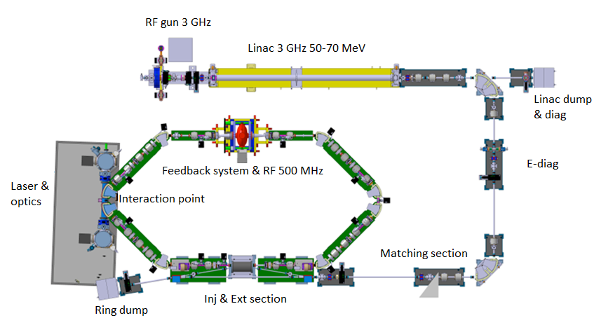
Compton X-ray source for societal applications
e⁻ + laser
e⁻ + X-ray
X-ray
f_{col} = 16,7 MHz

Slide 3
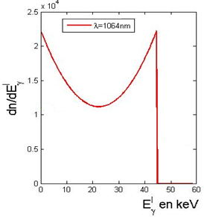
Compton sources: Principle
hn
Laser
X/g ray
Compton Back Scattering (CBS)
Electron
q
e⁻ + g_{laser}
e⁻ + X/g ray
Scattered electron
E_{electron}=50ΜeV
E_{X/g ray, max} ~ 4g_{e}² hn
hn  1,1 eV
~ 40 000 for 50 MeV electrons
Energy distribution (a.u.)
Powerful mechanism to boost photons
Ex/g in keV

Slide 4
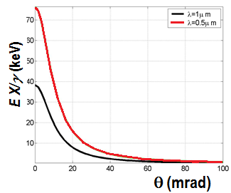
Compton sources: advantages & applications
Angular dependence
Wide energy range
E_{X/g ray} = f(q)
Diaphragm
X/g ray
Laser
Electron
q
Quasi mono-energetic beam
E_{X/g ray, max} ~ 4g_{e}² hn
($\frac{\text{D}E}{E}=$ 1-10%)
E_{X/g ray}
10 keV – 100 keV | 1 – 30 MeV | > 30 MeV
30 - 80 MeV | 0,26 – 1,4 GeV | > 1,4 GeV
Radiography, radiotherapy | Nuclear waste management | Polarized positron source
Art history | Nuclear physics | gg collider
E_{e}
Increase the size
of the accelerator
Applications

Slide 5
Practical use
low
s_{c}  0,5 barn
Main level arm
n_{x}  s_{c}$\frac{Ne\left(\frac{Plaser}{hvlaser}\right)\left(\frac{fcol}{vlaser}\right)}{4\text{p}\text{s}\text{x}\text{s}\text{y} }$
n_{x}  s_{c}$\frac{Ne\left(\frac{Plaser}{hvlaser}\right)\left(\frac{fcol}{vlaser}\right)}{4\text{ps}\text{x}\text{s}\text{y} }$
X-ray flux:
n_{x} = 10¹³ ph/s
Plaser = 600 kW
Societal applications
State-of-the-art laser + ampli: 500 W
Store laser power in a Fabry-Perot cavity
LAL best achievement : 100 kW
Limited by thermal effects

Slide 6
FABRY-PEROT CAVITIES IN THE PULSED REGIME
LASER
OPTICS

Slide 7
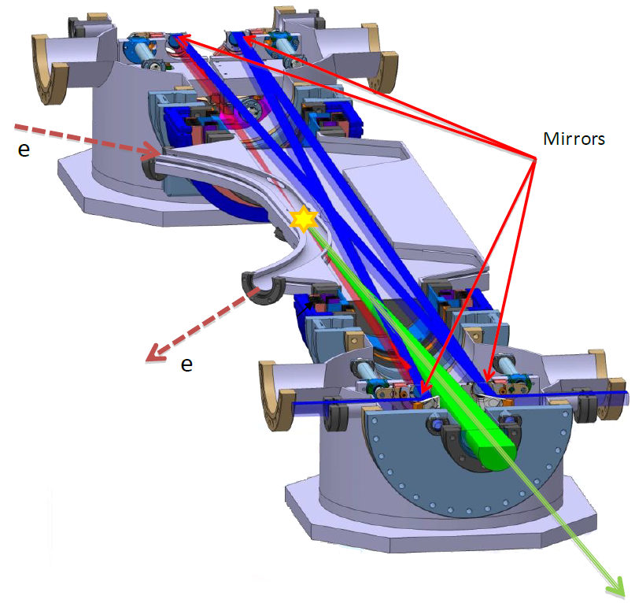
Fabry-Perot cavity
Two plane mirrors
Two spherical mirrors
Round-trip frequency
n₀ = 33,3 MHz
R&D
Cavity optical length: 9 m
Laser power: 50-100 W
Expected gain: 10 000
Thermal
effects
Expected stored power:
300 kW – 1MW
Requirements: 600 kW

Slide 8
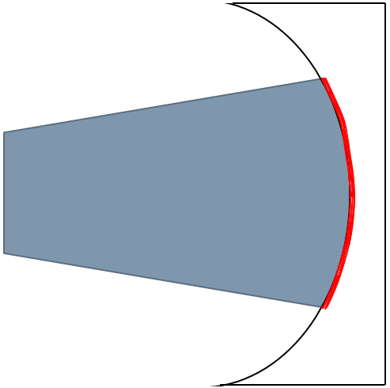
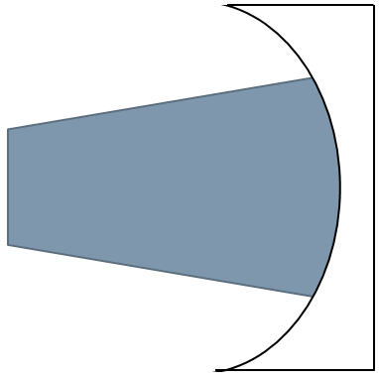
Thermal effects on the mirrors
Thermal expansion
Thermal lensing
Reflection
Transmission
Laser
Temperature gradient
in the coating
Temperature gradient
in the substrate
ds
ds
Variation of the index of refraction
Curvature variation
$$\frac{∂n}{∂T}≠0$$

Slide 9
Quantification of the thermal effects
Winkler model
W. Winkler et al. Physical Review A, 44(11) 1991
Thermal expansion coefficient
Thermal expansion
Absorption in the coating ~ 0,5-1 10⁻⁵
ds  $\frac{α}{4πκ}acPs$
Curvature change
Stored power
in the cavity
Heat conductivity
a,k, a only depend on the material
 | a (10⁻⁷ K⁻¹) | k (W/m/K) | ds (nm)
Fused Silica | 5,5 | 1,31 | 16,7
ULE | 0,1 | 1,38 | 0,29
For Ps = 500 kW
Cost…
Ultra Low Expansion glass

Slide 10
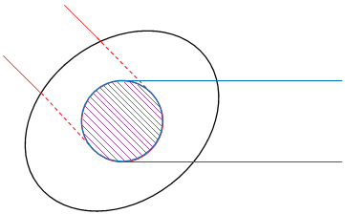
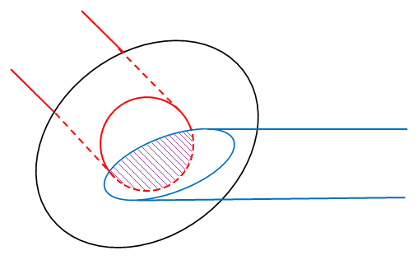
Coupling losses
Input laser beam
Spatial matching
Stored power decreases
Circulating
laser beam
Stored power = Coupling*Pmax
Perfect
Thermal effects
Coupling = ${\frac{1}{N}\left|\iint_{−∞}^{+∞}{EinE^{∗}circⅆxⅆy}\right|}^{2}$
Input laser beam
n_{x} = s_{c}$\frac{Ne(\frac{Plaser}{Eγ})(\frac{fcol}{frep})}{4 π σxσy}$
Circulating
laser beam
Elliptical modes
Deterioration

Slide 11
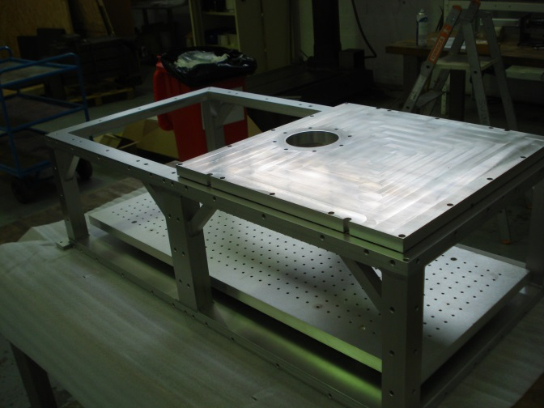
Conlusion and prospects
ThomX
Compton backscattering-based machine
Societal applications
High photons flux required
Thermal effects must be mastered
Analytic calculations
Simulations
Studies on prototypes
~ end 2015
ThomX installation (2016), electronics, commissioning (2017), first applications…

Slide 12
Thank you for your attention

