Slide 1
Analog and digital signal processing in the liquid argon calorimeter trigger system of ATLAS detector in the High-Luminosity LHC
PACHECO RODRIGUEZ Laura, SCHWEMLING Philippe, DESCHAMPS Hervé, ZONCA Eric
CEA-Saclay

Slide 2
Outline
LHC
ATLAS
Calorimeter trigger system
Calorimeter upgrade
Demonstrator project
Demonstrator Data Analysis
LTDB development
Results & perspectives

Slide 3
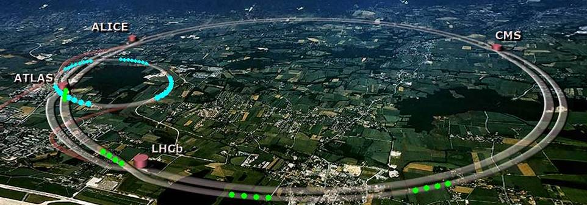
Large Hadron Collider (LHC)
Built by the European Organization for Nuclear Research (CERN)
First operation in 2008
Proton-proton & Pb-Pb collisions at 40MHz
Center of mass energy 14 TeV
Luminosity: L = 10³⁴ cm⁻²s⁻¹

Slide 4
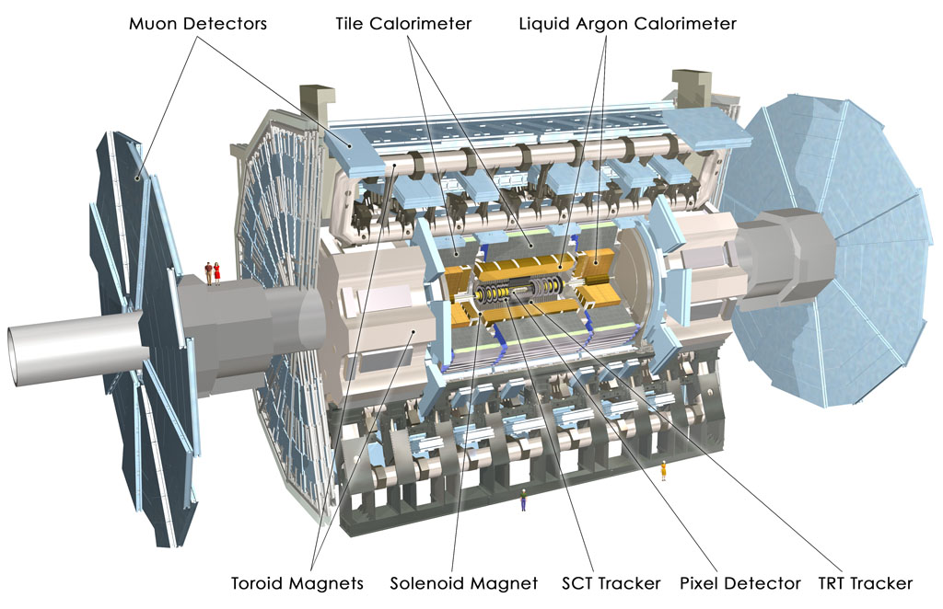
ATLAS
A Toroidal LHC ApparatuS
General detector:
investigate Higgs boson (identified in 2012),
provide EW symmetry breaking details,
search of extra dimensions, look for new physics…
Sub-detectors
Inner detector. Tracker
Muon Spectrometer. Tracker
Calorimeter.
Liquid Argon Calorimeter.
Liquid argon as active medium.
Measure the E_{T} deposited by electrons & photons.

Slide 5
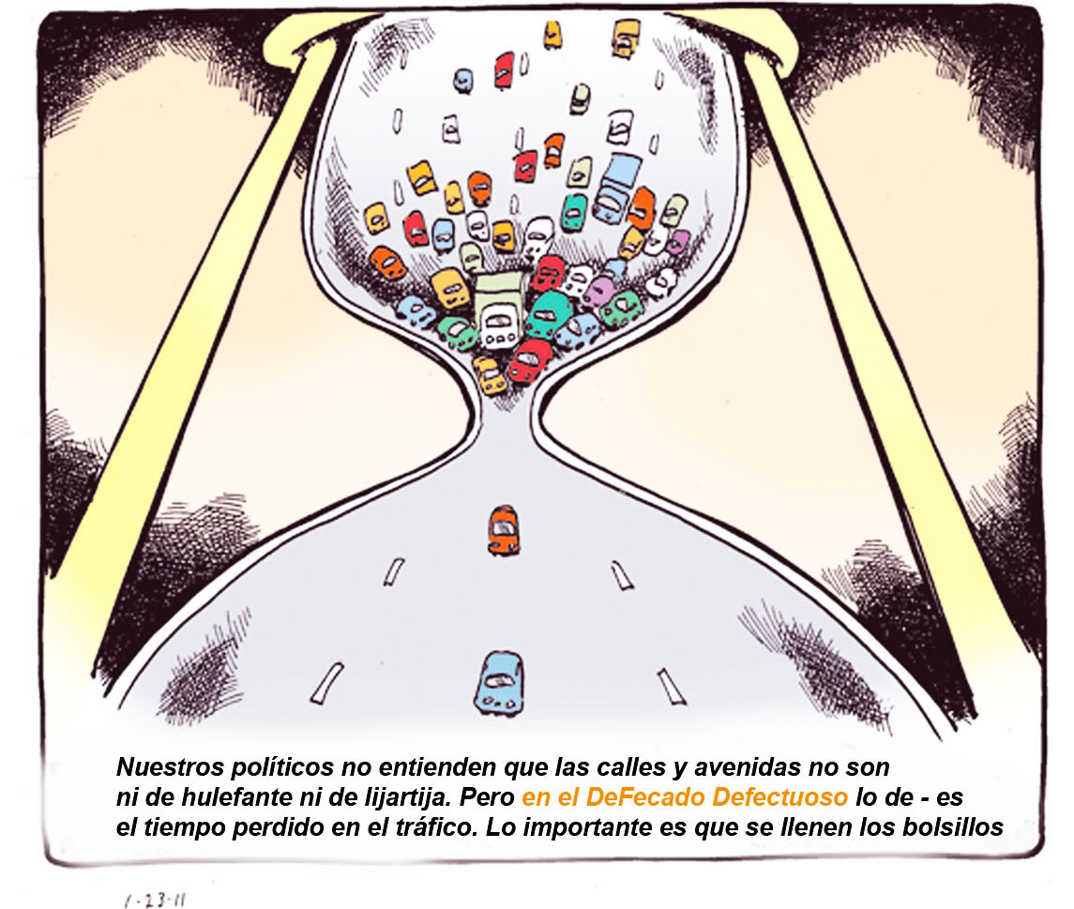
Calorimeter trigger system
1 event ~ 1.6MB of data → ~petabytes/s if ALL events were recorded.
Impossible to manage!
→ Trigger: Selector of events before recording.
CRITERIA OF SELECTION IN CALORIMETER: Energy deposited > E_{T} threshold?
Luminosity will increase in next years:
Run 3 (2021) 2 x nominal luminosity L_{nominal} = 10³⁴cm⁻²s⁻¹
HL-LHC (2026) 5 to7 x nominal luminosity
MORE LUMINOSITY → MORE DATA → HIGHER TRIGGER RATE
ATLAS trigger bandwith won’t be able to manage all that data!
FIND A WAY TO DECREASE TRIGGER RATE
Increase E_{T} threshold ?
Implement an additional criteria of selection

Slide 6
LAr Calorimeter Upgrade
Calorimeter Trigger rates dominated by background (QCD jets) → Produces fake triggers
QCD jets distinguishable from EM particles if looking at shower shape.
NEW TRIGGER CRITERIA: LOOK AT ENERGY DEPOSITION SHAPE
Implementation.
Increase spatial resolution of calorimeter, new calorimeter segmentation (Super cells) → Develop new electronics
Develop algorithms of shower shape analysis.
Shower shape variables:
Rn, wn,2 and f3
Resolution increased 10 times
Trigger rates vs ET threshold for Run 2 (blue) and Run 3 for two sets of shower shape variables (green and black),
BEFORE
AFTER UPGRADE

Slide 7
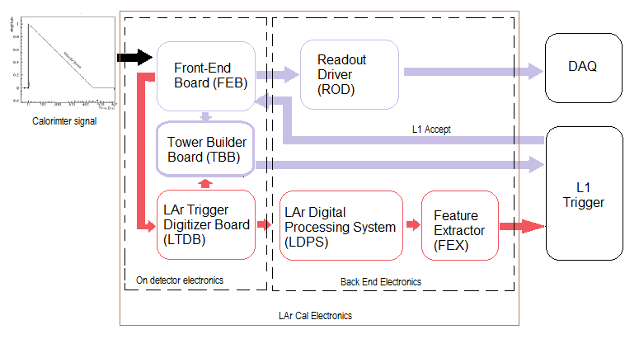
Demonstrator Project
First Implementation of LAr Calorimeter Upgrade for test
Σ
My PhD work is focused on
Testing performances of LTDB
Demonstrator
Data Analysis
(CERN)
Electronics Development
(CEA)
LAr trigger readout architecture
In violet current trigger chain
In red new trigger chain
Installation in summer 2014

Slide 8
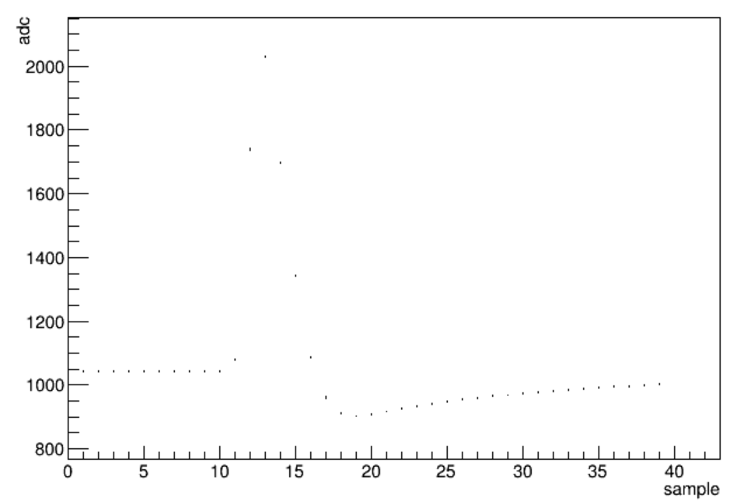
Demonstrator Data Analysis
Useful for…
Comissioning demonstrator (electronics & readout firmware)
Measuring demonstrator performances
DATA TAKEN:
Calibration runs
Physics runs during Run 2 (2015)
PP runs ~91 000 events
HI runs ~360 000 events.
Prepared for 2016 ATLAS data
Pulse from pp collision
Port …18:2
DAC value 1500
Signal Amplitud
[ADC counts]
Time, units of 25ns
Data Analysis done up to now
Detection of data taking problems (channel connectivity, errors in transmission, readout files issues) → Firmware readout & Electronics development oingoing
Pulse reconstruction
Linearity response
ATLAS readout & Demonstrator readout comparison

Slide 9
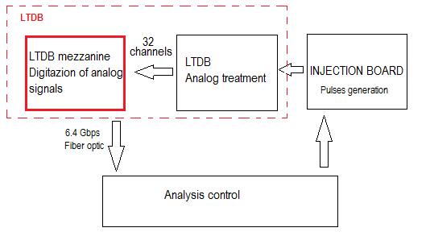
LTDB Development
LTDB:
Analog Treatment Part designed and implemented by CEA Saclay
Performance tests are required:
(noise, cross-talk, linearity, pedestal stability, pulse shape, saturation efects…)
Impossible to test it directly in its real environment
(ATLAS detector, no acces)
Need for a test bech (laboratory system test)
→Instrumentation boards to be designed:
Injection Board
Digitization Board
Digitization board:
Conversion Analog to Digital of super cells signals.
Selirialization and transmission
FPGA programation and simulationOK
Implementing demo systemOK
Implementing Board ongoing

Slide 10
Results
Data taking analysis has allowed the commissioning of Demonstrator System (still ongoing)
LTDB Digitalizer Board was designed and some stages were successfully tested by simuation and implementation. PCB Fabrication is oingoing.
Perspectives
Forthcoming pp collisions from ATLAS will produce more demonstrator data for continuing analysis works.
We expect LTDB Digitilizer board will be ready in next months to start testind demonstrator performances.

Slide 12
BACK UP

Slide 13
LTDB Development
Mezzanine LTDB Main Specifications:
Digitization
Sampling 32 channels at 40MHz (Frequency of collisions)
Scale digitizacion in the order of calorimeter noise (32MeV & 125MeV depending of the region on calorimeter)
ADC 16-bit dynamic range (for E_{T} values up to 102 GeV and 400 GeV)
Serialization and transmission
Serialize 32-ch parallel data to 1 single channel
Optical transmition with low error transmission rate.
Power
Low power consumtion (<15W whole LTDB)
Two power lines: 2.5V and 3.3V available.
Others
10 Mezzanines for LTDB (32 x 10 = 320 channels)
Uses LHC TTC signals for synchronization (CLOCK, BCR -bunch crossing reset-)
Design solutions:
Digitization by ADC LTM9006-14 (x4)
8-Channel Simultaneous Sampling,
40MHz, Low Power, LVDS signals.
Serialization and transmission by FPGA Artix 7.
8b/10b SerDes Parallel In Serial Out (PISO)
SFP + Transceiver at 6.5Gbps for data transmission.
Configured with Vivado Software.
Power
LDO regulators and Power-on sequencing
Others
Clock distribution: Jitter attenuator, LVDS fanout Buffer, XTAL
Flash memory for configure FPGA
JTAG programation

Slide 14
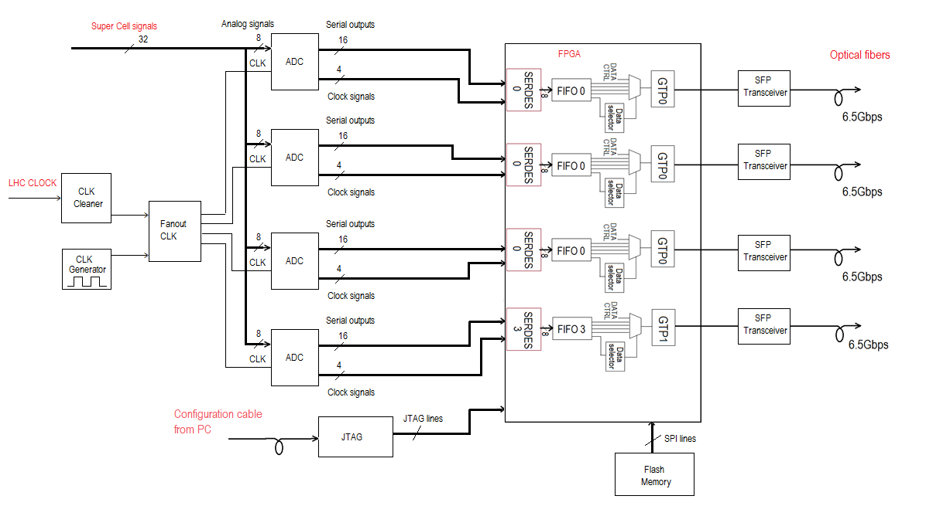
LTDB Development
Developments ongoing, prepearing for first Prototype at the end of 2015
ATLAS Validation until end of 2018
Full Calorimeter Installation at end of 2019
FPGA programation and simulation
ModelSim Simulator.
Timing constraints & Data Serialization OK
Implementing demo system
ADC demo board (DC1751)
FPGA demo board (AC701)
Optical link transmission OK.
Digitalization & Serialization OK.
Flash memory & JTAG programation OK
Implementing Board
FPGA programation for 4 ADCs ongoing
Electronic schematic verification state
PCB routing ongoing
PCB cablling not started
Test & verification not started
Simplified block diagram of LTDB Digitalization board

Slide 16
LAr Calorimeter Upgrade
Resolution increased 10 times:
Longitudinal segmentation in 4 layers (PS, Front, Middle, Back)
Finer resolution in n and φ region for 2 & 3 layers.
Quantization scale
High precision (level of noise)
125 MeV in the middle layer and 32 MeV elsewhere.
(compared to 1GeV for Run2)
Analog part
Digital part

Slide 17
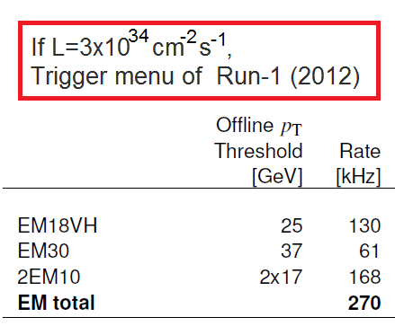
Trigger system
Instantaneous Luminosity increases:
→ increase number of interactions per bunch crossing (µ): 40 [Run 1] —> 50 [Run 2] —> 80 [Run 3]
increase occupancy (more fakes (non-physics) trigger)
EM Calorimeter triggers:
→ Selection of EM objets (photons, electrons, T leptons)
Expected to increase linearly with L.
L1 trigger rate is limited to 100kHz!!

Slide 18
LAr Calorimeter Upgrade
Facts:
In high luminosity impossible to do a trigger selection as in Run 1 (limited rate at 100kHz).
Need to keep low thresholds for single leptons for a possible new physics signatures.
Trigger rates dominated by QCD jets background.
Solution. Decrease L1 trigger rate by improving trigger selection.
QCD jets rejection. Using shower shape information (NOT ONLY energy information as currently)
Improving energy reconstruction algorithms.
Implementation.
Increase spatial resolution of calorimeter, new segmentation in Super cells → Design new electronics
Develop algorithms of shower shape analysis and energy reconstrucion.
Shower shape variables:
Rn, wn,2 and f3
Resolution increased 10 times
L1 rates vs EM ET threshold for Run 2 (blue) and Run 3 for two sets of shower shape variables (green and black),
BEFORE
AFTER UPGRADE

