Slide 1
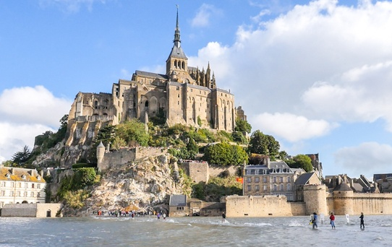
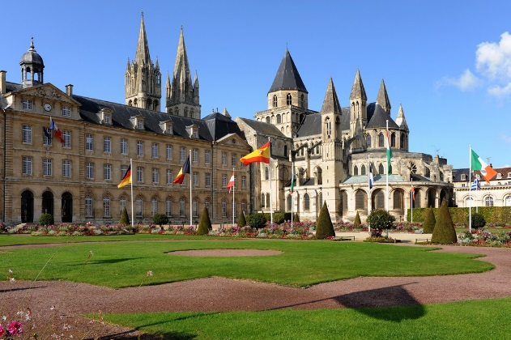
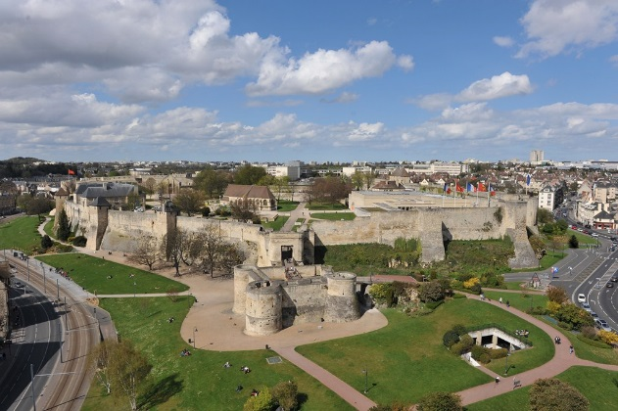
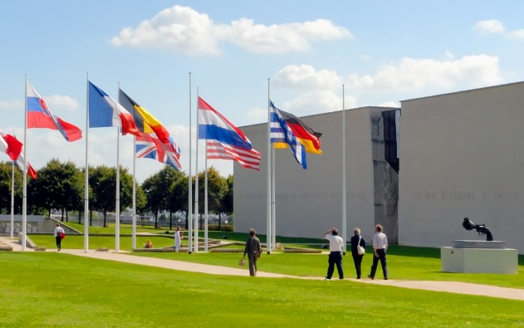
IPAC 2020
Caen-Normandy Candidacy

Slide 2
France bid for IPAC20 The selection process
IPAC 2020
3 villes : Caen, Strasbourg and Lyon
Candidature unifiée pour toute la communauté française des accélérateurs (CEA, CNRS, SOLEIL, ESRF)
Tous les partenaires s’engagent avec CAEN pour supporter le LOC (Local Organising Committee)

Slide 3
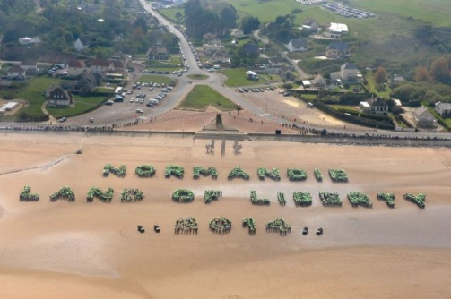
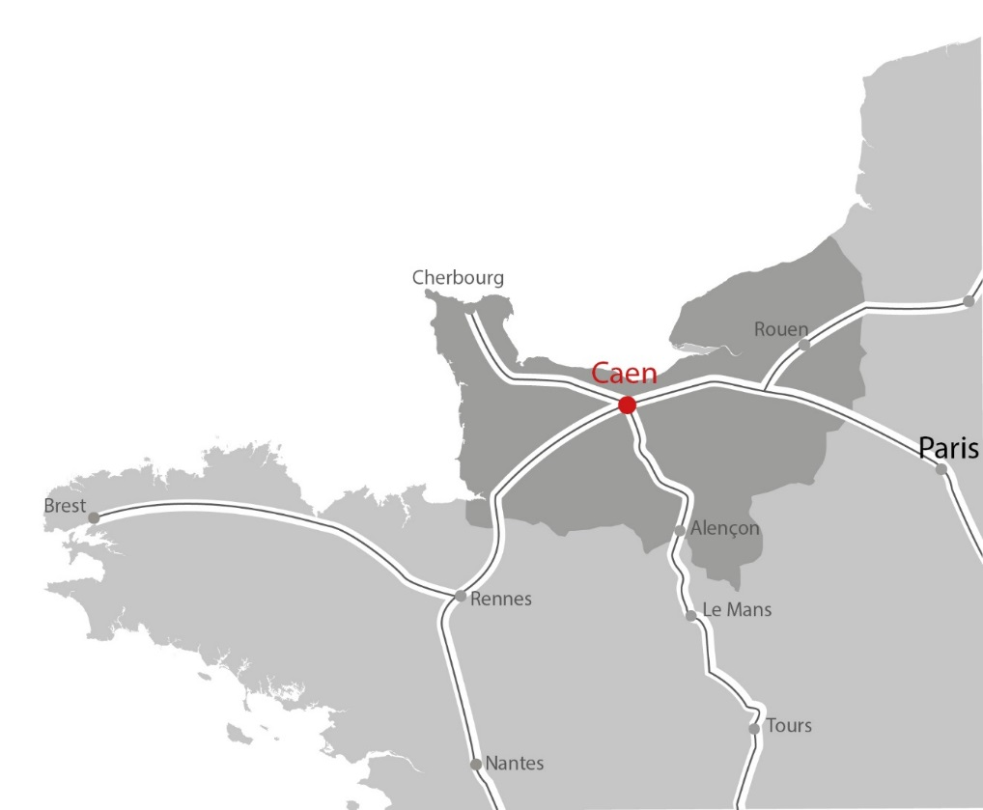
Welcome to Normandy
IPAC 2020
Located in North-West of France
Strong history heritage
Numerous places to visit and discover
The second touristic region most known in the world !

Slide 4
IPAC 2020
Welcome to Caen
« City of Art and History » label
Exceptional environment : marina, green areas in city centre…
Gastronomic destination
Home of innovation and creativity
Joël BRUNEAU, Mayor of Caen

Slide 5
IPAC 2020
GANIL, strongly involved in the IPAC20
SPIRAL2
Cyclotrons
Large National Heavy Ion Accelerator

Slide 6
Visit GANIL / SPIRAL2
IPAC 2020
only at 10 minutes from the Conference Centre
In term of accelerators :
5 cyclotrons
A superconducting linear accelerator SPIRAL2
12 rooms of experiences and detectors and spectrometers
GANIL facilities visits :
A great tradition : each year GANIL opens its doors to 700 visitors on one day.
Florent STALEY, GANIL Director

Slide 7
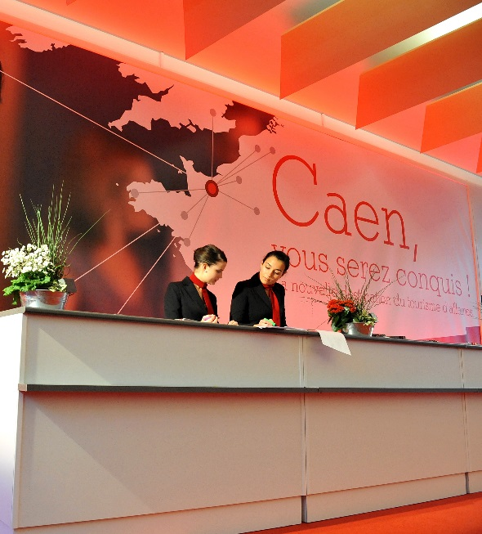
Caen’s Congress Centre
IPAC 2020
Delegate’s registration
Accommodation management
Airport and train shuttles
Social program creation
General coordination and support
Our mission :
Make your Conference a Success !

Slide 8
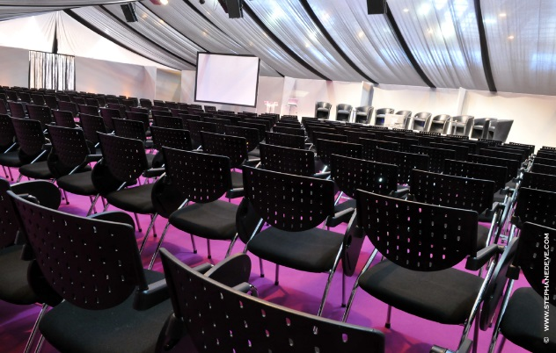
Conference Centre
IPAC 2020
Centrally located
Easy access to city center
3 flexible main rooms
Offering up to 170,000 square feet of space
Renovated in 2014
Highly motivated, accessible and professional staff

Slide 9
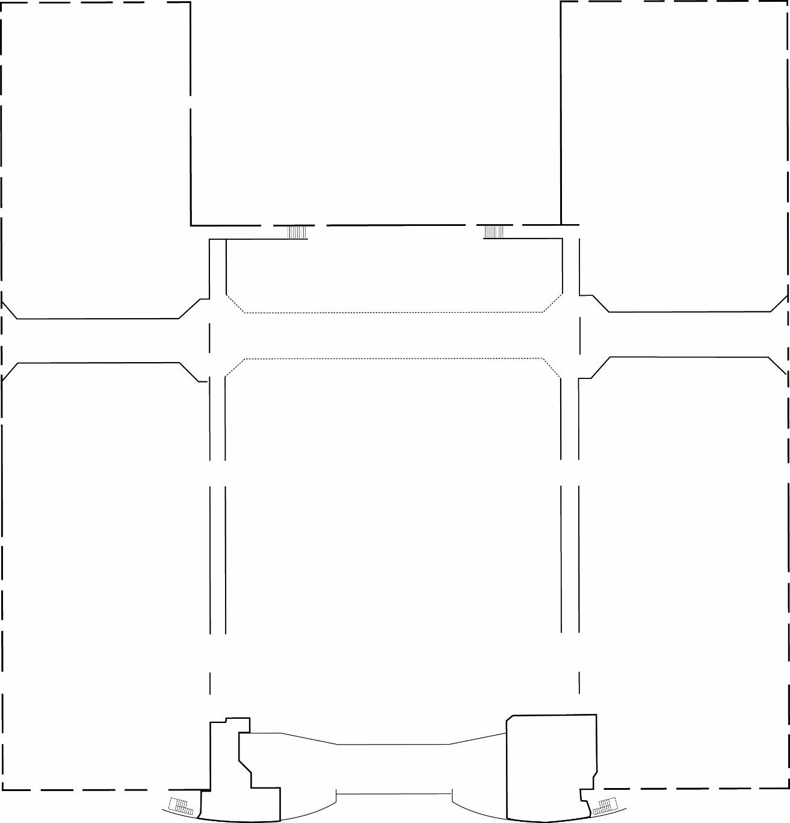
IPAC 2020
HALL 2
Reception desk
Organizer office : 150m²
Main entrance
Equipments
RECEPTION
HALL 3
OFFICE
E N T R A N C E
HALL 1

Slide 10
IPAC 2020
HALL 2
PLENARY ROOM
1300 delegates meeting room
Christie 15000 lumens
4 side screens
Fibre optic transmission
Technical director and video, sound & lights technicians
RECEPTION
HALL 3
OFFICE
E N T R A N C E
HALL 1

Slide 11
MEETING ROOMS
150 delegates
AV technician staff
MEETING
ROOM
600 delegates
Panasonic 5000 lumens
2 side screens
IPAC 2020
HALL 2
PLENARY ROOM
1300 persons
RECEPTION
HALL 3
OFFICE
E N T R A N C E
HALL 1

Slide 12
IPAC 2020
CONVERTIBLE
MEETING ROOMS
150 persons
MEETING
ROOM
600 persons
HALL 2
PLENARY ROOM
1300 persons
EXHIBITION AREA
6000 m²
380 posters
100 stands
RECEPTION
HALL 3
OFFICE
E N T R A N C E
HALL 1

Slide 13
IPAC 2020
CONVERTIBLE
MEETING ROOMS
150 persons
MEETING
ROOM
600 persons
HALL 2
PLENARY ROOM
1300 persons
EXHIBITION AREA
380 posters & 100 stands
RESTAURANTS
RECEPTION
3 restaurants
French specialities
HALL 3
OFFICE
E N T R A N C E
HALL 1

Slide 14
Accommodation
IPAC 2020
Categories | Hotel capacity
 | Number of hotels & residences | Number of rooms
Hotels & Residences 5* | 1 | 19
Hotels & Residences 4 * | 6 | 537
Hotels & Residences 3* | 16 | 1064
Hotels & Residences 2* | 21 | 989
Hotels & Residences 1* | 5 | 286
Economic Hotels & Residences | 8 | 171
Total capacity | 57 | 3066

Slide 15
2,5 km between conference centre
and city centre hotels
IPAC 2020
2,5 km
Conference centre

Slide 16
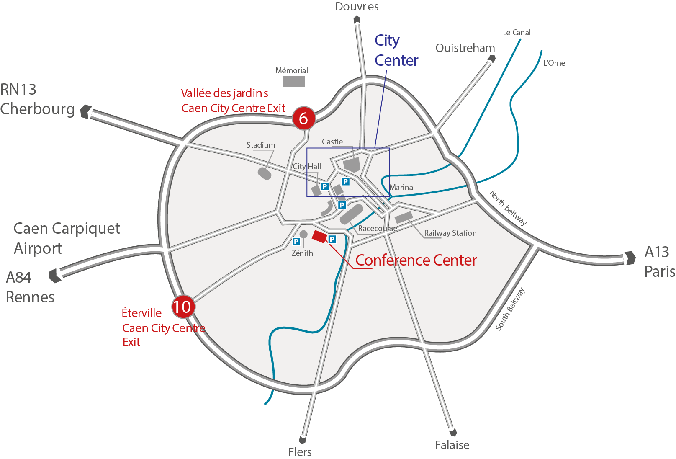
Access to Caen
IPAC 2020
1h45 from Paris St Lazare Railway Station Direct bus line from Caen Railway Station to the Conference Centre & City Centre
1h15 London / 1h15 Lyon Airport at 10 minutes
2 hours from Paris
Great Britain Harbour station at 15 minutes from Caen

Slide 17
Circulate in Caen
IPAC 2020
Bus & tram network
Direct bus lines to the Conference Centre : 8-11*-18-22-29-BV 9 - BV 10 (*direct from the railway station) - 4-15-23- BV 12
Ticket 1,45 €
Group 1,09 €
3 days pass 7,90 €
Véol : 40 stations and more than 350 bicycles
Private shuttles from the hotels to the conference center

Slide 18
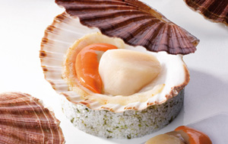
IPAC 2020
French and Norman Gastronomy
Normandy is Haute-Cuisine Heaven for food lovers
More than 300 traditional and specialized restaurants
3 Star chefs in Caen
Famous normand specialities

Slide 19
IPAC 2020
Welcome cocktail and Chairperson dinner
The Men's Abbey, City Hall of Caen
Le Grand Hôtel of Cabourg
Le Domaine de la Baronnie

Slide 20
Social program
IPAC 2020
Historic Sites and Monuments
World heritage UNESCO
Guided tour themes :
D-Day
William the Conqueror
Impressionism
Architecture
Gastronomy

Slide 21
IPAC 2020
IPAC 2020
Welcome to Caen – Normandy!

Slide 22
Prochaines étapes
Constitution du groupe de travail
Comité local GANIL
CEA :Pierre Védrine et Antoine Dael (industrie)
CNRS : JL. Biarrote
Caen Event et bureau des Congrès de Caen
Préparation venue du Scientific Program Committee (SPC)
A Caen du 19 au 20 janvier 2017
25 personnes
Visite du site
Etablissement de la liste des fonctions (cf IPAC17) et Participation des autres laboratoires

