Slide 1
Energy deposition
around
the conventional source target
- an update -
T. Takahashi
Sep. 15 2016
PosiPol2016

Slide 2
Contents
Motivation
at LCWS2015
Update
a realistic geometry
Geant4 and FLUKA
Summary

Slide 3
Why
Energy deposition on the
Target
Flux concentrator booster linac
A major issue for the (conventional) positron targets,
cooling
radiation shielding.
We need precise estimate.

Slide 4
At LCWS2015 in Whistler
Using a simple model to get a rough estimate
Geant4 simulation
Particle tracking with some level
Standing wave RF no beam loading effect.
FC: a cone
Cu
RF structure: a solid tube Cu
W
Target

Slide 5
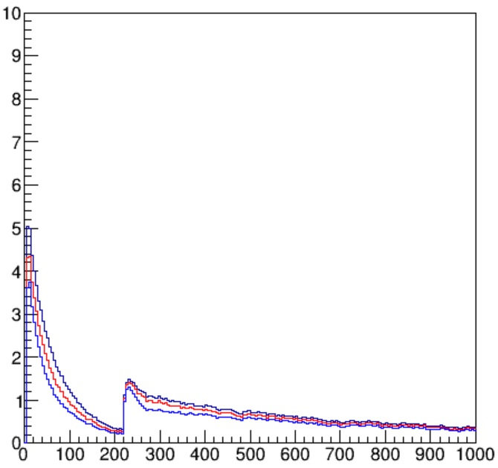
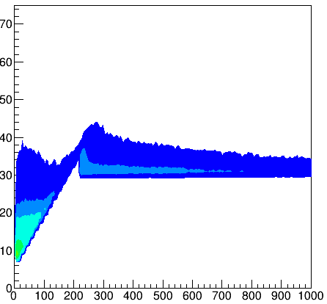
Ee = 4.8GeV, target thickness 16 mm sigma of E beam = 3.5mm
kw/cm
energy deposit
total
inner 20 mm
inner 10 mm
yield: 1.55e+/e-
PEDD 30J/g
67kW in first 1.27 m
energy deposit density
kW/cm^3
2.5
r(mm)
2.0
1.5
1.0
0.5
0.1
1.0kW/cm^3
0.05
0.01
z (mm)

Slide 6
Summary and outlook at LCWS2015
Energy deposition
normalized for 3.0×10¹⁰ e+/bunch after capture linac
E electron (GeV) | P electron (kW) | sig electron (mm) | PEDD target (J/g) | E dep. Target (kW) | E depo. FC (kW) | E dep. Acc (kW) | E dep. Acc 1.27m (kW)
6.0 | 292 | 4.0 | 27 | 40 | 42 | 186 | 92
4.8 | 292 | 4.0 | 27 | 46 | 43 | 128 | 76
4.8 | 193 | 3.5 | 29 | 39 | 32 | 113 | 65
Should energy deposition around the target
cooling, temperature control
need to put more realistic geometry in the simulation

Slide 7
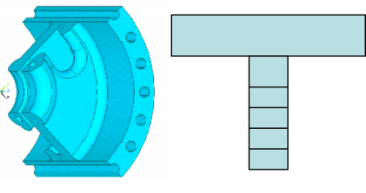
Going to a realistic geometry
SLAC-PUB-11766

Slide 8
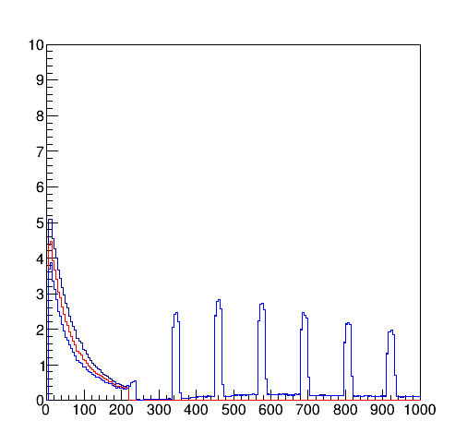
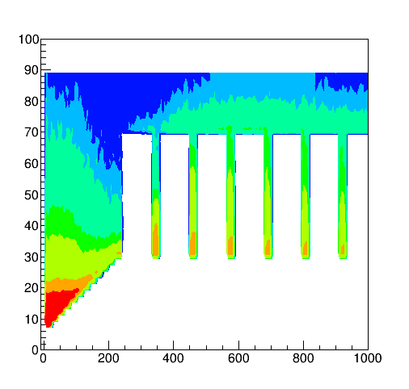
Ee = 4.8GeV, target thickness 16 mm sigma of E beam = 3.5mm
kw/cm
energy deposit
energy deposit density
kW/cm^3
yield: 1.55e+/e-
PEDD 30J/g
67kW in first 1.27 m
r(mm)
1.2kW/cm^3
z (mm)

Slide 9
Geant4 VS FLUKA
Geant4
Electromagnetic and nuclear interaction
Particle tacking with time dependent EM fields
No common tools to estimate radiation dose or residual activities
FLUKA
Electromagnetic and nuclear interaction
Limited particle tacking in time the EM fields
Tools to estimate radiation dose or residual activities available
Hope FLUKA is available for radiation estimates

Slide 10
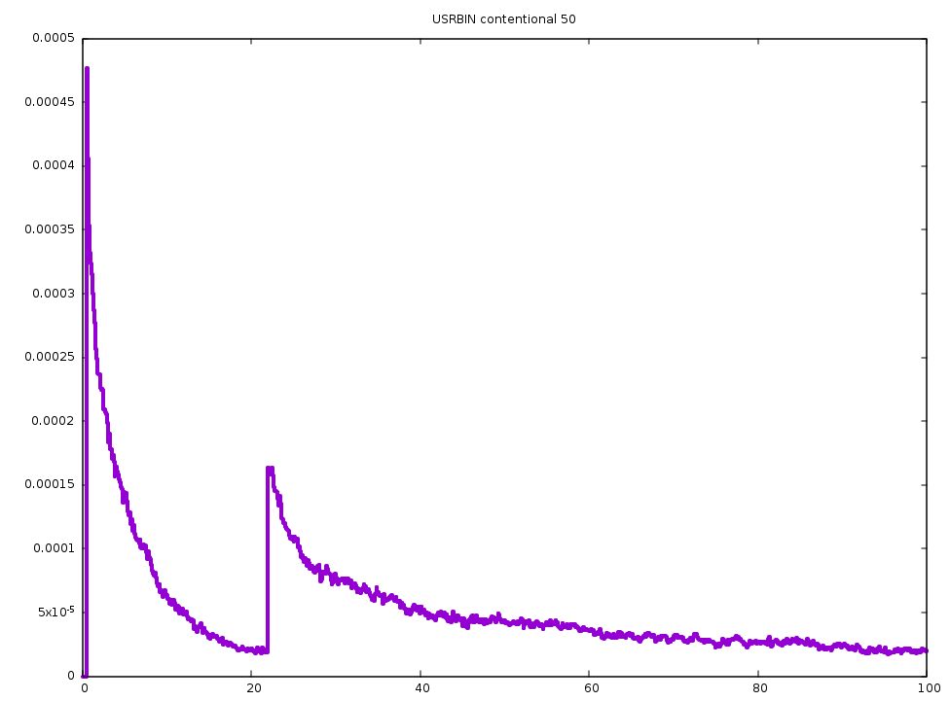
Comparison of G4 and FLUKA
Geant4
FLUKA
ｚ(mm)
0
200
400
600
800
ｚ(mm)

Slide 11
Summary and Plan
Tracking simulation with Genat4
progress with an realistic geometry but
does not have dose estimate tools
detailed study, incl. beam loading etc, is in progress
FLUKA is working
energy deposit is consistent with G4 even w/o EM fields
dose have dose/residual activity estimate functionality
I got some results and try to understand them
Radiation estimates w/ FLUKA seems reliable
put detailed geometry
shielding study

Slide 12
Comparison of G4 and FLUKA
Geant4
FLUKA

