Slide 1
Production of Highly Polarized Positrons
From
MeV Polarized Electrons
PEPPo
Eric Voutier on behalf of the PEPPo Collaboration
Institut de Physique Nucléaire d’Orsay
Orsay, France
Physics motivations
Polarized positron production
The PEPPo experiment
PEPPo measurements
Perspectives
POSIPOL 2016 Workshop
Orsay, September 14th-16th, 2016

Slide 2
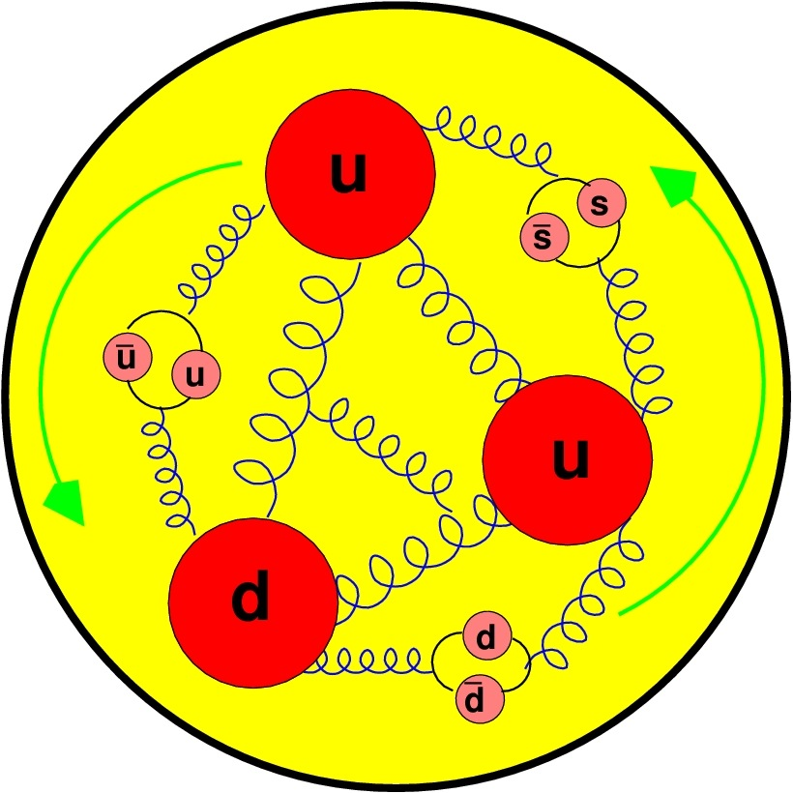
Physics Motivations
Two-photon physics (U,P)
Generalized parton distributions (U,P)
Strange/Charm parton distributions (U,P)
Spin dependent EMC effect (U,P)
Search for the U-boson coupling to dark matter (U,P)
Charge conjugation violation to access C_{3q} (P)
Thermal positron facilities (U,P)
Interference
Physics
Charge Current
Physics
Standard
Model Test
Positron
Applications
Orsay, September 14-16, 2016
2/19

Slide 3
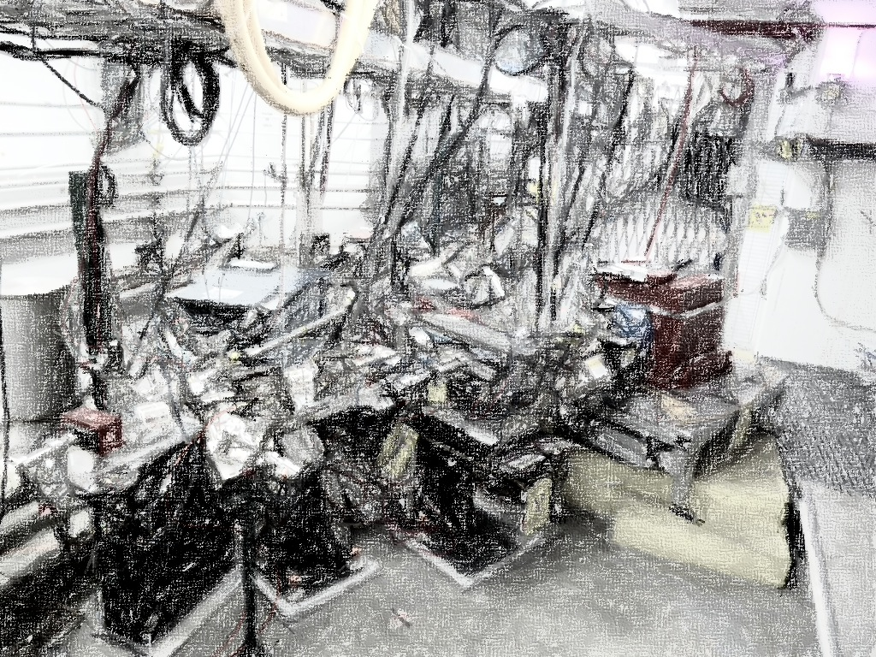
Polarized Positron Production
Polarization transfer physics
Polarized bremsstrahlung
Orsay, September 14-16, 2016

Slide 4

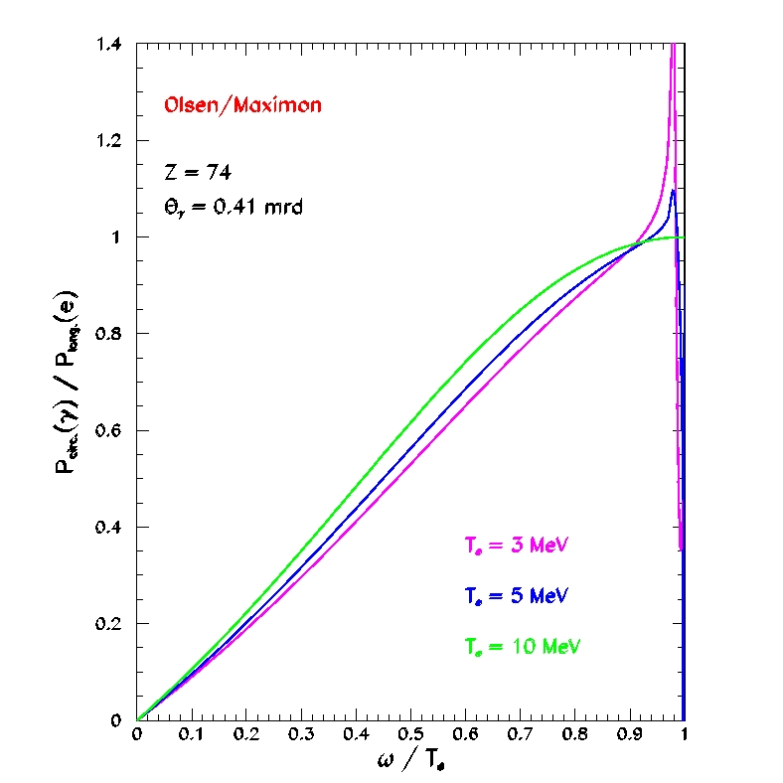
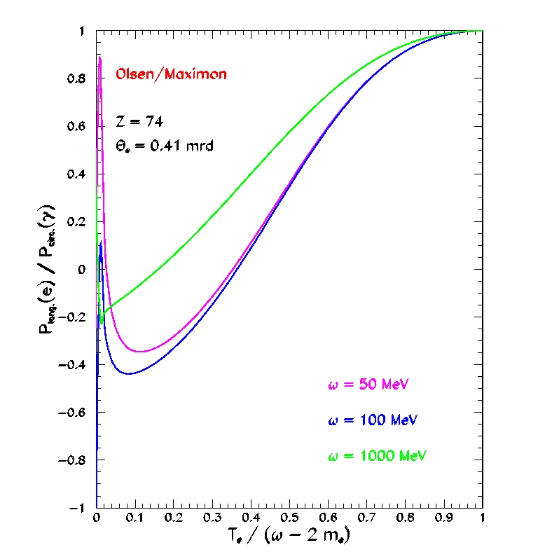
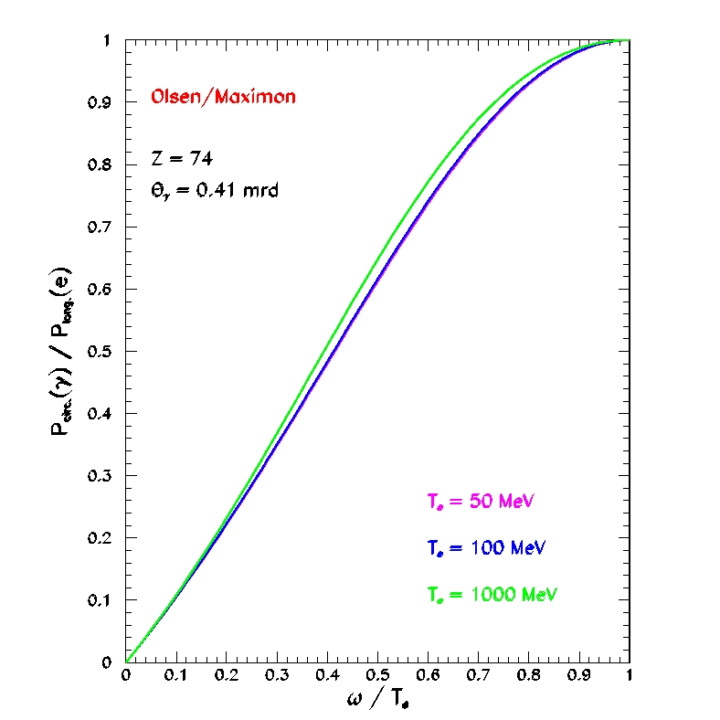
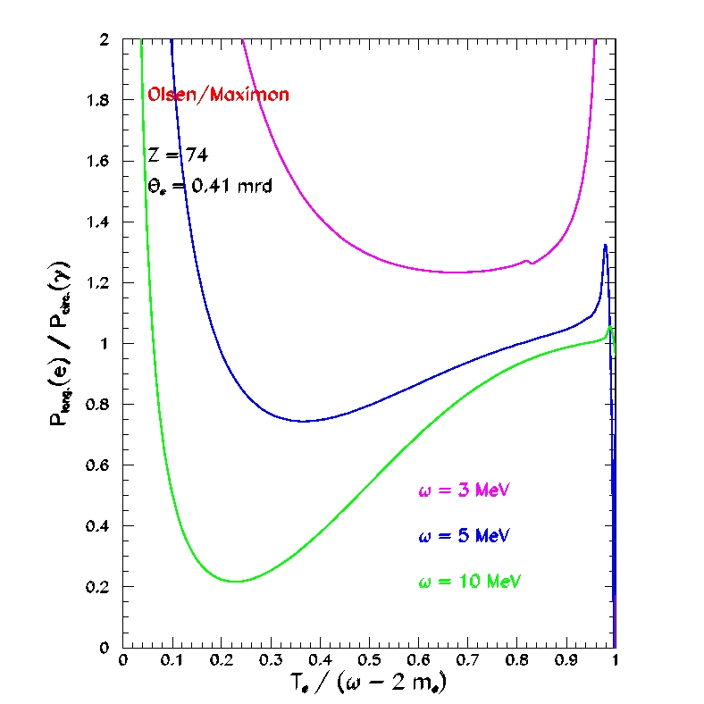
Ultra-relativistic approximation
Eric Voutier
Bremsstrahlung and Pair Creation
H. Olsen, L. Maximon, PR114 (1959) 887
The most currently used framework to evaluate polarization transfer for polarized bremsstrahlung and pair creation processes is the O&M work developped in the Born approximation for relativistic particles and small scattering angles.
BREMSSTRAHLUNG
PAIR CREATION
Orsay September 14-16, 2016
4/19

Slide 5

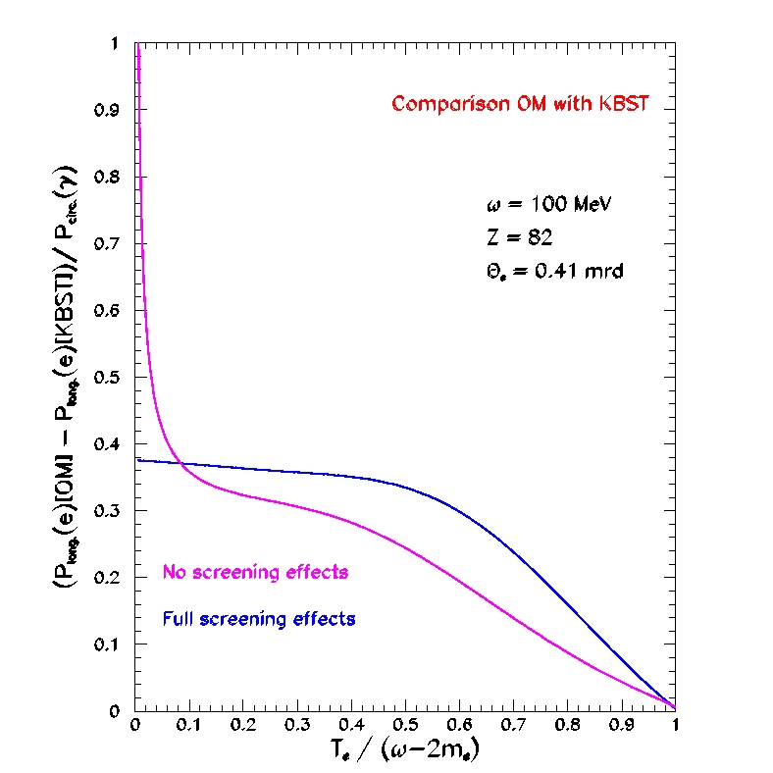

Polarization transfer physics
Eric Voutier
Bremsstrahlung and Pair Creation
E.A. Kuraev, Y.M. Bystritskiy, M. Shatnev, E. Tomasi-Gustafsson, PRC 81 (2010) 055208
These reference processes have been revisited considering the finite mass of the leptons, generating additional terms to the leptonic tensor.
BREMSSTRAHLUNG
PAIR CREATION
Orsay September 14-16, 2016
5/19

Slide 6

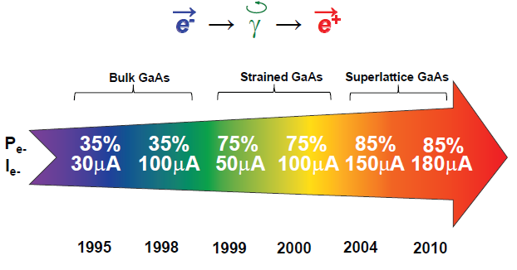
Photon circular polarization transfer
Eric Voutier
Polarized Bremsstrahlung
J. Grames, E. Voutier et al., JLab Experiment E12-11-105, 2011
E.G. Bessonov, A.A. Mikhailichenko, EPAC (1996) A.P. Potylitsin, NIM A398 (1997) 395
e⁻ → γ → e⁺
The purpose of the PEPPo (Polarized Electrons for Polarized Positrons) experiment at the CEBAF injector was to demonstrate feasibility
of using bremsstrahlung radiation of polarized electrons
for the production of polarized positrons.
Sustainable polarized electron intensities up to 4 mA have been demonstrated
from a superlattice photocathode.
R. Suleiman et al., PAC’11, New York (NJ, USA), March 28 – April 1, 2011
Orsay September 14-16, 2016
6/19

Slide 7
PEPPo Experiment
Proof-of-principle experiment
PEPPo operation
Electron & positron polarimetry
Orsay, September 14-16, 2016

Slide 8
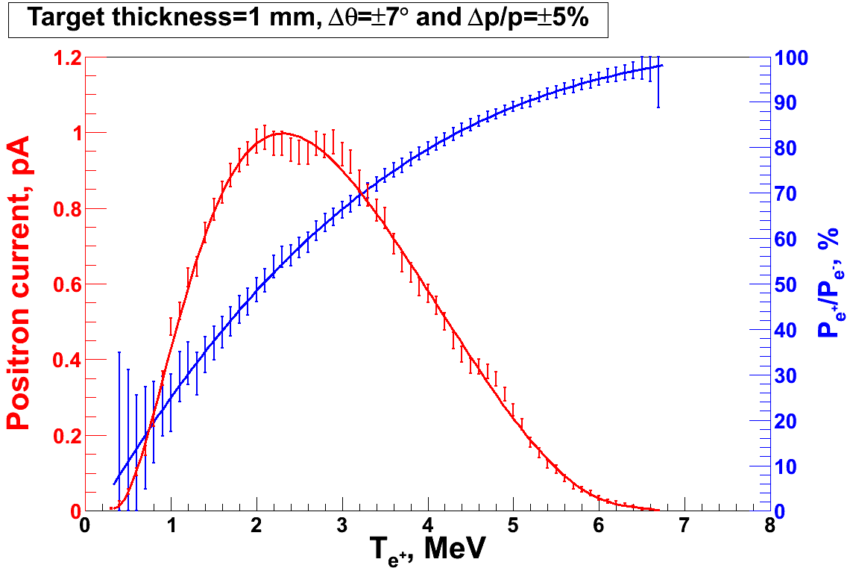
Proof-of-principle experiment
Eric Voutier
Principle of Operation
Polarized Electrons
(< 10 MeV/c) strike production target
Positron Transverse and Momentum Phase Space Selection
Geant4
E_{e} = 6.3 MeV
I_{e} = 1 µA
T₁ = 1 mm W
S₁
P_{e-}
e⁻
D
T₁
PEPPo
COMPTON TRANSMISSION
Polarized e⁺ convert into polarized γ (P_{γ}) whose transmission through a polarized iron target (P_{T}) depends on P_{γ}.P_{T}
BREMSSTRAHLUNG
Longitudinal e⁻ (P_{e-}) produce elliptical γ whose circular (P_{γ}) component is proportional to P_{e-}
PAIR PRODUCTION
In the same target, γ produce e⁺e⁻ pairs and transfer Pγ into longitudinal (P_{e+}) and transverse polarization averages to zero
J. Dumas, PhD Thesis (2011)
S₂
P_{e+}
P_{T}
D
Calorimeter
e⁺
T₂
Compton Transmission Polarimeter
PEPPo measured the longitudinal polarization transfer from 8.25 MeV/c e⁻
to e⁺ in the 3.07-6.25 MeV/c momentum range.
Orsay September 14-16, 2016
8/19

Slide 9
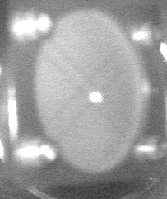
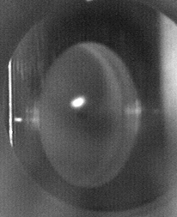
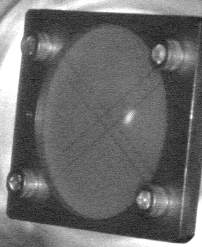
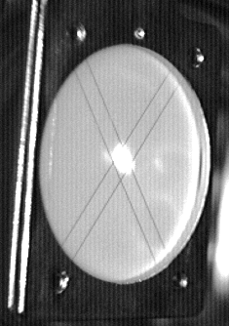
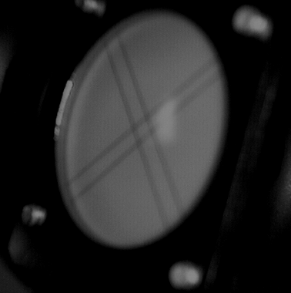
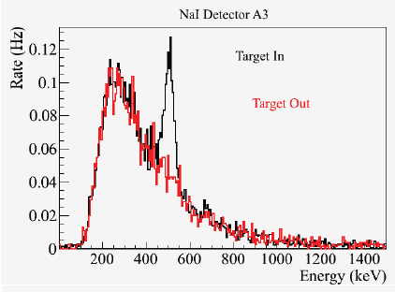
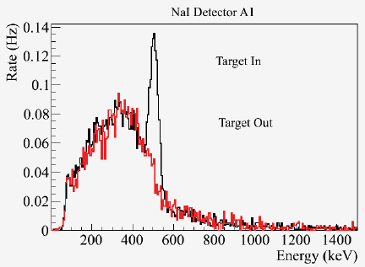
PEPPo operation
Eric Voutier
Orsay September 14-16, 2016
9/19

Slide 10
PEPPo operation
Eric Voutier
Energy Deposit Spectra
511 keV from e+ annihilation at rest
Bremsstrahlung
end-point
Energy (FADC units)
The location of the 511 keV peak is used for in-situ monitoring of the effective gain of the read-out chain, and provides a link to radioactive source calibration data.
Compton physics asymmetries are obtained from the polarization sensitive energy deposit spectra in the central crystal.
The coincidence time spectra allow for accidental subtraction.
Orsay September 14-16, 2016
10/19

Slide 11
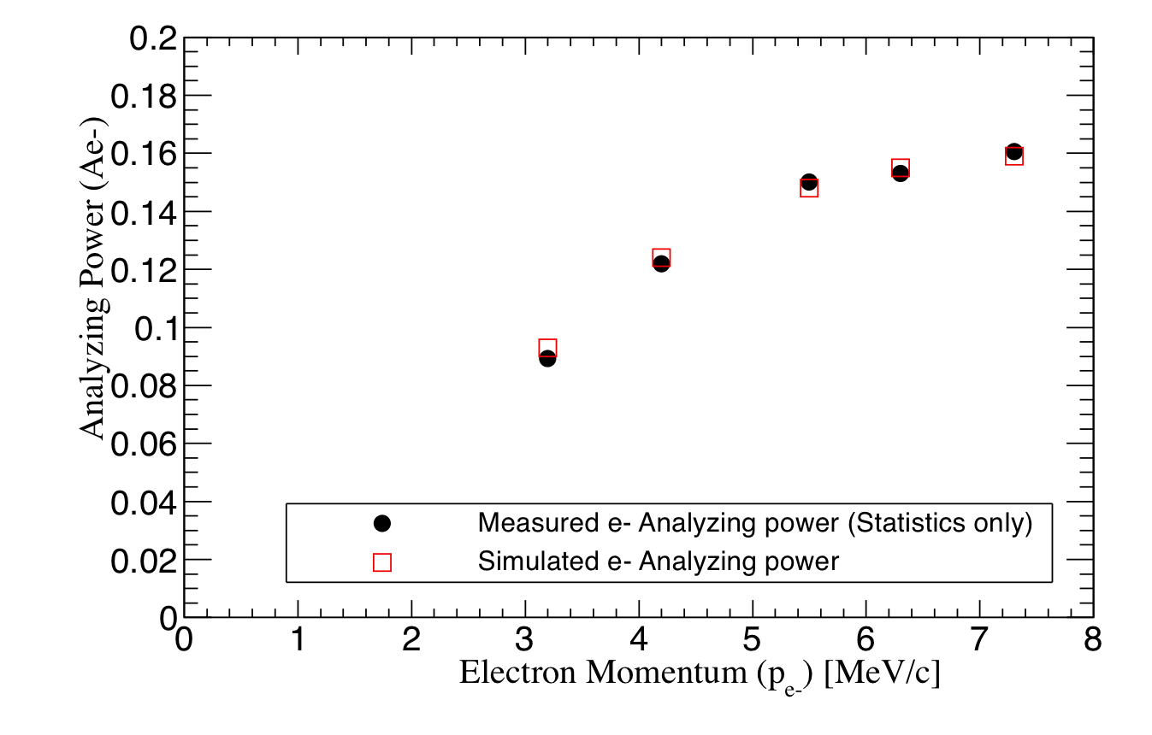
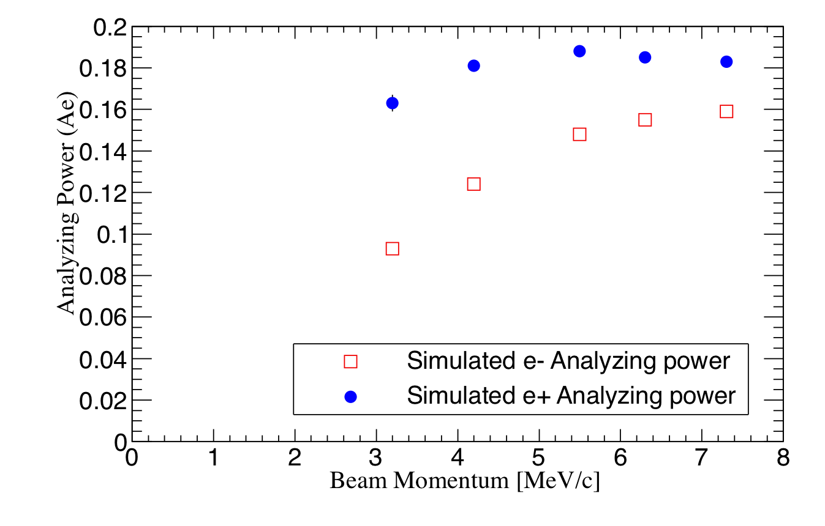
Positron analyzing power
Eric Voutier
Positron Analyzing Power
A. Adeyemi (Hampton University)
GEANT4 simulations allow to link the measured electron analyzing power to the expected positron analyzing power of the PEPPo Compton transmission polarimeter.
Orsay September 14-16, 2016
11/19

Slide 12

Positron polarization
Eric Voutier
PEPPo Results
(PEPPo Collaboration) D. Abbott et al. , Phys. Rev. Lett. 116 (2016) 214801
PEPPo demonstrated efficient polarization transfer from 8.2 MeV/c electrons to positrons, expanding polarized positron capabilities from GeV to MeV accelerators.
e⁻ beam polarization
85.2 ± 0.6 ± 0.7 %
Whenever producing e⁺ from e⁻, polarization is coming for free
if initial electrons are polarized.
Orsay September 14-16, 2016
12/19

Slide 13
PEPPo Collaboration
P. Aderley¹, A. Adeyemi⁴, P. Aguilera¹, M. Ali¹, H. Areti¹, M. Baylac², J. Benesch¹,
G. Bosson², B. Cade¹, A. Camsonne¹, L. Cardman¹, J. Clark¹, P. Cole⁵, S. Covert¹,
C. Cuevas¹, O. Dadoun³, D. Dale⁵, J. Dumas^{1,2}, E. Fanchini², T. Forest⁵, E. Forman¹,
Freyberger¹, E. Froidefond², S. Golge⁶, J. Grames¹, P. Guèye⁴, J. Hansknecht¹,
P. Harrell¹, J. Hoskins⁸, C. Hyde⁷, R. Kazimi¹, Y. Kim^{1,5}, D. Machie¹, K. Mahoney¹,
R. Mammei¹, M. Marton², J. McCarter⁹, M. McCaughan¹, M. McHugh¹⁰, D. McNulty⁵, T. Michaelides¹, R. Michaels¹, C. Muñoz Camacho¹¹, J.-F. Muraz², K. Myers¹²,
Opper¹⁰, M. Poelker¹, J.-S. Réal², L. Richardson¹, S. Setiniyazi⁵, M. Stutzman¹,
R. Suleiman¹, C. Tennant¹, C.-Y. Tsai¹³, D. Turner¹, A. Variola³, E. Voutier^{2,11},
Y. Wang¹, Y. Zhang¹²
¹ Jefferson Lab, Newport News, VA, US ² LPSC, Grenoble, France ³ LAL, Orsay, France
⁴ Hampton University, Hampton, VA, USA ⁵ Idaho State University & IAC, Pocatello, ID, USA
⁶ North Carolina University, Durham, NC, USA ⁷ Old Dominion University, Norfolk, VA, US
⁸ The College of William & Mary, Williamsburg, VA, USA ⁹ University of Virginia, Charlottesville, VA, USA ¹⁰ George Washington University, Washington, DC, USA ¹¹ IPN, Orsay, France
¹² Rutgers University, Piscataway, NJ, USA ¹³ Virginia Tech, Blacksburg, VA, USA
Many thanks for advice, equipment loan, GEANT4 modeling support, and funding to
SLAC E-166 Collaboration
International Linear Collider Project
Jefferson Science Association Initiatives Award
Orsay, September 14-16, 2016
13/19

Slide 14
Perspectives
Polarized positron beam at Jlab
e⁺ @ CLAS12
e⁺ @ JLEIC
Orsay, September 14-16, 2016

Slide 15
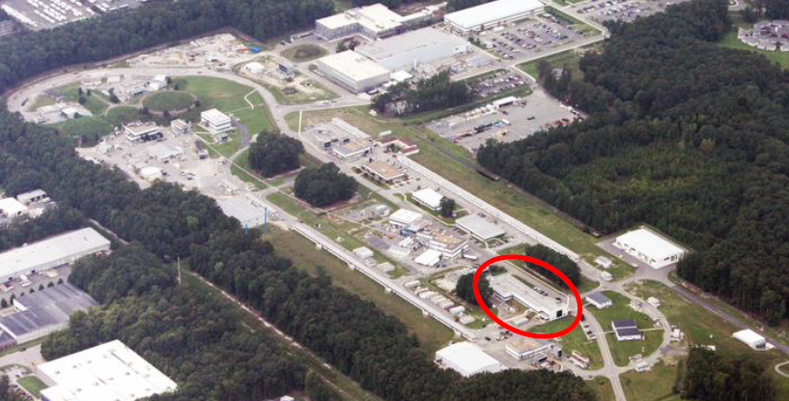
Polarized positron beam at JLab
Eric Voutier
e⁺ Production Scenarii
CEBAF INJ (10-100 MeV)
LERF (100 MeV)
CEBAF (12 GeV)
Orsay September 14-16, 2016
15/19

Slide 16
e⁺ @ CLAS12
Eric Voutier
Basic Characteristics
M. Mazouz (2015)
5mm
11 GeV electrons
Tungsten target
6 GeV (±2‰) positrons
50 μA beam
10 nA beam
80% longitudinal polarization
65% longitudinal polarization
δθ = 17 mrd
3 kW (heat)
High power target (~ 3 kW)
High power beam dump (~ 0.5 MW)
Significant radiation impact
Orsay September 14-16, 2016
16/19

Slide 17
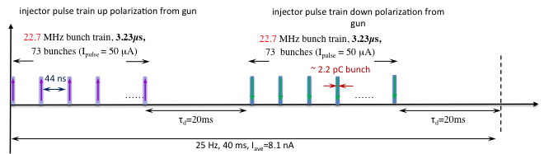
e⁺ @ JLEIC
Eric Voutier
Expected Performances
A group (J. Grames, J. Guo, F. Lin, V. Morozov, E. Voutier) is exploring a proposal to test a prototype polarized positron injector for JLEIC.
L ≥10³³cm⁻²s⁻¹ P_{e+}≥40%
20 times CEBAF
A pulsed beam with low average current (~10 nA) but significant bunch charge (~2pC) and high macro-pulse peak current (~50µA) is required for injection into JLEIC.
Instead of using a GeV electron beam for positron production, a novel approach being considered is to use and accumulate an MeV electron beam to then directly produce the positron bunch train.
Positron polarization is produced by the PEPPo method.
Orsay September 14-16, 2016
17/19

Slide 18
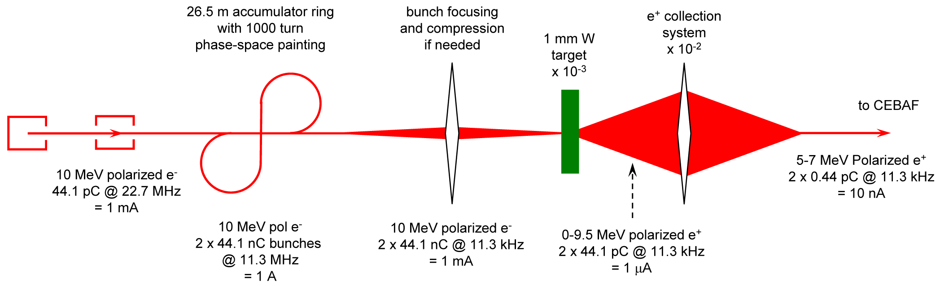
e⁺ @ JLEIC
Eric Voutier
Conceptual Design
J. Grames, J. Guo, F. Lin, V. Morozov (2016)
Polarized e⁻ Source
CEBAF like polarized electron source, with low-frequency laser.
Higher voltage gun to provide higher e⁻ bunch charge.
Polarized e⁻ Accumulator
High gain (>100) accumulation of e⁻ in a spin preserving ring
Fast injection/extraction (<100 ns)
Polarized e⁺ Source
High polarization transfer by PEPPo method
~nC e⁻ -> ~0.! pC e⁺ (/bunch)
e⁺ CEBAF direct acceleration
Orsay September 14-16, 2016
18/19

Slide 19
Conclusions
Eric Voutier
Summary
The PEPPo technique provides
an efficient, reliable, radioactive-less, and low cost method
opening access to polarized positron beam to a wide community.
JLab12, JLEIC, ALTO, PRAE…
The next step in low energy scheme e⁺ source R&D is
maximizing the beam intensity and the beam quality.
A polarized positron experimental program
at JLab12 and JLEIC became realistically and is currently being developed.
(http://wiki.jlab.org/pwg pwg@jlab.org)
Please consider joining this effort !!
Orsay September 14-16, 2016
19/19

Slide 21
Electromagnetic form factors
Eric Voutier
Experimental Observables
M.P. Rekalo, E. Tomasi Gustafsson, NPA 742 (2004) 322 C. Carlson, M. Vanderhaeghen, ARNPS 57 (2007) 171
Unpolarized e± elastic scattering and polarization transfert observables off the nucleon involve up to 5 unknown quantities.
Cross Section
Polarization
Transfert
5 unknown contributions for 6 independent observables
Combining polarized electrons and positrons allows a model independent separation of the electromagnetic form factors of the nucleon.
Orsay September 14-16, 2016

Slide 22
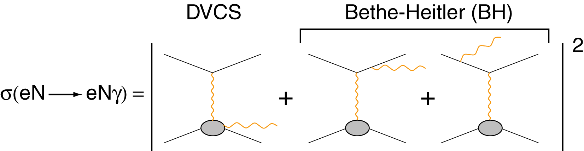
Generalized parton distributions
Eric Voutier
N(e,e′γN) Differential Cross Section
M. Diehl at the CLAS12 European Workshop, Genova, February 25-28, 2009
Additional observables
Electron
observables
Electron & positron
observables
Polarized electrons and positrons allow to separate the
unknown amplitudes of the cross section for electro-production of photons.
Orsay September 14-16, 2016

Slide 23
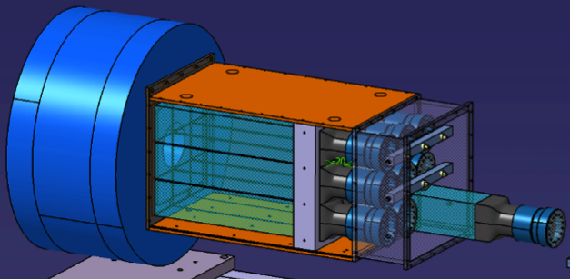
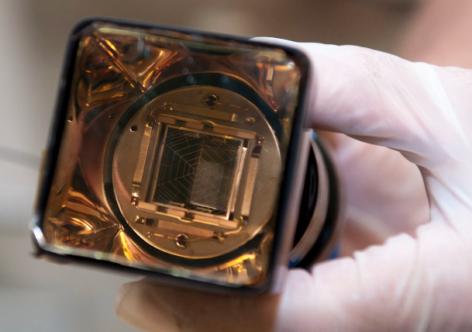
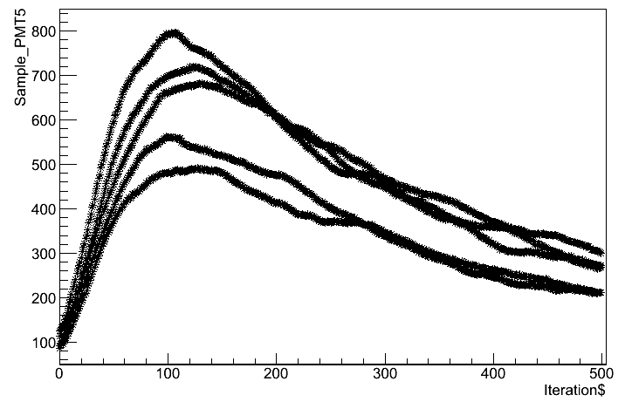
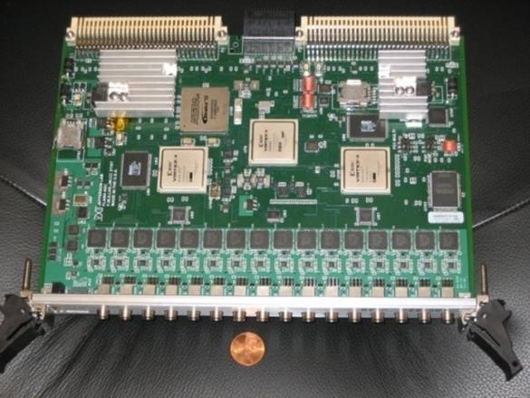
Electron and positron polarimetry
Eric Voutier
Compton Transmission Polarimeter
CsI crystals a (6×6×28 cm³) are coupled to PMTs equiped with custom amplified bases to extend the PMT life-time in the high rate environment of PEPPo.
The ~2 µs long and 2 V optimized signal is fed into the JLab custom FADC250 that sampled the signal at 250 MHz.
Hamamatsu R6236-100
The flexibility of the FADC250 allows for 3 data taking modes :
Sample (500 samples /detector event);
Semi-integrated (1 integral / detector event);
Integrated (1 integral /helicity gate event).
FADC 250
Orsay September 14-16, 2016

Slide 24
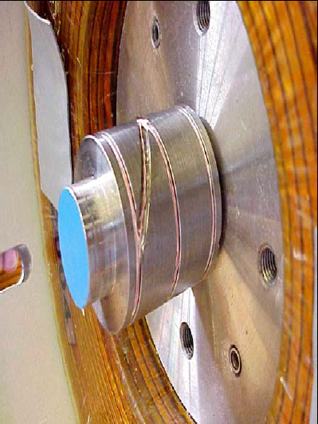
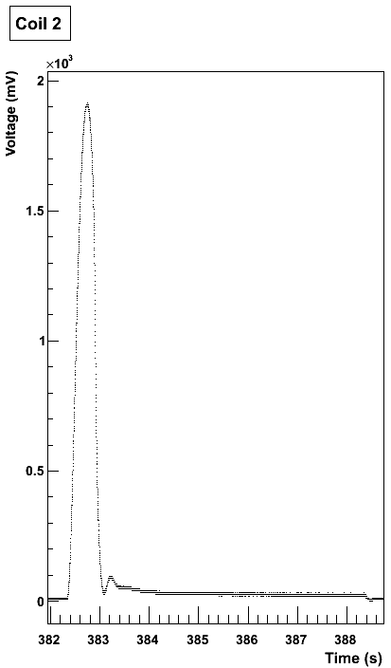
Electron and positron polarimetry
Eric Voutier
Magnetic Flux Measurement
E. Froidefond, E. Voutier, PEPPo TN-14-02 (2014)
The iron core target is equipped with 3 pick-up coils measuring the magnetic flux generated by the magnet current variation (ramping-up, polarity reversal).
Specific cycling procedures are used during the experiment to monitor the target polarization.
P_{T} = 7.06% ± 0.05%_{Stat.} ± 0.07%_{Syst.}
Orsay September 14-16, 2016

Slide 25
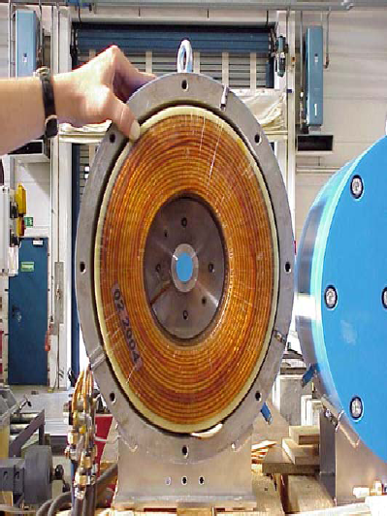
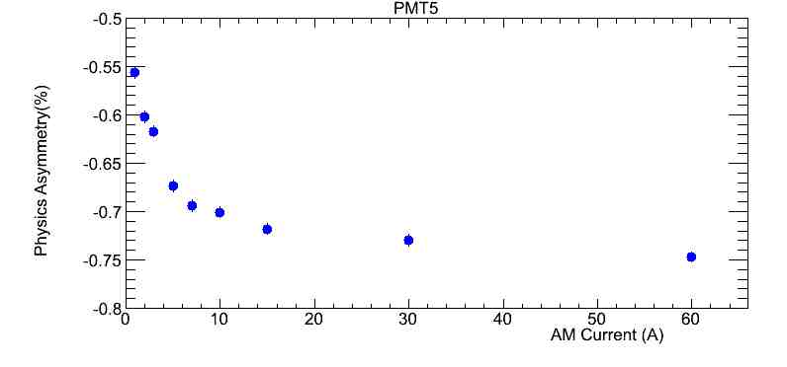
Electron and positron polarimetry
Eric Voutier
Analyzing Magnet Response
G. Alexander et al., NIMA 610 (2009) 451
Experimental asymmetries are measured with respect to beam helicity ; they are linearly proportional to the target polarization, itself proportional to the target magnetization.
IHWP inserted
A. Adeyemi (Hampton University)
P_{T} = 7.06% ± 0.05%_{Stat.} ± 0.07%_{Syst.}
Orsay September 14-16, 2016

Slide 26
Polarized positron beam at JLab
Eric Voutier
Expected Performances
J. Dumas, Doctorate Thesis (2011)
The optimized FoM at each electron beam energy defined the « operational conditions »; simplistic cuts mimic a capture system and/or an accelerator acceptance, and define the quantitative source performances.
Δp/p = 10% ΔΘ = 10°
In the 100 MeV energy range, one can reasonably expect to optimaly achieve
75% electron polarization transfer and 10⁻⁴-10⁻³ e⁺/e⁻.
Orsay September 14-16, 2016
21/28

