Slide 1
R&D of
Freedback-Free Optical Resonant Cavity
Tohru Takahashi
Hiroshima University
for
Y.Hosaka, Y. Uesugi，J. Urakawa，T. Omori，A. Kosuge，T. Takahashi，Y. Honda，M. Washio^{B}
September 14 2016
PosiPol2016@LAL Orsay

Slide 2
Contents
Status and Issues of the Optical Resonant Cavity
An idea of the feedback-free cavity
Status of the R&D
  Continuous Wave -> Pulsed Oscillation

Slide 3
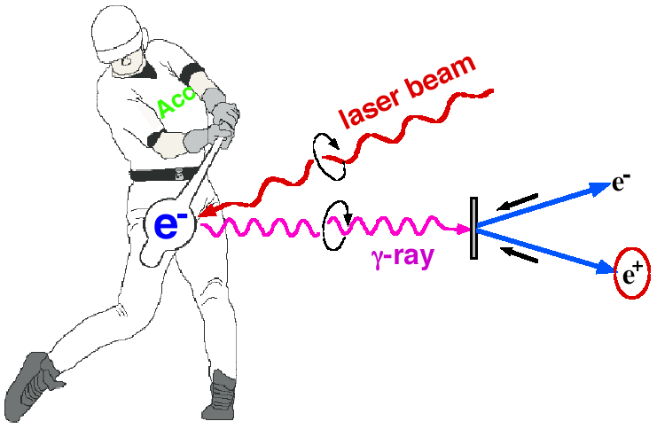
Introduction
Photons by Laser-Compton Scattering
  Lower electron energy
  Polarized photons
Ee~1GeV for 10MeV gammas
x ray
Polarized gamma ray:
M.Fukuda. et. al, Phys. Rev. Letts. 91, 164801 (2003)
Polarized e+ ;
T.Omori, et. al, Phys. Rev. Letts 96, 114801(2006)
Issue
increase intensity of photons

Slide 4

Miyoshi PosiPol2010
L_{cav}
λ
dL∝λ/enhancement ~0.01nm
for enhancement ~1000

Slide 5
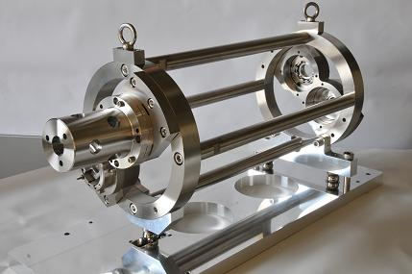
The KEK-Hiroshima Cavity
Plane Mirror
Plane Mirror
Concave Mirror
IP
Concave Mirror
Main Parameters
Circumference: L_{cav}=1.68m
Finesse: F=4040(Measured)
Power Enhansement: 1230 2.5kW average

Slide 6

Taward High Power Storage
High reflective mirrors
  99.999%
  very low power loss O(ppm) to prevent thermal effect
  sophisticated control system
  sophisticated mirror treatment and leaning
(currently ~16pm)
  A Feedback free cavity

Slide 7
Self- Resonating Mechanism
(KEK,Waseda,Hiroshima)
Laser medium
An Optical cavity is embedded in the laser oscillation
Start laser oscillating with a wavelength selected by the cavity (positive feedback)
If the cavity length changes, the system continue or resume to oscillation with a new wavelength selected by the cavity
Cavity

Slide 8
Schematic
Yb fiber amp.
Pump LD
Output
Isolator
Input
Cavity

Slide 9
A real optical ray-out
to SP
YDF
to SP
Coupler1
WDM
Coupler2
FI1
PD2
M2
M1
Pump LD
FP cavity
HWP
FC2
W2
W1
FC1
FI2
PBS2
L2
QWP3
QWP2
L1
PBS1
QWP1
PD3
PD1

Slide 10
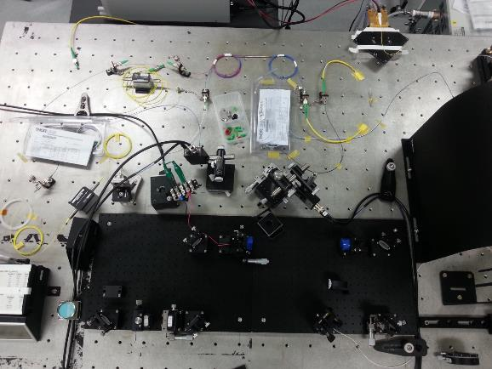
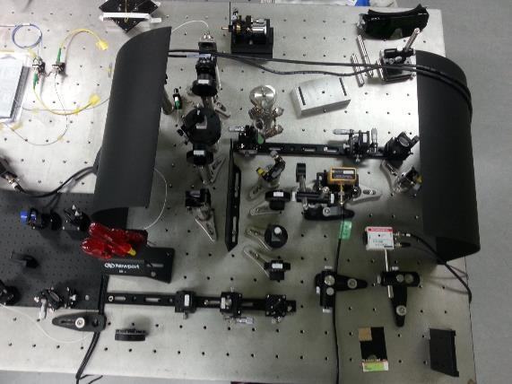
It looks,,,
WDM
YDF
Cavity
Pump LD

Slide 11
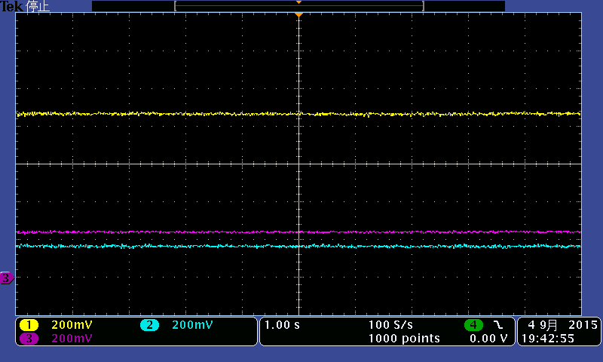
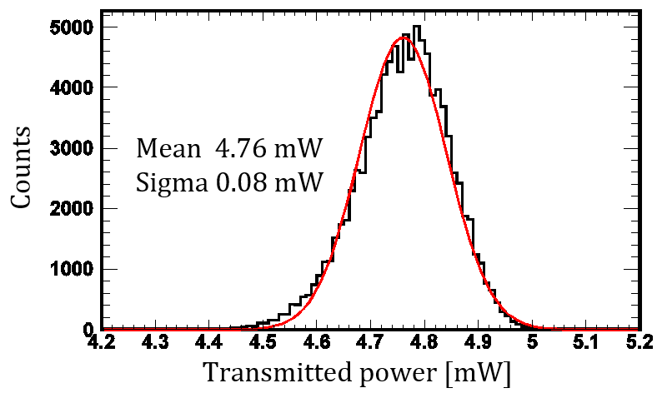
High Finesse Oscillation
Incident power 13.5 mW
Transmitted power 4.8 mW
σ ~ 1.7 %
Reflected power 2.8 mW
Enhancement factor
=187,000
  The Effective Finesse inc. stability of the system
  = 324,000
to SP
Amplifier
PD2
PD3
Cavity
PD1

Slide 12
Toward the mode locked pulse Oscillation
Seeding mode locked pulses with
Nonlinear Polarization Rotation (NPR) optics
NPR fiber optics

Slide 13
Pulse Oscillation
Mode locked pulsed oscillation requires overlap of laser pulses in the
inner loop (cavity ) and the outer loop
We chose,,,,,

Slide 14
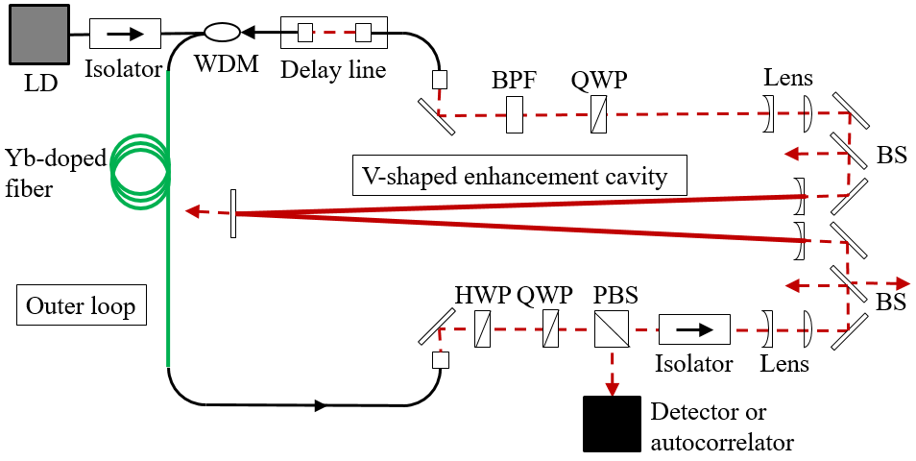
Demonstration of the pulse oscillation

Slide 15
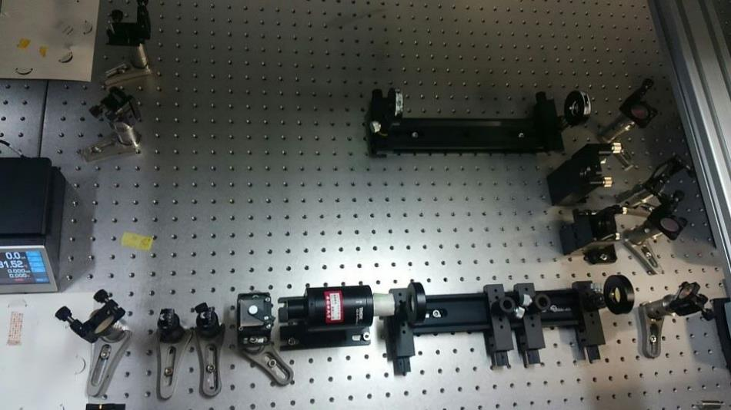
Pulsed Feedback-Free Self-Resonating Cavity

Slide 16
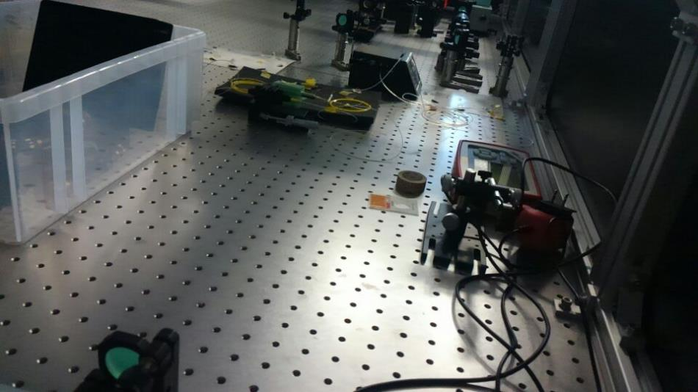
Pulsed Feedback-Free Self-Resonating Cavity
1.8 m

Slide 17
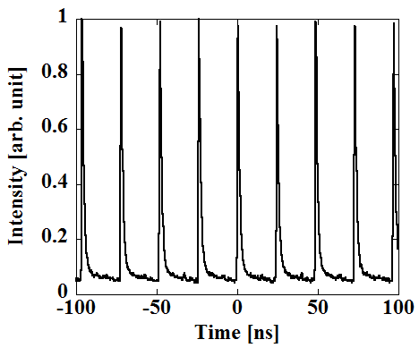
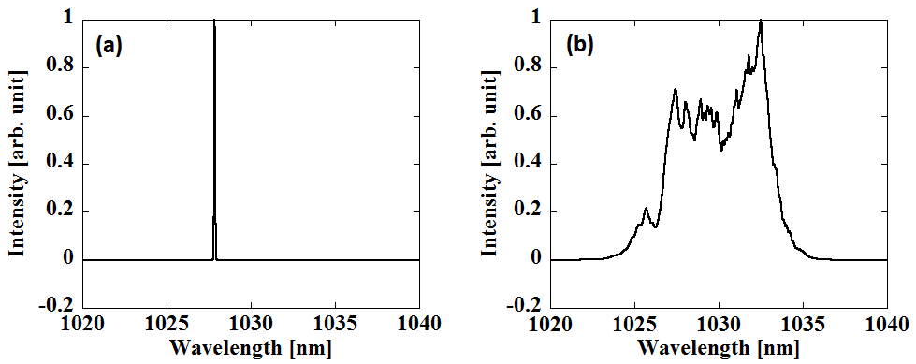
Model locked pulse oscillation
After adjustment of L_{loop}
CW
Mode-Locked
Pulse
Intensity [arb. unit]

Slide 18
Power and enhansements
Power Inside the cavity 4.2W
Incident power 0.111W
Power Enhancement 38

Slide 19
Summary
New idea to avoid precise control of high finesse is on going.
Successfully demonstrated
  High finesse oscillation with continuous wave
  mode locked pulse oscillation
Plan and issues
  need more stability to keep oscillation
  more power in the outerloop
  more finesse in the cavity
Compton

Slide 20
Performance of the cavity (alone)
Cavity
PD
Decay time constant
τ = 142.5±0.1 [us]
Laser
1047 nm
Transmitted power [a.u.]
Triger signal
Switch OFF
Time [us]
Finesse: F = 2πcτ / L (L: cavity length)
☆ Measured finesse:
F = 650,000 which corresponds to R = 99.99952 %
ΔL must be less than 1.6 pm to keep this cavity on resonance

