Slide 1
Central Region Group Status and Positron Region
K. Yokoya
2016.9.14. Posipol2016, LAL

Slide 2
Issues Discussed in CRWG
Positron-related
  10Hz operation
  Auxiliary positron source (APS)
  Positron target region
MPS,PPS
Beam dumps
  Main dumps
  Tune-up dumps
BDS-related
  Muon wall
Tunnel of the Central Region

Slide 3
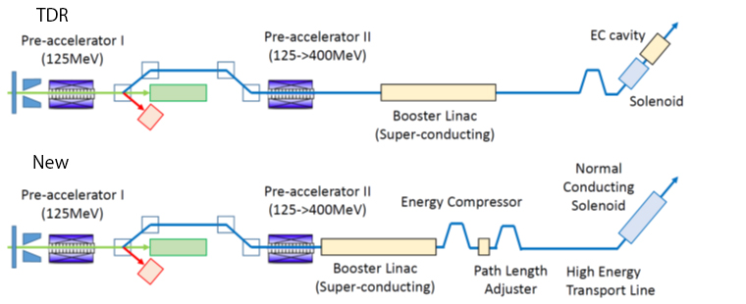
These are already accepted?
Relocation of positron booster linac → Yes
  Positron spin rotator
    2 parallel line for up and down polarization → Yes
    (strong request from physics and positron groups)
    Superconducting or normal-conducting solenoid?
  Location of Global timing chicane
DR
400MeV
5GeV
  Location of 1.5km ML tunnel extention → Not yet

Slide 4
10Hz Operation
TDR mentions 10Hz operation for E_{CM} < 250GeV
  Gives parameter sets for 200 and 230GeV
  Damping ring with stronger wigglers
  But detail of linac operation, additional beam line, beam dynamics are not given
Is 10Hz operation really needed?
  200-250GeV: sweep the region above LEP
  But most important is Z-pole (92GeV) and W-pair (160GeV)
Conclusion in CRWG
  Prepare spaces for beamlines that guarantee down to E_{CM}=200GeV
    Preliminary beamline optics to tune-up dump by Okugi
  This does not guarantee E_{CM}<200GeV.
    Beam dynamics complex
    Will think of 92GeV and 160GeV later, if turn out to be necessary

Slide 5
Tune-up Dumps
Change of the commissioning strategy
  Tuning by weak beam using local tune-up dumps
  Use main dumps for full current tuning
Reduced power scale of all the tune-up dumps
  Maximum ~400kW
    Except main dumps (E-5,E+5) and photon dump E+7
  Proposal of a new dump E+8 for spent electron after positron generation in 5+5 Hz operation
Will soon come to a change request

Slide 6
New specification of Power Levels
Not final yet

Slide 7
XFEL Dump
Solid dump being constructed as the main beam dump for XFEL
Similar pulse structure and total power as ILC BDS tune-up dump and undulator photon dump
Except (compared with photon dump)
  Electron dump vs. photon
  Max energy 25GeV vs. some 100MeV
  (Be careful: lower energy does not mean easier)
XFEL Beam Parameters for the main beam dump
Beam energy | =< 25GeV | Repetition rate | 10Hz
Bunch distance | >= 200ns | Average power | <= 300kW
Pulse length | <= 800μs | RMS spot (x,y) | >= 2mm
Bunch charge | <= 1nC | Slow sweep | R=5cm
Train charge | <= 4000nC | Fast (ibtratrain) sweep | no
Train energy | <= 100kJ | Life | 20 years
Description of the Beam Dump Systems for the European XFEL
M. Schmitz, EDMS: D00000004303811 Feb.4.2014

Slide 10
Main Dumps
Two 14 MW main dumps (plus 6.3MW spent electron dump)
  Detailed check of the dump system is not CRWG expertise
Need specialist team
  Beam dump specialists
  CFS
Issues
  Robot work
  Safety in particular window breakdown
  Required human access

Slide 11
10atm water beam dump layout
B. Smith, CCLRC:
0-TB-0067-404-00-A
D00000000945405

Slide 12
Water beam dump surface site scheme
B. Smith, CCLRC:
0-TB-0067-410-00-A
D00000000945465
Shows surface facilities that service the dump, including cooling and exhaust for gases (tritium!)

Slide 13
Positron (target region)
Main issues needed as inputs to CRWG
  Design of photon dump
    A problem (radiation damage of the window by photon beam) of TDR design pointed out at Santander
  Required shielding of the target region including the thoughts on
    Target replacement
    Where/how waste targets to be stored
    Path to take waste target to the surface
Will be discussed in POSIPOL@LAL next week
This would take some more time

Slide 14
Consensus among ILC positron team
  No human access to the accelerator and service tunnels needed during high-energy beam on (normal operation and commissioning) as in main linac region
  Special shield wall needed for target+FC+solenoid+a few cavities
  Photon/electron dumps must also be shielded
This figure is for illustration only. To be discussed in the WS

Slide 15
BDS Tunnel (electron)
Okugi’s proposal
  Single (kamaboko) tunnel from ML end to e+ ECS
  Twin tunnel to muon wall
    Penetration for cables only (no waveguides)
    Small tunnel cross-section possible after collimators
Must come to final conclusion
  Info from positron team needed
e-linac end
IP

Slide 16
BDS Tunnel (positron)
Okugi’s proposal
  Move electron source upstream
Must come to final conclusion
  Required size of the components
  Then, send to CFS team for tunnel layout
TDR
Okugi

Slide 17
Muon Wall
TDR: 5m long magnetized spoiler, filling the tunnel crosssection.
Background to the detector was re-estimated with different conditions
 | #/200 bunches R=6.5m detector | #/200 bunches R=2.5m TPC
No spoilers | 138 | 9648
2x 5m mag.spoilers | 25 | 1008
5x 5m toroid | 3.3 | 273
both | 0.5 | 17
Can we remove 5m magnetized iron?

Slide 18
Auxiliary Positron Source
Our conclusion has been to retain it for DR and BDS commissioning
  Weak intensity but can still useful for DR emittance tuning if stacking possible
  Does it require a wider tunnel?
Now, under new commissioning strategy, is it still useful?

Slide 19
New Members to CRWG
Members Since Dec.2015)
K.Yokoya (KEK,chair), E.Paterson (SLAC), G.White (SLAC), B.List (DESY), T.Okugi (KEK), M.Kuriki (Hiroshima U.), M.Miyahara (KEK), T.Sanuki (Tohoku U.)
Reorganization of CFS team in Japan
  Lead by Hayano & Terunuma
New members (all KEK)
  Shinichiro Michizono
  Hitoshi Hayano
  Nobuhiro Terunuma

Slide 20
Future Plan
Expect change of organization in December
Some items may come to conclusion by that time
  Positron BDS tunnel
  Auxiliary positron source
Some items require more inputs
  Electron BDS tunnel including positron target region
  Main dump-related issues
Whole system must be reviewed
  Installation
  Commissioning
  Accidents
Problem
  Expand the expertise?

Slide 21
Recent Decision by the Technical Board after a meeting with CRWG
The CRWG will submit a CR to specify the dump layout and power levels. We will try to do this before the Sept 20th CMB meeting.
Glen White will work with the experimentalists to ascertain whether the muon spoiler is necessary. If not then a CR will be generated.
The CFS team will create a basic central region concept based on Okugi-san’s 2-tunnel scheme. It is recognized that no design exists at present for the high power (multi-MW dumps) so these areas will be shown generically. Likewise the positron target area and photon dump is also not defined and again will be represented generically for the present time.
We will endeavor to obtain assistance (from CERN) to develop the design of the high power dumps and associated remote handling scheme. The low power dumps will be based on the existing designs such as he solid dump for XFEL and aluminum ball dump of JLAB.
There will be no action on the positron system until after the upcoming POSIPOL meeting

