Slide 1
Conventional e⁺ Source
Rotation Target R/D
T. Omori (KEK)
On behalf of the Truly Conventional Collaboration
ANL, IHEP, Hiroshima U, U of Tokyo, KEK, DESY, U of Hamburg, CERN
  Rotation target design study: ongoing with Rigaku
15-September-2016
Posipol 2016, LAL, Orsay, FRANCE

Slide 2
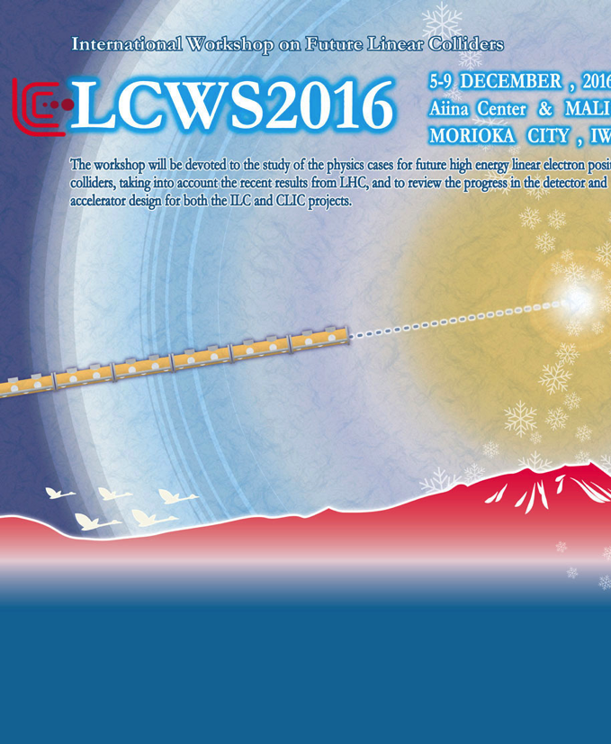


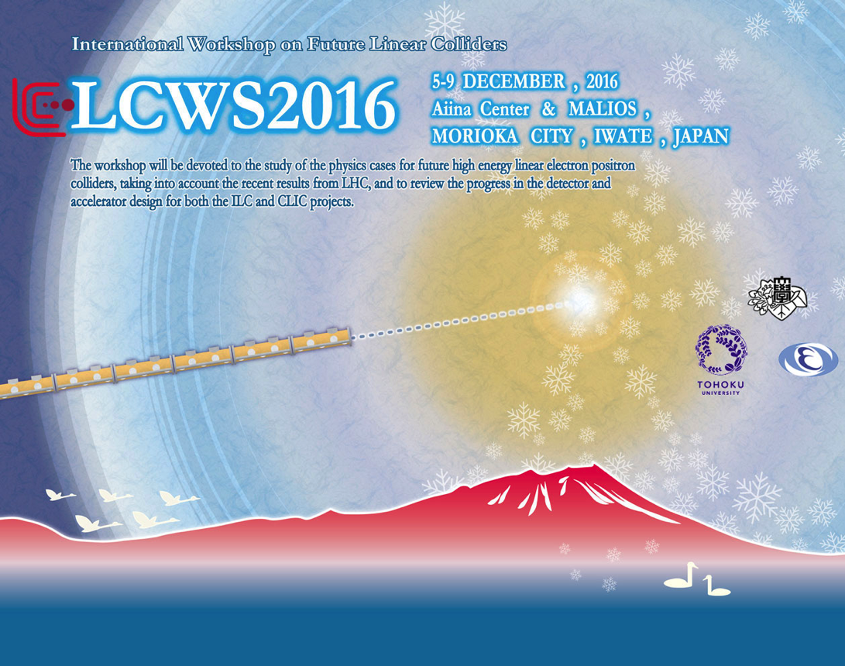
LCWS 2016
5-9 December, Morioka, Iwate, Japan
Tokyo Event 2016
The T-shut and other Kitty
Goods will be sold
at LCWS 2016.

Slide 3
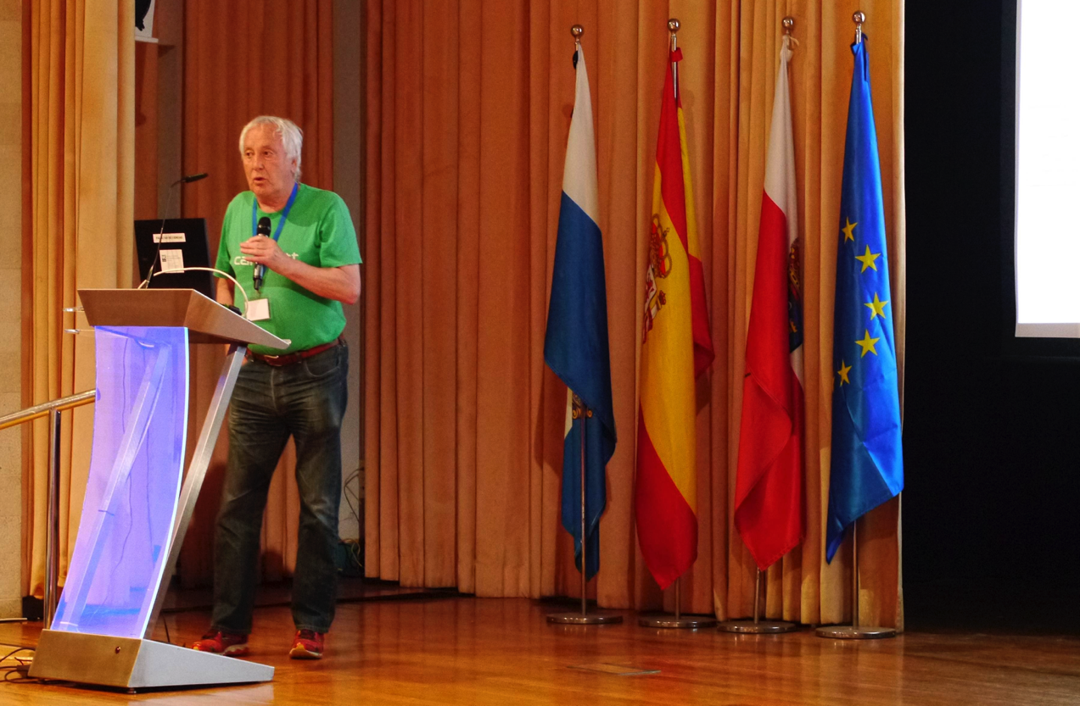
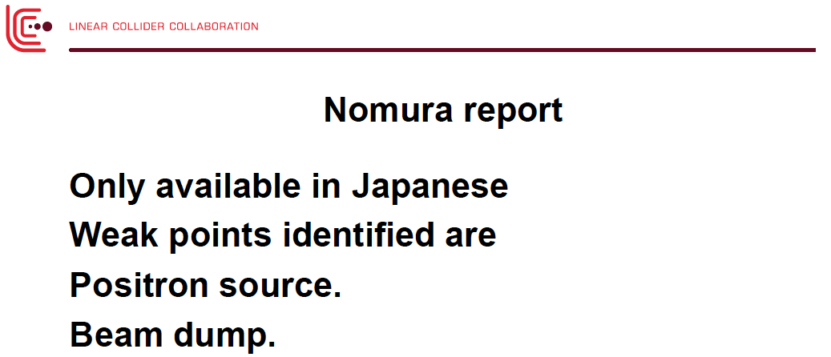
Plenary Talk by Lyn EVANS
2nd-June-2016 ECFA LCWS Santander, SPAIN
陽電子源＆Beam Dump

Slide 4
Today’s Talk
R/D of the Slow Rotation Target
of the Conventional e+ Source
for ILC
• Overview
• Target R/D (1): Heat and Stress Simulations
• Target R/D (2): Radiation, Vacuum, and Prototype
• Summary

Slide 5
Overview

Slide 6
Conventional e+ Source for ILC
Normal Conducting Drive and Booster Linacs in 300 Hz operation
e+ creation
go to main linac
20 triplets, rep. = 300 Hz
• triplet = 3 mini-trains with gaps
• 44 bunches/mini-train, T_{b_to_b} = 6.15 n sec
2640 bunches/train, rep. = 5 Hz
• T_{b_to_b} = 369 n sec
Drive Linac
Several GeV
NC
300 Hz
Booster Linac
5 GeV
NC
300 Hz
DR
Target
T_{b_to_b} = 6.15 n sec
Amorphous Tungsten
Slow Rotation
2640 bunches
60 mini-trains
N_{b} = 2600
Time remaining for damping = 137 m sec
We create 2640 bunches
in 63 m sec
Stretching
NIM A672 (2012) 52—56
Notes:
6

Slide 7
Moving Target
~5m/sec required (1/20 of undulator scheme)
rotating target with ferromagnetic seal
ferromagnetic
fluid seal
air
vacuum
issues: vacuum, heat, stress

Slide 8
The target R/D (1)
Heat and Stress Simulation

Slide 9

Thermal Analysis:
We did both CW beam analysis (for simplicity) and
pulse beam analysis (more realistic).
We assume 2600 bunches in all analysis.
• CW beam analysis
38kW (35kW+3kW⁽*⁾) CW
* Note
3 kW is not correct
should be 1 kW
beam
FC
• Pulse beam analysis: step 1
114.1 kW(111.1kW+3kW) 63 ms
0 kW ( 0kW+0kW) 137 ms
beam
FC
• Pulse beam analysis: step 2
20 trains (pulses) in 63 ms
• Common condition
Cooling water: 30 l /min, T at inlet: 25℃
N_{b} = 2600

Slide 10
Thermal Analysis:
We did both CW beam analysis (for simplicity) and
pulse beam analysis (more realistic).
We assume 2600 bunches in all analysis.
• CW beam analysis
38kW (35kW+3kW⁽*⁾) CW
* Note
3 kW is not correct
should be 1 kW
beam
FC
• Pulse beam analysis: step 1
114.1 kW(111.1kW+3kW) 63 ms
0 kW ( 0kW+0kW) 137 ms
Reported
ALCW 2015,
Apr., 2015, Tsukuba
and
Posipol 2015,
Sep., 2015, Daresbury
beam
FC
• Pulse beam analysis: step 2
20 trains (pulses) in 63 ms
N_{b} = 2600
• Common condition
Cooling water: 30 l /min, T at inlet: 25℃

Slide 11
Thermal Analysis:
We did both CW beam analysis (for simplicity) and
pulse beam analysis (more realistic).
We assume 2600 bunches in all analysis.
• CW beam analysis
38kW (35kW+3kW⁽*⁾) CW
* Note
3 kW is not correct
should be 1 kW
beam
FC
• Pulse beam analysis: step 1
114.1 kW(111.1kW+3kW) 63 ms
0 kW ( 0kW+0kW) 137 ms
beam
FC
• Pulse beam analysis: step 2
20 trains (pulses) in 63 ms
Reported
LCWS 2015,
Nov., 2015, Whistler
N_{b} = 2600
• Common condition
Cooling water: 30 l /min, T at inlet: 25℃

Slide 12
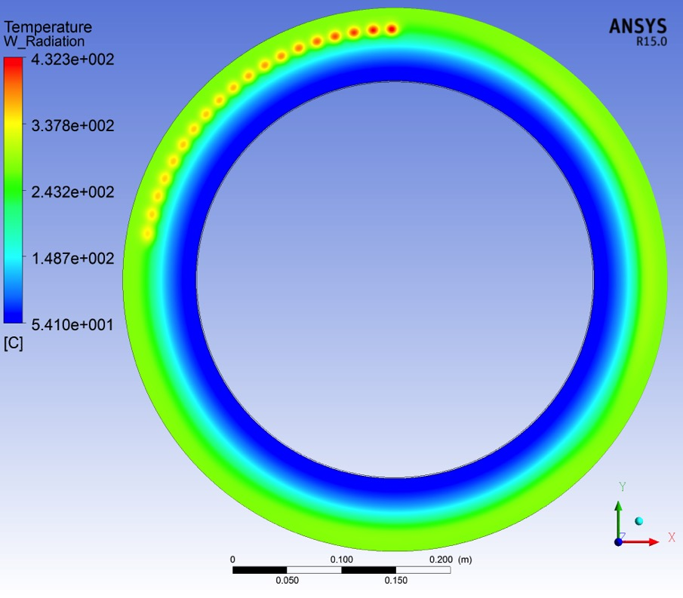
Pulse Beam Analysis
Rotation speed = 220rpm
step 2:
1 train = 373 kW(**) in 0.99 m sec (*)
20 trains in 63 ms
train to train separation: 3.3 m sec
432 ºC
at train hit
* Note: 1
One train corresponds 132 bunches,
but time structure in a train is ignored.
* Note: 2
This is NOT totally correct.
Pulse width of a train is NOT 0.99 m
sec. It is 0.99 micro sec.
But difference in the results are small.
baseline temperature
262 ºC
** Note: 3
This value is NOT accurate.
This is 5% larger than correct value.
N_{b} = 2600
Simulated by Rigaku
Nb=2600
T. Omori, LCWS 2015, 3-Nov-2015, Whistler, CANADA

Slide 13
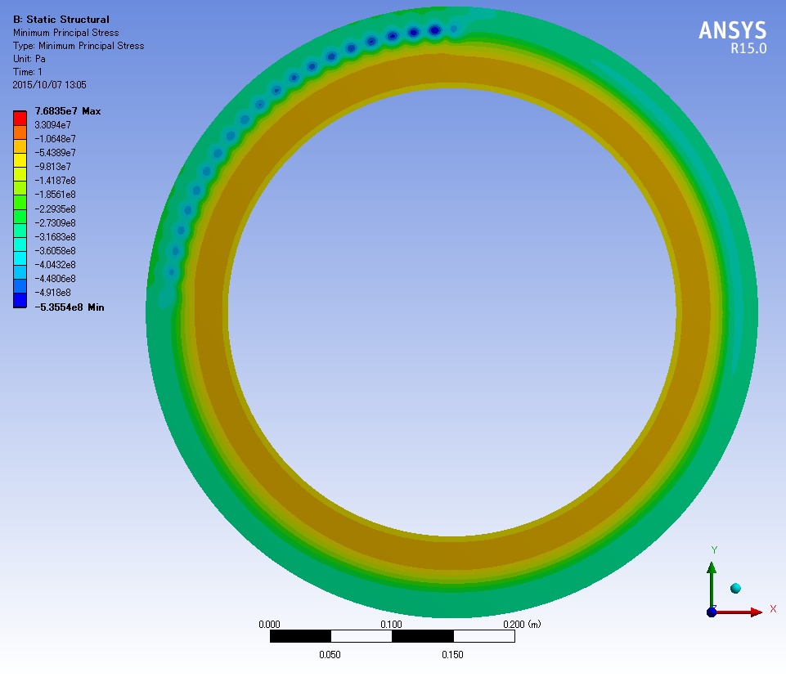
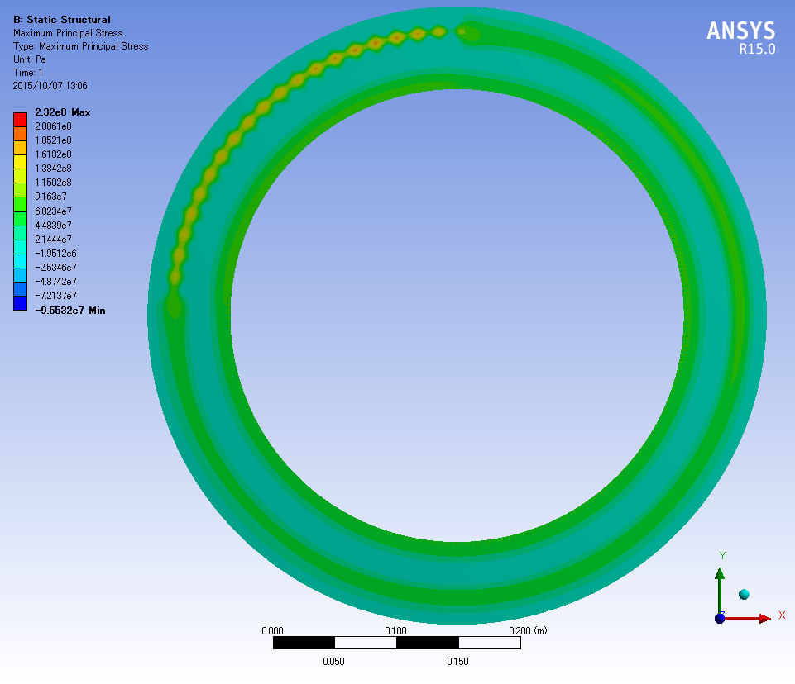
Stress: rotation speed 220 rpm, Pulse Beam Analysis, Step 2
20 trains in 63 ms
最小主応力
→ -5.4e+8Pa(圧縮)
最大主応力
→ 2.3e+8(引張り)
Min Principal Stress (Compression)
→ - 5.4e+8Pa
Max Principal Stress
(Expansion)
→ 2.3e+8Pa
N_{b} = 2600
Simulated by Rigaku
T. Omori, LCWS 2015, 3-Nov-2015, Whistler, CANADA

Slide 14
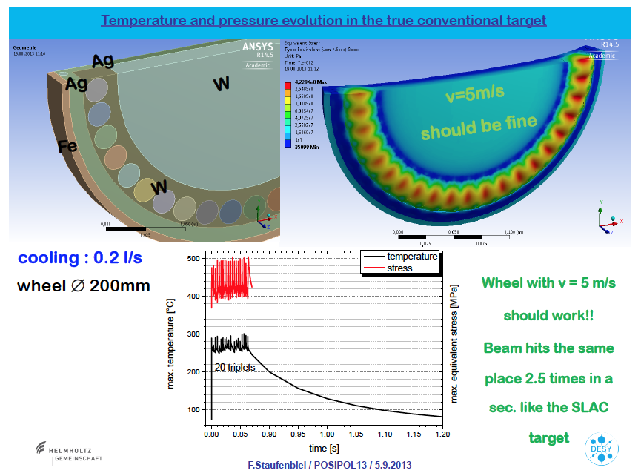
ILC target Analysis by Friedrich-san
cf.
Posipol 2013, 5th/Sep., at ANL
Max Stress 500 MPa (132 bunches hit the same spot)(Von Mises)
Max 300 度C

Slide 15
Is ILC Target Safe?
with 540 MPa Peak Stress

Slide 16
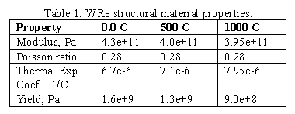
Is ILC Target Safe?
with 540 MPa Peak Stress
WRe: Yield Strength and Fatigue Limit
Freidrich Staufenbie, Posipol 2013, 5th/Sep. at ANL
Peak Stress ~ Fatigue Limit

Slide 17
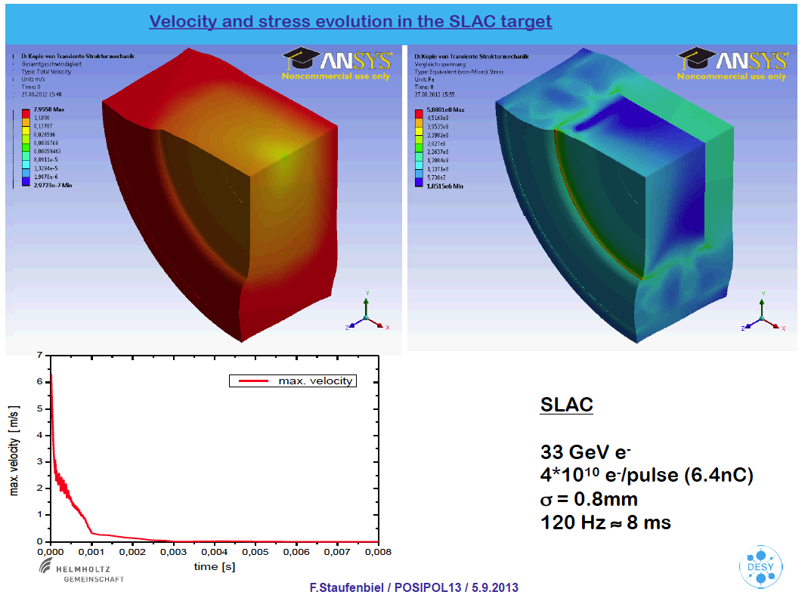
SLC target Analysis by Friedrich-san
cf.
Posipol 2013, 5th/Sep., at ANL
Max Stress 508 MPa (single bunch)
(Von Mises)
Zoom up if you want see the number.

Slide 18
Is ILC Target Safe?
The greatest achievement so far is the SLC target.
Max stress in the SLC target
508 MPa (analysis by Freidrich-san)
560 MPa (analysis by SLAC, SLAC-PUB-9437)
Max stress in the ILC target
540 MPa (analysis by Rigaku, T. Omori LCWS2015)
SLC target stress and ILC target stress are comparable.
SLC target was destroyed after 3-4 years of operation.
SLC target worked in 3-4 years.
In view point of Max Stress:
ILC target is as safe as SLC target.

Slide 19
Is ILC Target Safe?
Comparison of SLC and ILC
In View Point of Fatigue Effect
PEED
SLC 29 J/g (for 1 bunch)
comparable
ILC 27 J/g (for 132 bunches)
cf. Max Stress of SLC and ILC are comparable. ---> consistent
PEED represents effect of all parameters of the beam and the target; beam energy, spot size, target thickness.
Comparison can be made by number of hits per year.
Beam hits run along the circle.
Compare number of hits per unit length.
(Not per unit area, because PEDD already take into account beam spot size.
Circumferences
SLC: 180mm
ILC: 1500mm

Slide 20
Is ILC Target Safe?
Comparison of SLC and ILC
In View Point of Fatigue Effect
Number of hit / Year.mm
SLC:
120 Hz x 3600 s/h x 24 h/d x 365 d/y / 180 mm = 2.1 e+7 hits/year.mm
ILC:
2600/132 x 5 Hz x 3600 s/h x 24 h/d x 365 d/y / 1500 mm= 2.1 e+6 hits/year.mm
Def. of hit
SLC: 1 hit = 1 bunch
ILC: 1 hit = 132 bunches
In view point of Number of hit / year.mm;
In the view point of Fatigue;
ILC target (conventional) 10 times ease than SLC target.
Note: rather rough estimation：
N_{b} = 2600

Slide 21
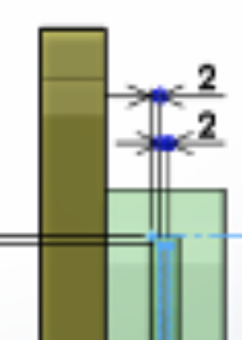
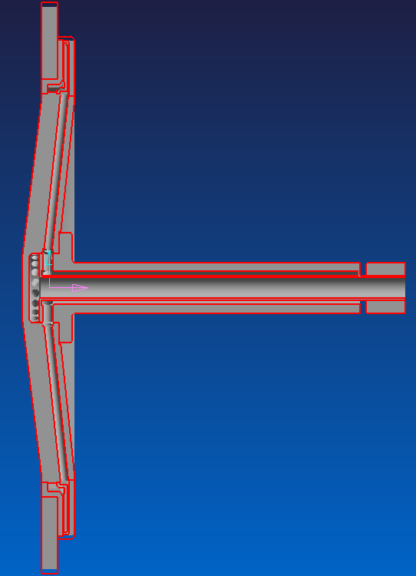
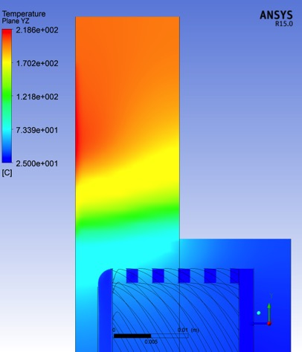
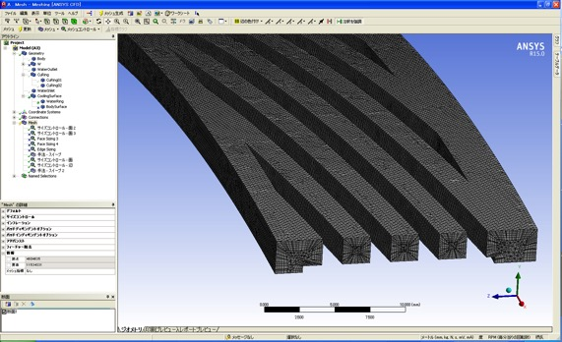
To Get Improved Safety (1)
Trying Better Cooling: water channel design
Outline
Detail: Old Design
(Model 39)
Detail: New Design
(Model 50)
detail

Slide 22
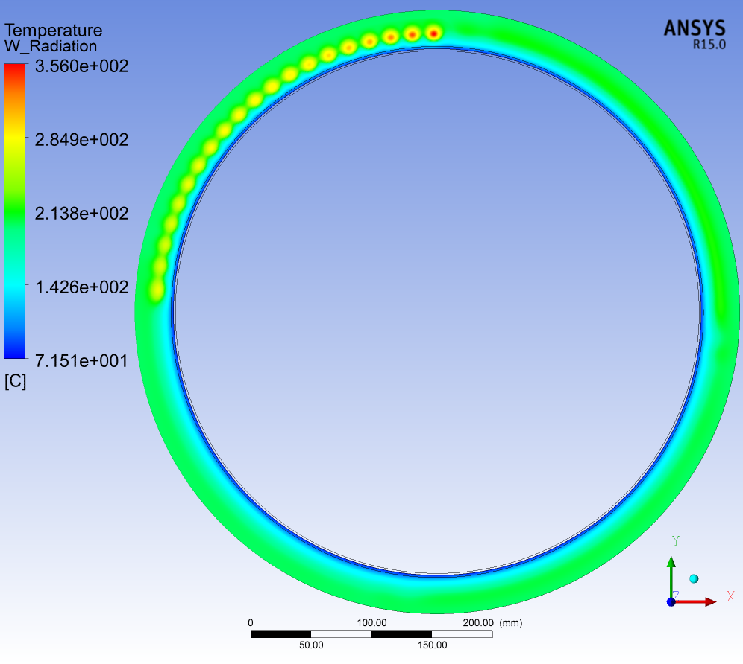
To Get Improved Safety (1)
Trying Better Cooling: water channel design
非定常解析 Pulse#02 225rpm
Pulse beam analysis: step 2
20 trains (pulses) in 63 ms
Temp.Max.; 356.0℃
About 100℃
reduction.
with new water
channel design
in the disk.
(Model 50)
Simulated by Rigaku

Slide 23
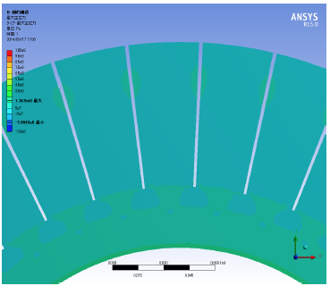
To Get Improved Safety
We have another room of improvement
  SIEVERS's law:
  Small pieces with many free bounderyes make stresses small.
Target outer disk
with radial slits

Slide 24
The target R/D (2)
Radiation Issues,
Vacuum Issues,
and
Prototype Target

Slide 25
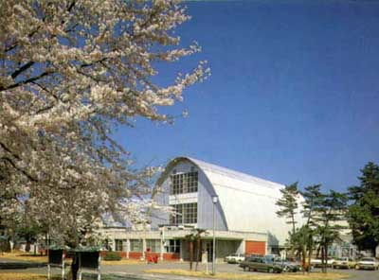
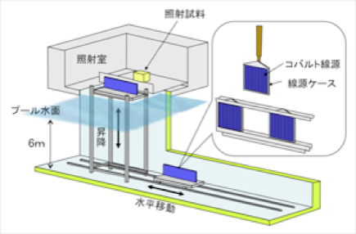
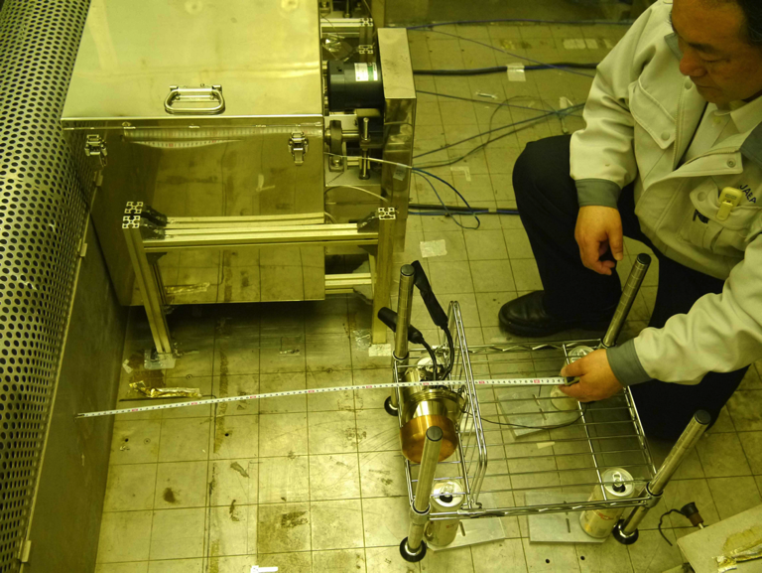
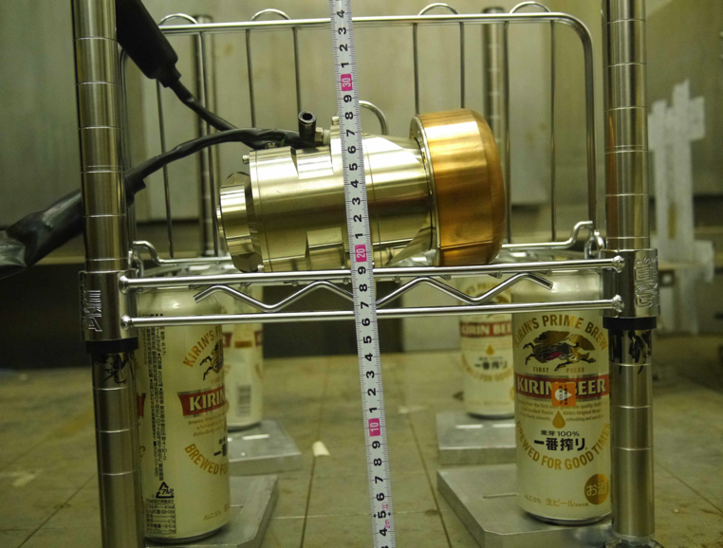
  TEST: Radiation Tolerance
Mar 2015
Takasaki Advanced Radiation Research Institute, JAEA
Irradiation to the small (d=10 cm)
off-the-shelf rotation target.
Radiation test of the whole system.
cf. ferrofuid test was already done separately upto 4.7 Mgy (3 ILC years).

Slide 26
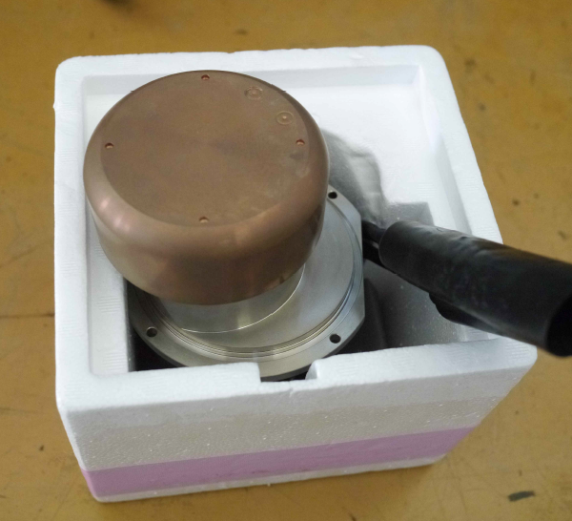
  TEST: Radiation Tolerance
Mar 2015
Irradiation to the small (d=10 cm) off-the-shelf rotation target
  Radiation test of the whole system: motor, bearing, ferrofluid,,,
  0.6 M Gy irradiation on the motor.
  corresponds 1 ILC year
Before Irradiation
After Irradiation
  After irradiation, we made rotation and vacuum test.
  We found NO problem

Slide 27
Plan of Prototpe in FY2015-2017
(1) We are making the prototype in three years (FY2015-2017).
(Old Plan: It was two-year plan in FY2015-FY2016)
(2) The prototype is full-size, d=500 mm.
(3) Full-size means that target wheel has the same radius,
the same weight, the same moment as those of the real
target. The locations of the vacuum seal and bearing
in the prototype are as same as those in the real one.
(4) The prototype is not totally as same as the real one.
• The prototype has no water channels in the disk.
• We don’t use W for disk.
(5) We will use irradiated ferromagnetic fluid in the
prototype.
(6) We will make continuous running test (~1 year?)
and will prove that vacuum always stay good level.

Slide 28
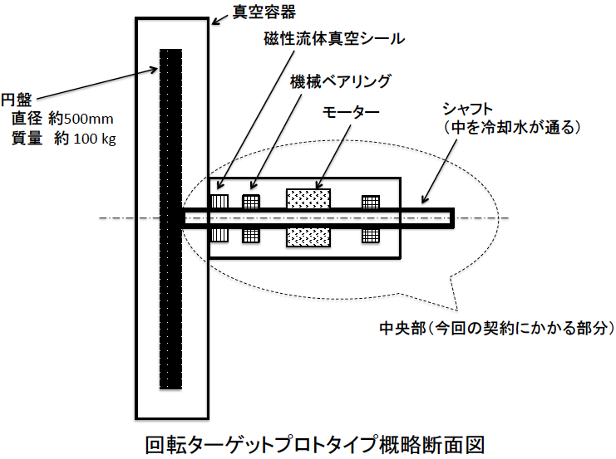
Prototype: We have made a contract with Rigaku.
vacuum chamber
ferrofluid seal
baring
motor
hollow shaft
disk
• d= 500 mm
• wait ~ 70 kg
• no water
channel
finished in FY2015

Slide 29
Prototype: We have made a contract with Rigaku.
vacuum chamber
ferrofluid seal
motor
hollow shaft
disk
• d= 500 mm
• wait ~ 70 kg
• no water
channel
Old plan:
We start making the disk beginning of JPY2016.
But, due to budget situation, we postpone making the disk for 1 year.
finished in FY2015

Slide 30
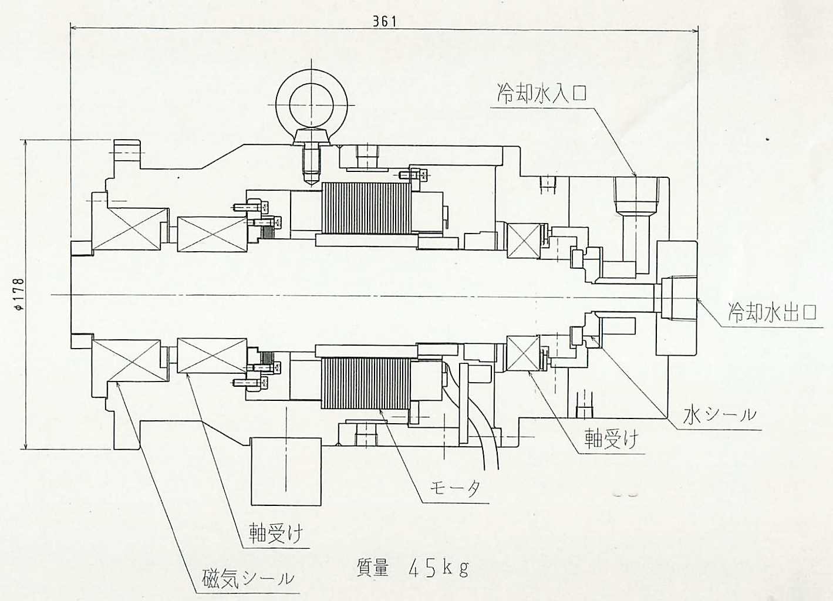
Prototype: Central Part
water inlet
hollow shaft
water outlet
water seal
baring
motor
baring
finished in March 2016
ferrofluid seal

Slide 31
Central Part Prototype Vacuum Test
Plan in 2016 June-November
Vacuum Level
Visual Check of ferrofluid after several month of operation
Residual Gas Analyzer

Slide 32
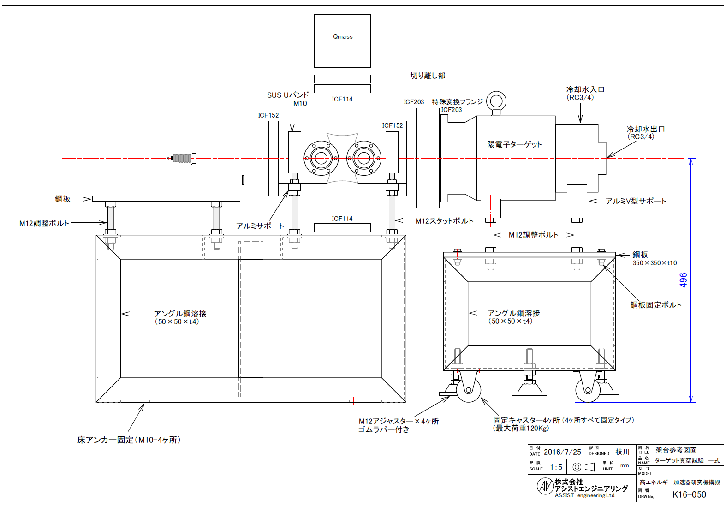
Central Part Prototype Vacuum Test
Plan in 2016 June-November
Plan in 2016 June-September
Vacuum Level
Visual Check of ferrofluid after several month of operation
Residual Gas Analyzer

Slide 33
Summary

Slide 34
Summary
Heat and Stress Simulations:
• Max stress of ILC target and SLC target are comparable.
• SLC target survived 3-4 years.
• Comparison of Number of hit / Year.mm
N_{ILC} = N_{SLC}/10
• We are pursuing better cooling for more safety.
• Possible stress reduction by divided rim?
2. Vacuum Issue and Prototype Target
• Irradiation test of the whole system (small off-the-shelf
rotation target) was performed. NO problem was found.
• Central part of the prototype was finished.
• Disk and large vacuum vessel delay due to budget.
• Central part vacuum test is planed in November 2016.

Slide 35
Backup

Slide 36
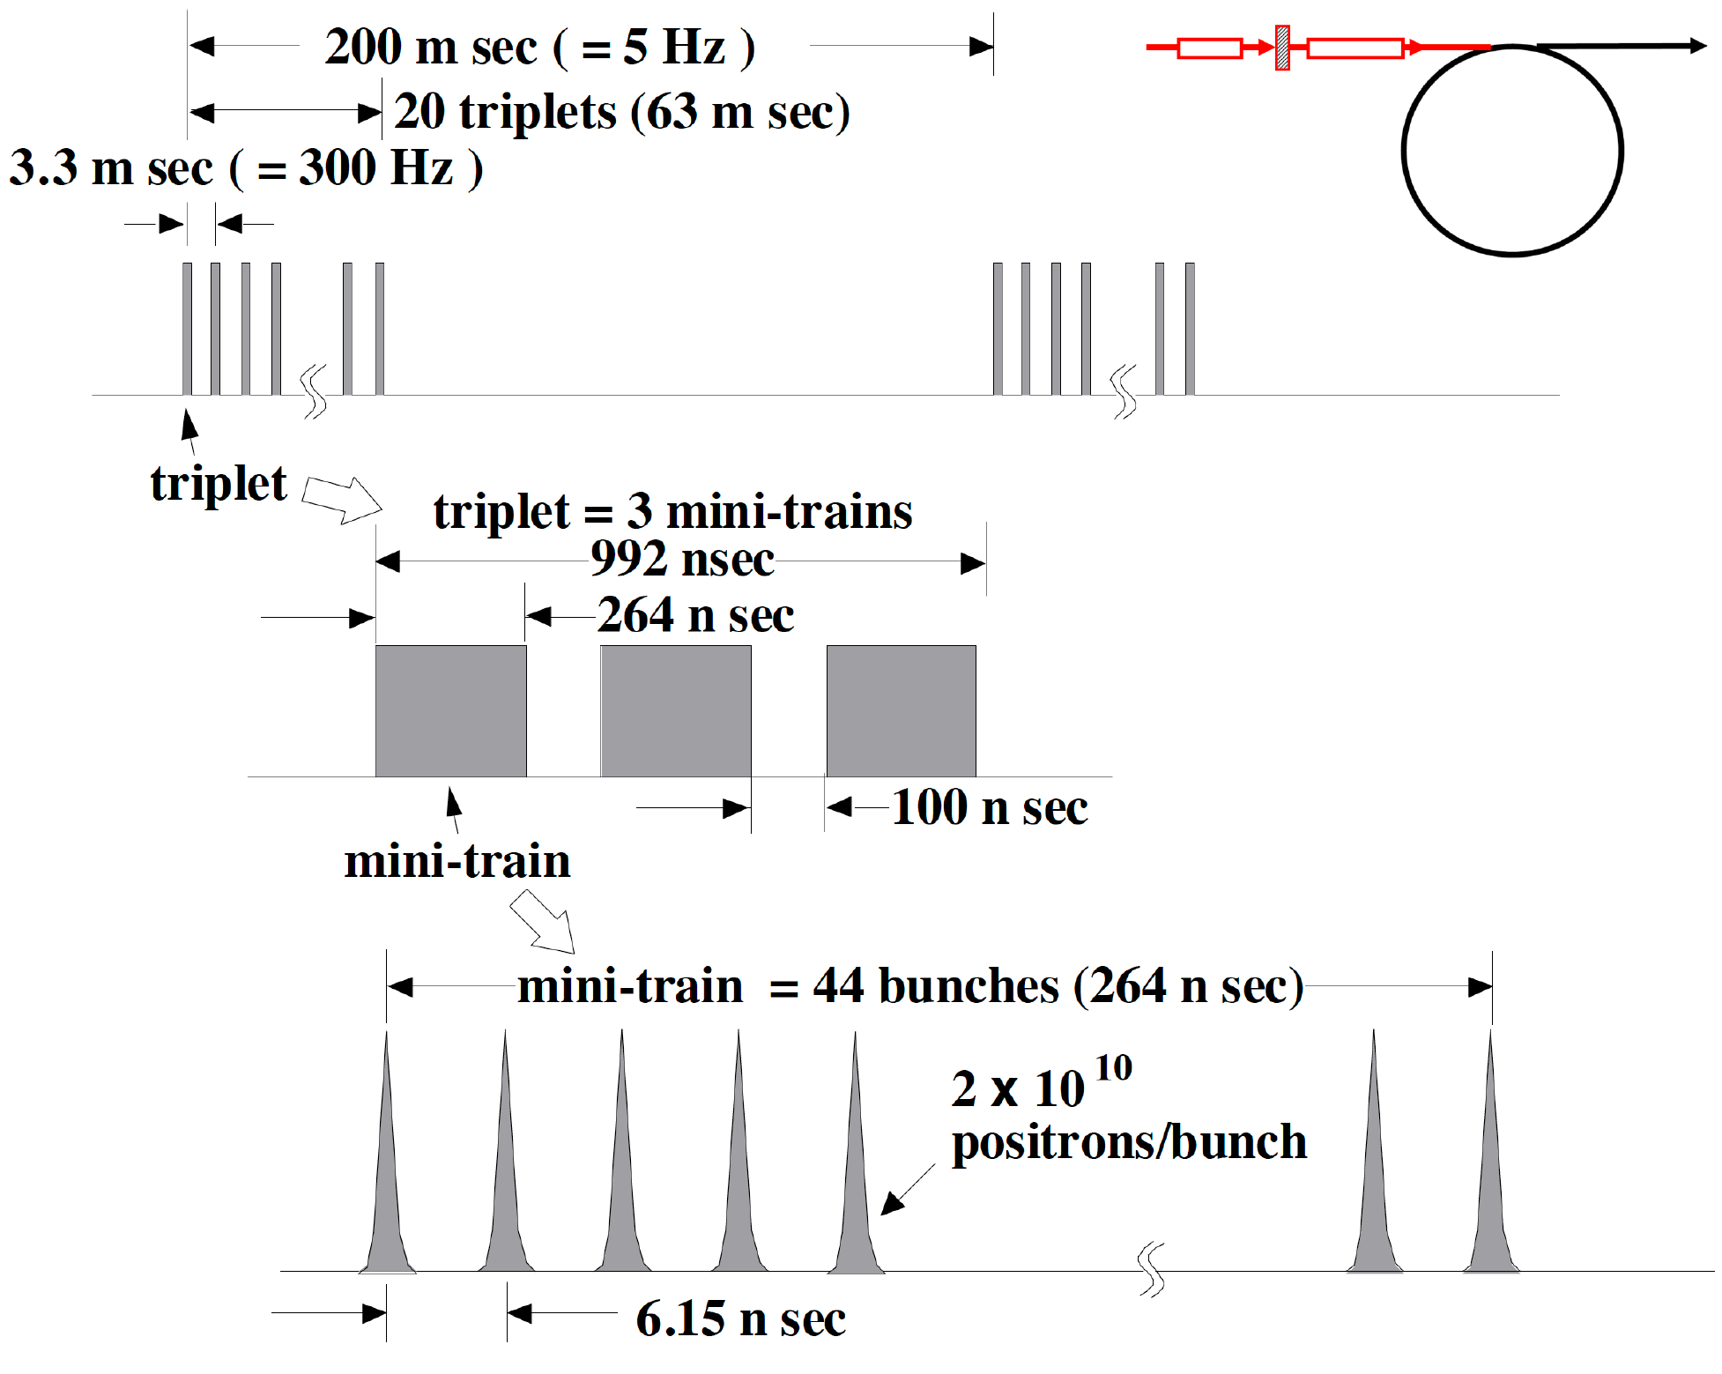
Beam before DR
=132 bunches
Injection: usual kicker ( ~ 1 us)
no stacking is necessary
<-- the 100 ns gap is required to cure
an e- cloud problem in e+ DR.

Slide 37
Conventional e+ Source for ILC
Normal Conducting Drive and Booster Linacs in 300 Hz operation
e+ creation
go to main linac
20 triplets, rep. = 300 Hz
• triplet = 3 mini-trains with gaps
• 44 bunches/mini-train, T_{b_to_b} = 6.15 n sec
2640 bunches/train, rep. = 5 Hz
• T_{b_to_b} = 369 n sec
Drive Linac
Several GeV
NC
300 Hz
Booster Linac
5 GeV
NC
300 Hz
DR
Target
T_{b_to_b} = 6.15 n sec
Amorphous Tungsten
Slow Rotation
2640 bunches
60 mini-trains
Today’s Talk
Time remaining for damping = 137 m sec
We create 2640 bunches
in 63 m sec
Stretching
NIM A672 (2012) 52—56
Notes:
37

Slide 38
Thermal Analysis: Target Model and Cooling Condition
FY2014-2015
Model : 500 mm diameter rotation target
Rim (φ500-φ366×14t) W + Central Cu Disk (water flow inside)
Rotation: 200 - 600rpm
Water temperature at inlet: 25 ºC
Software; ANSYS CFX
Model 39

Slide 39
Points of the prototype
The loads on the vacuum seal and the bearing are determined by the weight and the moment of the target disk.
So we will make full size prototype.
The purpose is vacuum test.
It is not necessary to use W for the disk.
We don’t use W for cost saving.
Water channels will be unimplemented. It is cost saving. Target rotation is slow, water circulation is within the past experience of the company. We have no need to demonstrate.

Slide 40
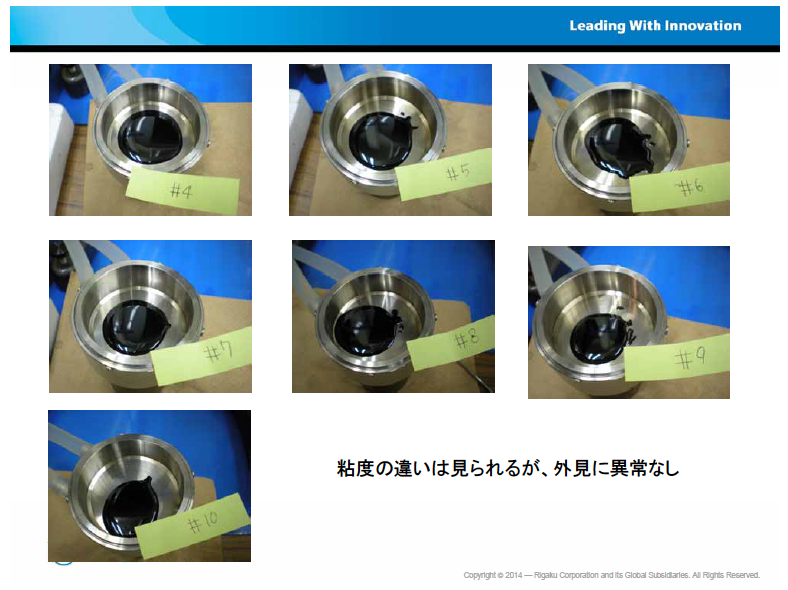
  TEST: Radiation Tolerance
FY2014
  More systematic study for CN oil
November 2014

Slide 41
Seal against Water
Seal against Ar
Seal against Air
Ar-purging
Ferrofulid seal
Magnet

Slide 42
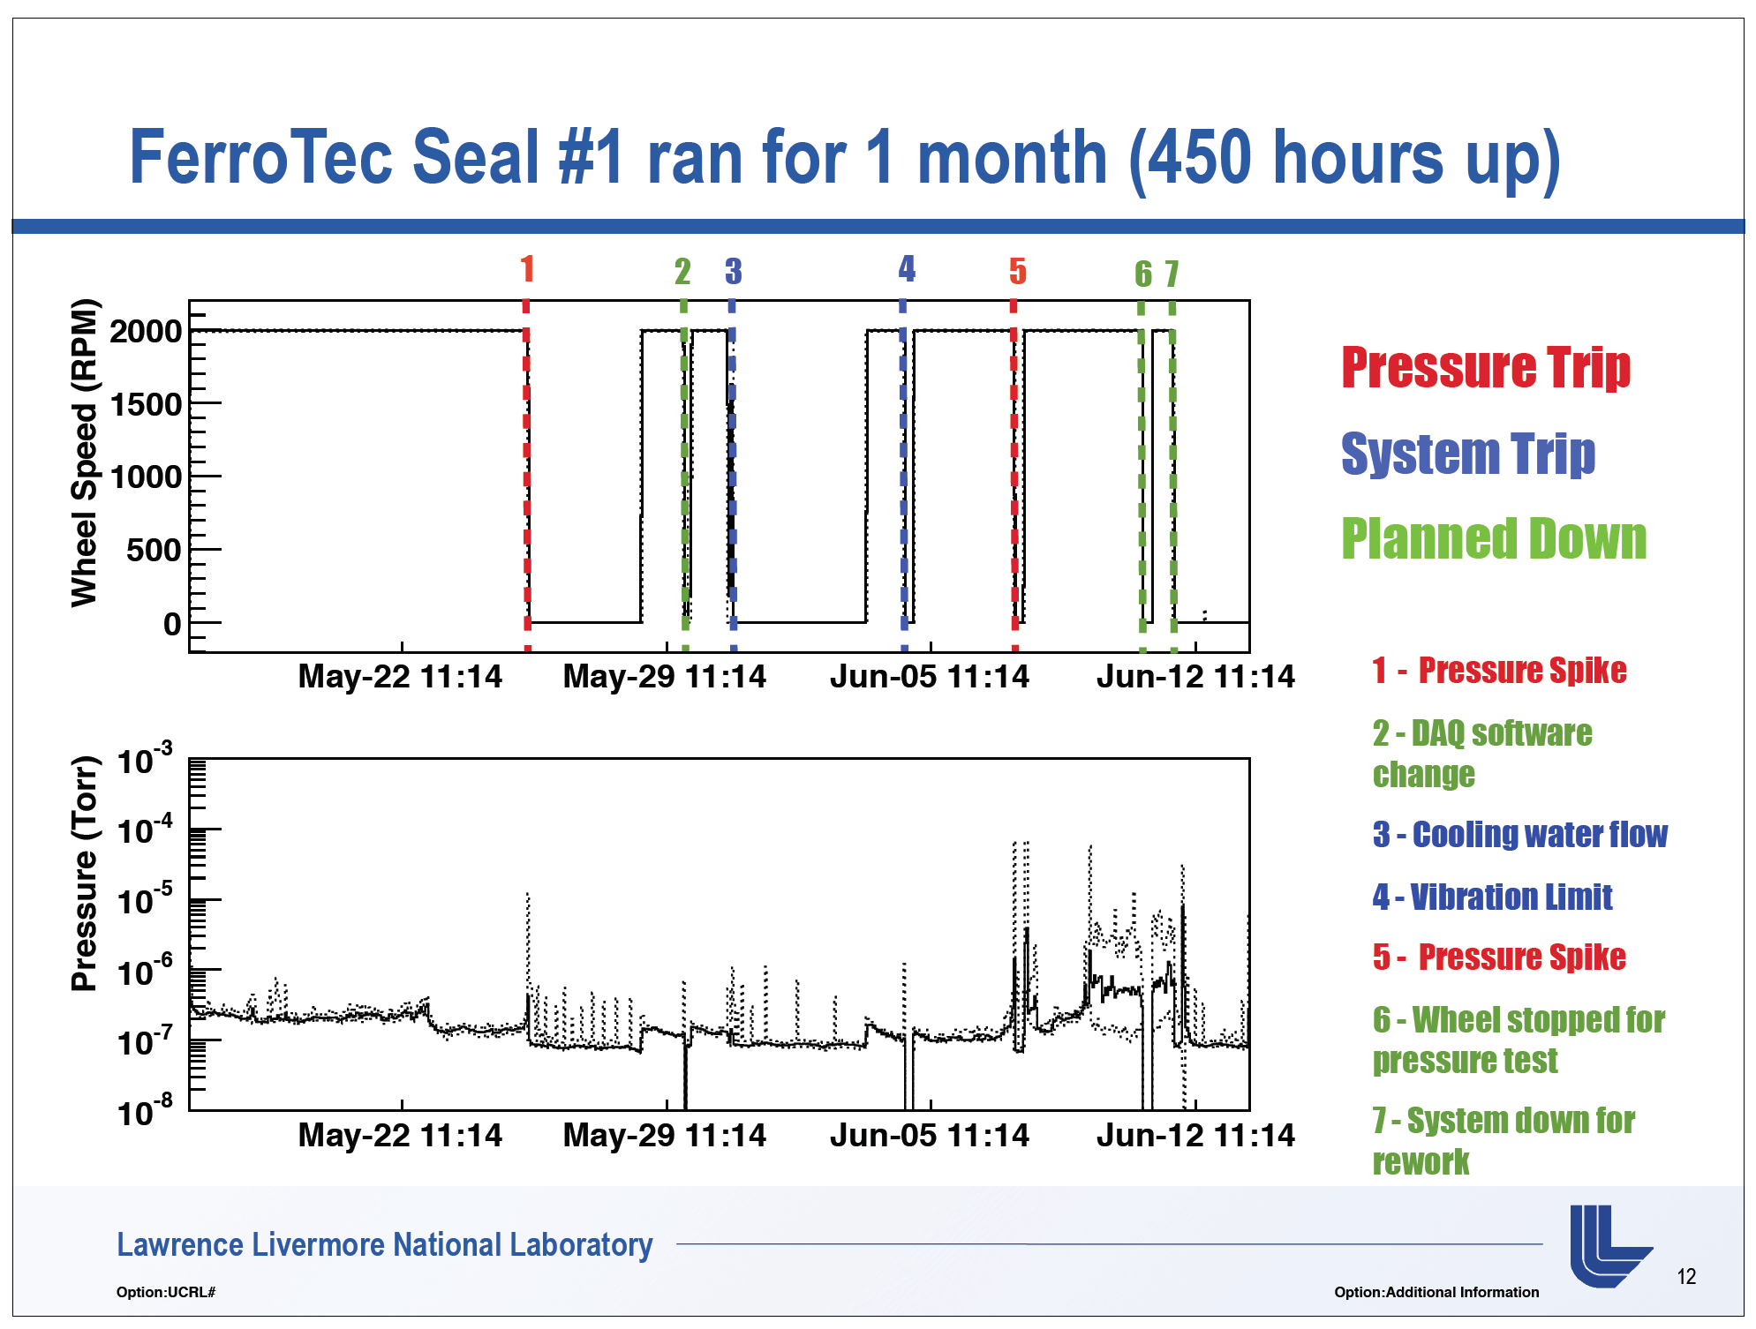
undulator source：Vacuum test of rotation seal
Issue of Slow Rotation Target
Issue: Can we sustain ultra-high vacumme?

Slide 43
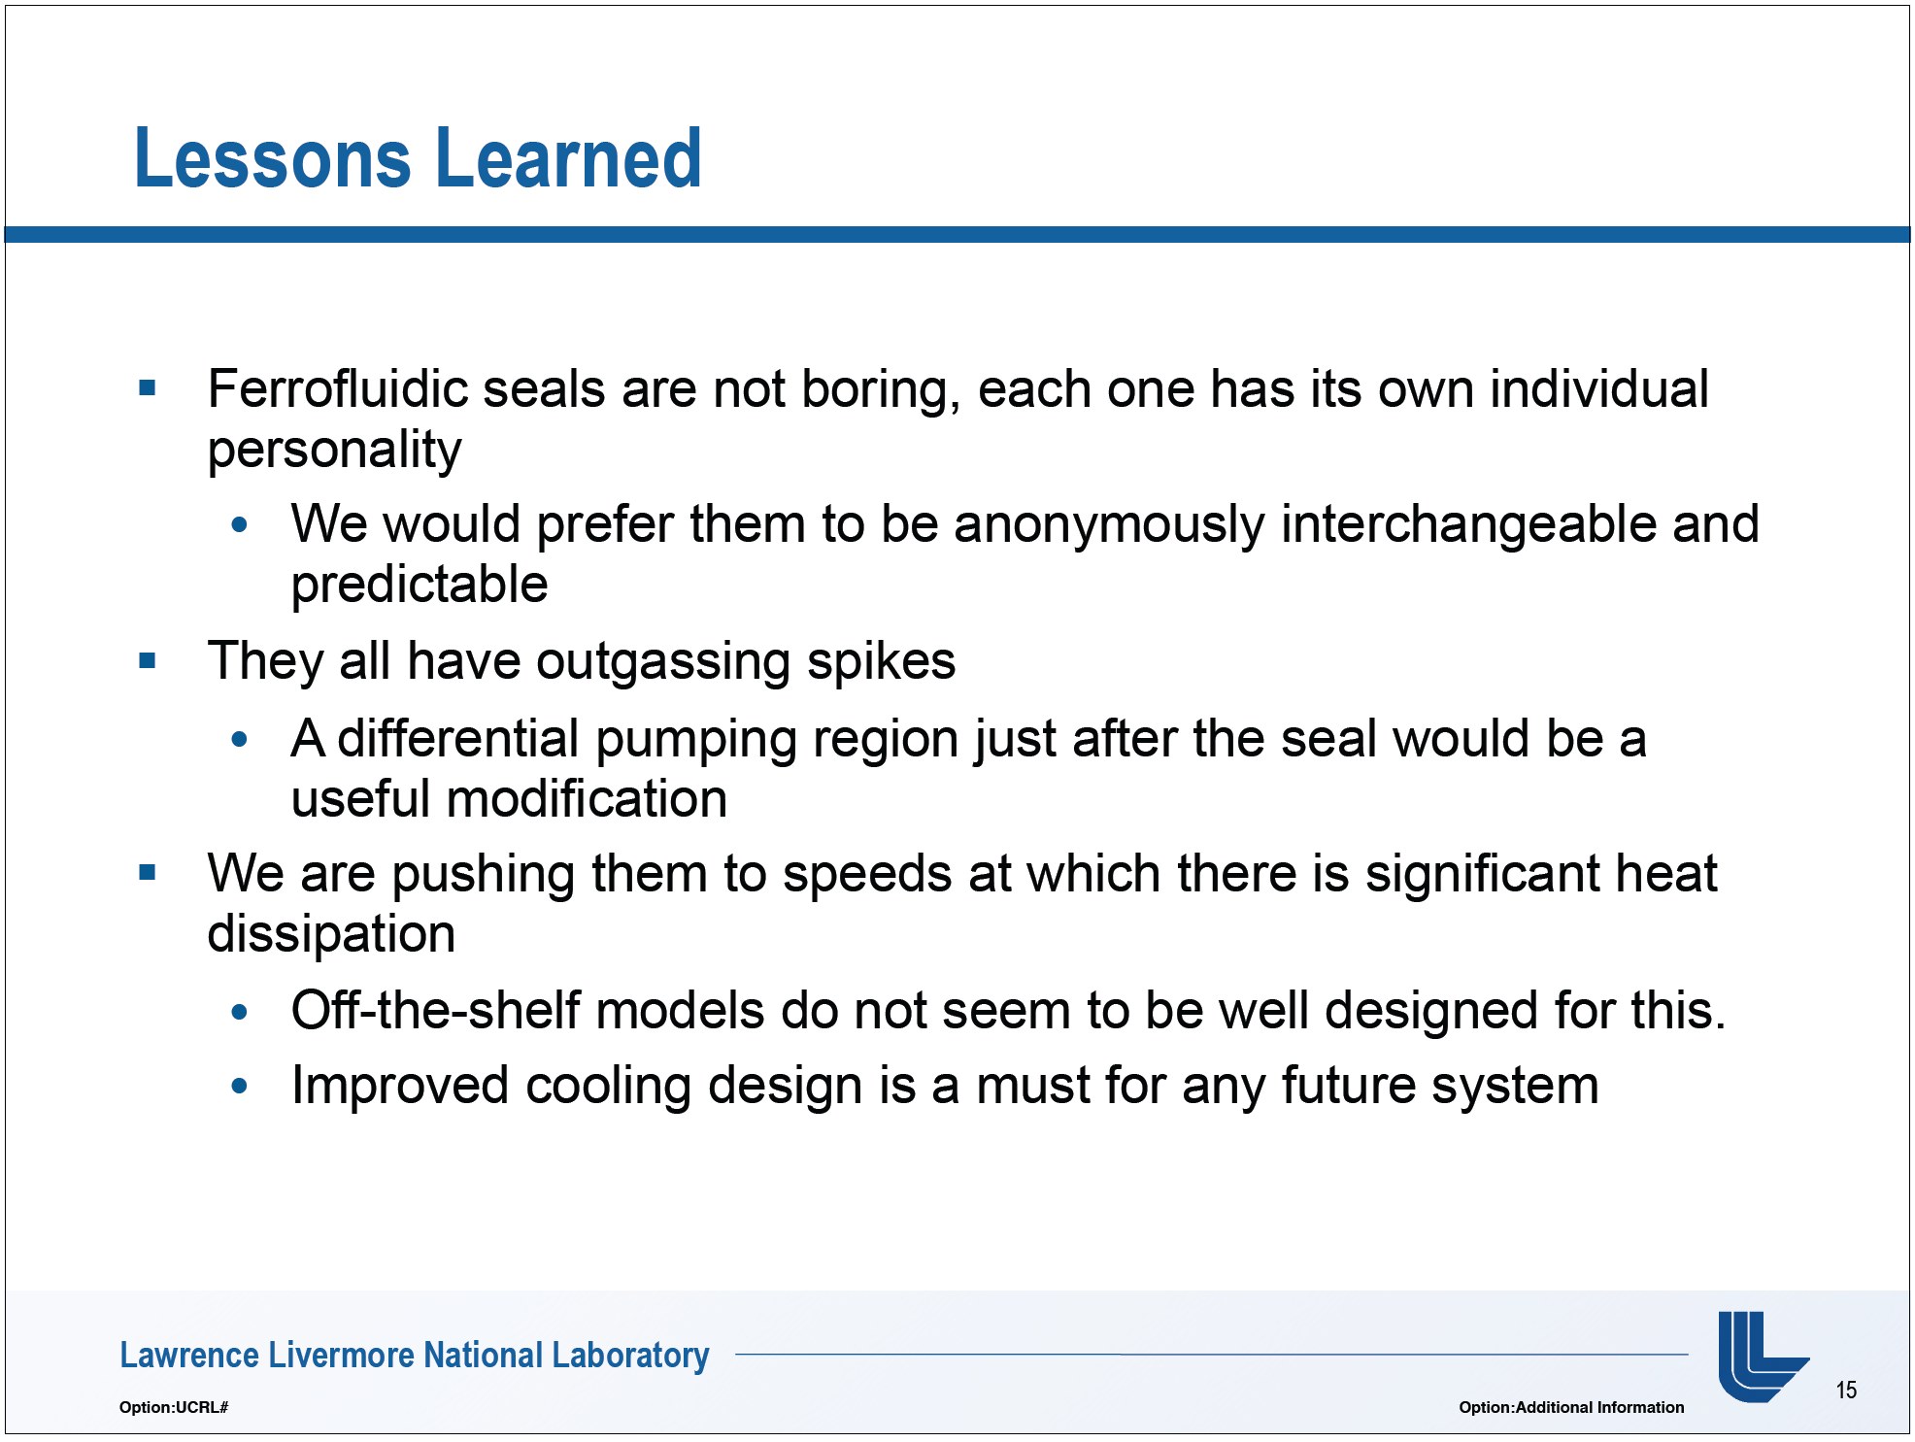

Slide 44
  Rotation target design study: ongoing with Rigaku
FY2014-2015
  Points:
  Diameter, material, shape, rotation speed, cooling,,,
  B-filed on the target disk (Hiroshima),
  Flux concentrator (IHEP, BINP)

Slide 45
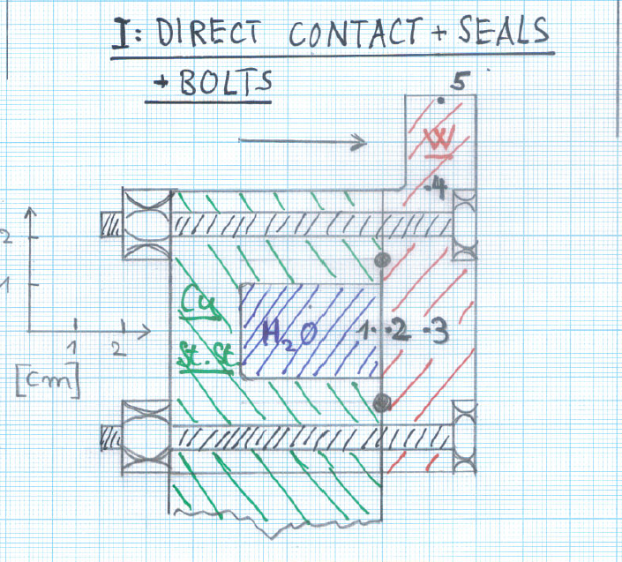
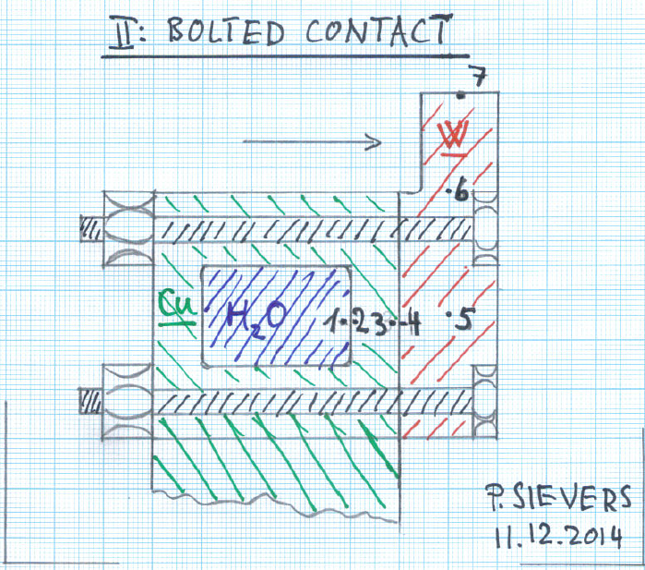
Peter SIEVERS (CERN)
Rotation target design study
FY2014
Ｉ Direct Cooling
ＩＩ Indirect Cooling
Ｉ 直接冷却
ＩＩ 間接冷却
W-Cu joint
metal gaskets
remain UHV leak tight?
"monolithic welded water circuit entirely of the same material (Cu)”

Slide 46
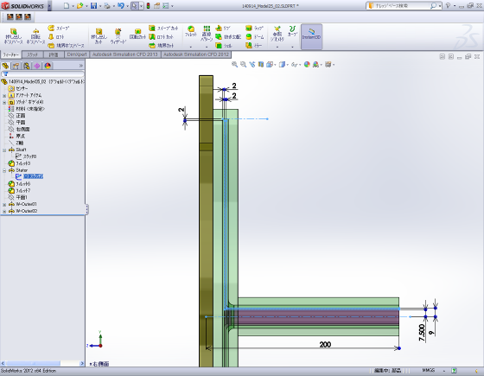
Rigaku
Rotation target design study
FY2014
Ｉ Direct Cooling
ＩＩ Indirect Cooling
Ｉ 直接冷却
ＩＩ 間接冷却

Slide 47
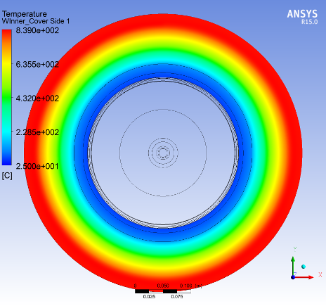
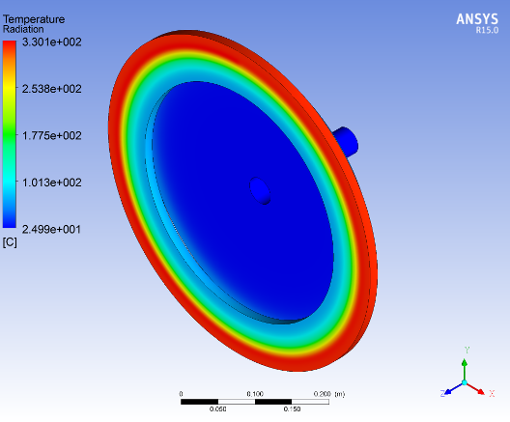
Rigaku
Rotation target design study
FY2014
Ｉ Direct Cooling
ＩＩ Indirect Cooling
Temperature Distribution
Temperature Distribution
Max. 330℃
Max. 840℃
600rpm
CW Beam
Conclusion: Indirect cooling is better.

Slide 48
  TEST: Radiation Tolerance
FY2013: Conclusion
F-oil
Dissociation/degradation occurred at low dose,
0.27 MGy. No hope.
CN-oil
Viscosity increased, but NO dissociation/
degradation occurred.
-->
We planed more systematic study.
• Viscosity change as a function of dose.
• Use irradiated fluid in vacuum seal.

Slide 49
The target R/D
in 2013-2014, and
the first half of 2015.

Slide 50
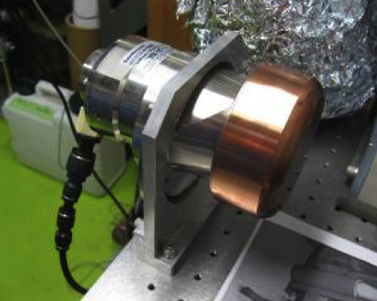
TEST: Vacuum Leak Rate
Conclusion: No problem
Leak Rate Measurement:
various speed, various temperature
no problem (both CN-oil and F-oil)
Lake rate was small enough.
We can get P< 1x10⁻⁷ Pa, if we put reasonable
pumps (several 1000 letters/s) at the upstream
of the target.
FY2013
Small (d=10 cm) off-the-shelf rotation target

Slide 51
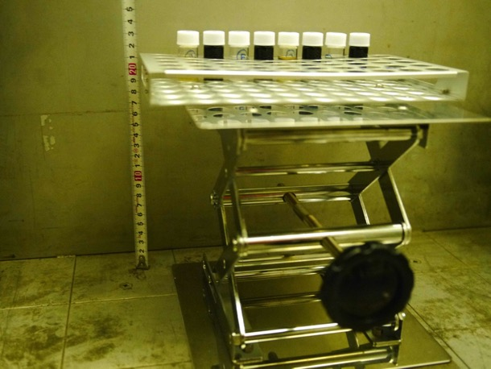
Radiation Tolerance Test FY2013
Takasaki Advanced Radiation Research Institute, JAEA
Gamma-ray source: Co 60
1.1 x 10⁴ Gy/h
Photo: Dec/2013

Slide 52
2016年2月4までのシミュレーションのまとめ
132 bunch (= 一塊 = 回転ターゲットから見た時の１パルス) が１ケ所に当たる部分の peak 温度は466 度C
466 度C の部分のストレスは 530MPa (圧縮)
この状況は安全か？。
500 度C の時の W-Re の fatigue limit は 520 MPa
（Yield Strength は 1300 MPa)
したがって 466 度C で 530 MPa は Fatigue Limit ギリギリの所。
結論
現状設計では Yield strength に対しては十分余裕があるが、Fatigue Limit (多数回の繰り返しを考量した値)を考えるとマージンは
ゼロ。

Slide 53
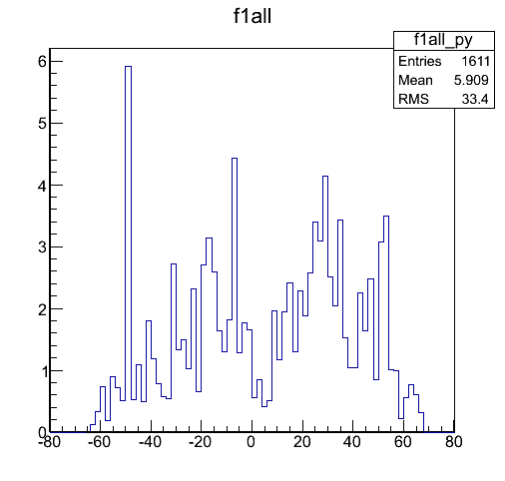
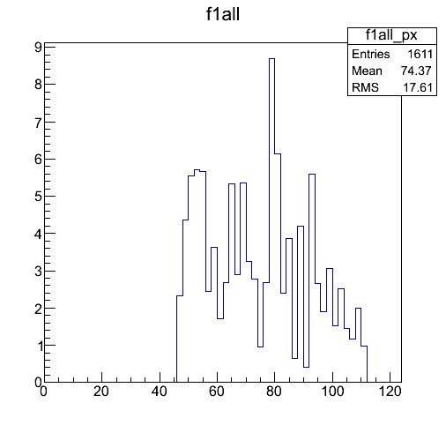

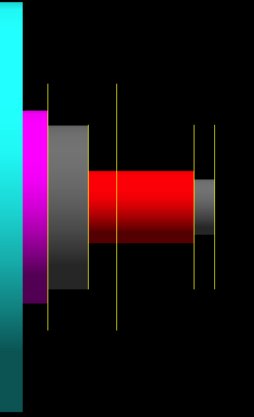
Results
  Dose Estimation
FY2014
d = 40 cm with radiation shield
T. Takahashi (Hiroshima)
Energy Depotit(MeV)/2mm/5×10^5e-
S(mm)
Z(mm)
S
Z
Peak 1.5MGy/year
(2630 bunches/pulse, 5Hz 2e10/bunch 1 year = 10^7s)

Slide 54
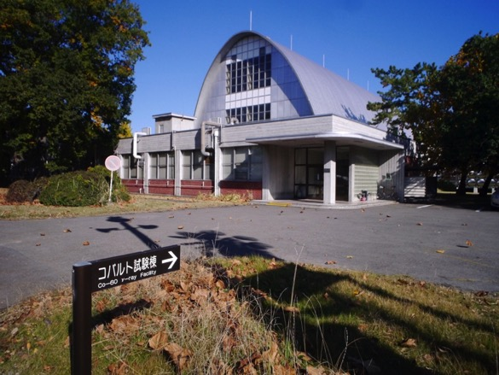
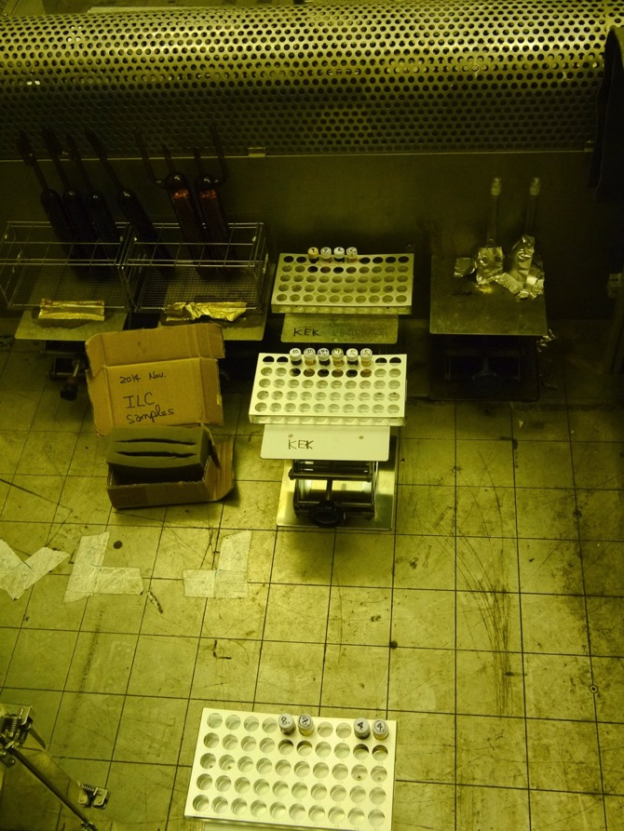
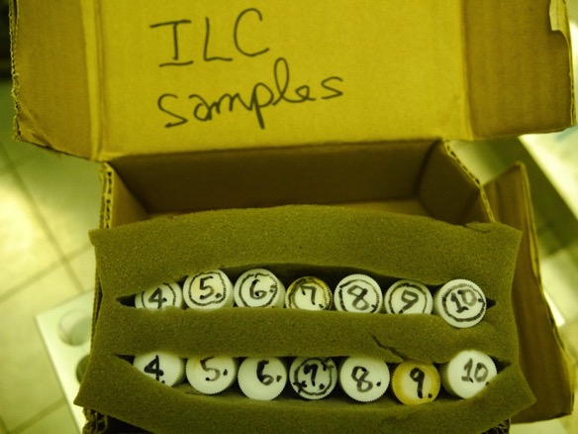
  TEST: Radiation Tolerance
FY2014
Takasaki Advanced Radiation Research Institute, JAEA
November 2014
  10-Nov-2014

Slide 55
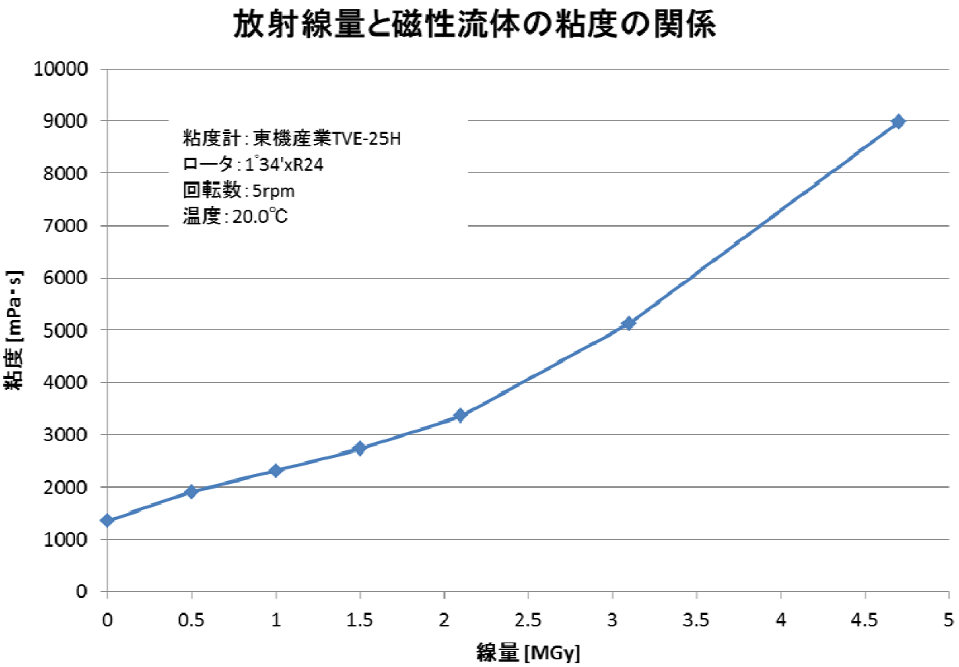
  TEST: Radiation Tolerance
FY2014
November 2014
  More systematic study for CN oil
Viscosity as a function of dose
Viscosity
Dose [MGy]

Slide 56
  TEST: Radiation Tolerance
FY2014
November 2014
  More systematic study for CN oil
Viscosity as a function of dose
4.7 MGy
Viscosity
Dose [MGy]

Slide 57
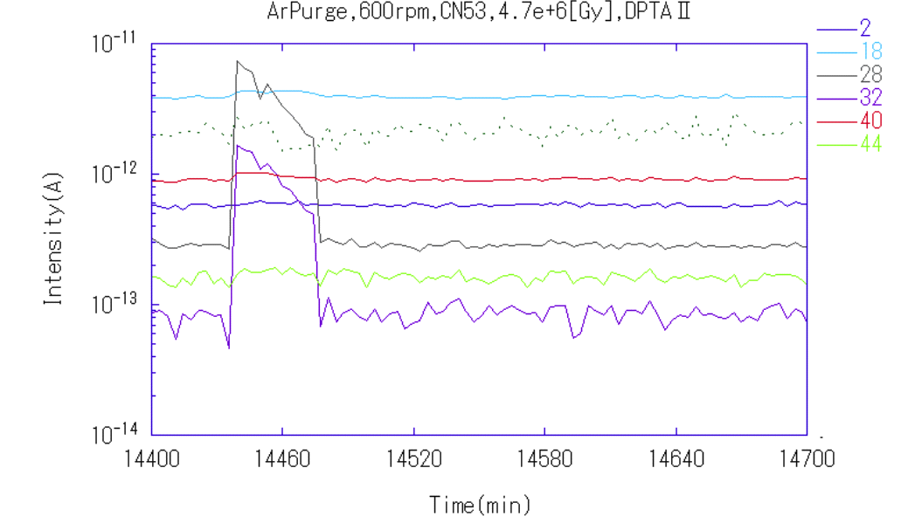
PY2014: Radiation Test:
• We used irradiated CN-oil (4.7 MGy) in a small rotation target.
• Made vacuum test after Ar-purging.
Air atmospher
Ar purge seal test
Ar
Vac.
RGA
The seal dosed 4.7 MGy (3 ILC year) is examined with Ar purged chamber.
Rotation : 0-600 rpm.
No leak was found. (m/q = 28 and 32 are N₂ and O₂ from air)
FF seal
N₂(28)
Ar(40)
O₂(32)

Slide 58
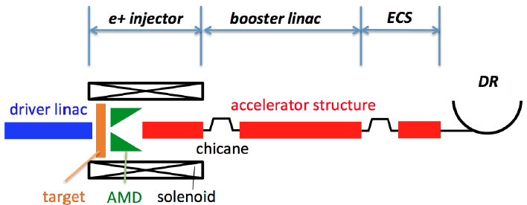
Seimiya & Kuriki
(Hirosima U.)
FY2014
Rotation target design study
AMD is employed is a capture section.
The AMD will be a pulse Flux Concentrator.
Seimiya, Kuriki (Hirosima U.), et al.
Submitted to PTEP
Need to consider the effect of the Flux Concentrator leakage field on the target disk.

Slide 59
FY2014
Rotation target design study
The effect of the FC leakage field on the target.
The FC B-field is pulse.
The pulse is fast.
half cycle ~12 micro second (roughly sinusoidal)
Dominant
(2) The target is rotating.
Rotation is slow. ~5 m/s.
Small, Negligible (2)/(1) ~ 1/1000

Slide 60
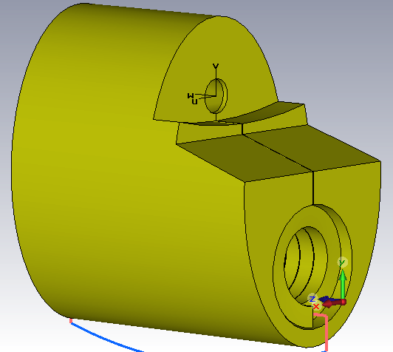
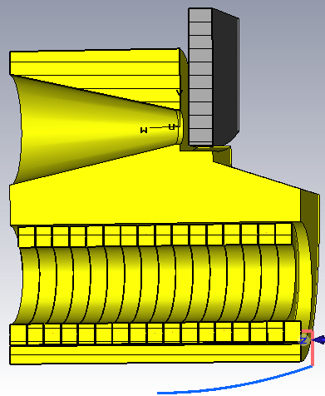
Pavel Martyshkin (BINP)
FY2015
Rotation target design study
Flux Concentrator (FC) leakage field on the target disk.
Cone diameter is 16 mm (Nose FC)
Sun Xianjin (IHEP) also made a study too, based on another design (2014-2015).

Slide 61
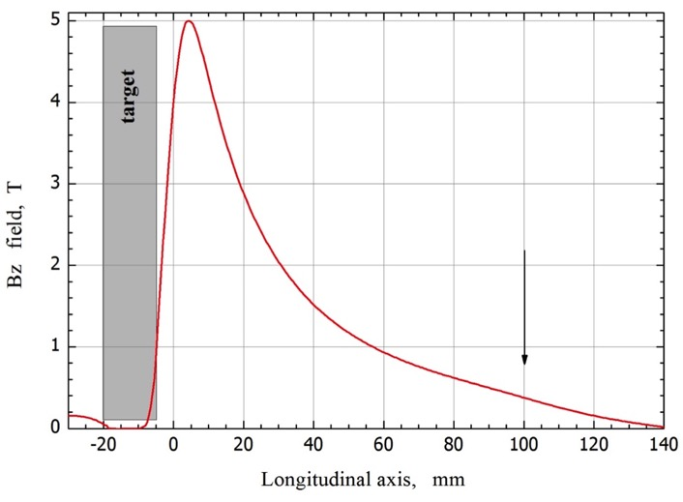
Pavel Martyshkin (BINP)
FY2015
Rotation target design study
Flux Concentrator (FC) leakage field on the target disk.
Cone diameter is 16 mm (Nose FC)
Nose FC type
D 16 mm
25 kA
5 Tesla
50-60 mTesla
half of sine
25 µs
≈ 10 J/pulse
≈ 140 J/pulse
3.2 kW
41 kW
B = 1 Tesla at Target Disk
Peak current
Peak field
Peak transverse field
Current shape
Current pulse length
Target ohmic loss
FC ohmic loss
Repetition rate 300 pps *
Target losses *
FC losses *
* When we calculate real average, we need to divide the numbers by three.
Sun Xianjin (IHEP) also made a study too, based on another design.

Slide 62
FY2014-2015
Rotation target design study
The effect of the FC leakage field on the target.
Heating:
1 kW (3.2 kW in 63 msec). It is 1/30 of the heat by beam.
Conclusion: No problem.
Note:
At LCWS2015 (Tsukuba), Omori reported heating is
190kW. It was rough estimate by hand.
Omori reported that we need cure.
But new conclusion based on detail simulation is
NO PROBLEM.
Forces:
Small in both braking and attractive/repulsive forces.
Conclusion: No problem.

Slide 63
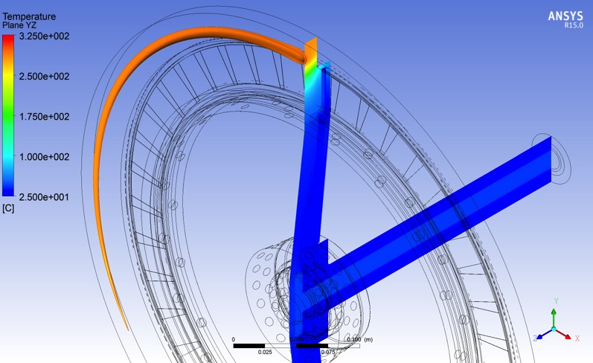
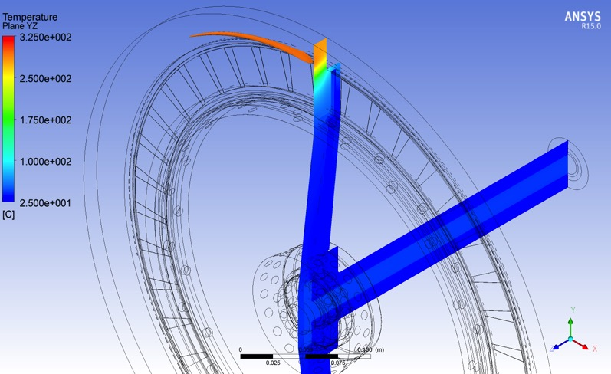

Temperature in various rotation speeds: CW beam analysis
200rpm
Max.; 322℃
400rpm
Max.; 304℃
600rpm
Max.; 298℃
等温度平面; 295℃
Nb=2600

Slide 64
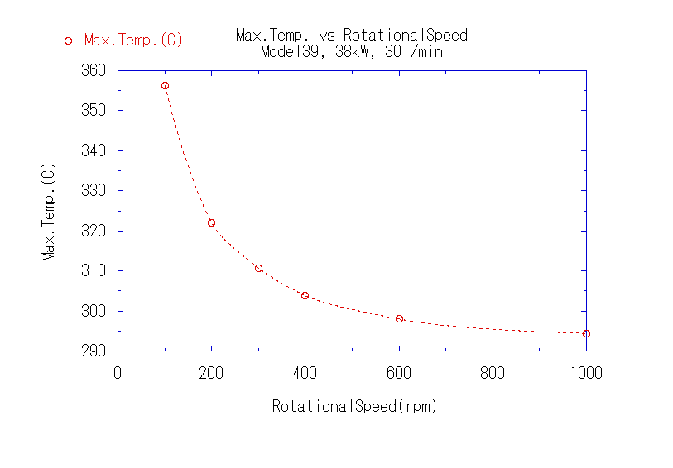
Temperature in various rotation speeds: CW beam analysis
Nb=2600

Slide 65



Stress: rotation speed 200 rpm, CW Beam analysis
Direction (arrows)
Min Principal Stress (Compression)
→ - 3e+8Pa
Max Principal Stress
(Expansion)
→ 2e+8Pa
高温部の応力を正確に得る為に非定常解析が必要
Nb=2600

Slide 66
Thermal Analysis:
We did both CW beam analysis (for simplicity) and
pulse beam analysis (more realistic).
We assume 2600 bunches in all analysis.
• CW beam analysis
38kW (35kW+3kW⁽*⁾) CW
FY2014-2015
* Note
3 kW is not correct
should be 1 kW
beam
FC
• Pulse beam analysis: step 1
114.1 kW(111.1kW+3kW) 63 ms
0 kW ( 0kW+0kW) 137 ms
FY2015 New
Reported in Posipol 2015
beam
FC
• Pulse beam analysis: step 2
20 trains (pulses) in 63 ms
New²
• Common condition
Cooling water: 30 l /min, T at inlet: 25℃

Slide 67


Pulse beam analysis: Comparison of 200 rpm and 220 rpm
step 1
200 rpm
220 rpm
After reaching steady state
After reaching steady state
Max Temp = 441 ºC
Max Temp = 373ºC
220 rpm is BETTER than 200 rpm.
At 220 rpm: Temperature more UNIFORM and LOWER maximum value.
Simulated by Rigaku
At Posipol 2015, Omori presented 200 vs 180.
Nb=2600

Slide 68
Rotation = 220 rpm : Photos of 1st turn.
Photos = Lab. Frame Views
• Photo 1
Beam
• Photo 2
Beam
• Photo 3
Beam
Begin 1st turn
On
On -> Off
off
Just after
T = 0
End of 1st shot
T = 63 ms (~ 68)
T = 136 ms (68 x2)
Rotation
Rotation
Rotation
1st shot starts T=0
• Photo 4
Beam
• Photo 5
Beam
• Photo 6
Beam
End 1st turn
Off -> On
On
On -> Off
Just after
T = 200 ms (~68x3)
End of 2nd shot
T = 263 ms (~68x4=272)
T = 200 ms (~68 x 3)
Rotation
Rotation
Rotation
2nd shot starts T=200
One turn takes 272 m sec.
272 m sec / 4 = 68 ms
68 ms ~ 63 ms (duration of beam on)
68 ms x 2 ~ 137 ms (duration of beam off)
68 ms x 3 = 200 ms (one cycle of ILC)

Slide 69
Rotation = 220 rpm
Target Rest Frame Views
2nd shot
1st shot
off
off
off
9
off
4
1
8
5
12
1st turn
2nd turn
3rd turn
3
2
7
6
11
10
3rd shot
off
off
off
off
4th shot
5th shot
13
4th turn
One turn takes about 272 m sec.
Each Red number (1, 4, 7, 10, 13) corresponds 63 m sec.
Each Green number ( 2,3, 5,6, 8,9, 11,12 ) corresponds 68.5 m sec.
63ms + 68.5ms + 68.5ms = 200ms

Slide 70
Rotation = 200 rpm
Target Rest Frame Views
1st shot
off
5
off
1
9
off
2nd shot
6
4
1st - 2nd turn
2nd turn
1st turn
2
8
3
off
7
off
3rd shot
4th shot
10
5th shot
13
3rd turn
11
12
off
off
One turn takes about 272 m sec.
Each Red number (1, 4, 7, 10, 13) corresponds 63 m sec.
Each Green number ( 2,3, 5,6, 8,9, 11,12 ) corresponds 68.5 m sec.
63ms + 68.5ms + 68.5ms = 200ms

Slide 71

Pulse Beam Diagram
Rotation speed = 220rpm
hit = 111 kW in 63 ms
Schematic diagram of the first 1 sec.
hit
cool down
Remaining
heat
Temperature (NOT scaled)
Vertical scale shows just symbolic expression
cool down
Remaining
heat
cool down
Remaining
heat
Schematic diagram
made by Rigaku
Note: actual temperature is determined
by sum of the hit and remaining heats.

Slide 72

Pulse Beam Diagram
Rotation speed = 200rpm
hit = 111 kW in 63 ms
Schematic diagram of the first 1 sec.
hit
cool down
Remaining
heat
Temperature (NOT scaled)
Vertical scale shows just symbolic expression
cool down
Remaining
heat
cool down
Remaining
heat
Schematic diagram
made by Rigaku
Note: actual temperature is determined
by sum of the hit and remaining heats.

Slide 73
解釈（これは安全か？）
SLCのターゲットの実績と比べてみる
SLCのターゲットの Max ストレスは約 500 MPa (by Freidrich さん)→ ILC とほぼ同じ
SLAC 自身による解析 (SLAC-PUB-9437) では Max ストレス 560 MPa→ ILC とほぼ同じ
SLCのターゲットは数年の間、壊れずに動いた

Slide 74
解釈（これは安全か？）
SLCのターゲットの実績と比べてみる：続き 年間の hit 数を比べる
シャーワーによるエネルギー密度 (Max) SLCがおよそ 29 J/g（１バンチ）,
ILCのパラメーターは 132 バンチが事実上一ヶ所にあたり、その合計で、約27J/g
パルスあたりのエネルギー密度はほぼ同じと考えていい。（この場合 SLC は１バンチが１パルス、ILC は 132 バンチを纏めて１パルスとしている） これは、 Max ストレスが
SLC と ILC でほぼ同じであることとコンシステント。
この場合は 入射ビームエネルギーや、ビーム半径の因子は、この数値に繰り込まれているので、パルス数での比が妥当な計算。
ビーム半径の因子はすでに織り込まれていることから、単位面積あたりのパルス数ではなく、単位周長あたりのパルス数を比較する
ビームが落ちる周長の比較
SLCでは 180mm
ILCでは 1500mm
の領域（長さ）がビームを受け入れる。

Slide 75
解釈（これは安全か？）
SLCのターゲットの実績と比べてみる： 年間の hit 数を比べる （続き）
パルス数をこれで除したものが、年間あたりの周長あたりのパルス数。
SLC 120 x 3600 x 24 x 365 / 180 = 2.1 e+7 pulse/year.mm
ILC 2600/132 x 5 x 3600 x 24 x 365 / 1500 = 2.1 e+6 pulse/year.mm
（SLC は１バンチが１パルス、ILC は 132 バンチを纏めて１パルスとしている）
年間 hit 数では ILC は SLCとくらべて 10 倍らくと考えられる。
注意：
これはかなり荒っぽい計算

Slide 76
Summary of the R/D
in Past 2.5 Years:
FY2013-mid.FY2015

Slide 77
FY2013: Leak Rate measurement
We took leak rate data by using a small (d=10cm)
rotation target off the shelf.
Conclusion: Leak Rate is small enough.
FY2013-2014: Radiation Test:
We made radiation test of ferrofluid at Takasaki Lab.
Conclusion:
F-oil: No hope.
CN-oil: No problem up to 4.7 MGy (about 3 ILC years).
FY2014-2015: Target Design Study.
We made design study with the company, Rigaku.
Study included both mechanical design and thermal
stress analysis.
We now have a nearly final mechanical design.
Thermal stress study is ongoing.

Slide 78

Pulse Beam Analysis
Rotation speed = 220rpm
step 2:
20 trains in 63 ms
1 train = 373000 kW(**) in 0.99 micro s (*)
train to train separation: 3.3 m sec
1 train simulated
* Note: 1
One train corresponds 132 bunches,
but time structure in a train is ignored.
464 ºC
at train hit
Note: 2
Pulse width of a train is NOT 0.99 m
sec. It is 0.99 micro sec.
We made correction
But difference in the results are small.
baseline temperature
262 ºC
Corrected.
** Note: 3
This value is NOT accurate.
This is 5% larger than correct value.
Simulated by Rigaku
Nb=2600
T. Omori, LCWS 2015, 3-Nov-2015, Whistler, CANADA

Slide 79

Posipol 2015 以降 (2015年9月7日以降) の解析
(2)
まず (1) の方法で十分に長い間シミュレーションし定常状態に達した後、その温度分布を元に、引き続いて、1 μsの間に 132 バンチがほぼ同一地点に当たるパルスの peak (1μs の間に 373 MW(注1)：132 バンチはまとめて一塊=パルスとする）をシミュレーション。
Max 435 度C (@220rpm)
前ページの場所(注3)のストレスを求める。
注3）前ページでは 466 度C となっている。
本当は 466度C であるべきだが、間違った温度分布が使われている。
ただしこのことによる差異は小さい。
山片さんの 2016年2月4日のメール
160204_Model39_3D_最小主応力_拡大.jpg
Max 応力
530 MPaの圧縮力(符号がマイナス)

Slide 80
  Dose Estimation
30
W
FY2014
Cu
d = 40 cm with radiation shield
T. Takahashi (Hiroshima)
200
165
W
85
5
Fe
50
17
FerroFluid
64.5

Slide 81
Conventional e+ 源 (E-Driven) のR/D
ターゲット R/D
回転ターゲットは、類似のものが X 線発生目的で数多く作られているが、ILC 陽電子源の要求は、重量、大きさ、真空度などで、かなり異なる点がある。シミュレーションだけで十分でない部分もあり ILC がアプルーブされる前に実機大モデルの製作・実証が必要。
0. これまでに磁性流体の耐放射線試験や熱負荷、
冷却、ストレスを考慮した基本設計を実施
1. 従来の計画（右図）
実機大モデル（＊）を H27-H28年度 で製作
H27 : 中央部製作
H28 : ディスクと真空容器製作
長期間運転：真空テスト
（＊）実機大ではあるが、ディスクの材質は
W ではない、ディスクに冷却チャネルなし
65 kg
2. 新しい計画（＊） （広島大で 120-200 万円を用意）
小さな真空容器を作り中央部のみで真空テスト
基本設計のさらなる練り上げ
補正予算がもらえればディスクと真空容器製作
＊暫定案、正式には 4/12 に 広大-KEK meeting で決定
中央部(H27度制作中)
Capture 部、5 GeV Booster、シールド、 トンネル内配置
H28年度計画：全体製作
シミュレーション、図上検討を継続

Slide 82

To Get Improved Safety
Trying Better Cooling: water channel design
Outline
Detail: Old Design
(Model 39)
Detail: New Design
(Model 50)

