Slide 1
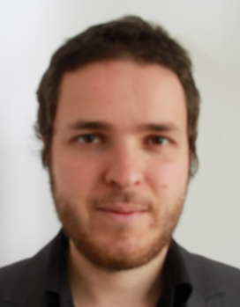
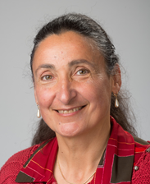
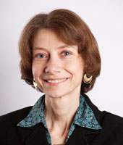
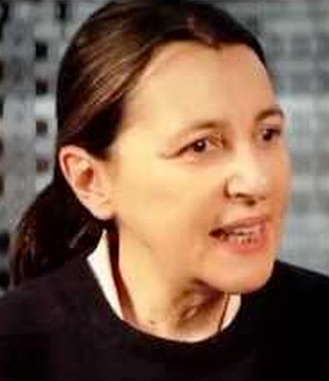
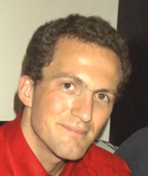
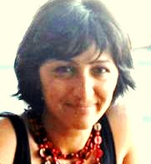
Olivier
Diviyan
Isabelle
Paola
Causal discovery
for CDS practitioners
Michele
Philippe
Berna
Diviyan Kalainathan, Olivier Goudet, Isabelle Guyon, Michele Sebag, Philippe Caillou, Paola Tubaro, Berna Batu
Equipe TAO, LRI, UPSud and ChaLearn

Slide 2
Are these two variables “related”?
B
A

Slide 3
Simpson’s paradox:
if we condition on Z, A and B are independent
B
Z
A
A | B | Z

Slide 4
Maybe NO:
Z = gender
B = life expectancy
Female
Z
Chocolate
Life length
Male
A = chocolate intake
A | B | Z

Slide 5
Maybe YES:
Z = mood
B = life expectancy
Happy
Z
Chocolate
Life length
Depressed
A = chocolate intake
A | B | Z

Slide 6
Ambiguity: Markov equivalence
A | B | Z
P(A, B | Z) = P(A | Z) P(B | Z)
A
Z
B
P(A, B , Z) = P(A | Z) P(B | Z) P(Z)
A
Z
B
P(A, B , Z) = P(B | Z) P(Z | A) P(A)
A
Z
B
P(A, B , Z) = P(A | Z) P(Z| B) P(B)

Slide 7
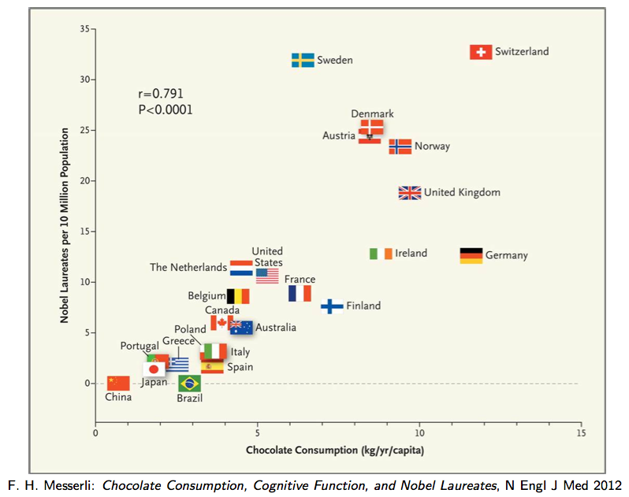
Correlation
≠ Causation
Thanks to Jonas Peters for this example

Slide 8
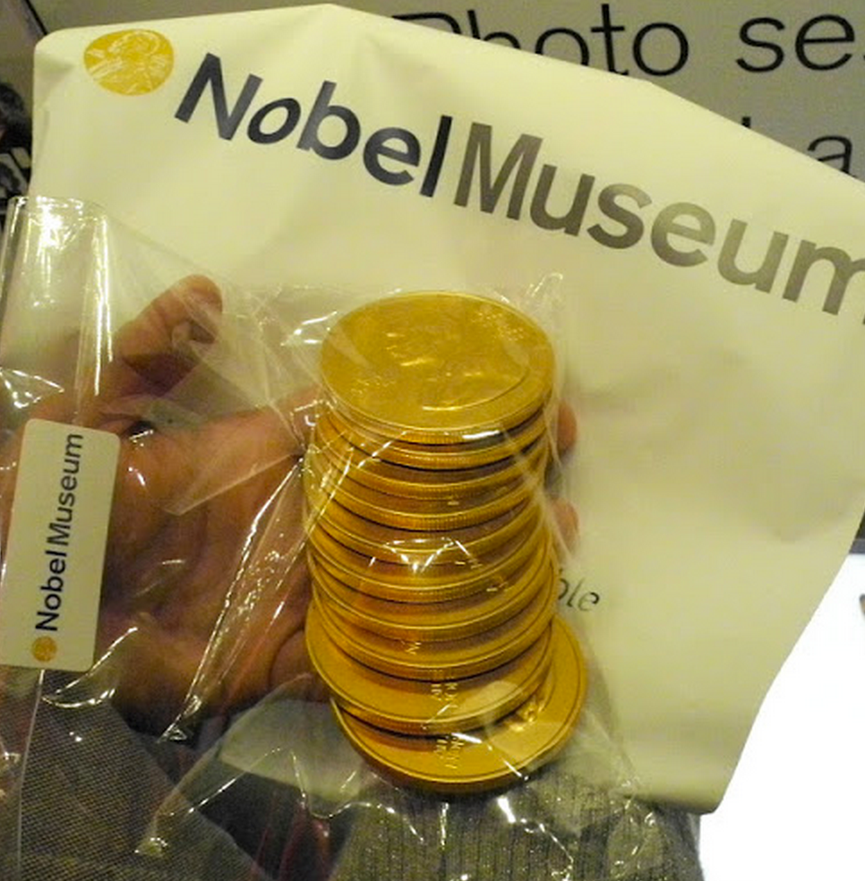
Randomized experiments
“Please test your researchers for ten years: Randomly pick half of them and give them chocolate for desert and give apples to the other half. Then compare the number of Nobel prizes in the two populations.”

Slide 9
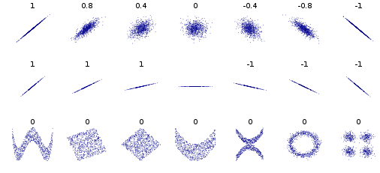
From correlation coefficient to causation coefficient?
Pearson Correlation Coefficient: C(A,B) = cov(A,B)/(σ_{A}σ_{B})
Denis Boigelot, Université libre de Bruxelles, Belgium, Wikipedia

Slide 10
?
B
A

Slide 11
Non identifiable case
Linear
Gaussian input
Gaussian noise
B
A

Slide 12
n=1000
A = unif(n, -1, 1)
noise = unif(n, -1, 1)/3
B = 4 (A² - 1/2)² + noise
B
A

Slide 13
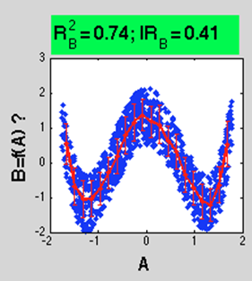
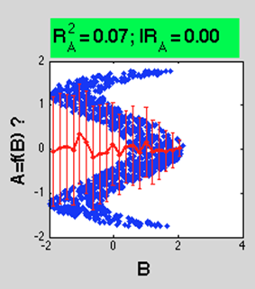
Identifiable cases
Non-invertible function
or
Non-Gaussian input
or
Non-Gaussian noise

Slide 14
?
A
B

Slide 15
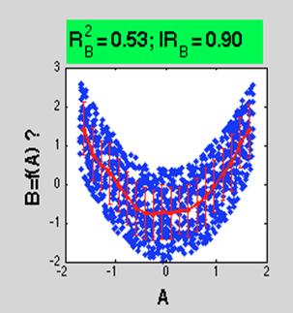
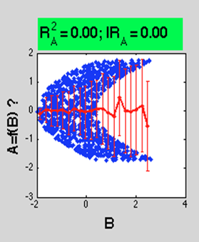
Correct! Wrong

Slide 16
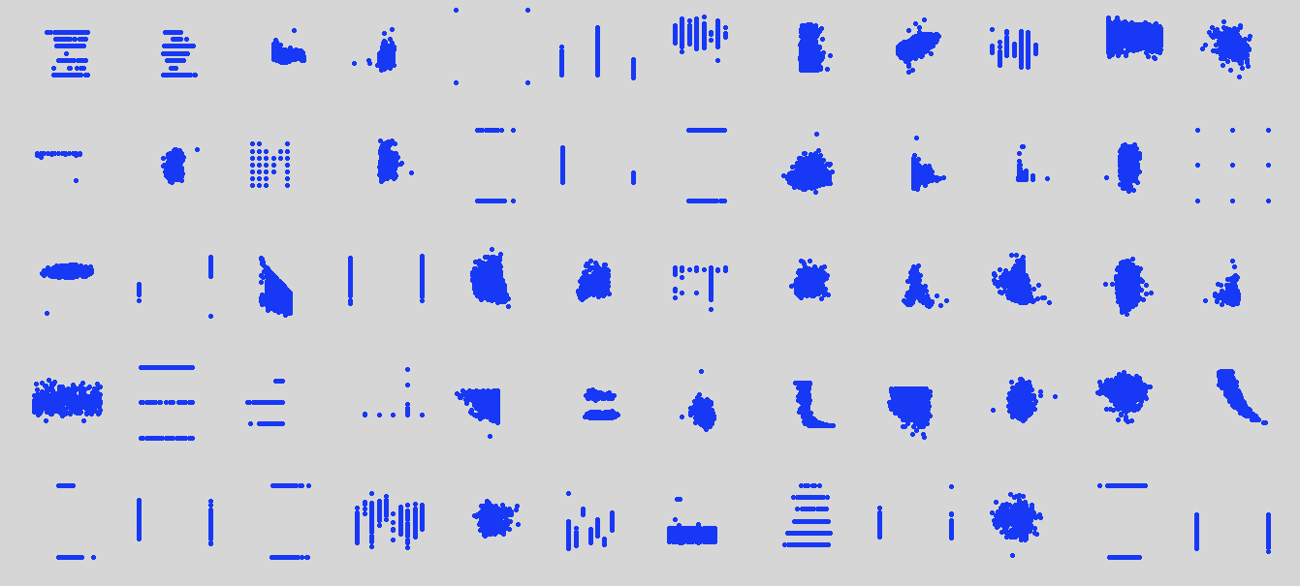
Cause-effect pair challenge
(2013)
A | B
A ← B
?
A → B
A ← Z → B

Slide 17
Winners used ensembles of decision trees
CDS(A|B) > CDS(B|A)
no
yes
H(A) > H(B)
H(A) > H(B)
no
yes
no
yes
Max(H(A), H(B))>2.5
A->B
B->A
Max(H(A), H(B))>2.5
no
yes
no
yes
A->B
B->A
B->A
A->B
Based on Fonollosa 2013

Slide 18
Improvements 2013-2016
Lopez-Paz et al 2014-2015: Use Fourier coefficients.
- The Randomized Causation Coefficient (2014)
- Towards a Learning Theory of Cause-Effect Inference (2015)
Lopez-Paz et al 2016: Use neural networks
- Discovering Causal Signals in Images
Goudet-Kalainathan 2016:
- New methods based on neural networks (coming soon!)
Over 80% correct

Slide 19
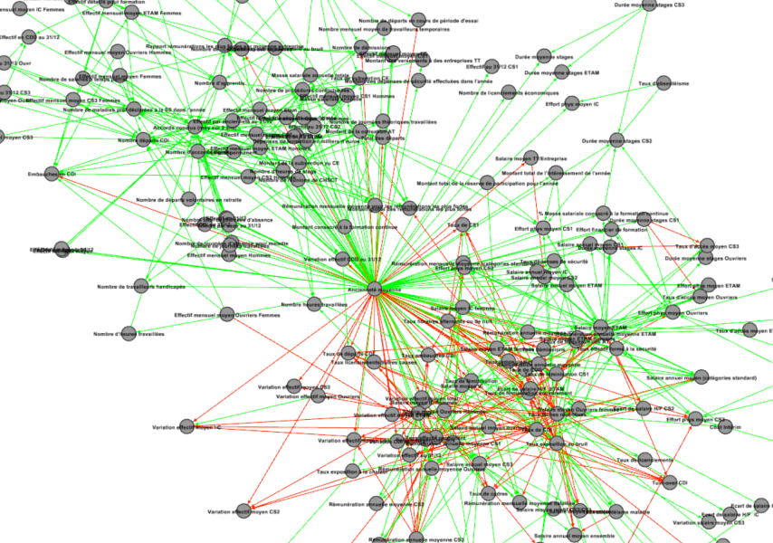
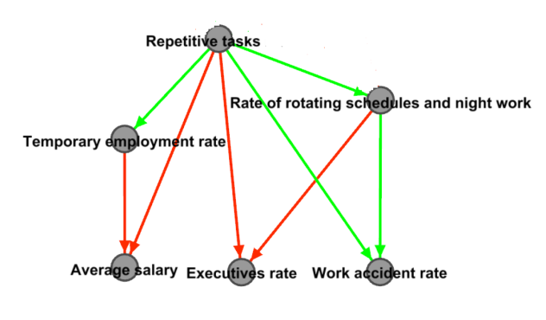
Full pipeline
First network sketch:
(using pairwise
dependencies)
Remove spurious (indirect) connections:
Orient edges:

Slide 20
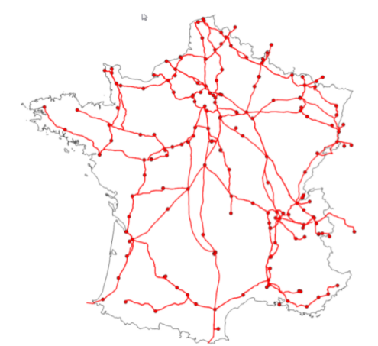
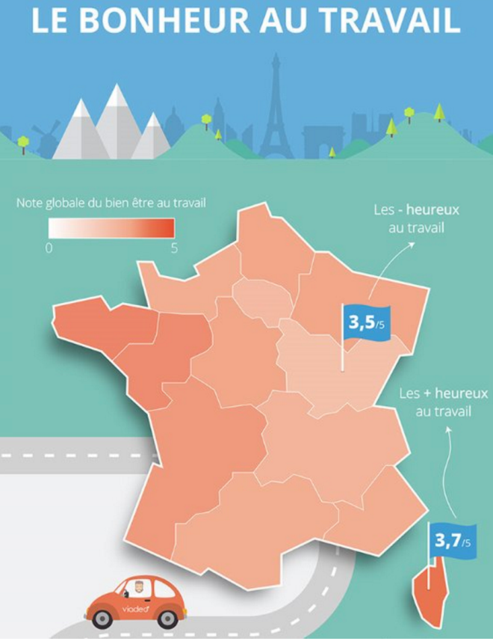
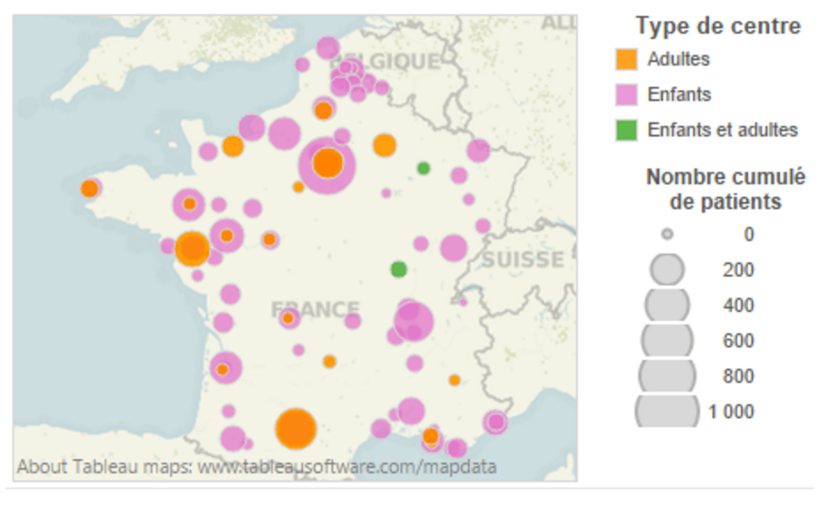
Current applications
Transport d’électricité (avec RTE)
Questionnaire DARES
(Ministère du travail)
Diabète (avec INSERM)

Slide 21
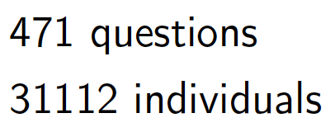
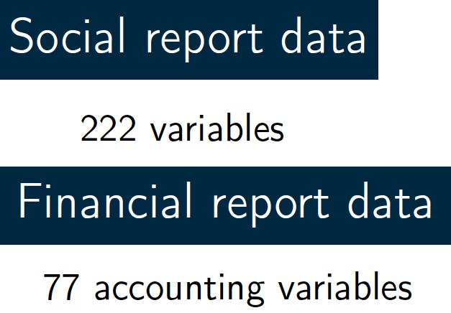
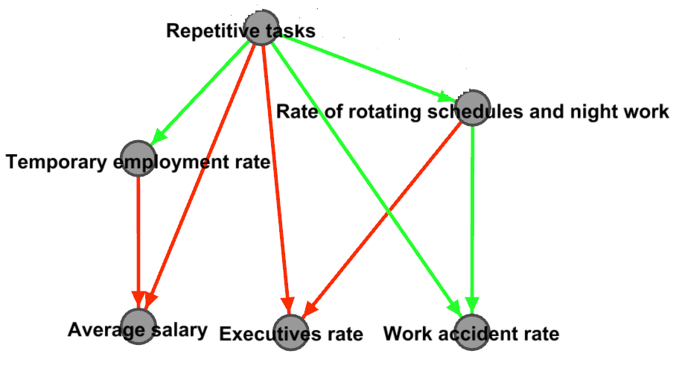
Amiqap project Quality of Life @ work ↔ Company Performance
Notes:
https://media.licdn.com/mpr/mpr/shrinknp_400_400/p/3/005/04e/255/1914f02.jpg

Slide 22
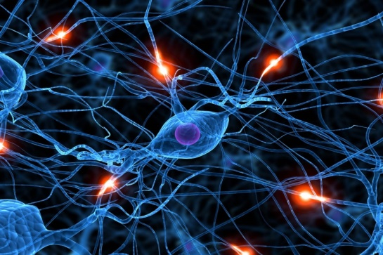
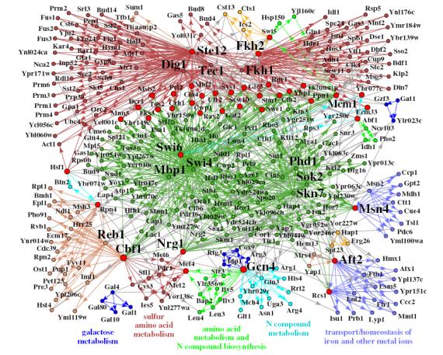
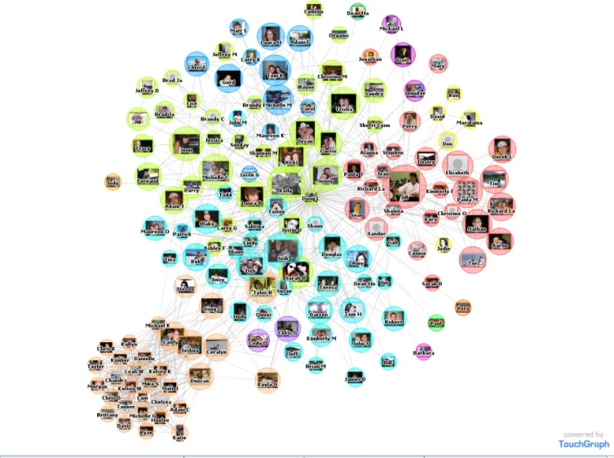
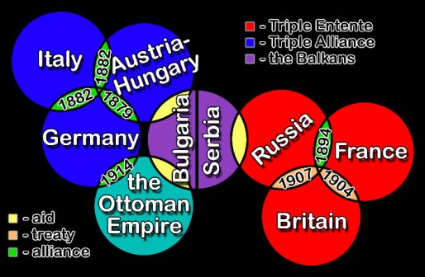
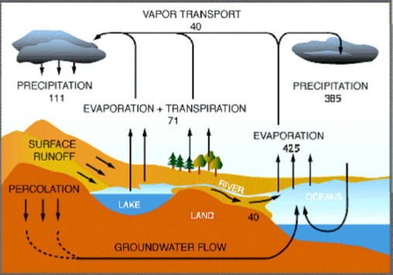
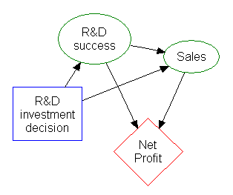
Conclusion
Causal modeling needed for:
UNDERSTANDING
DECISION SUPPORT
Bring us your data!
iguyon@lri.fr

