Slide 1
Simultaneous measurement of the neutron-induced ²³³U capture and fission cross sections @ n_TOF
M. Bacak^{1,2,3}, E. Berthoumieux², M. Aiche⁴, G. Bélier⁵, R. Cardella¹, A. Chatillon⁵, M. Diakaki²,
E. Dupont², F. Gunsing^{1,2}, J. Heyse⁶, S. Kopecky⁶, B. Laurent⁵, H. Leeb³, L. Mathieu⁴,
P. Schillebeeckx⁶, J. Taieb⁵, V. Vlachoudis¹ and the n_TOF Collaboration
¹ CERN, Geneva, Switzerland
² Irfu, CEA, Université Paris-Saclay, Gif-sur-Yvette, France
³ TUW Atominstitut, Vienna, Austria
⁴ CENBG, CNRS/IN2P3-Université de Bordeaux, Gradignan, France
⁵ CEA, DAM, DIF, F-91297 Arpajon, France
⁶ JRC Geel, Belgium

Slide 3
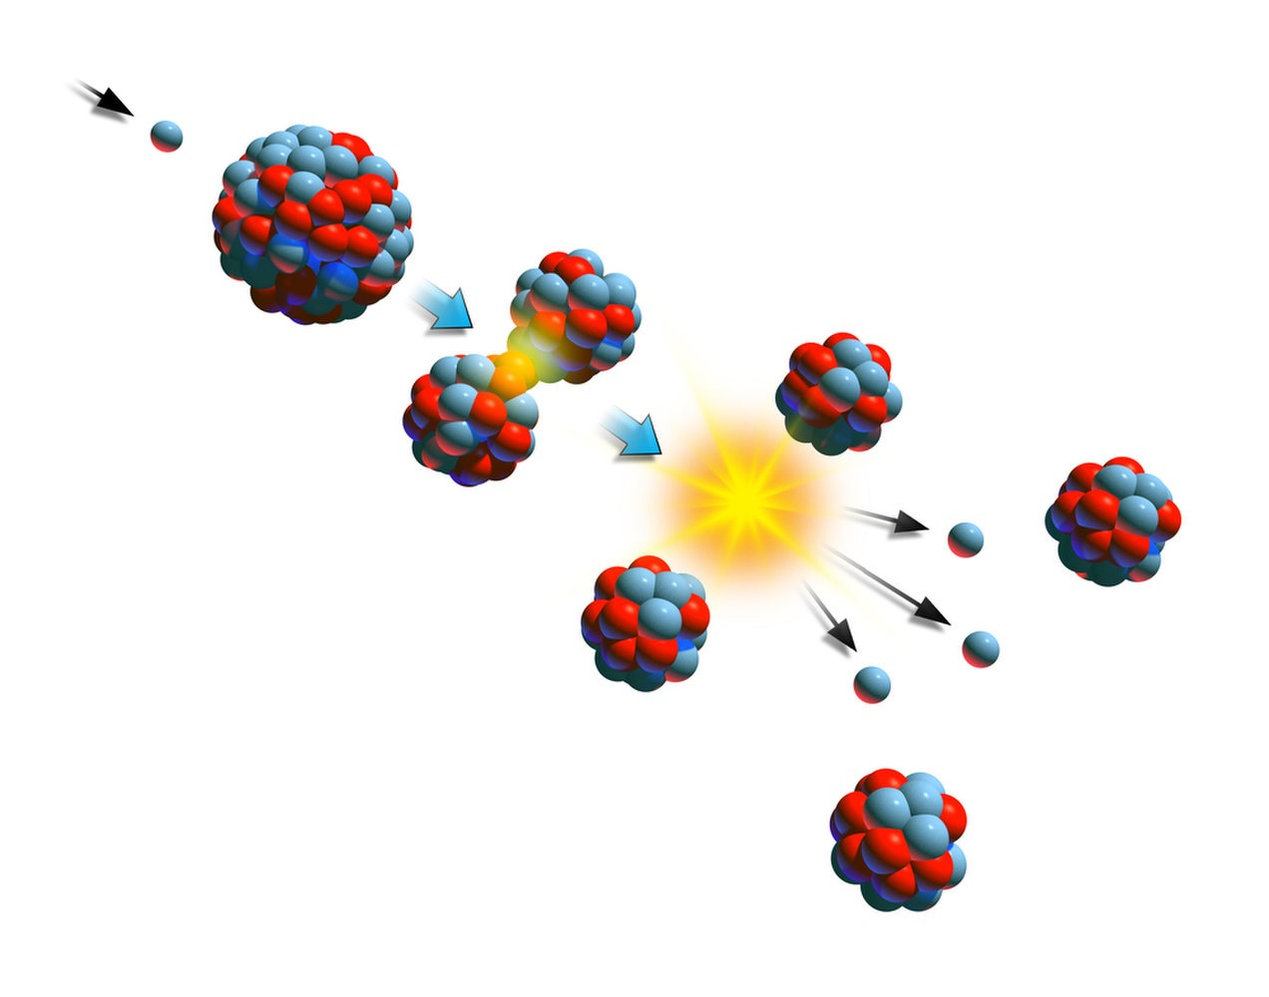
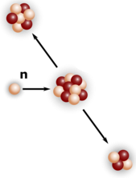
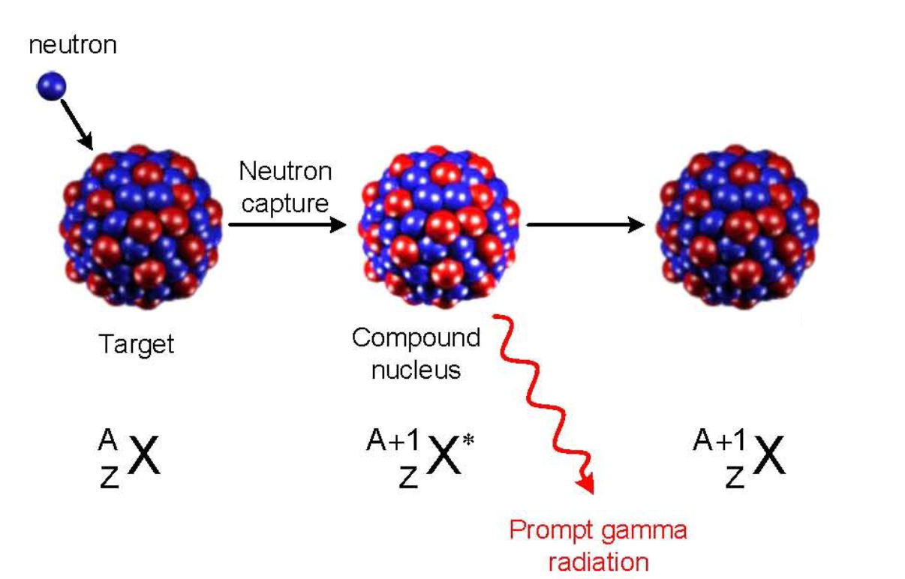
WHAT: Neutron-induced reactions
Radiative capture
(n,𝛾)
Fission
(n,f)
Charged particle emission
(n,cp)
neutron
⁷Li
unstable nucleus
target nucleus
¹⁰B
neutron
neutrons
⁴He
fission fragments
Particle to be detected:
𝛾-ray
Particle to be detected:
fission fragments
Particle to be detected:
light charged particles

Slide 4
WHERE: The CERN accelerator complex
CERN: European Organization for Nuclear Research (Geneva, Switzerland)
Since 1954
Various accelerators
Most recent discovery:
2012 Higgs Boson
Neutron Time Of Flight facility: n_TOF

Slide 5
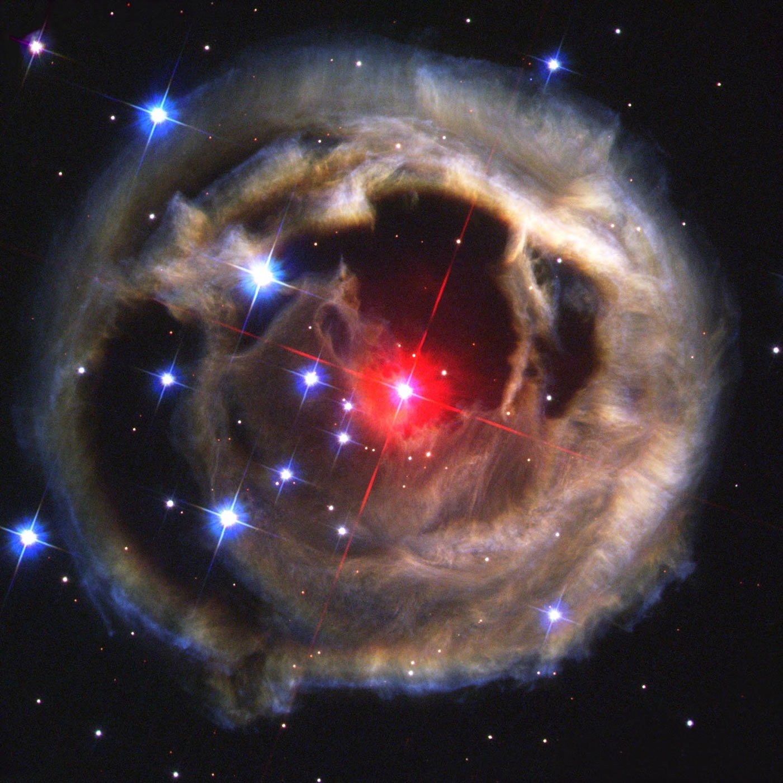
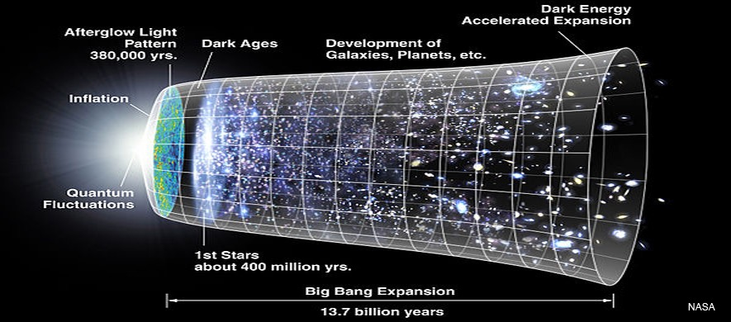
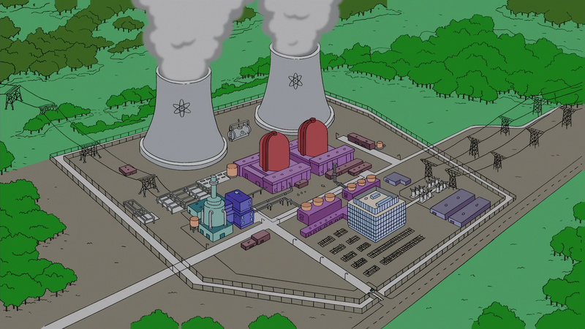
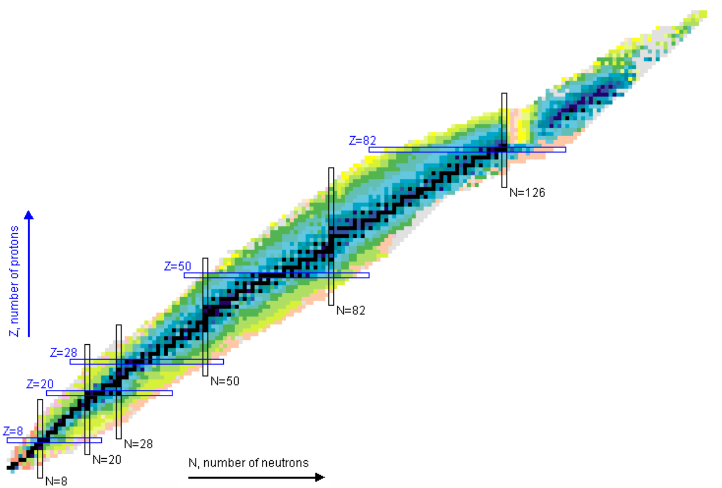
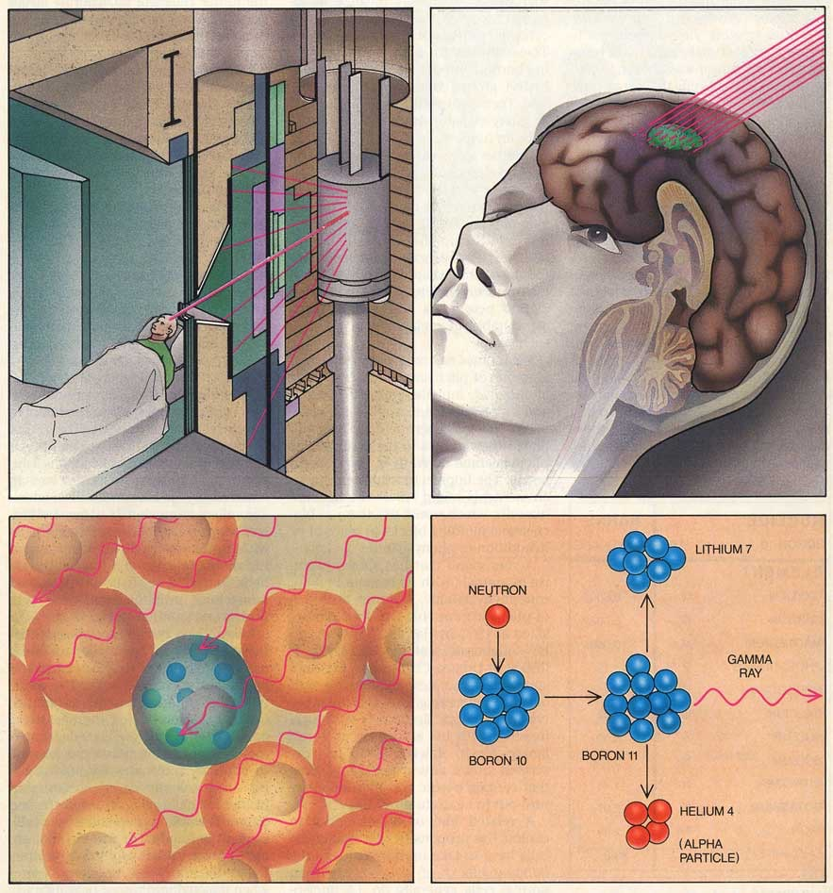
WHY: n_ToF in a nutshell
Nuclear Astrophysics
Stellar Nucleosynthesis
Big Bang Nucleosynthesis
Nuclear Technologies
Nuclear reactors (energy production)
Waste management
Nuclear Medicine
Neutron Capture Therapy

Slide 6
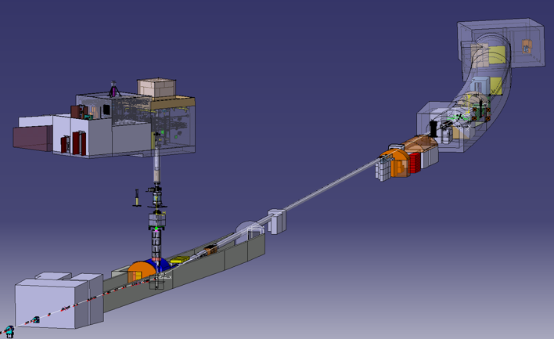
HOW: n_TOF in a nutshell
Some figures
2 beam lines (185 and 20 m)
2 experimental areas (EAR1 and EAR2), both Class-A lab
Some figures
 | EAR1 | EAR2
Wide energy range | thermal to 1 GeV | thermal to 300 MeV
High instantaneous neutron flux | 10⁵ n/cm²/pulse | 10⁶ n/cm²/pulse
Low repetition rate | < 0.8 Hz (1 pulse/2.4 s max)
High energy resolution | ΔE/E=10⁻⁴ (@10 eV) | ΔE/E=10⁻² (@10 eV)
EAR2
EAR1
Collimators
Sweeping magnets
Pb spallation target
p-beam from PS

Slide 7
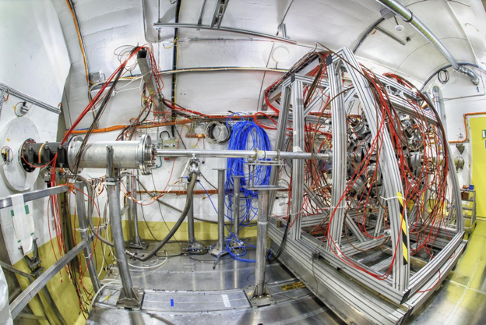
HOW: n_TOF EAR1
neutron beam

Slide 8
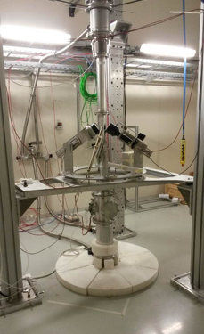
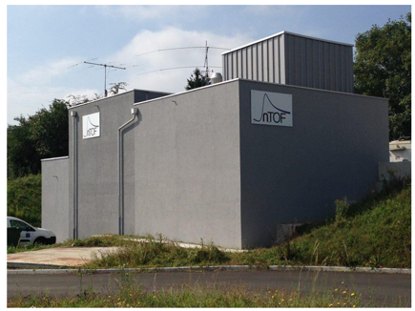
HOW: n_TOF EAR2
neutron beam
neutron beam

Slide 9
HOW: time-of-flight (TOF) technique
spallation target
detectors
moderator
sample
reaction products
protons
Flight path – ~ 185 m or ~ 20 m
start
t0
stop 1
tstop
stop 2
t'stop
time
Need of a pulsed neutron source charged particle impinging on a heavy target
neutrons from SPALLATION reactions induced by protons
photoneutrons from BREMSSTRAHLUNG induced by electrons

Slide 10
HOW: time-of-flight (TOF) technique
spallation target
detectors
moderator
sample
reaction products
protons
Flight path – ~ 185 m or ~ 20 m
start
t0
stop 1
tstop
stop 2
t'stop
time

Slide 11
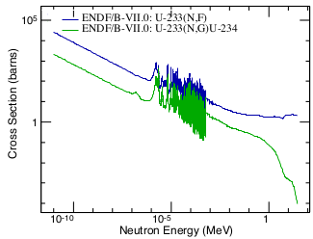
The ²³³U case - Motivation
Th-U fuel cycle / Gen-IV systems
NEA Nuclear Data High Priority Request List
Challenging R&D to measure (n,γ)-XS of fissile actinides
²³³U(n,γ) | σ | σ
E_{n} | Thermal – 10 keV | 10 keV – 1 MeV
Target accuracy | 5% | 9%
Fission
Tagging

Slide 12
²³³U targets
Molecular plated by JRC-Geel
14 unsealed spots
4 cm diameter
46.5 mg total mass
264.5 µg/cm² on average
Complicated mounting in glove box
risk of contamination due to self-sputtering and high activity (1.2 MBq per target)
Isotope | w%
²³³U | 99.936
²³⁴U | 0.0496
²³⁵U | 0.0012
²³⁶U | 0.0002
²³⁸U | 0.0128

Slide 13
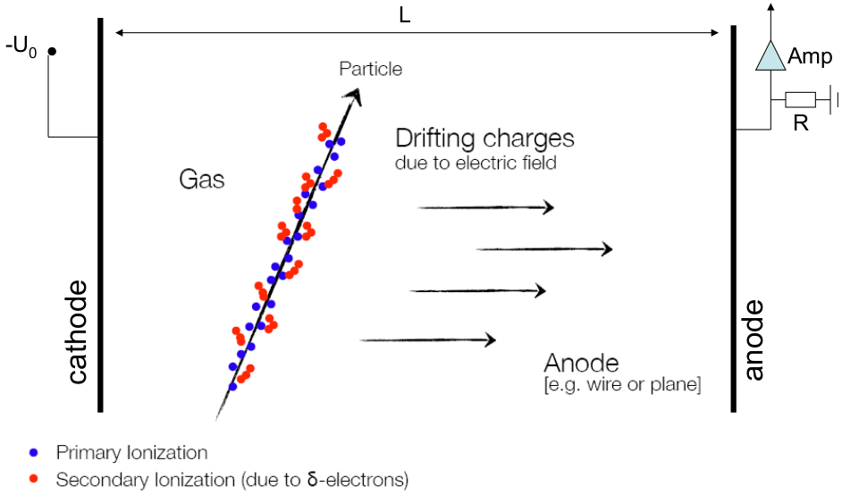
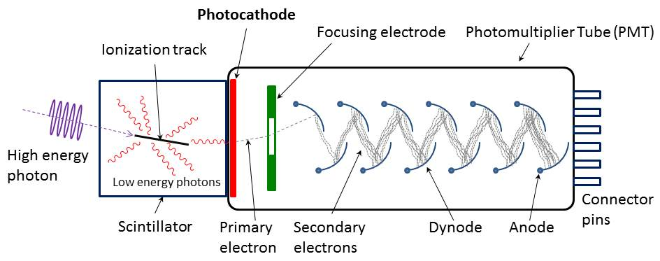
Measuring (n,γ) & (n,f)
Radiative capture (n,𝛾)
Fission (n,f)
Detection of 𝛾-rays
i.e. with scintillators
Detection of heavy charged particles i.e. with a gaseous detector

Slide 14
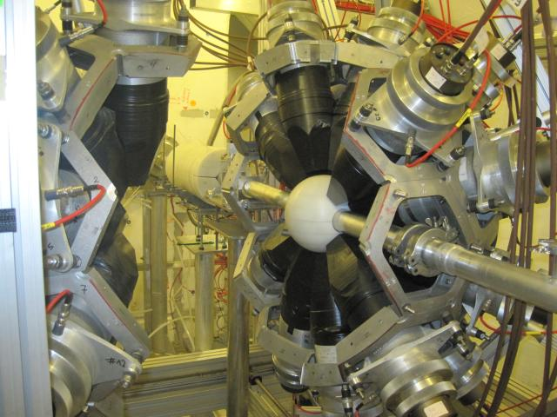
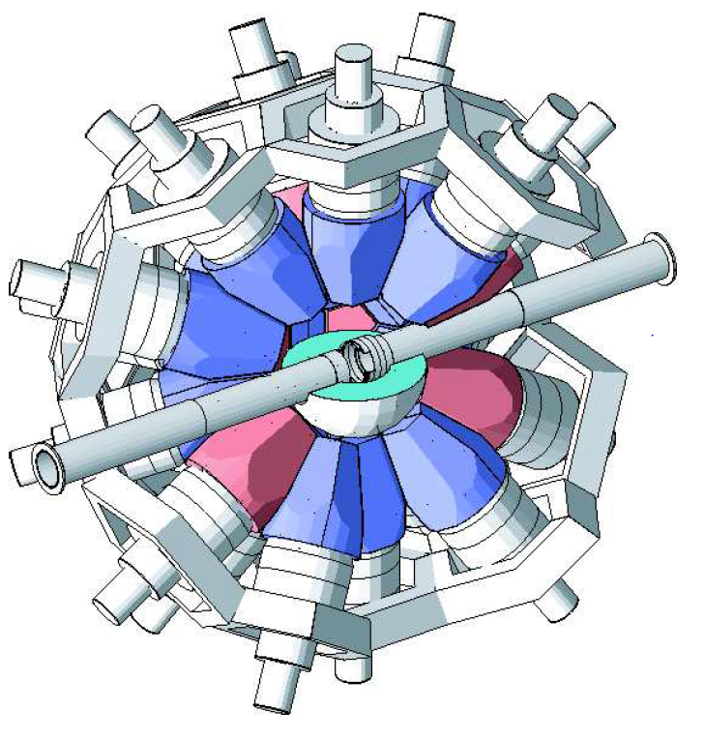
Experimental Setup I
(n,γ) with Total Absorption Calorimeter TAC
Spherical array of 40 BaF₂ crystals
Inner diameter 20 cm
Absorber (polyethylene + 7.5% Li) to reduce neutron scattering into the BaF₂
neutrons
γ
$$E_{Sum}=E_{1}+E_{2}+E_{3}$$
$$m_{cr}=1+1+1$$
γ
γ

Slide 15
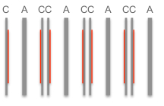
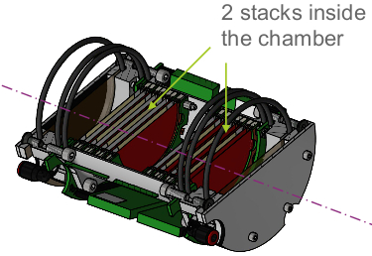
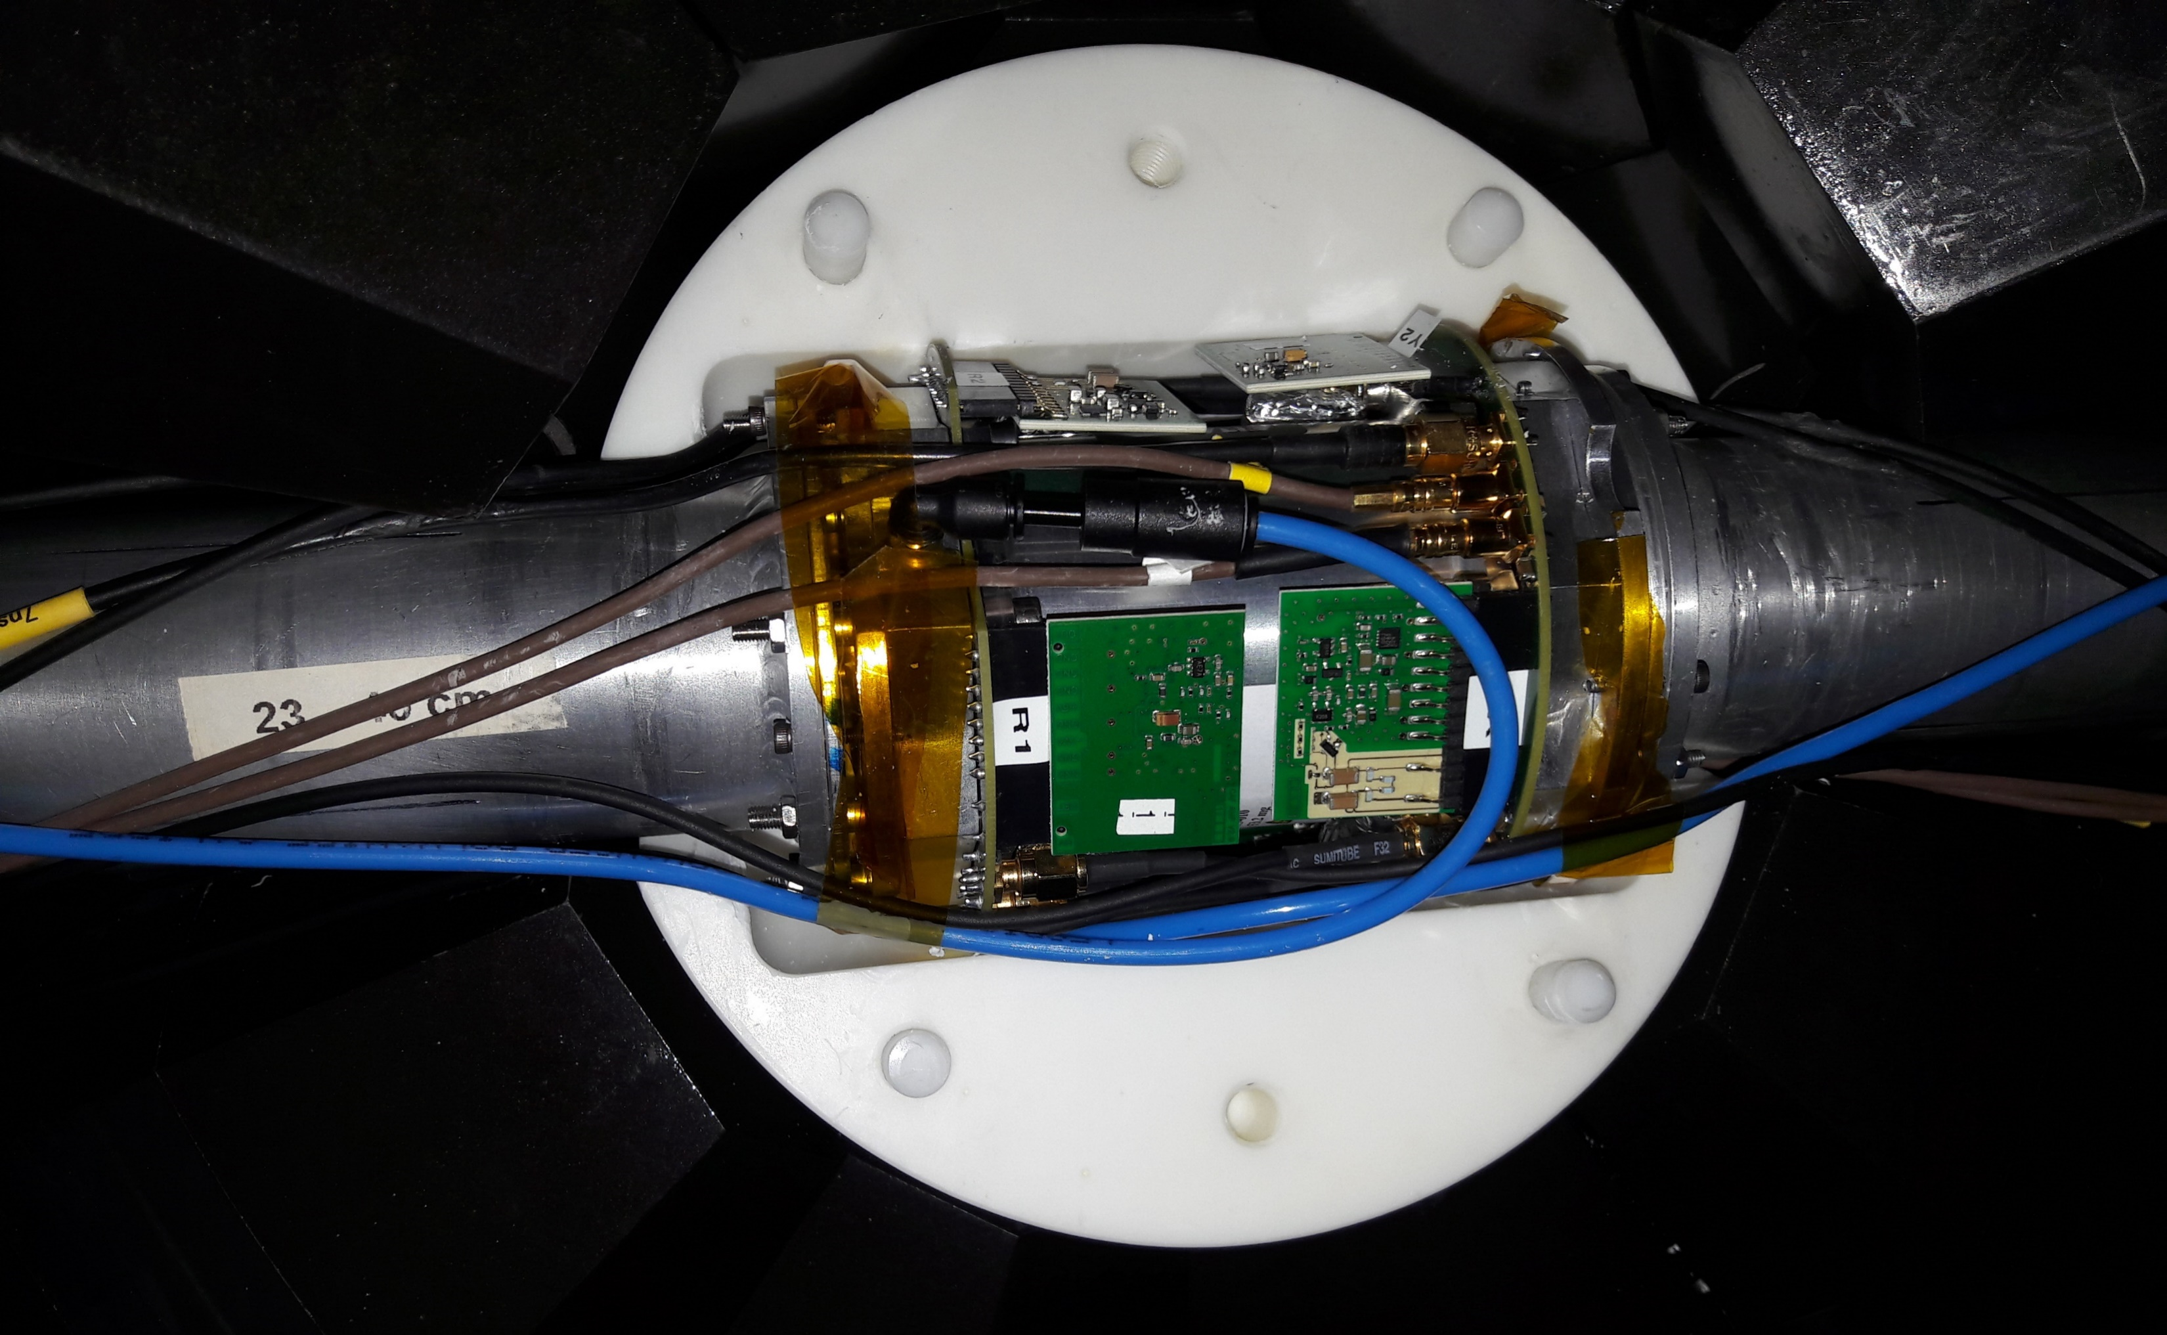
Experimental Setup II
(n,f) with compact ionisation chamber (FICH) for fission tagging
Must fit in TAC/absorber
High α-count rates require:
Fast ionizing gas CF₄ @ 1100 mbar
Dedicated electronics (CEA/DAM/DIF)
Dummy for background measurement

Slide 16
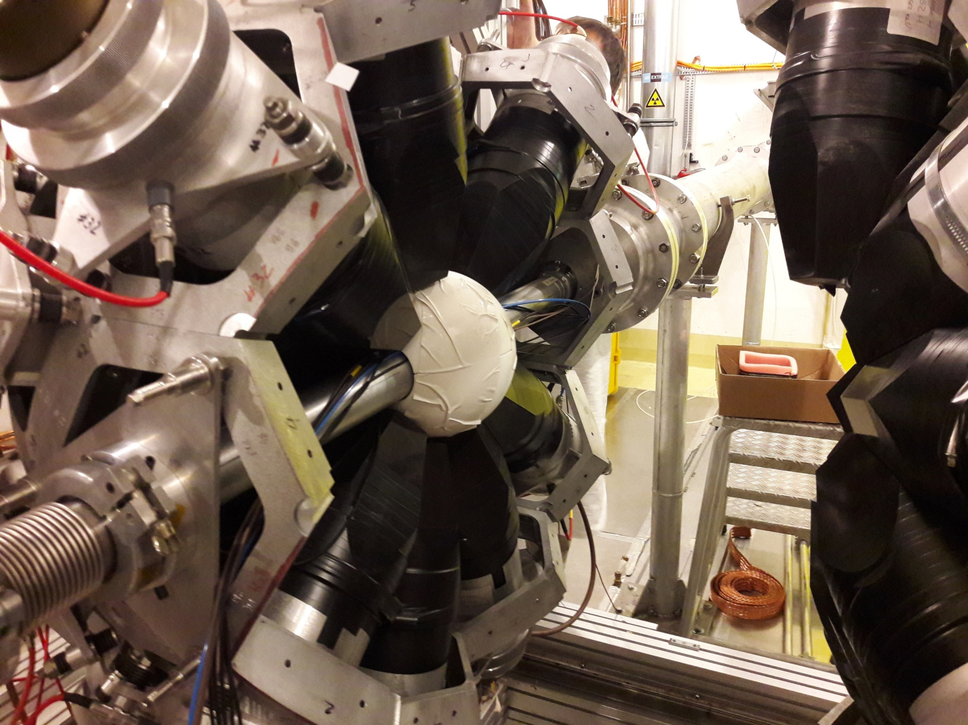
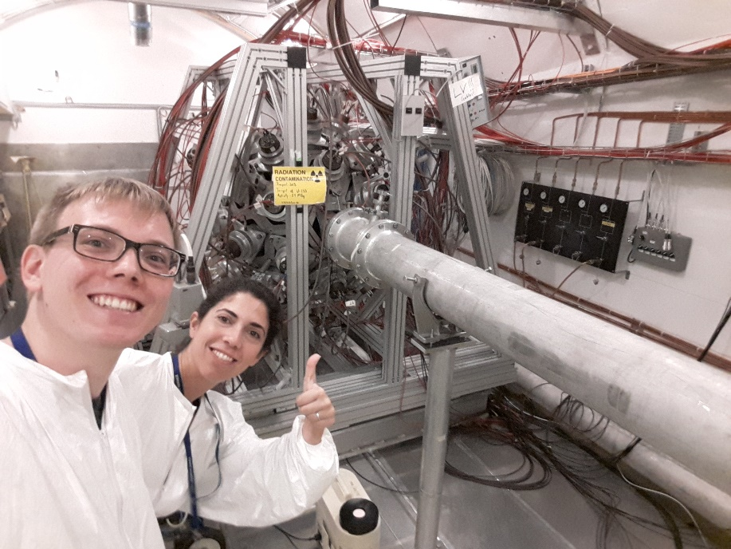
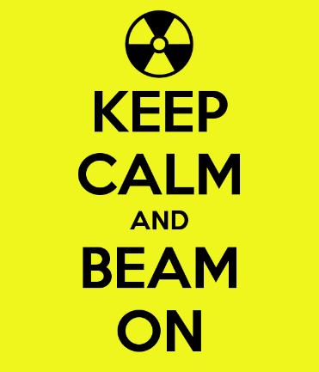
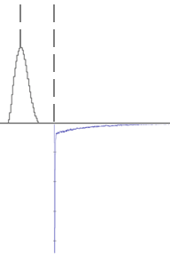
The Analysis
TAC
FICH
FICH
Coincidence
(fission)
Anti-Coincidence
(capture + background)
TAC

Slide 17
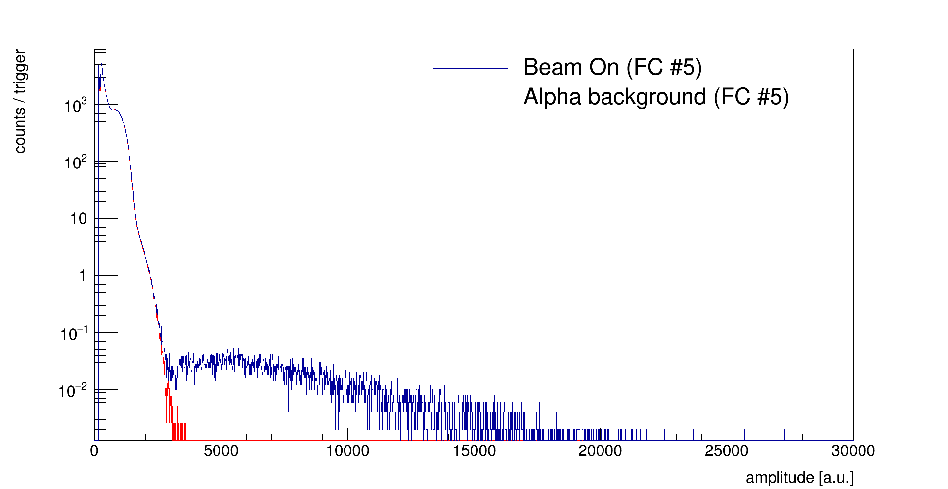
FICH – total amplitude spectrum
1 trigger = 100 ms
α
FF

Slide 18
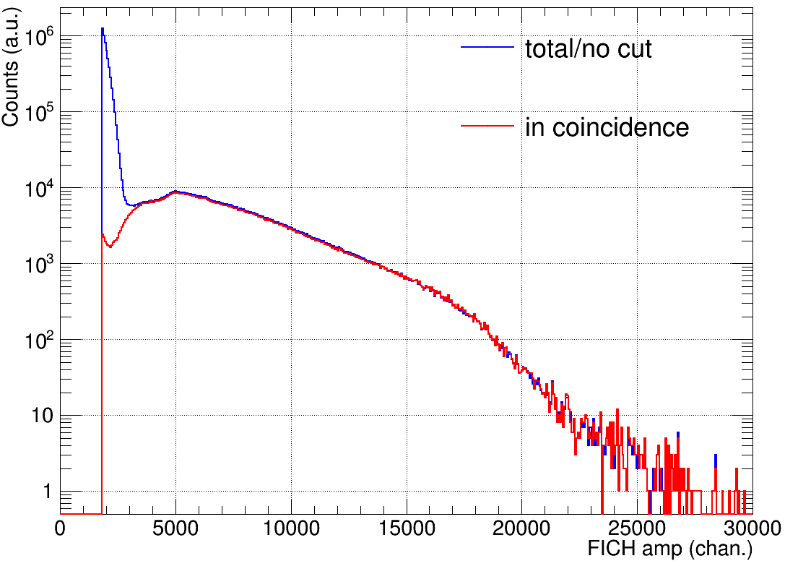
FICH – Fission events in coincidence
α
FF

Slide 19
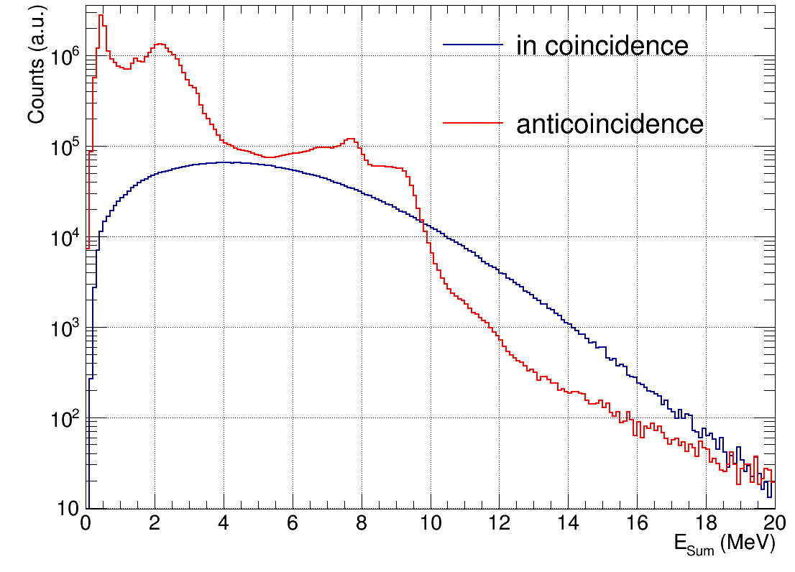
Anti-/Coincidence - E_{Sum}
¹H_{n,γ}
⁴⁰K
¹³⁰Ba_{n,γ}
¹³⁵Ba_{n,γ}

Slide 20
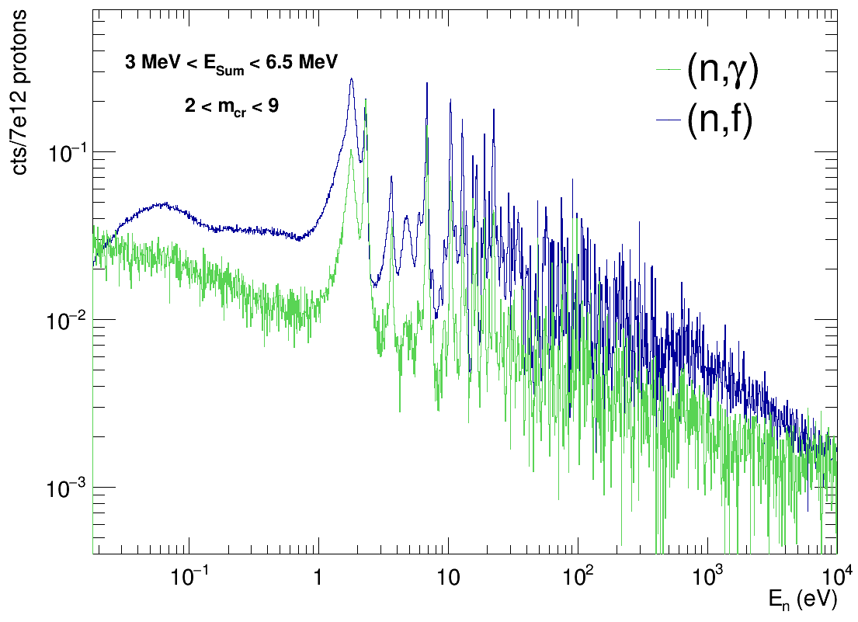
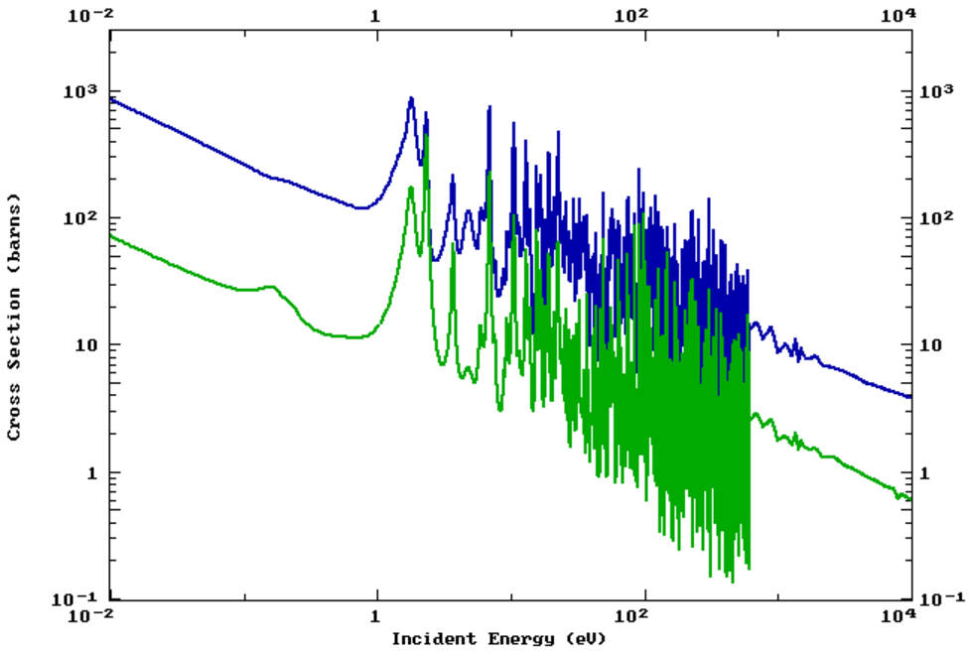
Fission vs. Capture – 10% of statistics
*
*(n,γ) = AntiCoincidence
– BeamOn Dummy
– BeamOff ²³³U in

Slide 21
Summary & Outlook
Successful data taking
4.4e18 protons on target
1.5 months of beam time
Auxilliary measurements
Gold for normalization
Dummy/Background
Calibrations with radioactive sources
950 TB of data
Extraction of preliminary count rates
Numerical simulations:
GARFIELD: fission chamber
E_{dep} for FF/α
α pile-up correction
Efficiency
Geant4: TAC/full setup
E_{Sum} and m_{cr}
Efficiency
Dead time correction
Background study
Extraction of final cross sections
R-Matrix analysis of resonances

Slide 22
Merci beaucoup

Slide 24
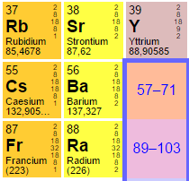
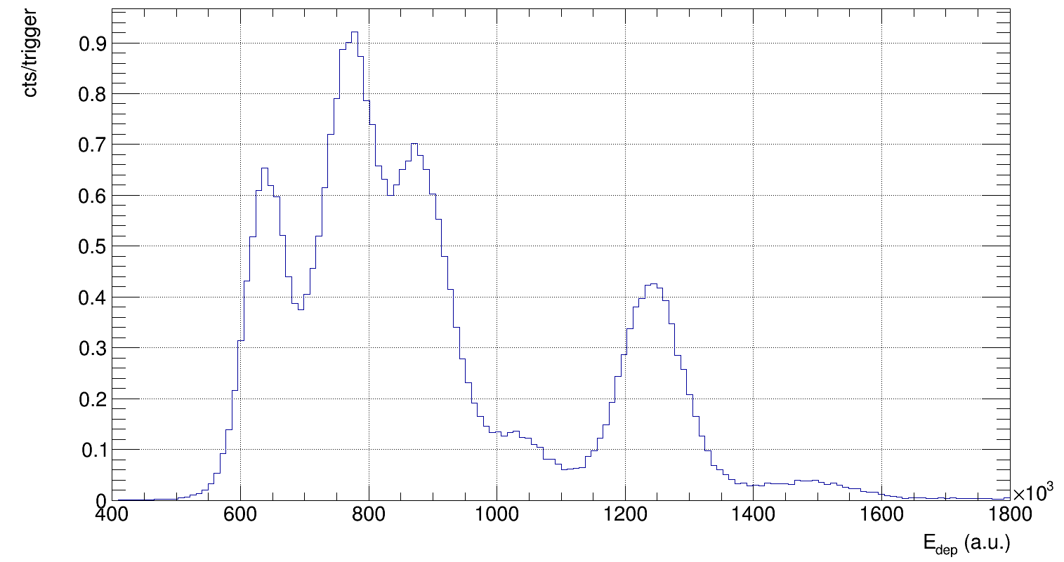
Gain drift correction
²²⁶Ra impurities in the crystals from production
Leads to alpha decay chain
Can be distinguished by pulse shape
# | Decay | E_{α} (MeV)
1 | ²²⁶Ra -> ²²²Rn | 4.87
2 | ²²²Rn -> ²¹⁸Po | 5.59
3 | ²¹⁸Po -> ²¹⁴Pb | 6.12
4 | ²¹⁴Po -> ²¹⁰Pb | 7.83
5 | ²¹⁰Po -> ²⁰⁶Pb | 5.41
2 & 5
3
1
α
4
γ

Slide 25
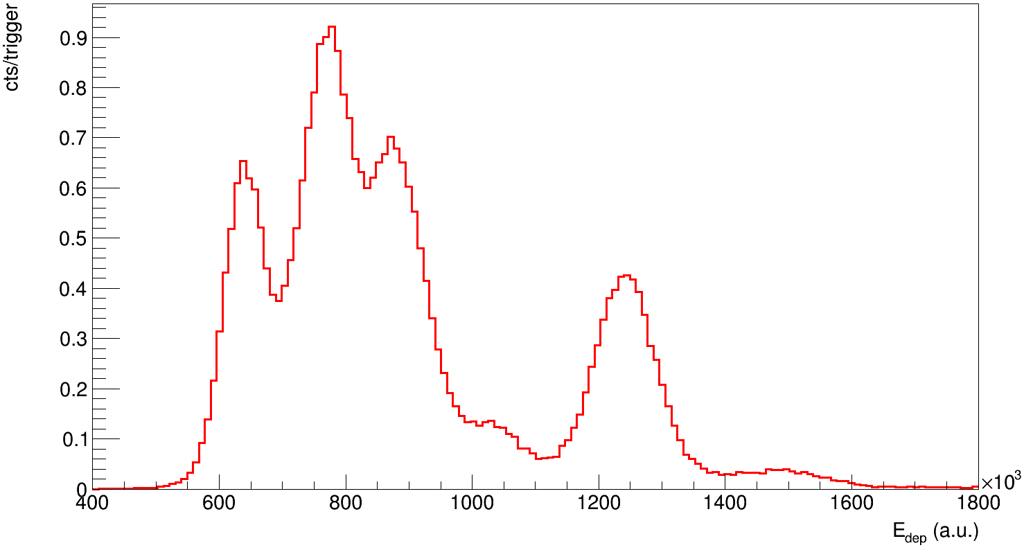
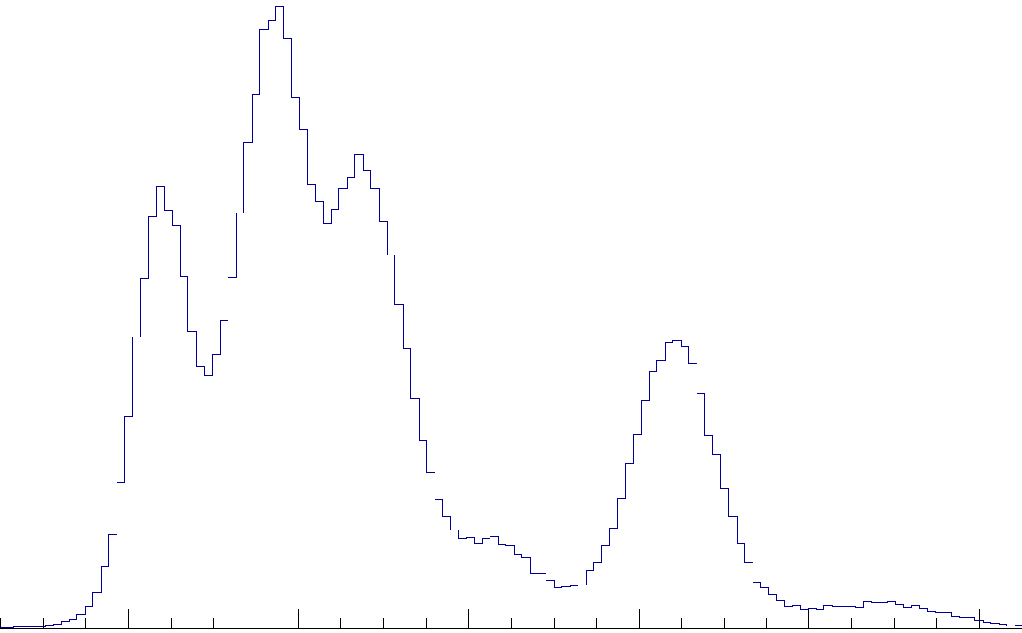
Gain drift correction II
0.70
0.75
0.80
0.85
0.90
0.95
1.00
0.65

Slide 26
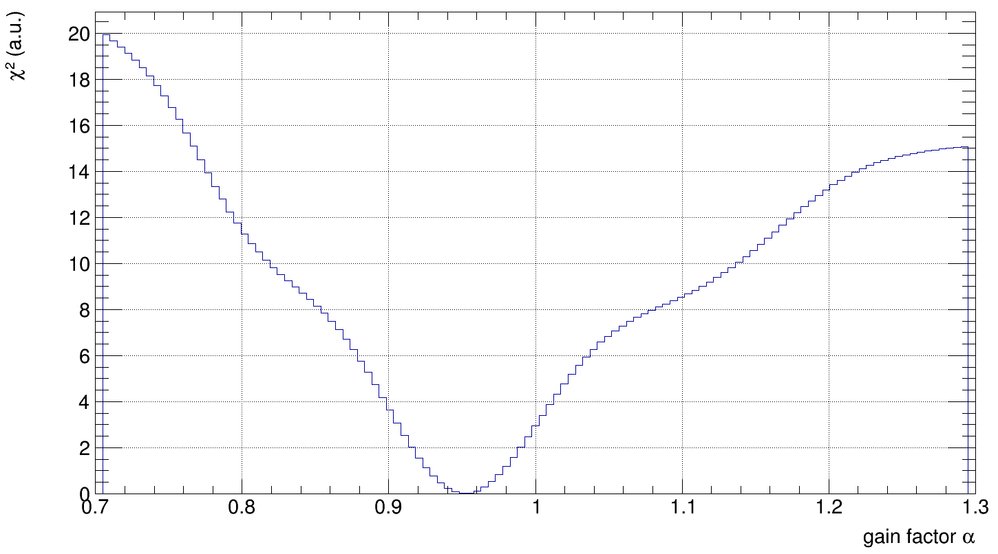
Gain drift correction III
χ² method* for varying gain factor α
Gain factor = min(χ²)
$$χ^{2}(α) = \sum_{i=1}^{nbins}{{\left( h_{Ref}\left[i\right] − h_{Example}\left[i\right]\left(α\right)\right)}^{2}}$$
min(χ²)
*Javier Balibrea Correra & CIEMAT

Slide 27
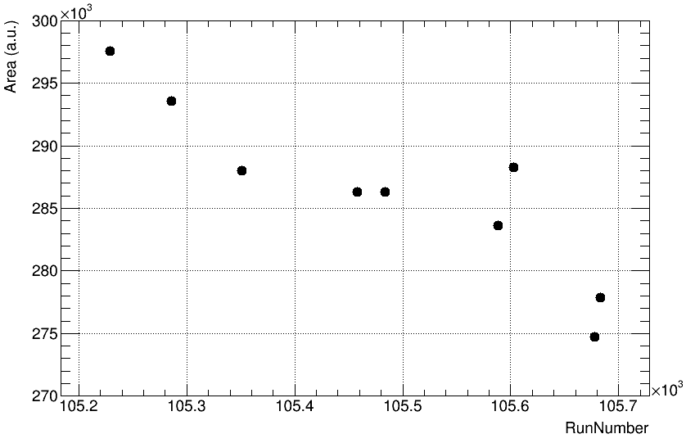
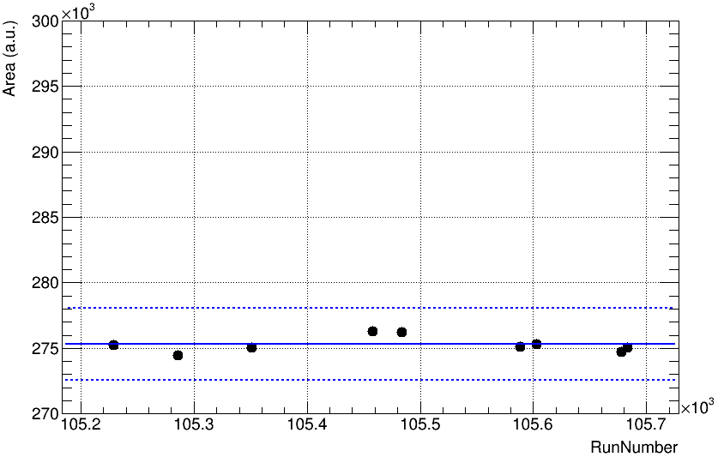
Gain drift correction II
Proof it works with Cs peak positions throughout the campaign
+1%
average
-1%

Slide 28
Energy Calibration I – γ-sources
0.66 MeV
0.90 MeV
1.84 MeV
4.43 MeV
6.13 MeV

Slide 29
Time Calibration I - method
Detectors misaligned in time due to different electronic chains, i.e. cable lengths
Coincidence analysis requires alignment of the detectors
Method:
Use ⁸⁸Y source (2 simultaneous γ)
Choose one reference detector (#29)
Look for coincidences with other detectors in a big time window ( ±100 ns) and calculate the time difference δT:
Expected δT shape : sharp peak (real coincidences) sitting on constant background
Determine the centroid of the peak which will corresponds to the T_{Offset} between the detectors

Slide 30
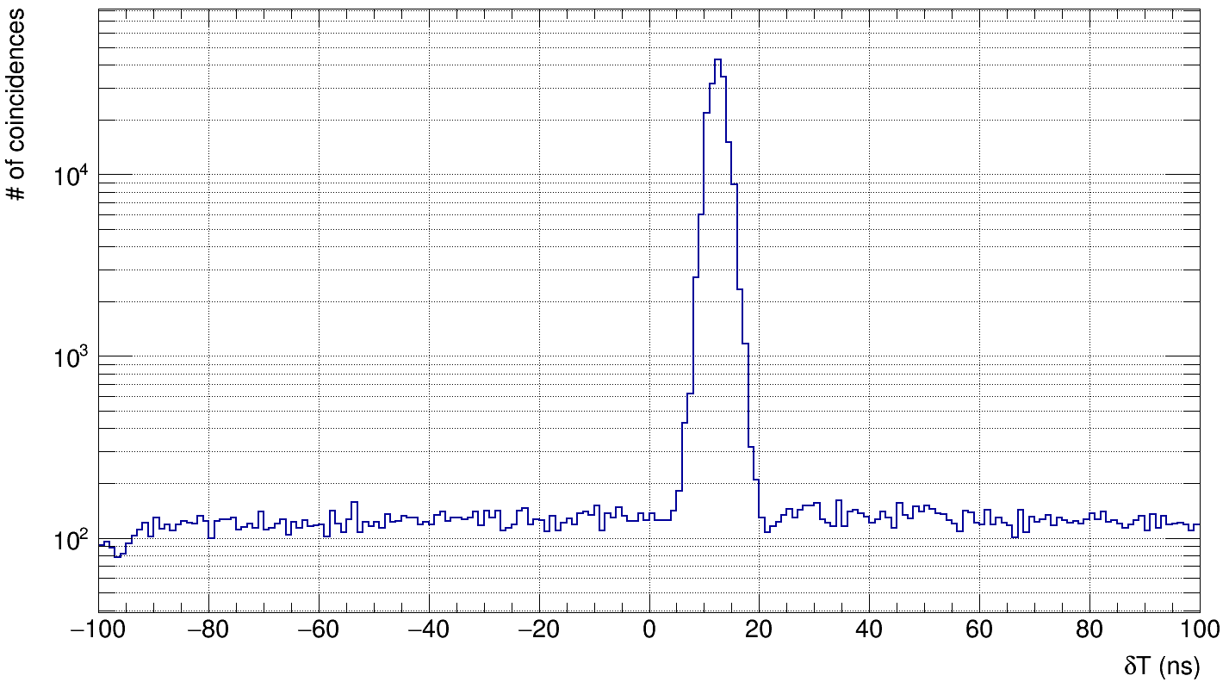
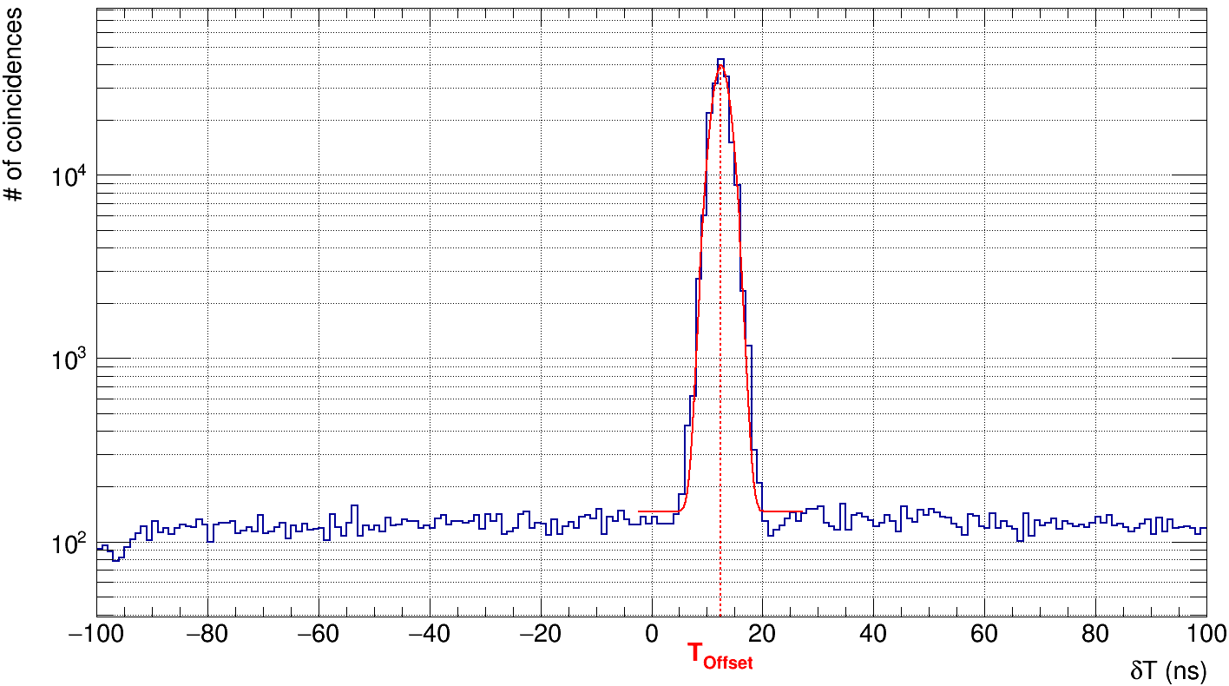
Time Calibration II

Slide 31
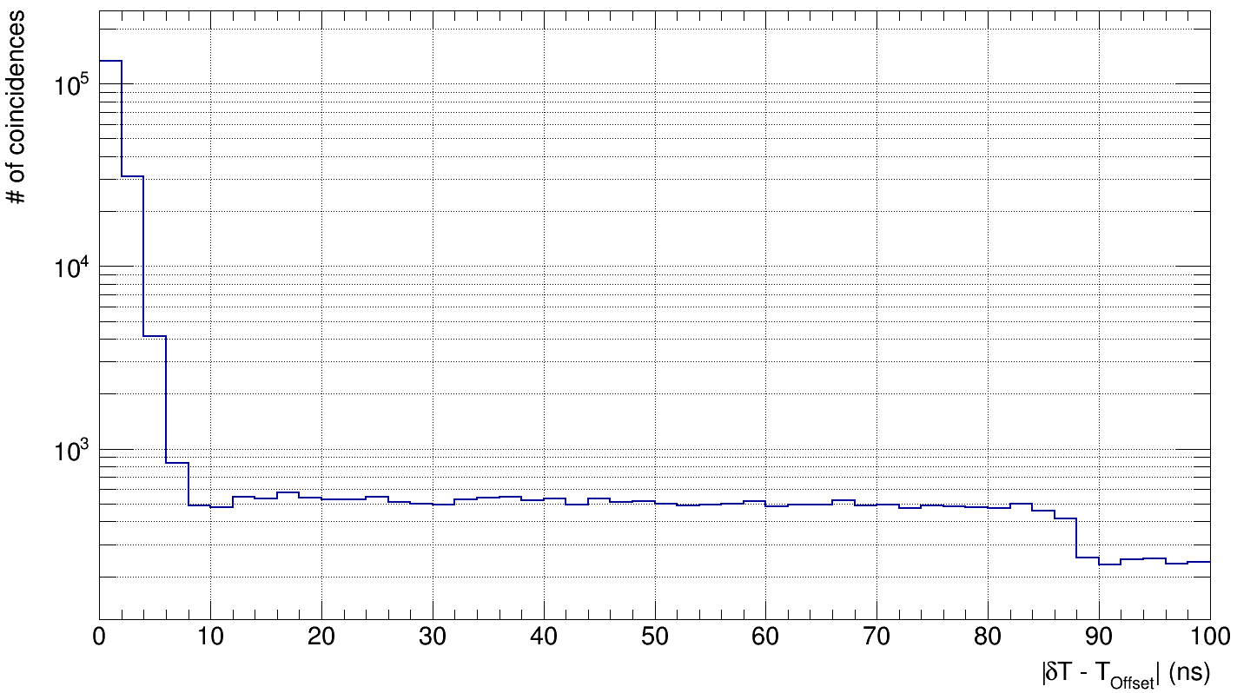
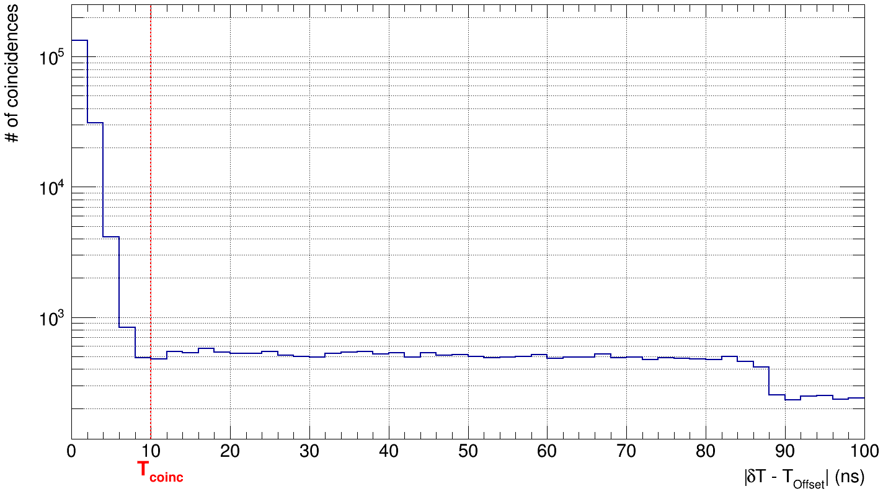
Time Calibration III

Slide 32
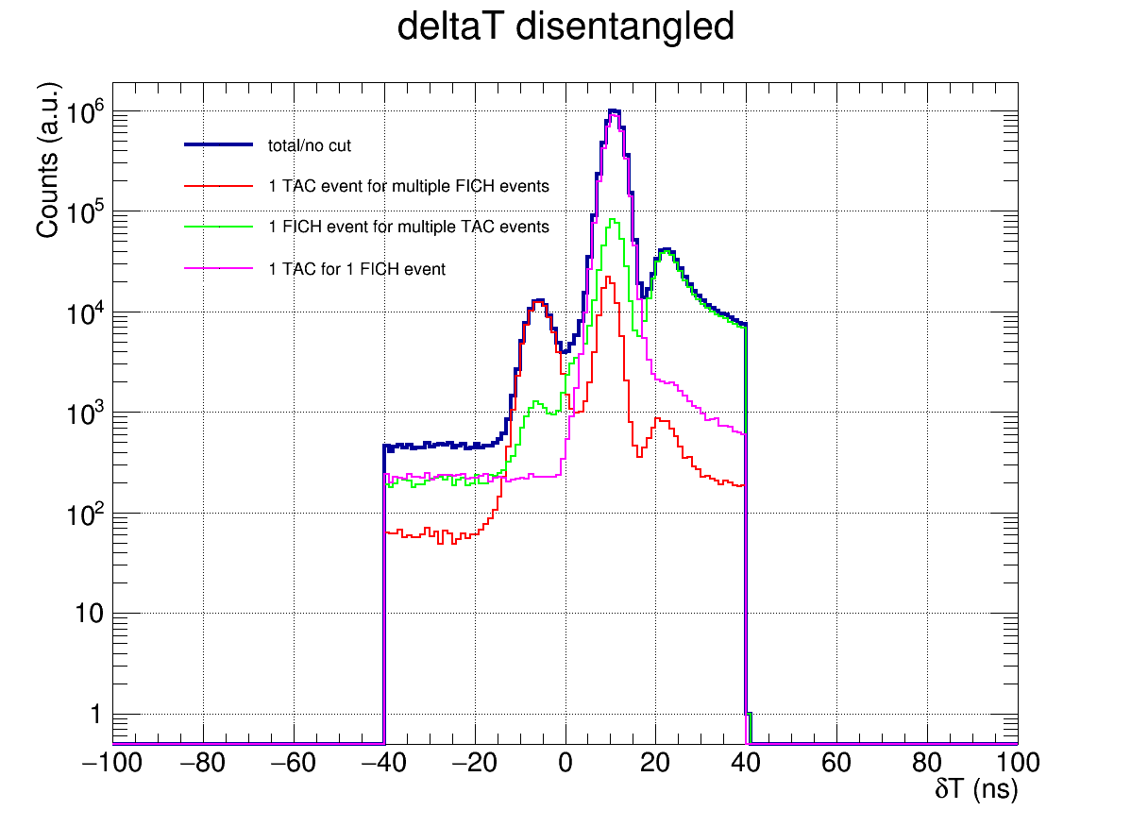
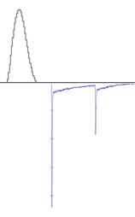
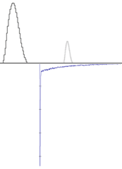
Coincidence - δT
FICH
TAC
FICH
TAC
„main“ coincidences

Slide 33
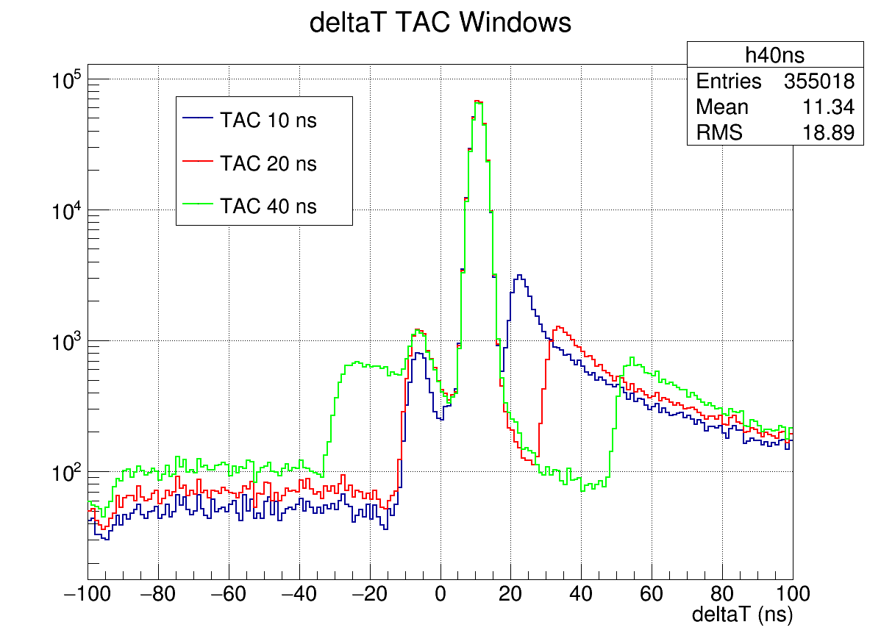
Coincidence I - δT
FICH
TAC
FICH
TAC

Slide 34
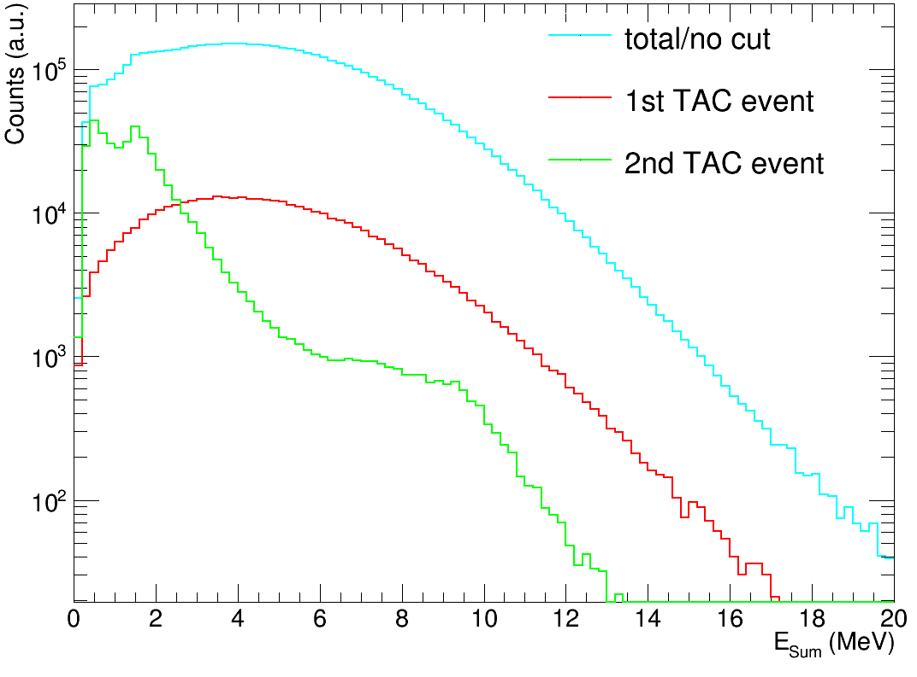
Coincidence II - δT
2nd
1st

Slide 35
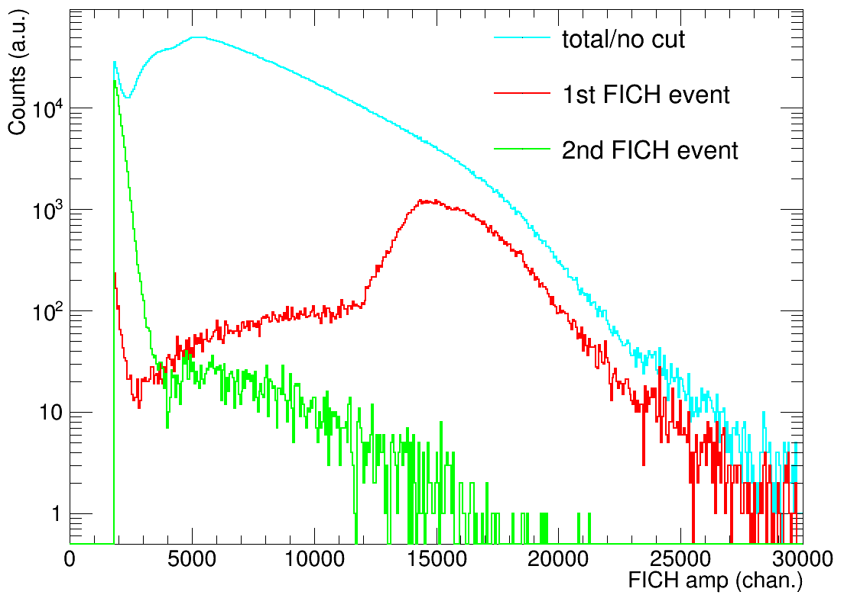
Coincidence III - δT
1st
2nd

Slide 36
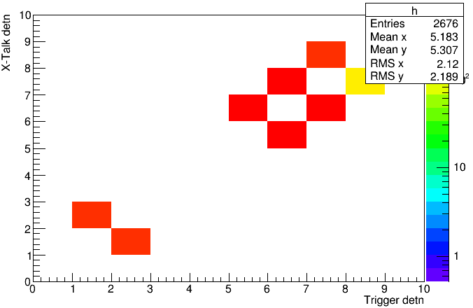
Coincidence IV - δT
Left peak:
Strict time correlation (16 ns)
Mostly appears after high amplitude fission signal
Conclusion: Induced signals/X-Talk

Slide 37
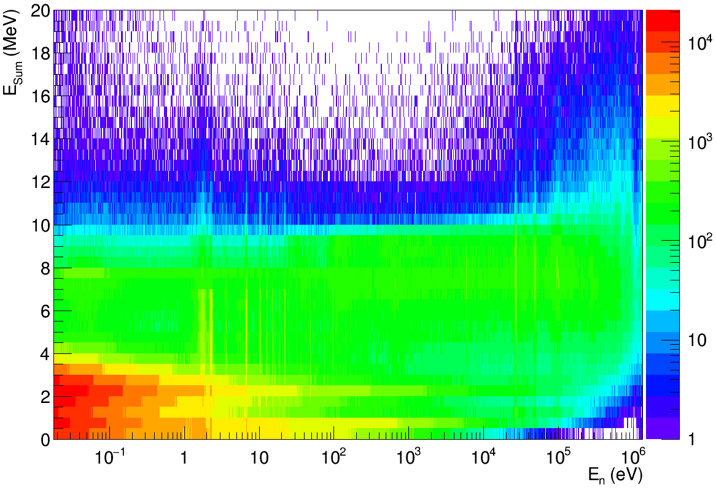
E_{Sum} – Fission vs. „Capture“
Coincidence/Fission
AntiCoincidence/“Capture“
$$E_{dep}^{BaF2} =100 keV$$

Slide 38
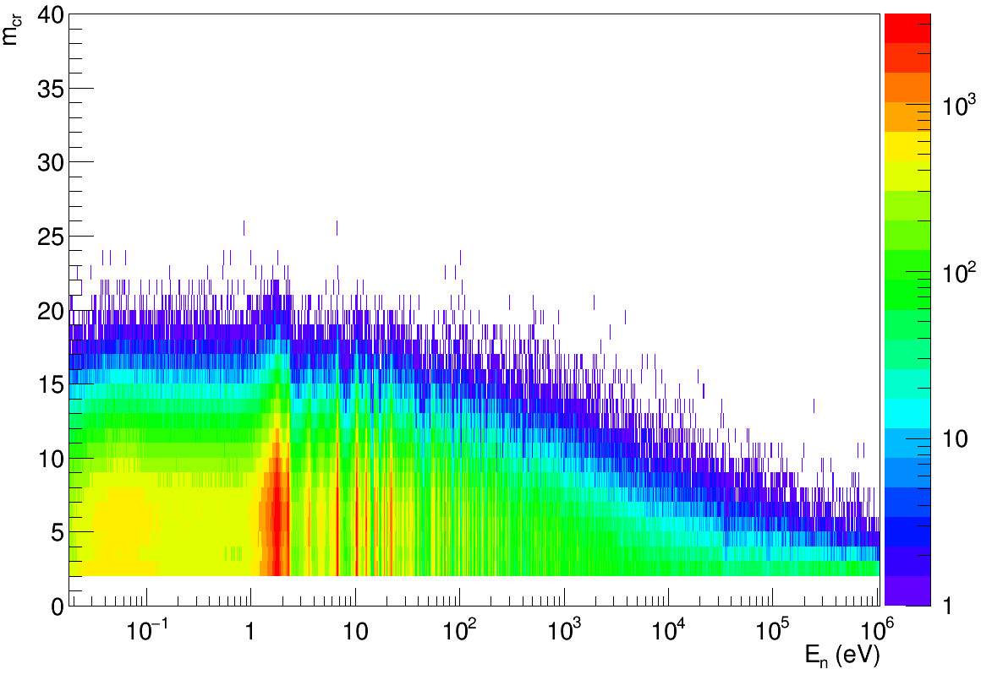
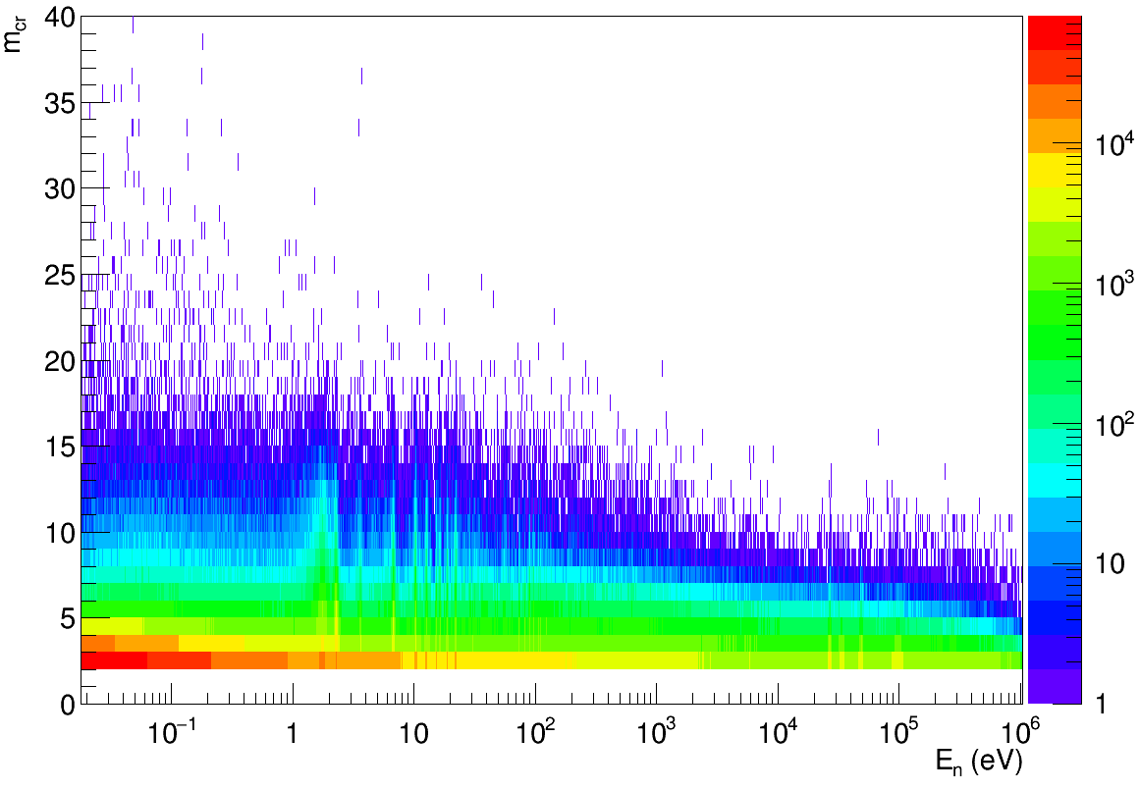
Multiplicity m_{cr} – Fission vs. „Capture“
Coincidence/Fission
AntiCoincidence/“Capture“
$$E_{dep}^{BaF2} =100 keV$$

Slide 39
Coincidence – Fission
$$E_{dep}^{BaF2} =100 keV$$

Slide 40
AntiCoincidence – „Capture“
$$E_{dep}^{BaF2} =100 keV$$

