Slide 1
The ion cloud effect
Alexis Gamelin (LAL)
Thesis supervisor: Christelle Bruni (LAL)
Alexis Gamelin

Slide 2
Overview
What
We want to locate ion clouds in an electron storage ring
Why
To minimize the electron beam degradation by the ion cloud effect
How
By understanding the physics and simulating the ion dynamics
Alexis Gamelin

Slide 3
Accelerator 101
Dipole magnets:
Produce constant vertical magnetic field to bend the trajectories of particles
Alexis Gamelin

Slide 4
Accelerator 101
Dipole magnets:
Produce constant vertical magnetic field to bend the trajectories of particles
Quadrupoles magnets:
Produce a position dependent magnetic field to focus particles, just like a lens would do for light
Alexis Gamelin

Slide 5
Accelerator 101
Dipole magnets and Quadrupoles magnets shape what is called the optics of the accelerator. The optics determines the behavior of the beam inside the accelerator.
Alexis Gamelin

Slide 6
Coordinate system
Horizontal axis x
Vertical axis y
Longitudinal axis s
Transverse plane
Alexis Gamelin

Slide 7
Ionisation of residual vacuum
M
Electron bunch
Molecules of residual vacuum
Alexis Gamelin

Slide 8
Ionisation of residual vacuum
M
e⁻
e⁻
M⁺
e⁻
e⁻
Ions are produced from residual vacuum molecules
Electron bunch
Alexis Gamelin

Slide 9
Ion cloud effect
M⁺
Positively charged ions are trapped in the beam space charge potential and undergo strong transverse oscillations
Electron bunch
Alexis Gamelin

Slide 10
Ion cloud effect
CO⁺/H₂⁺/…
But ions also affect the beam via multiple Coulomb interactions.
Residual ions can significantly degrade the performance of an accelerator and produce various beam instabilities.
To be able to treat these problems more effectively it is important to understand the dynamics of these ions in the accelerator.
F_{E}
Alexis Gamelin

Slide 11
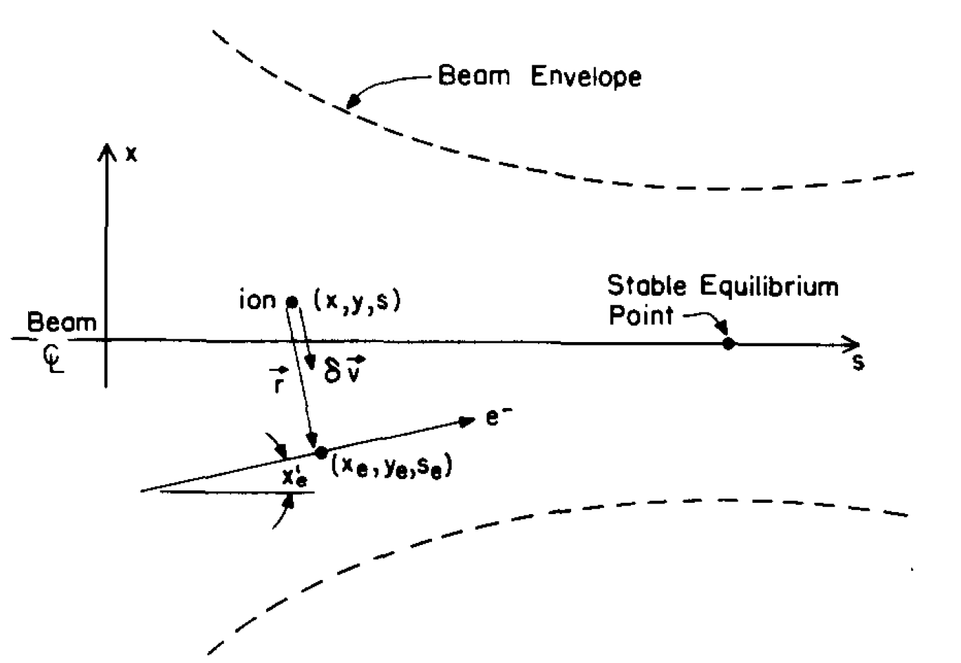
A model to describe the beam-ion interaction
Starting from the Coulomb force felt by an individual ion from a single electron:
$$\frac{δ{\vec{v}}_{i}}{δt}= \frac{1}{Am_{p}}{\vec{F}}_{ei}=\frac{−e^{2}}{4πε_{0}r_{ei}^{2}Am_{p}}{\vec{u}}_{ei}$$
If this equation is integrated during the time it takes for an ultra relativistic electron to cross the ion, it gives the transverse velocity kick that an ion will feel:
$$Δ\vec{v}= \frac{K}{r_{ei}^{2}}\vec{r_{ei}}$$
Figure from D. Sagan
Alexis Gamelin

Slide 12
A model to describe the beam-ion interaction
Assuming that the beam is Gaussian in transverse dimensions, the total velocity kick undergone by the ion during the beam crossing is obtained by summing on the N electrons of the beam:
$$Δ\vec{v_{T}}= \frac{N}{2πσ_{x}σ_{y}}\iint_{−∞}^{+∞}{Δ\vec{v} e^{−\left(\frac{x_{e}^{2}}{2σ_{x}^{2}}+\frac{y_{e}^{2}}{2σ_{y}^{2}}\right)}dx_{e}dy_{e}}$$
After some math, this give the Bassetti-Erskine formula, which express the transverse velocity kicks felt by an ion when an electron beam is crossing by:
$$iΔv_{x}+{Δv}_{y}=\frac{−NK\sqrt{π}}{\sqrt{2\left(σ_{x}^{2}−σ_{y}^{2}\right)}}\left(w\left(\frac{x+iy}{\sqrt{2\left(σ_{x}^{2}−σ_{y}^{2}\right)}}\right)−e^{−\left(\frac{x^{2}}{2σ_{x}^{2}}+\frac{y^{2}}{2σ_{y}^{2}}\right)}w\left(\frac{x\frac{σ_{y}}{σ_{x}}+iy\frac{σ_{x}}{σ_{y}}}{\sqrt{2\left(σ_{x}^{2}−σ_{y}^{2}\right)}}\right)\right)$$
Alexis Gamelin

Slide 13
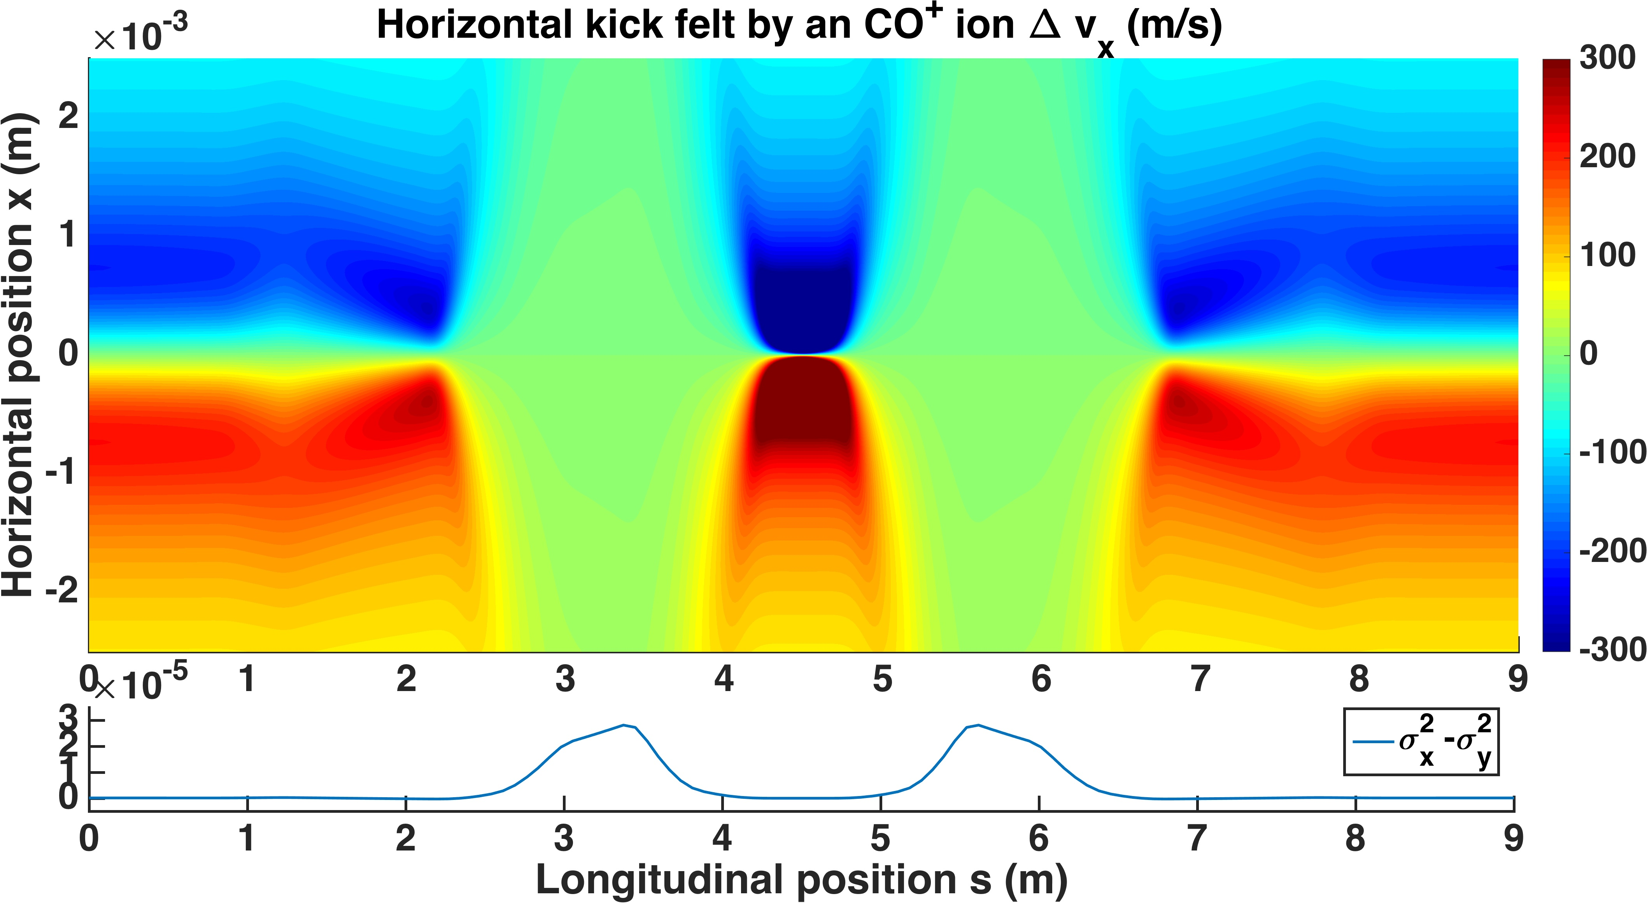
Alexis Gamelin

Slide 14
A model to describe the beam-ion interaction
Using the same type of derivation for the longitudinal dimension it is possible to get Sagan formula which gives the longitudinal kick that an ion will feel when the electron beam is crossing:
$${Δv}_{s}=\left(−α_{x}ε_{x}+ηη^{′}σ_{ε}^{2}\right)\frac{∂Δ_{x}}{∂x}−α_{y}ε_{y}\frac{∂Δ_{y}}{∂y}$$
Alexis Gamelin

Slide 15
A model to describe the beam-ion interaction
Using the same type of derivation for the longitudinal dimension it is possible to get Sagan formula which gives the longitudinal kick that an ion will feel when the electron beam is crossing:
$${Δv}_{s}=\left(−α_{x}ε_{x}+ηη^{′}σ_{ε}^{2}\right)\frac{∂Δ_{x}}{∂x}−α_{y}ε_{y}\frac{∂Δ_{y}}{∂y}$$
The alpha Twiss Parameter is a property of the accelerator, fixed by the position and the strength of the quadrupoles magnets used to focus the beam. It is related to the variation of the beam size.
Alexis Gamelin
Figure from JUAS lecture, J.De Conto

Slide 16
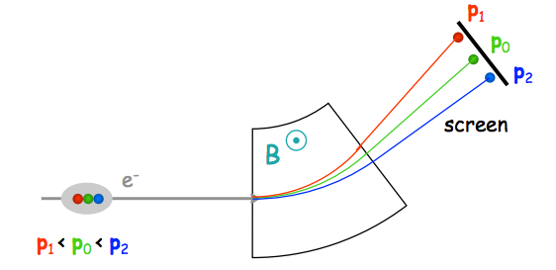
A model to describe the beam-ion interaction
Using the same type of derivation for the longitudinal dimension it is possible to get Sagan formula which gives the longitudinal kick that an ion will feel when the electron beam is crossing:
$${Δv}_{s}=\left(−α_{x}ε_{x}+ηη^{′}σ_{ε}^{2}\right)\frac{∂Δ_{x}}{∂x}−α_{y}ε_{y}\frac{∂Δ_{y}}{∂y}$$
The dispersion functions are properties of the accelerator, fixed by the position and the strength of the dipole magnets used to curve the trajectory of the beam. It is related to the increase of the beam size in curved section of the accelerator.
Alexis Gamelin
Figure from JUAS lecture, E.Metral

Slide 17
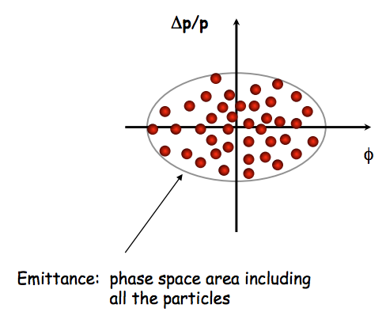
A model to describe the beam-ion interaction
Using the same type of derivation for the longitudinal dimension it is possible to get Sagan formula which gives the longitudinal kick that an ion will feel when the electron beam is crossing:
$${Δv}_{s}=\left(−α_{x}ε_{x}+ηη^{′}σ_{ε}^{2}\right)\frac{∂Δ_{x}}{∂x}−α_{y}ε_{y}\frac{∂Δ_{y}}{∂y}$$
Emittances $ε_{x/y}$ and the energy spread $σ_{ε}$ are properties of the electron beam
Alexis Gamelin
Figure from JUAS lecture, E.Metral

Slide 18
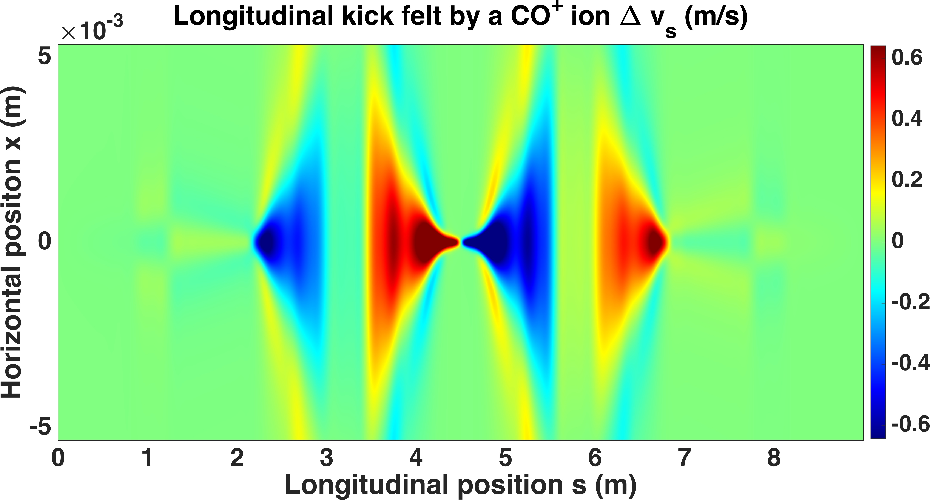
Alexis Gamelin

Slide 19
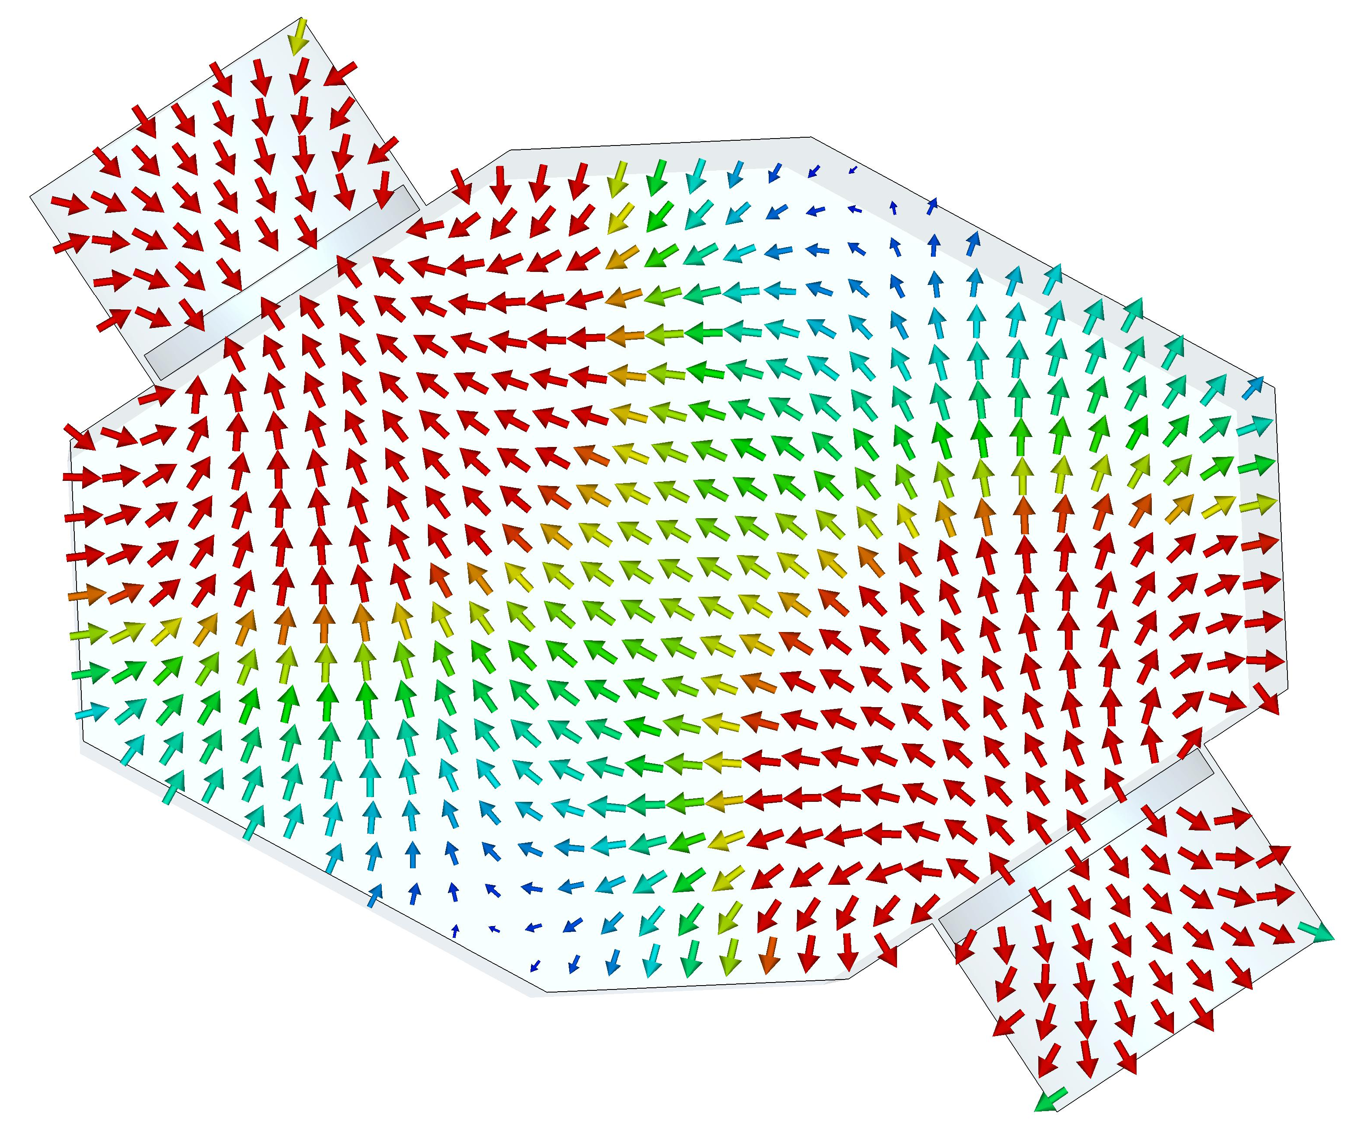
NUAGE code for ion cloud tracking
In order to be able to locate ion clouds and minimize them, a simulation code named NUAGE has been developed at LAL which includes:
Transverse and longitudinal ion dynamics
Tracking in magnetic elements such as dipoles magnets or quadrupoles magnets.
Effect of electrodes which clear the ions using a constant electric field
Alexis Gamelin

Slide 20
Dipole =
Clearing electrode =
Alexis Gamelin

Slide 21
In a nutshell
Ion clouds due to ionisation of residual molecules of the vacuum can degrade accelerator performances
The ion cloud dynamic is determined by the accelerator design
Simulations are done to optimise clearing techniques
A good example of very rich physics which has many more subtleties: magnetic mirror effect, multi charged ion, ion cloud space charge, …
Alexis Gamelin

Slide 22
In a nutshell
Ion clouds due to ionisation of residual molecules of the vacuum can degrade accelerator performances
The ion cloud dynamic is determined by the accelerator design
Simulations are done to optimise clearing techniques
A good example of very rich physics which has many more subtleties: magnetic mirror effect, multi charged ion, ion cloud space charge, …
Thank you !
Alexis Gamelin

