Slide 1


Climate science, climate change latest updates
Valérie Masson-Delmotte
valmasdel

Slide 2
Introduction : climate sciences
Indicators of the state of the climate system
Scenarios and projections
Next IPCC reports

Slide 3
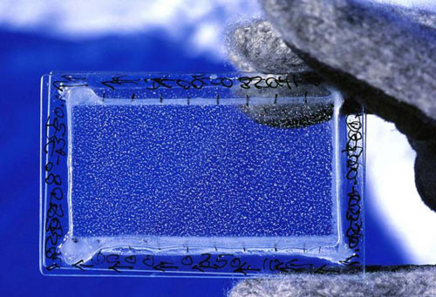
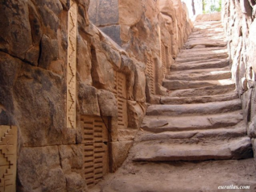
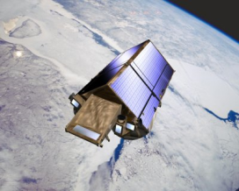
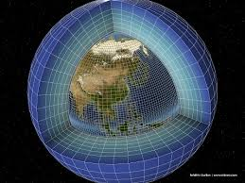
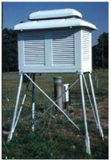
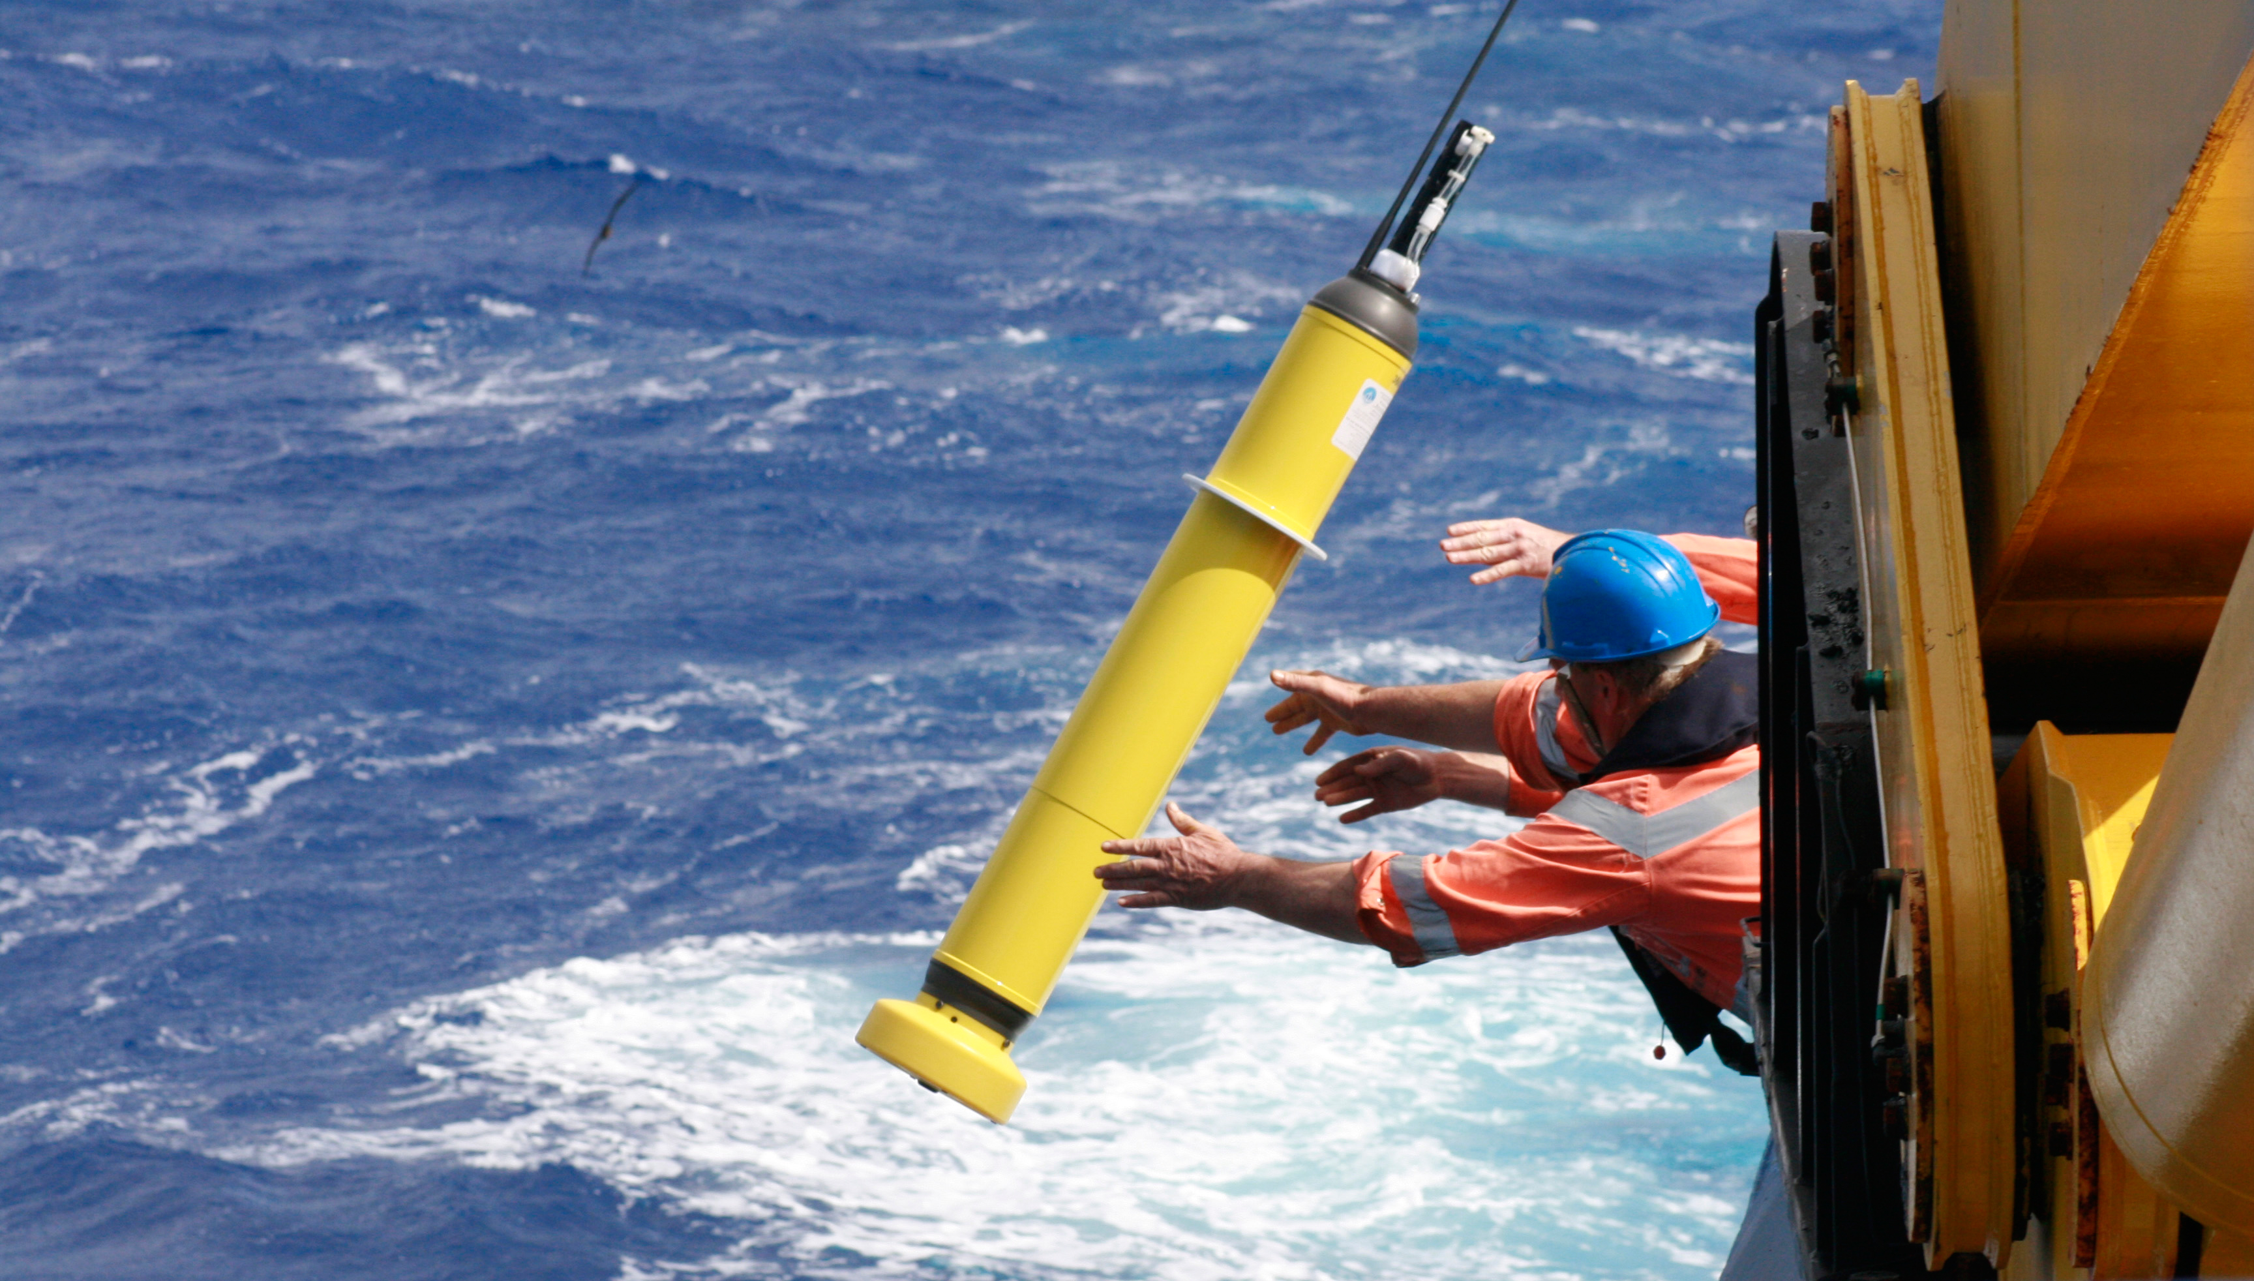
A major scientific endeavour
Fluid physics
Thermodynamics
Radiative transfers
Chronology, proxies
Super computors
Satellites
Antiquity
Middle
Age
17th C
Weather
instruments
19th C
Networks
Ice ages
Greenhouse
effect
20th C
Past climate
Climate modelling

Slide 4
From knowledge production …
Number of peer-review papers with « climate change » keyword

Slide 5
to the assessment of the state of knowledge
The IPCC assesses the scientific, technical and socio-economic information relevant to understanding the scientific basis of risk of human-induced climate change, its potential impacts and options for adaptation and mitigation.
IPCC reports must be policy-relevant but not policy-prescriptive

Slide 6
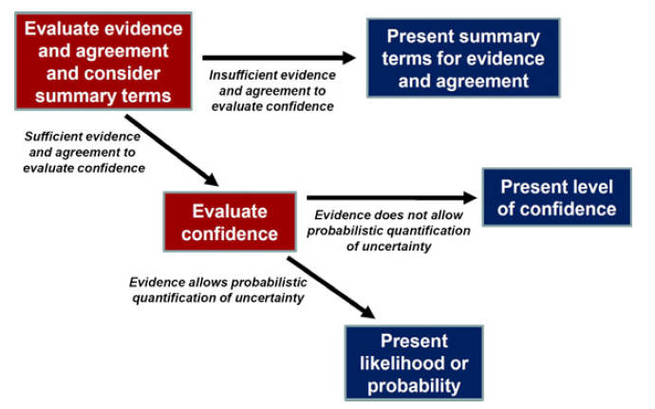
How to assess and report confidence in findings?

Slide 7
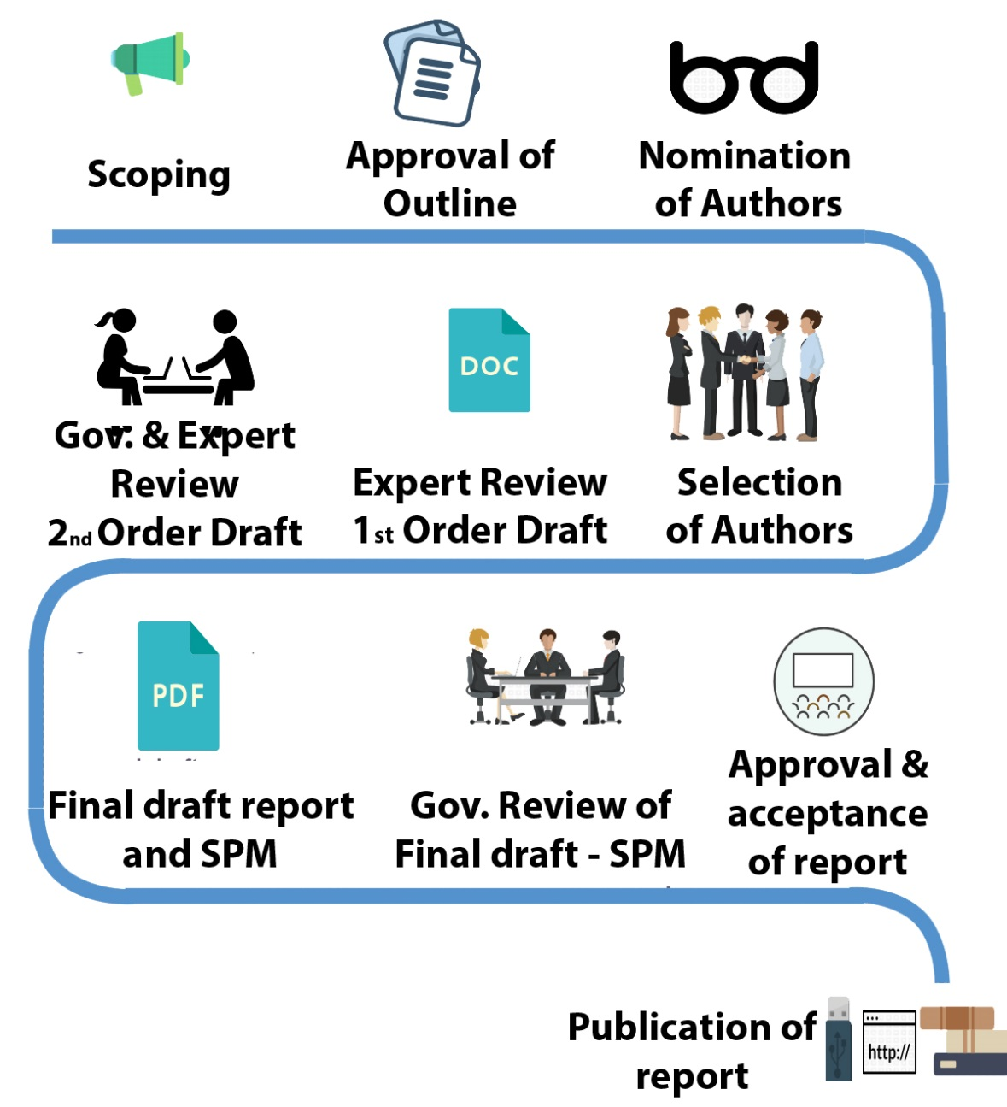
IPCC report preparation steps

Slide 8
Introduction : climate sciences
Indicators of the state of the climate system
Scenarios and projections
Next IPCC reports

Slide 9
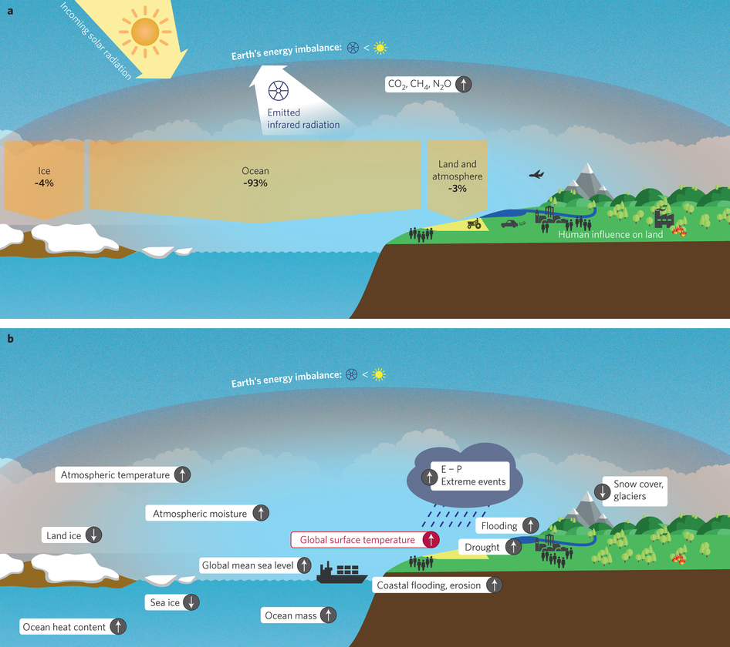
Nos activités agissent sur le bilan d’énergie de la Terre

Slide 10
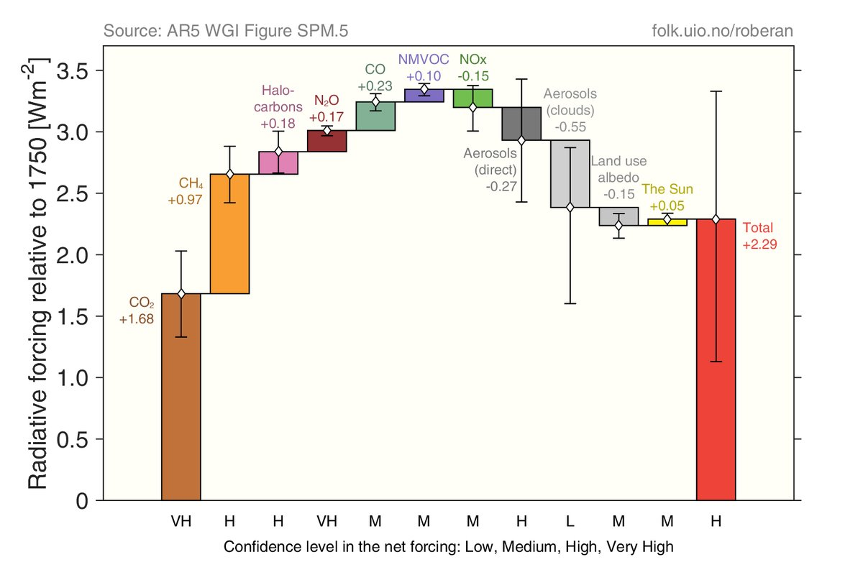
Causes of radiative imbalance

Slide 11






World sources of greenhouse gas emissions
24%
14%
6.4%
21%
35%
Building
Agriculture,
forestry and land use
gestion des terres
Industry
Transport
Energy

Slide 12
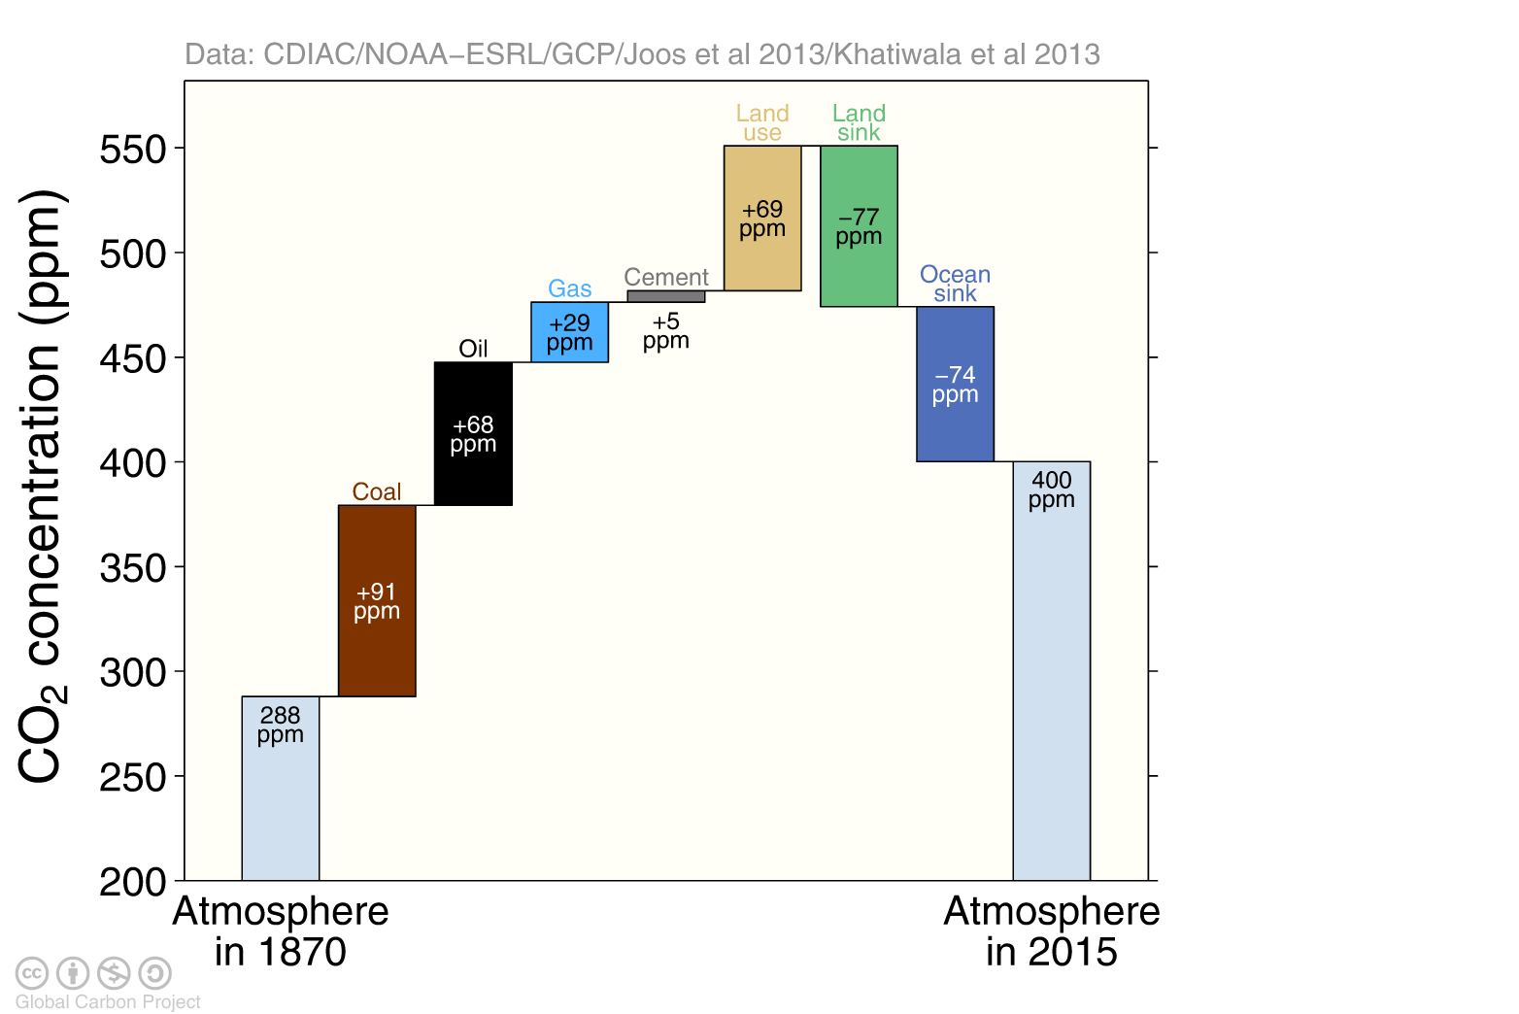
Causes of atmospheric CO₂ concentration change since 1750
Global Carbon Project, 2016
Notes:
Emissions 2002-2015
44% stay in the atmosphere
31% land carbon uptake
26% ocean carbon uptake

Slide 13
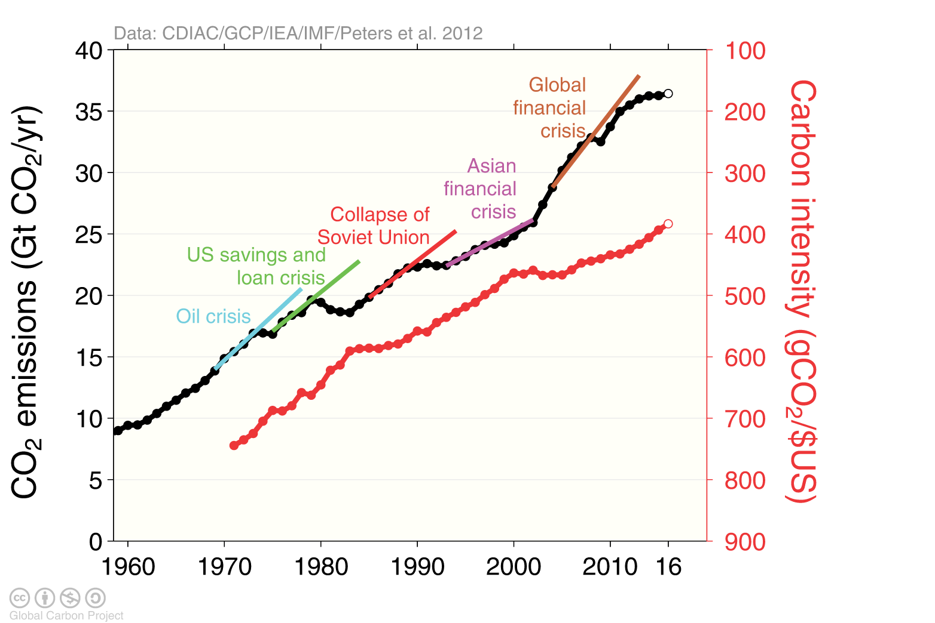
Fossil fuel CO₂ emissions
+63% entre 1990 et 2015

Slide 14
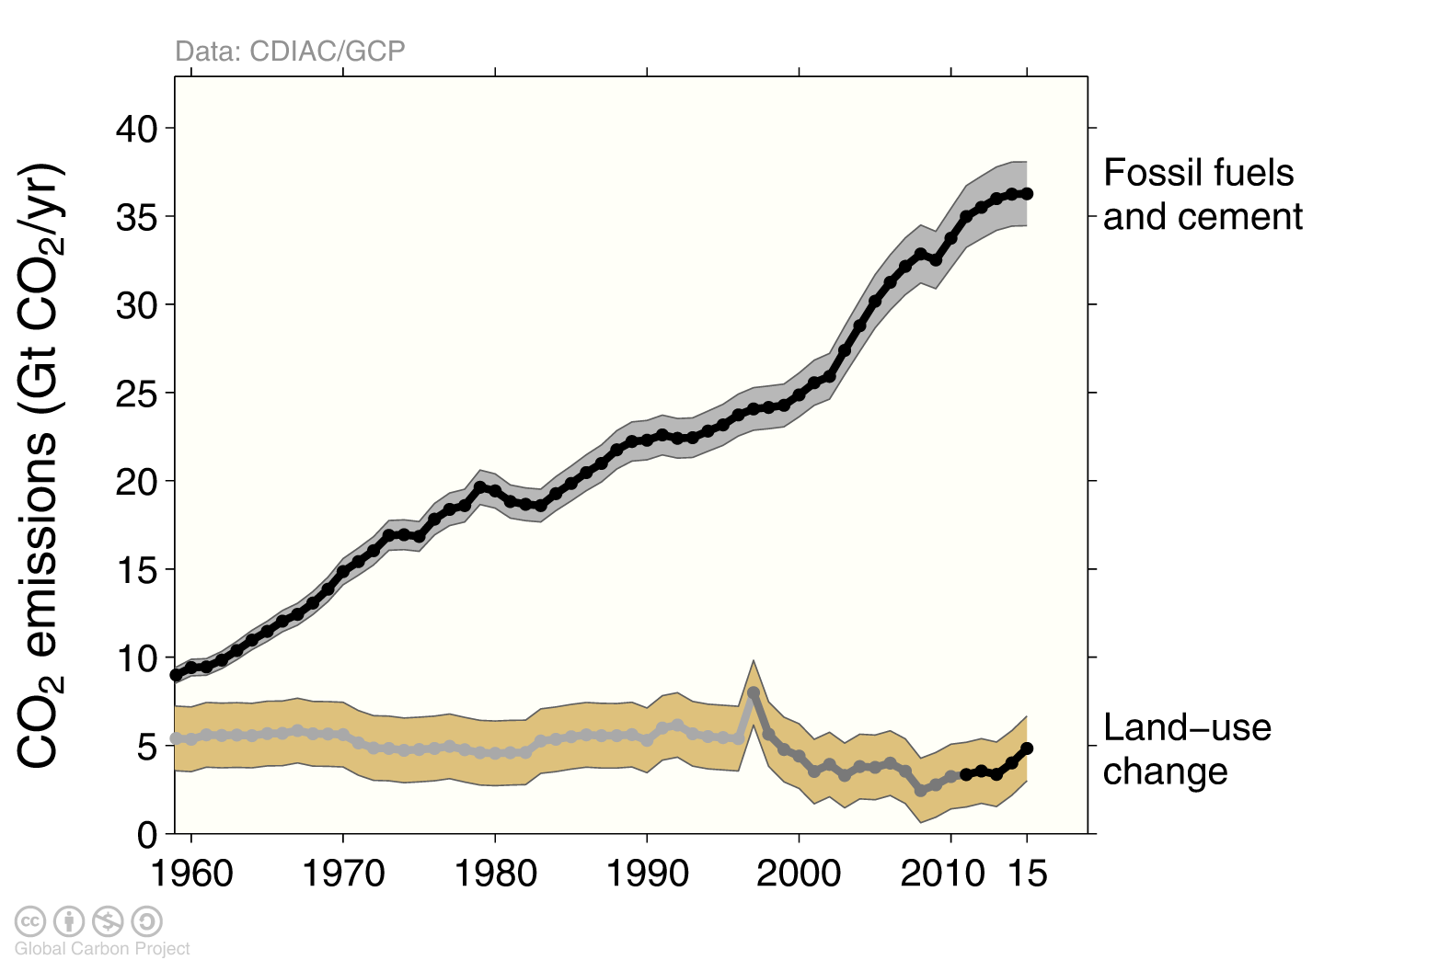
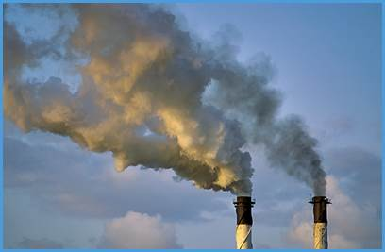
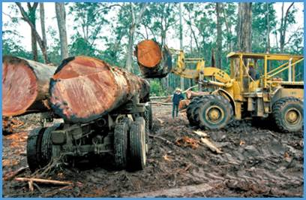
Deforestation :
30% of 1960 CO₂ emissions
9% of 2006-2015 emissions

Slide 15
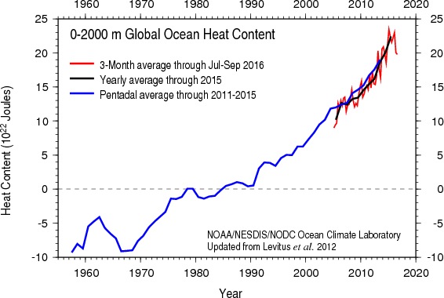
Change in ocean heat content
NOAA

Slide 16
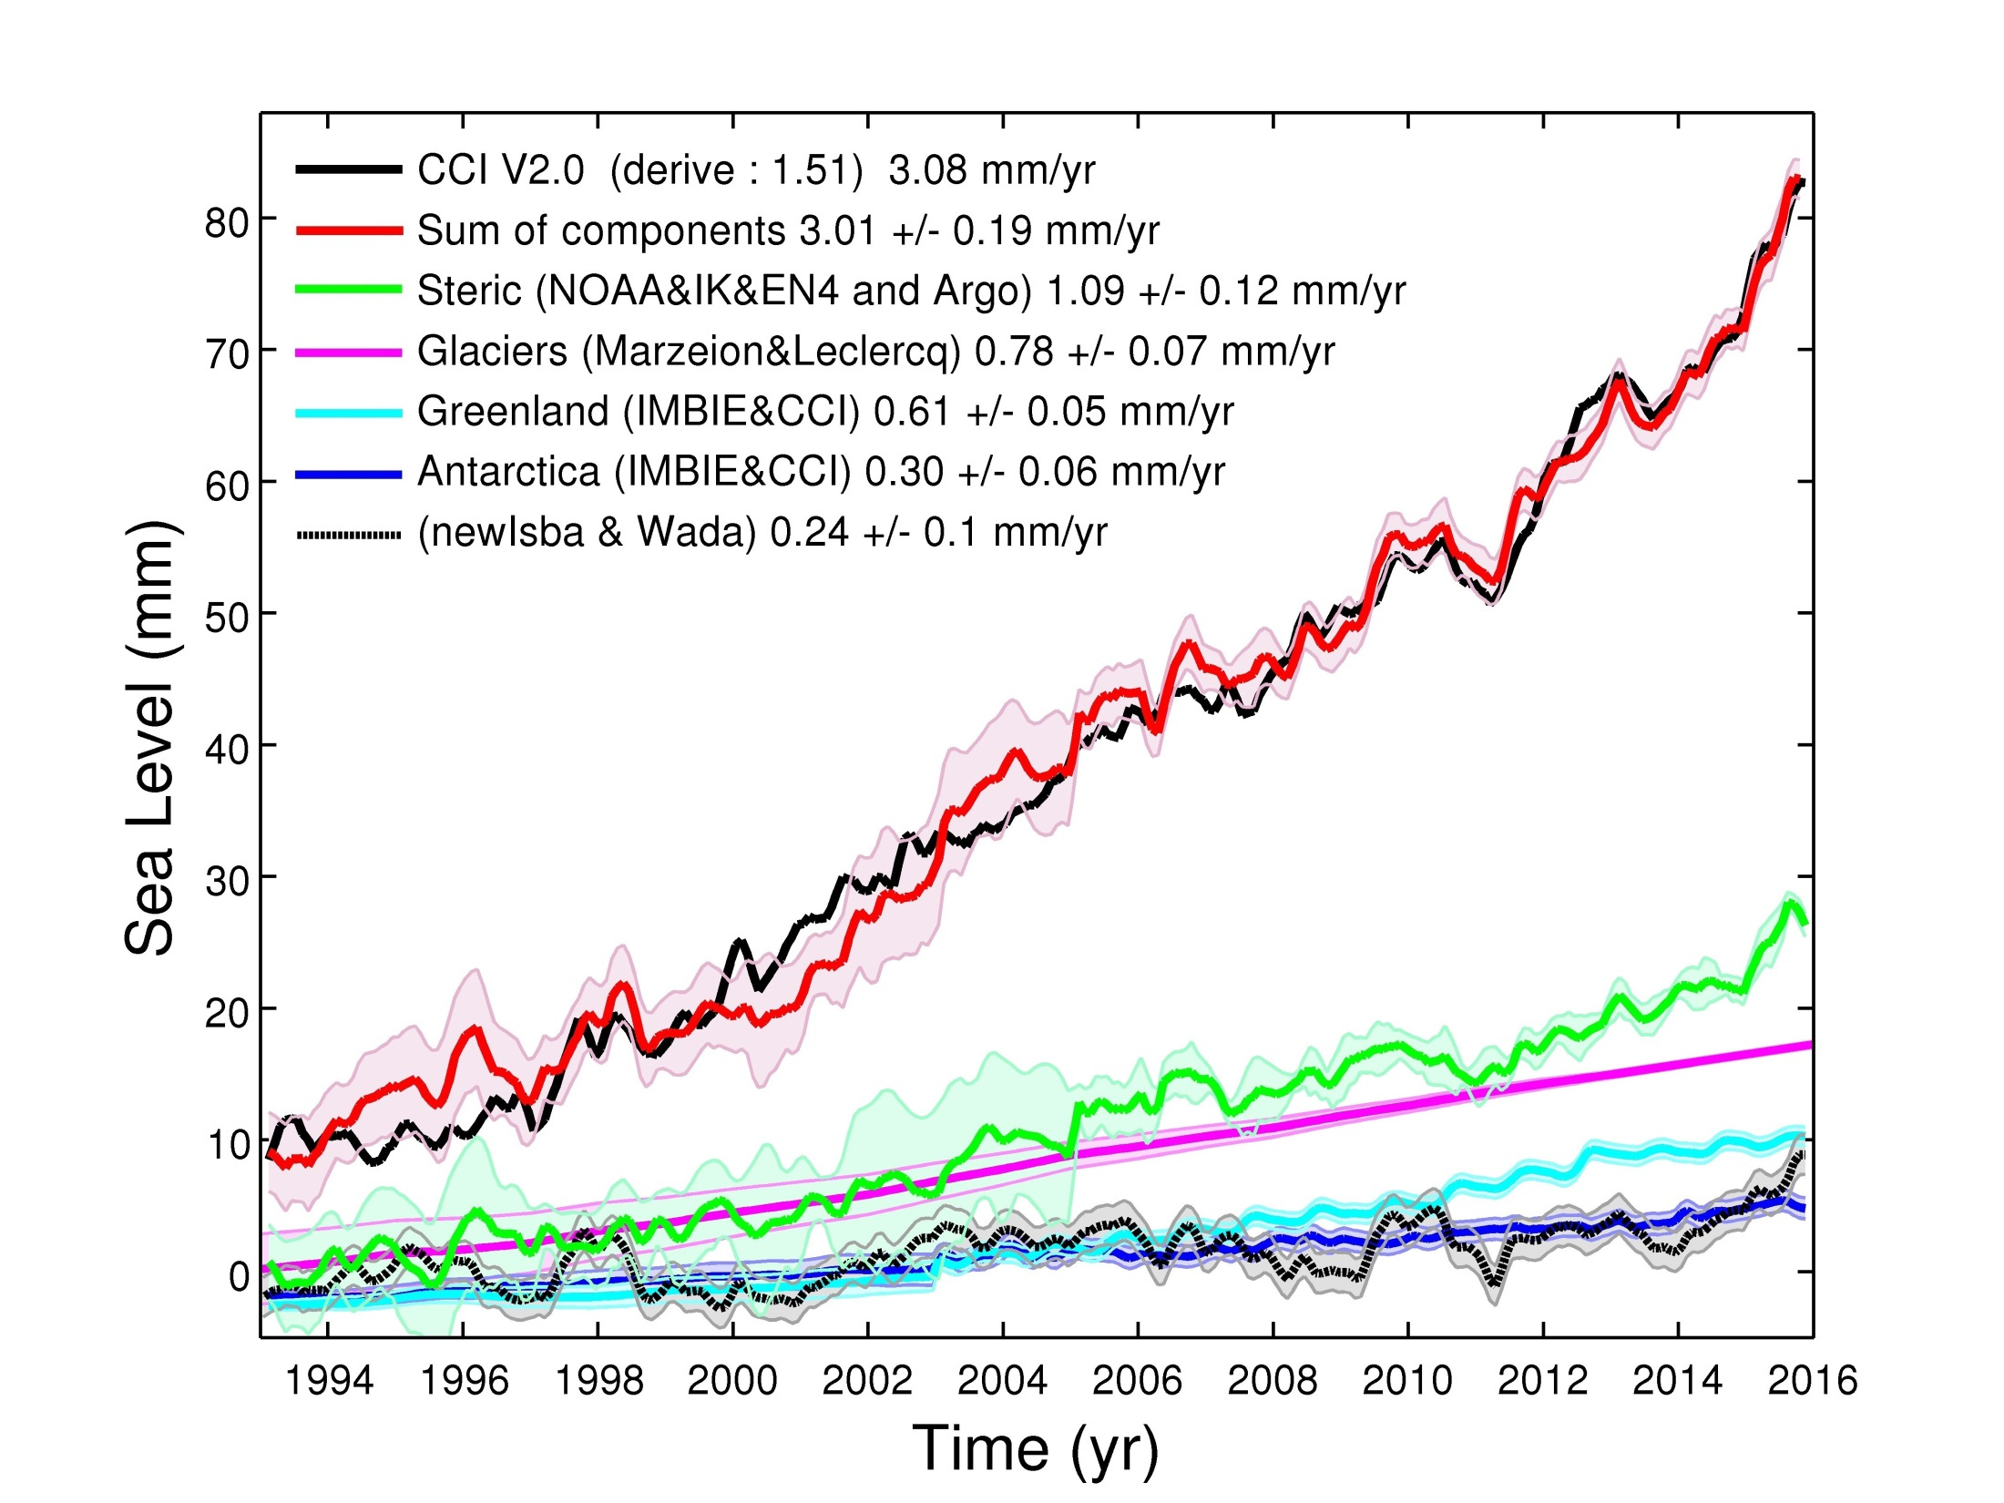
Global mean sea level
1900-1990 : 1,2 à 1,9 mm / an
1993-2016 : 3,1 ± 0.4 mm / an
Ocean 34%
Ice 56%
Water 8%
LEGOS

Slide 17
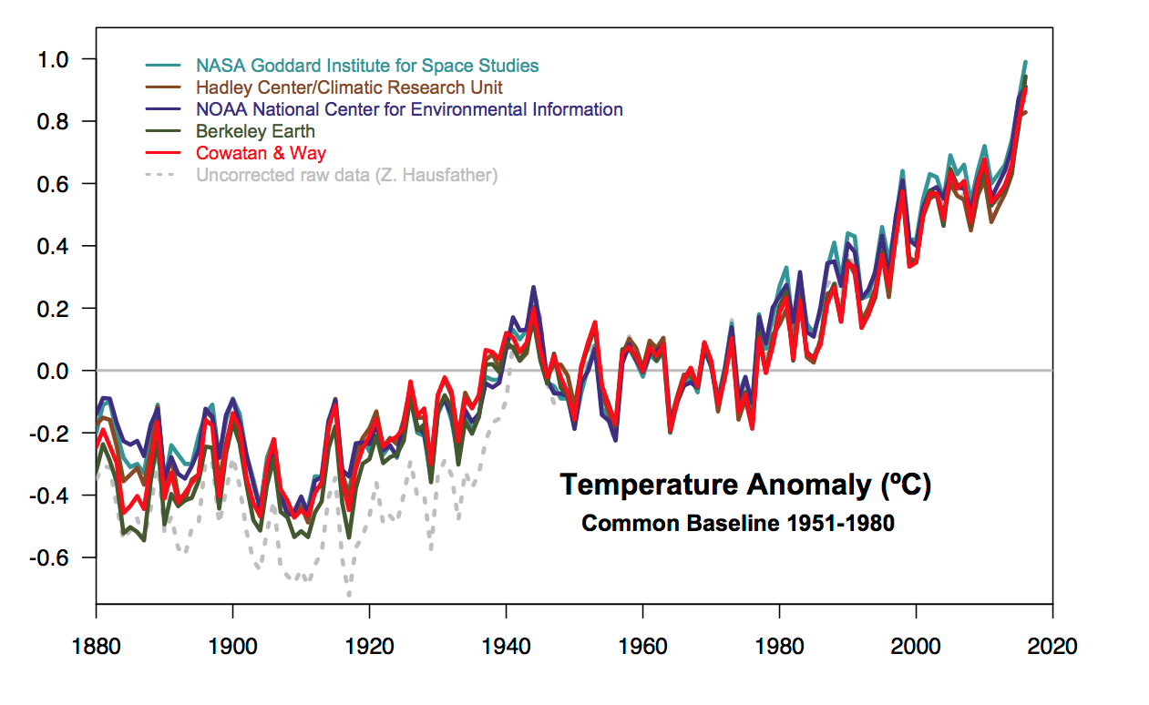
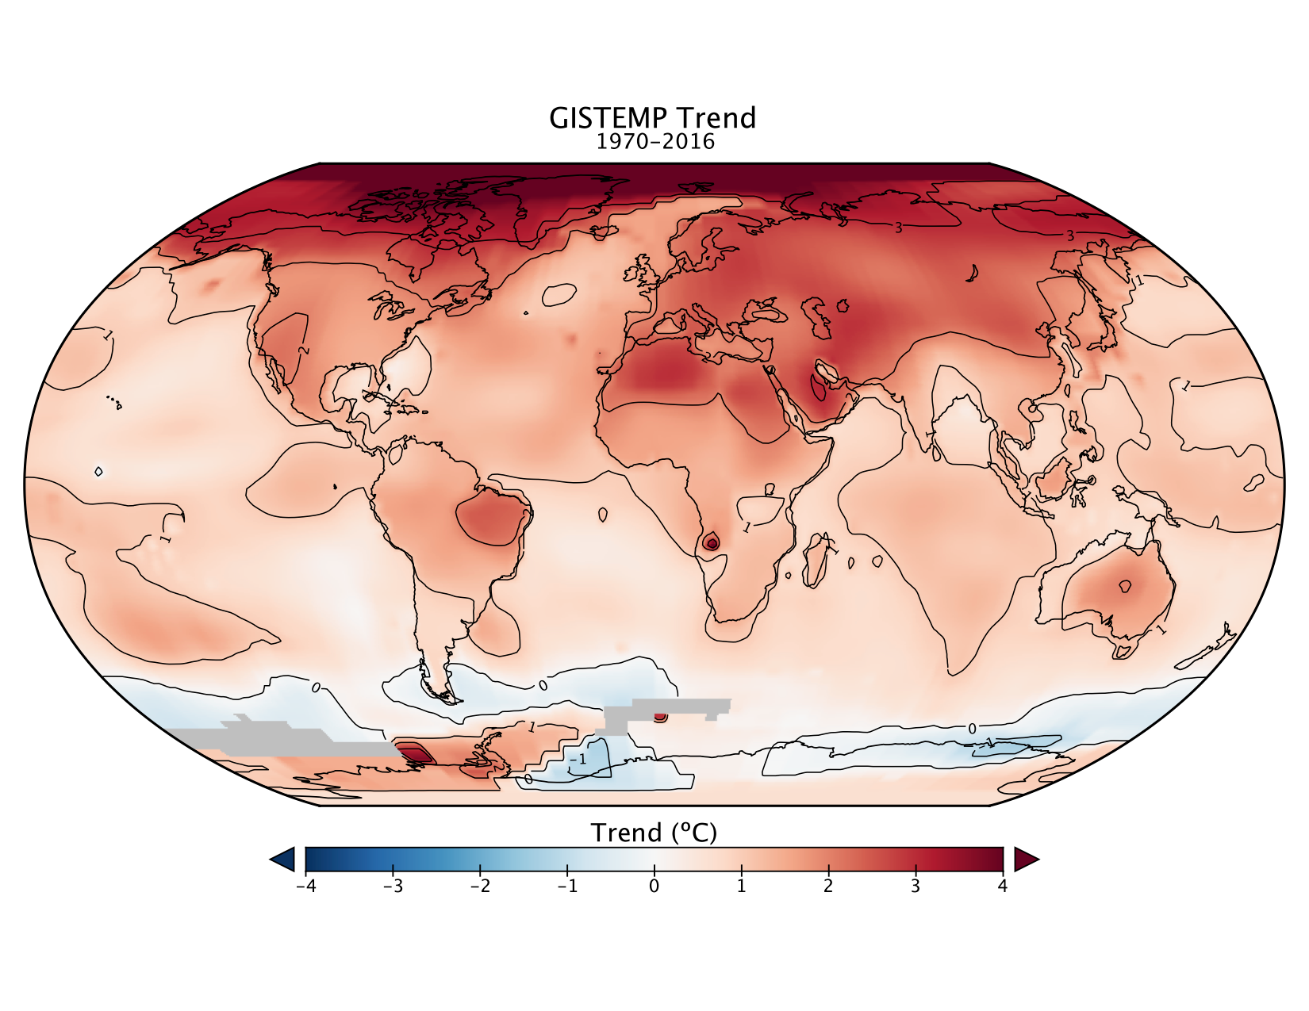
Change in global mean surface temperature
Trend : + 0,18°C par décennie
2015 and 2016 : >1°C above pre-industrial
NASA GISS; Hawkins et al, BAMS, 2017

Slide 18
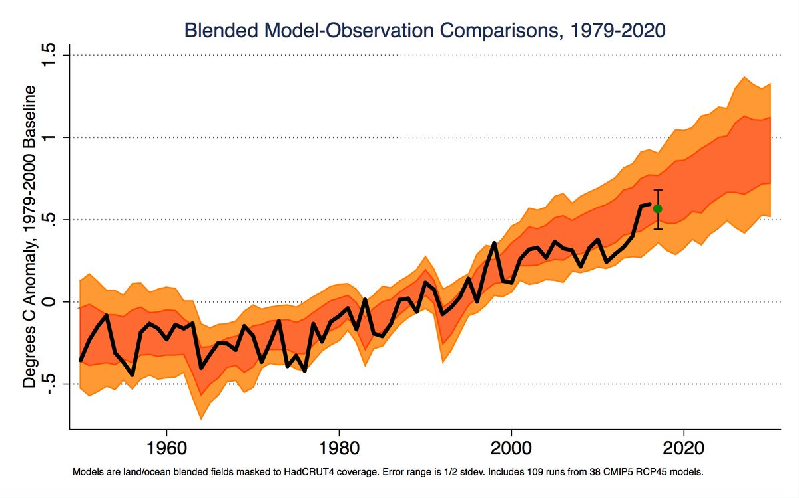
Comparison between observed and projected warming (from IPCC 2013)
Met Office ; Z. Hausfather

Slide 19
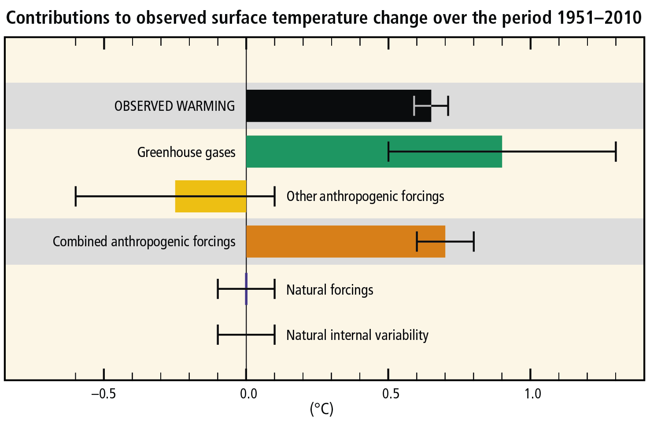
Contributions to warming from 1951 to 2010
Observed
Greenhouse gas
Other human influences
Net human influence
Natural factors (Sun, volcanoes)
Internal climate variability

Slide 20
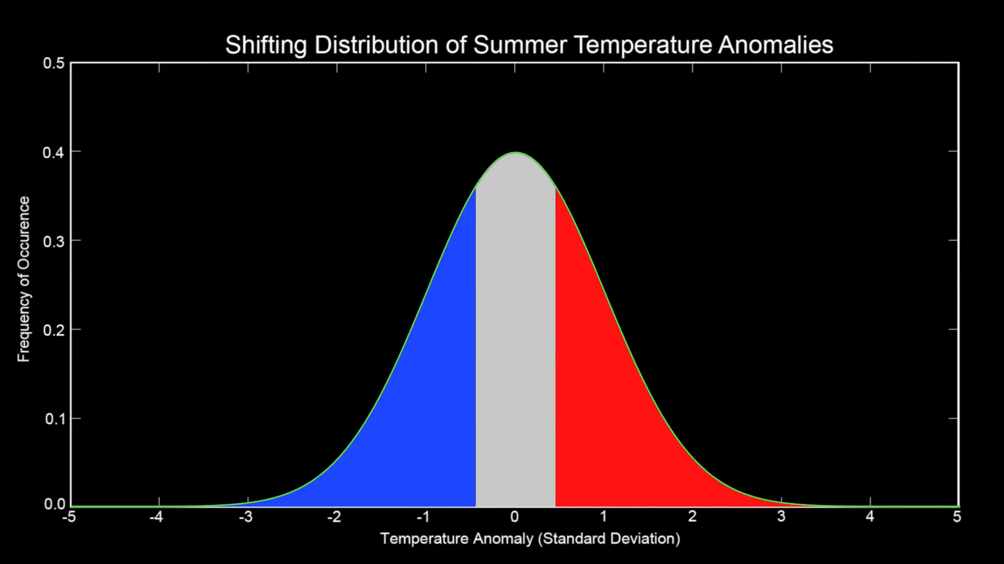
Change in summer temperature distribution above continents

Slide 21
Introduction : climate sciences
Indicators of the state of the climate system
Scenarios and projections
Next IPCC reports

Slide 22
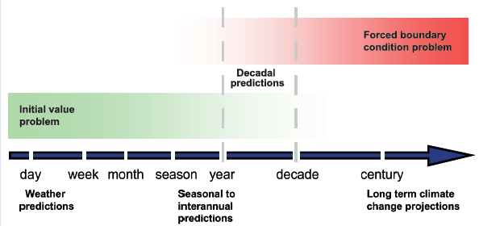
Future : predictions vs projections

Slide 23
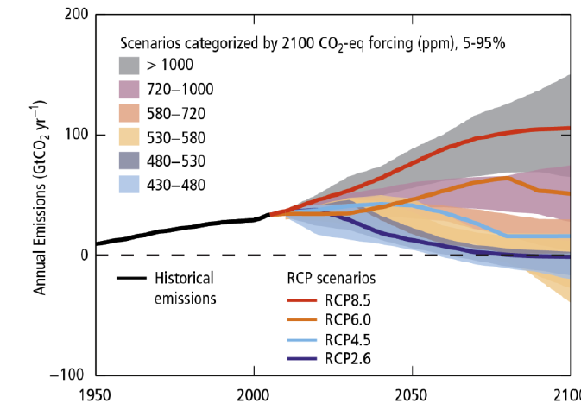
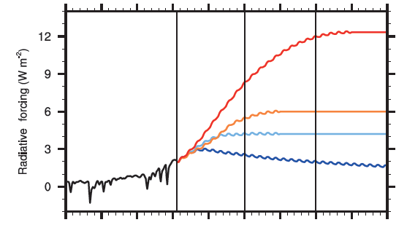
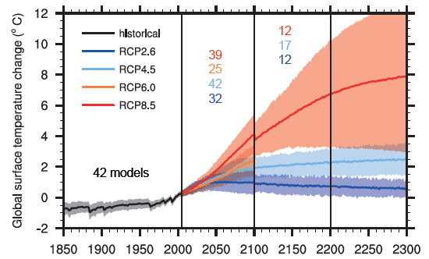
Future : scenarios and projections
Greenhouse gas emissions
Radiative forcing (W/m²)
Climate response (°C)

Slide 24
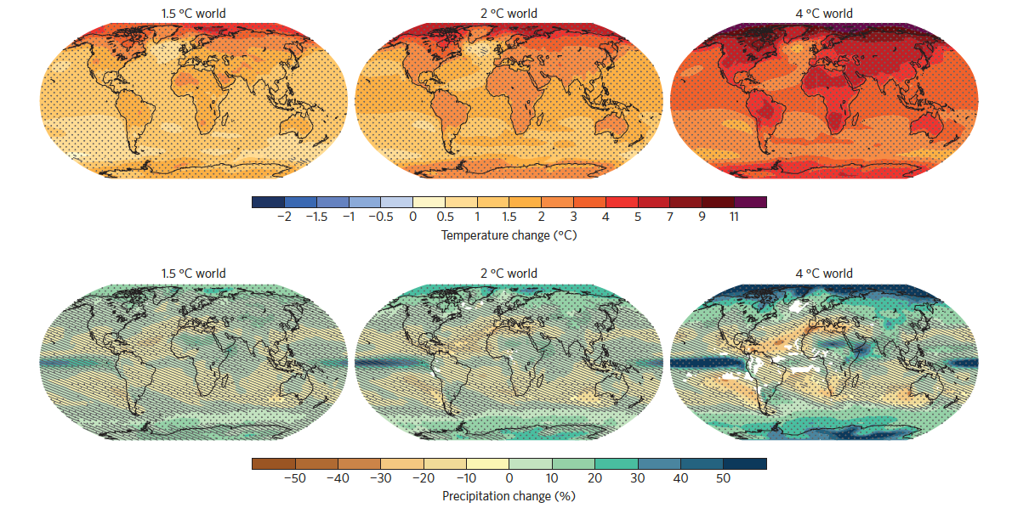
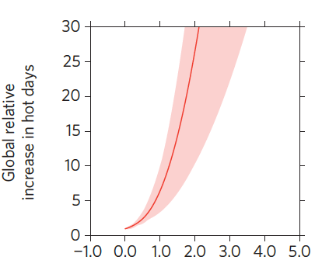

What are the implications of 1.5°C, 2°C or 4°C warming?
Very hot days
Knutti et al, Nat. Geo., 2015

Slide 25
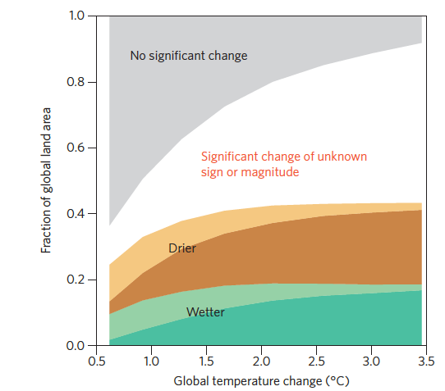
What are the implications of 1.5°C, 2°C or 4°C warming?
Changes in global water cycle :
50% of the world’s population at +2°C
50% of the land surface at +3°C
Sedlacek and Knutti, 2014; Knutti et al, Nat. Geo., 2015

Slide 26
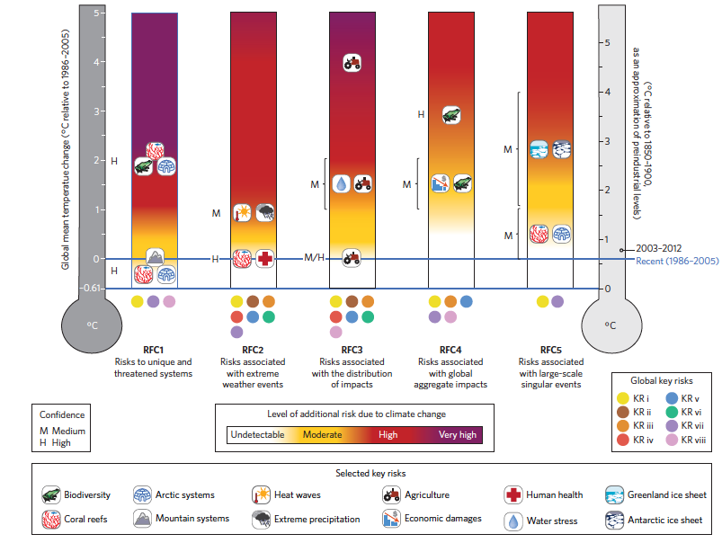
Future additional risks
Global warming
(°C) above 1850-1900
2016
Unique and threatened systems
Extreme events
Distribution
of impacts
Global aggregated impacts
Large scale
singular events
O’Neil et al, NCC, 2017

Slide 27
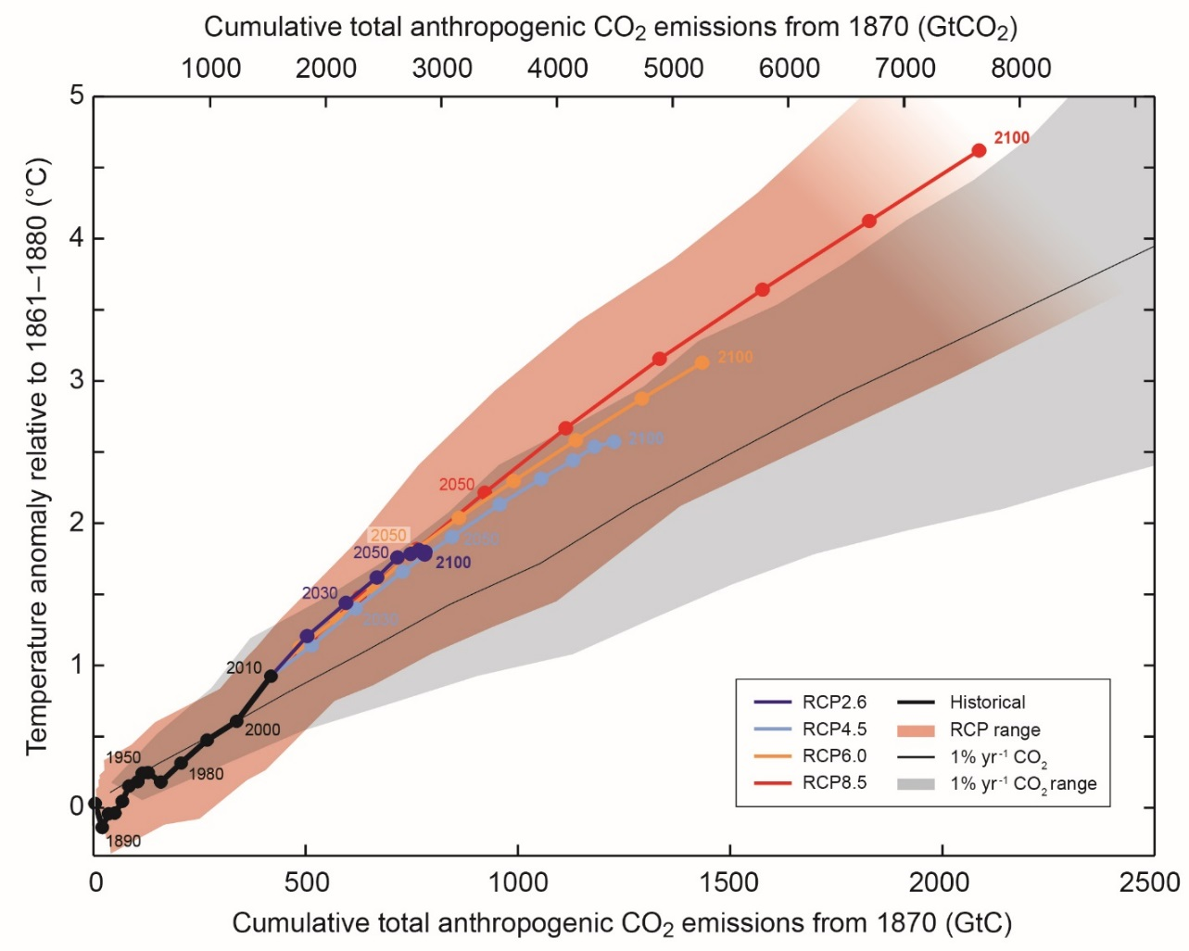
Carbon budget concept: cumulative CO₂ emissions
<2.0°C, >66%
Indicative range
450-1050GtCO₂
800
GtCO₂
Amount
Remaining
2100
GtCO₂
IPCC 2013
Notes:
Déjà consommé 72% du budget carbone pour <2% avec 2/3 de chance de succès…

Slide 28
Solutions to reduce risks
Adaptation, and long term reduction of greenhouse gas emissions
Delayed action increases technological, economical, social and institutional challenges to reduce greenhouse gas emissions
Mitigation has a cost but also generates co-benefits (ex: air quality and health), and avoided costs (loss and damage)

Slide 29




Mitigation options
Energy efficiency
Low and zero carbon energy
Carbon sinks
• Forestry
• Biomass energy with capture and storage
Behavior and lifestyles

Slide 30
Relationships between IPCC reports and international climate policy
FAR (1990)
leads to
UNFCCC
SAR (1995)
elements for
Kyoto Protocol
TAR (2001)
Impacts and adaptation
attention to
AR4 (2007)
2°C target; post-Kyoto basis
elements for
AR5 (2013/2014)
elements for
Paris Agreement

Slide 31
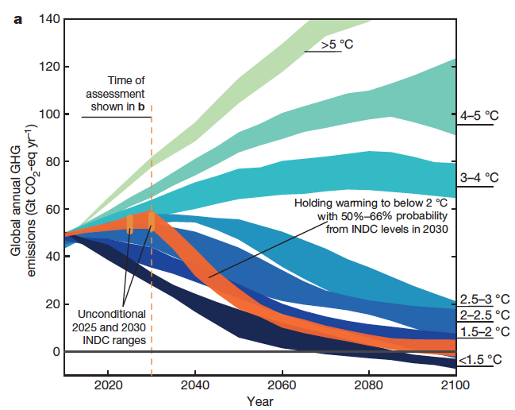
Paris agreement mechanism
National contributions
Dialogue 2018
Global stocktake 2023
adaptation, mitigation, finance
Emission decrease towards carbon neutrality
Long term target
Rogelj et al, Nature, 2016

Slide 32
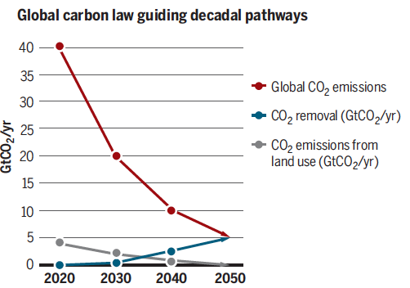
Challenges
Rockström et al, Science, 2017

Slide 33
Introduction : climate sciences
Indicators of the state of the climate system
Scenarios and projections
Next IPCC reports

Slide 34

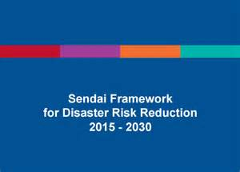
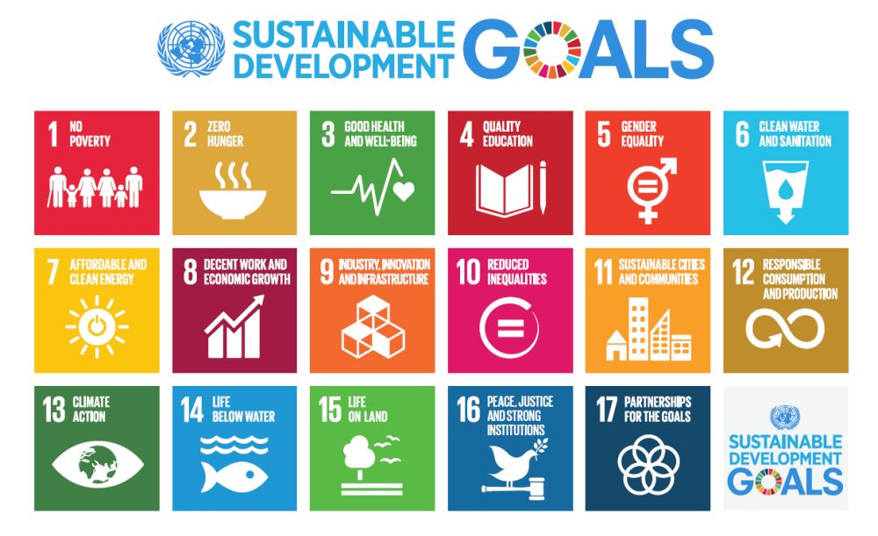
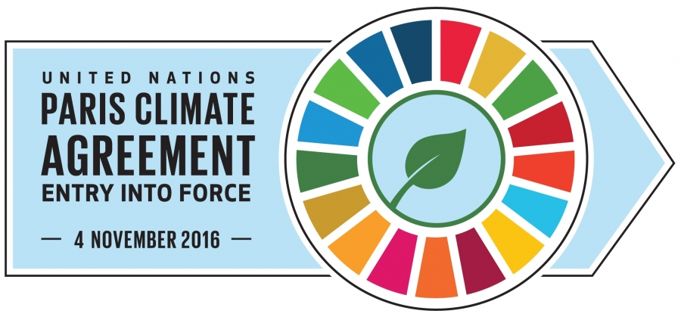
Specificities of the IPCC 6th Assessment Cycle?
International 2030 agenda
  Paris Agreement stocktake
  Needs for knowledge-based solutions

Slide 35

Global warming of 1.5°C (SR1.5)
Chapter 1: Framing and context
Chapter 2: Mitigation pathways compatible with 1.5°C in the context of sustainable development
Chapter 3: Impacts of 1.5°C global warming on natural and human systems
Chapter 4: Strengthening and implementing the global response to the threat of climate change
Chapter 5: Sustainable development, poverty eradication and reducing inequalities
15
40
60
50
20
Notes:
542 nominations d’auteurs
Sélection finalisée la semaine prochaine (83 CLA, LA, RE)
Pression de sélection 1/7

Slide 36


IPCC Special Report on the Ocean and Cryosphere in a Changing Climate (SROCC)
Chapter 1: Framing and context
Chapter 2: High mountain areas
Chapter 3: Polar regions
Chapter 4: Sea level rise and implications for low lying islands, coasts and communities
Chapter 5: Changing ocean, marine ecosystems, and dependent communities
Chapter 6 : Extremes, abrupt changes and managing risks
Box : Low lying islands and coasts
15
30
50
50
65
20
<5

Slide 37

IPCC Special Report on Climate Change and Land (SRCCL)
Chapter 1: Framing and context
Chapter 2: Land-climate interactions
Chapter 3: Desertification
Chapter 4: Land degradation
Chapter 5: Food security
Chapter 6 : Interlinkages between desertification, land degradation, food security, and greenhouse gas fluxes : synergies, trade-offs and integrated response options
Chapter 7 : Risk management and decision making
In relation to sustainable development
15
50
35-40
40
50
40
40

Slide 38


IPCC AR6 Working Group I
Physical Scientific basis
Chapter 1: Framing, context, methods
Chapter 2: Changing state of the climate system
Chapter 3: Human influence on the climate system
Chapter 4: Future global climate: scenario-based projections and near-term information
Chapter 5: Carbon budgets, biogeochemical cycles and feedbacks
Chapter 6: Short-Lived Climate Forcers and Air Quality
Chapter 7: The Earth’s Energy Budget, Climate Feedbacks, and Climate Sensitivity
Chapter 8: Water Cycle Changes
Chapter 9: Ocean, Cryosphere, and Sea Level Change
Chapter 10: Linking Global to Regional Climate Change
Chapter 11: Weather and Climate Extreme Events in a Changing Climate
Chapter 12: Climate change information for regional impacts and risk assessment

Slide 39
IPCC AR6 Working Group II Report
1: Point of departure and key concepts
2: Terrestrial and freshwater ecosystems and their services
3: Ocean and coastal ecosystems and their services
4: Water
5: Food, fibre and other services from managed ecosystems
6: Cities, settlements and key infrastructure
7: Health, wellbeing and the changing structure of communities
8: Poverty, livelihoods and economic development
9: Africa
10: Europe
11: Asia
12: Australasia
13: North America
14: Central and South America
15: Small Islands
16: Key risks across sectors and regions
17: Decision-making options for managing risk
18: Climate resilient development pathways and transformation

Slide 40
IPCC AR6 Working Group III Report
Chapter 1: Introduction and Framing
Chapter 2: Recent trends and drivers
Chapter 3: Long term mitigation goals and pathways
Chapter 4: Mitigation and development pathways in the near- to mid-term
Chapter 5: Demand, services and social aspects of transformation
Chapter 6: Energy systems
Chapter 7: AFOLU
Chapter 8: Urban systems and other settlements
Chapter 9: Buildings
Chapter 10: Transport
Chapter 11: Industry
Chapter 12: Responses across and beyond sectors
Chapter 13: National and sub-national policies and institutions
Chapter 14: International cooperation
Chapter 15: Mobilising finance
Chapter 16: Innovation, technology development and technology transfer
Chapter 17: Accelerating the transition in the context of sustainable development

Slide 41
Schedule
Sept 2018
Fall 2019
April 2021
October 2021
April 2022
Global warming of
1.5 ºC
Oceans
and cryosphere
The Physical Science Basis
Climate Change Impacts, Adaptation and Vulnerability
The Synthesis Report
Facilitative dialogue
UNFCCC
Land Use
Mitigation
of
Climate Change
Global stocktake 2023
UNFCCC
Fall 2019
July 2021
Cities and Climate Change Science Conference (March 2018)
Notes:
Mentionner :
Renforcement de la prise en compte des villes
Rapport sur les méthodologies d’inventaires des émissions (2019)

Slide 43
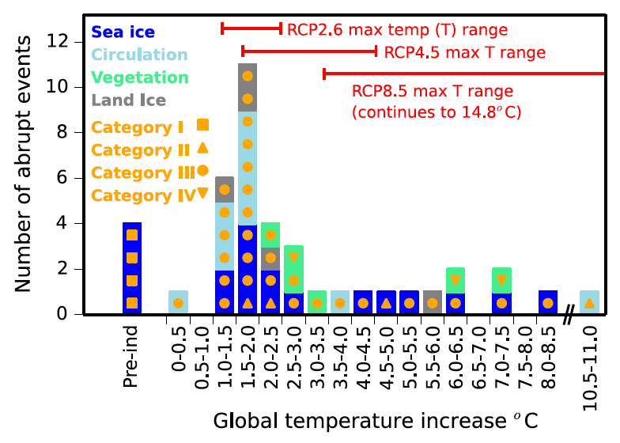
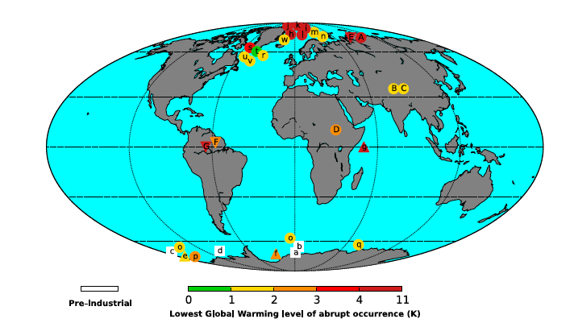
Quels risques de changements abrupts?
Catalogue dans les simulations climatiques CMIP5
Intensité du réchauffement global (°C)
Drijfhout et al, PNAS, 2015

Slide 44
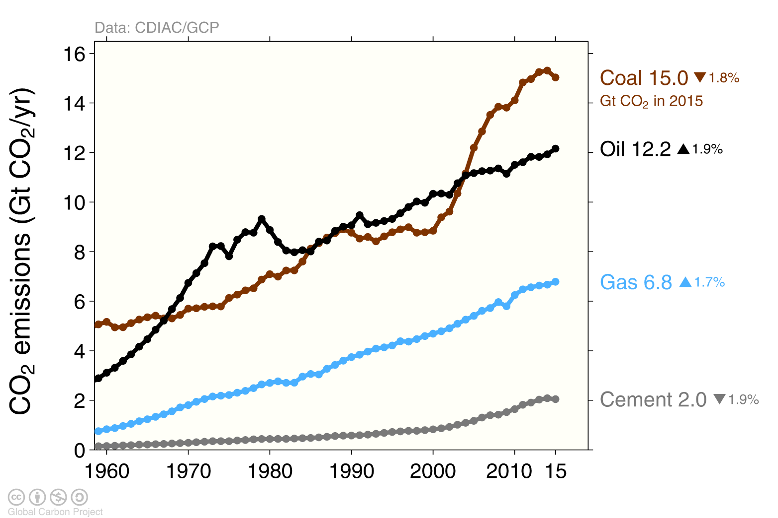
Emissions liées au charbon, pétrole, gaz et ciment

Slide 45
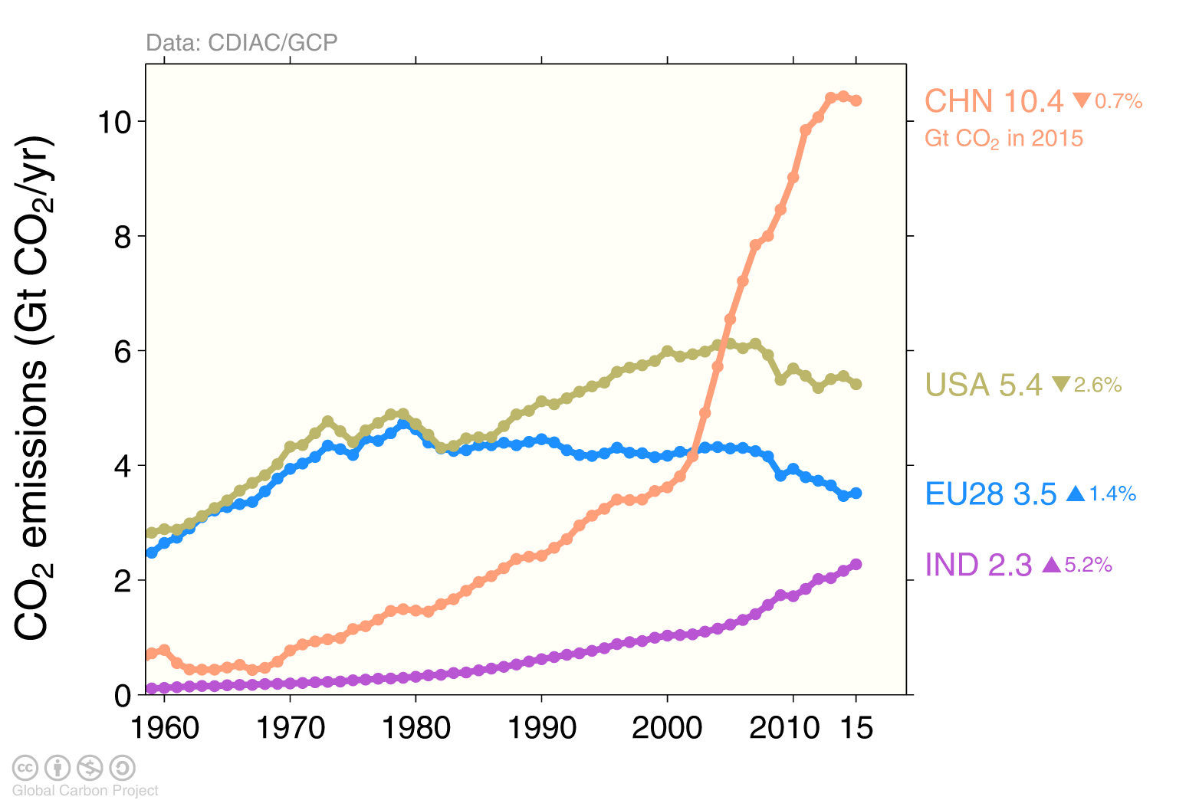
Le top 4 : 59% des émissions mondiales

Slide 46
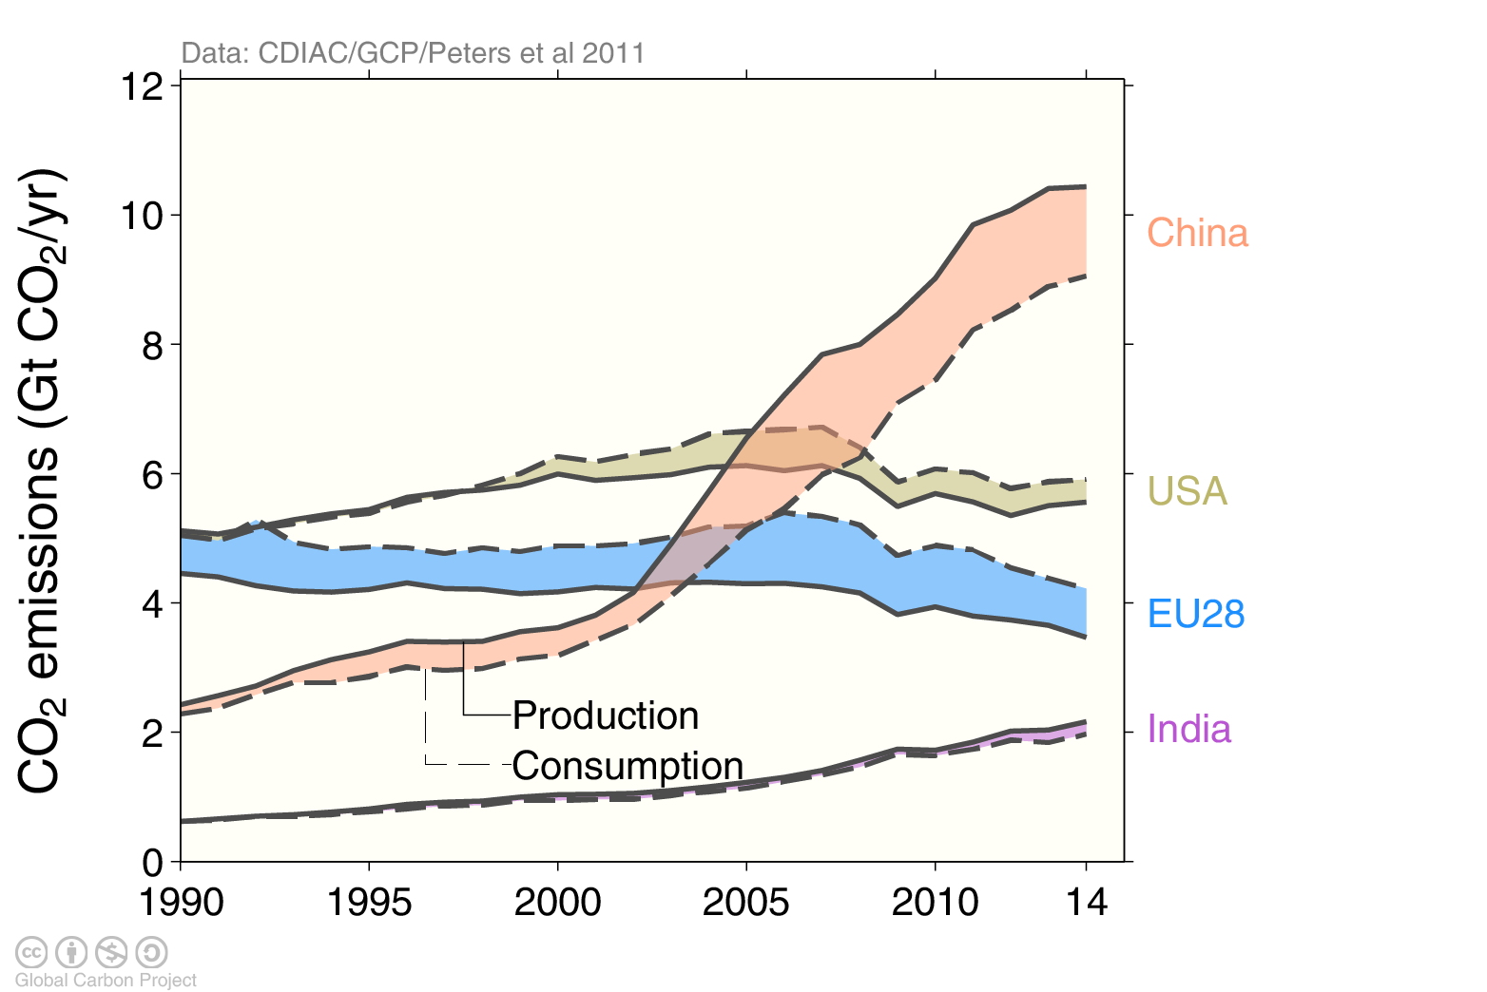
Une autre perspective si l’on considère la consommation et non la production

Slide 47
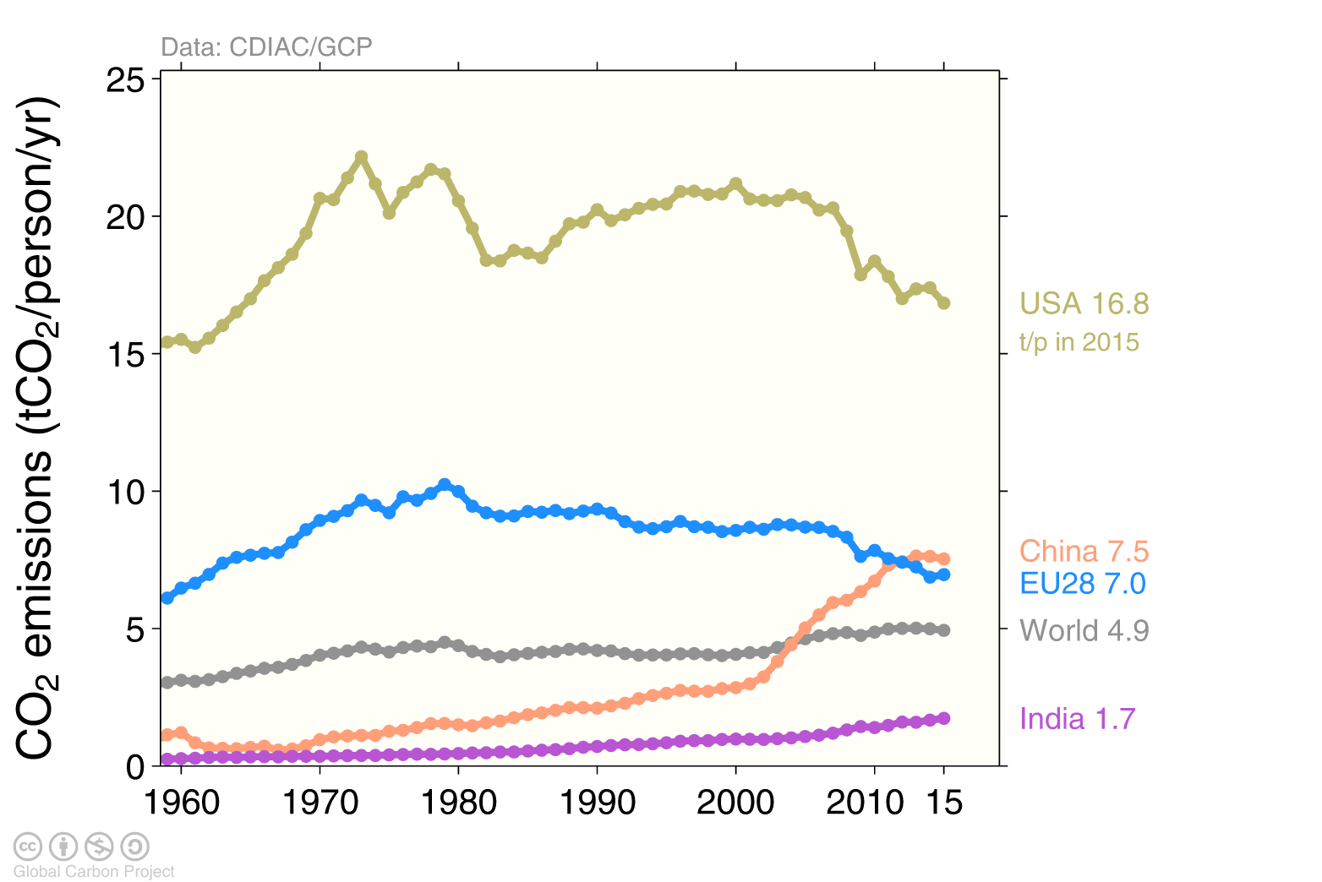
De grands contrastes dans les émissions par personne

Slide 48
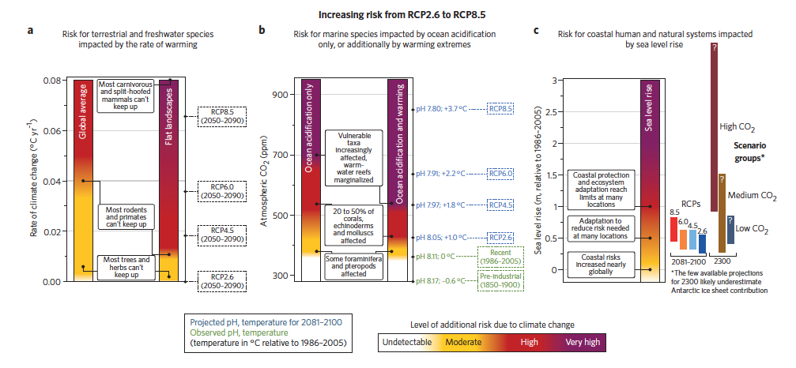
Futur : risques supplémentaires
Vitesse de réchauffement
et biodiversité
En mer : stress thermique et acidification
Niveau des mers
et zones côtières
O’Neil et al, NCC, 2017

Slide 49
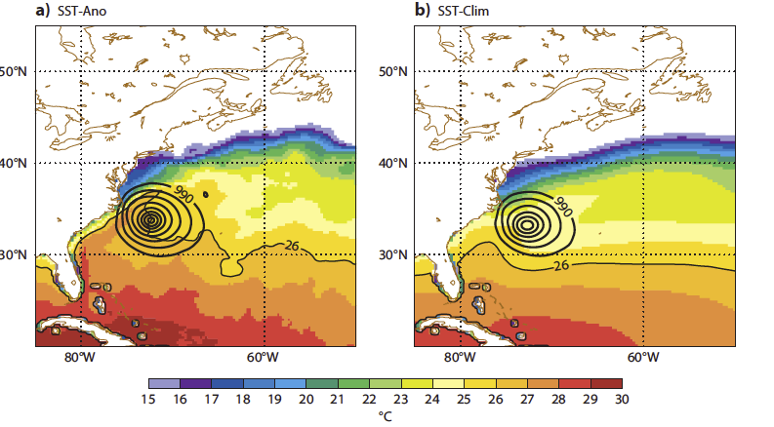
Intensité de l’ouragan Sandy
(30 oct. 2013)
70 milliards de $ de dégâts autour de New York : vents, pluies et submersion
Prévision (avec température mer réelle)
Prévision (température mer «normale »)
Magnusson et al 2013 WMR
Notes:
Un mot sur la sécheresse en Syrie?

Slide 50
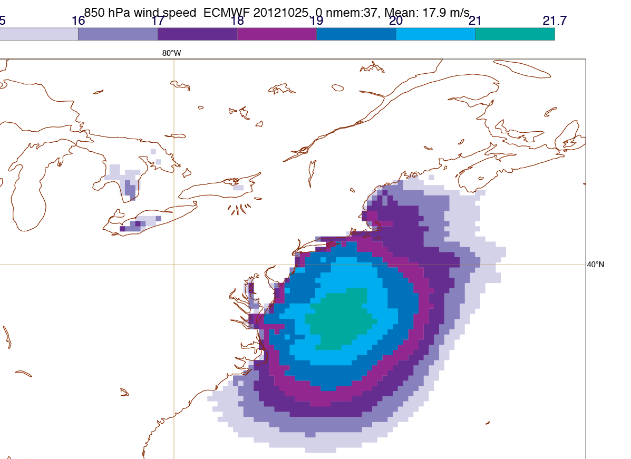
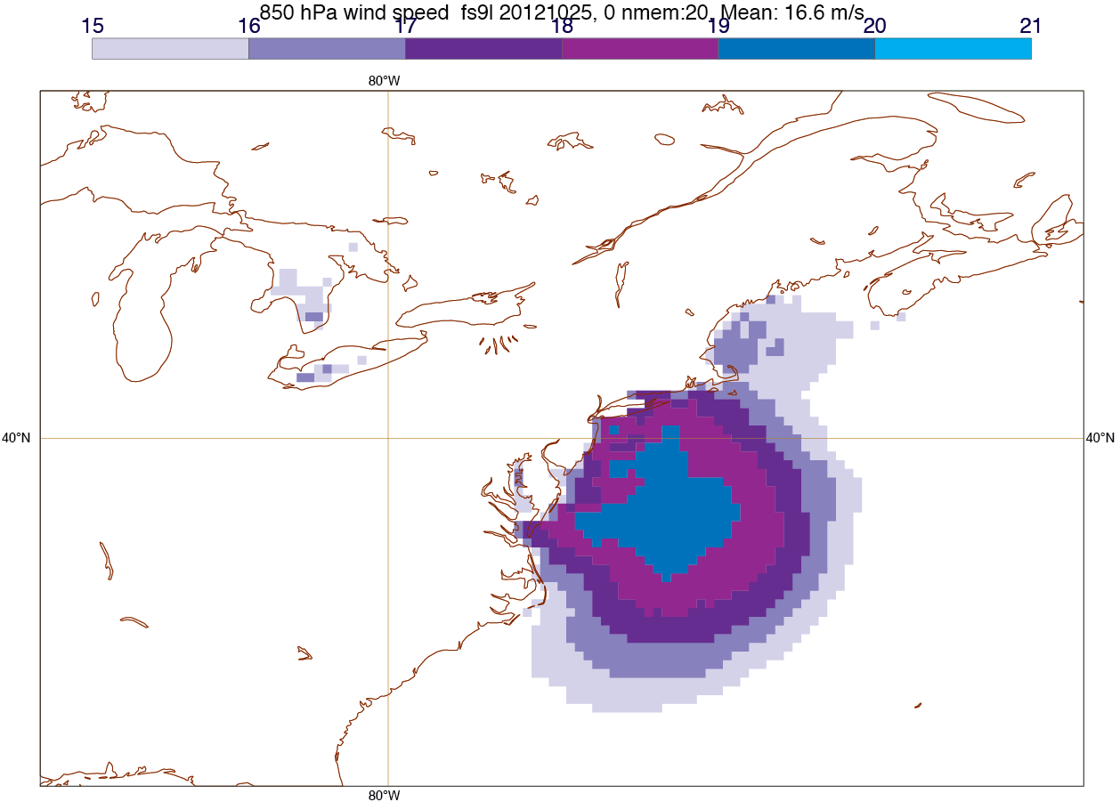
Intensité de l’ouragan Sandy : rôle du réchauffement océanique
Vents (avec température mer réelle)
Vents (température mer «normale »)
Température mer plus élevée: vents +3.6 m/s, pluies +35%
Niveau mer +19 cm
Magnusson et al 2013 WMR

Slide 51
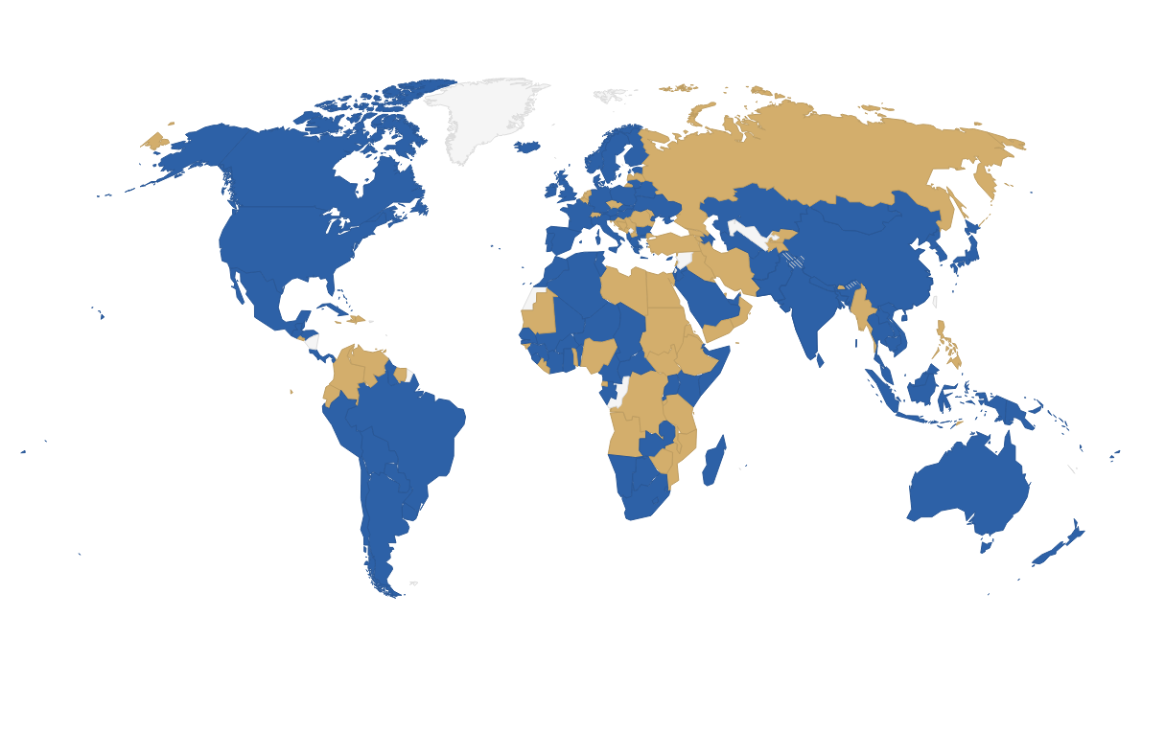
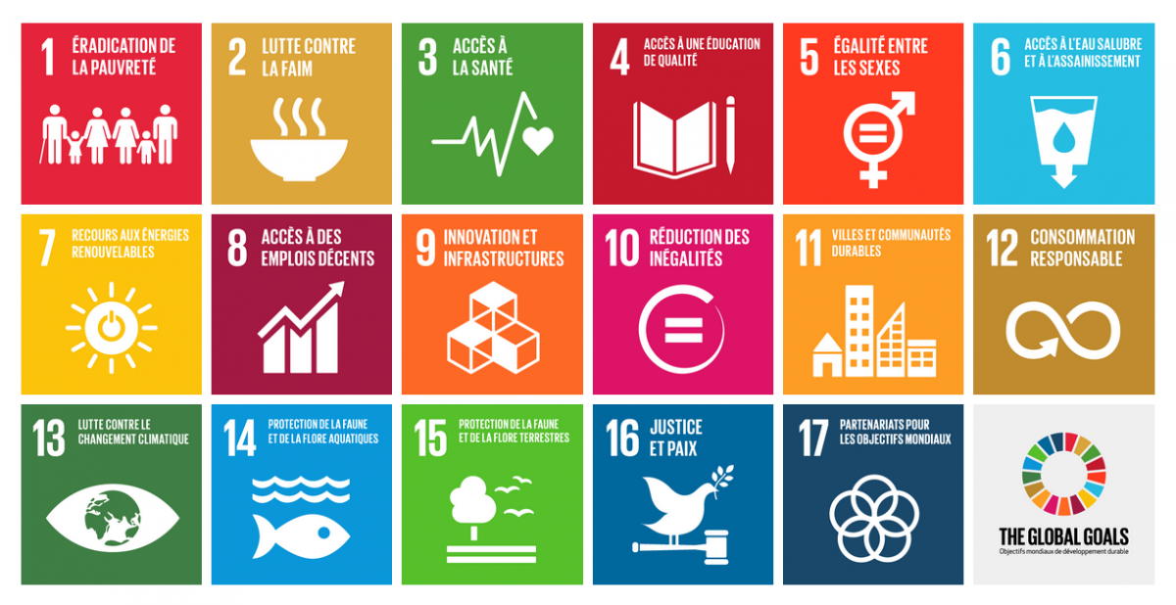
Agenda 2030
Accord de Sendai pour réduire le risque de catastrophe
Accord de Paris sur le climat
signé par 194 parties
ratifié par 143 parties (82% des émissions mondiales)
Objectifs du développement durable
Nouvel agenda urbain

Slide 52
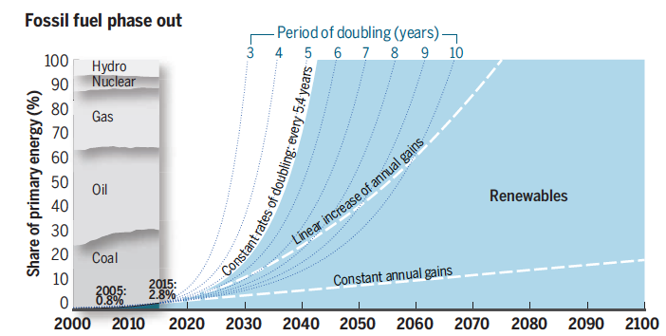
Nécessaire transition énergétique
Rockström et al, Science, 2017

Slide 53
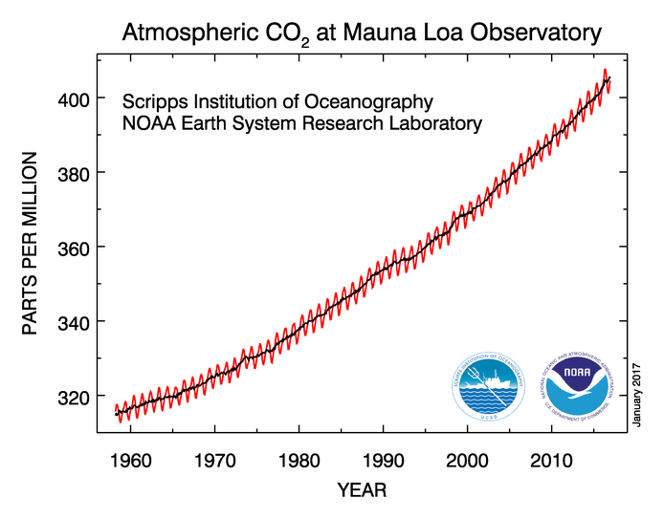

Concentration en gaz à effet de serre
dans l’atmosphère
NOAA

