Slide 1
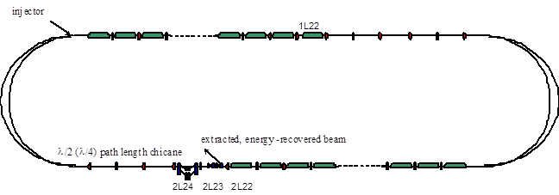
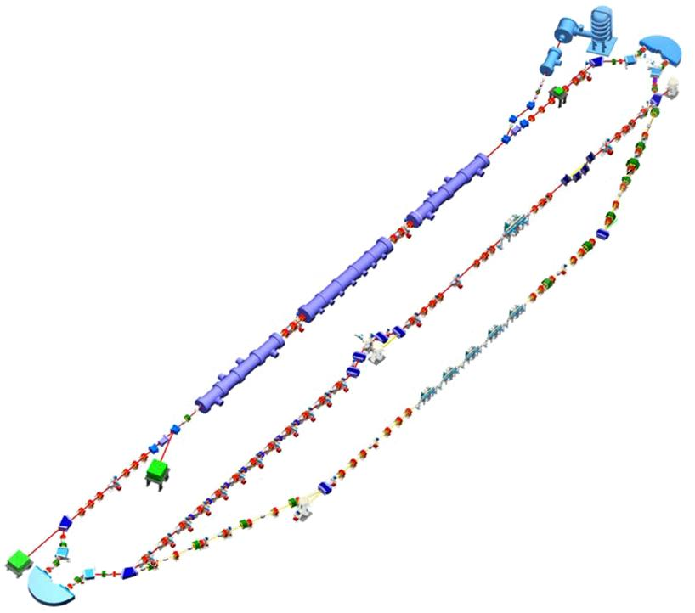
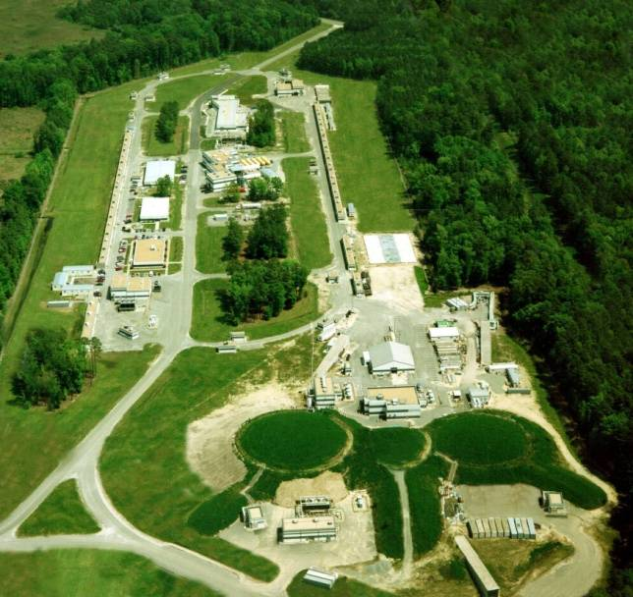
Operation and Monitoring in CW SRF Recirculators and ERLs
David Douglas
Jefferson Lab

Slide 2
Outline
State of the Art
Fundamental Limitations
JLab ERL monitoring systems
Operational Lessons Learned/Diagnostic Requirements
longitudinal dynamics
RF drive
ERLs as non-equilibrium systems
multi-beam transport
Implications/Recommendations
Acknowledgments

Slide 3
State of Art
What systems are out there?
What performance was achieved?

Slide 4
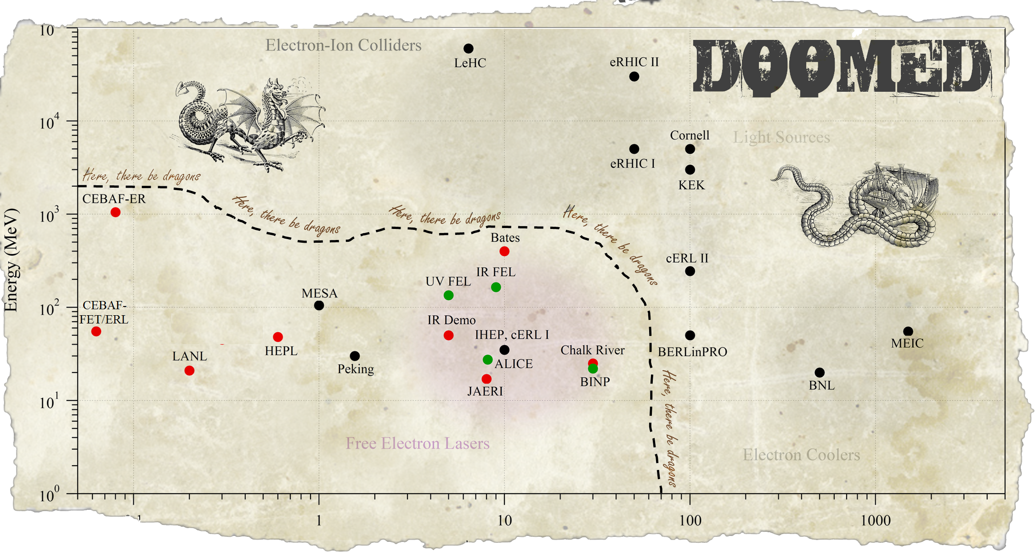
Where is PERLE in the ERL Landscape?
Which are CW SRF ERLs with P_{beam} > P_{RF}?
LHeC
ER@CEBAF
X
notional EUV systems
CERN ERL-TF
X
PERLE
X
X
Cβ
JLEIC cooler
X
X
X
X
X
legacy/ decommissioned
operating
proposed/in construction
Current (mA)
(cartography by C. Tennant)
Notes:
P_{beam} > M P_{RF}; M=multiplication factor ideally >1

Slide 5
JLab ERL Operational History
JLab IR Demo, Upgrade, UV Demo: 15+ years operation, ~(few) 1000 hrs/year typical
1-2 shift/day, 5 days/week, 6 months/year
CW operation with
energies from 20-165 MeV
currents up to ~9 mA
(full energy beam power) > 1 MW > (linac RF drive) ~1/8th MW
Users
FEL R&D (primary)
high power optics testing
nanomaterials
THz & other basic/applied science
nuclear/high-energy physics/internal-target based dark matter search

Slide 6
Constraints From System Architecture
What are the fundamental limits?
How do these structure operation?

Slide 7
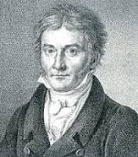
Constraining Features of ERL Architecture
Motivation for ERL architecture: save money on RF drive while delivering bright high power beams
ideal ERLs have P_{beam} >> P_{RF}; involve very high CW beam powers
RF dynamics ⬄ significant cost/performance impact
beam quality preservation and control of paramount importance
ERLs are basically just time-of-flight spectrometers
they exist to create specific conspiracies between time and energy
Must control longitudinal motion (“longitudinal match”) with care
ERLs are non-equilibrium systems
ERLs look like rings, behave like injector chains
high power beam ⇒ “injection efficiency” (99.999+%) critical
beam is not Gaussian, beam and machine are different
beam and lattice can evolve independently, be mismatched

Slide 8
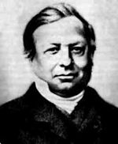
no equilibrium ⇒ stability a challenge
CEBAF parity-quality beam sets benchmark
high beam power/absence of equilbrium ⇒ CW is a game-changer
beam loss monitoring/suppression
beam quality generation and preservation: “What happens in Vegas doesn’t stay in Vegas…” (Liouville: the beam remembers…)
beam quality declines from cathode onward* ; “best” injected beam not necessarily “best” delivered beam
*unless emittance compensation implemented; can be applied at high energy for, e.g. CSR management
if beam degrades at full energy ⇒ anti-damping makes things worse during recovery
Recirculator/ERL ⇒ multiple beams/common transport (at least in linac!)
creates challenges for monitoring & control

Slide 9
Overview - JLab ERL Diagnostics
What tools have the JLab ERLs used?
How were they implemented?

Slide 10
Overview of JLab ERL Monitoring
Our basic monitoring systems have changed little over the 20 years we’ve run the ERLs
Sketch of what we have –
not a proposed solution (definitely NOT!)
just shows what we used for lessons learned
This is as much a cautionary tale as anything else…

Slide 12
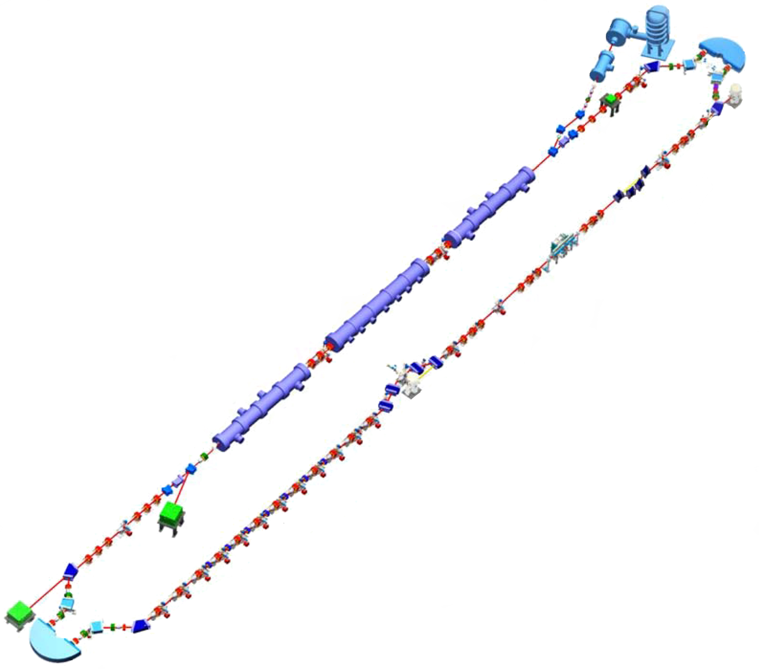
Diagnostic Inventory
34 BPMs
4 BCMs
1 Unser monitor
2 bunch length monitors (MP interferometer, THZ spectometer)
20+ BLMs (PMT)
Halo monitor
34 Viewers
8 SLMs
Basically… we avoid bare beam pipe: if it’s not holding magnets or RF, it has a diagnostic.
arcs serve as energy spectrometers
viewers, SLMs give both position and profile data
BLMs used for both tuning (loss reduction, halo control) and machine protection

Slide 13
These are implemented in a system with a phase advance of ~6 to 7 oscillations from the injection point to the dump.
4+ BPMs/betatron wavelength
Extensive suite of diagnostics and controls
accesses separate information about the beam and the machine
allows operational flexibility, working point agility
multiple bunch charges/timing, energies, currents…
Analog Monitoring System (AMS) gives access to RF control signals, BLMs, etc with moderate (~10 MHz) bandwidth
monitor RF transients, tune on beam loss with high power pulsed beam, etc.
HOM loads instrumented & can directly observe onset of BBU

Slide 14
Lessons Learned (often the hard way…)
ERLs are time-of-flight spectrometers
RF drive ⬄ more than energy recovery
ERLs operate away from equilibrium
Multi-pass transport is hard

Slide 15
Lessons Learned #1: ERLs are time-of-flight spectrometers, not transport systems
Exist solely to create conspiracies between phase and energy
no closed orbit; may not be betatron stable/have “matched” beam envelopes ⇒ beam and lattice are different (mismatch often advantageous)
longitudinal match constrains system architecture
need full suite of longitudinal diagnostics for both machine (lattice) and beam
phase transfer function system (R₅₅, T₅₅₅)
bunch length monitoring/noninvasive energy, energy spread (SPM)
(tomography to capture/correct nonlinear phase space distortion)
spectrometer-grade components
perturbations at high energy anti-damp during recovery
aberration management critical: nonlinear modeling/diagnosis/control needed

Slide 16
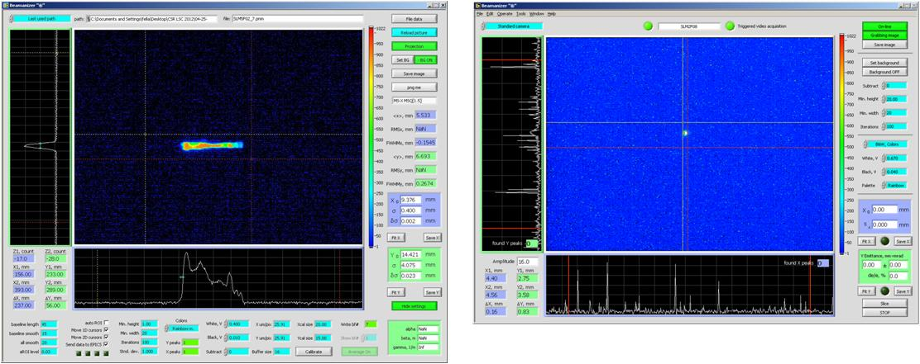
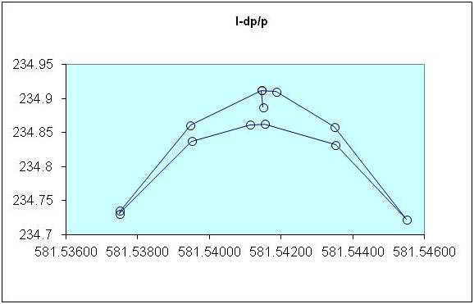
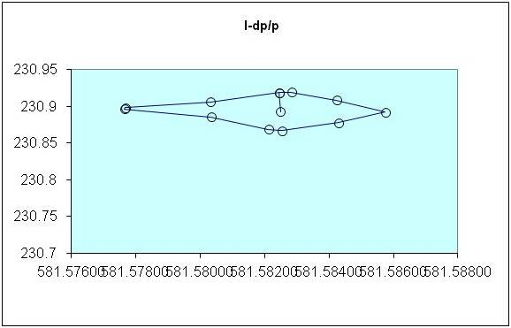
Influence of Longitudinal Match
ERL performance sensitive to longitudinal dynamics
Can switch between quite different operational modes with only minor parametric changes
e.g. cross-phasing of linac cavities/modules: change single phase setpoint and go from short bunch to small dp/p
Allows management/control/improvement of beam quality (and degradation) in presence of collective effects, coherent phenomena, ...
Examples:
LSC management, bunch length compression during acceleration/transport; energy compression during energy recovery
UV bunch compression w/o chicane
RF curvature correction w/o harmonic RF
Bunch length compression with positive compaction (M₅₆>0)
Suppression of RF curvature effects ⬄ reduction in dp/p (cf. to on-crest/in trough operation)
Can run with longer bunch/mitigate LSC effects
Enhancement/suppression of LSC/CSR/μBI
E (MeV)
E (MeV)
low
energy
high
energy
low
energy
high
energy
t (nsec)
t (nsec)

Slide 17
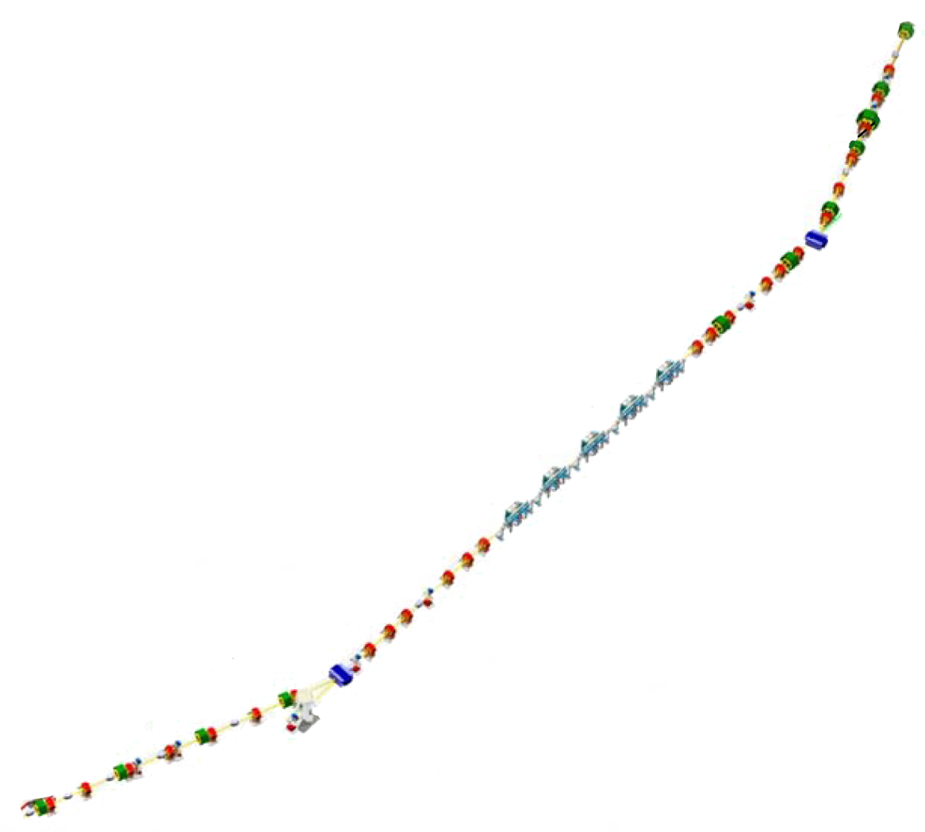
Longitudinal Matching Scenario
DC Gun
E
Requirements on phase space:
high peak current (short bunch) at FEL
bunch length compression at wiggler
using quads and sextupoles to adjust compactions
“small” energy spread at dump
energy compress while energy recovering
“short” RF wavelength/long bunch,
large exhaust δp/p (~10%)
get slope, curvature, and torsion right
(quads, sextupoles, octupoles)
φ
E
IR Wiggler
φ
SRF Linac
E
Bunching Chicane
E
φ
E
φ
Dump
E
φ
φ

Slide 18
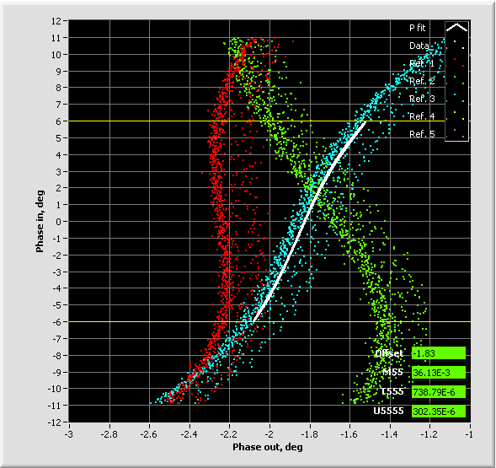
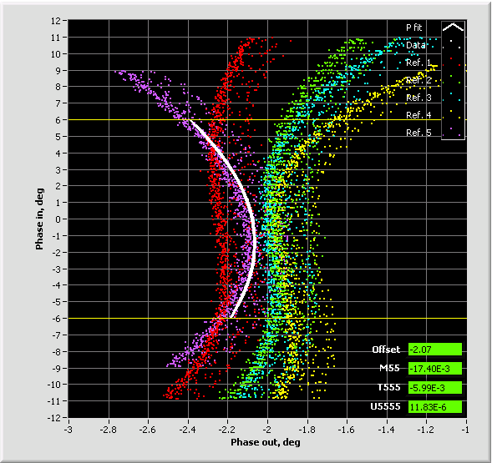
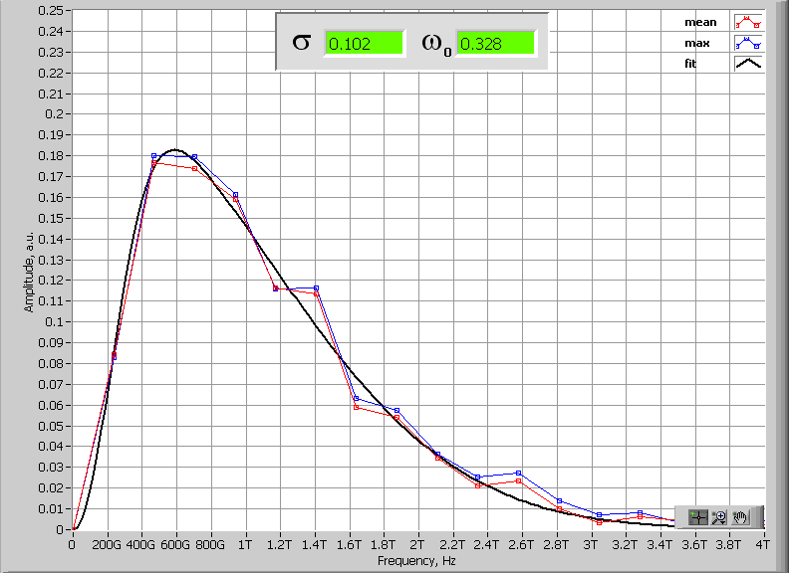
JLab FEL bunch compression and diagnostics
JLab IR/UV Upgrade FEL operates with bunch compression ratio of 90-135 (cathode to wiggler); 17-25 (LINAC entrance to wiggler).
To achieve this compression ratio nonlinear compression is used – compensating for LINAC RF curvature (up to 2nd order during acceleration and 3rd order during recovery).
The RF curvature compensation is made with multipoles installed in dispersive locations of 180° Bates bend with separate function magnets - no harmonic RF
Operationally longitudinal match relies on:
a. Bunch length measurements at full compression (Martin-Puplett Interferometer)
b. Longitudinal transfer function measurements R₅₅, T₅₅₅, U₅₅₅₅
c. Energy spread measurements in injector and exit of the LINAC
Trim quads
(B’dL) 740 G
Sextupoles
(B’dL) 12730 G
Trim quads
(B’dL) 700 G
Sextupoles
(B’dL) 10730 G
Trim quads
(B’dL) 660 G
Sextupoles
(B’dL) 8730 G
Martin-Puplett Interferometer data
in frequency domain – give upper limit on the RMS bunch length
Courtesy Pavel Evtushenko

Slide 19
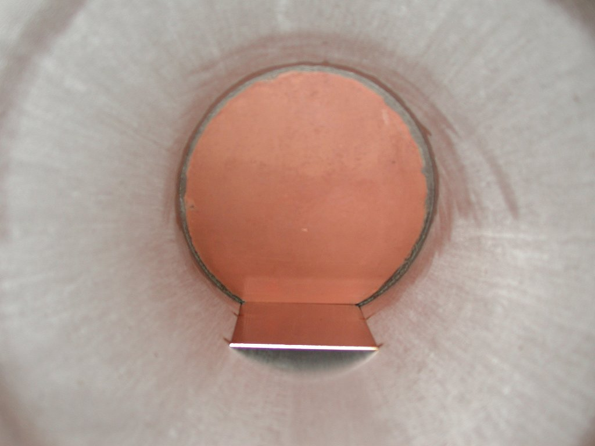
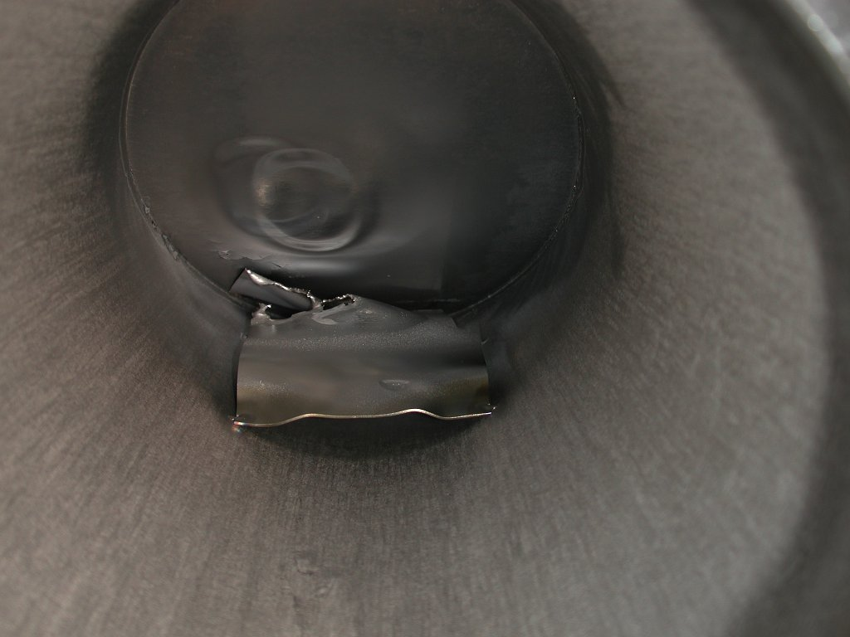
JLab IR Demo Dump
core of beam off center, even though BLMs showed
edges were centered
(high energy tail)

Slide 20
Lessons Learned #2: RF Drive Involves More Than Recovering The Beam
Access to RF drive and control signals very important
Analog Monitoring System (AMS) allows measurement of transients with high bandwidth
provided insight/correction of stability control issues
6π/7 mode instability/“bad lasing mode”
beam off/on, FEL off/on transient monitoring & control
Transient management + longitudinal match defines power requirements
high Q_{ext} can require more power than low Q_{ext} …

Slide 21
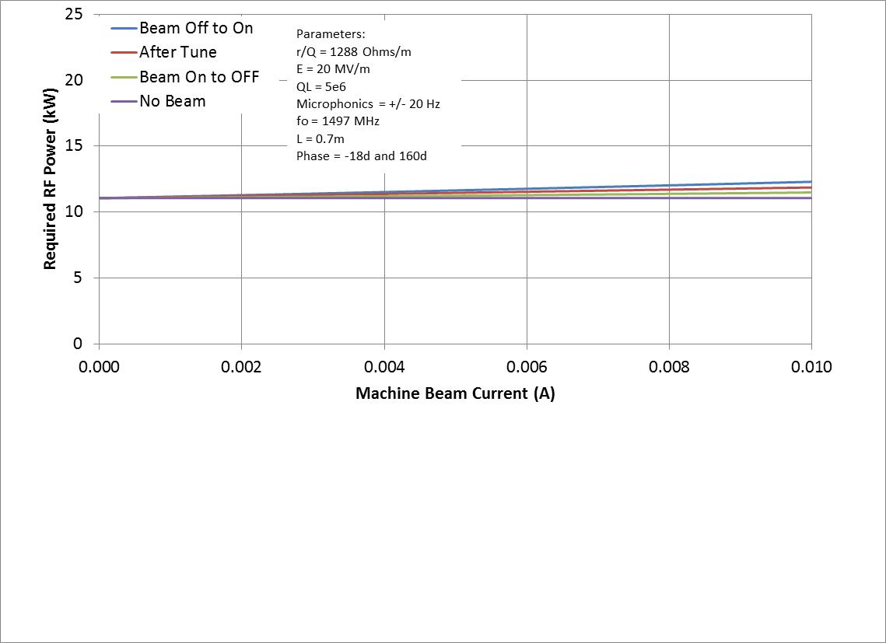
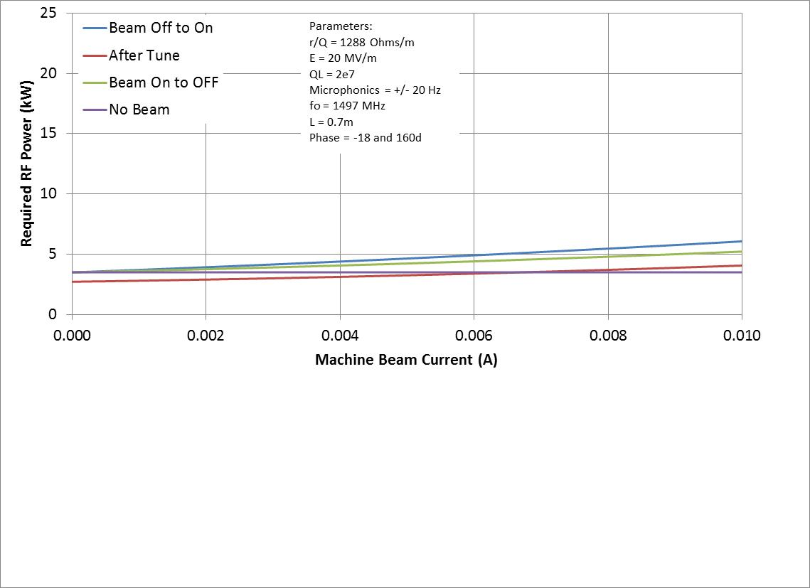
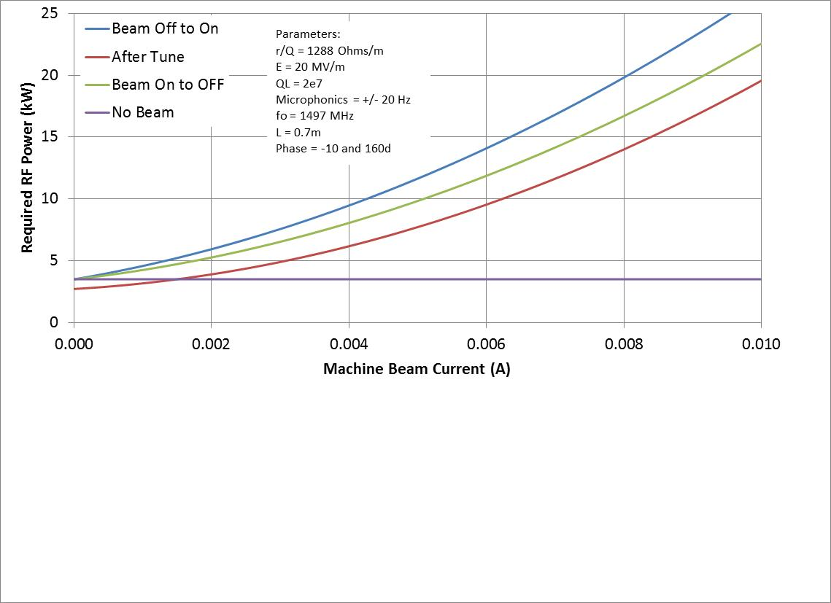
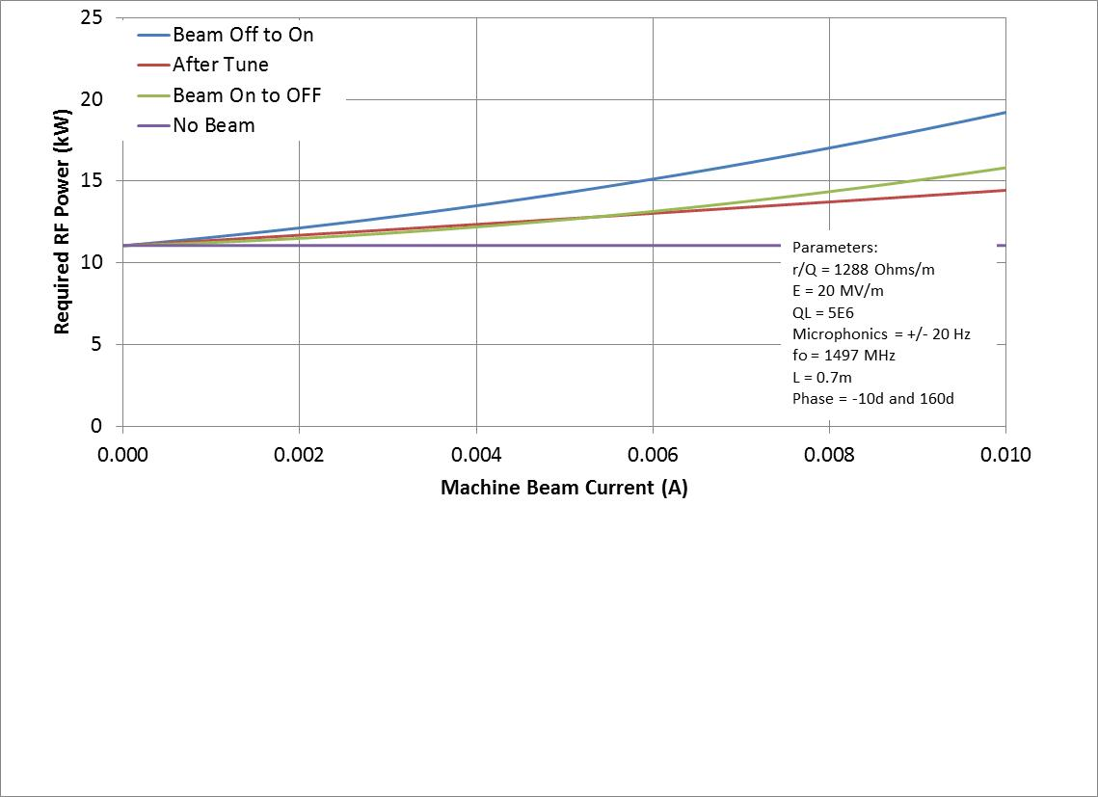
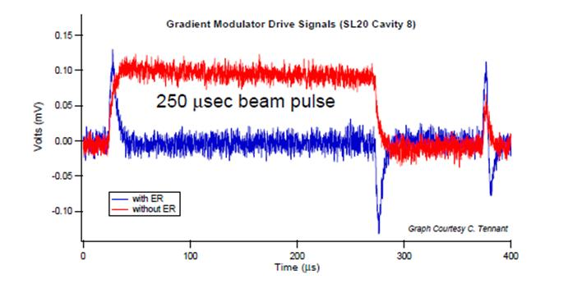
RF Transient Effects
Beam off/on
transient beam loading
cavities detune
FEL off/on
energy transients
reinjection phase transient
transient beam loading
cavities detune
Need adequate RF control & power to avoid tripping
Specs/methods depend on details of cavity design and operational modes

Slide 22
charts courtesy Tom Powers

Slide 23
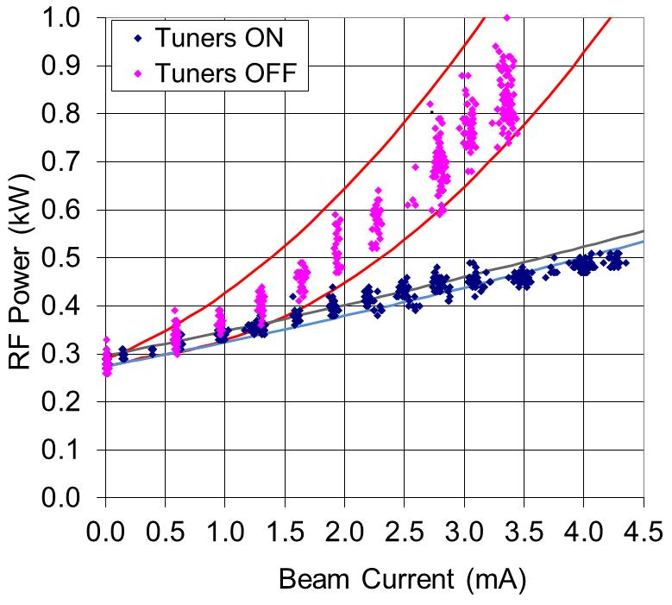
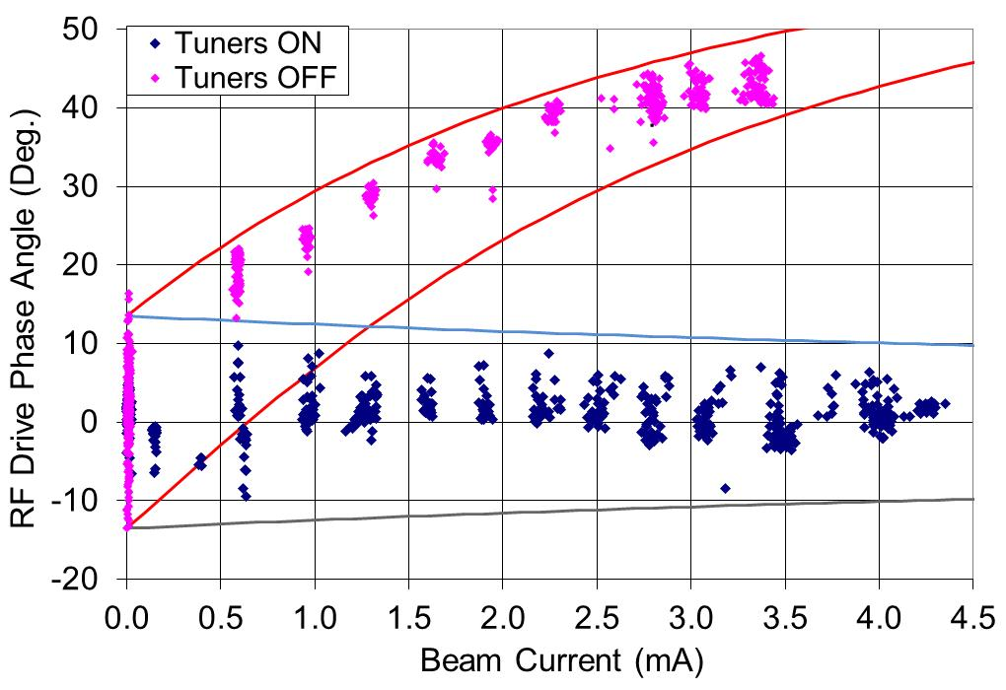
PREDICTED AND MEASURED FORWARD POWER/RF DRIVE PHASE IN AN ERL
The solid lines indicate the predicted values based on:
Q_{L} = 2 x 10⁷
E = 5.6 MV/m.
Δf = 10 Hz
Test Process:
Tune the cavity with no current.
Disable the mechanical tuners.
Ramp the current up and record the forward power and phase.
Repeat with Tuners enabled.

Slide 24
Lessons Learned #3: ERLs Are Nonequilibrium Systems
Beam and lattice are different
even under simple linear transport beams have complex structure/do not occur in regular distributions
beam does not come to equilibrium
“Nσ” is not a meaningful measure of where electrons might go when running high power
beam evolves under influence of both lattice and collective effects
Beam loss in CW ERLs is not like in storage rings, its equivalent to loss in a storage ring injector chain
high power ⇒ 99.999% capture efficiency/losses << 0.001% (~few W/m)
halo ⇒ major operational impediment
Need to diagnose beam and lattice individually
beam quality preservation: performance is source-limited – “as good as it gets…” (Liouville) => conservative design
“bad” things at high energy (power extraction, beam-beam, beam-target, SR, etc, etc…) adiabatically anti-damp to limit performance at back end
need large dynamic range (LDR) diagnostics
1:10⁵, 1:10⁶ dynamic range to quantitatively control loss to the W/m level
Beam loss accounting/machine protection ⬄ sensitive and fast

Slide 25
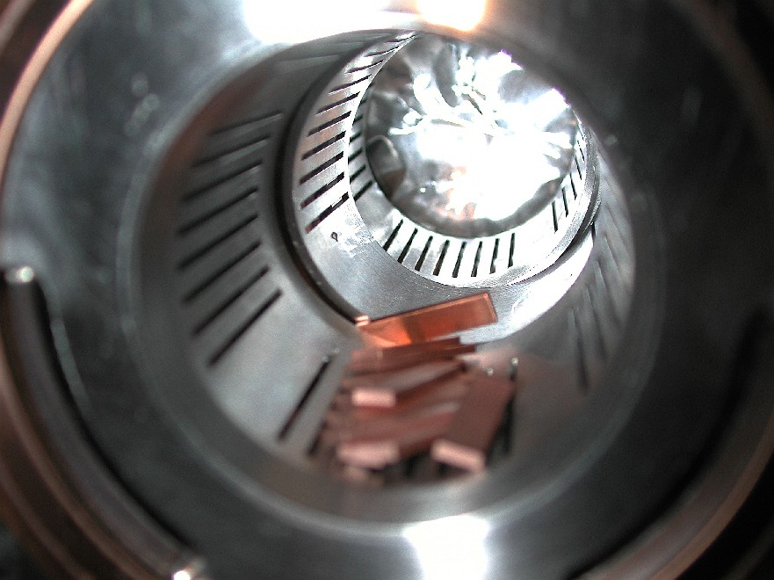
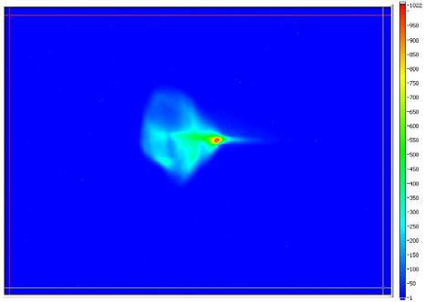
Halo – a dominant CW performance issue
Calibration: see losses from “10 mm-mrad” beam… at points with 5600 mm-mrad acceptance
“Real beams do not occur in distributions named after dead mathematicians” (P. O’Shea).
typically multi-component (transversely and longitudinally)
Makes betatron matching tricky (match phase space volumes to phase space volumes, not beam spots to beam spots)
“Halo” = large emittance, low intensity component(s) of beam
6 mm
6σ
mismatched to core
sample large amplitudes
can be tightly focused (but with large divergence)
“stuff” that’s too dim to see with standard diagnostics (down by ~3+ orders of magnitude in density), but has enough power to burn things up
“Nσ” not a good measure of required aperture
50 mm

Slide 26
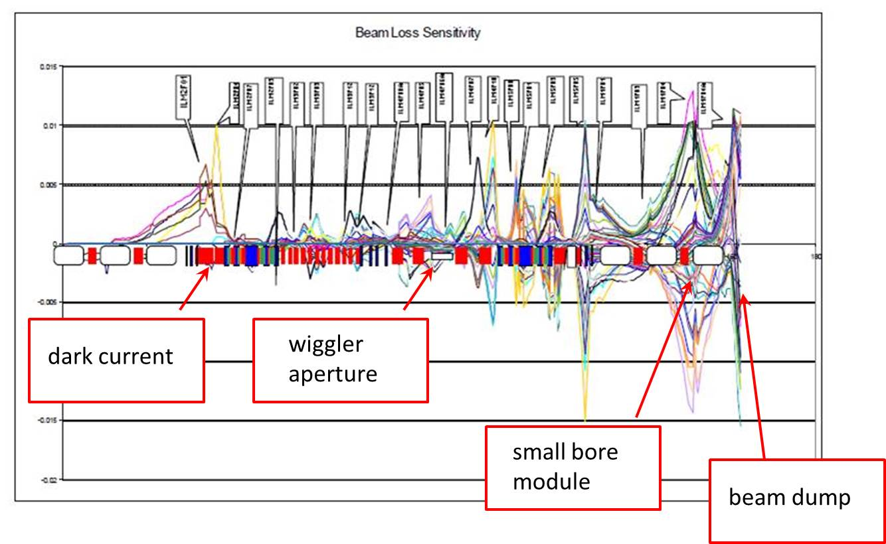
Halo Experience
Sources of halo:
dark current (primary source of background) field emission
dynamics of bunch formation stray light on cathode
IBS, beam/gas scattering ...
We’ve seen
Halo on beam in injector
CW beamlets at ~40-50 MeV, 110 MeV, ... (drive laser shutter closed)
loss at aperture constraints,
high radiation background around machine (RF on, beam off)
Can map out halo patterns:
Beam and lattice are different:
lattice defines what happens to beam
beam doesn’t a priori match lattice
Halo almost always mismatched
Assess where “big amplitude” stuff goes (e.g. by mapping out envelope of all correctors)
matches surveys/observed loss, guides locating BLMs

Slide 27
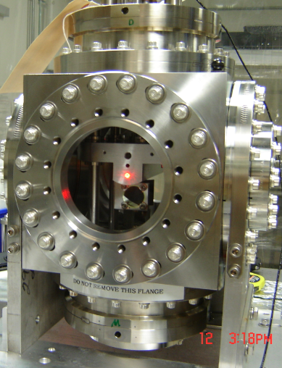
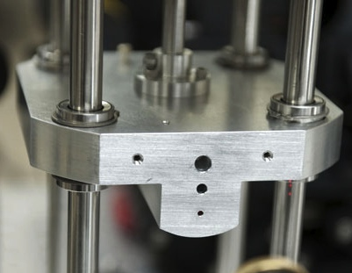
Halo Management
Can control halo – to some extent
Use mismatch to adjust halo envelopes at aperture constraints
Find quad where halo large, core beam small;
adjust “halo” knob, reduce halo size at aperture (vary phase advance);
use BLMs as diagnostic
Need to have flexible transport system design and
diagnostics showing where losses occur…
Method becomes problematic when
aperture is constrained over significant phase advance
halo envelopes mismatched ⬄ ring
multiple beams share common transport
Halo evolves along beam line ⇒ different passes have different halo dynamics
“Quantitative/deterministic” control – will need large (10⁶) dynamic range multipass diagnostics, tomography, …
Evtushenko ⬄ 10⁵ range in “DarkLight” run; 10⁶ in develoment
“You can’t collimate electrons, you can only make ‘em mad…” (G. Neil)

Slide 28
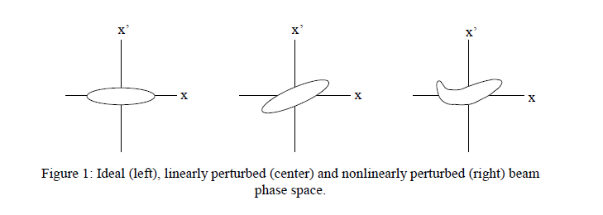
“The Beam Remembers”: Field Quality
ERLs: time-of-flight spectrometers ⇒ differential B errors a problem:
ΔB ⇒ δx’= ΔBl/Bρ = (ΔB/B) θ_{dipole}
δx’ ⇒ δl = M₅₂ δx’
δl ⇒ ΔE_{dump} = E_{linac} sin φ₀ (2π δl/λ_{RF})
= E_{linac} sin φ₀ (2π Μ₅₂(ΔB/B)θ_{dipole}/λ_{RF})
Tolerance ΔB/B needed for specific acceptance ΔE_{dump} tighter for higher E_{linac}, shorter λ_{RF}, larger dispersion (M₅₂ = M₂₂M₁₆ – M₁₂M₂₆)
JLab numbers: ΔE_{dump} ~ 3400 MeV * (ΔB/B)
(observed! ΔB/B ~ 10⁻⁴ ⇒ few 100s of keV at FEL dump)
ΔB ⇒ δx’=ΔBl/Bρ∼ΔBl/(33.3564 kg-m/GeV * E_{linac}) ⇒ δl=M₅₂ δx’
δl ⇒ ΔE_{dump} = sin φ₀ (2π Μ₅₂(ΔBl/33.3564 kg-m)/λ_{RF})
Tolerable absolute “error integral” ΔBl is set by dump acceptance; is independent of linac length/energy gain; tolerable relative field error falls as energy (required field) goes up

Slide 29
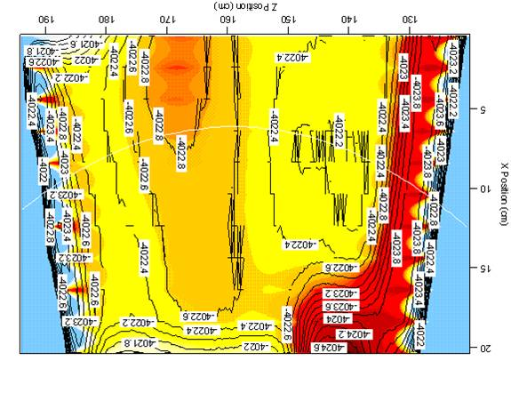
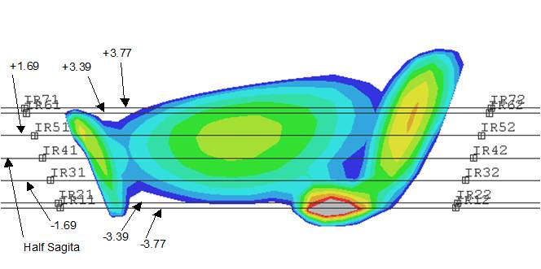
Dealing With Field Quality…
Palliative measures:
make better magnets
use lower energy linac
reduce M₅₂ (smaller dispersion, stronger focusing)
provide means of compensation (diagnostics & correction knobs)

Slide 30
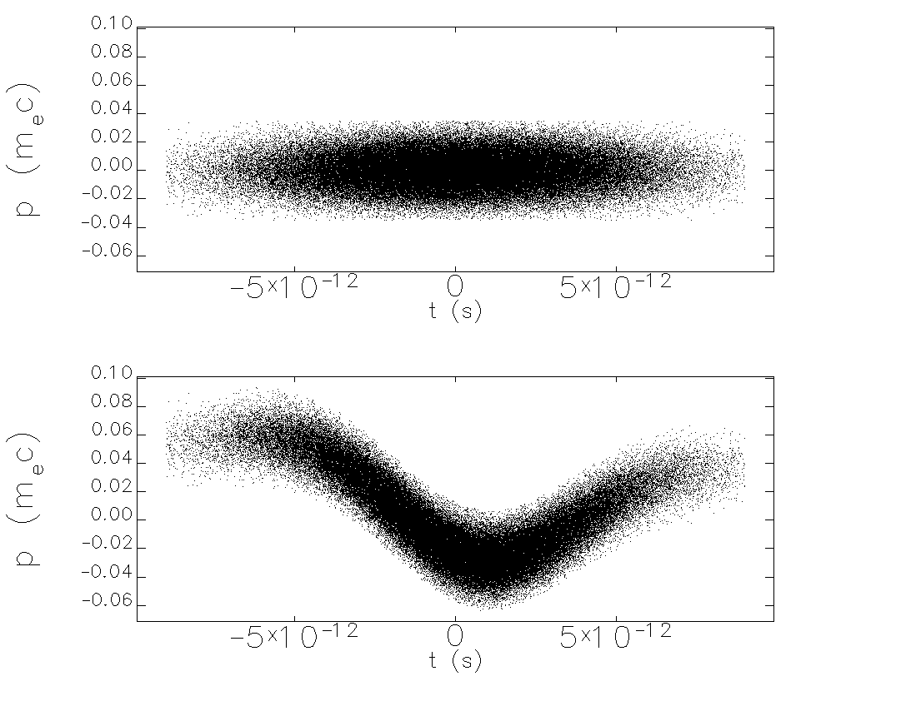
High Power/High Brightness/CW ⬄ Unanticipated Phenomena
CW operation “different”
high power beam ⇒ power-flow management (i.e., “don’t lose beam or excite wakes”…)
halo & collective effects… more challenging as charge/current increase
transition to/from CW and in/out of various operational modes couples to RF, environmental impedances
power goes to unanticipated places via multiple mechanisms (CSR, RF heating…)
encounter significant machine/personnel protection issues when running high beam powers
Beam loss in CW ERLs is not like in storage rings, its equivalent to loss in a storage ring injector chain – a CW injector chain
Collective effects in an inherently high-brightness system
BBU (everyone’s favorite…)
resistive wall heating (in a linac?) was operational impediment in FEL; F heating of beamline elements
ion accumulation, residual gas scatting, IBS,…
surprising amounts of power end up in surprising places; bunch distorts in unexpected ways (e.g CSR, μBI)

Slide 31
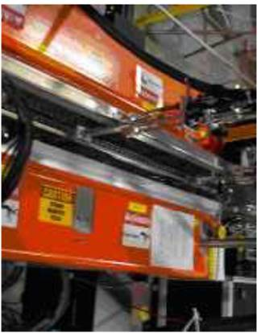
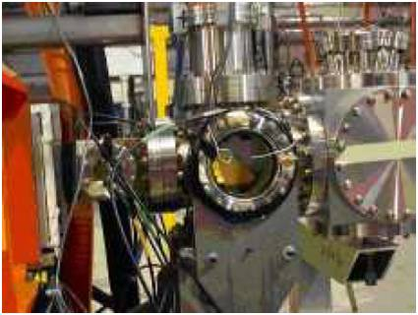
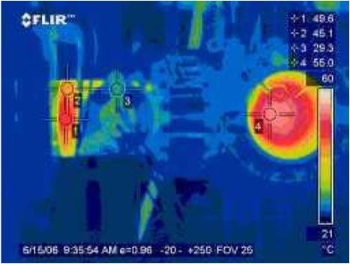
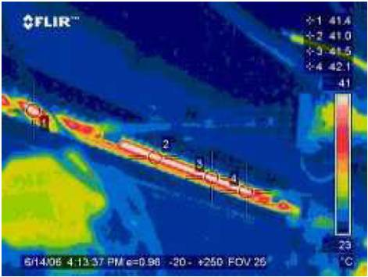
Collective Effects: Inherent in High-brightness Systems
Collective contributions to halo
dynamics of beam formation, Touschek/intrabeam scattering, …
[you can’t collimate electrons, you can only make ‘em mad…],
wakes, impedances, interaction of beam with itself &/or environment
BBU, CSR, LSC, μBI…
Space charge ->100+ MeV; “injector stretches from cathode to FEL”… and back to dump…
losses can be worse at lower charge than at higher (e.g. 30 pC worse at dump than 135 pc due to loss of space charge focusing)
dominates dynamics/performance down linac
THz, resistive wall, RF heating… all performance issues in IR Upgrade
Simple tools were vital to disentangling sources of operational challenges
FLIR camera
“Instrumented” HOM loads, Analog Monitoring System, archivers, …

Slide 32
Lessons Learned #4: Multipass Transport Challenges
The hardest part of running the JLab ERLs: getting the recovery pass through the linac ⇒ common transport (two+ passes in one beam line) can be tricky (and risky).
Done in CEBAF and microtrons – but at very low charge/current
Done at MIT/Bates (3 pass – one up, one coast, one down), IR Demo (same scheme), and CEBAF-ER
Limits flexibility and control; forces tighter specs (expensive); worse sensitivity
Multibeam transport ⬄ error correction challenges (multipass coupling)
Completely local correction of errors effective – but may not be possible (diagnostic precision, density of control variables)
Nonlocal correction requires multibeam optimization
Notionally easier to use asymmetric gains in linacs & have separate transport of each pass on each end (GERBAL)
Better control of beam envelopes in multipass operation
“short” linac => “preaccelerator” to “long” linac
More “knobs”
Can deal with slight mismatches of energy pass-to-pass (reduced aperture requirements)
Relaxed energy gain matching on linacs (if S/R acceptance adequate)
Separates each pass for feedback stabilization

Slide 33
Lessons Learned #4: Multipass Transport Challenges
The hardest part of running the JLab ERLs: getting recovery pass through the linac ⇒ common transport (two+ passes in one beam line) can be challengin.
Done in CEBAF and microtrons – but at very low charge/current
Done pulsed at MIT/Bates (3 pass – one up, one coast, one down), pulsed IR Demo (same scheme), and CW in CEBAF-ER (low current)
Limits flexibility and control; forces tighter specs ⬄ error sensitivity
ER@CEBAF will test on large scale but at low current
Cβ will test at higher current on smaller scale (comparable to PERLE)
Multibeam transport ⬄ error correction challenges (multipass coupling)
Completely local correction of errors effective – but may not be possible (diagnostic precision, density of control variables)
Nonlocal correction requires multibeam optimization
Beam profiles challenging if beams coaxial

Slide 34
Alternative Topology
Notionally easier to use asymmetric gains in linacs & have separate transport of each pass on each end (GERBAL)
Better control of beam envelopes in multipass operation
“short” linac => “preaccelerator” to “long” linac
More “knobs”
Can deal with slight mismatches of energy pass-to-pass (reduced aperture requirements)
Relaxed energy gain matching on linacs (if S/R acceptance adequate)
Separates each pass for feedback stabilization

Slide 35
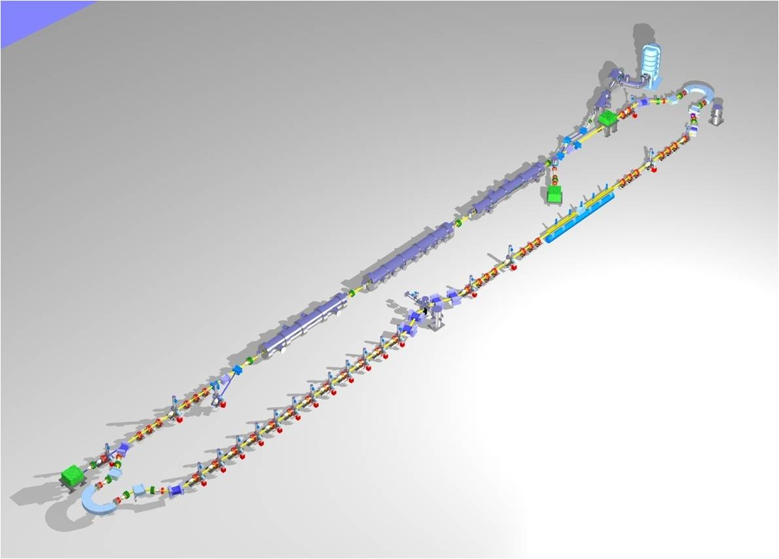

Slide 36
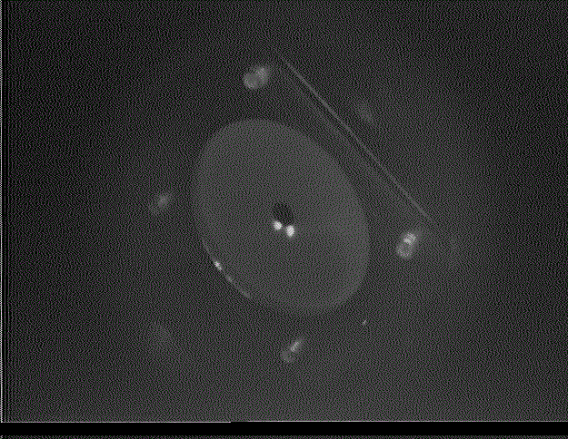
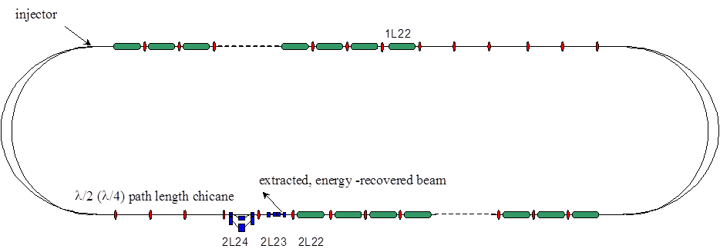
Multipass Control During Common Transport
Multipass orbit monitoring conceptually simple, more involved in practice
e.g. can look at transients from an ion clearing gap
Multipass beam property measurements challenging
Quad scans ⬄ changes incoming beam properties for higher passes (Tennant)
Multi-monitor ⬄ monitor calibration

Slide 37
Implications and Recommendations

Slide 38
Implications for Diagnostics & Controls
What does this experience imply about diagnostic requirements and how to run these machines (a topic for a very long discussion…)?
Lots of longitudinal/time of flight/bunch length/energy diagnostics
longitudinal matching, correction of field errors
Measure positions and properties of multiple beams in common transport in an operationally noninvasive manner
beams out of phase: signals cancel in some diagnostics
BPM every ¼ betatron wavelength
“no empty vacuum chamber: if it’s not a magnet or cavity, make it a diagnostic…”
Must diagnose lattice and beam separately
Large dynamic range (LDR) diagnostics to characterize high power beam & control halo
Fast machine protection at high power
Provide regular operational access to RF dynamics & drive parameters, vacuum levels, … to “bootstrap” performance
ERLs are non-local; performance is coupled in many dimensions ⇒ commissioning/operation are iterative

Slide 39
Recommendations
Begin with the end in mind:
Coordinate commissioning, operational plans/processes/procedures with system design/engineering
⇒drive diagnostic/controls/correction system definition/design
Drive laser (if any) stabilization, synchronization and control
Costing optimum can be counterintuitive but is quantitative
T. Powers/ILC cost workbook
Beware ISR effects on longitudinal emittance (esp. at higher energy)
Bunch lengthening (M₅₆^{emission->reinjection} not zero everywhere) + σ_{dp/p} => entertainment (as with magnetic field quality)…
High power FELs from ‘80s on serve as cautionary tale: use caution during scale-up

Slide 40
Acknowledgments
Many thanks to the organizers for the opportunity to participate in this discussion!
Many colleagues have contributed to the work on which this talk is based; specific information, ideas, and/or slides were provided by
Pavel Evtushenko – George Neil
Chris Tennant – Steve Benson
Tom Powers – Jim Boyce
Bob Legg – Gwyn Williams
Carlos Hernandez-Garcia – Fay Hannon
Shukui Zhang – Kevin Jordan
Geoff Krafft
Notice: Authored by Jefferson Science Associates, LLC under U.S. DOE Contract No. DE-AC05-06OR23177 and by the Southeastern Universities Research Association, Inc. under U.S. DOE Contract No. DE-AC05-84ER40150. The U.S. Government retains a non-exclusive, paid-up, irrevocable, world-wide license to publish or reproduce this manuscript for U.S. Government purposes.

