Slide 1
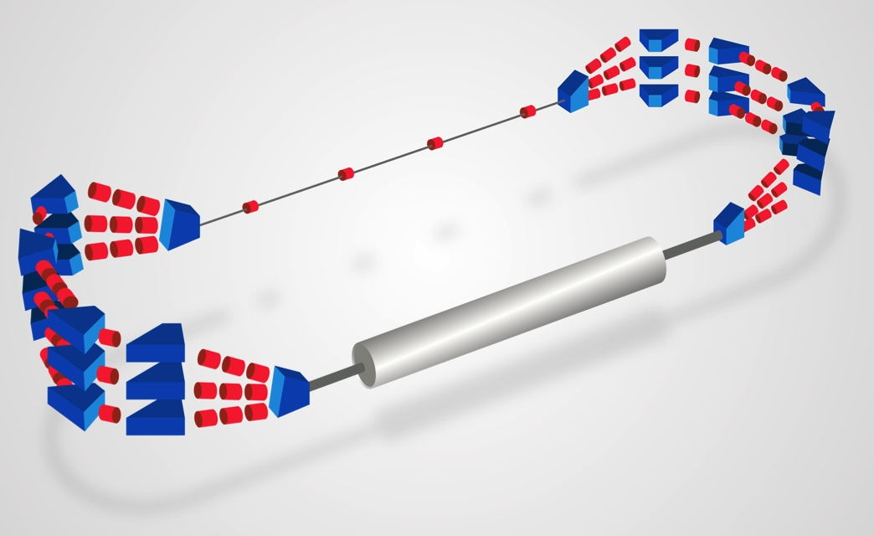
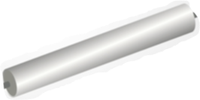


Cryomodules Challenges for PERLE
Sebastien Bousson
PERLE Workshop, Orsay, 24th January 2017

Slide 2
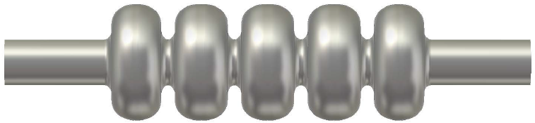
SRF: key technology for ERLs
When you have
Continuous wave operation, or long pulse mode / high duty cycle
Accelerate high beam currents (from a few mA to several tens of mA)
Then SRF is the technology of choice to take benefit from the very low surface resistance and allow efficient and cost-effective CW operation
802 MHz cavity for Perle designed by JLab

Slide 3
Some key challenges of SRF for ERLs
SC Cavities
CW operation at high gradients and low cryogenic losses: High Qo
Reliable operation with very low trip rate
Very low microphonics levels : require a careful mechanical cavity design
HOM control: avoid trapped modes and perform HOM damping: cavity design optimized for sufficient cell to cell coupling and for efficient HOM power extraction
RF power system and control
Cost optimization for RF control, power sources and input couplers
Active and fast cavity frequency RF controls
Energy stability: require a very good RF cavity field stabilization
Cryostat and cryogenics
Effective cryogenic system for high cryo-loads (CW operation)
High Qo -> cryostat design optimized for magnetic shielding
Low microphonics level -> cryostat carefully designed for vibration damping
Then SRF is the technology of choice to take benefit from the very low surface resistance and allow efficient and cost-effective CW operation

Slide 4
Cryomodules
The main functions of a cryomodule
Give the cryogenic environment for the cold mass, i.e. the cavity and/or magnet (only cavity in the PERLE case): perform the cryofluids distribution
  Helium (LHe) and/or Nitrogen (LN)
  Handle the liquid and vapor phase of the cryofluids
    Cavity operating temperature: 4K (atm. Pressure) or 2K (~30 mbar)
    Thermal shield could be actively cooled by cold He gaz or LN
    Power coupler might required an active cooling
  Vacuum
Perform the thermal insulation against all heat transfer from room temperature to the cold mass:
  limit losses by conduction, convection or radiation
Supporting and positioning of the components:
  Structural support for the cold mass
  Precise alignment of the cavities with respect to the beam axis and keep the alignment over the thermal cycles
Provide magnetic shielding to the cavities

Slide 5
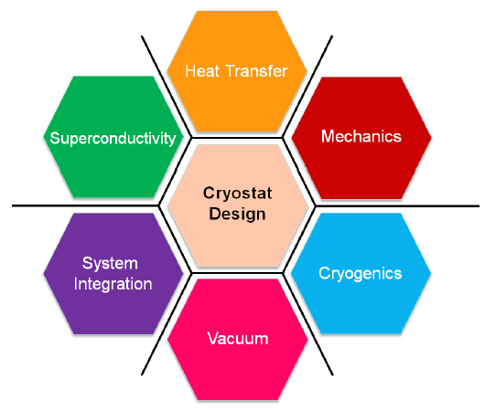
Constraints for cryomodule design
And don’t forget
Licensing
Courtesy V. Parma (CERN)

Slide 6
Cryomodule requirements for Perle
Several cryomodule requirements could be listed for PERLE, and some of them are very challenging. They are of two types:
1. The classical challenges imposed by SRF:
  Limit as much as possible heat transfer
  Take into account all mechanical constraints
  Design allowing an easy assembly procedure
  … and as usual, optimize for cost !
2. The aditionnal constraints coming from the cavities operated in the ERL mode and CW/high current operation mode:
  High CW cryo loads
  Low level of vibration, and damping of them
  Excellent magnetic shielding (high Qo)
  Accurate cavity alignment

Slide 7
The classical challenges in designing SRF cryomodules

Slide 8
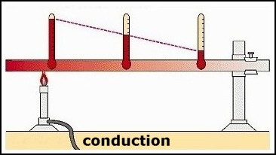
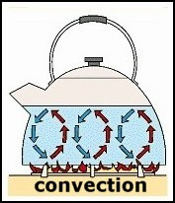

Generic constraints for cryomodule design
1. Limit as much as possible heat transfer
Cold mass (spoke cavities) needs to operate at 2K.
And 1 W dissipated @ 2K costs ~700 W of electrical power to maintain @ 2K !
-> optimization of running cost for the accelerator
The 3 heat transfer mechanisms:
Use of material exhibiting poor thermal conductivity
Use small sections for the interface rods
Use thermal intercepts
Operate in vacuum !
Use thermal shields at intermediate temperature
Use low emissivity materials
Use multi-layer insulation

Slide 9
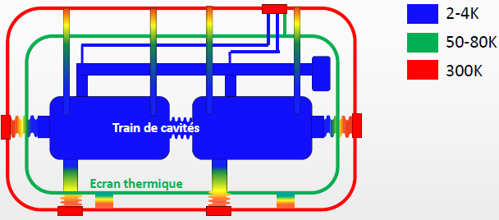
Generic constraints for cryomodule design
2. Mechanical constraints
Isolation vacuum:
The cryomodule external vessel has to sustain external pressure
Thermal gradients:
Thermal contractions induces mechanical constraints
Gravity: component mass
A fully equipped cavity can weight > 250 Kgs
They all have an impact on the alignment and component stability
Use material with low thermal contraction coefficient (ex: TiA6V, composite materials)
Use geometrical “tricks” to add flexibility (bellows, bended tubes,…)
Use of materials with high elastic limit to sustain the forces
Temperature map in the ESS spoke cryomodule
(P. Duchesne, IPNO)

Slide 10
Generic constraints for cryomodule design
3. Assembly and maintenance constraints
The cavity string is prepared and sealed in a clean room
  Reduce as much as possible the amount of material inside clean room for improved contamination control
  Optimize the number of assembly operations inside the clean room
Design a cryomodule which can be “easily” assembled and maintained
    Optimize parts and components access
    During all assembly steps, maintain or control/monitor alignment
4. Cost constraint !
    Obvious: optimize the cryomodule component cost but also the required amount of manpower to assemble
    Also think about the cost of assembly tooling

Slide 11
Specific challenges of ERLs cryomodules

Slide 12
Specific constraints in ERLs cryomodules
High cryo loads generated by the CW and high current operation mode
A large number of significant dynamic heat loads in an operation mode where dynamic loads are >> static loads
  Cavity
  HOM load
  CW input couplers
Design question/optimization points to find for cryostat/cryoplant: cryo load
  Thermal shield temperature optimum
  How to efficiently extract HOM power, at what T°
  Cryo load varies a lot between RF on/off : cryoplant flexibility is required
  Cavity optimum operating temperature: cost vs cavity performances vs helium bath stability
  How to cool the cavities (series/parralel) in order to insure “magnetic hygiene” (really an issue for high Qo @ 802 MHz ?)

Slide 13
Specific constraints in ERLs cryomodules
Design question/optimization points to find for cryostat: vibrations management
  How to insure low mechanical vibrations levels – what is the source ?
  How to damp vibrations to ease cavity control
Design question/optimization points to find for cryostat: magnetic shielding (required for high Qo, required cavities submitted to les than a few mG)
  What magnetic material, at what temperature ?
  How many layers of magnetic shield ?
  Active shielding could help ?
  Very few worldwide experience of magnetic shielding requirements for high Qo at frequencies in the 500 – 800 MHz range
Design question/optimization points to find for cryostat: cavity alignment
  How to insure alignment in the range 0.5 mm ? Does the spec could be even smaller ?

Slide 14
Local expertise in cryomodule design and technological platforms for SRF

Slide 15
Cryomodule recent design experience @ Orsay

Slide 16
Cryomodule recent design experience @ Orsay

Slide 17
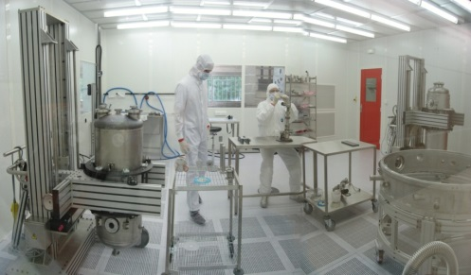
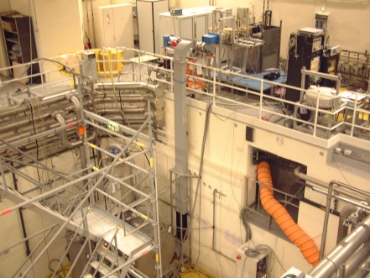
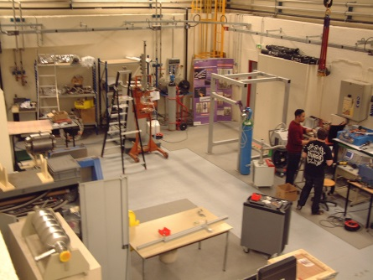
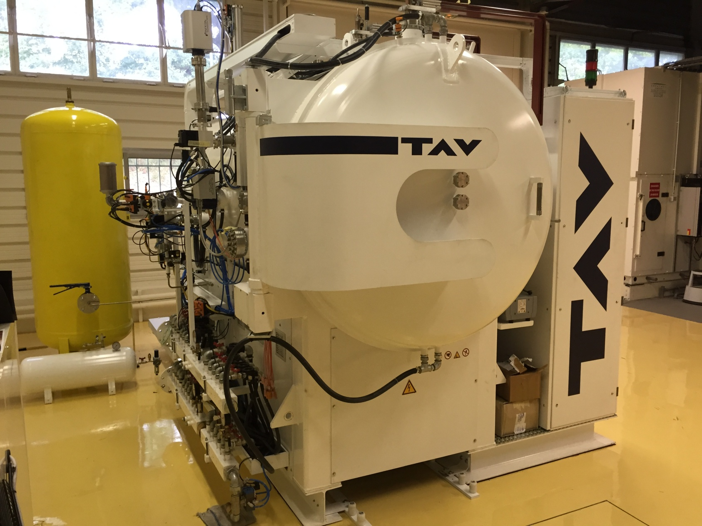
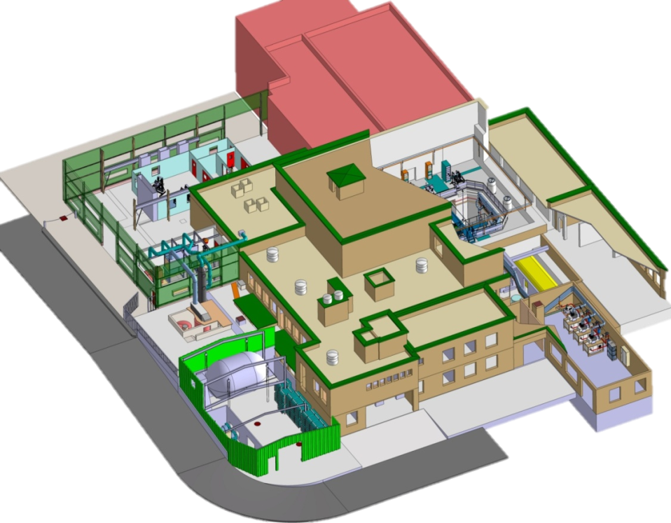
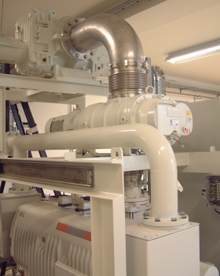
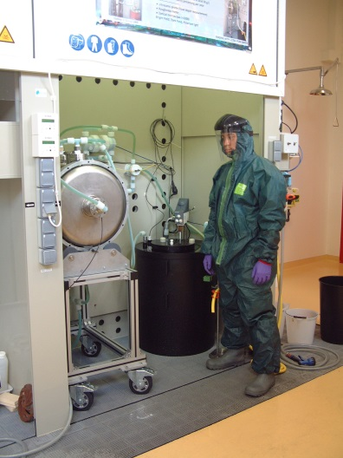
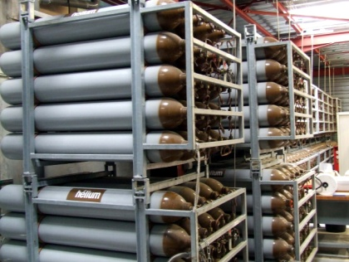
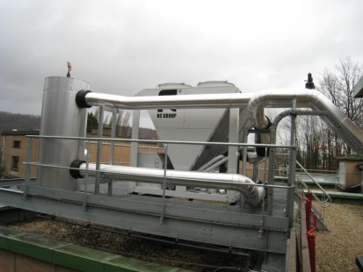
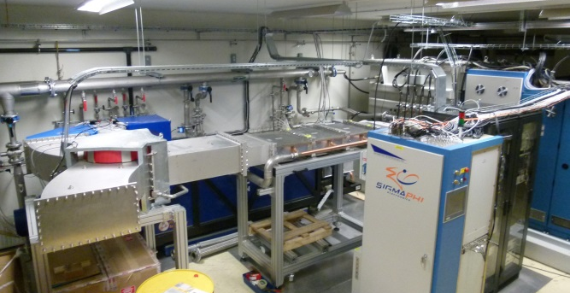
SRF Technological platform @ Orsay
Clean room ISO 4
Cryogenic Test Hall
Cryomodule assembly Halls
Vacuum furnace (cavity H degaz)
Helium pumping system
Cavity Surface
treatment
laboratory
Recovery and compression
of helium gas
Cooling water production
400 kW
2.8 MW, 352 MHz Klystron

Slide 18
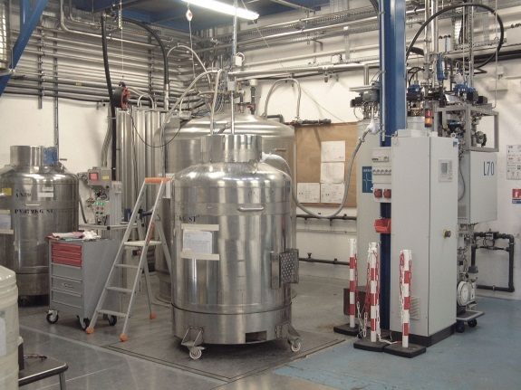
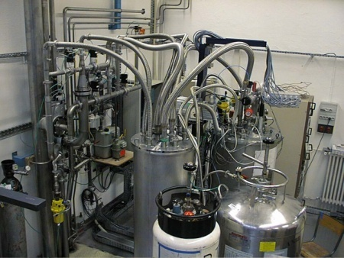
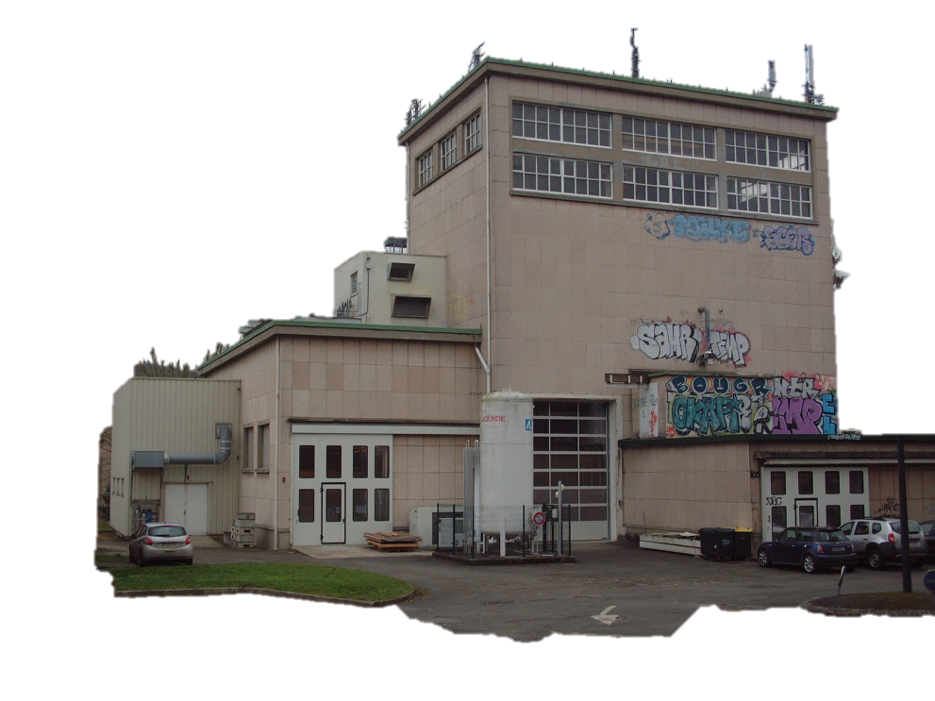
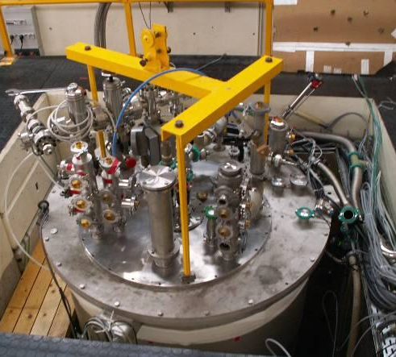
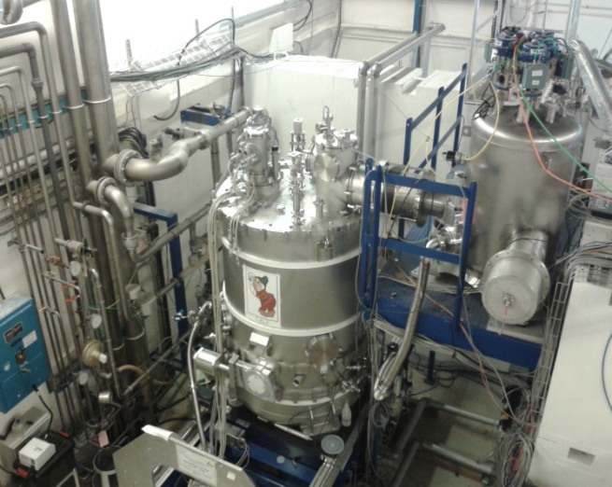
SRF Technological platform @ Orsay
Helium liquefier
Cryo T° sensor calibration station
2nd cryogenic test facility « cryodrome »
(vertical cryostats)

Slide 19
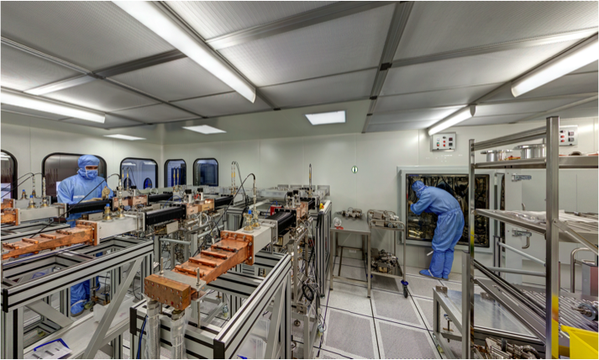
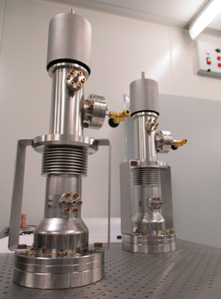
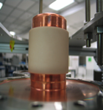

SRF Technological platform @ Orsay
Power coupler facility @ LAL (control, preparation, assembly, conditionning)

