Slide 1


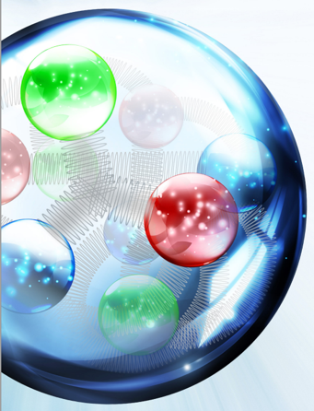
800 MHz SRF Cavity status
R. Rimmer, J. Henry, F. Marhauser, L. Turlington
* Authored by Jefferson Science Associates, LLC under U.S. DOE Contract No. DE-AC05-06OR23177

Slide 2
Outline
LHeC (PERLE) cavity development context
Requirements
Design philosophy
  Cell shape optimization (see Frank Marhauser’s talk)
  HOM damping (see Frank Marhauser’s talk)
952.6 MHz prototype cavity status
800 MHz cavity status and plans
SNS-like Cryostat update
Conclusions
“strong” bunched-beam electron cooling
Modular Cryostat update

Slide 3
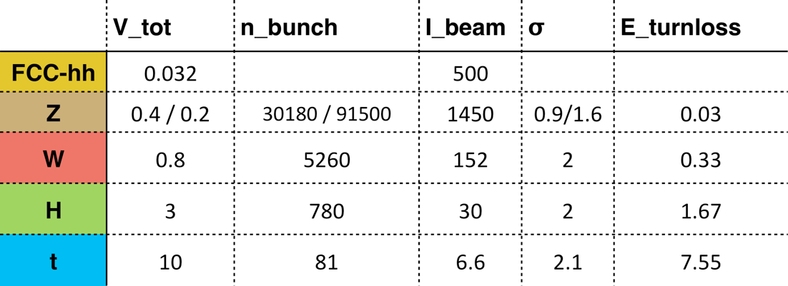
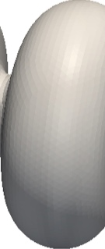
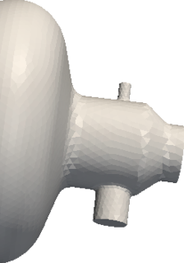
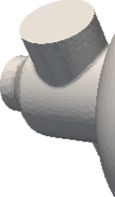
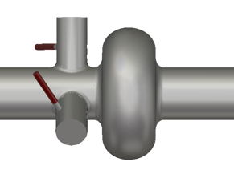
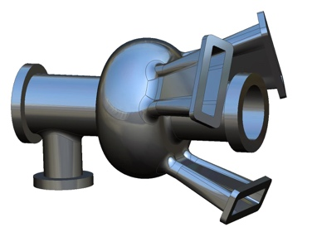
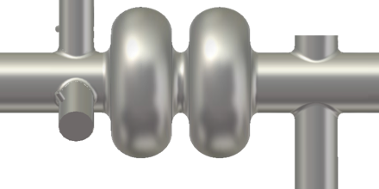
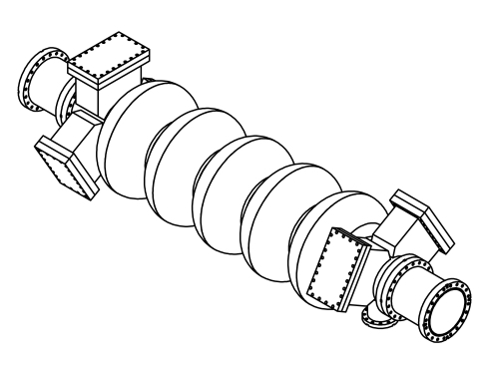
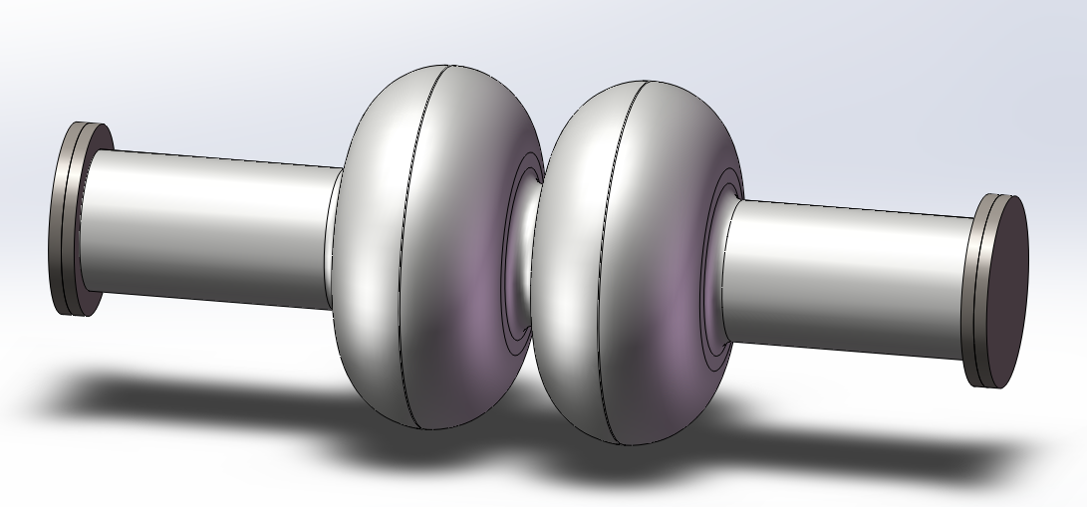
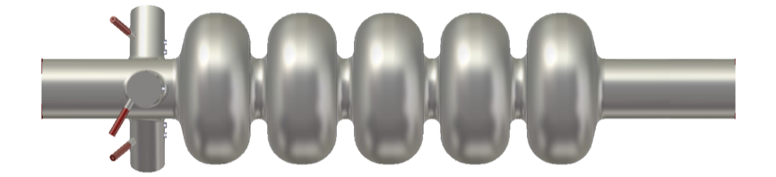
LHeC cavity design context:
FCC and EIC cavities for low and high energy
O. Brunner, FCC Week 2016, Rome
400MHz,
1 cell, Nb/Cu
400/800 MHz, multi-cells, Nb/Cu
952.6 MHz
J. Zhai
650 MHz CEPC
Jlab cavities with coax and on-cell dampers

Slide 4
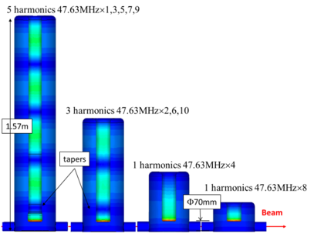
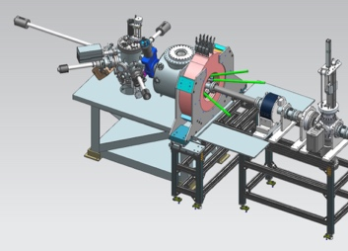
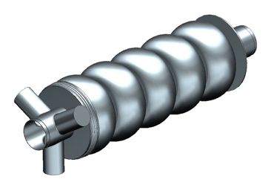
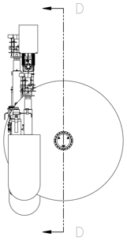
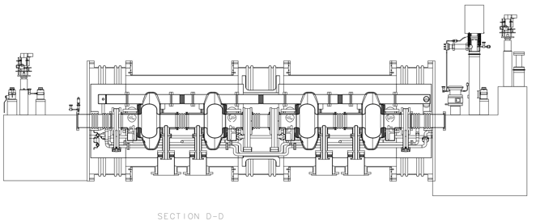
JLEIC “Strong” bunched-beam cooling
Electrons circulate 10 to 30 turns in circulator ring, fed by an ERL current?
Beam current and bunch repetition frequency reduced by a factor of 10 to 30
Fast kickers (FK) needed with rise and fall-off times of a fraction of a ns
Ion Beam
1 T Cooling Solenoid
FK
Circulator ring
FK
Magnetized Gun
Harmonic kicker system
(Y. Huang)
50 MeV Linac Cryomodule
Booster
Beam dump

Slide 5
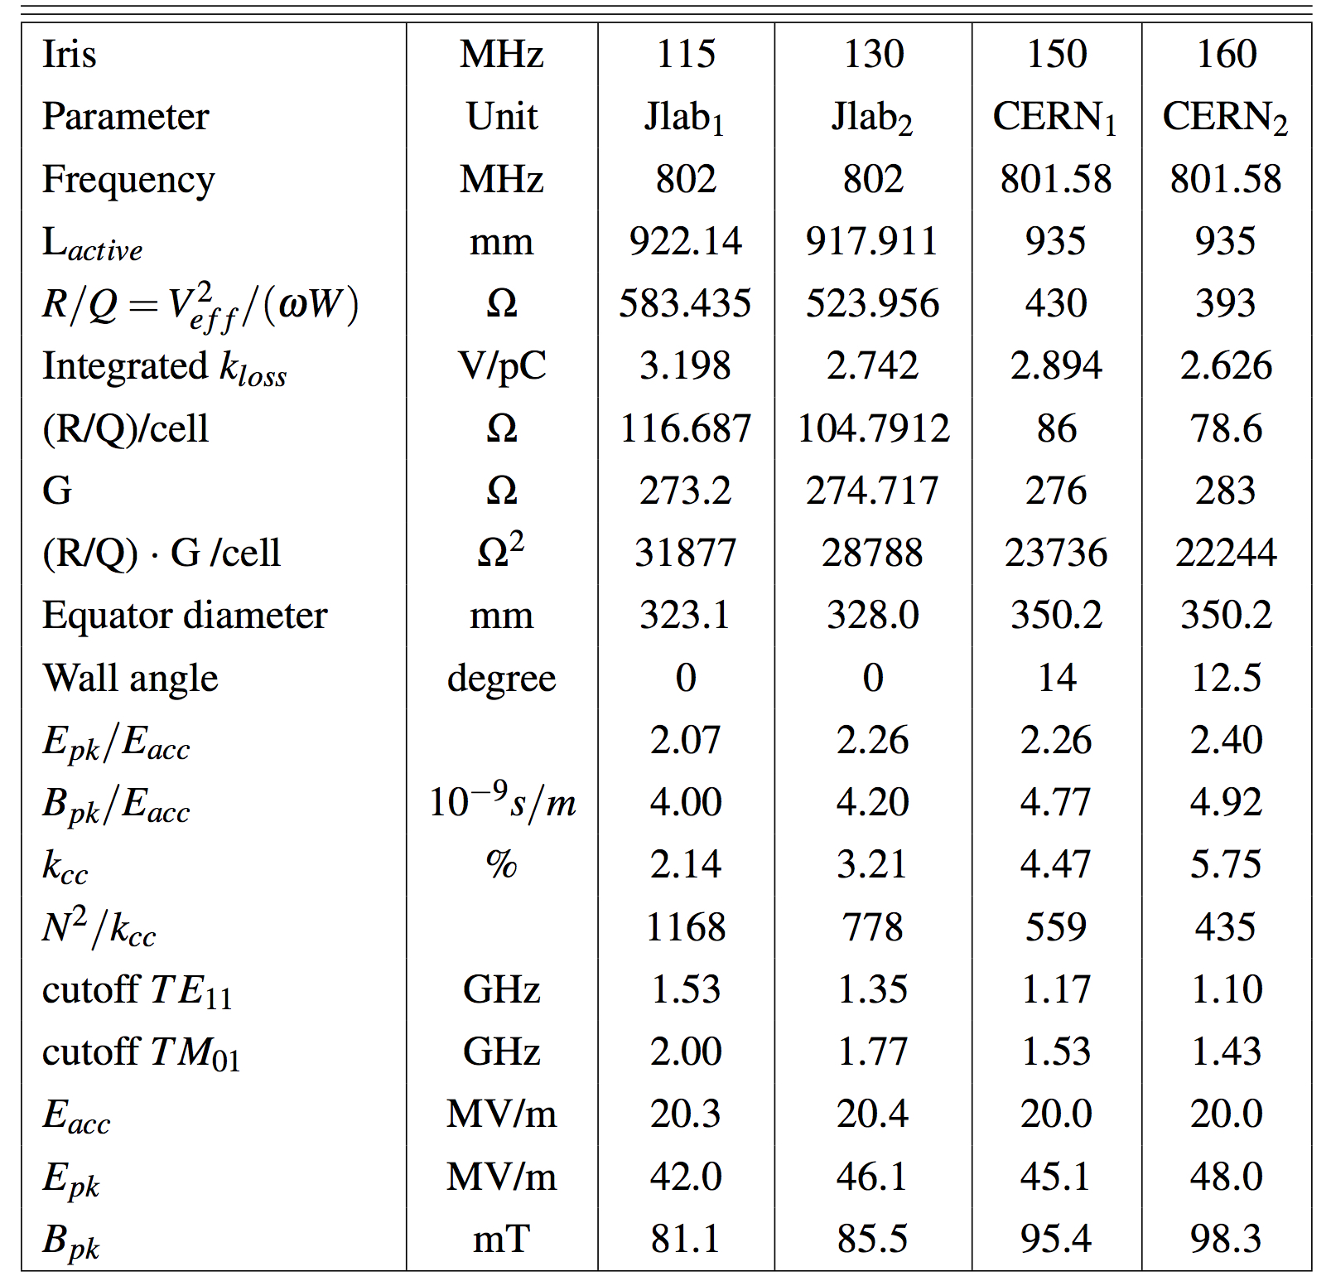
Cavity parameters
Table of parameters from PERLE CDR

Slide 6
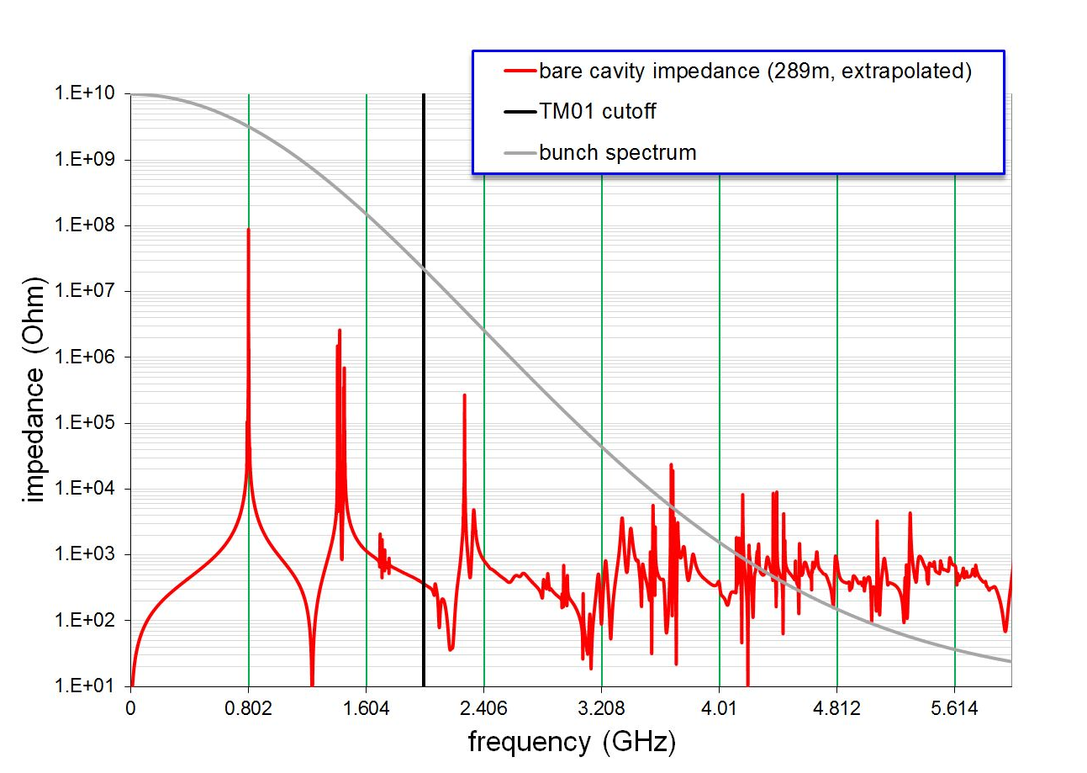
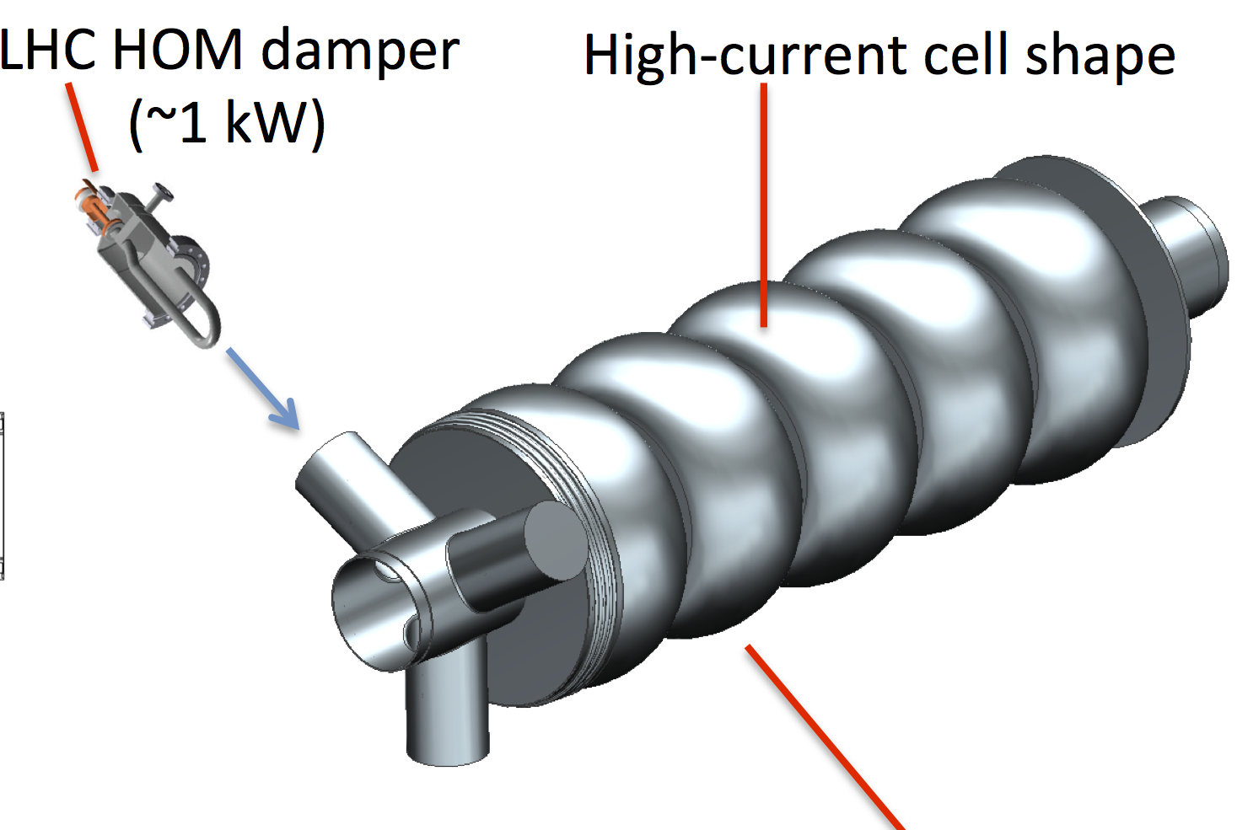
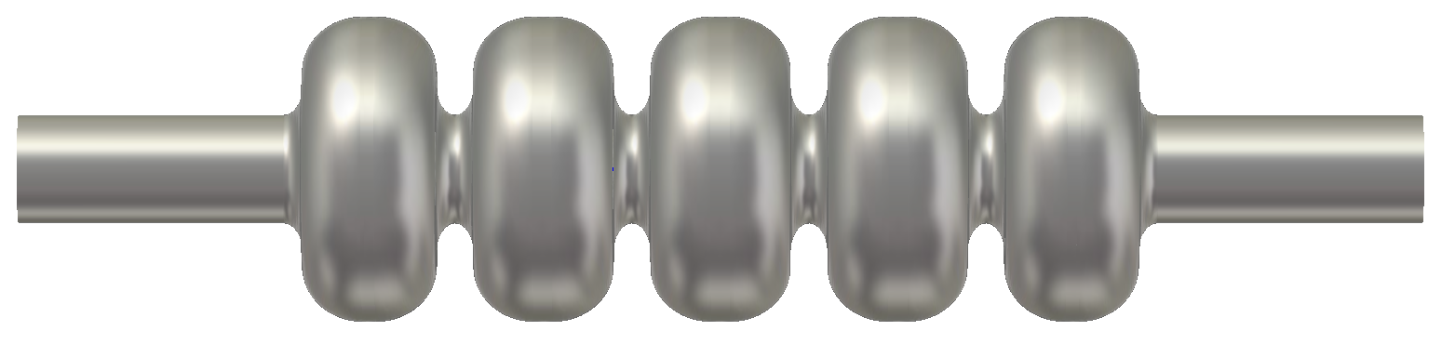
Design philosophy: cell shape
Closely follow JLEIC 952.6 MHz cavity design (based on previous 750 MHz high current ERL 5-cell).
  Optimize for HOM spectrum in the cell (avoid RF lines)
  Strong cell to cell coupling
  Good efficiency
  Acceptable surface fields
  Low multipacting impact energy

Slide 7
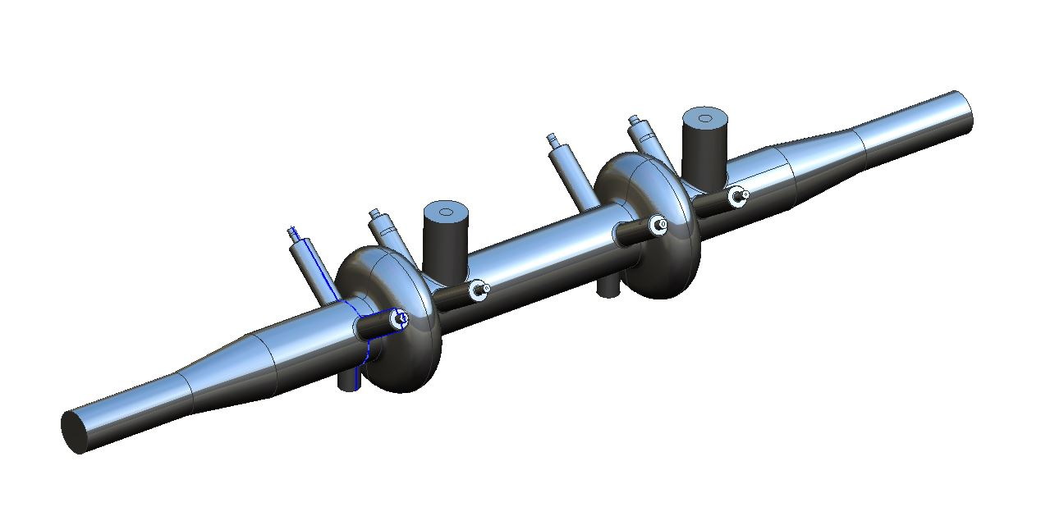
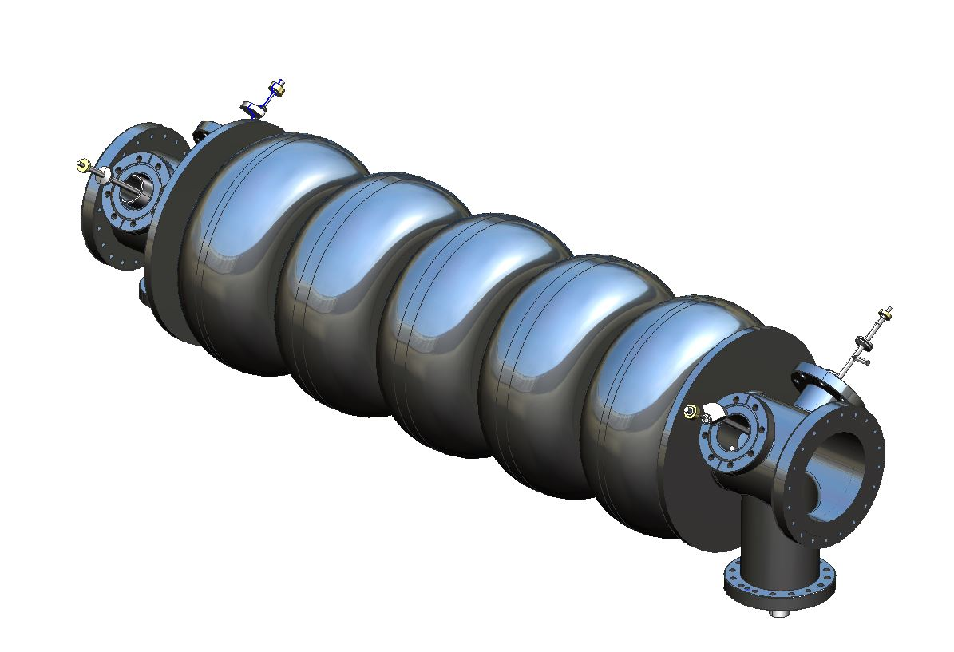
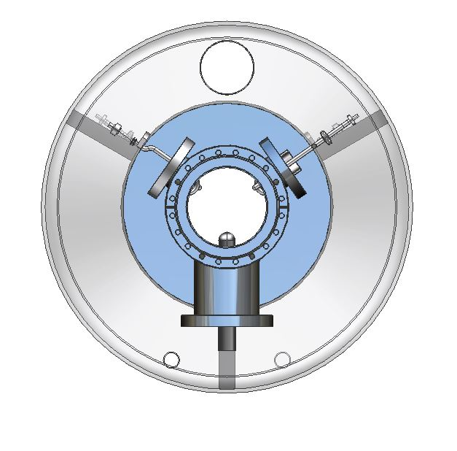
Design philosophy: HOM damping
Evaluate scaled LHC type coupler and HOM dampers (Rama’s model)
  LHC power coupler is well proven but may be overkill
  JLab FEL waveguide dampers may be overkill*
  LHC HOM dampers are somewhat narrow band (tuned)
  High power capability (~1 kW), active cooling
  Demountable
  Evaluate scaled TESLA couplers in the same location
  See Frank’s talk
Rama’s model
5-cell model
* Or not, depending on filling pattern

Slide 8
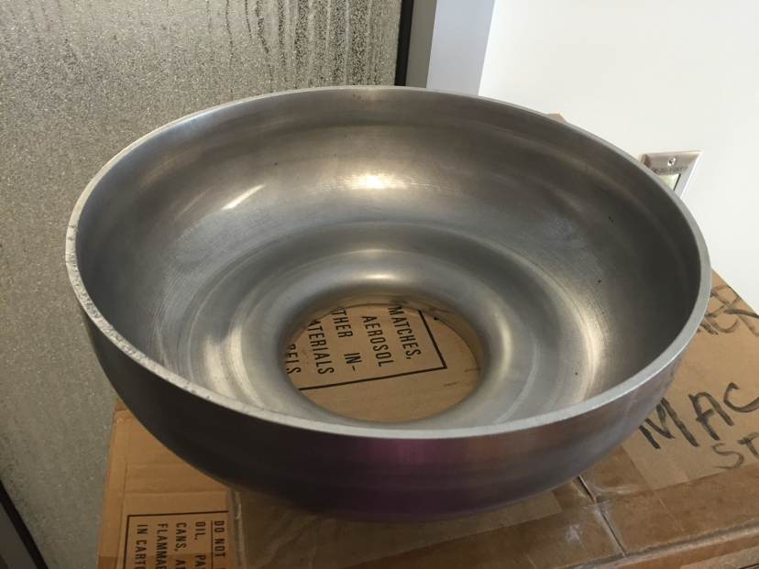
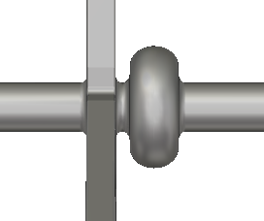
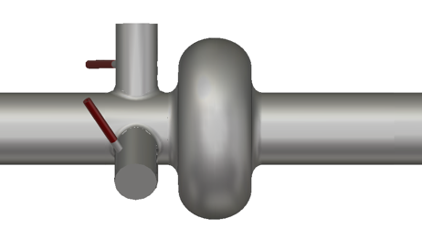
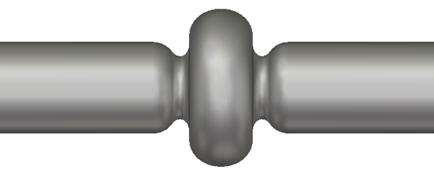
Jlab 952.6 MHz cavity current status
New 952.6 MHz high-current cavity shape developed
1-cell prototype in progress
HOM damping schemes under evaluation
Full RF system parameter tables defined
1) 3WG. 2) 3 x coax dampers. 3) enlarged beam pipes (ref) 4) on-cell dampers
Cooler needs 5-cells in the ERL, 1-cells in the injector.
Ion ring might use 2-cells

Slide 9
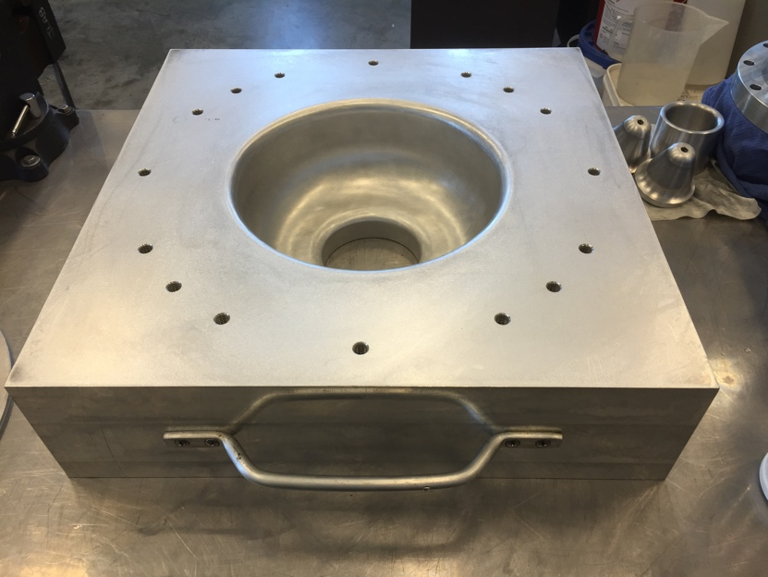
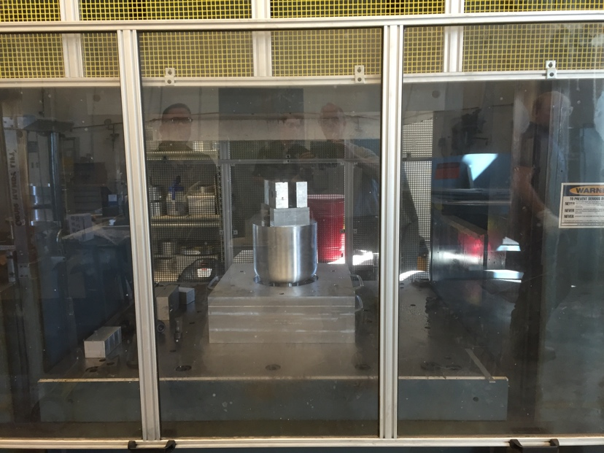
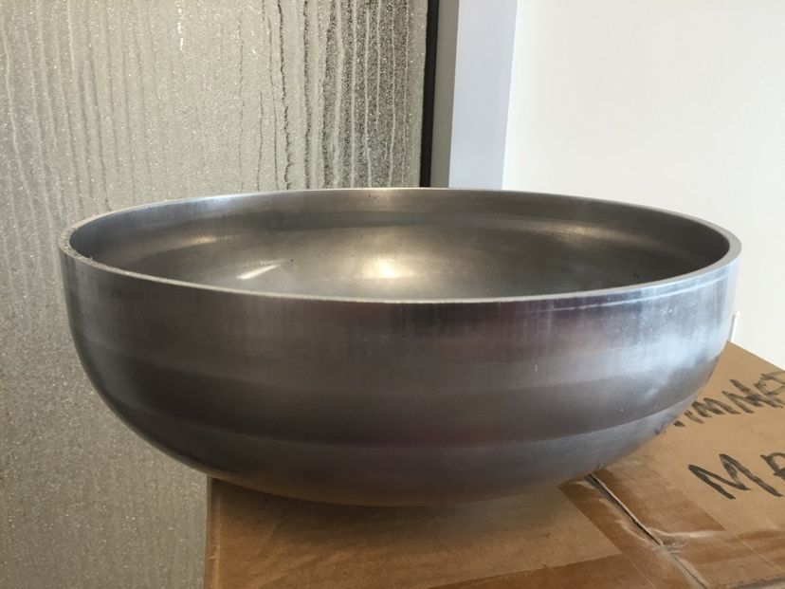
First 952.6 MHz test pressings

Slide 10
800 MHz cavity status and plans
Cell shape design complete (F. Marhauser talk)
Preliminary port locations proposed
Die set designed and out for bids
Blank size determined by scaling from JLEIC cavity
To do:
Develop bill of materials for CERN
Test dies with Aluminum or copper disks
Fabricate 1 or more Cu 1-cells for coating at CERN
1-cell Nb prototype (with or without ports?)
5-cell Nb prototype with ports
Optional:
Integration into SNS type cryomodule
Cost estimate for PERLE requirements

Slide 11
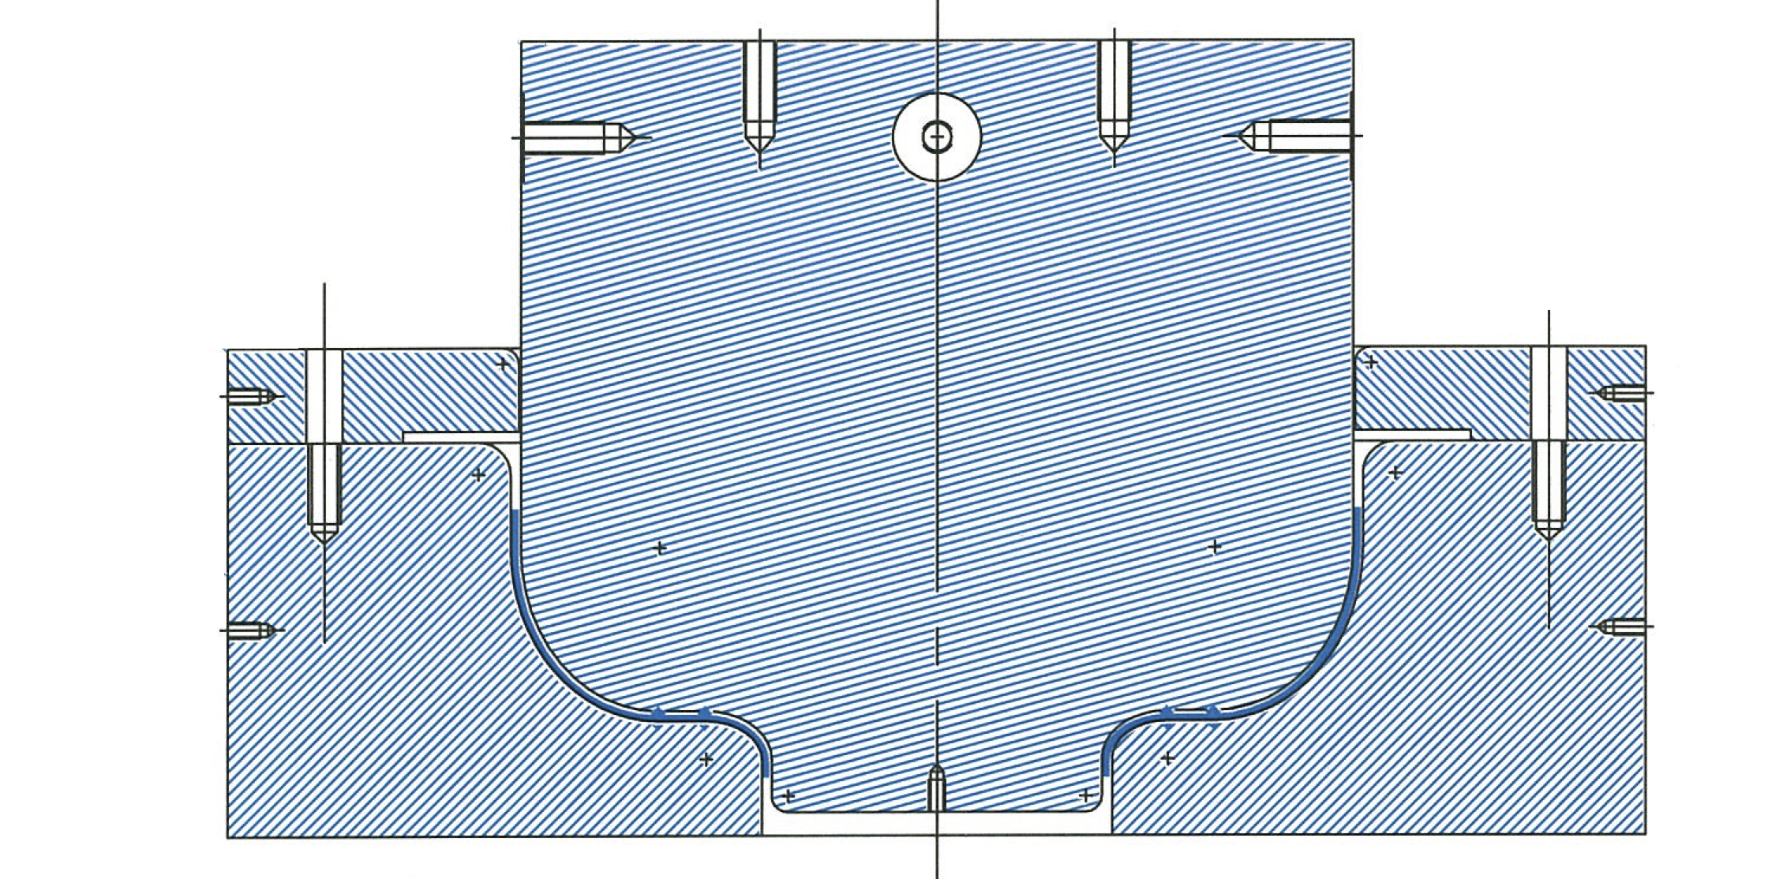
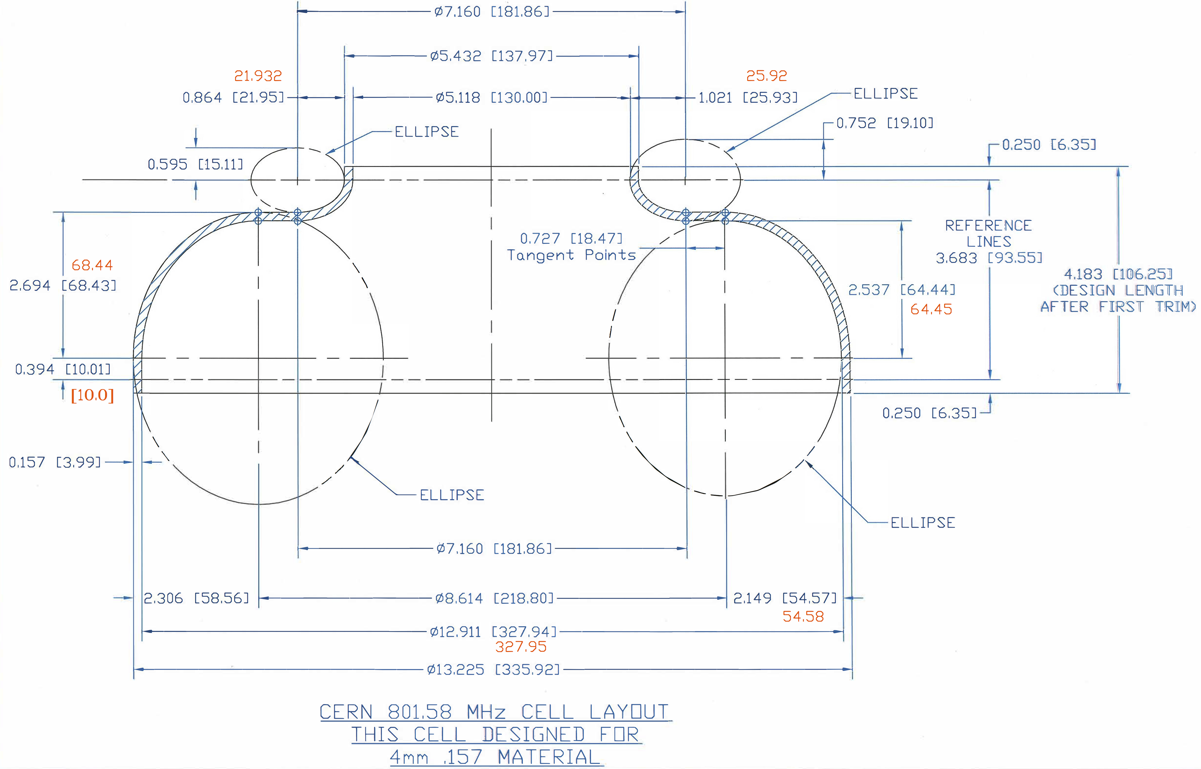
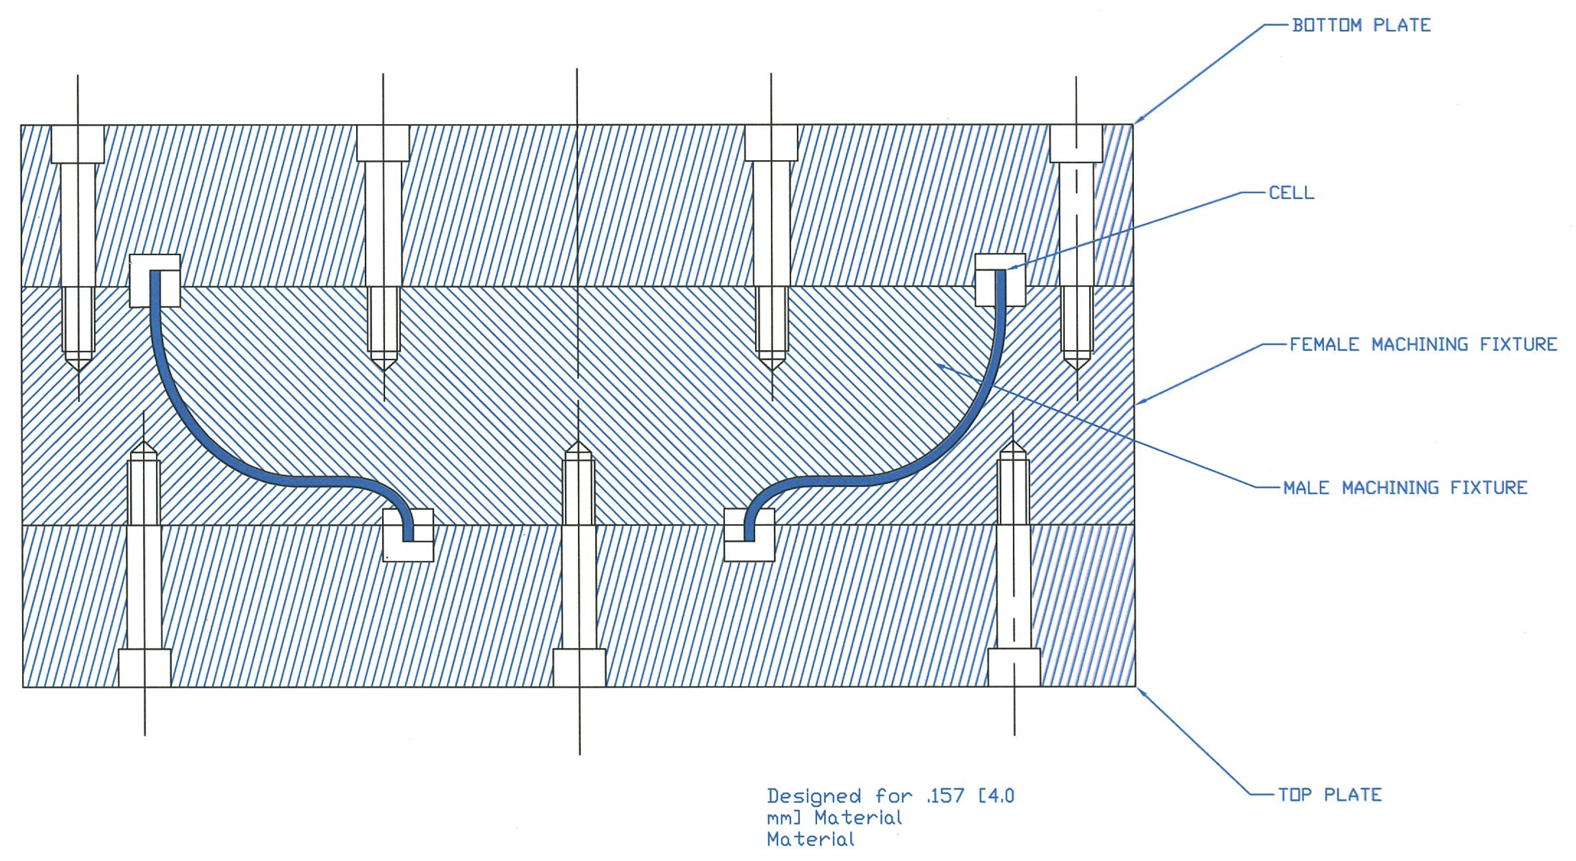
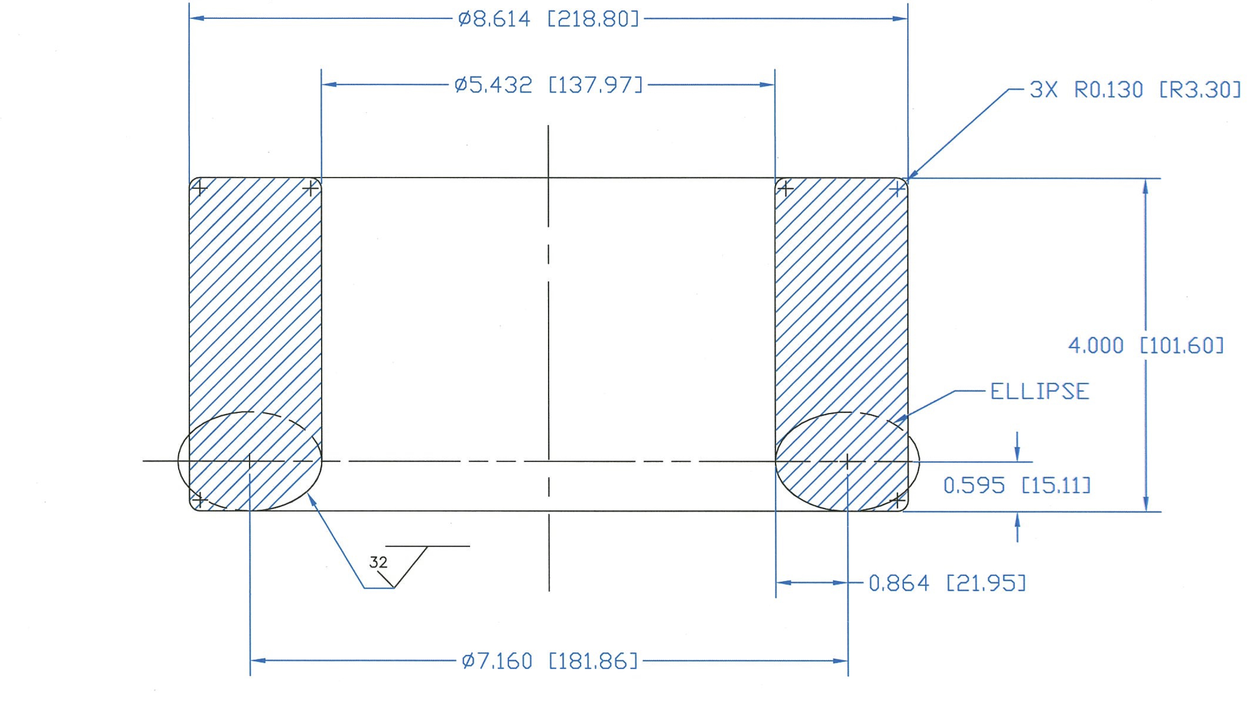
802.58 MHz die set
Out for bid…
Cup profile
Forming dies
Coining fixture
Machining fixtures

Slide 12
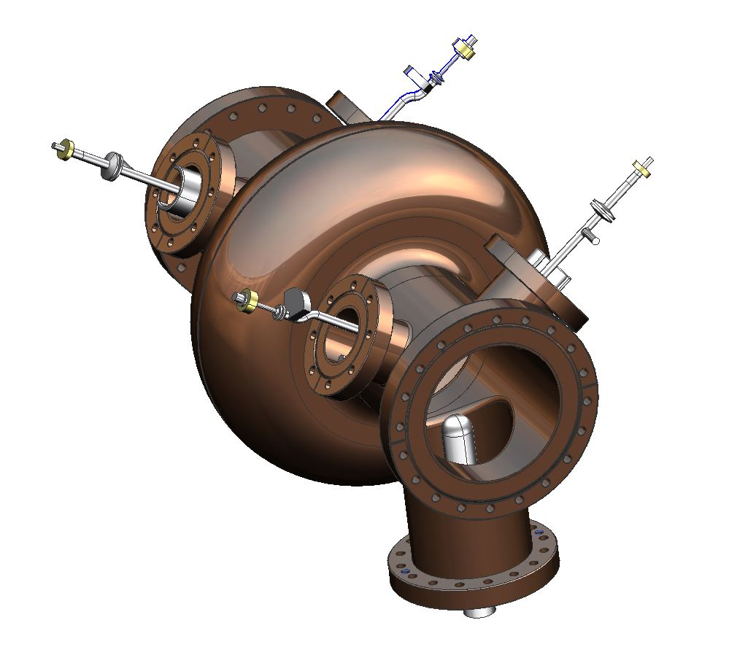
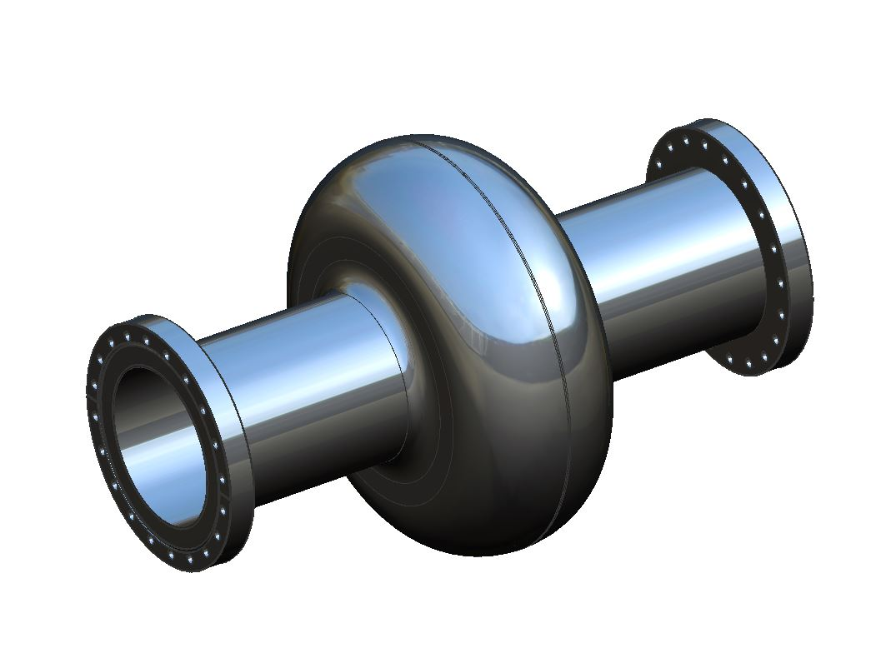
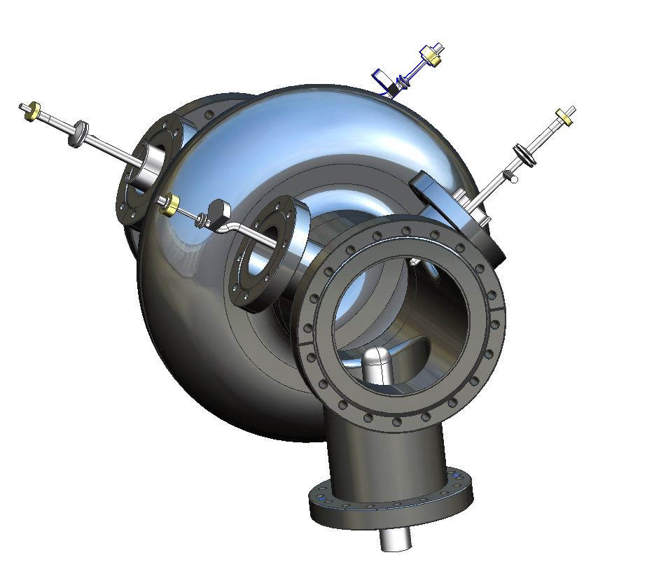
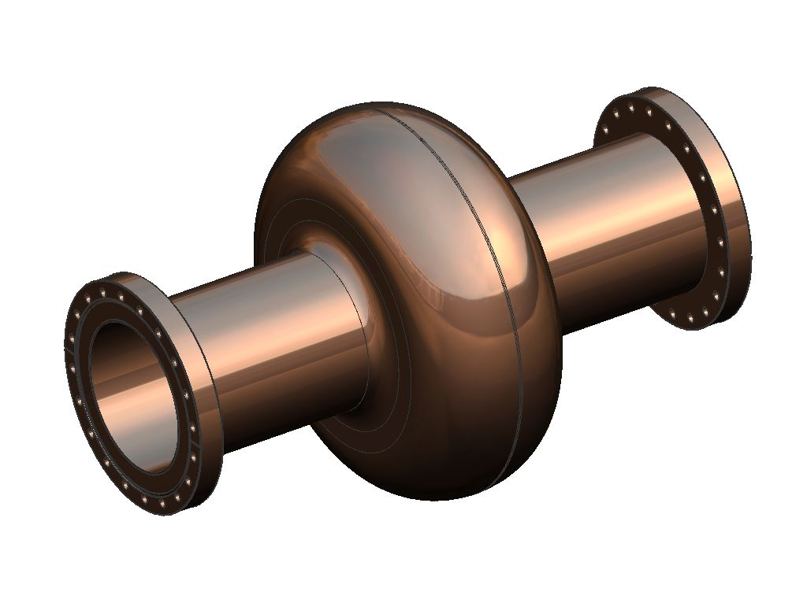
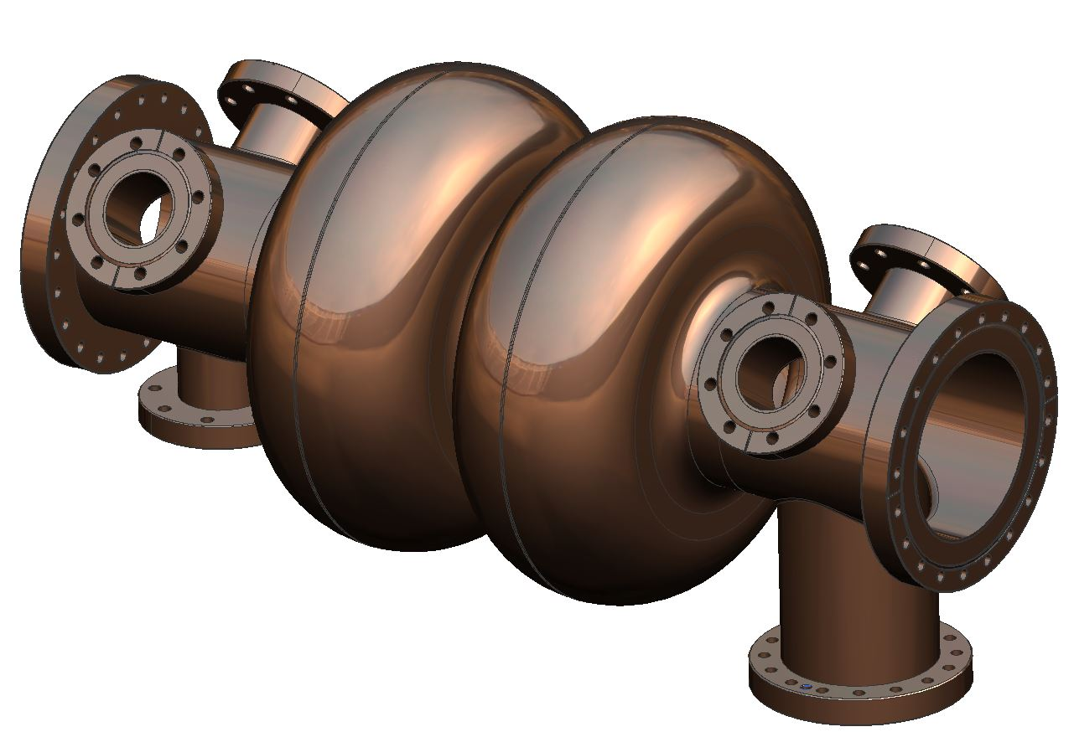
Plan forward
Fabricate dies. Q2 FY17
Test dies with Al or Cu disks, check dimensions etc.
Fabricate one or more copper 1-cell cavities. Q3 FY17
Check tuning procedure and useful for CERN coating tests
Can add ports for development of HOM couplers
Fabricate one bare Nb single cell. Q3 FY17
Validate frequency, Qo and gradient
Option to make one large grain single cell
Fabricate bare 5-cell cavity (no He vessel) with ports. Q4 FY17
✔
?
✔
?
✔
?
✔ = in plan, ? = option

Slide 13
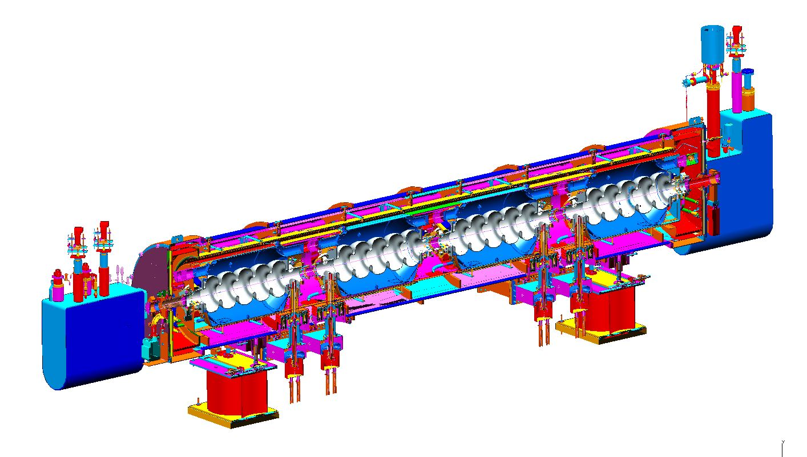
SNS like cryomodule
Cavity fits well in SNS type (805 MHz) cryomodule
Cost and fabrication processes well understood
Some updates for pressure code have been made by ORNL
Plans to build new modules for SNS Power Upgrade
Fresh cost estimate in hand, can be adapted to PERLE

Slide 14
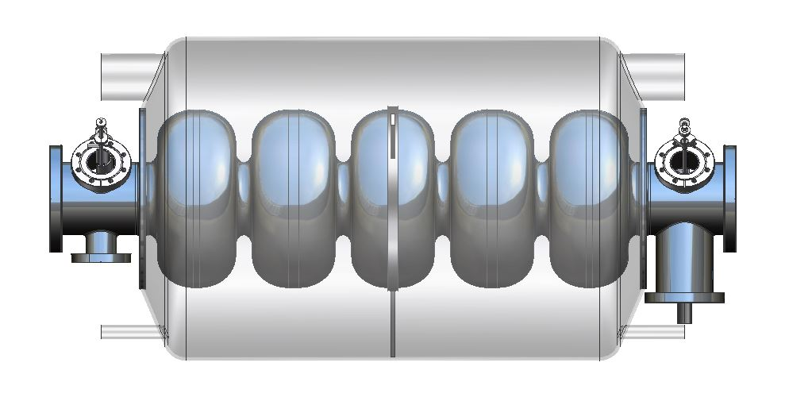
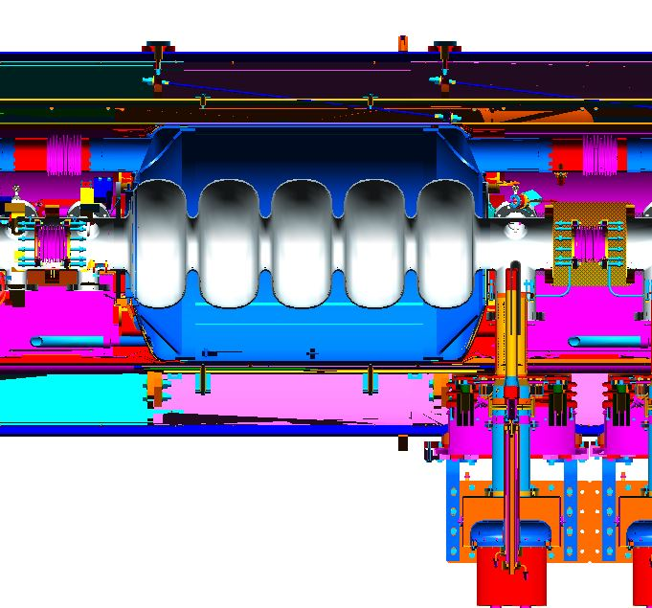
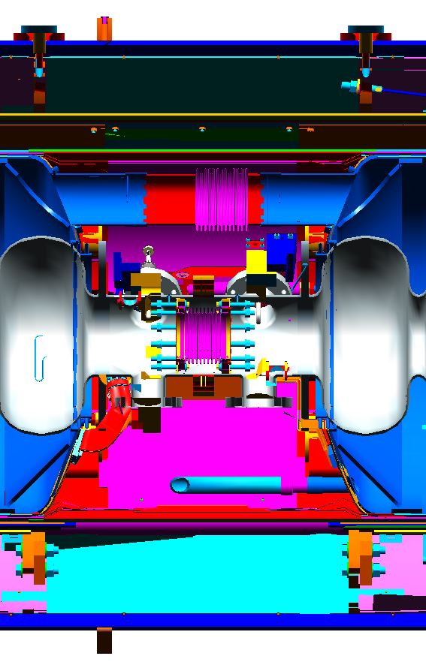
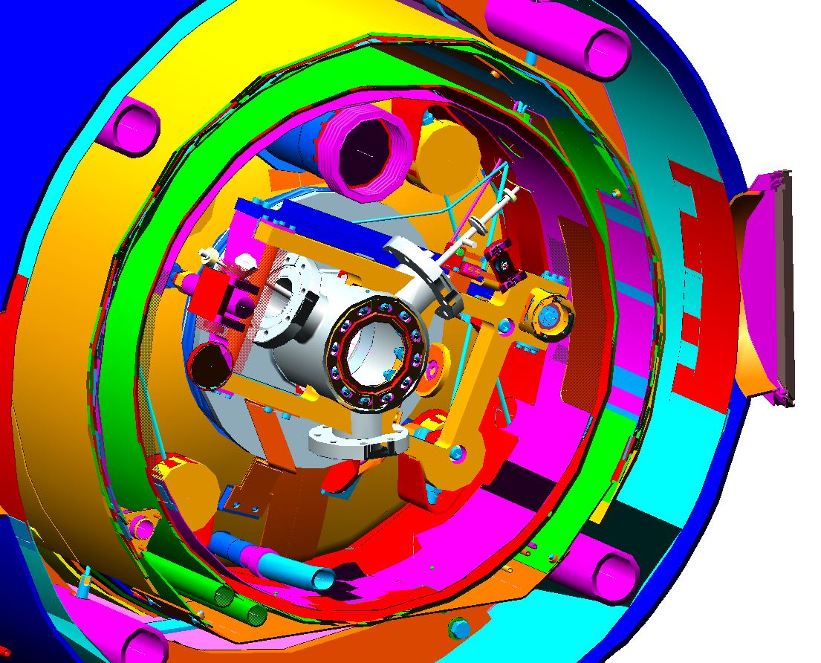
SNS-like cryomodule
Some detail changes needed:
Helium vessel bellows
Cavity interconnects
FPC (SNS version is smaller)
Tuner interference with HOM loads
interference
interference

Slide 15
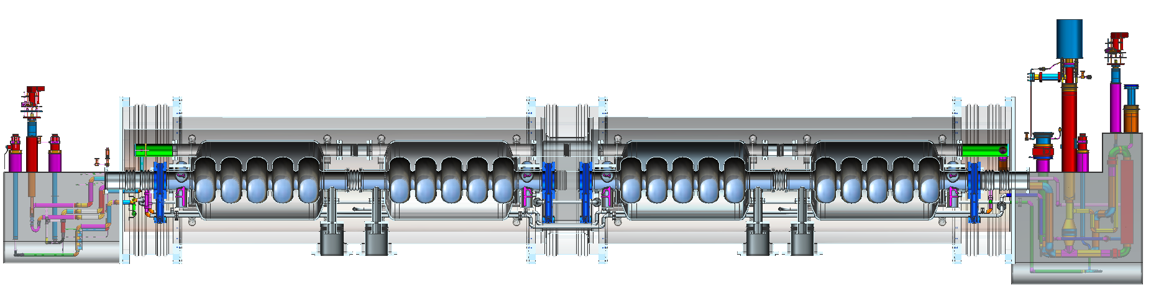
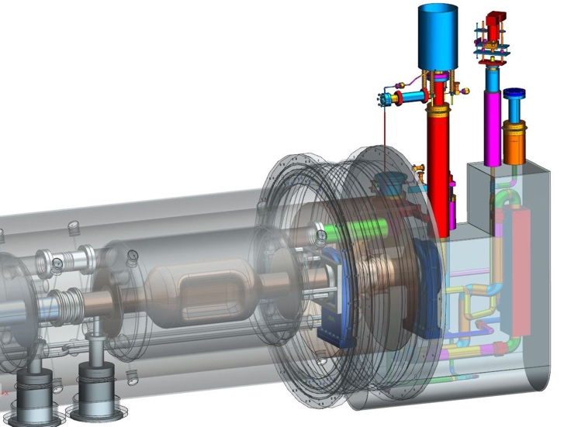
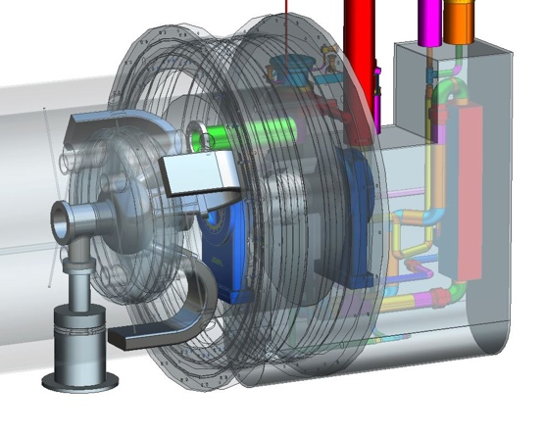
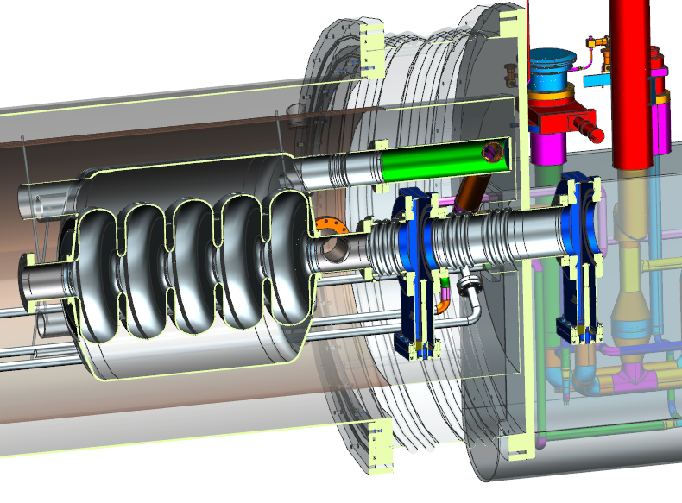
Jlab Modular Cryostat
Take the best features of previous JLab designs
Modular approach to hold various different cavities
Design suitable for industrial production
Simple concepts, low parts count to reduce costs
Cooler ERL, 5-cell cavities
476.3 MHz Crab cavity
On-cell damper concept
β=0.6 650 MHz cavity

Slide 16
Conclusions
JLEIC 952.6 MHz RF cavity is progressing
802.58 MHz cavity is following a step behind
Optimized cell shape is done
HOM damping analysis in progress
802.58 MHz dies designed, out for bids
Insertion into SNS-type cryomodule looks straightforward
  Minor changes needed
  Tooling in hand, costs well understood
Damped cavities may work for other projects
  e.g. FCC-hh

Slide 17
Backup

Slide 18
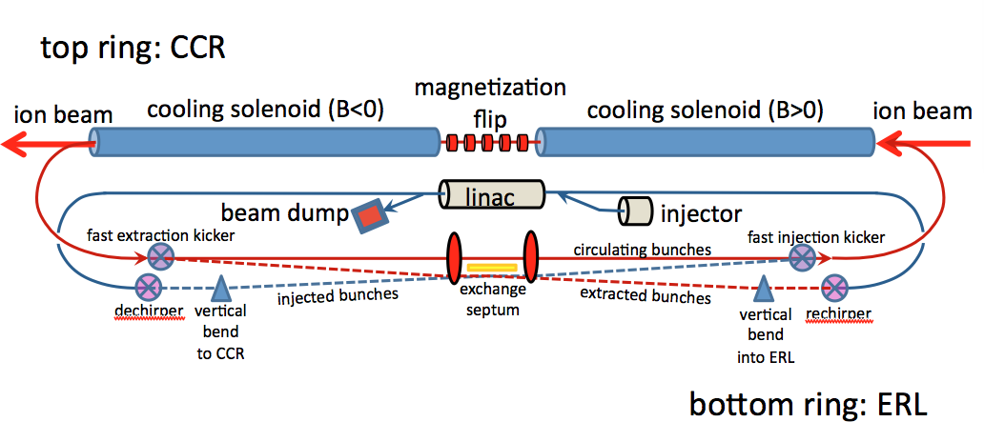
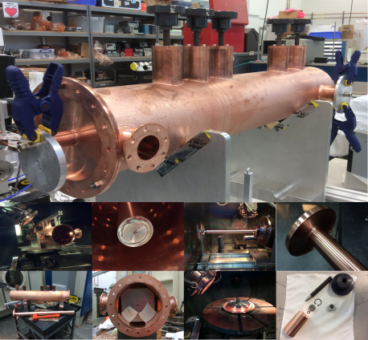
Baseline: strong cooling
ERL cooler +
Multi-turn circulator ring
Enabling technologies :
Fast kickers, risetime <1 nsec
Magnetized source ~75mA
Electron energy | MeV | up to 55
Bunch charge | nC | 3.2
Turns in circulator ring | turn | ~20
Current in CCR/ERL | A | 1.5/0.075
Bunch repetition | MHz | 476
Cooling section length | m | 60
RMS Bunch length | cm | 3
Energy spread | 10⁻⁴ | 3
Cooling solenoid field | T | 1
Cooling section length | m | 2x30

Slide 19





952.6 MHz cavity prototype
Preliminary engineering analysis is complete
Cell and beam tube dies (110mm) have been fabricated
Test blanks have been pressed
End group design will be chosen based on simulations
Impedance requirements (Q spec)
HOM power (i-ring, e-ring, ERL)
Will produce single-cell first (possibly using ingot material)
J. Henry
L. Turlington
F. Fors
σ_{e,max} = 15.2 MPa
F. Fors
Notes:
Red Interior Page Design 1

Slide 20







JLab high-current cavities
Two 1.5 GHz, one 750 MHz prototypes built and tested
  Results exceed requirements for 4th gen. light source
  High power RF window demonstrated to > 60 kW CW
1.5 GHz ERL cavity
Shape optimization
1.5 GHz ERL cavities
1.5 GHz window
BBU simulations for 1.5 GHz ERL
750 MHz ERL cavity
Module concept

Slide 21

JLab high current cryomodule
JLab 750 MHz ERL module (based on modified SNS layout)
Very large apertures (halo!) Very high BBU threshold
Waveguide HOM dampers with high power loads

