Slide 1
Photon beam generation at PERLE
Outline:
Introduction on Compton scattering
Expectations for the PERLE facility
Optical/laser system for high average laser power

Slide 2
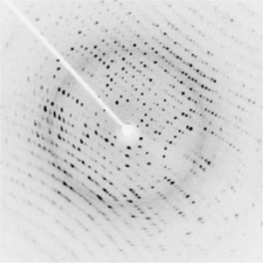
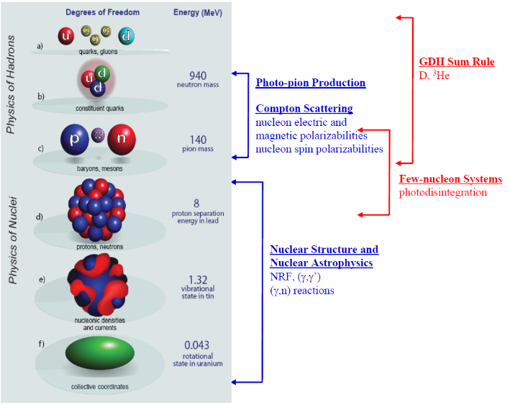
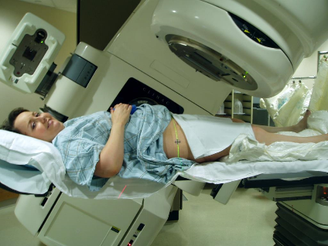
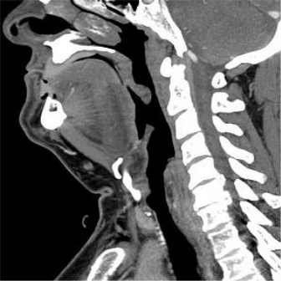
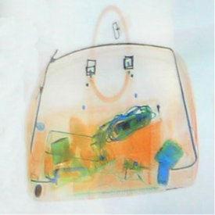
Applications
ELI-NP-GS
(@LAL)
ThomX
(@LAL)
PERLE
X-ray Imaging
Nuclear Physics
Radiotherapy
http://en.wikipedia.org/wiki/Radiation_therapy
http://en.wikipedia.org/wiki/X-ray
http://www.tunl.duke.edu/documents/public/higs2_prospectus_31aug2012.pdf

Slide 3

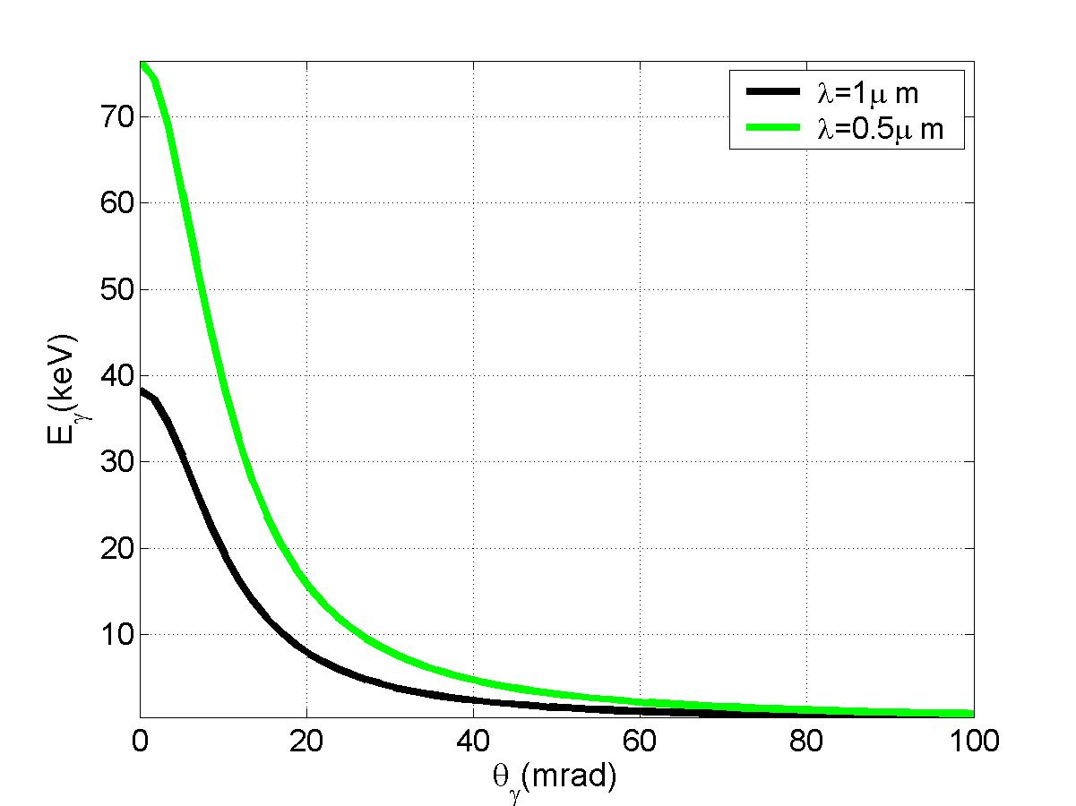
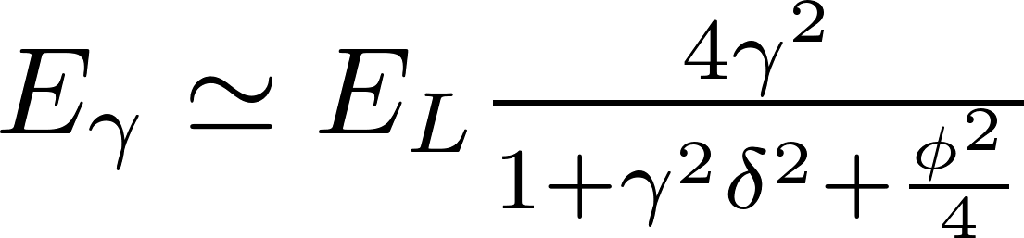
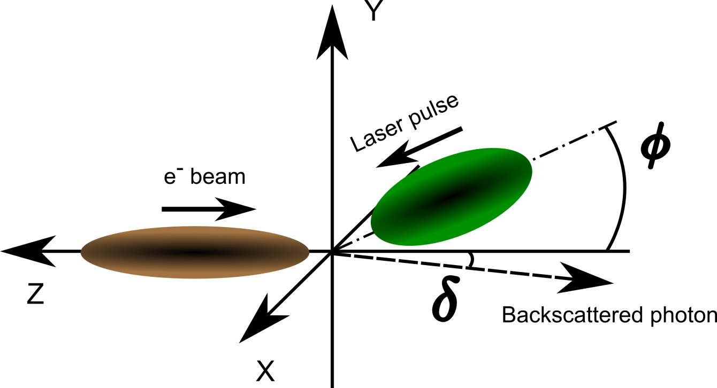
Compton Scattering
Cross-section ≈ physics
γ = 98
(E_{e} = 50 MeV)
luminosity ≈ geometry
E_{γ} (keV)
δ (mrad)

Slide 4
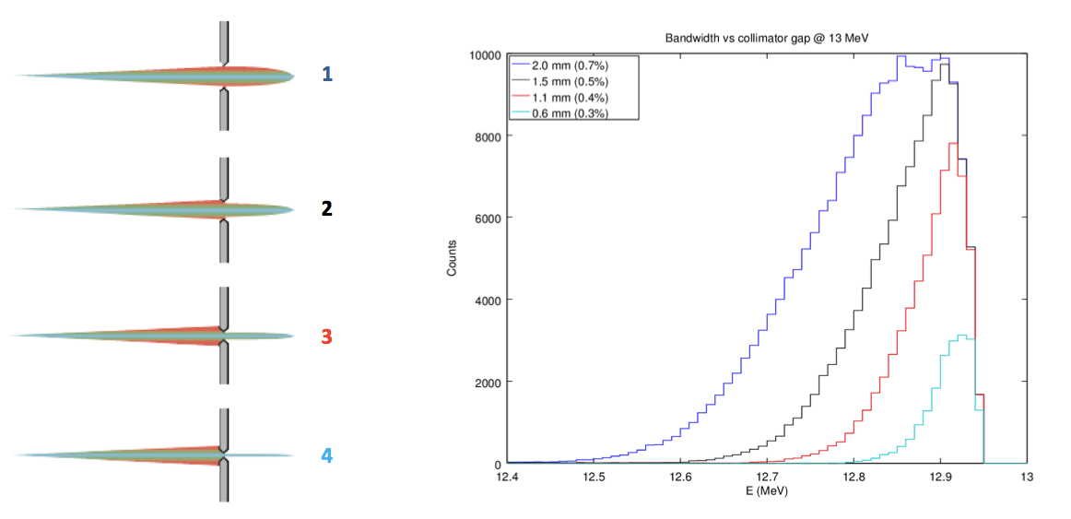
Compton Scattering properties
Electron beam
parameters
Laser beam
parameters
Nonlinear
effects
Angular acceptance
V. Petrillo et al., NIM A 693 (2012) 109–116
M. Gambiccini, P. Cardarelli et al. technical design meeting collimation and characterisation system review

Slide 5
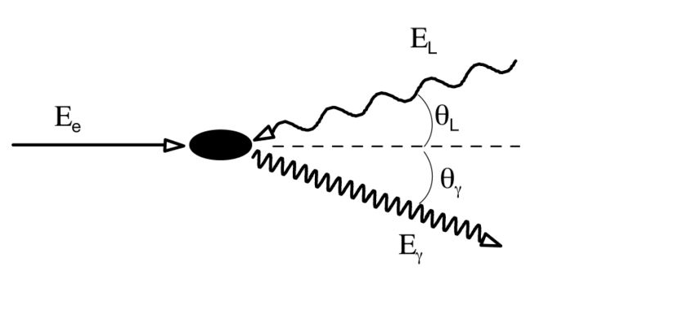
Gamma beams at the PERLE Facility
Incident
laser beam
Incident
electron beam
LASER BEAM PARAMETERS
Wavelength | 515 nm - 1030 nm
Average Power | 300kW - 600 kW (can be increased R&D)
Pulse length | 3 ps (can be reduced)
Pulse energy | 7.5mJ - 15 mJ
Spot size | 30 µm (can be reduced)
Bandwidth | 0.02 %
ELECTRON BEAM PARAMETERS
Energy | 900 MeV
Charge | 320 pC
Bunch Spacing | 25 ns
Spot size | 30 um
Norm. Trans. Emittance | 5 um
Energy Spread | 0.1 %
GAMMA BEAM PARAMETERS (for λ=515nm)
Energy | 30 MeV
Spectral density | 9*10⁴ ph/s/eV
Bandwidth | < 5%
Flux within FWHM bdw | 7*10¹⁰ ph/s (total flux 9*10^12)
ph/e⁻ within FWHM bdw | 10⁻⁶
Peak Brilliance | 3*10²¹ ph/s*mm²*mrad² 0.1%bdw
A. Valloni

Slide 6
Optical systems
LASER BEAM PARAMETERS
Wavelength | 515 nm - 1030 nm
Average Power | 300kW - 600 kW
Pulse length | 3 ps
Pulse energy | 7.5mJ - 15 mJ
Spot size | 30 um
Bandwidth | 0.02 %
Repetition Rate | 40 MHz
Optical resonator

Slide 7
Fabry-Perot cavity: Principle with continuous wave
Gain=1/(1-R)∼10000
~10kW
e beam
~1W
isolateur
LASER
~1W
When ν_{Laser} ∝ c/2L ⇒ résonance
But: Δν/ν_{Laser} = 10⁻¹¹ ⇒ STRONG & ROBUST laser/cavity feedback

Slide 8
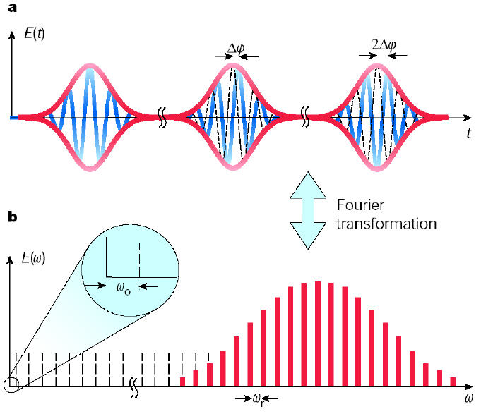
Pulsed laser/cavity feedback technique
T=2π/ω_{r}
Δφ_{ce}
Specificity ➔ properties of passive
mode locked laser beams
ω_{n}= nω_{r}+ ω₀
n~ 10⁶
Frequency comb ➔ all the comb
must be locked to the cavity
➔ Feedback with 2 degrees
of freedom :
control of the
Dilatation (rep. Rate)
&
Translation (CEP)
(well known metrological technics)
T. Udem et al. Nature 416 (2002) 233

Slide 9
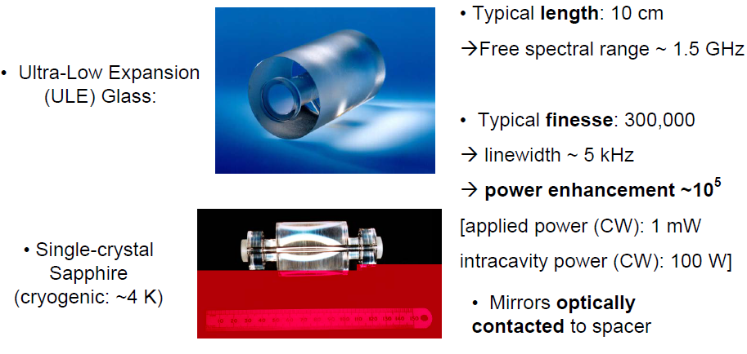
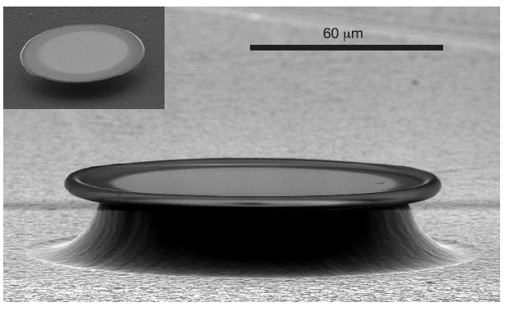

Illustration of one issue : the laser cavity feedback
PERLE Facility
Cavity finesse : F~10⁴ × π
Optical path length : L~7.5m
Cavity resonance
frequency linewidth
Δν=c/(LF)~1.3 kHz !
Δν/ν=λ/(LF)=~10⁻¹²
Same numbers as in metrology !!!
Linewidth 1.3kHz
➔F=10⁶…
M. Oxborrow

Slide 10
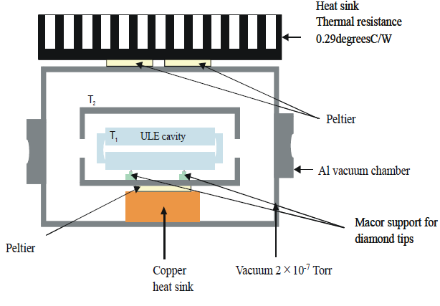
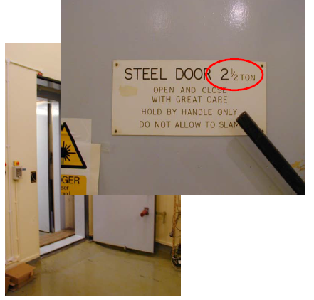
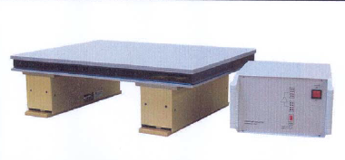
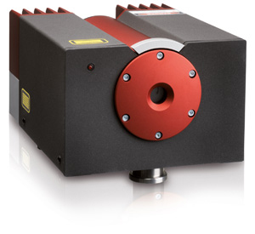
Besides
In metrology experiments :
The hyper stable small cavity is ‘hyper’ temperature stabilised
Into an hyper isolated room
For γ Compton machines
‘Geant’ mechanical structure
Noisy accelerator environment
Pulsed laser beam regime
  > 1kHz linewidth oscillator
  ‘Huge’ average & peak power !
Put on an hyper stabilised optical table
And an hyper stable LOW POWER cw laser is used, linewidth 1kHz
http://www.innolight.de/index.php?id=mephisto
M. Oxborrow

Slide 11
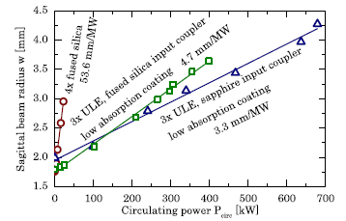
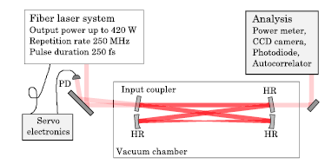
Stack power in pulsed regime
State of the art (Garching MPI):
~670kW, 10ps pulses, 1040nm @250MHz (F~5600)
OL39(2014)2595
Issues
control of thermal lensing an thermoelastic effects
Damage threshold of mirror coatings

Slide 12
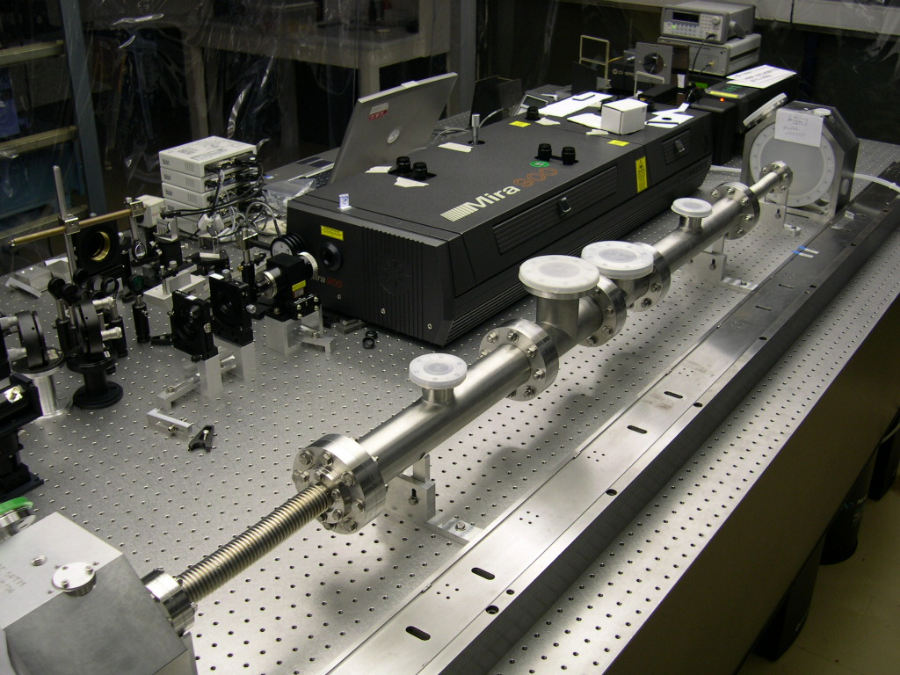
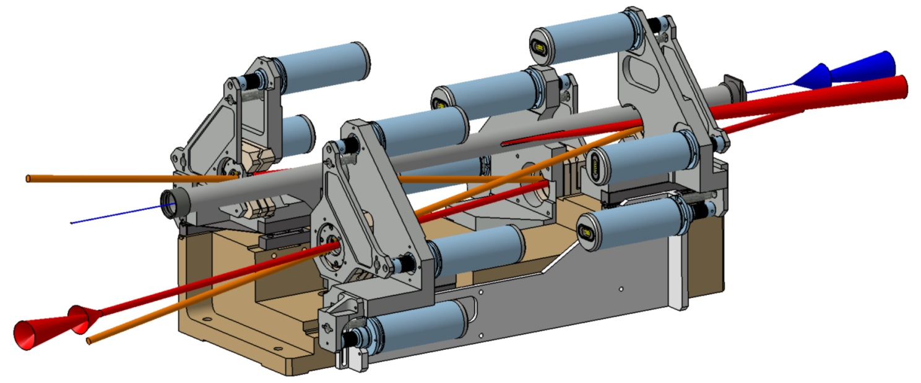
Highest cavity gain/finesse in pulsed regime
2-mirror cavity
Non planar 4-mirror cavity
LAL, LMA
CELIA/KEK/LMA/LAL
Yb fiber oscillator
100fs pulses @ ~200MHz
  Stable lock, finesse~30000
  (➔BW feedback~10MHz)
Yb fiber system amplifier
Ti:sapph oscillator
Picosecond pulses @ ~75MHz
  Stable lock ,finesse~30000
  (➔BW feedback~100kHz)
Installed /tested at ATF/KEK
(Compton e+ polarized source)

Slide 13
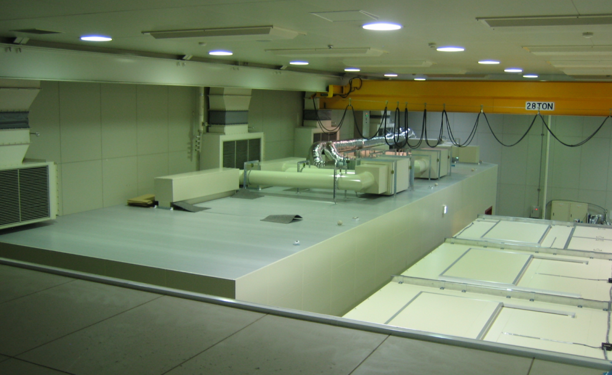
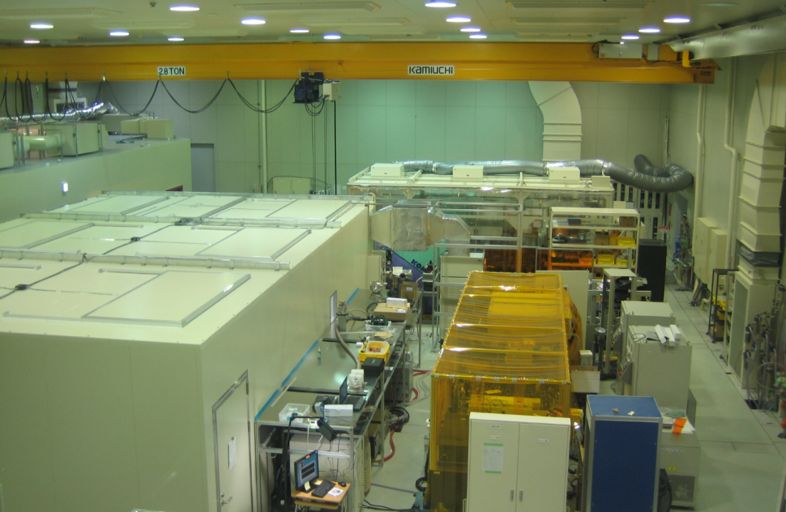
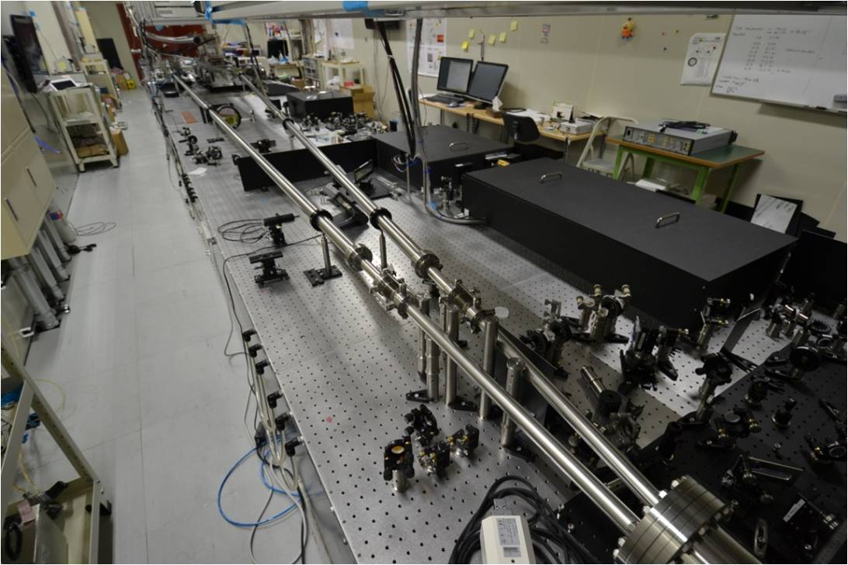
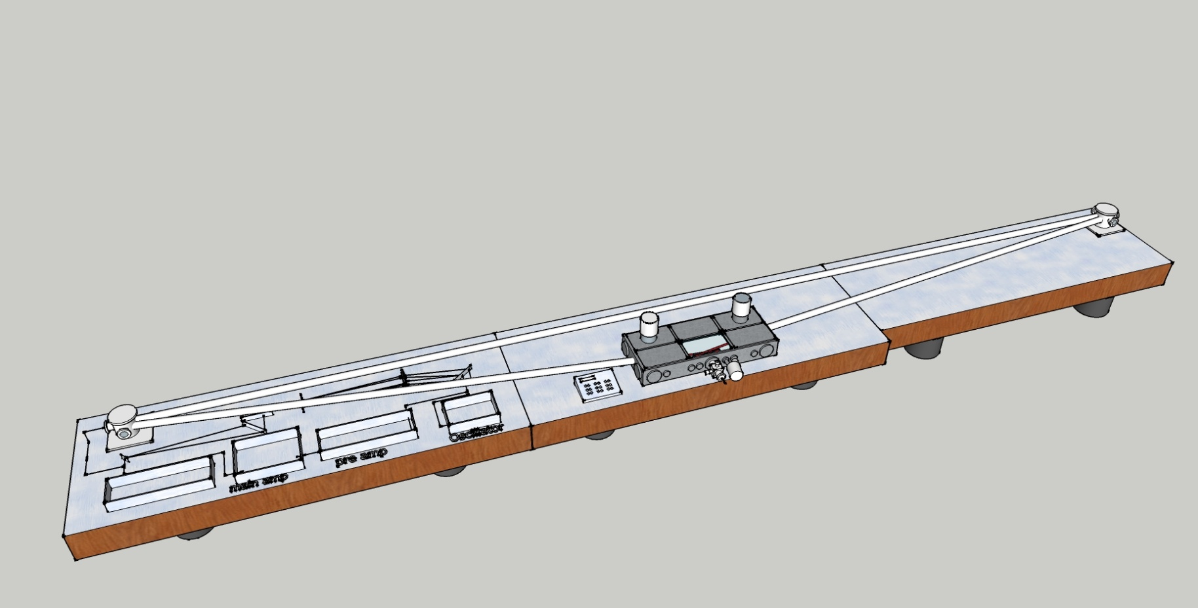
Very long monolithic cavity setup (Finesse~300) for harmonic generation
~17 m
~4.5m
Vibration and sound isolation for external cavity
4-mirrors bow-tie cavity
(30m cavity length➔ 10MHz rep rate)
~15ｍ
~15 m
Ozawa-san, University of Tokyo, Japan. UFO2013/Davos

Slide 14
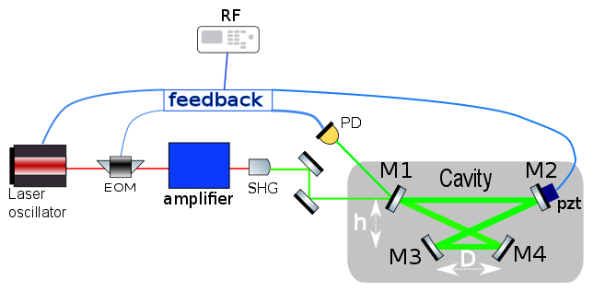
Cavity for the PERLE Facility
  4-mirror cavity of 7.5 m round-trip length
    1 inch mirror diameter
    HR coatings
  40 MHz Yb doped oscillator and fiber amplifier
~2m

Slide 15


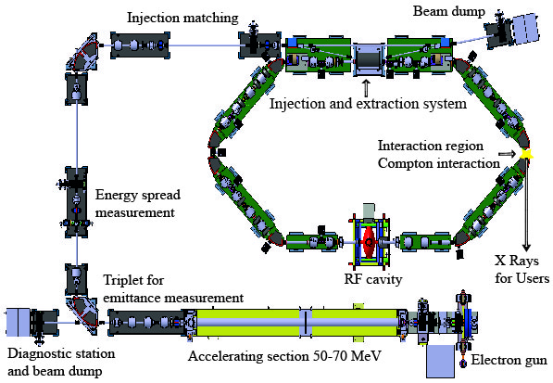







Compact X ray source ThomX machine
Under construction at Orsay
~10m
Optical resonator 37MHz
GOAL:
  10-20ps
  >150W incident power
  Cavity finesse~30000
  ➔goal : 1MW average power
~7m

Slide 16
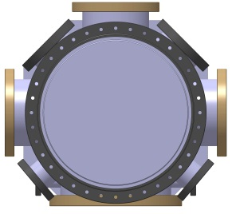
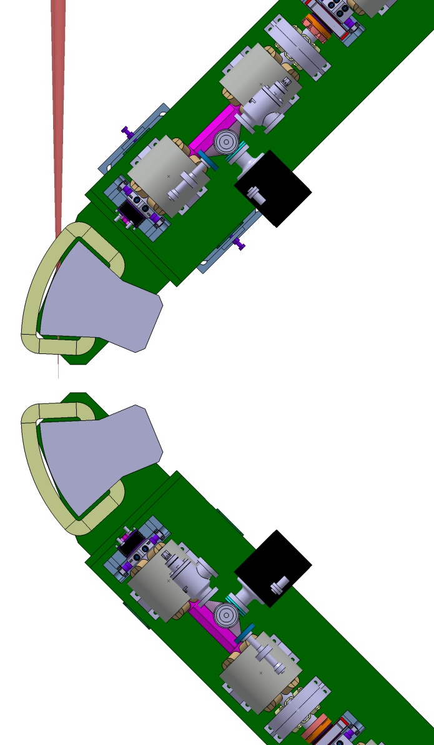
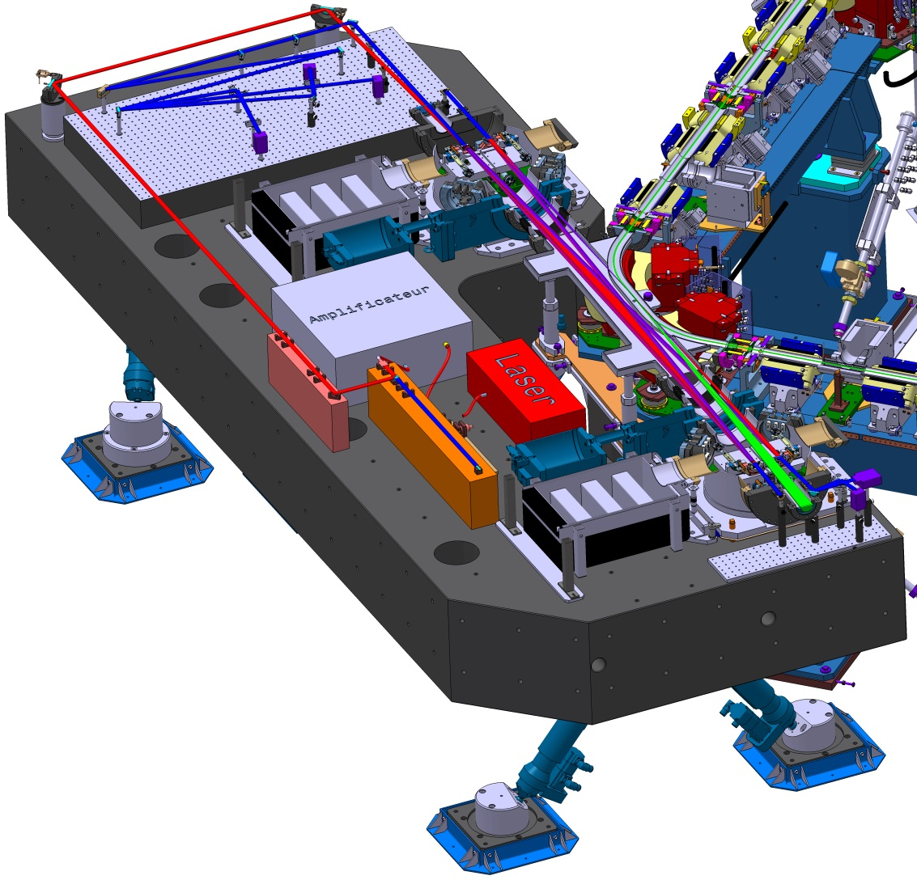
ThomX
  Mechanical stability
  ➔4-mirror cavity
  ➔8 m round-trip
2m
Interaction point

Slide 17
Input laser beam: Configuration 1
‘higher’ finesse / ‘lower’ input power
Configuration for PERLE gamma source :
~same as ThomX project (CELIA, LAL)
R&D going on at LAL and CELIA Labs.
ps master Oscillator
Stretcher
Fiber amplifiers
Compressor
150 W
10 ps
1030 nm
Frequency doubling
Feedback loop
Gain(MAX) ~10000
Fabry Perot Cavity
70 W
7 ps
515nm
E. Cormier (CELIA)

Slide 18
Input laser beam: Configuration 2
‘Lower’ finesse / ’higher’ input power
Fiber amplifiers
Coherent combiner
ps master Oscillator
Stretcher
Compressor
•
N
•
Fiber amplifiers
Frequency doubling
N x 70 W
7 ps
515nm
Feedback loop
Gain(MAX) <10000
Fabry Perot Cavity
E. Cormier (CELIA)

Slide 19
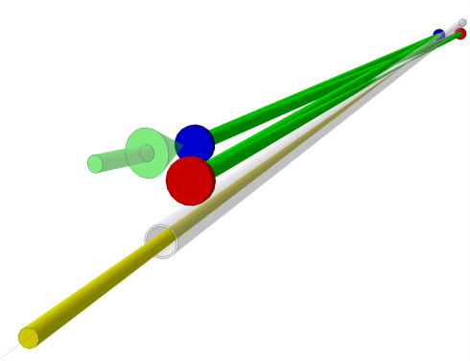
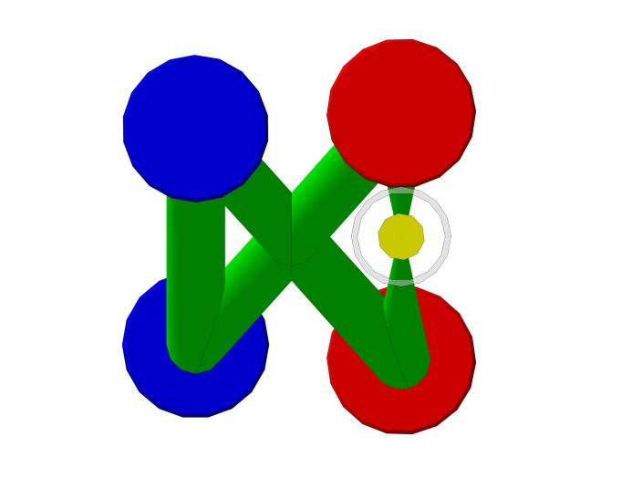
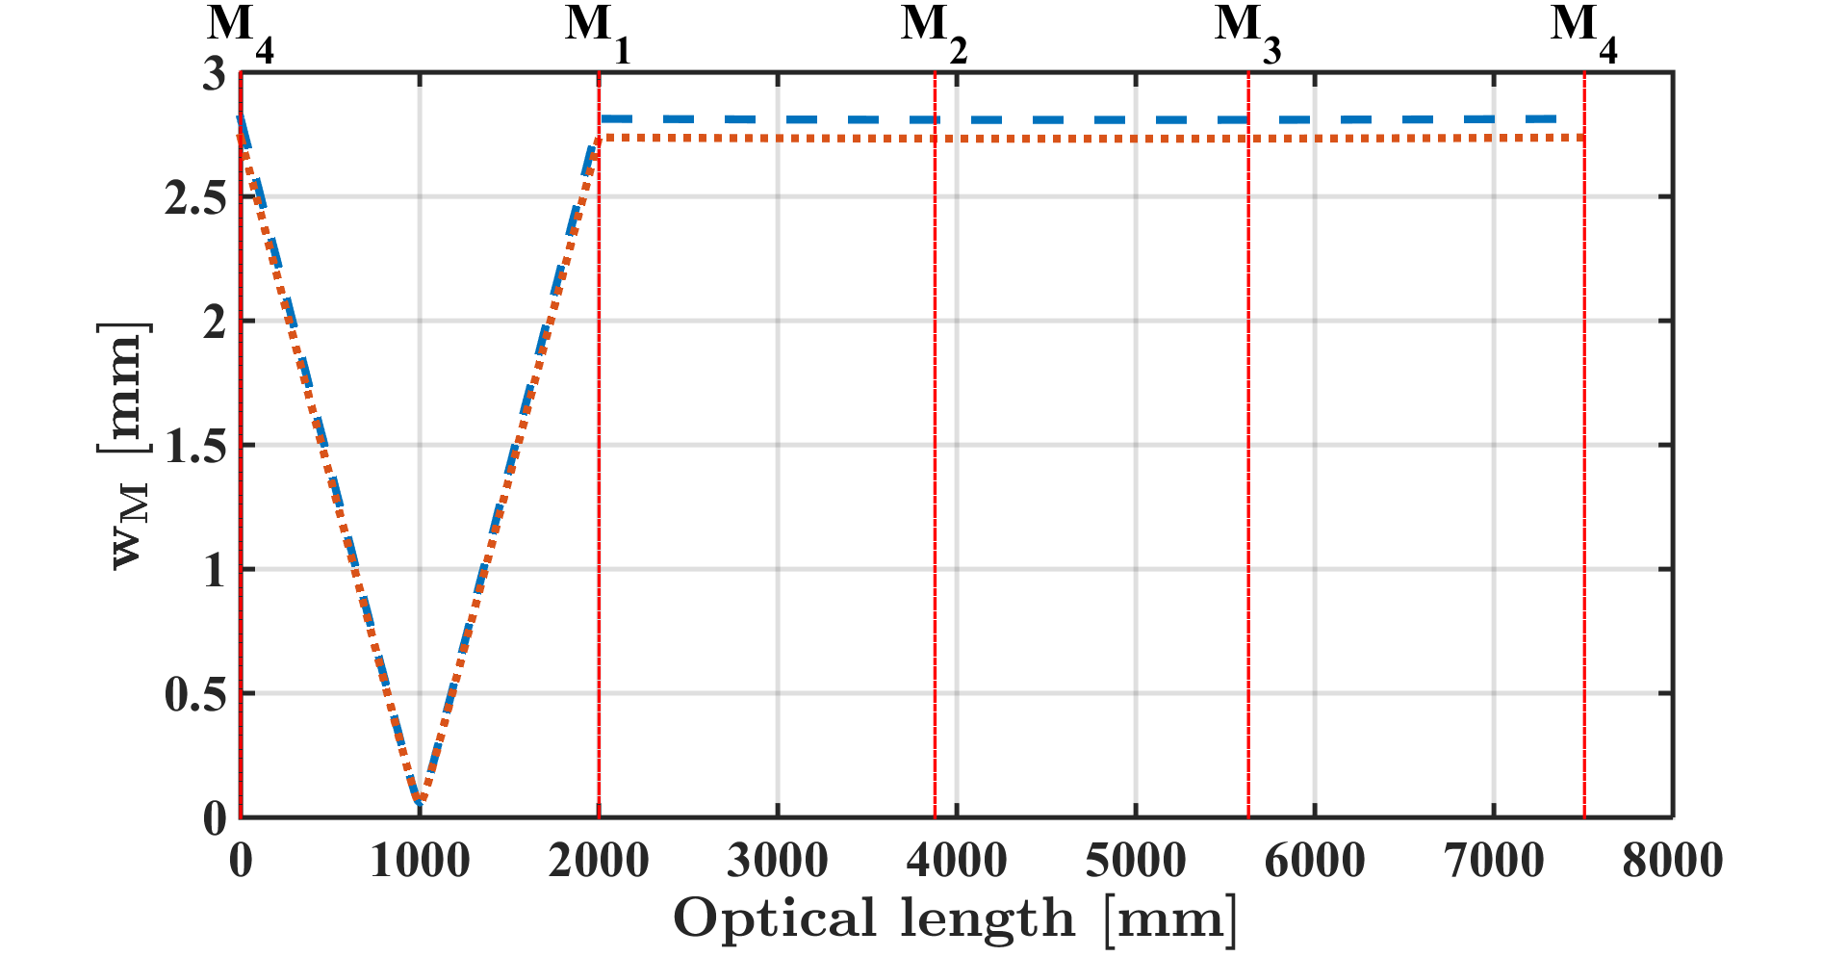
Possible implementation
2 plane
mirrors
2 concave
mirrors
Incident
laser
Gamma beam
Intensity spot size 30 µm
Could be
optimized

Slide 20
Summary
PERLE offers the opportunity to provide gamma ray facility
  Very high flux expected (at least 2 orders of magnitude above expected upgrades of existing facilities)
  Spectral density above existing facilities
Fabry-Perot cavities are suitable to produce this high gamma ray flux
  670kW average power demonstrated (@1040nm…)
  Technology tested on accelerators (e.g. ATF/KEK)
  Various projects are under-way to push the technology at its limits (➔1MW stacked power)
High average power Yb doped fiber mature technology & related techniques mitigate the risks
  Higher/lower cavity finesse ➔ lower/higher input laser average power

Slide 21
Thank you !

Slide 22
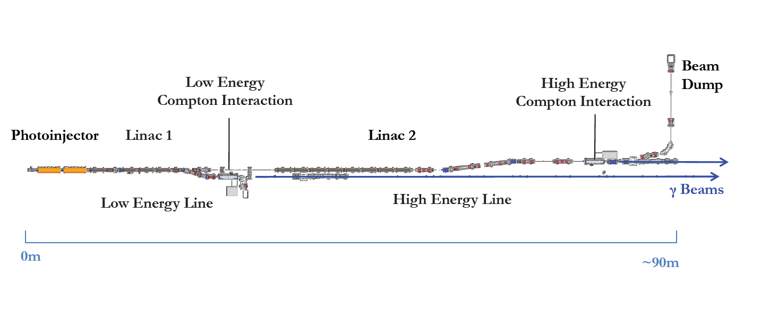
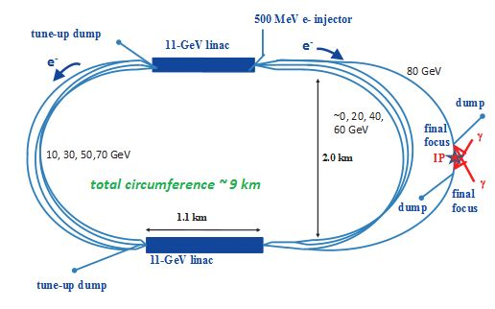
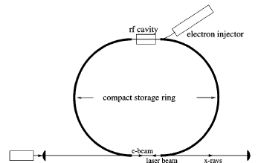
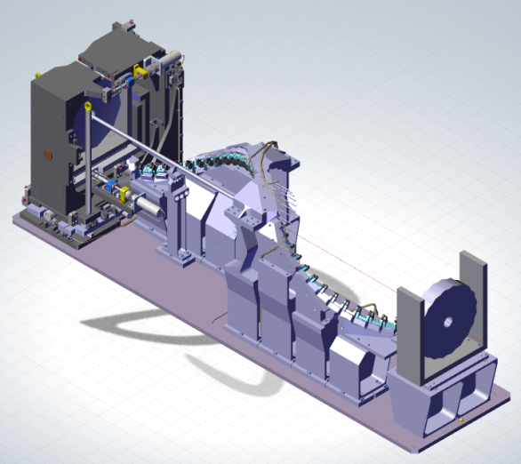
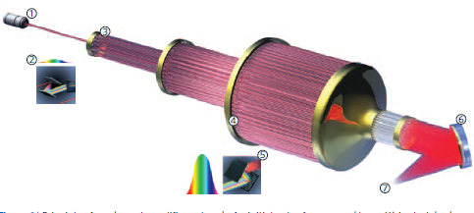


Low frequency e-bunch
trains (~100Hz) & low
nb bunch/train
‘Low’ frequency cw e-beam
(<1MHz)
High frequency cw e-beam
(>10MHz)
e.g. γγ colliders
arXiv:1208.2827
e.g. compact X ray
Compton machines
Huang&Ruth PRL80(1998)977
(Lyncean Co.)
e.g ELI-NP γ ray
‘reasonable’ laser
average power
‘Large’ peak power
➔laser pulse
recirculator
Large average power
1MW
Large peak power
1 TW
Large average power
‘reasonable’ peak power
➔Fabry-Perot cavity
http://www.izest.polytechnique.edu

Slide 23
Applications of Compton scattering: e- + hν → e- + X/γ
Compton X/γ energy threshold for λ_{laser} = 1µm
Posipol R&D (CELIA/KEK/LAL)
E_{X/γ} [MeV]
ELI-NP-GS
(@LAL)
ThomX
(@LAL)
PERLE
E_{e-} [MeV]
~10-1MeV
Low energy applications
Radiography & Radiotherapy
Museology
…
~1MeV-100MeV
Nuclear physics
Nuclear fluorescence
Nuclear survey
Nuclear waste management
…
>100MeV
High energy applications Compton polarimeter
γγ collider
Polarised positron source
…
Notes:
A supprimer ?

Slide 24
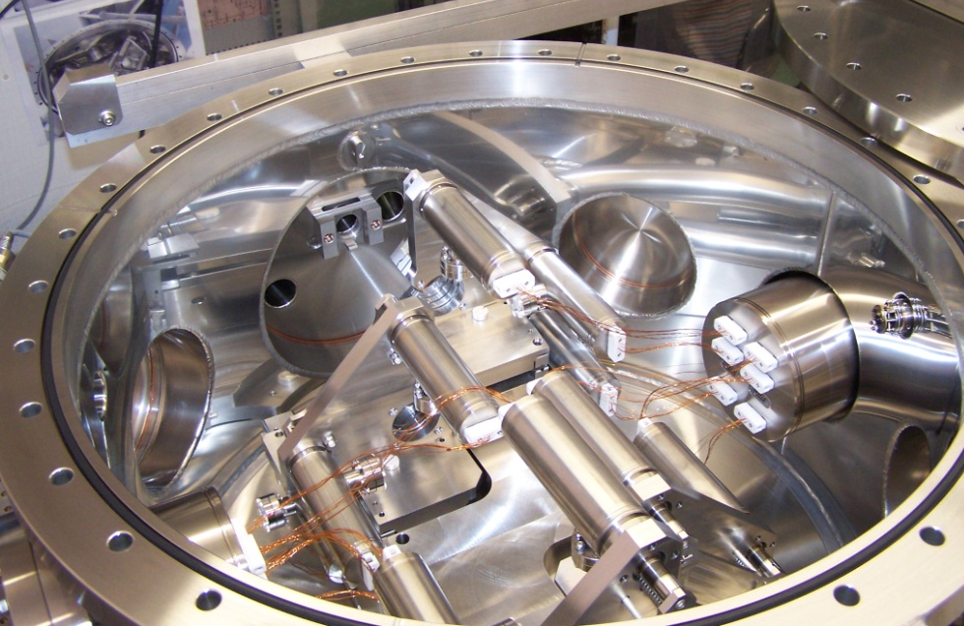
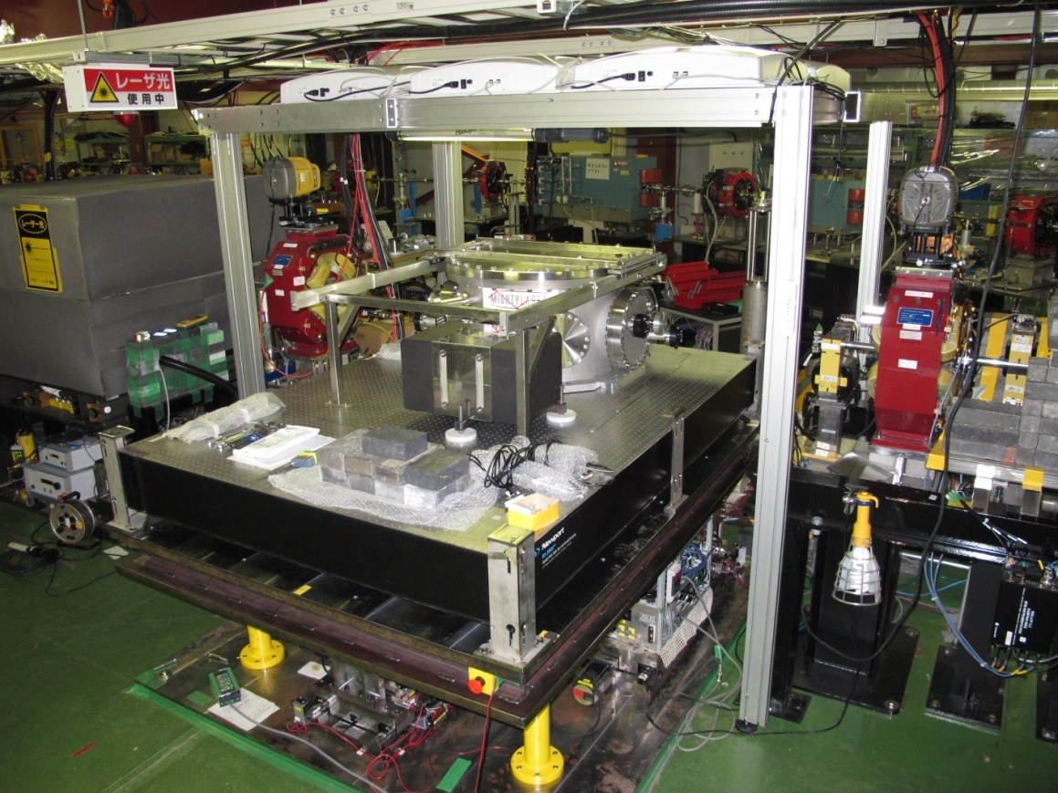
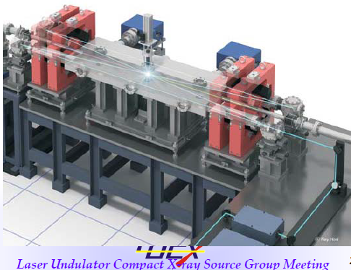
Some of the ATF/KEK 4-mirror cavities
e+ polarised
R&D
LAL/CELIA/LMA/KEK
J. Urakawa KEK
Notes:
A supprimer ?

