Slide 1
Linac beam dynamics
Linac dynamics : C. Bruni, S. Chancé, L. Garolfi,
Rf input :P. Lepercq, M. Elkhaldi
Magnetic field input : C. Vallerand
Laser input : V. Soskov
TL beam dynamics : A. Loulergue, A. Gamelin, C. Bruni, S. Chancé
Mecanics : A. Gonnin, D. Auguste

Slide 2
Outline
General layout of the injection and extraction line
Detail of the linac
Simulation results of the linac
Tracking in the Transfer line
  Proposed improved scheme
Tracking in the Transfer line taking into account collective effetcs

Slide 3
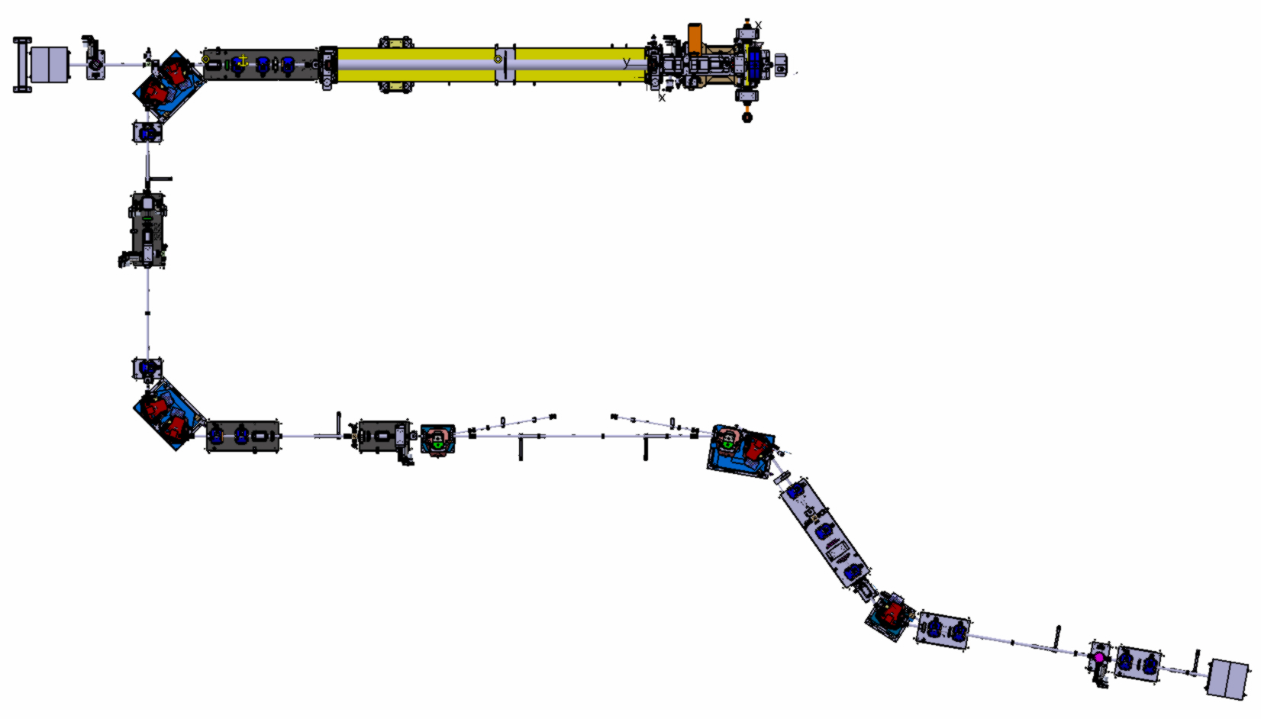
Linac and TL
Straight line
quadrupole
Photo-injector
Solenoids
Accelerating section
To the ring
To the EL/dump
Injection dipole

Slide 4
Linac and TL
Diagnostic station
For emittance and twiss reconstruction
Diagnostic station and scraper
For energy spread and bunch length reconstruction
To the ring
To the EL/dump

Slide 5
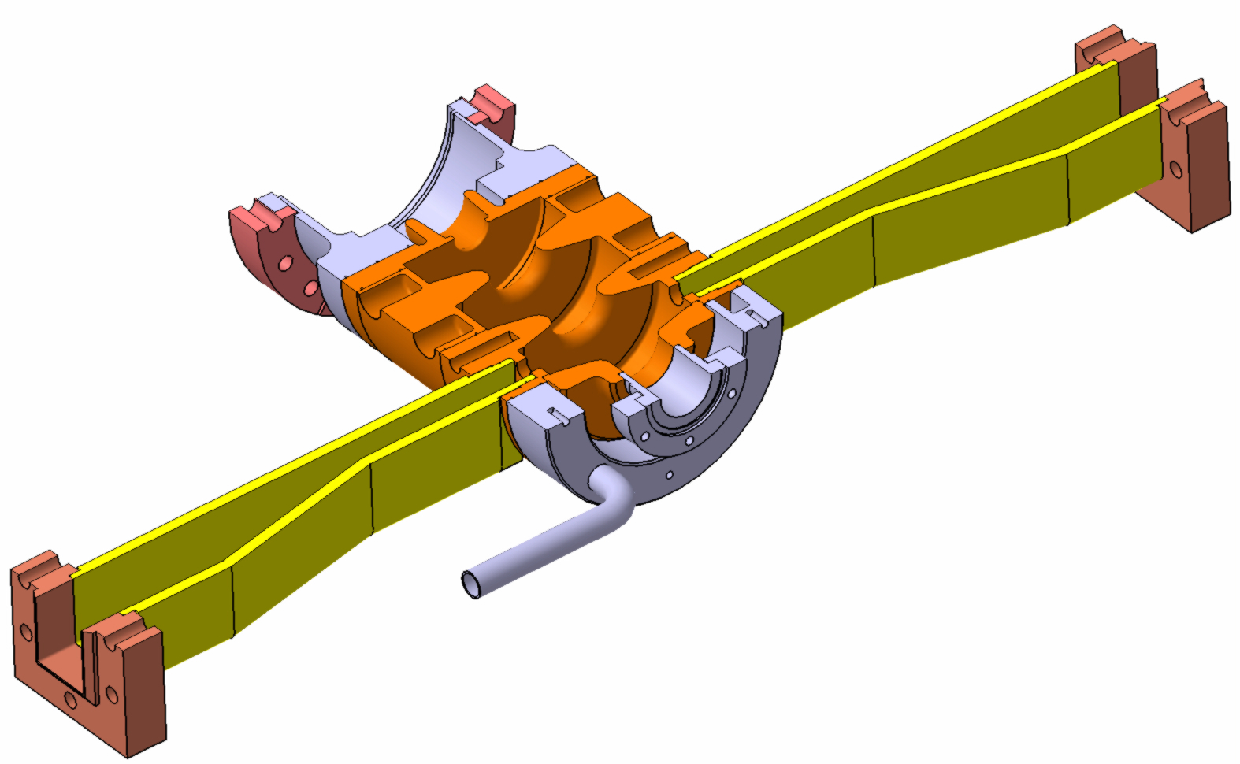
The RF gun – probe gun of CTF3
RF Power
cathode
Frequency | 2998,55MHz
Number of cells | 2,5
Q | 14000
Gradient | 80MV/m
RF Power | 5MW
Coupling Iris
Water cooling
Short cut

Slide 6
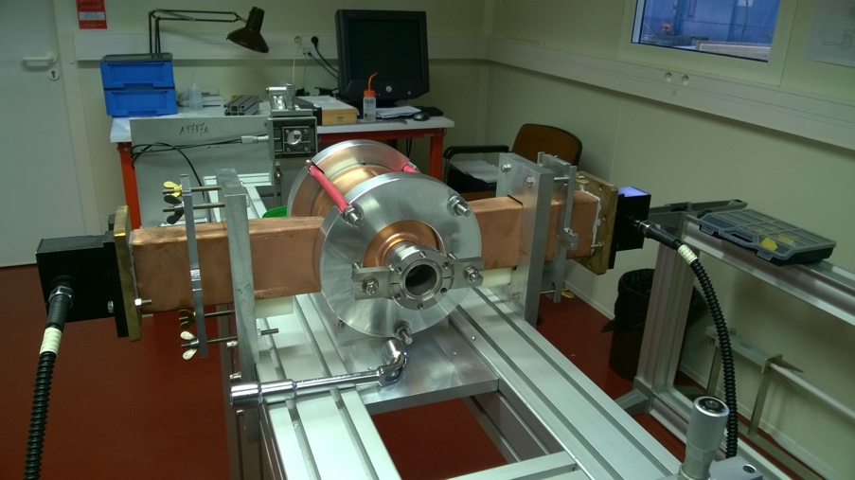
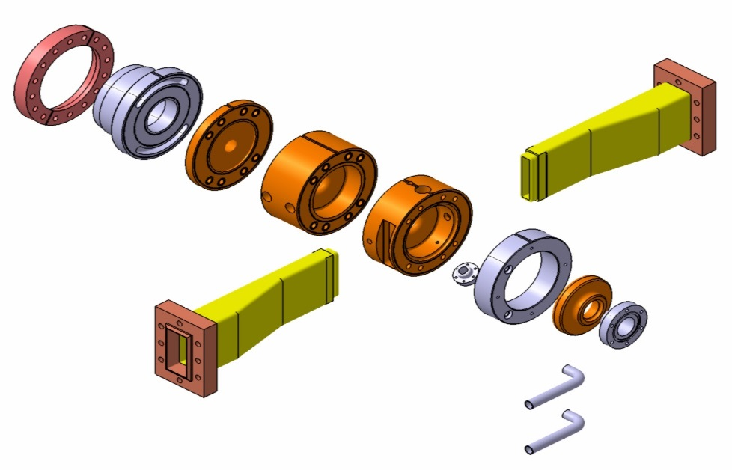
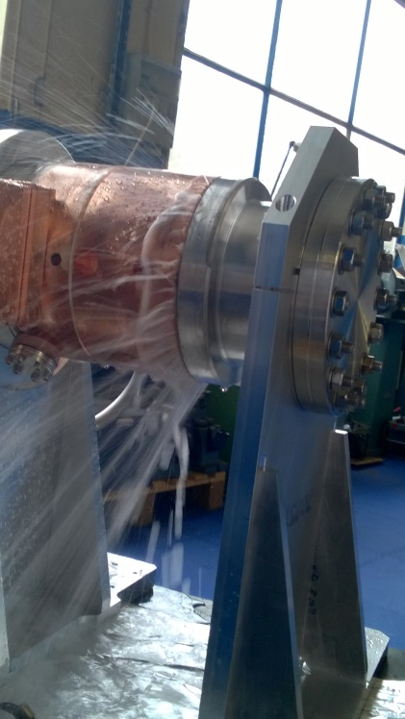
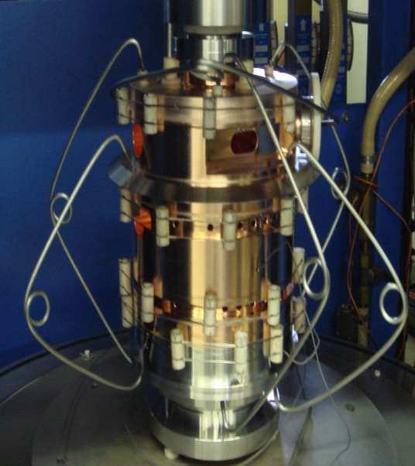
Construction of the RF gun
Low level RF measurement with network analyser
Recovery of coupling, cell diameter, …
Brazing of the pieces copper/copper et copper/inox
Gun 1 | Air leak
Gun 2 | Water leak due to re-use of gun 1
Gun 3 | Brazing done, ready
Gun 4 | Wrong electric contact

Slide 7
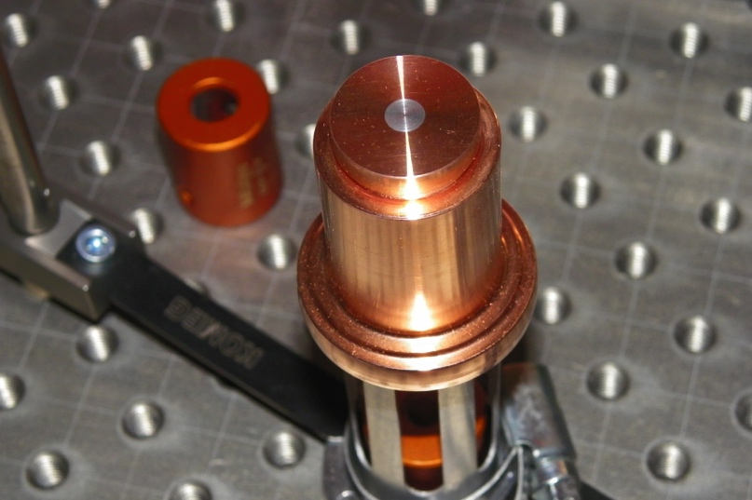
Photo-cathodes
Magnesium to reach the nominal charge of 1 nC
  Less drawback than CsTe cathode
  Need to clean the cathode surface with the laser
  Measures done on PHIL test line
  Copper for the begining of the commissioning phase (Run @ 100 pC)

Slide 8
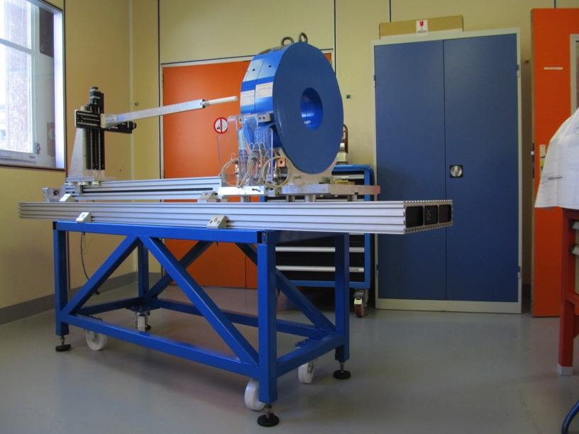
Solenoids
Agreement between measurement and simulations
Measurement : linear behavior

Slide 9
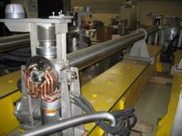
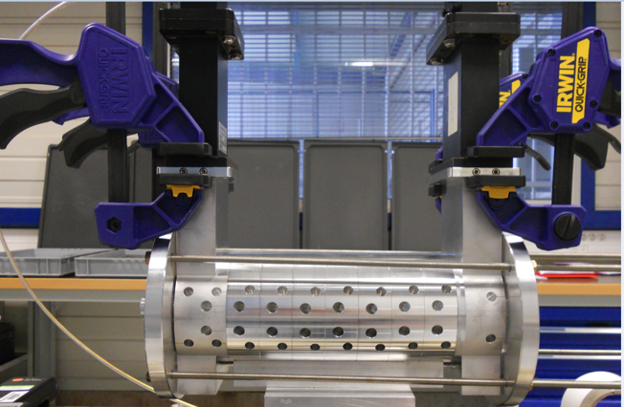
Accelerating section
 | LIL (lend by SOLEIL) | LAL/PMB In progress
Frequency | 2998,55MHz
Cell number | 135 | 96
length | 4,5 | 3.2m
Gradient | 14MV/m | 20.5MV/m
RF Power | 12MW | 22MW
Mechanical tolerance problem for the prototype in Aluminium
Copper prototype foreseen for may 2017

Slide 10
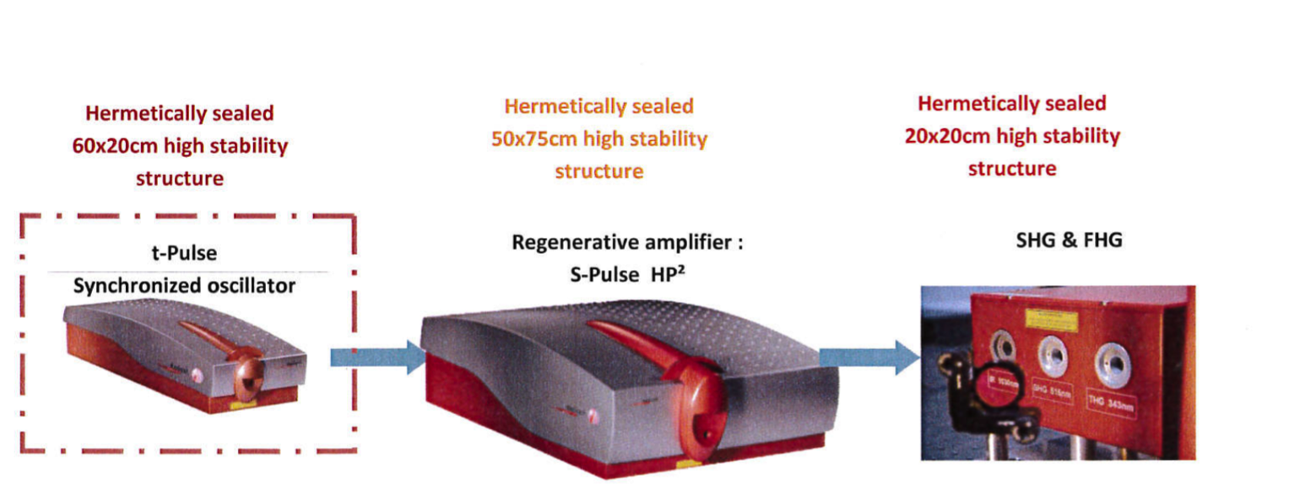
Laser illuminating the cathode
Directly diode-pumped Ytterbium laser (Yb:KGW) from amplitude technologie
Energy in IR (1030 nm) | 2mJ
Repetition rate | 1-100 Hz
Energy in UV (258nm) | 200μJ
Pulse duration | 4-9 ps FWHM
Synchronisation jiter | <300 fs rms

Slide 11
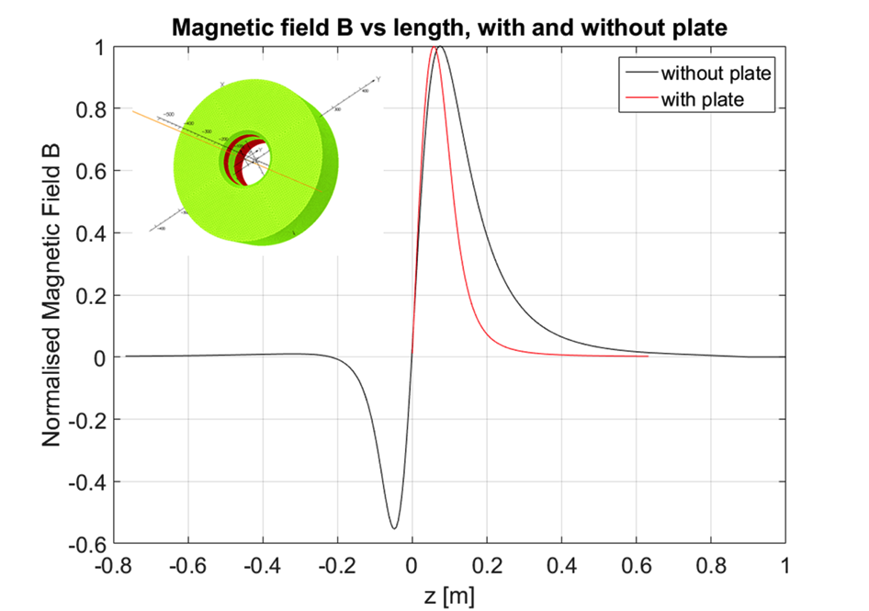
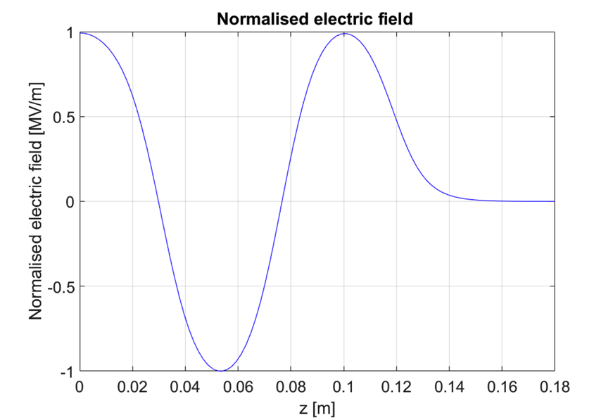
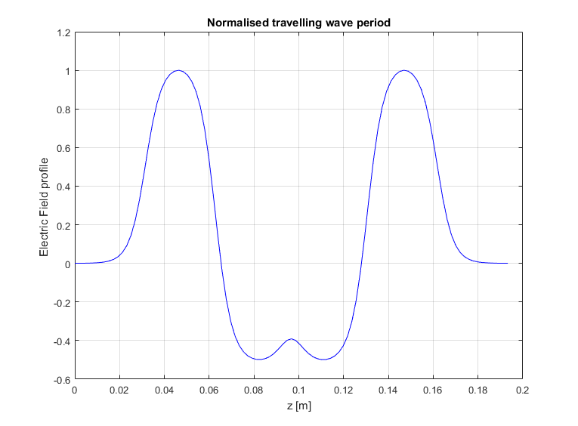
Astra simulations of the linac
gun
LIL
z = 0
z = 6 m
11

Slide 12
Ideal case of the TDR
Transverse dimension | 2.1mm
Bunch length | 4ps
Energy spread | 0.46%
emittance | 3.2 pi mm mrad
Laser profile not achieved
Assumption in the solenoid and RF field
New simulations with
- opera solenoid profile
- Superfish RF field for Gun and LIL
- gaussian laser profile of the laser

Slide 13
Emittance and energy spread « preservation » for 1nC
Constraints : energy spread for ring injection, emittance for Compton interaction
Laser duration | 4ps |  |  | 2ps
Laser transverse dimension | 0.6mm | 0.5mm | 0.4mm | 0.6mm | 0.5mm
Transverse emittance (pi mm mrad) | 8 | 6 | 5 | 7 | 5
Transverse dimension (mm) | 3 | 3 | 2.5 | 3 | 3
Energy spread (%) | 0.55 | 0.65 | 1 | 0.45 | 0.65
Bunch duration (ps) | 4.5 | 4.8 | 5.7 | 3.5 | 4
- Need to increase the laser transverse dimensions to decrease the electronic density of the electron beam at the cathode at the expense of the transverse emittance
- Need to decrease the bunch length to decrease the energy spread

Slide 14
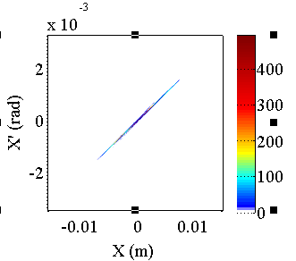
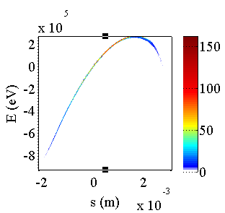
Consequence on the optics
Strong beta and alpha function at the end of the linac
(2ps/ 0.6mm)

Slide 15
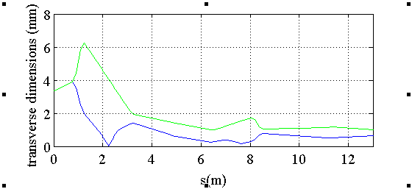
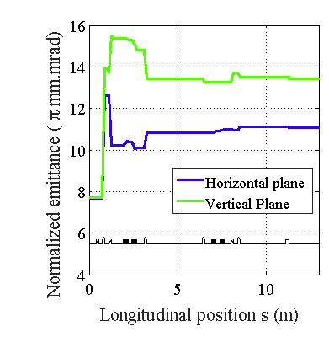
Consequence on the transfer line
Emittance blow up due to chromatic and large beam size
Tracking of the ouput distribution from astra without collective effects
Possibility to reduce with half charge scraping

Slide 16
How to reduce the optical function
The solenoid focuses strongly the electron beam at 5cm when the beam is at least at 2MeV
- the transverse field of accelerating cavities of the section due to divergence and transverse size « generates strong beta functions»
Proposed cure : move and add a solenoid

Slide 17
Move the focusing solenoid after the gun
TDR case
Ideal position should be roughly at 15cm, by just moving the focusing solenoid
  but the mechanical contraints of the gun (wave guide and water) disable such a configuration
The focusing solenoid can be moved at 23cm, which is far for the emittance compensation
But reduced the beta function
As a consequence two solenoids at 5cm and 23 cm are necessary

Slide 18
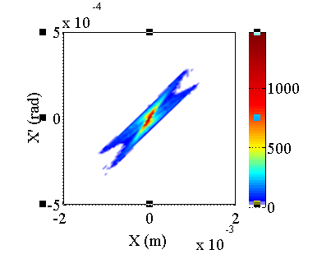
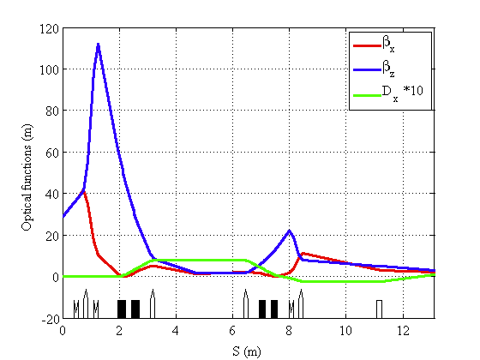
2 focusing solenoids
Transfer line
LINAC

Slide 19
2 focusing solenoids
Input
β=30m
α=-7.5
ε=6pi mm mrad
ΔE/E=0.45%
Output
ε=7pi mm mrad
ΔE/E=0.4%
στ=6ps
Transfer line

Slide 20
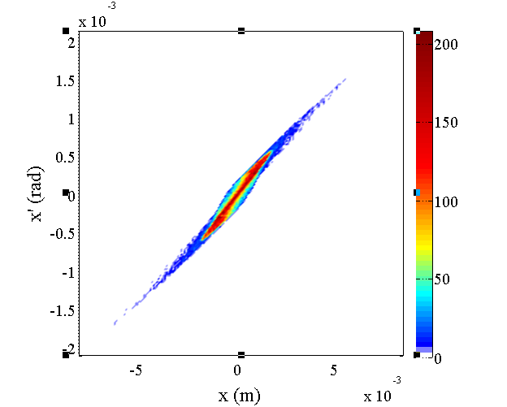
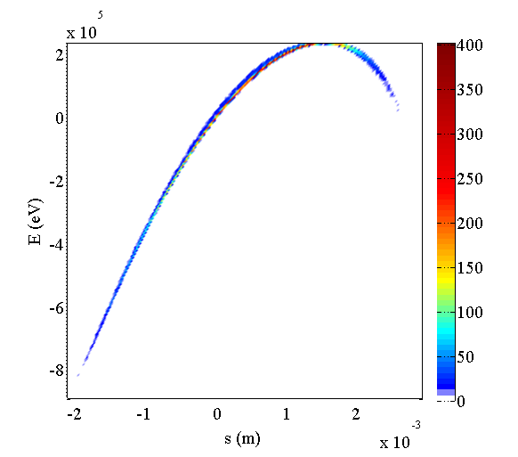
Focusing solenoid placed at 23cm
Linac
β=18m
α=-5.3
ε=10pi mm mrad

Slide 21
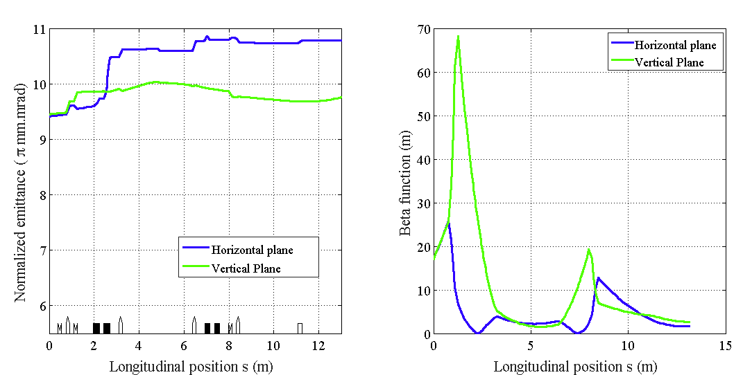
Focusing solenoid placed at 23cm
Transfer line
Tracking with collective effects

Slide 22
Conclusion
Components of the linac are well known thanks to expert participation in each steps and confrontation of theory and measurement
Start to end simulations from the cathode to the ring entrance
Strong emittance dégradation and charge scraping in the transfer line in the nominal configuration of ThomX linac
Solutions have been fund to avoid emittance dilution in the Tranfert line while keeping reasonable energy spread
  To be checked if it is possible with all the actors
Many thanks to all the contributors

