Slide 1
Diagnostics for ThomX
Nicolas HUBERT, Marie LABAT, Moussa EL-AJJOURI, D. PEDEAU, Synchrotron SOLEIL
Iryna CHAIKOVSKA, N. DELERUE, LAL

Slide 2
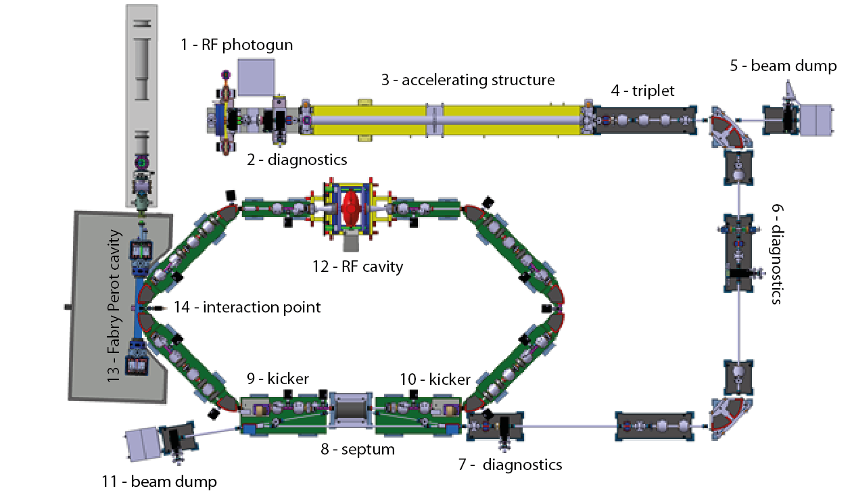
Diagnostics for ThomX (outline)
Charge
Position
Diagnostic stations
Length
Stripline for transverse feedback
Losses

Slide 3
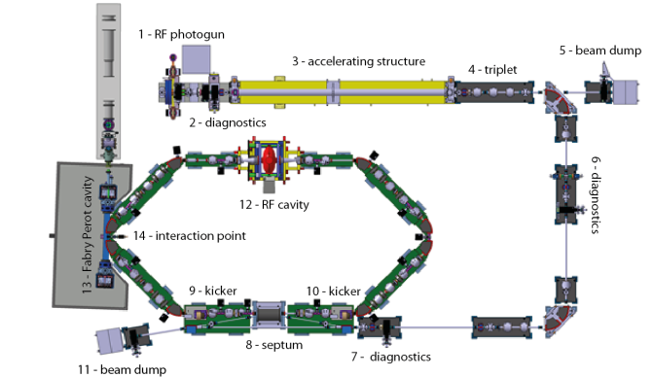
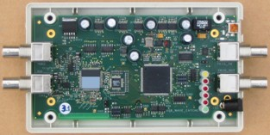
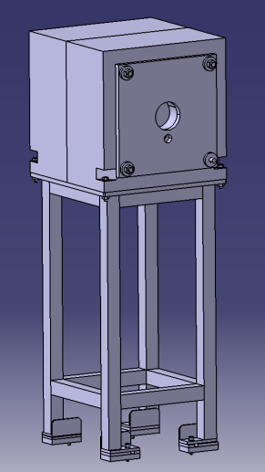
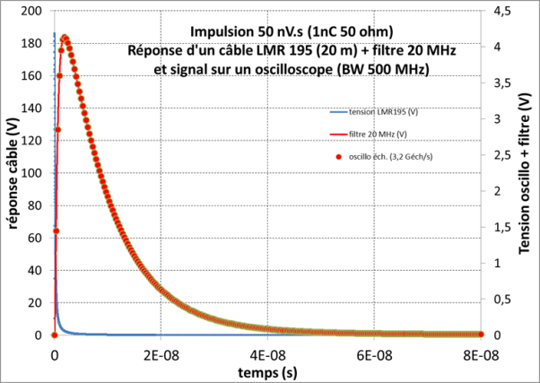
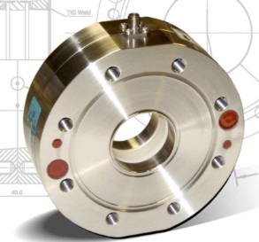
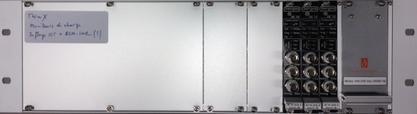
Charge measurement
3 integrated current transformer (ICT)
  Location:
    @ LINAC entrance
    @ Linac exit (before first TL bending magnet)
    @ Transfer Line (between the 2 bending magnets)
  Type:
    In-flange integrating current transformer from Bergoz
    Dedicated electronics BCM-IHR provides analog voltage proportional to the beam charge
    Acquisition to be integrated in the control system
2 Faraday cups (FC)
  Location: in the beam dumps
    @ the end of Linac (behind first TL bending magnet)
    @ the end of extraction line
  Acquisition:
    Few tens of ns pulse to be acquired synchronously to injection or extraction trigger
    Use of Low Pass filtering and acquisition with the Wavecatcher board ( BW 500 MHz; 3.2 Gech/s)
    Tango device ready
Mechanics delivered
Acquisition defined
Mechanics and electronics delivered
Electrical test
Acquisition to be defined
In-flange ICT & Electronics
Wavecatcher
Low-pass filtered signal
Beam dump

Slide 4
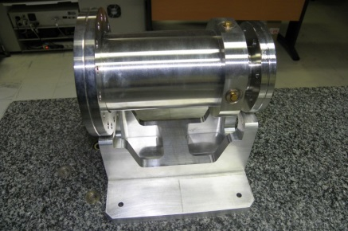
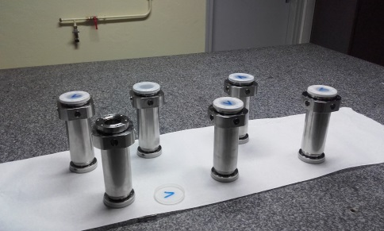
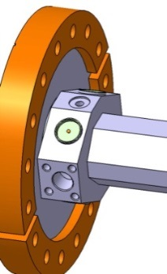
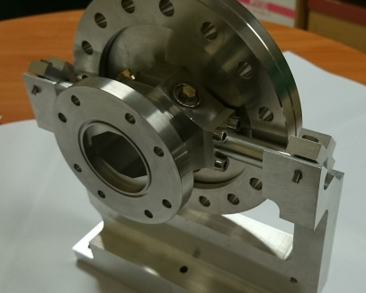
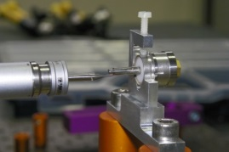
Position measurement (BPM)
Mechanics
5 Striplines for Linac and Transfer Line
12 button BPMs for the storage ring
LINAC
LT
  Design, mechanics and soldering (feedthroughs) are done at LAL
Ring (prototype)
  Prototype done at LAL
  Mechanics and soldering are done by RIAL Vacuum, to be delivered in spring
Feedthrough
Design
Manufacturing
Feedthrough welding
Electrical test
Design
Manufacturing
Feedthrough welding
Electrical test
Design
Prototyping
Manufacturing
Feedthrough welding
Electrical test

Slide 5
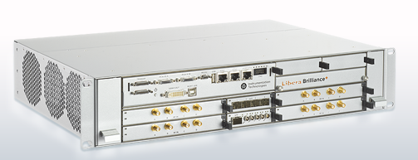
Position measurement (BPM)
Electronics
Libera Brilliance+ (Instrumentation Technologies)
  4 BPM boards per crate
  Data Flow:
    Single Pass for Linac and Transfer Line
    @ 8,33 MHz (half rev. freq.) ~turn by turn data for storage ring
    @10 Hz slow acquisition data for storage ring
  Automatic gain control
  Post-mortem and interlock possibilities
  Tango device available and fully configurable embedded on the ARM processor
Libera Brilliance +
Design (adaptation)
Manufacturing
Reception tests (more than one year…)

Slide 6
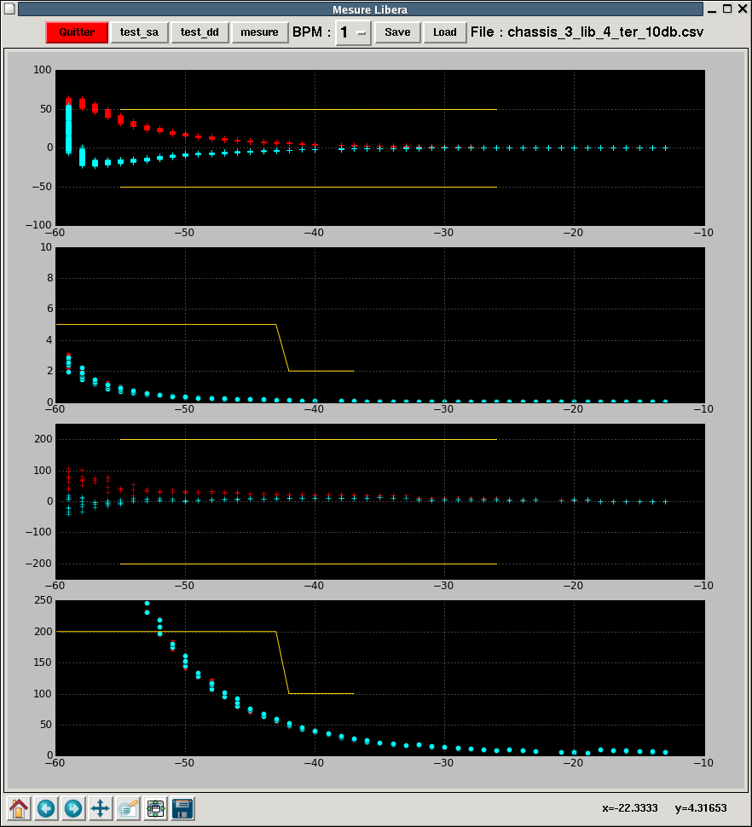
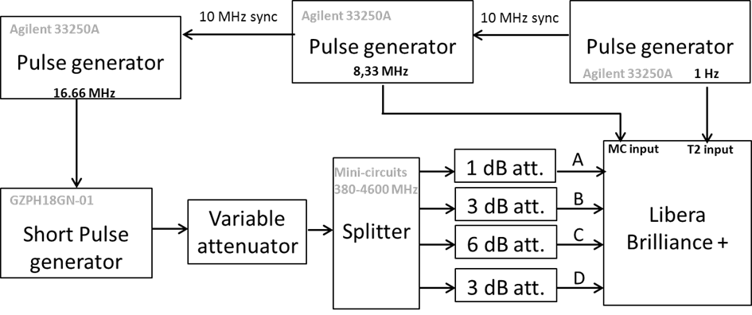
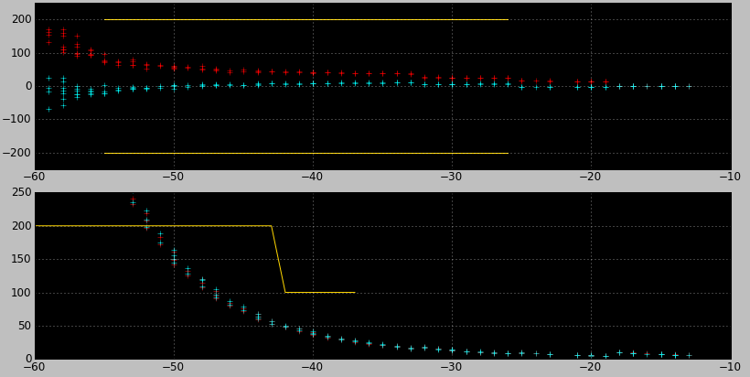
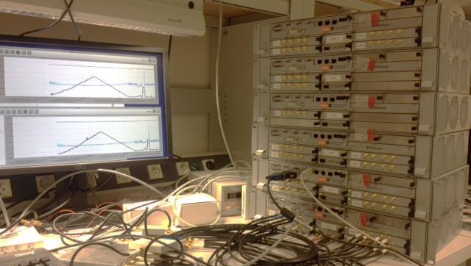
Position measurement (BPM)
Electronics
Beam current dependence
Specification
µm
Slow Acquisition Data
ThomX working point
Standard deviation
(100 samples)
Acceptance tests
µm
Input level (dBm)
Beam current dependence
Turn by Turn Data
ThomX working point
Standard deviation
(10 ksamples)
Test bench for acceptance test
Single Pass Data
Input level (dBm)
Beam current dependence
Specification
Standard deviation
(10 ksamples)
Specification

Slide 7
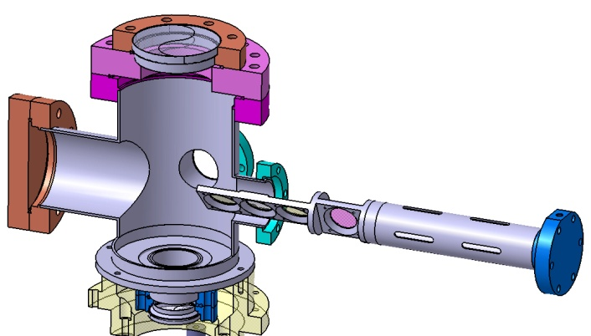
Diagnostic stations
Location
  On Linac and transfer lines
Purpose:
  Beam size, emittance and energy measurement
Principle:
  Screen translation stage
    Calibration plate
    YAG (Ce): 25 mm diameter, 100 µm thick
    OTR : 25 mm diameter, 100 µm aluminised silicon wafer
    Sapphire screen (station 2 @ end of Linac)
  View port: Fused Silica DN 60 CF
  Imaging system
  Gigabit Ethernet trigged CCD
Screen translation stage
Design
Screens are delivered
1 translation stage is ready, the others to be ordered

Slide 8
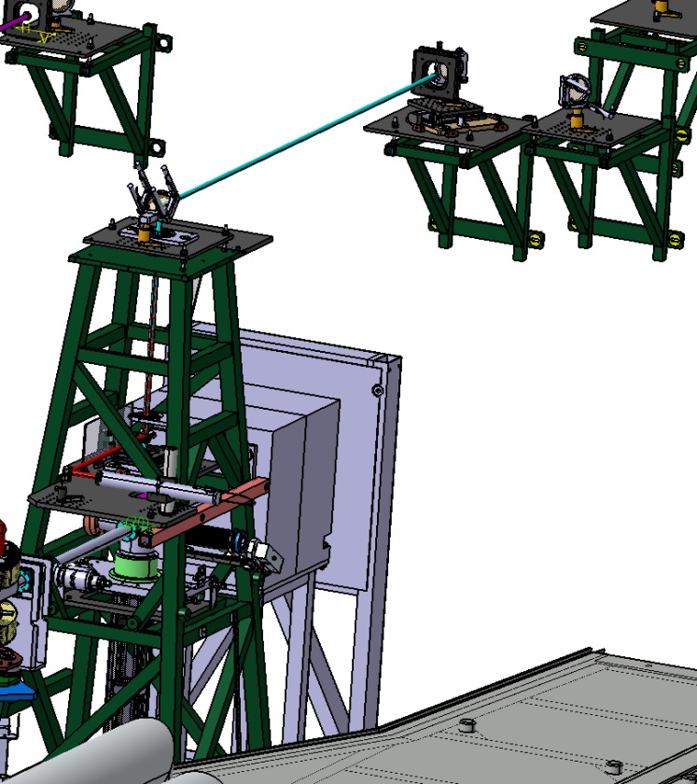
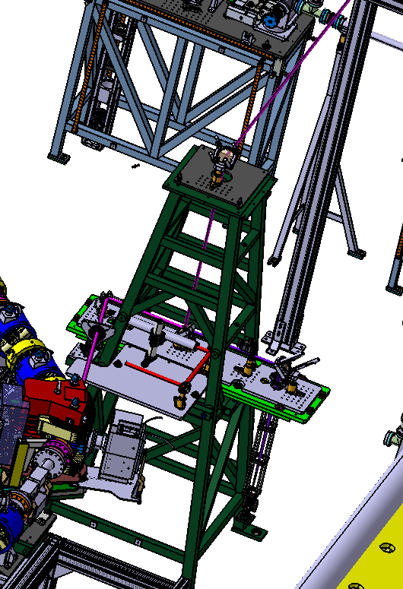
Bunch length measurement
End of Linac:
  Cherenkov radiation produced when the electron beam passes through the sapphire screen
  Sapphire window to extract light
  Transport the radiation to a streak camera to measure the photon pulse length. @ a SR dipole
Storage Ring:
  Synchrotron radiation produced when the electron beam changes its trajectory in the bending magnet
  Sapphire window to extract light
  Transport the radiation to a streak camera to measure the photon pulse length. @ a SR dipole
SR extraction port

Slide 9
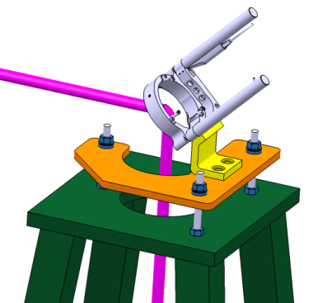
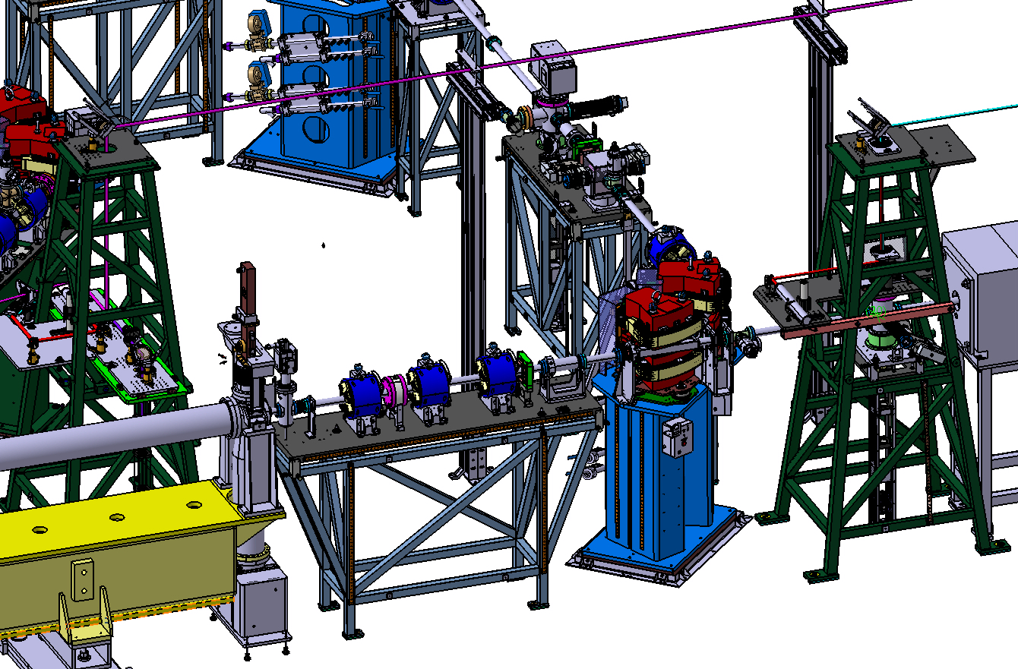
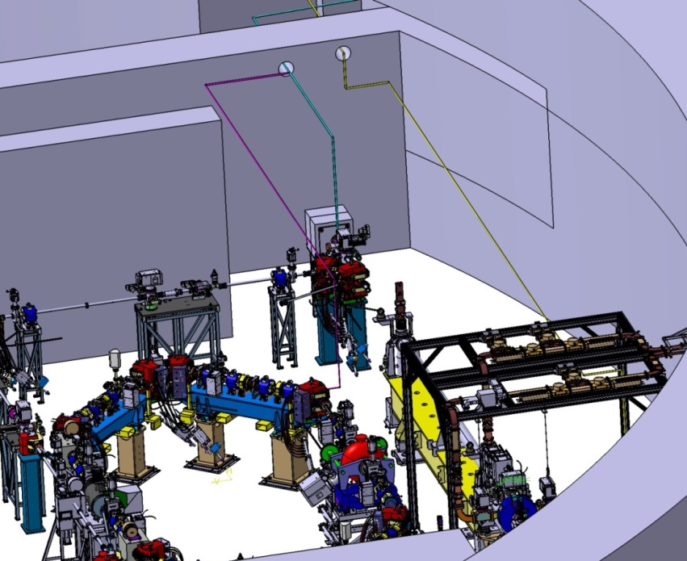
Bunch length measurement
Mirror support
Streak camera in house and tested on PHIL
Transport design almost ready, final height depending on slab roughening
Complex transport path
Precise alignment and high stability required

Slide 10
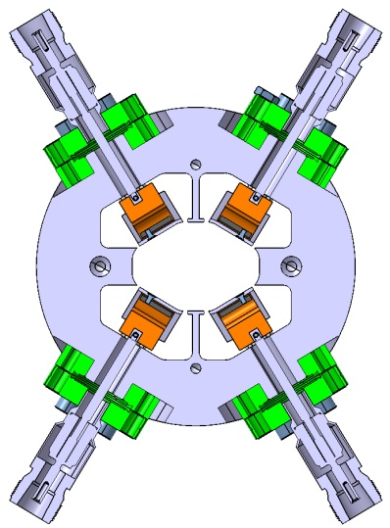
Transverse feedback
Detector:
  One set of additional button from BPM
Actuator
  Stripline (kicker)
    Electrode length: 300 mm
    4 electrodes for acting in H and V planes
    Rise time < 1 ns
Design main steps:
  Characteristic impedance
    Geometric factor
    S parameters
  Shunt impedance
    Efficiency
  Wakefield/Beam longitudinal impedance
  Thermic studies
Simulations and design
Drawings
Consultation
Manufacturing
Reception tests
FBT stripline

Slide 11
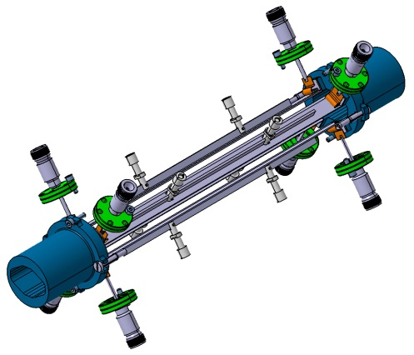
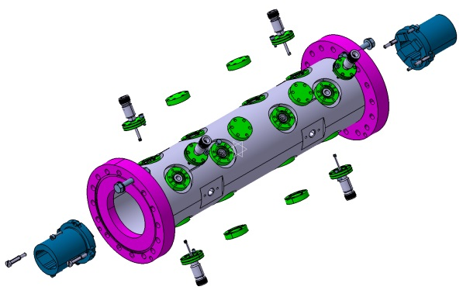
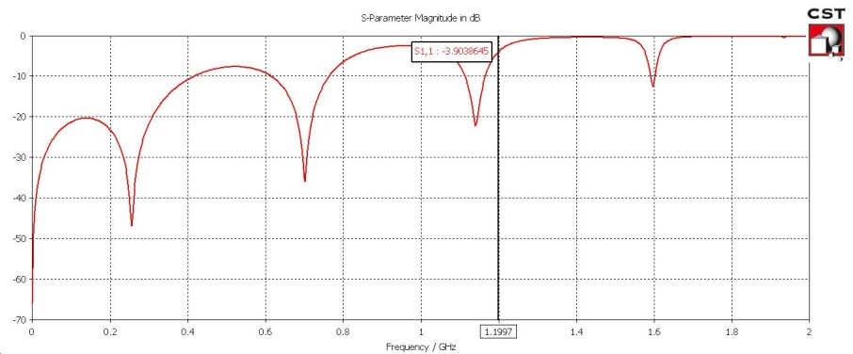
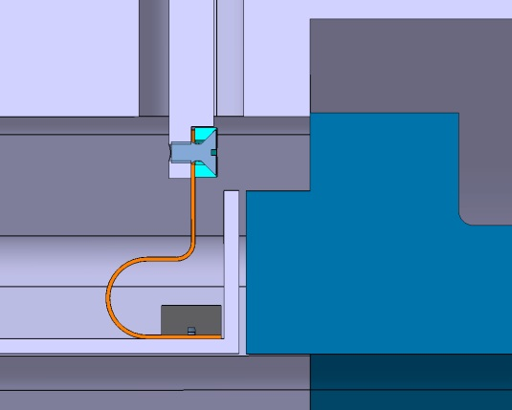
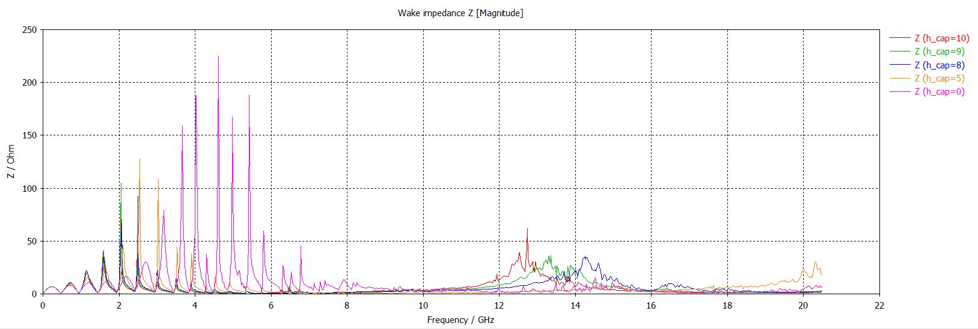
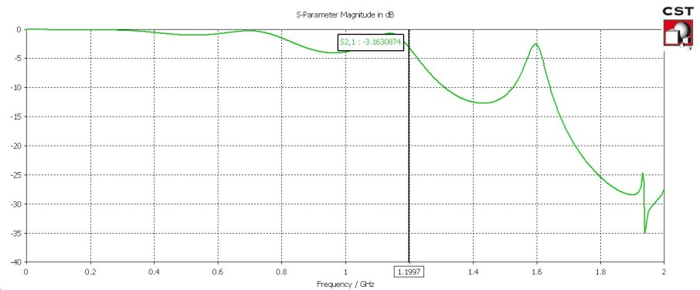
Transverse feedback
Stripline
Reflexion
Transmission
Longitudinal impedance minimization
Stripline Adaptation (Characteristic impedance)

Slide 12
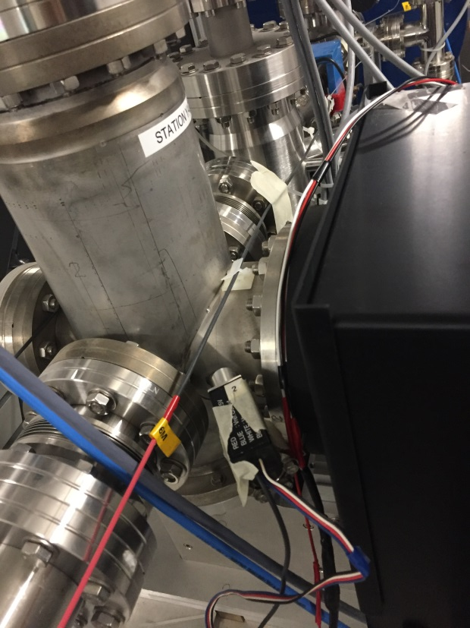
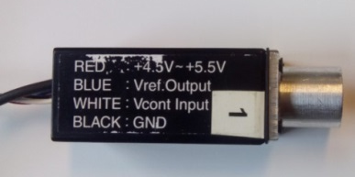
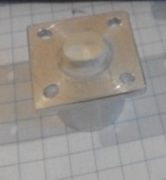
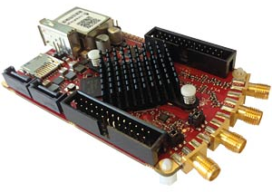
Beam Loss Monitors
Fiber Beam Loss Monitor (FBLM)
  1 fiber for the LINAC, 1 for the TL, 4 for the SR and 1 for the EL.
  The choice of the fibers and PMTs are made, the order to be passed before the end of the year/beginning of 2017. The controller for the DAC to control remotely the PMT gain: the order to be passed at the beginning of 2017.
  DAQ: Wavecatcher + Scope for the SR (to be ordered at the beginning of 2017) => inside crate Diag 5 and 6.
  Beam test @ PHIL: Wavecatcher and its Tango DS have been successfully tested with the FBLM.
Scintillators coupled to the PMT to monitor the local losses (e.g. @injection)
  A few assemblies will be prepared to be used during the commissioning and operation.
  CsI(Tl) + PMT: Scintillator is available, PMT and controller for the DAC will be ordered at the same time as for the FBLM.
  DAQ: RedPitaya card (Tango DS is ready) is under the test => inside crate Diag 5 and 6.
  The assembly has been tested using the scope with the radioactive sources and with the beam @ PHIL.
@PHIL
CsI(Tl) + PMT
Red Pitaya

