Slide 1
Understanding Sun-NP Data
Santanu Das

Slide 2
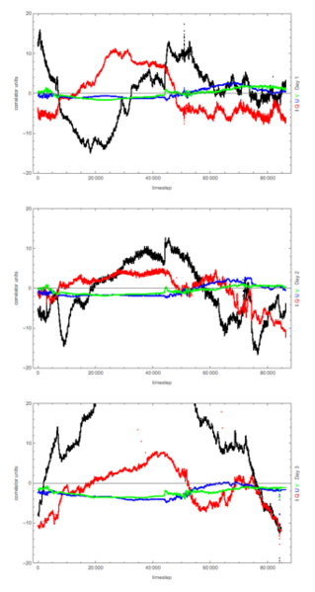
NorthPole_20160513184533_20160516181643
Albert’s plot last day
I = XX + YY
Q = XX - YY
U = 2 Re XY
V = 2 Im XY
Black and Red has some random feature
Green and Blue has some feature which is getting repeated everyday
Albert’s hypothesis was that may be some signals are getting reflected on ground or somewhere (may be on the dish in front of those).

Slide 3
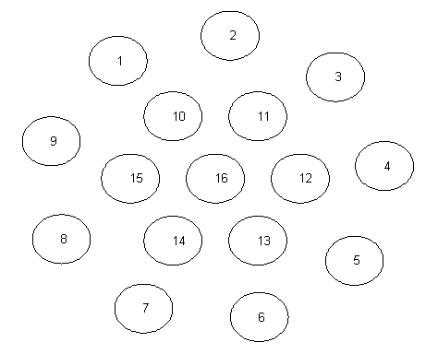
Rough position of the Dishes
According to data given in the Wiki
http://tianlai.bao.ac.cn/wiki/index.php/Position_of_dishes_and_cylinders_antennae#The_theory_data

Slide 4
V = P * exp( i φ)
Where P is the absolute value of the visibilities. If the array were calibrated we would expect P to be the same for each and every visibility. The information is all in the phase phi.
φ = 2*π* δ / λ
δ = path length difference between the 2 dishes.
When the sun is overhead (and approximating its path as strictly east-west), the path difference is
δ = 8.8 meters * sin(ɵ)
ɵ is the angle of the sun relative to the zenith. So, when the sun is overhead, an angle change in the position of the sun of 0.028 radians will produce a phase shift of 360 degrees.
It would happen at approximately 10 minute intervals.
John’s Calculation

Slide 5
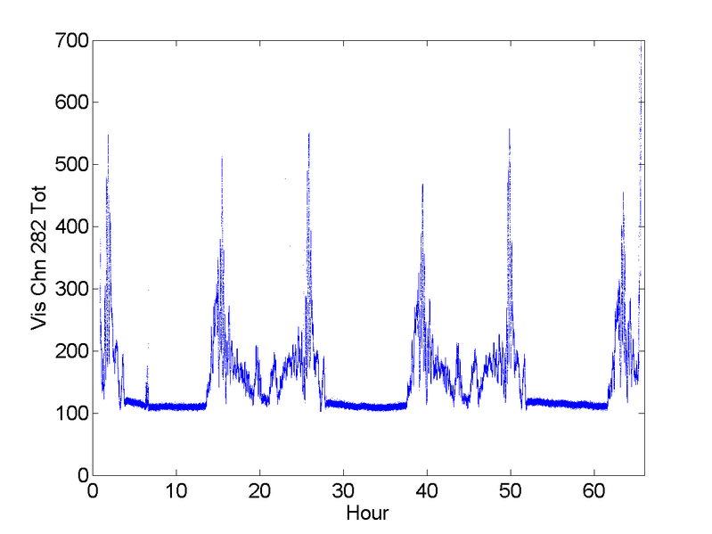
Sun-NorthPole Data
275 - (25,27)
295 - (29,31)
320 - (19,21)
282 - (26,28)
302 - (30,32)
329 - (20,22)
Everyday during daytime same kind of pattern is getting repeated.

Slide 6
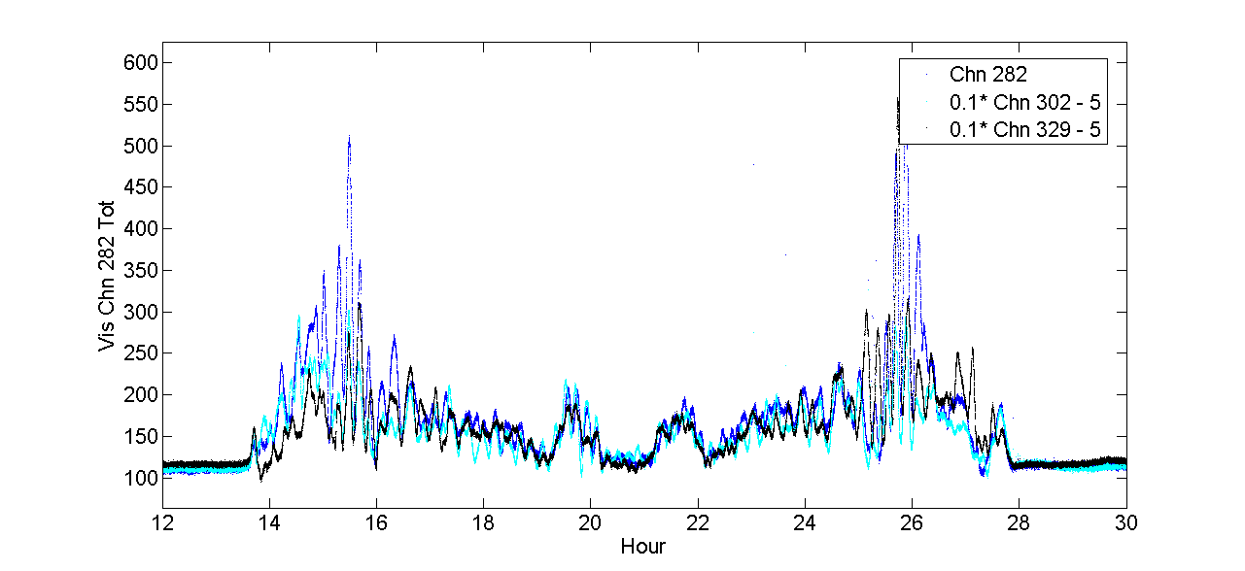
Sun-NorthPole Data
275 - (25,27)
295 - (29,31)
320 - (19,21)
282 - (26,28)
302 - (30,32)
329 - (20,22)
Amplitudes for three channels. Almost superimpose over each other. (With some scaling and bias term)

Slide 7
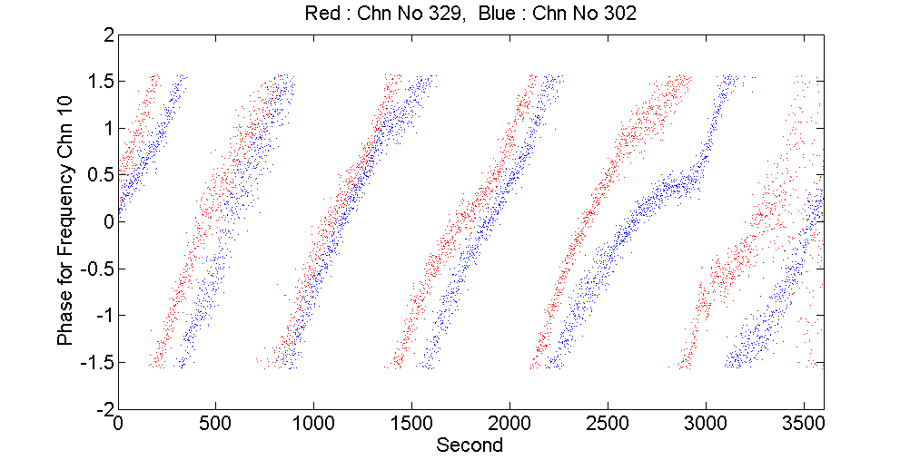
Sun-NorthPole Data
275 - (25,27)
295 - (29,31)
320 - (19,21)
282 - (26,28)
302 - (30,32)
329 - (20,22)
Phases for Hour 17-18 of the 1st day.
Phases are changing as expected.

Slide 8
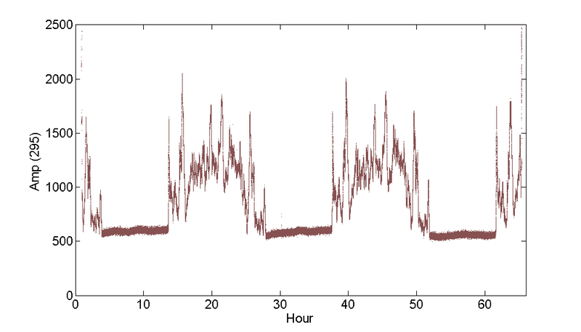
Sun-NorthPole Data
275 - (25,27)
295 - (29,31)
320 - (19,21)
282 - (26,28)
302 - (30,32)
329 - (20,22)
For the other set of polarization:
Data is getting repeated. But nature is different.

Slide 9
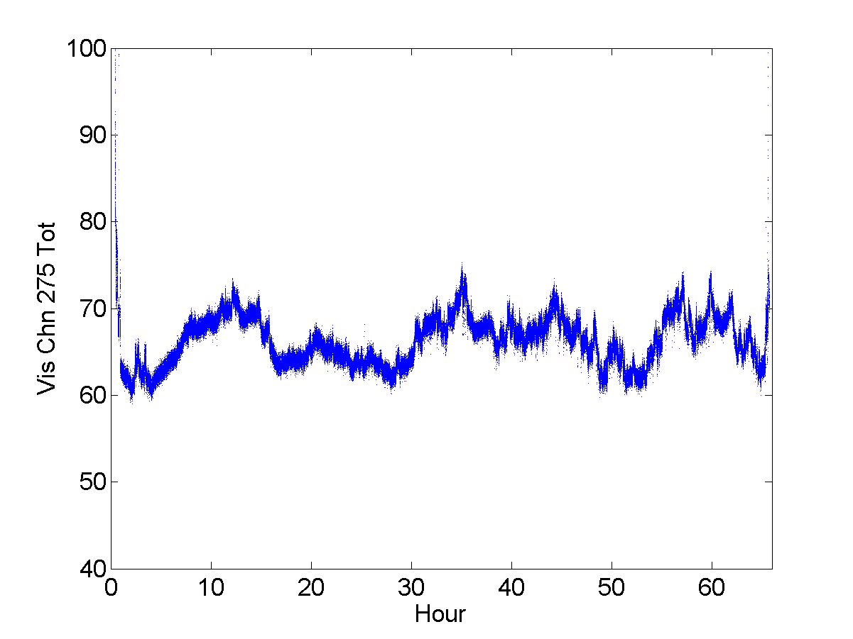
Sun-NorthPole Data
275 - (25,27)
295 - (29,31)
320 - (19,21)
282 - (26,28)
302 - (30,32)
329 - (20,22)
Where is the repetition??

Slide 10
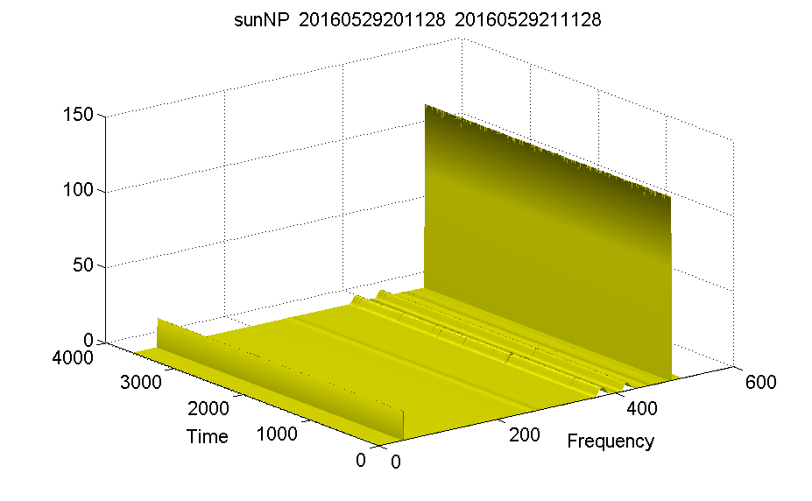
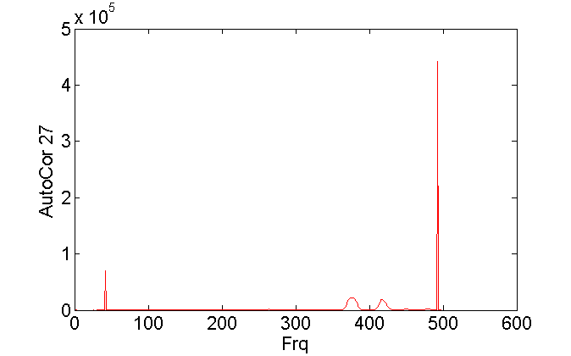
Sun-NorthPole Data
275 - (25,27)
295 - (29,31)
320 - (19,21)
282 - (26,28)
302 - (30,32)
329 - (20,22)
Channel No : 27
27 is a bad channel. Even though its not marked as bad. (Chn 21, 23, 24 are also bad.. Chn 22 has few bad frequency bands)

Slide 11
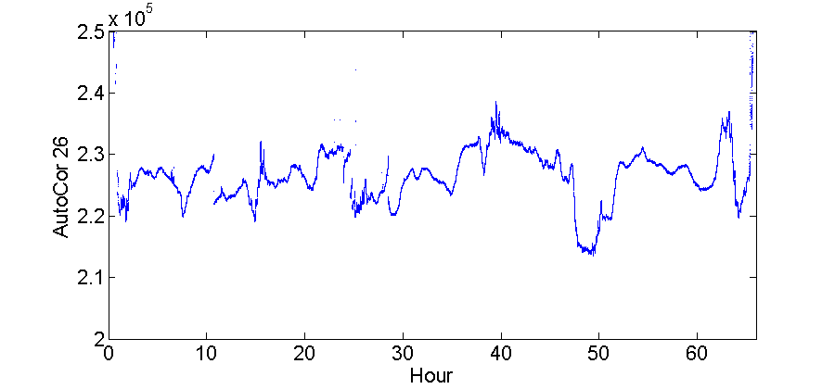
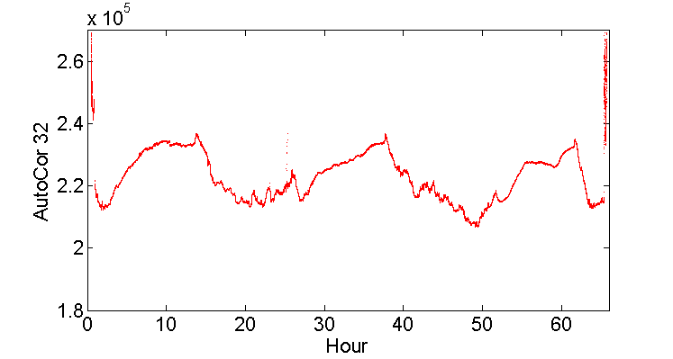
Sun-NorthPole Data
275 - (25,27)
295 - (29,31)
320 - (19,21)
282 - (26,28)
302 - (30,32)
329 - (20,22)
Why??
Auto Correlation (useless)
No pattern?? Probably because its all noise

Slide 12
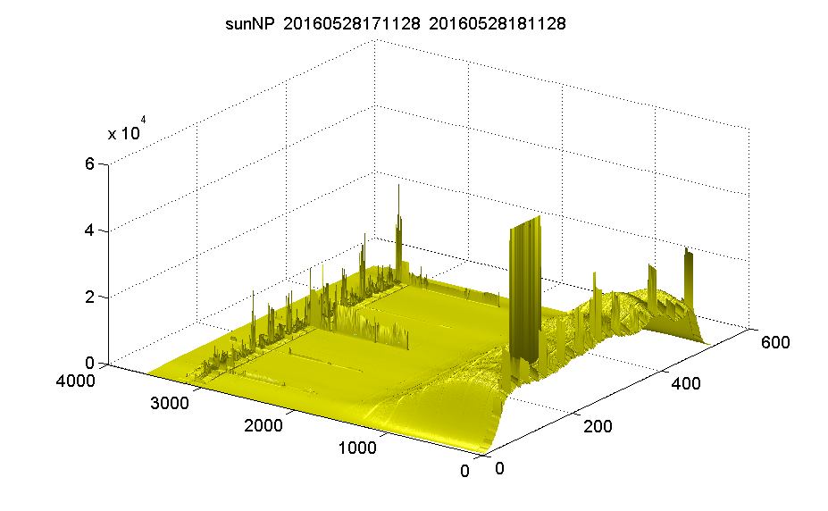
Sun-NorthPole Data
275 - (25,27)
295 - (29,31)
320 - (19,21)
282 - (26,28)
302 - (30,32)
329 - (20,22)
Auto Correlation of 26
What are these spikes in the frequency bands?
These spikes are there in many of the feeds. I don’t understand why they are coming
GOD knows.... Or may be HE is also waiting for us to understand it !!

Slide 13
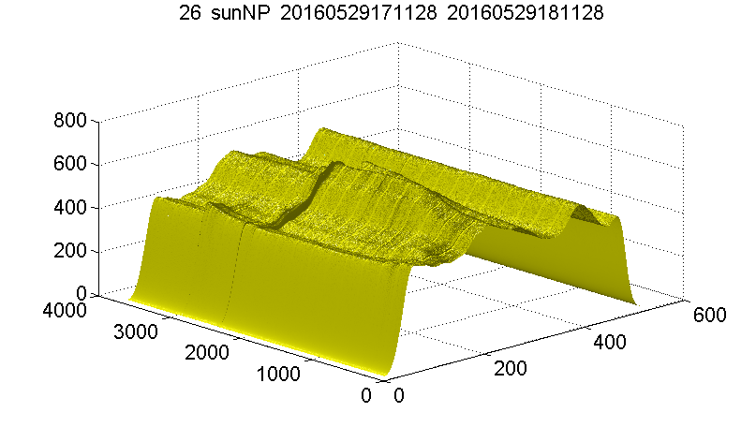
Sun-NorthPole Data
275 - (25,27)
295 - (29,31)
320 - (19,21)
282 - (26,28)
302 - (30,32)
329 - (20,22)
Auto Correlation of 26
Why are these discontinuity in the data??
Are these due to the noise?? Or there something wrong going on ?
GOD knows.... Or may be HE is also waiting for us to understand it !!

Slide 14
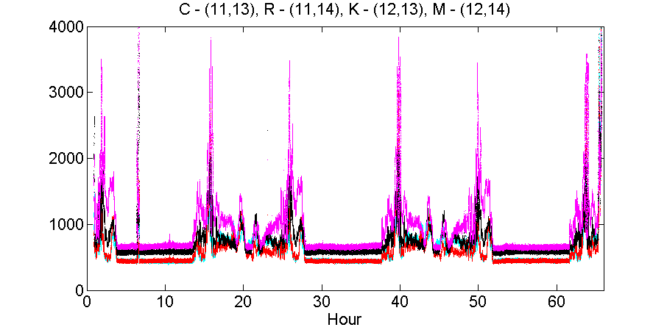
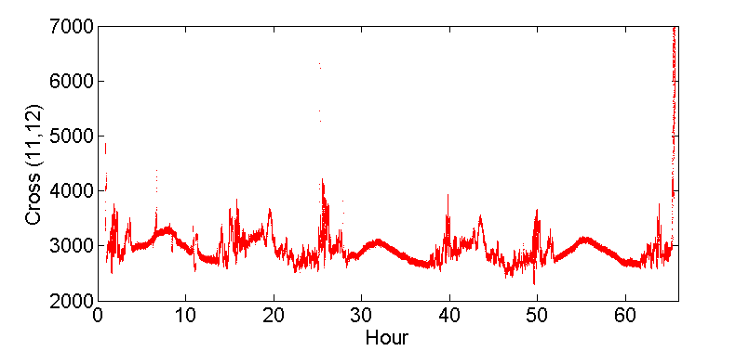
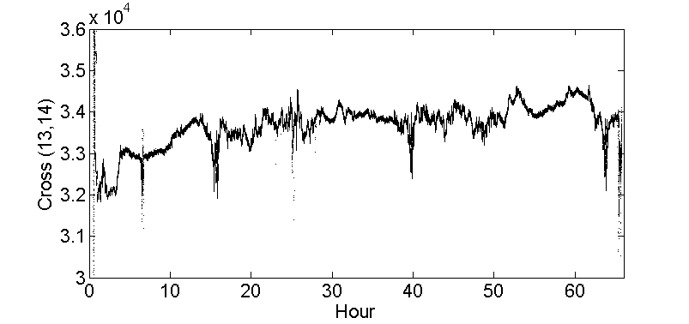
Sun-NorthPole Data
275 - (25,27)
295 - (29,31)
320 - (19,21)
282 - (26,28)
302 - (30,32)
329 - (20,22)
Is 295 also bad?? Or is it detecting something else?

Slide 15
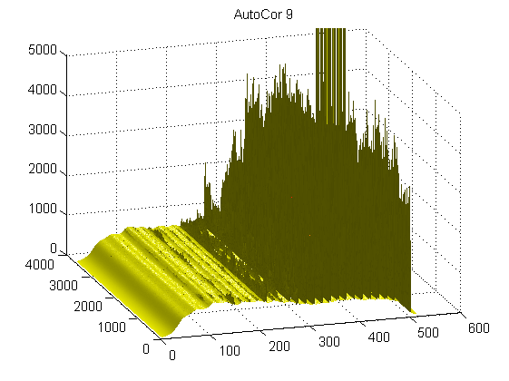
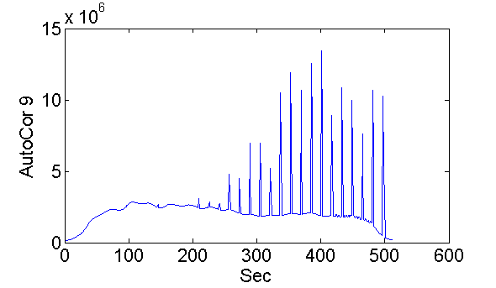
Sun-NorthPole Data
275 - (25,27)
295 - (29,31)
320 - (19,21)
282 - (26,28)
302 - (30,32)
329 - (20,22)
Channel No 9 Bad
I saw many other channels with similar features (22,..)

Slide 16
Summary :
There are more bad channels then listed.
Some bad channels can be fixed by removing few rows.
Why some spikes are coming in some of the frequency bands??
Why Channel No 295 is behaving like that?

Slide 17
Thank You
for not sleeping in my talk
If you have the answers then please explain

