Slide 1
Beam Dynamics study by using Genetic Algorithms
and
the ELI-np case
Alberto Bacci – INFN-Milano
Alberto Bacci, Laboratoire de L’Accélérateur Linéaire (Orsay – France), 13th June
Notes:
and the Eli-np case

Slide 2
Outline
Genetic Algorithms (GAs) introduction
  Historical notes
  Hints on What are & Why use GAs
  Where: Genetic Algorithms in Beam Dynamics Optimization
GAs applied to Beam-Lines Optimization
  From Beam-Lines to Chromosomes
  Following Genetic Laws: Fitness, Reproduction, Mutations, …
  E.G.: SPARC beam line Optimization in Thomson case
The GIOTTO code
  The Data-Based DB
  Inputs & Outputs
  Fitness function (or Idoneity) definition
  Optimizations & Statistics on Specific Cases:
    Ultra short bunches by Hybrid Velocity Bunching
    Comb bunches distributions
  Eli-np Case: The reference Working Point & Statistic

Slide 3
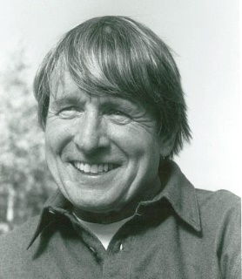
Genetic Algorithms (GAs) introduction: Historical Notes
1970 John Holland - schemata theorem
1975 J. Holland publication: “Adaptation in Natural and Artificial Systems: An Introductory Analysis with Application to Biology, Control, and Artificial Intelligence”. The Seminal work
1975 K. De Jong (J. Holland’s student), Thesis: “An analysis of the behavior of a class of genetic adaptive systems”. Broad applicability of GAs
1989 David Goldberg Book: “Genetic Algorithms in Search, Optimization, and Machine Learning”
  It deals with the topic at high level and is considered a milestone in GAs story. It reports techniques like Multi Objective GA (MOGA), today very current.
John Holland
Notes:
Important historical steps

Slide 4
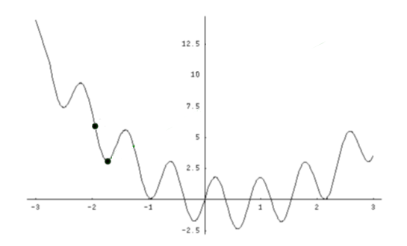


Introduction: What & Why
What are Genetic Algorithms (GAs)
  Searching procedures based on natural selections (genetic laws)
Why choosing GAs versus other techniques …
  A basic answer:
    Newton-Raphson methods (and many variants) are based on local information. The Scan moves in direction of “local maxima” or “local minima”
A Parabola
Local extrema
start
start
End
End

Slide 5
Introduction: What & Why
Why Genetic Algorithms **
  Despite, Newton-Raphson methods can overcame the local solutions issue by some tricks …
  GAs are:
  naturally able to manage the local solution issue
  naturally parallelizable
  usable with a minimum mathematical effort
  And, by empiric results,
    show strong capability to manage problems where other methods fail
** pros and cons in literature

Slide 6
Where: Genetic Algorithms (GAs) in Beam Dynamics Optimization -1
GAs give strong advantages …
in multi-dimensional problems with variables strongly non linear correlated
A main example :
Space Charge & its non-linear nature: correlates low energy beam-line parameters
Also frozen beams (space charge off): Other complex situations
Example (1) Thomson/Compton Sources (e.g. SPARC_lab, STAR, ThomX, ELI-np, Munich Compact Light Source) which ask for :
  For the spectral density: 1) very low DE/E, 2) low Emit
  For the photon flux : 3) Q_{bunch} as high as possible
Notes:
each other
The Space Charge dominated beams:

Slide 7
Where: … - 2
Example (2) Ultra short e-beams (e.g. SPARC_lab, LCLS, REAGE, XFEL, EUPRAXIA, … ):
Femtosecond light pulses (FEL/X-FEL), Atoms in chemical reactions, phase-transition, Photosynthesis Water Splitting : timescale 1-100 fs [2014 “first snapshots of water splitting” by LCLS; ScienceDaily; Nature]
Plasma Wave Acceleration: λ_{plasma} order of 30-600 fs . The Witness much shorter, the Driver (pwfa) comparable to λ_{plasma}
Femtosecond Electron Diffraction (FED)
  Molecular or atomic motion movies: phase transitions, …, . Timescale: few 10s of fs. Relativistic case: E_{b} ≈ 5MeV, Q_{b} ≈ 100fC, ε_{tr}<0.1 mm-mrad, σ_{z}<30μm (100fs)
THz radiation (by CoTrRad)
  0.1 up to tens THz is of great interest for both longitudinal electron beam diagnostics (fs scale) and spectroscopy in pump-and-probe experiments ....

Slide 8
Genetic Algorithms
applied to Beam-Line Optimization

Slide 9
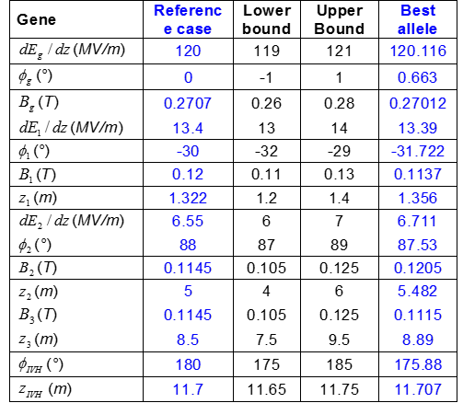
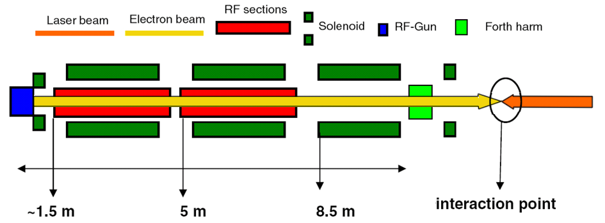
From Beam-Lines to Chromosomes
Genetic Laws work on Chromosomes ==> Chromosomes are made of genes (parameters)
Beam-Line = Parameters Array ==> One Chromosome
Chromosome
A Beam-Line
=

Slide 10
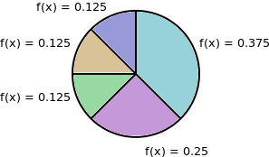
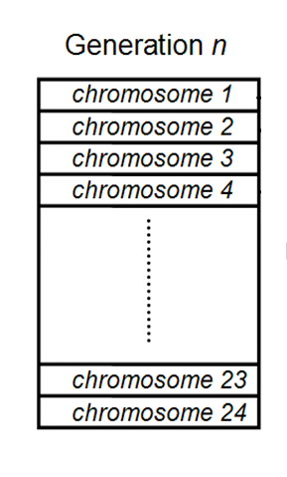
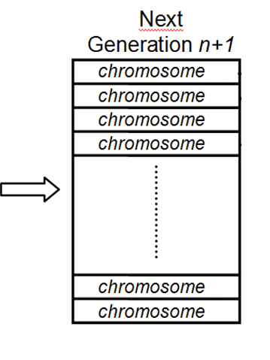

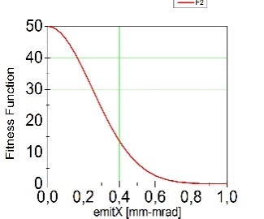
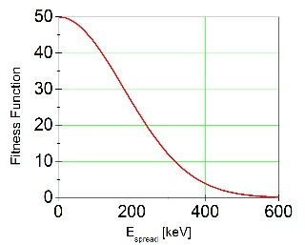
Following Genetic Laws: Fitness Function
Rules to pass generation ➔ in generation:
Selection: bluffed Roulette wheel
Mutations
…. & others methods & tricks. The rule: closest to Nature, best performances
Starts from random generation
Chromosomes Must be sorted by a Fitness function
==
ε_{n,x}
Δγ/γ
+

Slide 11


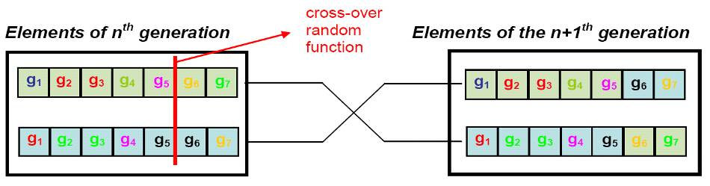
Following Genetic Laws: Reproduction & Mutation
Chromosome Sorting by
0 <
< 100
99.
97.
90.
By the Roulette Wheel: two Chromosomes
85.
Tracking
code
sum of probability == 1
60.
58.
Chromosomes reproduction
Gun Ф injection
Gun gradient
Mutation, with
probability < 1%
B_{z} intensity first solenoid
Notes:
Far ruotare la ruota

Slide 12

Following Genetic Laws: Real coding (1) and binary coding (2)
Main loop,
Generation in Generation
Chromosome
(1) Genetic rules on Real Numbers
0 < Gene Value < 255.127
0|0|0|0|0|0|0|0. 0|0|0|0|0|0|0
(2)Binary
Coding
1|1|1|1|1|1|1|1 . 1|1|1|1|1|1|1
8 bits
7 bits
As DNA in Genetic Laws
15 bits X Gene
Genetic rules on binary arrays
Decoding to decimal and compute the fitness
Main loop,
Generation in Generation

Slide 13

Following Genetic Laws: Elitism
Concluding: the elitism
>
Sorting
+2
+5
oper
Nowadays “quasi-classic” optimization techniques
  elitism
  advanced mutation operators
  hill climbing
  regeneration from best solutions
  … … …
  & parallelization quasi-mandatory

Slide 14
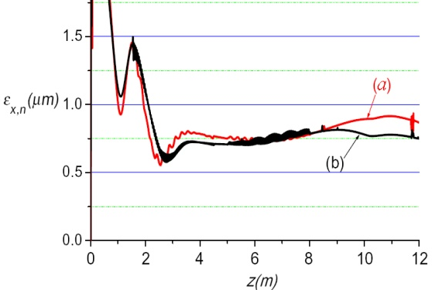
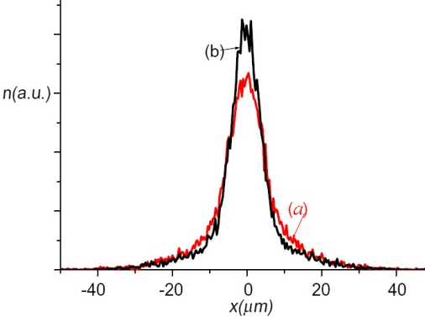
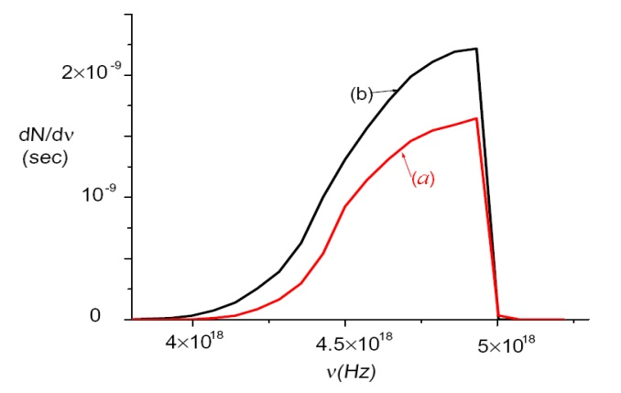
E.G.: SPARC beam line Optimization in Thomson case
Old Kind of Fitness Function
By hand
By GA
spot
spectrum
“MAXIMIZING THE BRIGHTNESS OF AB ELECTRON BEAM BY MEANS OF A GENETIC ALGORITHM”
A. Bacci, C. Maroli, V. Petrillo, A. Rossi, L. Serafini - NIMB 263 (2007) 488-496

Slide 15
The
GIOTTO code

Slide 16
GIOTTO - Genetic Interface for OpTimising Tracking with Optics
WAS BORN in 2008; Language: Fortran 90/95
USE for Optimization of Generic Code’s Parameters or for Statistical (Jitters) Analysis
INPUTS based on NameList & on two internal DataBase
CAN easily Drive different codes:
  Now: ASTRA’s Generator, ASTRA, QFluid (Plasma acceleration, A. Rossi modifications)
Current Version (Ver. 10.0):
  Linux 64 bit; Windows 64 – (compilers gfortran or INTEL fortran)
  Parallelized with OPEN-MPI (Linux), MS-MPI or INTEL MPI (Windows)
  Used @ PSI (S. Bettoni) and tested at Desy-Pitz
Code and Documentations:
  URL: http://pcfasci.fisica.unimi.it/Pagine/GIOTTO/GIOTTO.htm (server down, pardon!)
  Exist an User manual for version 8.5 2012 (needs updates)

Slide 17
GIOTTO – Genetic Interface for OpTimising Tracking with Optics
From 2008 up to day, the code is grew in power and capability
Optimization techniques: elitism; advanced mutation operators; hill climbing; ant colony regeneration from best solutions
user freely defined by Astra outputs:
Targets: bunch PosZ or Time, En, En_{spread}, SigZ, Xemit, sigX, divergX, Yemit, ….
Important GIOTTO’s features:
Every NameList ’s variables can be used as a GENE (optimizable) & Any code working with NameList is directly importable in GIOTTO.
ASTRA e.g. : Phi(1)…Phi(50), MaxE(1:50), MaxB(1:50), sig_x (laser cathode) ,sig_clock (Laser @ cathode), …, … (no limit on the number)
Constraints freely defined by the user (under test)
Switch from Optimizations to Statistical analysis is really EASY
Jitters sampling interval: Uniform or Gaussian

Slide 18
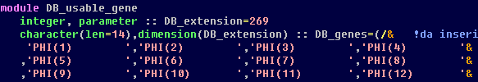
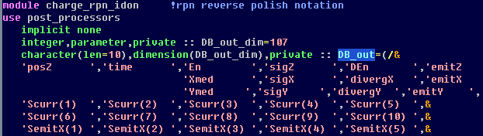
GIOTTO’s Data-Bases
All variables usable in
THE BEAM-LINE
Now: Astra_generator, Astra, QFluid
DB_1
Optimizable variables
THE GENEs
Sub-DB_1
Astra Outputs (or other codes)
THE FITNESS
emittance, envelope, En_spread,
etc. …
DB_2

Slide 19
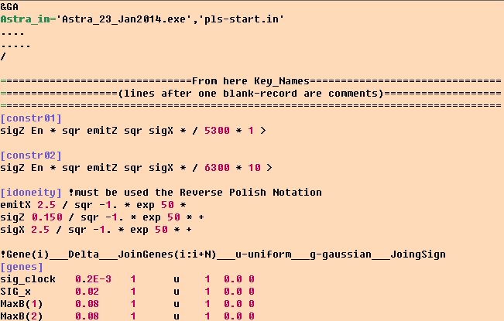
GIOTTO’s INPUT FILE
GINxx.xx.ini is divided in two parts:
  One NameList (&GA) giving all the directive to GIOTTO
  Three keyNames defining: CONSTRAINTS, FITNESS and GENES
1)
2)

Slide 20
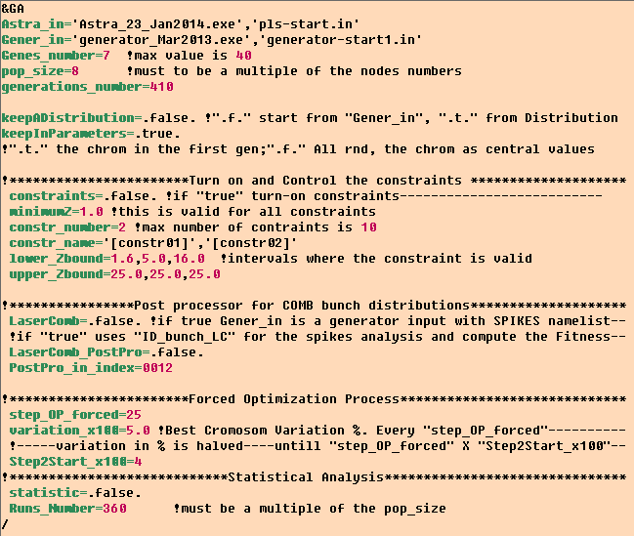
GIOTTO’s INPUT FILE: &GA NameList
Under developing (it slows down heavily GIOTTO)
Usually few variables are used
Optimization
Rarely needs changes
Fitness & Genes

Slide 21
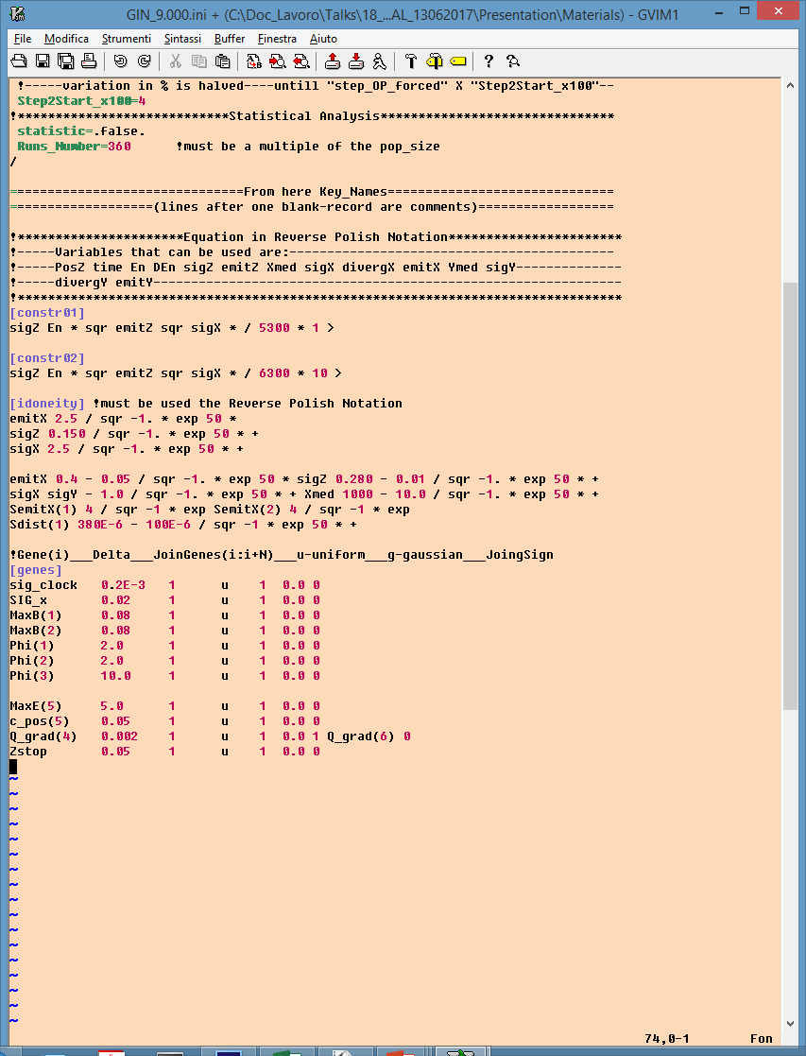
GIOTTO INPUT FILE: Key_Names
Rarely needed
Definition
Comments
GENES
Definition
Comments

Slide 22
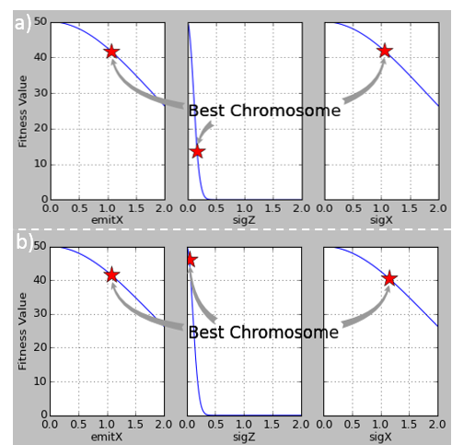


GIOTTO: FITNESS FUNCTION
Reverse Polish Notation: Opers Follow Operands
  3 4 + = 7
  Stack based operation
  Does not need brackets
a) not yet full optimized
$$=$$
b) full optimized
$50∙e^{−{\left(\frac{emitX}{2.5}\right)}^{2}}$+$50∙e^{−{\left(\frac{sigZ}{0.15}\right)}^{2}}\text{+}50∙e^{−{\left(\frac{sigX}{2.5}\right)}^{2}}$
Fitness Funciont strategy to Cope with Multi Objectives Problems (MO):
One Single Criterium per Equation piece (Objectives Wights)
To be close to the Goal mean close to the Gaussian Curve Top
The ‘Far region’ (referring to optimization) has to be on the maximum Gaussin slope
change the FF in real time (ander implementation)

Slide 23
GIOTTO
Optimization & Statistical analysis

Slide 24
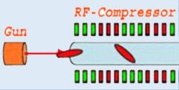
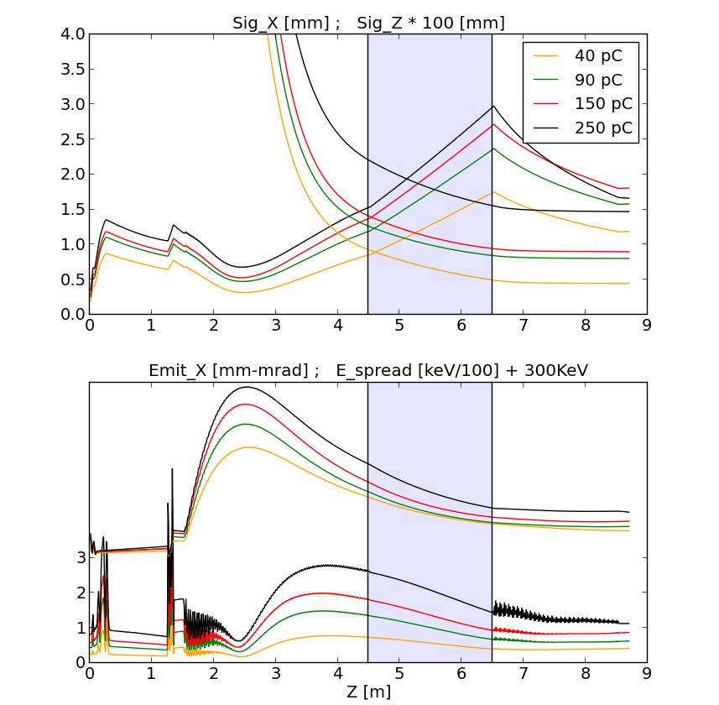
Beam-Line Optimization for: ultra short, ultra cold, High brightness bunches
2.0 m drift
C-band cavity
GOALS:
Low Emittance
Low Energy Spread
femptosec. Sig_Z
GIOTTO
RESULT
Drift @
20 MeV
A Beam-Line studied with:
Experience
An Ad hoc GIOTTO use
Envelop[mm]
Sig_z[um]
GENES in the Optimization:
Gun:
  (1) Phase & (2) Solenoid (B_{z})
TW cavity (RF- Compressor):
  (3) Phase & (4) Solenoids
C-band cavity: (5) Phase
ΔE =100 keV
Emit[um]

Slide 25
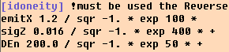
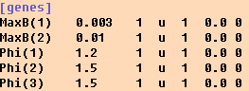
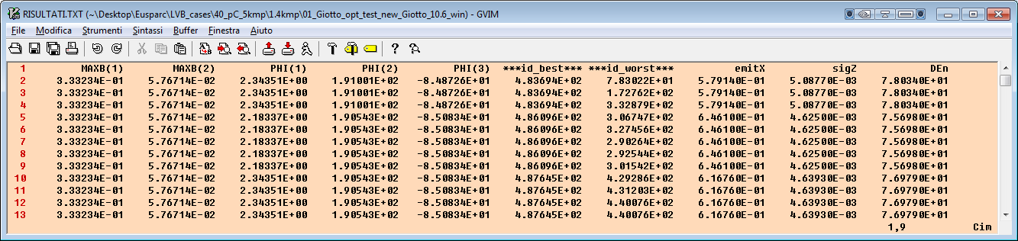
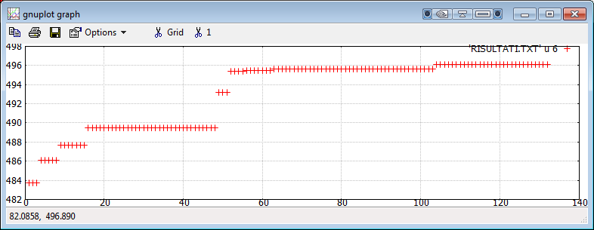

GIOTTO OUTPUT: RISULTATI.TXT
GENES
RISULTATI.TXT
Emit
sigZ
$$∆E$$
Best Chromosome of the
Generation N.5
Id value
Generation

Slide 26
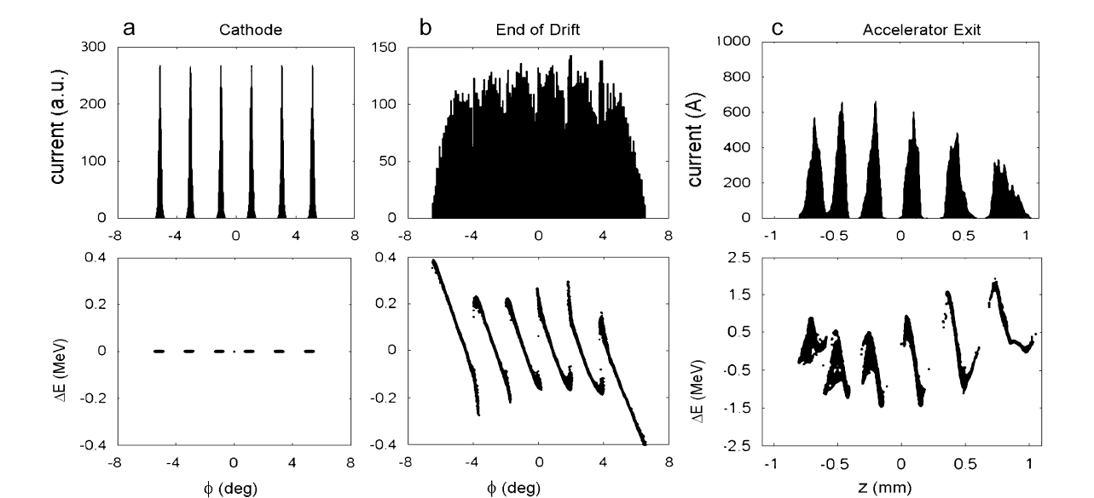
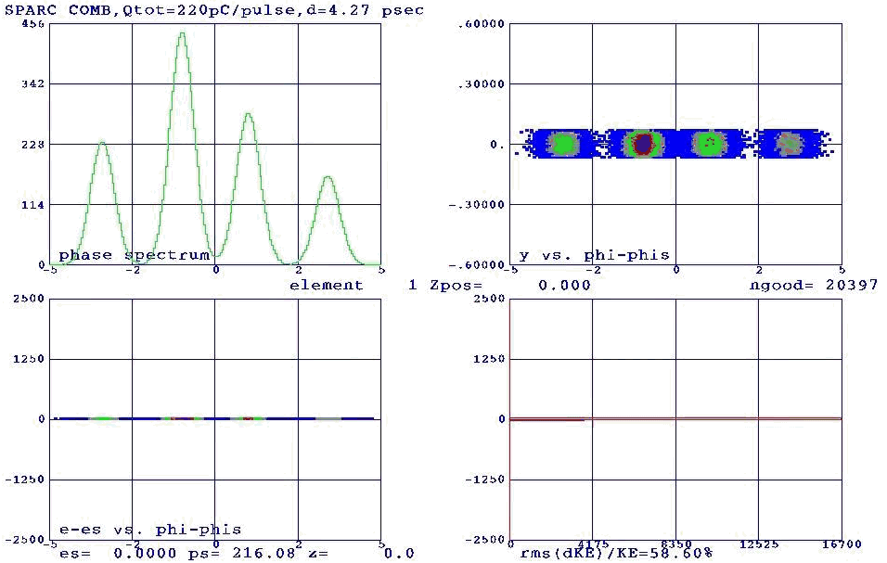
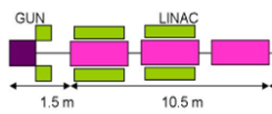
Beam-Line STATISTIC for Laser Comb (ECHO Bunch Generations)
6 Bunches
4 Bunches
- P.O.Shea et al., Proc. of 2001 IEEE PAC, Chicago, USA (2001) p.704.
- M. Ferrario. M. Boscolo et al., Int. J. of Mod. Phys. B, 2006 (Taipei 05 Workshop)

Slide 27

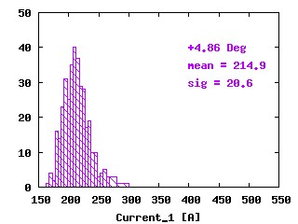
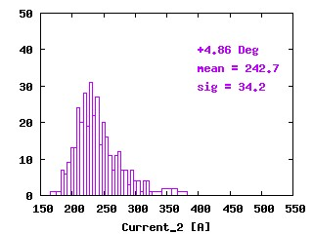

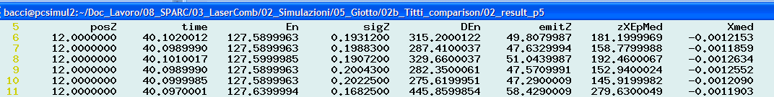
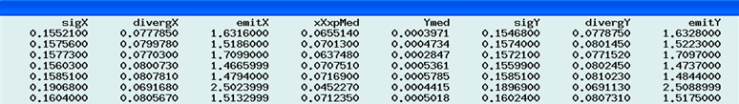

Beam-Line STATISTIC for Laser Comb – TWO Bunches case : Current Statistic
360 cases

Slide 28
GIOTTO
and the ELI-NP case

Slide 29
ELI-NP LINAC machine
Beam Dynamic features
Electron Linac design to drive bright Compton back-scattering gamma-ray sources
A. Bacci, D. Alesini, P. Antici, M. Bellaveglia, R. Boni et al.
J. Appl. Phys. 113, 194508 (2013); online: http://dx.doi.org/10.1063/1.4805071
The Peculiar Gamma Ray Source features
In next page,
how to reach these parameters

Slide 30


ELI-NP Injector merit factors
The Emittance
Maximization of electron density into transverse phase space :
==> means ==> very low emittance ̴ 0.4 mm-mrad
The Energy Spread
Minimization of the energy spread: the source spectral density require Δγ/γ < 0.1%, we have chosen a conservative threshold of 0.05 %
Energy Spread by RF curvature:
Booster freq.
σ_{z} < 280 µm @ the injector exit

Slide 31
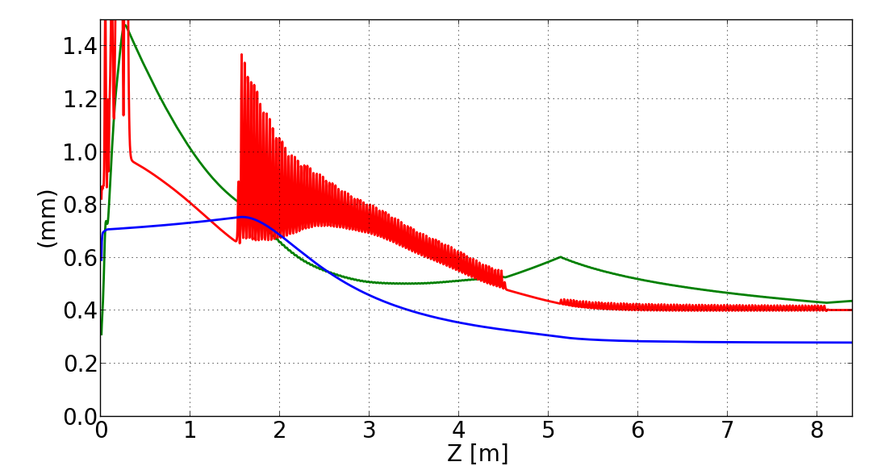
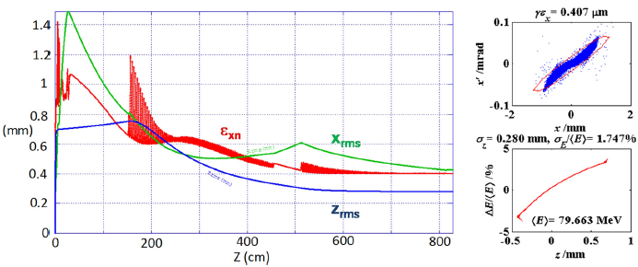
Result: GIOTTO optimization on merit factors ( booster’s injector)
Comparison using Tstep (a Parmela heir) & Astra codes
A space charged dominated region needs a double check
Astra gives the possibility to use Giotto (Giotto improves 30-60 %)
Astra with GIOTTO
Tstep
Astra
γε =0.4 μm
<E>=79.8 MeV
σ_{z}= 0.279 mm
σ_{E}/<E> = 1.65%
Tstep

Slide 32
Injector jitters analysis
a full S2E:
Injector→ C Booster → γ-Source
Astra→ Elegant → Cain

Slide 33
ELI-NP booster’s Injector Jitters (9 parameters)
Jitters kept in Consideration in GIOTTO:
RF:
  200 fs Phase (overestimated): (1) Gun & (2,3) TW cavities (S- band)
  2‰ in pick field: (4) Gun & (5,6)TW cavities (S- band)
laser:
  (7) 200 fs arrival time
  (8) 20 µm pointing instabilities (on cathode)
  (9) 5% energy fluctuation (Charge fluctuation)
Different Machines:
+/- 70 µm as misalignments for: RF Cavities, Gun Solenoid, TW Solenoid
Uniform distributions Jitters; a very conservative choice

Slide 34
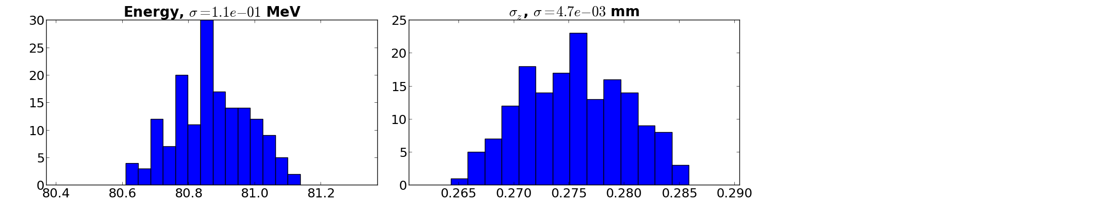
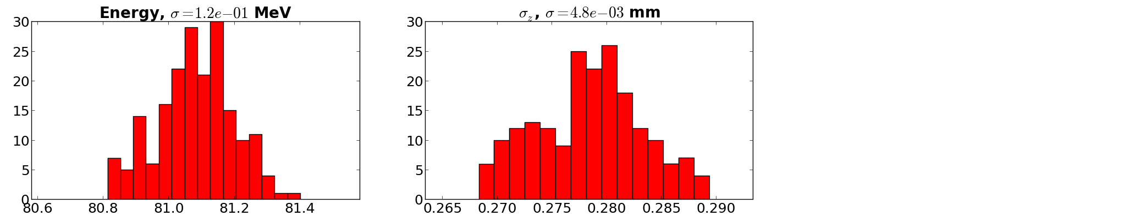
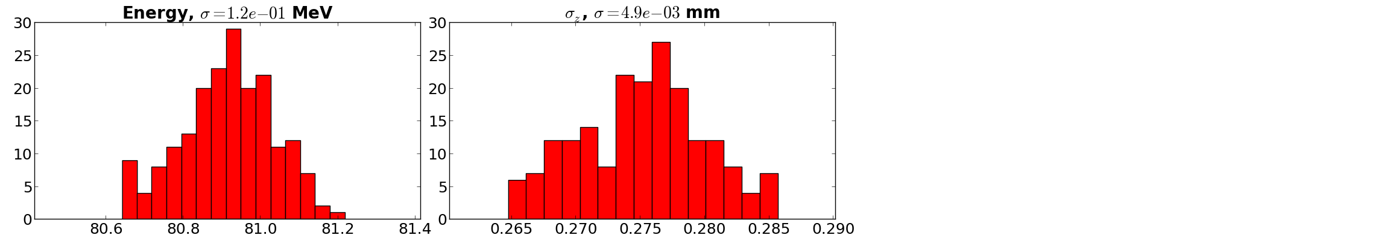
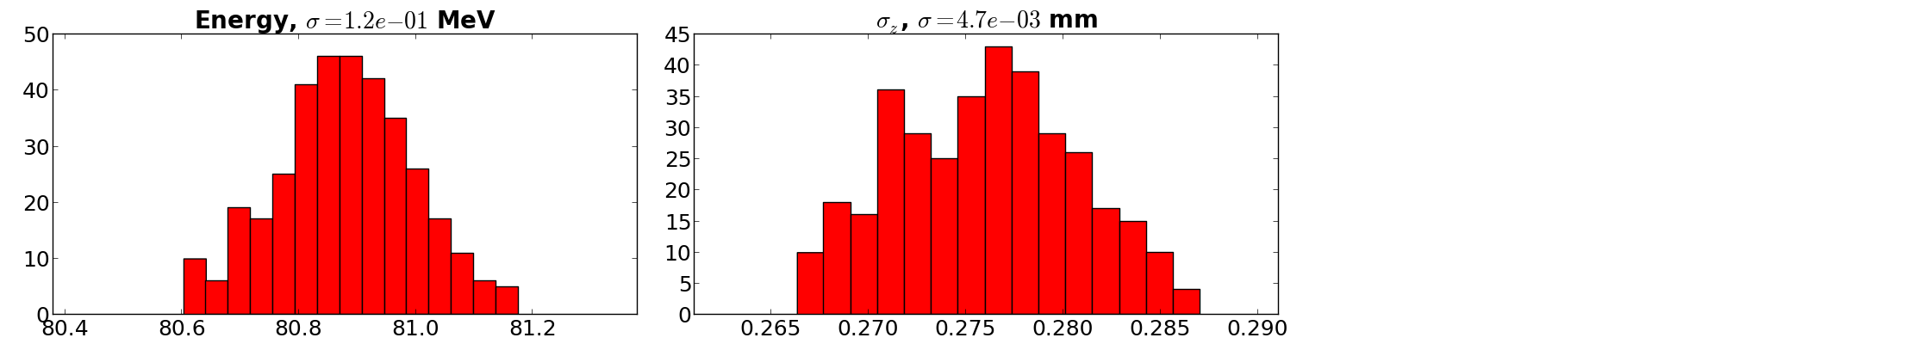
ELI-NP Injector Jitters Analysis – Energy & Bunch length
All jitters
σ_{z}
Machine_1 160 runs
Machine_2
160 runs
Machine_3
160 runs

Slide 35
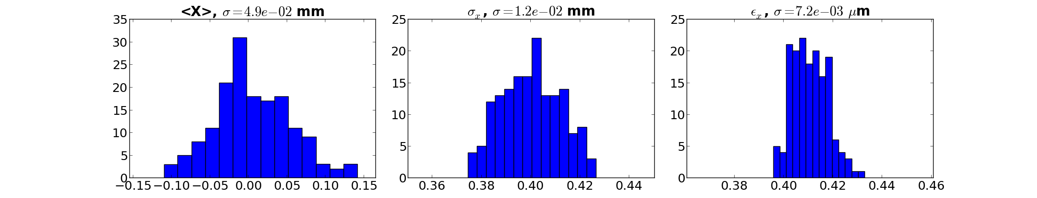
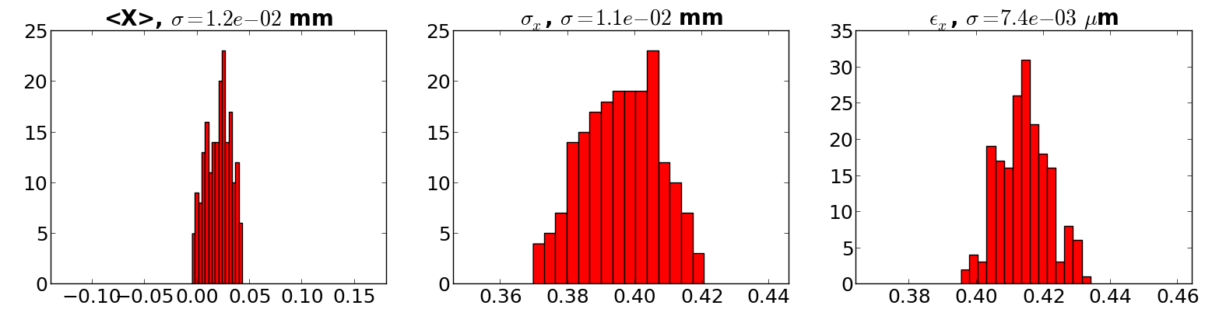
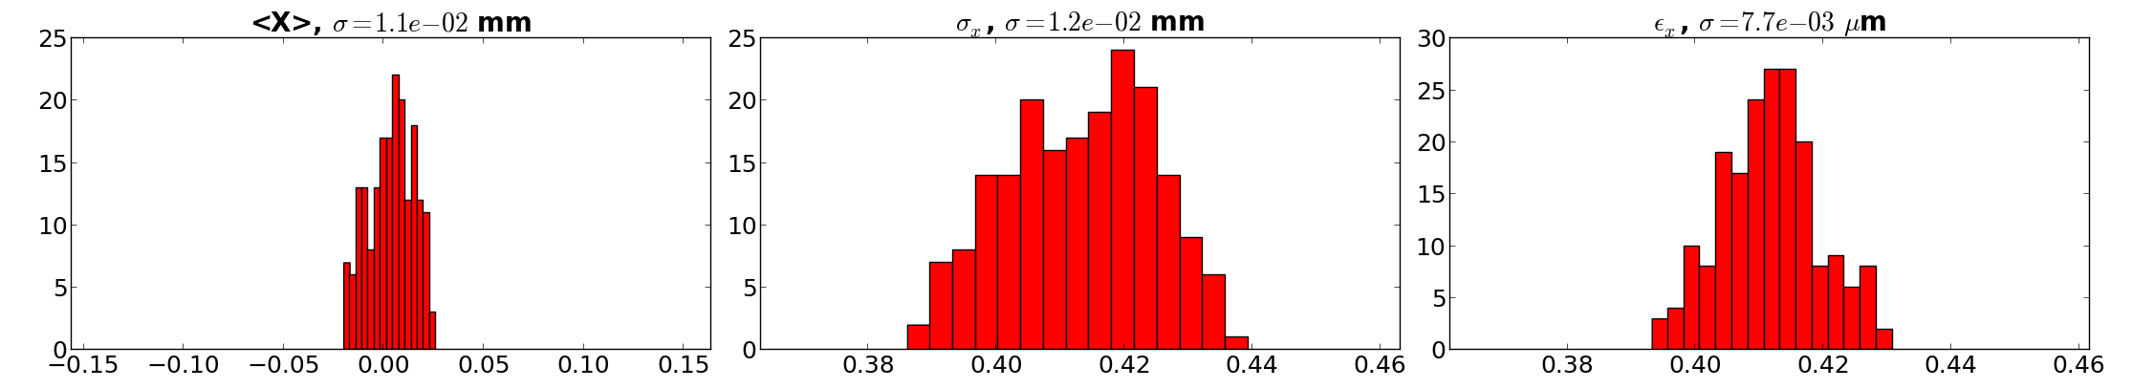
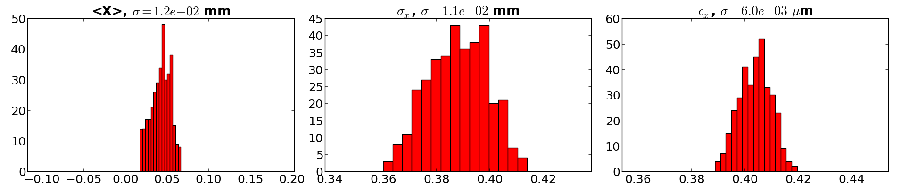
ELI-NP Injector Jitters Analysis – Centroid, Envelope, Emittance
All jitters
Machine_1 160 runs
Machine_2
160 runs
Machine_3
160 runs

Slide 36
In Conclusion
Genetic Algorithms show great promise in the Beam Dynamics optimization and problem solution.
GIOTO has been applied successfully to:
refine known beam lines, with improvements around 20-40 % (in the performances)
have been used to find completely new schemes, as in case of the hybrid velocity bunching
Thanks for your attention
Demand of EXTREME HIGHT QUALITY electron beams doesn’t stop and often it makes necessary to cope with strong space charge
Beam-Line optimization is Nowadays really a critical issue

Slide 37
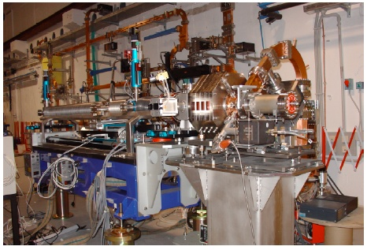
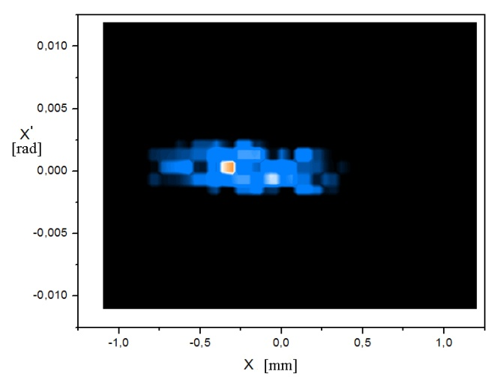
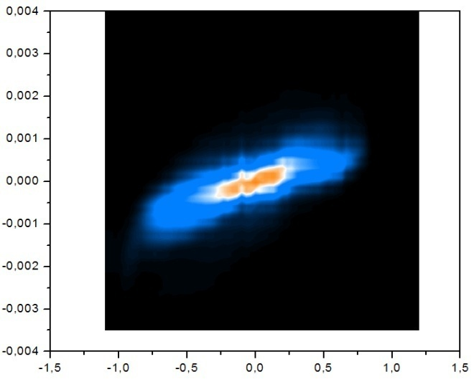
Emittanzometro
RF-Gun 1.6 S-band 120 MV/m
Emittanzometro’s data are handled by a dedicate algorithm that return an intensity matrix PhaseSpace.txt (successively interpolated to increase the definition)

Slide 38
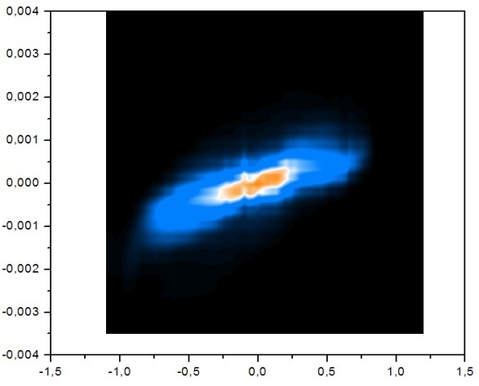
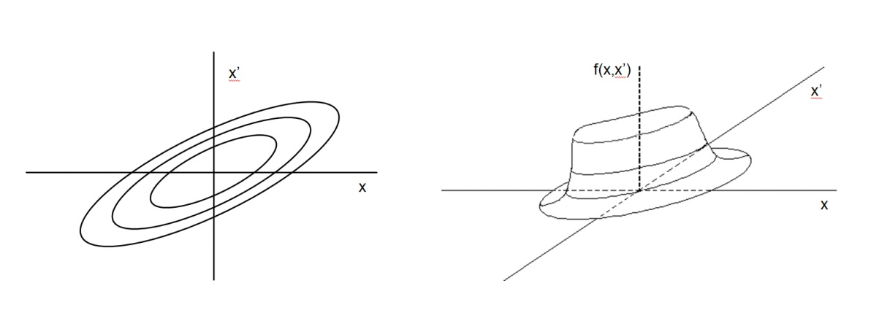
Emittance in Real Beam
Since real beams usually do not have well defined boundaries, a method for calculating the emittance, is to choose a specific density contour, in the phase space, that represents from the 50% (worst cases) up to the 98-99% (best cases) of the whole bunch charge (or integrated intensity). Within this density contour and under certain conditions, such emittance satisfies the Liouville’s theorem and thus is conserved
97%
95%
100%
GMESA normalization

Slide 39
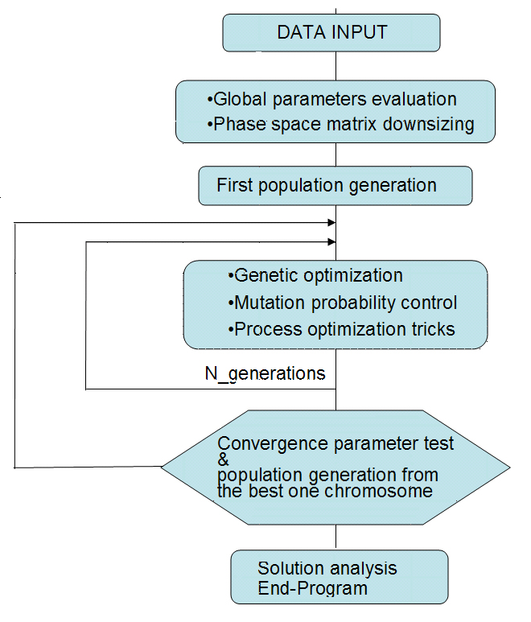
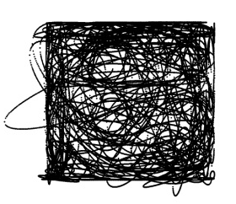
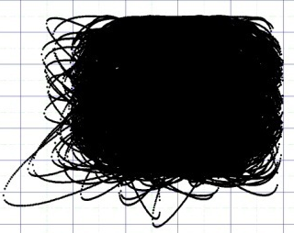

One of the 30 generation’s chromosome with 25 genes
c
g
b
a
g
b
a
g
b
a
30
2
8
1
The space phase ellipse’s sampling is a thorny issue as uniformity and dimension. A shuffled uniform random generator is used.

Slide 40




Data analysis at SPARC - Some relevant results
One of the more significant curve - analyzed also with two other methods - that shows a strongly marked double minimum
Some phase space of the emittance curve
From first tests the code seemed to be able to analyze the rough phase space images, not yet interpolated
An output file

Slide 41

4
BPM and Genetic control of the steering correctors A code to compute the rms emittance of high brightness electron beams
Developing of a dynamic link library (dll), in fortran 90, that can interface with LabView
N. Corrector
Current of maximum variation per corrector
rms of the BPM off-set
Sample of the Correctors configurations
Generation n
best solution
Generation n+1
memory of the best solution
from simulations it converges to 0.200 mm of maximum off-set after 80 generation Considering 2s to test each configuration → 36 minutes
The real world could be faster
ant colony optimization

