Slide 1

Cryogenic search for neutrinoless double beta decay of cadmium (CYGNUS project)
Fedor Danevich
Institute for Nuclear Research 03028 Kyiv, Ukraine
CSNSM, Univ. Paris-Sud, CNRS/IN2P3, Univ. Paris-Saclay, 91405 Orsay, France
Acknowledgment to the “Jean d’Alembert” grants program of the University of Paris-Saclay
F.A. Danevich Cryogenic search for neutrinoless double beta decay of cadmium French-Ukrainian workshop, 6-8 Nov 2017, Orsay, France

Slide 2
Content
Introduction: 2β decay and particle physics
Choice of ¹¹⁶Cd
2β of ¹¹⁶Cd with conventional scintillation detectors
CYGNUS: low temperature breakthrough
Conclusions and Prospects
F.A. Danevich Cryogenic search for neutrinoless double beta decay of cadmium French-Ukrainian workshop, 6-8 Nov 2017, Orsay, France

Slide 3
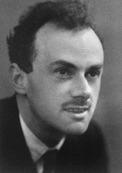

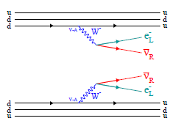
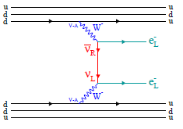
Double beta (2β) decay and particle physics
Introduction: 2β decay and particle physics
2ν2β decay
0ν2β decay
Paul Adrien Maurice Dirac
Ettore Majorana
The 2ν2β decay is allowed in the Standard Model, observed in 11 nuclei with T_{1/2}∼10¹⁹-10²⁴ yr
0ν2β decay breaks the Lepton number and is possible if the neutrino is a Majorana particle
Sensitive to the absolute value of the neutrino mass, the neutrino mass hierarchy, the Majorana CP phases
The 0ν2β decay can be mediated by presence of right handed currents in weak interactions, massless (or very light) Nambu-Goldstone bosons (majorons), and many other effects beyond the Standard Model
F.A. Danevich Cryogenic search for neutrinoless double beta decay of cadmium French-Ukrainian workshop, 6-8 Nov 2017, Orsay, France
Notes:
Particle is identical to its own anti-particle

Slide 4
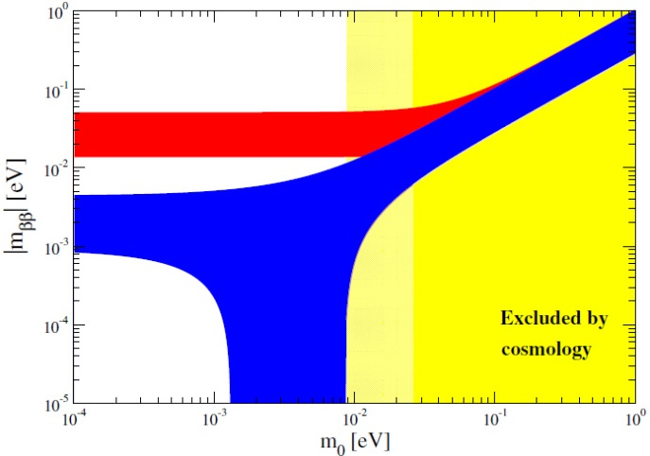
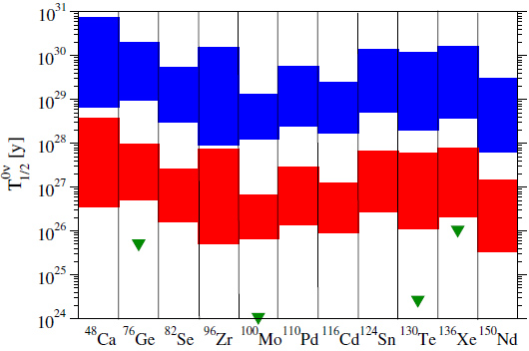
Status of 0ν2β decay experiments
Introduction: 2β decay and particle physics
The 0ν2β is not observed, the best limits: limT_{1/2}∼10²⁴-10²⁶ yr → ⟨m_{ν}⟩∼0.1-1 eV
The experimental sensitivity should be advanced to explore the inverted hierarchy of the neutrino mass ⟨m_{ν}⟩ ∼ 0.02-0.05 eV, T_{1/2}∼10²⁶ - 10²⁷ yr
Normal Hierarchy
?
Inverted Hierarchy
NME of the 0ν2β decay calculated in the framework of different approaches
Investigations of several nuclei are requested:
  observation of 0ν2β in several nuclei
  the ambiguity of NME calculations
  possible breakthroughs in detection technique
  test the NME calculations by using the ratio of lifetimes
[1] J.D.Vergados, H.Ejiri, F.Šimkovic, Neutrinoless double beta decay and neutrino mass, IJMPE 25 (2016) 1630007
F.A.Danevich Investigation of rare nuclear decays by using scintillation detectors CNNP2017, 15-21 October 2017, Catania, Italy

Slide 5
Choice of 2β nuclei
Choice of ¹¹⁶Cd
Natural Isotopic abundance (%)
Sensitivity (half-life T_{1/2}) of 2β experiments:
2615 keV γ ²⁰⁸Tl
− detection efficiency
δ − concentration of 2β isotope
m − mass of detector
t − time of measurements
R − energy resolution
BG − background
¹³⁰Te
30
20
Large Q_{2β} > 2615 keV
⁸²Se
¹⁰⁰Mo
Enrichment ∼ 10² - 10³ kg
¹³⁶Xe
10
⁷⁶Ge
High detection efficiency
Low background
High energy resolution
¹⁵⁰Nd
¹¹⁶Cd
⁹⁶Zr
⁴⁸Ca
0
1
2
3
4
Energy of decay, Q_{2β} (MeV)
There are crystal scintillators with ⁸²Se, ¹⁰⁰Mo and ¹¹⁶Cd, ¹³⁰Te is component of TeO₂
F.A. Danevich Cryogenic search for neutrinoless double beta decay of cadmium French-Ukrainian workshop, 6-8 Nov 2017, Orsay, France

Slide 6
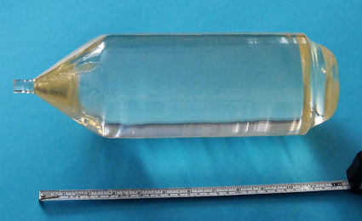
¹¹⁶Cd is one of the “gold” 2β nuclei
Choice of ¹¹⁶Cd
High energy of decay Q_{2β}=2813.49(13) keV, the Q_{2β} is known with high accuracy
Comparatively high isotopic abundance δ=7.5 2(54)%, possibility of gas centrifugation
Promising theoretical estimations in the framework of different methods: IBM, QRPA-TBC, QRPA-Jy, NREDF, REDF [1]
¹¹⁶Cd
Existence of detector: CdWO₄ crystal scintillators
20 kg CdWO₄ crystal
Production of high quality CdWO₄ crystal scintillators is well established
[1] J.D.Vergados, H.Ejiri, F.Šimkovic, Neutrinoless double beta decay and neutrino mass, IJMPE 25 (2016) 1630007
F.A. Danevich Cryogenic search for neutrinoless double beta decay of cadmium French-Ukrainian workshop, 6-8 Nov 2017, Orsay, France
Notes:
(IBM) interacting boson mode; (QRPA-TBC) quasy particle phase approximation Tuebingen–Bratislava–Caltech, Jyv¨askyla; (NREDF) non-relativistic energy density functional; (REDF) relativistic energy density functional

Slide 7
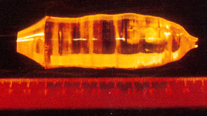
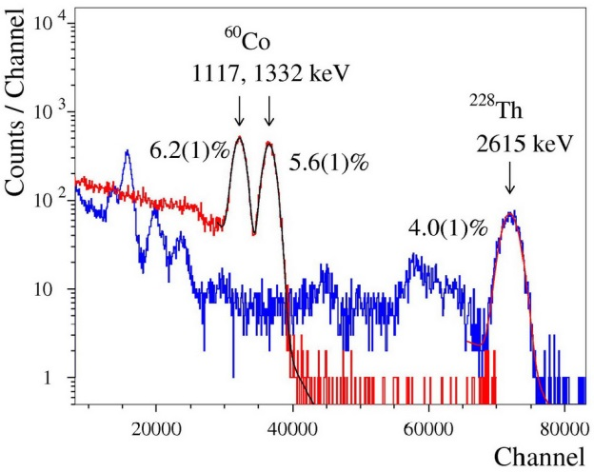
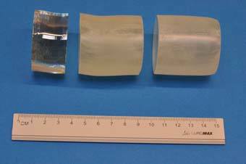
R&D of enriched ¹¹⁶CdWO₄ crystal scintillators
2β of ¹¹⁶Cd with conventional scintillation detectors
δ(¹¹⁶Cd) = 82%
¹¹⁶CdWO₄ crystal (510 g) grown in 1986 for the Solotvina experiment [2]
¹¹⁶CdWO₄ scintillator 1868 g
Yield of crystal 87%
Losses of ¹¹⁶Cd ≈ 2%
Optical transmission curve of ¹¹⁶CdWO₄ crystal before and after annealing
The excellent optical and scintillation properties were obtained thanks to the deep purification of ¹¹⁶Cd and W, and advantages of the low-thermal-gradient Czochralski technique [1]
The crystal was cut into 3 scintillation elements
[1] A.S. Barabash et al., JINST 06( 2011) p08011
[2] F.A.Danevich et al., JETP Lettt. 49 (1989) 476
F.A. Danevich Cryogenic search for neutrinoless double beta decay of cadmium French-Ukrainian workshop, 6-8 Nov 2017, Orsay, France
Notes:
Attenuation length 31±5 cm at the wavelength of CdWO₄ emission maximum 480 nm

Slide 8
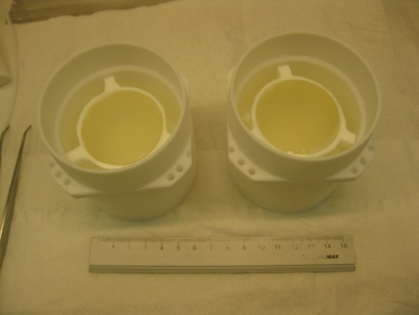
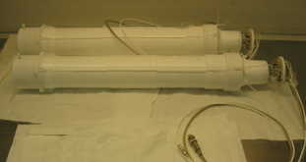
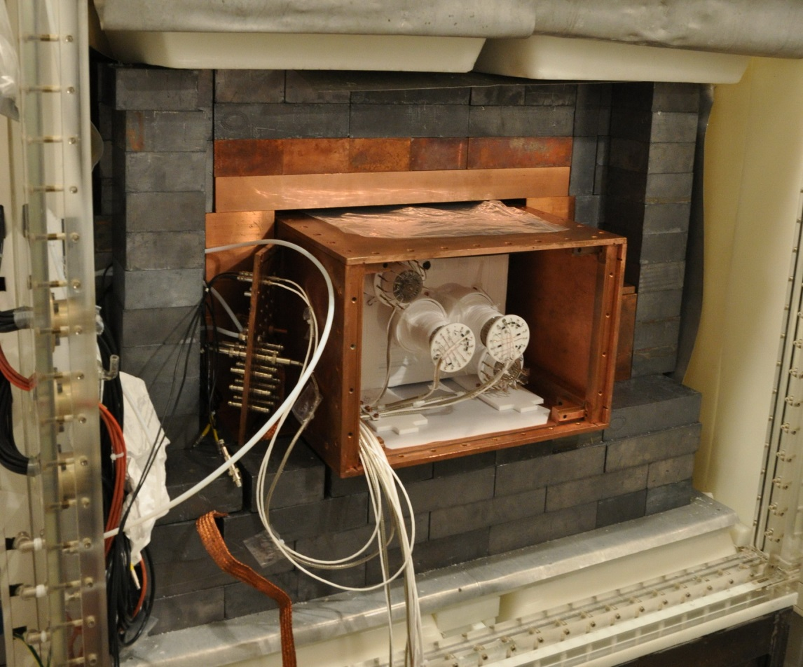
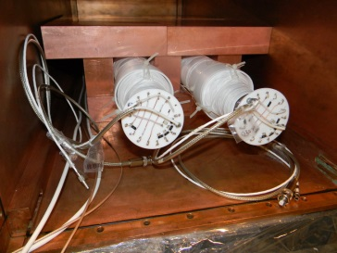
Low background ¹¹⁶CdWO₄ scintillation detector
Gran Sasso underground laboratory
2β of ¹¹⁶Cd with conventional scintillation detectors
Lead 15 cm
Air-tight Cu box flushed by high purity N₂ gas
Copper 10 cm
¹¹⁶CdWO₄
¹¹⁶CdWO₄ detectors
PTFE container filled by Borexino liquid scintillator
High purity quartz light-guide ∅7×40 cm
Cadmium 1.5 mm
Plexiglas box continuously flushed by high purity N₂ gas
Polyethylene 4-10 cm
FWHM ≈ 5% at 2615 keV
DAMA R&D set-up
F.A. Danevich Cryogenic search for neutrinoless double beta decay of cadmium French-Ukrainian workshop, 6-8 Nov 2017, Orsay, France

Slide 9
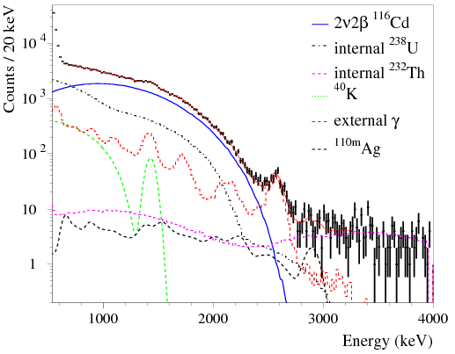
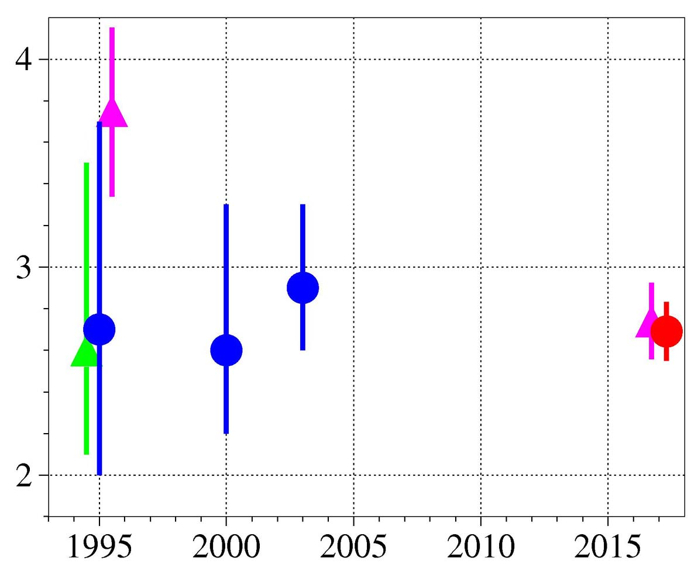
Two neutrino 2β decay of ¹¹⁶Cd
2β of ¹¹⁶Cd with conventional scintillation detectors
NEMO-2 [3]
25037 h
Solotvina 2000 [4]
2ν2β ¹¹⁶Cd
T_{1/2} ×10¹⁹ yr
Solotvina 2003 [5]
NEMO-3 [6]
Aurora
2017
ELEGANT V [1]
Solotvina 1995 [2]
Year
The most accurate value of (error 5.3%)
[1] H. Ejiri et al., J. Phys. Soc. Japan 64 (1995) 339; [2] F.A. Danevich et al., Phys. Lett. B 344 (1995) 72;
[3] R.Arnold et al., Z. Phys. C 72 (1996) 239; [4] F.A.Danevich et al., PRC 62 (2000) 045501; [5] F.A.Danevich et al., PRC 68 (2003) 035501; [7] R. Arnold et al., PRC 95 (2017) 012007;
F.A. Danevich Cryogenic search for neutrinoless double beta decay of cadmium French-Ukrainian workshop, 6-8 Nov 2017, Orsay, France

Slide 10
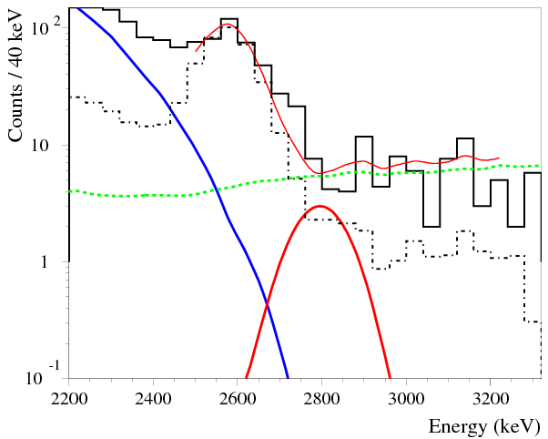
Limit on 0ν2β decay of ¹¹⁶Cd
2β of ¹¹⁶Cd with conventional scintillation detectors
0ν2β 2813
28 741 h
Background was reduced by selection of events:
²¹²Bi (α) → ²⁰⁸Tl (Q_{β} = 5 MeV, T_{1/2} = 3 min)
0.11 → 0.07 cnts/(keV yr kg) in the ROI 2.7-2.9 MeV
ext.Th
int.Th
2ν2β
Effective Majorana neutrino mass:
⟨m_{ν}⟩ ≤ (1.1 – 1.6) eV [1-4]
The best ¹¹⁶Cd 2β experiment realized with a negligible budget
[1] T.R. Rodr´ıguez, G. Mart´ınez-Pinedo, Phys. Rev. Lett. 105, 252503 (2010).
[2] F. Šimkovic, V. Rodin, A. Faessler, P. Vogel, Phys. Rev. C 87, 045501 (2013).
[3] J. Hyvärinen, J. Suhonen, Phys. Rev. C 91, 024613 (2015).
[4] J. Barea, J. Kotila, F. Iachello, Phys. Rev. C 91, 034304 (2015).
F.A. Danevich Cryogenic search for neutrinoless double beta decay of cadmium French-Ukrainian workshop, 6-8 Nov 2017, Orsay, France

Slide 11
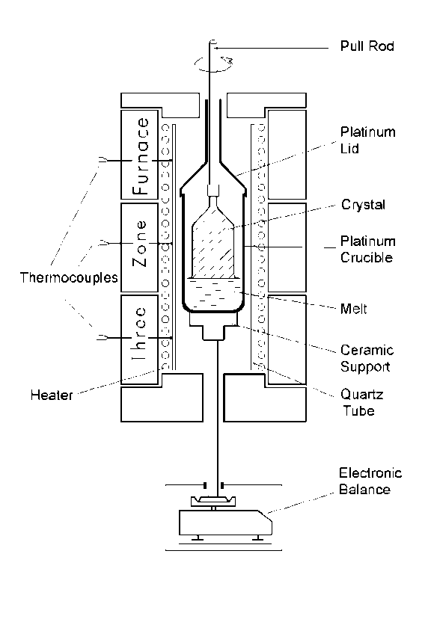
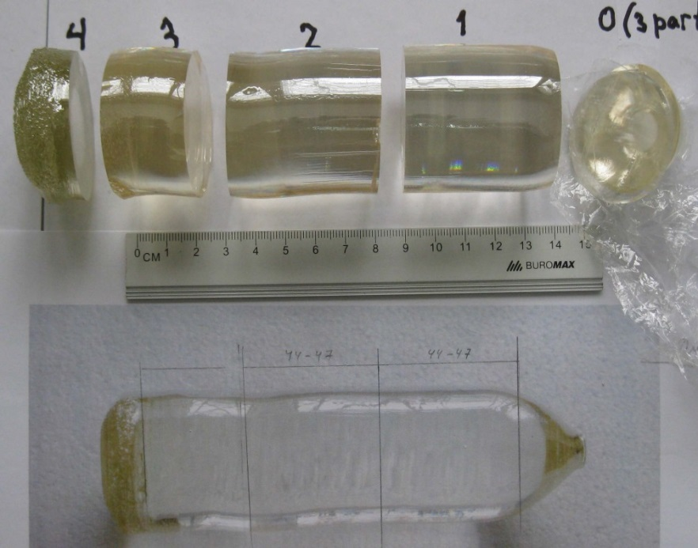
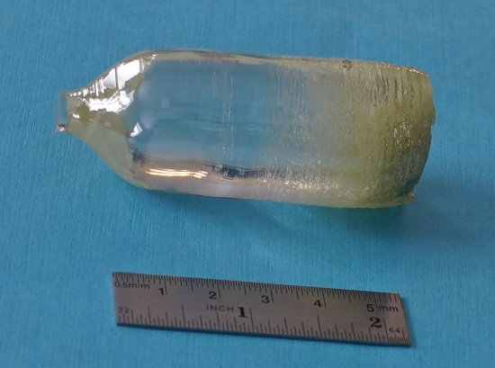
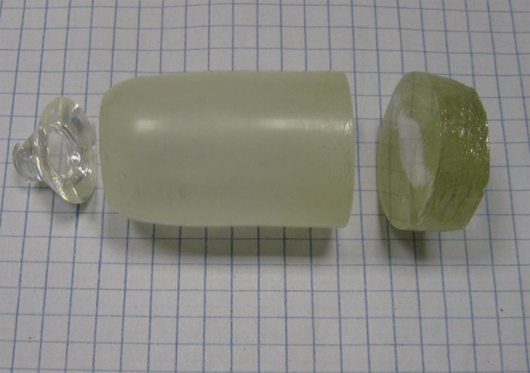
An important technical result: ¹¹⁶CdWO₄ crystals radiopurity was improved by recrystallization
2β of ¹¹⁶Cd with conventional scintillation detectors
²²⁸Th activity, μBq/kg
100
40
20
286 g (88%)
326 g
2nd crystallization by the low-thermal-gradient Czochralski technique
195 g
The Th contamination was reduced by a factor 10, down to the level 0.01 mBq/kg. The total α activity of U,Th was reduced by 3, down to 1.6 mBq/kg [1]
¹¹⁶CdWO₄ crystals of ∼μBq/kg purity can be obtained
[1] A.S.Barabash et al., NIMA 833 (2016) 77
F.A. Danevich Cryogenic search for neutrinoless double beta decay of cadmium French-Ukrainian workshop, 6-8 Nov 2017, Orsay, France

Slide 12
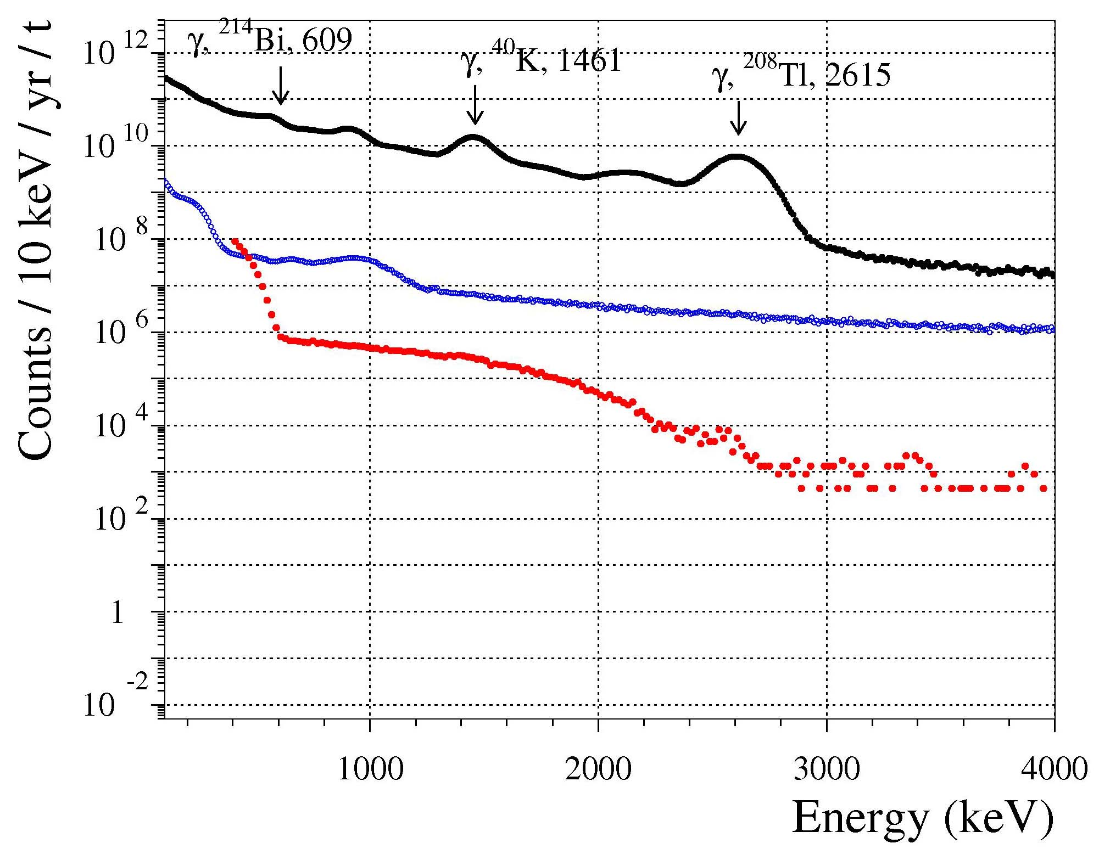

A significant background reduction is requested for CUPID
CYGNUS: low temperature breakthrough
CdWO₄ 2.2 kg no shield
CdWO₄ 2.2 kg
15 cm Pb, 11 cm Cu,
μ-veto (surface lab)
¹¹⁶CdWO₄ 1.2 kg
DAMA R&D at LNGS
2ν2β ¹¹⁶Cd
T_{1/2}=2.6×10¹⁹ yr
Q_{2β}¹¹⁶Cd
CUPID [1,2]
[1] G. Wang et al., CUPID: CUORE (Cryogenic Underground Observatory for Rare Events) Upgrade with Particle IDentification, arXiv:1504.03599
[2] G. Wang et al.,, R&D towards CUPID (CUORE Upgrade with Particle IDentification), arXiv:1504.03612
F.A. Danevich Cryogenic search for neutrinoless double beta decay of cadmium French-Ukrainian workshop, 6-8 Nov 2017, Orsay, France

Slide 13

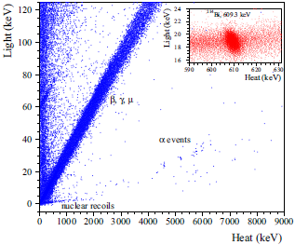
Cryogenic search for 0ν2β decay of ¹¹⁶Cd
CYGNUS: low temperature breakthrough
project CYGNUS: Cryogenic search for neutrinoless double beta decay of cadmium
Energy resolution: 130 keV → 5-7 keV at Q_{2β} [1,2]
Background can be reduced: → 1.4 cnts in 10 keV ROI over 3 yr
Q_{2β}, 2813 keV
ext.Th
The reduction of background (mainly ²⁰⁸Tl) is expected due to particle discrimination and high energy resolution to αs
β, γ, μ
α
int.Th
2ν2β
α
β
²¹²Bi → ²⁰⁸Tl →
Search for 0ν2β decay of ¹¹⁶Cd with advanced sensitivity:
Demonstration of ¹¹⁶Cd option capability for the large scale experiment (i.e., CUPID)
Advantage of ¹¹⁶Cd is lower BG due to random CC of 2ν2β decay
[1] A.S. Barabash et al., EPJC 76 (2016) 487
[2] C. Arnaboldi et al., Astropart. Phys. 34 (2010) 143.
F.A. Danevich Cryogenic search for neutrinoless double beta decay of cadmium French-Ukrainian workshop, 6-8 Nov 2017, Orsay, France

Slide 14
In addition to 0ν2β of ¹¹⁶Cd one could investigate some other rare processes using CdWO₄:
CYGNUS: low temperature breakthrough
Two neutrino 2β of ¹¹⁶Cd can be studied with a very high accuracy (a good example is 2ν2β of ¹⁰⁰Mo with Li₂¹⁰⁰MoO₄)
2β of ¹⁰⁶Cd, ¹⁰⁸Cd, ¹¹⁴Cd, ¹⁸⁰W (resonant 0ν2ε), ¹⁸⁶W
β decay of ¹¹³Cd to study the axial vector coupling constant g_{A}
α decay of ¹⁸⁰W
Search for eka-tungsten [1]
[1] P Belli et al., Search for long-lived superheavy eka-tungsten with radiopure ZnWO4 crystal scintillator, Phys. Scr. 90 (2015) 085301
F.A. Danevich Cryogenic search for neutrinoless double beta decay of cadmium French-Ukrainian workshop, 6-8 Nov 2017, Orsay, France

Slide 15
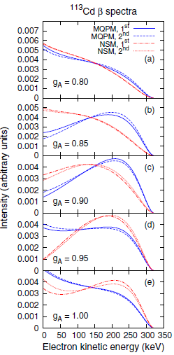
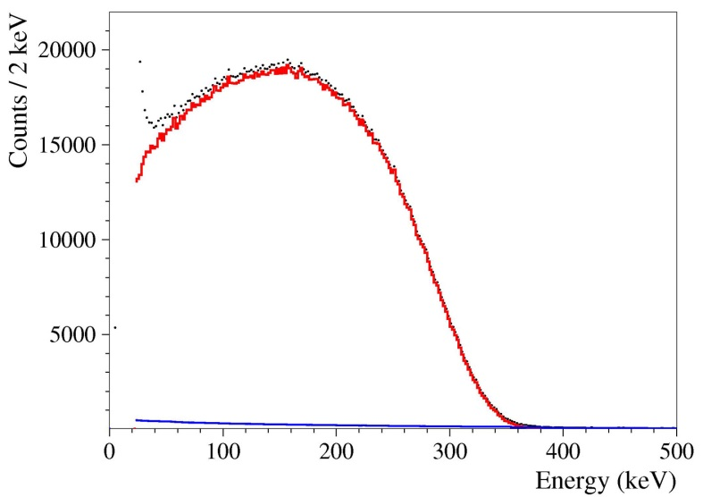
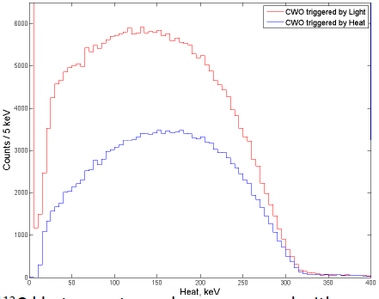
An example: β decay of ¹¹³Cd
CYGNUS: low temperature breakthrough
the axial vector coupling constant g_{A} is a crucial parameter to calculate nuclear matrix elements for neutrinoless double beta decay
the calculated shape of the ¹¹³Cd β spectrum is quite sensitive to the values of g_{V} and g_{A} [1]
β spectrum of ¹¹³Cd measured with CdWO₄ scintillator in the DAMA R&D set-up at the Gran Sasso Lab [2]
Q_{β} =323 keV
28 keV
preliminary
β spectrum of ¹¹³Cd measured with CdWO₄ low temperature scintillator in the EDELWEISS set-up at the Modane Lab
Goal: energy threshold ∼5 keV
[1] M. Haaranen, P. C. Srivastava, J. Suhonen, PRC 93 (2016) 034308
[2] P. Belli et al., PRC 76 (2007) 064603
F.A. Danevich Cryogenic search for neutrinoless double beta decay of cadmium French-Ukrainian workshop, 6-8 Nov 2017, Orsay, France

Slide 16
Conclusions and Prospects
¹¹⁶Cd is one of the most promising 0ν2β candidates
CdWO₄ scintillators: high energy resolution, radiopure, the production (including crystals from enriched cadmium) is well stablished
CYGNUS low temperature ¹¹⁶CdWO₄ experiment will investigate the 0ν2β decay of ¹¹⁶Cd with a sensitivity , and set a basis for ¹¹⁶Cd in CUPID
F.A. Danevich Cryogenic search for neutrinoless double beta decay of cadmium French-Ukrainian workshop, 6-8 Nov 2017, Orsay, France

