Slide 1

French-Ukraine workshop – LAL
French Task force for Phase 2 ATLAS Tracker construction
Future Contributions of LPNHE & LAL
and IRFU
Giovanni Calderini – LPNHE, Paris
Abdenour Lounis- LAL, Orsay

Slide 2
Overview of the presentation
Introduction to the ATLAS context
Contributions to the development of the Inner Tracker system
Future plans for ATLAS ITK construction
Infrastructures to contribute as an ATLAS pixel production center
Conclusions

Slide 3

Pixel sensors R&D groups (Almost 10 yea rs)- People involved
LAL:
A. Lounis,
Phd Students : T. Rashid+ Dmytro Hohov (Kiev)
Past contributions: C. Nellist (PostDoc), E. Gkougkousis (PhD)
A. Bassalat (PhD), M. Benoit (PhD), J. Idarraga (PostDoc), Vladimir Linhard (PostDoc)
For the Construction: D. Varouchas, L. Fayard, C.A. Bourdarios, R.Tanaka
LPNHE:
G. Calderini
M. Bomben, G. Marchiori, F. Cresoli,
PhD student : A. Ducourthial , J. Chauveau
Yourii Piadyk, Mykyta Haranko (Kiev)

Slide 4
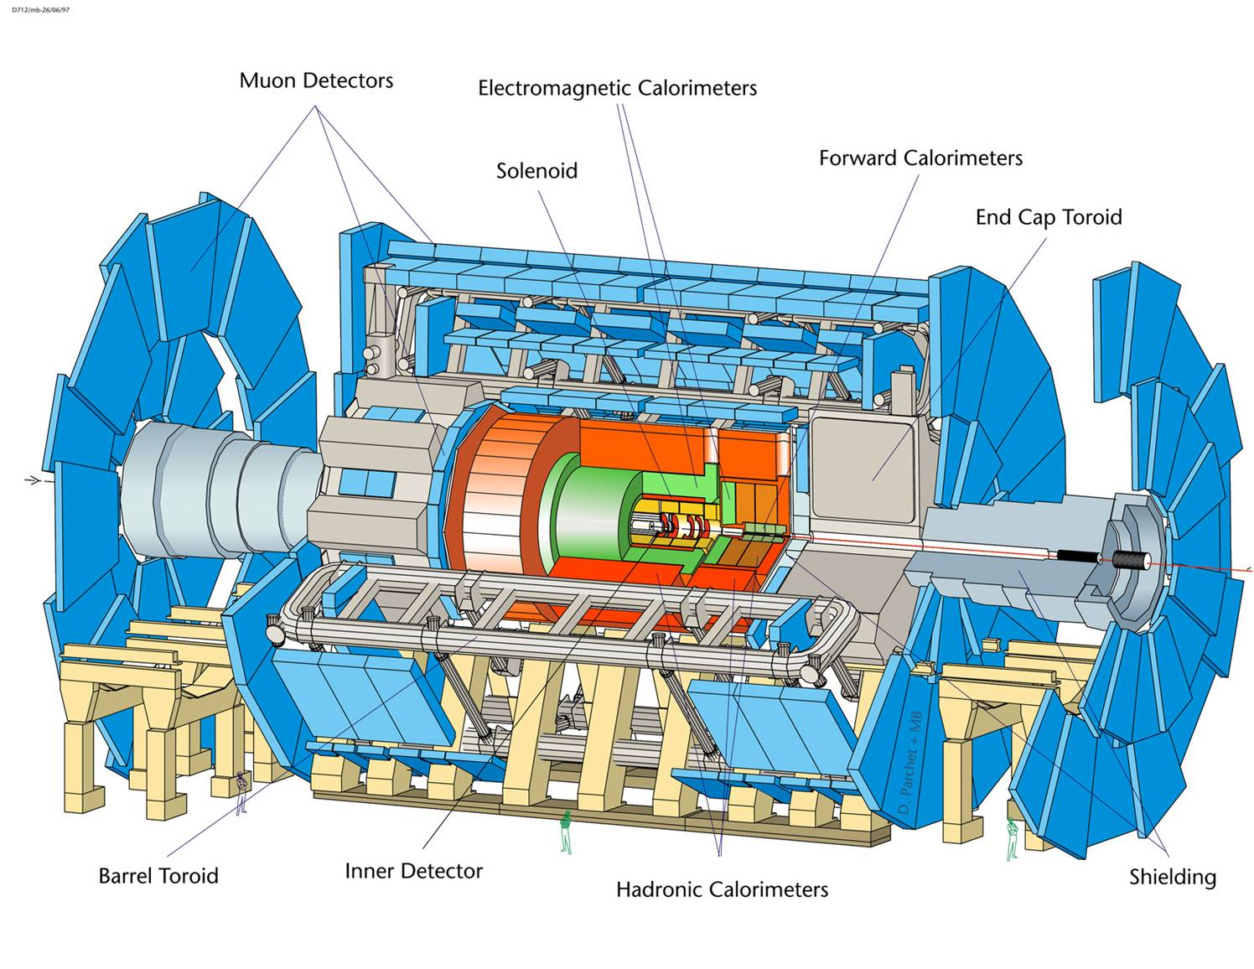
ATLAS detector
Huge multi-purpose detector; 46 m long; diameter 22 m; weight 7000 t
Tracking system: 7 m long; diameter 2.3 m; 2 T field

Slide 5
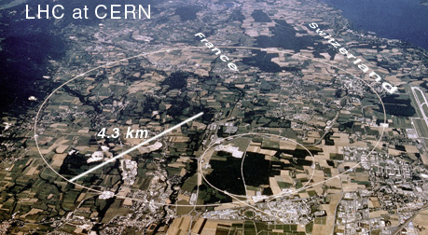
ATLAS Tracker at LHC
Large Hadron Collider in ~27km, E=14 TeV, L=10³⁴ cm⁻²s⁻ Beam-crossing: 40MHz
    1 GHz interaction rate, 10³ particles each 25 ns.
Tracking detectors must fulfill the conditions:
    Fast (40MHz), Rad-Hard (10-100kGy), high granularity & good pattern recognition capabilities (10³ tracks/25 ns).
Environment is very radiation hostile: Accuracy and we should be able to measure tracks!
    To measure momenta (→dynamics, invariant masses)
    To measure vertices
        Primary → improve on p and E measurements
        Secondary → tag ps living particles (b,τ)→ markers of events with significant physics content
    To help identifying photons

Slide 6
Bref summary of what has been acheived

Slide 7
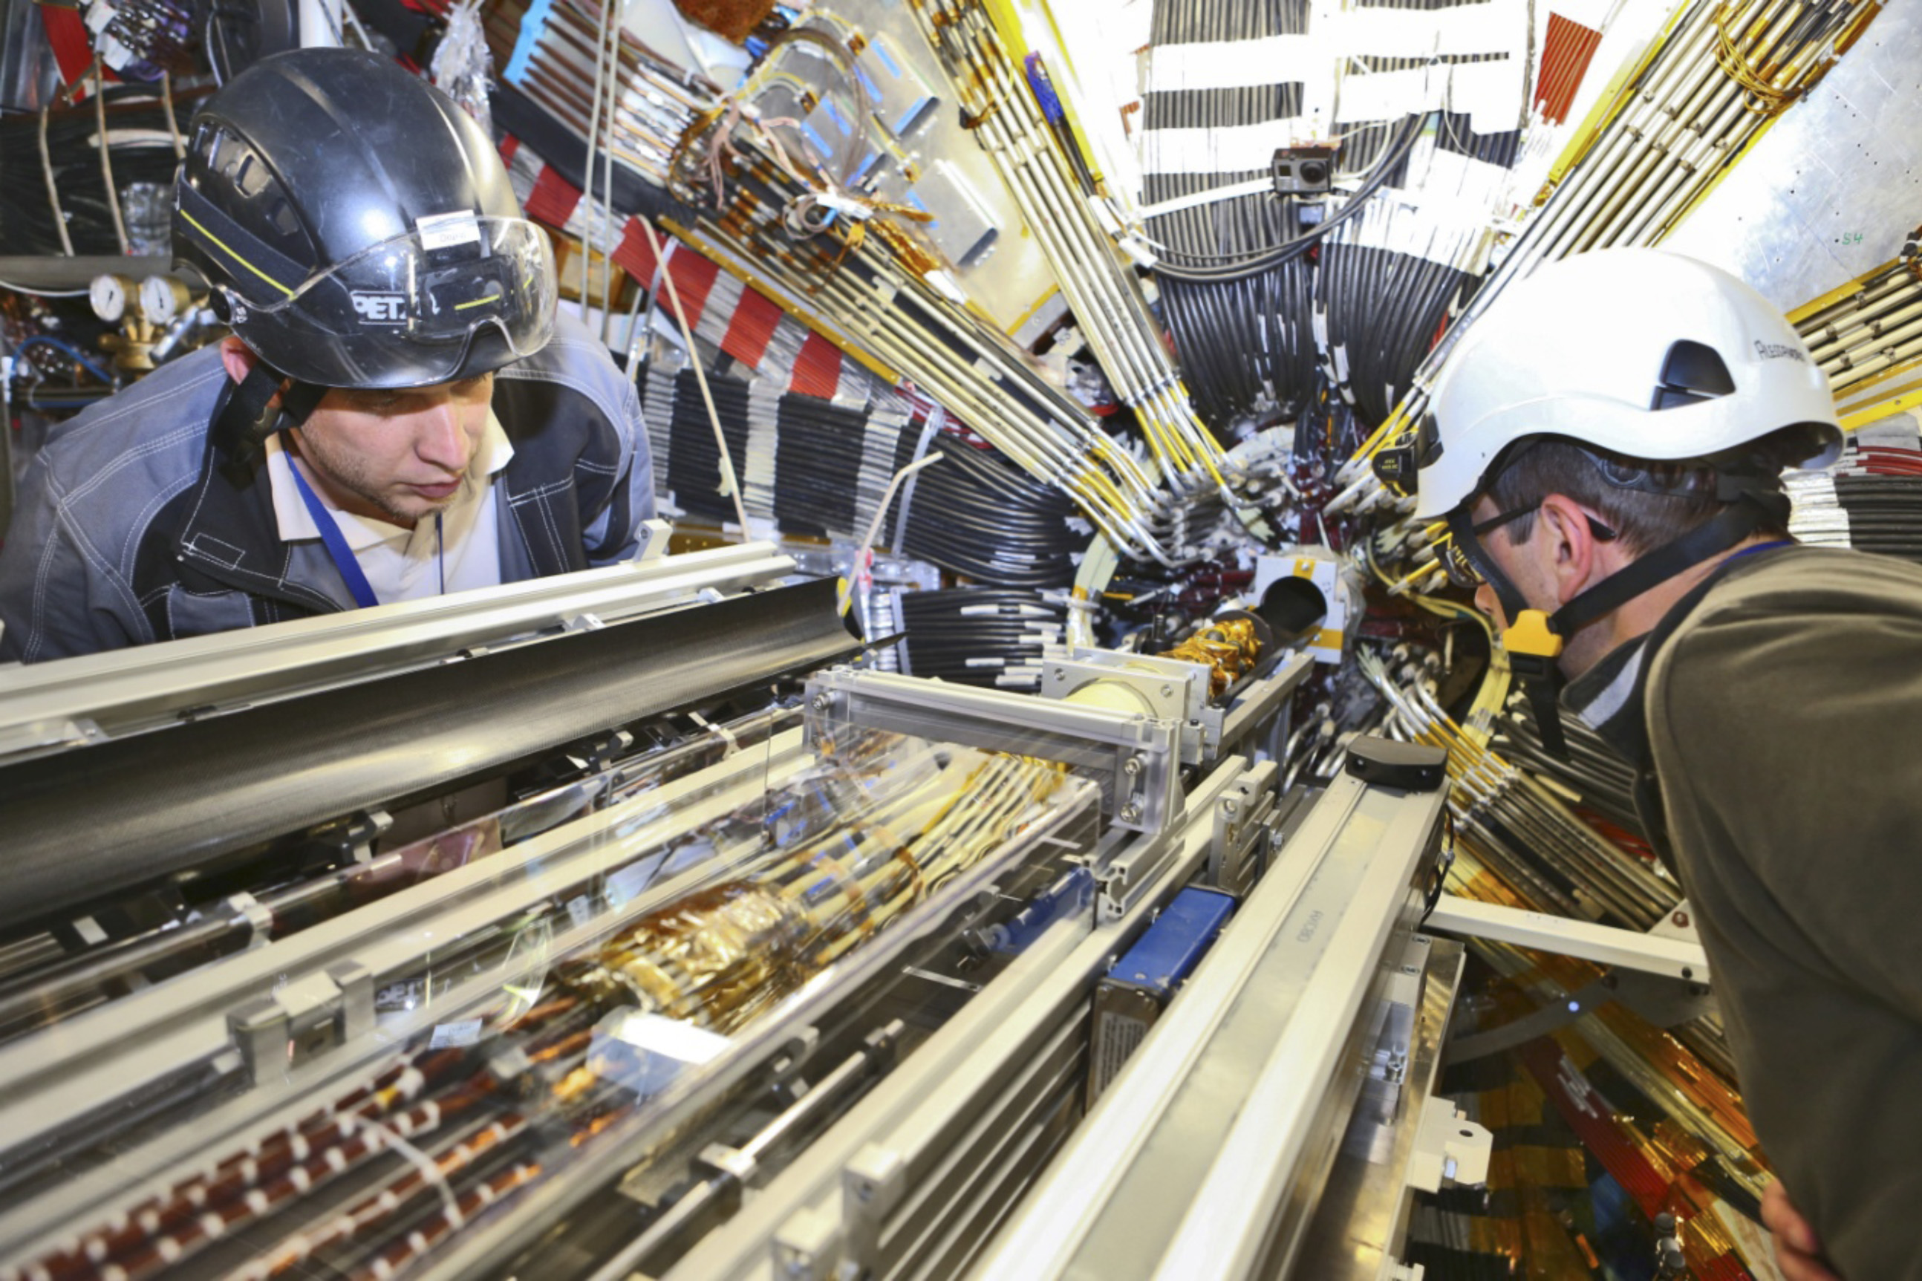
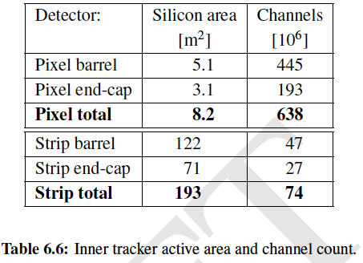
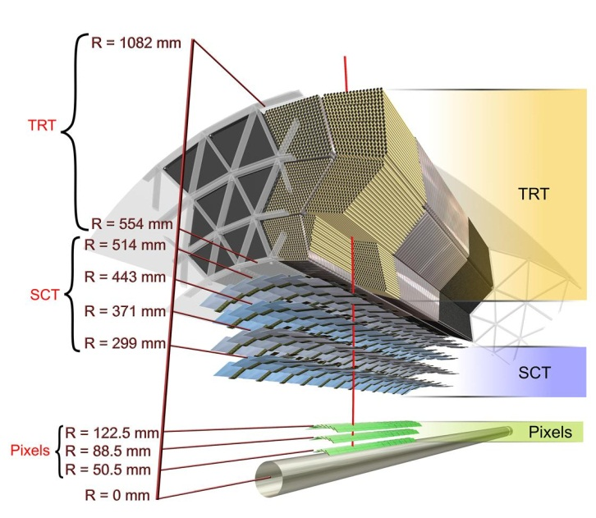
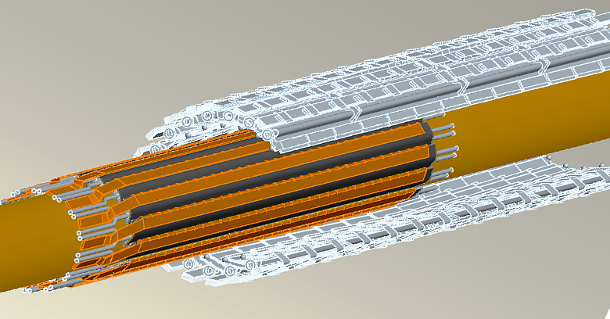
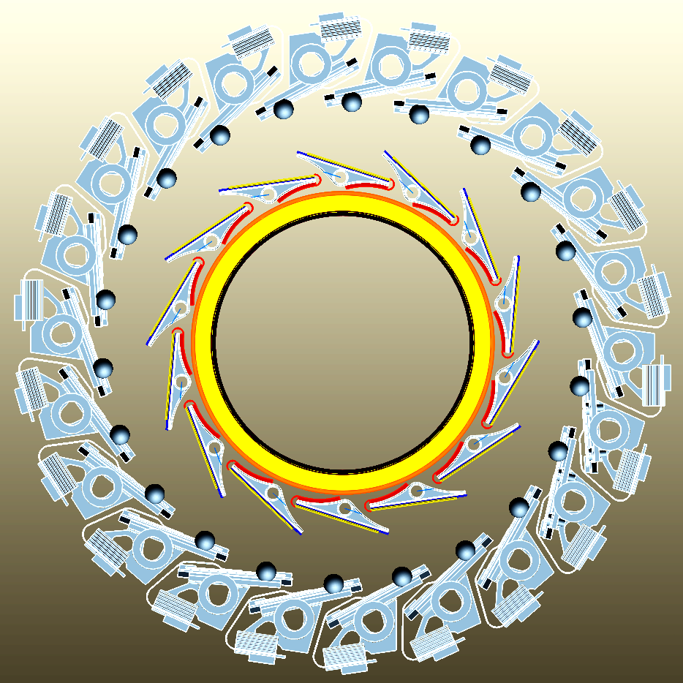
Focus on the actual pixel system
Actual geometry
Existing B-layer
Newbeam pipe
IBL mounted on beam pipe
NEW LAYER ADDED IBL 30 mm radius

Slide 8
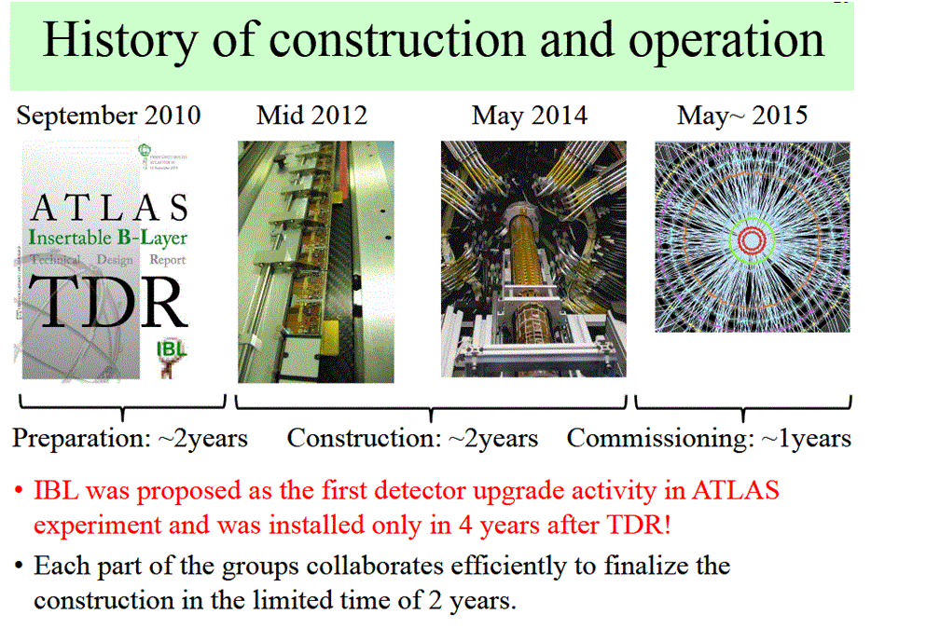
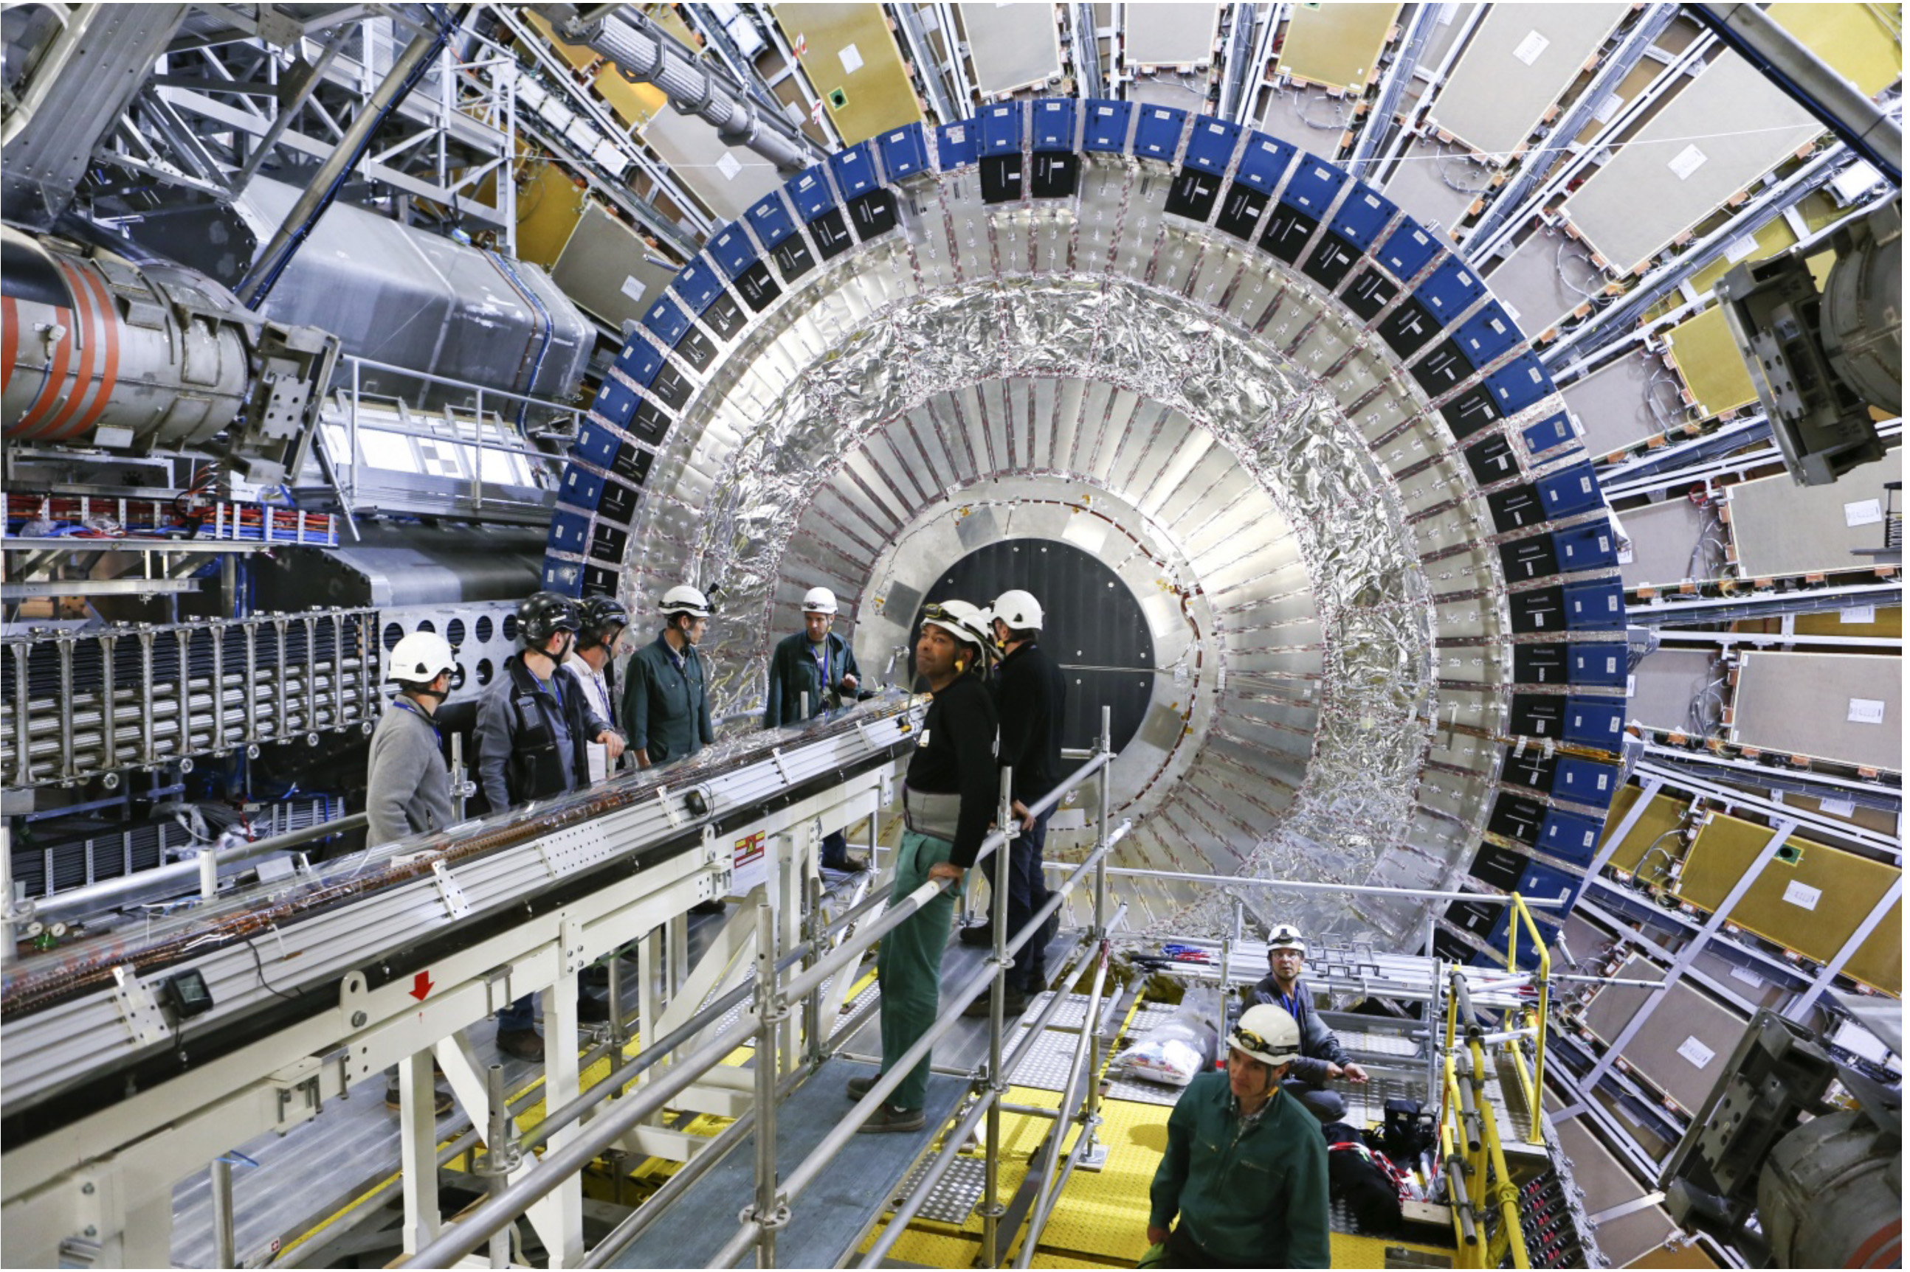
Past important contributions
IN2P3 important contributions
(2010-2015) for the Insertable B Layer project :
  Sensors
  Cooling
  Mechanics
  Integration
  Work in Labs & manpower
  (1 LAL-PhD student @CERN)

Slide 9
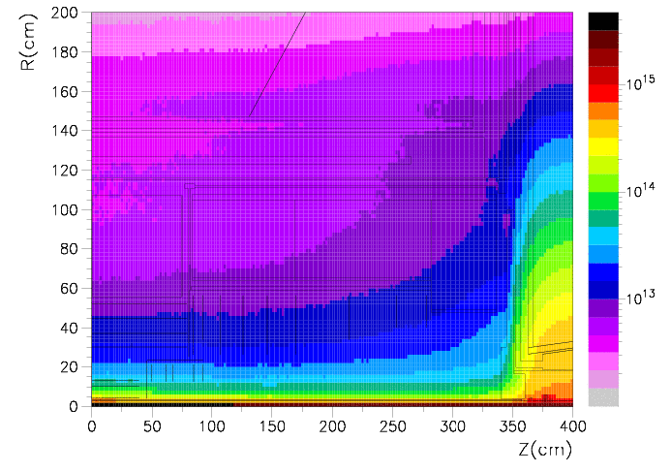
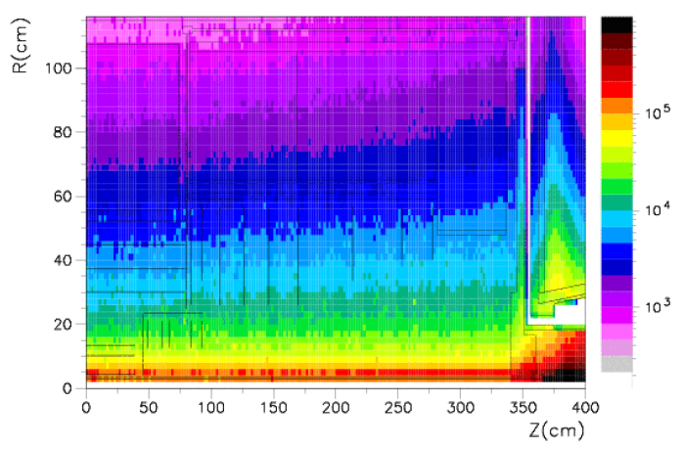
One important issue at LHC: Extreme radiation levels !
Plots show radiation dose and fluence per high luminosity LHC year for ATLAS (assuming 10⁷ s of collisions; source: ATL-Gen-2005-001)
Fluence [1 MeV eq. neutrons/cm²] Radiation dose [Gray/year]
“Uniform thermal neutron gas” Put your cell phone into ATLAS !
It stops working after 1 s to 1 min.
Neutrons are everywhere and cannot easily be suppressed

Slide 10
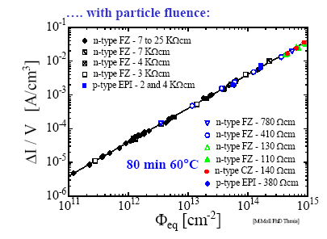
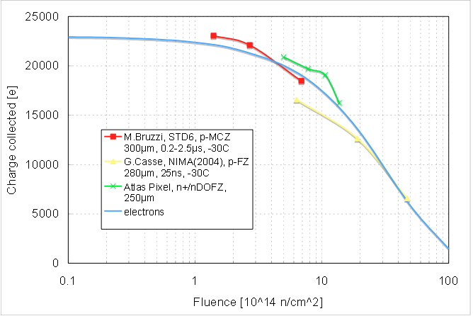
Radiation-hard sensors
Radiation induced leakage current
independent of impurities; every 7°C
of temperature reduction halves current
cool sensors to ≈ -25°C (SCT = -7°C)
“type inversion” from n to p-bulk
⬄ increased depletion voltage
oxygenated silicon helps (for protons);
n+-in-n-bulk or n+-in-p-bulk helps
Charge trapping
the most dangerous effect at high fluences
⬄ collect electrons rather than holes
⬄ reduce drift distances
Notes:
Expand this into a few slides

Slide 11
Alternatives for Planar pixel technology
n-in-n
More expensive
Double-sided processing
Limited suppliers
Some experience with “large” scale production
  CMS/ATLAS pixels, LHCb VELO
n-in-n
Bias Ring
Guard Ring
SiO₂
n⁺
p-spray/stop
n⁻ bulk
Al
p⁺
Bias Ring
Present
Guard Ring
n-in-p
~50% less expensive than n-in-n
Single-sided processing
More suppliers (Japan, EU )
Limited production experience
Better radiation hard tolerance
n⁺ R/O kept
Bias Ring
n-in-p
Guard Ring
SiO₂
n⁺
p-spray/stop
p⁻ bulk
Al
p⁺
Future

Slide 12
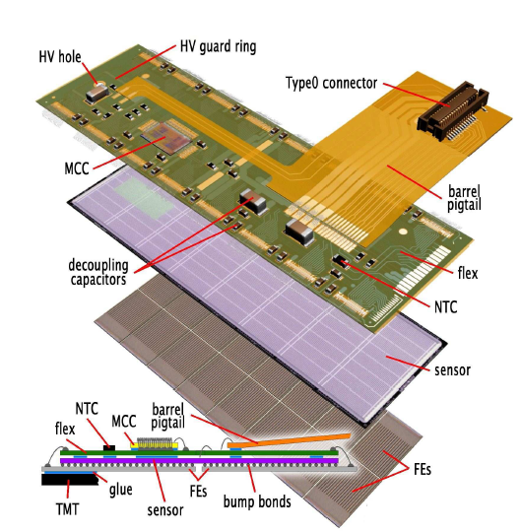
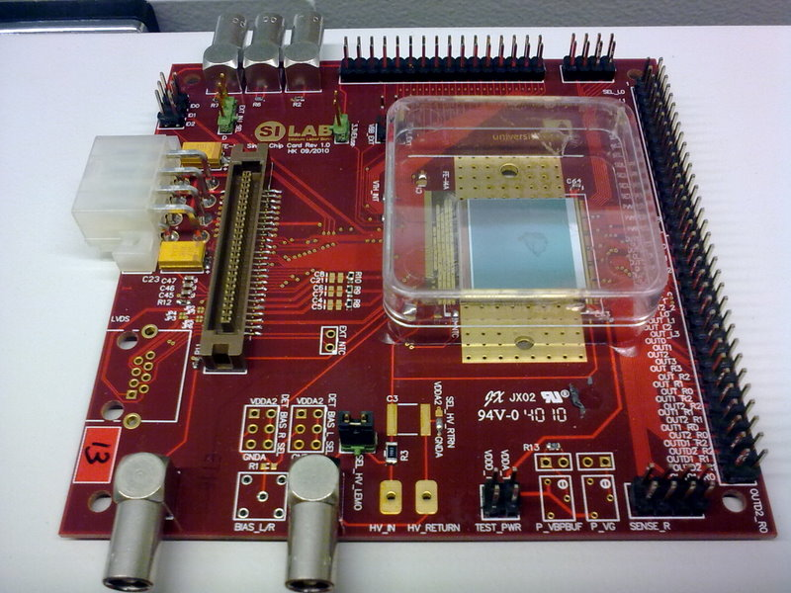
Pixel Module Detection Unit
Intrinsic Module Detection device
Hybrid pixel detector:
The sensor and the readout electronic are realized in different semiconductor substrates
Size of the electronic readout pixels is equal to the size of the sensor pixels
The connection between the electronic and the sensor is done via bump bond connections
Silicon sensor
Bias plane
Bump bond connection
Readout chip
Pixe Matrix

Slide 13
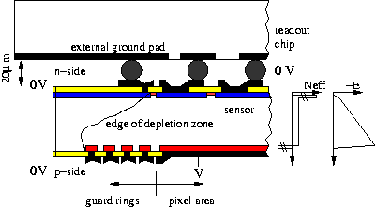
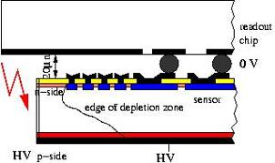
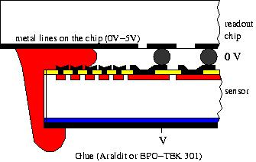
R&D :Towards (n-in-p) Edgless Sensors for the future
n-in-n
ATLAS pixel detector uses
n-in-n-sensors
  double sided processing (back side is structured)
  all sensor edges at ground
  most expensive part of the module
  Exploring n-in-p sensors as alternative
  Studies show radiation hardness (LAL&LPNHE Member of RD50 coll.)
  single sided process ~ price benefit of factor 2-3
    Develop Active Edge Technology
  Absence of guard rings on back side lead to risk of (destructive) sparking to the ROC
n-in-p

Slide 14
LPNHE & LAL: Active contributions within ATLAS Pixel R&D
  Tasks to improve the Planar Pixel Silicon detector for the ATLAS upgrade
  Goals
  Performance : evaluate & improve sensor design for radiation tolerance up to 3x10¹⁵n_{eq}/cm² fluence.
  Productions : work on various wafer productions (Cis, VTT Advacam & FBK)
Biasing Structure
Optimize Biasing structure
Higher Efficiency at Pixel boundary
Bumpbonding
Better UBM material
Higher Flip-Chip Yield
Active Edge
Smaller Edge size
Higher Efficiency at Edge region
Bump
Bias-rail
Poly-Si
Under Bump
Metalization
Simulation
Doping concentration
Charge collection
Guard Ring
n⁺
Radiation Tolerance
Assembly
Production…
e⁻
P-stop
e⁻
h
e⁻
h
h

Slide 15
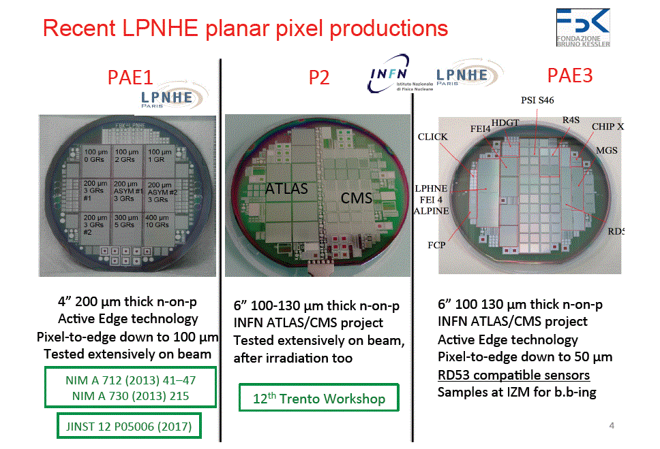
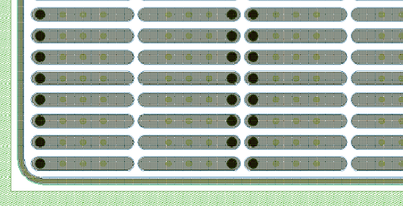
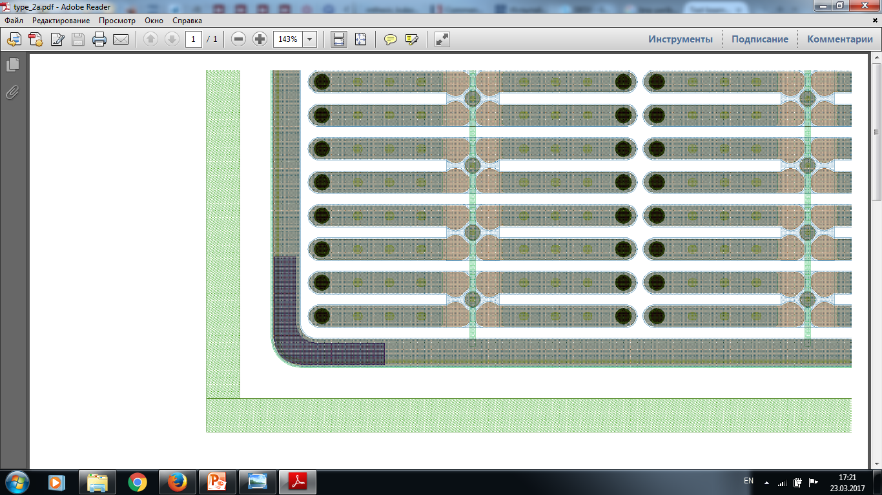
DUT#20 DUT#21
Edgless & Slim edge Pixels for Phase 2
Typical pixel sensor design for phase 2
  n-in-p common ATLAS wafer production VTT- ADVACAM- Finlande
  Characterized in clean room at LAL and tested in Beam tests at CERN
ADVACAM NP150-6-1A
(thickness – 150 um) active edge design
ADVACAM NP100-7-2A
(thickness – 100 um) slim edge
100 um
50 um
Guard Ring
Bias Ring
Punch-through structure

Slide 16
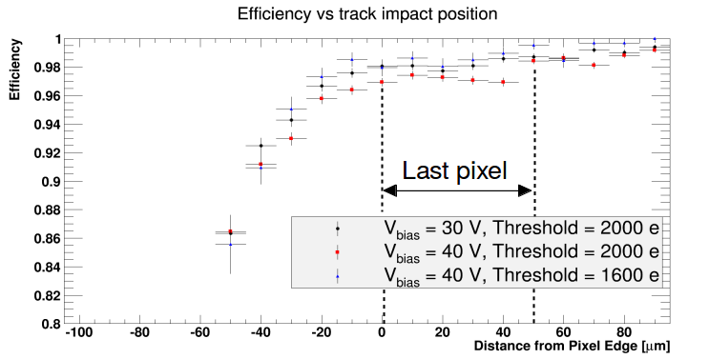
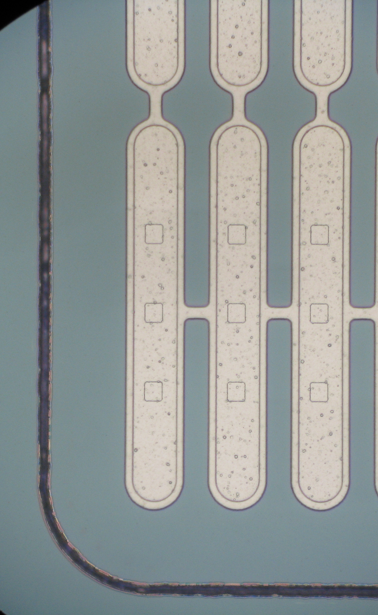
Hit-efficiency at the edge
Hit-efficiency above 90% up to 40 µm away from the last pixel
No good tracks beyond -50 µm due to quality cuts

Slide 17

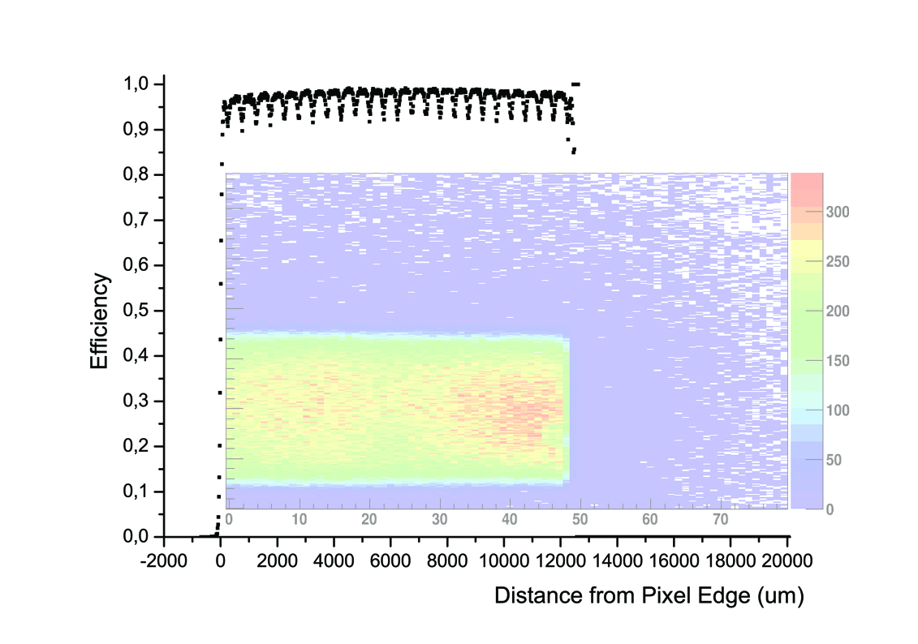
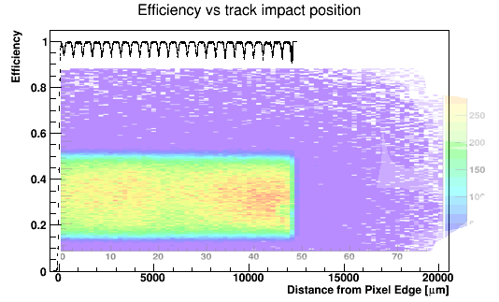
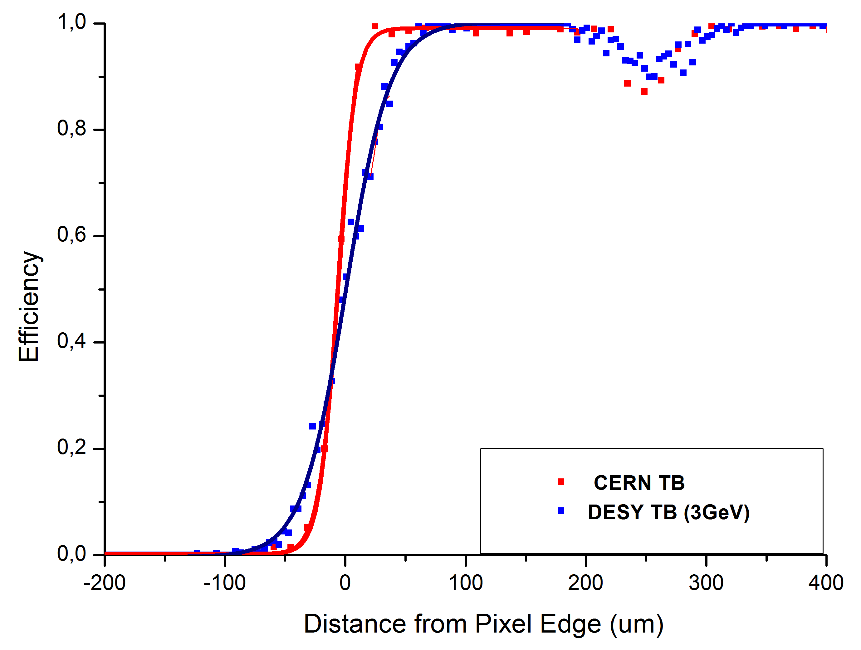
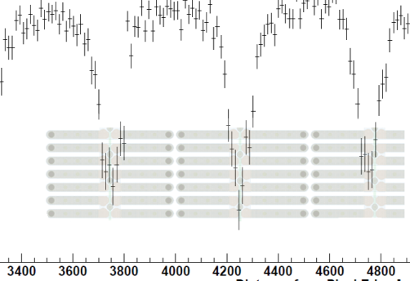
Efficiencies from beam tests
- Efficiency vs track impact position DUT#22
Sensor border
Pixel border
Last pixel column
(250 um)
Analysis from Dmytro Hohov ATLAS@LAL

Slide 18
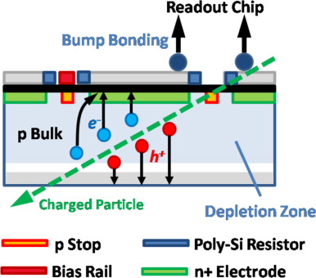
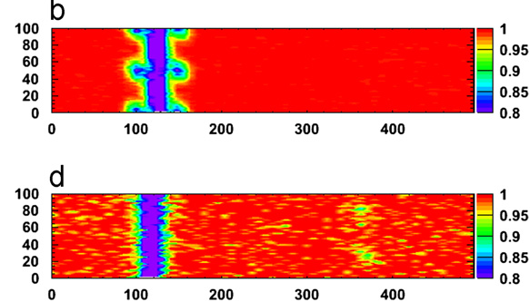
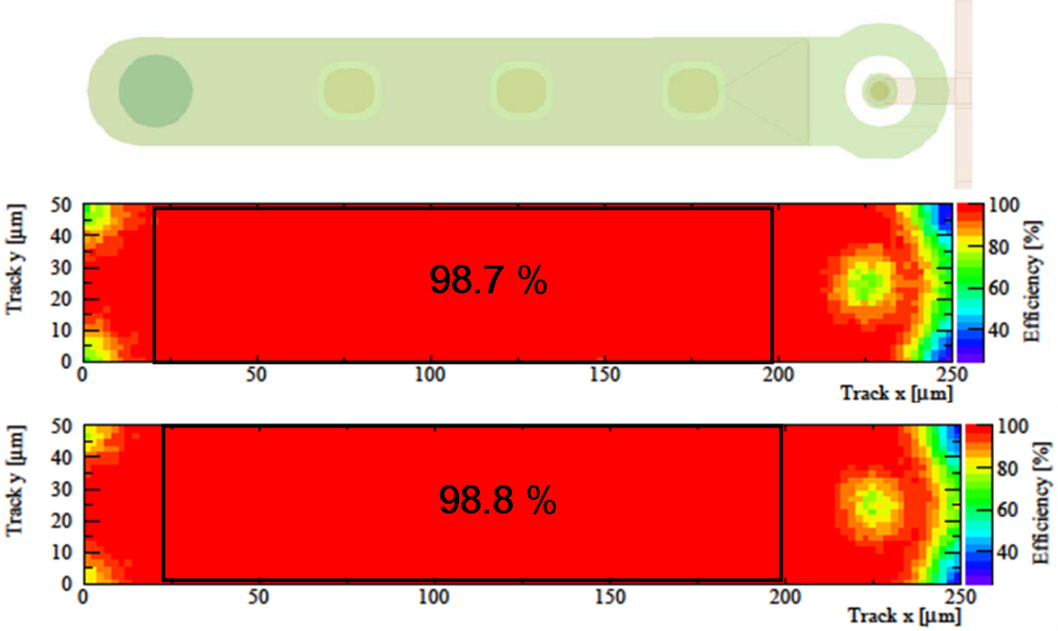
Irradiated pixel behavior at high fluence
Beam-tests results
Bias Rail
Position of polarization rail
O⁰tilt
Eudet 120 GeV pions/ Φ=4x10¹⁵ n_{eq} cm⁻²
15⁰ tilt
Pixel Matrix Hitmap at 5. 10¹⁵ neq/cm² and Temperature -15⁰c.
Loss of Effiicency around Bias rails and implants

Slide 19
Future plans for ATLAS ITK construction

Slide 20
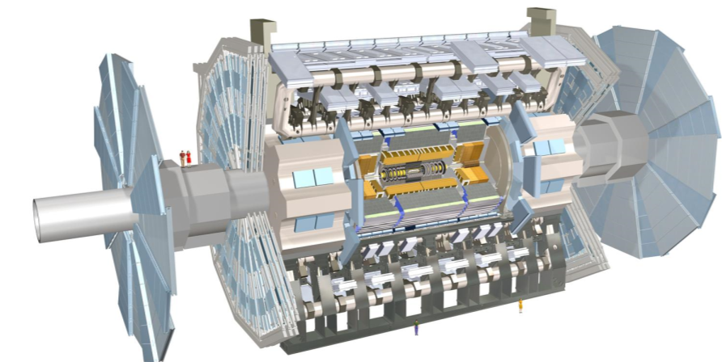
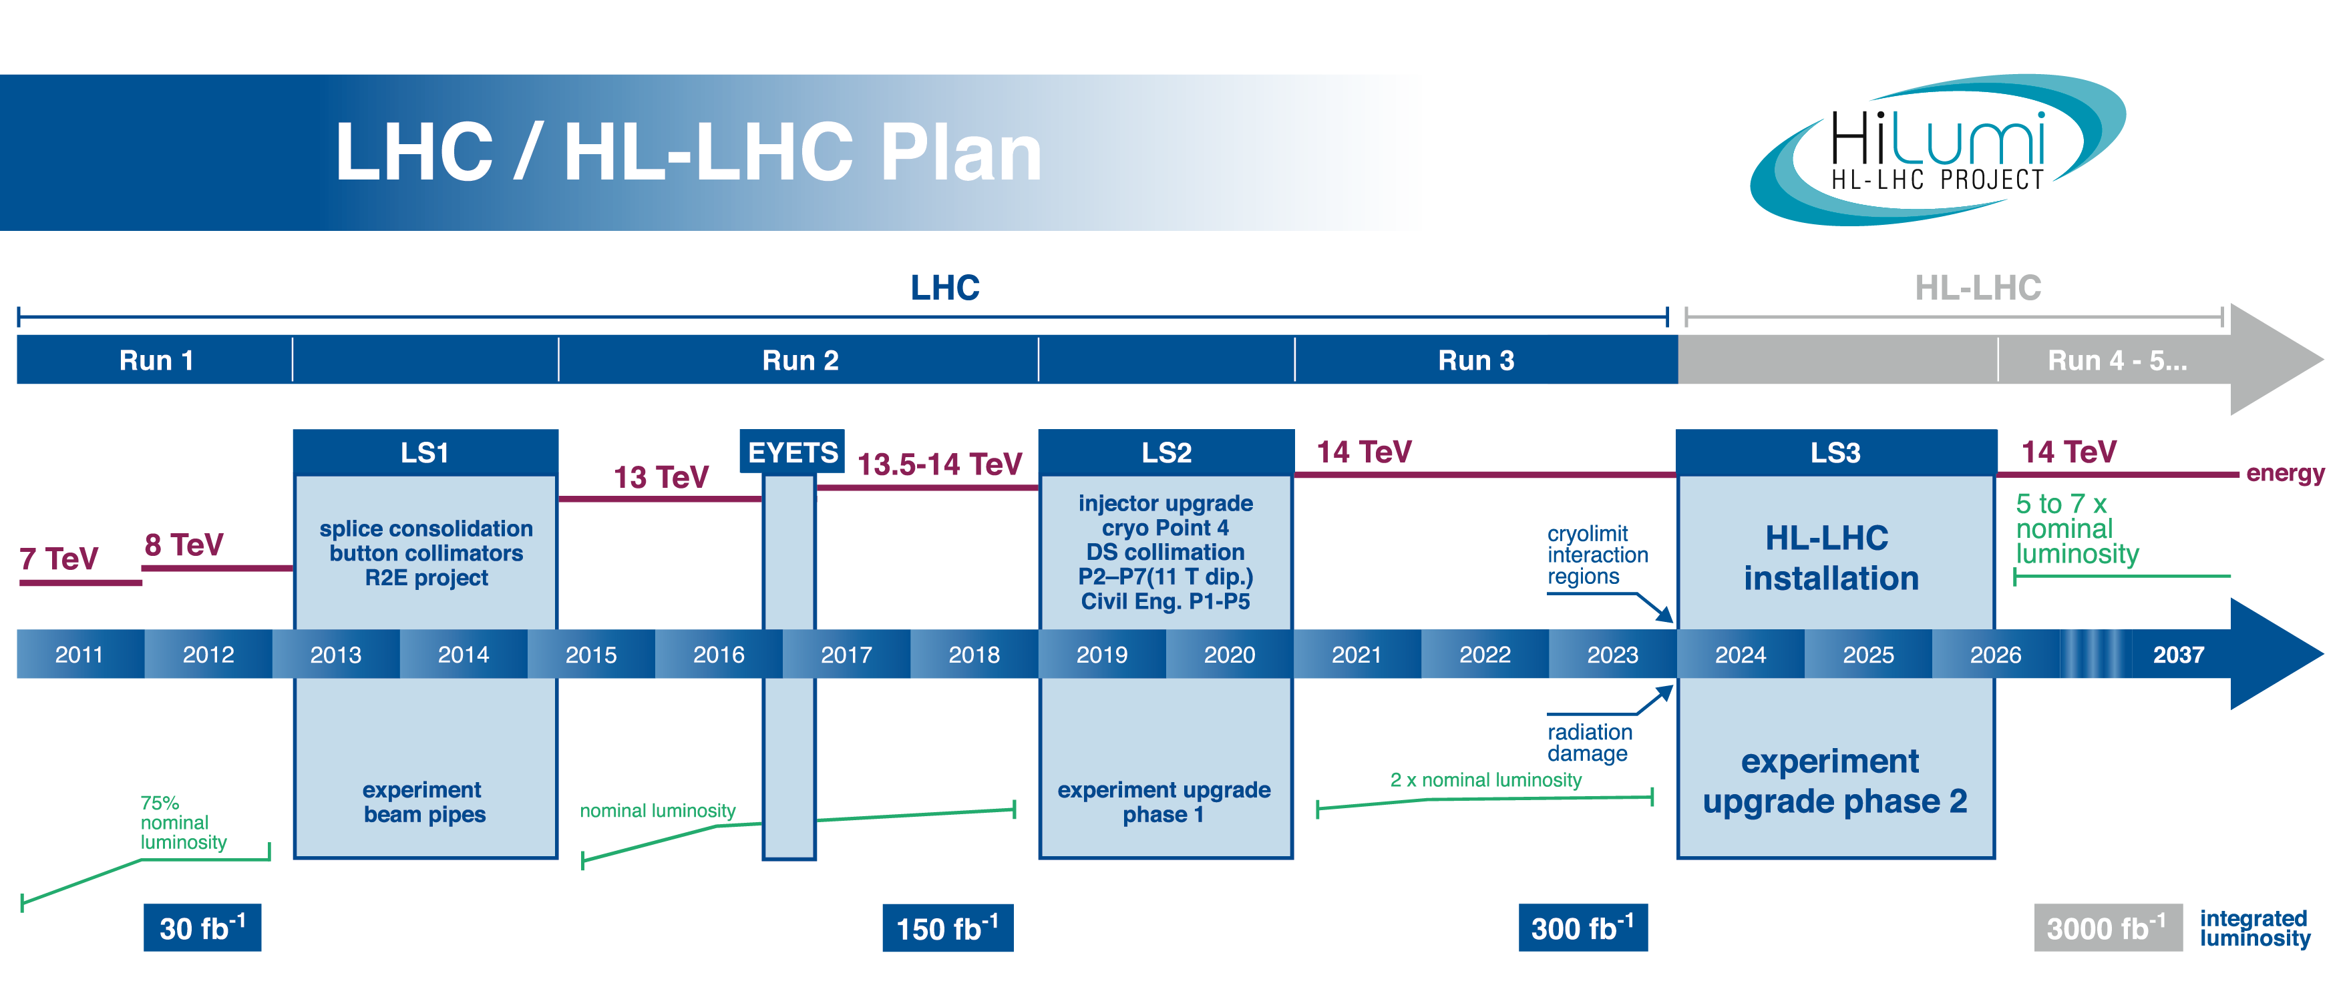
Roadmap for ATLAS phase 2
Internal Detector
Installation IBL
Fast track (FTK) for Trigger
Tile calorimeter
Front end Electronics replacement
Full replacement
Muon spectrometer
Argon liquid Calorimeter (LAr)
Trigger upgrade
Replacement of Front-End electronics
Forward Calorimeter upgrade.
<μ> =
50-80
<μ> =
140-200
LUMINOSIY

Slide 21
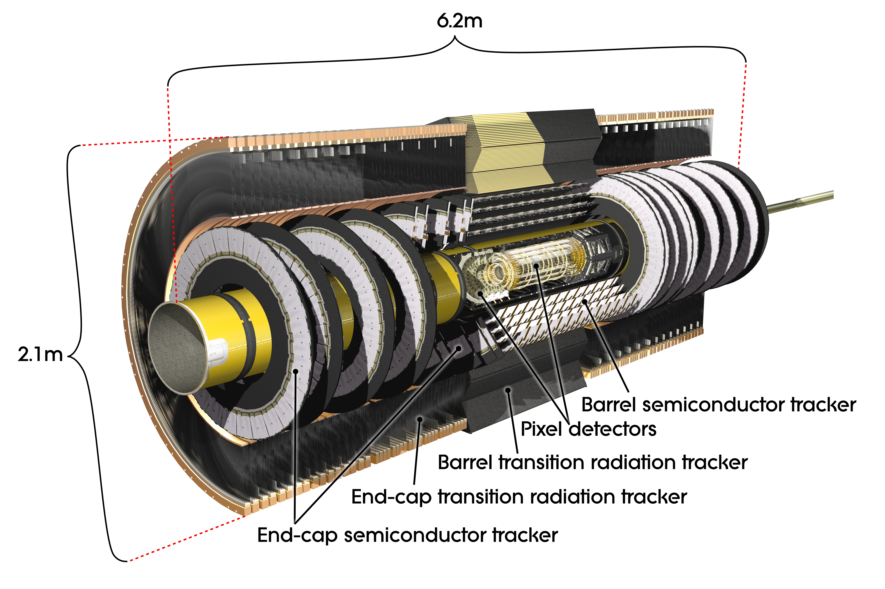
Challenges for a new inner tracker
But !
Same or better performance required !
  Use quite “transparent tracker” Low X0
  Provide V. High granularity sensors
  Go du deep submicron technologies
  Raise the transfer data band-with (5Gps)
  Improve the layout and mechanics
High Luminosity LHC conditions will affect
Drastically the current design
Peak Luminosity will increase by a factor 5-7 :
5-7 10**34
Average Pileup : a factor of 8 <m> ~200
Integrated luminosity : a factor 10 : 3000 fb-1
Radiation hardness : a factor 20 : 2x10 n_{eq}/cm²

Slide 22
Expected fluences (1 MeV n_{eq}.cm⁻²)
Pixels | R (mm) | Fluence Max (Neq/cm2) | Dose (Mrad)
Layer 0 | 39 | 2,25 .10*16 | 1710
Layer 1 | 75 | 0,82 .10*16 | 715
Layer 2 | 155 | 0,25 .10*16 | 148
Layer 3 | 213 | 0,12 .10*16 | 96
Layer 4 | 271 | 0,12 .10*16 | 61
Endcap | 80 | 0,67 .10*16 | 687
8 MGy , 1.4x10¹⁶ n cm⁻²
1 MGy , 2x10¹⁵ n cm⁻²
2 MGy , 4x10¹⁵ n cm⁻²
L0
L1
L0
ATLAS ITk Simulation, FLUKA to 3,000 fb⁻¹

Slide 23

Production planning of the next Pixel Tracker : Planning 2017-2025
2017
2018
2019
2020
2021
2022
2023
2024
2025
Q1 | Q2 | Q3 | Q4
Q1 | Q2 | Q3 | Q4
Q1 | Q2 | Q3 | Q4
Q1 | Q2 | Q3 | Q4
Q1 | Q2 | Q3 | Q4
Q1 | Q2 | Q3 | Q4
Q1 | Q2 | Q3 | Q4
Q1 | Q2 | Q3 | Q4
Q1 | Q2 | Q3 | Q4
Estimation for the module production including the loading
32-36 months
RD53-A test
FE design
Pre-prod
sensors
Pre-prod
Module production
Loading
Integration
Test in SR1
Production centers
PIT
CERN

Slide 24
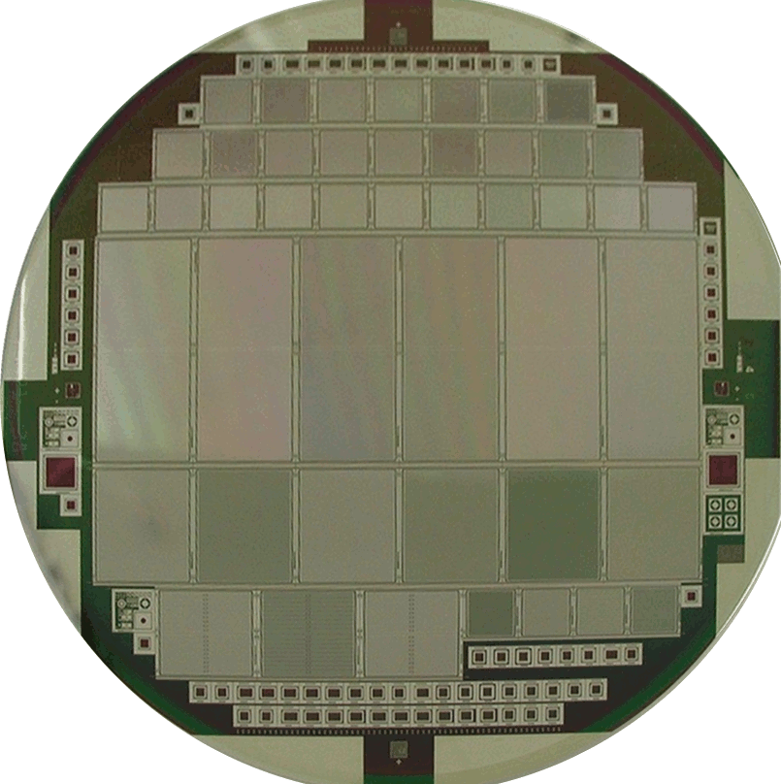
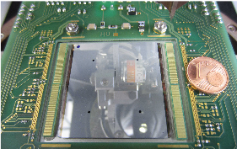
Estimation in terms of module construction
Fully inclined (Front-end)
Layer 0 | 936 FE
Layer 1 | 2016 FE
Layer 2 | 3200 FE
Layer 3 | 4752 FE
Layer 4 | 6264 FE
Rings
Layer 0 | 3264 FE
Layer 1 | 5472 FE
Layer 2 | 6144 FE
Layer 3 | 7680 FE
Quad
doublet
Total | 22560 FE
Total | 17168 FE
singlet
Supposing single chip for layer 0
double chip module Layer 1
Quads for Layers 3 et 4
Total Modules including rings ~ 12.000 Modules
Quad FEI4 Module prototype
Major investment of IN2P3 for ITK
LAL-IN2P3-CPPM-LPSCG-LAPP
Contribution (LAL+ LPNHE)~ ~1000-2000 Modules

Slide 25
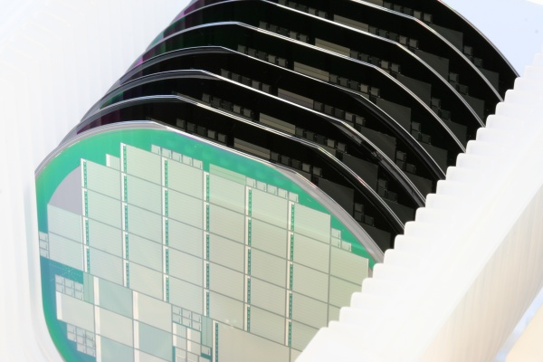
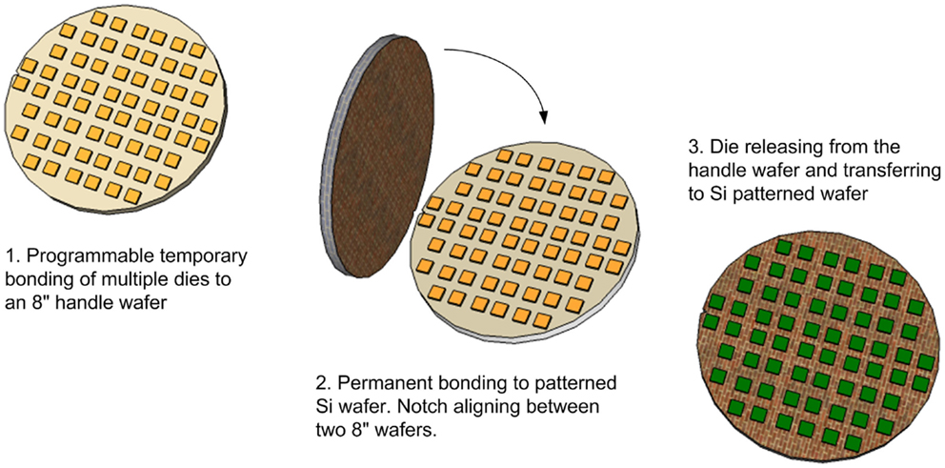
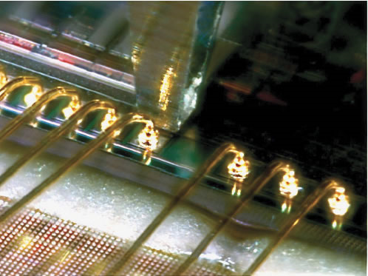
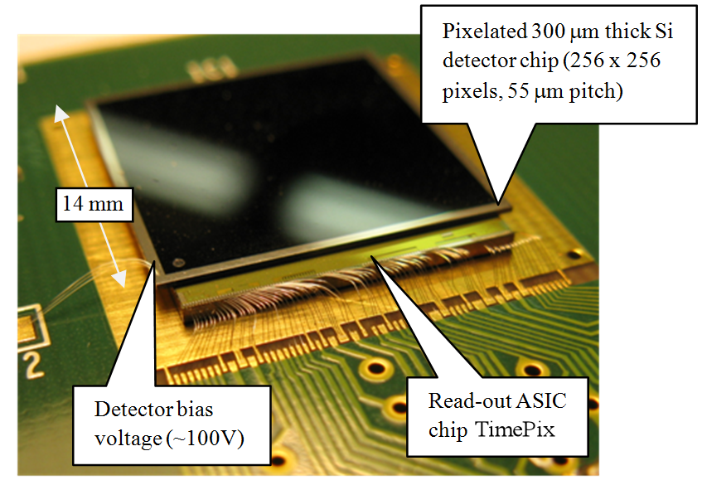
Strategy for module construction
Probe tests
connexion
Module construction
RECEPTION-INSPECTION OPTICAL TESTS ONE WAFER SI -SENSORS INDIVIDUAL TESTING OR WAFER TESTINGS
INTERCONNECTION MATRICES PIXELS WITH INDIUM BUMPS / PIXEL SENSORS TO READOUT CHIP (FLIP-CHIP)
CONNECTION OF MODULE ON READOUT CARD (WIRE BOND)
Wire bonding
GLUING OF FLEX CABLE AND WIRE BONDS OF SIGNAL, BIAS, TENSION, CLOCKS
Si Wafer
SITE : : LAL LPNHE
INDUSTRY
Flip Chip
LAL LPNHE+ IRFU
LAL LPNHE+ IRFU
COMPLETE CHARACTERIZATION AND MODULE SELECTION ACCORDING TO GRADES ,DATABASE Classification
EXPEDITION OF MODULES SELECTED TOWARS LOADING AND INTEGRATION CENTERS (CERN, CPPM, et…..)
DEBUG
Tests on modules with béta source , laser …
NO
Module
LAL LPNHE
OK

Slide 26
Infrastructures to contribute as an ATLAS production center
Clean room (LAL, LPNHE, CEA-IRFU)

Slide 27
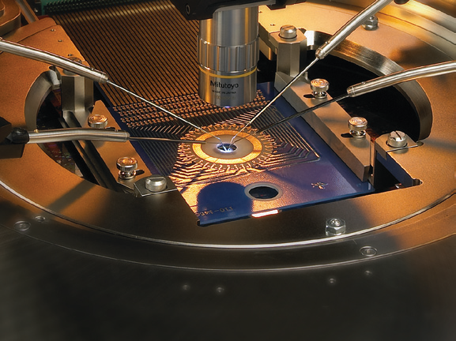
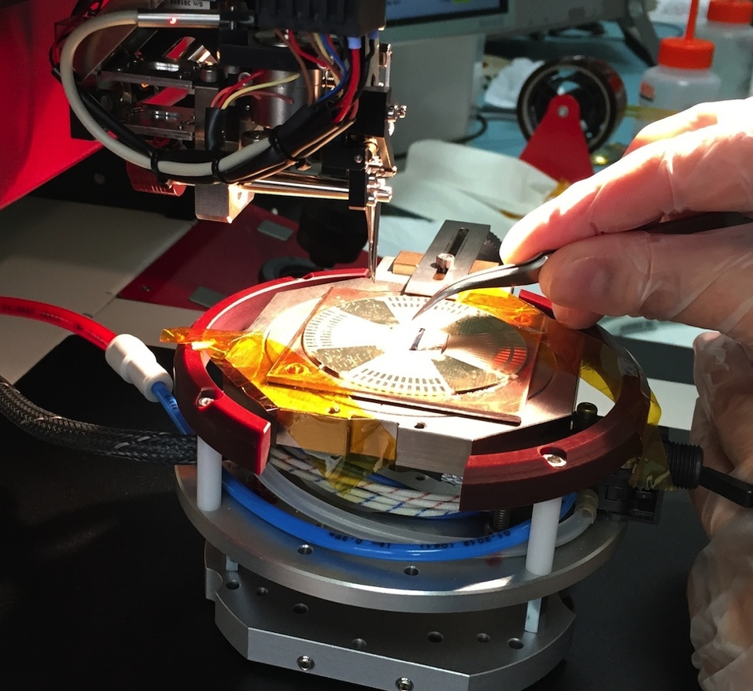


Modern and state of the art for Pixel development: Captinnov plateform
High precision technology equipment for silicon devices characaterization & low noise electronics front end readout
Machine semi-automatic for probing devices
Integrated Fraday Cage for low current detection
Performances in terms of low courants (0.1 fA) et capacités (A.Farads)
Machine completely programmable
Possibilité of probe card insertion (Test multi-variables)
Ultra sonic wire bond machine , programmable with pattern recognition.
Probe station
Wire bondiong machine 20 μm
Semi automatic Karl Suss prober

Slide 28
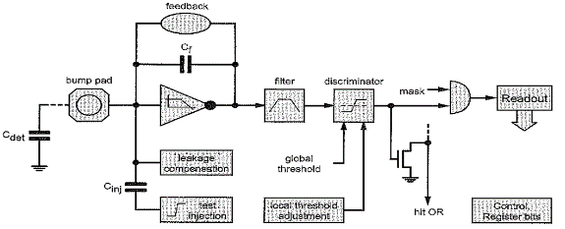
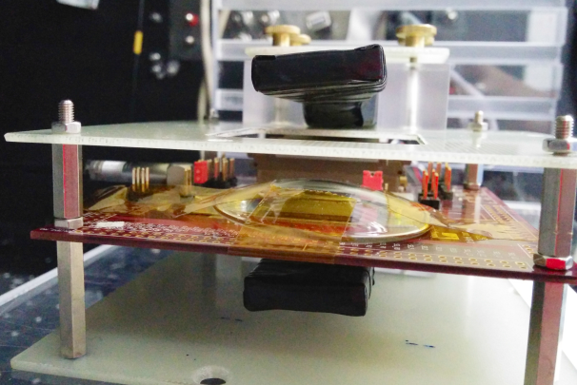
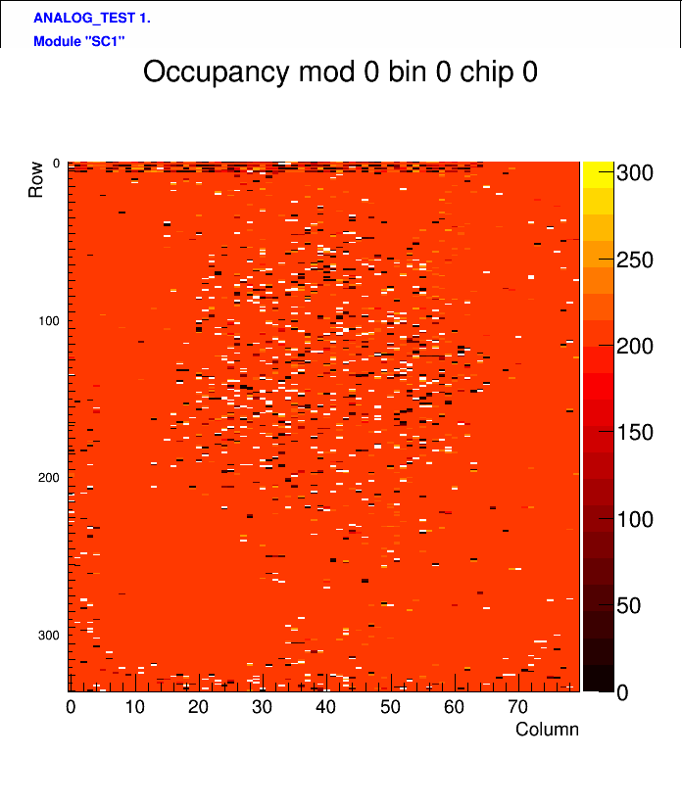
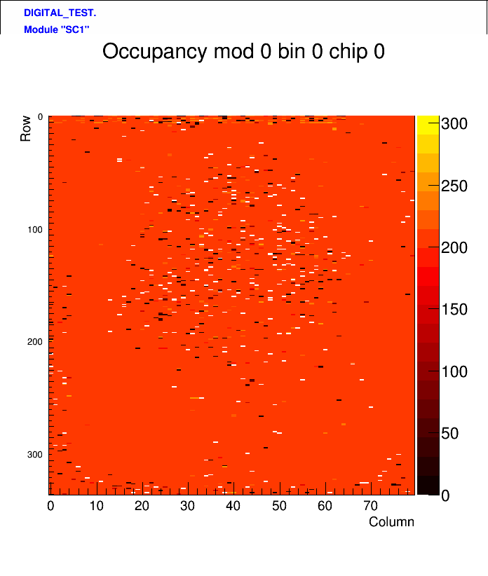
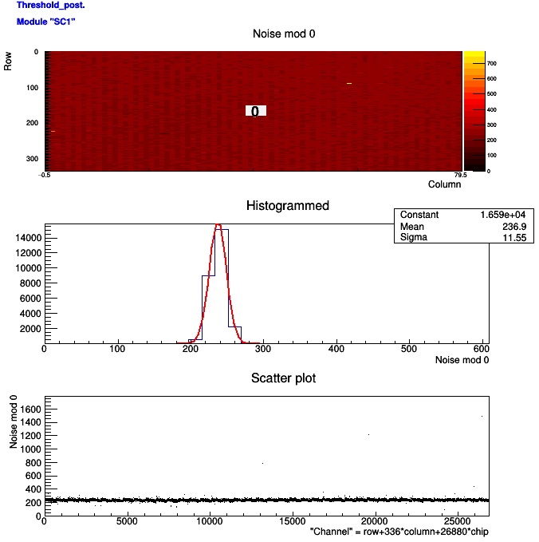
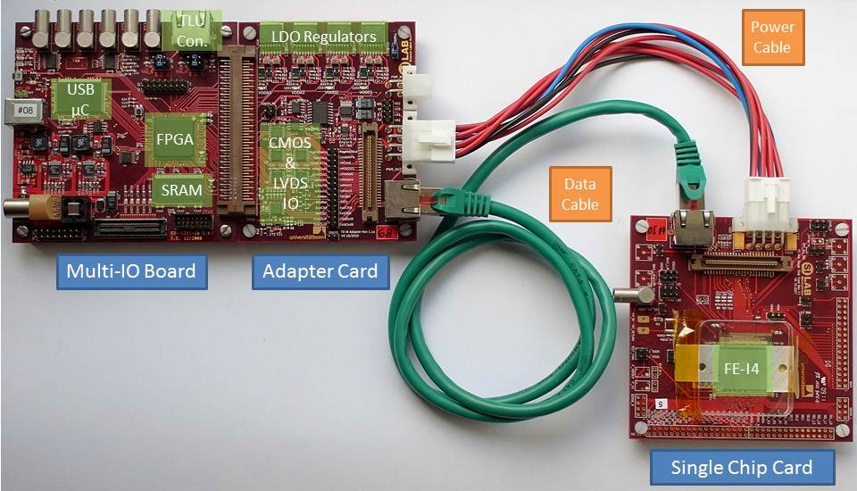
Cosmic and source for Pixel module testing
Tests of modules before and after irradiation
scintillator
Analog scan
Digital scan
Analogue tests
Digital tests
scintillator
Trigger by Wave-catcher
Noise and dispersion
measurements
ATLAS Pixel Readout

Slide 29
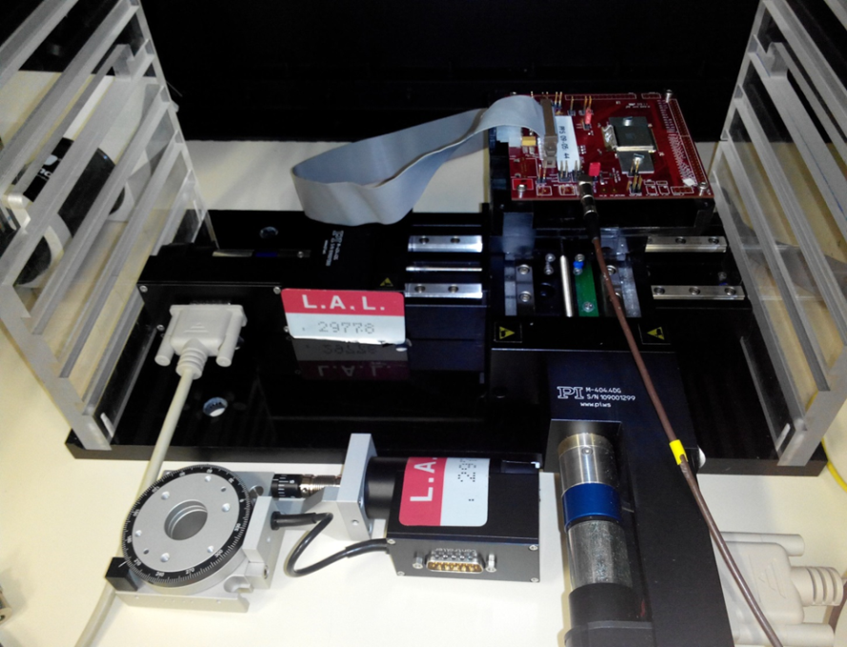
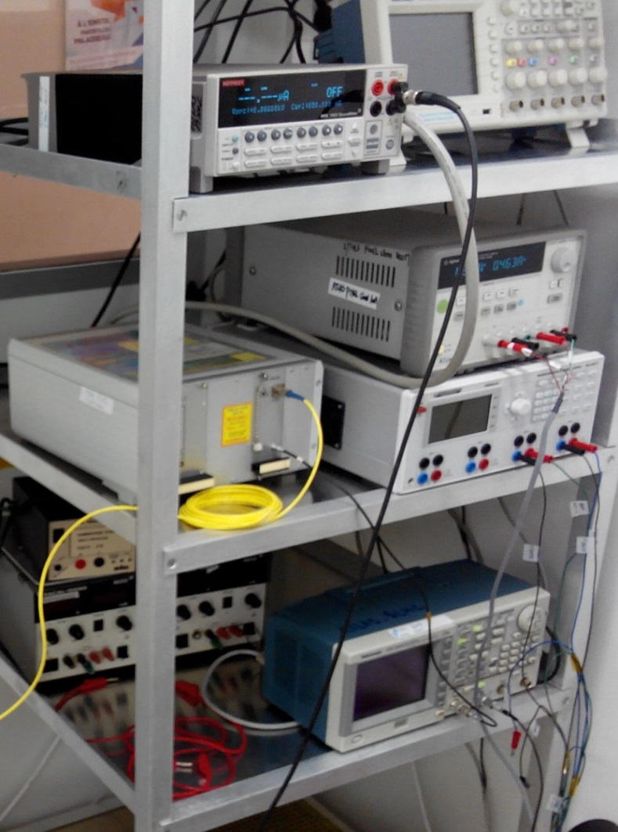
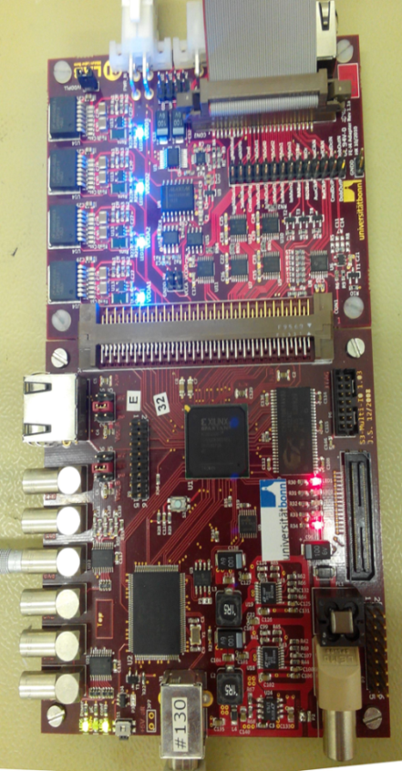
Construction of a Laser testbench
Scan des pixels , dead pixel detection, cross talk.
Laser
To USBPix
Optical fiber
Trigger
From Module
Bias HV
USBPix system: ATLAS Standard device
29

Slide 30



Laser holder
Under progress
Pixel detector
Mechanics for inclined
pixel position
Improvement of Laser testbench
for pixel module Characterization
(PhD project- D. Hohov)

Slide 31




Captinnov Infrastructure
Probe station
Man at Work
CAPTINNOV Clean Room
Pixel Matrix
Pixel under tests

Slide 32
Conclusions

Slide 33
Comments & conclusions
An IN2P3 task force has been set to gather their efforts to contribute in a significant way to the construction of the new tracker for ATLAS phase 2
The ATLAS Phase 2 project is highly challenging requiring high level of technical expertise, for mastering precision silicon detectors, low noise electronics and many other aspects (mechanics, cooling, metrology…)
LPNHE and LAL are key players in ATLAS project since a long time, in various fields from Technology Computed Aided simulation, pixel sensor design, high precision low noise silicon characterization, to module assembly
Important technical infrastructures and skills have been accumulated
it offers an excellent opportunity for students to embark in one of the most attractive project for students and young scientist so Welcome!!

Slide 34


LAL clean room
Thank you for your attention and
welcome on board !!
LPNHE clean room

Slide 35

Improving efficiency: biasing solutions
Aim is to find a solution that reduces the inefficiencies in the biasing region within the pixel cell.
CiS FE-I4 planar sensor, with four bias rail designs on the same sensor.
Both show increased noise for one design
Test beams:
A sample was tested in the CERN SPS test beam in July 2015.
  Reconstruction and data analysis performed at LAL.
  This device will be irradiated and tested in a future test beam.
Testbeam: LAL & LPNHE joint activity

Slide 36




The FBK/LPNHE Active Edge pixel 1 production
2013 4”n-on-p active edge production, on 200 µm FZ wafers
  Plus: 500 µm support wafer
9 FEI4-compatible sensors (IBL)
4.5 μm wide
200 μm deep
trench
FBK-AE1
Tested with radioactive source
And now on beam
M. Bomben et al. Nucl. Instrum. Meth. A 712 (2013) 41

Slide 37



Temporary metal at FBK
trench
Temporary metal
Before temporary metal removal
After temporary metal removal
after resist patterning
Technical solution allowing to remove the
metal grid used to bias pixels during tests.
After the metal removal, no inefficiency
left due to bias network

Slide 38


DESY March testbeam
The sample: LPNHE5, featuring 100 µm pixel-to-trench distance and no GRs
  2 samples more available; not enough time to
  measure them
Several configurations tested
Results – next slides
Testbeam: LAL & LPNHE joint activity
beam

Slide 39
CONCLUSIONS AND OUTLOOK

Slide 40
Comments & Conclusions
The HL-LHC phase preparation is moving forward
The new tracker demands new (pixel) readout chip, cooling, mechanics, trigger, and sensors
The ATLAS IN2P3 R&D groups are involved in many of these activities playing a leading role in most of them
The LAL and LPNHE are important actors in this field thanks to new pixel productions, simulation studies, modules assembly, characterization and measurement

Slide 41
BACKUP

Slide 42
Tracker sensor design requirements
Fast & High Bandwith
Low Material budget : Thin sensors
Full Sensitivity : Egless Sensors
Granularity 50x450 ➔ 50x250➔ 50x50 μm2
Radiation : use N-in-P and low thickness
Cost : N-in-N actual to N-in-P technology
Fast High Bandwith
Thin : Low material Budget
Full geometrical sensitivity-Granularity
Radiation tolerant
Cost effective

Slide 43

Breakdown voltage performance
P-spray dose: 3x10¹²/cm²
Depletion Voltage: 20 V
Large breakdown voltage values already with 100 µm pixel-to-edge distance!

Slide 44

Pushing the limits
Chips/Modules
Edges width
Sensor Thickness
Sensor pitch
ASIC +sensor thickness
ASIC technology
Bump bonding technologies
1 CHIP
2 CHIPs
4 CHIPS
1 mm
250 μm
100 μm ← 0
300 um
280 um
150um ←75um, 50um
50X400
50X250
50x125
50x50
mms
mms
1 mm
500 um ←150 um
0,25 um
0,13 um
0,065 um
0,040 um
3D Technology
Bump bonding
~ 50 um
Micro Bump bonding
~ 10-20 um
SLID, TSV
~ 10 um
Direct Bonding
~5 um
2010
2013
2015-2017
202X
MICRON,ADVACAM ,VTT,
IZM ,EMFT,TEZZARON,CIS,
HAMAMATSU,TSMC,IBM, LETI

Slide 45





Testing the the performances at the borders to increase the overall surface efficiency
Performances of pixels planaires under High energy Pions
Pixel border
Sensor border
AIDA HIGH RESOLUTION PIXEL TELESCOPE
Active Edge 50 μm
bords
Résultats presented at CERN
Atlas Upgrade Week-27-31/03/2017
D. Hohov, LAL
Last pixel column
(250 um)
Distribution of residuals
20030
(> 90% efficiency)
DUT#20
16 μm
DUT#21
17 μm

Slide 46


In-pixel efficiency
No biasing structure➔ (small) very uniform charge efficiency
  effect due to charge sharing at the pixel’s corners
Thr 1600, V_{bias} = -40 V

