Slide 1


The proton radius from atomic/molecular spectroscopy :
Current status and perspectives
Jean-Philippe Karr
¹Laboratoire Kastler Brossel (UPMC, ENS, CNRS, Collège de France)
²Université d’Evry – Val d’Essonne
5th French-Ukrainian workshop
Instrumentation developments for high energy physics
LAL, Orsay, 7 November 2017

Slide 2
Metrology at Lab. Kastler Brossel
4 research axes
Quantum gases
Atoms and light in dense or complex media
Quantum optics and quantum information
Test of fundamental interactions and metrology
International
collaborations
2 research teams
H atom spectroscopy
(F. Nez)
Metrology of simple systems
and fundamental tests
CREMA
(Muonic Atom
spectroscopy)
Heavy ions and exotic ions
(P. Indelicato)
Atom interferometry
(S. Guellati, P. Cladé)
GBAR
(Gravitational
Behaviour of Anti-
hydrogen at Rest)
H₂⁺ spectroscopy
(L. Hilico)
Metrology of trapped ions
HMI theory
(JPK)

Slide 3
Outline
I. Introduction
Atomic energy levels, and the proton radius
II. Current status of the “puzzle”
After recent measurements in hydrogen
III. New experiments
Focus on the hydrogen molecular ions

Slide 4
Finite-size shift of atomic energy levels
e,µ
The proton radius is defined as
: Sachs electric form factor
p
Modification of the Coulomb potential w.r.t. a point-like proton:
Leading order:
In atomic physics: ~ ~

Slide 5
Finite-size shift of atomic energy levels
Shift of an atomic bound state:
Hydrogen-like atom, nl state:
Orders of magnitude
Hydrogen atom, 1S state: 5.10⁻¹⁰ ν_{1S-2S}
Exp. accuracy 1% on
Muonic hydrogen, 2S state: 2% of
Exp. / theor. accuracy 5.10⁻⁴ on

Slide 6
Hydrogen atom energy levels
Main dependences on fundamental constants
Schrödinger
Relativistic
and QED corr.
Finite nuclear
size corr.
and determined by other experiments
2 measurements required to determine and
2S-4P 486 nm
A single narrow transition: 1S-2S (Δν = 1.3 Hz)
measured with high accuracy.
Other transitions: natural width ~ MHz.
Each measurement, combined with 1S-2S,
yields a correlated pair .
1S-3S
205 nm
1S-2S
243 nm

Slide 7
The proton-radius puzzle
∼ 100 kHz on
CODATA 2014: P.J. Mohr, D.B. Newell, and B.N. Taylor, Rev. Mod. Phys. 88, 035009 (2016)
e-p scattering: J. Arrington and I. Sick., J. Phys. Chem. Ref. Data 44, 031204 (2015)
µp spectroscopy
H spectroscopy

Slide 8
Muonic hydrogen spectroscopy at PSI
λ = 6 µm

Slide 9
Muonic hydrogen spectroscopy at PSI
Δν_{stat} = 0.7 GHz
Linewidth: 18 GHz
(τ_{2P} = 8.5 ps)
R. Pohl et al., Nature 466, 213 (2010)
A. Antognini et al., Science 339, 417 (2013)

Slide 10
H atom spectroscopy

Slide 11
1S-2S transition (MPQ Garching)
f_{1S-2S} = 2 466 061 413 187 035 (10) Hz
Linewidth:
2 kHz
C.G. Parthey et al., PRL 107, 203001 (2011)
f_{1S-2S} = 2 466 061 413 187 018 (11) Hz
A. Matveev et al., PRL 110, 230801 (2013)

Slide 12
Challenges in high-resolution spectroscopy of H
Determine the center of a line to a small fraction (10⁻³-10⁻⁴) of its width
High statistics
Precise understanding of lineshape and systematic effects:
- 1st or 2nd-order Doppler effect: velocity distribution in atomic beam
- AC Stark shift (especially for two-photon transitions)
- Pressure (collision) shift
- Quantum interference effect
- …

Slide 13
New! 2S-4P transition (MPQ Garching)
- Cold (5.8 K) H(2S) atoms
- Single hyperfine level
populated:2S_{1/2} F=0
Natural linewidth: 12.9 MHz
+ Doppler broadening,
power broadening
Linewidth: 20 MHz

Slide 14
New! 2S-4P transition (MPQ Garching)
Quantum interference effect
f _{2S-4P} = 616 520 931 626.8(2.3) kHz
Δf ∼ 10⁻⁴ Γ !
Main source of uncertainty: 1st-order Doppler shift
A. Beyer et al., Science 358, 79 (2017)

Slide 15
Preliminary! 1S-3S transition (LKB Paris)
Nd:YVO₄ Laser
Frequency sum
FP Cavity
Nd:YAG
Laser
Ti:Sa Laser
FP Cavity
1064 nm
Ref. cavity FPR
Laser diode/ Rb
Frequency comb
3S
656 nm
205 nm
2P
1S

Slide 16
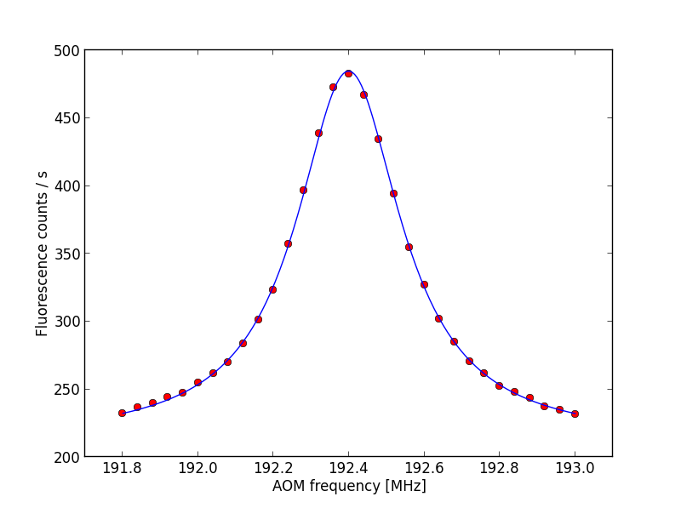
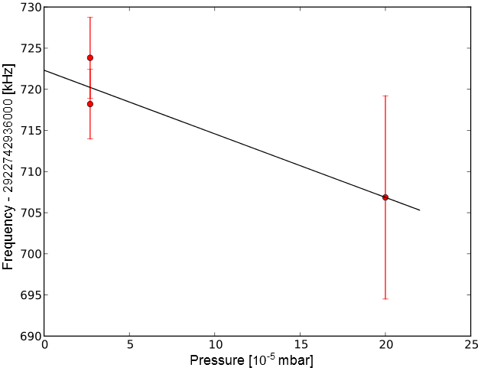
Preliminary! 1S-3S transition (LKB Paris)
Pressure shift
Corrected from light shift
Linewidth:
1.5 MHz
f _{1S-3S} = 2 922 743 278 xxx.x (2.4) kHz
S. Galtier et al., J. Phys. Chem. Ref. Data 44, 031201 (2015)
QI effect: H. Fleurbaey, F. Biraben, L. Julien, JPK, F. Nez, PRA 95, 052503 (2017)
H. Fleurbaey et al., in preparation
Next step : cold (77K) H beam

Slide 17
Overview
2S-4P
1S-3S
2S-4P
1S-3S

Slide 18
What to do now ?
“To summarize, the possibilities are:
1. The electronic hydrogen experiments are almost, but not quite,
as accurate as stated.
2. The QED calculations in µp are almost, but not quite, as accurate as stated.
3. The two-photon exchange term that depends on proton polarizability has not
been correctly evaluated.
4. The electron and the muon really do have different interactions with the proton
so there is physics beyond the Standard Model.
None of these possibilities seem very likely, but all must be pursued.”
R. Pohl et al., Annu. Rev. Nucl. Part. Sci. 63, 175 (2013)
C.E. Carlson, Progr. Part. Nucl. Phys. 82, 59 (2015)
“Beyer et al. do not claim to have solved the proton-size puzzle. After all, it is only one measurement, and the data analysis was very complicated. Moreover, one would need to understand why other measurements in hydrogen are so far off or, possibly, exhibit a systematic shift in the same direction. There is presently no explanation for that. Also, the proton size deduced from electron-proton scattering disagrees. Thus, more measurements are what is needed.”
W. Vassen, Science (Pespective) 358, 39 (2017)

Slide 19
Spectroscopy projects
Hydrogen-like systems
2S-2P in H (YU Toronto) ⇒
1S-2S in He⁺ (VU Amsterdam + MPQ Garching) ⇒
Rydberg states in High-Z ions (NIST Gaithersburg) ⇒
electronic
muonic
2S-2P in µHe⁺ (PSI) ⇒
1S-2S in Positronium e⁺e⁻ (ETH Zürich + UC London) ⇒
1S-2S in Muonium µ⁺e⁻ (PSI + ETH Zürich) ⇒ µ-specific forces ?
leptonic
One-electron molecules ⇒
H₂⁺ / HD⁺ (VU Amsterdam + Düsseldorf + LKB Paris)
Two-electron atoms
He (VU Amsterdam + Hefei)
D / µD
discrepancy
Two-electron molecules ⇒
H₂ / HD (VU Amsterdam + ETH Zürich)
Muonic Li, Be … (JGU Mainz + PSI)

Slide 20
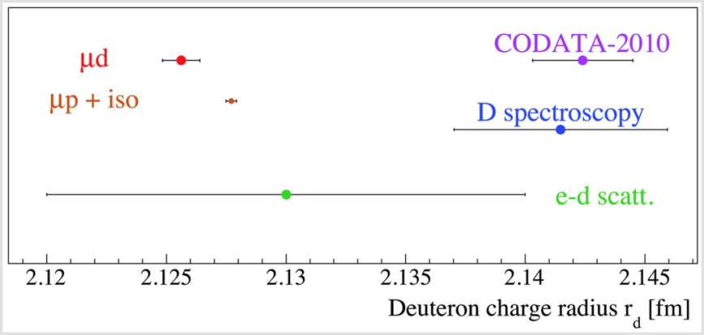
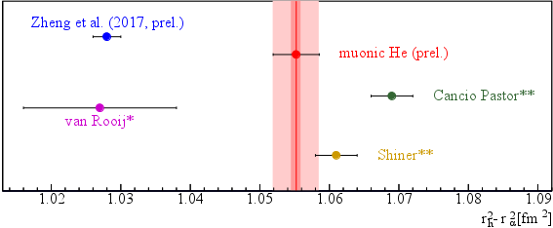
³He/⁴He isotope shift (preliminary)
Other nuclei
Deuteron radius
2012
2011
1995
Another >5σ discrepancy ?

Slide 21
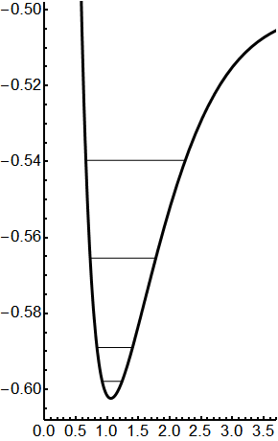
Hydrogen molecular ions
1sσ_{g}
Dependence of ro-vibrational transition
frequencies on fundamental constants :
Energy [a.u]
H₂⁺
Internuclear distance [Å]
1. Strong dependence on :
⇒ Determination of and by laser spectroscopy of H₂⁺/HD⁺
W.H. Wing, G.A. Ruff, W.E. Lamb Jr., J.J. Spezeski, PRL 36, 1488 (1976)
2. All ro-vibrational transitions in 1sσ_{g} electronic state are very narrow
⇒ Measuring several transitions in H₂⁺/HD⁺ could provide a
reliable determination of , , , cross-checking H/D results and shedding light on the proton-radius puzzle.
J.Ph. Karr, L. Hilico, J.CJ. Koelemeij, V.I. Korobov, PRA 94, 050501(R) (2016)

Slide 22
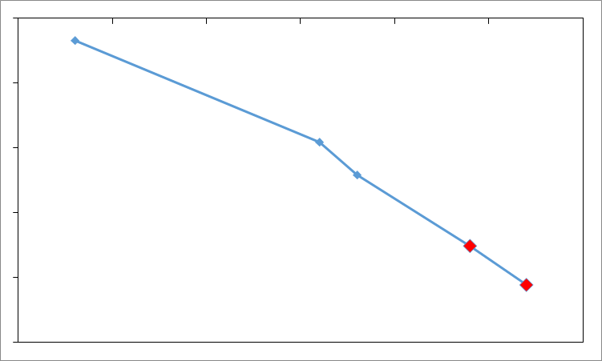
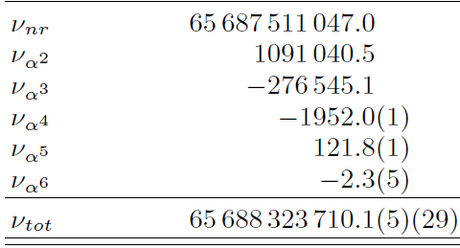
Status of theory
H₂⁺ (v = 0, L=0) → (v’=1, L’=0) interval in kHz
1990
2000
2010
2020
10⁻⁷
10⁻⁸
Current experiments
10⁻⁹
10⁻¹⁰
2014
10⁻¹¹
2017
Objective
(11)
10⁻¹²
H atom theory
Theoretical uncertainty
Uncert.
on
7.6 10⁻¹²
Discrepancies
on and
V.I. Korobov, L. Hilico, J.-Ph. Karr, PRL 118, 233001 (2017)
Further improvement by a factor of 2-3 would allow discriminating
between conflicting measurements of
from a well-chosen set of ro-vibrational transitions.

Slide 23
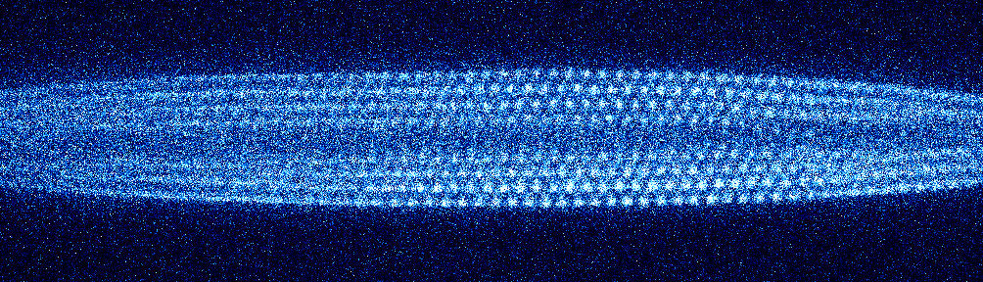
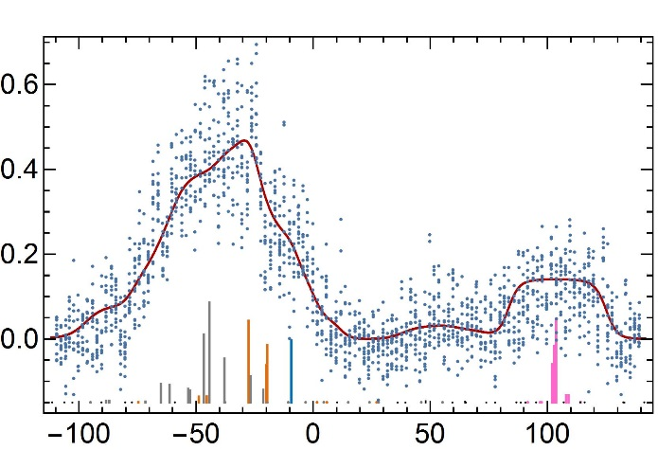
Experimental state of art
One-photon ro-vibrational transitions in HD⁺
Linear RF trap
Sympathetic cooling
by laser-cooled Be⁺ (T~10 mK)
Detection by selective dissociation
of the excited state (REMPD)
Measurement of HD⁺ ion number
by motional excitation
313 nm
750 Be⁺
40-85 HD⁺
Image: J.C.J. Koelemeij (VU Amsterdam)
HD⁺ v = 0 → 8 transition
Main limitation: Doppler broadening
Fractional HD⁺ loss
J.Biesheuvel, J.-Ph. Karr, L. Hilico, K.S.E. Eikema,
W. Ubachs, J.C.J. Koelemeij, Nature Comm. 7, 10385 (2016)
ν – 383 407 177.150 [MHz]

Slide 24
Experimental state of art
Düsseldorf 2007
v = 0 → 4
⇒ Determination of
with 2.5 ppb accuracy
Düsseldorf 2012
v = 0 → 1
S. Patra, J.-Ph. Karr, L. Hilico,
M. Germann, V.I. Korobov, J.C.J. Koelemeij,
arXiv:1710.11537, to appear in J. Phys. B
Amsterdam 2016
v = 0 → 8
-4
-3
-2
-1
0
1
2
3
4
Theory – Experiment [ppb]
1sσ_{g}
1sσ
Next step:
Doppler-free two-photon transitions
Goal accuracy : 10⁻¹²
Energy [a.u]
λ₂ = 1445 nm
HD⁺ v = 0 → 9
Amsterdam VU
H₂⁺ v = 0 → 1
LKB
λ₁ = 1442 nm
λ = 9.17 µm
24
Internuclear distance [Å]
Internuclear distance [Å]

Slide 25
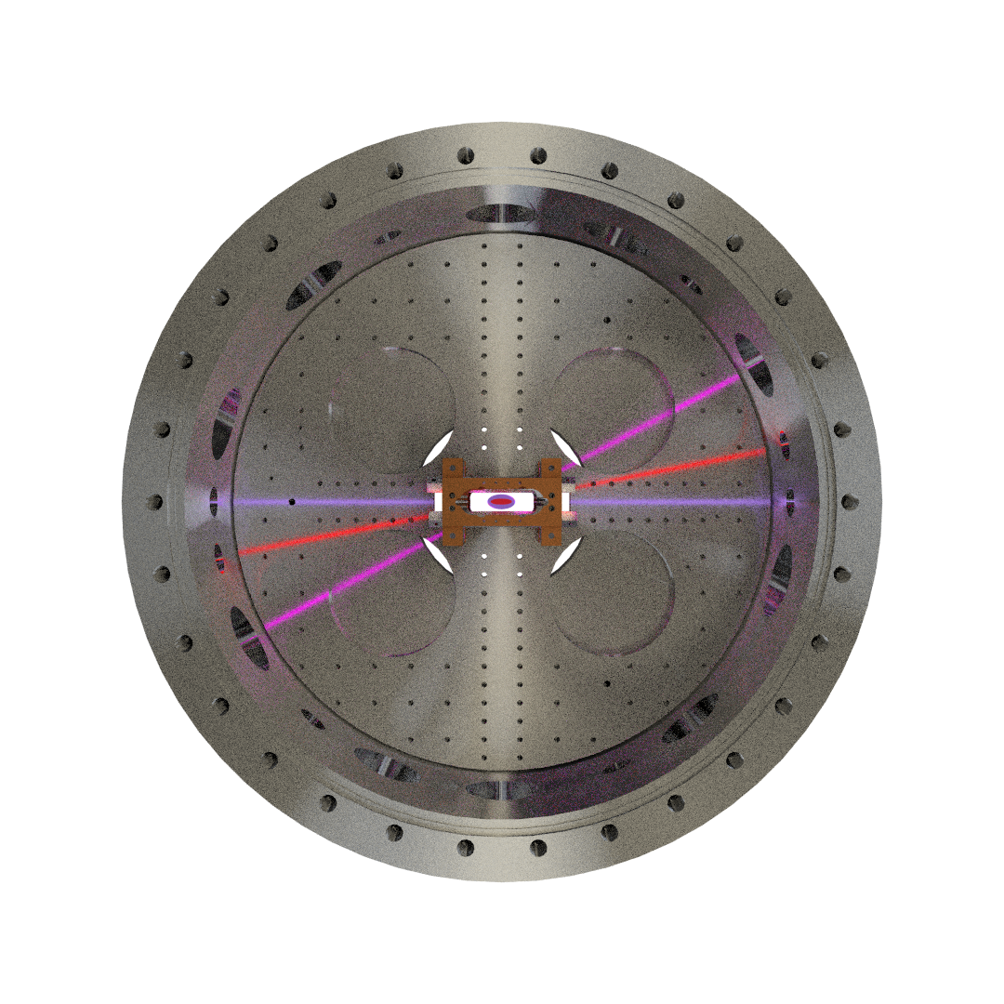
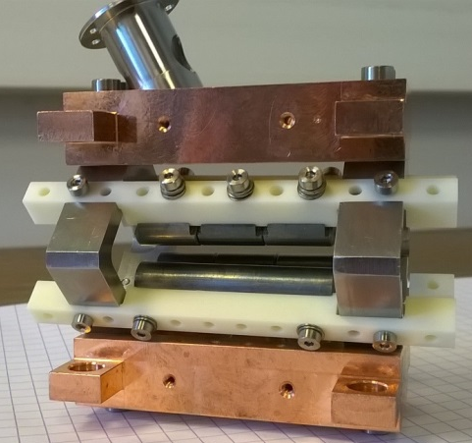
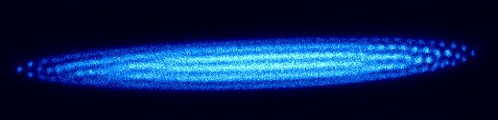
H₂⁺ two-photon spectroscopy setup
213nm (photodissociation)
H₂
313nm (cooling) + 303 nm (REMPI)
9.17µm (spectroscopy)
Linear ion trap
Crystal of laser-cooled Be⁺

Slide 26

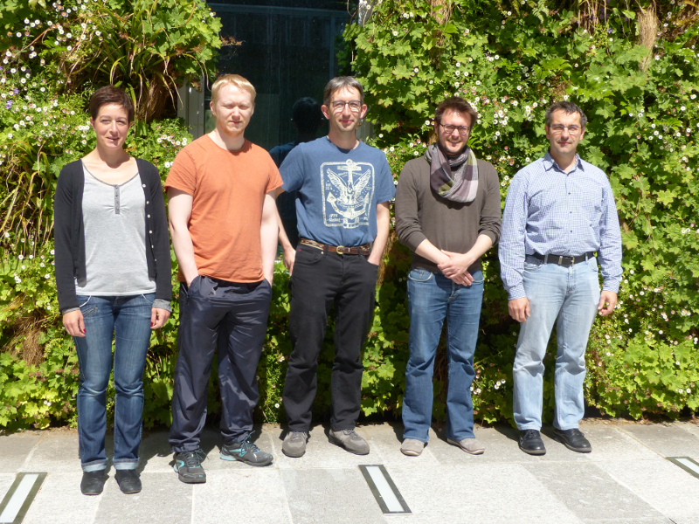




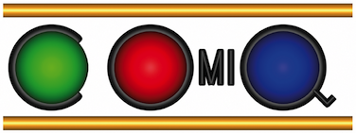


Acknowledgements
Albane
Douillet
Nicolas
Sillitoe (PhD)
Johannes
Heinrich (PhD)
Laurent
Hilico
Thomas Louvradoux (PhD)
Vladimir Korobov
(JINR, Dubna, Russia)
Amsterdam VU
Sayan Patra
Matthias Germann
Juriaan Biesheuvel
Frank Cozijn
Kjeld Eikema
Wim Ubachs
Jeroen Koelemeij

Slide 27
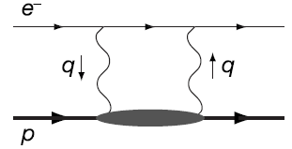
Finite-size corrections in muonic hydrogen
In addition to the leading term, higher-order QED corrections involving
the proton structure have to be considered.
µ
Two-photon exchange : - elastic
- inelastic : proton polarizability
- subtraction of QED correction to proton radius

Slide 28
Muonic hydrogen spectroscopy at PSI

Slide 29
2S-nS(D) transitions (LKB Paris)
Example: 2S_{1/2}-8S_{1/2}
f (2S_{1/2}-8S_{1/2}) = 770 649 350 012.0(8.6) kHz
(+ 4 other transitions)
Linewidth: 770 kHz
Main source of uncertainty: AC Stark shift
B. De Beauvoir et al., PRL 78, 440 (1997) and EPJD 12, 61 (2000)
C. Schow et al., PRL 82, 4960 (1999).

