Slide 1




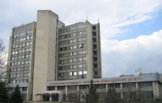



Development of versatile test platforms for research of radiation detectors for medical applications - first steps of Ukrainian partners of LIA IDEATE
STCU project
Speaker: Oleg Bezshyyko (TSNUK)
Orsay 2017
The fifth French-Ukrainian workshop on the instrumentation developments for HEP, November 6-8, 2017, LAL, Orsay

Slide 2
R&D and educational experimental platforms for instrumentation
for medical imaging and other applications
in the framework of
France-Ukraine International Associated Laboratory (LIA)
“Instrumentation Developments for Experiments at Accelerator facilities and accelerating TEchniques” – LIA IDEATE
Proposal by the LIA Ukrainian teams
(56 participants)
to
STCU ( SCIENCE & TECHNOLOGY CENTER IN UKRAINE)

Slide 3
Ukrainian teams (Participating Institutions):
Taras Shevchenko National University of Kyiv of Ministry of Education and Science of Ukraine (TSNUK)
V. N. Karazin Kharkiv National University of Ministry of Education and Science of Ukraine (KhNU)
National Science Center "Kharkiv Institute of Physics and Technology" of National Academy of Sciences of Ukraine (KIPT)
Kyiv Institute for Nuclear Research NASU of National Academy of Sciences of Ukraine (KINR)
Institute of Applied Physics NASU of National Academy of Sciences of Ukraine (IAP)

Slide 4
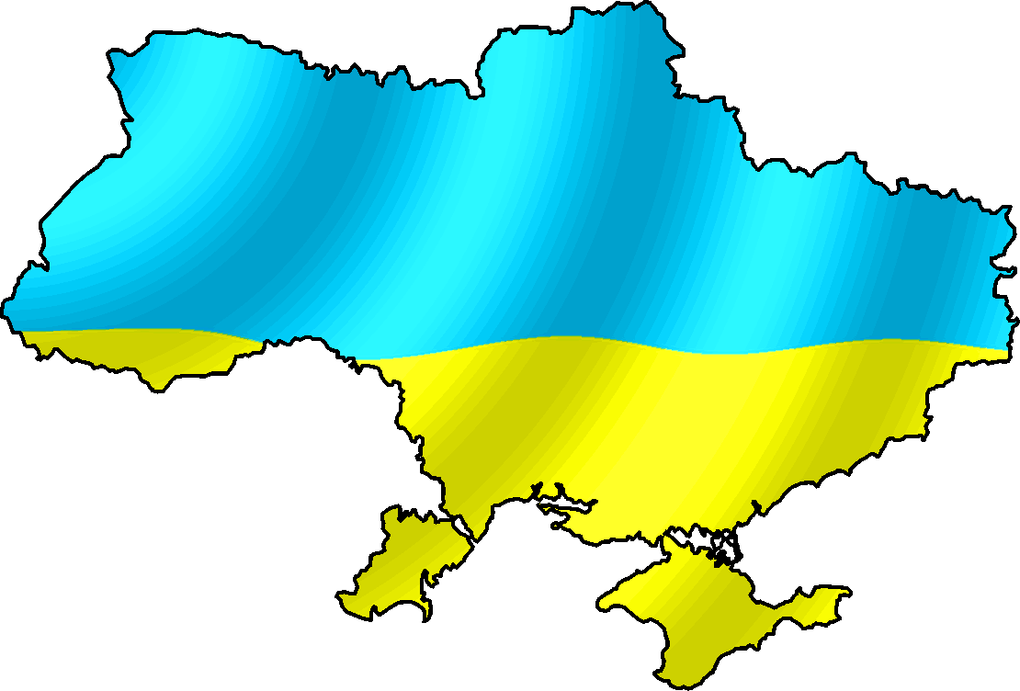
Ukrainian teams propose:
Sumy: IAP
Kyiv:
TSNUK, KINR
Kharkiv: KNU, KIPT
the development of comprehensive set of experimental techniques and versatile test platforms for development, characterization and testing of wide range of radiation detector systems for medical imaging, beam and dose monitoring and other medicine applications. On the base of these platforms set of prototype systems for using in radiation therapy and diagnostics will be designed and built. The set of versatile test platforms is divided territorially on Kyiv platform and Kharkiv platform.
Construction/operation of the platforms will be assisted by the CNRS (LAL) scientists and engineers (advisory and technical expertise) via the LIA program

Slide 5
Sites to host the platforms
Two sites at major universities of Ukraine : Taras Shevchenko National University of Kyiv and V. N. Karazin Kharkiv National University
The hosting universities will engage :
  to provide the location;
  to cover electricity/water/… consumption;
  to provide technical support of their platform with the local manpower;
  to provide access to the platform site and equipment, to provide required help and assistance to the LIA partners;
  to receive partner’s trainees.
Each site provides a free of charge assistance (except for cost of materials) to the entire group of LIA partners

Slide 6
Kyiv platform
Platform profile:
generic services
MPGD, SiPM, scintillating detectors
Detector-equipped phantoms
Open source dose planning system for radiation oncology
X-ray "phase contrast" imaging techniques
Kharkiv platform
Platform profile:
R&D of planar detectors (resistive detectors, Si PIN detectors and photosensors, SiPM, MAPS etc.) and detector systems (single detectors and arrays of Si PIN photosensor + scintillator, Si PIN detector + metallic Gd converter) operated at room temperature

Slide 7
Kyiv platform : instrumentation
Generic tools, services
Cutting laser machine (micromachining)
Multi-axis
(5 or more) machining center
Wire bonding machine
Hot air infrared soldering station
Tools for specisic developments
Platform for major R&D of MPGD detectors
Platform for major R&D of silicon photodetectors in Geiger mode - SiPM
Irradiation by isotope sources: γ, β, α, neutrons,
D-D neutron generator
- Provided entirely by hosting University
- Part of materials and equipment requested from STCU, main development by the LIA team
- Equipment requested from STCU

Slide 8
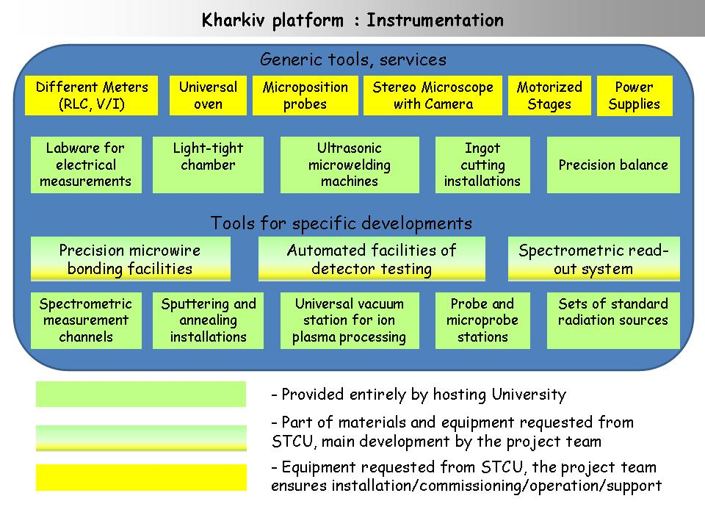

Slide 9
Construction of the Kyiv platform: responsibilities
Responsibilities:
TSNUK
KINR-LP
KINR-HEP
IAP
R&D and educational platform for instrumentation for medical imaging and other applications
Development of the test platform for studies of MPGD
Development of the test platform for studies of SiPM
Development of detectorized phantom prototypes for dose delivery verification (heavy-ion radiotherapy in oncology)
Development of the technique of new 3D printing technology to produce anthropomorphic phantoms for gamma, electron, proton, heavy-ion therapy in oncology
Construction of an X-ray detector based on sensor array panel for X-ray contrast imaging
Development of low background scintillation detectors for monitoring of trace radioactivity levels
Developmentof graphical interface of RTPS, development of the main algorithms for RTPS
Deliverables after 2 years
Test platform for studies of MPGD
Test platform for studies of SiPM
Tests of the detectorized phantoms at different radiation facilities
Prototype of 3D printing tool to produce anthropomorphic phantoms
Sample of X-ray detector based on sensor array panel for X-ray contrast imaging
Highly radiopure crystal scintillators: CdWO4, ZnMoO4, Li2MoO4, ZnWO4, low background setup with phosphich low background detector
First version of graphical interface of RTPS, main algorithms for RTPS
Micro-TPC
First SiPM characteri-zation results, local cooling for SiPM
Simulation of dose delivery based on the Monte Carlo code
Samples of anthropomorphic phantoms

Slide 11
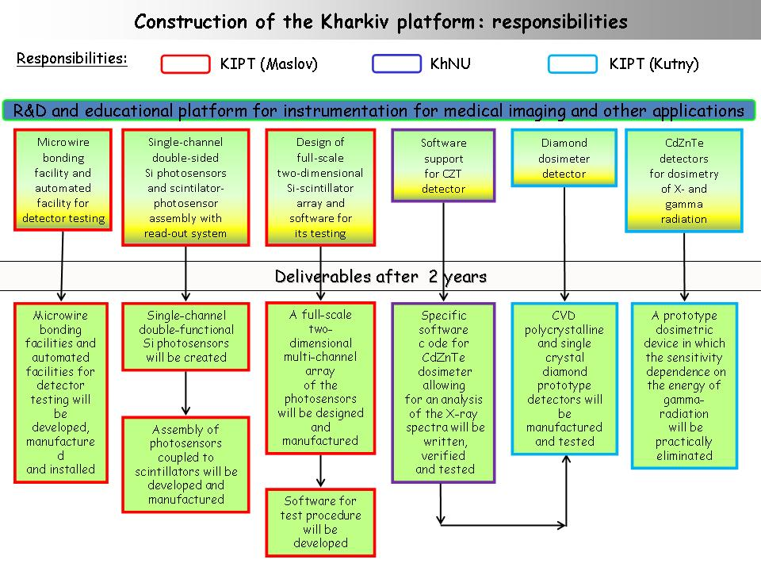

Slide 12
Kyiv platform
F.Danevich group of KINR
Responsibility – Fedor Danevich
Low background scintillation spectrometer to measure low level radioactivity in crystal scintillators and in samples of materials will be developed in the framework of the project. High performance radiopure CdWO₄, ZnMoO₄, Li2MoO₄, ZnWO₄ crystal scintillators will be developed and tested. New nuclear data (more accurate half-life values or new improved half-life limits) on radioactivity of cadmium, tungsten, zinc and molybdenum isotopes will be obtained.

Slide 13
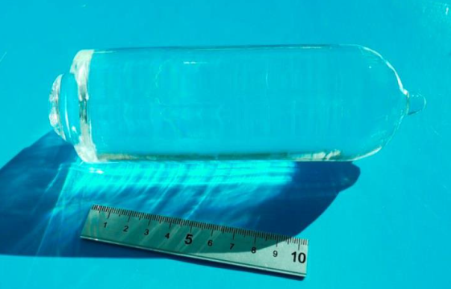
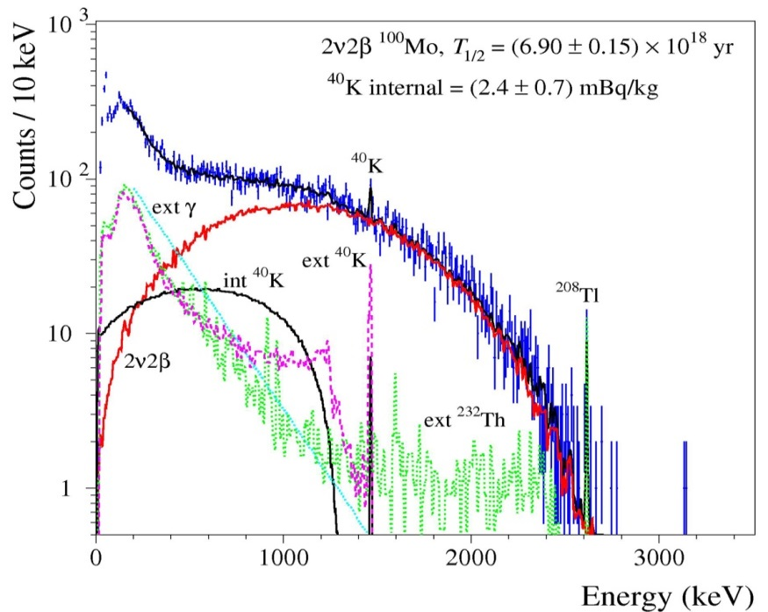
Development of low background scintillation detectors
R&D of ZnMoO₄ and Li₂MoO₄ cryogenic scintillation detectors
Collaboration with CSNSM, Orsay, France
Production of high quality zinc (ZnMoO₄) and lithium molybdate (Li₂MoO₄) crystal scintillators (including scintillators from enriched ¹⁰⁰Mo) has been developed
186 g Li₂¹⁰⁰MoO₄, 1303 h in EDELWEISS set-up at the Modane underground Lab
2ν2β, ¹⁰⁰Mo
Li₂MoO₄ ∅53 mm
High performance Li₂¹⁰⁰MoO₄ scintillating bolometers:
Energy resolution FWHM = 4-6 keV at 2615 keV
Particle discrimination capability:
DP_{α/β} = 9 – 18
Low radioactive contamination:
< 10 μBq/kg of ²²⁶Ra and ²²⁸Th
An important physical result: the most accurate T_{1/2} of ¹⁰⁰Mo
[1] E. Armengaud et al., Development of ¹⁰⁰Mo-containing scintillating bolometers for a high-sensitivity neutrinoless double-beta decay search submitted to EPJA ; arXiv:1704.01758v2 [physics.ins-det] 4 Oct 2017
F.A.Danevich Development of low background scintillation detectors for monitoring of trace radioactivity levels

Slide 14
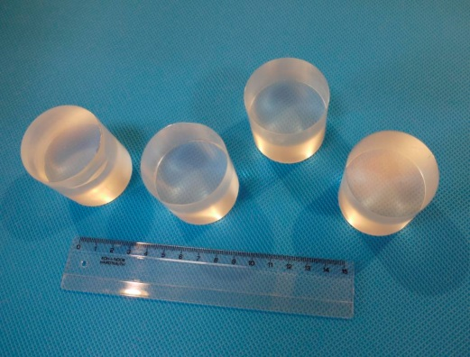
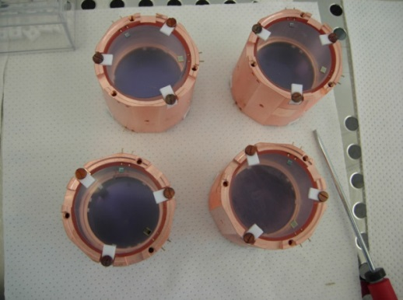
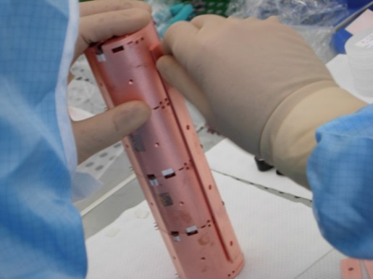
A pilot 0ν2β experiment with 20 radiopure Li₂¹⁰⁰MoO₄ crystal scintillators should start in the beginning of 2018
20 enriched Li₂¹⁰⁰MoO₄ crystals are produced
Assembling of the Li₂¹⁰⁰MoO₄ detectors is in progress aiming to start a pilot experiment beginning of 2018
Assumed background is 10⁻³ counts/yr/kg/keV in 10 keV window centered at Q_{2β} of ¹⁰⁰Mo:
Sensitivity to 0ν2β decay of ¹⁰⁰Mo over 6 month:
Production of the next 20 Li₂¹⁰⁰MoO₄ detectors is foreseen in 2018
Sensitivity with 40 detectors over 3 yr:
F.A.Danevich Development of low background scintillation detectors for monitoring of trace radioactivity levels

Slide 15

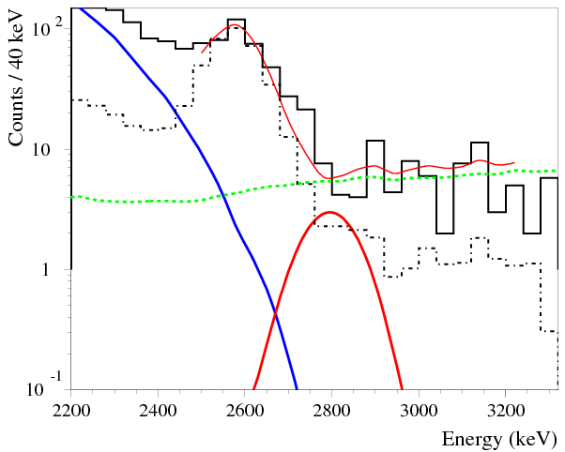
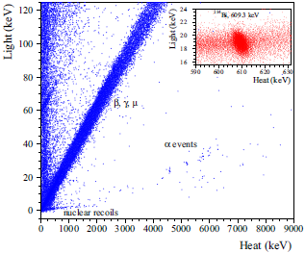
Cryogenic search for 0ν2β decay of ¹¹⁶Cd is in preparation
project CYGNUS: Cryogenic search for neutrinoless double beta decay of cadmium
Energy resolution: 130 keV → 5-7 keV at Q_{2β} [1,2]
Background can be reduced: → 1.4 cnts in 10keV ROI over 3 yr
Q_{2β}, 2813 keV
ext.Th
The reduction of background (mainly ²⁰⁸Tl) is expected due to particle discrimination and high energy resolution to αs
int.Th
β, γ, μ
α
2ν2β
α
β (T_{1/2} ≈ 3 min)
²¹²Bi → ²⁰⁸Tl →
Search for 0ν2β decay of ¹¹⁶Cd with advanced sensitivity:
Demonstration of ¹¹⁶Cd option capability for the large scale experiment (i.e., CUPID)
[1] A.S. Barabash et al., EPJC 76 (2016) 487
[2] C. Arnaboldi et al., Astropart. Phys. 34 (2010) 143.
F.A.Danevich Development of low background scintillation detectors for monitoring of trace radioactivity levels

Slide 16
Kyiv platform
V.Pugach group of KINR
Responsibility – Valery Pugatch
Within the framework of the project the new experimental setup for the studies in the field of the spatially fractionated hadron therapy will be designed, built and tested. It will include tissue equavalent phantom equipped with ultrathin metal microdetectors and readout electronics, multi-slit and matrix collimators for shaping 1D and 2D hadron multi-beam structures.
Features of those setup components will be defined from the Monte Carlo simulations aimed at optimization of the irradiation field structure on the basis of the Peak-toValley-Dose-Ratios for different types of hadron beams and their energies determined by the depth of a tumor location and its shape.
Radiation hard metal micro-strip sensors will be produced and instrumented by the readout microelectronics. Tests of the Detectorized Phantom will be performed at the KINR isochronous cyclotron U-240.

Slide 21
Kyiv platform
TSNUK (Kyiv University)
Responsibility – Oleg Bezshyyko
- Developed and built test subplatform for studies of MPGD detectors with automated systems of gas control and power supply (low and high voltage), data acquisition system, mechanical sub-system.
- Developed and built micro-TPC system on the base Micromegas/Ingrid chip using subplatform for studies of MPGD detectors.
- Developed and built test subplatform for studies of silicon photodetectors using Geiger mode – SiPM with automated systems of 3D movement (better than 5 µ), control of temperature conditions (-70⁰C - +50⁰C), precise power supply and measurement of current of SiPM, laser (light) system (picosecond lasers and wide range of wavelength of light source), data acquisition system, mechanical sub-system.
- A small prototype for 3D printing system to print complex structures of anthropomorphic phantoms with using of various dose detector systems.
- Phantom samples.
- Open source RTPS (Radiation Therapy Planning Systems).

Slide 22
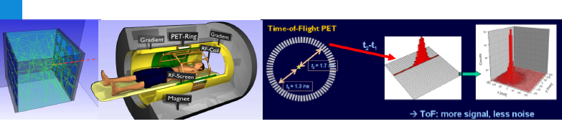
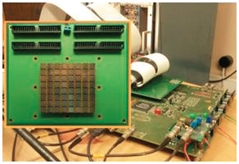
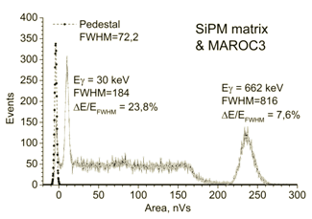
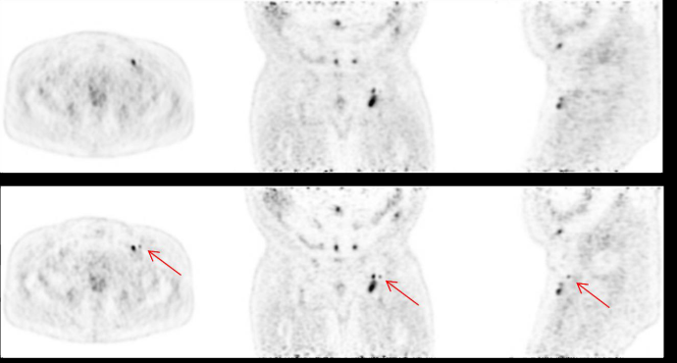
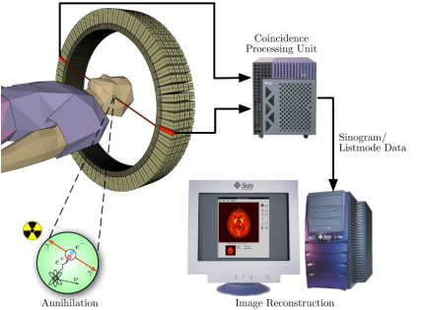
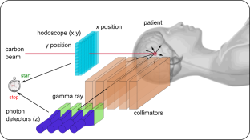
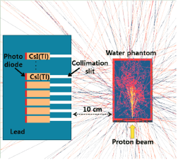
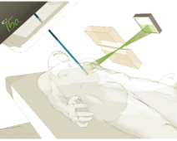
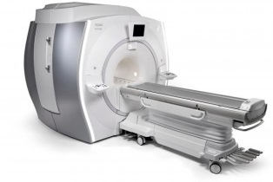
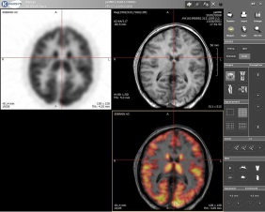
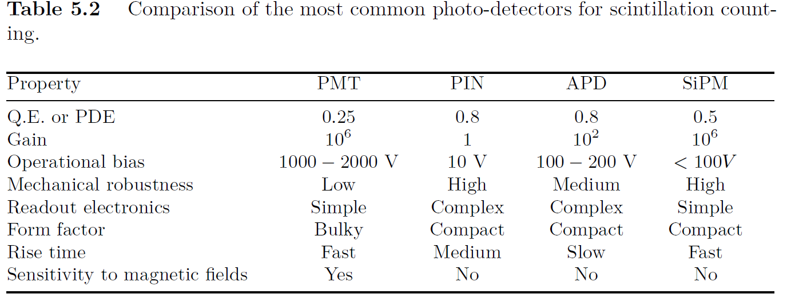
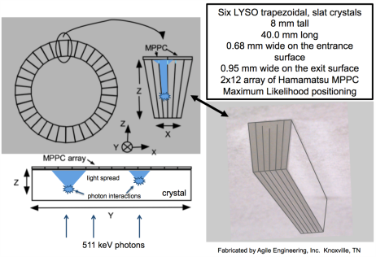
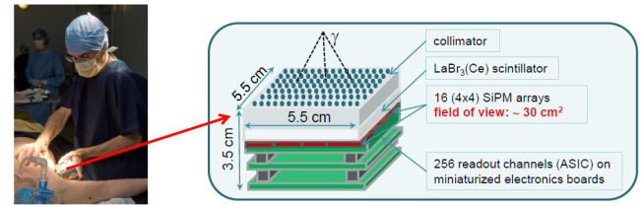
Possible applications of SiPM in medicine
Development of SiPM-based gamma camera, full-body SPECT
(2015)
(2015)
(2011)
Ultra precise timing with SiPM-Based TOF PET scintillation and Cherenkov detectors
(2015)
(2009)
Prompt gamma camera for real-time range control in Proton Therapy; dose distribution in real time for ion beam therapy by means of prompt gamma detection; prompt gamma imaging with a slit camera
PET/MR System With Time-of-Flight Capability
Depth Of Interaction (DOI) determination
SIPMED camera

Slide 23
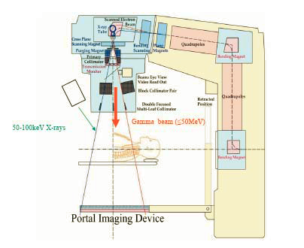
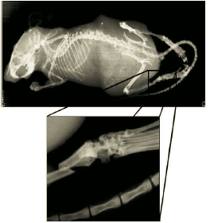
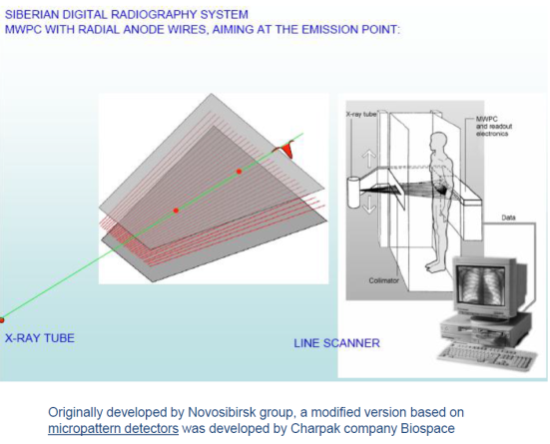
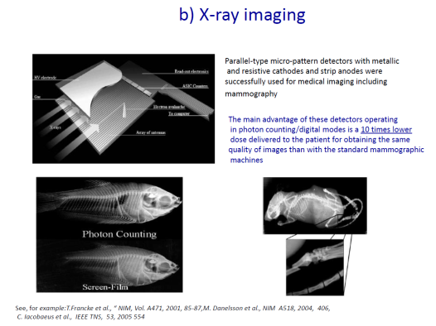
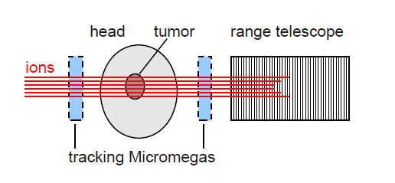
Possible applications of MPGD in medicine
Portal Imaging
Simple X-ray imaging system and system for a medical application as a proton beam monitor
Application of Micromegas in medical ion transmission tomography
Fast and thermal neutron detection
Possible collaboration with RD51 (CERN) for further developments

Slide 24
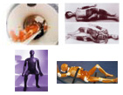
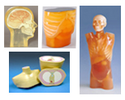
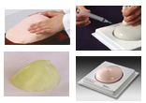

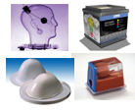
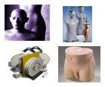
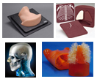
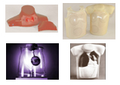

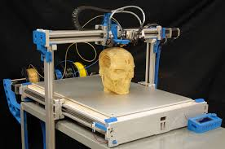
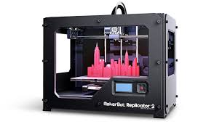

Anthropomorphic phantoms
Radiation Therapy Phantoms

Slide 25
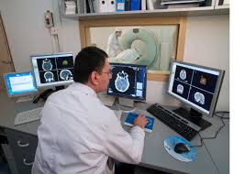
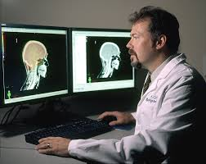
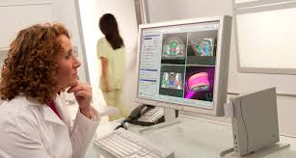

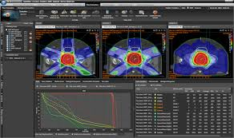
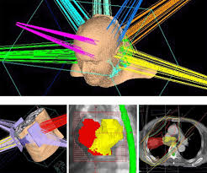
Planning systems for dose calculations for radiation oncology - RTPSs
Commercial RTPSs (Pinnacle, XiO, Eclipse,TMS, KonRad, iPlan etc.) – are very power systems but also very expensive and tied strongly to a specific manufacturer equipment. It restricts firmly possibilities for effective education of new personal, students in universities (medical physics, clinical dosimetry specialties…), providing of second calculation path to estimate the dose obtained by patient (requirements of regulation documents). Open Source functional RTPS – solution of this problem
Calculation algorithms and methods - Monte Carlo method (fast variants), Semi-Empirical algorithms (also called Correction or Factor based) -> model based algorithms, Pencil Beam algorithm (Convolution), Convolution-Superposition algorithms…

Slide 26
Development of open source planning system for dose calculations for radiation oncology - RTPS
Comparison of chosen approaches and algorithms with reputable commercial RTPS of vendors well-known in the world
Development of the main semi-analytical algorithms for RTPS
Creation of first variant of graphical interface of RTPS
Development of the main Monte Carlo algorithms for RTPS
Using GPU, other parallel hardware tools: estimations
Testing of RTPS

Slide 27
Kyiv platform
IAP (Sumy)
Responsibility – Dmitry Nagorny
- In the framework of the project a prototype of the detector based on multisensor array will be designed, manufactured and tested. The detector will be focused on the research on study of X-ray phase contrast. Testing of the detector will be carried out at the channel quasi-monochromatic X-ray end-station at the IAP NAS of Ukraine.

Slide 28
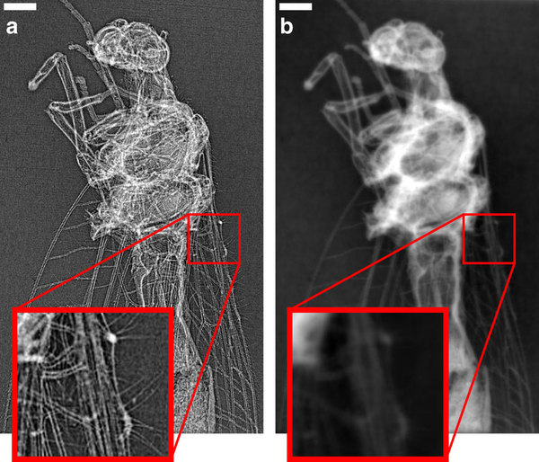
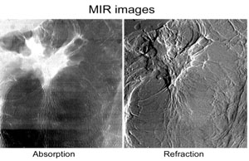
Technology of X-ray phase contrast imaging (PCI)
http://www.nature.com/articles/srep13581 (2015)
http://www.ncbi.nlm.nih.gov/pubmed/23220766 (2013)
http://www.ncbi.nlm.nih.gov/pubmed/22330515 (2013)
https://en.wikipedia.org/wiki/Phase-contrast_X-ray_imaging
Quantitative X-ray phase-contrast microtomography from a compact laser-driven betatron source
http://www.nature.com/ncomms/2015/150720/ncomms8568/full/ncomms8568.html
(a) The image shows a selected single-shot radiograph dominated by X-ray in-line phase contrast. Small details are highlighted due to the strong edge enhancement effect (see insets of magnified sections). (b) The corresponding quantitative phase map was retrieved using a single-material constraint.
http://mirc.iit.edu/research/phase-contrast-x-ray-imaging/

Slide 29

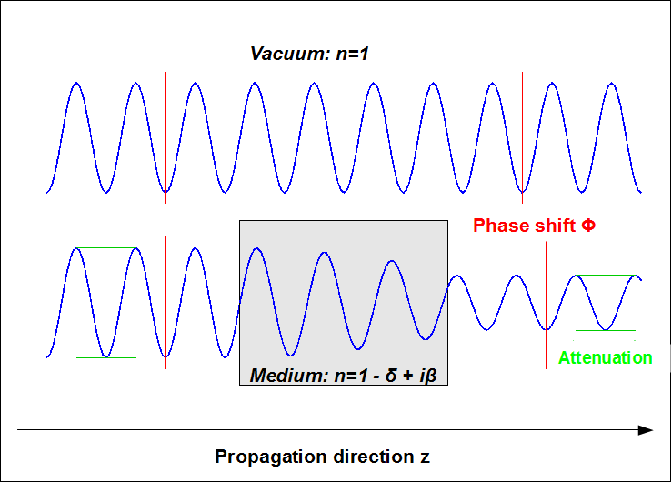
Phase-contrast X-ray imaging
Phase-contrast X-ray imaging (PCI) is a general term for different technical methods that use information concerning changes in the phase of an X-ray beam that passes through an object in order to create its images.
the phase shift
an exponential decay factor decreasing the amplitude of the wave

Slide 30
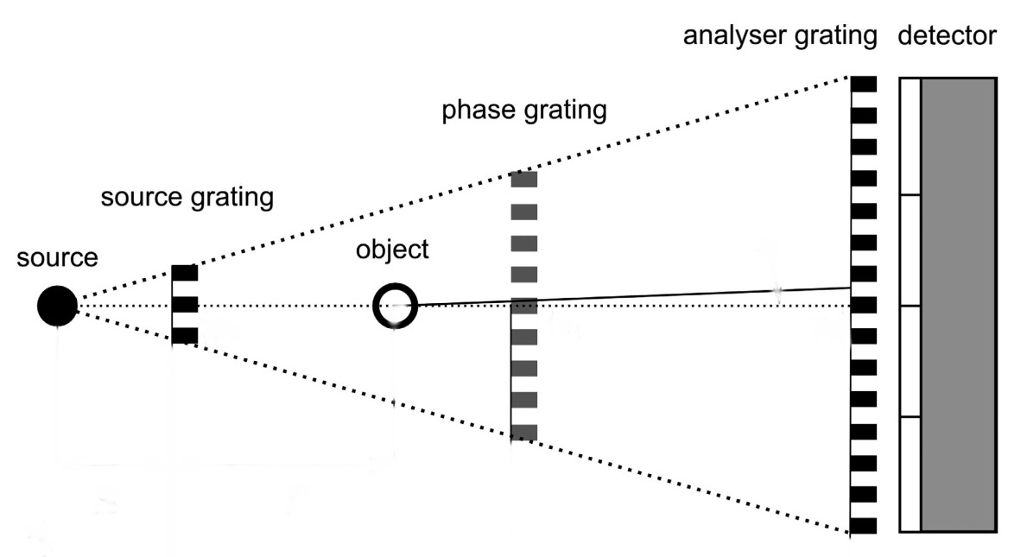
Phase-contrast X-ray imaging.
Experimental realisation
Crystal interferometry
Grating Bonse-Hart
Analyzer-based imaging
Propagation-based imaging
Edge-illumination
Grating-based imaging
(Talbot interferometry)
Required characteristic of radiation for X-ray phase contrast
Energy range | ∆E/E | Source size | Size on the object | Flux on the object | Coherence
> 10 keV | 3% | small | 50 cm | > 10^(9) ph/s | yes

Slide 31
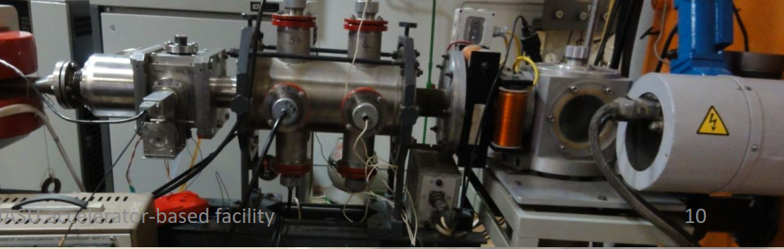
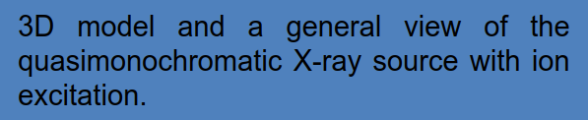
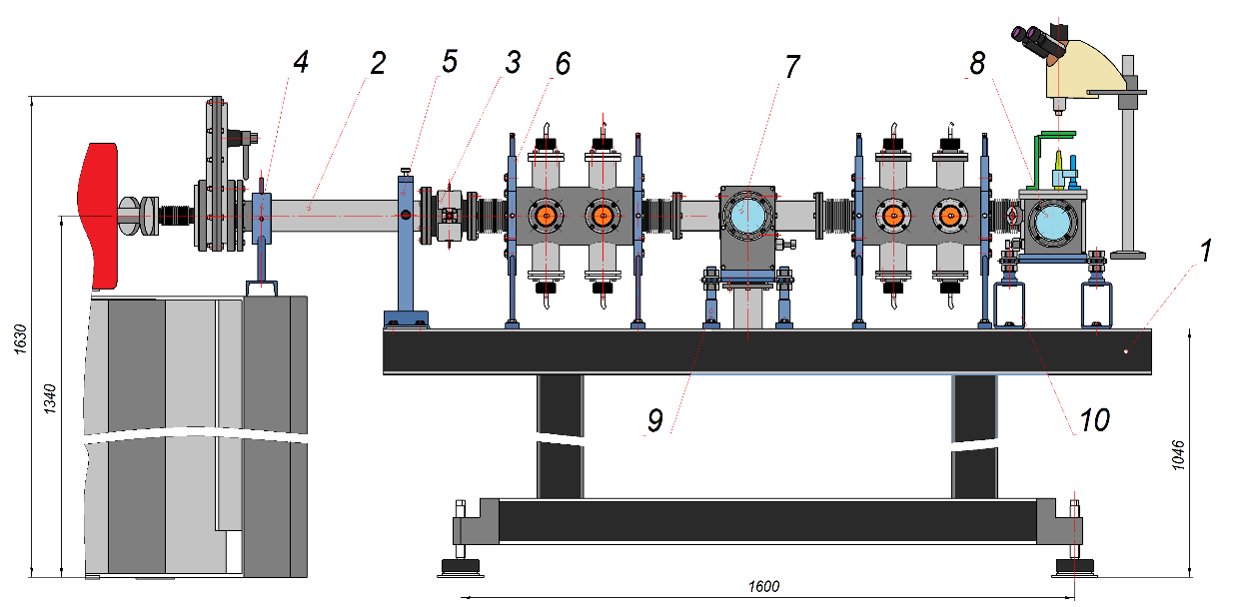
Accelerators based compact source
of quasi-monochromatic X-ray at IAP NASU

Slide 32

Multimatrix X-Ray detector
for phase contrast imaging experiments
Basic parameters
Sensitive Area | 90x60mm
Optical Configuration | 2x2 cells
DQE(0) | 0.44
Optical Resolution | up to 12 pl/mm
Dynamic Range | equal to 14bits
Energy of detected X-Ray quantum | 9-100keV (for different conversional screens)
Frame rate | 15-150 FPS
External digital interface | Gigabit Ethernet
Optical scheme of the detector
Photo of the Multimatrix Hybrid X-Ray Detector
3D CAD Driwing of the Multimatrix Hybrid X-Ray Detector

Slide 33
Kharkiv platform
Profile: planar detectors and dosimeters

Slide 34


Development, installation and commissioning of microwire bonding facilities
and automated facilities of detector testing
The objective
Development of a set of experimental instrumentation, techniques and versatile test platforms for development, characterization and testing of wide range of radiation detector systems
The team
N.I.Maslov (PhD) a.o., NSC KIPT, Ukraine
Expected results
Microwire bonding facilities and automated facilities for detector testing will be realized on the basis of the available facilities at KIPT and with the additionally purchased equipment. The created facilities will allow to perform a full cycle of manufacturing and automated testing of research silicon detector systems. Besides, they will allow training students in modern instrumentation and process equipment.
Double-sided (two-coordinate) microstrip detector (DSMD), produced in KIPT
Double-sided (two-coordinate) microstrip detector (628 channels on each side ), constructed by Kharkiv group for HEP
Microstrip detector in the test station with the microprobes
34

Slide 35


Single-channel and double-sided Si photosensors
The objective
Development of a set of experimental instrumentation, techniques and versatile test platforms for development, characterization and testing of wide range of radiation detector systems
The team
N.I.Maslov (PhD) a.o., NSC KIPT, Ukraine
Expected results
A single-channel double-sided silicon photosensor with its separated photosensitive and signal output functions will be realized and investigated. Using single-channel double-sided Si photosensor a scintillator-photosensor assembly will be manufactured. The spectrometric read-out system will be developed and manufactured.
Single-channel single-sided silicon spectrometer detector
Measurement of radiation of isotope source ²⁴¹Am using uncooled detector. The energy resolution of 1.16 keV. Preamplifier with resistive feedback.
Single channel silicon detector for room-temperature spectrometry
35

Slide 36
Specific software code for CdZnTe dosimeter
The objective
Development and characterization of CdZnTe detectors for the application in dosimetry of X- and gamma-radiation
The team
S.P.Fomin (PhD) a.o., Kharkiv National University, Ukraine
Expected results
Specific software code for CdZnTe dosimeter allowing for an analysis of the X-ray spectra will be written, verified and tested
36

Slide 37


Dosimetry of X- and gamma-radiation and electron therapy beams
CVD diamond detectors for dosimetry of X-ray and electron therapy beams
The objective
Development and characterization of CVD polycrystalline diamond detectors for the application in dosimetry of X-ray and electron therapy beams
The team
V.E.Kutny (PhD) a.o., NSC KIPT, Ukraine
http://www.kipt.kharkov.ua/kipt_sites/isspmst/nrdetectors/en/detectors/diamond/
Expected results
CVD polycrystalline and single crystal diamond prototype detectors will be manufactured. Their parameters and properties will be investigated and irradiation tests under X-ray and electron and proton beams will be conducted.
Polycrystalline diamond film grown on a silicon substrate
Their compliance with the requirements for external beam radiotherapy detectors will be determined. The response to proton beam will also be investigated.
L.N.Davydov, et al.. SPIE Proceedings, Vol. 8507, p. 85071N-1, 2012.
V.E. Kutny, et al., Problems of atomic science and technology. No. 3(91), (62), 2014. p.162.
Calibration of diamond detector in X-ray radiation field
Interdigitated Al contacts on the growth surface of the diamond film
37

Slide 38

Dosimetry of X- and gamma-radiation and electron therapy beams
CdZnTe detectors for dosimetry of X- and gamma-radiation
The objective
Development and characterization of CdZnTe detectors for the application in dosimetry of X- and gamma-radiation
The team
V.E. Kutny (PhD) a.o., NSC KIPT, Ukraine
http://www.kipt.kharkov.ua/kipt_sites/isspmst/nrdetectors/en/detectors/
Expected results
A prototype dosimetric device will be created, in which for precision measurements of the dose (dose rate) statistical parameters of gamma-radiation spectra will be used.
A limiting relation between transfer parameters of electrons and holes in CdZnTe detectors will be determined, beyond which the realization of the proposed method will be possible. The technique of calibration and metrological tests of the developed dosimeter will be developed.
Relation between CdTe and CdZnTe detector sensitivities and average amplitude of pulses created in detectors at the registration of gamma-quanta.
A. V. Rybka et al. Nucl. Instr. & Meth. A, 2004, vol. 531, pp.147-156.
A. Zakharchenko et al. Proc. SPIE, Vol. 8507, Paper 85071I, 2012.
A. A. Zakharchenko et al. // Proc. SPIE, Vol. 8852, Paper 88521B, 2013.
38

Slide 39


