Slide 1
PERLE @ Orsay:
Introduction and Status
French-Ukrainian Workshop
Walid Kaabi-LAL/CNRS
LAL, November 6th 2017

Slide 2
Introduction:
PERLE is a high current, multi-turn ERL facility, designed to study and validate main principles of the Large Hadron Electron Collider (LHeC).
The Orsay realization of PERLE (Called PERLE@Orsay) is a smaller version (400 MeV) with the same design challenges and the same beam parameters:
Target Parameter | Unit | Value
Injection energy | MeV | 5
Electron beam energy | MeV | 400
Normalised Emittance γε_{x,y} | mm mrad | 6
Average beam current | mA | 15
Bunch charge | pC | 375
Bunch length | mm | 3
Bunch spacing | ns | 25
RF frequency | MHz | 801.58
Duty factor |  | CW
French-Ukrainian Workshop

Slide 3
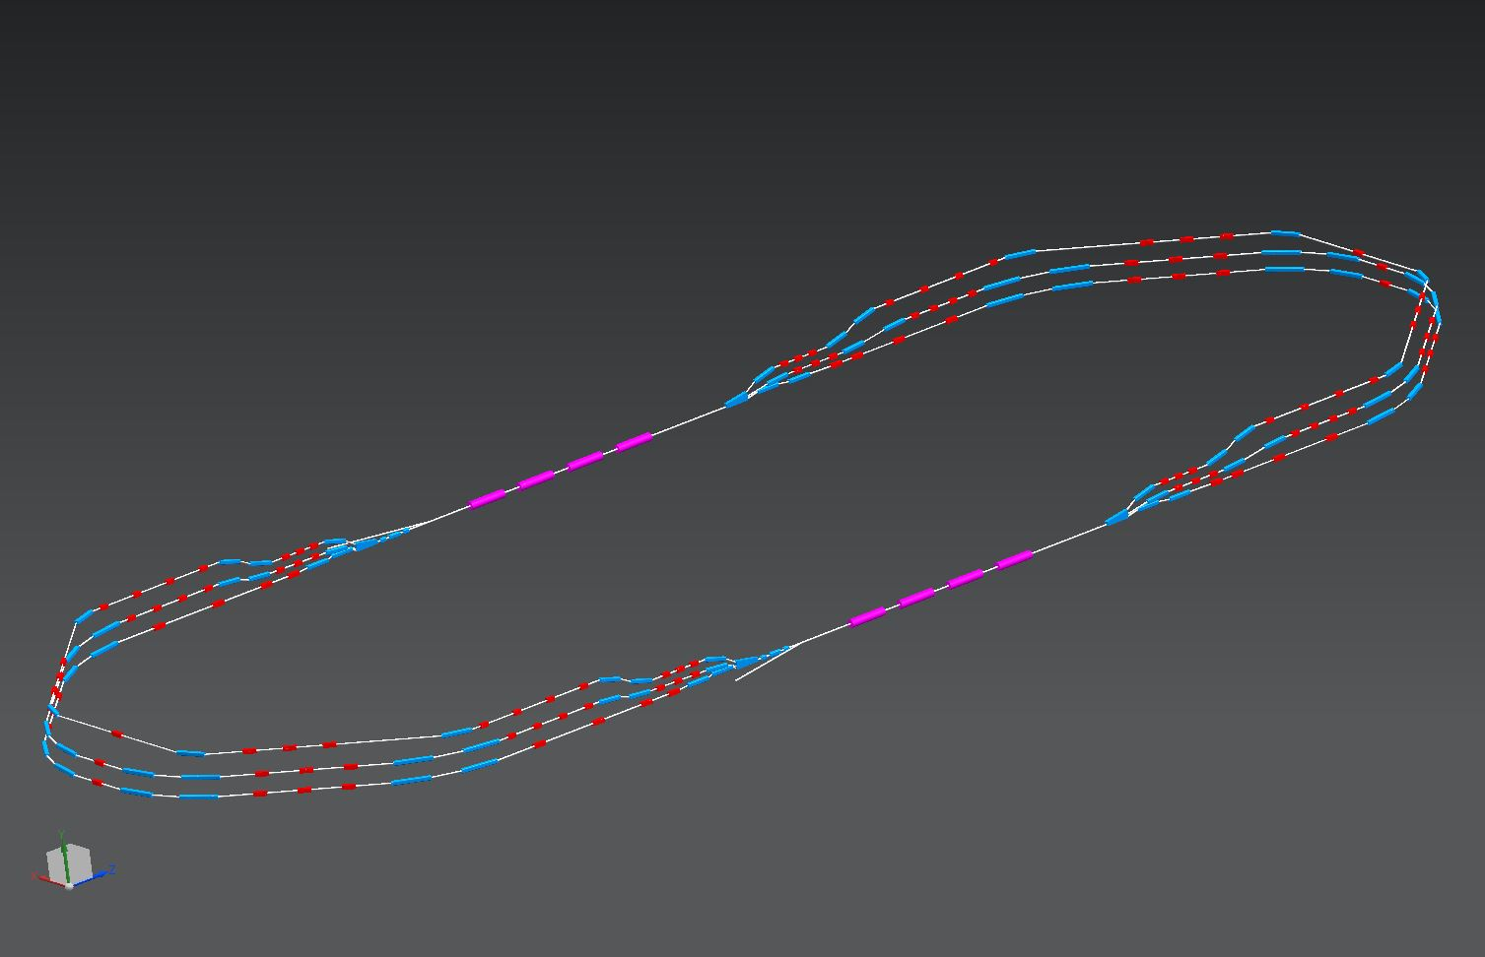
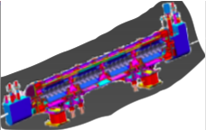
PERLE@Orsay:
Courtesy to A. Bogacz
2 Linacs (Four 5-Cell 801.58 MHz SC cavities)
3 turns (131 MeV/turn)
Max. beam energy 400 MeV
1 : 3 : 5
DE = 65.5 MeV
5.5 m
injector
5 MeV
0.8 m
24 m
DE = 65.5 MeV
2 : 4 : 6
5 MeV
dump
Footprint: 24 x 5.5 x 0.8 m³
DC = l_{RF}/2
French-Ukrainian Workshop

Slide 4
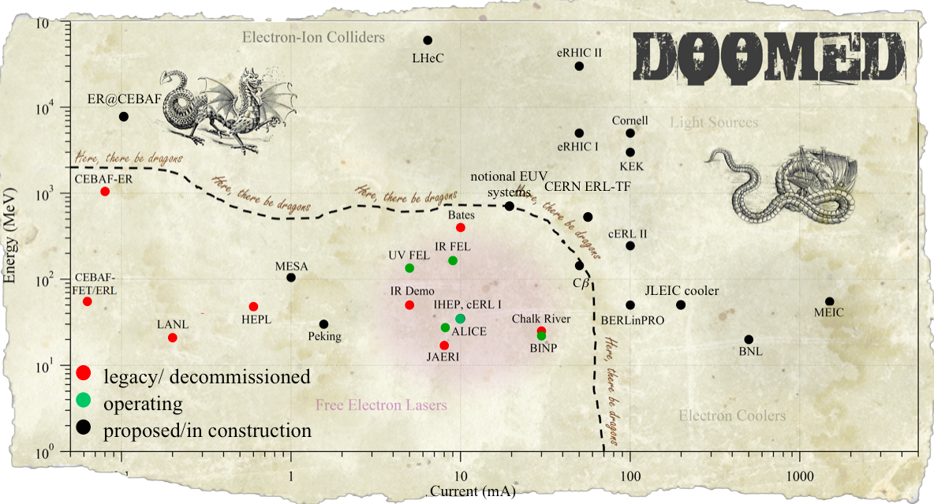
PERLE@Orsay in the global landscape:
PERLE
Courtesy to Chris Tennant
French-Ukrainian Workshop

Slide 5
PERLE: An ERL at Orsay
Why an ERL?
Accelerator R&D at its best.
Compact accelerator with high performances that need smaller investment (site area, cryogenic plant, RF source…)
A clever concept that allow energy saving: a key word for future machine construction.
Why @ Orsay?
Involvement of local accelerator experts around an ambitious project.
Opportunity to host the first superconductive R&D facility in Paris-Saclay campus.
Develop and acquire expertise in design and operation of ERL.
French-Ukrainian Workshop

Slide 6
Why PERLE?
The opportunity to work within an international collaboration with expert in ERL design and operation.
Technical challenges imposed by the machine design:
Multi-turn recirculation,
High current operation,
New SRF cavities & cryomodules to be tested with beam,
beam stability (intensity, position and size) in acceleration and deceleration phases,
Injector versatility,
A unique technology test bed to explore and validate the key design choices for future larger machine.
Compact but powerful machine that could provide electron beam for low energy physics experiment, intense Compton generation or FEL radiation to light source users.
French-Ukrainian Workshop

Slide 7
PERLE collaboration:
The PERLE @ Orsay collaboration includes today CERN, JLAB, ASTeC Daresbury, University of Liverpool, BINP, LAL and IPN Orsay.
We are open to new collaborators.
The collaboration signed the PERLE Conceptual Design Report (CDR) submitted for publication in J. Phys. G
LAL organized PERLE @ Orsay workshop in February 23-24th 2017.
PERLE@Orsay was presented at ERL 2017 conference and meet a high interest of the community, supportive to see PERLE becoming a real project, with proposals of synergetic work with other ERLs in construction worldwide.
Next step will be the redaction of PERLE Technical Design Report (TDR).
French-Ukrainian Workshop

Slide 8
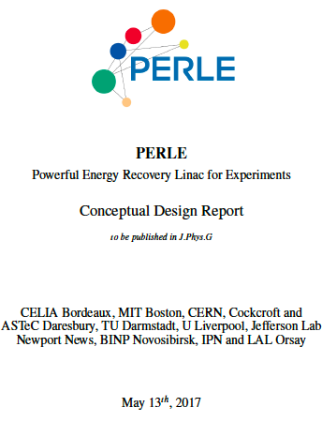
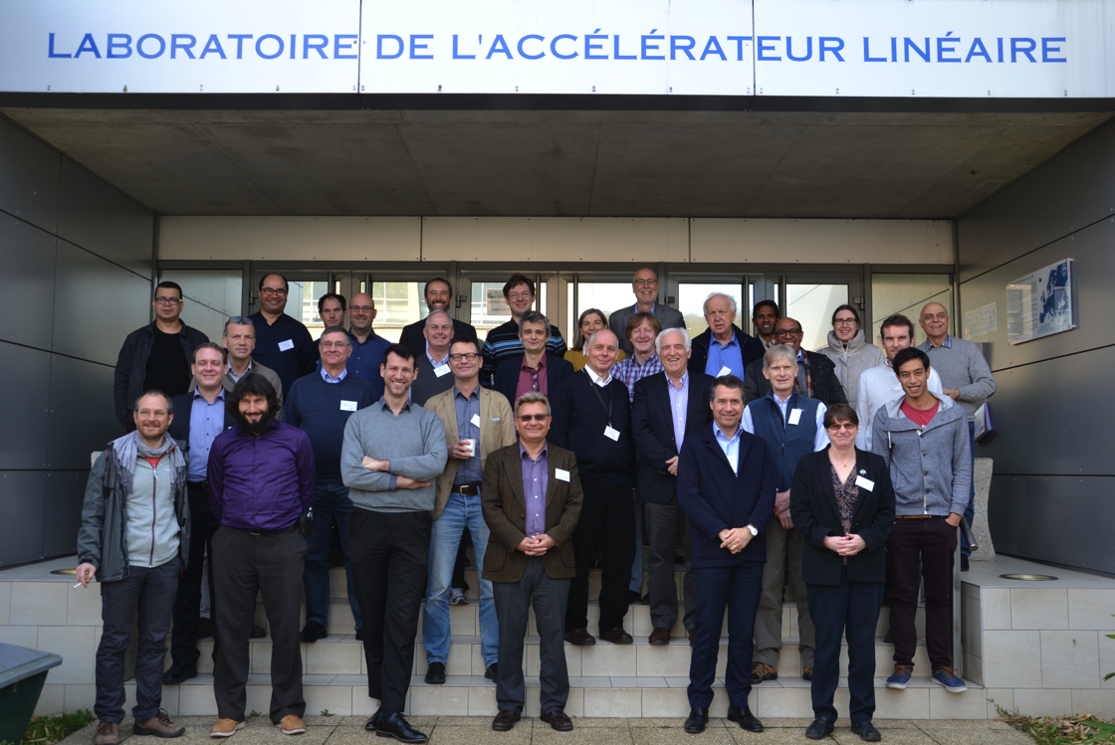
PERLE collaboration:
For more details:
the PERLE CDR [arXiv:1705. 08783] →
the indico site of PERLE Workshop held in February 2017 at Orsay
https://indico.lal.in2p3.fr/event/3428/
French-Ukrainian Workshop

Slide 9
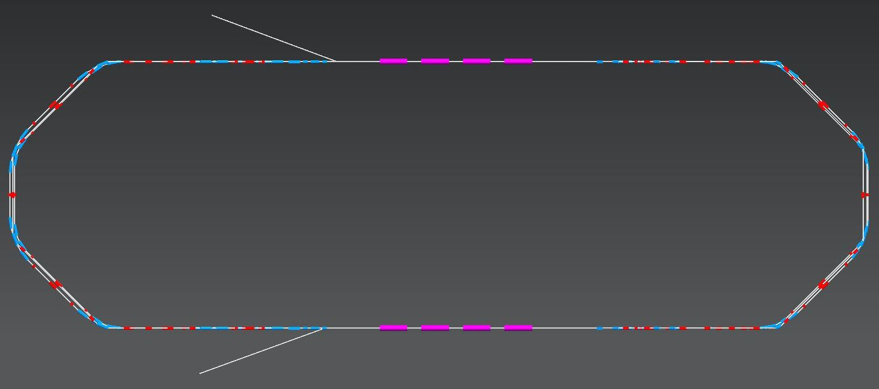
PERLE Layout:
Alex Bogacz
Top view
5.5 m
24 m
4 m
10 m
2 : 4 : 6
Side view
1 : 3 : 5
0.4 m + 0.4 m
French-Ukrainian Workshop

Slide 10
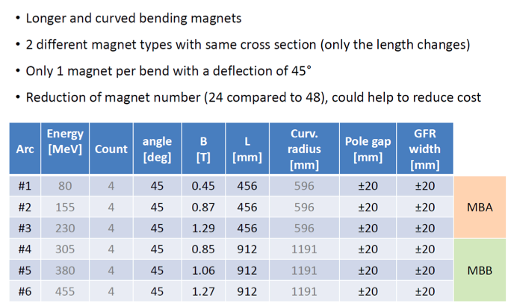
Cost-effective magnet solution:
Pierre-Alexandre Thonet
French-Ukrainian Workshop

Slide 11
PERLE magnet design (dipoles and quadrupoles):
French-Ukrainian Workshop

Slide 12
1 pass up + 1 pass down optics:
More details in tomorrow’s A. Bogacz presentation
Pass-1 ‘up’
20
2
BETA_X&Y[m]
DISP_X&Y[m]
0
-2
0
BETA_X
BETA_Y
DISP_X
DISP_Y
50.8316
5 MeV
71 MeV
137 MeV
Pass-1 ‘down’
20
2
BETA_X&Y[m]
DISP_X&Y[m]
0
-2
0
BETA_X
BETA_Y
DISP_X
DISP_Y
50.8316
137 MeV
71 MeV
5 MeV
French-Ukrainian Workshop

Slide 13
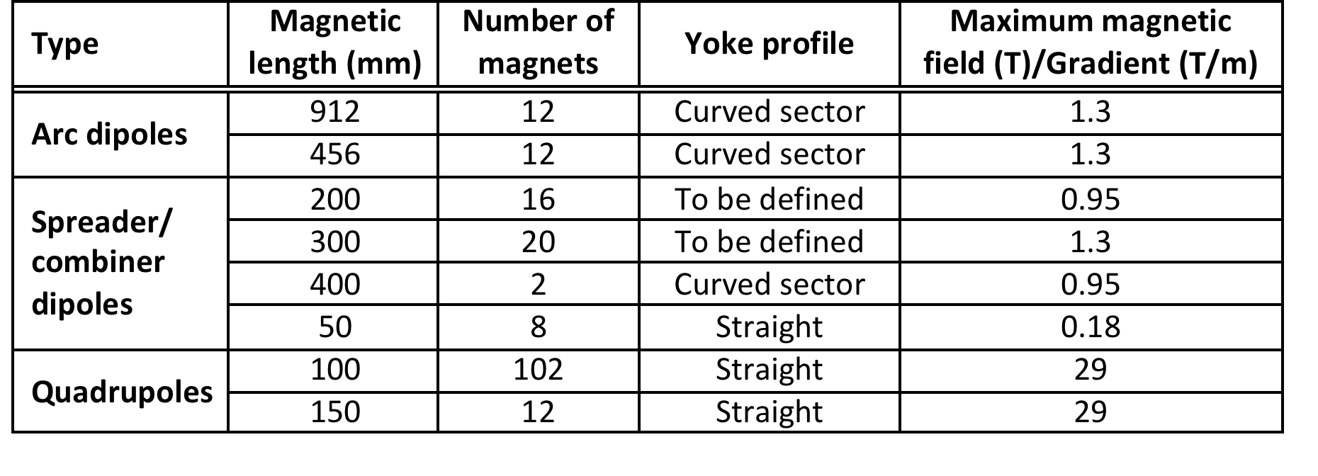
Magnets inventory:
C. Vallerand, P.A. Thonet & A. Milanese
Summary of magnetic element features
Bends: 70
Quads: 114
French-Ukrainian Workshop

Slide 14
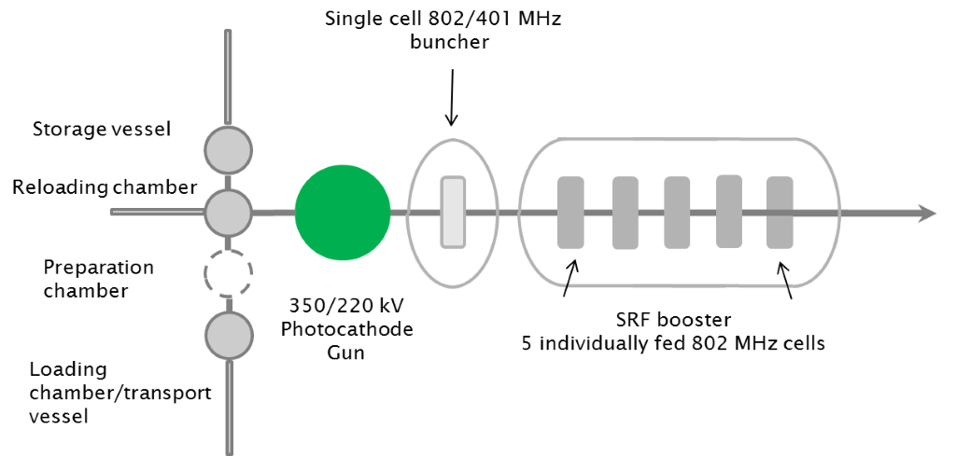
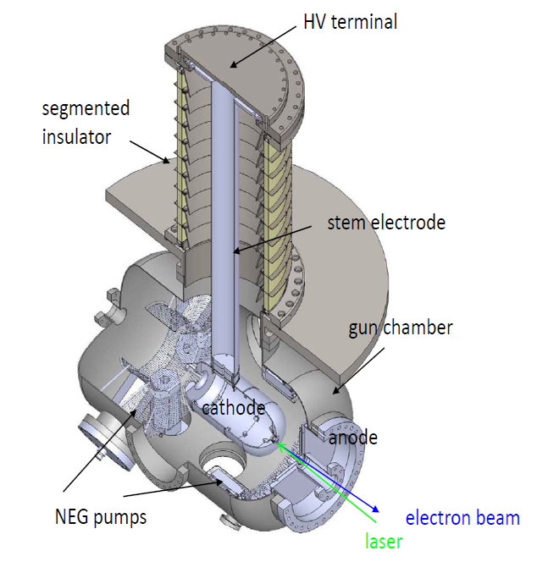
Electron source and injector:
Boris Militsyn
Preferred concept: Photocathodes, DC Gun, single cell buncher and SRF accelerator (booster),
Laser allows flexible bunching sequence,
Nominal repetition rate 40.1 MHz (20th sub-harmonic of 801.56 MHz),
Nominal bunch charge: 2.34 10⁹ e- = 375 pC → 375 pC x 40 MHz = 15 mA.
350 kV for Sb-based photocathodes (unpolarized)
220kV for GaAs photocathodes (polarized) to reduce dark current
DC Gun
French-Ukrainian Workshop

Slide 15
Injector versatility:
Erk Jensen
One purpose of PERLE is to test SRF cavities/cryomodules with beam.
→ Thanks to the flexibility of laser pulse driven photocathode, sub-harmonics are used to test different frequencies with PERLE beam. Two interesting sub harmonics are found:
f₀ = 10.835 MHz
Harmonic | Frequency (MHz)
30 | 325
37 | 401
39 | 422
46 | 499
60 | 650
65 | 704
74 | 802
88 | 953
120 | 1300
f₀ = 12.146 MHz
Harmonic | Frequency (MHz)
29 | 352
33 | 401
58 | 704
66 | 802
107 | 1300
French-Ukrainian Workshop

Slide 16
Injector versatility:
@ CERN
International
Programme | Frequency (MHz)
LHC, spare and more | 401 MHz
LHC upgrade | 200 MHz, 802 MHz
HIE-ISOLDE | 101 MHz
HL-LHC crab cavities | 401 MHz
Linac 4 (NC) | 352 MHz
SPL (ESS) | 704 MHz
LHeC, FCC-he | 802 MHz
FCC-ee, FCC-hh | 401 MHz & 802 MHz
Programme | Frequency (MHz)
ILC, X-FEL, LCLS-2, CBETA, CERL, MESA… | 1,300 MHz
PIP-II | 650 MHz
SNS | 805 MHz
PERLE | 802 MHz
ESS | 352 MHz, 704 MHz
eRHIC | 422 MHz
JLAB MEIC | 953 MHz
JAERI | 500 MHz
French-Ukrainian Workshop

Slide 17
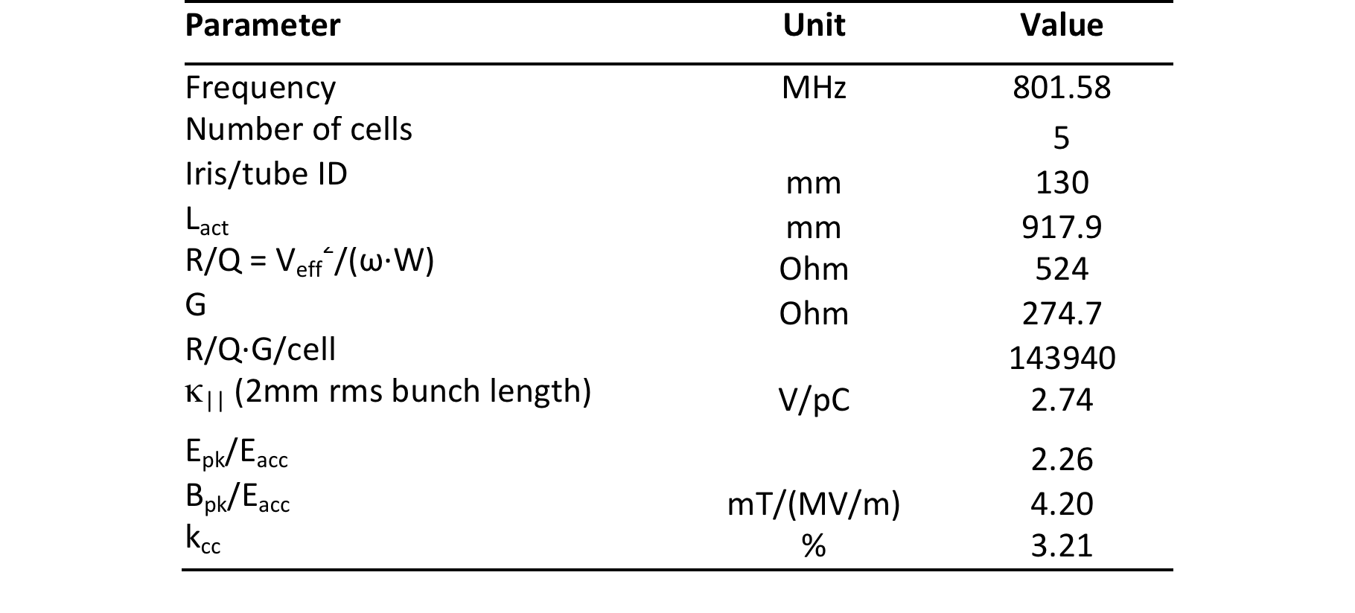
Main cavity parameters
French-Ukrainian Workshop

Slide 18
Cavity fabrication status:
French-Ukrainian Workshop

Slide 19
Cavity fabrication status:
The first Nb 802 MHz five-Cell cavity fabricated mid-October at JLAB
French-Ukrainian Workshop

Slide 20
Sébastien Bousson
Cryomodule requirement for PERLE:
Several cryomodule requirements could be listed for PERLE, and some of them are very challenging. They are of two types:
The classical challenges imposed by SRF:
Limit as much as possible heat transfer
Take into account all mechanical constraints
Design allowing an easy assembly procedure
… and as usual, optimize for cost !
2. The additional constraints coming from the cavities operated in the ERL mode and CW/high current operation mode:
High CW cryo loads
Low level of vibration, and damping of them
Excellent magnetic shielding (high Q₀)
Accurate cavity alignment
French-Ukrainian Workshop

Slide 21
Sébastien Bousson
Specific constraints in PERLE cryomodule:
High cryo loads generated by the CW mode and high current operation
→ A large number of significant dynamic heat loads in an operation mode where dynamic loads are >> static loads
Cavity
HOM load
CW input couplers
Design question/optimization points to find for cryostat/cryoplant: cryo load
Thermal shield temperature optimum
How to efficiently extract HOM power? at what T°?
Cryo load varies a lot between RF on/off : cryoplant flexibility is required
Cavity optimum operating temperature: cost vs cavity performances vs helium bath stability
How to cool the cavities (series/parallel) in order to insure “magnetic hygiene” (really an issue for high Q₀ @ 802 MHz ?)
French-Ukrainian Workshop

Slide 22
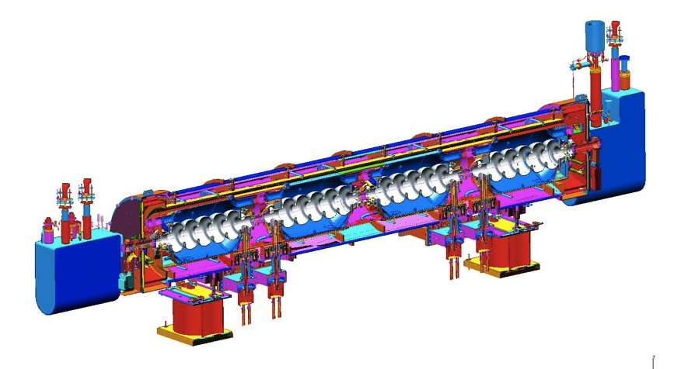
5-cells elliptical 805 MHz
Side loading
Space frame
SNS Cryomodule
French-Ukrainian Workshop

Slide 23
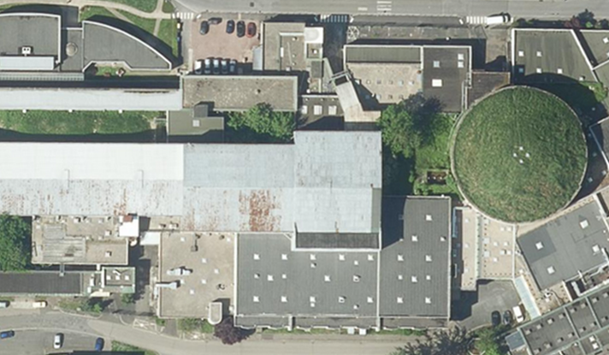
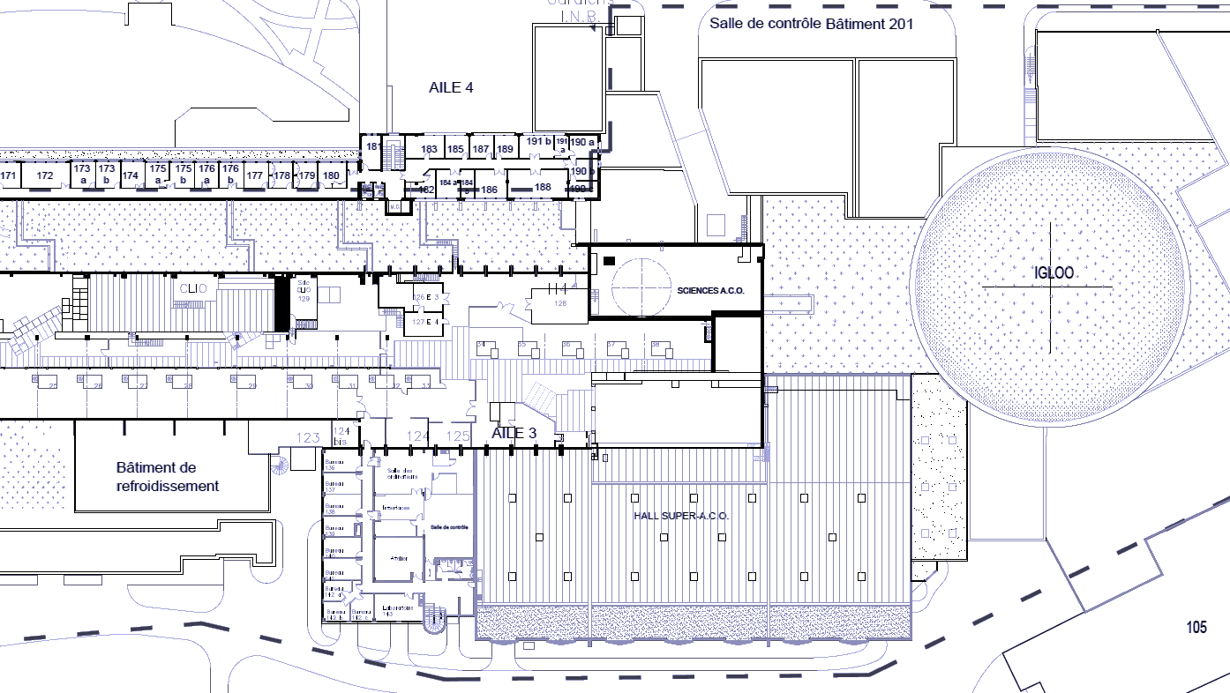
Site to host PERLE:
IGLEX: Thomx + Andromede
PRAE
42 x 12 m²
Hall Super ACO
(1850 m²)
Possible use of a 2nd levels for RF source and power supplies installation
French-Ukrainian Workshop

Slide 24
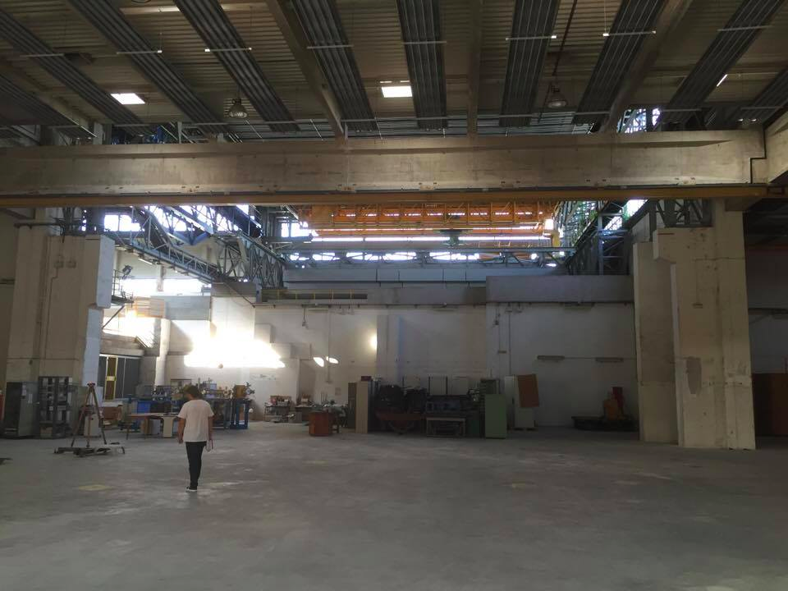
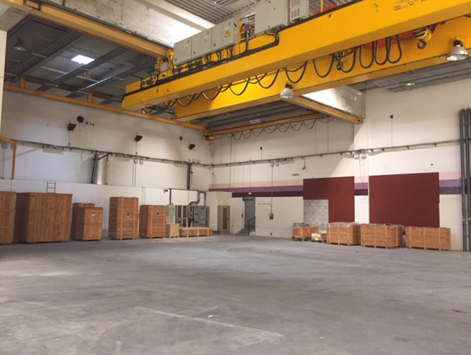
Site to host PERLE:
French-Ukrainian Workshop

Slide 25
Site description:
The experimental hall is equipped with crane, electricity and is partially shielded
Water cooling circuit could be shared with other machines nearby.
Possibility to install the RF source and power supplies in a different level than the accelerator
A large area of ground have the required resistance to allow installation of PERLE.
A control room that overlooks the hall could be used for PERLE.
No Cryogenic plant around, has to be built.
Space available for experiments.
Support for the infrastructure is fully assured.
French-Ukrainian Workshop

Slide 26
Next steps…
Important R&D effort still to be done in several fields:
Beam Dynamics
Lattice and optics
Electron source and injection
Cavities, HOM study and cryomodule design and tests
Magnets and power supplies
Beam dumps
RF power source
Cryogenics
Beam instrumentations
LLRF
Control software system
Shielding and safety system
French-Ukrainian Workshop

Slide 27
Thank you for your attention!
LHeC and FCC-eh Workshop

