Slide 1

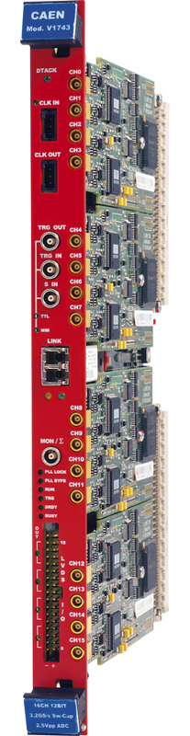
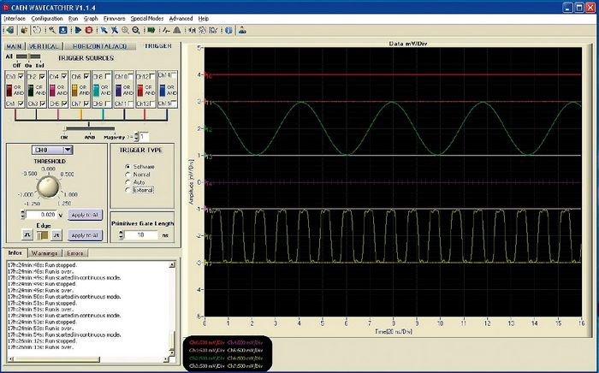
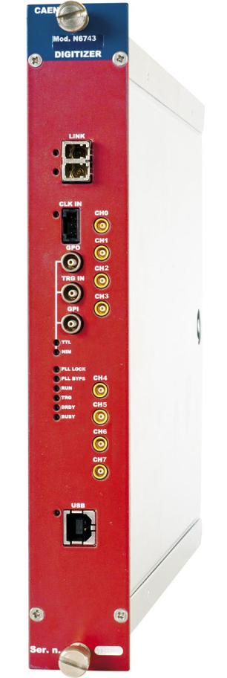
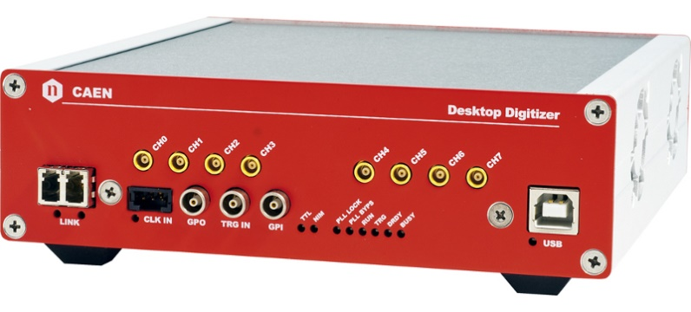
CAEN V1743, DT5743, N6743 digitizers:
Synchronization and trigger management
Carlo Tintori (c.tintori@caen.it)
WaveCatcher and SAMPIC Workshop at LAL - February 7th -8th, 2018

Slide 2


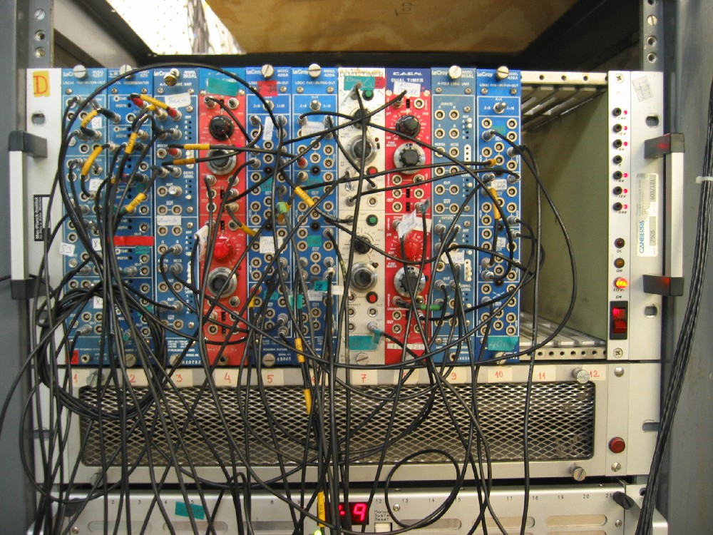
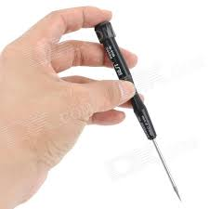
Traditional readout system
Many analog
modules and cables
A/D conversion
at end of chain
Detector
Shaping
Amplif
Peak
Sensing
ADC
Pulse Height
Preamp
Energy Spectrum (MCA)
Delay
QDC
Charge
(Integral)
Analog
Digital
Gate,Trg, …
Timing
Filter
SCA1
Logic
Veto
Coinc
Scaler
MCS/Rates
SCA2
Counts
TDC
Rise Time
PSD
Manual
Settings
TDC
Arrival
Time
TAC/TOF
Tref

Slide 3


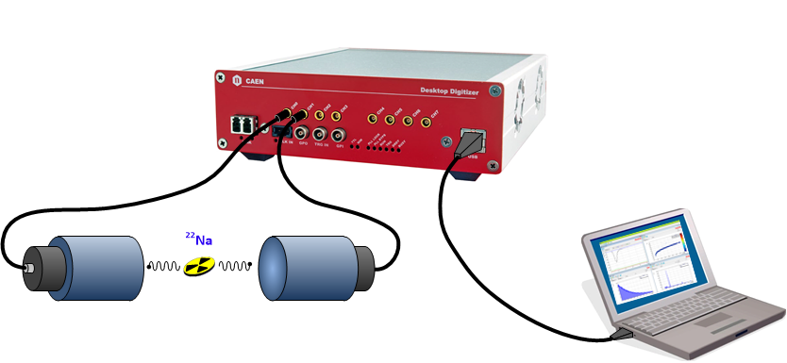
Digital Readout: all-in-one
early A/D conversion
Detector
FPGA
FADC
streaming
Preamp
01100101
Shaping
BLR
Peak
Sensing
PHA
Energy Spectrum (MCA)
Delay
BLR
Integral
QDC
Double
Integral
Fast/Slow
PSD
Timing
Filter
Discr
Logic
GPIOs
Scaler
Counts
MCS/Rates
Sync
clock
TDC
Time
TAC/TOF
Software
Settings

Slide 4
x743 digitizers: technical specifications
Switched Capacitor Array digitizer based on SAMLONG chip (developed at LAL)
Three form factors: VME (16 channels), Desktop and NIM (8 channels)
3.2, 1.6, 0.8, 0.4 GS/s, 12 bit resolution, max. 1024 samples per trigger
2.5 Vpp input dynamic range (MCX connector, single ended, 50 ohm)
125 µs dead time (conversion time)
Multi-Event Memory buffer: up to 7 events
QDC mode (readout of gated integrals, no waveforms, low throughput)
Individual discriminators in hardware (low trigger latency)
Readout interfaces
  VME (up to 160 MB/s in 2eSST mode)
  USB 2.0 (30 MB/s)
  CONET daisy chainable optical link: 80 MB/s per link. One A3818 PCIe card (4 links) can read up to 32 digitizers (512 channels) with an aggregate bandwidth of 320 MB/s

Slide 5
SCA vs Flash ADC
Switched Capacitor Arrays |  | Flash ADCs
PROs | CONs | PROs | CONs
High density (16 or 32 channels in a VME board) | Dead Time (typ. 100-200 µs) | No dead time in the acquisition | Power consumption
High sampling rate (> 1 GS/s) | Low depth (e.g. 1024 points = 300 ns) | Continuous data acquisition and processing | Cost per channel
Low Power | Need amplitude and timing calibration | Good linearity and ultra low jitter | Huge data throughput to manage
Low cost per channel | Not independent channel triggering | Independent channels

Slide 6

V1743 architecture
4 mezzanines
50 MHz
4 channels
200 MHz
PLL
CLK-IN
CLK-OUT
Sclk
FPGA
SAMLONG
(1/2)
Readout Controller
CONET, USB, VME
samples
Local Bus
Inputs
ADC
Other Boards
Stop
AcqTrg
Trg/Sync
Logic
ChTrg
PairTrgs
External Trg Logic
(e.g. V2495)
Threshold
Discr
DAC
LVDS I/Os
Other Boards
TRG-IN
Other Boards
TRG-OUT
SYNC/RUN

Slide 7
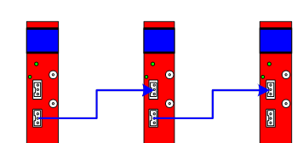
Synchronization (clocks)
    GOAL: have the same sampling clock (e.g. 3.2 GHz) in all channels
    On-board programmable PLL, locking either the internal oscillator (50 MHz) or any external frequency, generates clocks for the SAMLONG chips (200 MHz) and for the FPGAs (100 MHz)
    3.2 GHz produced inside SAMLONG from the 200 MHz reference clock
    VME models have front panel clock IN and OUT (LVDS). Daisy-Chain clock distribution: the 1st board is the clock master (using either internal or external clock), the 2nd board takes the clock-out of the 1st one and so on.
    The clock skew due to cables and ports can be compensated by a programmable delay in the PLL

Slide 8
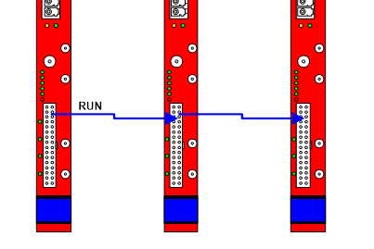
Synchronization (time stamps)
    GOAL: have the same zero for the time stamp
    T=0 @ Start of Run: propagated in daisy chain via front panel I/Os
    Start sent to the 1st board of the chain; can be either a HW signal feeding SIN or a SW command
    Propagation delay (skew) compensated in firmware by adding a given number of clock cycles
    NOTE: parallel fan-out for the sync signal has no skew but is prone to 1 clock cycle uncertainty (jitter) in the time stamp except for the unlikely case where the sync signal is synchronous with the digitizer clock and the setup/hold time constraints are met

Slide 9
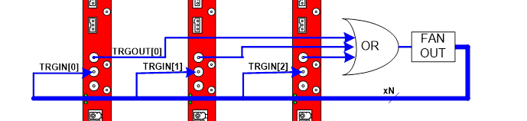
Synchronization (triggers)
    GOAL: propagate and combine self-triggers to have the same global trigger for the acquisition
    Individual discriminator (leading edge) on each channel
    Channel self-triggers combined 2 by 2 (AND/OR) to make pair-wise triggers
    8 pair triggers propagated to main trigger logic at board level (16 channels => 8 triggers)
    Pair triggers can be used to generate a global NIM/TTL TrgOut signal (e.g. OR of 16 channels) or propagated to an external logic via LVDS I/Os (8 output lines)
    The acquisition trigger for the 16 channels can be internal (from self-triggers) or external (from TRGIN). All boards/channels acquire simultaneously.
    Veto/busy logic prevents the loss of synchronization in the event data acquisition

Slide 10
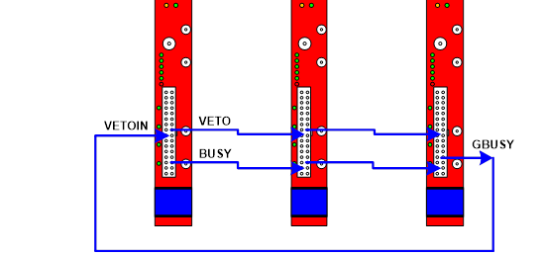
Synchronization (data)
    GOAL: keep event data aligned across boards
    Each trigger produces a data packet that is saved into the channel memory buffer
    One board asserts the Busy signal (LVDS) when its memory buffer is almost full
    The busy signal is propagated in daisy chain to the last board, then fed back into the veto input of the first board or used to inhibit the global trigger logic
    The Veto signal is propagated in daisy chain from the first to the last board
    Propagation time of busy/veto signals smaller than the dead time; implicit overrun protection

Slide 11
Synchronization Ex. 1: Common External Trigger
Triggering: Common External Trigger. All channels trigger at the same time.
Cabling:
ClkIn-ClkOut daisy-chain; 1st board clock master (either int or ext clk)
External trigger feeds TRGIN of the boards in parallel (fan-out); daisy-chain is possible but trigger delay can be an issue
Daisy chained Run signal to start/stop the acquisition and reset the time stamp
Start of Run by SW command or by SIN in 1st board
Daisy chained BUSY; last board inhibits trigger source

Slide 12
Synchronization Ex. 2: Trigger-less Acquisition
Triggering: Common Trigger =
OR of self-triggers (one channel triggers all). No external Trg.
Cabling:
ClkIn-ClkOut daisy-chain; 1st board clock master (either int or ext clk)
TrgOut[n] (internal OR of self-triggers of board n) feeding an external OR.
Fan-out feeding Trg-In[n]
Daisy chained Run signal to start/stop the acquisition and reset the time stamp
Start of Run by SW command or by SIN in 1st board
Daisy chained Busy; last board feeds VetoIn of 1st board (daisy chained Veto)
Reproduction, transfer, distribution of part or all of the contents in this document in any form without prior written permission of CAEN S.p.A. is prohibited

Slide 13
Synchronization Ex. 3: coincidences
Triggering: external logic looking for coincidences between channels
Cabling:
ClkIn-ClkOut daisy-chain; 1st board clock master (either int or ext clk)
Pair TrgOuts (8 per board) propagated to the V2495 through LVDS outputs
V2495 generates the acquisition trigger and feeds TRGINs (fan-out)
Daisy chained Run signal to start/stop the acquisition and reset the time stamp
Start of Run by SW command or by V2495 through SIN in 1st board
Daisy chained Busy; last board uses TrgOut as Busy output to inhibit the trigger in the V2495
Reproduction, transfer, distribution of part or all of the contents in this document in any form without prior written permission of CAEN S.p.A. is prohibited
Reproduction, transfer, distribution of part or all of the contents in this document in any form without prior written permission of CAEN S.p.A. is prohibited

Slide 14
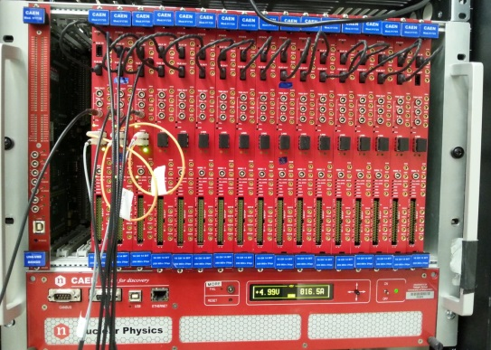
An example of 256 channel readout system

Slide 15
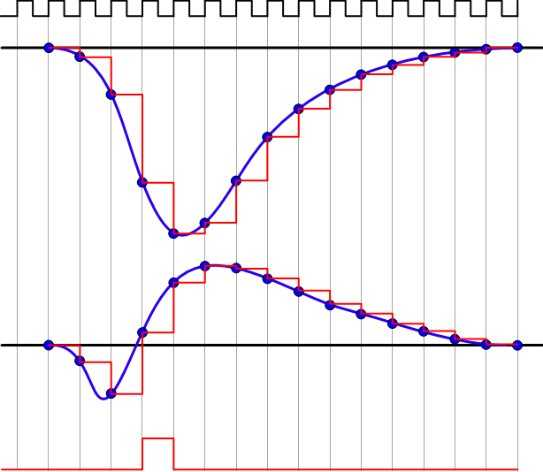
Digital CFD
CLK
INPUT
digital CFD: same principle as analog
CFD_{N+1} = f * S_{N} - S_{N-D}
f = Fraction, D = delay
COARSE TSTAMP = T_{CLK} * Clock Counter
FINE TSTAMP = T_{CLK} * B/(B-A)
Linear interpolation: good results if there are at least 3/5 points on the rising edge. If not, the "ZC correction algorithm" can be applied to improve the timing resolution
ZC FINE TSTAMP
B
CFD
COARSE TSTAMP
A
TRIGGER

Slide 16
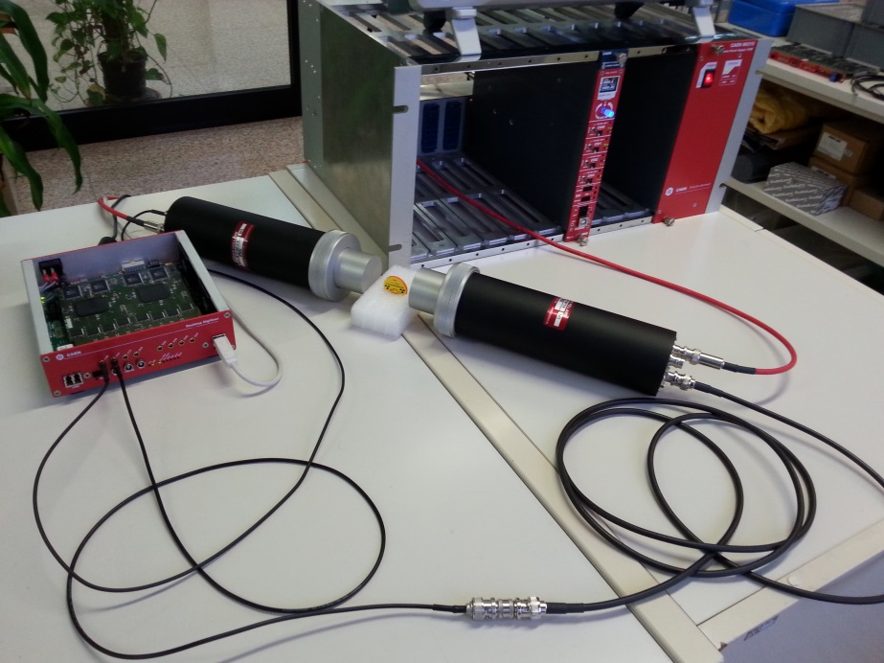
Test Setup
Test n 1: Pulse generators
Agilent 81110A and Tektronix AFG3252 to generate pulses with different rising edges (1, 2.5, 5, 10 and 20 ns)
Passive splitter + cable delay to make a start-stop measurement (self timing)
HP Step Attenuator (10, 20, 30, 40 dB) on the stop signal to measure the walk
Test n 2: Self-timing of LaBr₃ and BaF₂ detectors
Single detector output, passive splitter and cable delay (~11 ns)
BaF₂: 1” mod. Scionix 38A38/2M-E1-BAF-X-N (PMT: Hamamatsu H3378-51)
LaBr₃: 2” mod. Saint Gobain Brilliance 380 (PMT: R6231)
²²Na source
ROI @ 511 keV peak
Test n 3: TOF between two BaF₂ detectors
Two BaF2 detectors (same mod. as test 2)
Gamma-gamma coincidence
ROI @ 511 keV peak
Digitizer:
DT5730: 500 MS/s, 14 bit Flash ADC
On-line digital CFD in FPGA (no waveform readout)

Slide 17


Digital CFD: results
Test | Rise Time | Amplitude | ZC corr | Start-Stop Resolution
 |  |  |  | RMS | FWHM
Pulse Generator | 1 ns | 450 mV |  | 9.5 ps | 22 ps
Pulse Generator | 5 ns | 450 mV |  | 10.1 ps | 24 ps
Pulse Generator | 20 ns | 450 mV |  | 1.9 ps | 4.5 ps
BaF₂ to BaF₂ | 1.3 ns | 130 mV |  | 120 ps | 280 ps
BaF₂ to BaF₂ | 1.3 ns | 130 mV |  | 538 ps | 1.3 ns
BaF₂ to LaBr₃ | 1.3/15 ns | 130/200 mV |  | 186 ps | 437 ps
NaI to NaI | 20 ns | 100 mV |  | 1.02 ns | 2.40 ns

Slide 18
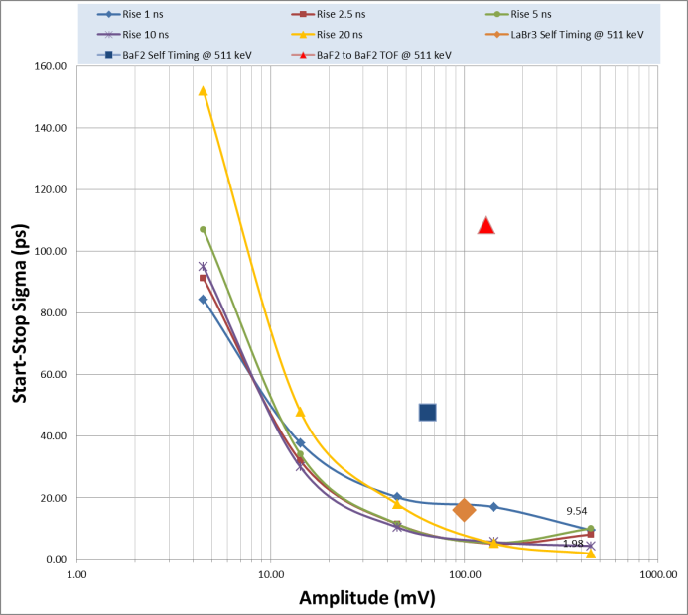
Digital CFD: RMS vs Amplitude

Slide 19
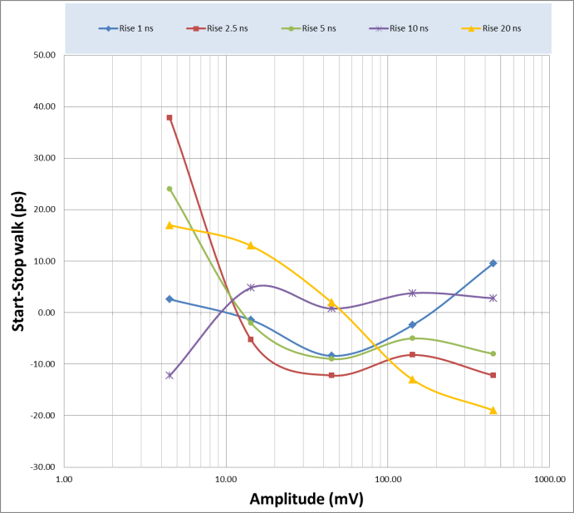
Digital CFD: Walk vs Amplitude

