Slide 1
EuroGammaS
WaveCatcher-based Machine Protection System tools for the commissioning of the ELI-NP Gamma Beam Source
Stefano Pioli
2018/02/08

Slide 2
Outline
ELI-NP Gamma Beam Source
System Architecture
Fast-Interlock system
WaveForm Mask
Beam Loss Monitors
Cherenkov Beam Loss Position Monitor
Conclusion and Next steps
Stefano Pioli

Slide 3
Outline
ELI-NP Gamma Beam Source
System Architecture
Fast-Interlock system
WaveForm Mask
Beam Loss Monitors
Cherenkov Beam Loss Position Monitor
Conclusion and Next steps
Stefano Pioli

Slide 4
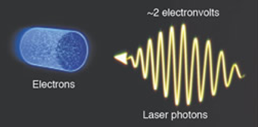
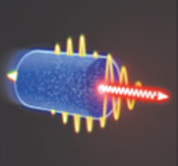
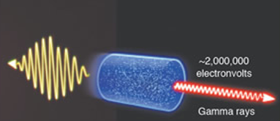
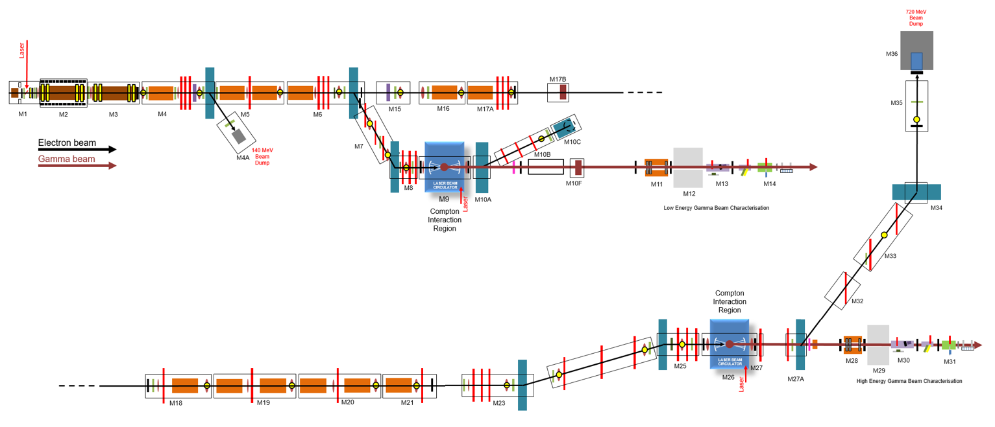
ELI-NP Gamma Beam Source
Gamma beam params
Energy | 0.2 – 20 MeV
Spectral density | 0.8 – 4 * 10⁴ $\frac{ph}{s ∗eV}$
Bandwidth (RMS) | < 0.5 %
Peak brillance | > 10²⁰ $\frac{ph}{s∗{mm}^{2}∗{mrad}^{2}∗0.1\%}$
Spot size | 10 – 30 µm
Compton back-scattering gamma source from the interaction of an high brightness electron beam and high power laser pulse.
Electron beam params
Energy | 75 – 740 MeV
Bunch charge | 25 – 400 pC
Number of bunches/pulse | 32
Bunch distance | 16 ns
Bunch length | 100 – 400 µm
Pulse length | 512 ns
Energy spread (RMS) | 0.04 – 0.1%
Norm. Emittance | 0.4 mm * mrad
RF repetition rate | 100 Hz
13 Modulators
S-band (2856 MHz) injector
C-band (5712 MHz) booster with 12 acc. structures
2 RF deflectors
20 Vacuum regions
Stefano Pioli

Slide 5
Outline
ELI-NP Gamma Beam Source
System Architecture
Fast-Interlock system
WaveForm Mask
Beam Loss Monitors
Cherenkov Beam Loss Position Monitor
Conclusion and Next steps
Stefano Pioli

Slide 6
MPS Architecture
Guarantee electron beam transport
Check bending field
Beam Loss Monitors
Supervisor
Cherenkov
Light
Hall Probes
Power RF
LLRF
and
Synchro
Beam Loss Monitors
FCTs
and
BPMs
IP Trajectory Feedback
Beam
Diag.
Vacuum
Magnets
Fast-ILK
Power RF
LLRF
Cooling
Controls
Fast
Interlock
System
Personnel
Safety
Vacuum
Critical Systems
Hardwired network
High-reliability
Fast intervention before next RF pulse
EPICS controlled systems
On-line monitoring
Stefano Pioli

Slide 7
Outline
ELI-NP Gamma Beam Source
System Architecture
Fast-Interlock system
WaveForm Mask
Beam Loss Monitors
Cherenkov Beam Loss Position Monitor
Conclusion and Next steps
Stefano Pioli

Slide 8
Fast-Interlock system - WaveForm Mask
Scope of work: monitor real-time RF-signals to detect breakdown events in WG and accelerating structures and operate RF systems in less than 10 ms.
It is going to be involved for:
all RF sources conditioning
RF Gun during whole commissioning
Specifications:
Sample real-time 1,5 µs reflected RF signal from a directional coupler;
Hardwired to RF sources;
Analyze sampled signal;
Trip RF Modulator in less than 10 ms.
Modulator
Klystron
RF Load
DC
Accelerating Structure
Stefano Pioli

Slide 9
Fast-Interlock system - WaveForm Mask
Scope of work: monitor real-time RF-signals to detect breakdown events in WG and accelerating structures and operate RF systems in less than 10 ms.
It is going to be involved for:
all RF sources conditioning
RF Gun during whole commissioning
Specifications:
Sample real-time 1,5 µs reflected RF signal from a directional coupler;
Hardwired to RF sources;
Analyze sampled signal;
Trip RF Modulator in less than 10 ms.
Modulator
Fast-ILK
Klystron
Digitizer
Schottky diode
RF Load
DC
Accelerating Structure
Stefano Pioli

Slide 10
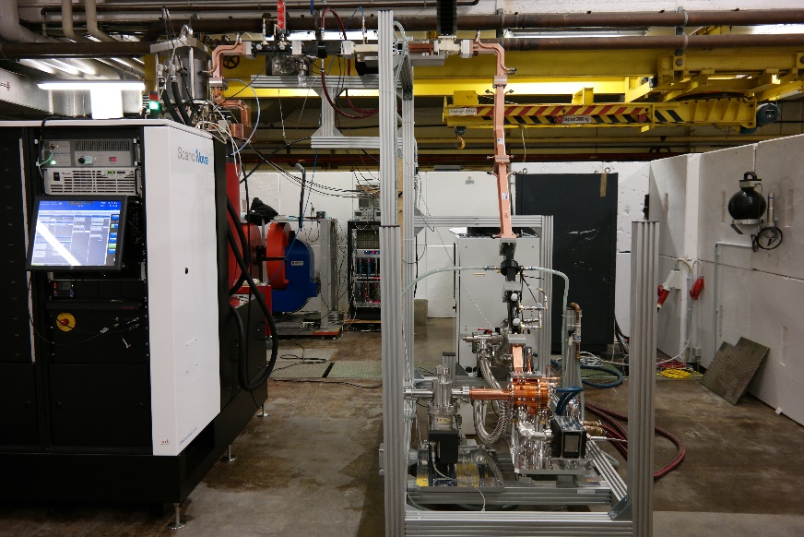
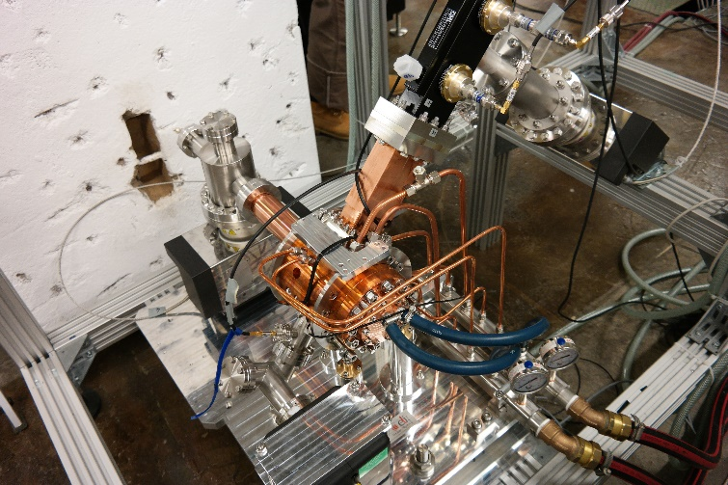
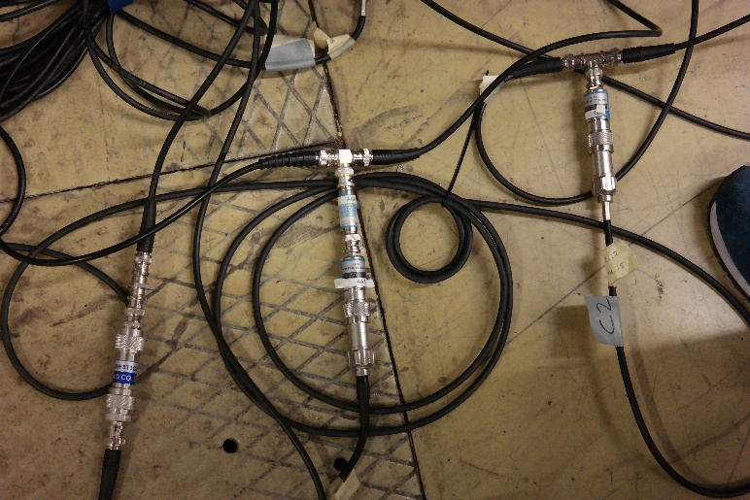
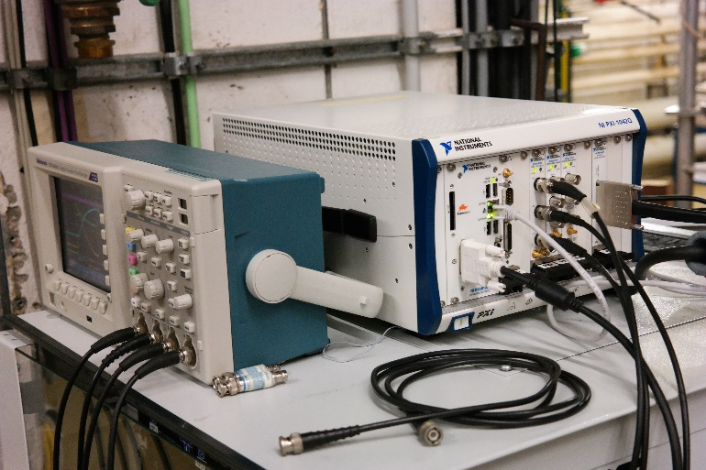
Fast-Interlock system - WaveForm Mask
Scope of work: monitor real-time RF-signals to detect breakdown events in WG and accelerating structures and operate RF systems in less than 10 ms.
Tested to operate in real-time with signals with repetition rate up to 100 Hz.
ELI-NP RF-GUN
Rep. Rate | 100 Hz
Working mode | Π mode (SW)
Max RF input | 16 MW
RF peak field | 120 MV/m
Filling time | 420 ns
Unloaded Q factor | 15000
RF-Gun conditioning Bonn 12/2015
NI PXI
Digitizer specs:
Sampling Rate | 2 GS/s
Sample depth | 10-bit
BW | 1,5 GHz
Memory | 16 MB
Cost/channel | 7,5 k€
Prototype
DC
Schottky diode
Stefano Pioli

Slide 11
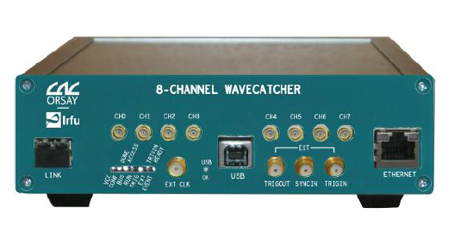
Fast-Interlock system - WaveForm Mask
Scope of work: monitor real-time RF-signals to detect breakdown events in WG and accelerating structures and operate RF systems in less than 10 ms.
Tested to operate in real-time with signals with repetition rate up to 800 Hz.
ELI-NP RF-GUN
Rep. Rate | 100 Hz
Working mode | Π mode (SW)
Max RF input | 16 MW
RF peak field | 120 MV/m
Filling time | 420 ns
Unloaded Q factor | 15000
RF-Gun conditioning Bonn 12/2015
Digitizer specs:
Sampling Rate | 3,2 GS/s
Sample depth | 12-bit
BW | 0,5 GHz
Memory | 128 B
Cost/channel | 400 €
Prototype
DC
Schottky diode
"The WaveCatcher family of SCA-based 12-bit 3.2 GS/s fast digitizers“
D. Breton, E. Delagnes, J. Maalmi, P. Rusquart
Stefano Pioli

Slide 12
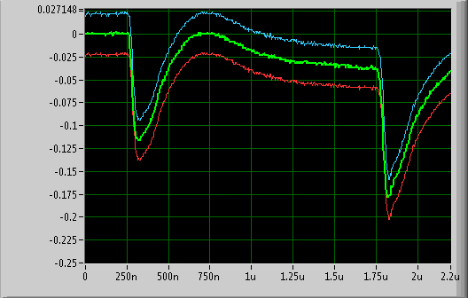
Fast-Interlock system - WaveForm Mask
Healthy signal
Scope of work: monitor real-time RF-signals to detect breakdown events in WG and accelerating structures and operate RF systems in less than 10 ms.
Tested to operate in real-time with signals with repetition rate up to 800 Hz.
Upper mask
Lower mask
Reflected RF
Digitizer specs:
Sampling Rate | 3,2 GS/s
Sample depth | 12-bit
BW | 0,5 GHz
Memory | 128 B
Cost/channel | 400 €
Prototype
DC
Schottky diode
"The WaveCatcher family of SCA-based 12-bit 3.2 GS/s fast digitizers“
D. Breton, E. Delagnes, J. Maalmi, P. Rusquart
Stefano Pioli

Slide 13
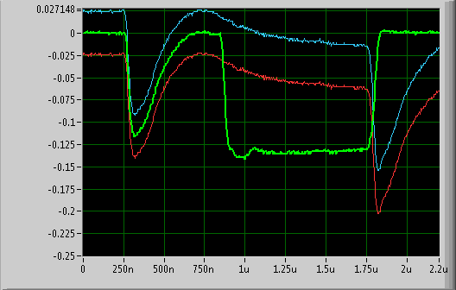
Fast-Interlock system - WaveForm Mask
Arc signal
Scope of work: monitor real-time RF-signals to detect breakdown events in WG and accelerating structures and operate RF systems in less than 10 ms.
Conditioning completed with 550 breakdown events detected (quite all without any vacuum activity).
Upper mask
Lower mask
Reflected RF
Digitizer specs:
Sampling Rate | 3,2 GS/s
Sample depth | 12-bit
BW | 0,5 GHz
Memory | 128 B
Cost/channel | 400 €
Prototype
DC
Schottky diode
"The WaveCatcher family of SCA-based 12-bit 3.2 GS/s fast digitizers“
D. Breton, E. Delagnes, J. Maalmi, P. Rusquart
Stefano Pioli

Slide 14
Outline
ELI-NP Gamma Beam Source
System Architecture
Fast-Interlock system
WaveForm Mask
Beam Loss Monitors
Cherenkov Beam Loss Position Monitor
Conclusion and Next steps
Stefano Pioli

Slide 15
Cherenkov Beam Loss Position Monitor
Scope of work: map beam loss along whole accelerator to enable operation for machine and personnel safety.
Specifications:
Locate beam loss and the involved device of lattice.
Trip RF-Gun and Photo Cathode laser.
Cover the facility in 9 different trunks (max. length of 20 m) to avoid background saturation due to the dark current transport.
GSR
AB1
AB2
GP04
GP06
GP08
GP09
Stefano Pioli

Slide 16
Cherenkov Beam Loss Position Monitor
$$\cos{θ_{C}}\left(λ\right)= \frac{1}{βn\left(λ\right)}$$
Cherenkov cone semi-angle
Core refractive index: $n=1,479$
NA=0.22
Acceptance
$$\cos{0}= \frac{1}{βn\left(λ\right)}$$
$$β=\frac{1}{n}≈0,7$$
Cherenkov energy threshold
$$θ_{C}= \left\{\begin{aligned} 17° if β≈0,7 \\ 48° if β≈1\end{aligned}\right.$$
electron beam direction
vacuum chamber or
accelerating structure
$φ< φ_{max}=\sin^{−1}{\frac{NA}{n}}=8,4°$
Total internal reflection limit angle
termination
$$φ<φ_{max}$$
MPPC
$$θ_{C}$$
$$\frac{dN}{dxⅆλ}=\frac{2πα}{λ^{2}}\sin^{2}{θ_{C}}=\left\{\begin{aligned} 2 \frac{ph}{mm} if θ_{C}=17° \\ 13 \frac{ph}{mm} if θ_{C}=48°\end{aligned}\right.$$
trapping 5%
trapping 33%
$$λ=\left[400 nm−500 nm\right]$$
Light wavelength
$$θ$$
$$α$$
loss electron or
electron shower
Fine structure constant
Cherenkov photons from a single charged particle
Stefano Pioli

Slide 17
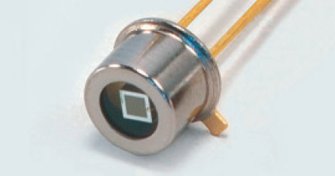
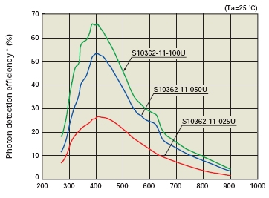
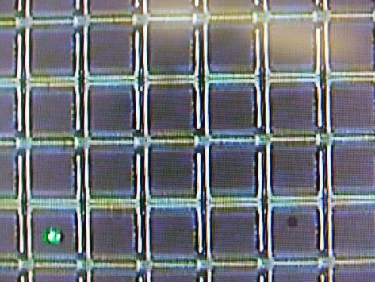
Cherenkov Beam Loss Position Monitor
Multi-Pixel Photon Counter
Array of 400 avalanche photodiodes (APDs) in parallel
Reverse bias (photon causes APD breakdown)
Photomultiplier-like gain (10⁵ – 10⁶)
Insensitivity to magnetic field
Time resolution: rise time 100 ps
Compact and Low cost
Hamamatsu MPPC
50 µm x 50 µm
Digitizer specs:
Fiber vs MPPC coupling: efficency ~45%
Sampling Rate | 3,2 GS/s
Sample depth | 12-bit
BW | 0,5 GHz
Memory | 128 B
Cost/channel | 400 €
$$Δs=Δt · c{\left(\frac{1}{β}+n\right)}^{−1}$$
Optical fiber nominal longitudinal resolution
WaveCatcher
@3,2 GS/s time-of-flight resolution ~4 cm
"The WaveCatcher family of SCA-based 12-bit 3.2 GS/s fast digitizers“
D. Breton, E. Delagnes, J. Maalmi, P. Rusquart
Stefano Pioli

Slide 18
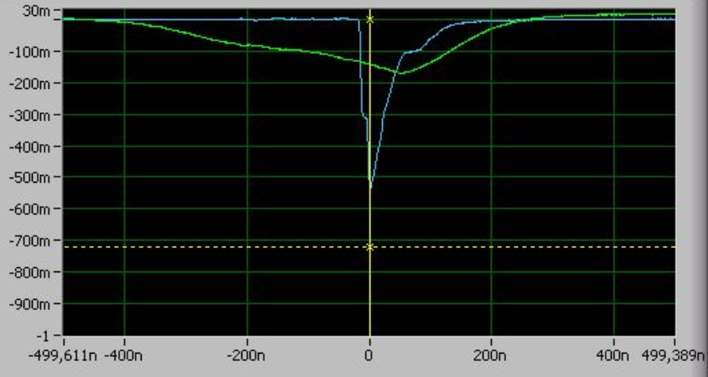
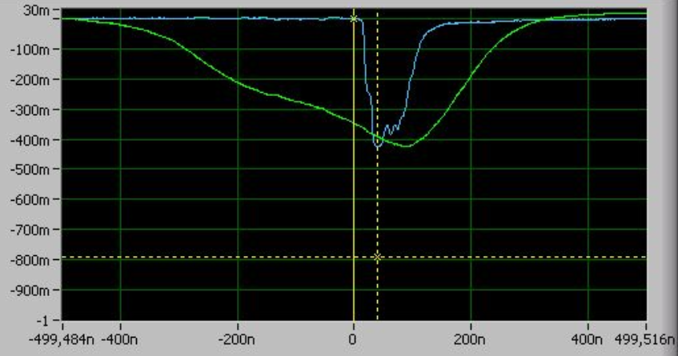
Cherenkov Beam Loss Position Monitor
Scope of work: map beam loss along whole accelerator to enable operation for machine and personnel safety.
Specifications:
Locate beam loss and the involved device of lattice.
Trip RF-Gun and Photo Cathode laser.
Distance between AC2FLAG and AC3FLAG
Distance from CAD | 3,5 m
Time-of-flight difference | ~ 30 ns
Reconstructed distance from Cherenkov BLPM | ~ 3,6 m
Sampling rate | 1 GS/s
DAQ accuracy | +/- 15 cm
Fiber signal
signal
background
Prototype
@SPARC_LAB
Stefano Pioli

Slide 19
Outline
ELI-NP Gamma Beam Source
System Architecture
Fast-Interlock system
WaveForm Mask
Beam Loss Monitors
Cherenkov Beam Loss Position Monitor
Conclusion and Next steps
Stefano Pioli

Slide 20
Conclusion and Next steps
Outcome
A new WaveCatcher driver developed for LabView.
WaveCatcher tested to operate as integrated real-time breakdown detector in Fast-Interlock system.
WaveCatcher proved as readout electronics for on-line high-resolution beam loss positionining system.
Future Prospective
Expand application of WaveCatcher to monitor accelerator perfomances.
[WISH] Include these MPS algorithms inside WaveCatcher FPGA firmware to remove the bottleneck of communication, reduce time response and operate the WaveCatcher itself as embeded unit decreasing requirements of waveform acquisition server.
Stefano Pioli

Slide 21
Thank you for your attention!

