Slide 1
Exotic Higgs Decays at HE/HL-LHC
Zhen Liu
Higgs Hunting 2018
Jul 23th 2018

Slide 2
Outline
Theory motivation
Classification and overall picture
Channels beyond above
Summary and outlook

Slide 3
Outline
Theory motivation
Classification and overall picture
Channels beyond above
Summary and outlook

Slide 4
Motivation
Higgs
Hierarchy
(Naturalness)
Dark Matter
Electroweak baryogenesis
Neutrino mass
Higgs boson discovery substantiates (more) many big questions in nature. It could well be the key to unlock some of nature’s secrets.
All connections could be revealed in Higgs measurements.
Higgs is the key to new physics.

Slide 5
Motivation
Higgs
Hierarchy
(Naturalness)
Dark Matter
Electroweak baryogenesis
Neutrino mass
Higgs boson discovery substantiates (more) many big questions in nature. It could well be the key to unlock some of nature’s secrets.
All connections could be revealed in Higgs measurements.
Higgs is the key to new physics.
Higgs boson can easily and well-motivated to be the portal to other BSM sectors. While most searches focus on heavy BSM particles, there is a whole zoo of light BSM particle not well explored at colliders.
(theoretical interests)
The precision does not pin-point a scale, the exotic decays are to fully probe the scale below Higgs mass. **
(complementarity)

Slide 6
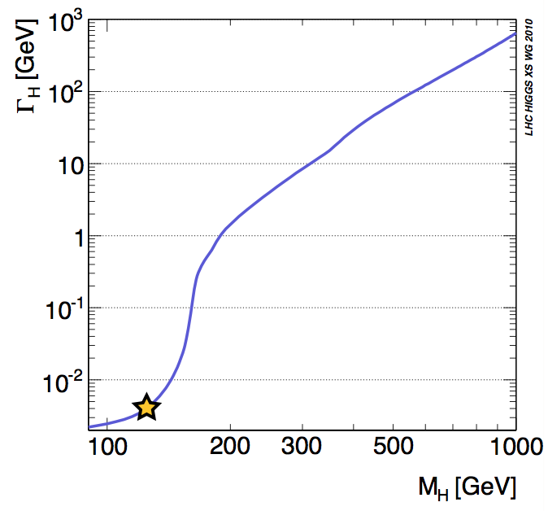
Why Exotic Decays?
Higgs has tiny width ~4 MeV
$$\frac{Γ}{M}=O\left({10}^{−5}\right)$$
*all* its decay modes are suppressed by various factors, couplings, loop-factors, phase-space, etc.
Dominant decays into bottom quark pairs are suppressed by the tiny coupling $y_{b}=0.017$

Slide 7
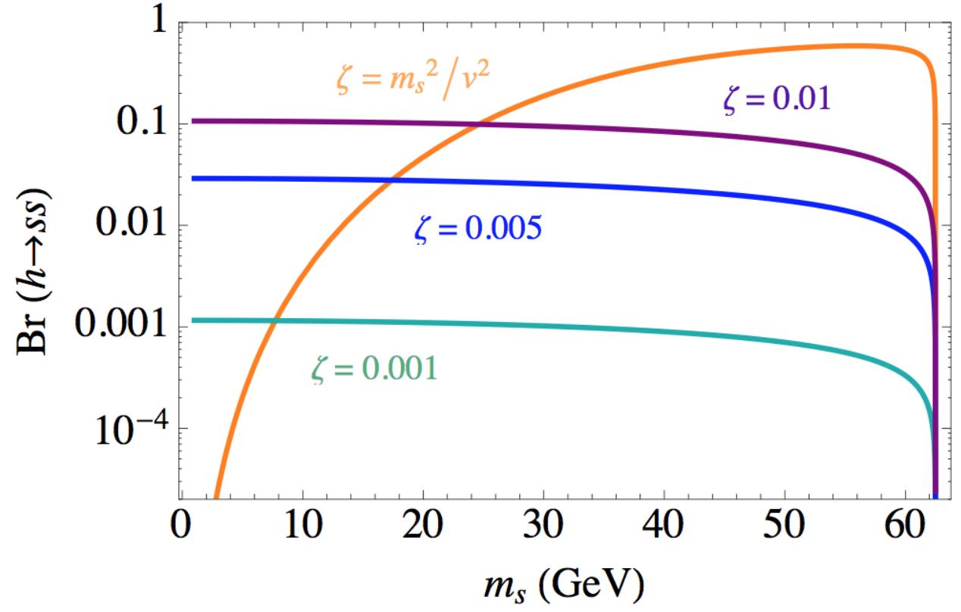
Why Exotic Decays? (continued)
Higgs has tiny width ~4 MeV
$$\frac{Γ}{M}=O\left({10}^{−5}\right)$$
*all* its decay modes are suppressed by various factors, couplings, loop-factors, phase-space, etc.
Dominant decays into bottom quark pairs are suppressed by the tiny coupling $y_{b}=0.017$
small couplings to BSM could have sizable branching, e.g.,
L $=\frac{\text{ζ}}{2}s^{2}{\left|H\right|}^{2}$
(common building block in extended Higgs sectors) can give BR(h➞ss)~O(10%) for ζ as small as 0.01 !

Slide 8
Organizing the study
1312.4992
observed 125 GeV state is primarily responsible for EWSB
usually requires “decoupling” limit → h production close to SM other scenarios possible, but this is generic and minimal
125 GeV state decays to new BSM particles
these BSM particles could primarily/only be produced through h decays do not consider rare or nonstandard decays directly to SM particles (captured in precision program, including angular distributions)
initial decay is 2-body
3-body and higher is possible, but requires new light states w/ substantial coupling to h to overcome phase space suppression

Slide 9
Organizing the study
1312.4992
observed 125 GeV state is primarily responsible for EWSB
usually requires “decoupling” limit → h production close to SM other scenarios possible, but this is generic and minimal
125 GeV state decays to new BSM particles
these BSM particles could primarily/only be produced through h decays do not consider rare or nonstandard decays directly to SM particles (captured in precision program, including angular distributions)
initial decay is 2-body
3-body and higher is possible, but requires new light states w/ substantial coupling to h to overcome phase space suppression
Higgs
Hierarchy
(Naturalness)
Dark Matter
Electroweak baryogenesis
Neutrino mass
Simplified (representative and well-motivated) models
covering most topologies and final states considered:
• SM + single scalar, essentially a simple higgs portal
• SM + 2HDM, with or without an extra neutral scalar
• SM with additional fermions: e.g., neutrino portal
• SM with a light Z'

Slide 10
Outline
Theory motivation
Classification and overall picture
Channels beyond above
Summary and outlook

Slide 11
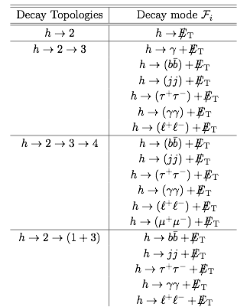
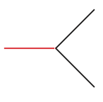
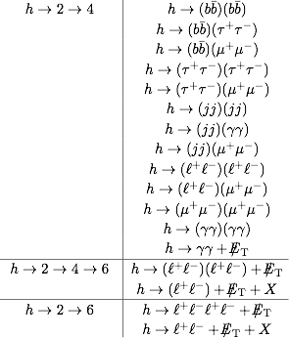
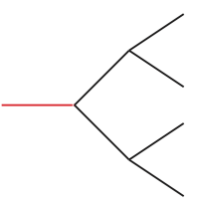
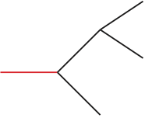
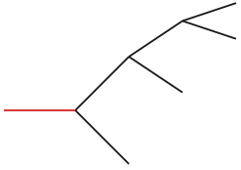
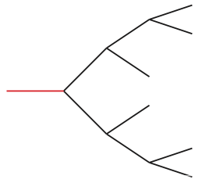
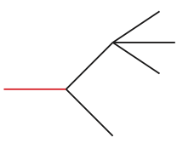
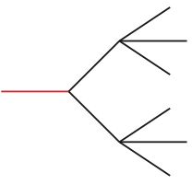
Organizing the study: A List

Slide 12
Coverage & Potential
HL/HE-LHC great Sensitivity
$$O(<10^{−5\sim 6})$$

Slide 13
~0.2 Billion Higgs produced at HL-LHC;
~2 Billion Higgs produced at HE-LHC;
3 orders of magnitude more than future lepton collider Higgs factories;
Unique Higgs properties can be learned and great discovery potential for certain channels;
Coverage & Potential
HL/HE-LHC great Sensitivity
$$O(<10^{−5\sim 6})$$

Slide 14
Coverage & Potential
Hard due to MET

Slide 15
Coverage & Potential
Hard due to Hadronic

Slide 16
Coverage & Potential
Some Challenges taken already
See, e.g., talks on Tuesday
by K.Hamano and S.Taroni

Slide 17
Coverage & Potential
Still a lot of uncharted territory for new searches!
Can be conquered using HL-LHC and future colliders with advanced analysis tools and new detectors.
For existing searches, there are new possibilities such as unequal masses, etc.

Slide 18
Outline
Theory motivation
Classification and overall picture
Channels beyond above
Summary and outlook
conquering using HL-LHC and future colliders with advanced analysis tools and new detectors.

Slide 19
Higgs decaying to long-lived particles
Why consider?
Lack of evidence at TeV scale solving the little hierarchy problem
Maybe the problem is solve by color-neutral top partners (hard to directly produce at the LHC, minimally only needs to couple to the Higgs)

Slide 20
Higgs decaying to long-lived particles
Why consider?
Lack of evidence at TeV scale solving the little hierarchy problem
Maybe the problem is solve by color-neutral top partners (hard to directly produce at the LHC, minimally only needs to couple to the Higgs)
Twin Higgs models (Chaco, Goh, Harnik, 05’)
Mirror SM with its own QCD (dark QCD)
Mirror Higgs with its own little hierarchy problem
Larger discrete group relates these two and let them cancel (Higher global symmetry) (see many works in UV completing Twin Higgs)

Slide 21
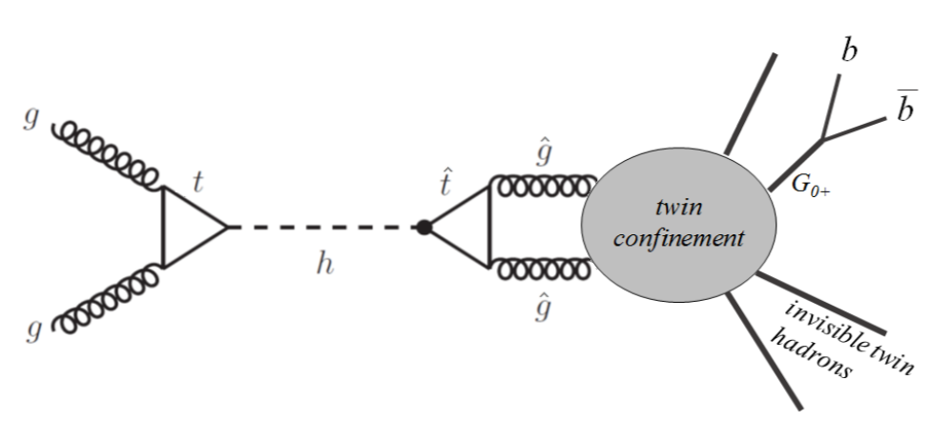
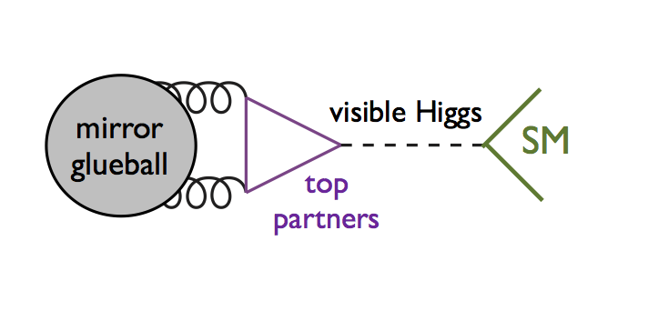
Higgs decaying to long-lived particles
Higgs as a portal to dark SM (like a Higgs portal)
Dark gluons produced via loop process then showers into glueballs
Due to high power suppression, the glueball is easily long-lived, leading to new pheno at the LHC for Higgs exotic decays
Craig, Katz, Strassler, Sundrum, 1501.05310

Slide 22
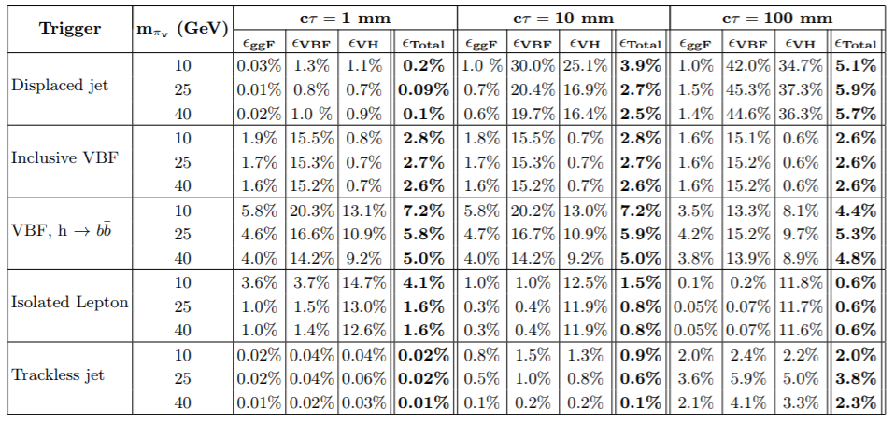
Challenges in the searches
In comparison with other LLP searches:
Only %-level trigger efficiency;
for longer lifetimes (>10 cm), except for VBF (and maybe trackless jet), the above will all fail, having even lower trigger efficiency.
One would rely on jet+MET, HT, etc., using hard ISRs for general signals, which will have even big trigger efficiency loss.
In comparison with all hadronic Higgs exotic decays:
Similar or slightly more trigger loss (due to long-lived)
Physics targets lower branching fraction
C. Csaki, E. Kuflik, S. Lombardo, O. Slone, 1508.01522

Slide 23
Precision timing--a new dimension
Precision timing information now compliments spatial information, and its bears great potential to fully realize LHC’s physics reach in LLP.
30 picosecond timing resolution at CMS after phase2 upgrade;
Proposed to enable 4d construction of vertices:
reducing the pile up level;
Reducing pile-up track mis-association in to the primary interaction;
ATLAS has HGTD proposal covering $2.4<\left|η\right|<4$
LHCb also has precision timing detector proposal

Slide 24
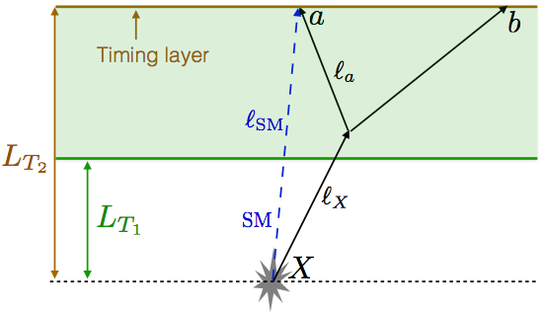
Timing BSM
signal arrival time
SM reference particles arrival time
L_{T1}, L_{T2}, are the acceptance region of a sub-detector.
Jia Liu, ZL, L.-T. Wang, 1805.05957

Slide 25
Timing BSM
signal arrival time
SM reference particles arrival time
For CMS MTD (1.2 m, t0=4 nanosecond)*, 30 picosecond timing resolution indicates sensitivity to BSM signal having >1% velocity (boost factor $γ<7$) /path difference w.r.t. SM particles!
LLP (with mass > 10s of GeV) typically all have much slower motion!
*for pseudorapidity 0; higher rapidity enlarges the timing difference;
*SM particles essentially all travel at speed of light;

Slide 26
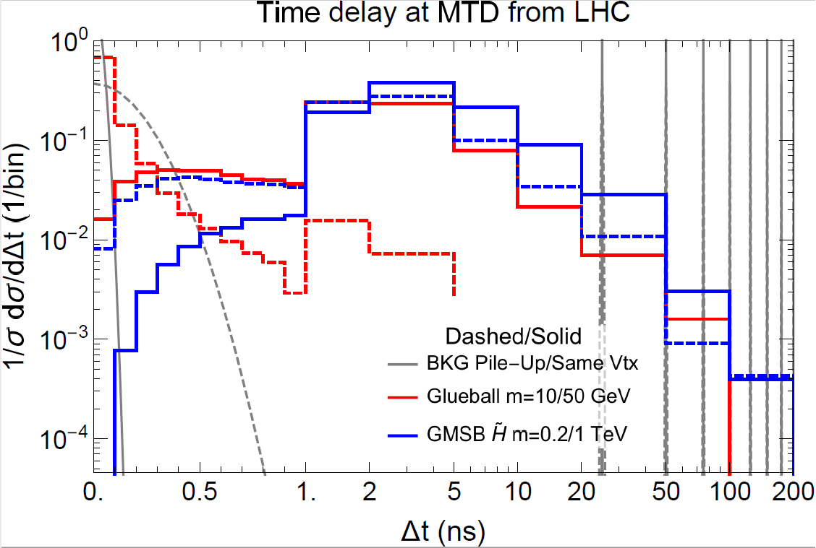
LLPs arrive (very) late
ctau =10 m
[Lt1,Lt2]=[0.2,1.2]m
We also consider a possible timing layer outside Muon spectrometer, making use of the large LHC detector volume.
Signals:
Red: Higgs decaying into glueballs (neutral naturalness)
Blue: non-resonantly pair produced Higgsinos
Backgrounds:
Gray (Dashed): Pile-up with natural spread of 190 ps (beam property)
Gray (Solid): Hard collision spread due to uncertainties in timing

Slide 27
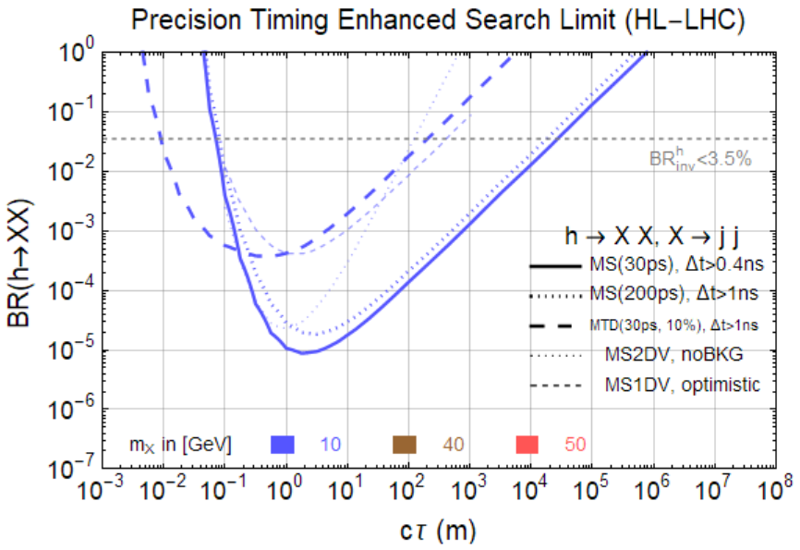
Late comers will be spotted easily:
CMS MTD $\left|η\right|<3.0$
ATLAS MS LLP search (without timing)
MTD: >0.8 ns timing cut (<25 ns always there)
MS: 0.2 ns or 1 ns timing cut (30 ps or 0.2 ns resolution sufficient)
10 GeV benchmark point sensitive to the timing cut, as they are more boosted and having less time delay.
13 TeV MS search projection (w.o. timing), C. Coccaro, D. Curtin, H. Lubatti, H. Russell, J. Shelton 1605.02742
Jia Liu, ZL, L.-T. Wang, 1805.05957

Slide 28
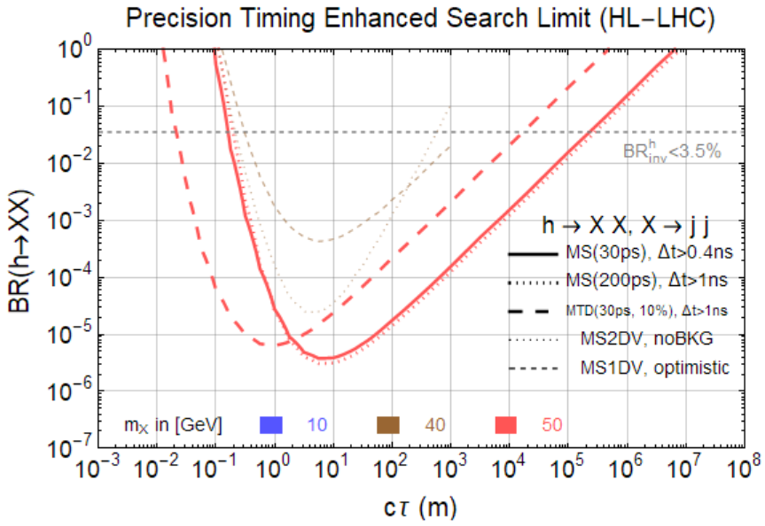
Late comers will be spotted easily:
CMS MTD $\left|η\right|<3.0$
ATLAS MS LLP search (without timing)
MTD: >0.8 ns timing cut (<25 ns always there)
MS: 0.2 ns or 1 ns timing cut (30 ps or 0.2 ns resolution sufficient)
Significant improvement!
13 TeV MS search projection (w.o. timing), C. Coccaro, D. Curtin, H. Lubatti, H. Russell, J. Shelton 1605.02742
Jia Liu, ZL, L.-T. Wang, 1805.05957

Slide 29
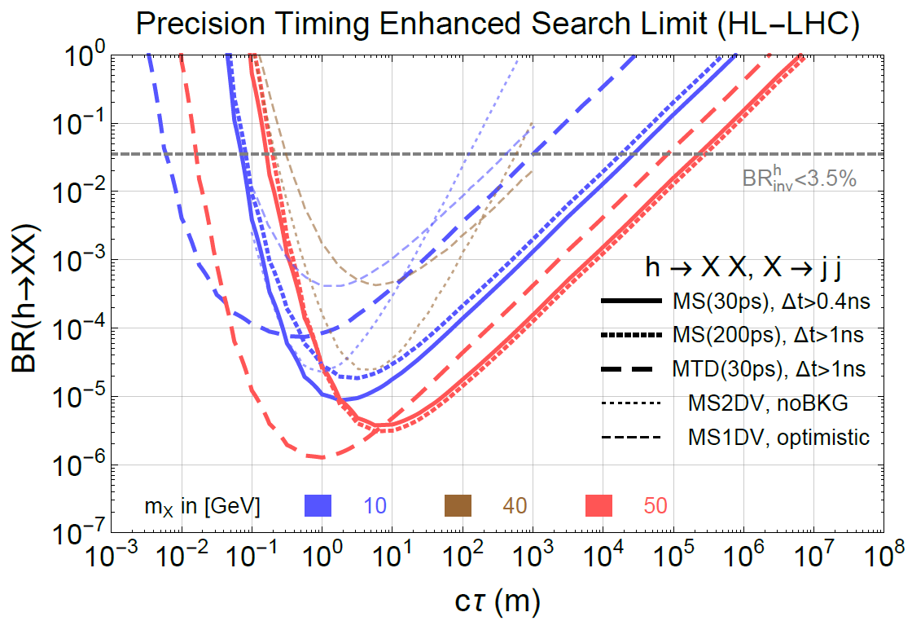
Late comers will be spotted easily:
CMS MTD $\left|η\right|<3.0$
ATLAS MS LLP search (without timing)
MTD: >0.8 ns timing cut (<25 ns always there)
MS: 0.2 ns or 1 ns timing cut (30 ps or 0.2 ns resolution sufficient)
Significant improvement!
This is one example how new pheno ideas, together with advancement in experiments would great enhance our coverage (and discovery potential) in Higgs exotic decays
13 TeV MS search projection (w.o. timing), C. Coccaro, D. Curtin, H. Lubatti, H. Russell, J. Shelton 1605.02742
Jia Liu, ZL, L.-T. Wang, 1805.05957

Slide 30
Higgs decay to mesons
Higgs SM rare decays to mesons + photon (or other SM gauge bosons) provides unique window to Higgs to light quark Yukawas

Slide 31
Higgs decay to mesons
Results from 1607.03400, 1507.03031, 1501.03276, 1712.02758, 1507.03031
Most results from 8 TeV puts an upper bound of ~1.5x10⁻³
13 TeV 36 fb⁻¹ start to lead us to realm of 10⁻⁴
HL/HE-LHC will lead us to the realm of ~10^{-5~6 **}
We will be able to measure these these rare decays of the Higgs boson, providing very nontrivial test of the Higgs boson properties, QCD and interference
Many new modes to measure H->mesons+W, mesons+Z, etc.
New studies on open fermion plus photon search also show compelling reach (in addition to quarks also applies to leptons)
Current limits
<8.8x10⁻⁴
<?
<4.8x10⁻⁴
<1.5x10⁻³
<1.3x10⁻³
<1.9x10⁻³
<1.3x10⁻³
**extrapolation on statistical only

Slide 32
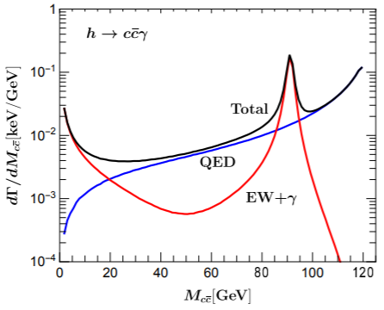
Higgs decay to mesons
Results from 1607.03400, 1507.03031, 1501.03276, 1712.02758, 1507.03031
Most results from 8 TeV puts an upper bound of ~1.5x10⁻³
13 TeV 36 fb⁻¹ start to lead us to realm of 10⁻⁴
HL/HE-LHC will lead us to the realm of ~10^{-5~6 **}
We will be able to measure these these rare decays of the Higgs boson, providing very nontrivial test of the Higgs boson properties, QCD and interference
Many new modes to measure H->mesons+W, mesons+Z, etc.
New studies on open fermion plus photon search also show compelling reach (in addition to quarks also applies to leptons)
T. Han, X. Wang
1704.00790
Current limits
<8.8x10⁻⁴
<?
<4.8x10⁻⁴
<1.5x10⁻³
<1.3x10⁻³
<1.9x10⁻³
<1.3x10⁻³
**extrapolation on statistical only

Slide 33
Summary and outlook
LHC will push our knowledge of the Higgs boson rare and exotic decays to new territory by two orders of magnitude or more;
A lot of new search channels to be covered, especially those with missing energy;
A lot more to explore with new ideas in searches using new tools and new detector upgrades. Precision timing as a new dimension greatly enhance the physics potential for Higgs decaying to long-lived particles;
Will achieve some very interesting benchmarks with the improved precision, e.g., probing Higgs decays to mesons, providing non-trivial tests to SM, QCD, and interferences;
Many more new ideas, Higgs diphoton on-shell interference (Campbell, Carena, Harnik, ZL, 1704.08259), Higgs decaying to multi-leptons (Izaguirre, Stolarsky, 1805.12136 ), new benchmarks from EWPT (Carena, ZL, Wang, ongoing), etc.
Thank you!

Slide 34
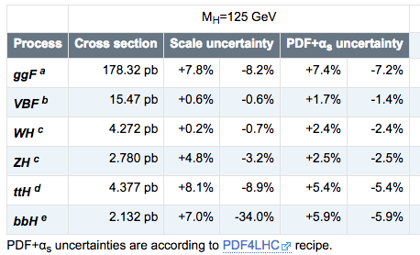
HE-LHC Higgs cross section
HE-LHC Higgs cross section

Slide 36
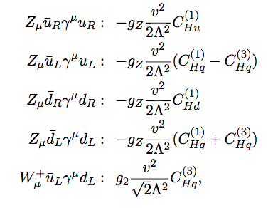
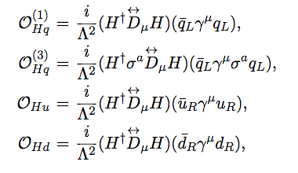
Complementarity (a case study)*
Trilogy of Z-pole, Higgs, and high energy
Taking the operators for example:
Putting both Higgs on VEV, they modify the Zqq gauge vertex
Putting one Higgs on VEV, they modify the ZqqH vertex
Similar modifications to the Wud and WudH vertex for the triplet operator
Also allowed for flavor structure
*preliminary results

Slide 37
Z-pole
We measured the Z total width to sub per mille precision.
However, our knowledge of the Zqq vertex are only at a few percent level
PDG

Slide 38
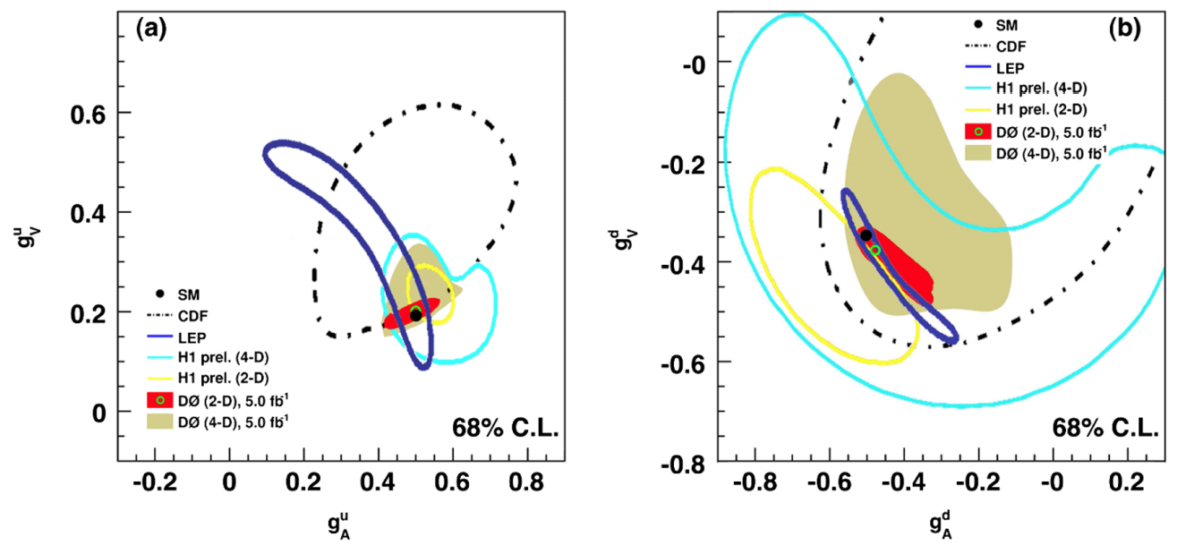
Z-pole
D0, Phys.Rev. D84 (2011) 012007
If we further ask the question of the chiral couplings, D0 from the forward-backward asymmetry analysis provides complementary/better constraints.

Slide 39
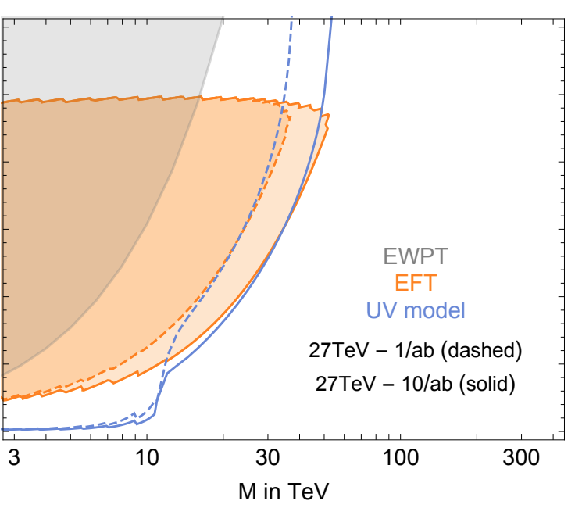
HE DY process
S. Alioli, M. Farina, D. Pappadopulo, J. Ruderman, 17’
Low mass, explicit search dominant;
Higher masses, EFT and UV model agrees well;
Beat EWPT at high masses;
Four-fermi operators, can be translated to our operators*, already see complementarity between Z-pole and High energy tails
* common complexity and dependences on other operators during translation

Slide 40
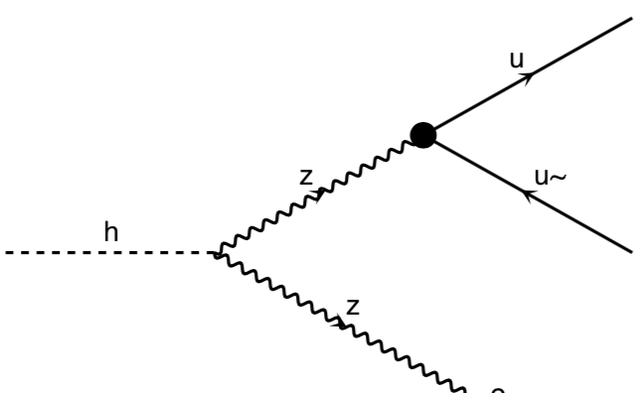
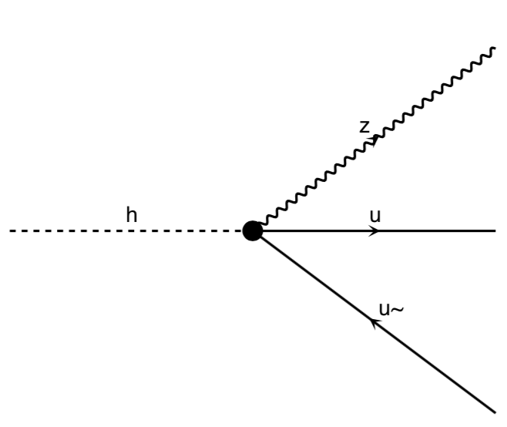
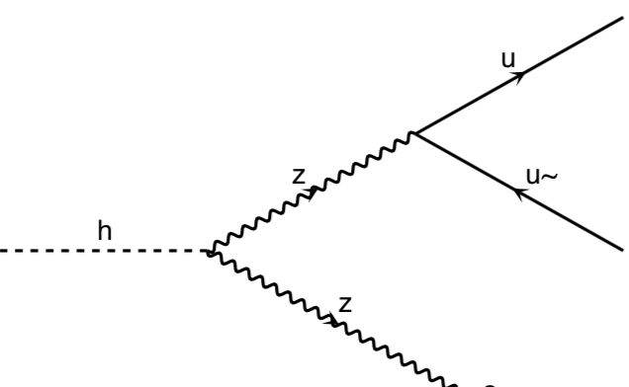
Higgs exotic decays
Modifications to Higgs to Zff decays, interfering with SM**
Modifying and interfering with the Z+meson decays, could change the rate significantly and make an early discovery.
No existing analysis yet from both the SM group or the exotic group (exotic group always do the equal mass assumption) for either decay modes
**Preliminary investigation indicates Zff decay not very competitive to the next probe

Slide 41
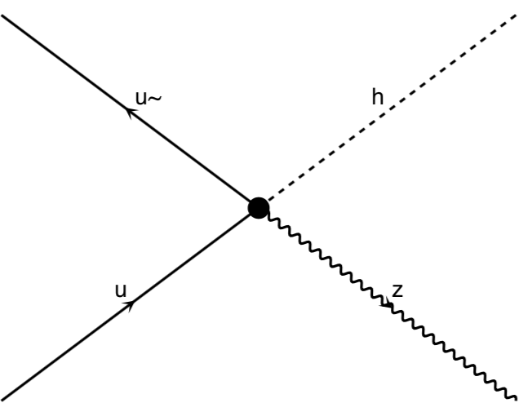
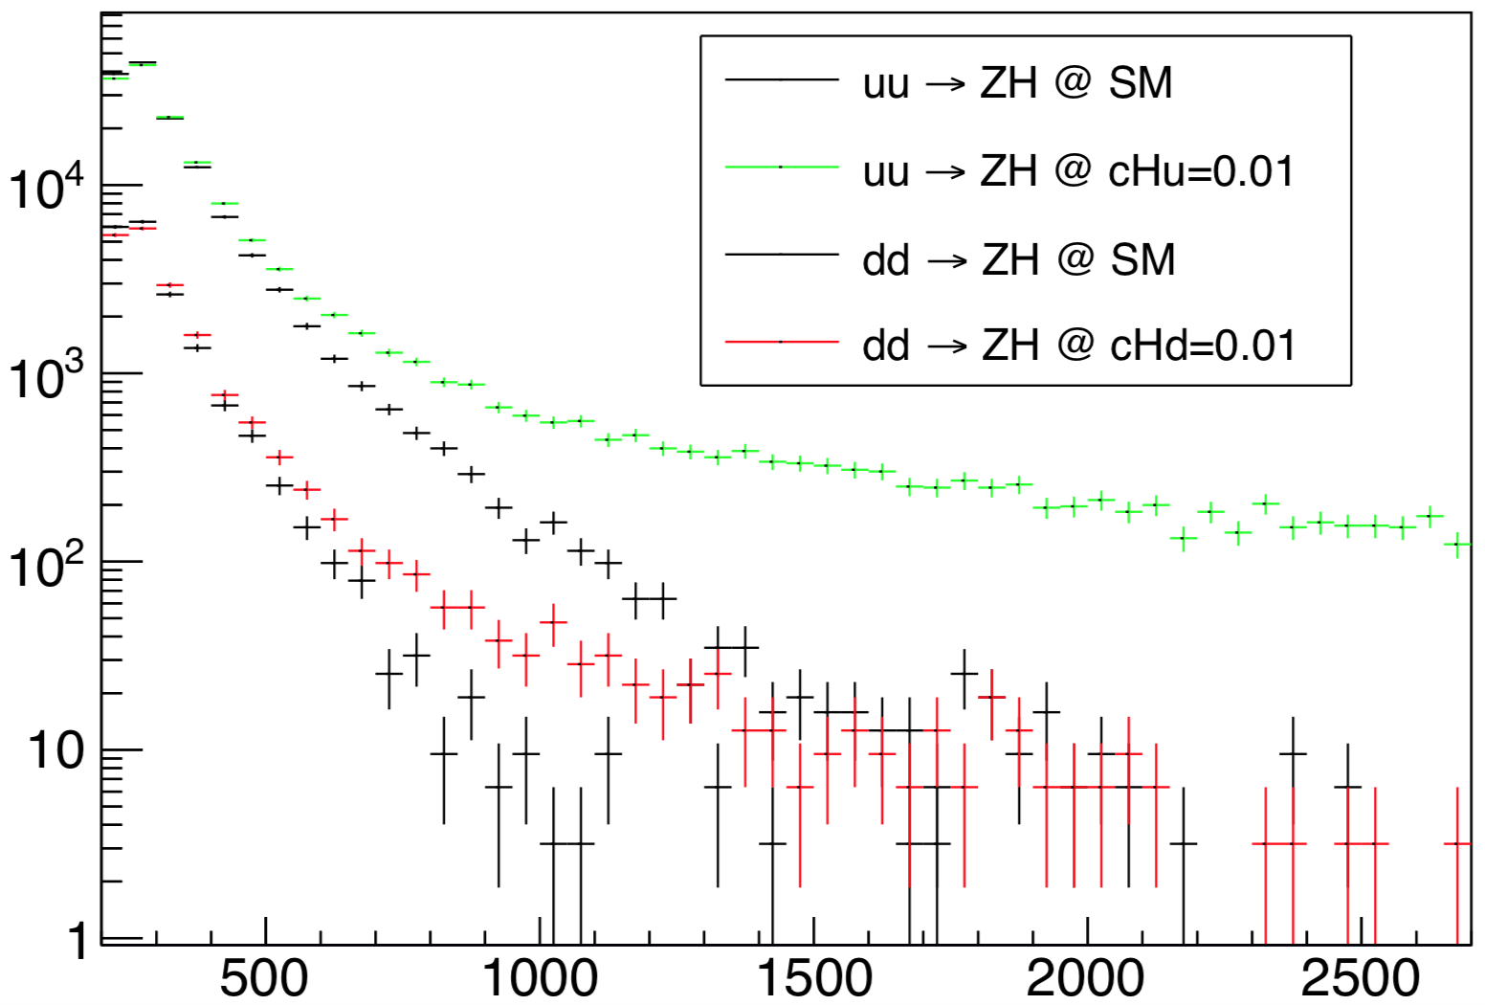
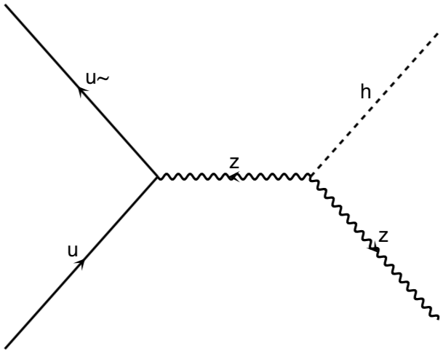
Higgs and Z boson at High Energies
Higgs exotic Decay
HE ZH production
#/50 GeV bin
@ HE-LHC 10 ab⁻¹
$$\frac{v\sqrt{s}}{Λ^{2}}$$
Growing faster than the SM (interfering) process
$$\frac{v}{\sqrt{s}}$$
m_{ZH} (GeV)
Also see similar study on high energy tail in Franceschini, Panico, Pomarol, Riva, Wulzer17’

Slide 42
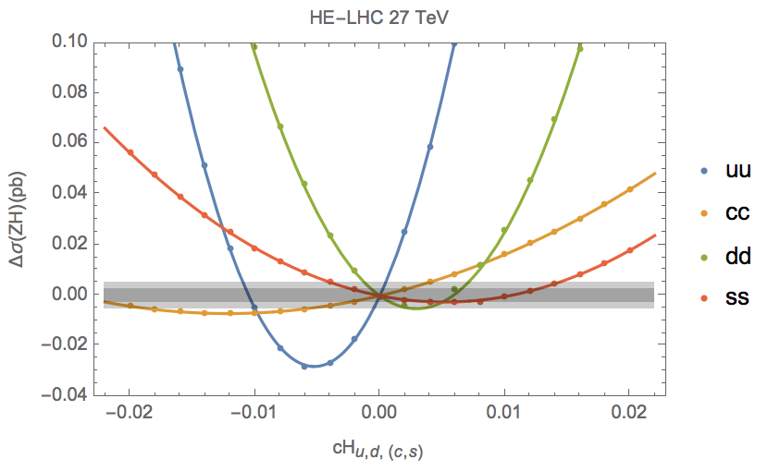
Higgs and Z boson at High Energies
Constraints on Wilson coefficients to O(0.001), corresponding to O(10 TeV);
Lots of room to improve;
#/50 GeV bin
@ HE-LHC 10 ab⁻¹
$$pp→ZH→(l^{+}l^{−})(b\overline{b})$$
50% signal efficiency.
Statistical dominance (true for current LHC)
S/B ratio around 1/3
Not yet the differential information analysis
Angular analysis
EFT validity scale weakly interacting**
m_{ZH} (GeV)
**well within linear regime

Slide 43
Exotic Decays (example 1)
$$H→aa→\left(jj\right)\left(jj\right)$$

Slide 44
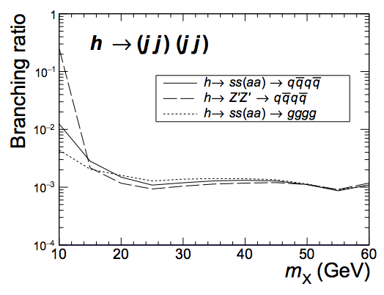
Exotic Decays (example 1)
$$H→aa→\left(jj\right)\left(jj\right)$$
Background mainly from $h→VV^{∗}→4j$ and $h→jj$ with FSR after pre-selection cuts
with
we choose the correction paring of the four jets into dijet system
then use
$δm$ vs.. $m_{j_{1}j_{2}}+m_{j_{3}j_{4}}$ 2D-likelihood function to selection (define the significance) and derive the limits

Slide 45
Exotic Decays (example 1)
$$H→aa→\left(jj\right)\left(jj\right)$$
Background mainly from $h→VV^{∗}→4j$ after pre-selection cuts
with
we choose the correction paring of the four jets into dijet system
then use
$δm$ vs.. $m_{j_{1}j_{2}}+m_{j_{3}j_{4}}$ 2D-likelihood function to selection (define the significance) and derive the limits
Great sensitivity on exotic branching fraction $O\left({10}^{−3}\right)$
Similar (better) result archived for 4b, 4c, etc.
Room for improvement using different strategy treating collimated jets.
Room for improvement including hadronic decaying spectator Z bosons.

Slide 46
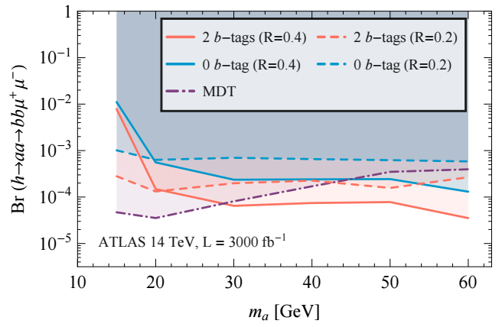
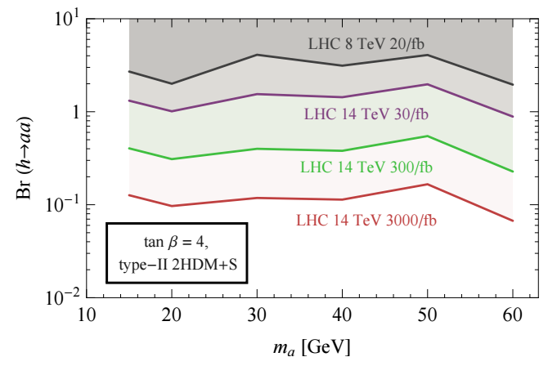
Exotic Decays (example 1)
$H→aa$ interpretation
Curtin, Essig, Zhong, arXiv:1412.4779

Slide 47
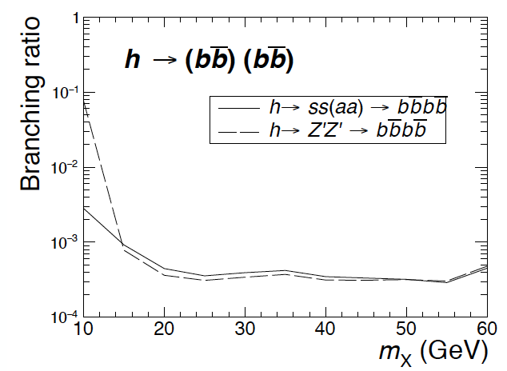
Exotic Decays (example 1)
$H→aa$ interpretation
Curtin, Essig, Zhong, arXiv:1412.4779
O(10%) limit on exotic branching fractions at the HL-LHC.
lepton colliders will improve the limits by two orders of magnitude, hitting more relevant regimes for various models’ preferred parameter space.

Slide 48
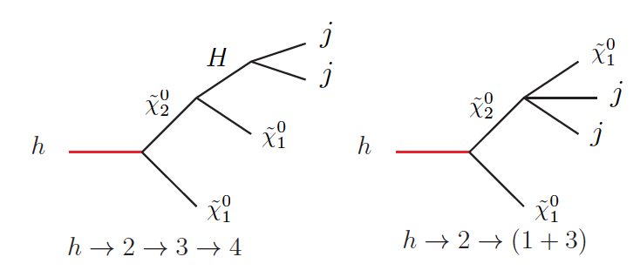
Exotic Decays (example 2)
$$H→x_{1}, x_{2}→j j+MET$$
j
Well-motivated from SUSY with light DM, or general DM models.
Very challenging, a nightmare at the (HL-) LHC
MET
Only light jets
no resonance signature from the dijet system, but rather a wide range of invariant mass bounded by the mass differences.
j
Invisible
Invisible

Slide 49
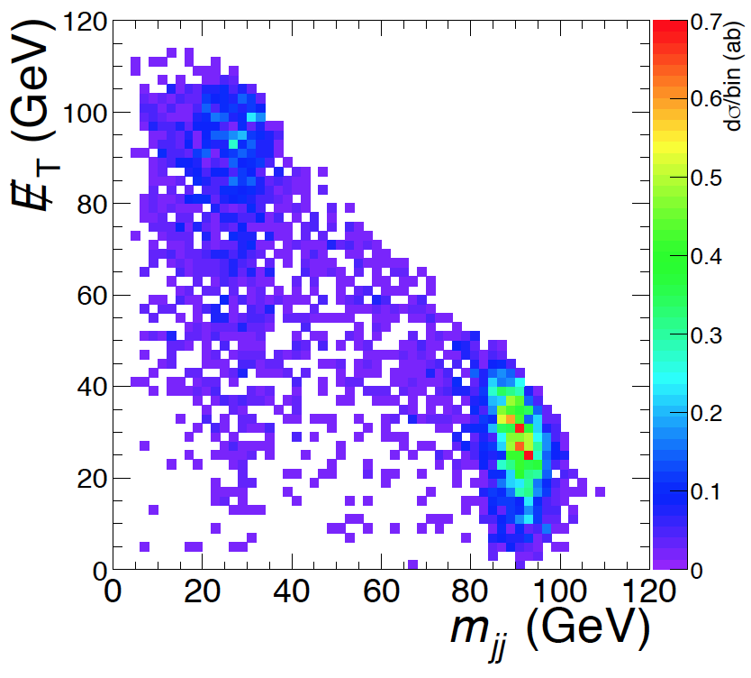
Exotic Decays (example 2)
$$H→x_{1}, x_{2}→j j+MET$$
$$h→ZZ^{∗},$$
$$Z^{∗}→jj, Z→νν$$
j
j
Invisible
$$h→ZZ^{∗},$$
$$Z→jj, Z^{∗}→νν$$
Invisible
Background dominant by the the SM Higgs decays into four quarks via ZZ* after pre-selection cuts
**another interesting improvement only available at lepton colliders, using ``recoil mass’’ again to veto the $Z^{(∗)}→νν$ mass peak.

Slide 50
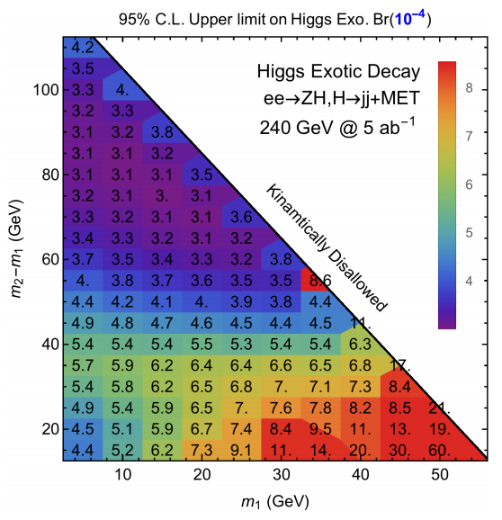
Exotic Decays (example 2)
$$H→x_{1}, x_{2}→j j+MET$$
j
j
invisible
invisible
Depending on the masses of the decaying particles, the exclusion reach on Higgs exotic BRs could be as low as $3×{10}^{−4}$ and remains this order for large range, except kinematic edges.
Similar (better) result archived for 4b, 4c, etc.
Room for improvement using different strategy treating collimated jets.
Room for improvement including hadronic decaying spectator Z bosons.

Slide 51
Exotic Decay summary
We visualize the sensitivity on Higgs exotic decay branching factions with some reasonable choice of model parameters.
The HL-LHC are from various studies and projections available in the literature;
The lepton collider sensitivities (except for the first channel, $h→inv$) are from our study with different $ee→ZH$ integrated luminosities and beam polarizations for different colliders.

Slide 52
Exotic Decay summary
with missing Energy SUSY motivated, DM motivated channels
3-4 order of magnitude improvement for the constraints on such exotic branching fractions

Slide 53
Exotic Decay summary
$h→4f$ generic Higgs sector extensions, also Higgs portals
2-3 order of magnitude improvement for the constraints on such exotic branching fractions

Slide 54
Summary
Higgs Exotic decays is a very important component of Higgs program at future colliders
Lepton colliders show great advantage for decays that are very challenging at the LHC, such as Higgs decays into jets and Higgs decays with missing energy
Hadron colliders and lepton colliders are complementary in probing Higgs exotic decays and could together provide a much more coherent picture for discovery
Many more works for Higgs exotic decays at both the LHC and future colliders are interesting and are needed.

