Slide 1

Futurs Programmes Européens et Co-Innovation Industrielle
Rencontres Accélérateurs 2018 de la SFP, 8 Octobre 2018
Maurizio Vretenar, CERN
ARIES Coordinator
Notes:
Why do we need ARIES

Slide 2

EU support to particle accelerator R&D
Integrating Activities
Design Studies,
Preparatory Phases
CARE 01/2004 – 12/2008
5 years, 15.2 M€ EU contribution
FP6
EuroNu DS, 2008/12, 4M€
only
projects coordinated by the ESGARD and TIARA Committees
SLHC-PP, 2008/11, 5.2M€
EuCARD 04/2009 – 03/2013
4 years, 10.0 M€ EU contribution
ILC-HiGrade, 2008/12, 5M€
TIARA-PP, 2011/13, 3.9M€
FP7
HiLumi LHC, 2011/15, 4.9M€
EuCARD-2 05/2013 – 04/2017
4 years, 8.0 M€ EU contribution
EuroCirCol, 2016/19
EUPRAXIA, 2016/19
H2020
ARIES 05/2017 – 04/2021
4 years, 10.0 M€ EU contribution
ESSnuSB, 2017/20
CompactLight, 2017/20
Integrating Activity
Design Study
ESFRI
Road map
Preparatory Phase
EC support line for new large scientific infrastructures
implementation

Slide 3
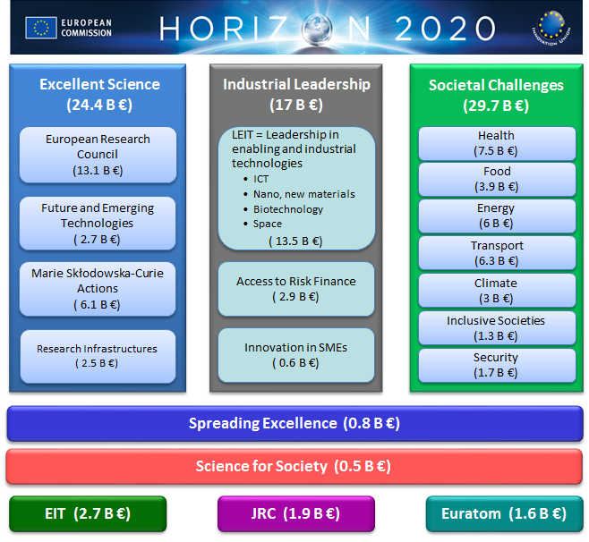
Particle Accelerator R&D in Horizon 2020
Our R&D is required for exploiting and upgrading the European particle accelerators, one of the pillars of EU Research Infrastructure.

Slide 4
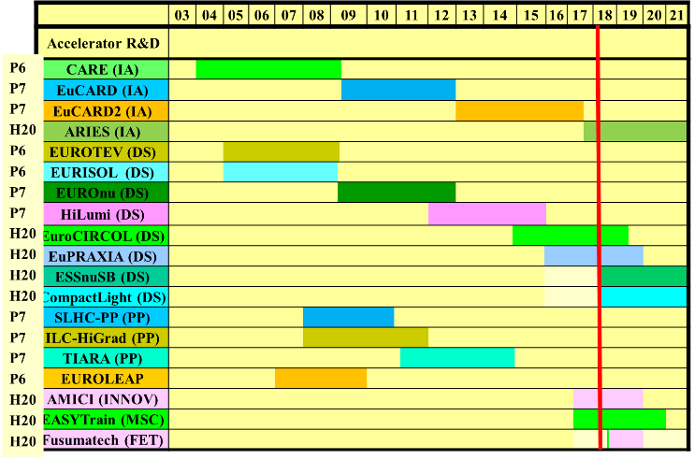
Accelerator projects coordinated by ESGARD/TIARA
a 19 projects supported: Total cost >305M€, EC contribution 105M€
More than 100 partners (labs, Uni., industry) in 21 countries involved

Slide 5
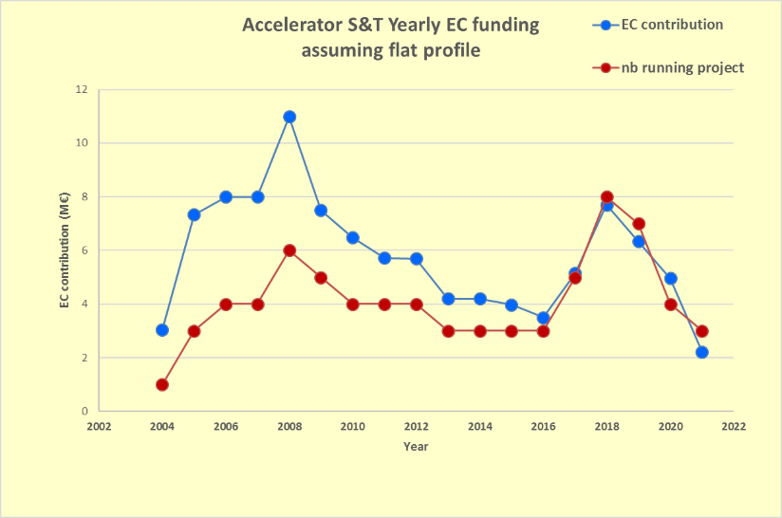
Funding profile

Slide 6
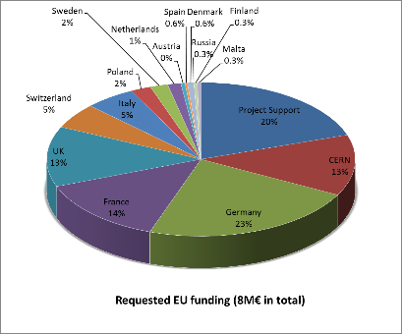
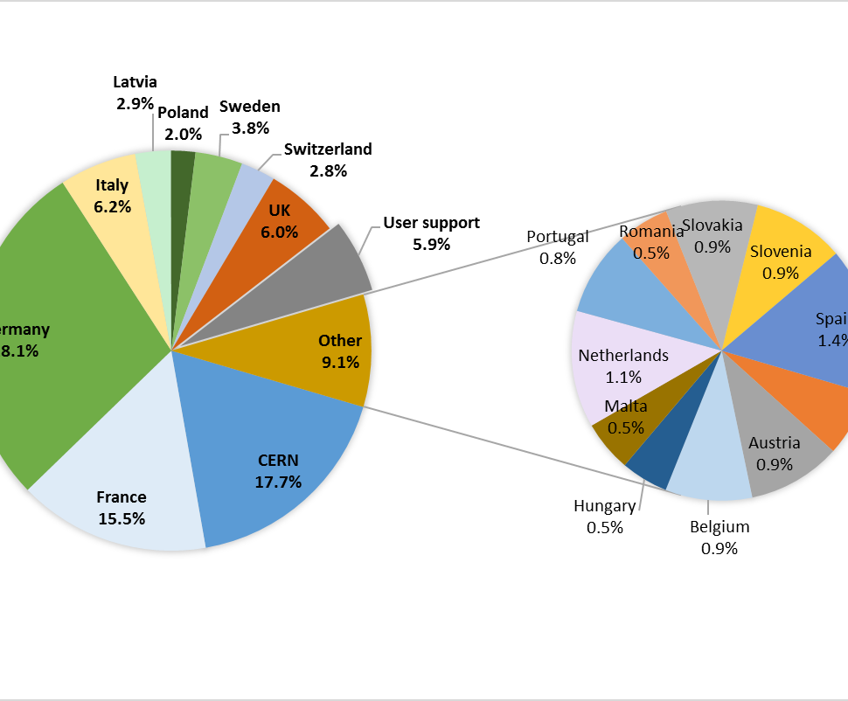
France in Integrating Activities (EuCARD2, ARIES)
EuCARD2: France 14%
CEA, CNRS, SOLEIL, Grenoble INP
ARIES: France 15.5%
CEA, CNRS, SOLEIL

Slide 7
Structure of projects and funding model
Integrating Activities structured in:
  Networks: Thematic studies, workshops
  Transnational Access: supported international access to test facilities
  Joint Research Activities: R&D and prototyping on selected topics.
Co-funding: about 50% of the cost covered by the EC contribution and 50% covered by the participating institute matching funds, which include the 20% overhead of H2020.
These projects have traditionally started from accelerators for particle physics, extended to high-energy nuclear physics.
Recently structured to include synchrotron light ring community (synergies with low-emittance rings) and accelerator applications (industrial and medical - not yet therapy).

Slide 8
Renewed support to particle accelerators
Accelerators are considered a super-advanced community, having 3 or more Integrating Activities.
The initial message from the EC (2014/15) was that they were willing to discontinue support to super-advanced communities and give priority to starting communities.
In 2015/16 a clear change in the messages from Brussels. The (probable) reason is that the Commission wants to show the impact of RI programmes on economy and on society. Accelerators as other advanced communities have a wide impact in line with the EC strategies, in terms of relation with industry and of societal applications.
Conclusion: the EC is ready to continue and possibly strengthen the support to accelerators, but moving the focus more towards «technology-oriented» research.

Slide 9


A follow-up for ARIES in a wider strategy
ARIES will be completed in April 2021.
A possible follow-up of ARIES should be approved in 2020.
The Research Infrastructure Programme Committee has defined a new instrument accordingly to new guidelines and priorities for super-advanced communities: the Innovation Pilot.
It is intended to be a pilot for larger programmes that could follow in the new Framework Programme, Horizon Europe, due to start in 2021.

Slide 10
Innovation pilot - status
H2020-INFRAINNOV-2019-2020-continued
Indicative budget: EUR 60 million (all in 2020)
Topics
INFRAINNOV-03-2020: Co-Innovation platform for research infrastructure technologies (follow-up of ATTRACT)
INFRAINNOV-04-2020: Innovation pilots
- this call is for incremental innovation activities suitable for joint R&D programmes of some super-advanced communities
- the Call will be targeted and is intended to have 100% success rate
- the planned budget envelope is 20 MEUR with two projects to be funded
- the EC intends to include detector and accelerator technologies as eligible separate topics
- cross-cutting activities (and consortia) between communities are expected, e.g. accelerator technologies of interest to HEP and light sources
(draft formulation, will be modified!)
Last call of H2020 (probable opening October 2019, deadline Jan 2020)
Content: collaborative technological developments (sort of JRAs), with an important industrial participation
We have to start preparation early in 2019 to be ready to submit a proposal in January 2020!

Slide 11
2) 2020 Innovation Pilots
INFRAINNOV-04-2020
  To explore and test new ways of integrating European RIs, in view of FP9
  INNOVATION PILOTS: target larger communities of RIs with high innovation potential which, in partnerships with industry and SMEs, focus on joint research activities and/or implement strategic roadmap in key technologies for the RI development and upgrade
(My) translation: development of key technologies for the next generations of particle accelerators, in partnership with industry, and with some view to societal applications (innovation potential).

Slide 12
Indicative Timetable of the amendment for the 2020 topics
2018-2019
June-Sep. 2018 | Preparation of revised WP and discussion with the PC
8 June | RI PC meeting
5 October | RI PC meeting
October 2018 | Finalised text
Nov.-Dec. 2018 | Inter-service consultation
January 2019 | Formal opinions of PC configurations
Jan.-Feb.2019 | Preparation of written procedure for the adoption
February 2019 | Adoption of the update of the 2018-2020 WP

Slide 13
What can we expect? Opportunities and challenges
Four super-advanced communities were identified as possible candidates for Innovation Pilot and future similar programmes: Lasers, Synchrotron lights, Accelerators, Detectors.
Lasers have already announced that they are not interested and they prefer more traditional funding for transnational access.
Instead, the synchrotron light user community has launched a strong initiative to compact the community and get more funding from Brussels: LEAPS (League of European Accelerator Based Photon Sources), https://www.leaps-initiative.eu/ .
The latest news were that the Commission has earmarked 10M€ for each of the three communities: synchrotron lights, accelerators and detectors.
Problem of the overlap with LEAPS: accelerators (rings and FELs) are part of their initiative, which could collide with our strategy of exploiting synergies between different categories of accelerators (grouping by application or by instrument?). Contacts have started and a coordination has to be put in place.

Slide 14
Co-innovation and industry engagement
It is time to start talking with our industrial partners to identify co-innovation subjects and companies that could participate to the new project – to be ready by end 2019!
Note 1: 10M€ is a large amount for JRAs: presently in ARIES only 4M€ for JRAs, including 0.8M€ going to industry.
Note 2: the JRAs in the new project should have an important industrial participation but this does not exclude topics developed exclusively in a research environment.
Examples of co-innovation in ARIES:
High Temperature Superconductors: pilot production of new high performance / low cost HTS tape.
Materials: industrial production of materials for extreme thermal management.
Timing: industrialisation of a modular timing system for medical and industrial applications.
Proof-of-concept fund (small projects with potential applications, 50 k€ each)
  Cleaning of marine diesel exhaust fumes by electron accelerators.
  Development of diamond-based composite materials for accelerator collimators and industry.
  Development of atomic layer deposition techniques for superconducting cavities.
Dealing with industry is difficult (IP management, selection, competition, …)

Slide 15
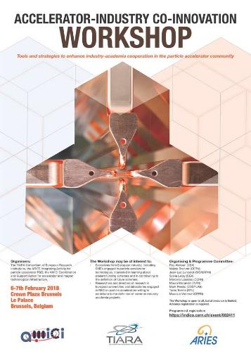
Accelerator-industry co-innovation workshop
Co-organized by the TIARA Committee and the ARIES and AMICI projects on February 6-7 in Brussels.
Goals:
To foster discussion on most effective ways to develop co-innovation with industry in Europe.
To identify sustainable structures, possible funding schemes and financing mechanisms.
To contribute to the definition of new EC instruments to boost co-innovation.
To provide a communication platform to all relevant stakeholders: policy makers, academia, industry and scientific management.
AMICI = Accelerator and Magnet Infrastructure for Cooperation and Innovation, EU project for common development and exploitation of European Particle Accelerator Technological Facilities

Slide 16
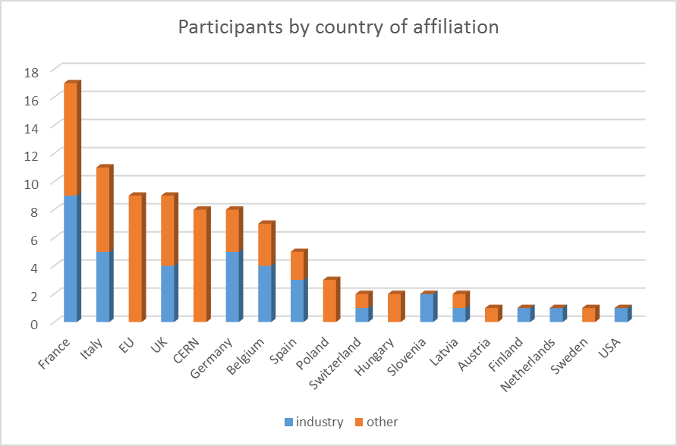
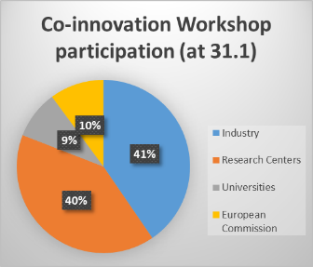
Outcome of the industry workshop
Very good participation:
Excellent collaboration spirit and clear common objectives.
Importance of training and education is shared by the industry community.
Agreement on the need for more co-innovation even if no clear message on the best strategies to achieve it.
EC people present gave a strong message of engagement and support to our future programmes.
41% of participants from industry
Largest number was from France!
+ Mini-Workshop on IP in Co-Innovation organised by ARIES and AMICI – presentations and conclusions on https://indico.cern.ch/event/723985/

Slide 17
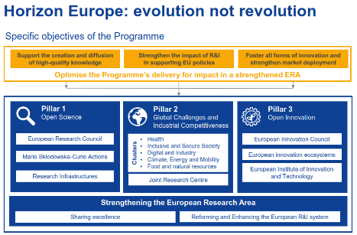
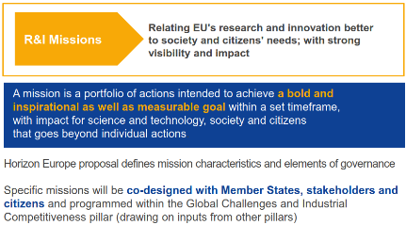
More opportunities in Horizon Europe (FP9)
HEurope in preparation, expected budget 86.6 B€ (H2020: 77 B€).
With respect to H2020, will support programs more than projects = longer term initiatives to support European scientific excellences.
As in H2020 a strong accent on innovation and industry participation.
Our community is well placed for a long-term multi-million programme, possibly within one of the “missions” announced in the HE programme.
The Innovation Pilot of H2020 is an experiment to test new funding schemes.
We need to show that we are a strong and integrated community, able to set its priorities internally (and possibly to distribute funding).

Slide 18
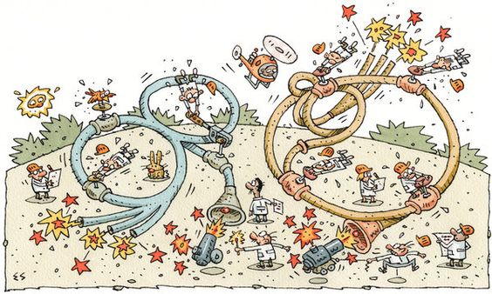
Thank you for your attention
maurizio.vretenar@cern.ch

Slide 19
Bonus:
Medical Accelerator plans at CERN

Slide 20
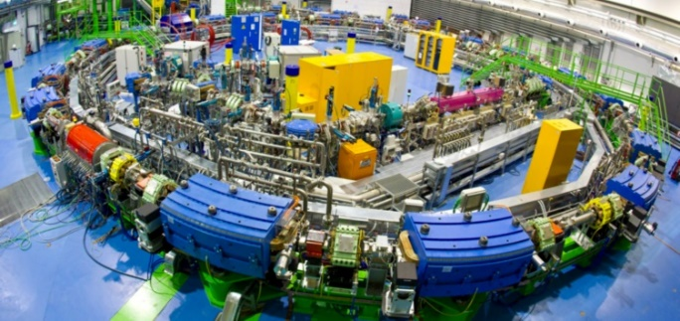
CERN Medical Initiatives
Renewed interest at CERN in promoting medical accelerator developments within the limits set by the «knowledge transfer for the benefit of medical applications» document approved by Council in March 2017.
This programme foresees a limited personnel and material budget, to be used as seed funding for collaborative R&D projects (receiving additional support from EU or other sources), using technologies and infrastructures that are uniquely available at CERN, and without competing with projects or industries in the Member States.
Proton therapy is now commercial (several vendors on the market) and we do not want to interfere.
Instead, we are exploring the options to start a collaborative design study, for a new generation of compact and cost-effective light-ion medical accelerators.
For the moment this initiative is called «PIMMS2» - as a follow-up of the old PIMMS (Proton Ion Medical Machine Study) that took place in 1997-2000 and lead to the CNAO and MedAUSTRON design.

Slide 21

The objective
The conclusion of our investigation is that to further advance ion therapy, we should aim for:
A multiple-ion research and therapy facility – built in Europe, possibly with support from the European Commission.
Based on innovative accelerator technologies - to become the test bench for a new standardised treatment facility.
Structured as a multi-national centre, addressing the entire European and worldwide community – no European country can afford building this facility alone.
In this programme, CERN can:
within a PIMMS2 initiative, contribute to identifying and developing new accelerator technologies
offer a multinational environment to grow the multi-national collaboration.

Slide 22
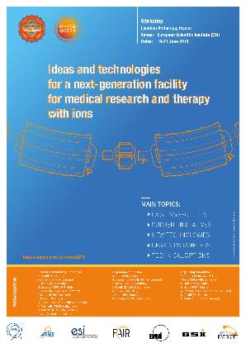
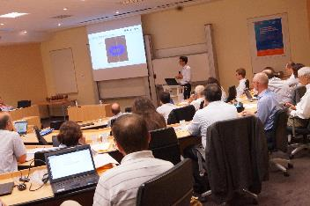
The Archamps Workshop
“Ideas and technologies for a next generation facility for medical research and therapy with ions”, ESI Archamps (France, Geneva area), June 19-21.
Co-organized by CERN, ESI, GSI - 63 participants
Objectives:
1. Highlight the potential of ion therapy for cancer.
2. Share the current experience: advantages and disadvantages of present implementations, ideas for future facilities, directions for improvement.
3. Explore the options for the design for a next generation medical research and therapy facility with ions in Europe, identify and motivate a community that could contribute.
4. Identify basic parameters, a set of technical options, and outline a possible basic R&D programme.

Slide 23
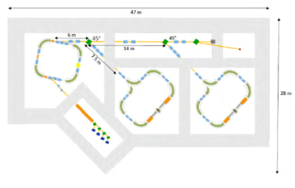
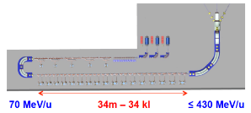
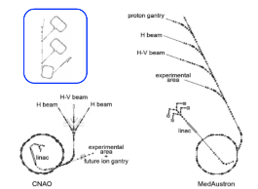
Key outcomes
Take away words:
Small and cheap
Fast delivery
Real time imaging
Low consumption
Higher intensity
Possibly with MRI
“Start from the patient”
Two technical options
Superconducting synchrotron
Four 90deg canted cosine theta magnets, Bmax 3.5T, ring 27m, gantry r=5.3m
Linear accelerator
Folded linac, 34m length, high rep. frequency and intensity, low emittance
Both options require development!
SC synchrotron compared to CNAO and Medaustron

Slide 24
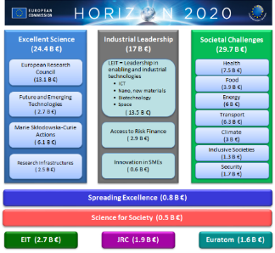
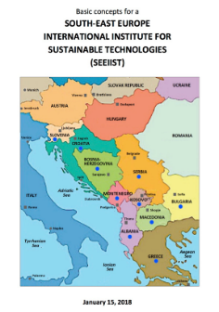
Development Options
The main avenue: from Health to RI
Submit in a proposal for a Design study to be supported by the EC (Research Infrastructures) for the design of a next-generation ion research (and therapy) facility.
Deadline: December 2019, duration 2-3 years. EC contribution 3 M€, partners’ matching funds ~3 M€ (total 6 M€).
~10 beneficiaries, 10-20 collaborating partners
Coordination with the SEEIIST
The design Study will be coordinated with the SEEIIST (South East Europe International Institute for Sustainable technologies) that has obtained EU support for the construction of a medical accelerator centre in the SE Europe.
SEEIIST can be the first user of the new facility design.

