Slide 1


Einstein Telescope
Michele Punturo
INFN Perugia

Slide 2
From Florent:
Here is a list of typical topics we would like you to cover:
  Quick summary of targeted GW sources and science goals (already covered by Nelson)
  Technical description, project status and time line
  Needed contributions: detector developments, data analysis, R&D, science expertise, source models,...
  What does it take to join the collaborations: entry ticket, publication rules,...

Slide 3
Table of Content
Motivations
A bit of history
Global Scenario
Science
From CDR to TDR
Sites
Timeline
The ET collaboration
Nelson
Why?
What?
Where?
When?
Who?

Slide 4
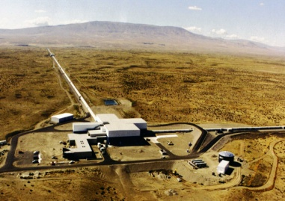


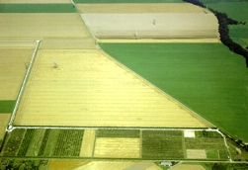
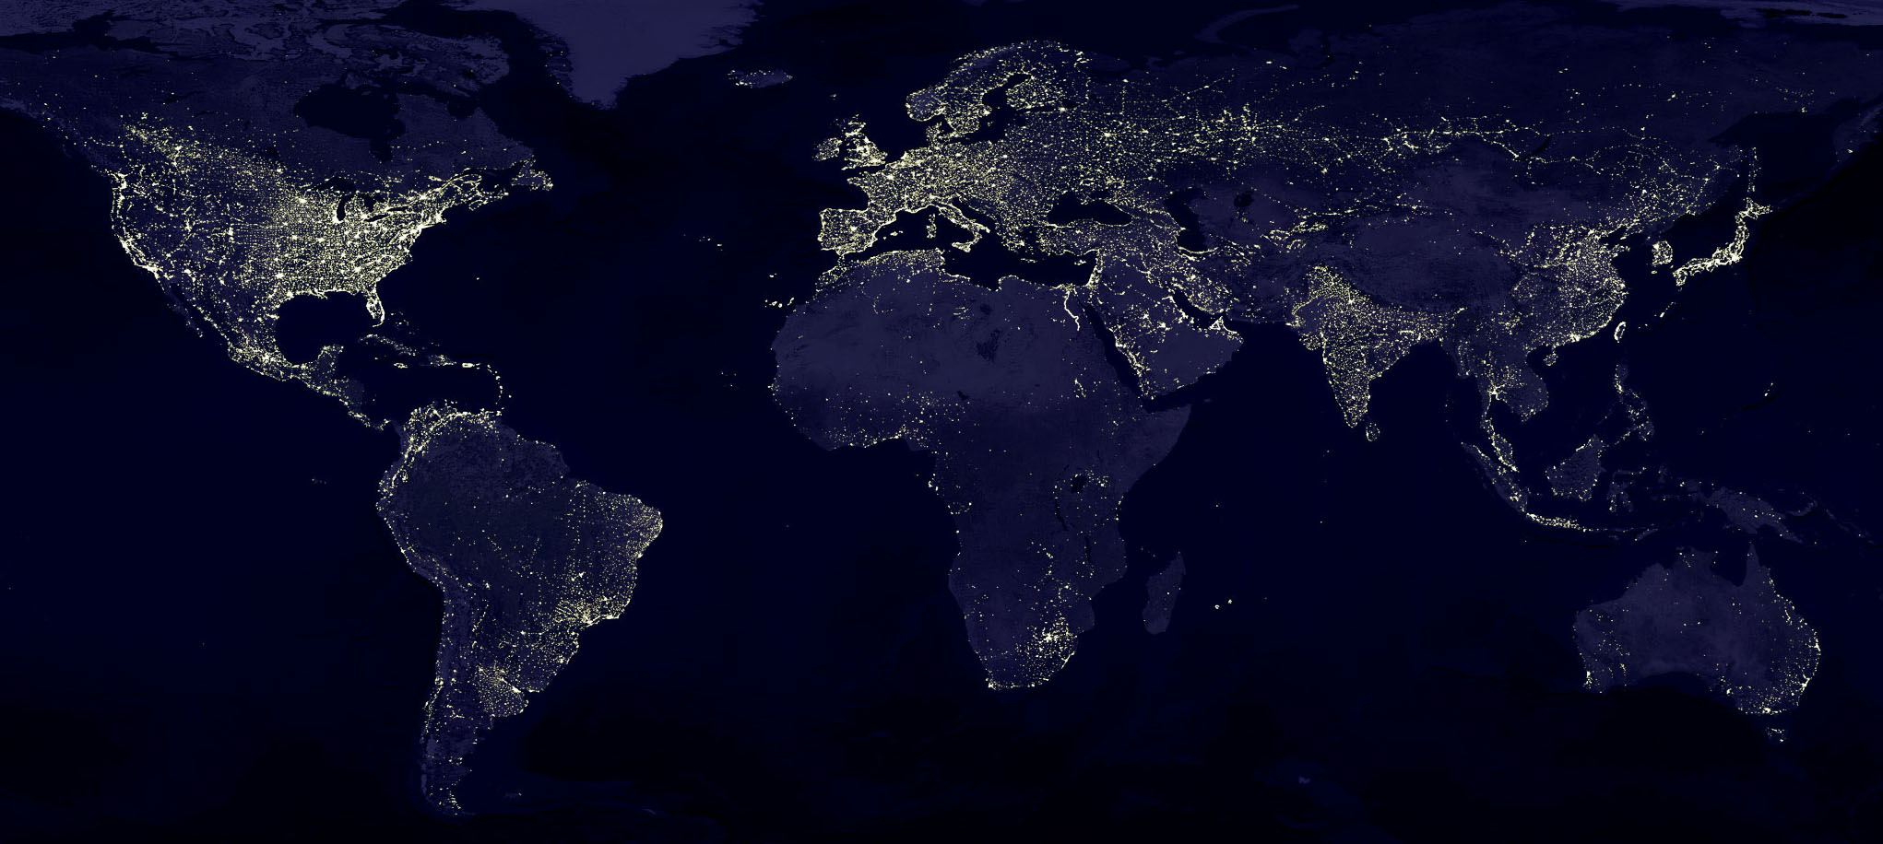
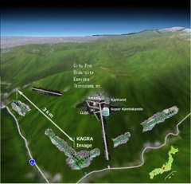
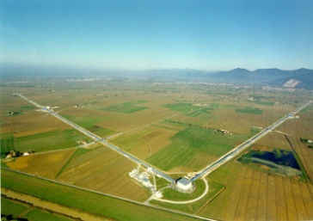




Terrestrial Detectors
Advanced detectors 2015-2025
GEO, Hannover, 600 m
~2019
aLIGO Hanford, 4 km
2015
~2025
8/2017
AdV, Cascina, 3 km
KAGRA Collaboration:
260 collaborators
12 countries
5 computing centres
~16.4 G¥ of construction costs
aLIGO Livingston, 4 km
LIGO Scientific Collaboration:
1263 collaborators (including GEO)
20 countries
9 computing centres
~1.5 G$ of total investment
Virgo Collaboration:
343 collaborators
6 countries
5 computing centres
~0.42 G€ of total investment

Slide 5
Short term evolutions
VIR-0943A-17

Slide 6
Short term evolutions
KAGRA, 3 km underground and cryogenic
LIGO-India
4km
Voyager?
VIR-0943A-17

Slide 7
How to keep a scientific relevance in Europe?

Slide 8
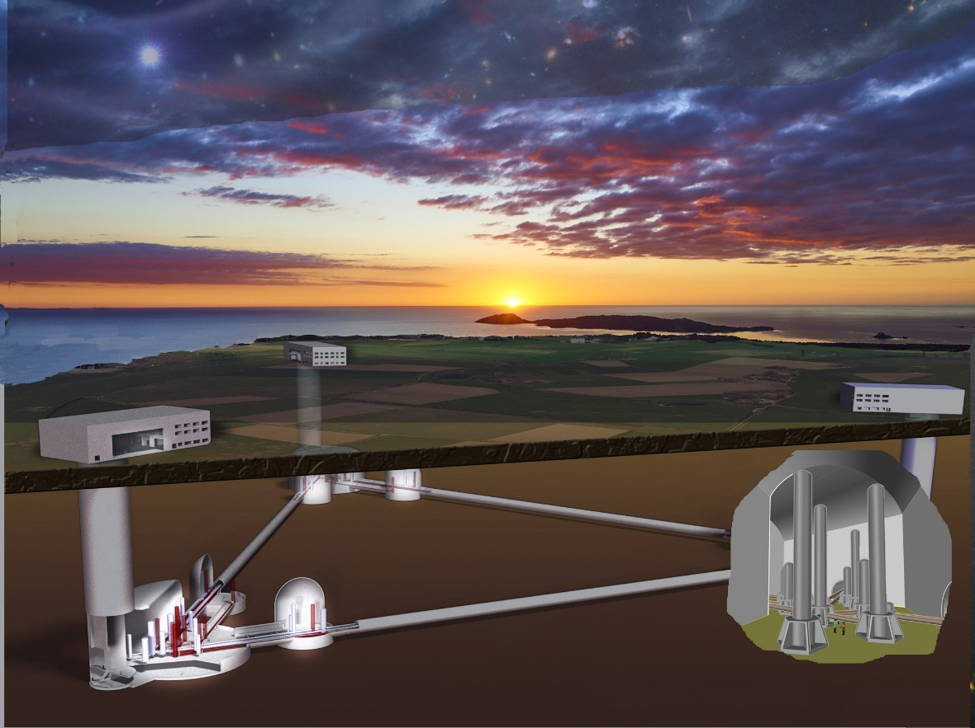
The Einstein Telescope
10 km

Slide 9
The ET history
The “what next” question has been posed since 2004:
  ILIAS N5-WP3 chaired by H.Lueck and M.Punturo
  ESF funded (Perugia, 2005) an “Exploratory Workshop” on 3G GW observatories
    Design Study idea
Design study funded by the EC in FP7 (2008-2011)
  Involving France, Germany, Italy, the Netherlands, UK
  ~400 pages conceptual design report:
    http://www.et-gw.eu/index.php/etdsdocument
Now the ET community includes also Hungary, Poland, Belgium and Spain
Project included in sectorial roadmaps (GWIC, APPEC, OECD,. …) and worldwide recognized as leading 3G project

Slide 10
The 3G/ET idea
To realise a 3G new GW observatory
  3G: Factor 10 better than advanced (2G) detectors
  New:
    We need a new infrastructures because
      Current infrastructures will limit the sensitivity of future upgrades
      In 2030 current infrastructures will be obsolete
  Observatory:
    Wide frequency, with special attention to low frequency (few HZ)
      Stellar mass Black Holes
    Capable to work alone (characteristic to be evaluated again)
      Localization capability
      Polarisations
      High duty cycle: redundancy
    50-years lifetime of the infrastructure
      Compliant with the upgrades of the hosted detectors

Slide 11
The Global Scenario
The GW detection and the beginning of the multimessenger astronomy stimulated a world wide acceleration toward 3G GW observatories
In Europe we are going toward the formation of a ET collaboration, a competition between ~3 sites candidate to host the infrastructure, the submission of an ET project proposal to the ESFRI roadmap
In US the idea of a giant 40km detector, named Cosmic Explorer, is now born and proposed as Design Study to NSF
We set up a global coordination committee (GWIC-3G) that is attempting to harmonise the efforts and to find synergies

Slide 12
GWIC 3G organisation
3G subcommittee
Chairs: M. Punturo, D. Reitze
Science Drivers for 3G detectors
Chairs:
V. Kalogera
B.Sathyaprakash
Coordination of the Ground-based GW Community
Chairs:
H. Lueck
D. McClelland
J.v.d. Brand
Networking among Ground-based GW Community
Chairs:
M. Punturo
D. Reitze
Investigate governance schemes
Agency interfacing and advocacy
Chairs:
S. Rowan (on behalf of the GWIC)
Chairs:
S. Katsanevas
G. Sanders
Science Case
Enabling Technologies, Common R&D
Networking,
Joint meetings
Talk to founding agencies
Governance, global organisation

Slide 13
GWIC 3G organisation
3G subcommittee
Chairs: M. Punturo, D. Reitze
Science Drivers for 3G detectors
Chairs:
V. Kalogera
B.Sathyaprakash
Coordination of the Ground-based GW Community
Chairs:
H. Lueck
D. McClelland
J.v.d. Brand
Networking among Ground-based GW Community
Chairs:
M. Punturo
D. Reitze
Investigate governance schemes
Agency interfacing and advocacy
Chairs:
S. Rowan (on behalf of the GWIC)
Chairs:
S. Katsanevas
G. Sanders
Seed Black holes
Neutron Stars
Compat binaries
Cosmology
Supernova
Multi-messenger observations
Extreme gravity
Waveform models
Detector networks
More than 200 scientists

Slide 14
Why? - The ET science case
The ET science case is introduced in the Conceptual Design Report
Its update will be given by the Science Case team of the GWIC 3G
  Several questions are posed, the different teams are investigating how 3G observatories can give answers
  Few Examples:

Slide 15
Some of the questions addressed by ET
Fundamental questions in Gravity:
  New/further tests of GR
  Exploration of possible alternative theories of Gravity
  How to disprove that Nature black holes are black holes in GR (e.g. non tensorial radiation, quasi normal modes inconsistency, absence of horizon, echoes, tidal deformability, spin-induced multipoles)
Fundamental questions in particle physics
  Axions and ultralight particle through the evaluation of the consequences of new interactions, their impact on two bodies mechanics, in population and characterisics of BHs, NSs
Probing the EOS of neutron stars
Exotic objects and phenomena (cosmic strings, exotic compact objects: boson stars, strange stars/gravastars, …)
Cosmology and Cosmography with GWs
Accurate Modelling of GW waveforms
GW models in alternative theory of gravitation
The population of compact objects discovered by GWs is the same measured by EM? Selection effects on BHs and NSs?
What is the explosion mechanism in Supernovae?
What is the history of SuperMassive black holes?
GW Stochastic Background? Probing the big bang?
Multimessenger Astronomy in 3G?

Slide 16
What?
From the conceptual design to the technical design

Slide 17
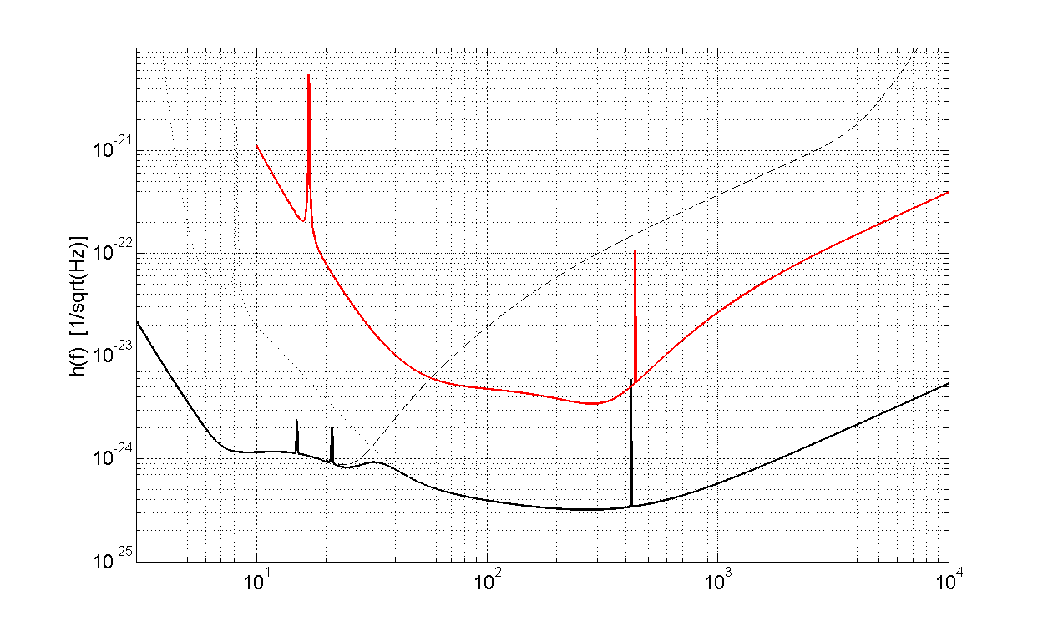
SENSITIVITY GOAL: ~×10 better
Advanced Virgo
MASS ACCURACY
HIGH MASS/HIGH Z
MERGER PHYSICS
LOCALIZATION
NUMBER of SOURCES
ET

Slide 18
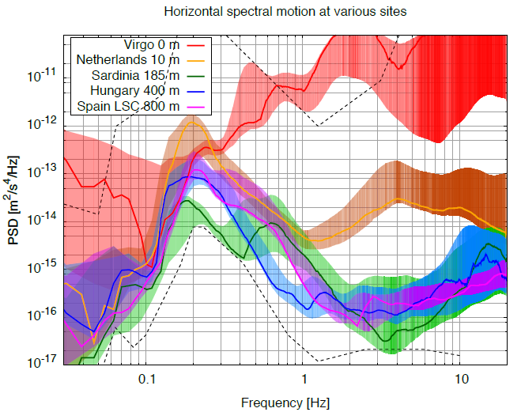
Widening the band: low frequency
Low frequency limitation for GW detectors is given by the seismic noise and Newtonian noise
  Both can be reduced going underground
noise at 2 Hz reduced by
~2 orders of magnitude
ET design study

Slide 19
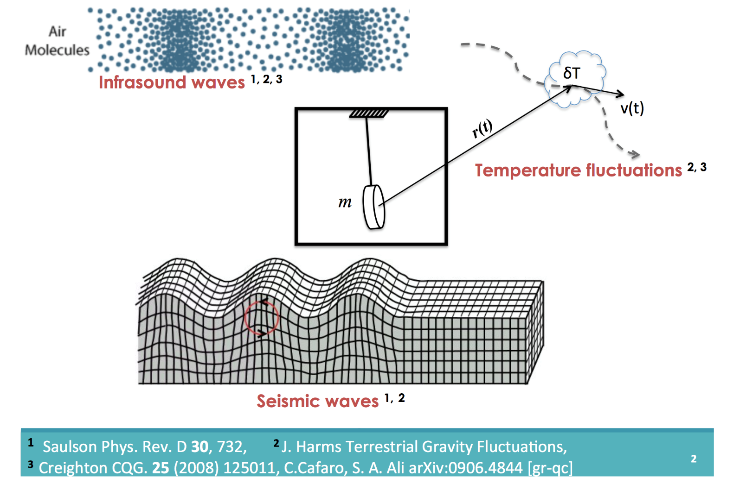

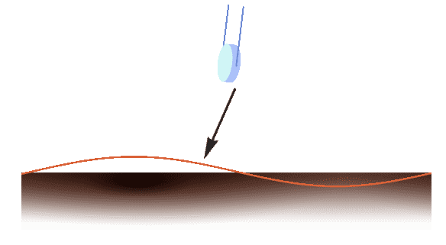
Newtonian Noise
NEWTONIAN NOISE
Credit M.Lorenzini

Slide 20
WIDEN THE BAND: XYLOPHONE
Improving al low and high frequency with a single detector is very challenging
  HF requires more laser power
  LF requires cold mirrors
Idea: split the detection band over 2 “specialized” instruments

Slide 21
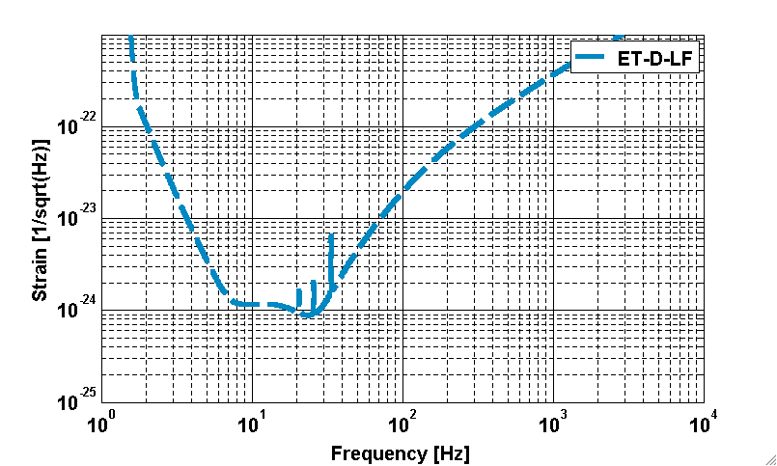
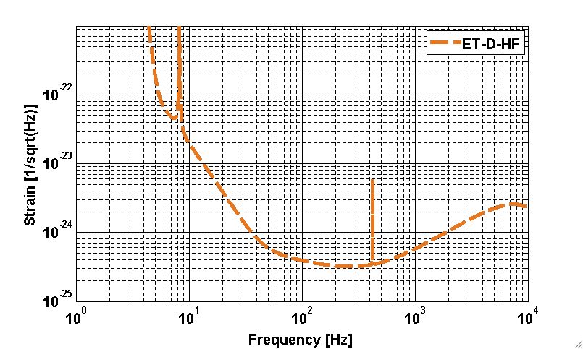
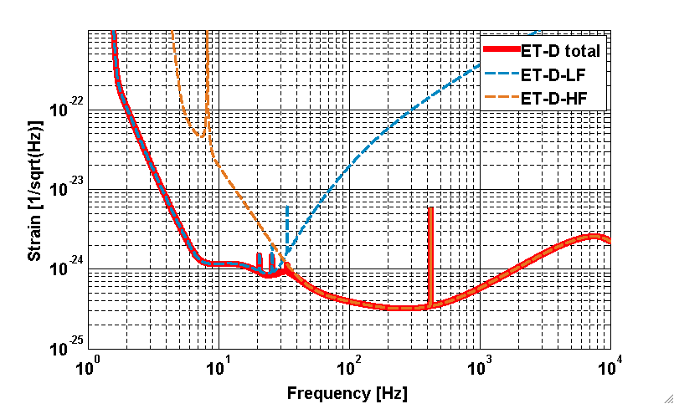
Xylophone principle

Slide 22
STAND-ALONE OBSERVATORY
Start with a single (xylophone) detector

Slide 23
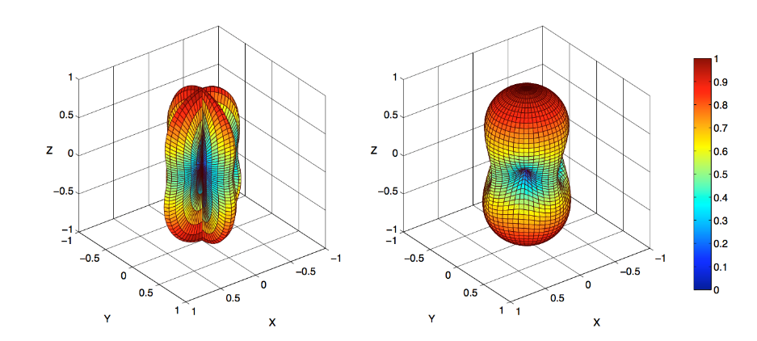
STAND-ALONE OBSERVATORY
Start with a single (xylophone) detector
Add a second one to fully resolve polarizations
Antenna pattern for a polarized GW:
simple “L” (left) vs Triangle (right)

Slide 24
STAND-ALONE OBSERVATORY
Start with a single (xylophone) detector
Add a 2nd one to fully resolve polarization
Add a 3rd one for null stream and redundancy

Slide 25
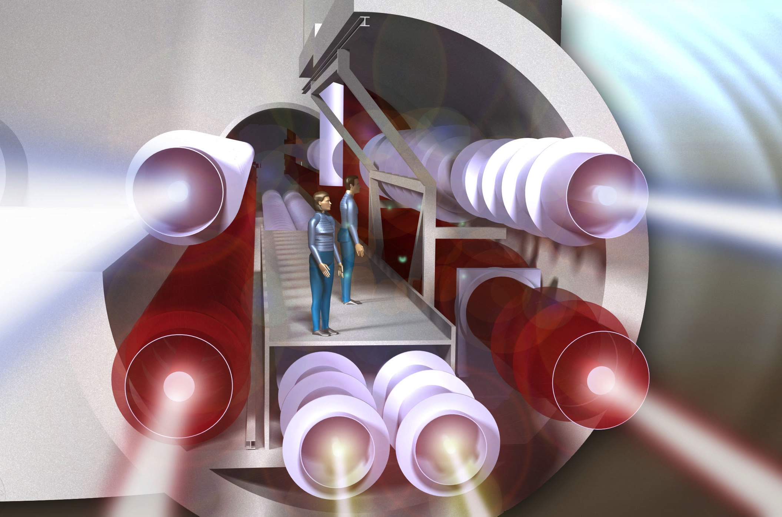
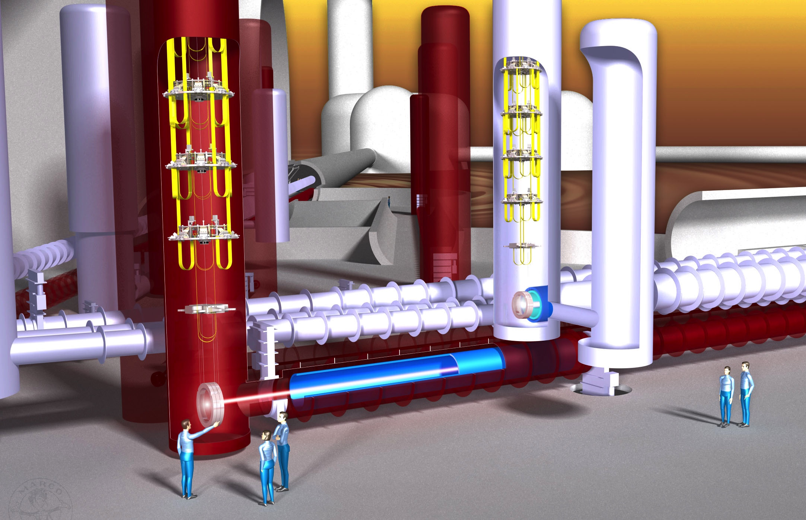
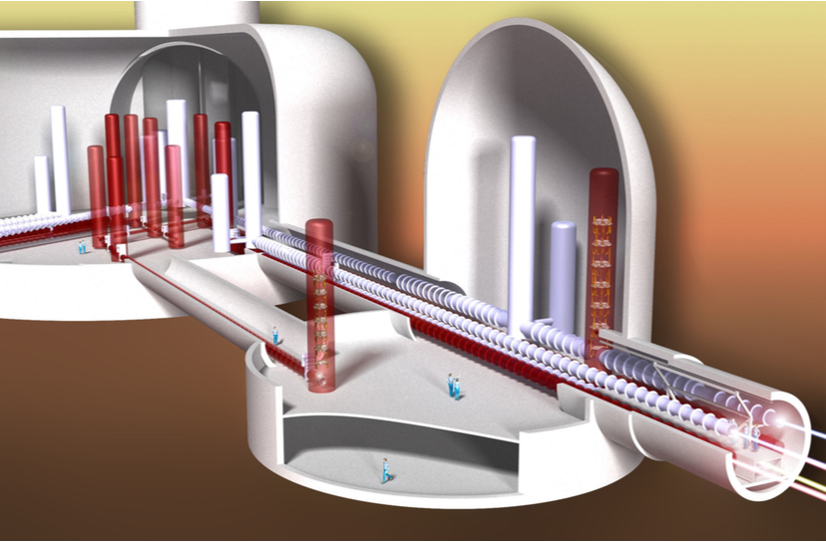
ET INFRASTRUCTURE CONCEPT
ET DESIGN STUDY, 2011

Slide 26
Technologies
The main ingredients are:
  Size: 10km vs 3km
  Xylophone design: ET-LF, ET-HF
  ET-LF:
    Underground
    Cryogenics
    Silicon (Sapphire) test masses
    Large test masses
    New coatings
    New laser wavelength
    Seismic suspensions
    Frequency dependent squeezing
  ET-HF:
    High power laser
    Large test masses
    New coatings
    Thermal compensation
    Frequency dependent squeezing

Slide 27
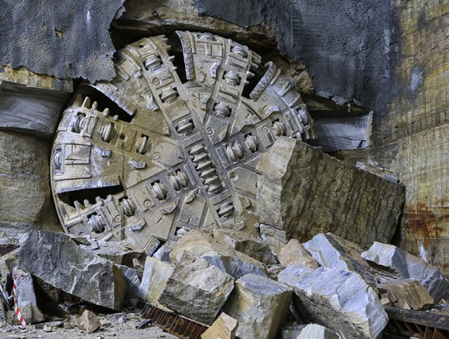
ET Infrastructure: Realistic Design

Slide 28
Realistic design
Conceptual design has been made by physicists in the “general and perfect case” hypothesis
We need to transform the conceptual design in a technical design, starting from the infrastructure
A team of Physicists, Engineers, Geologists belonging to INFN, EGO, Sassari University, IGEA and a private company is specialising the design for the Sardinia site (Sos Enattos) going deeper in the technical details
Similar teams are forming for the other site candidate

Slide 29
TUNNEL
Golden rules:
  a new (and expensive) infrastructure must not be born short in space
  avoid as much as possible complex arrangements
We tried to fit the ET xylophone configuration in a underground infrastructure making realistic assumptions
  space required for working around the pipes (e.g. welding the modules)
  avoid vertical arrangement of the ITF
  include realistic tower footprint
  WARNING: things might get even more complex (e.g. space required by cryogenics)
To further offload the tunnel we have moved the filter cavities into shorter (1 km), dedicated tunnels
  this is a working hypothesis, to be discussed by the detector design teams
The resulting tunnel diameter is ~2x larger wrt ET book

Slide 30
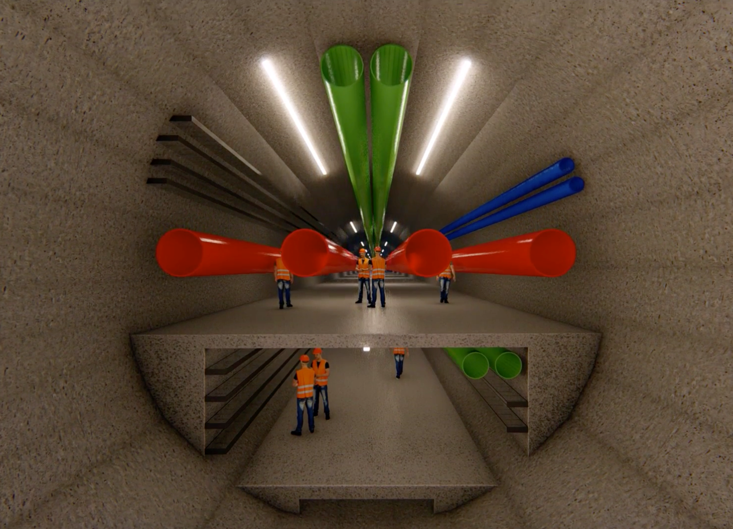
TUNNEL - _{in} 10m

Slide 31
CAVERNS AND ACCESS
Big caverns are a challenge
  structure stability
  atmospheric NN
65m diameter (ET concept) would be the largest cavern in the world
  We have studied solutions to reduce the volume while maintaining the infrastructure flexibility and development potential
Big shafts are expensive and challenging for civil engineering
  We have designed downhill accesses to the infrastructure and smaller diameter shafts for safety accesses

Slide 32
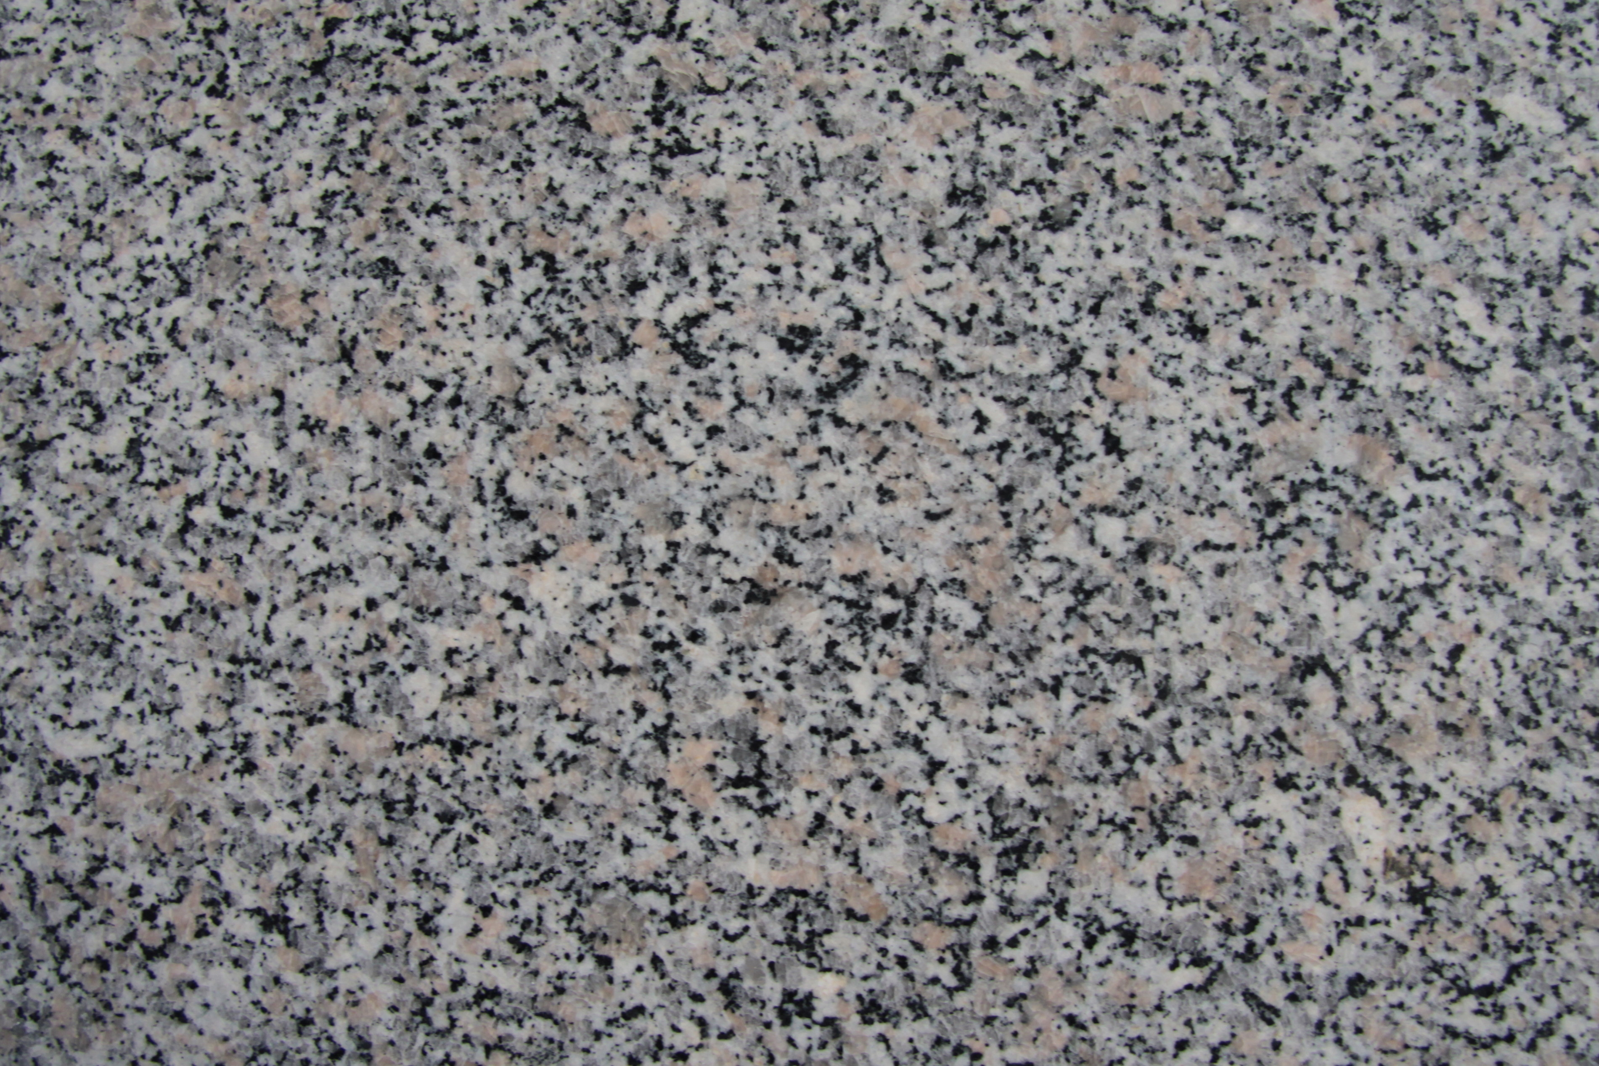
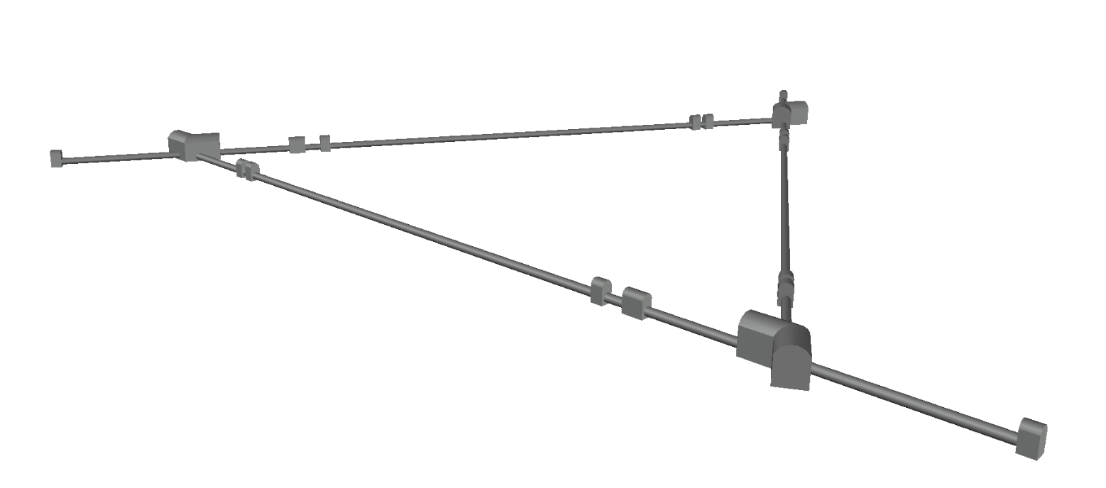
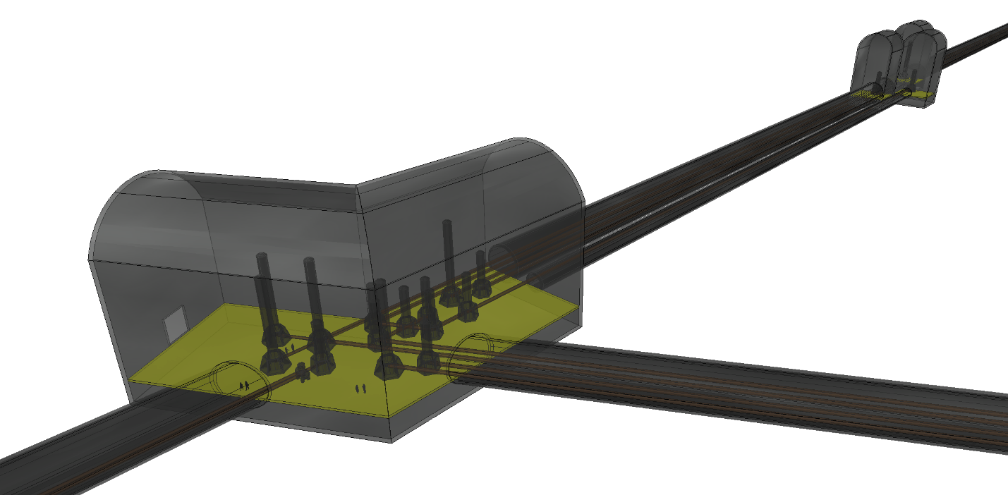
ET Triangle
Underground Base Infrastructure
Heights are not to scale
Cavern shape designed to be structurally feasible
and reduce the overall excavated volume
Satellite Cavern:
H=32m; V_{int}=7200 m³
Main Cavern:
H=36m; V_{int}=90000 m³

Slide 33
CORNER CAVERN

Slide 34
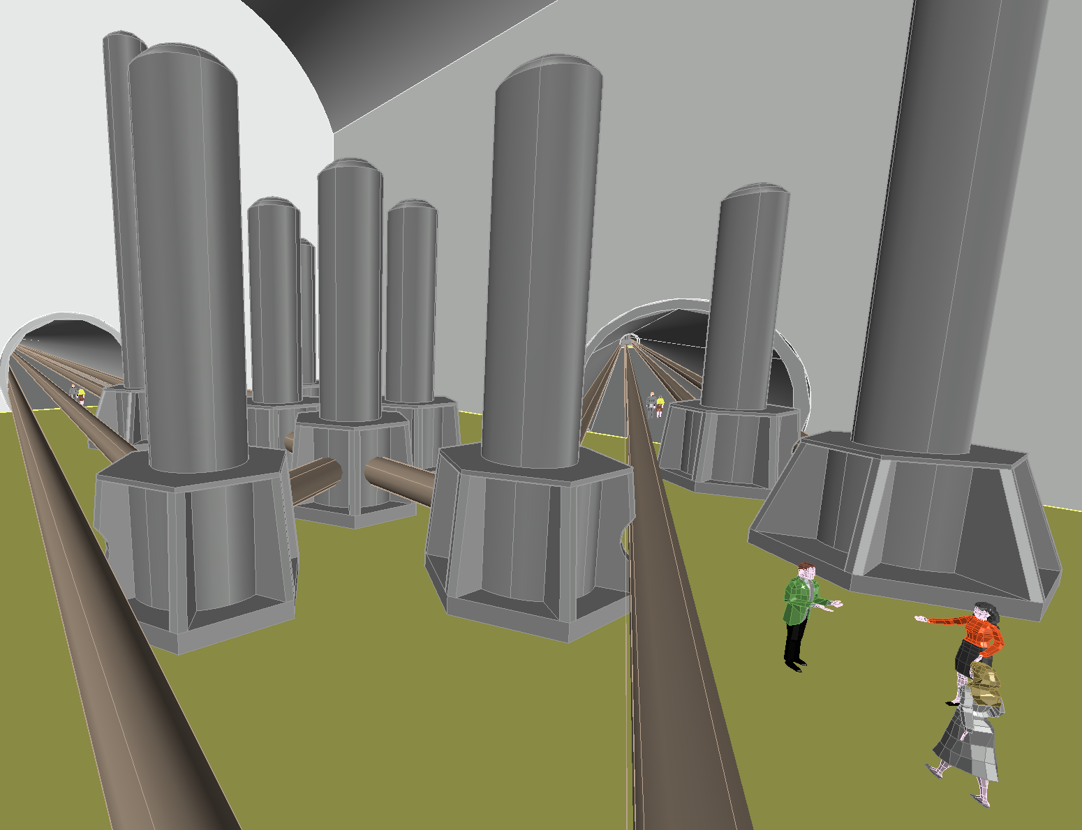
CORNER CAVERN

Slide 35
Where?

Slide 36
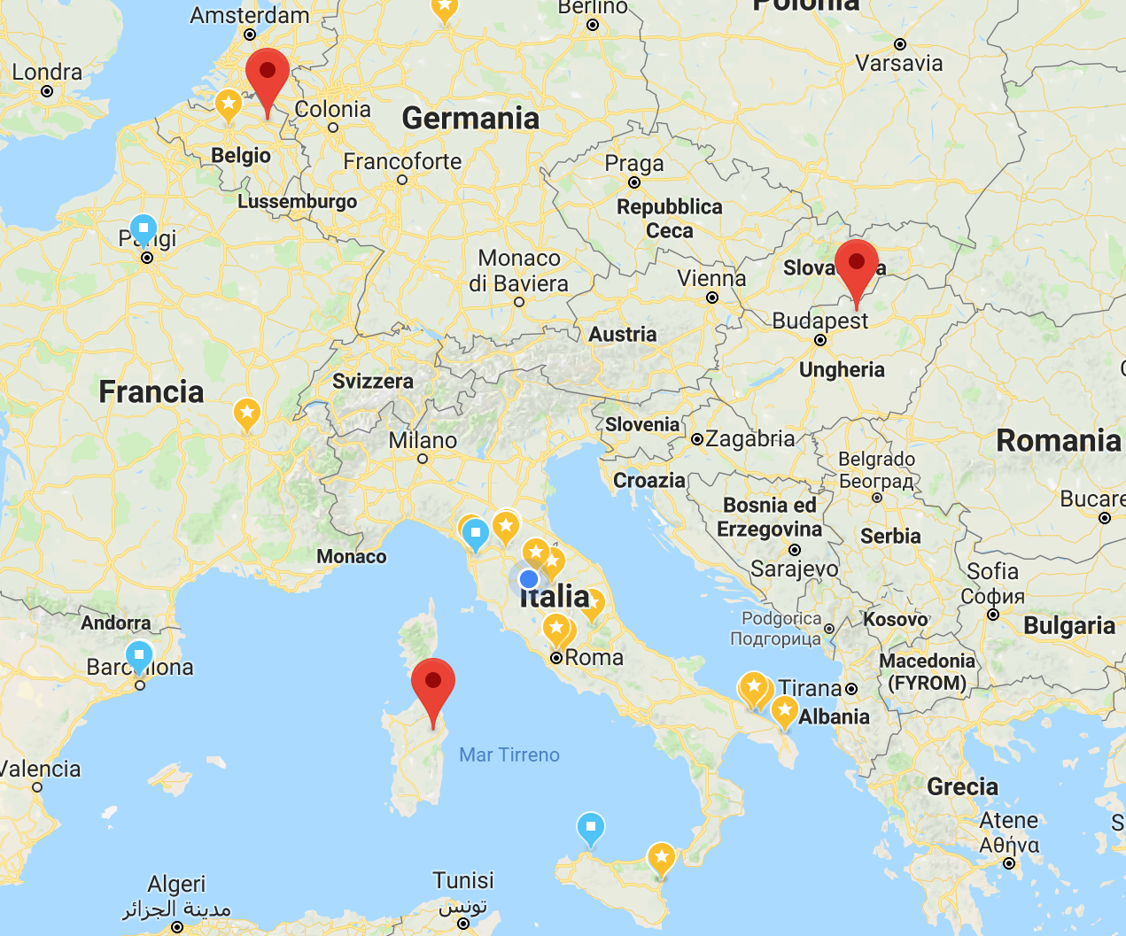
3 site candidates
Belgium-Germany-Netherlands
Hungary (Matra Mountain)
Italy (Sardinia-Sos Enattos)

Slide 37
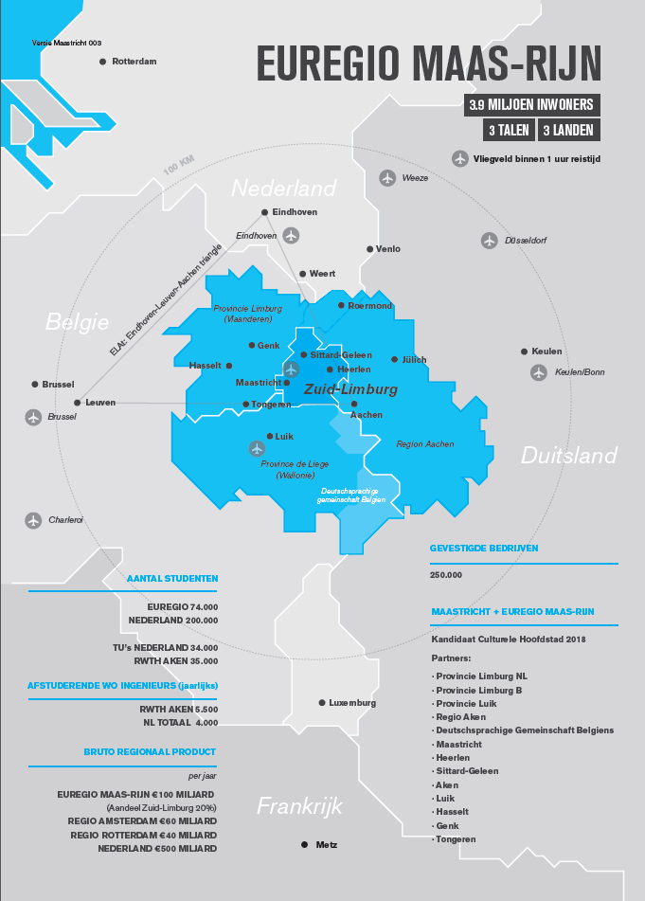
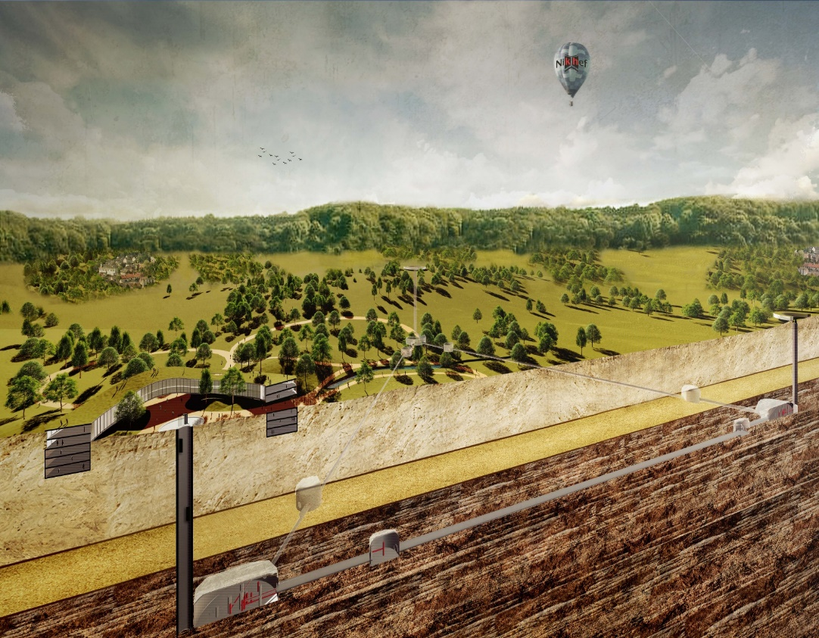
EUREGIO MEUSE-RHINE
A proposal to realize ET in the Limburg area
A strong asset: a detector hosted by 3 countries (B-D-NL)

Slide 38
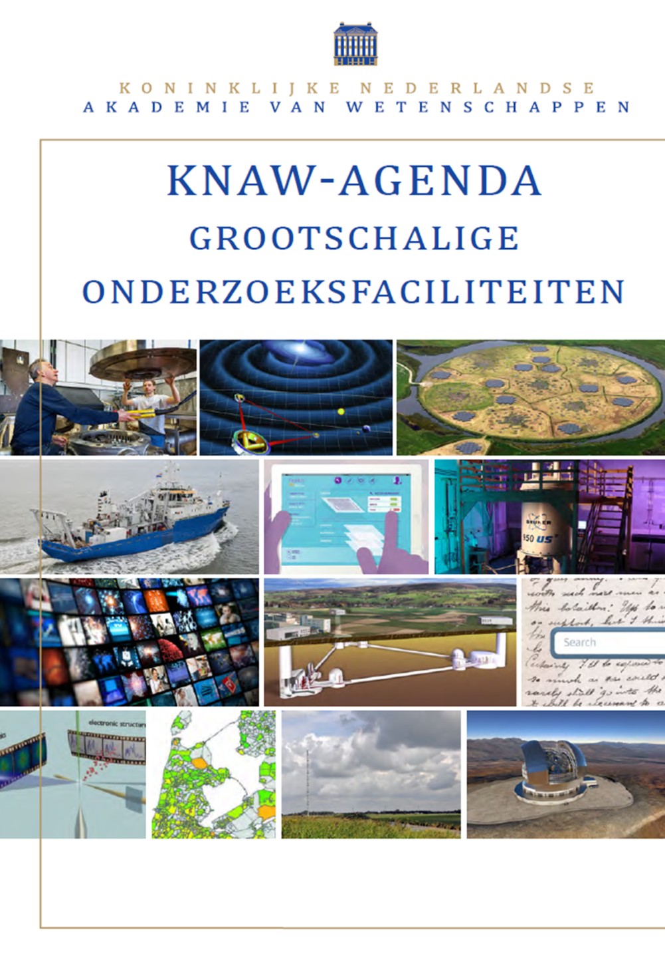
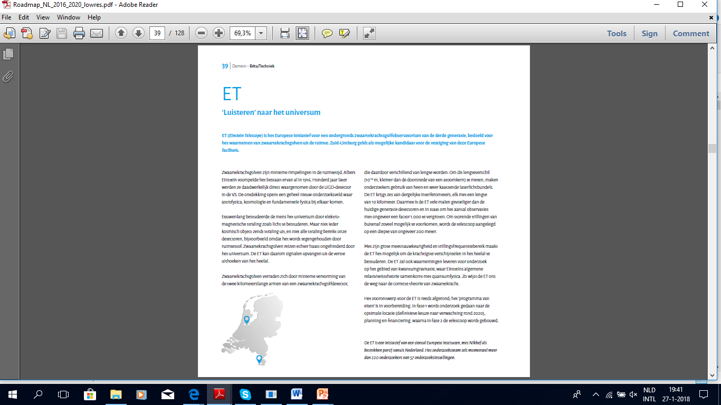
ET is appearing in NL roadmap

Slide 39
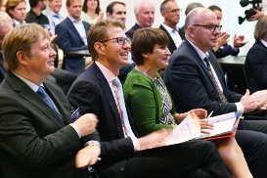
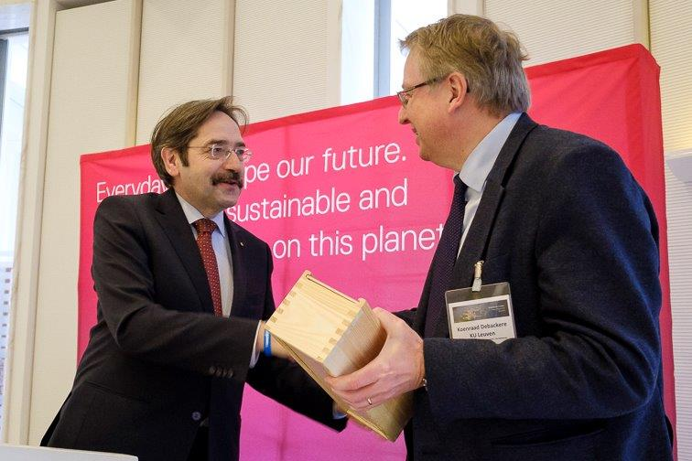
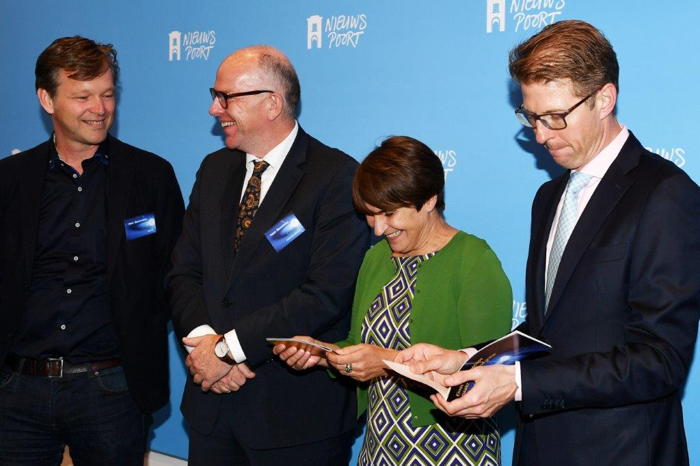
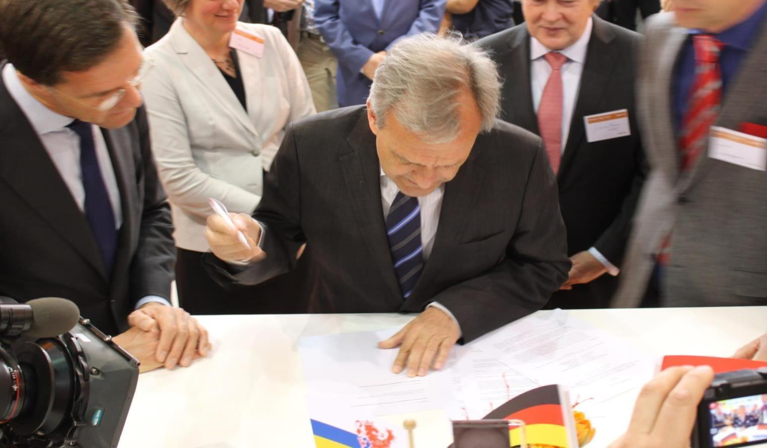
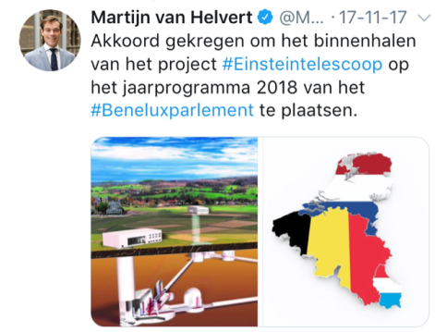
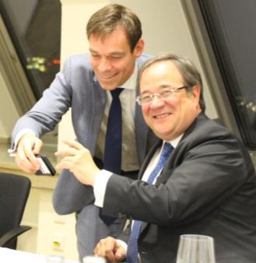
STRONG SUPPORT BY LOCAL (NL, B) POLITICIANS
Limburg
province
boss
KU Leuven
boss
Jo with two Dutch Ministers + …
AEI+Nikhef ET collaboration
+ Dutch Prime Minister
Stan with two Dutch Ministers + …

Slide 40
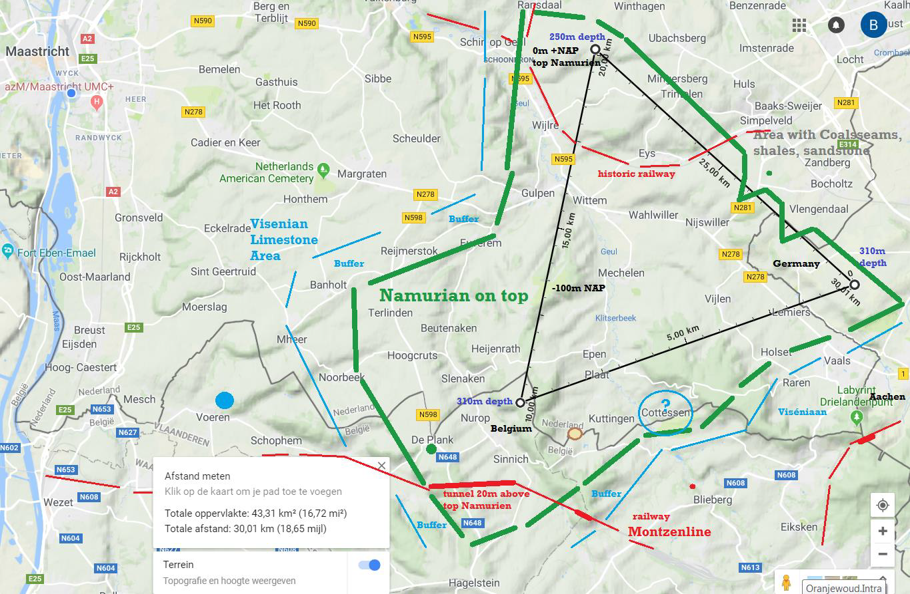
B-G-NL

Slide 41
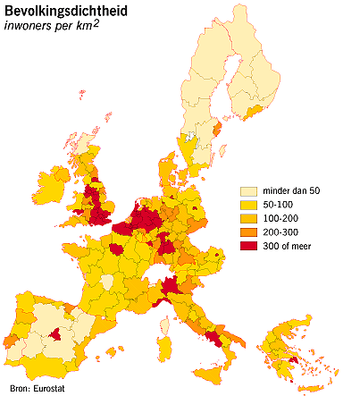
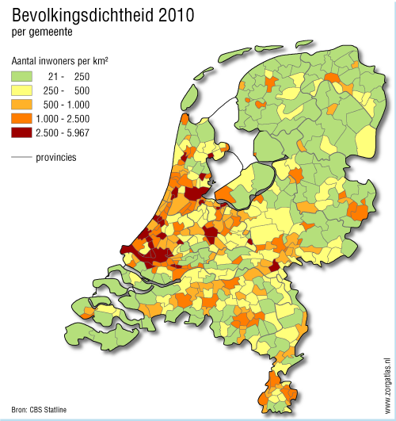
Population Density
Modest population density (200/km²)
Relatively ‘quiet’ in view of:
No heavy industry;
Windmills, highways, railroads
at a distance;
Tourism earmarked as a priority
(complicates our drilling activity …)
< 50/km²
50 - 100
100 - 200
200 - 300
> 300
21 - 250
250 - 500
500 - 1000
1000 - 2500

Slide 42
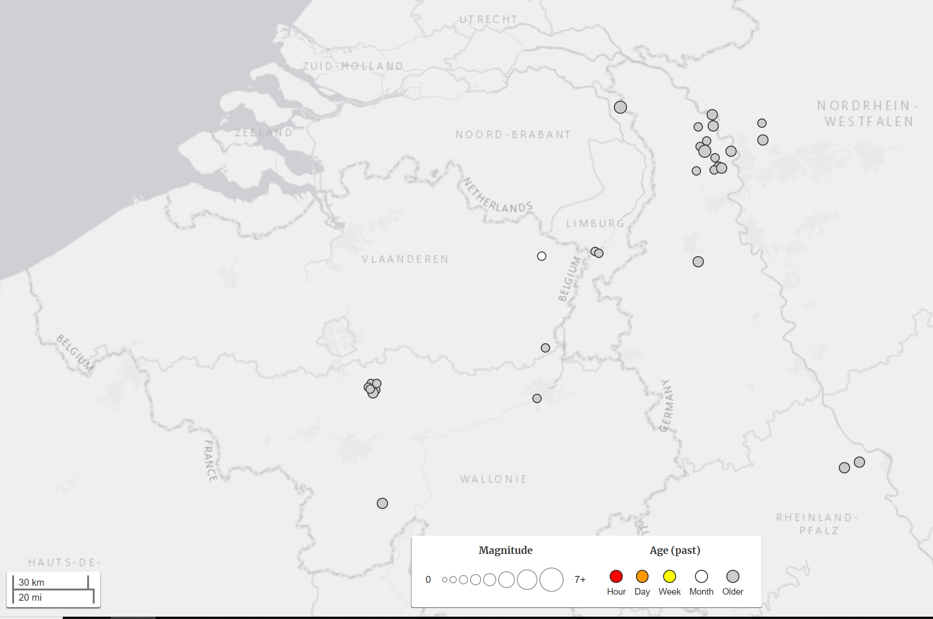
Seismicity B-G-NL
31 earthquakes M>1.5 in the last 10 years
https://earthquake.usgs.gov/

Slide 43
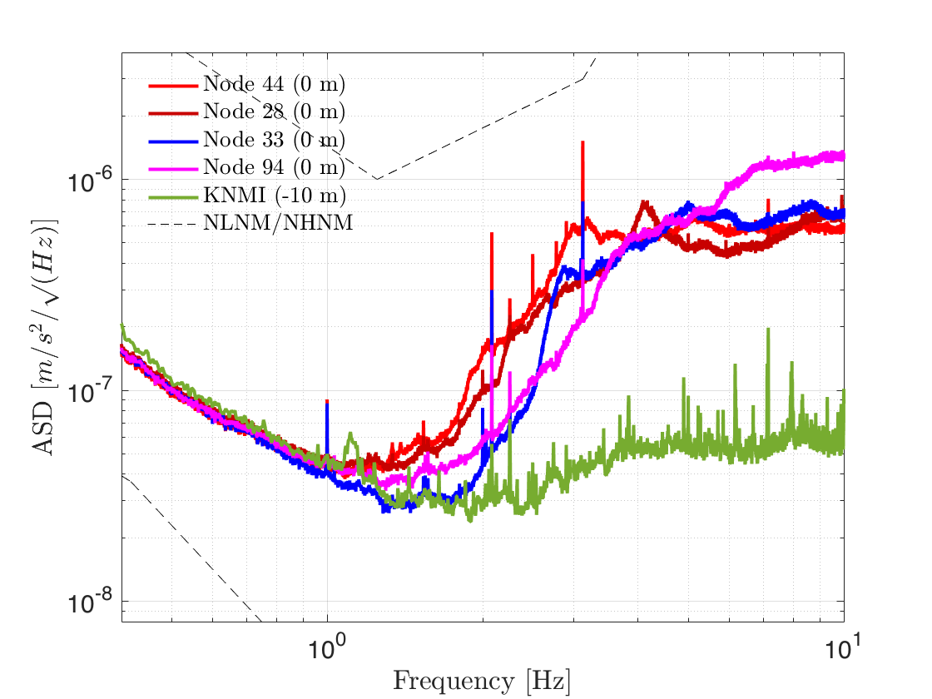
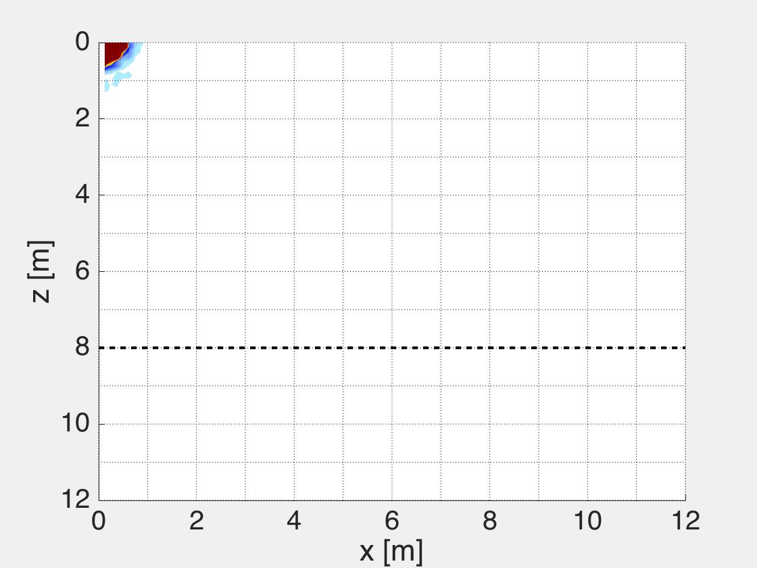
Rayleigh waves reflection
Only measurement so far …
Soft top layer on top of hard rock …
First step:
from on-top
just into the
hard-rock
@ surface
soft
hard
@ -10 m
specification
1
→ f [Hz]
10

Slide 44
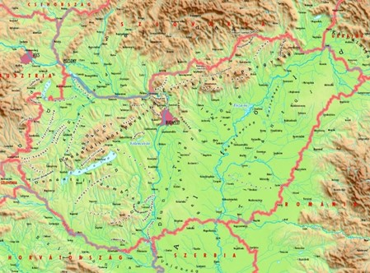
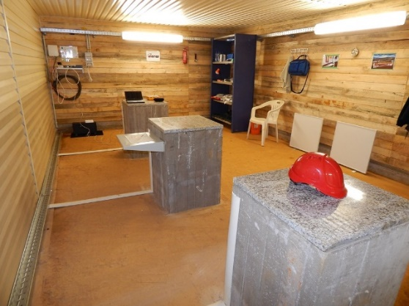
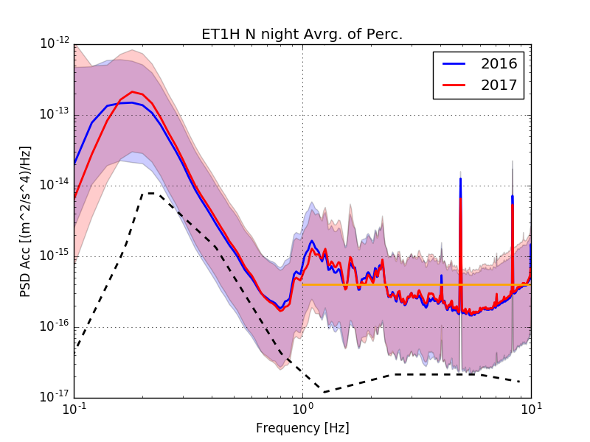
MATRA MOUNTAINS
Small underground lab (-88m) realized and used for seismic measurements
Two years of seismic data available

Slide 45
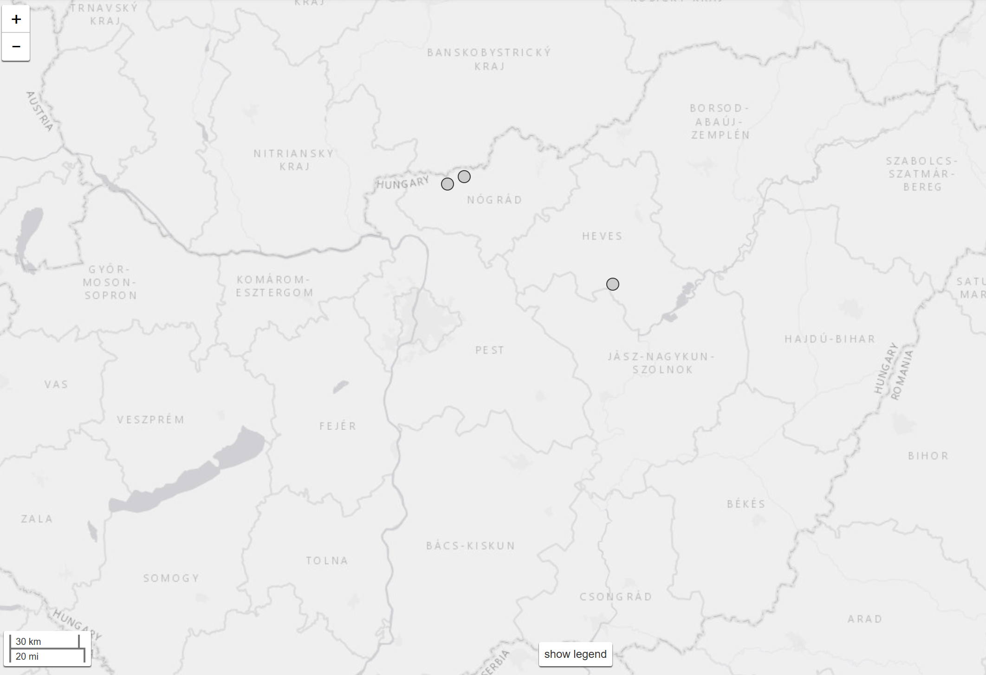
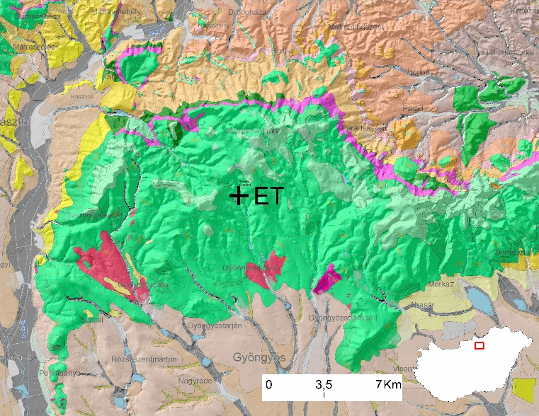
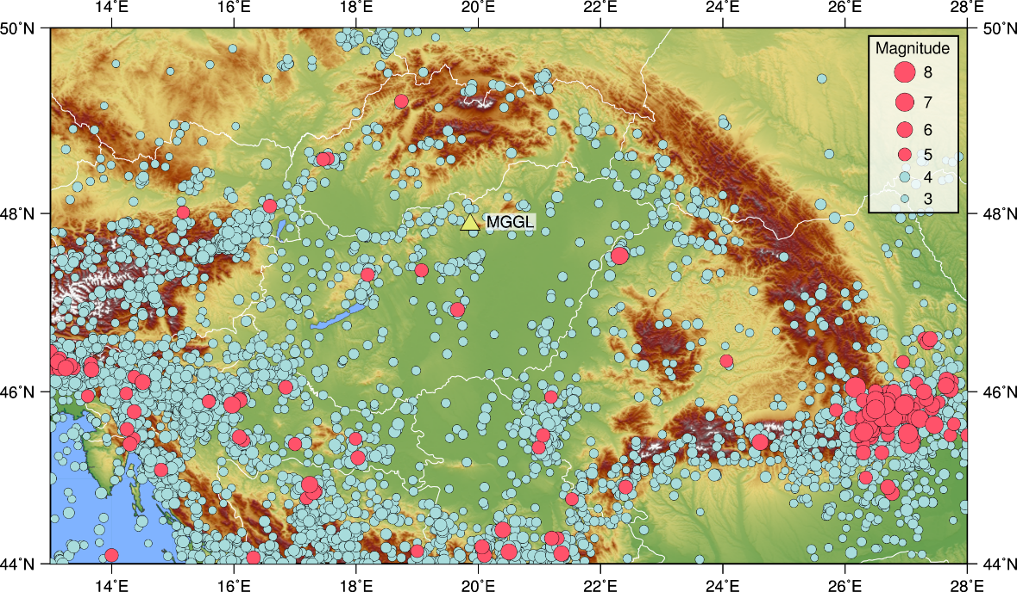
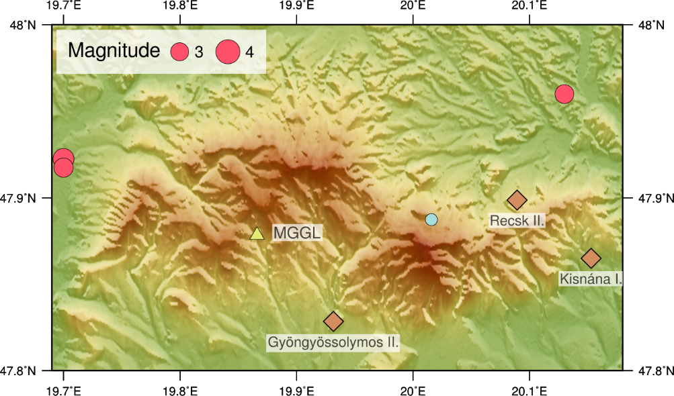
Natural and Anthropic seismicity
Various andesite types from same geological era, limestone basis
Local seismicity level
  3 earthquakes in the last 200 yrs
  M = 3.5 (1879), 3.2 (1895), 3.1 (1980)
Explosions nearby
  91 between 03.2016 – 12.2017

Slide 46
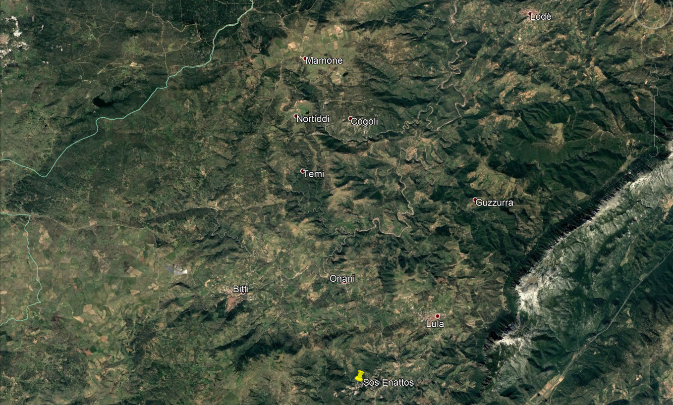
SOS ENATTOS

Slide 47
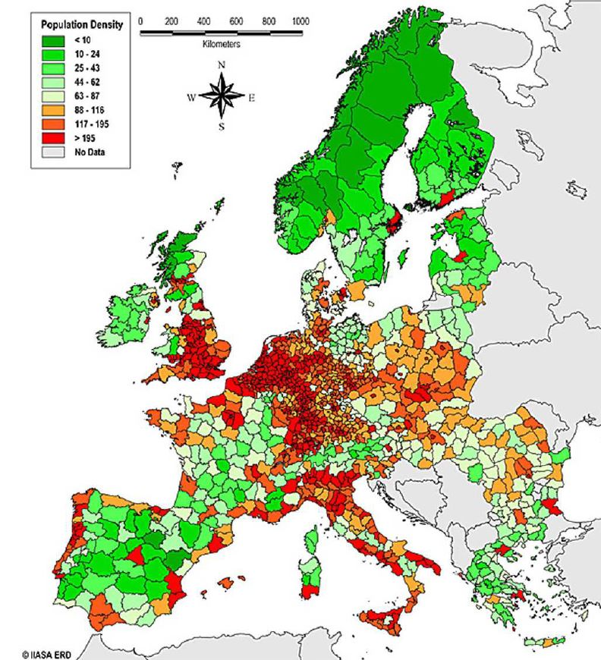
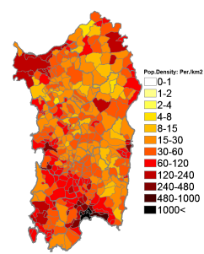
AREA ASSETS
One of the least populated areas in EU

Slide 48



AREA ASSETS
Ancient rocks, European continental landmass:
seismically quiet
Sardinia Crustal deformation
2 earthquakes M>1.5 in the last 10 years
https://earthquake.usgs.gov/
Notes:
Plots in alto a destra:
a) GPS velocities and 95 per cent confidence ellipses in a fixed Eurasian reference frame; blue arrows for GPS sites, yellow arrows for episodic sites and white arrows for solution coming from recent literature.
(b) Geodetic strain-rate parameters: the color in background shows the rate of areal change, while arrows represent the greatest extensional (red) and contractional (blue) horizontal strain rate (Palano et al. 2015)

Slide 49



LOCAL GEOLOGY
Lodè
Buddusò
Orthogneiss “Lodè type”
UCS: 92.6/60.8 MPa
Micaschist – Paragneiss - Quartzite
UCS: 9.9/8.8 MPa
Bitti
Lula
10 km
Granodiorite “Bitti type”
UCS: 72.1 MPa
*UCS: Uniaxial Compressive Strength

Slide 50

LOCATION - TRIANGLE

Slide 51

GEOLOGICAL SECTIONS

Slide 52





Italian Government Support
17 Meuros for AdV+, ET R&D and support of the Sos Enattos candidature

Slide 53
REGIONE SARDEGNA COMMITMENT
Regione Sardegna has promised to realized all the roads and the auxiliary surface infrastructure required by ET
Regione Sardegna is surveying the territory and preparing to propose sites for the disposal of the large amount of excavated rock (several millions of m³)

Slide 54
When

Slide 55
Target and Timeline
Target: to have ET operating in 2030 decade
Steps:
  2018 Form the ET collaboration
  2019 ESFRI roadmap
  2021-2022 Site Selection
  2023 Full Technical Design Report
    Cost definition
  2025 Infrastructure realization start (excavation, ….)
  2030 -2031 Commissioning start
  2032+: operation

Slide 56
Who

Slide 57
ET collaboration
The 19-20 April 2018 we had the 9th ET symposium
  Kick-off of the ET collaboration
  Appointment of an ET steering committee that is writing the ET statute
  Letter of intent to form the ET collaboration:
    http://www.et-gw.eu/index.php/letter-of-intent
    Currently signed online by 577 scientists (mainly in Europe)
    If you haven’t signed and you want to support the ET project, please, sign the letter of intent

Slide 58
ET Steering Committee
Defining the organisation of the ET collaboration:
  General Assembly → the collab representatives
  Executive Board → the technical body
  Oversight Committee → the funding agencies

Slide 59
The Executive Board

Slide 60
The Technical design Team

Slide 61

We Want You!
Michele Punturo

Slide 62
Spare Slides

Slide 63






A NEW MISSION FOR SARDINIA
50’ drive from Olbia airport to
the Sos Enattos mine
Sardinia Radio Telescope
“ARIA” PROJECT
(for the Gran Sasso Dark Side
DM detector)

