Slide 1
Pulsed magnets for ThomX
Patrick ALEXANDRE
Synchrotron SOLEIL

Slide 2
Outline
ThomX storage ring and beam injection/extraction requirements.
Pulsed magnets main characteristics for ThomX & injection/extraction scheme.
Designing a pulsed magnet system.
Pulsed systems work distribution for the ThomX project.
ThomX eddy septum magnet & pulser design and challenges.
ThomX fast kicker magnet & pulser design and challenges.
Current status of pulsed system design and manufacture.
Conclusion.

Slide 3
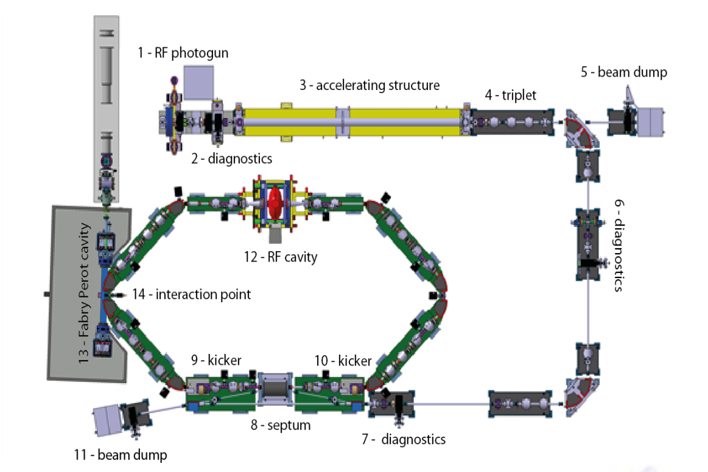
ThomX machine storage ring and beam injection/extraction requirements.
Electron beam energy: 50 MeV to 70 MeV.
Ring revolution period: 60 ns.
Proven injection method:
Eddy current septum magnet
Dipole kicker magnet
beam put on axis !
Deflection angles:
Septum: 160 mrad.
Kicker: 13 to 15 mrad.
Extraction of used beam is similar to injection. The septum is used for both injection & extraction.

Slide 4
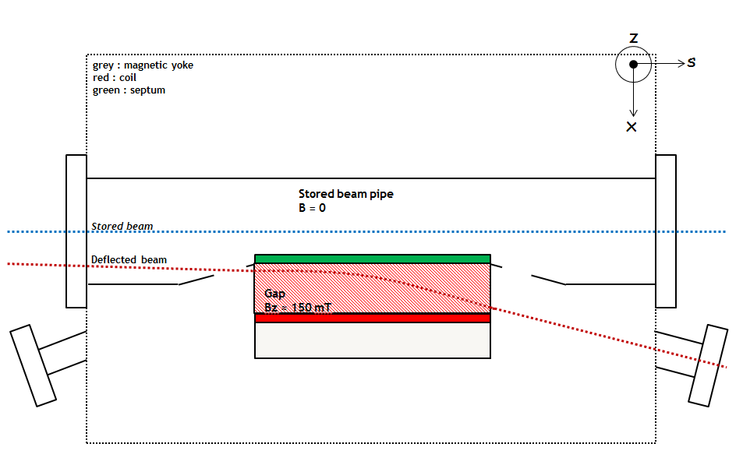
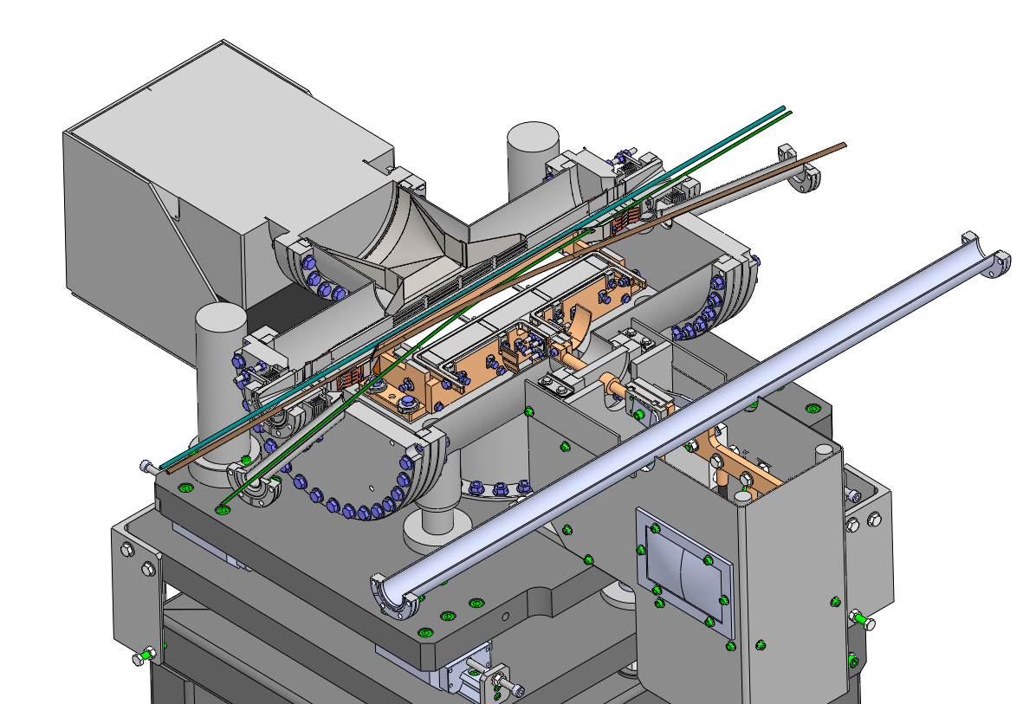
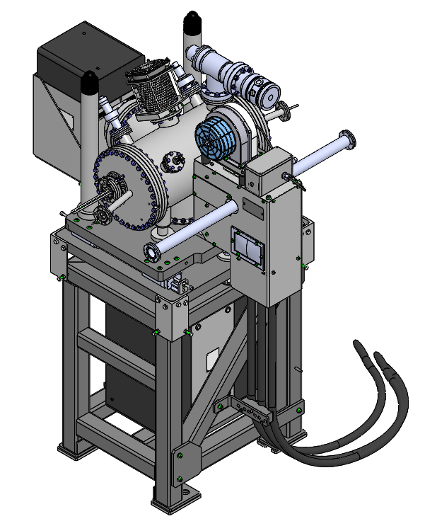
Pulsed magnets main characteristics for ThomX & injection/extraction scheme.
Eddy current septum magnet:
In-vacuum pulsed dipole magnet.
Used for both beam injection and extraction.
Flange to flange: 650 mm.
Mechanical magnetic separation between deflection region (gap) and stored beam region with septum blade and eddy current shielding.
Field integral: 37.3 mTm, 1% homogeneity.
Peak field: 150 mT with 250 mm magnetic length.
Magnet gap: 40 mm (H) x 12 mm (V).
Current pulse: full-sine wave.
150 µs width.
1800 peak Amps.
Repeated at 50 Hz.
Field leakage on stored beam : < 10 ppm of main field.

Slide 5
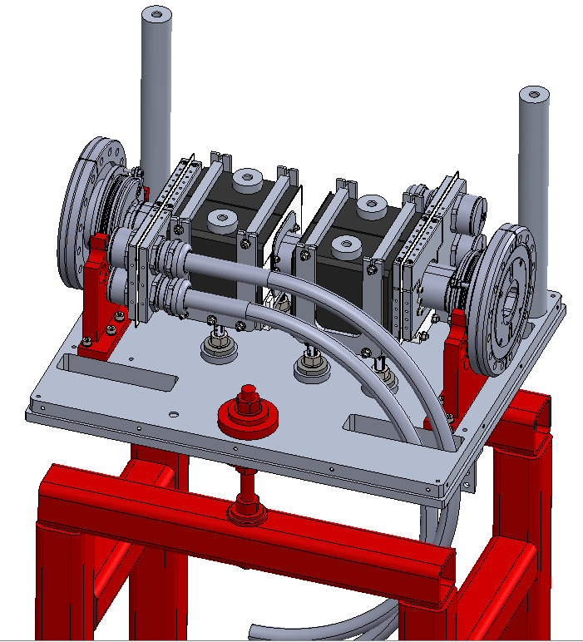
Pulsed magnets main characteristics for ThomX & injection/extraction scheme.
Fast dipole kicker magnets:
Window frame kicker with a single turn coil.
Mounted around a ceramic vacuum chamber.
Thin coating in ceramic chamber allows image current flow with minimal pulsed magnetic field distortion.
Current in coil = field in chamber !
Given the injection scheme, the injected bunch comes back in the injection kicker after one ring revolution so Tfall < 60 ns.
Similarly, for extraction Trise < 60 ns.
Pulse shape for kickers : half sine
Trise & Tfall < 60 ns.
Repeated up to 50 Hz.
Peak current : 740 amps for 70 MeV deflection.

Slide 6
Designing pulsed systems.
DESIGNING IT
Accelerator physics : injected beam position, integrated field, defect field at center, GFR, chamber apertures…
Magnet design : simulation (DC & Transient : Opera & Matlab), effect of Ti coating on fields, inductance…
Thermal study : image current & current in coils, mechanical stress in magnet/vacuum chamber…
Vacuum chamber design : aperture (H&V), Synchrotron Radiation (SR) ray tracing, static and dynamic pressure simulations, outgassing of materials…
Pulser design : high voltage (HV) pulsed electronics, choice of components, stability & reproducibility of the current pulse, HVPS, coaxial cable, EMC …
Mechanical design : magnet, pulser & HV insulator design, issues with alignment and metrology, vibration study, handling and installation …
Materials choice : issues with radiation, high voltage, ultra-high vacuum, availability, mechanical strength & expansion, etc…
Alignment and metrology : measure the magnet to accurately place on the accelerator.
Control system design : triggering, fault monitoring, interlock & safety…
Installation and commissioning : when and how install it, baking, testing...
Operation : ease of use / maintain, reliability..
Budget : money doesn’t grow on trees.
BUILDING IT
Subcontract parts manufacturing : which parts? control quality?
In-house manufacture : who can do what ? availability, work planning…
Prototyping : how much ? how far do you go ? how many tests ? what parts need prototyping ?
Manufacture management : series/parallel work, test subsystems…
Final testing : magnetic measurements, electrical tests, long duration tests, debugging…
Communicate : reports on technical design & simulations, procedures for installation-troubleshooting-operation, feedback for/from other groups, forms, various paperwork…
ITERATIVE WORK !
Find a solution that meets some physics specifications -> check all the other aspects…
Check tolerance to manufacturing errors for components, ruggedness of design…
New matters will rise ! You don’t always foresee all the problems…
Until your solution works and meets all the implicit and explicit specifications…
It can take a lot of people !

Slide 7
Pulsed system work distribution.
Preliminary design & feasibility done by SOLEIL: calculate main characteristics of magnets & pulsers, compare different solutions for kickers (in/out vacuum, stripline).
SOLEIL wrote specifications and preliminary design for :
Eddy current septum magnet: magnetic, electric & ultrahigh vacuum performances, materials, mechanical & alignment specifications.
Eddy current septum magnet pulser: required peak current & semi-conductor selection, high voltage charging power supply, reproducibility, EMC, triggering & control system, coaxial transmission etc…
Fast kicker magnet: magnetic & electric performances, vacuum chamber specifications, titanium coating thickness, mechanical & alignment specifications.
Fast kicker magnet pulser: required peak current & semi-conductor selection, high voltage charging power supply, reproducibility, EMC, triggering & control system, coaxial transmission etc…

Slide 8
Pulsed system work distribution.
SigmaPhi (Vannes, France) was subcontracted the following tasks:
Eddy current septum magnet: complete design and manufacture following SOLEIL specifications.
Eddy current septum magnet pulser: complete design and manufacture following SOLEIL specifications.
Fast kicker magnet: complete design and manufacture following SOLEIL specifications.
SOLEIL pulsed magnet team would keep:
Fast kicker magnet pulser: this very challenging aspect remained to be done by SOLEIL.
SOLEIL would also provide LAL the specifications for the control system (PLC & triggering).

Slide 9
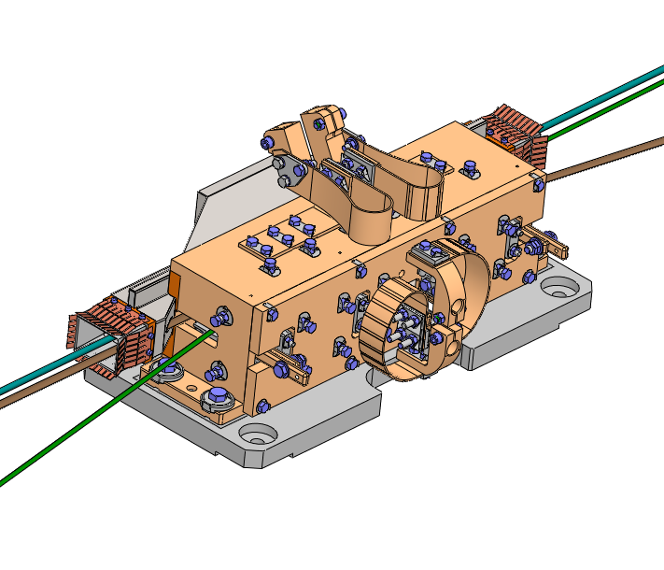
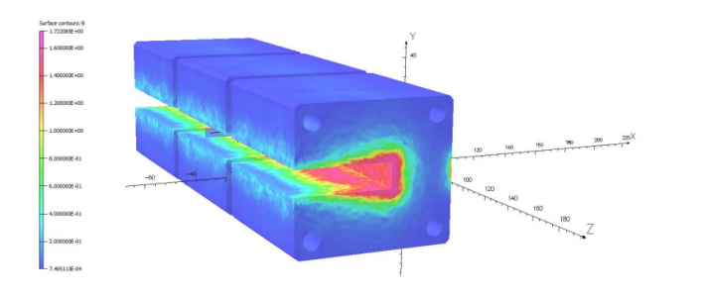
Eddy current septum magnet & pulser challenges
Vacuum design: smaller magnet than usual with reduced conductances so work was done to achieve good vacuum performance.
Pulsed magnetic design: achieve required deflections with minimal perturbation on stored beam. Main issue was Bz homogeneity in gap and leakage field near stored beam pipe apertures.
Mechanical design: ensure the magnet correctly fits in the 3D model of the hole machine, with all the fixtures on the vacuum vessel. Work on the mechanical tolerances to get quality magnet & septum that can be aligned.
Thermal design: given repetition rate (50Hz) & beam current induced heating, thermal dissipation had to be checked, especially in the yoke.
Material choice and part design: some parts were redesigned and/or had the material changed to accommodate for easiness of manufacture and improved reliability.

Slide 10
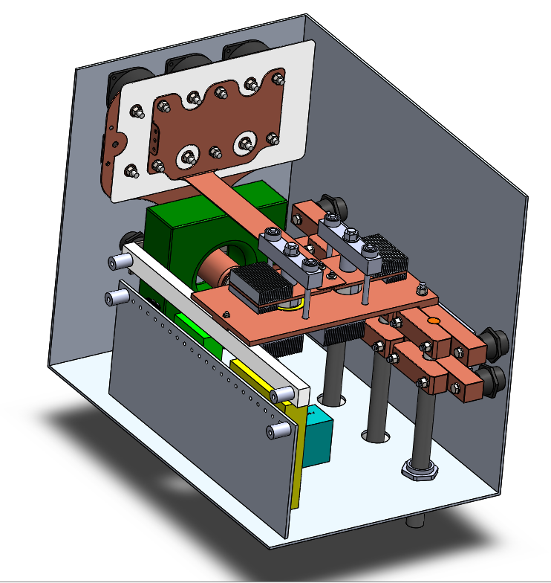
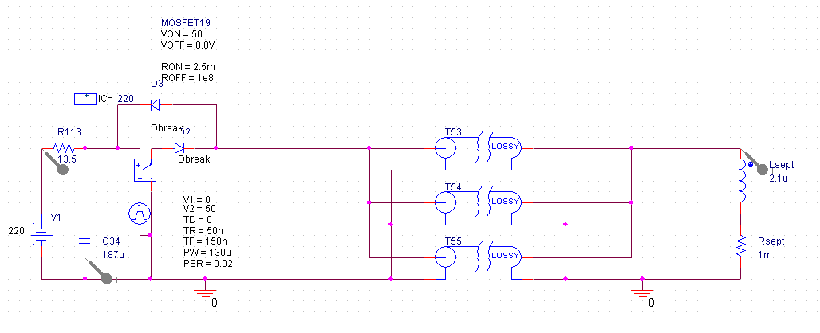
Eddy current septum magnet & pulser challenges
Pulser electric design: extensive simulations carried out to achieve required pulsed current shape in magnet with minimal power dissipation of the thyristor and diode.
HV capacitor charging mode: because of 50 Hz repetition rate, charging of capacitors is done by HV DC power supply with MOSFET decoupling in discharge mode.
Mechanical design: pulser rack and cabinet design, with focus on ease of installation, maintenance & safety.
Interlock & safety design: the pulser can be shut down by machine or PSS interlock. The design of the pulser rack is made to ensure maximal electrical safety in operation and maintenance
High voltage cable & control system wiring: high voltage coaxial cables link the magnet and pulser, which have integration constraints with limited bending radius. Control system & triggering wiring is standardized.

Slide 11
Fast kicker magnet & pulser challenges
Pulser electric design: preliminary studies (2012) were done at SOLEIL and first prototyping did not prove satisfactory, using traditional kicker methods (where the steady state approximation is considered). Pulses we could generate were about 250 ns wide.
Remember: the magnetic field has to rise from zero to peak in less than 60 ns and fall from peak to zero in less than 60 ns as well (so pulse width < 120 ns).
It was in late 2013 that we engineered a solution not using the steady state approximation that would enable to have high peak current fast pulses on the magnet. Simulations gave good results.
Specifications for these magnets were released to SigmaPhi early 2014.
Meanwhile, prototyping continued at SOLEIL to finalize pulser and magnet characteristics.

Slide 12
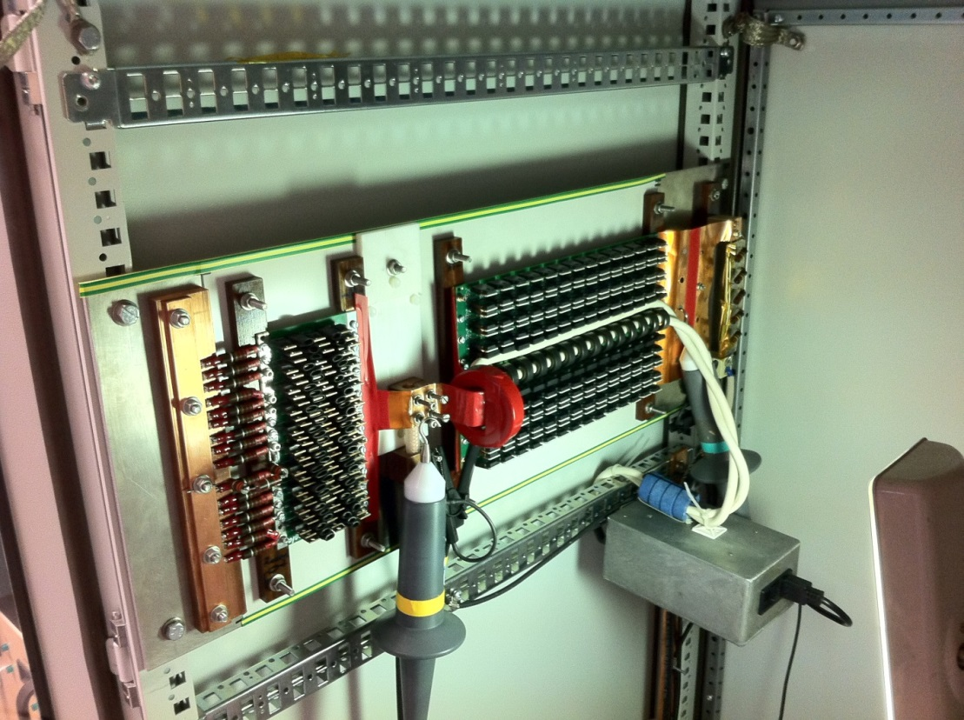
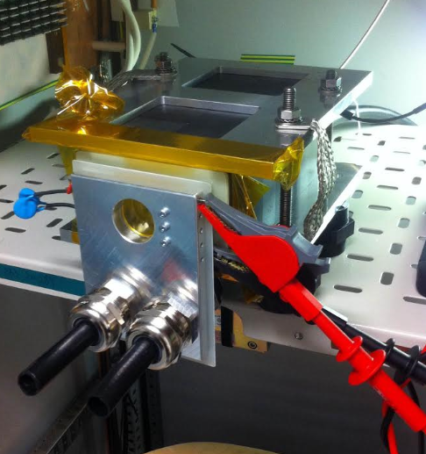
Fast kicker magnet & pulser challenges
Pulser electric design: the most important component is the high voltage semi-conductor switch (IGBT). A prototype board was lent by Soprano by Comeca for our tests.
An electric load that reproduced magnet behavior was also produced at SOLEIL

Slide 13
Fast kicker magnet & pulser challenges
Pulser electric design: by mid 2016, we had been pushed the concept of these new kickers as far as possible. Fall time of the pulse was ~80 ns.
Furthermore, the magnetic simulations done by SigmaPhi on the kicker magnets gave an inductance very close to the upper limit of the specifications, without taking into account connection inductances, critical for such short pulses.
So at SOLEIL, we worked on splitting the magnet into two smaller ones that would enable the pulse current to rise and fall faster than with one longer magnet, given the physics properties of our design.
We also worked on minimizing connection inductances. We reworked the 3D model of the magnet and then passed it on to SigmaPhi so they could finish their part of the job.
We also rebuilt our prototype and tested it.

Slide 14
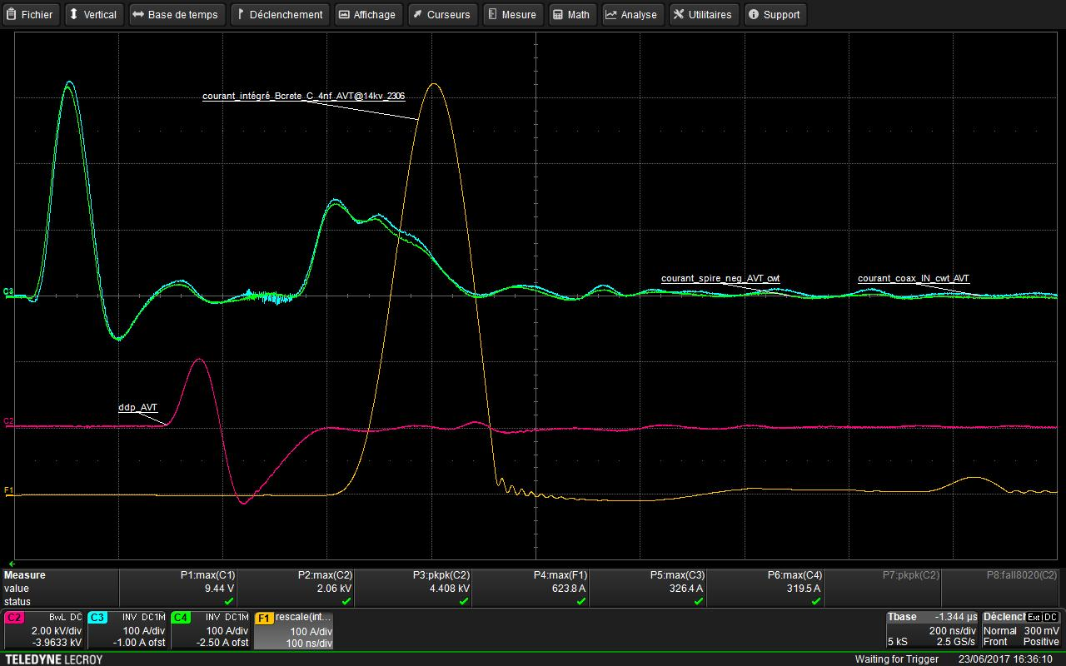
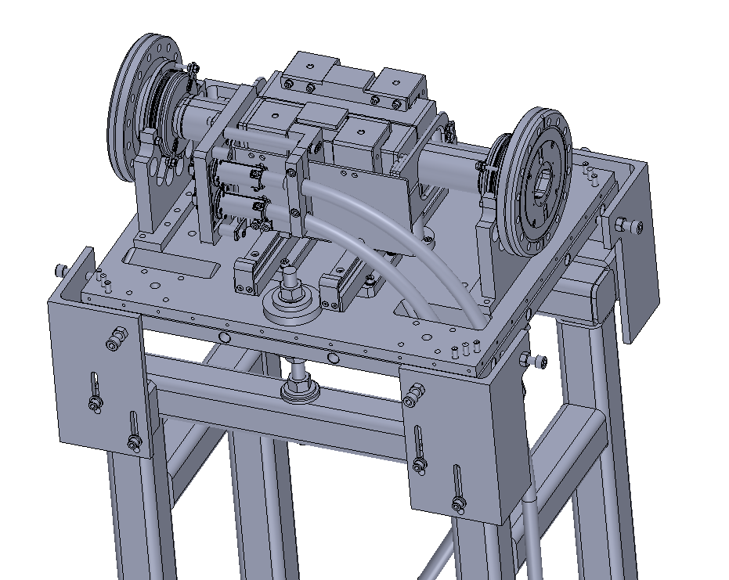
Fast kicker magnet & pulser challenges

Slide 15
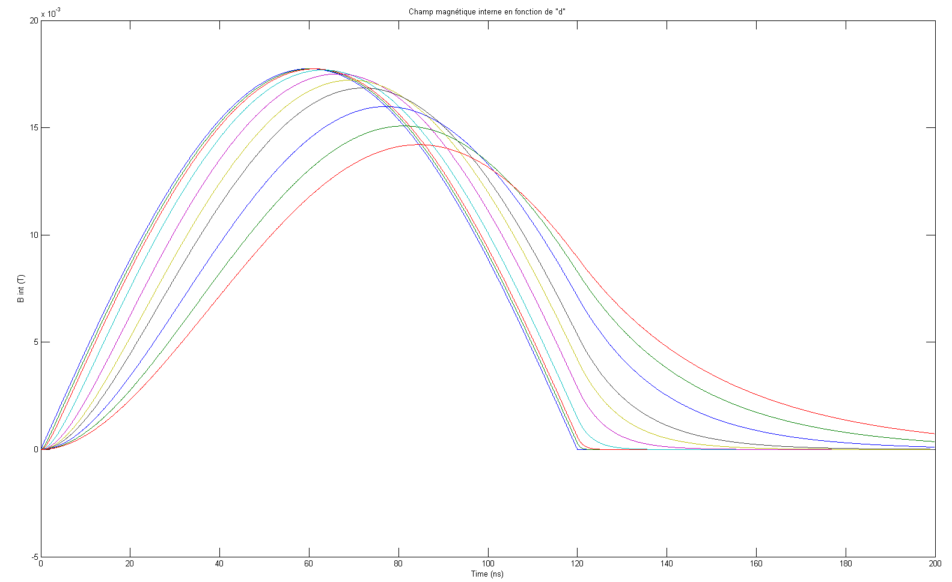
Fast kicker vacuum chamber challenges
Vacuum chamber: ceramic tube with flanges, aperture 40 mm H x 28 mm V.
Needs an internal coating to provide an easy path for image current.
If the coating is too thick, it screens the pulsed magnetic field.
Usually pure titanium is used (and applied by sputtering).
For ThomX, to ensure image current path (with acceptable heating) and acceptable magnetic field attenuation and dephasing, a coating of 50 nm of titanium is a good compromise.
But titanium oxides instantaneously in air. So the effective layer of conduction (TiO₂ is an insulator) would be 10 nm or less… which could possibly make the chamber unusable.
After searching for a replacement, we chose titanium nitride (TiN) for its equivalent conductivity, stability in air, compatibility in vacuum and compatibility for sputtering. Targeted thickness is the same.

Slide 16
Current status of pulsed system design and manufacture
All main design challenges and technical difficulties have been overcome, either on the septum or kicker systems.
The eddy current septum magnet is being manufactured (vacuum vessel, in vacuum parts and mechanical supports).
The septum pulser is being worked on by SigmaPhi after updated and refreshed specifications sent by SOLEIL.
The mechanics of the kicker magnets are being finalized, the ferrite yokes are being manufactured (long delay for procurement).
The pulsers for the kickers are being built at SOLEIL. SOLEIL will restart work on control system, which does not present any difficulty.
We expect installation and commissioning in January – February 2019, although delays in manufacture might occur on which we have to be very careful.

Slide 17
Conclusion
We have come a very long way from initial specifications (2012) to final designs (2018). Many problems were solved throughout the years. Downscaling of SOLEIL previous designs was not straightforward.
Numerous improvements on the septum magnet design.
Kicker system is a new design apparently not used before. Looking forward to see it work on the machine !
Still some work to make sure SigmaPhi delivers on time and the septum system and kicker magnets are within specifications.
Control system to be worked on.
Installation on ThomX ring.
Commissioning !
Thank you for your attention.

