Slide 1




Ring Beam Dynamics
Alexis Gamelin

Slide 2
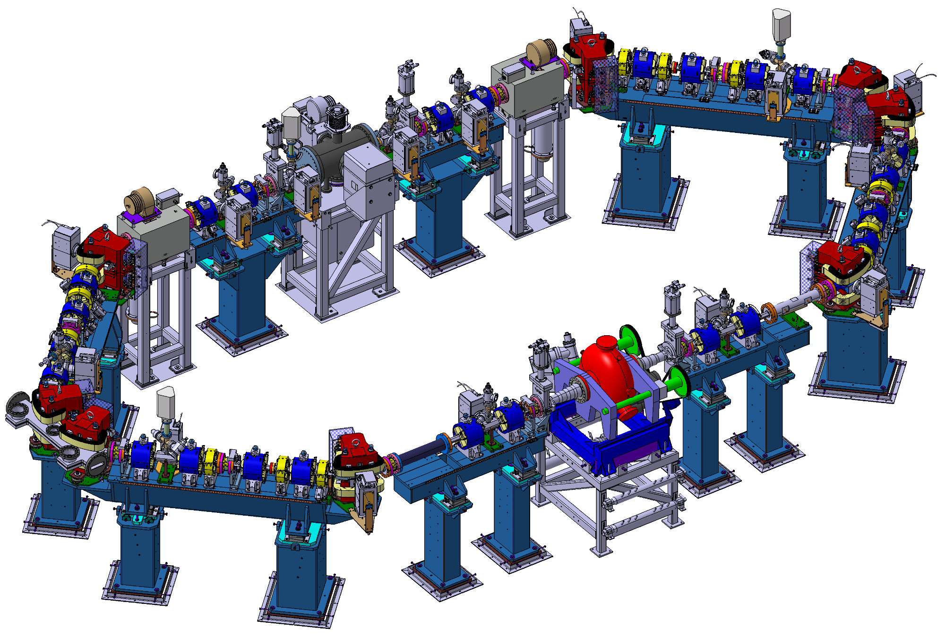
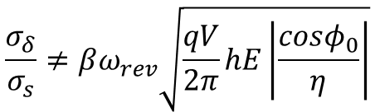

ThomX storage ring
Fast kickers
A single bunch of 1nC is injected into the ring every 20 ms
At 50 MeV, the beam is very sensible to collective effects
The storage time is short compared to the damping times:
The bunches are injected from the TL without longitudinal matching
Septum
$$τ_{x,y}=1 s$$
$$τ_{s}=0,5 s$$
Interaction point (IP)
No damping !
Transverse feedback
500 MHz RF Cavity
$$\frac{σ_{δ}}{σ_{s}}≠βω_{rev}\sqrt{\frac{qV}{2π}hE\left|\frac{cosφ_{0}}{η}\right|}$$
Alexis Gamelin

Slide 3
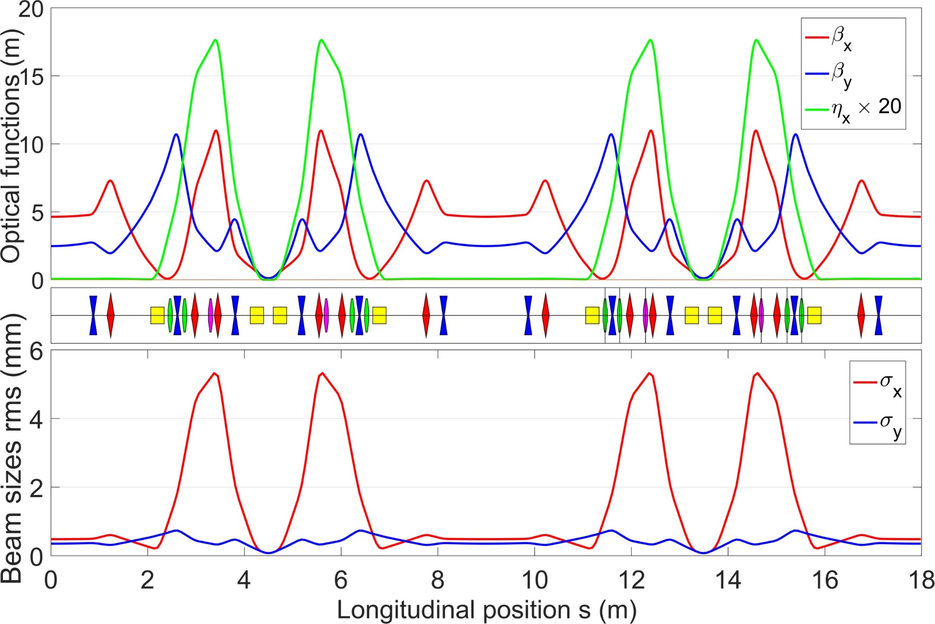
Nominal optics
Four-fold symmetry
Based on the DBA lattice
Transformation of two of the achromat lines to minimize the beam size at IP
Lattice designed to be versatile
Possibility to change momentum compaction
Alexis Gamelin

Slide 4
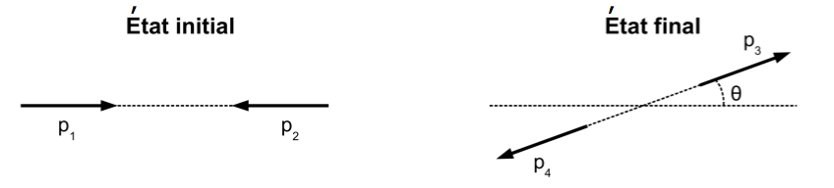


Collective effects
Impedance/Wakefield (Geometric and RW)
Intra Beam Scattering (IBS) / Touschek
Compton backscattering
Space charge
E
hν
F_{E}
e⁻
photon
F_{M}
hν’
E-ΔE
Coherent Synchrotron Radiation (CSR)
Ion Cloud
H⁺/H₂⁺/…
F_{E}
Alexis Gamelin

Slide 5
Collective effects
Impedance/Wakefield (Geometric and RW)
Intra Beam Scattering (IBS) / Touschek
Limit the beam lifetime
Compton backscattering
Space charge
Degrade the emttiance
and/or the e-spread
E
hν
F_{E}
e⁻
photon
F_{M}
Can lead to beam loss or instabilities
hν’
E-ΔE
Coherent Synchrotron Radiation (CSR)
Ion Cloud
H⁺/H₂⁺/…
F_{E}
Alexis Gamelin

Slide 6
Collective effects
Impedance/Wakefield (Geometric and RW)
Intra Beam Scattering (IBS) / Touschek
Compton backscattering
Space charge
Questions from previous MAC
E
hν
F_{E}
e⁻
photon
F_{M}
hν’
E-ΔE
Coherent Synchrotron Radiation (CSR)
Ion Cloud
H⁺/H₂⁺/…
F_{E}
Alexis Gamelin

Slide 7
Geometric/RW wakefields
Alexis Gamelin

Slide 8
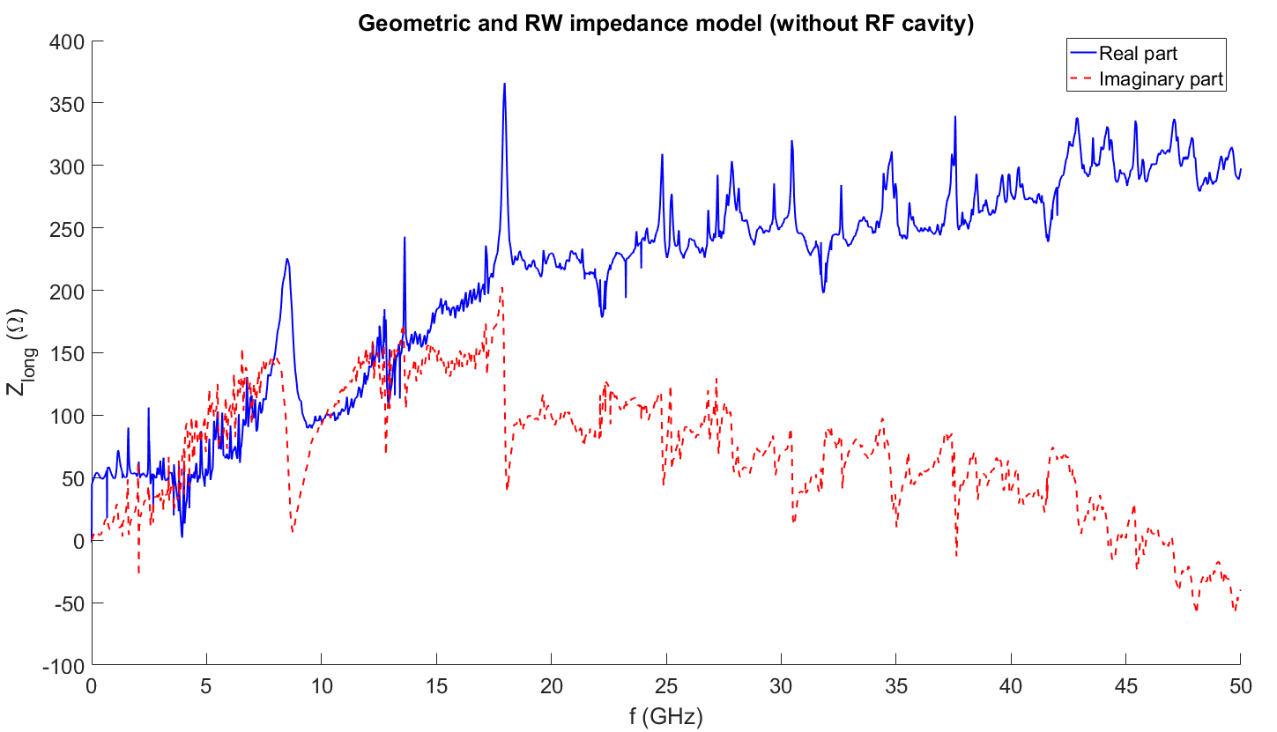
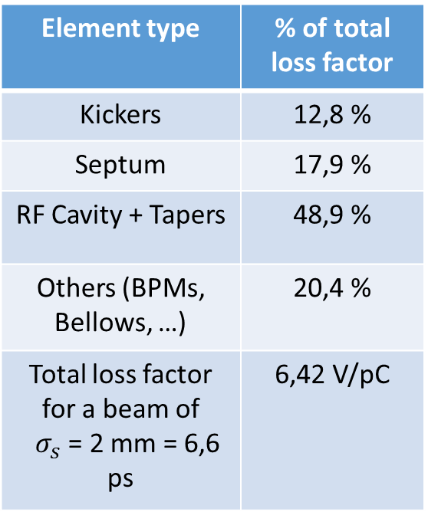
Impedance (Geometric and RW) model
ThomX longitudinal impedance model has been evaluated using simulations (CST PS), analytic models (IW2D) and checked against measurement using the coaxial wire method. Transverse impedance simulation are on the way.
Element type | % of total loss factor
Kickers | 12,8 %
Septum | 17,9 %
RF Cavity + Tapers | 48,9 %
Others (BPMs, Bellows, …) | 20,4 %
Total loss factor for a beam of $σ_{s}$ = 2 mm = 6,6 ps | 6,42 V/pC
Alexis Gamelin

Slide 9
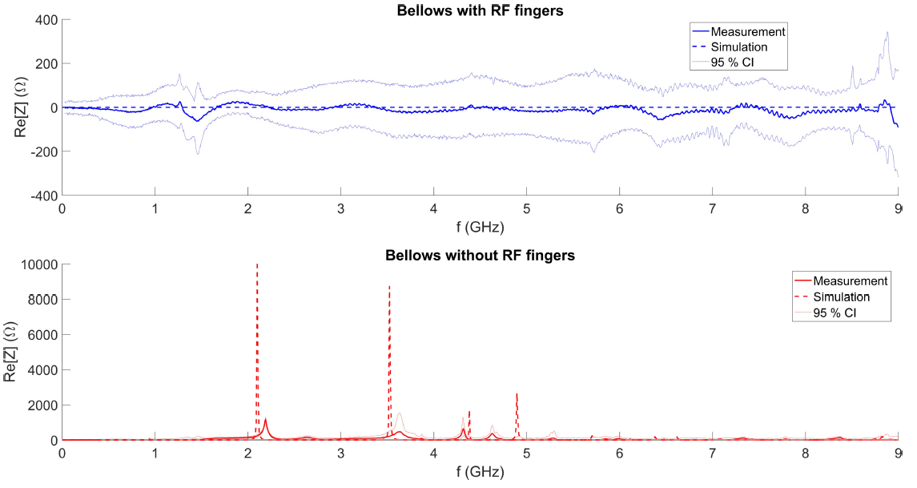
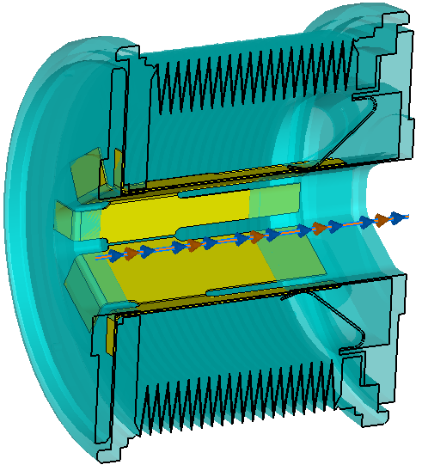
Impedance measurement using coaxial wire method
RF Fingers
Alexis Gamelin

Slide 10
Coherent Synchrotron Radiation (CSR)
Alexis Gamelin

Slide 11
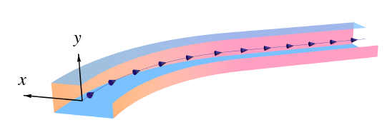
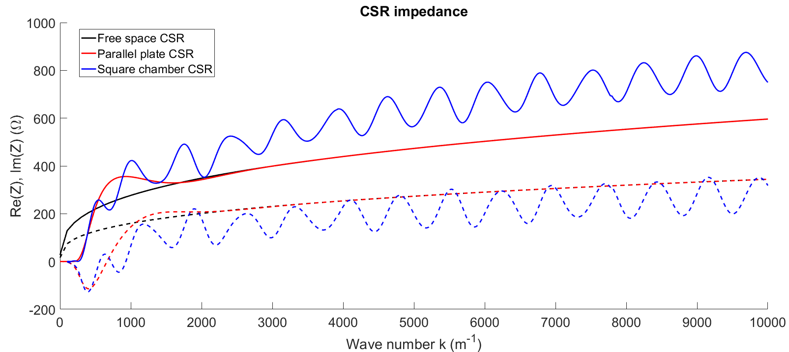

Coherent Synchrotron Radiation
The CSR impedance was simulated using a rectangular chamber model (CSRZ, D. Zhou)
Resonances inside dipoles
Transient effects in between dipoles
$$k= \frac{ω}{c}$$
Alexis Gamelin

Slide 12
Beam dynamics and 6D tracking
Alexis Gamelin

Slide 13
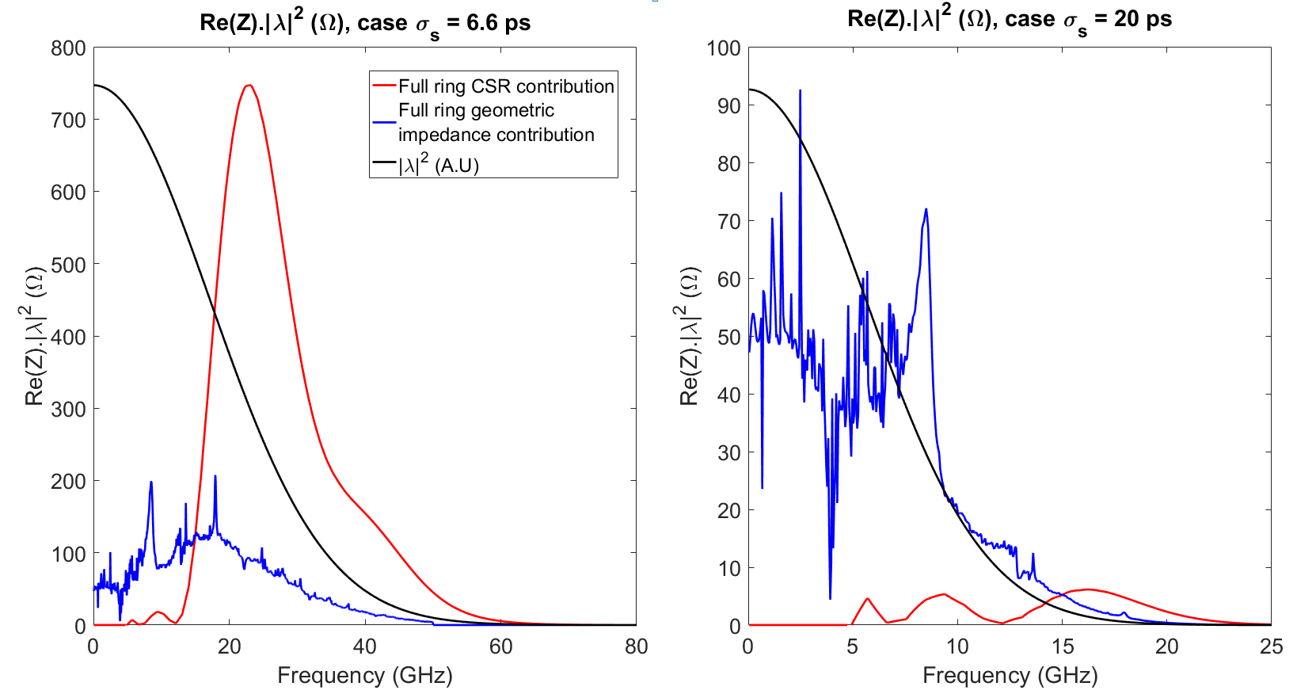
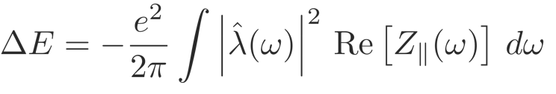
Why should we care: impact on beam dynamics
Total energy loss per bunch
Alexis Gamelin

Slide 14
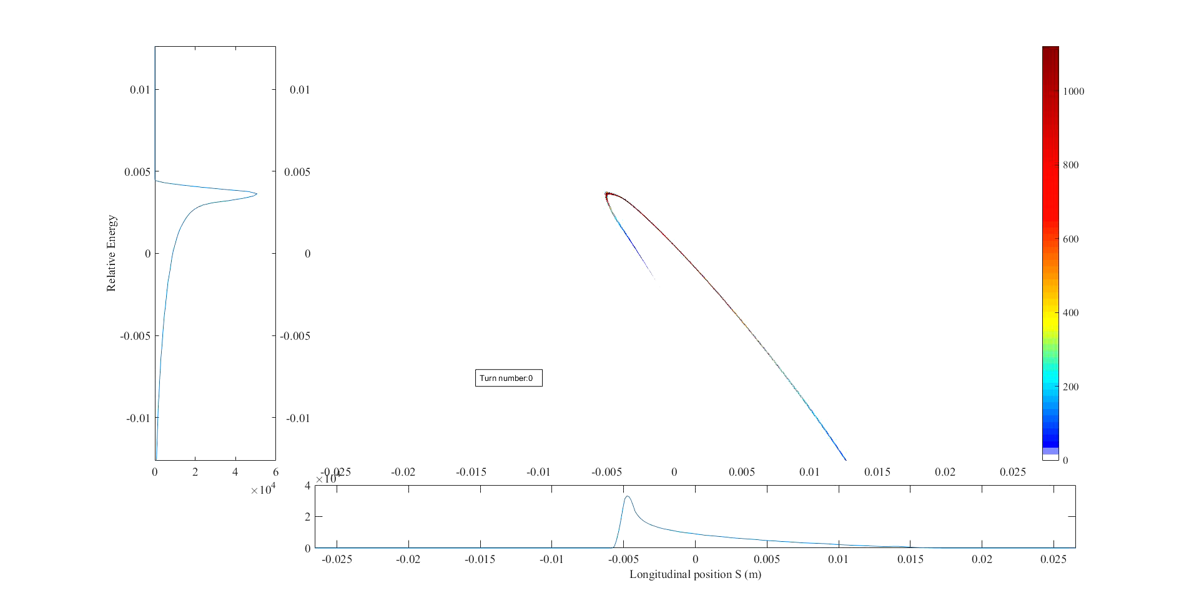

Start to end simulations: First turns at 100 pC
$$δE/E$$
6D non linear tracking element by element along the lattice
Injected bunch from Linac + TL simulations with collective effects
Longitudinal postion S (m)
Alexis Gamelin

Slide 15
Start to end simulations: First turns at 100 pC
$$δE/E$$
6D non linear tracking element by element along the lattice
Injected bunch from Linac + TL simulations with collective effects
Longitudinal postion S (m)
Alexis Gamelin

Slide 16
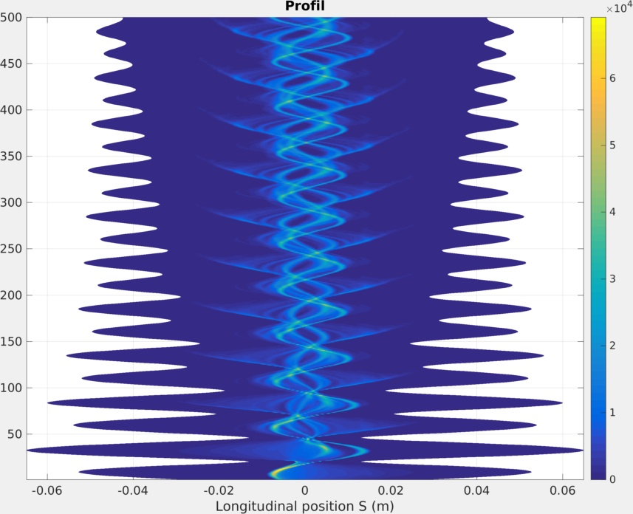
First turns at 100 pC
What we should see using the streak camera:
tail
head
Alexis Gamelin

Slide 17
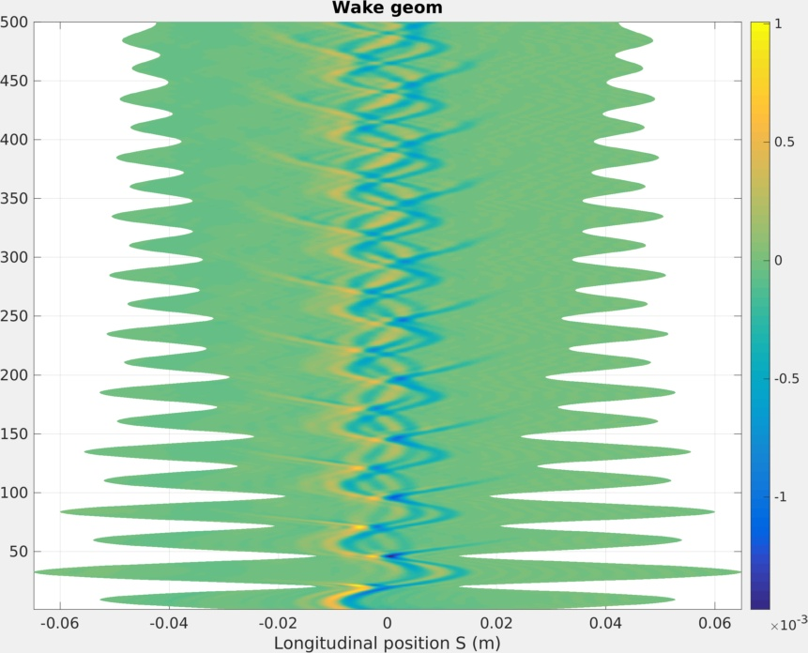
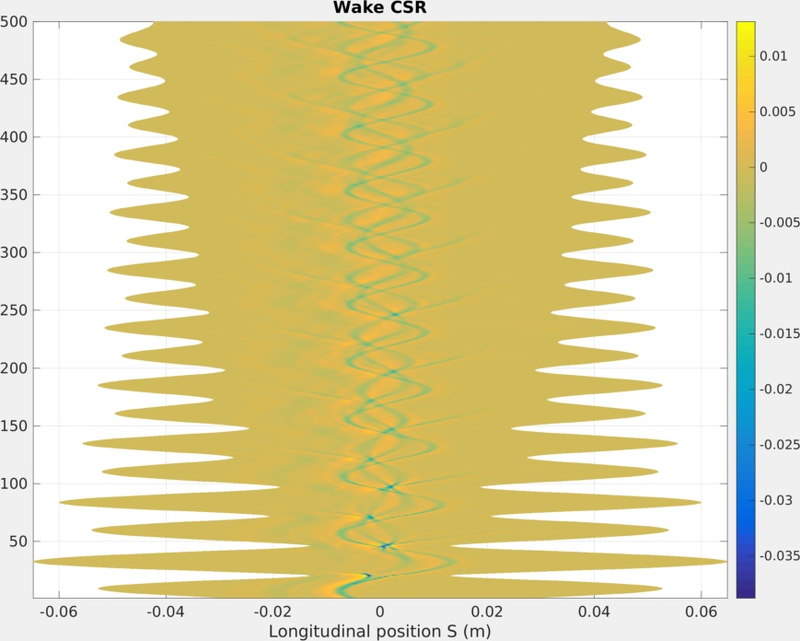

First turns at 100 pC
${×10}^{−3}$ (MV)
(MV)
tail
head
tail
head
Alexis Gamelin

Slide 18
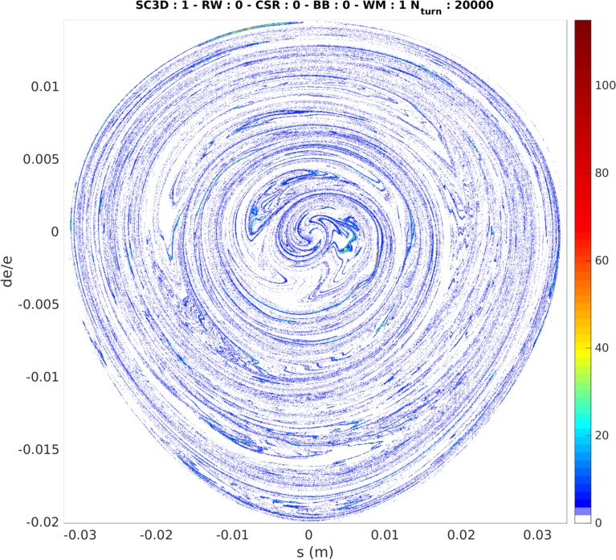
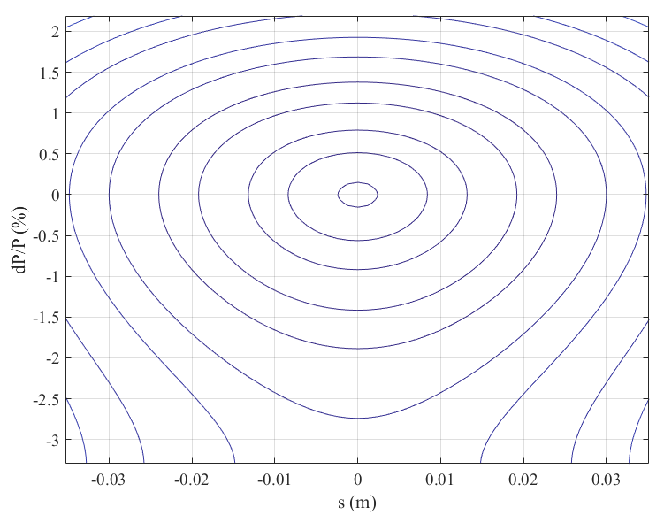
After 20 000 turns at 100 pC
Alexis Gamelin

Slide 19
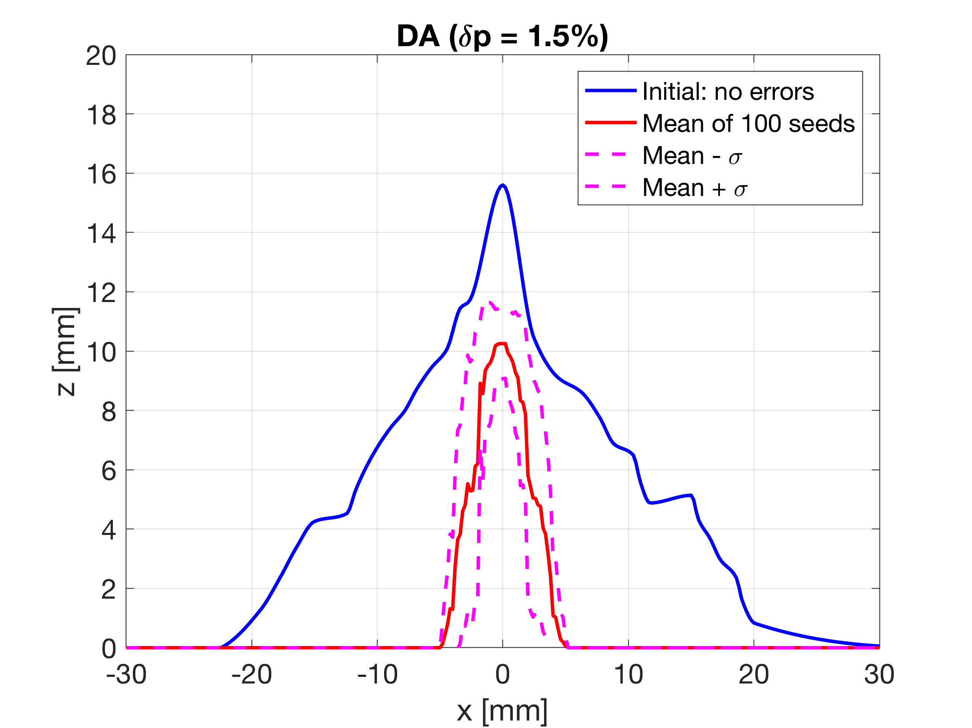
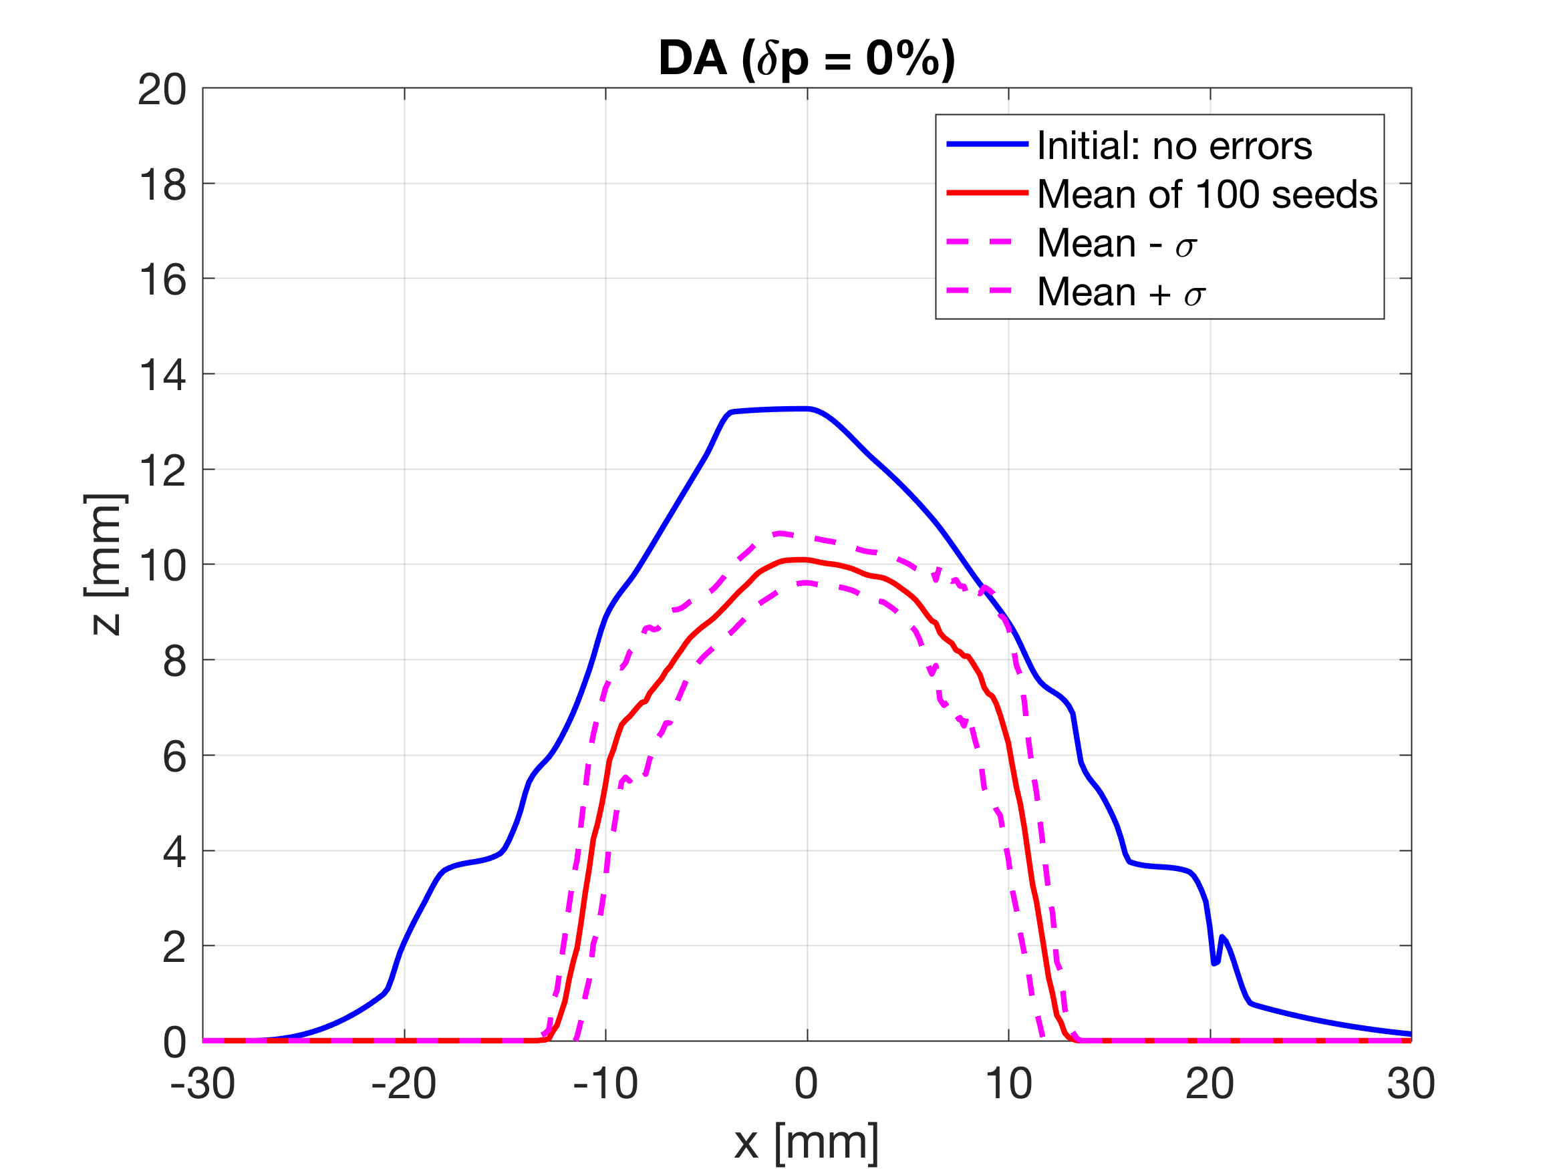
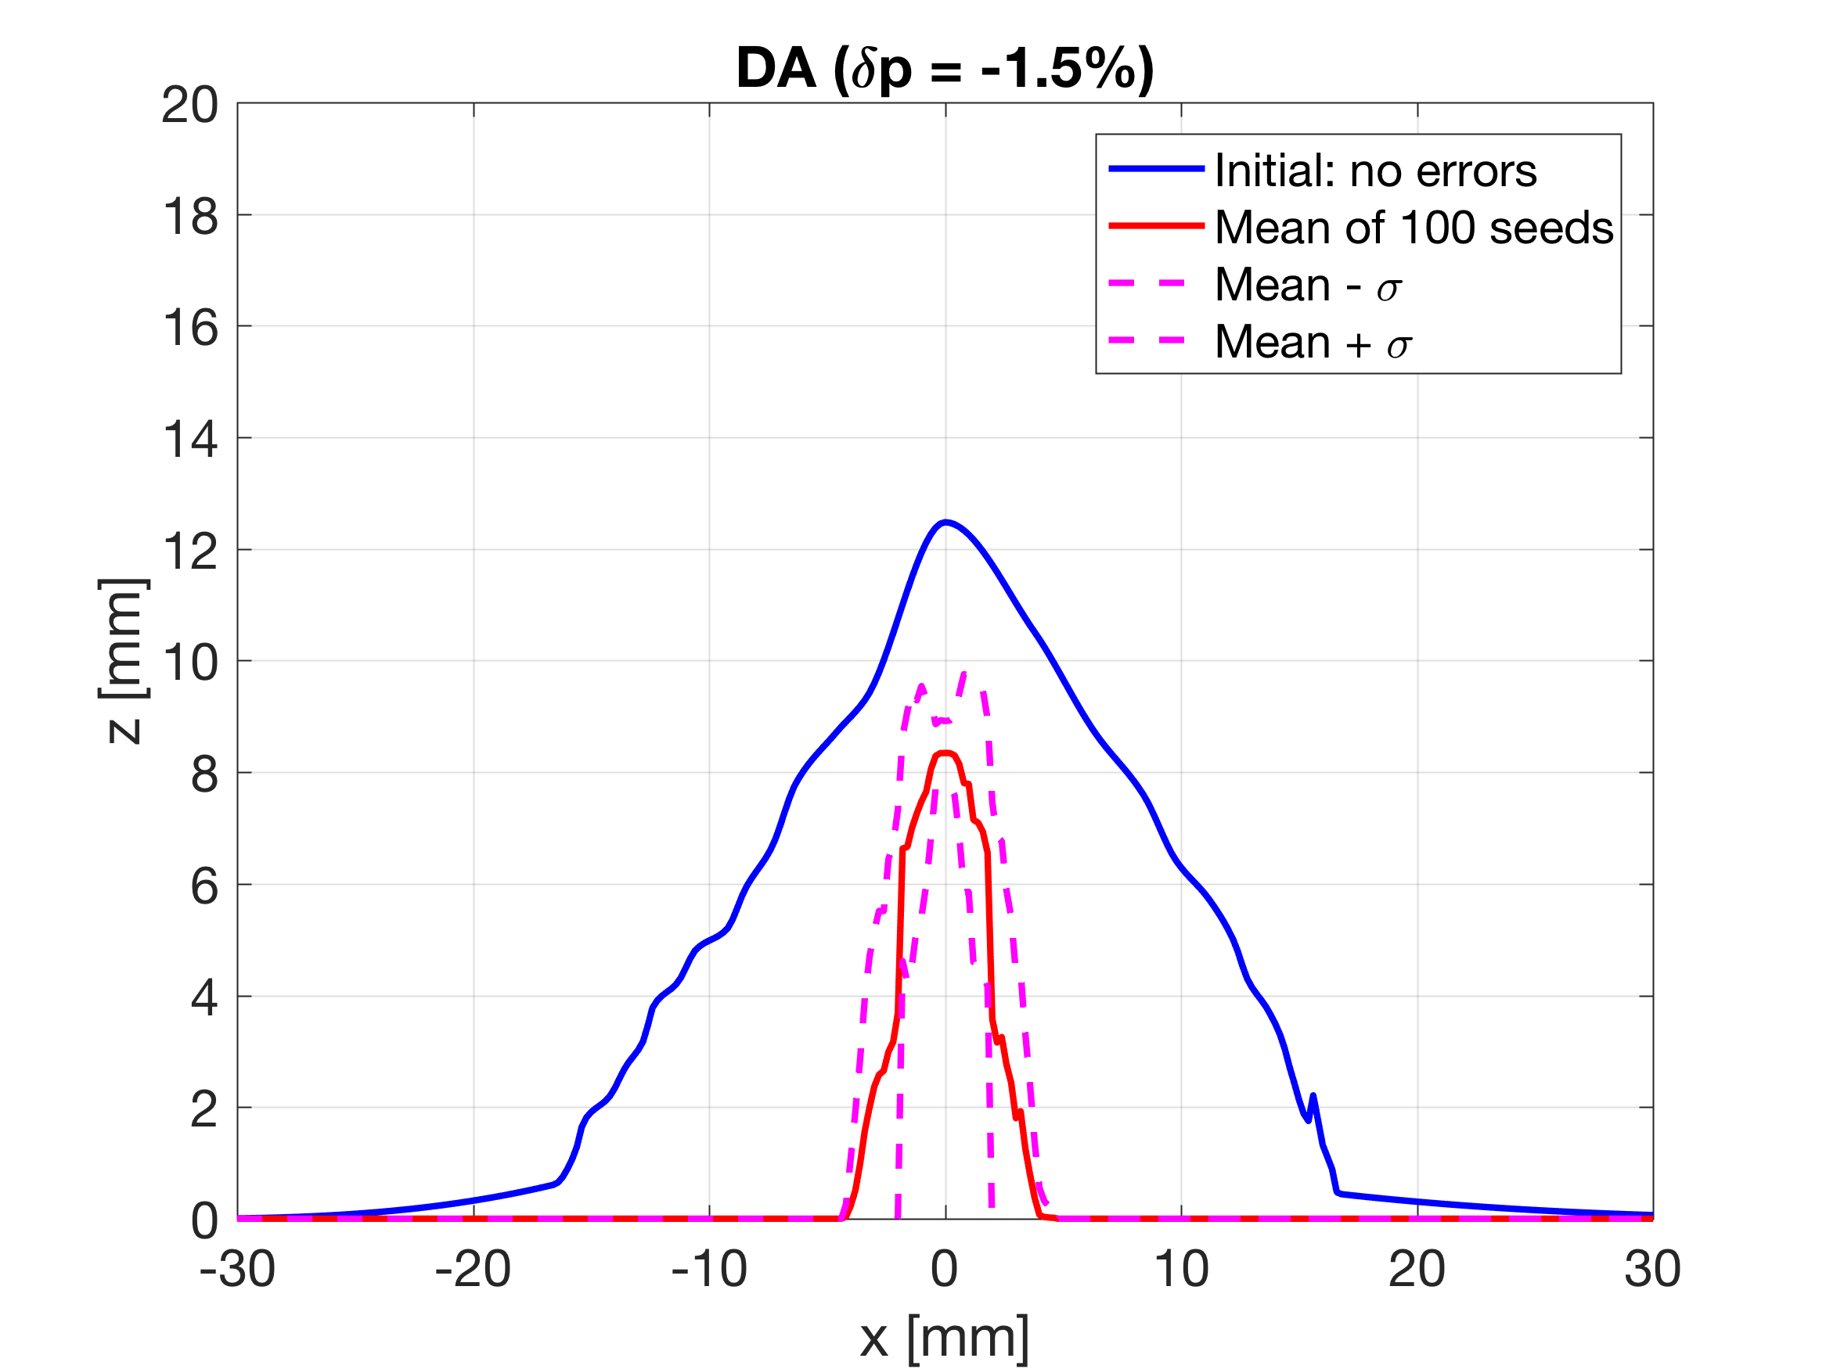
DA impact of all error sources
Alignement errors: 30μm - 200μrad rms
Gradient errors: 1e-3 rms
Dynamic apertures reduction including :
- Systematic Multipole fields
- Misalignement errors + orbit correction
- Gradient errors
Dynamic apertures are still at the level of the vacuum pipe limit
Alexis Gamelin

Slide 20
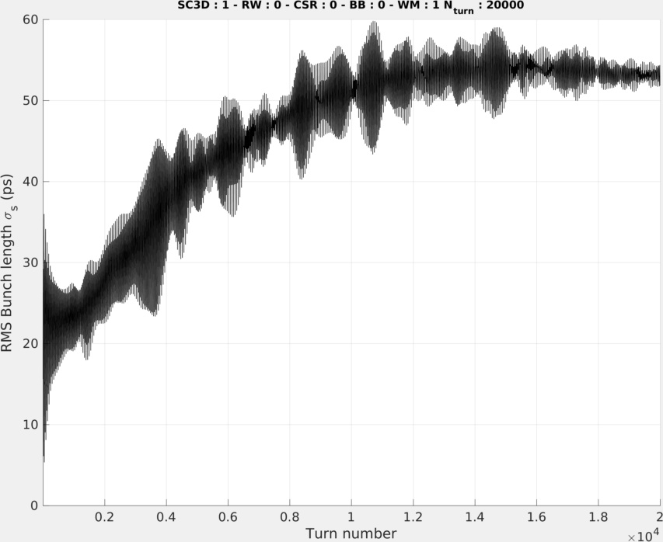
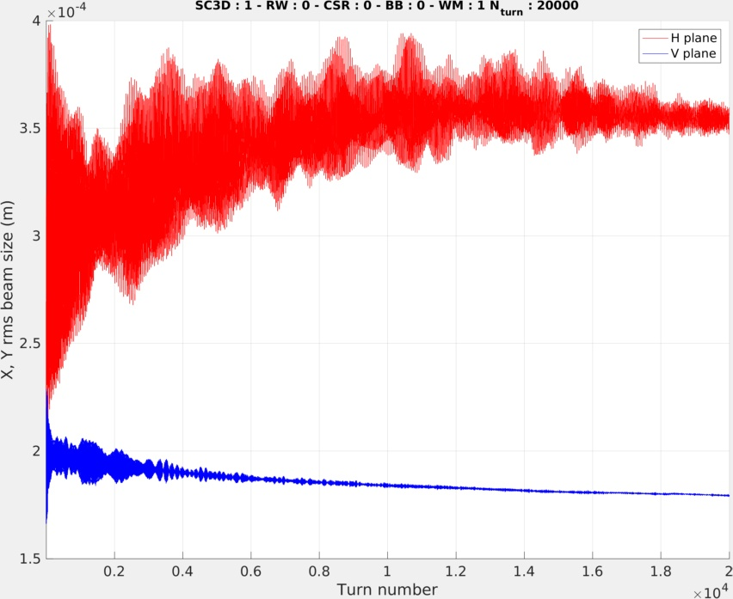



After 20 000 turns at 100 pC
$σ_{s}≈$55ps =16,5 mm
$$σ_{x}≈350 μm$$
$$σ_{y}≈180 μm$$
t =1,2 ms
t =1,2 ms
Alexis Gamelin

Slide 21


After 20 000 turns at 100 pC
$σ_{s}≈$55ps =16,5 mm
$$σ_{x}≈350 μm$$
$$σ_{x}≈65 μm$$
At the IP:
$$σ_{y}≈25 μm$$
$$σ_{y}≈180 μm$$
t =1,2 ms
t =1,2 ms
Alexis Gamelin

Slide 22
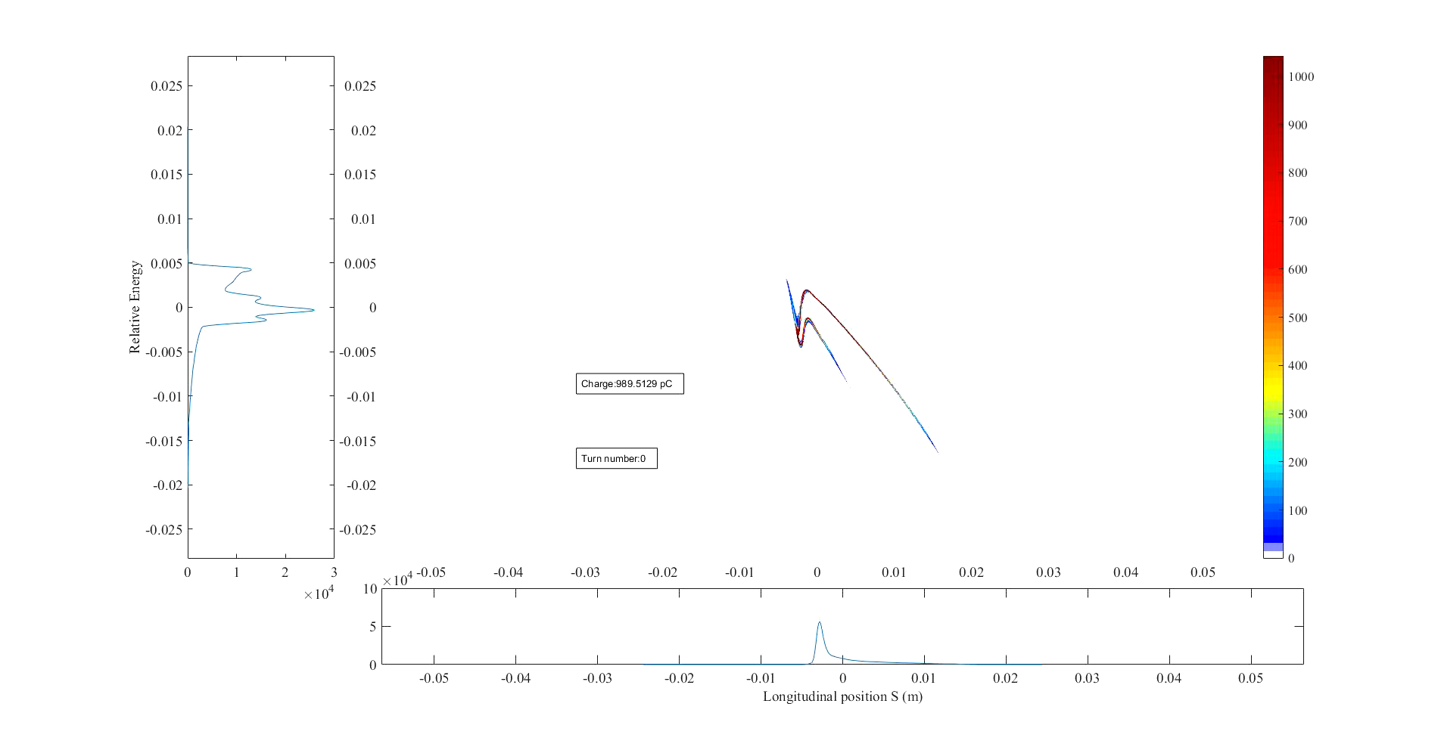

First turns at 1nC
$$δE/E$$
Longitudinal postion S (m)
Alexis Gamelin

Slide 23
First turns at 1nC
$$δE/E$$
Longitudinal postion S (m)
Alexis Gamelin

Slide 24





First turns at 1nC
What happend ?
Very strong CSR leads part of the beam outside of momentum acceptance $δ_{max,RF}≈2\%$
Possible mitigations:
Optimise Linac + TL to inject a « better » beam
Tweak the lattice
Increase $V_{RF}$
Increase $σ_{s}$ at injection (in fact decrease the longitudinal coherence, RMS is not very relevant)
$∝$ filamentation
$$\frac{ΔL}{L}=α_{c}δ+α_{2}δ^{2}$$
$$∝{\sqrt{Ω}}_{s}$$
$$V_{RF}∝\sqrt{Ω_{s}}$$
Alexis Gamelin

Slide 25
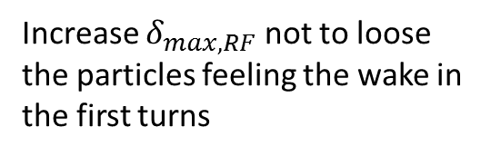

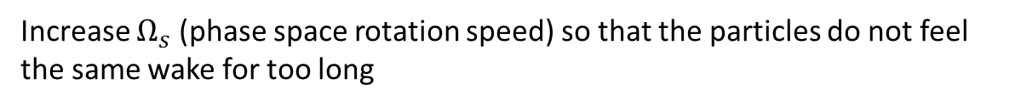

First turns at 1nC
What happend ?
Very strong CSR leads part of the beam outside of momentum acceptance $δ_{max,RF}≈2\%$
Possible mitigations:
Optimise Linac + TL to inject a « better » beam
Tweak the lattice
Increase $V_{RF}$
Increase $σ_{s}$ at injection (in fact decrease the longitudinal coherence, RMS is not very relevant)
$$δ_{max,RF}∝\frac{α_{c}}{α_{2}}$$
Increase $δ_{max,RF}$ not to loose the particles feeling the wake in the first turns
$∝$ filamentation
$$\frac{ΔL}{L}=α_{c}δ+α_{2}δ^{2}$$
$$σ_{s}∝\frac{α_{c}}{Ω_{s}}$$
Decrease the longitudinal coherence
$$∝{\sqrt{Ω}}_{s}$$
$$V_{RF}∝\sqrt{Ω_{s}}$$
Increase $Ω_{s}$ (phase space rotation speed) so that the particles do not feel the same wake for too long
Alexis Gamelin

Slide 26
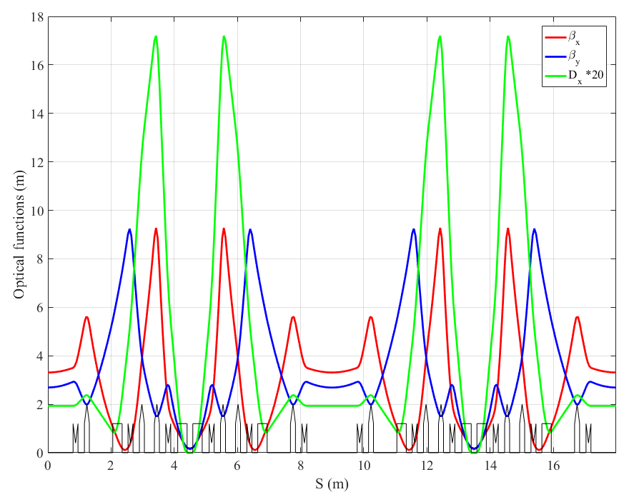
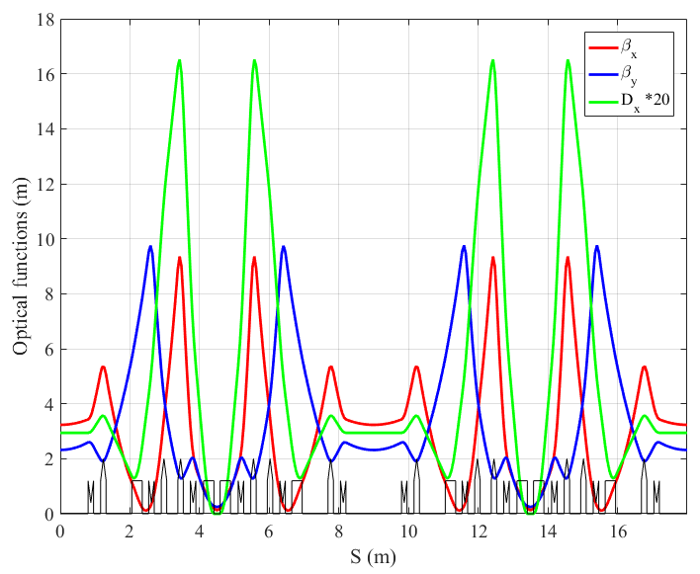

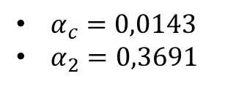


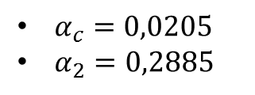


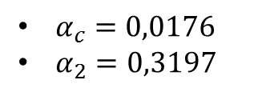

Alternative optics
$T_{s}=$synchrotron period$= \frac{2π}{Ω_{s}}$
$T_{0}=$revolution period$=$ 60 ns
$α_{c}=0,0143$
$α_{2}=0,3691$
In the nominal optics, there is:
$$T_{s}\left(V_{RF}=300kV\right)=49 T_{0}$$
$$T_{s}\left(V_{RF}=500kV\right)=38 T_{0}$$
$α_{c}=0,0176$
$α_{2}=0,3197$
$α_{c}=0,0205$
$α_{2}=0,2885$
$$T_{s}\left(V_{RF}=500kV\right)=34 T_{0}$$
$$T_{s}\left(V_{RF}=500kV\right)=31 T_{0}$$
Alexis Gamelin

Slide 27
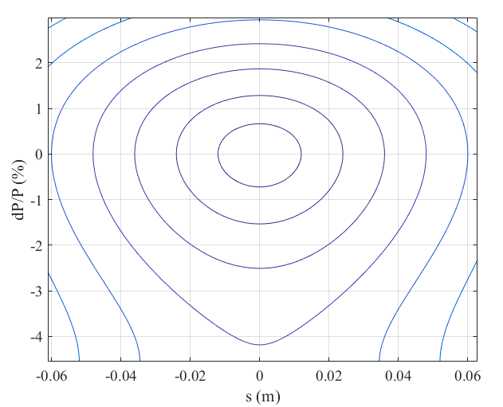
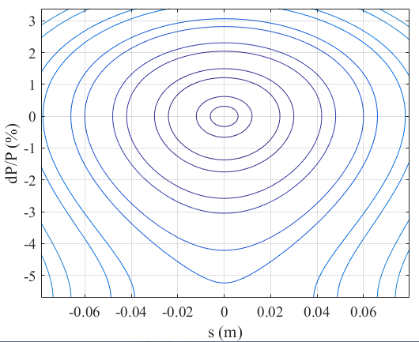
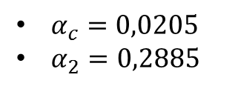
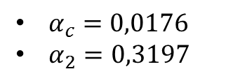
Alternative optics
$α_{c}=0,0143$
$α_{2}=0,3691$
In the nominal optics, there is:
$α_{c}=0,0205$
$α_{2}=0,2885$
$α_{c}=0,0176$
$α_{2}=0,3197$
Alexis Gamelin

Slide 28
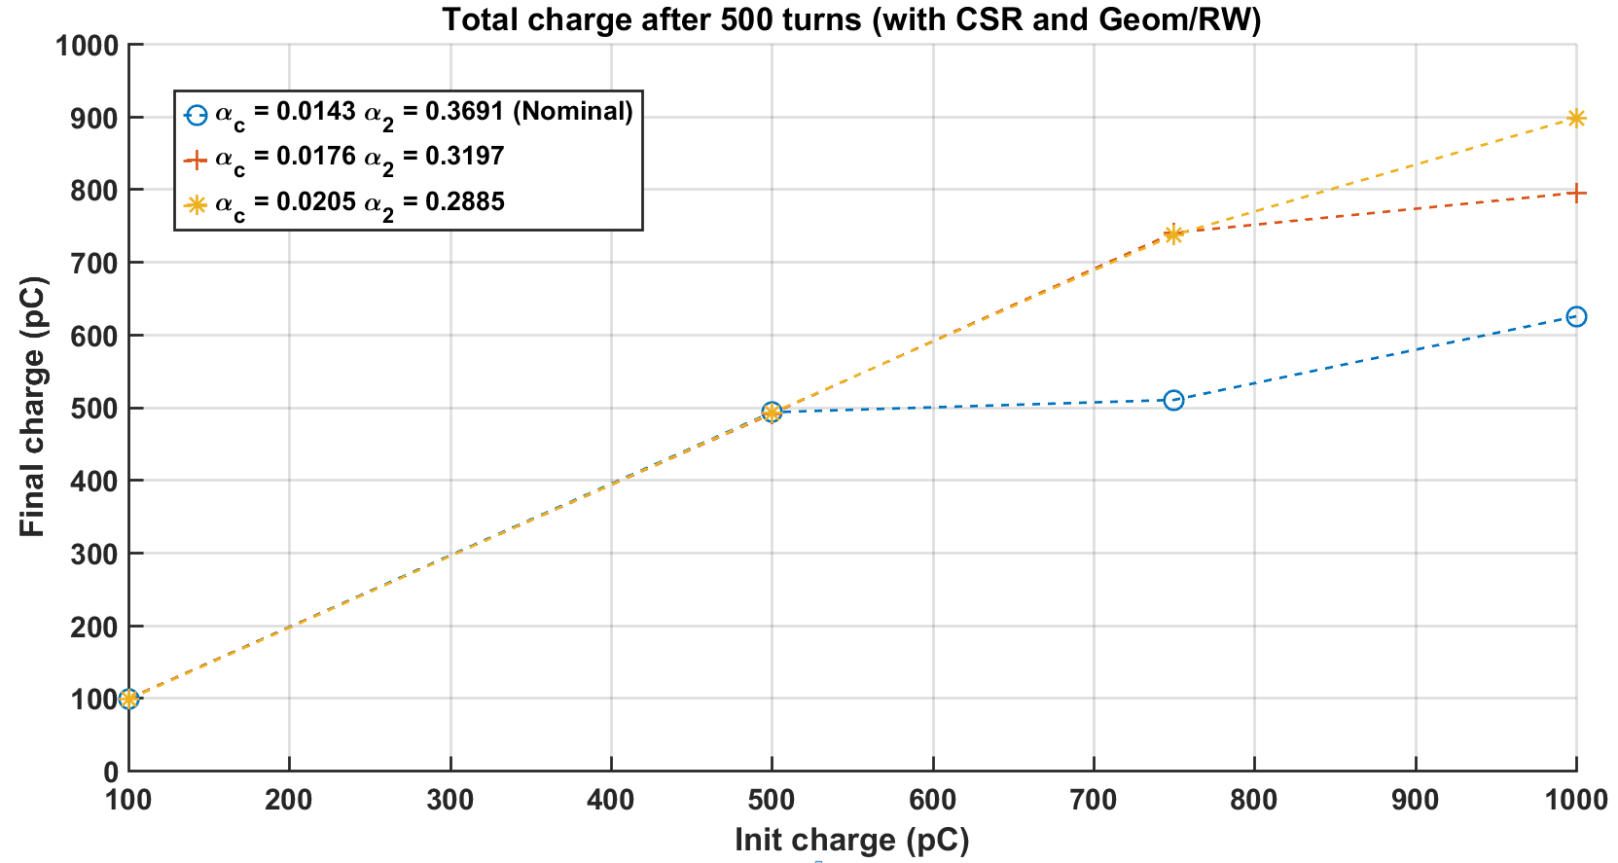

$$V_{RF}=500kV$$
Alexis Gamelin

Slide 29



$$V_{RF}=500kV$$
Gain thanks to the increase of $α_{1}$ and decrease of $α_{2}$
$$δ_{max,RF}$$
$$Ω_{s}$$
$$σ_{s}$$
Alexis Gamelin

Slide 30
Ion Cloud
Alexis Gamelin

Slide 31
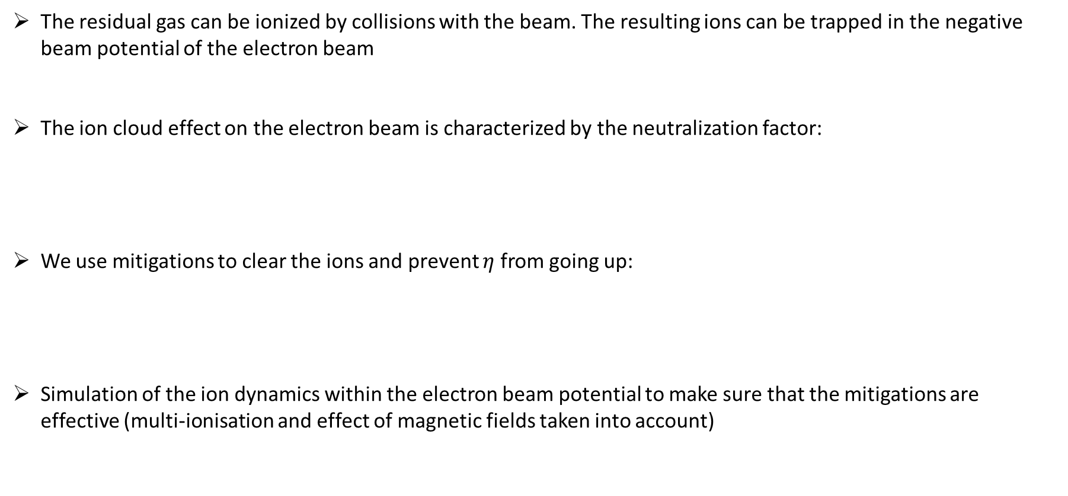

Ion Cloud
The residual gas can be ionized by collisions with the beam. The resulting ions can be trapped in the negative beam potential of the electron beam
The ion cloud effect on the electron beam is characterized by the neutralization factor:
We use mitigations to clear the ions and prevent $η$ from going up:
Simulation of the ion dynamics within the electron beam potential to make sure that the mitigations are effective (multi-ionisation and effect of magnetic fields taken into account)
$$η= \frac{n_{ions}}{n_{electrons}}$$
Tune shift, tune spread, halo increase and emittance blow-up proportional to $η$
Coupled electron/ion instability for $η≥\sim 0,1$
Gap of $4μs$ in between each bunch injection/extraction
DC clearing electrodes (Soleil BPM design)
Alexis Gamelin
PRAB paper recently published on the subject: https://doi.org/10.1103/PhysRevAccelBeams.21.054401

Slide 32
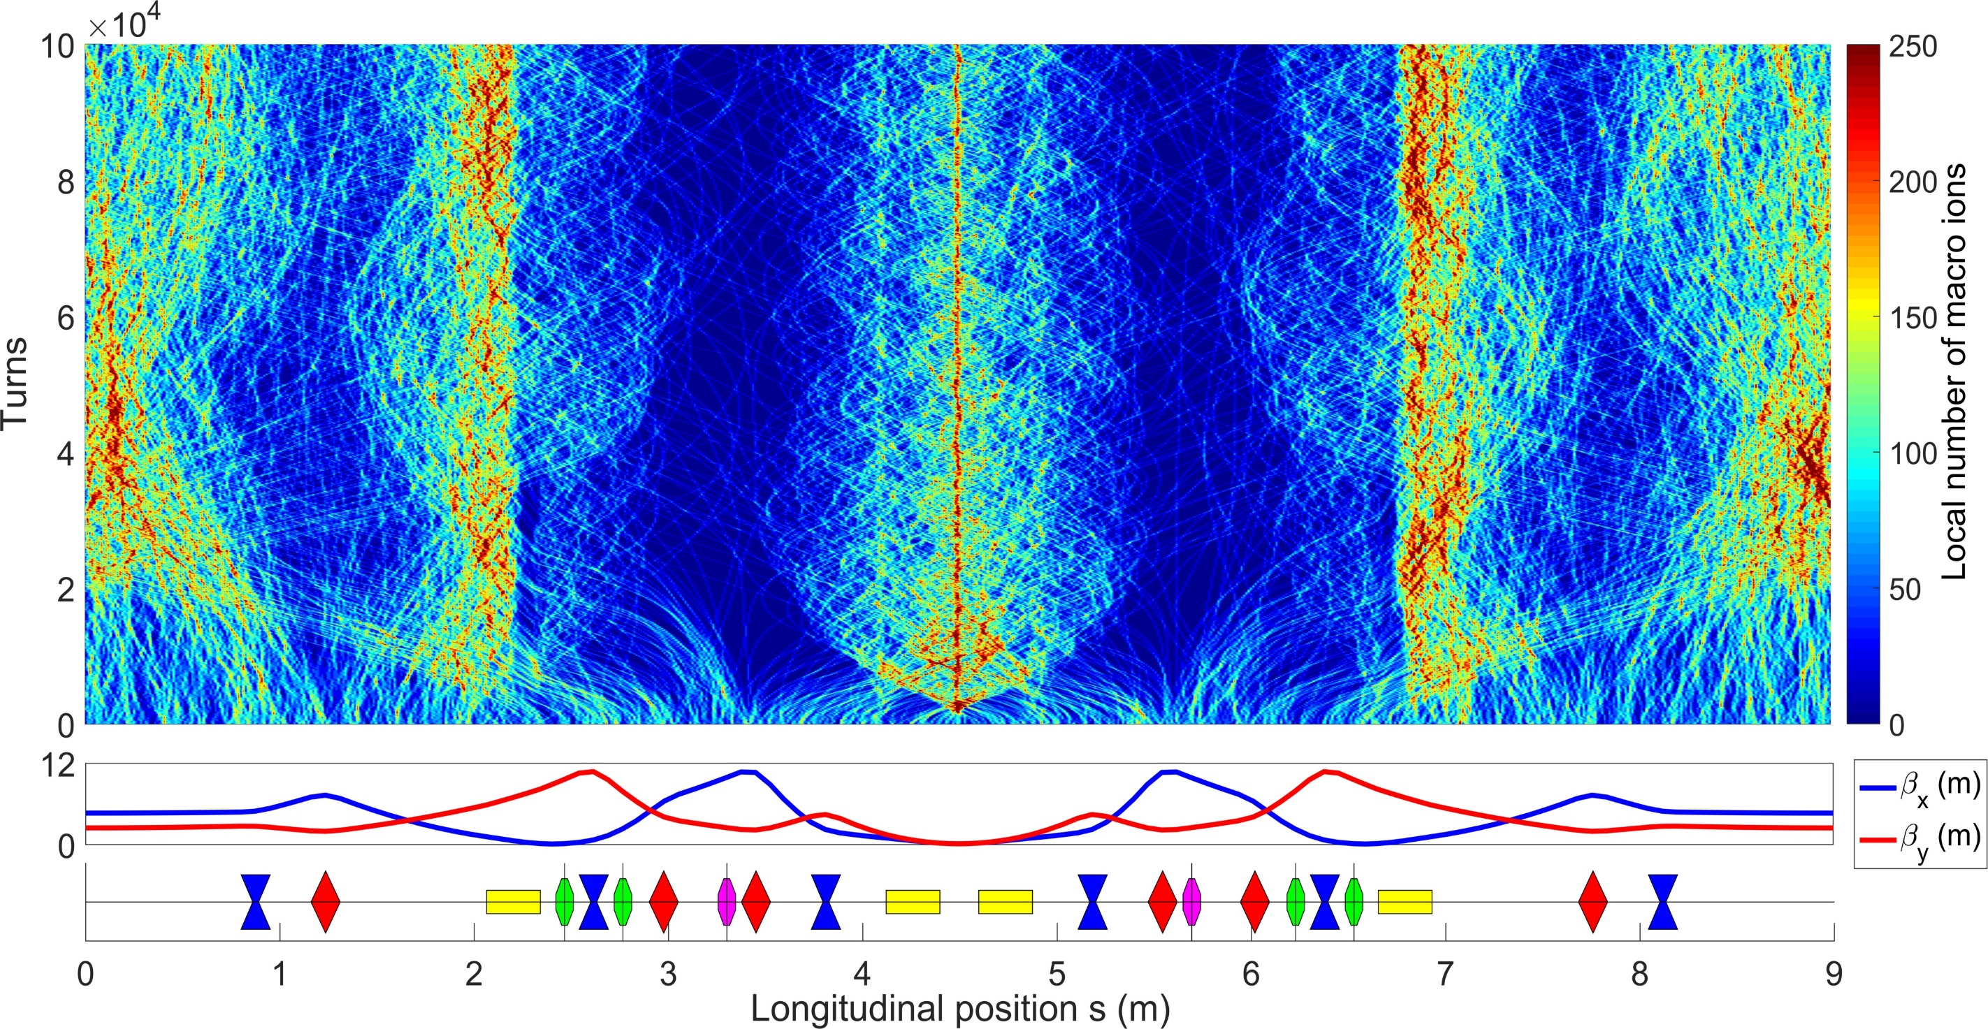

Evolution of the longitudinal distribution of CO⁺ during 100 000 during beam-ion interaction
Dipole =
Alexis Gamelin
NUAGE simulation, number of macro ions at start : 100 000

Slide 33
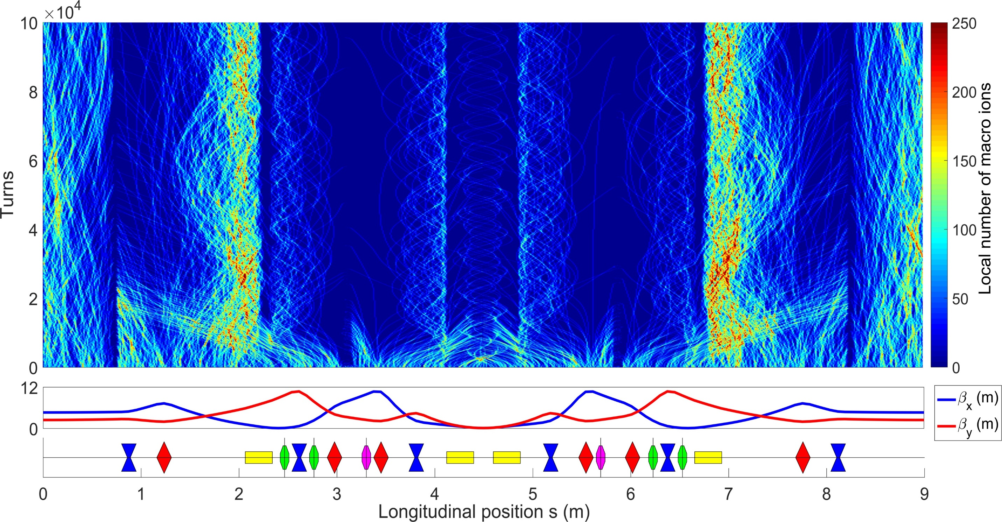
Evolution of the longitudinal distribution of CO⁺ using clearing electrodes
Dipole =
Clearing electrode =
Alexis Gamelin
NUAGE simulation, number of macro ions at start : 100 000

Slide 34
Evolution of the longitudinal distribution of CO⁺ using clearing electrodes
Dipole =
Clearing electrode =
Alexis Gamelin
NUAGE simulation, number of macro ions at start : 100 000

Slide 35
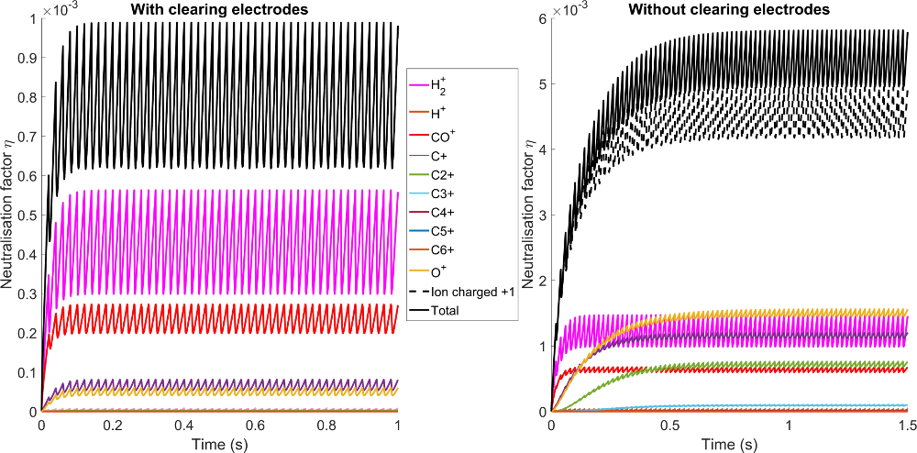



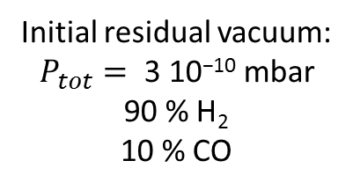

Ion Cloud with a clearing gap of $4μs$
Initial residual vacuum:
$$P_{tot}=\text{ 3 10}\text{−10} \text{mbar}$$
90 % H₂
10 % CO
$$\frac{η_{no clearing}}{η_{clearing}}≈6$$
With clearing electrodes:
$$ΔQ_{x,y}≈δQ_{x,y}≈{10}^{−4}$$
Without clearing electrodes:
$$ΔQ_{x,y}≈δQ_{x,y}≈8×{10}^{−4}$$
Alexis Gamelin
PRAB paper recently published on the subject: https://doi.org/10.1103/PhysRevAccelBeams.21.054401

Slide 36
Conclusion
No problem expected at low charge (100pC)
Injection and storage at 1 nC will be very difficult. We are investigating:
Ion effects should be well controlled by mitigations
Still to do among other things:
Optimisation of the injected bunch using start to end simulations
Alternative optics
RF manipulation (RF phase, RF voltage) during injection
Possibility to inject two bunches of 500pC
Add the measured multipole components to the collective effect tracking to estimate the losses
Transverse impedance model to invertigate the possibility of TMCI
Alexis Gamelin

Slide 37
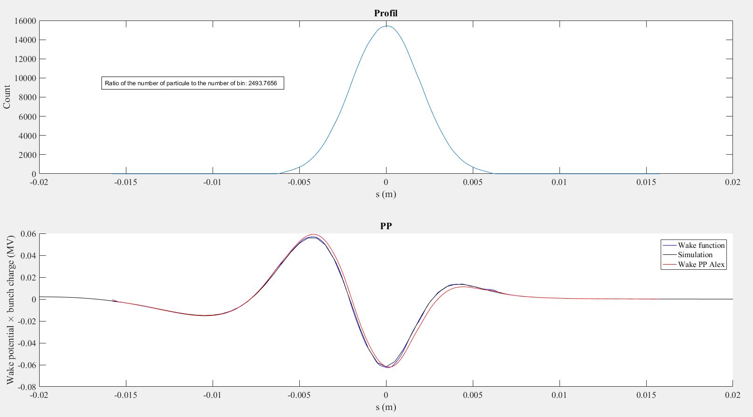
Modélisation du CSR
Nbin = 400
Nrms = 8
Np = 10^6
Wind = 5

Slide 38
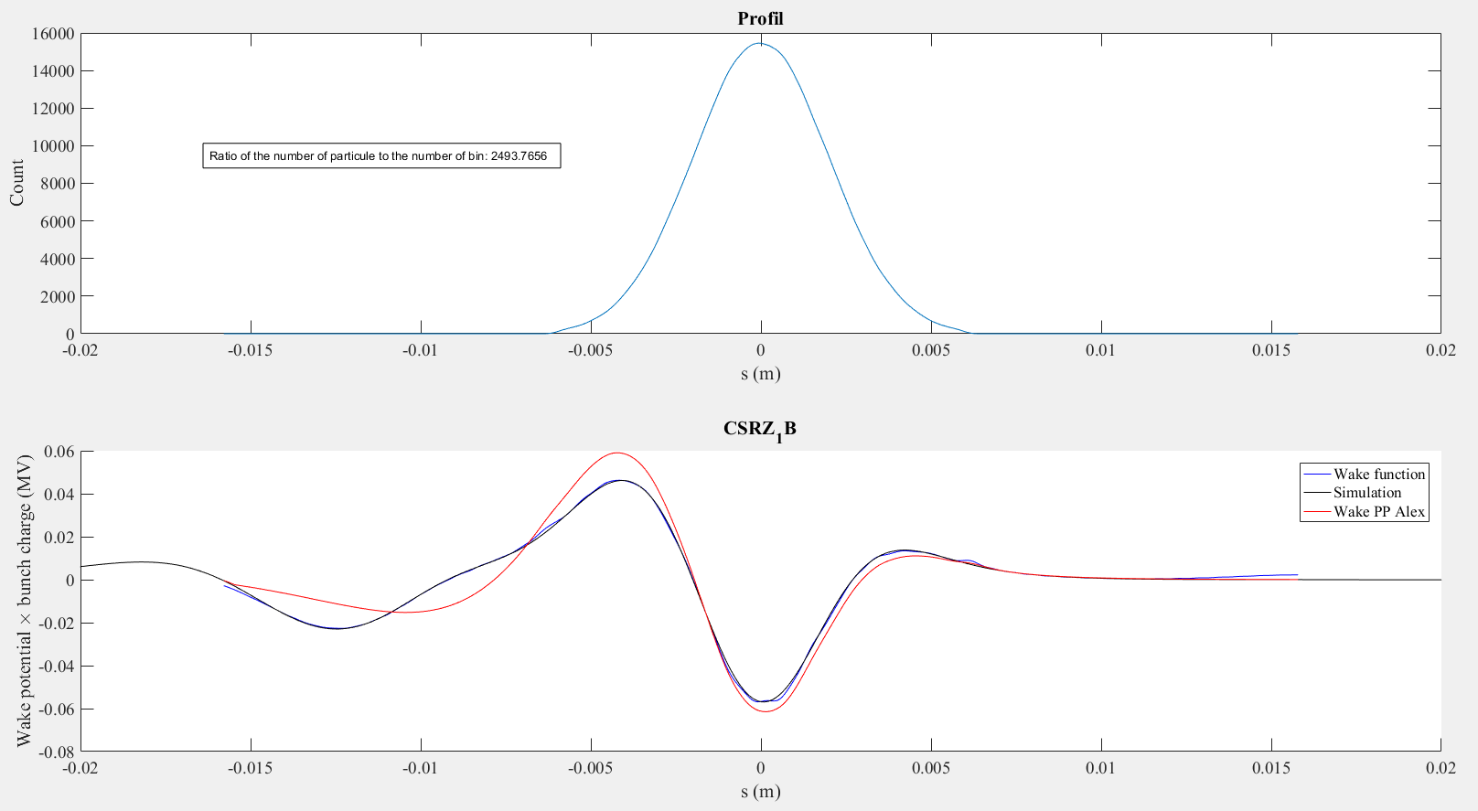
Modélisation du CSR
Nbin = 400
Nrms = 8
Np = 10^6
Wind = 5

Slide 39
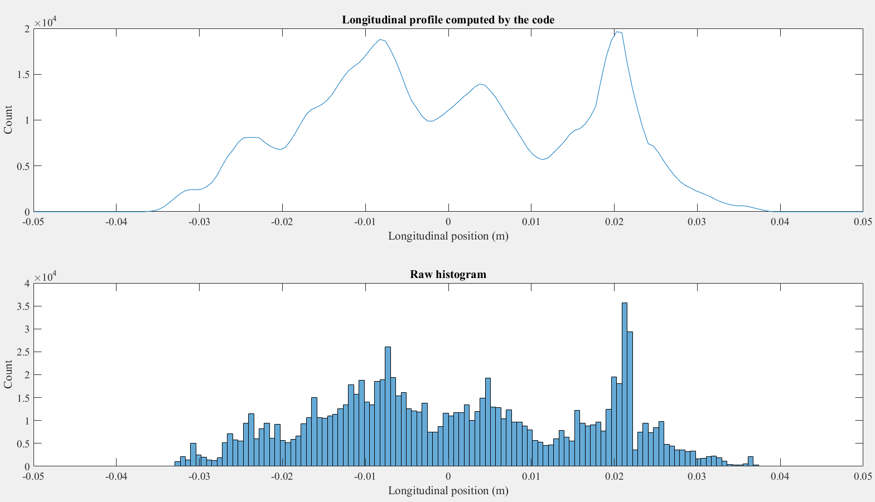
Modélisation du profil longitudinal
Nbin = 400
Nrms = 8
Np = 10^6
Wind = 5

Slide 40
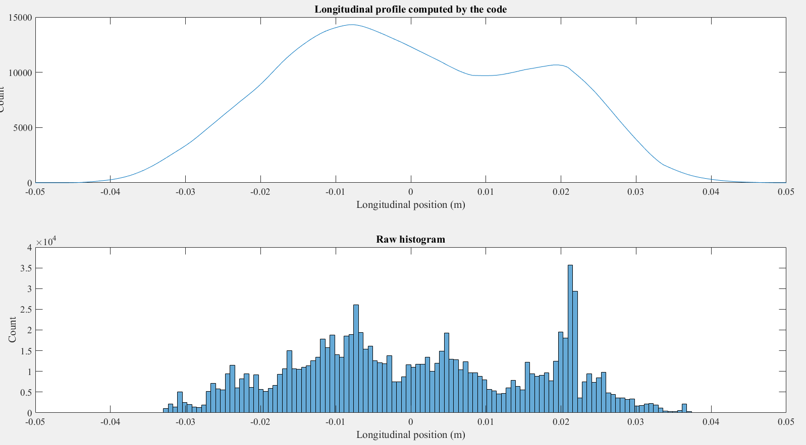
Modélisation du profil longitudinal
Nbin = 400
Nrms = 8
Np = 10^6
Wind = 20

Slide 41

Modélisation du profil longitudinal
Nbin = 400
Nrms = 8
Np = 10^6
Wind = 2

