Slide 1
Radiation Protection Status ThomX
MAC – 06/21/2018

Slide 2
Administrative Status
Convention between IPN Orsay and LAL signed
Radiation Protection and Safety convention incoming very soon
ASN License : Files completed, to be sent very soon

Slide 3
ASN License
Phase 1
LINAC only
50 MeV ; 100 pC ; 10 Hz
Phase 2
LINAC + TL + EL (+ SR)
50 MeV ; 100 pC ; 10 Hz
Phase 2bis
LINAC + SR + X-rays production
50 MeV ; 1 nC ; 50 Hz
Temporary license (end of 2018)
Evolutive license (first semester 2019)
Phase 3
LINAC + SR + X-rays production
70 MeV ; 1 nC ; 50 Hz

Slide 4
Radiation Protection Zoning
Phase 1 – 2
TX and ADROMEDE OFF
RF source OFF
Monitored area :

Slide 5
Radiation Protection Zoning
Phase 1 – 2
TX and ADROMEDE OFF
RF source ON
Monitored area :
Forbidden area :

Slide 6
Radiation Protection Zoning
Phase 1 – 2
TX ON
RF source ON
Monitored area :
Forbidden area :

Slide 7
Radiation Protection Zoning
Phase 1 – 2
TX and ADROMEDE OFF
RF source OFF
RPO keys removed
Monitored area :

Slide 8
Radiation Protection Zoning
Phase 2bis - 3
TX and ADROMEDE OFF
RF source OFF
Monitored area :
Restricted area :
Must be confirmed

Slide 9
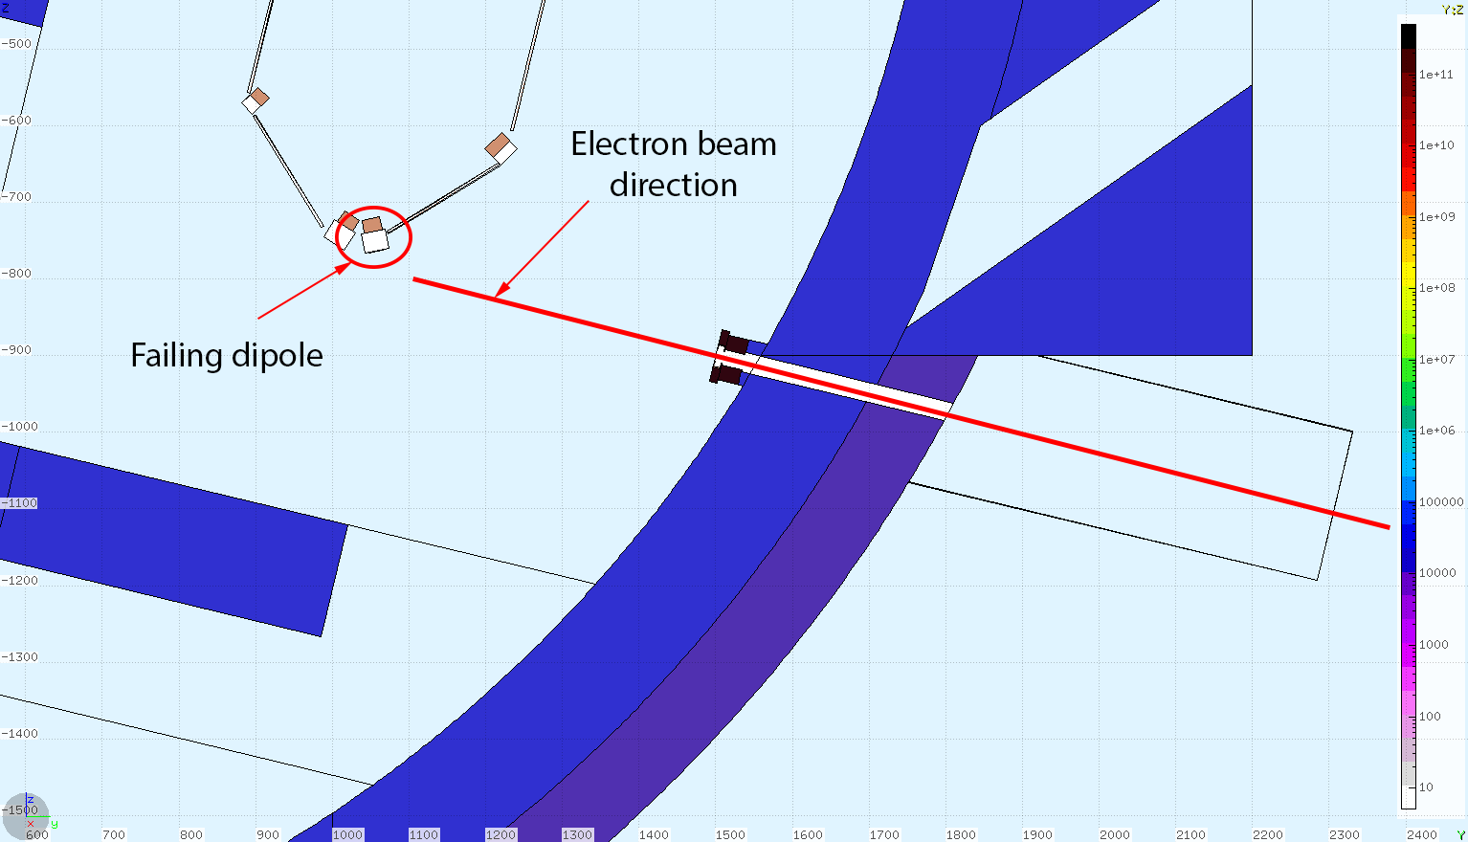
Beam-Loss in the IP Radiological Assessment
Scope : MAC asked for an evaluation of radiological impact in case of beam-loss near the interaction point
Two accidental scenarios have been studied:
Beam-loss in the straight section, north part of the ring.
Beam-loss after the failure of the second dipole, downstream the IP

Slide 10
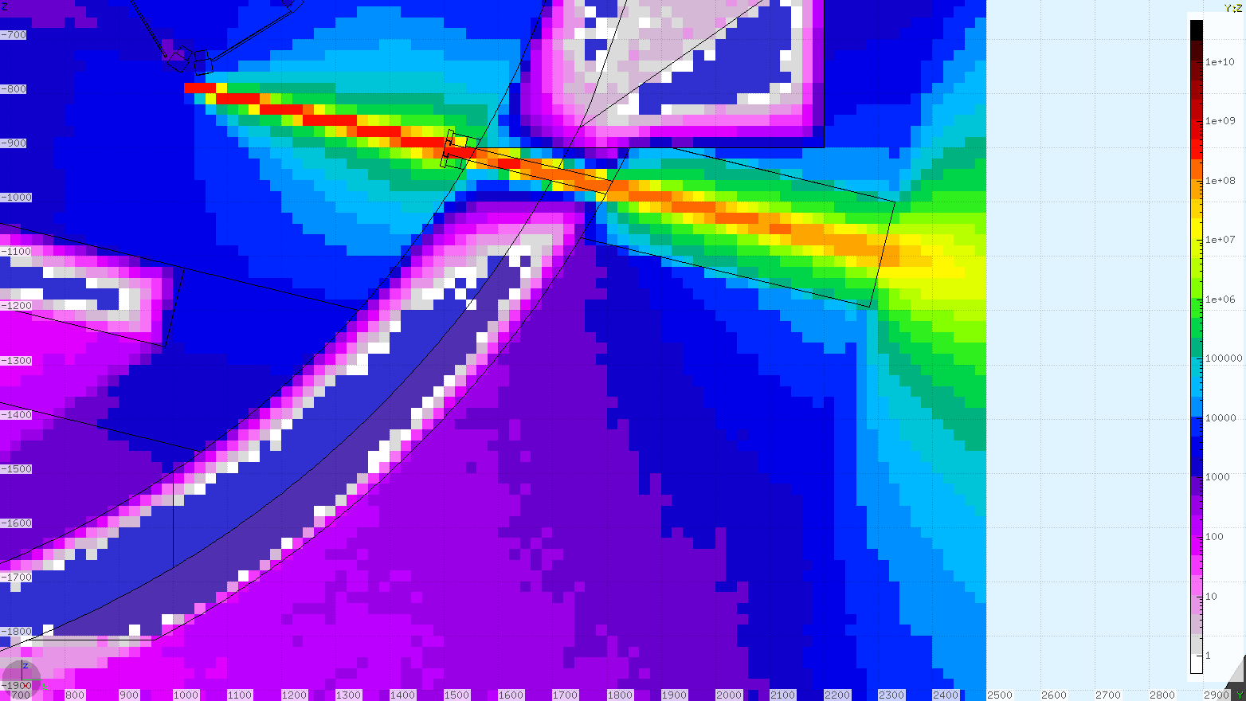
Beam-Loss in the IP Radiological Assessment
First scenario
Very limited integrated dose (inferior to 100 µSv in 5 seconds)
PSS interlocks between electron source and dipoles supply mandatories
Second scenario
Very high integrated dose (up to 150 mSV in 5 seconds)
Ambiant equivalent dose – Phase 3 – Shutter OFF - µSv.h⁻¹

Slide 11
Beam-Loss in the IP Radiological Assessment
Solution
PSS interlocks between electron source and dipole feed
Dipoles supply failure -> Injection stopped
Dipoles supply in series -> The four dipole are OFF in the same time
→ only one bunch lost through the X-rays hole
RMS interlocked too: gamma and neutron detector in the X-hutch → shutter closed and injection stopped
ThomX Exploitation Phase | Shutter state | Maximum Efficient Dose integrated with one bunch (µSv)
Phase 2 | Shutter ON | 5,6e-2
 | Shutter OFF | 5,6
Phase 2bis | Shutter ON | 5,6
 | Shutter OFF | 1,1e2 ; 2,8e2
Phase 3 | Shutter ON | 1,1e1
 | Shutter OFF | 2,8e2 ; 5,6e2

Slide 12
Beam-Loss in the IP Radiological Assessment
Solution
PSS interlocks between electron source and dipole feed
Dipoles supply failure -> Injection stopped
Dipoles supply in series -> The four dipole are OFF in the same time
→ only one bunch lost through the X-rays hole
ThomX Exploitation Phase | Shutter state | Maximum Efficient Dose integrated with one bunch (µSv)
Phase 2 | Shutter ON | 5,6e-2
 | Shutter OFF | 5,6
Phase 2bis | Shutter ON | 5,6
 | Shutter OFF | 1,1e2 ; 2,8e2
Phase 3 | Shutter ON | 1,1e1
 | Shutter OFF | 2,8e2 ; 5,6e2
In case of failure, access to the X-hutch will be forbidden to unclassified users if they were working in it.

Slide 13
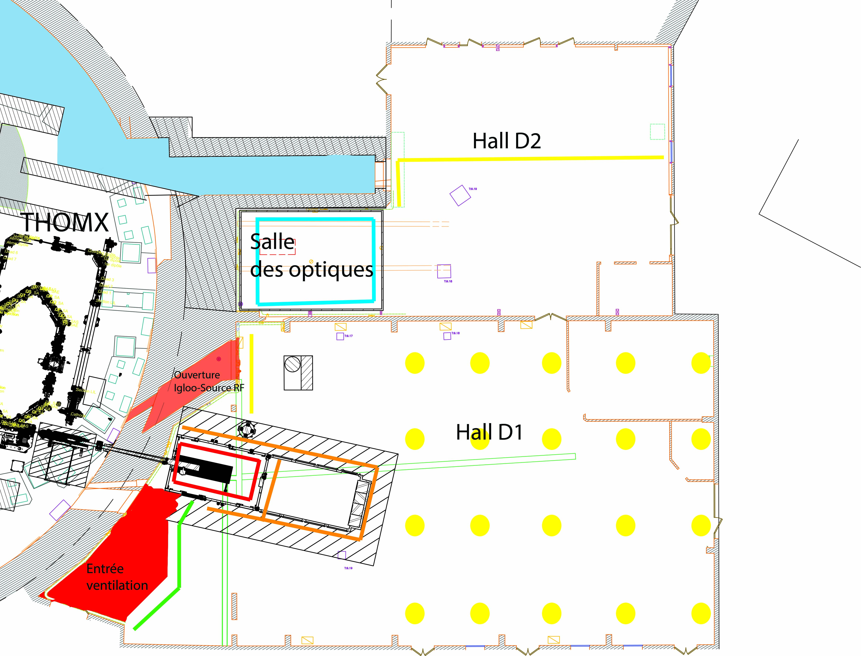
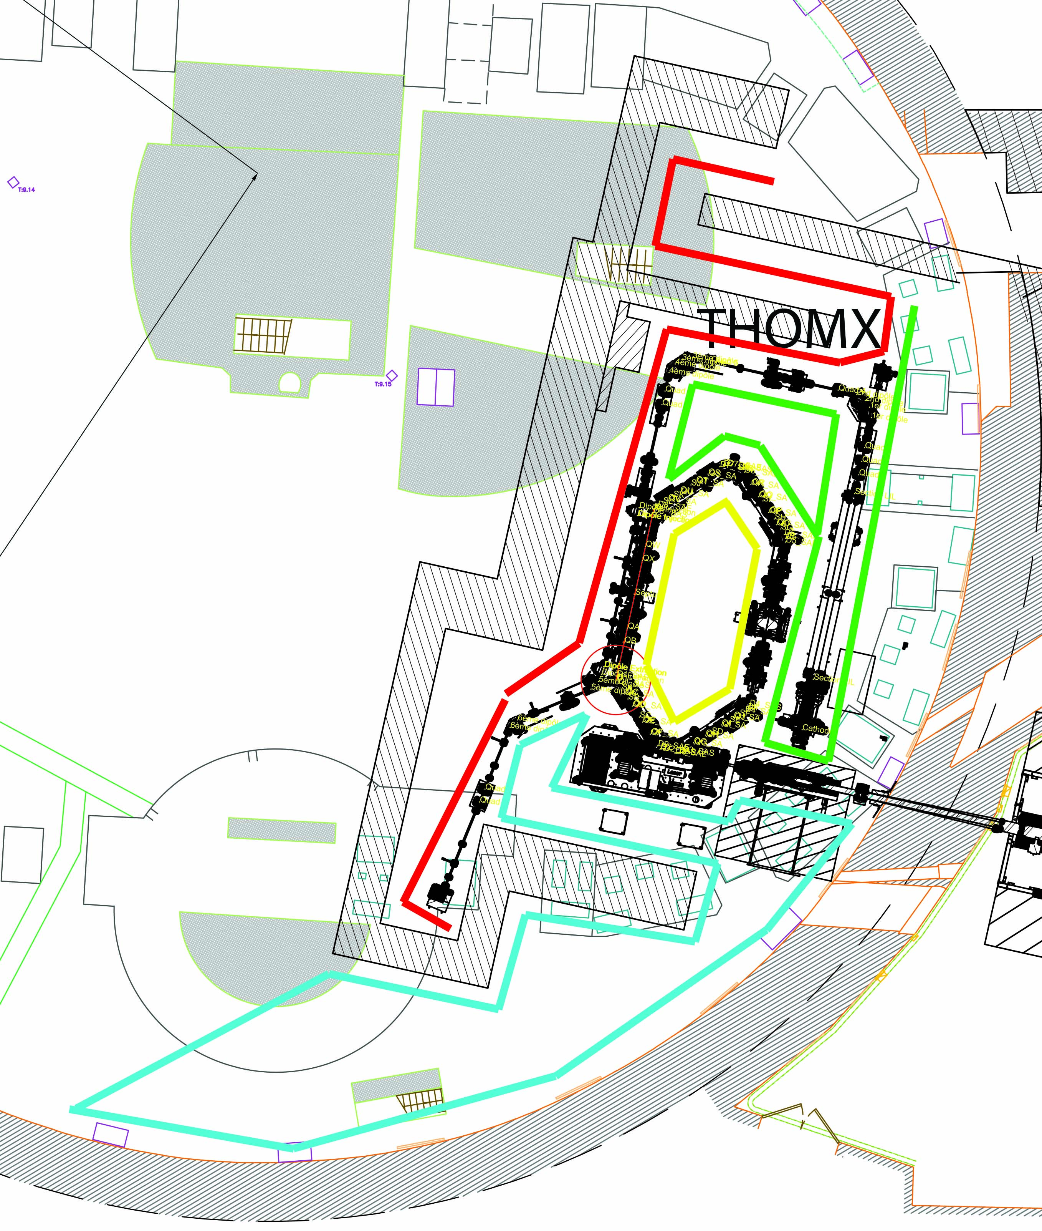
Next Steps: Validation Benchmarking
Ready for a new phase
Shielding validation
Benchmark
OK
NOK
Information to ASN
Shielding Adjustement

Slide 14
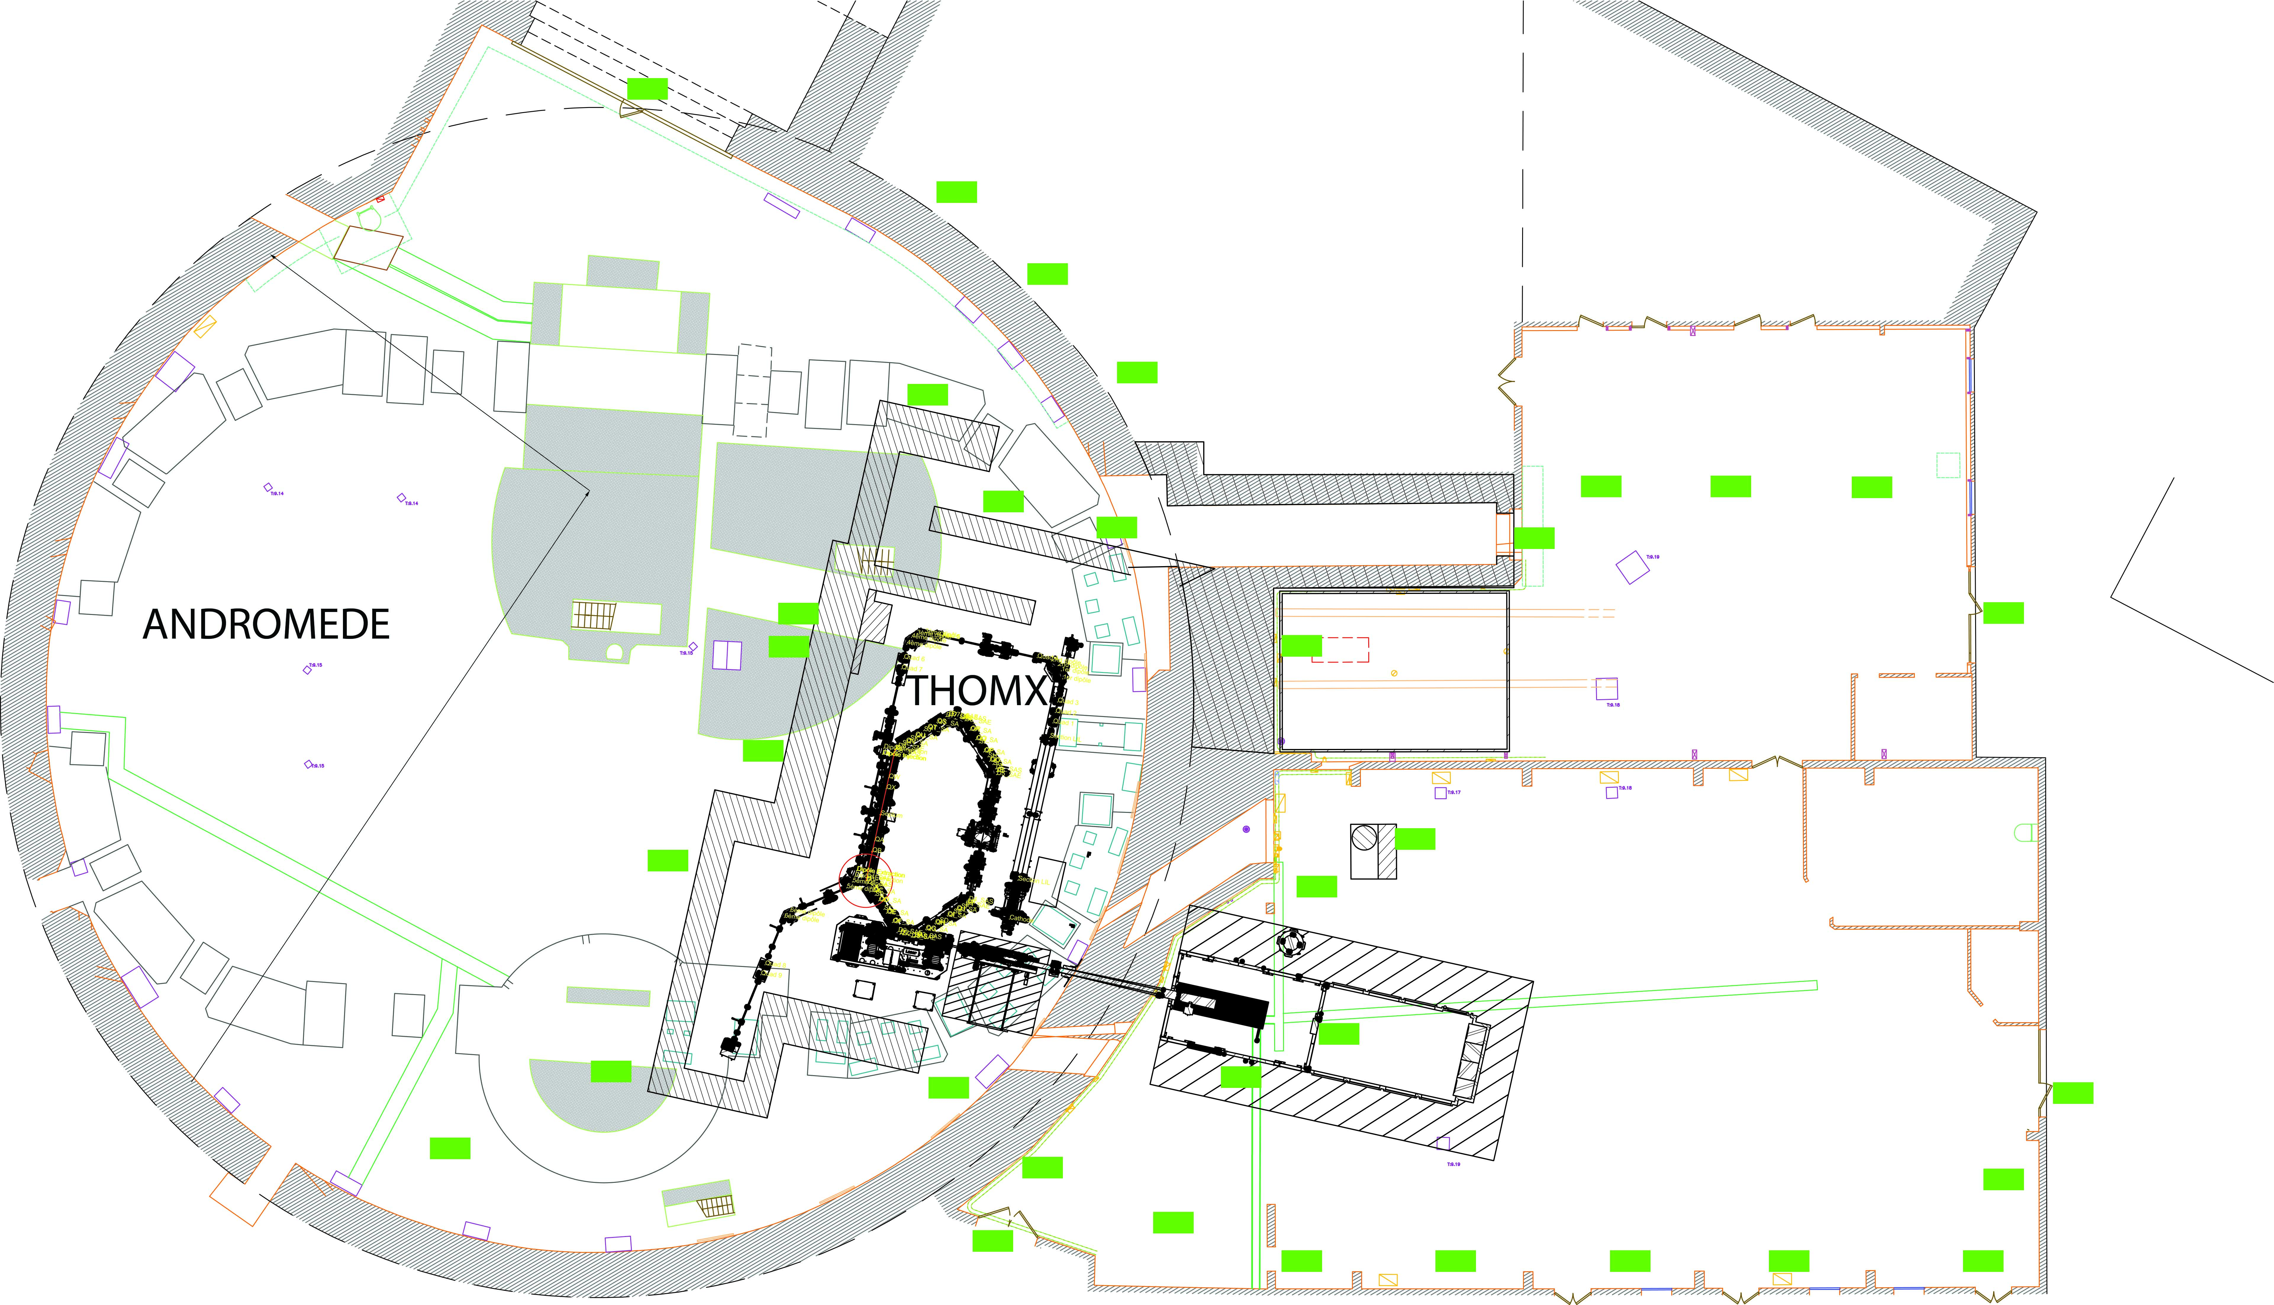
Next Steps: Validation Benchmarking
Ambiant dosimetry

