Slide 1
Status of PRAE beamline
Projet Emblématique
Programme SESAME
With the support of
Yanliang - Han
08/10/2018

Slide 2
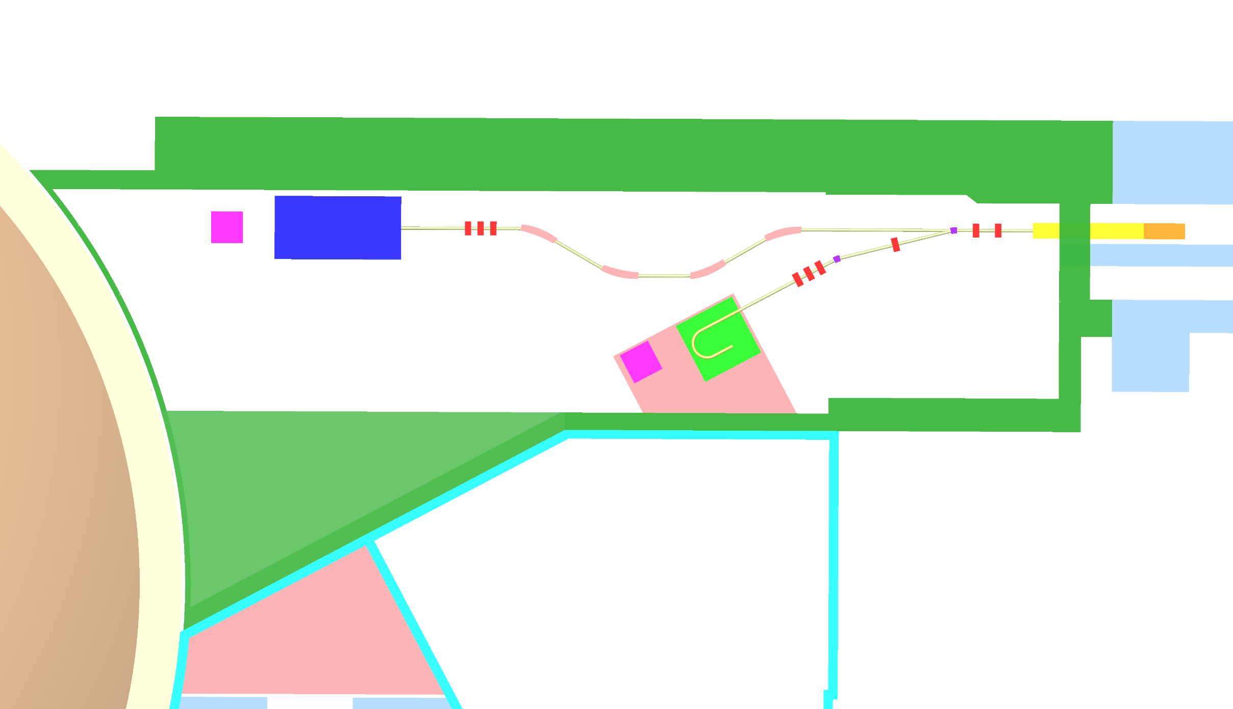
Task
Design the entire beam line
Provide the proper beam for end user
Fit the geometry requirement
Perform the realistic start-to-end simulation

Slide 3
End user requirement
ProRad Experiment Requirments:
Energy: 30, 50 70 MeV
σ_{x} = 20 – 30 μm
σ_{y} = 100 – 200 μm
σ_{x’,y’} < 50 μrad
σ_{E}/ E < 5 ⨉ 10⁻⁴
Q = 10 – 100 pC
Wide energy range
Need extremely small emittacne
The most difficult requirement: we need the energy compressor systme
Radiobiology Experiment Requirements:
Mini Beam
σ_{x,y} = 400 – 700 μm after 10 cm air + 3 cm water
Low divergence
FLASH beam
σ_{x,y} = 10 mm ⨉ 10 mm , Δt = 100 ms
σ_{x,y} = 26 mm ⨉ 18 mm , Δt = 500 ms
Wide beam size range

Slide 4
Simulation Environment
Lattice design: Madx
Placet
RF-Track
Astra
Proton Radius
Collimator
Dechirper
Dipole
Quadrupole
Linac
RF Gun
Radiobiology
+
Instrumentation
6 m
22.2 m
Radiobiology simulation: BDSIM

Slide 5
Status & Future
Status:
A beamline has been designed
A simulation enviornment has been setup
In ideal case:
The energy spread requirement for ProRad can be reached at 70 MeV beam
The requirement for radiobiology
Mini beam: can be met at 140 MeV beam
FLASH Beam: can be met with drift and defocusing quadrupole
Future:
Reoptimize the RF injector
start-to-end optimizization for RF Gun and Linac
Evaluate and simulate the CSR effect
Study the misalignment and the imperfection of all components
Investigate the passive dechirper structure

