Slide 1
RF Power & RF Distribution For PRAE Linac
Projet Emblématique
Programme SESAME
With the support of
Maher OMEICH
08/10/2018

Slide 2
RF Power for Linac
Source of power for Gun and Accelerating Structure
Modulator / Klystron
Home Made Modulator
Recycling elements from SLAC
CPI Klystron
2 phases for the Modulator :
Construction and test in Hall LAGARRIGUE
Transfer to PRAE site

Slide 3
Parameters
RF Peak Power max.: 45 MW
Peak Voltage max.: 310 kV
Peak Current max.: 350 A
Electrical Peak Power max.: 109 MW
Pulse Width ( Voltage ): 6,5 µS
Rep. Rate: 50 Hz
Delay Line type Modulator
Thyratron switching system

Slide 4
Modulator
Composition
HV Power supply
Up grade?
Pulse Forming Network
To be change to fit PRAE parameters
Thyratron switch system
Pulse Transformer, Tank & Tank auxiliary
New pulse transformer, New Tank ?
Auxiliaires Systems, control & measurement
To be change to fit PRAE parameters
Remote Control
New Interface

Slide 5
Status
Study & simulation of modulator : done
Choise of emplacement for construction
and test : Hall LAGARRIGUE
Power and water to feed in place : not yet
Recycling elements from SLAC : not yet
Pulse transformer and Tank : in progress
Auxiliaries systems : in progress
Remote control : not yet

Slide 6
Klystron
Klystron: VKS-8245C
RF power(output): 45 MW
RF power(input): 500 W
Cathode Voltage: 305 kV
Cathode Current: 340 A
RF Pulse Width: 4,5 µS
Rep. Rate: 50 Hz
Efficiency: 43 %
Gain: 47 dB
Perveance: 2, [µa/v ]
High impedance Electromagnet
3/2

Slide 7
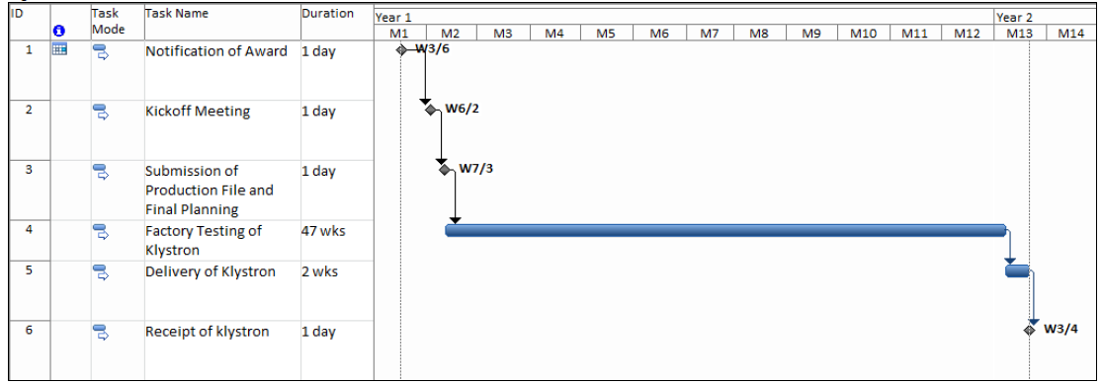
Status
Scheduele

Slide 8
RF Distribution
RF Distribution similar to ThomX (> Power)
Use of elements from CERN ( Waveguides & Loads )
ALL other elements from Industrie

Slide 9
Conclusion
Starting construction of the Modulator need:
1- Get the emplacement Hall LAGARRIGUE
2- Get elements from SLAC
Power and water connections
In progress: Pulse transformer & tank
Auxiliaries systems
Construction & test : 12 Months
Manpower: 1 Enginneer + 1 Technicien

