Slide 1












Etat d’avancement
Lot Aimants
Projet Emblématique
Programme SESAME
With the support of
Cynthia VALLERAND
08/10/2018

Slide 2
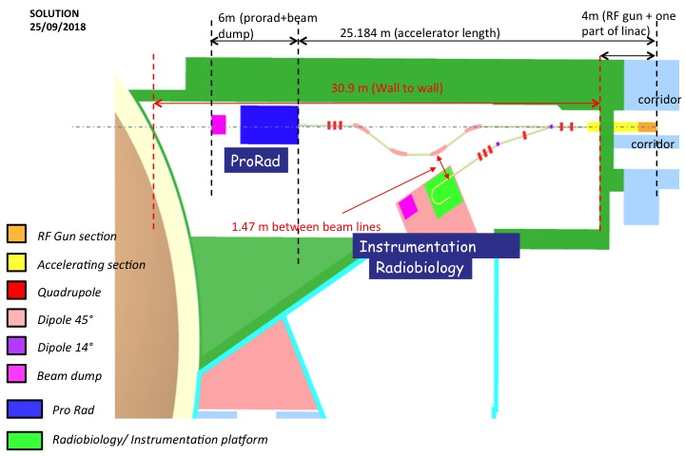
Context
  Nb of magnets and which ?
  6 Dipoles including 2 for the beam deviation (purple) and 4 for the energy selection of the beam (pink)
  9 Quadrupoles (red) for the beam focalisation
  6 Steerers for the beam trajectory correction

Slide 3
Specifications
DIPOLES |  |  | QUADRUPOLES
Bending angle (°) | 45 | 14 | Quantity | 12
Quantity | 4 (+2) | 2 | Gradient (T/m) | 28
Energy max. (MeV) | 150 |  | Iron length (m) | 0.2
Good field region (mm) | +/- 15 |  | Good field region (mm) | +/- 18
Gap (mm) | 40 |  | Energy max. (MeV) | 150
Iron length (m) | 1.2 | 0.2
Field Homogeneity determines precision of beam energy.

Slide 4
Interactions
MAGNETS
Vacuum
Cooling
(air, water)
Beam Dynamics
Power supply
Management
Integration/gestion des interfaces
Alignment
Safety/Radioprotection
Logistique
Purchase/Contract

Slide 5
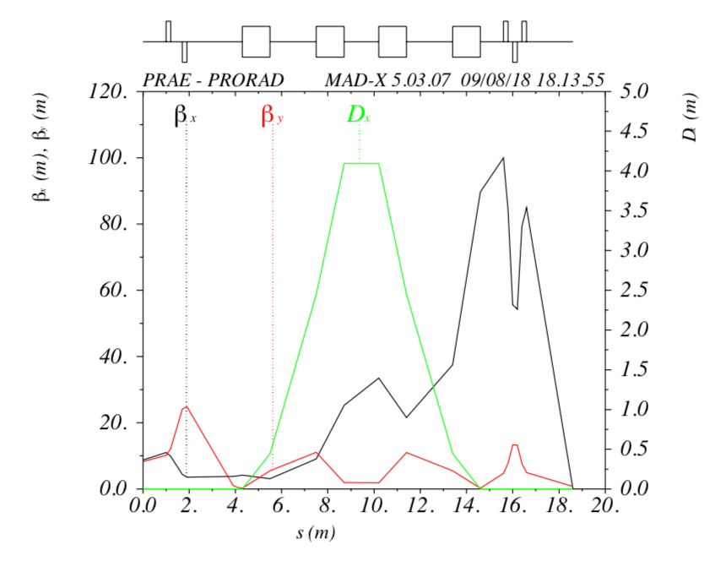
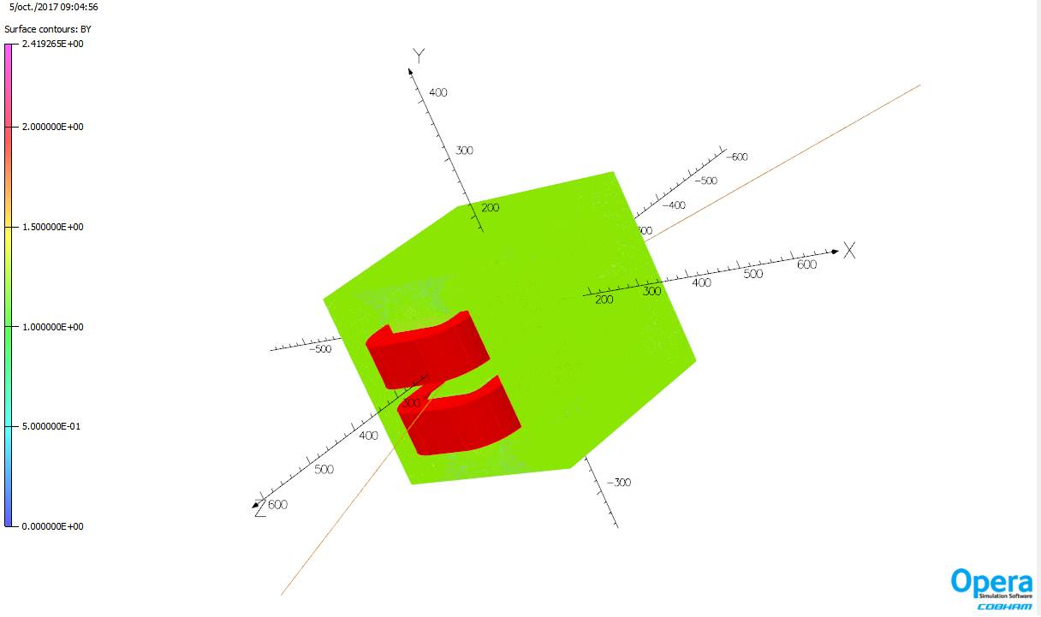
Status : ECS DIPOLE
Initial parameters :
σ_{x} = 6.53mm => ±8σ_{x} = 105mm
σ_{y} = 1.43mm => ±10σ_{y} = 30mm
Deviation angle = 45°
E = 150MeV
GFR = ± 15mm
Gap = 40 mm
STATUS : Pre-design is finished

Slide 6
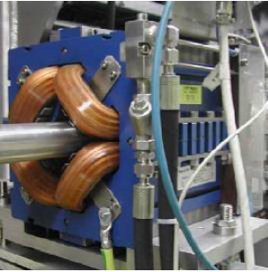
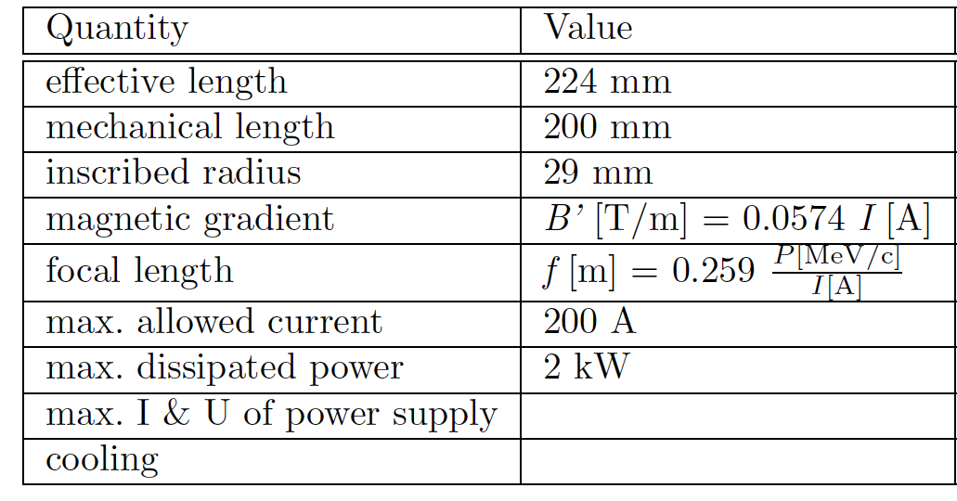
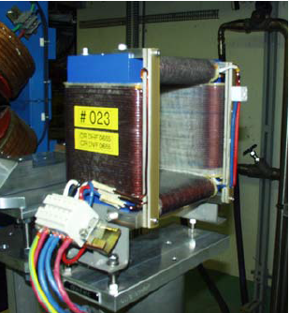

Status : Quadrupoles
Recuperation of CTF3 quadrupoles (12) and steerers (6)
Power supplies ?

Slide 7
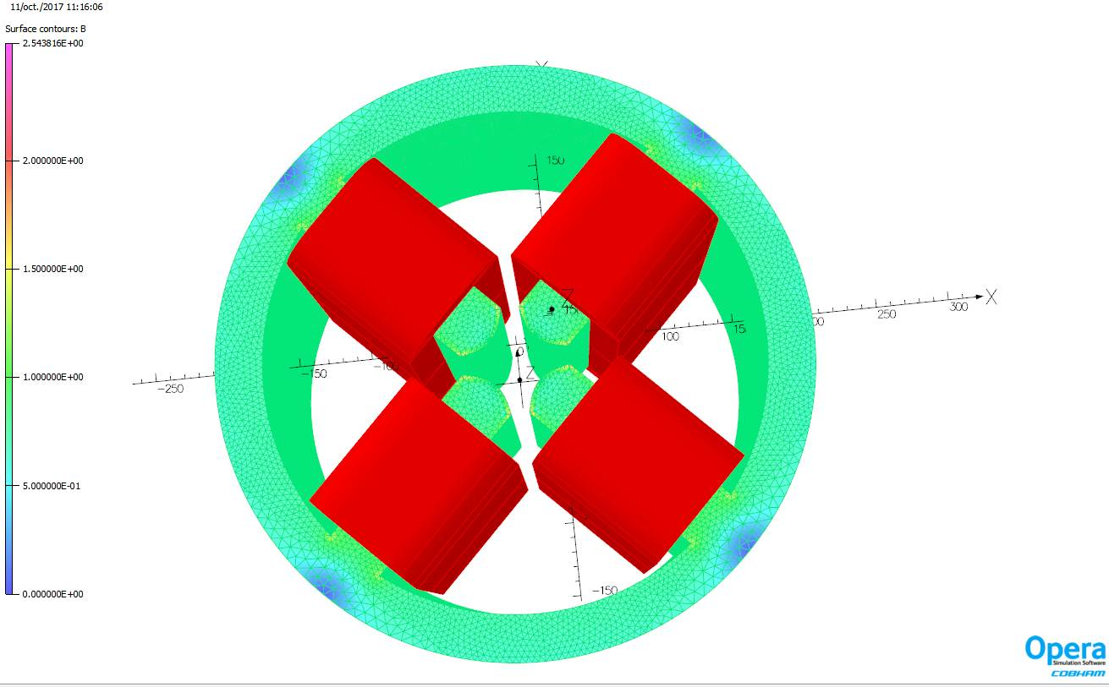
Status : Quadrupoles
Initial parameters :
R = 20mm
k = 28m⁻²
E = 150 MeV
Integrated magnetic field B2 = -0.07063 T.m
Magnetic gradient G = -14.6059 T/m
Magnetic length = 366 mm
STATUS : Pre-design is finished

Slide 8
What it remains to do
Design of 14° dipoles : March 2019
Finalisation of 45° ECS dipoles design : March 2019
Study of beam energy measurement dipoles with G. Quéméner : August 2019
Mechanical drawings of all dipoles for a tender call
    14° & 45° dipoles drawings : May 2019
Call for tender : July 2019 at the latest

