Slide 1
BEAM POSITION MONITOR BPM
Projet Emblématique
Programme SESAME
With the support of
Mohammed BEN ABDILLAH
Le 08/10/2018

Slide 2
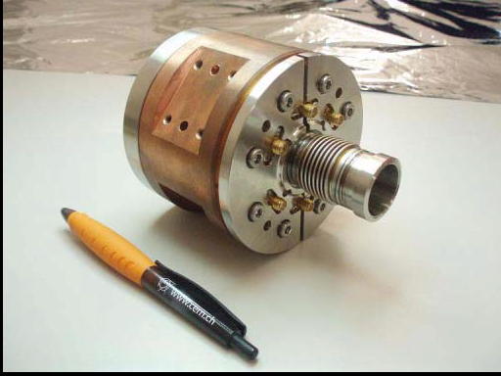
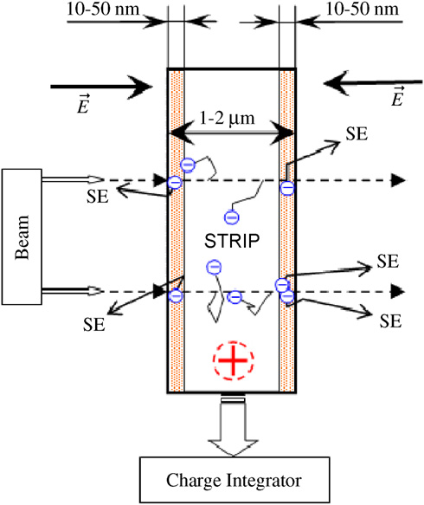
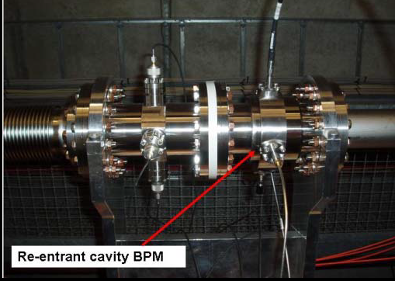
SPECIFICATIONS
BEAM PARAMETERS | PRAE
ENERGY | 50-70MeV (Phase 1)
Charge | 0,05pC-2nC
RF frequency | 3GHz
Repetition rate | 50Hz
Transverse size | 0,5mm
Bunch length | <10ps
Bunches per pulse | 1
Inductive pickup
Microstrip metal detector
Re entrant cavity

Slide 3
BPM: CTF3 IPU
BEAM PARAMETERS | PRAE
ENERGY | 50-70MeV (Phase 1)
Charge | 5pC-2nC (optimal 1nC)
RF frequency | 3GHz
Repetition rate | 50Hz
Transverse size | 0,5mm
Bunch length | <10ps
Bunches per pulse | 1
CTF3
150MeV
0,6nC-2,7nC
12GHz
0,83Hz-50Hz
0,5mm
4ps-20ps
240-1600

Slide 4
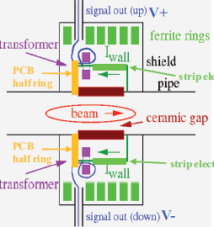
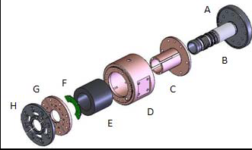
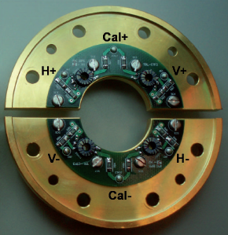
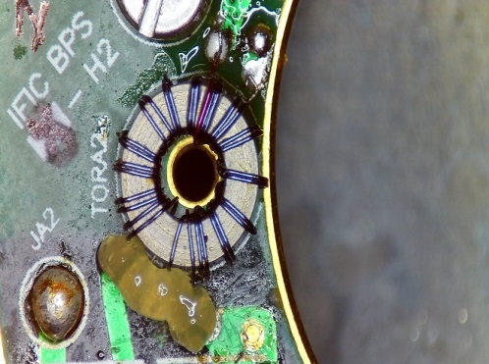
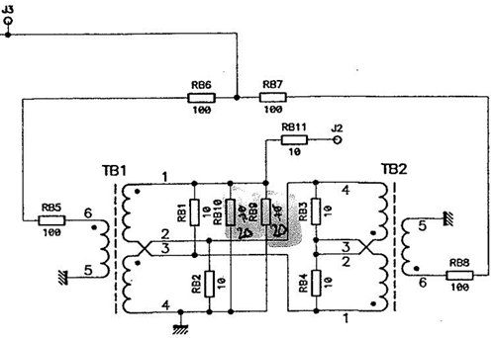
BPM : CTF3 IPU
Operation principle
PCB
PCB
Tore + Windings
PCB CALIBRATION CIRCUIT

Slide 5
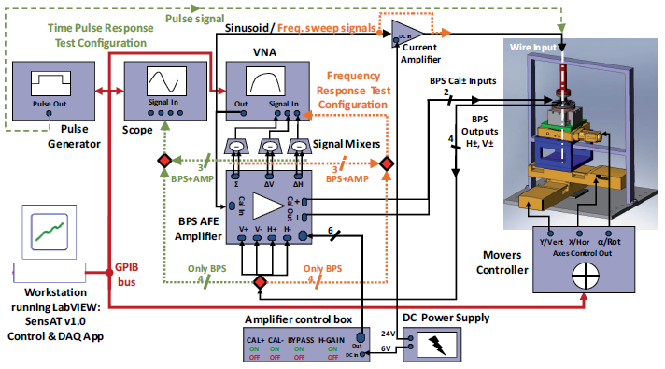
QUALIFICATION SETUP
X,Y displacements
Rotation over the
Z axis
Calibration goals:
Gain Equalization
Frequency and impulse responses for centered beam
Qualification tests:
Frequency response
Impulse response
Bunch response
Sensitivity measurements

Slide 6
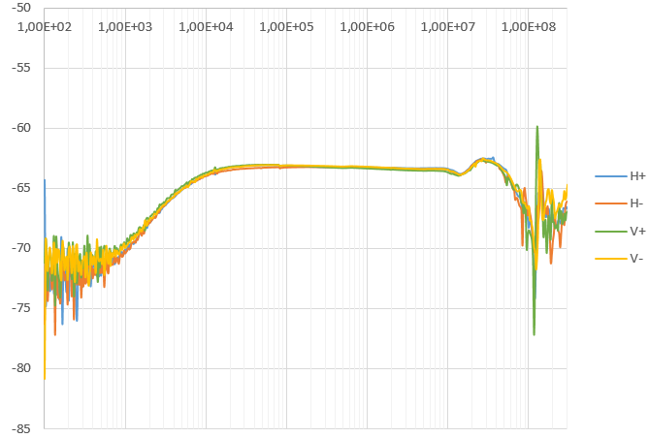
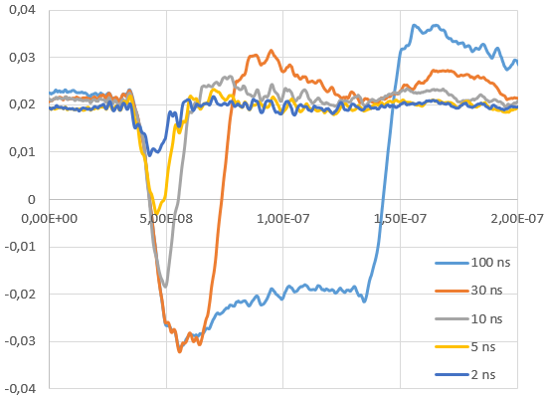
TESTS RESULTS
Frequency response
Impulse response
Hz
V
dB
s
Conclusion:
Cutoff frequencies: Low=2KHz; High=80MHz
⇒ Tdroop= 560ns; Trise=2ns
⇒ Low output for bunch with length <10ps
Setup: 4V impulse with impulse length varying from 2µs to 2ns
Impulse rise time = 0,8ns
Impulse length(ns) | 2000 | 100 | 30 | 10 | 5 | 2
Attenuation(dB) | 3 | 36 | 38 | 40 | 46 | 52

Slide 7
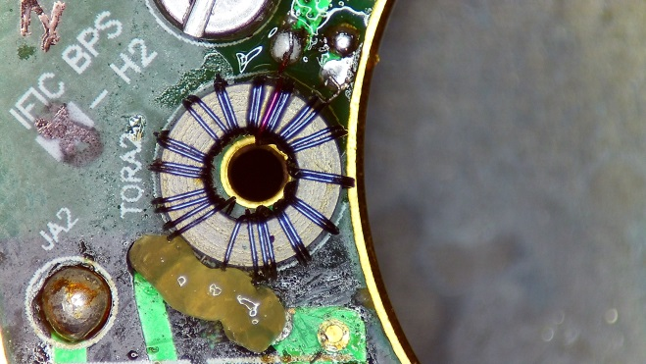
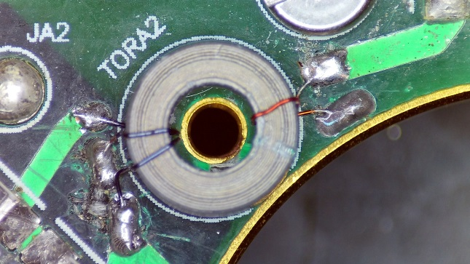
TESTS CONCLUSIONS
Frequency response:
BPM dynamic range = 20dB
Very low BPM response = 62 dB attenuation
Impulse response: very low BPM response
Calculated Sensitivity: 60mV/nC
Actions: Modify the tore windings,
30 turns in the secondary winding → 1 turn in the secondary windings
Expected Goals:
Decrease of 30dB in BPM attenuation
Sensitivity improved to 2V/nC
Previous Windings
Present Windings

Slide 8
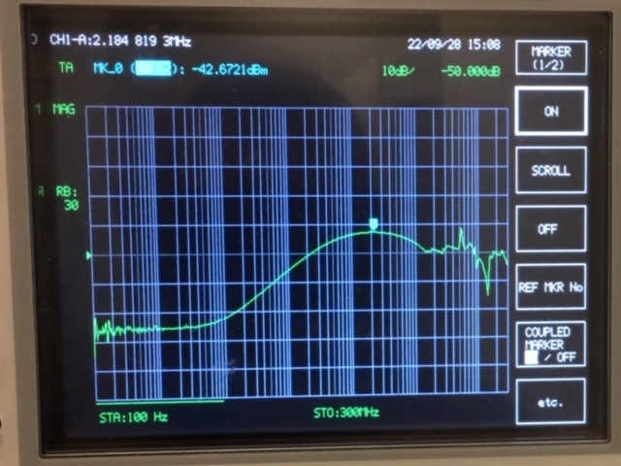
TESTS RESULTS
Frequency response
20dB decrease in BPM attenuation
Cutoff frequency decreased

Slide 9
Actions
Frequency response:
Matching study : (PCB electronics and setup configuration)
Decreasing BPM attenuation
Increase BPM cut off frequency ⇒ Trise ↓
Impulse response: need for short pulse generator for testing
Improve BPM sensitivity (Goal : 2V/nC)
Test of the BPM in configuration close to final operation
Electronics to improve the BPM output signal in real time operation
Design of a charge pump
Study of up-to-date solutions
BPM position sensitivity: Measurement with the test bench

Slide 10
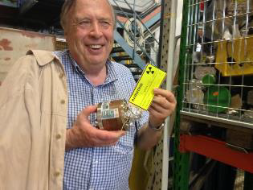
ACKNOWLEDGMENTS
Patrick Ausset
Angeles Faus Golfe
Michal Krupa
Thibault Lefebvre
Oleksander Makarchuk
Darren Ichirrante
Berthelot Sylvain
Pereira Manuel

