Slide 1
Synchronization & Machine Protection System
Projet Emblématique
Programme SESAME
With the support of
Noureddine ELKAMCHI
08/10/2018
PRAE International Workshop, 08-10 October 2018

Slide 2
Outline
PRAE Synchronization System
Role
Architecture
Hardware
PRAE Machine Protection System
Role
Architecture
Operation

Slide 3
SYNCHRONIZATION SYSTEM

Slide 4
Role of the Synchronization system
The task of a timing system is to synchronize all the (relevant) components in an accelerator complex.
One part of this task usually is to Control the injection by triggering the particle source (gun)
Triggering beam diagnostic components like beam position monitors, current transformers, profile monitors and so on, to be synchronized to the passage of the beam.
Fast timing, Slow timing
Events Generator
Events Receivers
Master clock

Slide 5
Architecture
Laser
Oscillator
Pilote
Amplification
Gun
φ
Section
Master clock
Cameras
ICTs
Modulator
Laser
50Hz mains
Supervision

Slide 6
Pilote
Pilote Schematic

Slide 7
Clocs Hardware
Time Delay Generator

Slide 8
Informations needed
RF source:
Laser oscillator frequency
Gun Bandwith
Pre-amplifier input power
Timing:
Number of channels
Time delay limits
Timing frequency
Tolerated jitter

Slide 9
MACHINE PROTECTION SYSTEM

Slide 10
Rôle MPS
The Machine protection system is a vital part of the machine which protect the accelerator elements from damage.
damage of accelerator equipment by beam impact or equipment damage due to its own malfunctioning.
Machine protection system is operating in a very reliable manner.
This system collects the critical defaults from the machine subsystems to switch off the RF which kills the beam.

Slide 11
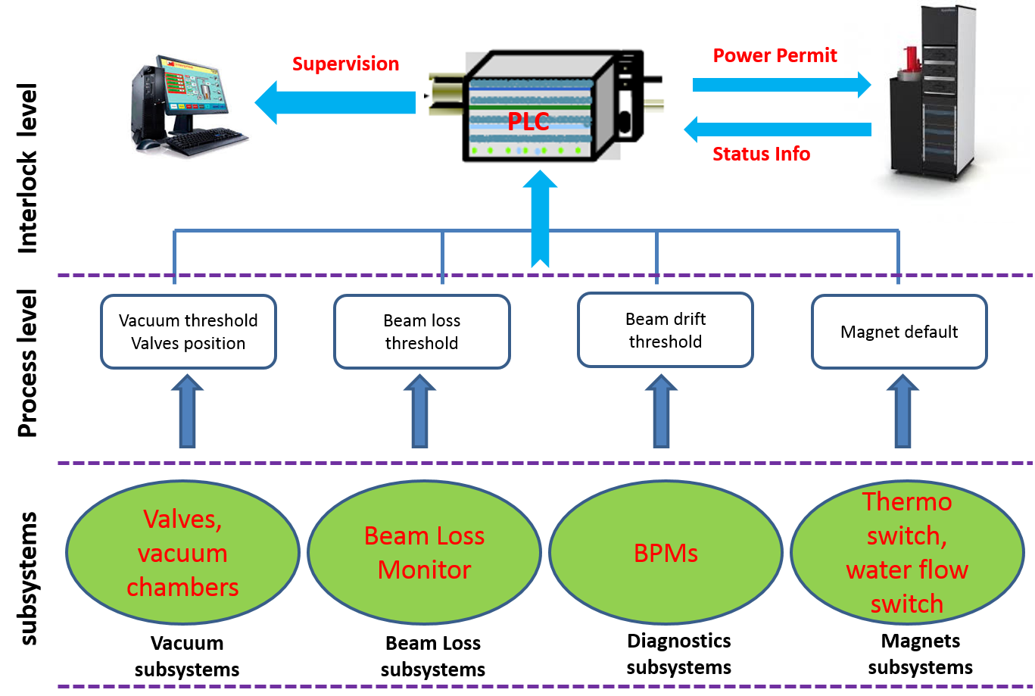
Architecture
Process Level: monitor the variations of different parameters of the machine subsystems, and generates default signal in case of operation problem.
Interlock Level: gathers and process all the default signals from subsystems, and stops the beam

Slide 12
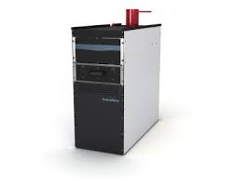
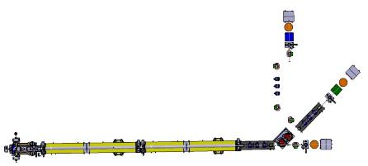
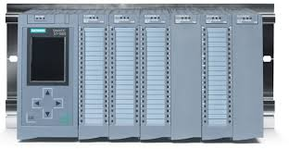
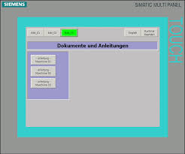
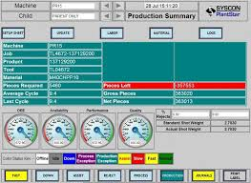
MPS Operation
Siemens S7-1500
supervision
Pupitre Siemens

Slide 13
Informations needed
Concerned elements
Action to be taken
Reset default
Operator mode / Expert mode
Alarm/interlock

Slide 14
Thank You

