Slide 1


Canted Cosine Theta Final Focus Magnets for the FCC-ee
M. Koratzinos
Joint Workshop of future tau-charm factory
5/12/2018

Slide 2
Acknowledgements
Glyn Kirby and Jeroen Van Nugteren of CERN/TE-MSC for fruitful discussions, guidance and the use of very useful tools (Field)
Katsunobu Oide and Frank Zimmermann for helpful discussions
The whole FFC collaboration for their support
Rapid prototyping courtesy of Ideasquared at CERN (Markus Nordberg, Jani Kalasniemi)

Slide 3

What is FCC?
… “coming” “soon” at a “laboratory near you”!
… coming soon at a laboratory near you!
Photo courtesy J. Wenninger

Slide 4
FCC-ee: very challenging accelerator design
Energy 45GeV to 182.5GeV per beam
Luminosities 2E36 (at the Z) to 1.5E34 (at the top)
Horizontal emittance: 0.3 to 1.5nm
Vertical emittance: 1 to 3pm
Crossing angle: 30mrad (crab-waist scheme)
Horizontal β*: 0.15m to 1m
Vertical β*: 0.8 to 1.6mm
Beam sizes at IP: horizontal 6-10μm vertical 30-70nm

Slide 5
What is a CCT magnet (a.k.a. “double Helix”)?
Conventional
CCT (Double Helix)
Novel idea (discovered in the 70ies, but gained momentum recently with the advent of CNC manufacturing and 3D printing)
  Excellent field quality
  Engineering simplicity: no pre-stress; fast prototyping
  Simpler and cheaper than conventional designs
  But: more conductor for same field compared to conventional design

Slide 6
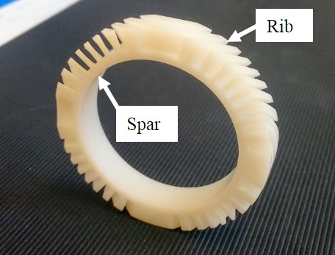
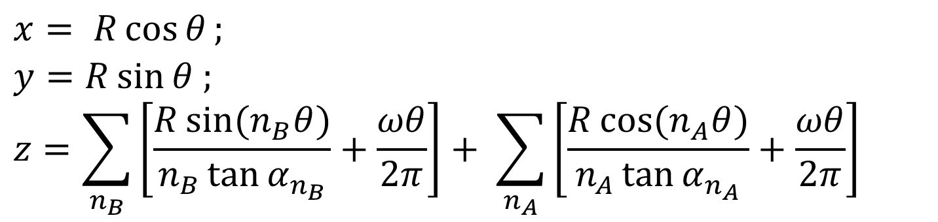
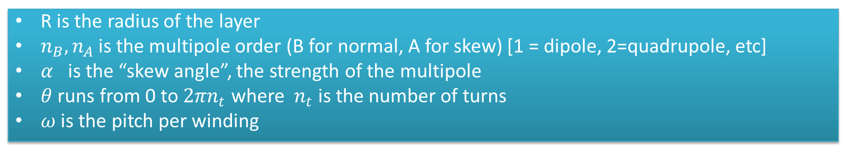
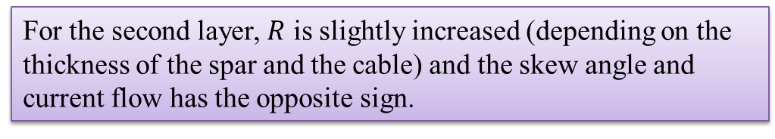
The CCT design in formulas
Tow layers are needed: The position of the centre of the groove is described by the following equations:
$$x= R\cos{θ};$$
$$y=R\sin{θ ;}$$
$$z=\sum_{n_{B}}{\left[\frac{R\sin{{(n}_{B}θ)}}{n_{B}\tan{α_{n_{B}}}}+\frac{ωθ}{2π}\right]}+ \sum_{n_{A}}{\left[\frac{R\cos{{(n}_{A}θ)}}{n_{A}\tan{α_{n_{A}}}}+\frac{ωθ}{2π}\right]}$$
R is the radius of the layer
$n_{B}, n_{A}$is the multipole order (B for normal, A for skew) [1 = dipole, 2=quadrupole, etc]
$α_{}$is the “skew angle”, the strength of the multipole
$θ$ runs from 0 to ${2πn}_{t}$ where $n_{t}$ is the number of turns
$ω$ is the pitch per winding
For the second layer, $R$ is slightly increased (depending on the thickness of the spar and the cable) and the skew angle and current flow has the opposite sign.

Slide 7
The CCT disadvantage
Each layer produces a field of the chosen multipole plus an (unwanted) solenoid field
The solenoid fields of the two layers exactly cancel out, but the multipole fields add up
Due to this cancellation, more conductor (~30% more) is needed to deliver the same field as a conventional design

Slide 8
The CCT advantage
The field away from the edges has excellent homogeneity and purity, as it is produced by a perfect cosine(theta) current.
Also, and most importantly for our application, the multipole mix is a local property of the magnet, which can vary along its length
This is not possible with a traditional design.
Stress management: highest stress where material is strongest; no need to pre-stress

Slide 9
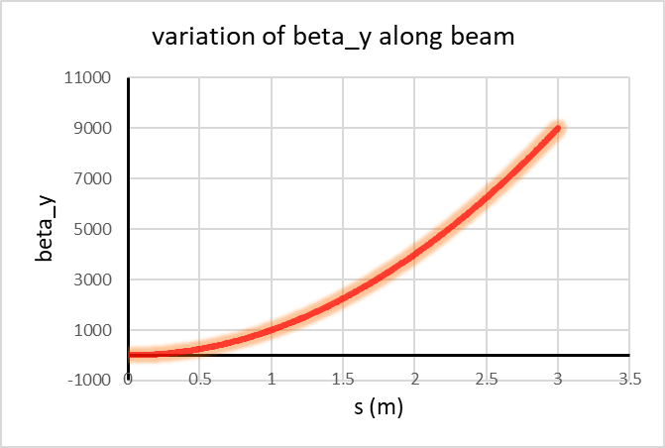
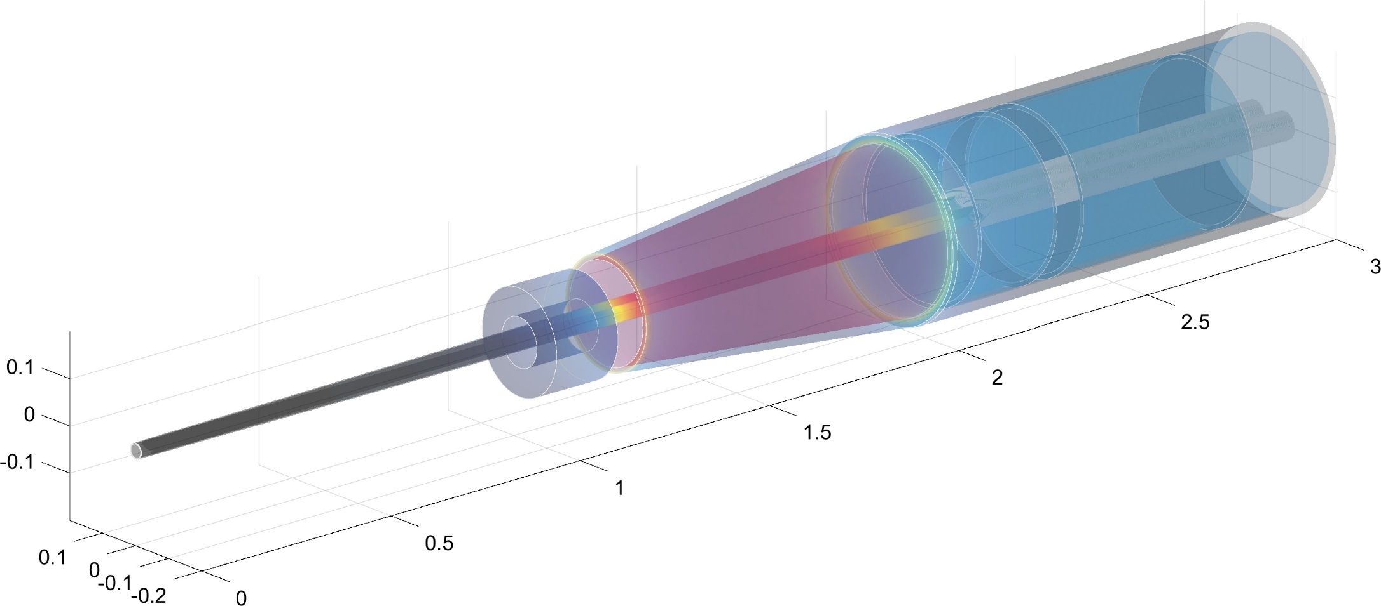
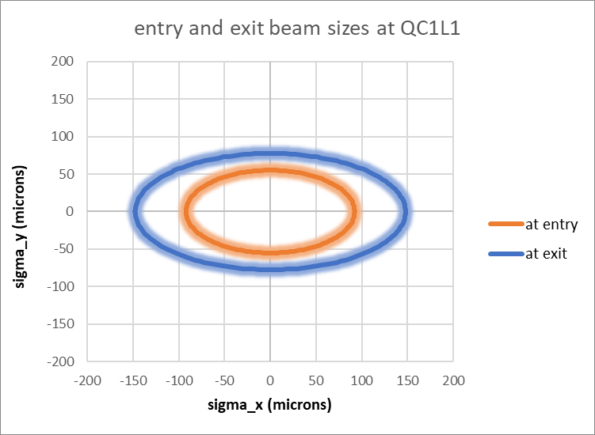
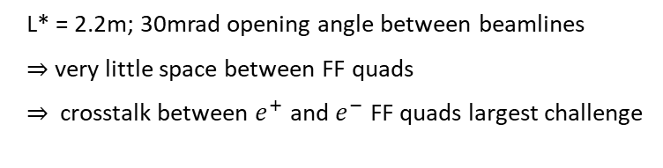
Our application: FCC-ee MDI region
L* = 2.2m; 30mrad opening angle between beamlines
very little space between FF quads
crosstalk between $e^{+}$ and $e^{−}$ FF quads largest challenge
FF quad QC1L1

Slide 10
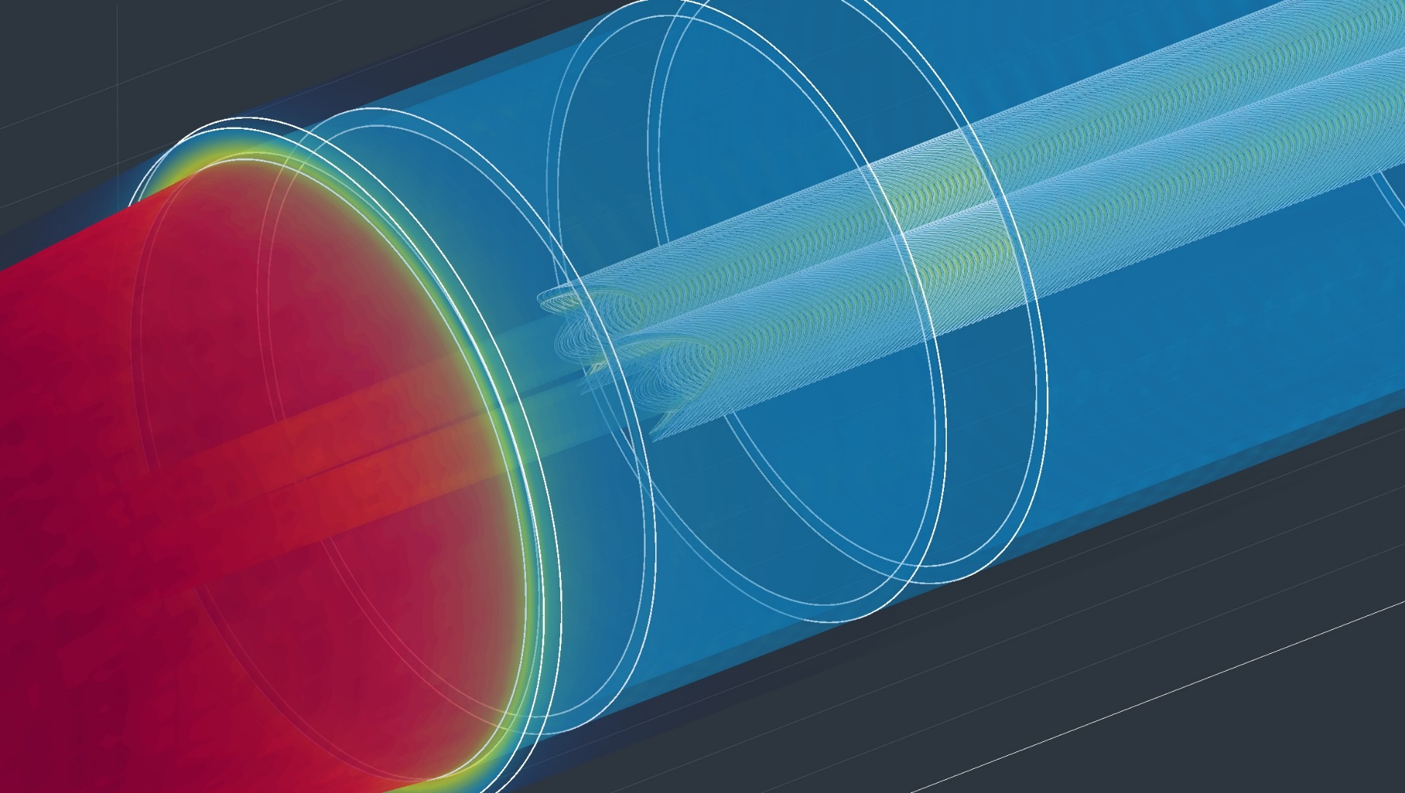
Zoom at 2.2m from the IP
FF quad QC1L1

Slide 11
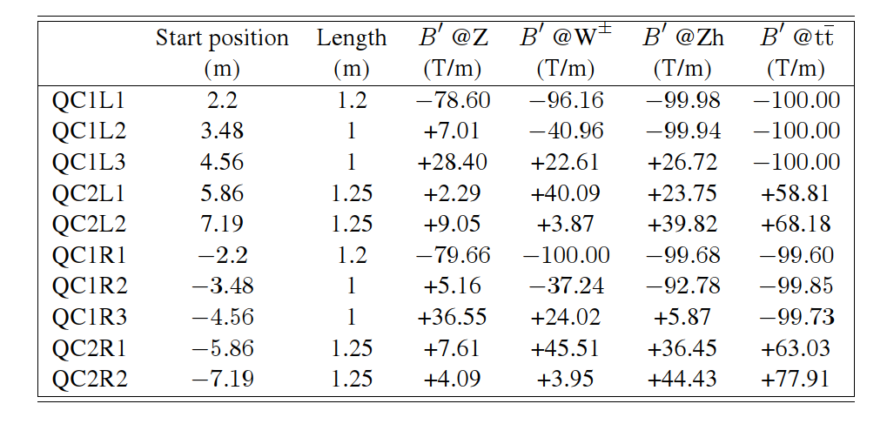
The FCC-ee Final Focus magnets

Slide 12
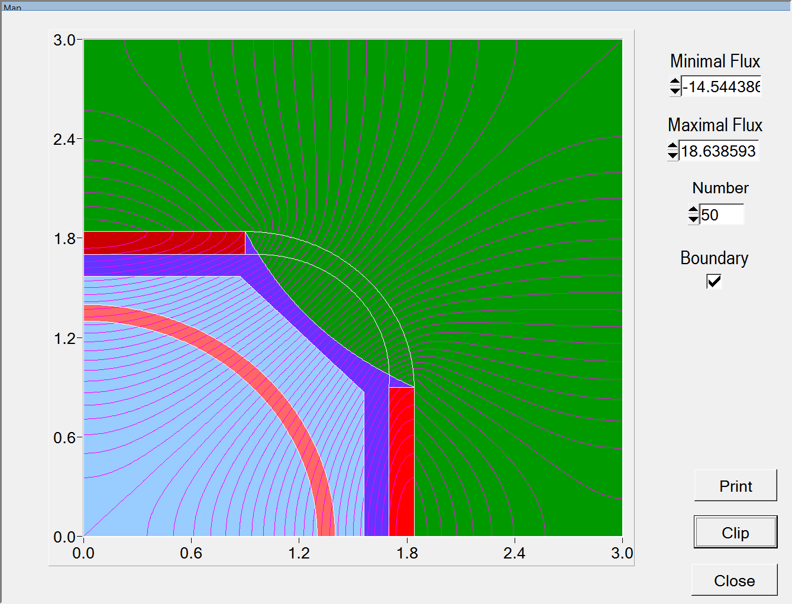
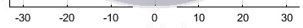
Can we design an iron-core quadrupole?
Maximum field needed to produce 100T/m is >~2.5T
Iron will be saturated at high gradients
This will introduce unwanted multipole components
mm
Beam pipe: radius 15-17mm
Quad can start here (radius 20mm)
My personal assessment: field quality will not be sufficient for gradients >~70T/m
Available space for coil and iron: 26mm
If coil + support is 10mm, this leaves only 6mm for the iron

Slide 13
Iron-free design
So, if iron will not provide the elimination of cross-talk, what will?
Answer: compensation must be embedded in the quadrupole design
This can be trivially done in a CCT design
Keep in mind that iron-free also means that everything is linear
First mention of a CCT approach for a similar application: Paoloni et al. for the SuperB project

Slide 14
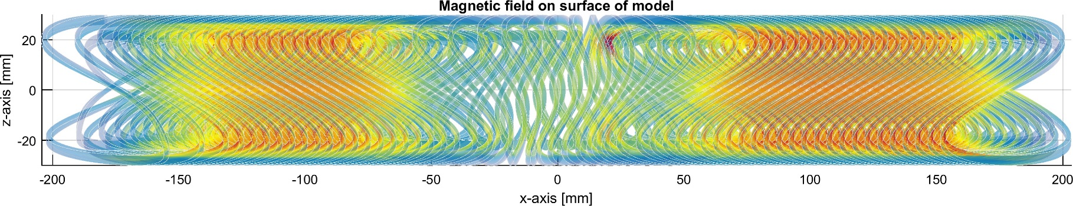
An illustration: an example of a “combined function” CCT magnet
CCT coils can be customised with any multipole ingredients that can change every two turns of the coils, allowing limitless customization…
(useless) example: QF/QD in one unit (with a sextupole in between)
In reality, multipole components needed to eliminate crosstalk are so small that the extra wiggles are not visible to the untrained eye
QF
sextupole
QD

Slide 15
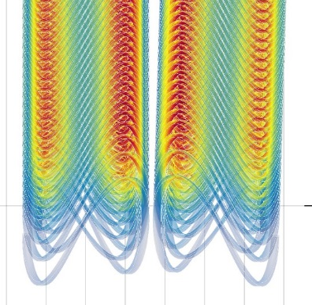
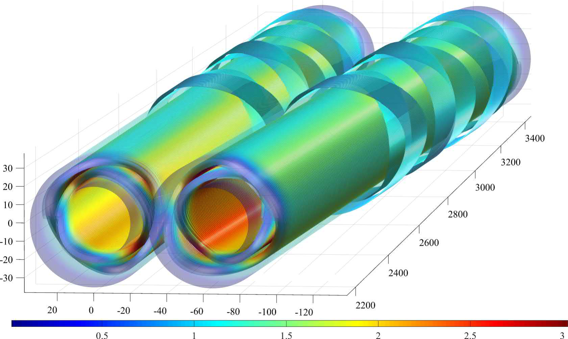
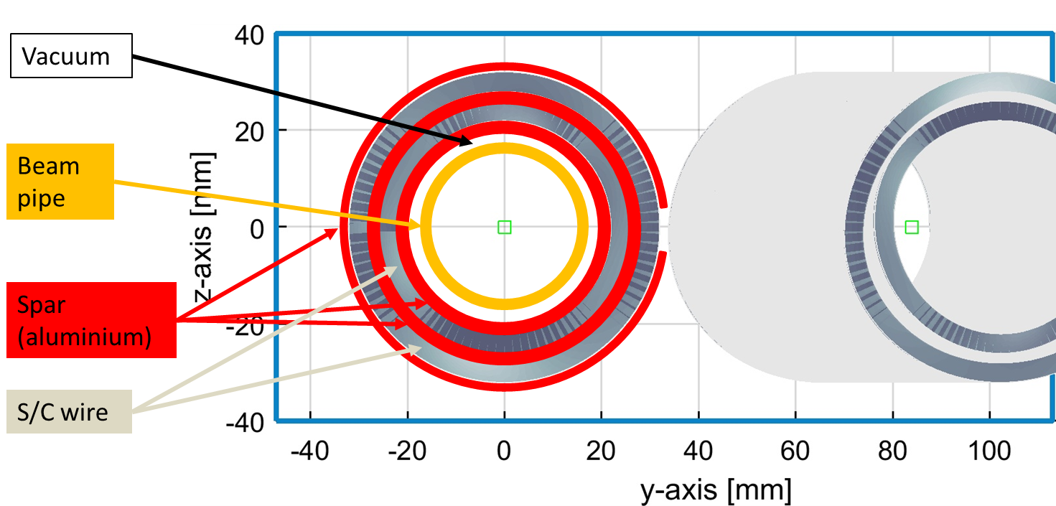
QC1L1
QC1L1 is the first and most demanding pair of quadrupoles of the final focus system of FCC-ee
Inner bore: 40mm (diameter)
Fits outside the warm water-cooled beam pipe of inner diameter 30mm

Slide 16
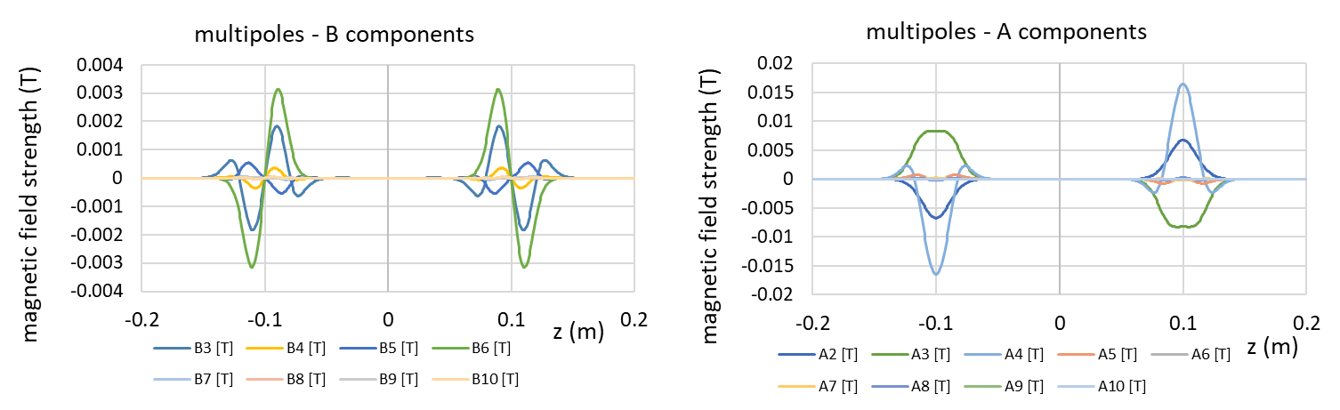
Typical CCT quadrupole field profile
Middle: All components (apart from main component) zero
Edges
  B components locally integrate to zero
  A components integrate to zero by integrating the whole magnet
For a ‘typical’ CCT quad of inner diameter 40mm, length 20cm, strength 100T/m, at a radius of 10mm (2/3 aperture)

Slide 17
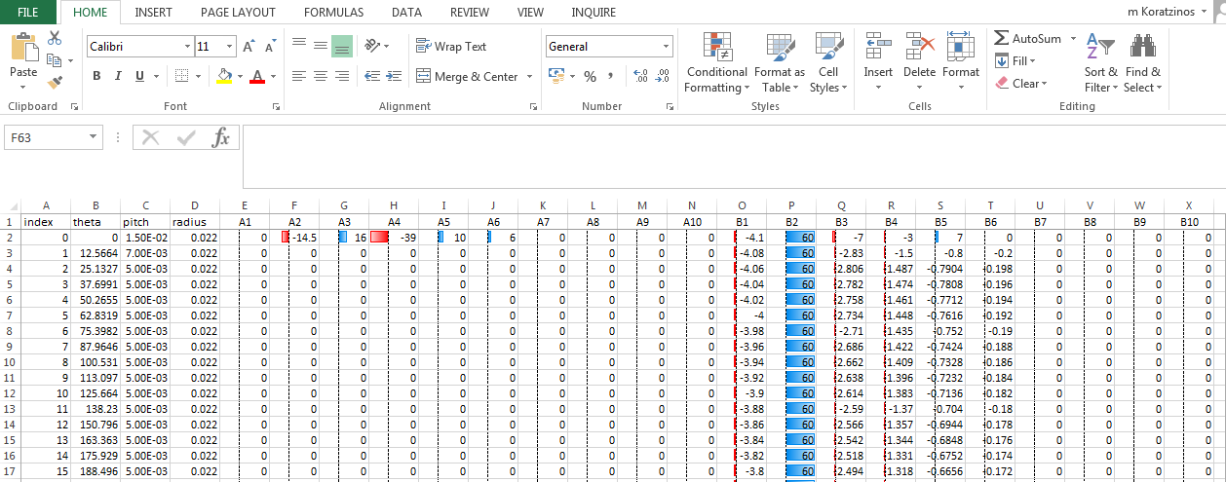
Crosstalk compensation
Small multipole components are introduced to exactly compensate for crosstalk. These corrections vary along the length of the quadrupole. The two quadrupoles are a mirror image of each other.
Below how the easy-to-use user interface (FIELD suite of programs by J. Van Nugteren) looks like:

Slide 18
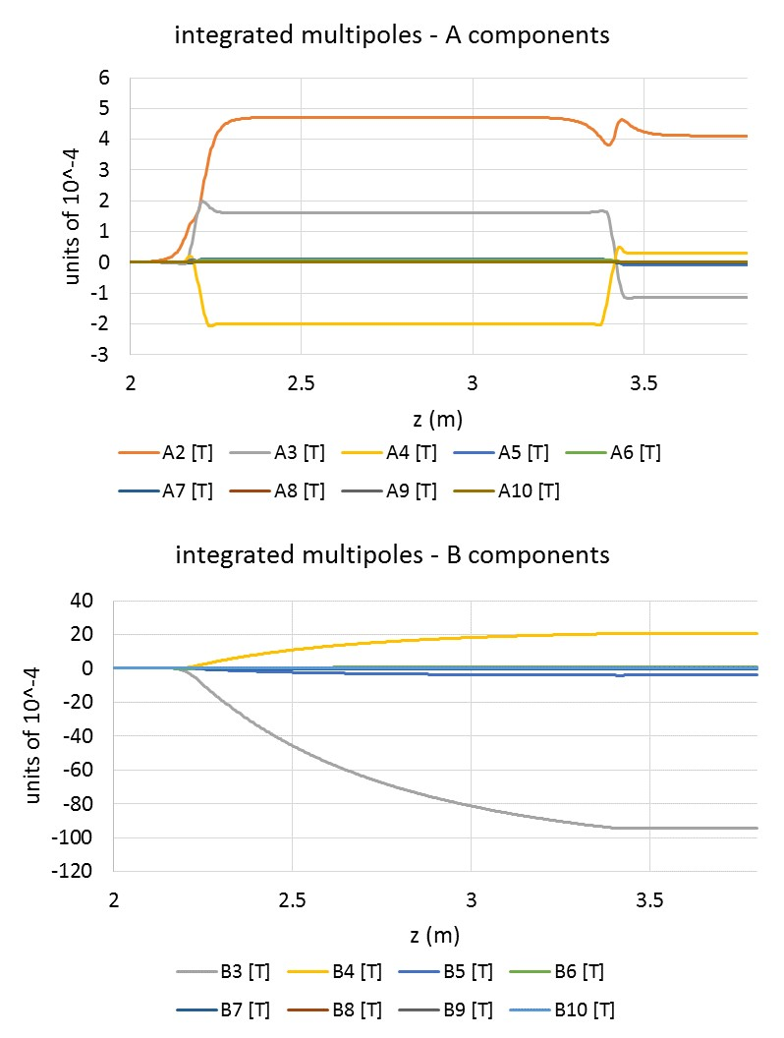
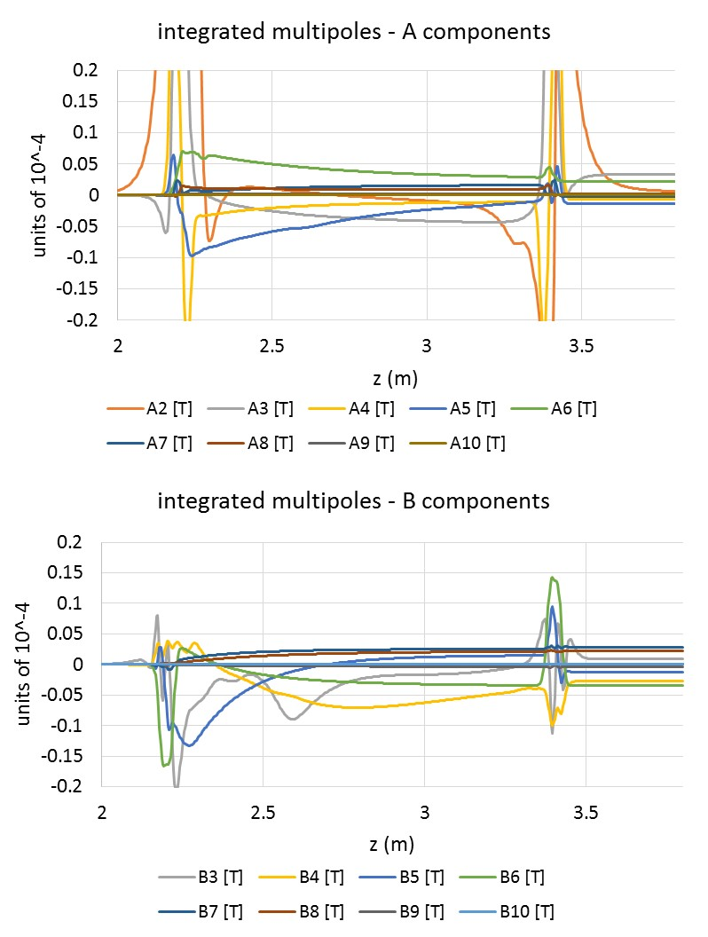
QC1L1 crosstalk correction
Before correction
After correction
Excellent field quality: all unwanted multipoles below 0.1 units (normal and skew)

Slide 19
A step further: local edges correction
We now have a design with integrated multipoles of <0.1 units of 10⁻⁴.
There are, however, local field errors at the edges of the quadrupole. These integrate out when considering the whole length of the quadrupole.
However, we are in a very demanding environment: field quality should be excellent even locally as we sit in an area of rapidly varying optics functions (the beam size at one and the other end of the quadrupole is different – beta_y @2.2m = 6km; beta_y at 3.4m = 14km

Slide 20
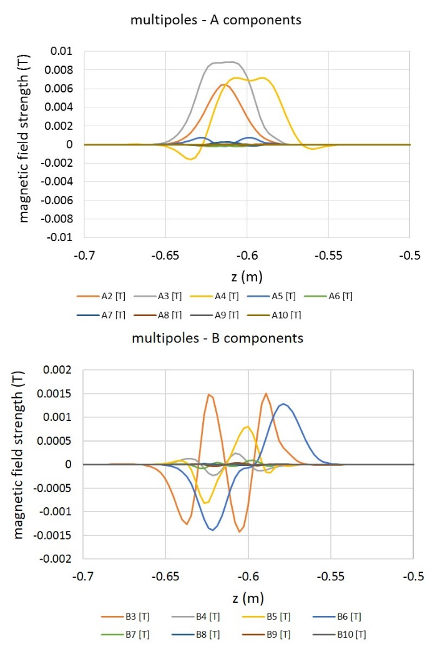
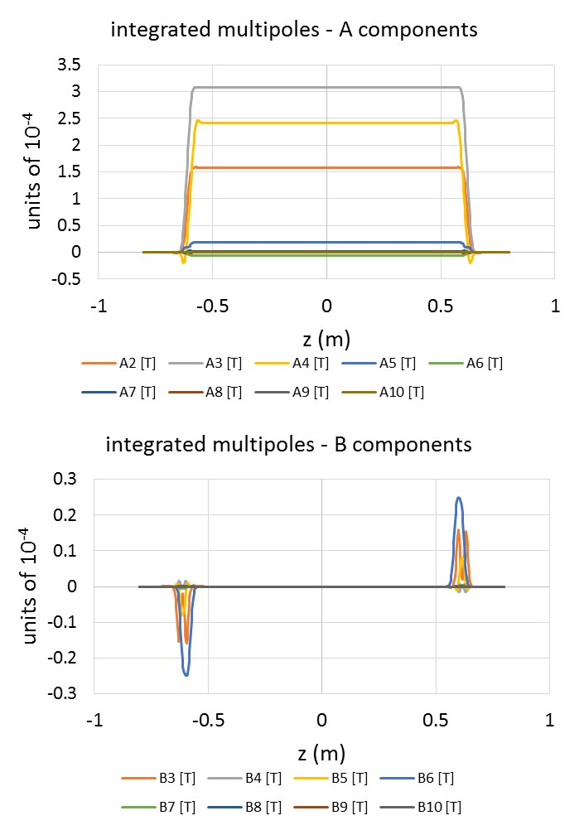
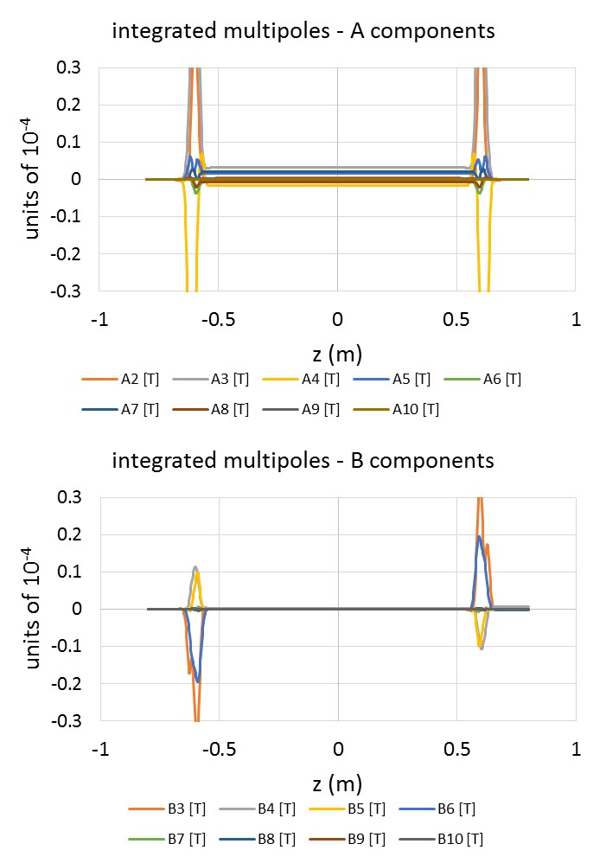
QC1L1 edge correction
Integrated multipoles before (centre) and after correction (right)
Also excellent results: edge errors can be corrected locally.
Before correction
Before correction
After correction

Slide 21
Packaging advantages
A number of correctors are needed as close to the IP as possible
The absence of iron in this design makes it possible to include a number of correctors as extra rings on top of the quadrupole
These correctors do not take extra space in the design.
Each corrector comes with its own compensating coil in the other aperture to compensate for the (small) crosstalk

Slide 22
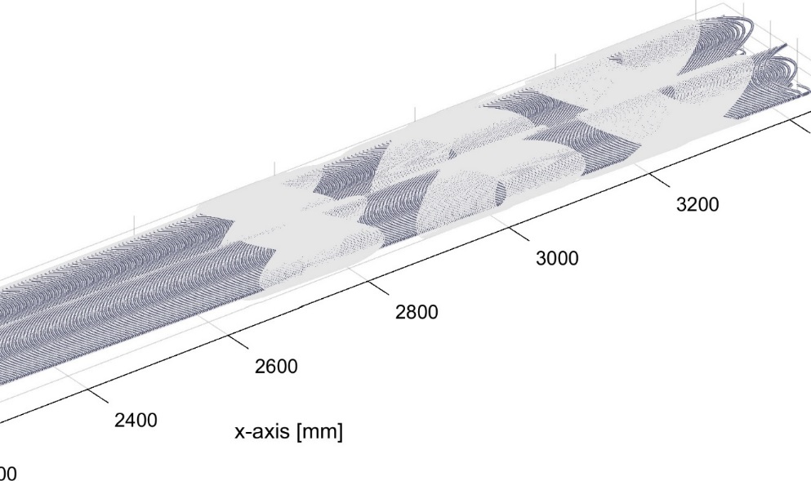
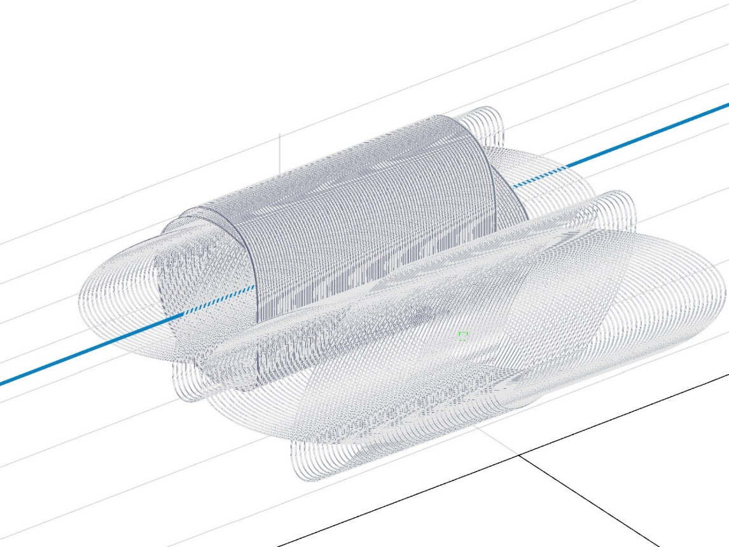
Correctors
Correctors can be packaged very efficiently
This is important for a design where space is at a premium
IP
Distance from IP (mm)
B1 corrector
A1 corrector
A2 corrector
Compensation loop of left corrector
0.5mm wire, critical current @3T is 300A, physical length ~20cm
Main right corrector, for reference
Main left corrector

Slide 23
Prototyping
This is a relatively new technique that needs to be demonstrated in the lab and not only in computer simulations
Great synergy with the MCBRD (Hi-lumi D2 orbit corrector) project at CERN (and soon in China) which is a CCT dipole
First prototype: single aperture, edges correction on one side only
  Nominal aperture, nominal field

Slide 24
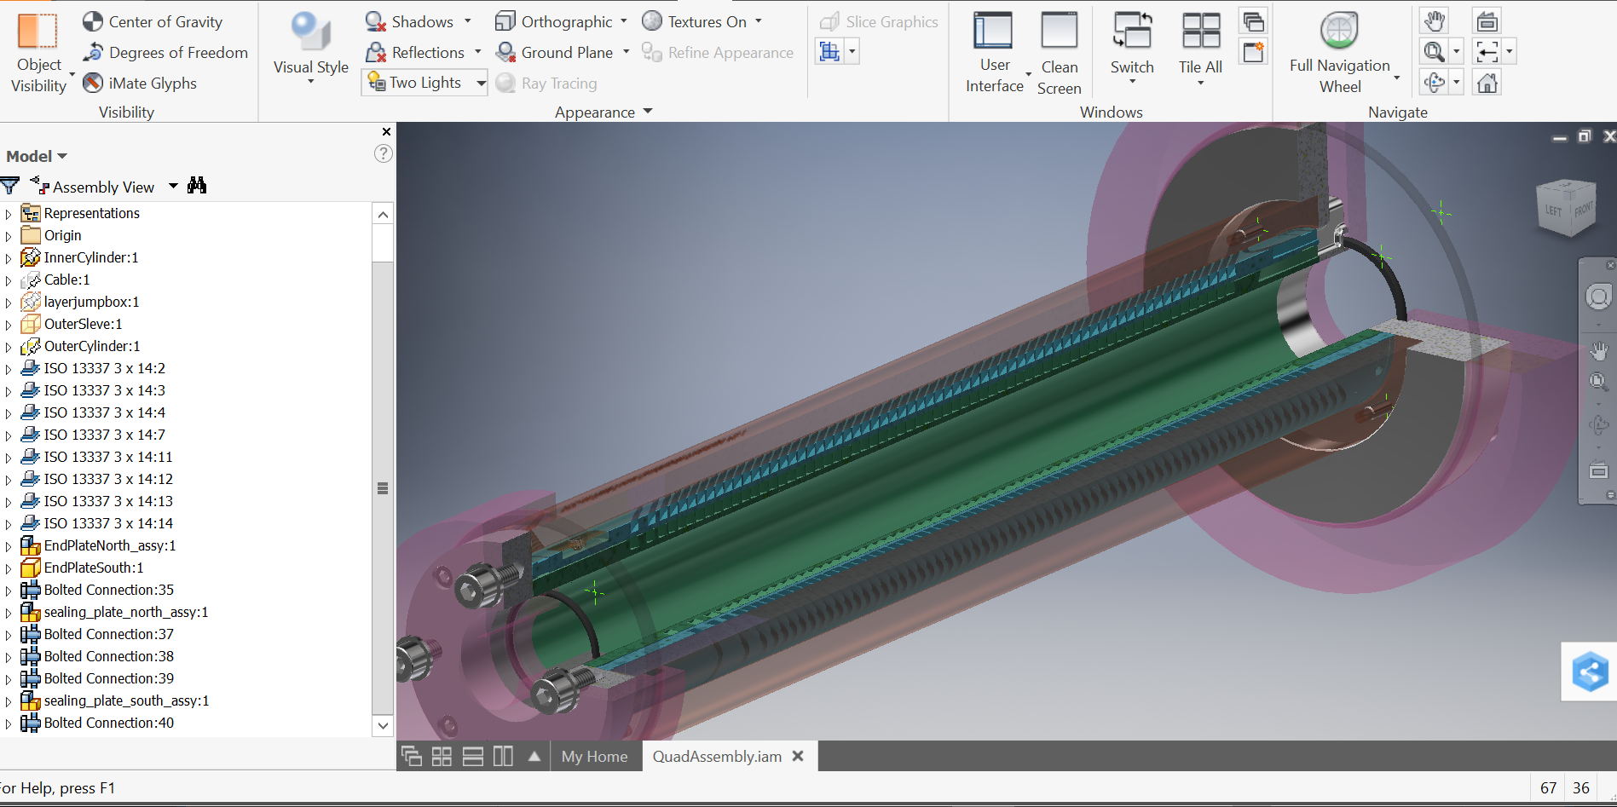
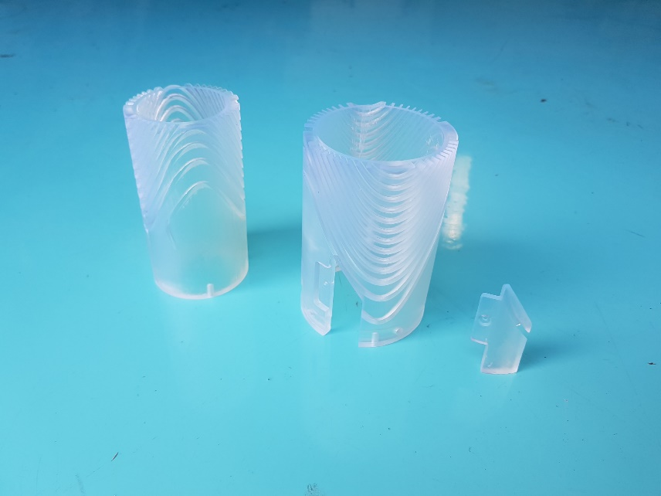
The FCC FF quad CCT prototype project
Advantages at a glance:
Excellent field quality (<1 unit)
No need for B3 correctors
Any correctors do not take additional space
Excellent LOCAL field quality at the edges
Excellent crosstalk compensation
Cheap (no pre-stress, simple winding, light construction)
Project milestones:
Magnetic design
Mechanical design
Manufacturing
Coil winding
Impregnation
Field measurement (at warm or cold)
Quench training / ultimate current
3D printed bottom end of prototype
Suitable for all applictions where space is at a premium and field quality is important: FCC-ee, CEPC, SuperKEKb
M. Koratzinos

Slide 25
FF quad prototype Mk I spec sheet
Technology: | CCT
Length of former: | 430mm
Aperture: | 40mm
Length of cable: inner/outer layer | 15 m X 8/20m X 8
Number of conductors / type | 8 X LHC NbTi cable 0.825 mm insulated
s/c to copper ratio | 1 to 1.9 (sc2nonsc = 0.34)
Cable diameter | 0.970 mm with insulation
Inductance | 6.3mH
Current | 725A per cable
Groove size | 2.05mm X 4 mm before anodization
Void factor | 4.27mm2 / 8.2 mm2 = 48%
Temperature margin | if T_bath=1.9, T_margin=2.5
Maximum field/ gradient | 2.71 T (corresponding to 93T/m)
J_e | 690 A/mm2

Slide 26
Load line
At 1.9K, no margin:
J_e = 950A/mm^2
I_e = 7,980 A
I_e per cable = 998 A (137T/m)
At 1.9K, 2K margin (or running at 77%):
J_e = 728A/mm^2
I_e = 6110A
I_e per cable = 764A (105T/m)
For 100T/m gradient, maximum field is 2.8T, I_cable = 725A, J=690A/mm^2

Slide 27
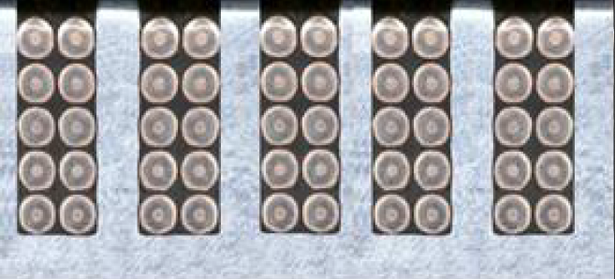
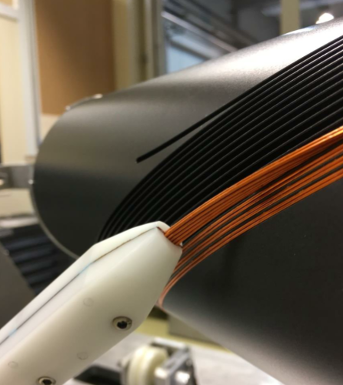
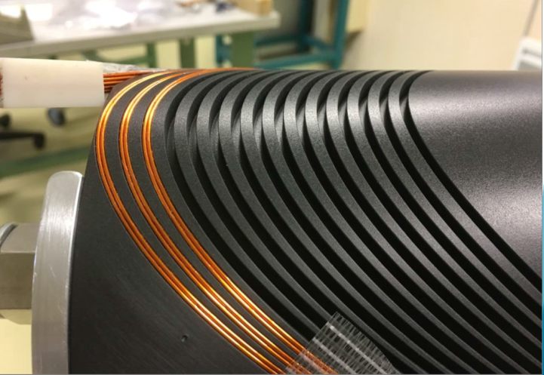
The cable
We are using the same cable and winding scheme as the D2 corrector HiLumi magnet, currently being prototyped.
D2: 5X2 individual insulated strands
QC1L1 magnet: 4X2 individual strands
Wiring tool in action

Slide 28
Mechanical design
Complete set of drawings

Slide 29
Accuracy needed for critical surfaces/lines: ±25 microns

Slide 30
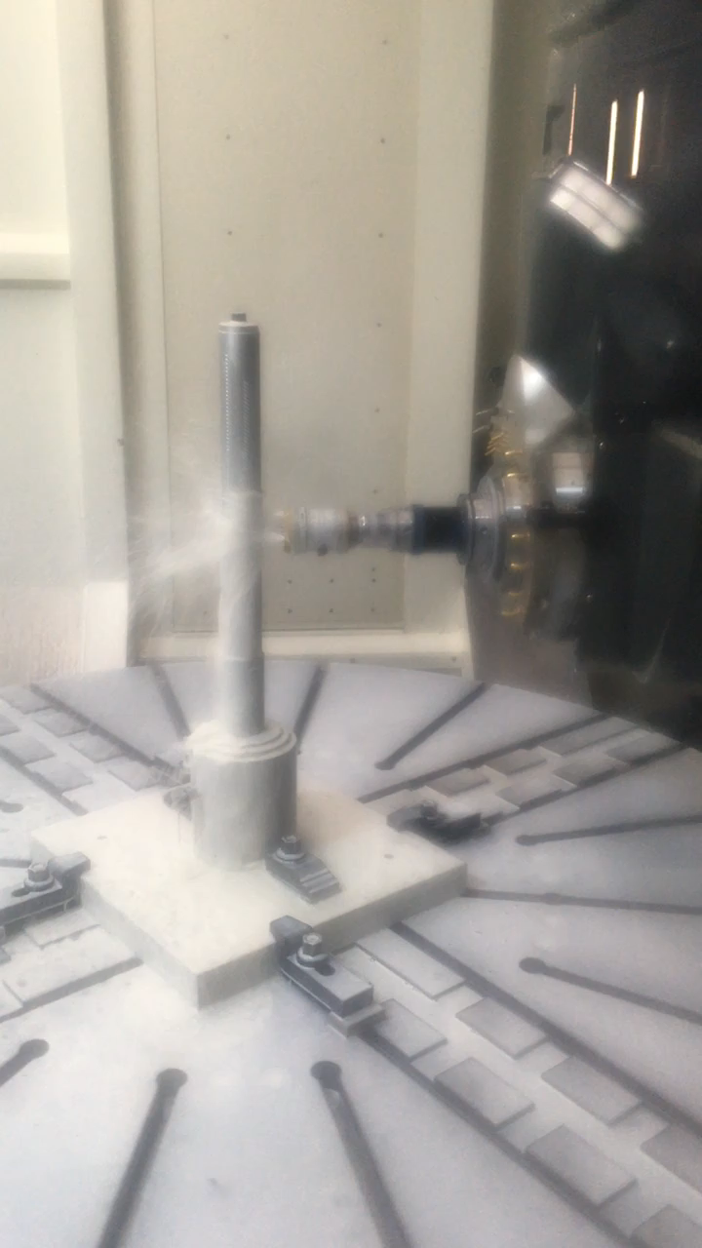
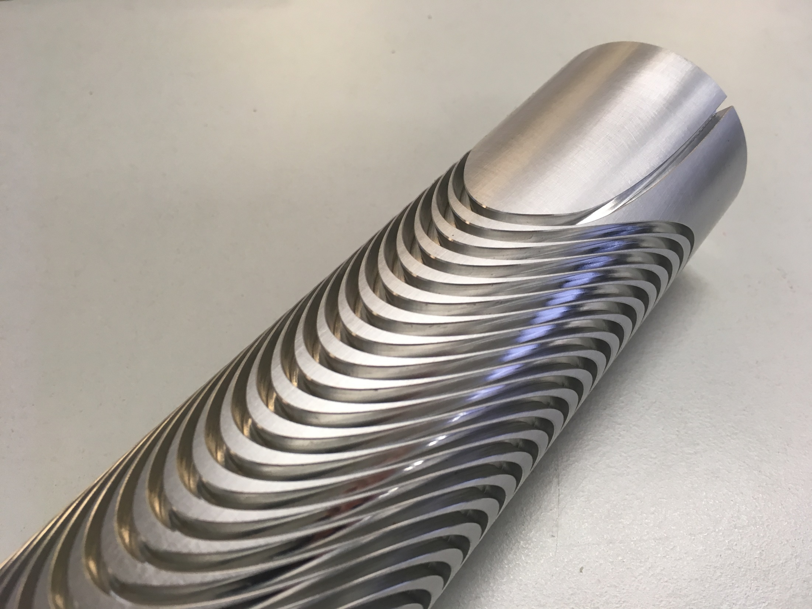
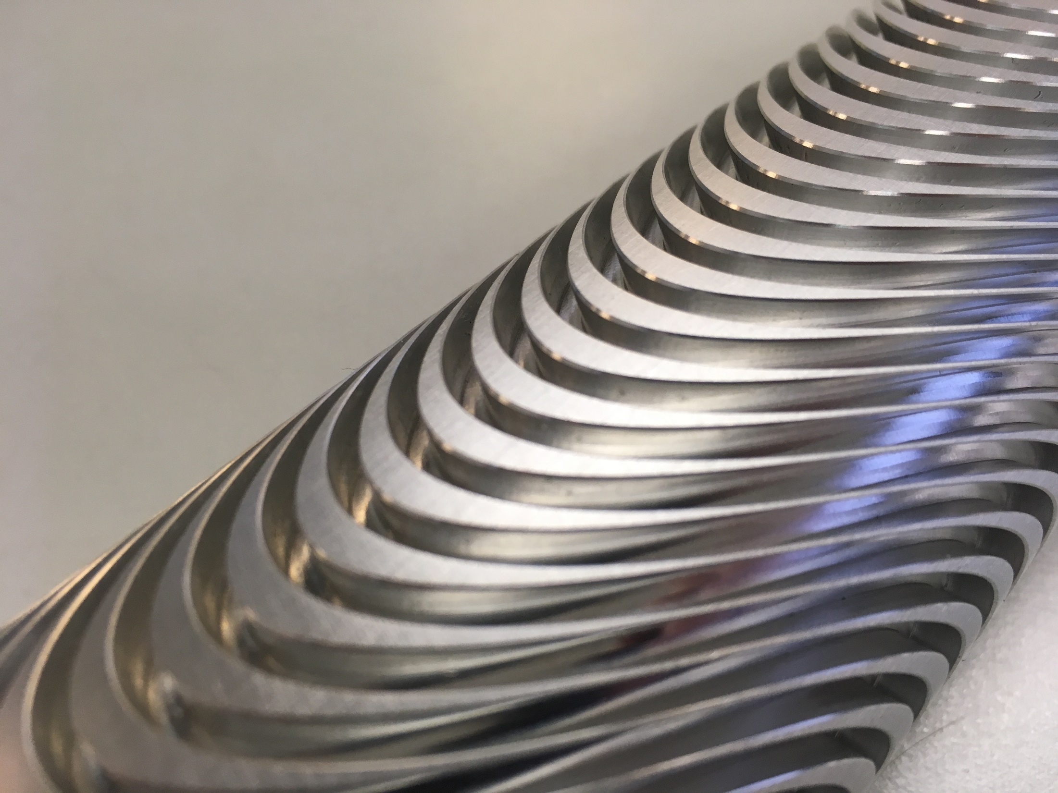
Machining
At the CERN main workshop
Precision +- 25 microns

Slide 31
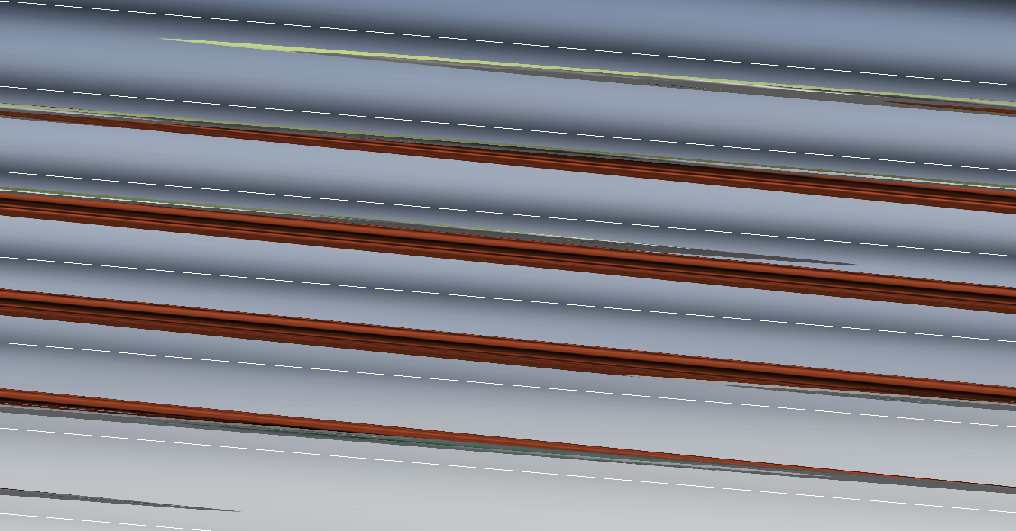
Promotional video – exploded view
(done directly from the CAD program, not an “artist’s impression”)

Slide 32
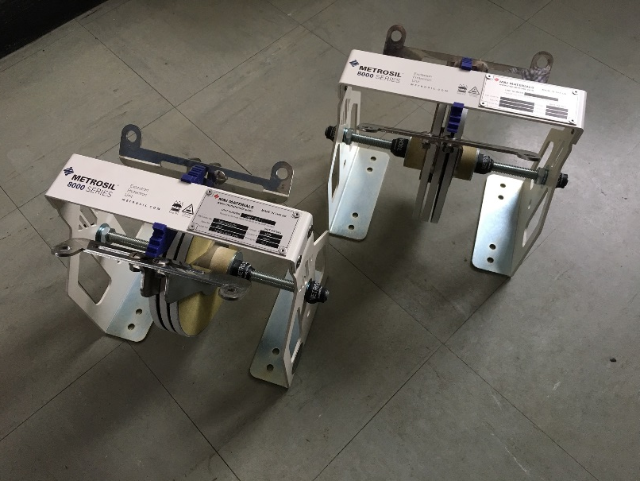
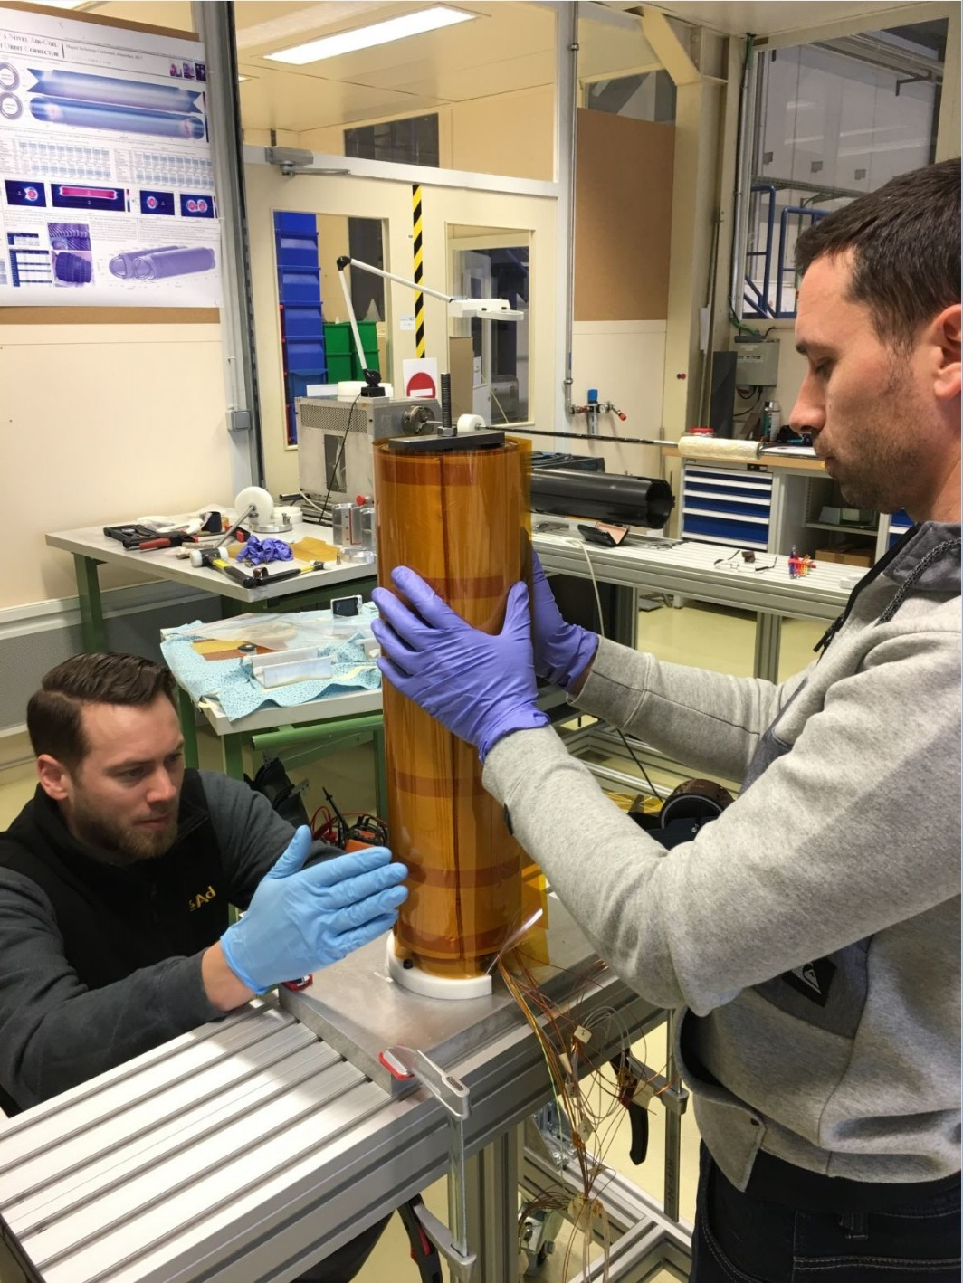
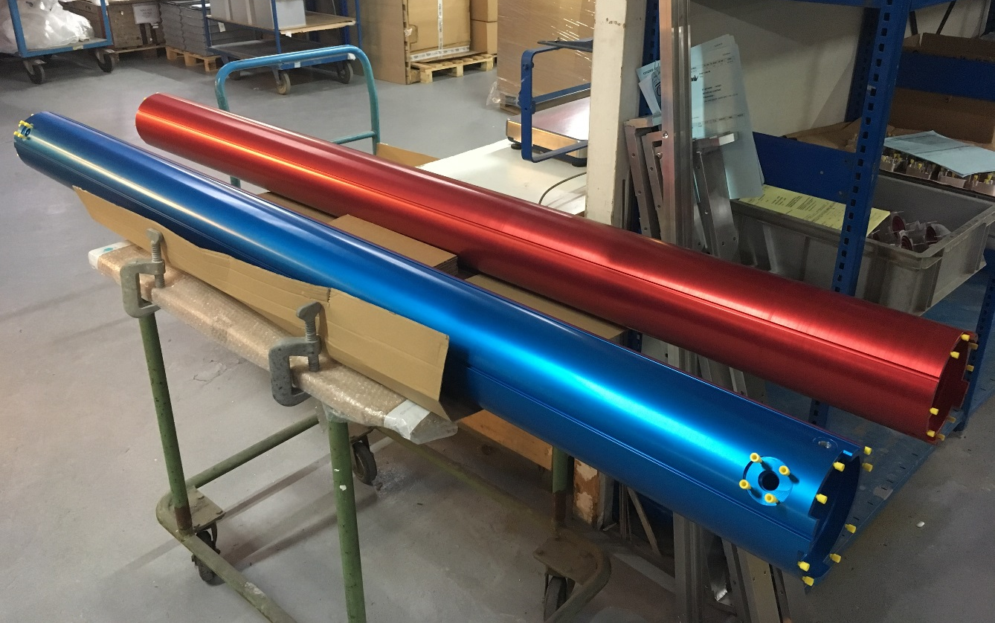
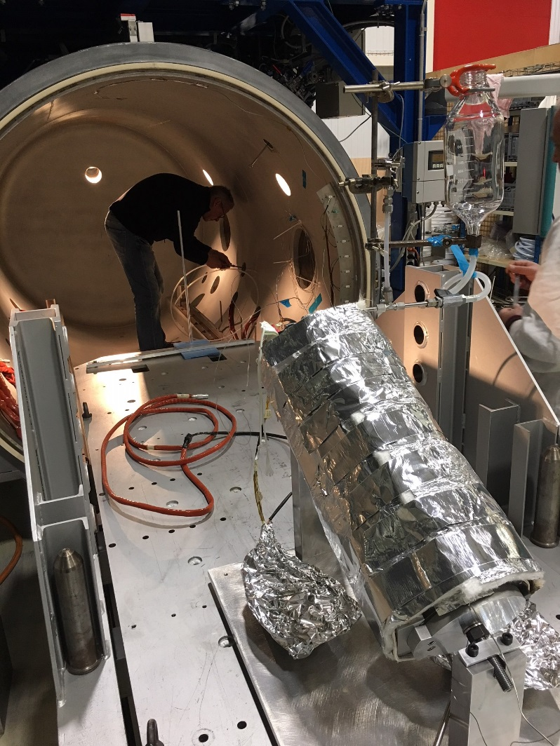
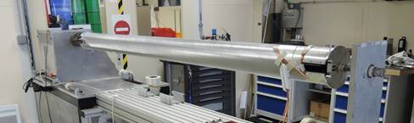
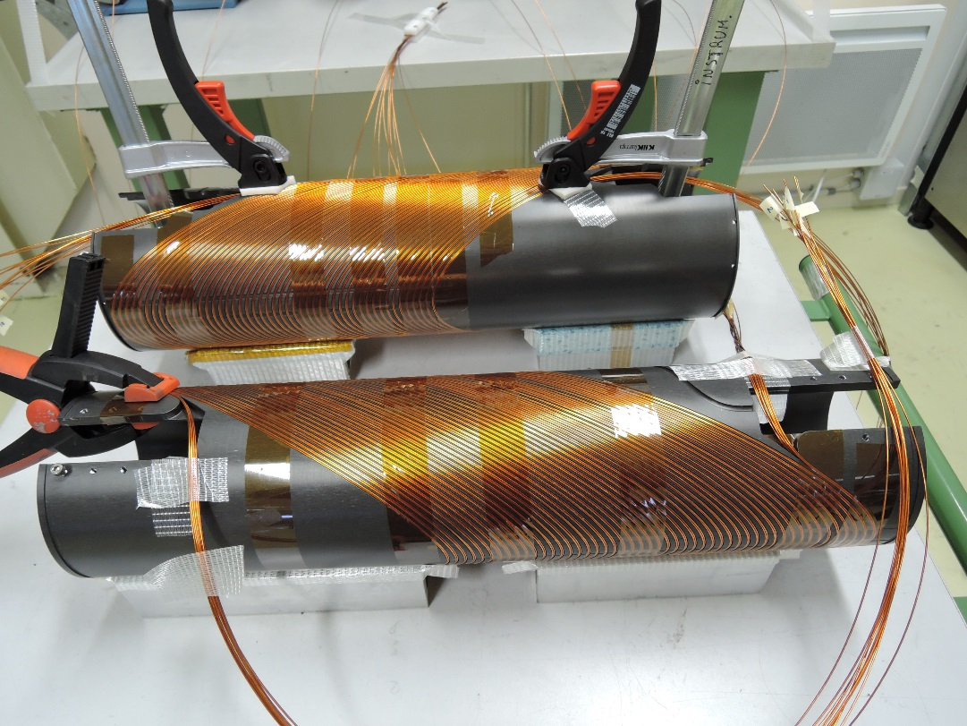
MCBRD (Hi-lumiD2 orbit corrector project)
CCT expertise is being built upon at CERN

Slide 33
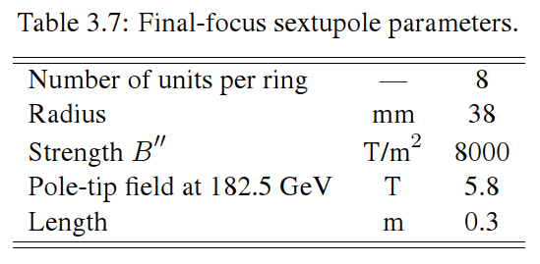
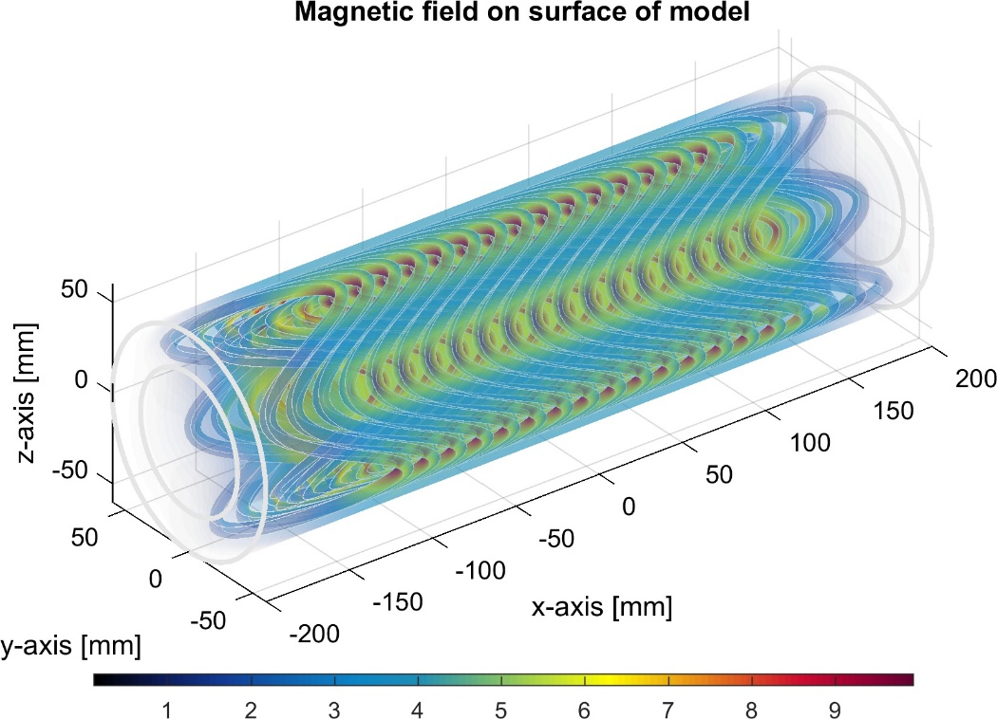
Second FCC-ee application
Crabbing chromaticity correction final focus sextupole
Very strong field, very short magnet
Ideal application to try a CCT HTS solution!
First attempt: 80 HTS tapes of 70um X 4mm can do the trick!
Still in the conceptual sphere

Slide 34
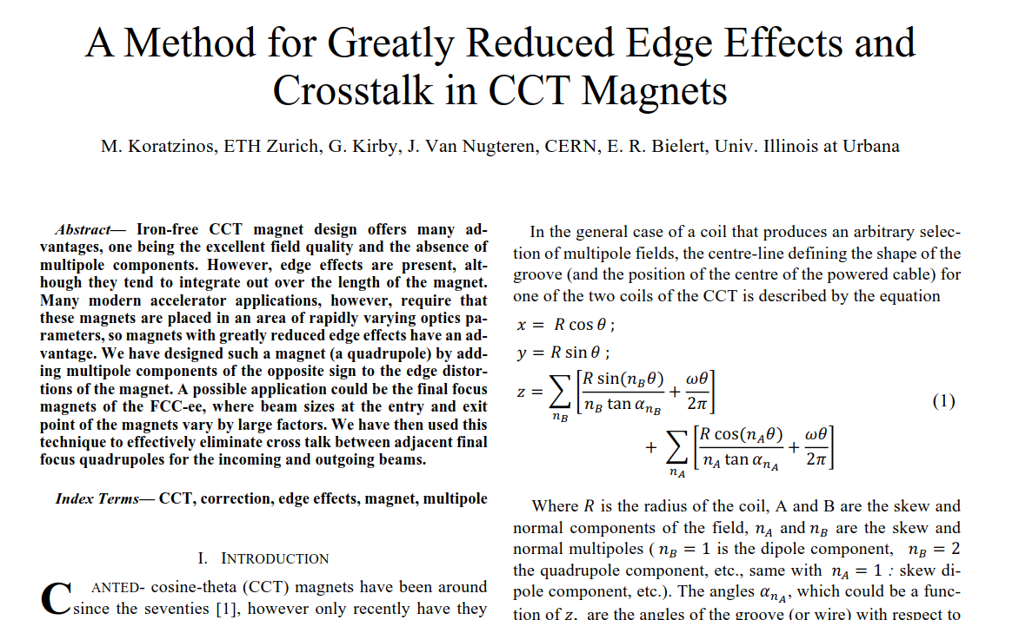
Further reading
· Journal: IEEE Transactions on Applied Superconductivity
· Issue Date: APRIL 2018
· Volume: 28, Issue:3
· On Page(s): 1-5
· Print ISSN: 1051-8223
· Online ISSN: 1558-2515
· Digital Object Identifier: 10.1109/TASC.2018.2806390

Slide 35
Conclusions
There emerges a new generation of precise magnets based on the CCT technique
Advantages are:
  Excellent field quality
  Able to correct cross talk
  Excellent packaging advantages for correctors
  Can be designed/manufactured at a fraction of the cost of traditional designs
A prototype FCC-ee FF quadrupole is being constructed and will be tested soon
Suitable for: FCC-ee, CEPC, next generation SuperKEKb, next tau-charm factory?

Slide 36
Extra slides

Slide 37
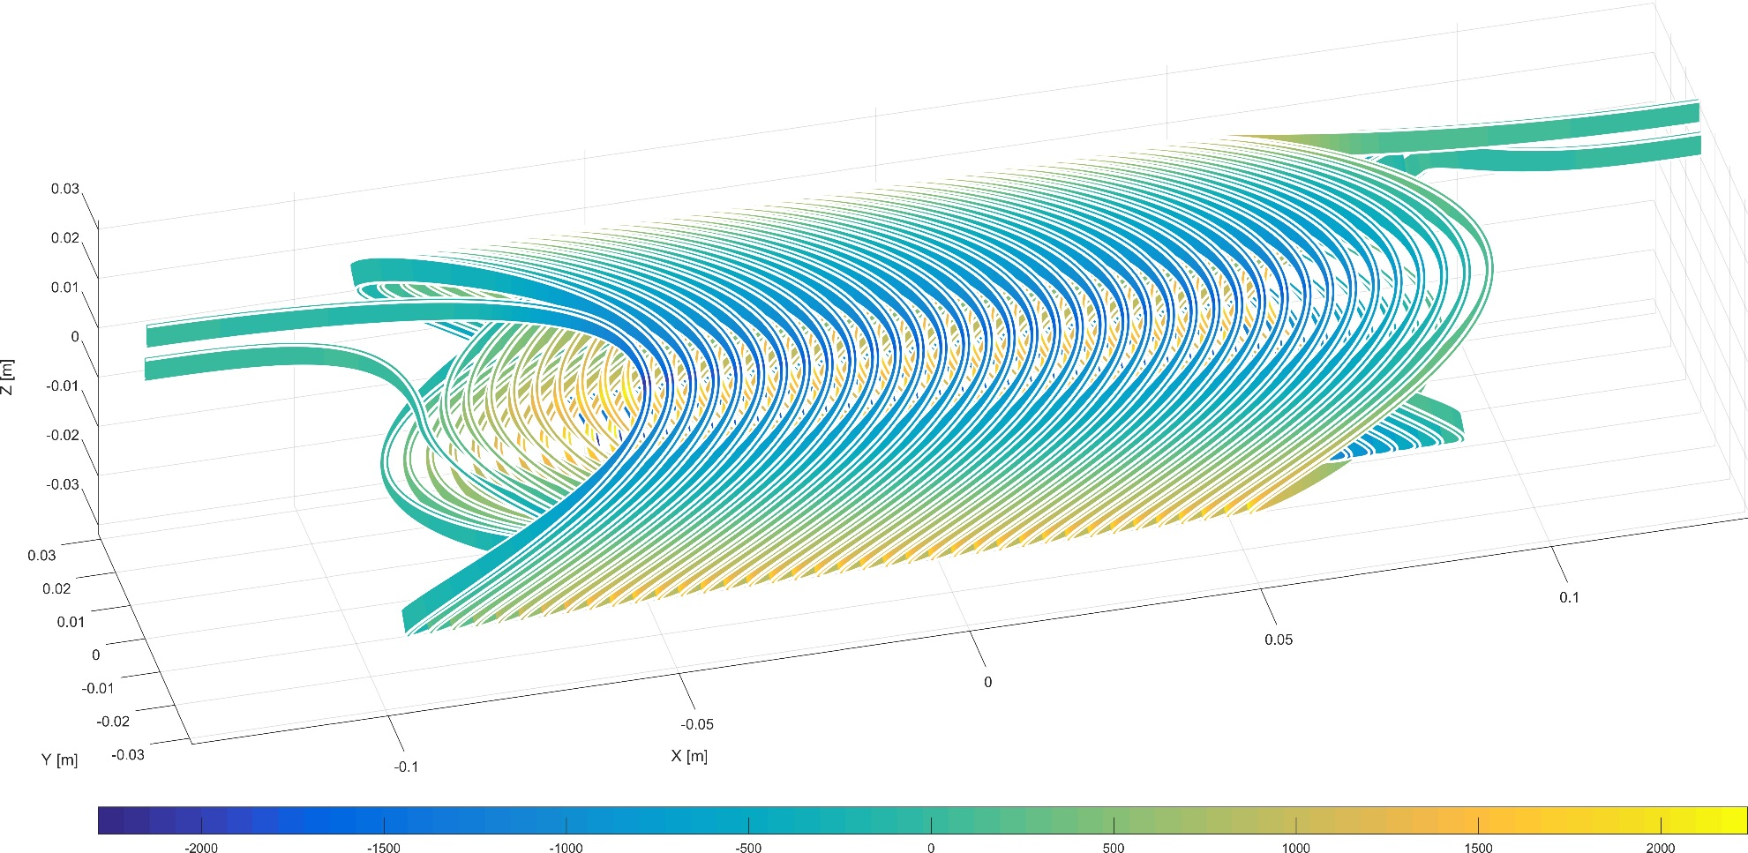
Forces and pressure - longitudinal
Here the longitudinal force is taken by the material between successive grooves – there the force is highest, groove distance is maximum.
We get 8000N/m, so for 2 cm the force is 160N, and the pressure is applied in an area of 4mmX2cm => 2MPa or pressure where the material is ~3mm thick
cable

Slide 38
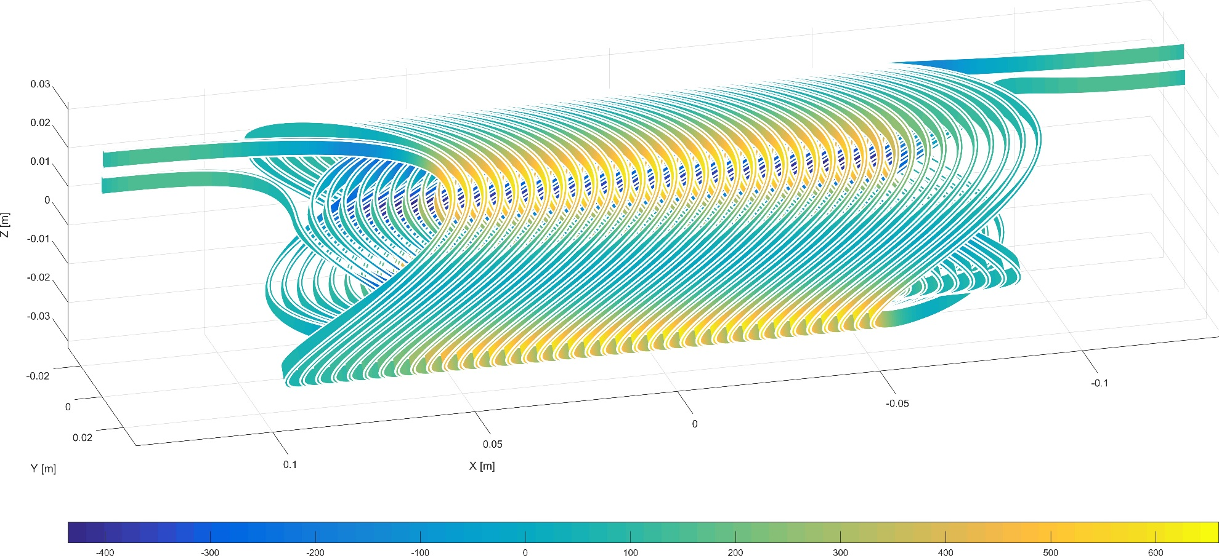
Forces and pressure - radial
Above is a test quadrupole with 50T/m. Multiply all forces by a factor 4! Maximum radial force is 2500N/m – “trying to make the circle a square”.
Force exerted in ~20mm strip along the magnet (20cm long, 30 windings) is 1500 N for 4000 mm2 or ~0.4MPa
Force is exerted on support tubes (in red). Note that since the force is quadrupole-like, any deformation does not affect the field quality!!

Slide 39
Pretty pictures

Slide 41
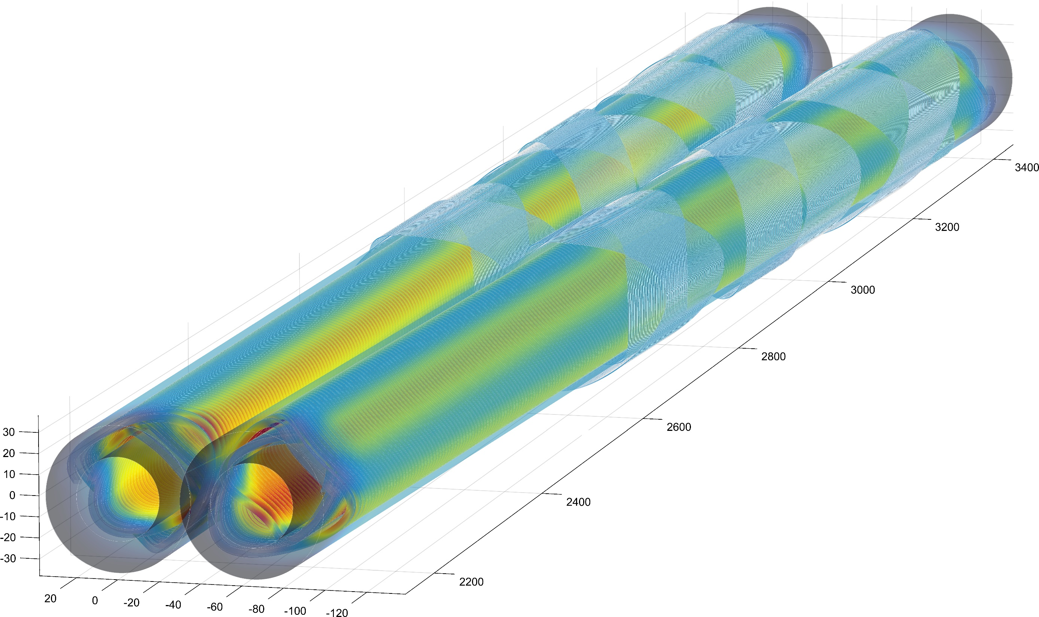

Slide 42
Inductance
 | QC1L2 inner left | QC1L2 outer left | Layer jump
QC1L2 inner left | 2.95 | -0.62 | 0.00048
QC1L2 outer left | -0.62 | 4.60 | 0.00050
Layer jump | 0.00048 | 0.00050 | 0.0011
Inductance given in | mH
Stored Energy | 0.0023 MJ
Total Inductance | 6.3031 [mH]

Slide 43
3D printed inner and outer layers (one edge) in translucent plastic

