Slide 1
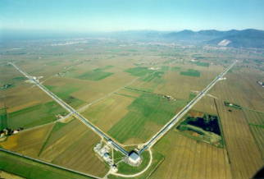
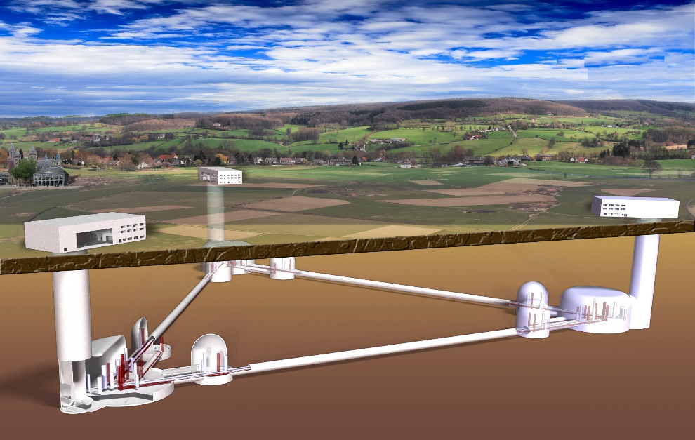
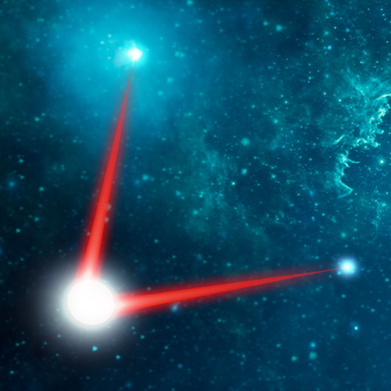



Gravitational waves:
from today to near and far future
Pierre Gruning, LAL-CNRS | French-Ukrainian workshop 26-28th September 2018

Slide 2
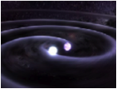
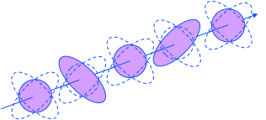


What are Gravitational waves ?
Solution from General Relativity derived by A. Einstein in 1916, first experiments in the 60s
Gravitation is a curvature of the space-time metric
Any massive object will introduce a deformation of the metric
Far from sources they can be seen as a perturbation of the metrics ie :
  They are ripples of space-time produced by rapidly accelerating mass distributions
  Provide info on mass displacement
  Weakly coupled – access to very dense part of objects
Main proprieties:
  Propagate at speed of light
  Two polarizations ‘+’ and ‘x’
  Produce a differential effect on metric
  Emission is quadrupolar at lowest order
  Need compact and relativistic objects

Slide 3
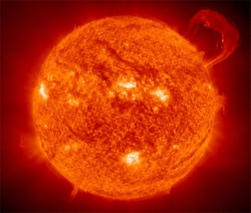
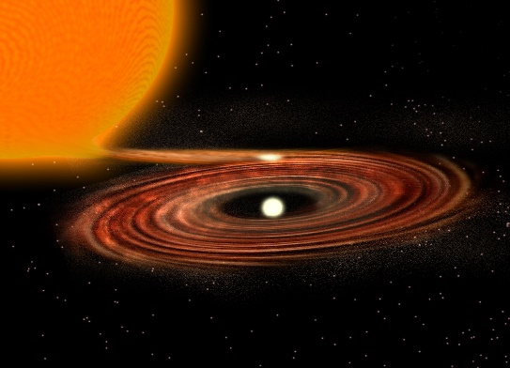
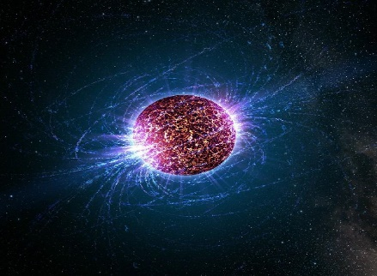
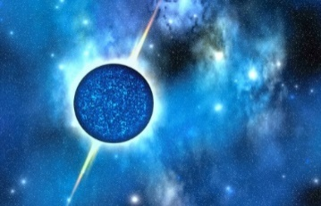
Astrophysical and cosmological sources of GW
Supernova
Assymetric
core collapse
And …
?
White dwarf
- Chandrasekhar limit :
1.4 solar masses
- Density : 1.10⁹ kg/m³
- Force : electron degeneracy
(Pauli exclusion principle)
Neutron star
- Tolman-Oppenheimer-Volkoff limit : up to 3 solar masses
- Density : up to 6.10¹⁷ kg/m³
- Force : neutron degeneracy
Hypothetical forms :
- Quark star
- Preon star
- Electroweak star
- Boson star
- Etc.

Slide 4
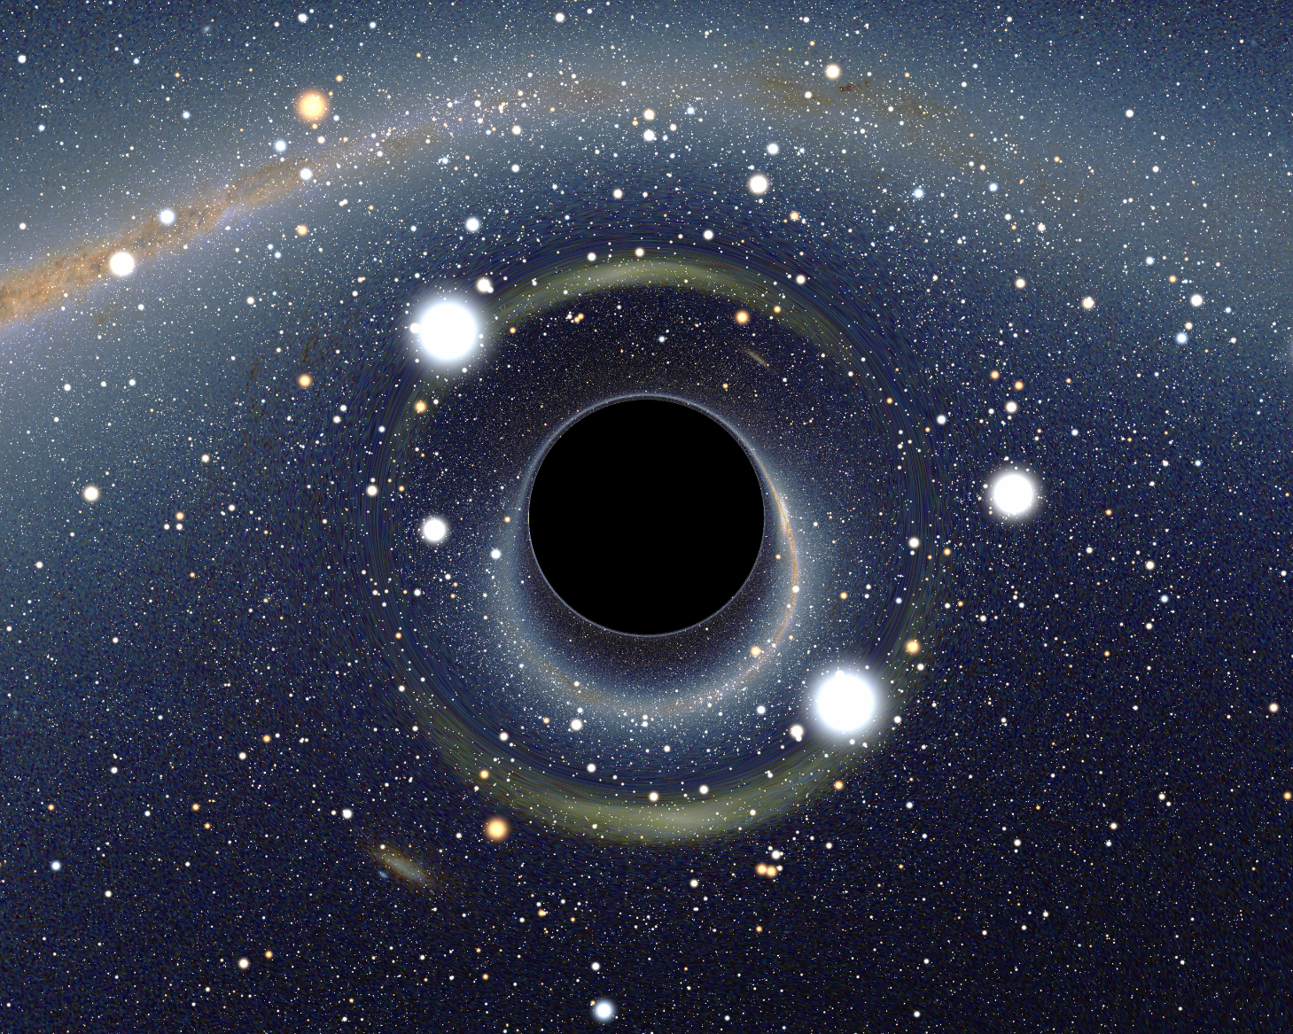
Astrophysical and cosmological sources of GW
Black Hole
- Mass limit : none
biggest known : 17 billion solar masses
- Density : ∞ (singularity)
- Force : none
No hair theorem : black hole can be described by only 3 parameters :
Mass
Angular momentum
Charge
Particularity : Emits no radiation (except Hawking radiation)

Slide 5
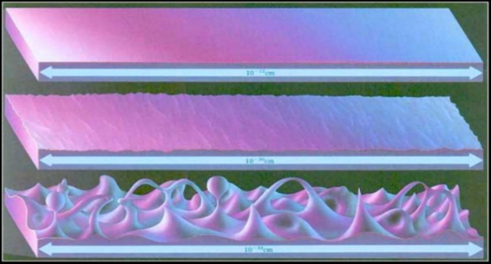
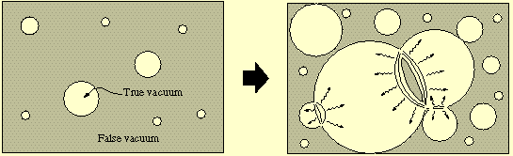
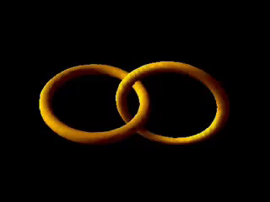
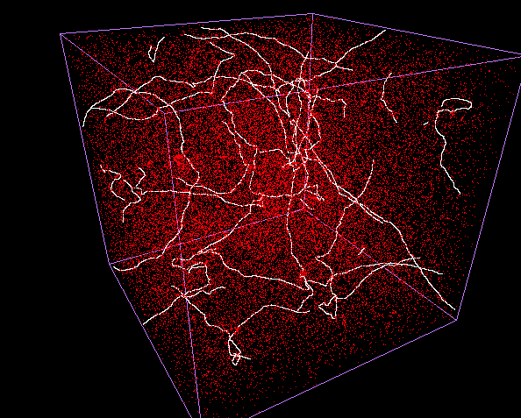
Astrophysical and cosmological sources of GW
GW emitted in the early universe :
Initial quantum fluctuations inflated
creating gravitational waves :
Phase transition : vaccum energy went through different states during inflation
Cosmic strings : a topological defect of the universe, 1D objects with high density (trillion times smaller than hydrogen atom but a 10 km string = Earth mass)

Slide 7
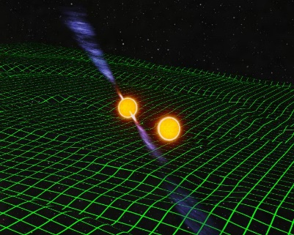
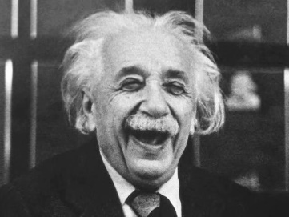
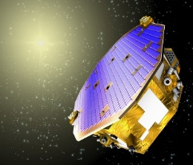

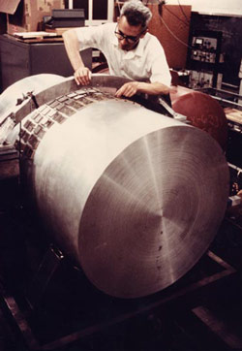
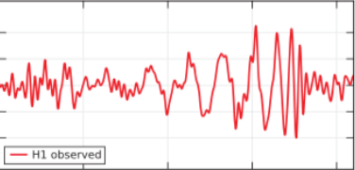
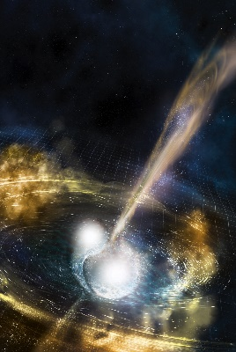
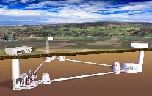
Gravitational waves : a brief history
- First 3 detector detection
- First observation of binary NS
- First EM counterpart
- Nobel prize
First attempt : Weber bars
First direct detection !
1918
14th September
2015
3rd December 2015
2017
1968
1974
eLISA
2034 ?
ET ?
A. Einstein
Über Gravitationswellen
First indirect detection :
Hulse-Taylor Pulsar
(Nobel prize)
Launch of LISA Pathfinder

Slide 8
Current situation
3 operational detectors: 2 LIGO (USA) + Virgo (Europe)
2 runs: O1 (LIGO) and O2 (LIGO + Virgo)
6 confirmed detections: 5 BBH + 1 BNS
Sensitivity better than 10⁻¹⁹ meters (1/10000 of the diameter of a proton)

Slide 9
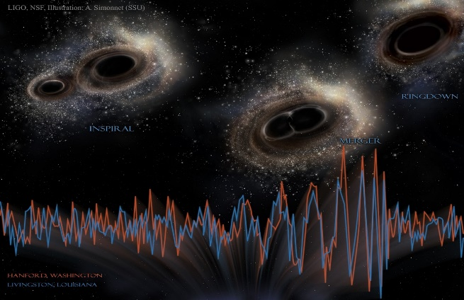
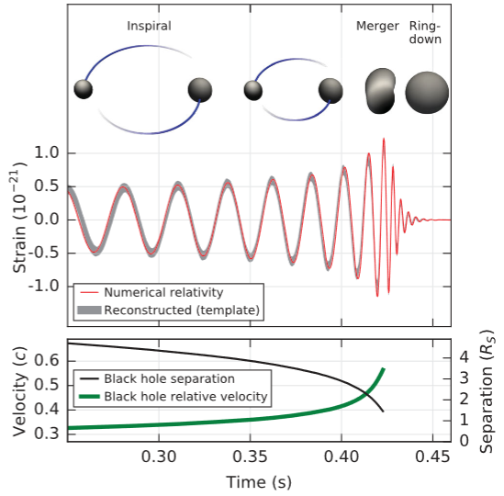
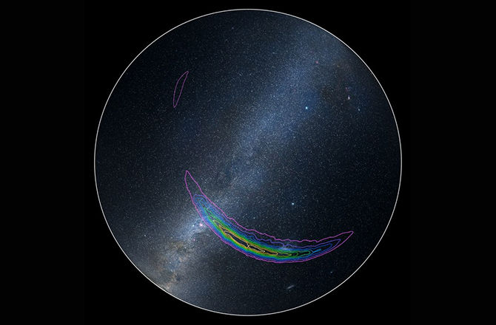
14th september 2015 : First direct detection of gravitational waves
LIGO has seen the merging of 2 stellar black holes that occured 1,3 billion years ago :
Merger of 2 black holes of 36 and 29 solar masses
Final black hole of 62 solar masses
Energy equivalent of 3 solar masses radiated in
gravitational waves
Source distance : 410 MPc = 1,3.10²⁵ m = 1,3.10⁹ Ly
To compare, the diameter of our galaxy is ≈ 100 000 Ly
But with only 2 detectors the event is localized in an area of 600 deg²

Slide 10
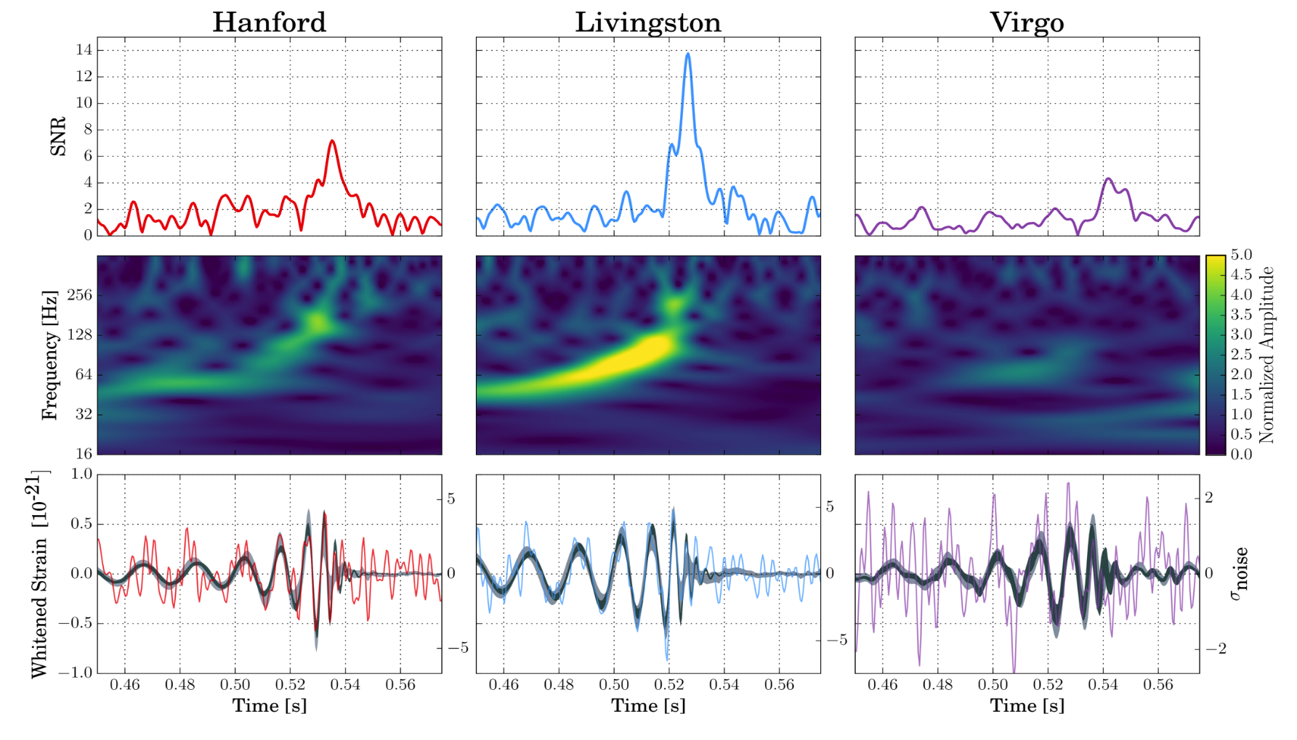
GW170814 : Virgo first detection
Signal arrived at on August 14, 2017 10:30:43 UTC at Livingston, 8 ms later at Hanford, 14 ms later at Virgo;
7.3
13.7
4.4
Random chance to have signal in Virgo
< 0.3 %
false alarm rate
< 1 in140,000 years
GW170814: A Three-Detector Observation of Gravitational Waves from a Binary Black Hole Coalescence, Abbott et al. , PRL 119, 141101

Slide 11
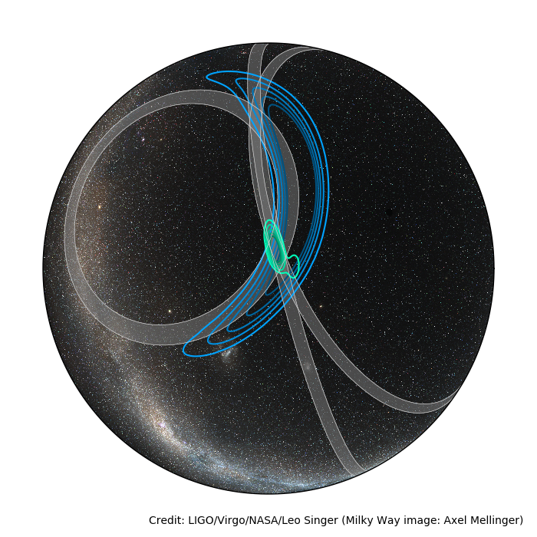
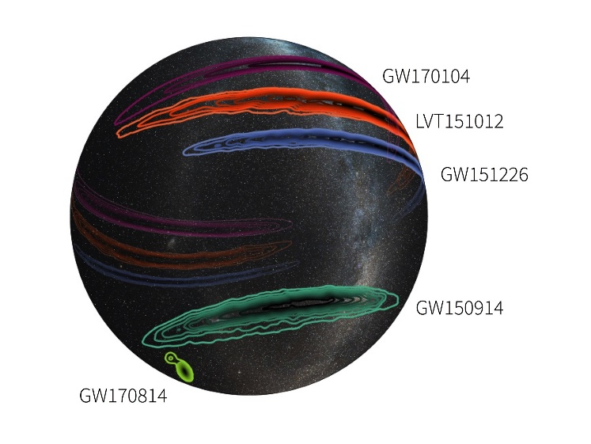
Better sky localisation
Rapid localization
HL
1160 deg²
540 Mpc
+130
1oo deg²
-210
RA = 03h 11m
Dec = -44° 57m
6o deg²
570 Mpc
+300
-230
HLV
Final localization
Error in sky area : factor 20 !
Reduced incertitude in distance by 1.5
GW170814: A Three-Detector Observation of Gravitational Waves from a Binary Black Hole Coalescence, Abbott et al. , PRL 119, 141101

Slide 12
3 days later …
SNR ~ 32.4, FAR ~ 110⁻⁶ year ⁻¹
Long event (~100 secs) can be seen in the data, light masses system !
Probability to have at least one neutron star is important
Possible electromagnetic counterpart !
Already a possible association with a gamma ray-burst

Slide 13
The full campaign
« Multi-messenger observations of a binary neutron star merger », Abbott et al., ApJ, 2017

Slide 14
Kilonova
During merger phase rich neutrons matter could produce heavy elements by neutron capture (r-process)
Quasi isotrope emission, heated by radioactivity, emission expected to shift from blue to red during cooling

Slide 15
Main results with GW170817
GW170817 is the closest (and loudest) GW event ever observed
First binary neutron stars system detected with GW
Having three detectors allow to have a quite good localization and allow a full observation campaign
Confirmed that this BNS is the central engine of a short GRBs – association with GRB170817A > 5.3 σ
Complete multi-messenger follow-up campaign confirm also association with a kilonova
Start to put some constraints on EOS
Test of fundamental physics can also be performed
A first H₀ independent measurement

Slide 16
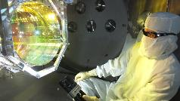
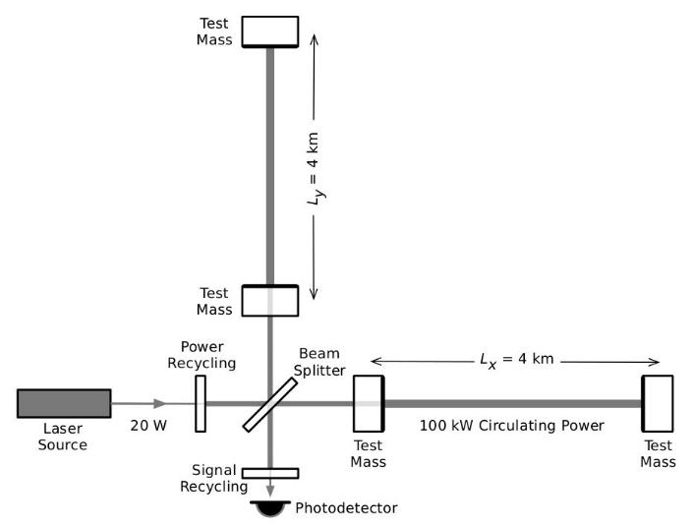
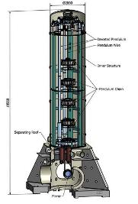
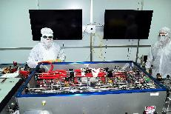
Advanced generation detectors
Michelson interferometer
Goal : (L_{x}-L_{y})/L_{x} = 10⁻²³
High quality
optics – 40 kg
Feedback loops from few Hz to few kHz
Fabry-Peroy
cavities
High power laser
Full system under
vacuum ~10⁻¹² atm
Suspended
Optics
Attenuation
10¹⁴ @ 10 Hz

Slide 17
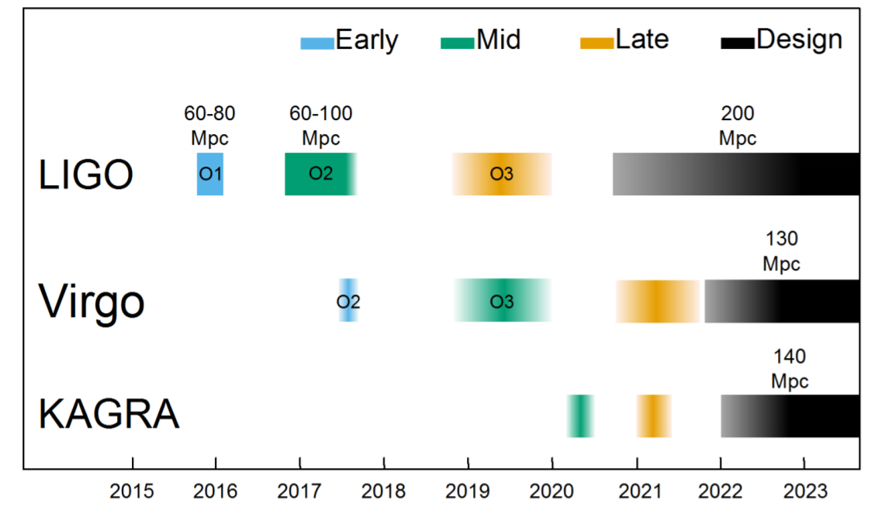
Near future: improvements on the current detectors between O2 and O3
LIGO: scattered light reduction, increase of the laser power and squeezing activites
Virgo: Re-install monolithic (fused silica) suspensions, install squeezer from GEO, increase of the laser power

Slide 18
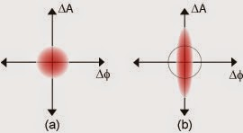
Near future: improvements on the current detectors between O3 and O4
Signal recycling Squeezed states of light

Slide 19
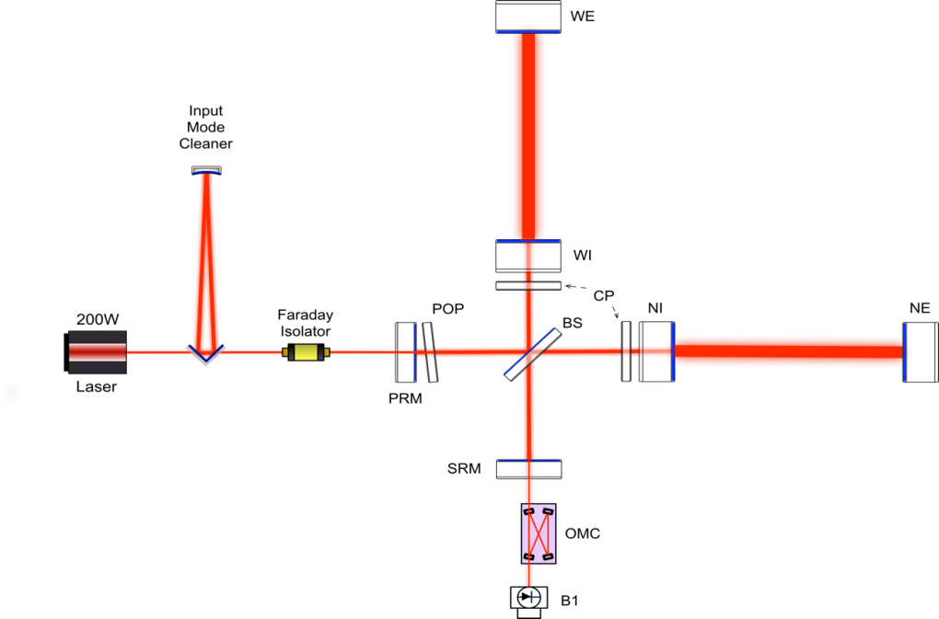
Beat the standard quantum limit using squeezed light
Thermal noise
(coating + suspension)
Radiation pressure fluctuation
Stray-light
Residual gas (phase noise)
Residual laser noise
Seismic vibration
Newtonian noise
Shot noise

Slide 20
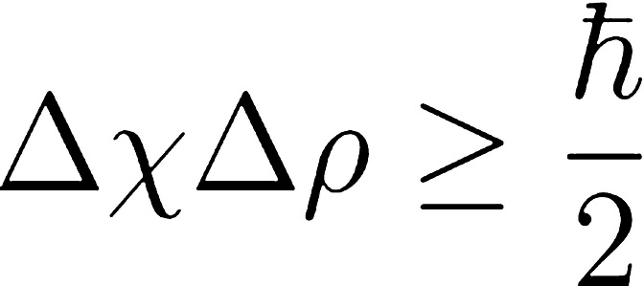
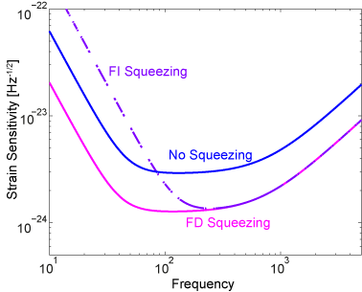
Squeezed light
The Heisenberg uncertainty principle puts a constrain on the product of the uncertainties of the position and the momentum but allows the increase or decrease of the individual parameters.
In advanced interferometric gravitational waves detectors the standard quantum limit is reached and we need to amplitude squeeze the coherent light at low frequency and to phase squeeze at high frequency
-> frequency dependent squeezing

Slide 21
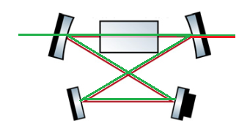
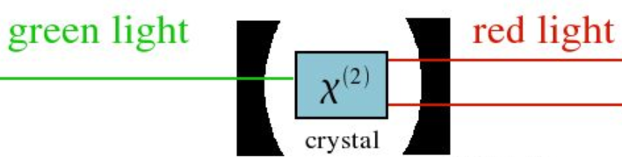
Generating squeezed light
1 photon of green light (532 nm) produces 2 photons of infrared light (1064 nm)
hν_{green} = 2hν_{ir}

Slide 22
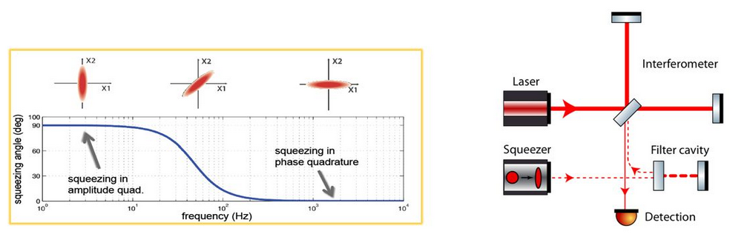
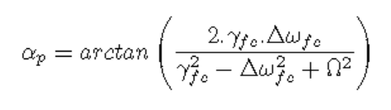
Frequency dependent squeezing
The rotation angle α_{p} depends on the filter cavity linewidth γ_{fs}, the detuning from resonance Δω_{fs} and the frequency Ω (10 Hz to 10 000 Hz).
The frequency where we want to rotate the ellipse depends directly on the mirror mass of the interferometer, 44 Hz for 42 kg mirrors.

Slide 23
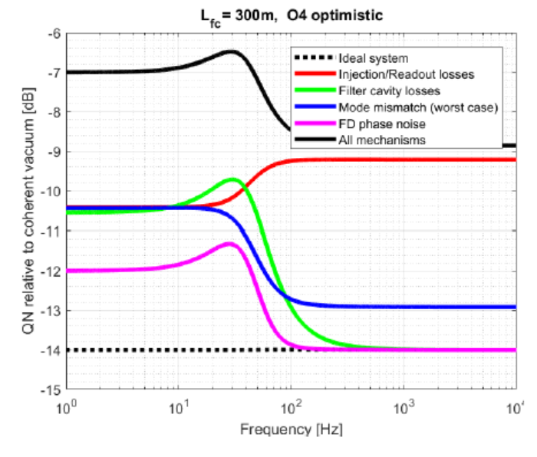
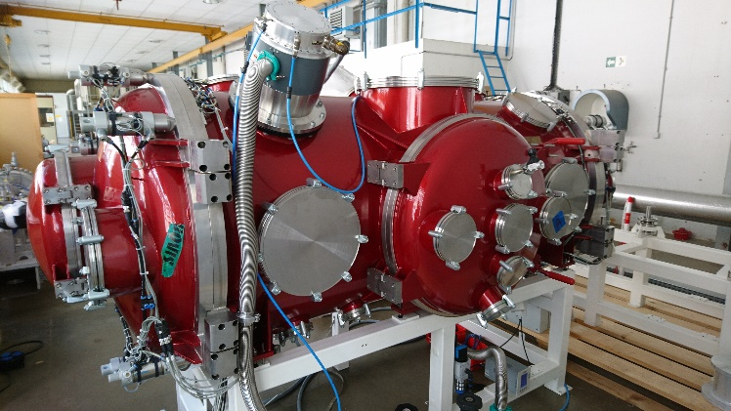
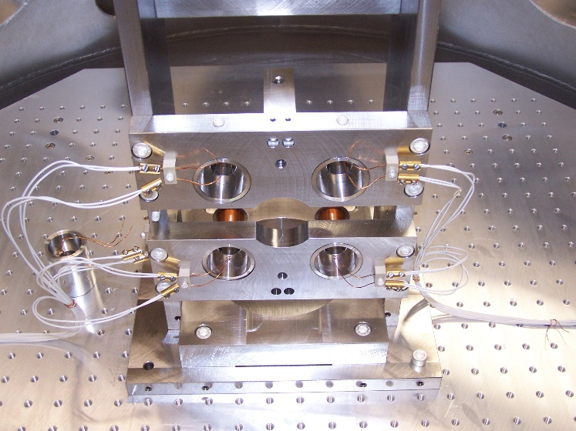
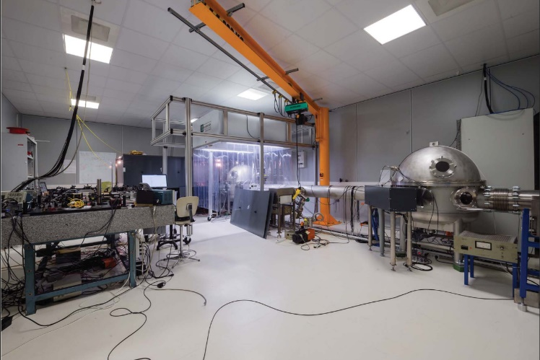
Frequency dependent squeezing: the filter cavity, a critical point
Due to losses the 14 dB of injected squeezing are reduced to 7 dB
Here at LAL: project of frequency dependent squeezing with a 50 m filter cavity (CALVA)

Slide 24
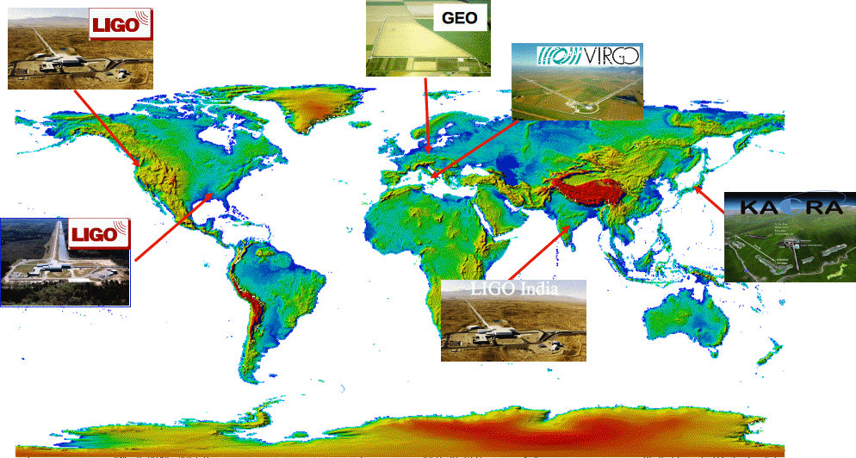
Next years: more terrestrial interferometers
LIGO –
Hanford 4-km
GEO 600m
Virgo 3-km
3-km in 2017-18
Full ITF in 2020
LIGO –
Livingston 4-km
4-km in 2020-22

Slide 25
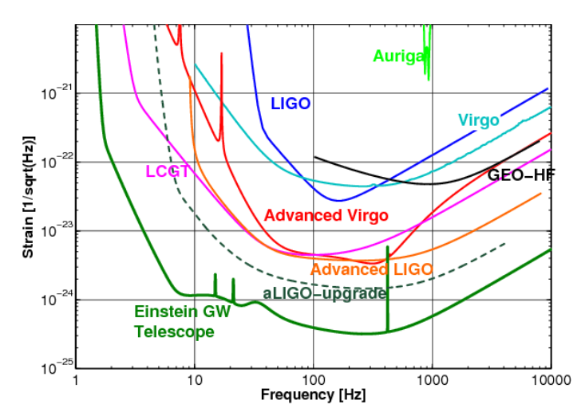
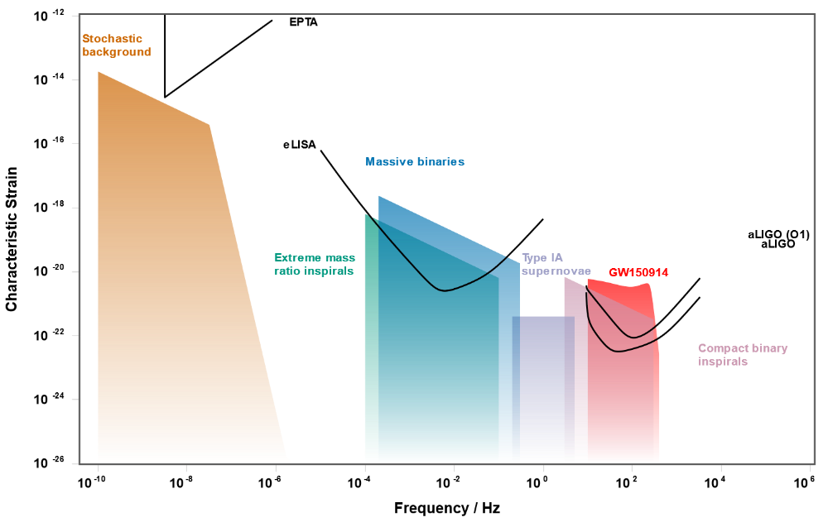
Far future: space based gravitational wave interferometer
At low frequencies all terrestrial interferometers will be limited by seismic noise
LISA will explore the frequency range from 0,0001 Hz to 1 Hz

Slide 26
LISA: Laser Interferometer Space Antenna
3 satellites forming a giant Michelson type interferometer with 2,5 million km arms
Picometer precision
Main sources: supermassive black hole binaries

Slide 27
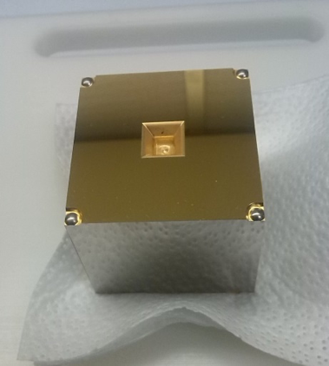
LISA: Laser Interferometer Space Antenna
For LIGO/Virgo the test masses are heavy superpolished mirrors, for LISA the test masses are cubes made of gold and platinum.
The test masses are floating inside the satellite and are isolated from exterior noises like the radiation pressure from the sun and thus are only submitted to gravitational forces.

Slide 28
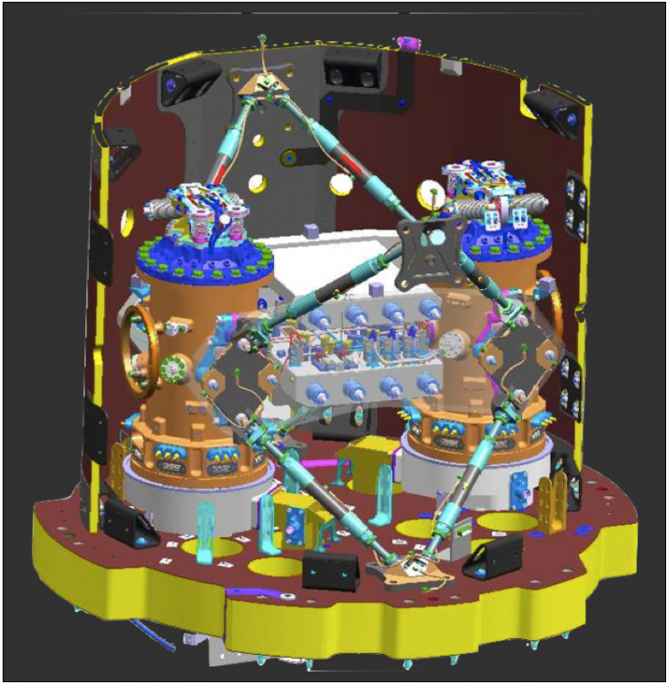
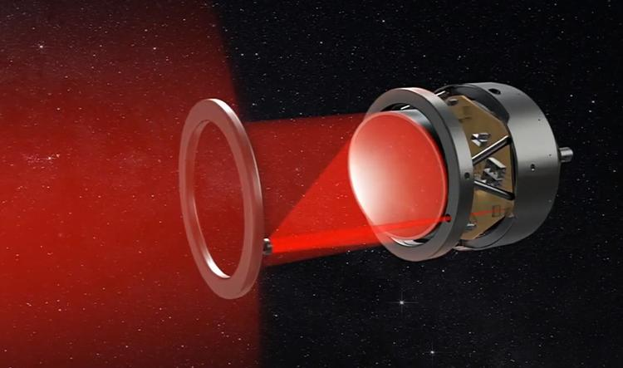

LISA: Laser Interferometer Space Antenna
Main noise sources for LISA:
Laser frequency noise
Shot noise (a few hundreds pW on the photodiodes)
Radiative pressure from the sun
Cosmic rays
Thermodynamic effects
Clock noise
Laser pointing
Diffuse light

Slide 29


LISA: Laser Interferometer Space Antenna
TDI : Time Delay Interferometry
TDI : a post processing method to reduce laser frequency noise
In an equal arm interferometer laser noise cancels, eLISA will have up to 30000 km relative length differences
+ Doppler and Sagnac effect

Slide 30


LISA Pathfinder: a technological demonstrator
LISA Pathfinder was launched the 3rd december 2015 to reach Lagrange point L1

Slide 31

LISA Pathfinder: a technological demonstrator
LISA Pathfinder was a great success: the community is ready for LISA
- The performances exceed the most
optimistic expectations
ASD at 5.2 ± 0.1 fm.s⁻²/$\sqrt{Hz}$
(0.54 ± 0.001) x 10⁻¹⁵ g/$\sqrt{Hz}$
between 0.2 and 20 mHz
5 times better than requirement and
1.25 better than eLISA requirement
Residual noise :
Brownian noise of residual gas and interferometer readout

Slide 32


Very far future
Einstein Telescope (ET) Big Bang Observer (BBO)

Slide 33

LISA: Laser Interferometer Space Antenna

