Slide 1


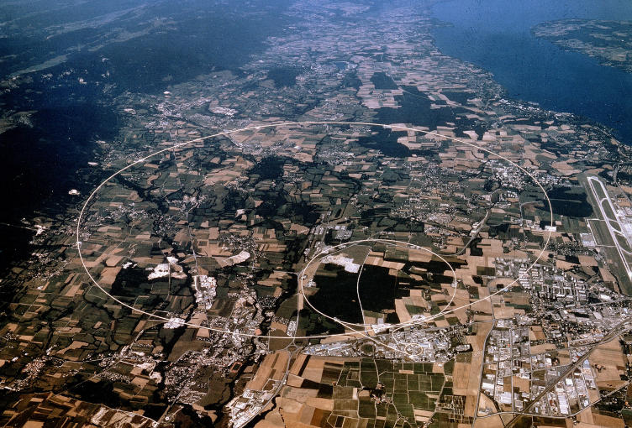

Pixel detector for Phase 2 ATLAS tracker and Captinov infrastructure
Abdenour LOUNIS,
Laboratoire de l’Accélérateur Linéaire, Orsay
Université de Paris-Sud XI
Large Hadron Collider,
Circumf ~27km, E=14 TeV L=10³⁴ cm⁻²s⁻¹, 40MHz beam crossing, 1 GHz interaction rate, 10³ particles each 25 ns.

Slide 2
Outline of the presentation
ATLAS detector and innovative technologies for tracker upgrade
First milestone activities : ATLAS ITK demonstrator
The ATLAS French IN2P3 cluster: task force for ITK construction
Conclusions

Slide 3
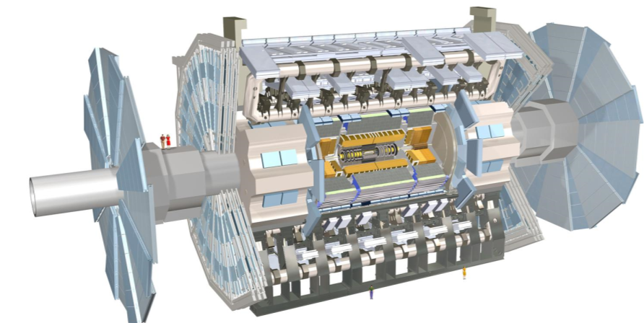
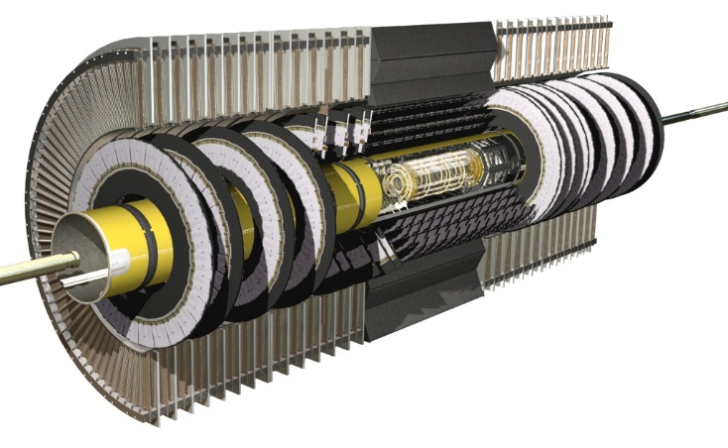
Atlas detector
ATLAS :
Width: 44m
Diameter :22 m
Weight: 7000 T
Calorimeters
Endcap Toroid
Tracker detectors greatest asset:
Fast (40 MHz), RadHard, High Granularity, low Materiel Budget
Pattern recognition capabilities
Environment is hostile, why measuring tracks?
To measure momenta (→dynamics, invariant masses)
To measure vertices
Primary → improve on p and E measurements
Secondary → tag ps living particles (b,τ)→ markers of events with significant physics content
To help identifying photons
Muon detectors
solenoid
6.2 m
Inner detector
detector | Accuracy | pitch | Readout channels (10⁶) | points
IBL | 10 (R−φ) 115 (Z-R) | 50x250 | 12 | 1
Pixel | 10 (R−φ) 115 (Z-R) | 50x450 | 80.4 | 3
Strip | 17 (R-φ) 580 (Z-R) | 80 | 6.3 | 4
TRT | 130 (R-φ) | - | 0.351 | 36
2.1 m
Pixel system

Slide 4
Upgrade project : Setting the scene
LHC Accelerator and ATLAS Upgrade calendar
CALO_Electronics-upgrade
ATLAS ITK + Timing Layer (HGTD)
ATLAS IBL
Run 2
Run 3
Run 4
LS1
splices
LS2
Injector Upgrade
LS3
HL-LHC installation
2013
2014
2015
2016
2017
2018
2019
2020
2021
2022
2023
2024
2025
2026
2027
2028
2029
Internal Tracker delivery
Ultimate Goal of ITK community
Pixel Tracker figures:
Detector | pixel size [μm²] LHC | pixel size [μm²] HL-LHC | ratio
ATLAS pixel | 50x400 | 50x50 (125x50) | 8
CMS pixel | 150x100 | 50x50 (25x100) | 6
Detector | Channels LHC | Channels HL-LHC
ATLAS Pixels | 92M | 5GP
CMS Pixels | 127M | 2GP
Cell granularity, the weapon against high-PU keeping occupancy at a reasonable level
Notes:
You are welcome again!!
AND ATLAS and CMS inner pixel layer replacements??
LHCb: "Tracker Turicensis" (TT)
ALICE Muon Forward Tracker

Slide 5
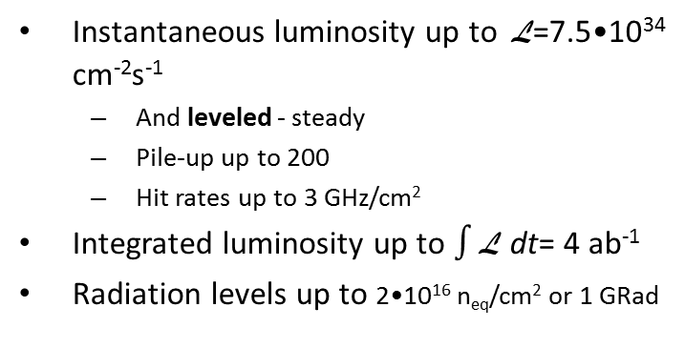
Phase 2 experimental constraints
Instantaneous luminosity up to L=7.5•10³⁴ cm⁻²s⁻¹
  And leveled - steady
  Pile-up up to 200
  Hit rates up to 3 GHz/cm²
Integrated luminosity up to $∫$L dt= 4 ab⁻¹
Radiation levels up to 2•10¹⁶ n_{eq}/cm² or 1 GRad
Radiation levels
HiLumi LHC Technical Design Report CERN-ACC-2015-0140
Pixels | Radius(mm) | Fluence Max (Neq/cm2) | Dose (Mrad)
layer 0 | 39 | 2,25 .10*16 | 1710
layer 1 | 75 | 0,82 .10*16 | 715
layer 2 | 155 | 0,25 .10*16 | 148
layer 3 | 213 | 0,12 .10*16 | 96
Layer 4 | 271 | 0,12 .10*16 | 61
Endcap | 80 | 0,67 .10*16 | 687
Just multiply with 2.5
L1
September 13th 2017 – the high PU fill – here PU=80
L0
Pileup
ATLAS ITk Simulation, FLUKA to 3,000 fb⁻¹
Notes:
Now, simply save this slide in all following talks – You are welcome ☺
They LHC can do it

Slide 6
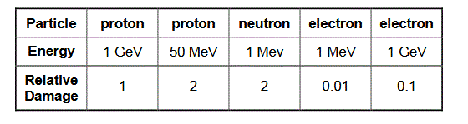
Radiation damage
Radiation effects : two basic types :
  Displacement damage :
  Incident particle displace Si Atoms from the lattice site « mechanical damage » : induces
    Electrical effects :
    increase of leakage current in the detectors
    Reduce carrier lifetime (signal loss to trapping)
    Reduce current gain in bipolar transistors
  Ionization damage :
    Energy deposition in insulating layers (SiO2) from e—hole pairs; some are trapped,
    Leading to charge buildup,
    Electrical effects :
    Increase surface leakage in detectors
    Shifts operation points in transistors
    This is a big source of noise incerease and loss effiency in detectors and readout

Slide 7
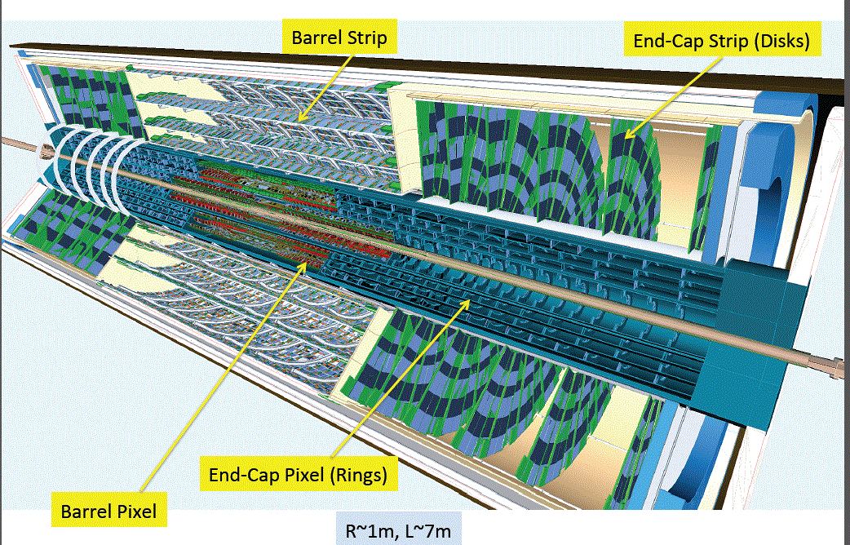
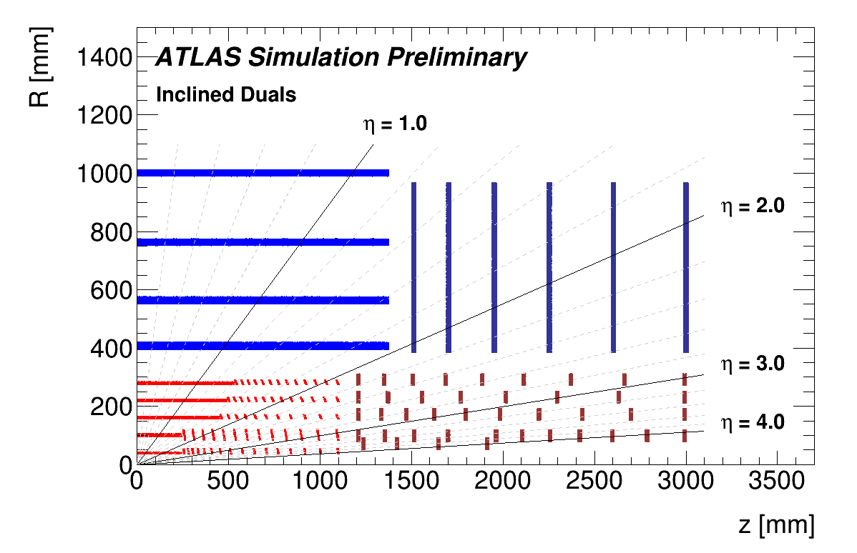
Future ITK at a glance
ATLAS ITK seen in a microscope: variety of sensor technologies and geometries
Sensor active thickness 100 - 300 μm
Various technologies (of sensor) types ,
Various geometrical conceptions : Simple, duals, quads, trapezoidal
Novel Mechanics et services systems ,
Large eta coverage,
Possibility of extraction,
Material budget minimal
Stereo
Rectangular
Strips
Wedge
pixel
η<4
# Pixel size : 50x50 um²
# pixel modules : 10276
# of FE chips : 33184
# of channels : 5 x 10⁹
CMOS
layer
3D!!
Easy Extraction
Inclined
All n-in-p inside with different thicknesses
ITK Layout : larger coverage extended to η= 4
Notes:
CMS 240um – still tuning!

Slide 8
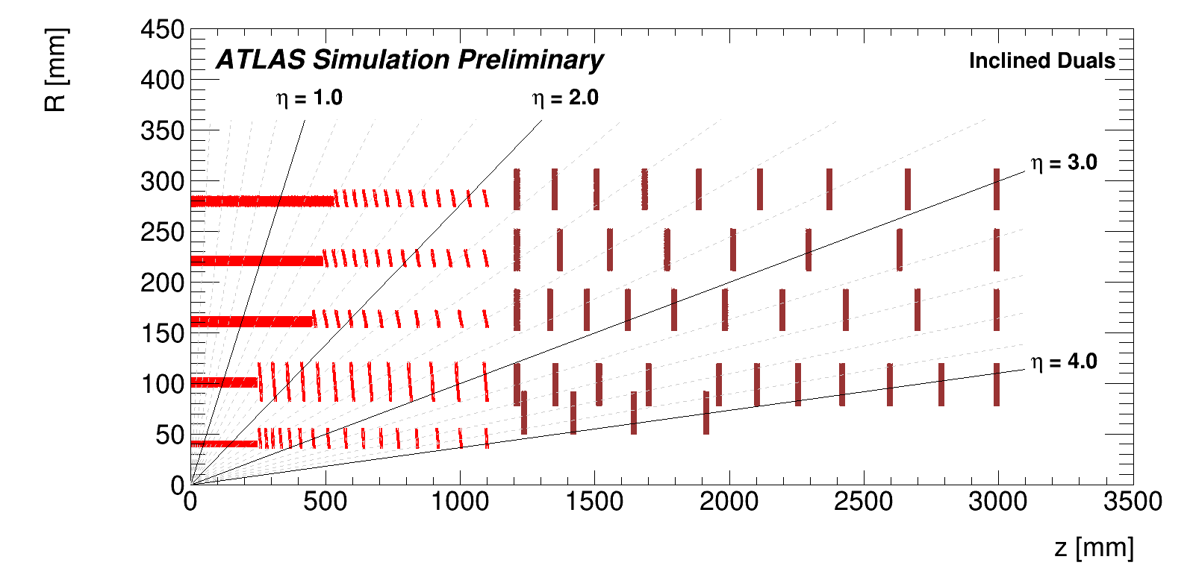
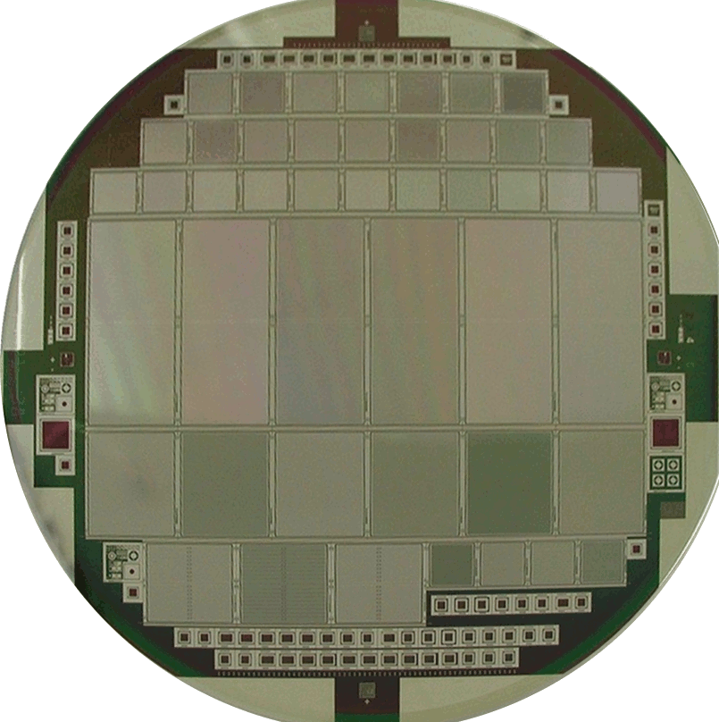
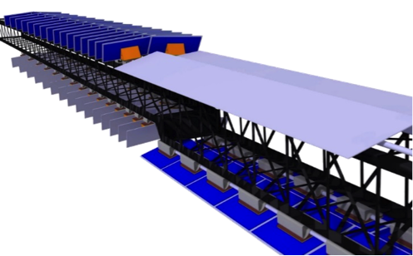
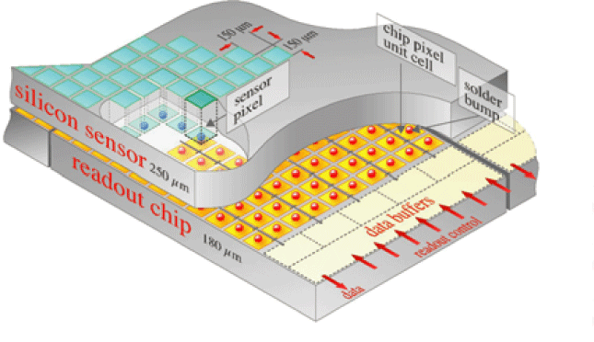
ITK Configuration
Monolithic
CMOS
quads
quads
doublets
Doublets 1x2
Doublets 1x2
Quads 2x2
Quads 2x2
Singlets
extractible {
Singlets
singlets
TECHNO 3D
Silicon Wafer
ATLAS ITK
Silicon Wafer
Novel Concept !! inclined modules
Reduces the material traversed and
improves :
Tracking performance
Less silicon surface
Needs : ITK 10276 modules
ATLAS Pixel system= 5 Layers with option:1 layer Full monolithic HV-CMOS
Mechanics based longeron
Imaginative solutions for cooling

Slide 9
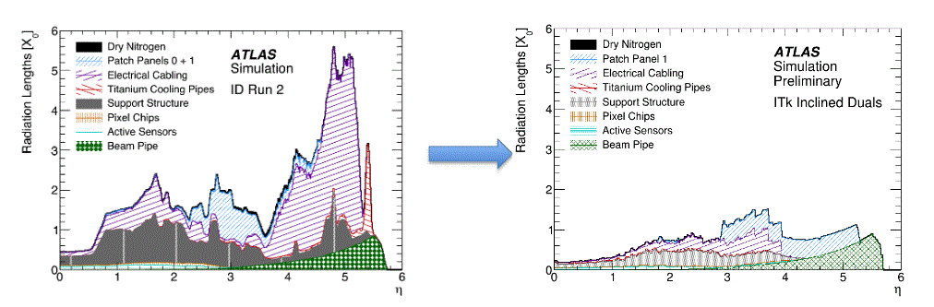
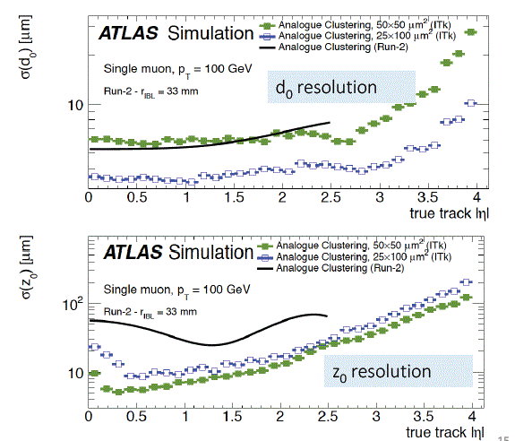
ITK design improvements
Material budget
Conceptual design of the ITK in terms of
Sensor material, cabling, services reduces
drastically the Material budget
Tracking resolution comparable to run2
or better , even <μ> ~200

Slide 10
Technologie for sensors
A critical point for choosing the sensor is the electrical performance with the readout chip
Charge collection efficiency with highly irradiated sensors is a critical parameter
Different sensor options are proposed
  Planar : Most largely used in conventional trackers, performances recently improved with edgeless designs
  3D: Evaluated recently in ATLAS IBL , manufacturability and yield stability in progress
  CMOS sensors are suggested by a strong community in ATLAS to equip one outer layer of the pixel part of the ITK

Slide 11
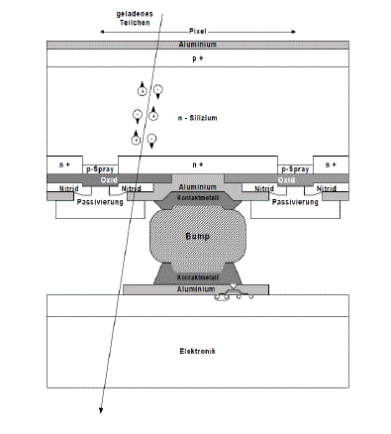
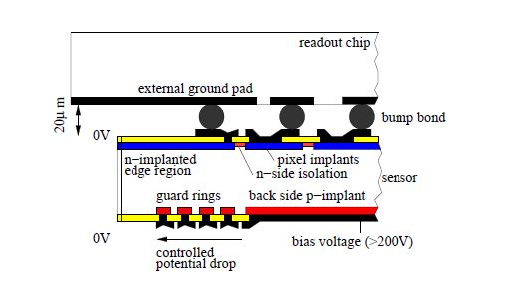
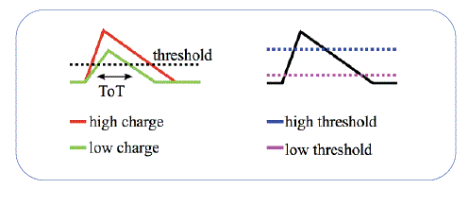
Hybrid planar sensor detector
Hybrid detector is based on a sensor connected
to its readout chip using bump bonding technique
SILICON SENSOR
Example : Actual FEI4 readout
-Store data until L1
- calculate TOT and
- Transfer TOT and Chip pixel address & Time stamp
INTERCONNEXION
FRONT-END-ELCTRONICS
Analaogue readout chain
Digital chain

Slide 12
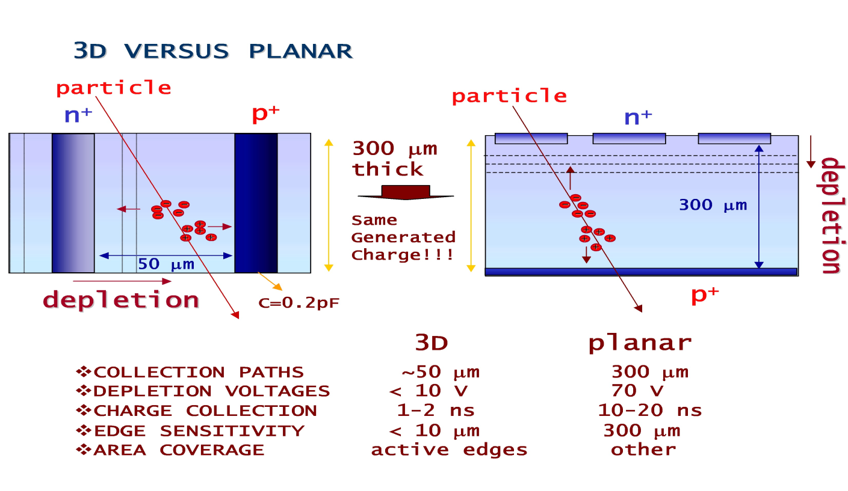
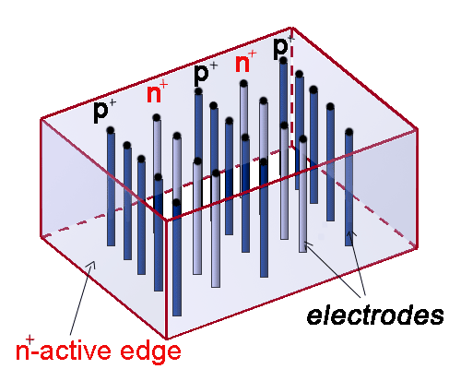
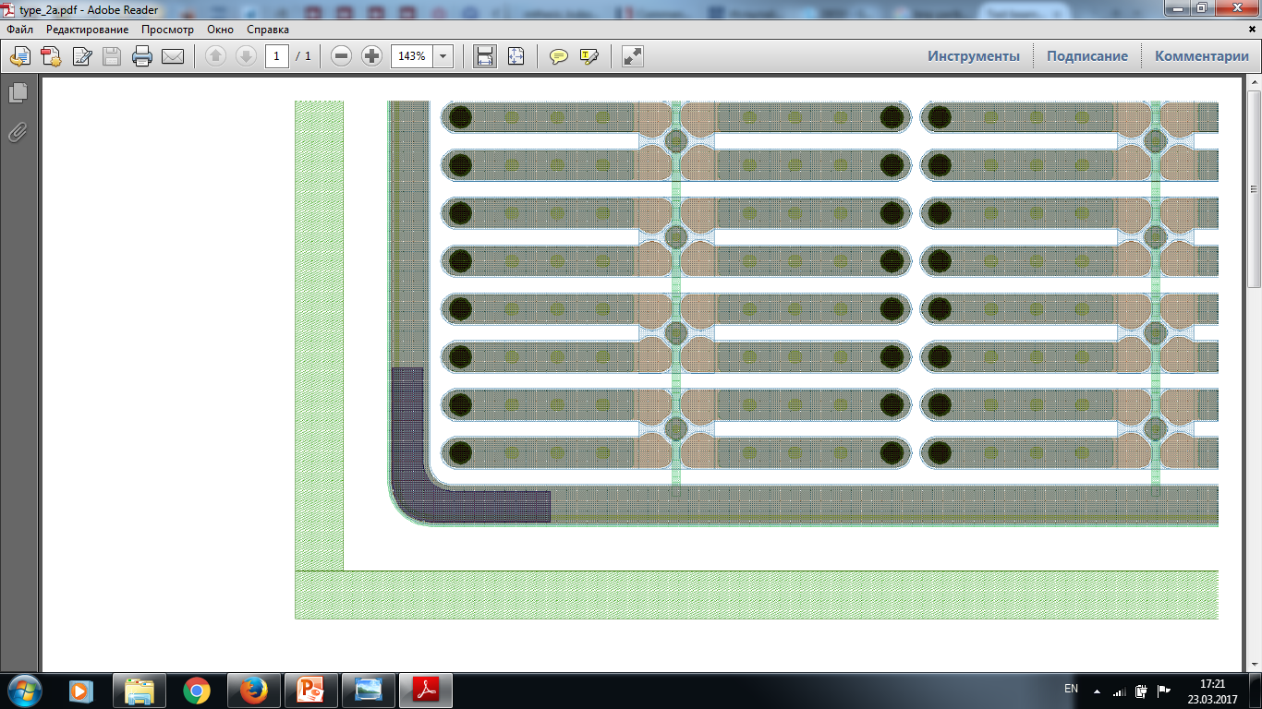
Alternative SENSOR technologies
3D
Due to short electrode spacing, 3D structures have small leakage currents, capacitances and small depletion voltages, short charge collection
distances permit small charge collection times
and radiation hard detectors.
Radiation sensitive area can be extended close to
the physical edges of the 3D detector.
3D have narrow column along detector thickness
Diameter 1à um, distance 50-100 um
Fast signal
3D
PIXEL
EDGE
PLANAR
Well proven technology
Goal to decrease the cost
(single mask process)
Non inverting material
Design improvements :
  Punch through bias grid optimization
  Edgless design
BIAS GRID

Slide 13
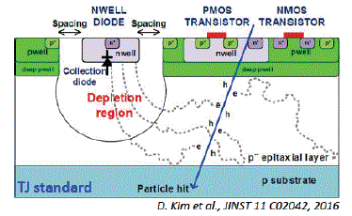
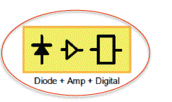
CMOS sensors
Technology based on implementation of sensors and electronics on the same substrate « monolithic design »
Advantages :
CMOS founderies have high yield througput
Offer optimal electronic integrated design within sensor bulk
Efficiency after irradiation under investigation for high radius

Slide 14
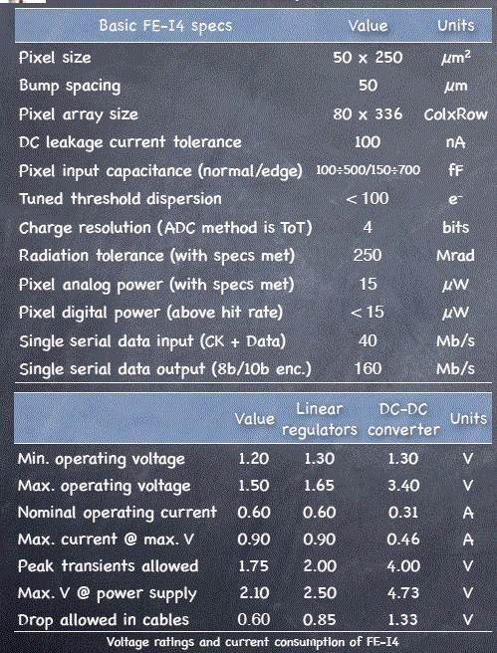
  Front end electronics upgrade : From CMOS 130 nm to 65 nm TSMC
Technology | 65 nm CMOS
Pixel size | 50x50 um²
Pixels | 400x192 = 76800
Detector capacitance | < 100 fF (200 fF for edge pixels)
Detector leakage | < 10n A (20 nA for edge pixels)
Detection threshold | <600 e-
In-time threshold | <1200 e-
Noise hits | < 10⁻⁶
Hit rate | < 3 GHz/cm² (75 kHz avg. pixel hit rate)
Trigger rate | Max 1 MHz
Digital buffer | 12.5 us
Hit loss at max hit rate (in-pixel pile-up) | ≤ 1%
Charge resolution | ≥ 4 bits ToT (Time over Threshold)
Readout data rate | 1-4 links @ 1.28Gbits/s = max 5.12 Gbits/s
Radiation tolerance | 500 Mrad at -15ºC
SEU affecting whole chip | < 0.05 /hr/chip at 1.5GHz/cm² particle flux
Power consumption at max hit/trigger rate | < 1 W/cm² including ShLDO losses
Pixel analog/digital current | 4uA/4uA
Temperature range | -40ºC ÷ 40ºC
In-time threshold <5000 e

Slide 15
First Milestone towards ITK construction: demonstrator activity
Actors : D. varouchas, D. Hohov, L. Fayard, A. Lounis, A. Kotsokechagia
G. Calderini, G. Marchiori, M. Bomben, R. Camacho

Slide 16

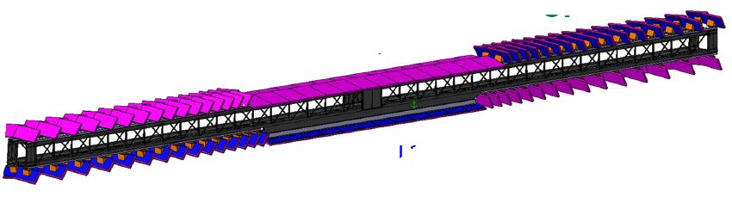
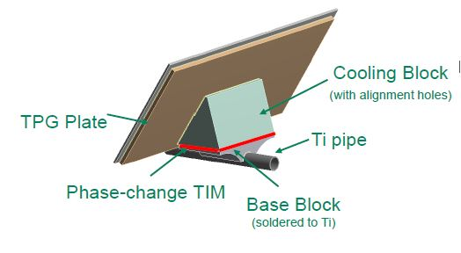
First step towards the ITK construction : Proof of concepts : the demonstrator
Project in a shared effort to evaluate and validate the SLIM concept : Longeron coupling cooling lines with flat and inclined modules, including design of
Thermofluidic, thermo-mecanical prototypes
Deploy electrical and heater modules modules (FEI4), serially powered, services routed inside the longeron structure
Exercice the integration work, tooling construction, tasks shared between institutes
Evaluation of the full procedure and validation of loading
Shared Effort
French teams are sharing their efforts
longeron
for layer 2 and layer 3 (1.6 m) 4 cooling lines
52 flat quad and 124 inclined double modules

Slide 17
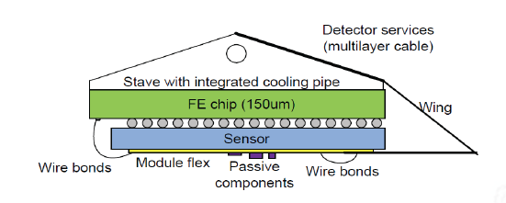
Module assembly task : the Basic building bloc
Cooling pipe
Basic building bloc is the pixel module
Bare module assembly consisting of sensor and FE chip
Flex hybrid for connection of data power line to the local support service
Connection between FE, sensors and Flex is done via wire bonding
Effort ongoing (up to 2019) to qualify firms for modules and bump bonding production
(1200 modules in 2 years~50 modules/week)
Notes:
Ion of d

Slide 18
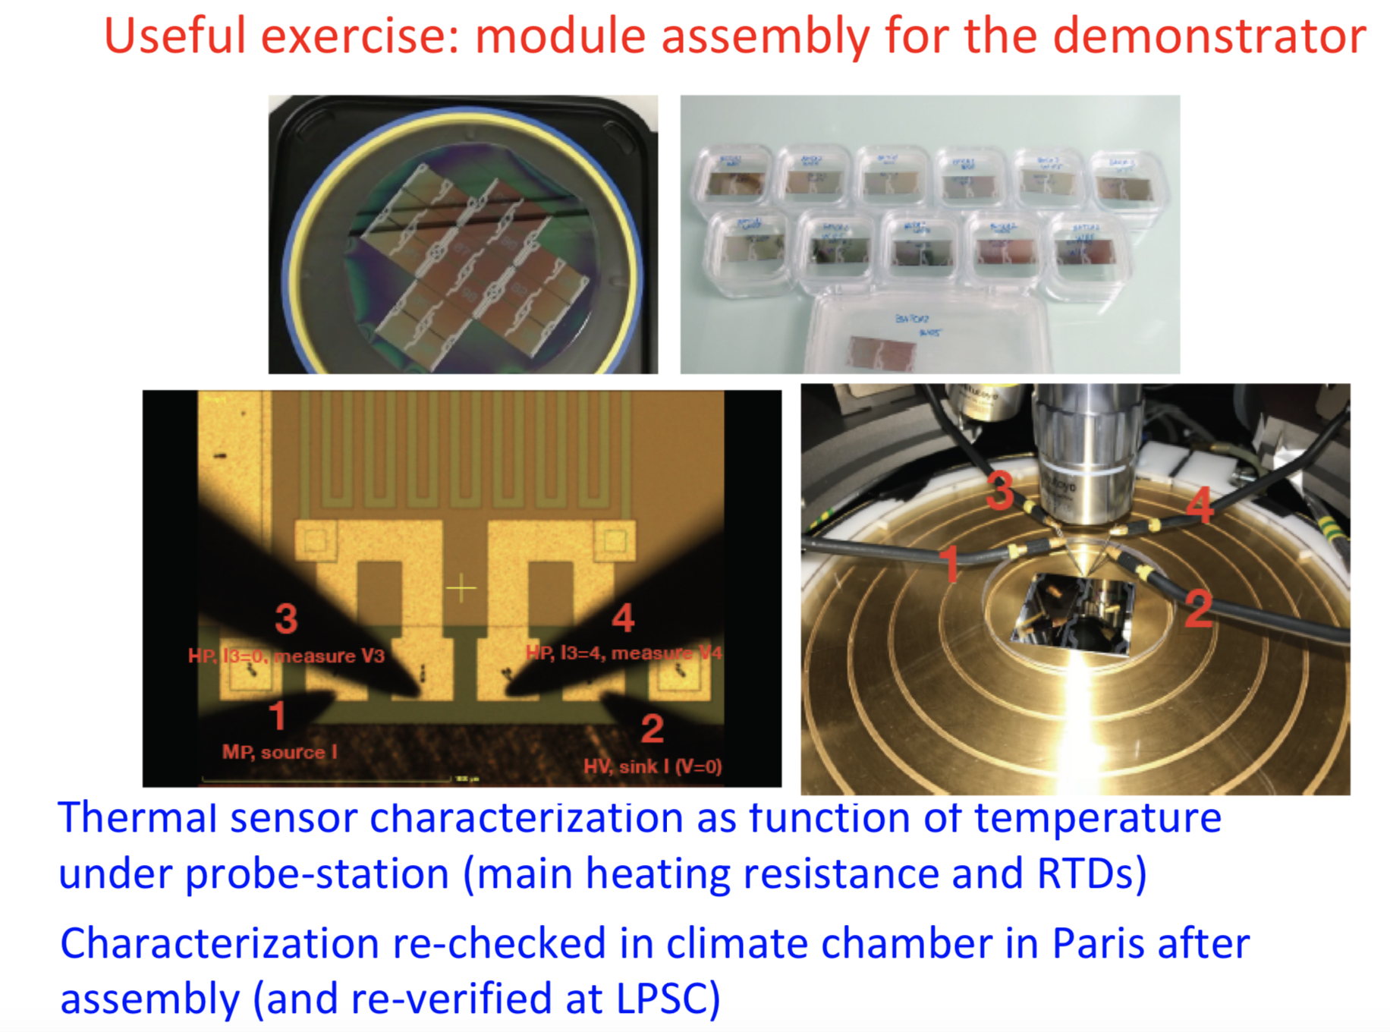

Demonstrator activities in LAL

Slide 19
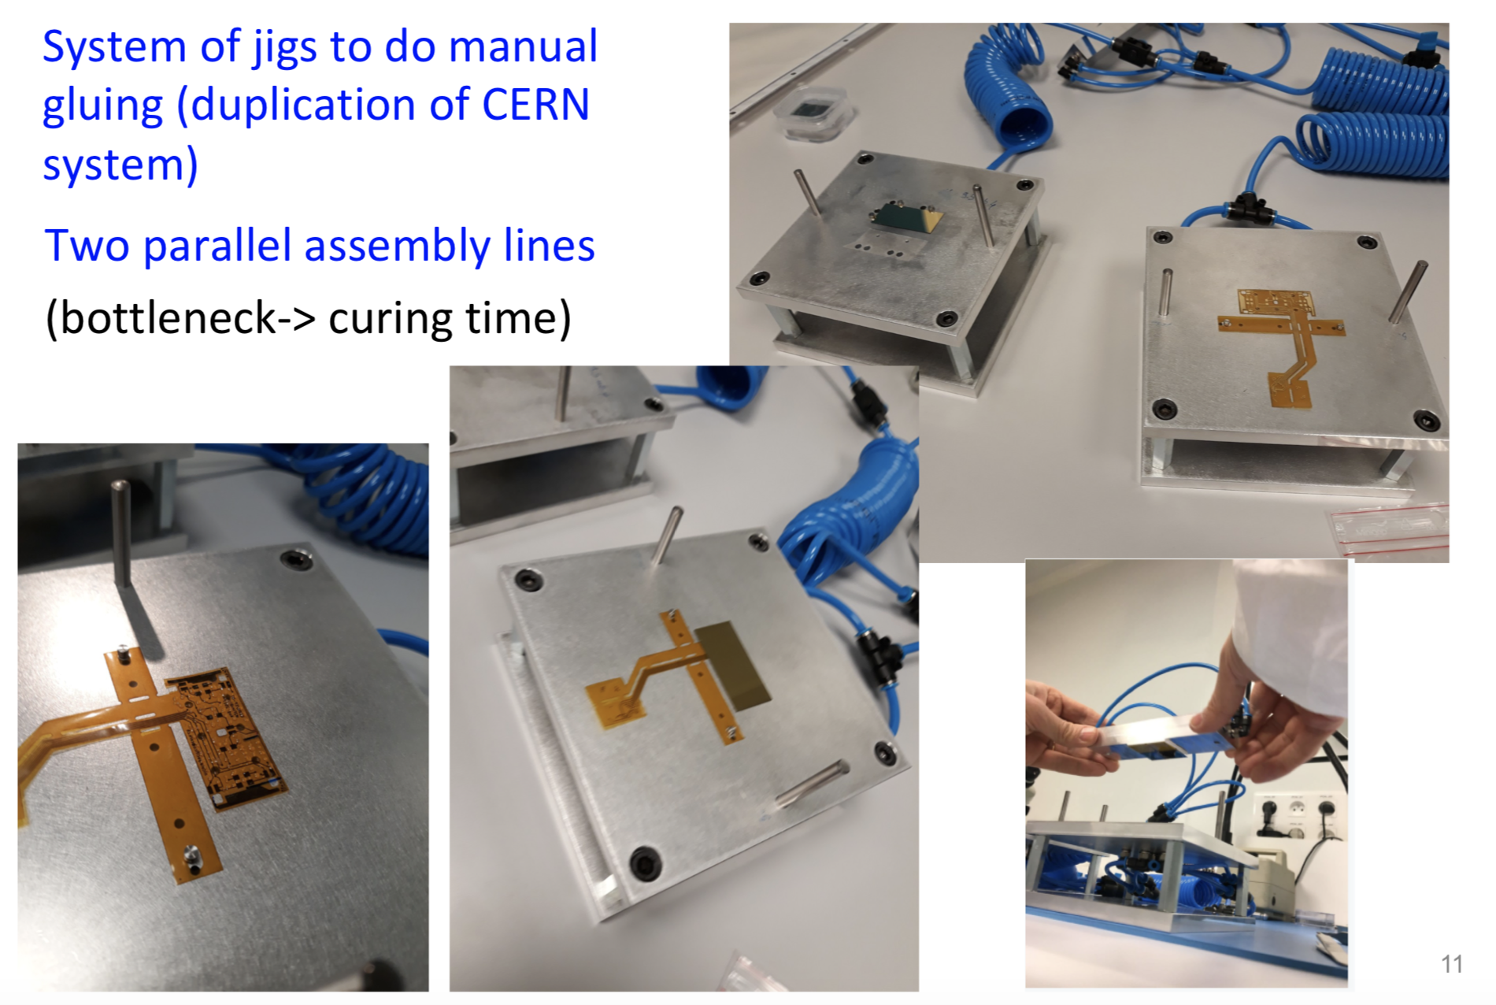
Installation of flexes on sensors
LAL & LPNHE involved

Slide 20
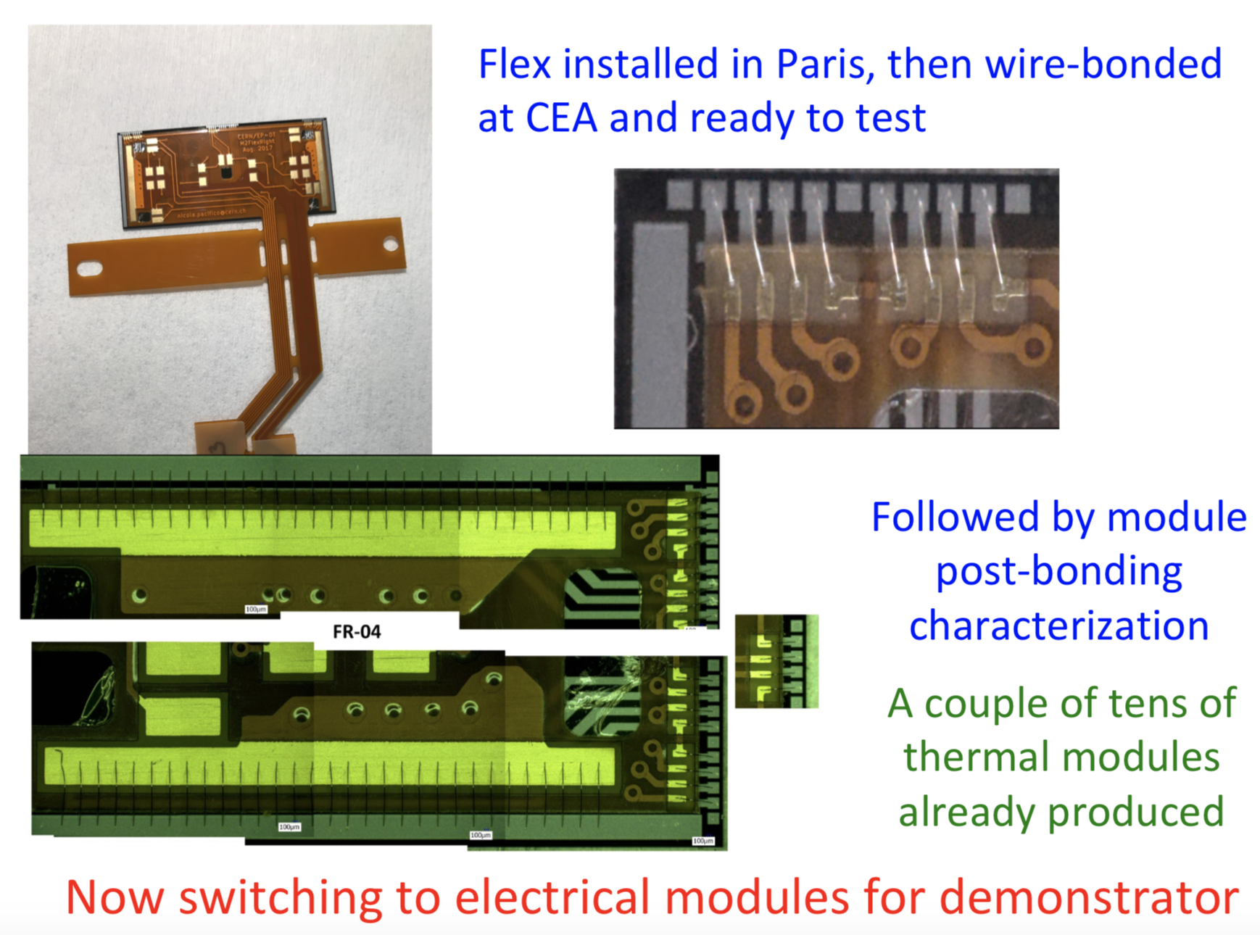
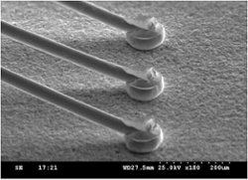

Wire bonding at Saclay

Slide 21
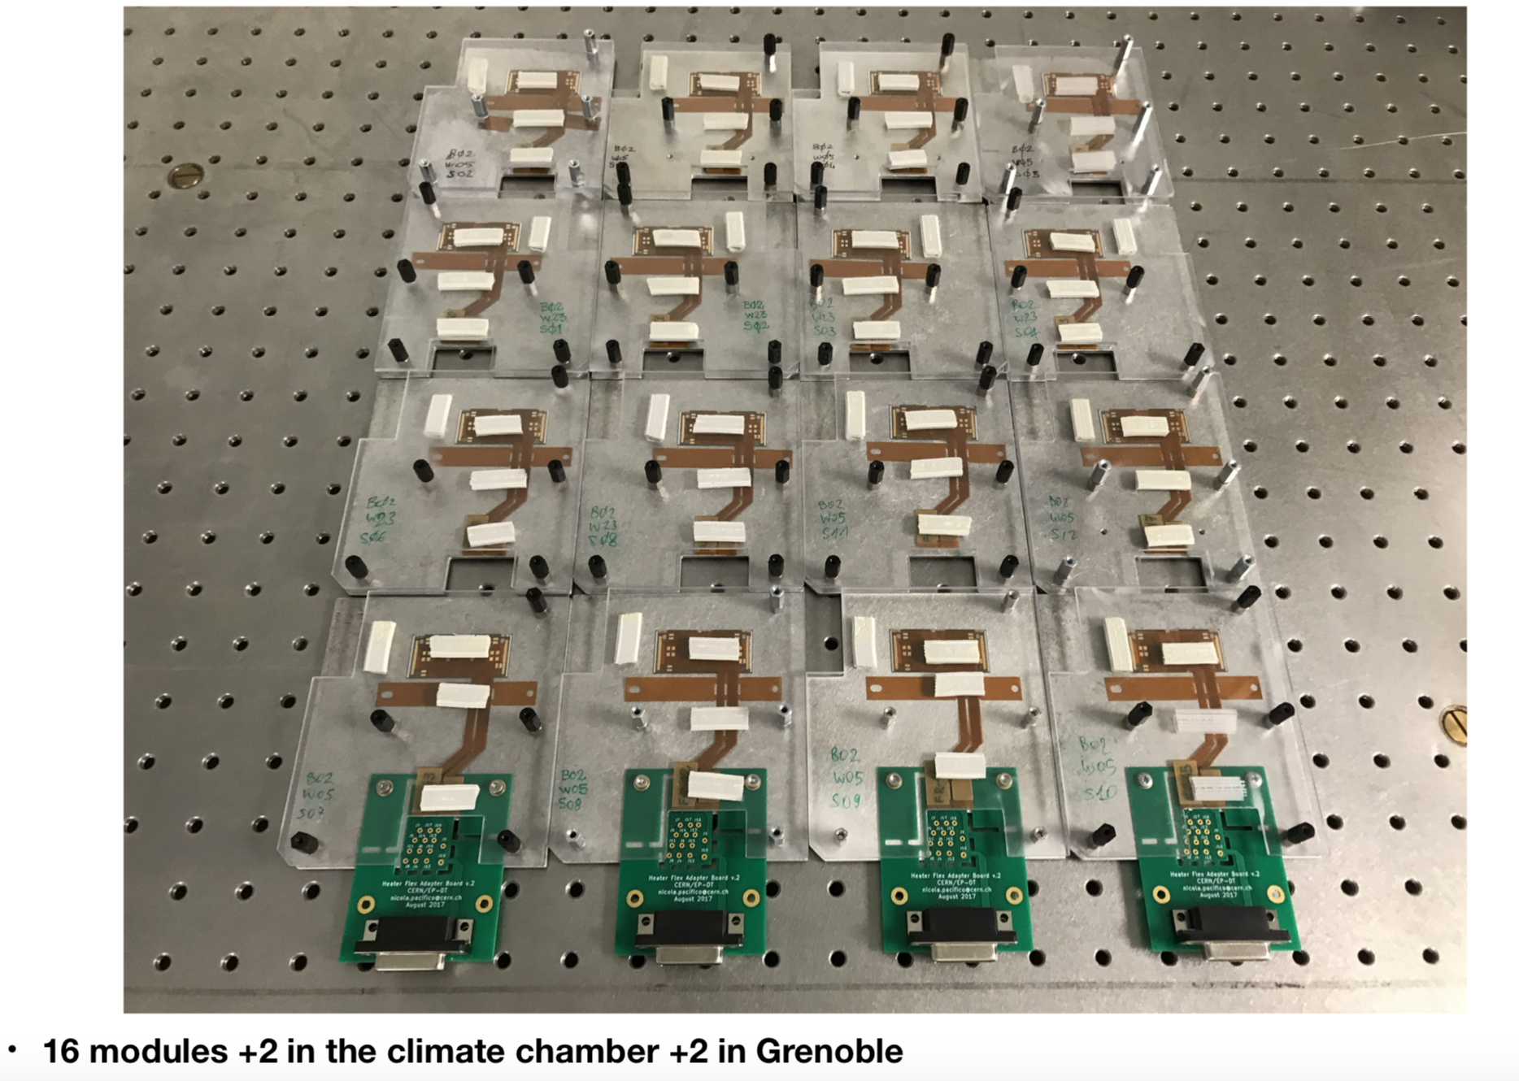
Acheivement
transferred to CERN

Slide 22
THE paris in2P3-CEA cluster
(LAL - lpnhe & CEA IRFU PIXEL GROUPs)
ATLAS ITK CONSTRUCTION

Slide 23

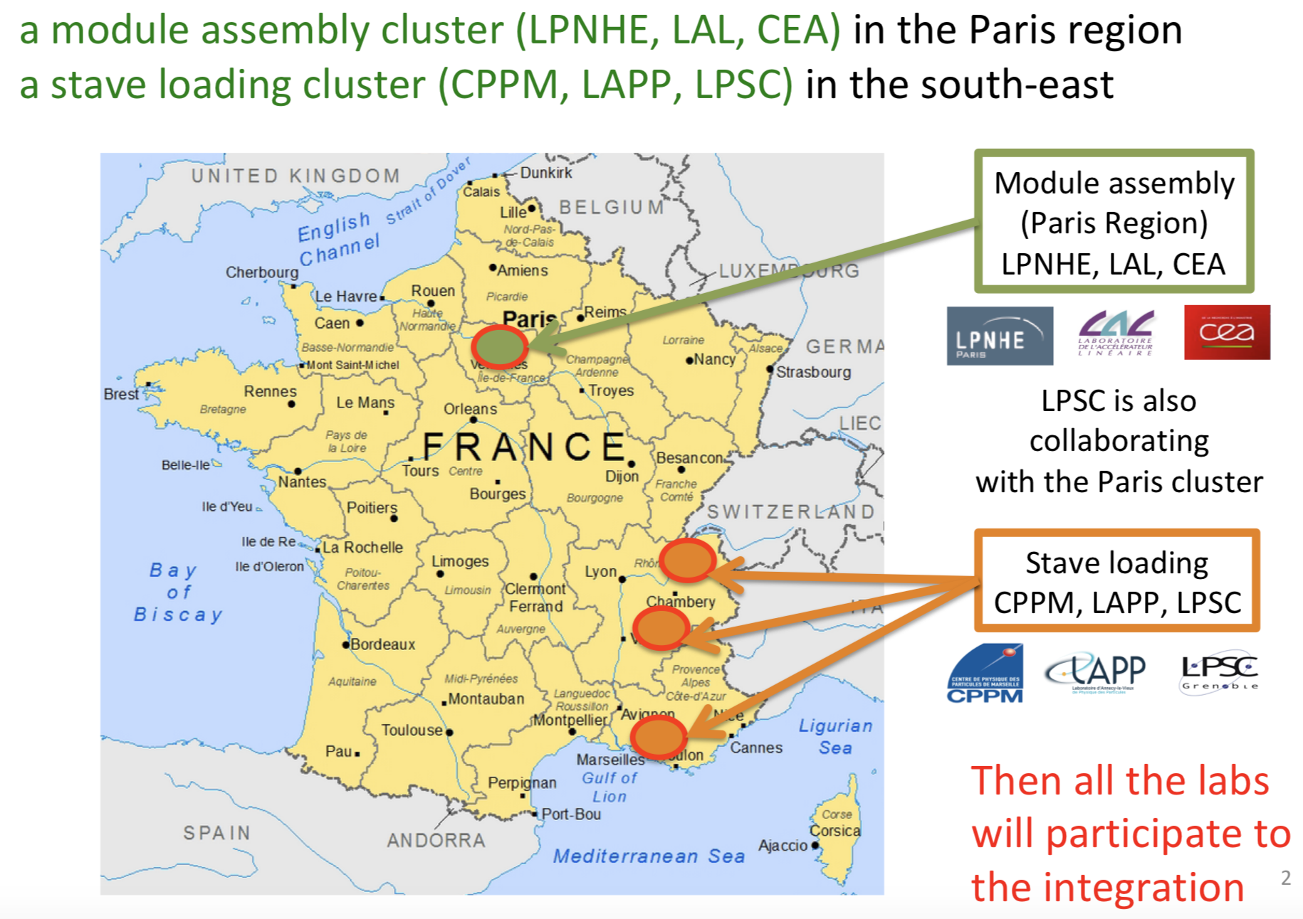
France position in ITk construction

Slide 24
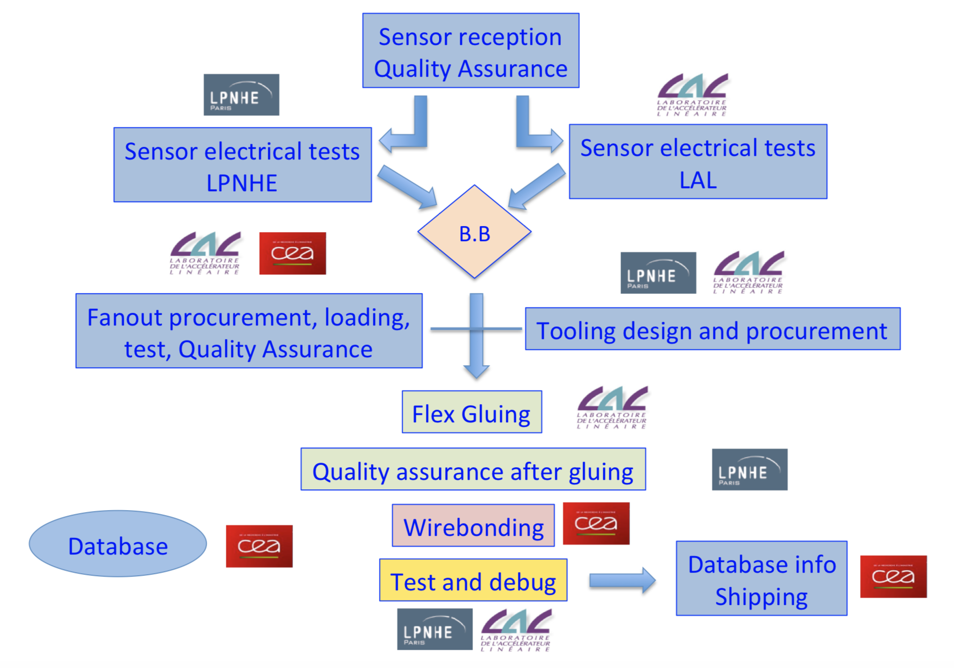
Paris-cluster tasks

Slide 25
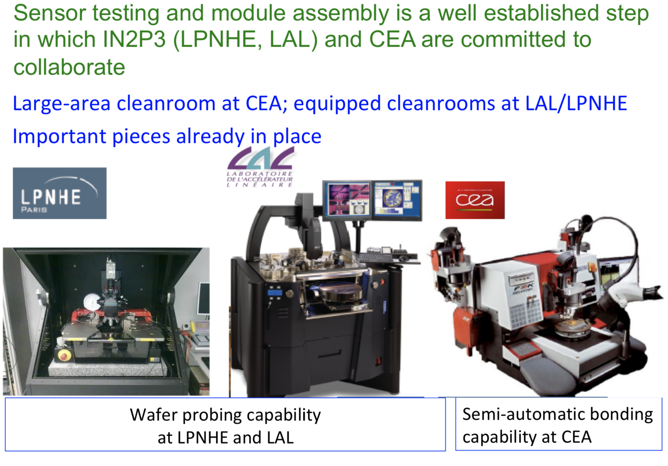
Paris cluster infrastructure

Slide 26
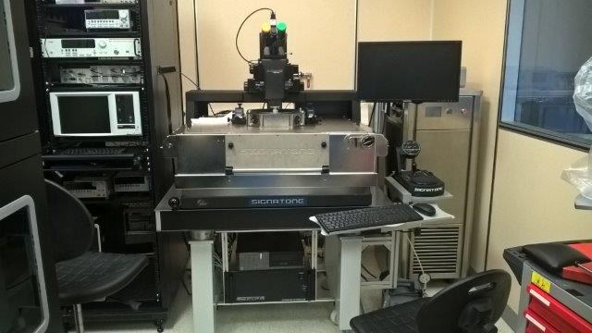
More details probestation -captinov
Semi-automated machine: probe positioning with vision assisted software
performance (<100 fA, 100 fF levels)
open software allows any kind of programming (Labview, Python, C…)
Features:
  30cm workholder in a micro chamber: black box & faraday cage, triaxial connectors Any kind of characterization (DC, AC -50GHz, S, noise, 1/f)
  Large choice of DC & RF probes
Able to perform:
  Wafer level tests or single die
  Probe card holder for specific probe
  configuration Micrometric resolution
Temperature control -60° to 200°
Installed in a clean room at LAL
HV sourcemeter
High resolution microscope
And camera
IV & CV tracer
Farady cage
Cooling plant
PC-Prober

Slide 27
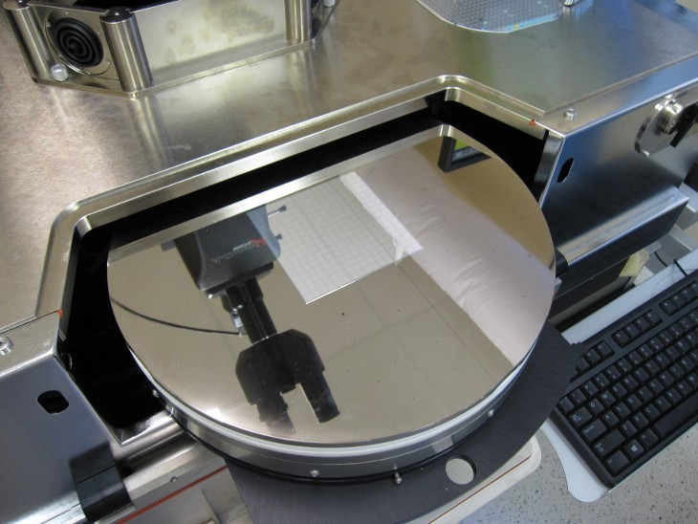
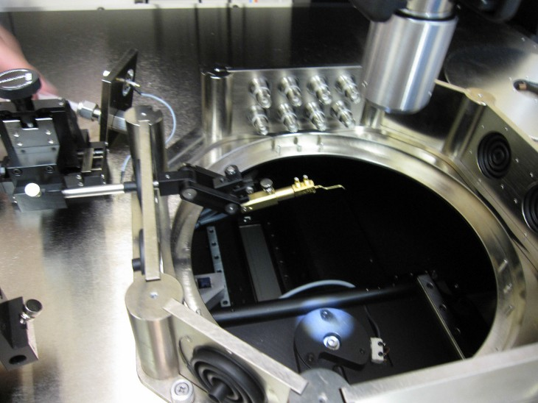

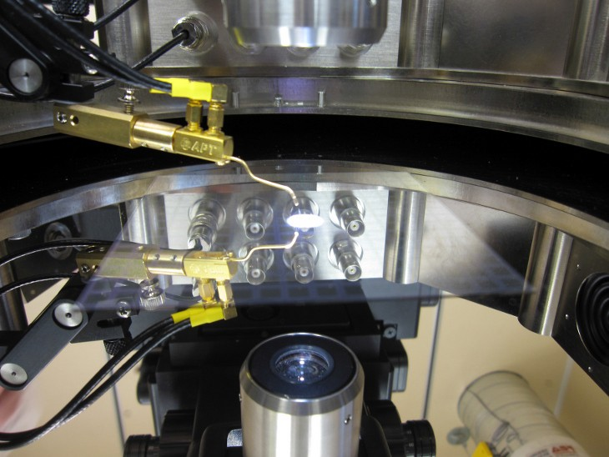
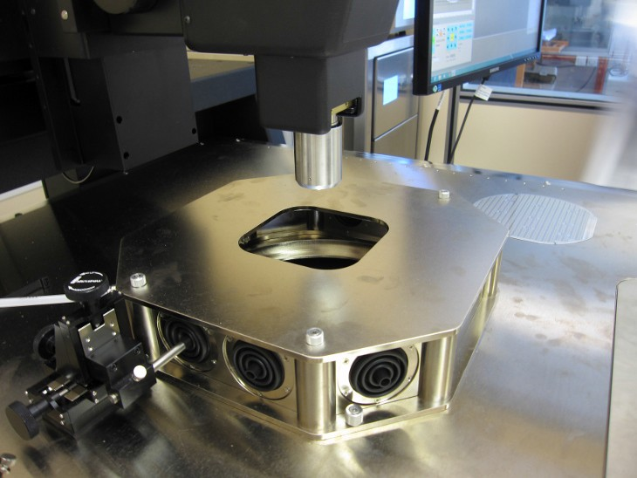
Probe-station
Probe holder
9 cm
Chuck (opened)
Probe
EMI enclosure
Microscope
DUT in position

Slide 28
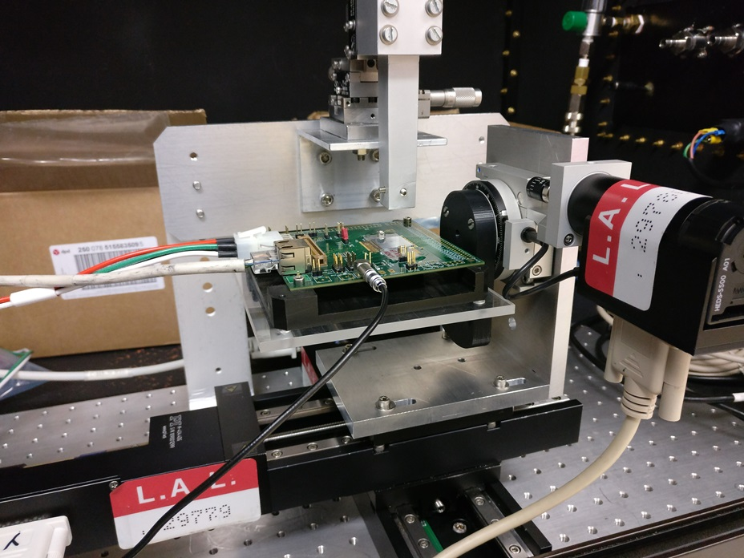
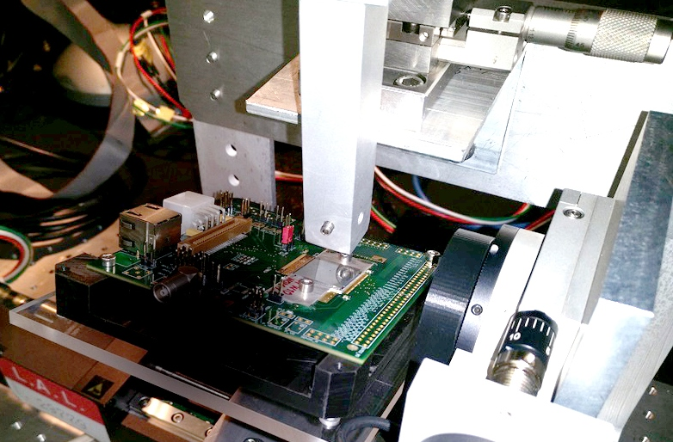
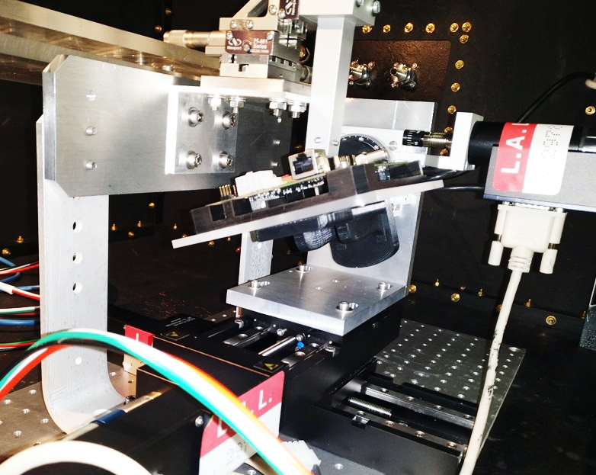
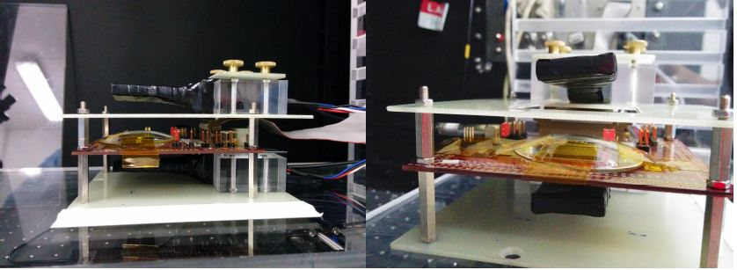
Clean room infrastructure for Pixel@LAL
Fibre Laser
Dmytro Hohov, PHD project
Sakhatski Kostiantyn internship
Laser and cosmic test bench
SCINT 1
SCINT 2

Slide 29
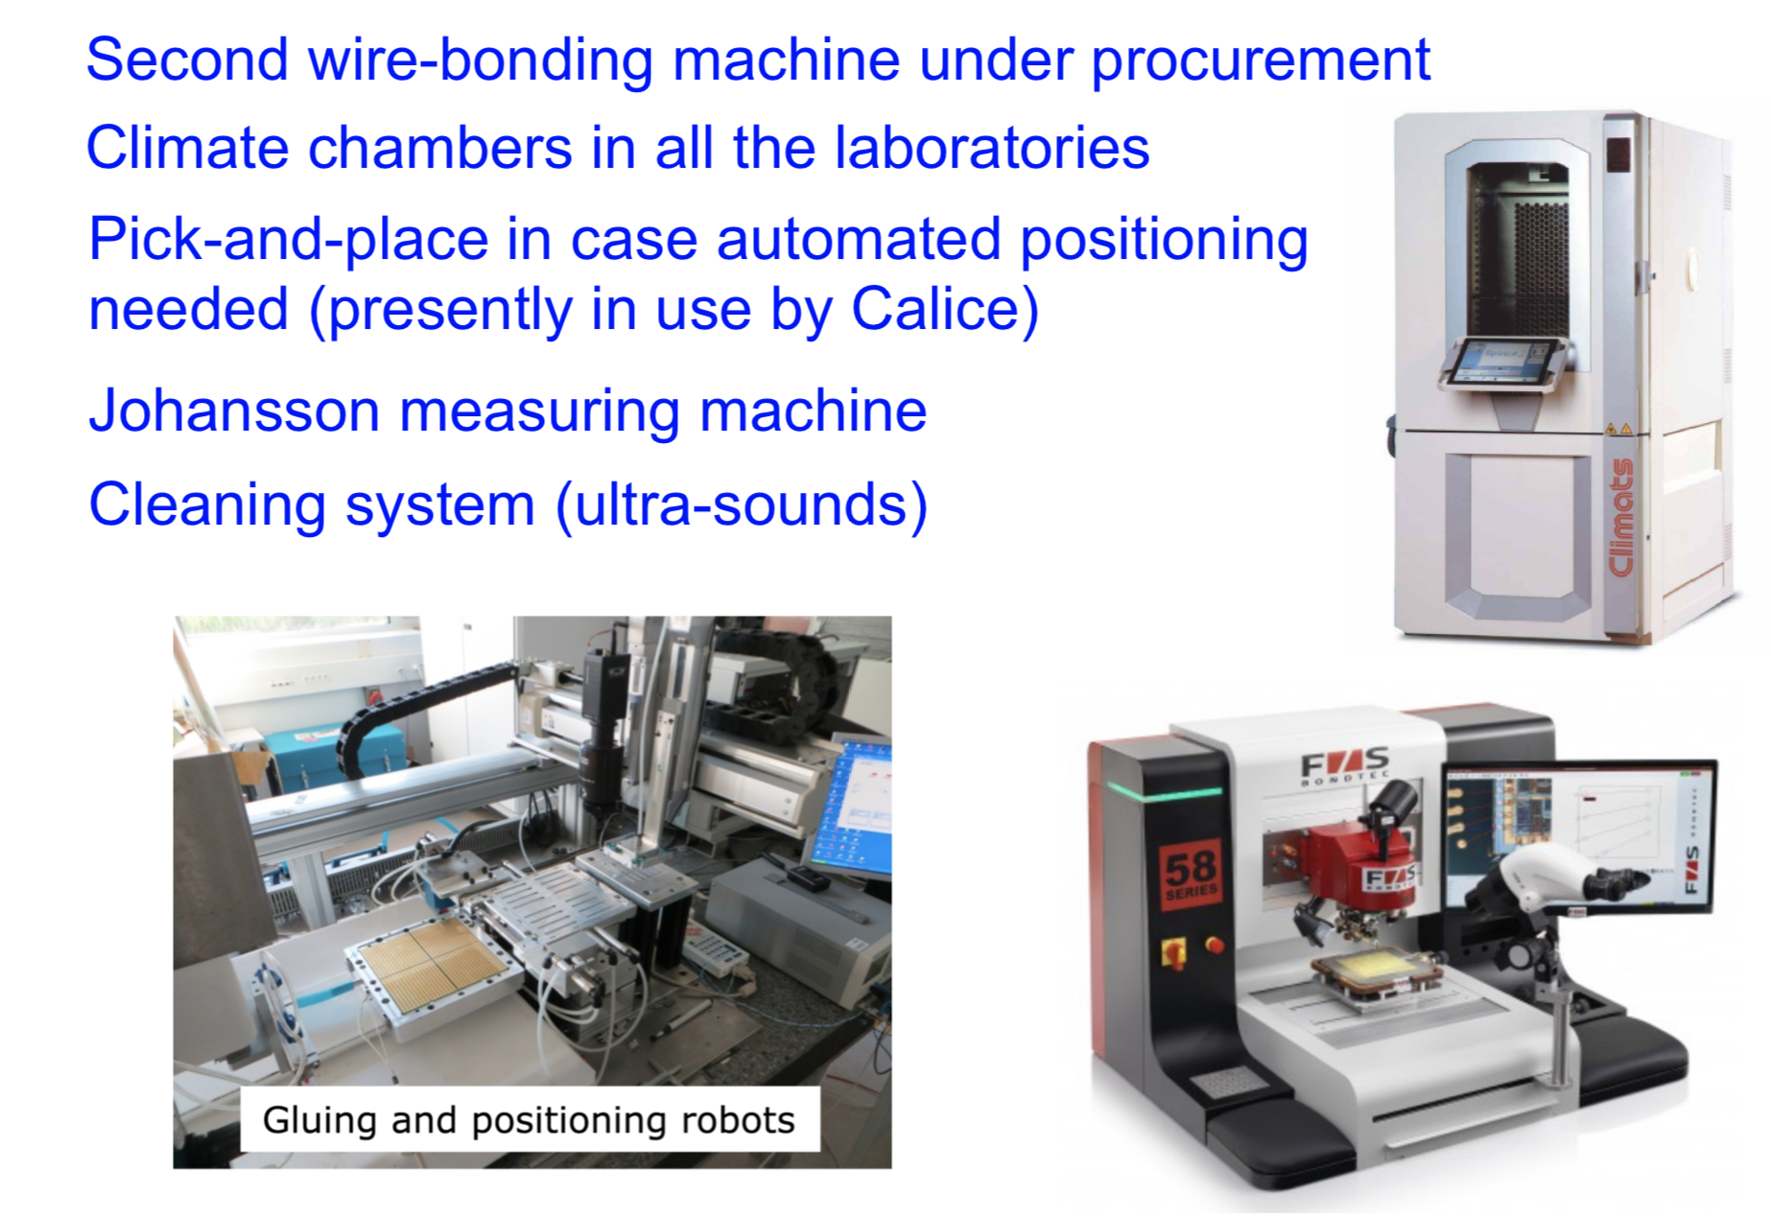
Paris cluster infrastructure: LPNHE

Slide 30
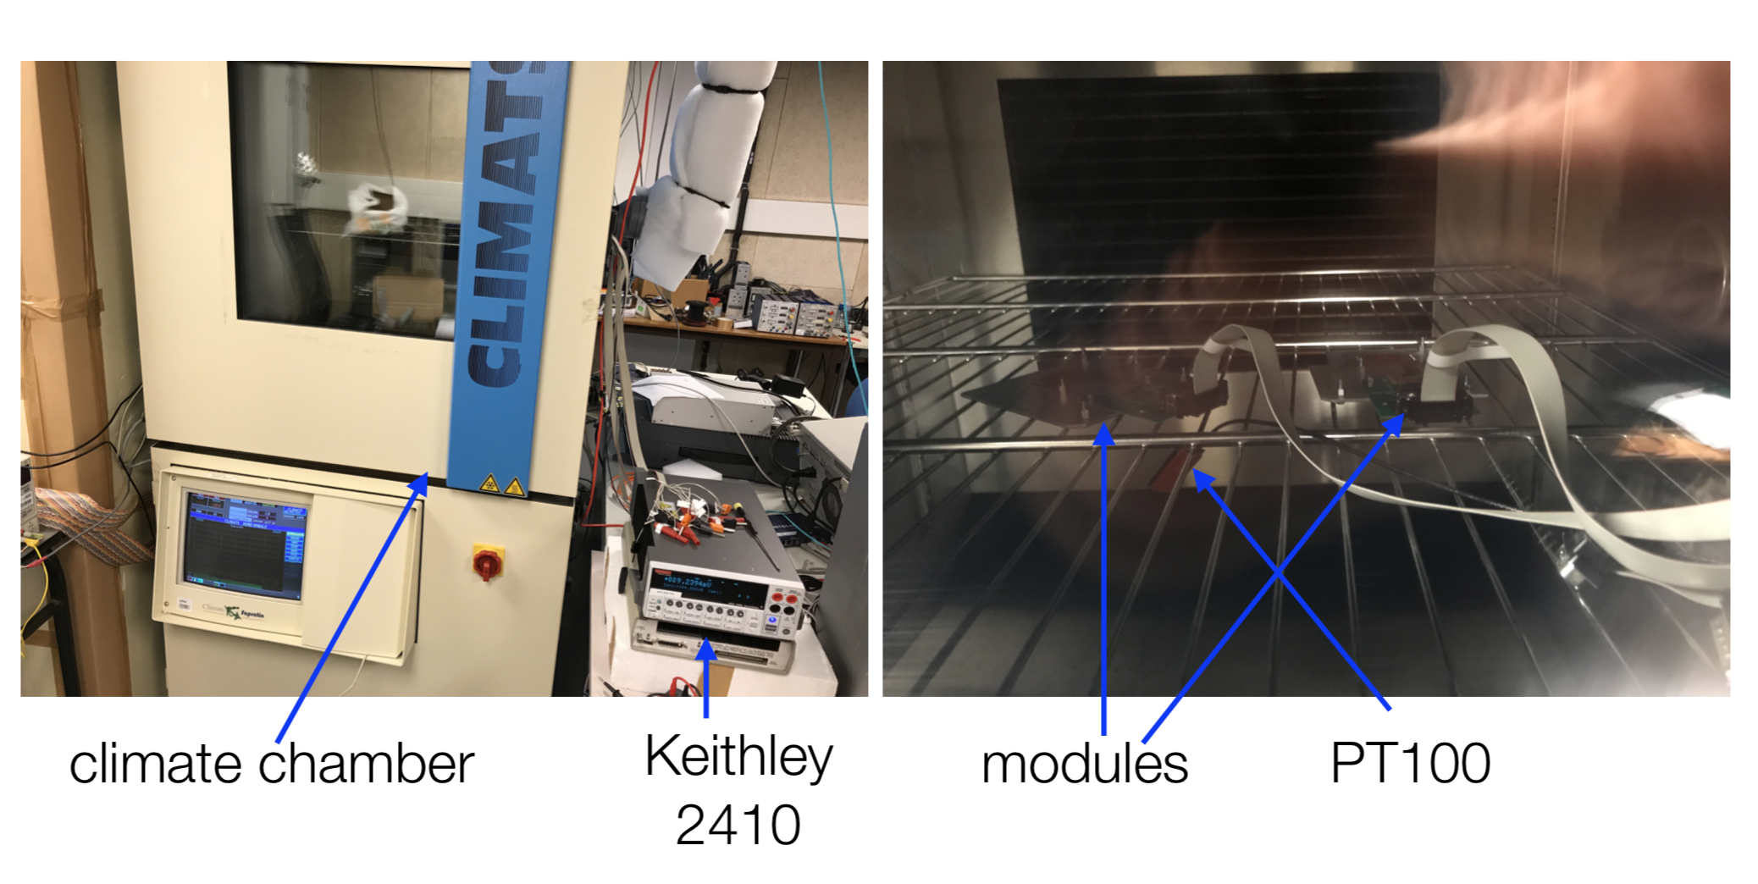

Post wire bonding calibration in climate chamber

Slide 31
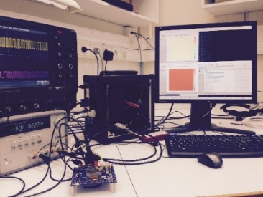
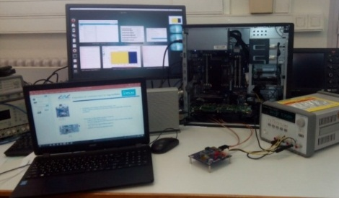
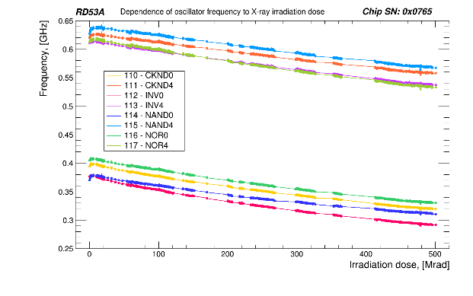
Contribution to RD53 front end chip
Contribution to Ring Oscillator design : successful chip (SERDI)
Role : To monitor irradiation behavior of the front end ATLAS electronics under
irradiations
M. Cohen Solal, J. Jeglot, O. Lemaire, C. Sylvia, P. Vallerand
Contribution to RD53 Ring Oscillator testing:
(Vasyl Drozd , Master 2 internship),
2 DAQ testing system developed
  YARR from Berkeley
  BDAQ53 from Bonn
Ring oscillator testing script delivered
(Python for BDAQ53 and cpp for YARR)
2 irradiation campaigns with CERN
  16/05/2018 – 22/05/2018
  14/06/2018 – 21/06/2018
Column C3 Chip for Front end parameter configuration
(K. sakhatskyi - internship Ukraine)
  Design validation tests
  Irradiation qualification at CERN IRRAD
YARR
BDAQ53

Slide 32
Conclusions and prospects
ATLAS LAL pixel group is involved in very ambitious and challenging project : the ATLAS ITK construction
Synergy developed between involved French teams to share efforts and expertise
Experience and know how is gained thanks to the ITK demonstrator in module assembly tasks (gluing, bonding, testing) to build the ATLAS demonstrator.
Major challenging scientific and technical project is in preparation to succeed to built the future inner tracker using state of the art modern silicon technology platform : captinov
Team is also involved in 65 nm chip design : RD53 Front End Chip : LAL oscillator Chip circuit
Hope to reinforce this precious link with ukrainian universities : a chance to welcome more students to work on European most advanced research programs
Thank you

