Slide 1
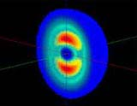


The DEUTERON
Electromagnetic Structure
G.I. Gakh, M.I. Konchatnji, N.P. Merenkov
NSC-KFTI Kharkov
Egle Tomasi-Gustafsson
CEA, IRFU, DPhN and Université Paris-Saclay, France
Egle.Tomasi@cea.fr

Slide 2
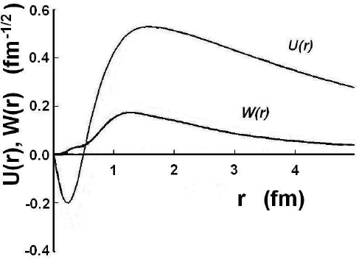
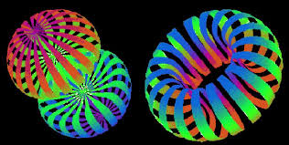
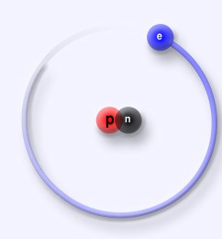
The deuteron : physical interest
  The smallest stable nucleus: M_{D}=1875.6 MeV, E_{b}=2.2 MeV
  a neutron and a proton
  in S=1, T=0 state (L=0 or 2)
  in : ≈96% S-state, ≈4% D state
  6q-states? exotics (L=1)?
  At small momenta:
    building of NN potentials
    deuteron radius
  At large momenta:
    quark configuration when n and p overlap?
  (r< 0.7 fm, q >0.3 GeV )
                As a probe: ‘an isoscalar photon’ (isoscalar spin transitions)
  Moscow
  Argonne
    M_{J}=0
    M_{J}=1

Slide 3
Our contribution
  Elastic scattering (e+d e+d)
    Electromagnetic form factors
    The deuteron size
  Deuteron break-up (e+d e+n+p)
    The neutron form factor
  Coherent pion production (e+d e+d+π⁰)
    Inelastic form factors
Cross sections, polarization observables, radiative corrections
Model independent formalism
Aim:
Test pQCD predictions
definition of the asymptotic regime
6-quark distribution in the deuteron
quantify deviations from the impulse approximation
Inelastic structure : beyond S and D waves

Slide 4
Elastic scattering

Slide 5
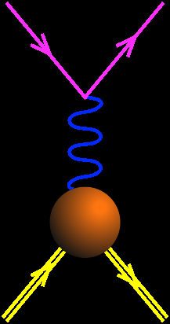

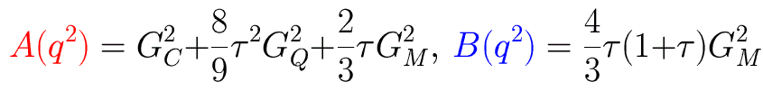
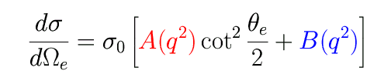
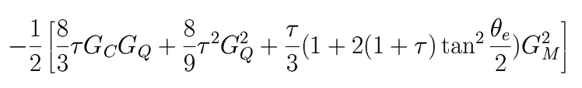
The deuteron (S=1, T=0)
e⁻
e⁻
e+d → e+d
q²<0
d
d

Slide 6
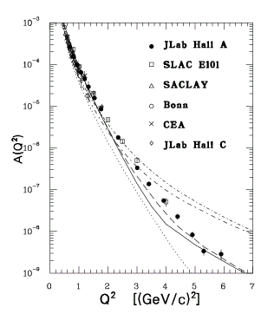
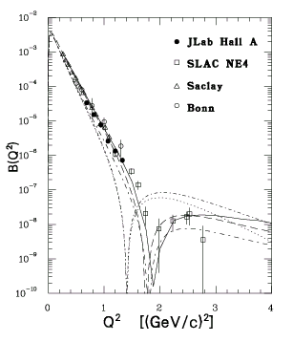
Cross section
B(Q²)
A(Q²)

Slide 7
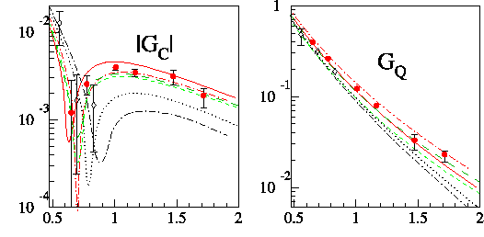
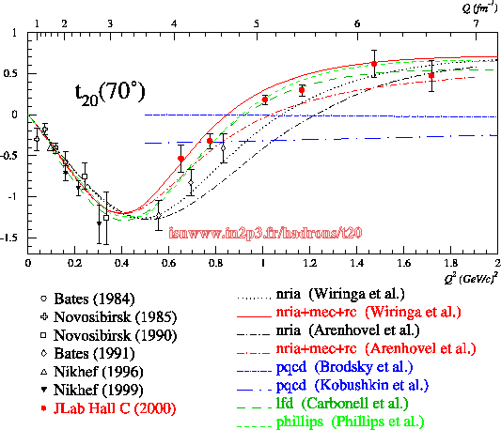
The Deuteron EM Form Factors
Jlab E94-018
Spokepersons:
B. Beise, S. Kox
Polarimetry at SATURNE!
D. Abbott et ql. Phys. Rev. Lett. 84,5053 (2000)

Slide 8
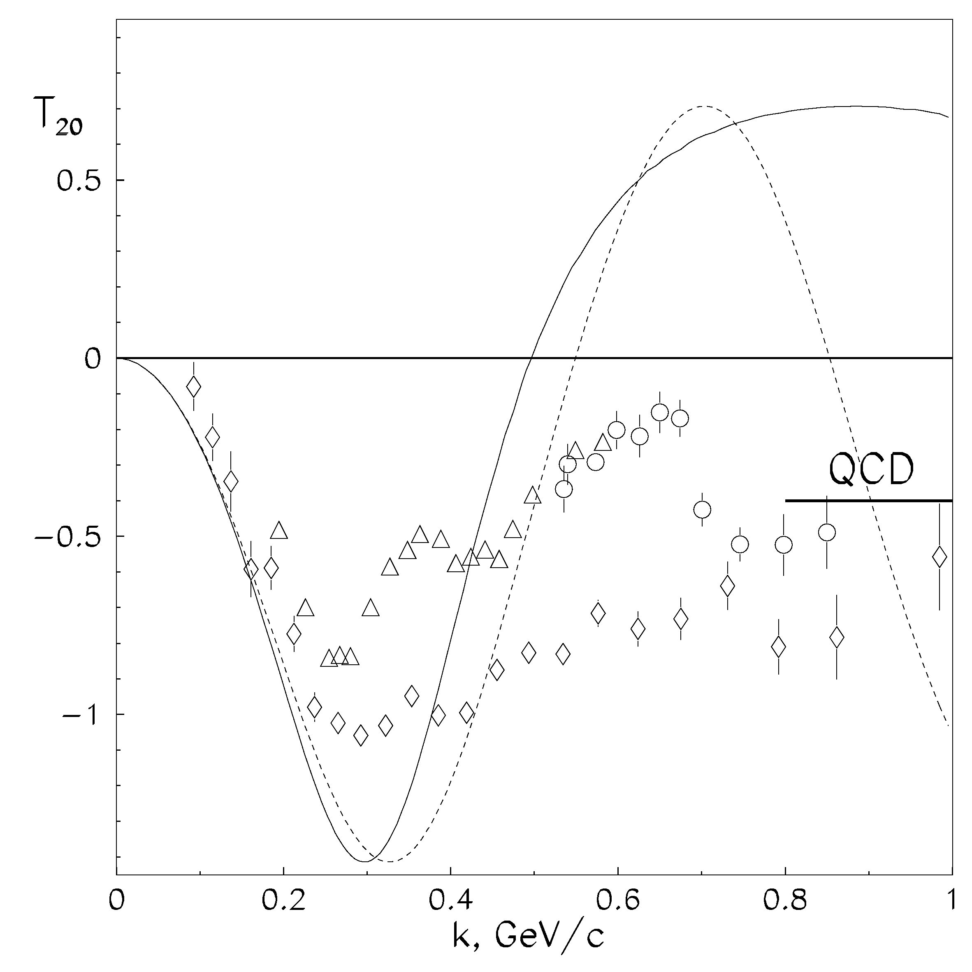
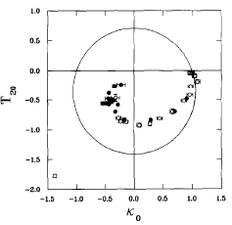
Non nucleonic degrees of freedom?
Backward elastic scattering ¹H(d,p)d
Inclusive break up ¹H(d,p)X (0 deg)
V.Punjabi et al., Phys.Lett.B350 (1995) 178
L.S.Azhgirey et al., Phys.Lett.B391 (1997) 22
L.S.Azhgirey et al., Phys.Lett.B387 (1996)

Slide 9
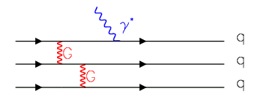
Dipole Approximation and pQCD
Dimensional scaling
  F_{n} (Q²)= C_{n} [1/( 1+Q²/m_{n}) ^{n-1}],
    m_{n}=nβ² , <quark momentum squared>
    n is the number of constituent quarks
  Setting β² =(0.471±.010) GeV² (fitting pion data)
    pion: F_{π} (Q²)= C_{π} [1/ (1+Q²/0.471 GeV²)¹],
    nucleon: F_{N} (Q²)= C_{N} [1/( 1+Q²/0.71 GeV²)²],
    deuteron: F_{d} (Q²)= C_{d} [1/( 1+Q²/1.41GeV²)⁵]
V. A. Matveev, R. M. Muradian, and A. N. Tavkhelidze (1973), Brodsky and Farrar (1973), Politzer (1974), Chernyak & Zhitnisky (1984), Efremov & Radyuskin (1980)…

Slide 10
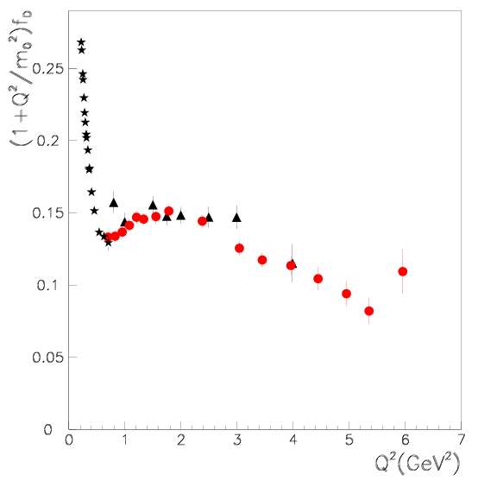

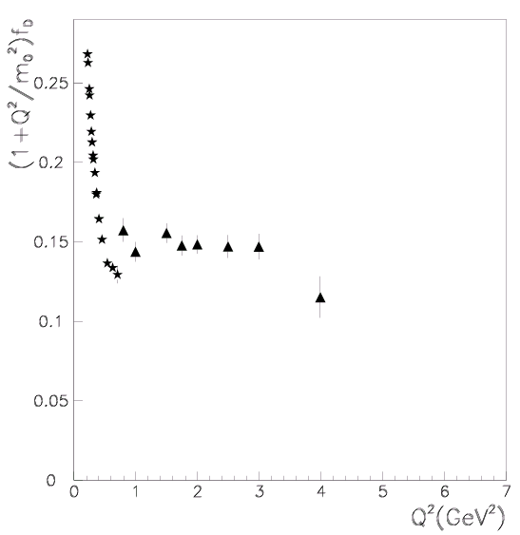
Reduced deuteron form factors
R. G. Arnold et al., SLAC,
PRL 57,174 (1986)
S. Brodsky and B.T. Chertok,
Phys. Rev. D 14, 3003 (1976)

Slide 11
Reduced deuteron form factors
R. G. Arnold et al., SLAC,
PRL 57,174 (1986)
S. Brodsky and B.T. Chertok,
Phys. Rev. D 14, 3003 (1976)
A. Alexa et al., Jlab Hall A,
PRL 82,1374 (1999)
M.P. Rekalo and E. T.-G., Eur. Phys. J. A, (2003)

Slide 12

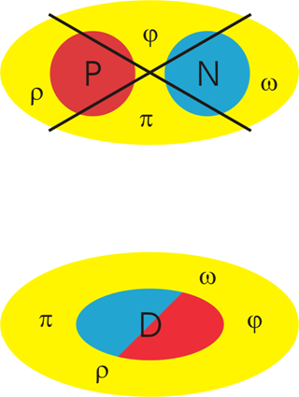



The Deuteron VMD: S=1, T=0
Normalization
Intrinsic term
(common to the 3 FFs)
Meson cloud: isoscalar vector meson only
C. Adamuscin, G.I. Gakh and E.T-G. PRC 73, 045204 (2006)

Slide 13
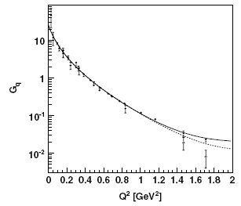
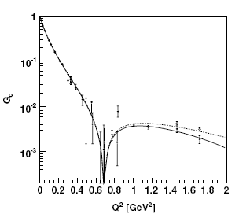
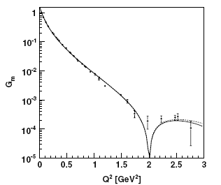
The best parametrization
C. Adamuscin, G.I. Gakh and E.T-G. PRC 73, 045204 (2006)
G_{Q}
G_{C}
G_{M}
  - 2 parameters fit
  - best χ²
  -TL region !

Slide 14
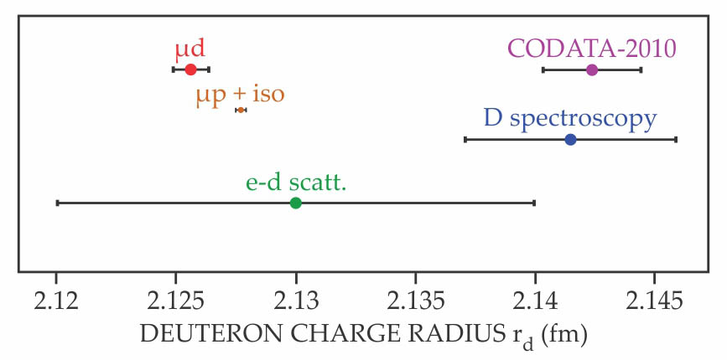

The deuteron size
Discrepancy between the determination of the proton radius:
  CODATA (ep scattering & H) and muonic hydrogen
  ep elastic scattering and μH
  Recent and previous Hydrogen Lamb shift experiments
Tension between analysis of ep-scattering:
extrapolation to Q²=0 !!!
Similar situation
for the deuteron !
Deuteron joins proton as smaller than expected
11 Aug 2016 in
Research & Technology
R. Pohl et al., Science 353, 669, 2016.

Slide 15

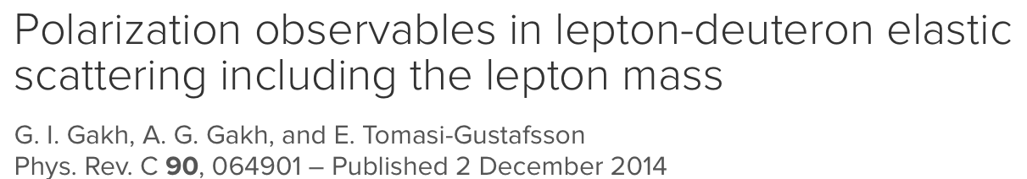
Our contribution
Model independent radiative corrections to elastic deuteron-electron scattering
G.I. Gakh, M.I. Konchatni N.P. Merenkov, E. T.-G.
arXiv.org>>hep-ph > arXiv:1804.01399
To appear in PRC

Slide 16
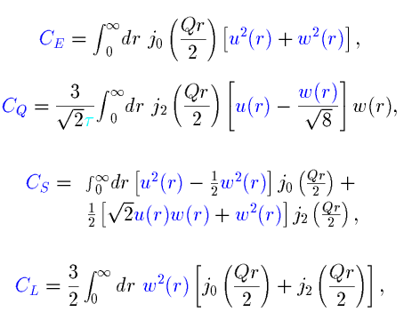




The IA deuteron structure: S=1, T=0
The nucleon
form factors:
2) The S (u) and D (w) deuteron wave function

Slide 17
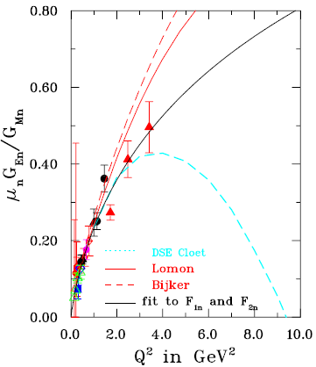
G_{En} from e-deuteron elastic scattering

Slide 18
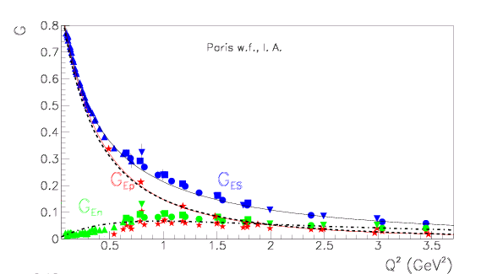
G_{En} from e-deuteron elastic scattering
G_{En} > G_{Ep} starting from 2 GeV² !
E. T-G. and M. P. Rekalo, Europhys. Lett. 55, 188 (2001)

Slide 19
Deuteron electrodisintegration

Slide 20
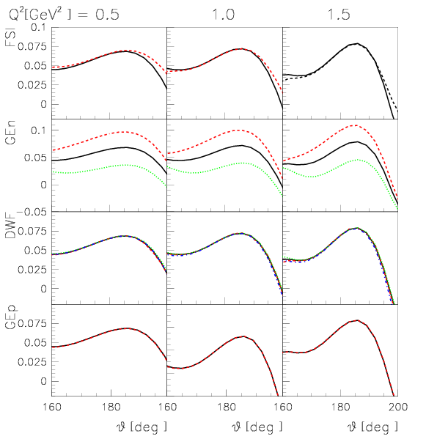
The reaction d(e,e’n)p - A_{x}
The KHARKOV model:
- Impulse Approximation
- Fully relativistic
- Kinematics: proton spectator
- Polarization observables
Select the quasi-elastic
kinematics
Large dependence of the asymmetry on GEn!
Polarized electron beam, polarized target or neutron polarimeter
G.I. Gakh, A. P. Rekalo, E. T.-G. Annals of Physics (2005)

Slide 21
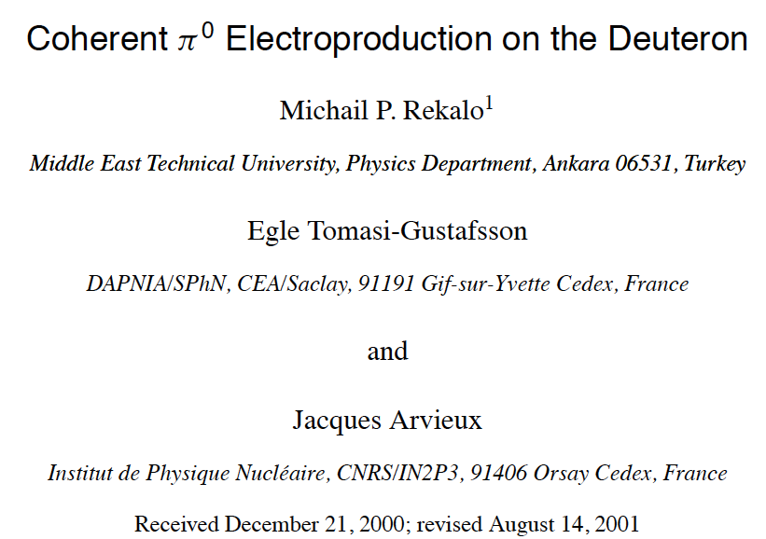
Coherent pion electroproduction
on the Deuteron

Slide 22
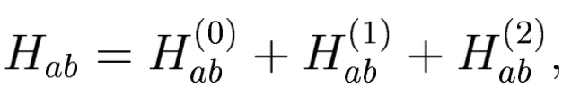




e+d e+d+P⁰
In general
Hadronic tensor :
H_{ab}⁽⁰⁾ : Unpolarized tensor depends on 4 SF
H_{ab}⁽¹⁾ : Vector polarized deuteron … 8 SF
H_{ab}⁽²⁾ : Tensor polarized deuteron … 16 SF
Longitudinally polarized electrons:
41 SF:

Slide 23
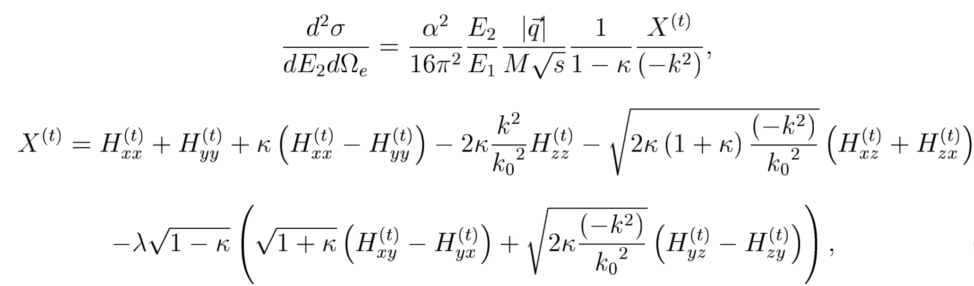
e+d e+d+P⁰
General expressions for the unpolarized cross section:
And for all polarization observables…
..to be then calculated according to a model: IA
G.I. Gakh, A. P. Rekalo, E. T.-G. Annals of Physics 295, 1 (2002)

Slide 24
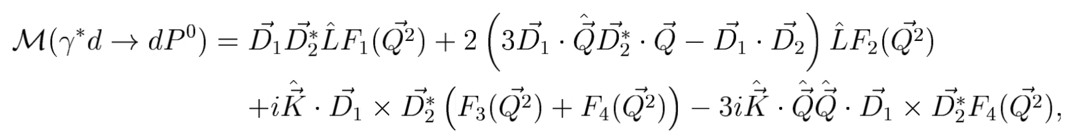
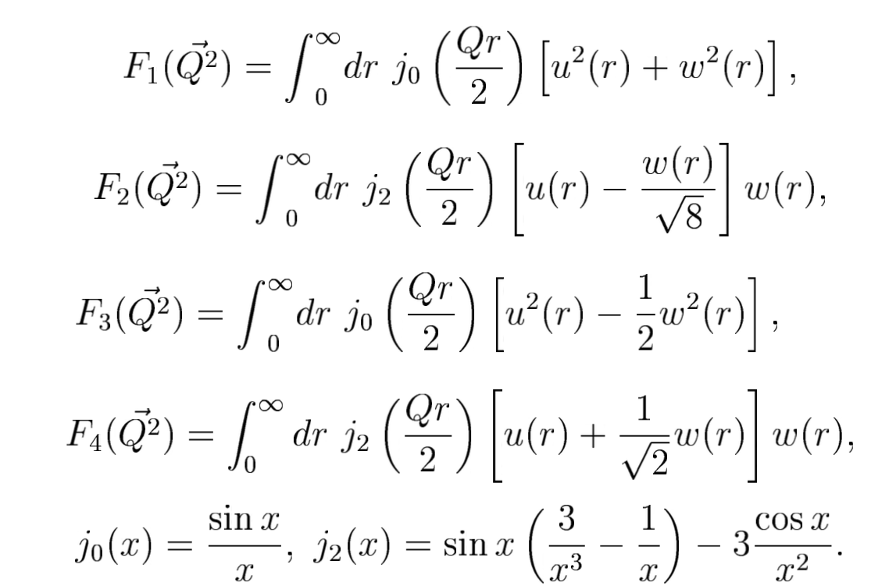
Impulse approximation for γ + d γ + d + P⁰
Inelastic Form Factors

Slide 25
γ*+N γ*+N+P⁰
γ*+p 220 MeV
γ*+p 240 MeV
γ*+p 260 MeV
γ*+p 300 MeV
γ*+n 240 MeV
γ*+n 300 MeV
Born s,t,u nucleon exchange channels
t-channel π, ρ, ω , exchange
Δ exchange
VMD model:
(near threshold)

Slide 26
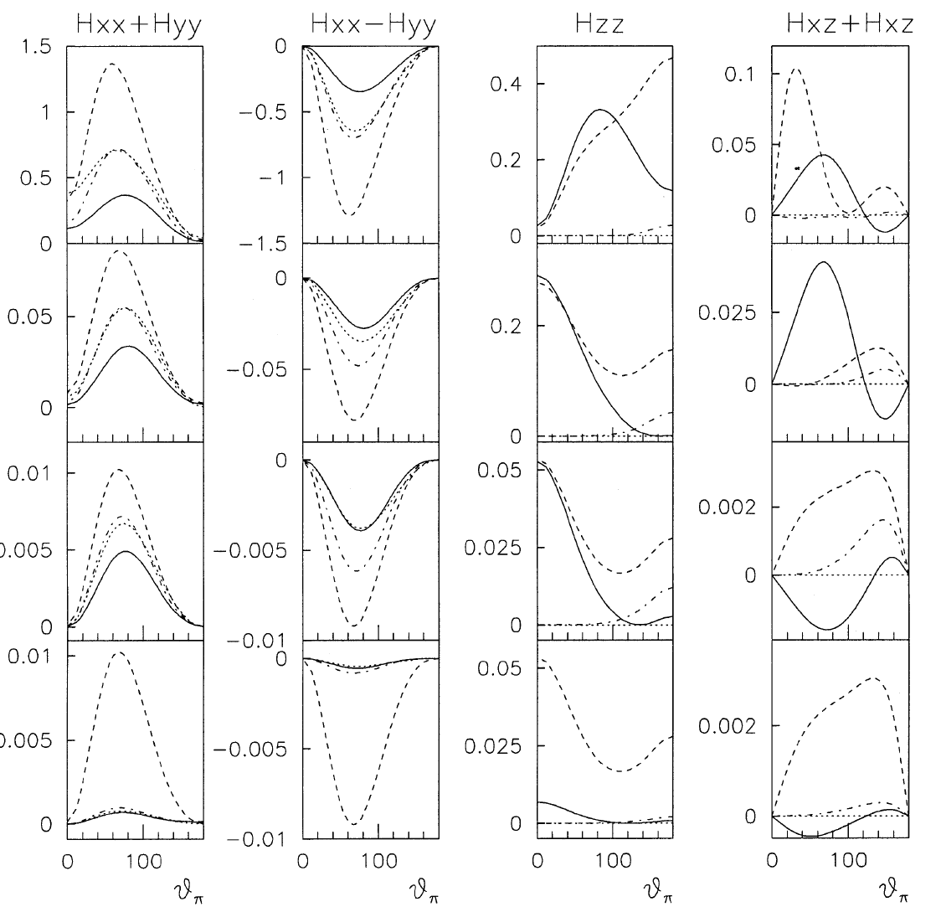
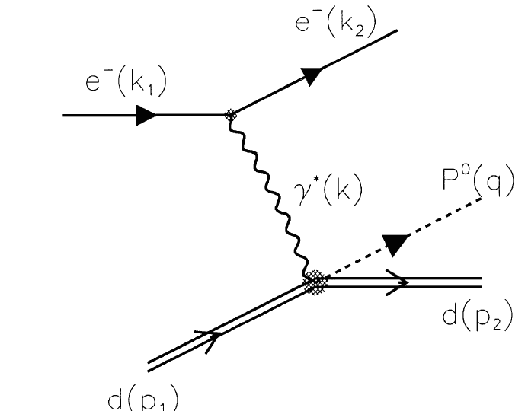
e+d e+d+P⁰
  Polarization
  phenomena
  in progress !
G.I. Gakh, A. P. Rekalo, E. T.-G. Annals of Physics 295, 1 (2002)

Slide 27
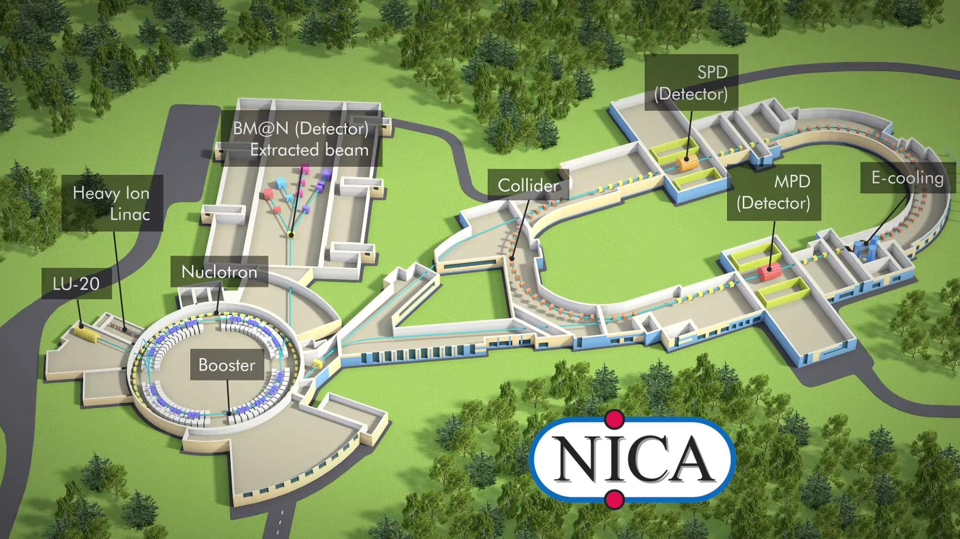
Conclusion
eD elastic scattering at large Q² with the
11 GeV Jlab upgrade
Measurements of neutron FFs
Deuteron: lightest nucleus to study quark and hadron dynamics at short distances:
  short range correlations
  three body forces
  six quarks states
  ……
  Polarized deuteron beam
  at 13 GeV already
  available at Dubna
  Nuclotron.
  NICA Collider soon 8
Jefferson Lab

Slide 28
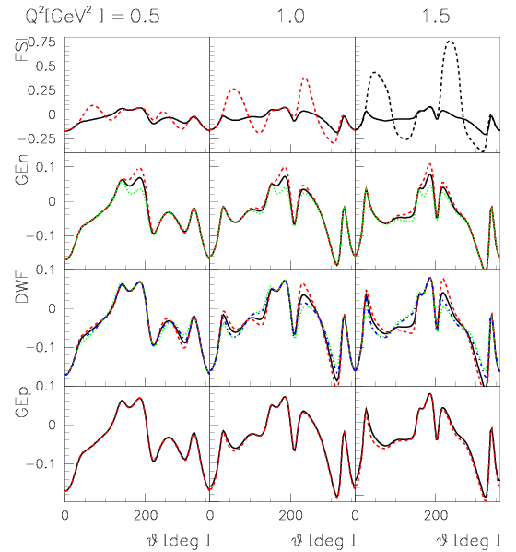
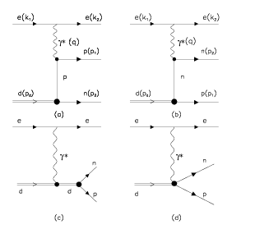
The reaction d(e,e’n)p - A_{x}
The KHARKOV model:
- Impulse Approximation
- Fully relativistic
- Kinematics: proton spectator
- Polarization observables
G.I. Gakh, A. P. Rekalo, E. T.-G. Annals of Physics (2005)

Slide 29


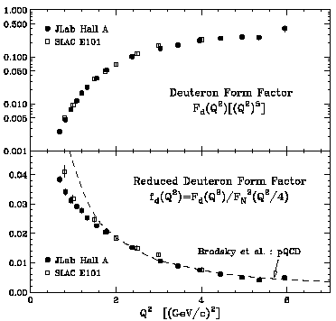


Reduced deuteron form factors
L.Alexa et al., PRL 82, 1374 (1999), HallA, JLab

Slide 30

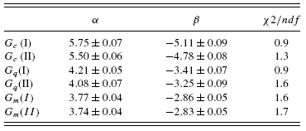
Results
  From 12 to 6 parameters fit
  1) Constrains on the nodes:
  Q²_{0C}=1.7 GeV², Q²_{0M}=2 GeV²
  2) Intrinsic part common to the 3 FFs:
  _{δ=1.04 ±0.03, γ=12.1 ± 0.5}

Slide 31
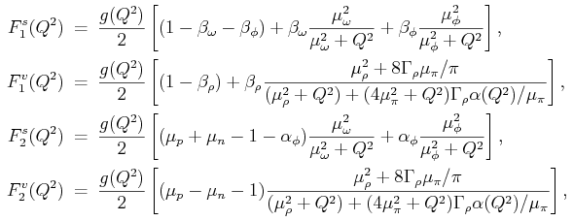


VDM: Iachello, Jakson and Landé (1973)
γ*
ω,ρ,ϕ
Isoscalar and isovector FFs
Intrinsic FF

Slide 32
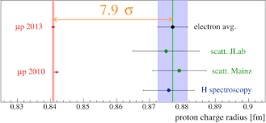

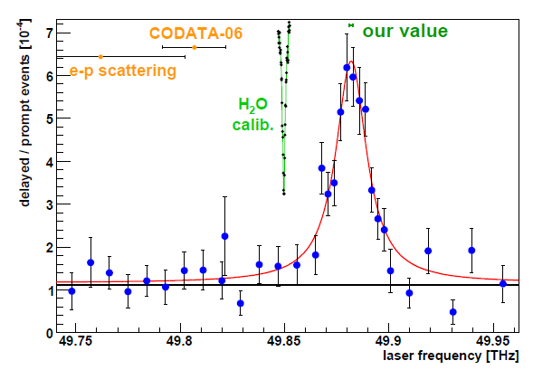


The Proton Size (Radius)

Slide 33
e⁺ + e⁻ → d + d
The time-like region:
G_{Q}
Imaginary part from the
intrinsic term
No finite width for ρ,ω mesons
G_{M}
U&A (Dubnicka)
G_{C}
Parametrization I (real part)
[Abbott, EPJA 2000]
G. I. Gakh, E. T-G, C. Adamuščín, S. Dubnička, and A. Z. Dubničková
PRC 74, 025202 (2006)

Slide 34
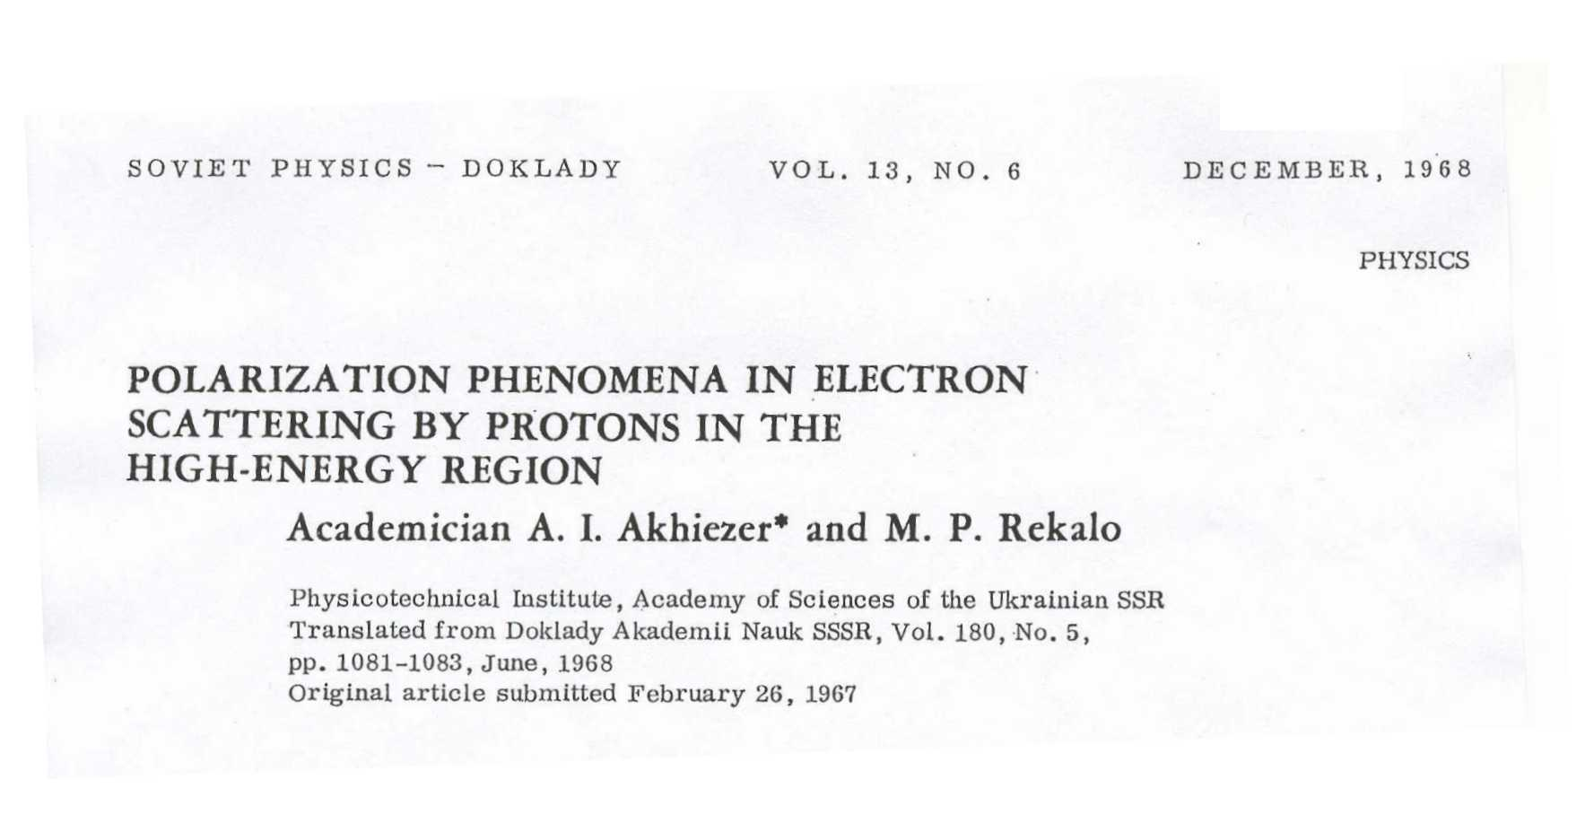
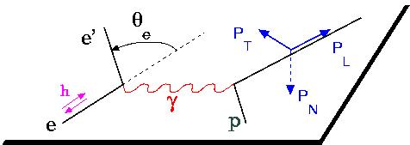
Electric NEUTRON Form Factor
  - Smaller then for proton, but not so small
  New results, based on polarization method
The polarization induces a term in the cross section proportional to G_{E} G_{M}
Polarized beam and target or polarized beam and recoil proton polarization

