Slide 1



LIA France-Ukraine Workshop 2016
September 27th, 2018
Detection properties and internal activity of newly developed La-containing scintillator crystals
G. Hull¹, F. Camera², G. Colombi², M. Josselin¹
Institut de Physique Nucléaire d'Orsay, CNRS-IN2P3, Univ. Paris Sud, Univ. Paris-Saclay, Orsay France
2 Università degli Studi di Milano, INFN Sezione di Milano, Milan, Italy

Slide 2
Outline
La-containing crystals
The tested crystals and the experimental set-up
Light yield and energy resolution
Response vs interaction point of the γ radiation
Internal activity
Summary
Pag. 1

Slide 3
New scintillator crystals
LaBr₃:Ce
Fast (~16 ns)
Bright (>60kγ/MeV)
Fast (~17 ns)
Bright (>60kγ/MeV)
No internal activity
CeBr₃
Very bright (>100kγ/MeV)
Slow (~1μs)
Suffer of self-absorption
SrI₂:Eu
Good energy resolution
Sensitive to thermal n
n/γ PSD discrimination
CLYC
(Cs₂LiYCl₆:Ce)
Pag. 2

Slide 4

New La-based scintillator crystals
JR1-PASPAG: Phoswich scintillator assemblies: Application to the Simultaneous detection of Particle and Gamma radiation
TASK1 Novel Scintillator Materials
Co-doped LaBr₃:Ce and Cs₂LiLaBr₆:Ce
 | Light Yield (ph/MeV) | Decay Constant (ns) | Wavelength of emission (nm) | ΔE/E @ 662 keV (%) | Propor.
LaBr₃:Ce,Sr | >80,000 | 25 | 390 | ~2.6 | Good
CLLB Cs₂LiLaBr₆:Ce | 60,000 | 180, 1080 | 410 | ~3.0 | Good
CLLB and LaBr₃:Ce,Sr crystals available from Saint Gobain
Pag. 3

Slide 5
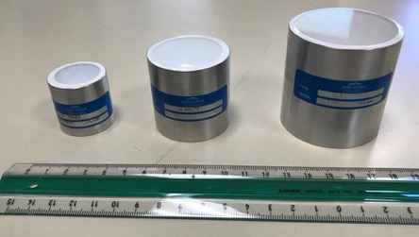
The experimental set-up
CLLB (CLLB1) ∅ 1″ × 1″
CLLB(CLLB2) ∅ 2″ × 2″
LaBr₃:Ce,Sr ∅ 1.5″ × 1.5″
LaBr₃:Ce ∅ 1″ × 1″
Standard spectroscopic chain:
  Mesytech preamplifier
  Ortec spectroscopy amplifier
  Multichannel analyser (MAESTRO and MCA8000A)
Digitizer CAEN DT5730
  8-channel 14-bit 500MS/s
PMT R6231-100-SEL-MOD
∅ 2″
8 dynodes
SBA photocathode
G = 4.7E4 @ 750V
G = 7.2E4 @ 800V
Pag. 4

Slide 6
Decay time
Collected charge as a function of the integration time (digitizer’s gate width)
y=A₀ + A₁[1-e(-x/τ₁)] + A₂[1-e(-x/τ₂)]
τ = 30.80 ± 0.01 ns
CLLB
τ₁ = 154.39 ± 0.04 ns 63%
τ₂ = 1096.8 ± 0.3 ns 37%
LaBr₃:Ce,Sr
Pag. 5

Slide 7
Light yield and linearity
LY measured with the digitizer in the energy range between 60 keV and 1.77 MeV
Deviation from linearity less than 1% for all tested crystals
Light yield proportion
LaBr₃:Ce : LaBr₃:Ce,Sr : CLLB1 : CLLB2
1 : 1.29 : 0.78 : 0.63
Pag. 6

Slide 8
The energy resolution
R measured with a standard spectroscopic chain in the energy range between 276 keV and 1.3 MeV
R=4.2% CLLB1
R=5.4% CLLB2
Pag. 7

Slide 9
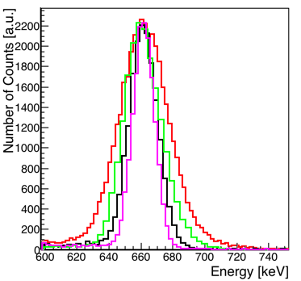
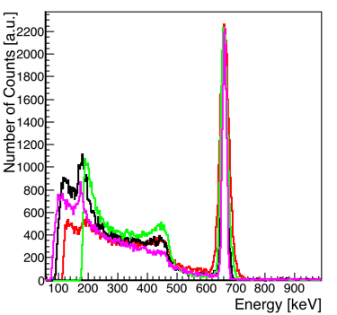
The energy resolution
CLLB 2”x2” – FWHM = 35.7 keV
CLLB 1”x1” – FWHM = 27.5 keV
LaBr₃:Ce – FWHM = 21 keV
LaBr₃:Ce,Sr – FWHM = 15.9 keV
Pag. 8

Slide 10
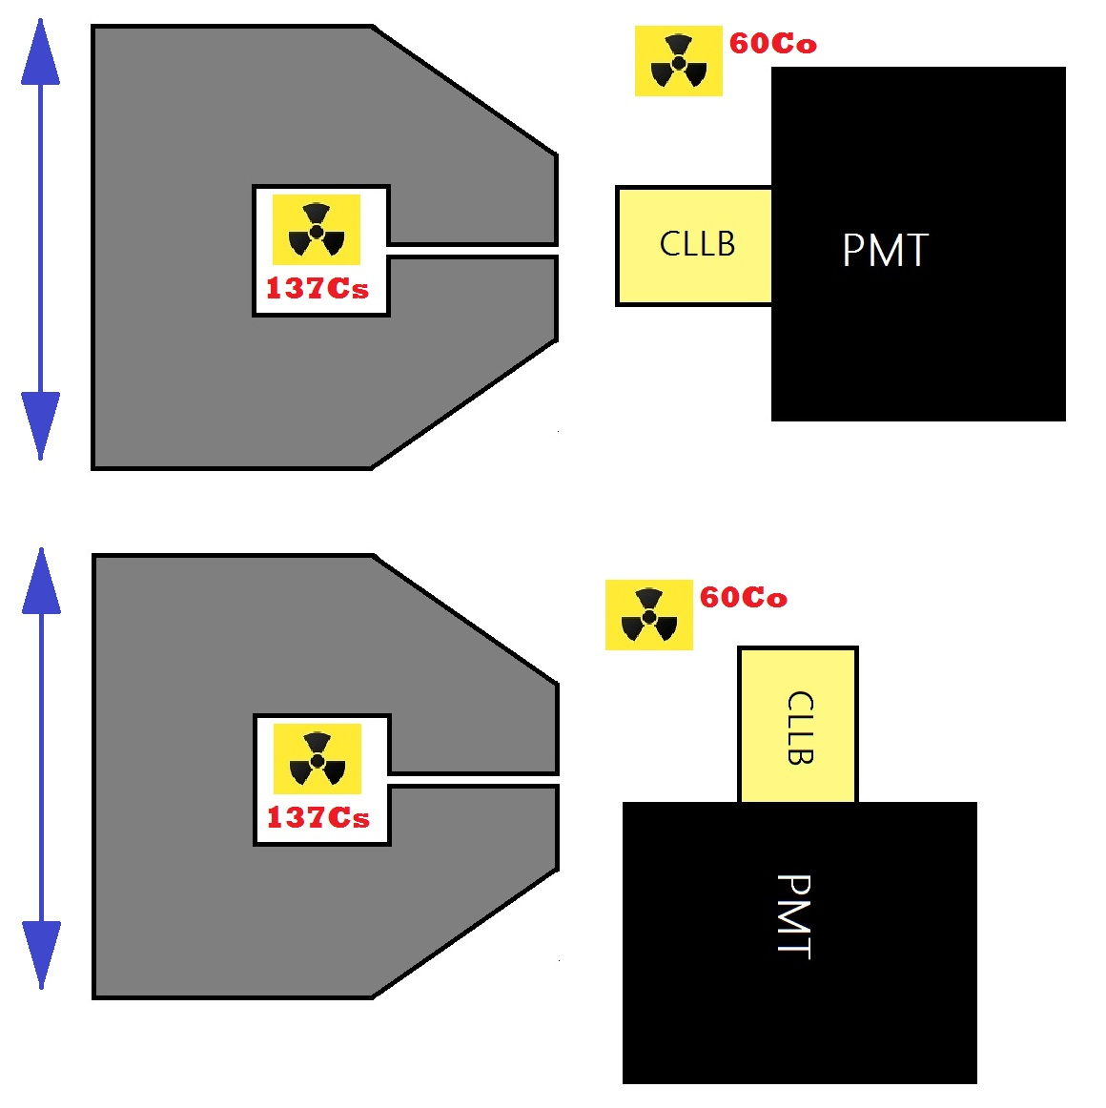
Response vs irradiation point
Highly-collimated 400MBq ¹³⁷Cs source mounted on a support that allows rigid translations in two directions
  Collimator in heavymet 8 cm long –  1 mm large
  A ⁶⁰Co source used as reference
Scan along the X and Y axis:
6 4-mm step for the CLLB1 and 12 4-mm step for the CLLB2
Scan along the z axis: 6 4-mm step for the CLLB1 and 13 4-mm step for the CLLB2
PMT
Pag. 9

Slide 11
Response vs irradiation point
Scan along the X and Y axis
CLLB 2”x2”
Less than 1 ch variation
CLLB 1”x1”
Between 3 and 5 ch variation, mostly on the edges
Pag. 10

Slide 12
Response vs irradiation point
CLLB 1”x1”
Scan along the Z axis
Evident anisotropy in the CLLB response
5 ch
CLLB 2”x2”
11 ch
Contribution to the energy resolution:
CLLB1 = 17 keV (➔ R=2.6%)
CLLB2 = 29 keV (➔ R=4.4%)
Subtracting this contribution to the measured energy resolution:
R = 3.3% for CLLB1 and R = 3.1% for CLLB2
Pag. 11

Slide 13
Peak width vs irradiation point
CLLB1: collimated source FWHM < 23 keV
R ~ 3.3%
Pag. 12

Slide 14
¹³⁸La activity
¹³⁸La: γ (1436 keV + 789 keV) + β
²²⁷Ac: mainly α (5.0 – 7.4 MeV)
Pag. 13

Slide 15
The internal activity
²²⁷Ac α peaks in the different regions for the different crystals
Higher α-activity for the co-doped LaBr₃:Ce compared to the standard one
Higher α-activity for the CLLB1 with respect to the CLLB2
Peaks at 1470 and 1440 keV well separated for the LaBr₃:Ce,Sr
LaBr3:Ce
~1440 keV
=
1436 keV
+
L and M Ba
LaBr3:Ce,Sr
~1470 keV
=
1436 keV
+
K-α Ba
CLLB1
CLLB2
Pag. 14

Slide 16
The internal activity
Crystal | Internal countig rate [Cts/s/cm³] E>70keV | α contribution [%] | α energy region [MeV GEE]
LaBr₃:Ce | 0.53 | 1.1 | 1.7 – 2.7
LaBr₃:Ce,Sr | 0.84 | 11.9 | 2.2 – 3.2
CLLB1 | 0.31 | 11.8 | 2.8 – 4.7
CLLB2 | 0.32 | 6.4 | 2.8 – 4.7
LaBr₃:Ce,Sr has more self-activity than LaBr₃:Ce
Different quenching for the different scintillators
Different alpha contribution
Pag. 15

Slide 17
Summary
We are carrying on an R&D activity on new scintillator materials for nuclear physics applications in the framework of the ENSAR2-JR1-PASPAG project
We tested two CLLB crystals, with different volume, and a co-doped LaBr₃:Ce from Saint Gobain
LaBr₃:Ce,Se is brighter and shows better energy resolution than LaBr₃:Ce
The CLLB1 produces 25% more light than the CLLB2
We observed a strong anisotropy in the CLLB light yield, which affects the measured energy resolution
The alpha quenching is different for all the tested crystals, in particular it is higher for LaBr₃:Ce and so the ²²⁷Ac contribution is better separated for the co-doped sample
The alpha contribution is higher for the CLLB1 than for CLLB2, this might indicates an improvement of the materials purification in the crystals production process
Pag. 16

Slide 18
Acknowledgment
This work was supported by the H2020-INFRAIA-2014–2015 Grant Agreement 654002 – ENSAR2-PASPAG

Slide 20
AmBe(Ni) n/γ PSD distrimination
Charge comparison method:
Ql calculated over a long gate = 4 μs,
Qs calculated over a short gate = 200 ns
Ql-Qs
Ql
PSD =
CLLB 2”x2”
CLLB 1”x1”
Pag. 15

Slide 21
AmBe(Ni) n/γ PSD distrimination
Separation from n to γ-rays, but not between n and α
Peak_{n}- Peak_{γ}
FWHM_{γ}+FWHM_{n}
FoM =
n/α
FoM=1
FoM=1.7
γ
n/α
γ
CLLB 2”x2”
CLLB 1”x1”
Pag. 16

Slide 22
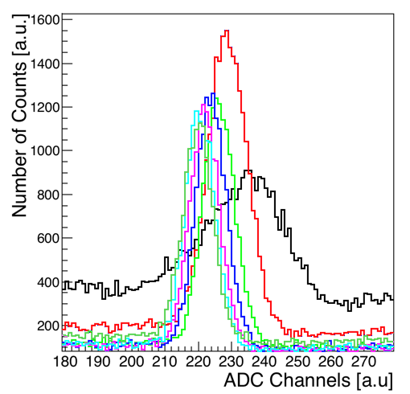
Peak position vs irradiation point
CLLB 2”x2”
Collimated
Uncollimated
0 mm
8 mm
16 mm
24 mm
32 mm
40 mm
48 mm
Energy resolution -R [%]
Collimated source
R ~ 4.3%
FWHM < 30 keV
Pag. 12

Slide 23
Decay time
Collected charge as a function of the integration time (digitizer’s gate width)
y=A₀ + A₁[1-e(-x/τ₁)] + A₂[1-e(-x/τ₂)]
Gate > 500ns
CLLB
LaBr₃:Ce,Sr
Gate > 4 μs
Pag. 5

Slide 24
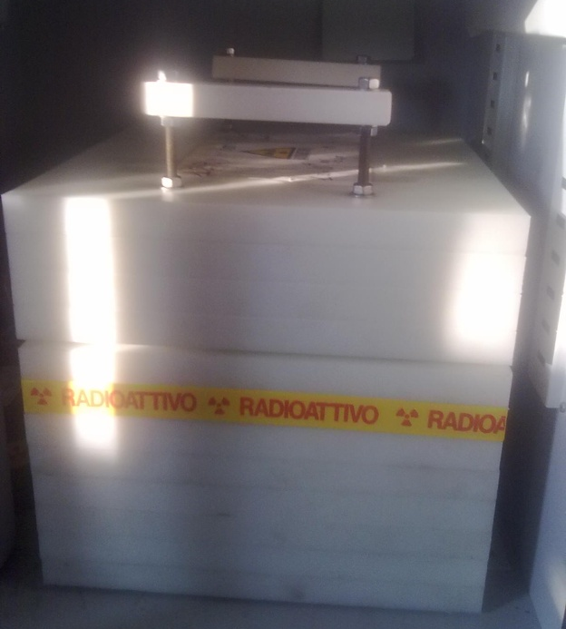
Response to the AmBe(Ni) source
Irradiation with neutrons and γ-rays up to 9 MeV
n peak detected at ~3.3 MeV GEE for the two CLLB crystals
Good linearity up to >4.4 MeV for all the testes crystals
Peak @ 9 MeV well visible for the CLLB2
Saturation above 7 MeV for the LaBr₃:Ce
n
Pag. 15

Slide 25
n/γ PSD distrimination – AmBe
Charge comparison method:
Ql calculated over a long gate = 4 μs,
Qs calculated over a short gate = 200 ns
Ql-Qs
Ql
PSD =
CLLB 2”x2”
CLLB 1”x1”
Pag. 16

Slide 26
n/γ PSD distrimination - AmBe
Separation from n to γ-rays
Peak_{n}- Peak_{γ}
FWHM_{γ}+FWHM_{n}
FoM =
FoM=1.7
n
γ
n
γ
FoM=1
CLLB 2”x2”
CLLB 1”x1”
Pag. 17

