Slide 1



Quarkonium production (at LHC)
Andrii Usachov
LAL, Orsay

Slide 2

Heavy flavour production
Powerful QCD tests, instead of using QCD to estimate observables, use production measurements to qualify QCD
New theory developments confronted to new experimental results. Impressive progress in both domains
Charmonia production puzzle:
First attempt created « J/ψ production puzzle »
Extension with « J/ψ production AND polarization puzzle »
« J/ψ production AND polarization AND η_{c}(1S) production puzzle » with the η_{c}(1S) production measurement by LHCb
More precision in conventional studies and new sources of input: associated production, isolation, production in pPb and PbPb collisions, …
Comprehensive model of HF production still missing
Notes:
q
The classical way of interaction between theory and experiment is estimation observables and comparing them with experimental measurements. However, in case of HF production in QCD different way was chosen. From known measured results theoretical parameters can be extracted to qualify QCD.
Adding new measurements allows to extend and improve theoretical models.
As an example attempt to describe J/psi production led to creating of « J/ψ production puzzle ». Polarisation measurement required more complicated model as well at the η_{c}(1S) production . So at the present model complete model is still missing

Slide 3
Quarkonium production in NRQCD
Two scales of production: hard process of QQ creation and hadronization of QQ at softer scales
Factorization:
Colour-singlet model: intermediate QQ state is colourless and has the same J^{PC} quantum numbers as the final-state quarkonium
Colour-octet model : not colourless, J^{PC} of QQ pair and charmonium differs
→ adjusted in the long-distance part by soft gluon(s) emission
→ LDMEs extracted from experimental data
Universality: same LDME for prompt production and production in b-decays
Heavy-Quark Spin-Symmetry: links between colour-singlet and colour-octet LDME of different quarkonium states
Short distance: perturbative cross-sections + pdf for the production of a QQ pair
Long distance matrix elements (LDME),
non-perturbative

Slide 4
Charmonium production processes
“Hard” processes
e+e- production (B-factories)
hadroproduction (hadron colliders)
Production in decays:
B-decays (~5 GeV)
– accessible at B-factories and hadron colliders
Bottomonium decays (~11 GeV )
– accessible at B-factories and hadron colliders(?), not many decays observed so far
Z decays (~90 GeV)
– not many decays observed so far
Higgs decays (~120 GeV)
– not observed so far
t-decays (~170 GeV)
– not observed so far
Production in soft processes (for soft QCD measurements):
Photoproduction
Central exclusive production

Slide 5
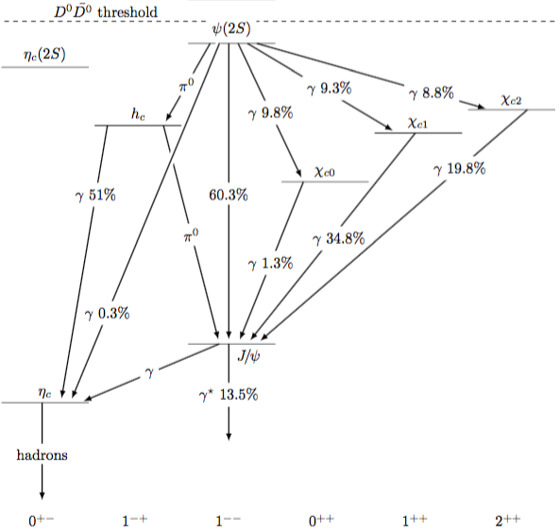
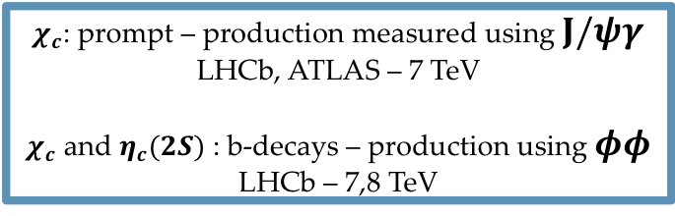
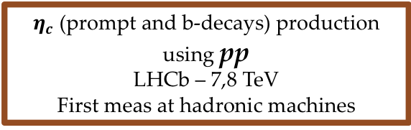
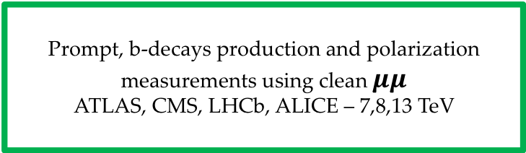
Charmonia family
$χ_{c}$: prompt – production measured using $J/ψγ$
LHCb, ATLAS – 7 TeV
$χ_{c}$ and $η_{c}(2S)$ : b-decays – production using $φφ$
LHCb – 7,8 TeV
Prompt, b-decays production and polarization measurements using clean $μμ$
ATLAS, CMS, LHCb, ALICE – 7,8,13 TeV
$η_{c}$ (prompt and b-deсays) production using pp
LHCb – 7,8 TeV
First meas at hadronic machines

Slide 6
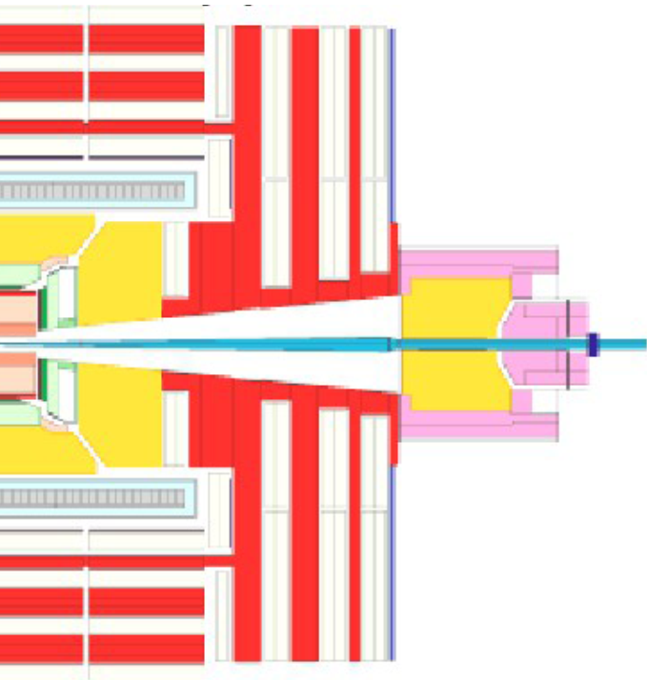
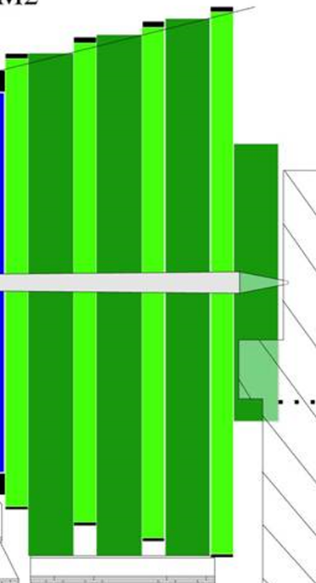
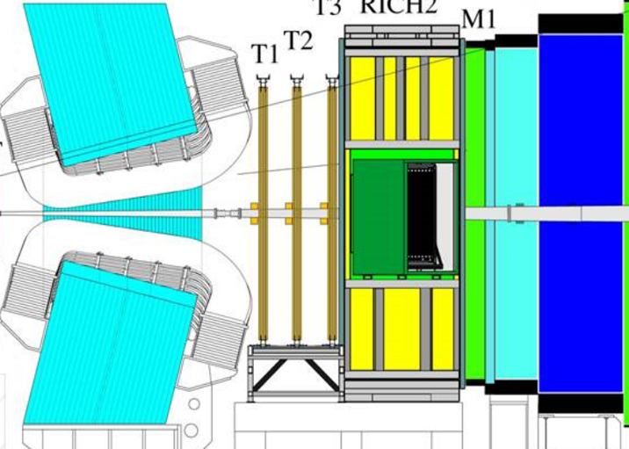
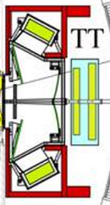

LHCb detector vs central detectors (ATLAS, CMS)
JINST 8 (2013) P08002,
INT.J.MOD.PHYS.A30 (2015) 1530022
Forward peaked HQ production at the LHC, second b in acceptance once the first b is in
Forward region 1.9 < η < 4.9, ~4% of solid angle, but ~40% of HQ production x-section
RICH counters (K/π ID)
CMS
LHCb
250 mrad
10 mrad
p
p
Vertex LOcator
Calorimeters
Muon
System
Tracking
Complementary cross-section measurements and overlap in terms of rapidity and p_{T}
Key detector systems for production measurements: vertex reconstruction (VELO), particle identification (Muon detector, RICHs), Trigger
Allows to perform study of charmonia decays through hadronic final states

Slide 7
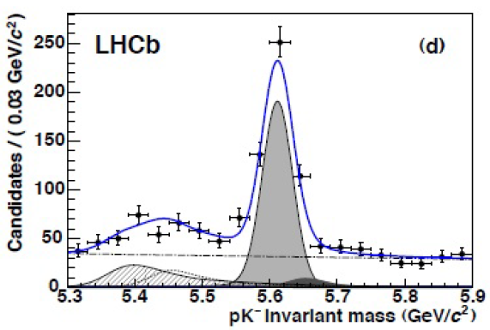

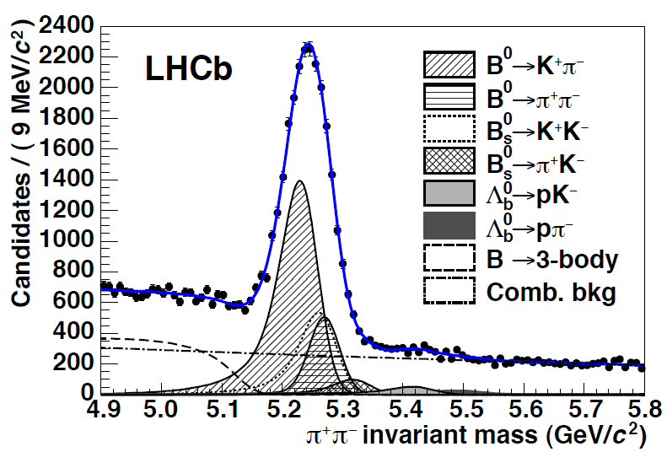
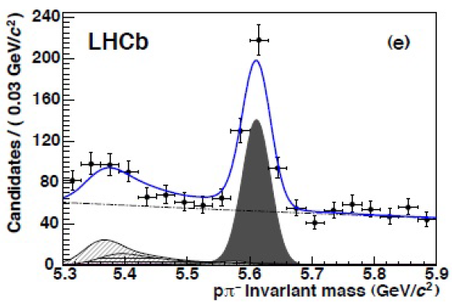

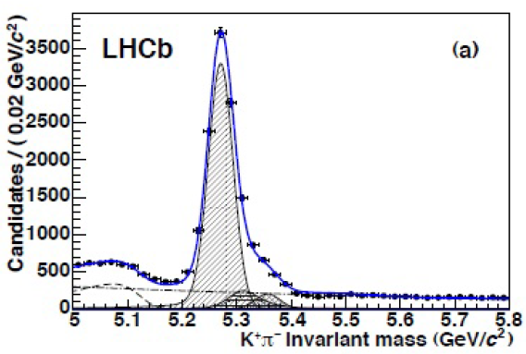
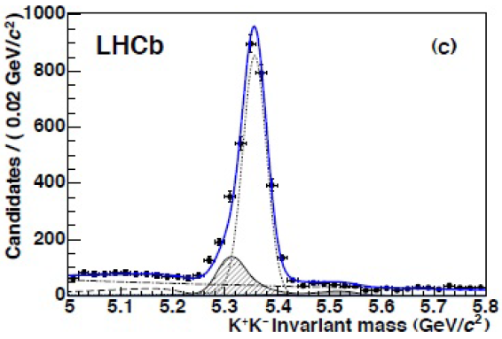
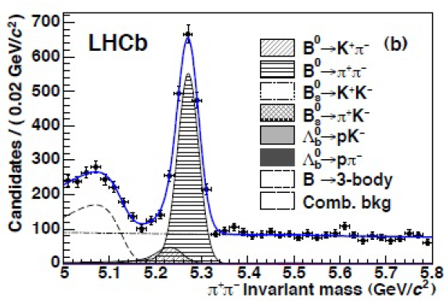



Charged hadron identification with RICH at LHCb
RICH performance: two-body b-hadron decays
JHEP 10 (2012) 037
ʃLdt ~ 0.37 fb⁻¹

Slide 8
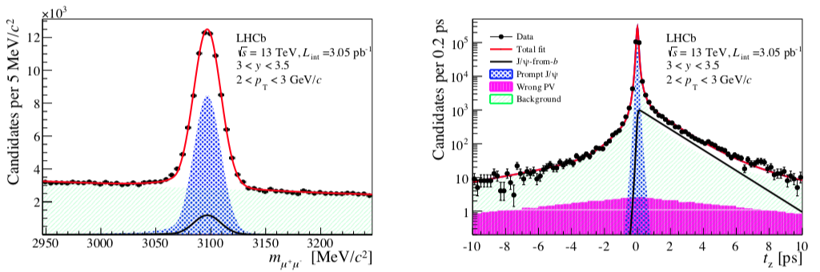
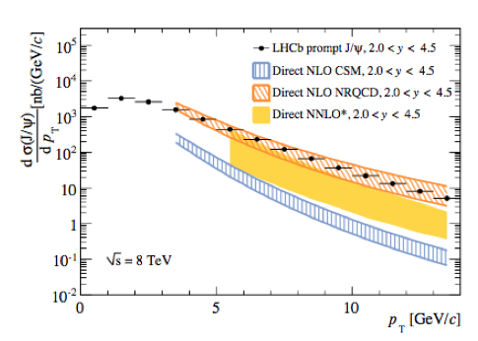
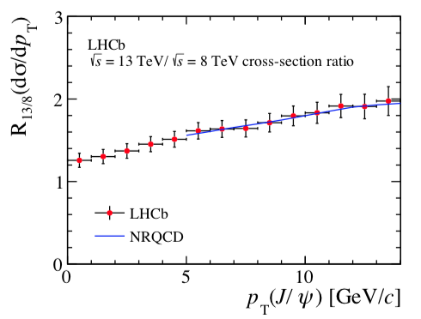
J/ψ hadroproduction at LHCb using J/ψ → 𝝁𝝁
clean signal from J/ψ → 𝝁𝝁
separate prompt production and production b-decays by fitting pseudo-proper lifetime
prompt
JHEP 1510 (2015) 172
Phys. Rev. Lett. 106 (2011) 022003
Phys. Rev. Lett. 98 (2007) 252002
Phys. Rev. Lett. 100 (2008) 232001
JHEP 1306 (2013) 064
Measurements of Tevatron and LHC (CDF, CMS, ATLAS, LHCb) experiments are in agreement
Could not be described by CS NLO and NNLO -> motivation to investigate CO
Described by NRQCD NLO, dominated by CO contributions
Ratio of 13 TeV/ 8 TeV production:
Many systematic uncertainties cancelled
Ultimane theory precision

Slide 9
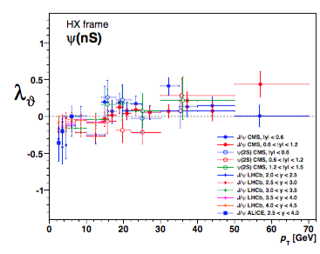
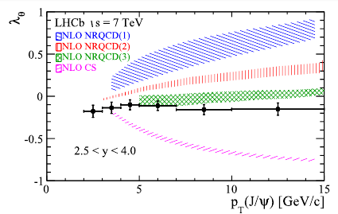
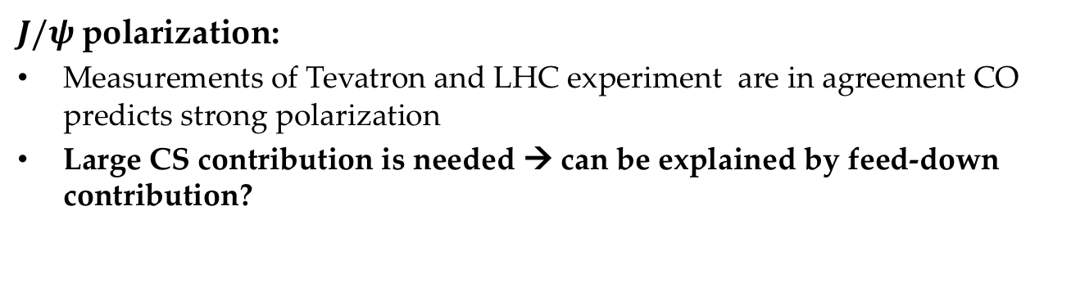
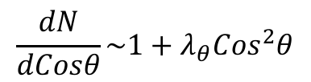
J/ψ polarization using J/ψ → 𝝁𝝁
Phys. Rev. Lett. 108 (2012) 172002
Phys. Rev. Lett. 110 (2013) 042002
Phys. Rev. Lett. 108 (2012) 242004
Phys. Rev. Lett. 108 (2012) 151802
Phys. Lett. B727 (2013) 381
Phys. Rev. Lett. 110 (2013) 081802
Eur. Phys. J. C73 (2013) 2631
Phys. Rev. Lett. 108 (2012) 082001
CMS, ALICE, LHCb
Eur.Phys.J. C73 (2013) no.11, 2631
$$\frac{dN}{dCosθ}\sim 1+λ_{θ}{Cos}^{2}θ$$
$J/ψ$polarization:
Measurements of Tevatron and LHC experiment are in agreement CO predicts strong polarization
Large CS contribution is needed → can be explained by feed-down contribution?

Slide 10
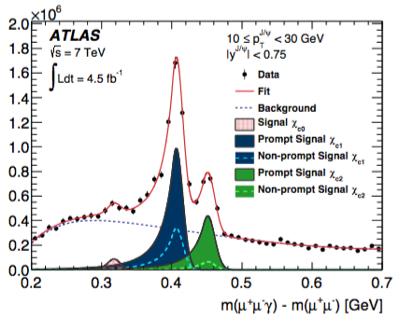
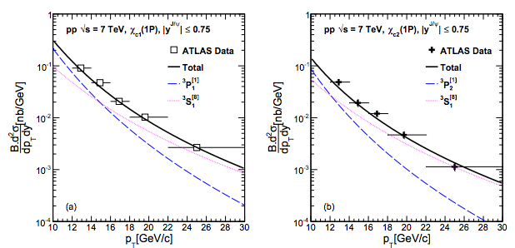
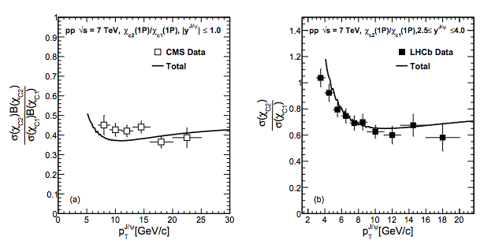
$χ_{c1,2}$ prompt production using $χ_{c1,2}→$J/ψ 𝛾
NRQCD fit for absolute production:
arXiv:1606.08265v2 [hep-ph]
ATLAS
JHEP 1407, 154 (2014)
JHEP 1407, 154 (2014)
More precise when looking for ratio:
CMS
LHCb
Eur. Phys. J. C 72, 2251 (2012)
JHEP 1310, 115 (2013)
color Octet LDME extracted from fit
small p_{T} region has to be explored

Slide 11
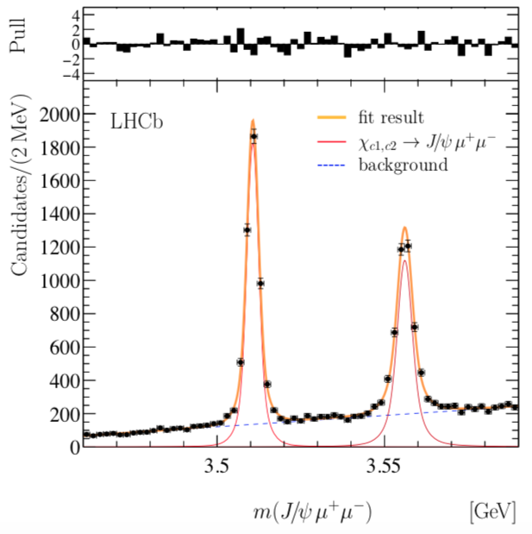
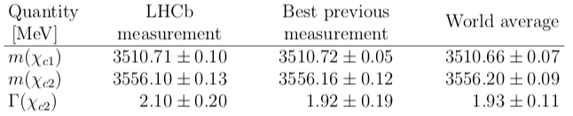
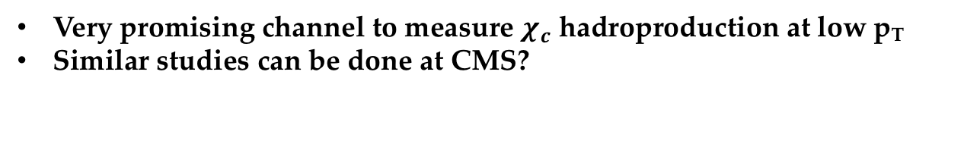
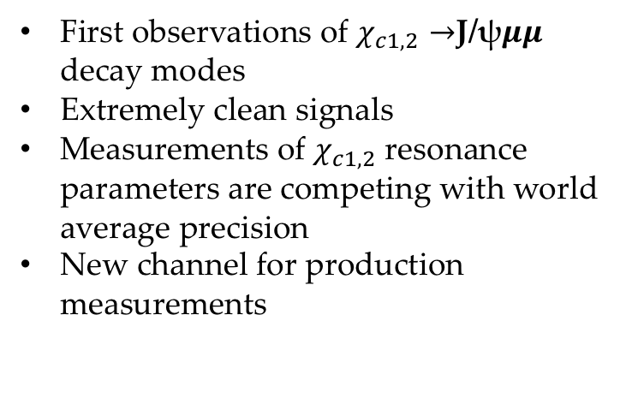
Accessing $χ_{c1,2}$ using $χ_{c1,2}→$J/ψ𝝁𝝁 at LHCb
First observations of $χ_{c1,2}→$J/ψ𝝁𝝁 decay modes
Extremely clean signals
Measurements of $χ_{c1,2}$ resonance parameters are competing with world average precision
New channel for production measurements
PRL 119 (2017) 221801
Very promising channel to measure $χ_{c}$ hadroproduction at low p_{T}
Similar studies can be done at CMS?

Slide 12
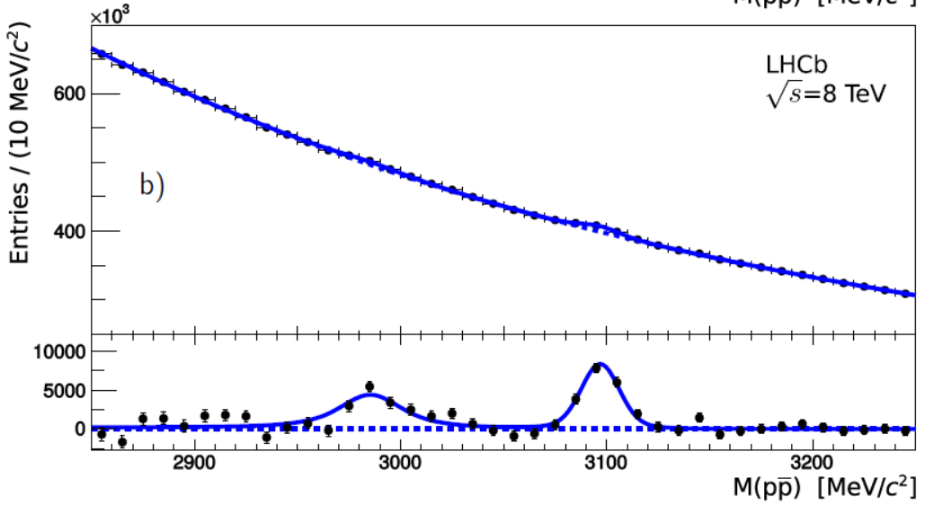
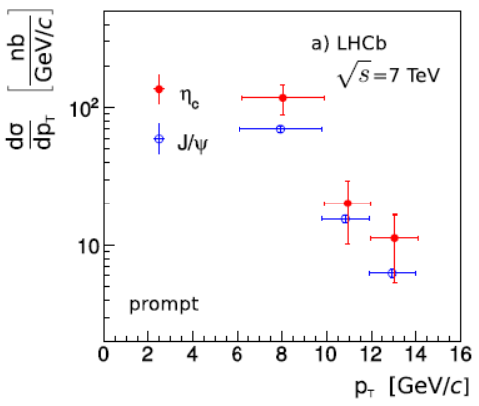
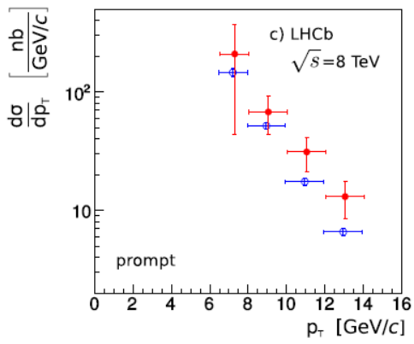





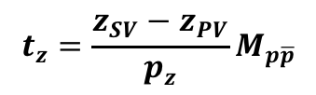
Charmonium production using decays to ppbar
Prompt and b-decay production distinguished via decay time value (t_{z}-cut) or t_{z}-fits
$$t_{z}=\frac{z_{SV}−z_{PV}}{p_{z}}M_{p\overline{p}}$$
First measurements of η_{c}(1S) prompt production at 7 and 8 TeV and b-decay production: PhD thesis (M. Teklishyn, 2014) and Eur.Phys.J. C75 (2015) 311,
Measurement of differential cross-sections (pT), experimental precision is worse than theoretical one
Strong impact on theory models: contrary to theory expectations, η_{c}(1S) prompt production entirely described by Color-Singlet contribution.
+ First measurement of η_{c}(1S) production in inclusive b-decays
Inv. mass spectrum of pp from collision vertex
Eur.Phys.J. C75 (2015) 311
Diff. cross-section of the η_{c}(1S) production
η_{c}(1S)
prompt
J/ψ
prompt
prompt

Slide 13
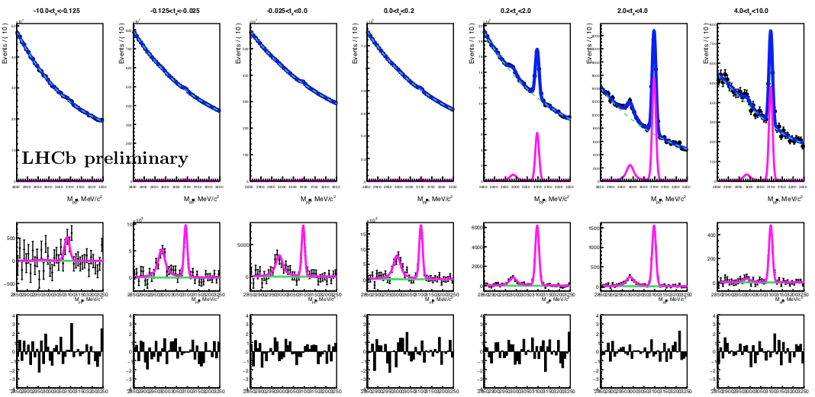
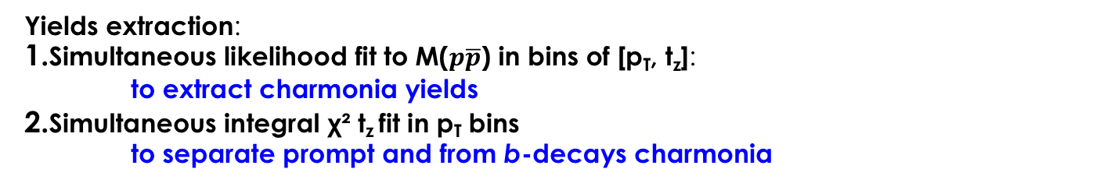

η_{c}(1S) production at 13 TeV using its decay to ppbar (internal results)
                Master thesis of Valeriia Zhovkovska
$$η_{c}$$
LHCb Internal plot
J/ψ
Yields extraction:
Simultaneous likelihood fit to M($p\overline{p}$) in bins of [p_{T}, t_{z}]:
to extract charmonia yields
Simultaneous integral χ² t_{z} fit in p_{T} bins
to separate prompt and from b-decays charmonia

Slide 14
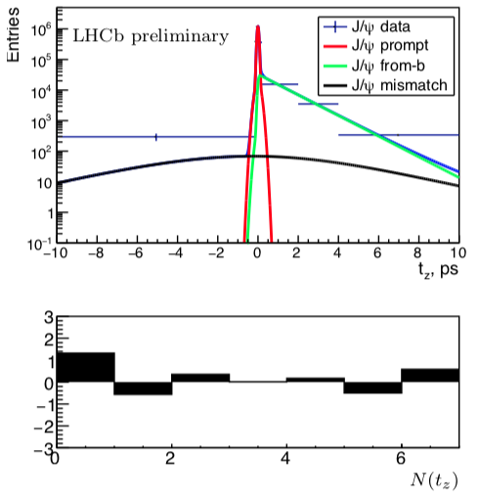
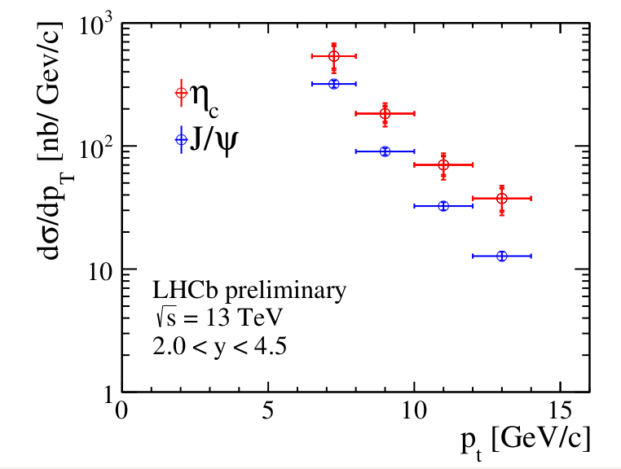
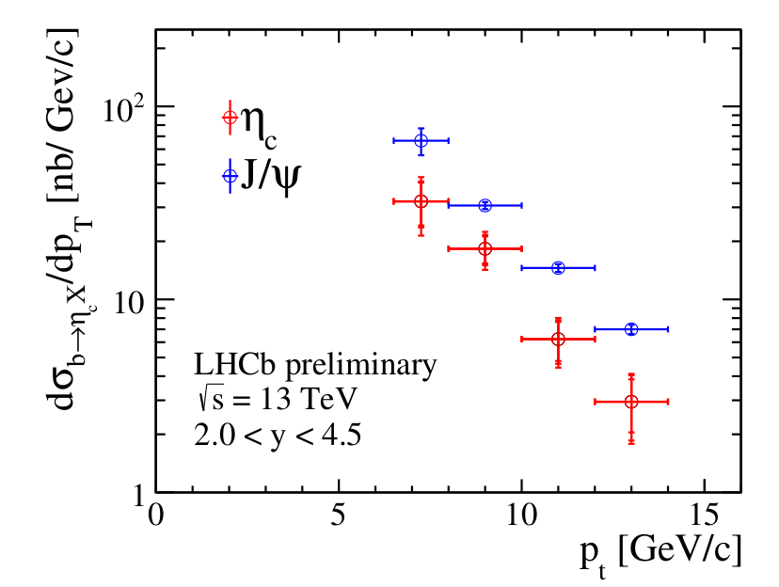
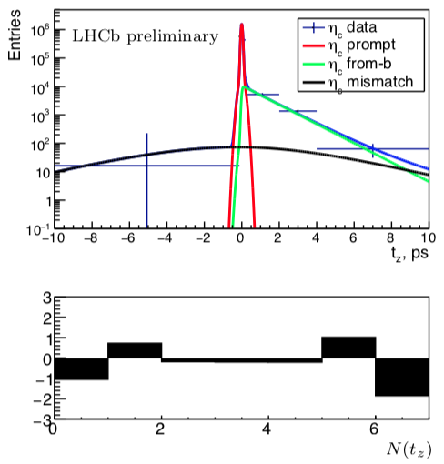
η_{c}(1S) production at 13 TeV using its decay to ppbar (internal results)
Measurement of differential cross-sections (pT)
Analysis of η_{c}(1S) production at 13 TeV being completed
Simultaneous ($J/ψ$ and $η_{c}$) $χ^{2}$integral $t_{z}$-fit
in bins of p_{T}: projection on p_{T} bin [8,10] GeV/c
Prompt production
Production from b-decays
LHCb Internal plot
JHEP 1705 (2017) 063
JHEP 1705 (2017) 063
LHCb Internal plots
Preliminary internal result:
σ$η_{c}$= 1.39 ± 0.12_{stat} ± 0.10_{syst} ± 0.16_{BR} μb
$$\frac{{BR}_{b→η_{c}X}}{{BR}_{b→J/ψX}}=0.444 ±{0.076}_{stat}±{0.034}_{stat}±{0.047}_{BR}$$
6.5 GeV/c < PT < 14.0 GeV/c / 2.0 < y < 4.5
Better precision for prompt production compare to Run I measurement

Slide 15
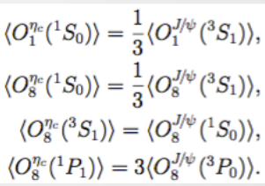
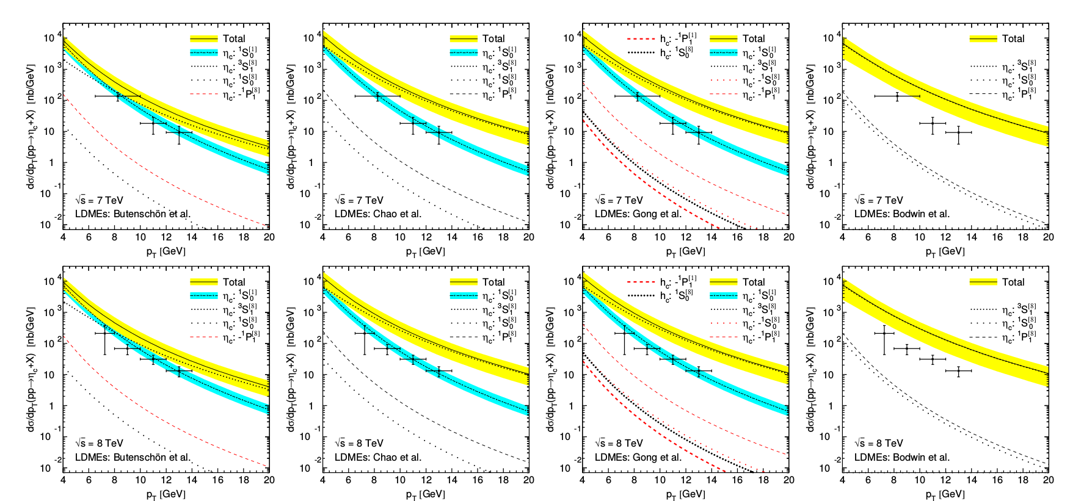
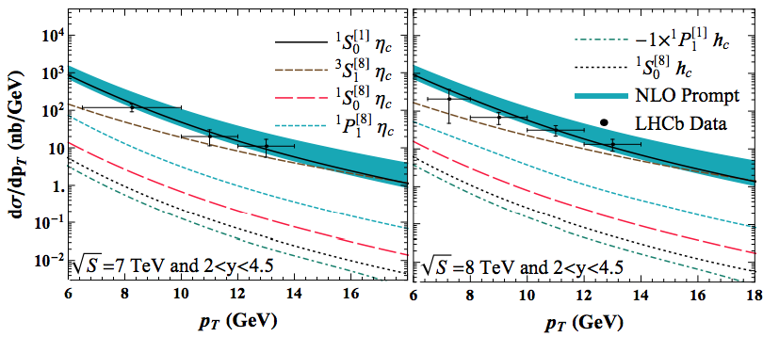
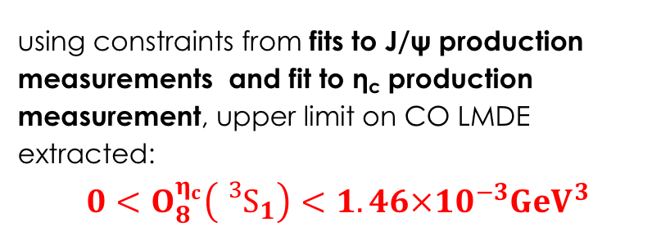
η_{c} production challenges NRQCD
η_{c} LDMEs determination:
determined from known HQSS relation for J/ψ
direct projection to LHCb data
PRD 84(2011),051501 (R)
PRL 108(2012),242004
PRL 110(2013),042002
PRL 113(2014),022001
=►LHCb data are entirely described by CS contribution
Recent progress in theoretical description:
PRL 114(2015), 092005
using constraints from fits to J/ψ production measurements and fit to η_{c} production measurement, upper limit on CO LMDE extracted:
$$0<O_{8}^{η_{c}}\left({{}_{}^{3}S}_{1}\right)<1.46×{10}^{−3}{GeV}^{3}$$

Slide 16
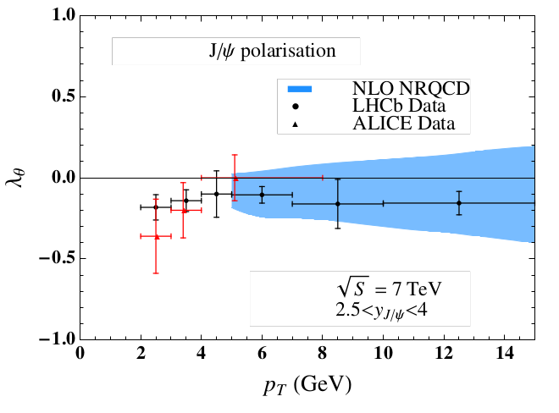
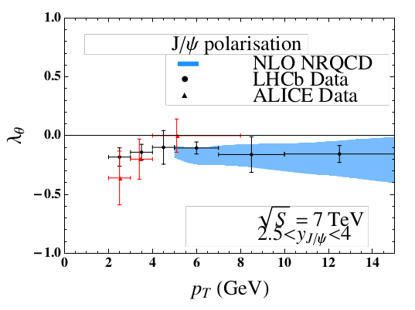
η_{c} production challenges NRQCD
PRL 114(2015), 092005
UL on O^{ηc}(³S₁^{[8]}) ⇒ new constraint on J/ψ polarization
Without η_{c} measurements
With η_{c} measurements
Outcome:
progress in data description
tension with CDF data
two large CO contributions cancel each other ⇒ hierarchy problem ⇒ Soft Gluon Fragmentation, etc.?
joint study of hadroproduction and production in inclusive b-decays?
Prospects:
- Theory fits to be updated with Run II measurement
- Similarly measure η_{c}(2S) prompt production using new dedicated trigger lines

Slide 17
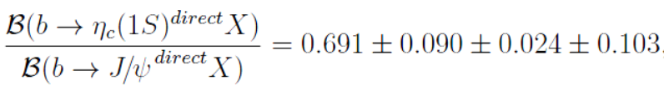
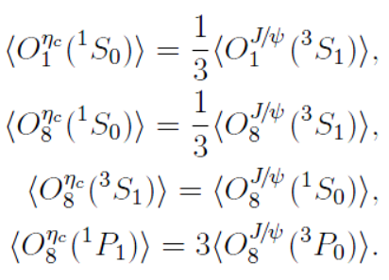
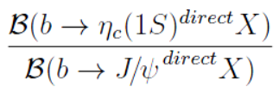


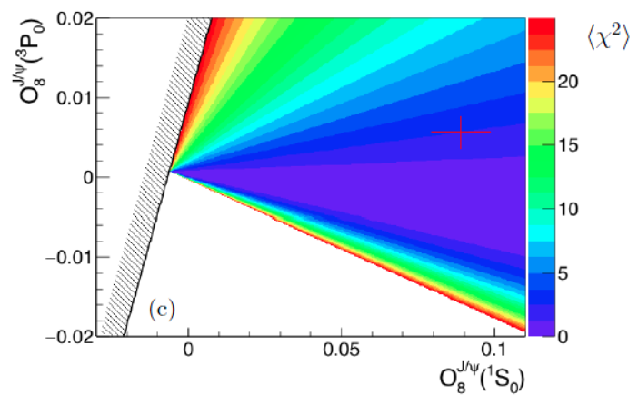
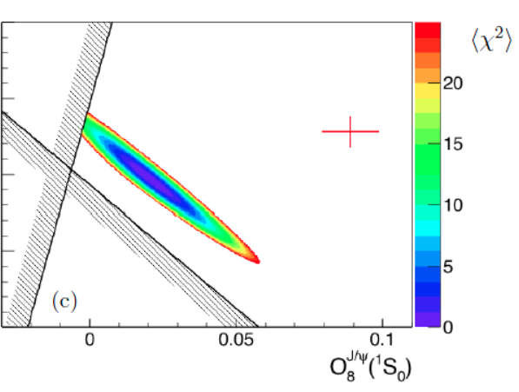

J/ψ and η_{c} production in inclusive b-decays
Usachov,Kou, Barsuk, LAL-17-051
From EPJC 75 (2015) 311 and
Chin. Phys. C40 (2016) 100001:
Relation between LDME from HQSS:
Branching fractions calculated in
Beneke, Maltoni, Rothstein,
PRD 59 (1999) 054003
Fit two LDME to measurements
Consecutively fix two remaining LDME from Chao et al.,
PRL 108 (2012) 242004
LDME from hadroproduction
PRL 108 (2012) 242004
Two independent measurements (constraints) important

Slide 18
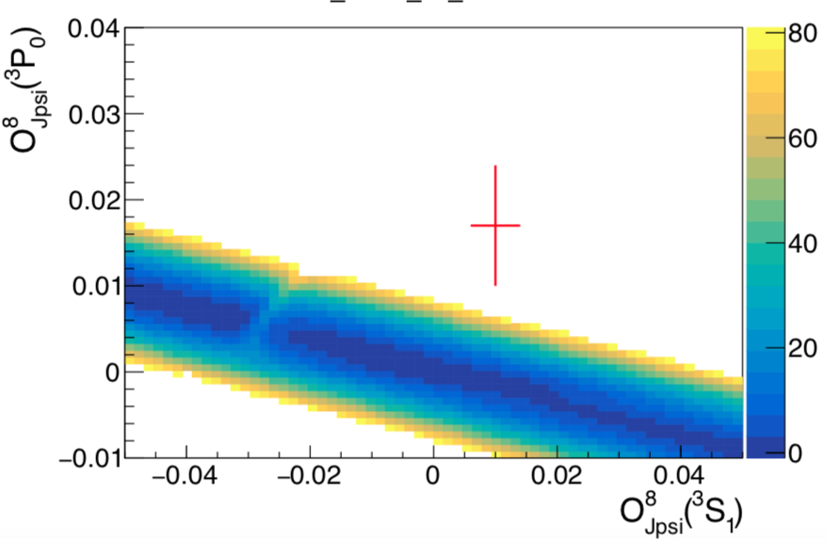





Theory fits to J/ψ and η_{c} production in inclusive b-decays
Estimate with theory errors included
$$χ^{2}$$
point from
PRL 114(2015), 092005
Compare determination of LDMEs from hadroproduction and from b-decays
Understanding of theoretical uncertainties crucial to make a comparison.
$$χ^{2}$$
$$χ^{2}$$

Slide 19





Joint fits to J/ψ and η_{c} production in inclusive b-decays and prompt production
Estimate with theory errors included
$$χ^{2}$$
point from
PRL 114(2015), 092005
Compare determination of LDMEs from hadroproduction and from b-decays
Understanding of theoretical uncertainties crucial to make a comparison.
$$χ^{2}$$
$$χ^{2}$$

Slide 20
Combining charmonium production measurements
Understanding of theoretical uncertainties crucial to make comparisons.
Theory calculations should be revisited, higher order corrections maybe needed.
This technique constrains theory using simultaneously results on charmonia hadroproduction and on charmonia from b-inclusive decays under assumptions of factorization, universality and HQSS, with different charmonium states.
Alternatively, once hadroproduction and production in b-decays measured for charmonium states with linked LDMEs, the above assumptions can be tested quantitatively.
Notes:
In order to improve theoretical prediction it’s important to understand its uncertainties
Including higher order calculations may improve results as well as simultaneous studying of prompt prod and producer in b-decays charmonia with different states
Altarnative way is to test it quantitatively using measured production

Slide 21





$χ_{c0,1,2}$ production in inclusive b-decays using $χ_{c0,1,2}→φ$𝞍
Eur.Phys.J. C77 (2017) 609
Charmonium reconstructed via decays to φφ; true φφ combinations using 2D fit technique
First measurement of χ_{c0} production in b-hadron decays: BR(b→χ_{c0}X)=(3.02±0.47±0.23±0.94)x10⁻³
Most precise measurements of χ_{c1} and χ_{c2} production in b-decays, consistent with B-factories
2D fit to 2${(K^{+} K}^{−})$ invariant mass
${M(K^{+} K}^{−})$ [MeV]
${M(K^{+} K}^{−})$ [MeV]
LHCb: (2.76±0.59±0.23±0.89) x 10⁻³
LHCb: (1.15±0.20±0.07±0.36) x 10⁻³

Slide 22







$χ_{c0,1,2}$ production in inclusive b-decays using $χ_{c0,1,2}→φ$𝞍
Usachov,Kou, Barsuk, LAL-17-051
From Eur.Phys.J. C77 (2017) 609 and Chin. Phys. C40 (2016) 100001:
Relation between LDME from HQSS:
Branching fractions calculated in Beneke, Maltoni, Rothstein, PRD 59 (1999) 054003
Fit to three measurements of branching fractions
Fit to two measurements of branching fraction ratios

Slide 23





η_{c}(2S) production in inclusive b-decays using η_{c}(2S) $→φ$𝞍
First measurement of η_{c}(2S) production in b-decays; first evidence for η_{c}(2S)→φφ
Eur.Phys.J. C77 (2017) 609
Lansberg, Shao, Zhang
arXiv:1711.00265
Important to measure η_{c}(2S) hadroproduction, recent theory prediction; dedicated trigger in 2018
Limits on production of X(3872), X(3915), χ_{c0}(2P) in b-decays
First evidence of Bs→ φφφ decays
+ φ polarization studies
Notes:
Etac 2s was measured at the firs

Slide 24




η_{c}(1S) branching fractions
Eur.Phys.J. C77 (2017) 609
Indirect determination:
from known B⁰_{s} and η_{c} yields Λ⁰_{b} fragmentation fraction f_{Λ}0_{b} momentum dependence and
estimated branching fractions ratio
significantly larger than the value determined from PDG:

Slide 25

Other decays of charmonia for production studies
 | $$μμ$$ | $$J/ψγ$$ | $$p\overline{p}$$ | $$φφ$$ | $$p\overline{p}π^{+}π^{−}$$ | $$φf_{0}(980)$$ | $$φf_{2}(1545)$$ | baryons $ΛΛ, ΞΞ, ΣΣ$, $$Λ∗Λ∗$$
$η_{c}$(1S) | forb. | - | 0.15% | 0.18% | 0.5% |  |  | ~0.1%
$$J/ψ$$ | 6% | - | 0.2% | forb. | 0.6% | 0.03% | ~0.1% | ~0.1%
$$χ_{c0}$$ | forb. | 1.3% | 0.02% | 0.08% |  |  |  | ~0.04%
$$χ_{c1}$$ | forb. | 34% | 0.01% | 0.04% | 0.05% |  |  | ~0.01%
$$h_{c}$$ | forb. |  | ? | forb. | ? |  |  | ?
$$χ_{c2}$$ | forb. | 19% | 0.1% | 0.01% | 0.1% |  |  | ~0.01%
$η_{c}$(2S) | forb. |  | ? | ? | ? |  |  | ?
$ψ$(2S) | 0.8% |  | 0.03% | forb. | 0.06% |  |  | ~0.02%
$η_{c}$(1S) $γ$ - is a promising channel to study $h_{c}$

Slide 26


ϒ production at 13 TeV at LHCb using ϒ → 𝝁𝝁
clean signal from ϒ(1S), ϒ(2S), ϒ(3S)
Double differential production cross-section has been measured
Similar studies at other LHC experiment

Slide 27






$χ_{b}$production at LHCb
clean signal from $χ_{b}$(1P), $χ_{b}$(2P) and $χ_{b}$(3P)
$χ_{b}$(3P) – first particle discovered at LHC
p_{T} - differential production cross-section measured
relative to ϒ(1S), ϒ(2S) and ϒ(3S)
Search for $χ_{b}$→ ϒ$μμ$?

Slide 28

Summary
Comprehensive model still missing to describe Heavy Flavor (e.g. charmonium) production
J/ψ (and ψ(2S)) hadroproduction has been measured at many LHC and Tevatron experiments. J/ψ production is well described by CO model
LHCb results allow to perform powerful tests of QCD and constrain theory:
  joint study of charmonium hadroproduction and production in decays
  𝜂_{𝑐}(1𝑆) prompt production measurement constrains CO LDMEs
Current progress:
  first observations of $χ_{c1,2}→$J/ψ𝝁𝝁 decay modes
  $χ_{c0,1,2}$ production in b-decays measured at LHCb using decays to $φφ$
  first evidence of 𝜂_{𝑐}(2𝑆) production in b-decays
Other charmonium states can be studied via hadronic decays:
  h_{𝑐} and 𝜂_{𝑐}(2𝑆) production
  decays to$Λ∗Λ∗,ΛΛ, ΞΞ,ΣΣ, {p\overline{p}π}^{+}π^{−}$ final states
ϒ and $χ_{b}$(3P) hadroproduction has been measured at LHC
$χ_{b}$(3P) – first particle discovered at LHC

Slide 30

Status of charmonia production measurements
 | Prompt hadroproduction | $$BR(B^{0}\left|B^{±}\right|b−baryons→(c\overline{c})X)$$ | $BR(B^{0}|B^{±}→(c\overline{c})X$)
$η_{c}$(1S) | LHCb - $p\overline{p}$ | $$\left(4.88±0.96\right)×{10}^{−3}$$ LHCb - $p\overline{p}$ | -
$$J/ψ$$ | LHCb, ATLAS, CMS -$μμ$ | $$\left(1.16±0.10\right)×{10}^{−3}$$ LEP - $ll$ | $$\left(1.094±0.032\right)×{10}^{−2}$$ direct : $\left(7.8±0.4\right)×{10}^{−3}$ BABAR, CLEO - ll
$$χ_{c0}$$ | - | $$\left(1.66±0.26±0.13±0.40B\right)×{10}^{−3}$$ *LHCb -$φφ$ | -
$$χ_{c1}$$ | ATLAS, LHCb, CMS -$J/ψγ$ | $$\left(1.4±0.4\right)×{10}^{−2}$$ LEP - $J/ψγ$ $$\left(1.41±0.30±0.12±0.36B\right)×{10}^{−3}$$ *LHCb -$φφ$ | $$\left(3.86±0.27\right)×{10}^{−3}$$ direct: $\left(3.24±0.25\right)×{10}^{−3}$ BABAR, Belle, CLEO -$J/ψγ$
$$h_{c}$$ | - | - | -
$$χ_{c2}$$ | ATLAS, LHCb, CMS -$J/ψγ$ | $$\left(0.63±0.11±0.05±0.15B\right)×{10}^{−3}$$ *LHCb -$φφ$ | $$(1.4±0.4)×{10}^{−3}$$ direct: $\left(1.65±0.31\right)×{10}^{−3}$ BABAR, Belle -$J/ψγ$
$η_{c}$(2S) | - | *LHCb -$φφ$ BR$(η_{c}\left(2S\right)→φφ)$ was not measured | -
$ψ$(2S) | LHCb, ATLAS, CMS -$μμ$ | $$\left(2.83±0.29\right)×{10}^{−3}$$ LHCb, CMS - $μμ$ | $$\left(3.07±0.21\right)×{10}^{−3}$$ BABAR, CLEO - ll
* preliminary
Limited information about charmonia production

