Slide 1
Heavy Ion Physics with LHCb

Slide 2
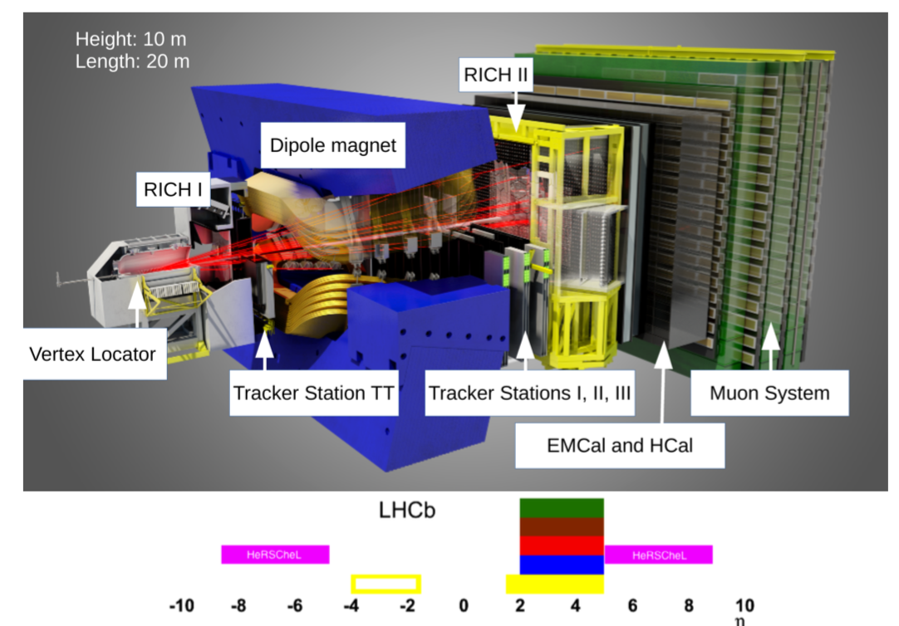
LHCb Detector
[JINST 3 (2008) S08005]
Precise tests of Standard Model with b and c hadron decays
QCD spectroscopy and EW measurements
But can be also used for Heavy-Ion physics: collisions and fixed target experiment

Slide 3
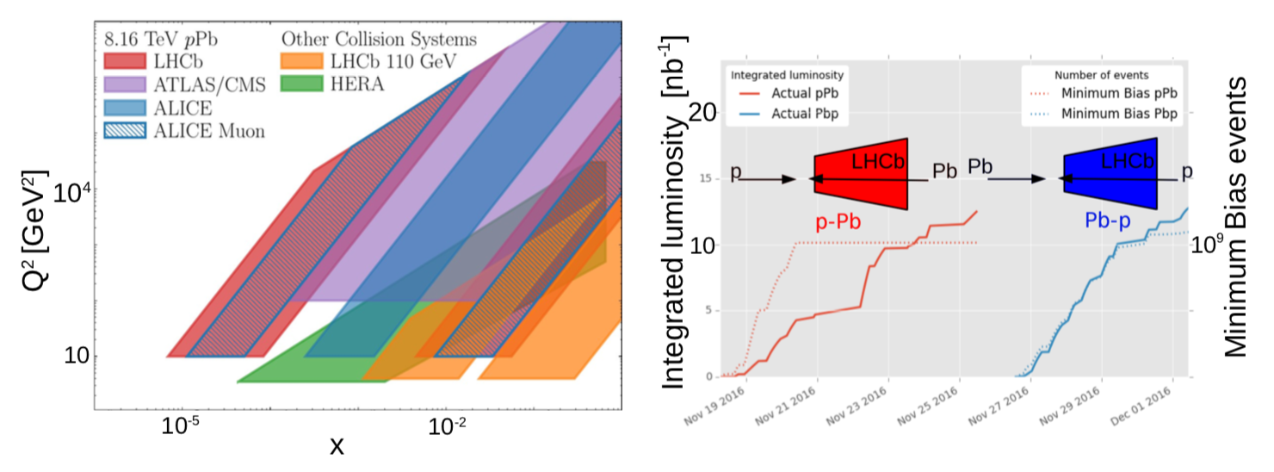
Forward acceptance for heavy-ion collider mode
2016: pPb at 8.16 TeV center-of-mass energy, 34 nb⁻¹ collected, 0.5x10⁶ J/ψ for pPb and Pbp each
Ion-Ion: 10 μb⁻¹ for PbPb (2015) and 0.4 μb⁻¹ for XeXe (2017), more data will be collected next month

Slide 4
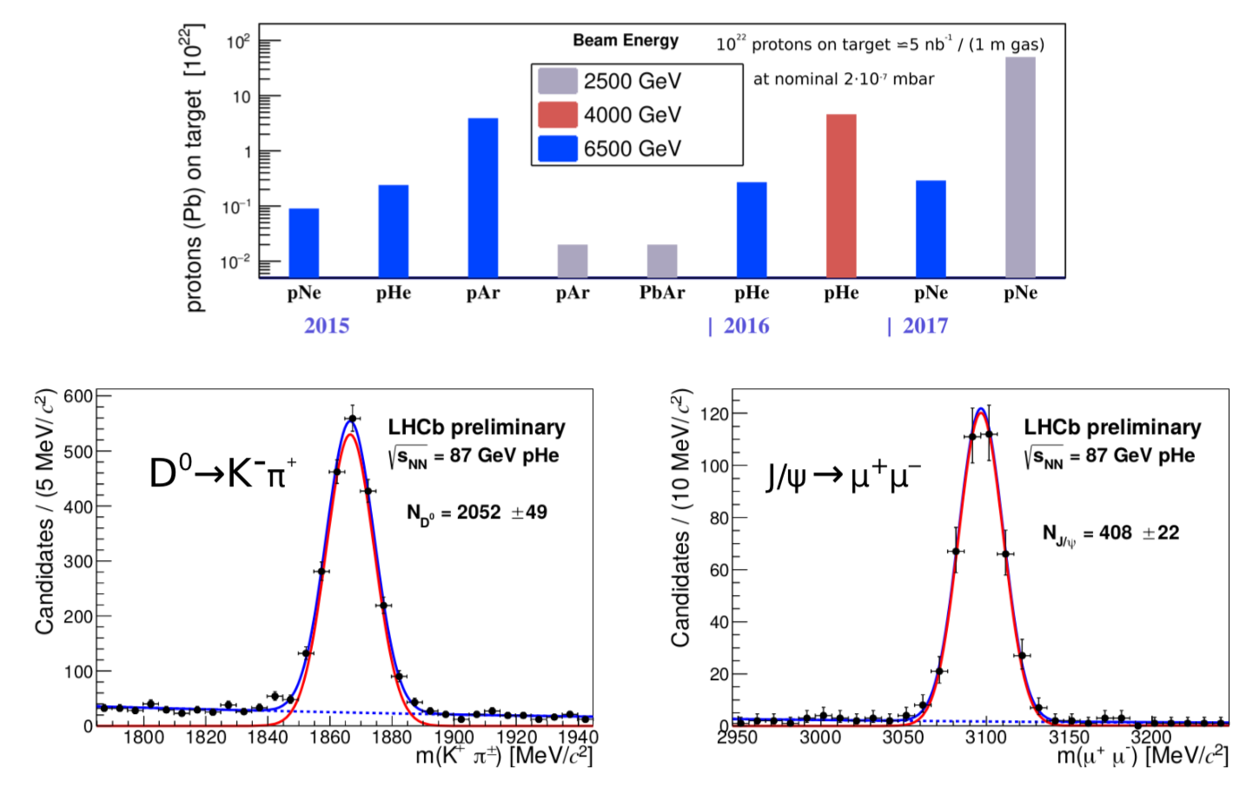
Fixed target mode
[JINST 9 (2014) 12]
SMOG: System for measuring overlap with gas
Used as internal gas target in parallel with collider data taking
Cosmic ray and heavy-ion physics with He, Ne and Ar targets
Physics case of fixed target at LHC developed in [S.Brodsky, F. Fleuret, C. Hadjidakis, J.P. Lansberg, Phys. Rep. 522 (2013) 239]

Slide 5
Results shown in this talk
p production in pHe fixed-target collisions: reference for cosmic rays
Charm production in fixed-target: pHe and pAr: intermediate and large-x and reference for ion-ion collisions
Heavy-flavour production in pPb: low-x, matter effect tests and reference for ion-ion collisions
Exclusive production of J/ψ in ultra-peripheral PbPb collisions: probe low-x and nuclear shadowing
[JINST 9 (2014) 12]
[LHCb-PAPER-2018-023, in preparation]
Λ_{c} and Y(nS): [LHCb-PAPER-2018-021, LHCb-PAPER-2018-035]
J/ψ (8.16 TeV) [PLB 774 (2017) 159] and D0 (5 TeV) [JHEP 10 (2017) 090]
[LHCb-CONF-2018-003]

Slide 6
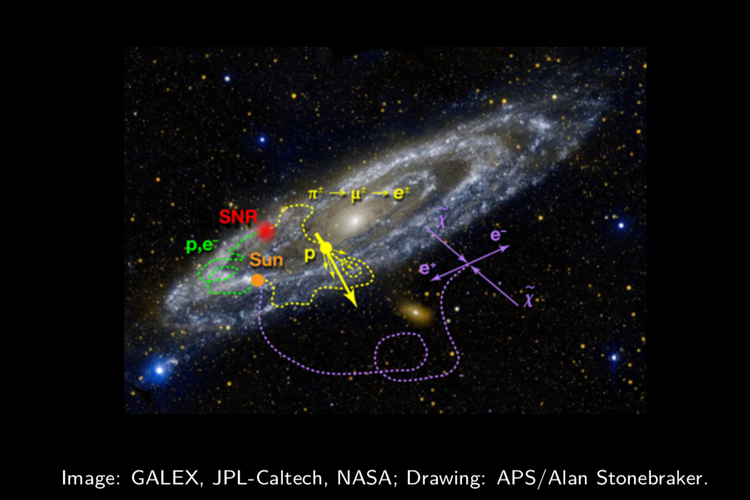
p from space
Matter: primary cosmic rays from Supernovae remnants and other sources
Possible anti-matter sources in space
Irreducible background: primary cosmic rays interacting with interstellar medium (H and He) produce secondary cosmic rays containing p
Direct detection with Pamela and AMS

Slide 7
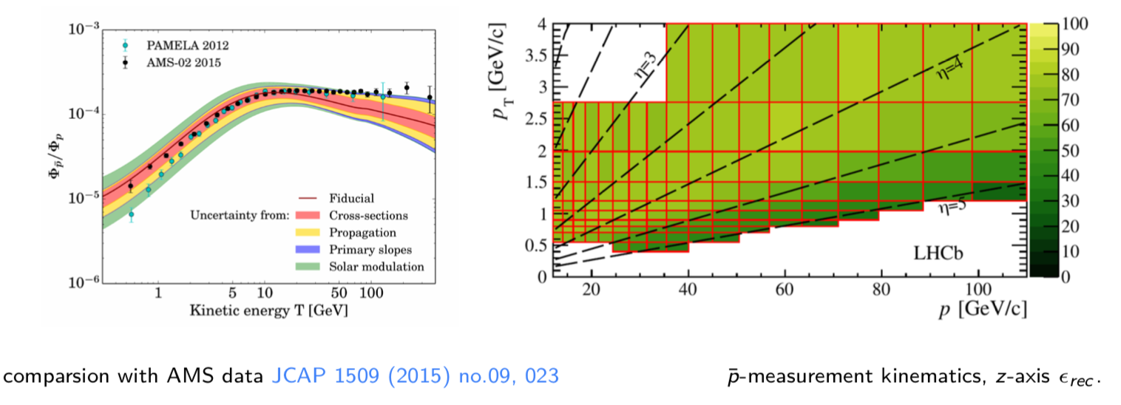
Production cross-section in pHe
[arXiv:1808.06127]
Prediction uncertainties in 10-100 GeV range dominated by cross-section uncertainties
p production in pHe never measured directly
LHCb in fixed-target mode covers the right kinematic range: [LHCb-PAPER-2018-031, arXiv:1808.06127] submitted to PRL.

Slide 8
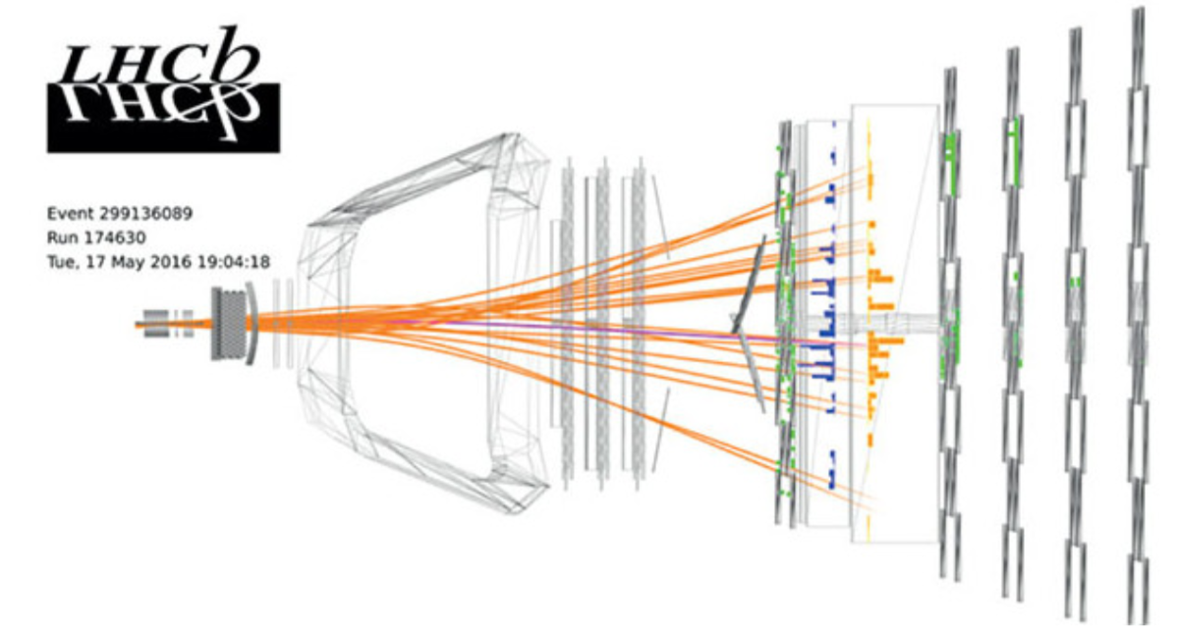
Prompt p production in pHe at 110 GeV
[arXiv:1808.06127]
p momentum : 12-110 GeV
p p_{T}: 0.4-4 GeV
Prompt: excluding hyperon decays
Trigger: activity in SPD and 1 charged track
Collision -700mm < z < 100 mm
Simulation from EPOS [PRS 92, 034906 (2015)]

Slide 9
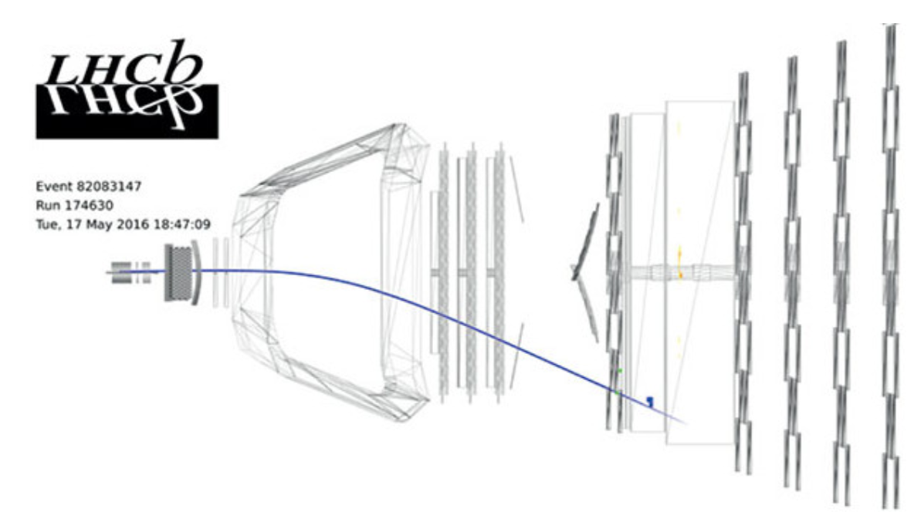
Prompt p production: luminosity
[arXiv:1808.06127]
Use very precisely known QED process: p-e scattering
Simulated with ESEPP generator [J. Phys. G41 (2014) 115001]

Slide 10
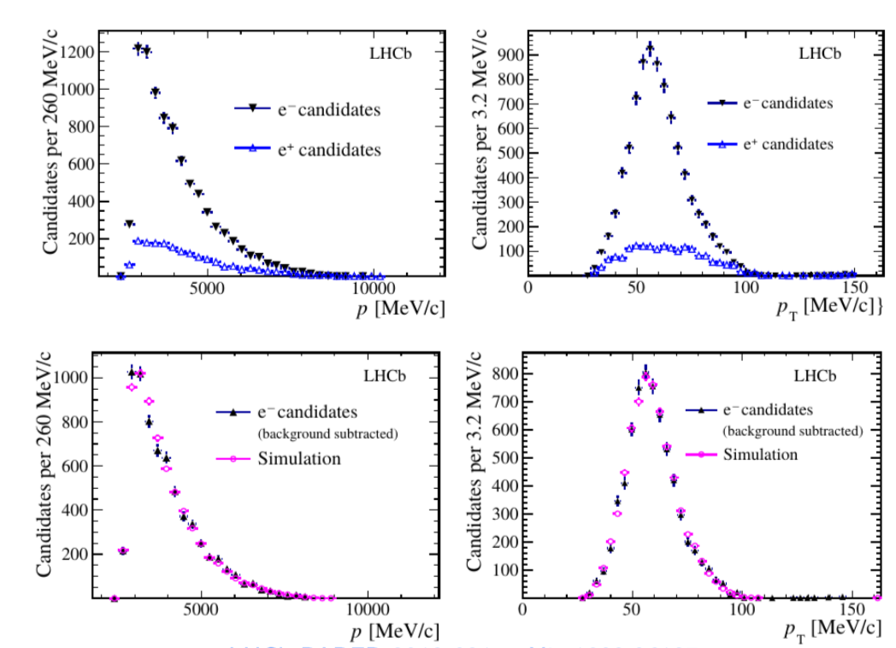
Prompt p production: luminosity
[arXiv:1808.06127]
Loose electron ID with ECAL
Background is charge-symmetric and determined from e⁺
BDT selection
5% relative uncertainty

Slide 11
Prompt p production: PID
[arXiv:1808.06127]
PID with 2 RICH detectors: distinguish negative tracks K⁻, π⁻ and p
3 set of templates:
pHe simulation;
K_{s}, Λ and φ decays from pHe and pp data
D⁰ decays from pp data
2 methods:
2-D likelihoods
Cut and count

Slide 12
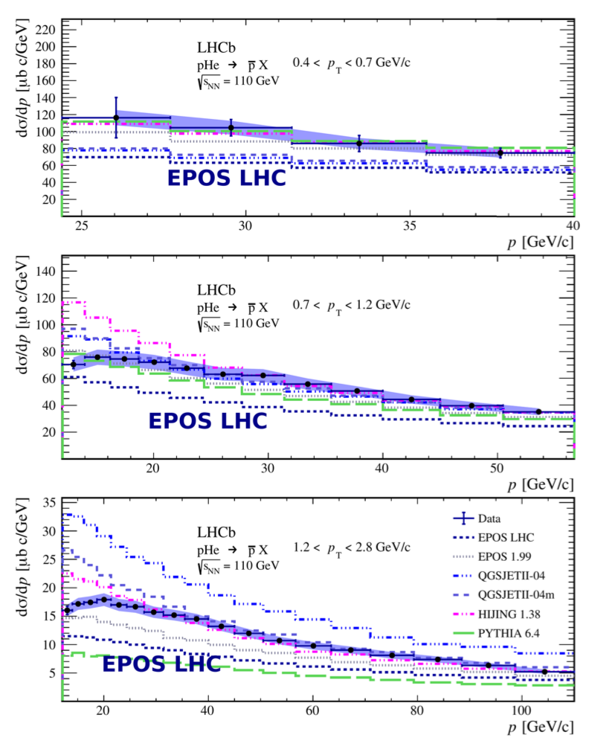
Prompt p production: results
[arXiv:1808.06127]
Uncertainties smaller than differences between models
EPOS-LHC underestimates cross-sections
Unique and precise: important contribution to reduce uncertainties for searches of dark matter
Natural extensions of measurement:
Include hyperon decays
π, K and p spectra
Data at 87 GeV is available

Slide 13
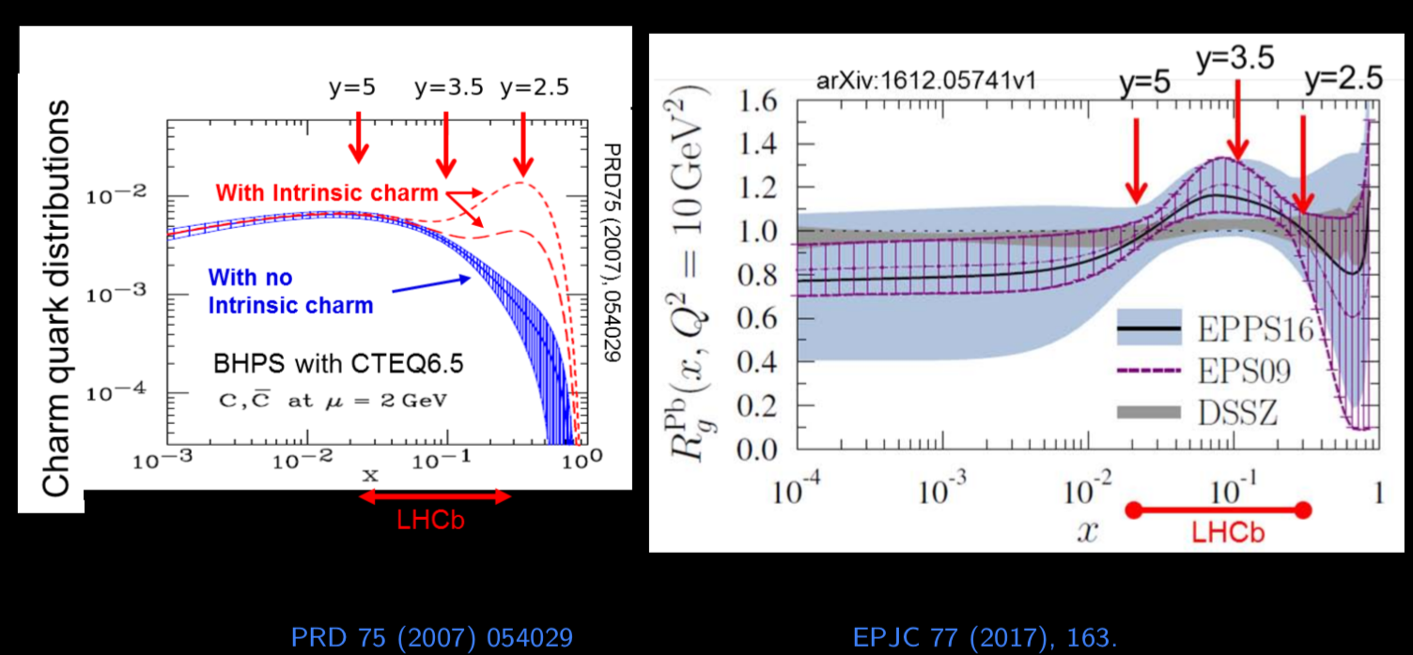
Charm production in pHe and pAr
Nuclear modification of parton distribution functions (PDF)
Intrinsic charm
Reference for future PbNe data to study Quark-Gluon Plasma: quakonium suppression and open charm at an energy between SPS and top RHIC energy

Slide 14
Charm production in pHe and pAr: datasets
[LHCb-PAPER-2018-022]
Between:
Tevatron/Hera fixed-target up to 42 GeV
RHIC at 200 GeV
Luminosity for pHe at 87 GeV obtained as for pHe at 110 GeV (see previous slides)
Indirect luminosity not available for pAr sample

Slide 15
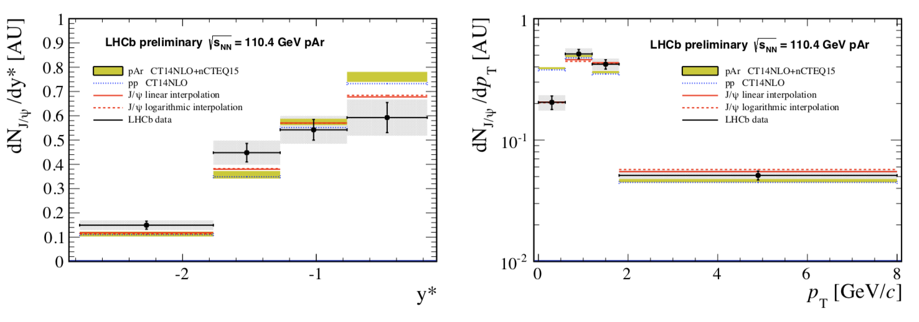
J/ψ production in pAr collisions at 110 GeV
[LHCb-PAPER-2018-022]
Backward hemisphere in center-of-mass probing Bjorken-x: 0.02 – 0.16
Shape in agreement for rapidity with phenomenological parametrisation [JHEP 1303 (2013) 122]
HELAC-Onia (yellow) [EPJC 77 (2017) 1] tuned for collider data is fine for rapidity but shows deviations for p_{T}

Slide 16
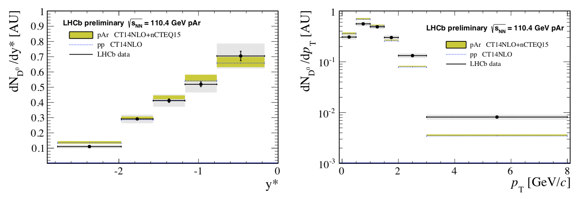
D⁰ production in pAr collisions at 110 GeV
[LHCb-PAPER-2018-022]
Probing Bjorken-x: 0.02 – 0.16
HELAC-Onia (yellow) [EPJC 77 (2017) 1] tuned for collider data is in good agreement for rapidity but shows deviations for p_{T}

Slide 17
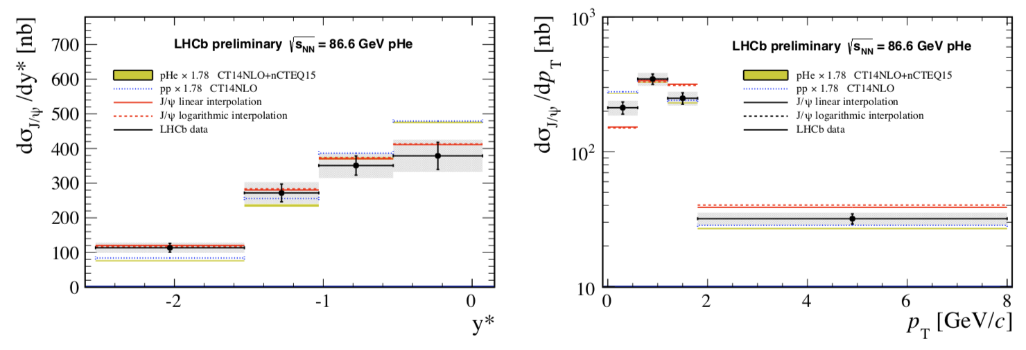
J/ψ production in pHe collisions at 87 GeV
[LHCb-PAPER-2018-022]
Probing Bjorken—x: 0.03 – 0.37
HELAC-Onia (yellow) [EPJC 77 (2017) 1] reasonable agreement for rapidity, need scaling factor of 1.78
In agreement for rapidity, tension for p_{T} with phenomenogical parametrisation [JHEP 1303 (2013) 122]

Slide 18
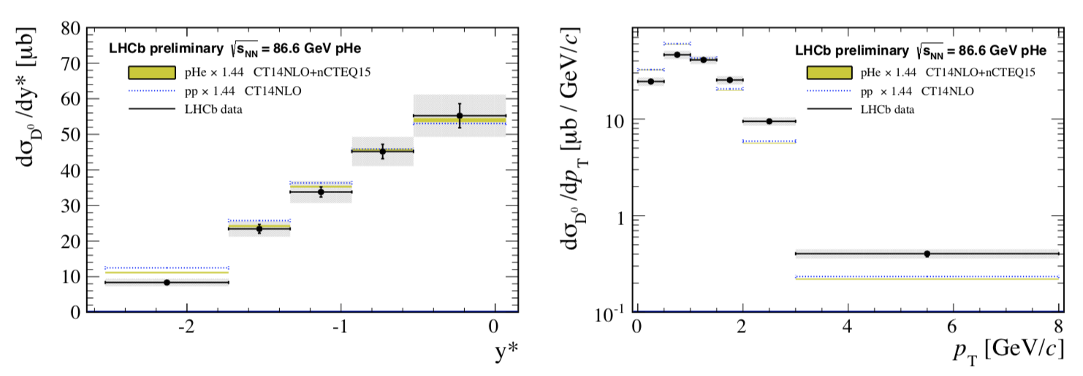
D⁰ production in pHe collisions at 87 GeV
[LHCb-PAPER-2018-022]
Probing Bjorken—x: 0.03 – 0.37
HELAC-Onia (yellow) [EPJC 77 (2017) 1] reasonable agreement for rapidity, need scaling factor of 1.44
No visible contribution of intrinsic charm in rapidity distribution
More detailed measurements possible with large pNe dataset at 69 GeV

Slide 19
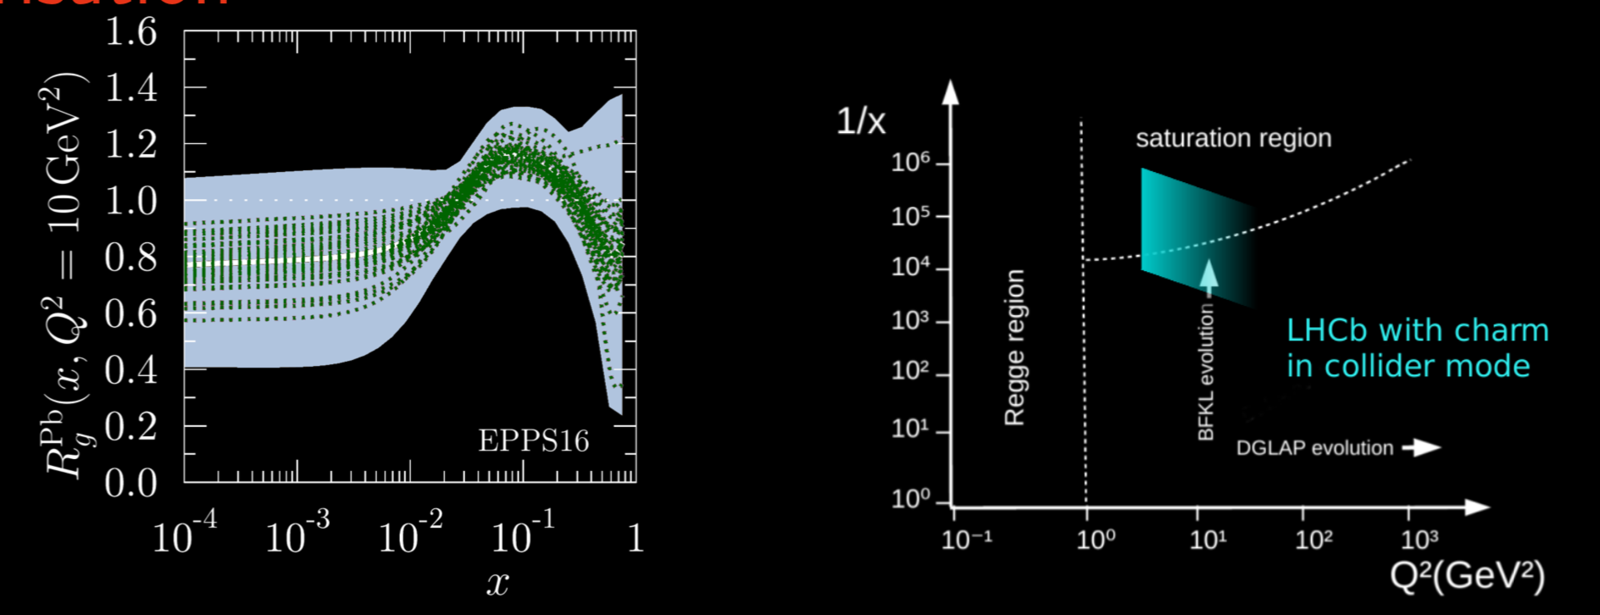
Proton-Ion collider mode
No HERA equivalent for lepton-nuclei: PDFs largely unconstrained for LHC heavy-ions
Probe for other effects that modifications of PDF: color glass condensate, coherent energy loss, …
LHCb acceptance: low Q² and x from heavy flavours

Slide 20
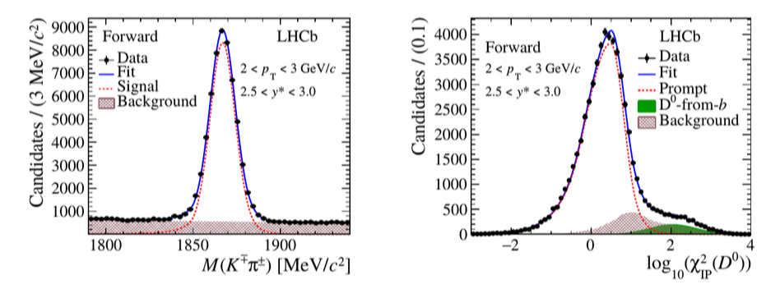
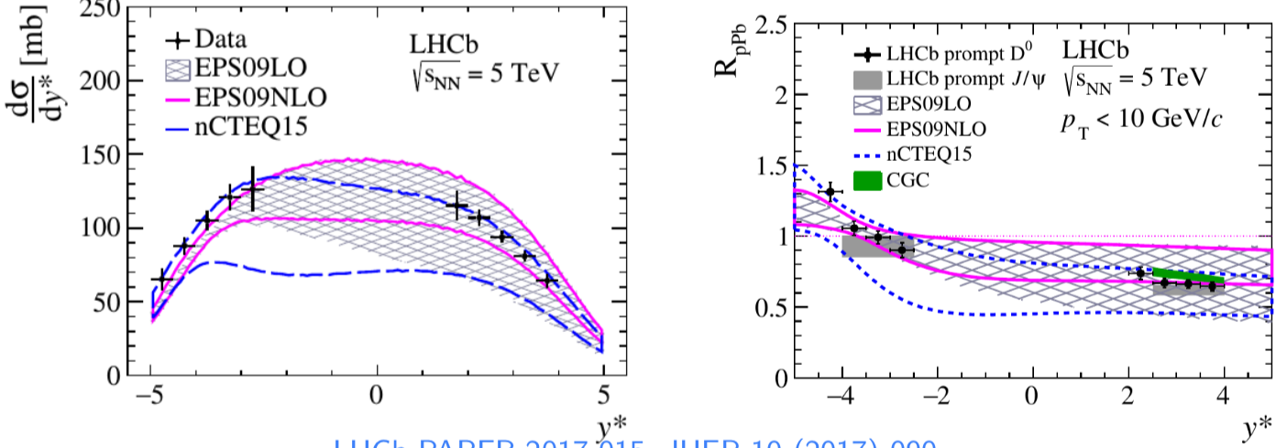
D⁰ production in pPb at 5.02 TeV
[JHEP 10 (2017) 090]
Precision data: strong suppression at forward rapidities, compatible with no suppression at backward rapidities, increasing towards enhancement
Nuclear PDFs [EPJC 77 (2017) 1] , color glass condensate [PRD 91 (2015) 114005] and energy loss [JHEP 1303 (2013) 122] in agreement with measurements.
Assuming no other effect: constrain nPDF at low-x [PRL 121 (2018) 052004]

Slide 21
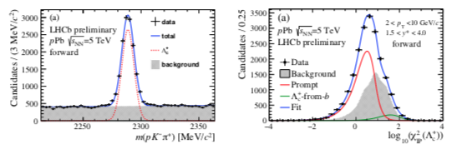
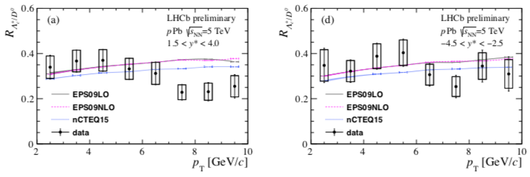
Λ_{c} production in pPb at 5.02 TeV
[LHCB-PAPER-2018-021]
Test of charm fragmentation in nuclear environment, comparing with other collision systems
Hadronisation pattern similar to model tuned on pp [EPJC 77 (2017) 1]

Slide 22
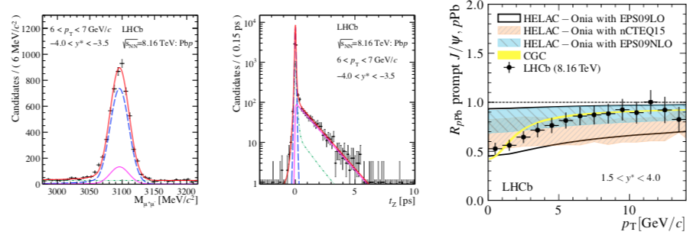
Prompt J/ψ production in pPb at 8.16 TeV
[PLB 774 (2017) 159]
Also high precision data: strong suppression at forward rapidity and low pT, 50% inceasing to no suppression at higher pT
Nuclear PDFs [EPJC 77 (2017) 1] , color glass condensate [PRD 91 (2015) 114005] and energy loss [JHEP 1303 (2013) 122] in agreement with measurements.
Assuming no other effect: constrain nPDF at low-x [PRL 121 (2018) 052004]

Slide 23
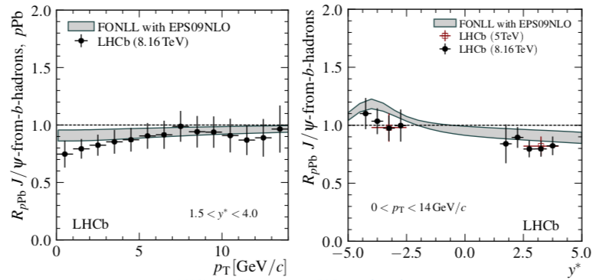
J/ψ from b production in pPb at 8.16 TeV
[PLB 774 (2017) 159]
Test of b production: suppression at forward rapidities
First precise measurement of b production at p_{T} close to 0
Also used to constrain nPDF
All these measurements are crucial input for understanding of PbPb data

Slide 24
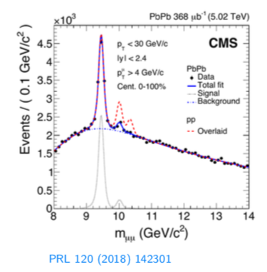
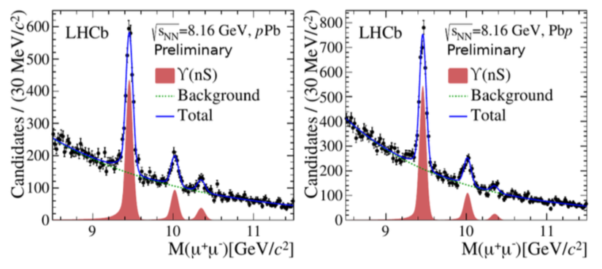
Y(nS) in heavy-ions
[LHCb-PAPER-2018-035]
Y(nS) probe deconfinement in PbPb
Y(nS) sequential suppression patterns observed in PbPb by CMS and ALICE
New LHCb measurement with higher statistics 2016 pPb data (20x 2013)

Slide 25
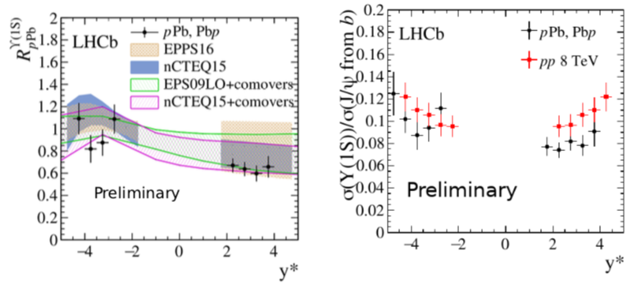
Y(nS) production in pPb at 8.16 TeV
[LHCb-PAPER-2018-035]
Y(1S) suppressed in forward region, and no suppression in backward, behaviour reproduced by nPDF within uncertainties
Y(1S) and J/ψ from b have similar behaviours in pp and pPb :
Expected if pure nPDF effect, or energy loss effect

Slide 26
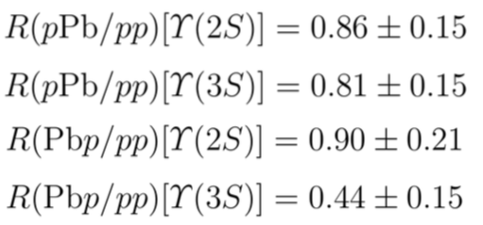
Y(nS) suppression patterns in pPb at 8.16 TeV
[LHCb-PAPER-2018-035]
Additional suppression of excited states observed: significant for Y(3S) in Pbp
Comprehensive understanding easier with upcoming ψ(2S) production measurements in pPb at 8.16 TeV

Slide 27
Ultra-peripheral PbPb collisions
Exclusive vector meson production via γ-pomeron scattering
Sensitive to generalized parton distribution functions for Bjorken-x in 10⁻² – 10⁻⁵.
LHCb well suited for exclusive production studies with Pb-beams: very forward detector Herschel

Slide 28
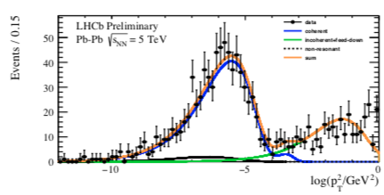
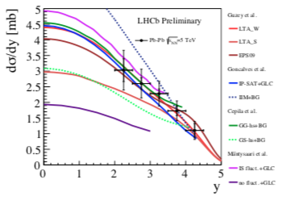
Ultra-peripheral PbPb collisions at 5.02 TeV: J/ψ
[LHCb-CONF-2018-003]
Coherent J/ψ production can be separated from incoherent part
Covered rapidity range and precision of measurement constraining models.
2018 PbPb run will increase statistics by at least factor 10: other states will also be accessible (ψ(2S) for example)

Slide 29
Conclusions
LHCb proved to be a versatile detector for heavy-ion physics:
Fixed target pHe with measurements related to cosmic ray physics
Fixed target pHe and pAr for charm production measurements
pPb and PbPb colliders: charm and beauty production for various states and environments

